Slide 1
Review on Layout and Construction of the 36 MHz HSI - RFQ
GSI-ARIES-APEC- Workshop
Intern. Wissenschaftsforum Heidelberg
15.-16.04.2019,
U. Ratzinger, IAP
Goethe-University Frankfurt

Slide 2
Content
Original motivation and early attempts
How the HSI - design got started
Complete layout
The IH – RFQ cavity
The beam dynamics and electrode designs
Frequency Tuning
-

Slide 3
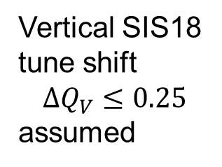
Original motivation
The construction of the SIS18-ESR complex at GSI began in 1986. However, there was no design for an adequate heavy ion linac injector
Vertical SIS18
tune shift
$$∆Q_{V}≤0.25$$
assumed
Penning
Source and
Wideroe 1-4:
Factor 500
missing!

Slide 4

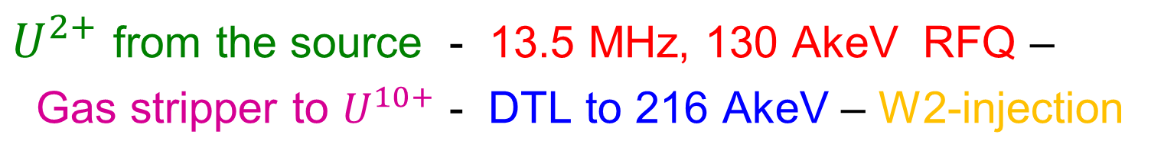



Early attempts
$U^{2+}$ from the source - 13.5 MHz, 130 AkeV RFQ –
Gas stripper to $U^{10+}$ - DTL to 216 AkeV – W2-injection
Design:
GSI & IAP
$$U^{2+}$$
$$U^{10+}$$
$$15.5 MV$$
Into W2
of Unilac
sou
$$2 MV \text{W}\text{0 }\text{for} U^{10+}$$
Gas Stripper
J. Klabunde et al., LINAC86 Conf., Stanford, p. 299

Slide 5
Early attempts
RFQ – layouts for $U^{2+}$, front ends beam tested
13.5 MHz Split-coaxial-RFQ, R.W. Müller, GSI, and
with IAP support
R.W. Müller, Proc. LINAC79,
Montauk, NY, p. 148

Slide 6
Early attempts
27 MHz Spiral – RFQ, IAP, with GSI support
Proc. LINAC92, p. 416.

Slide 7

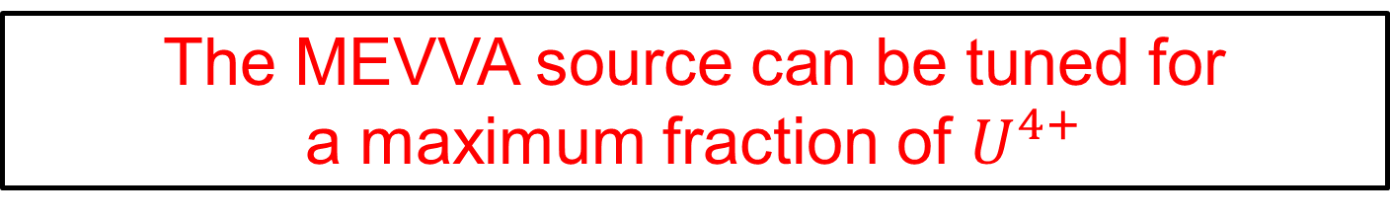
How the HSI - design got started
Results from MEVVA source $U$ beam tests
After some more improvements in 1993 it turned out:
The MEVVA source can be tuned for
a maximum fraction of $U^{4+}$

Slide 8
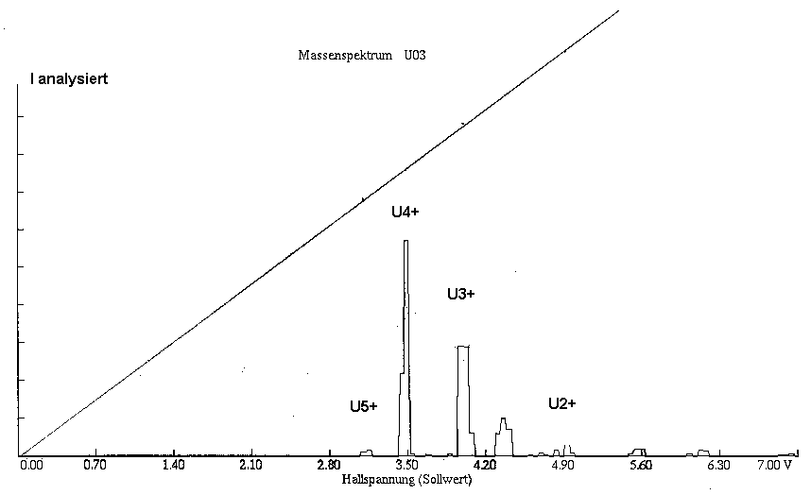
How the HSI - design got started
Talk, Peter Spädtke,
Okt. 2010, IAP, Ffm
MEVVA Source with tuned charge distribution

Slide 9
How the HSI - design got started
Design proposal bei UR
Complete
Wideroe W1-W4
Replacement.
No extra stripper
U. Ratzinger, Proc. EPAC94, London p. 288

Slide 10


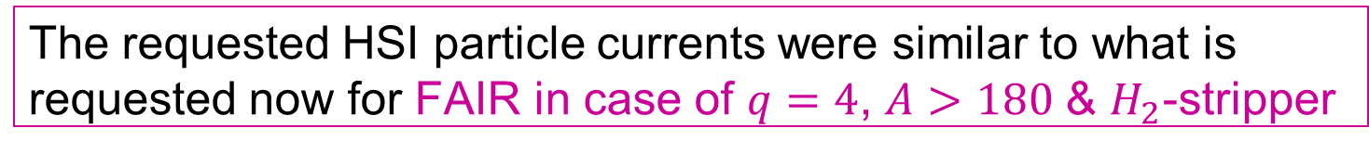

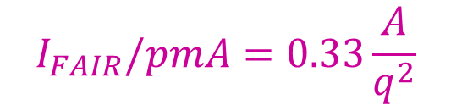

How the HSI - design got started
The requested HSI particle currents were similar to what is requested now for FAIR in case of $q=4$, $A>180$ & $H_{2}$-stripper
$$→60$$
due to RFQ
Field Emission
$$4+$$
$$I_{FAIR}/pmA=0.33\frac{A}{q^{2}}$$
For $q=4:$
& $N_{2}$ - stripper

Slide 11
Complete HSI - layout
The project started in 1995 with GSI money
The design was based on a factor 2.5 voltage increase against
the former Wideroe structure within the same tunnel length
Most active TAC – Members for HSI – project:
Günther Plaas, CERN acc. director, Dieter Trines, DESY acc. director
Klaus Bongardt, beam dynamics expert, FZ Jülich

Slide 12
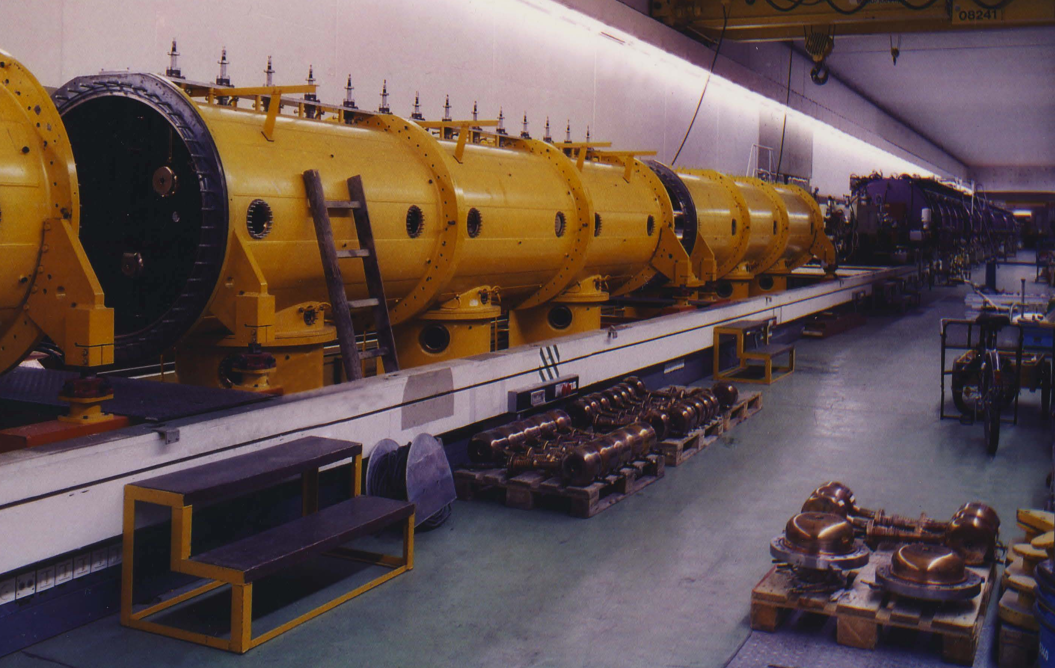
Demounting the 27 MHz GSI
Wideroe section in Nov 1998

Slide 13
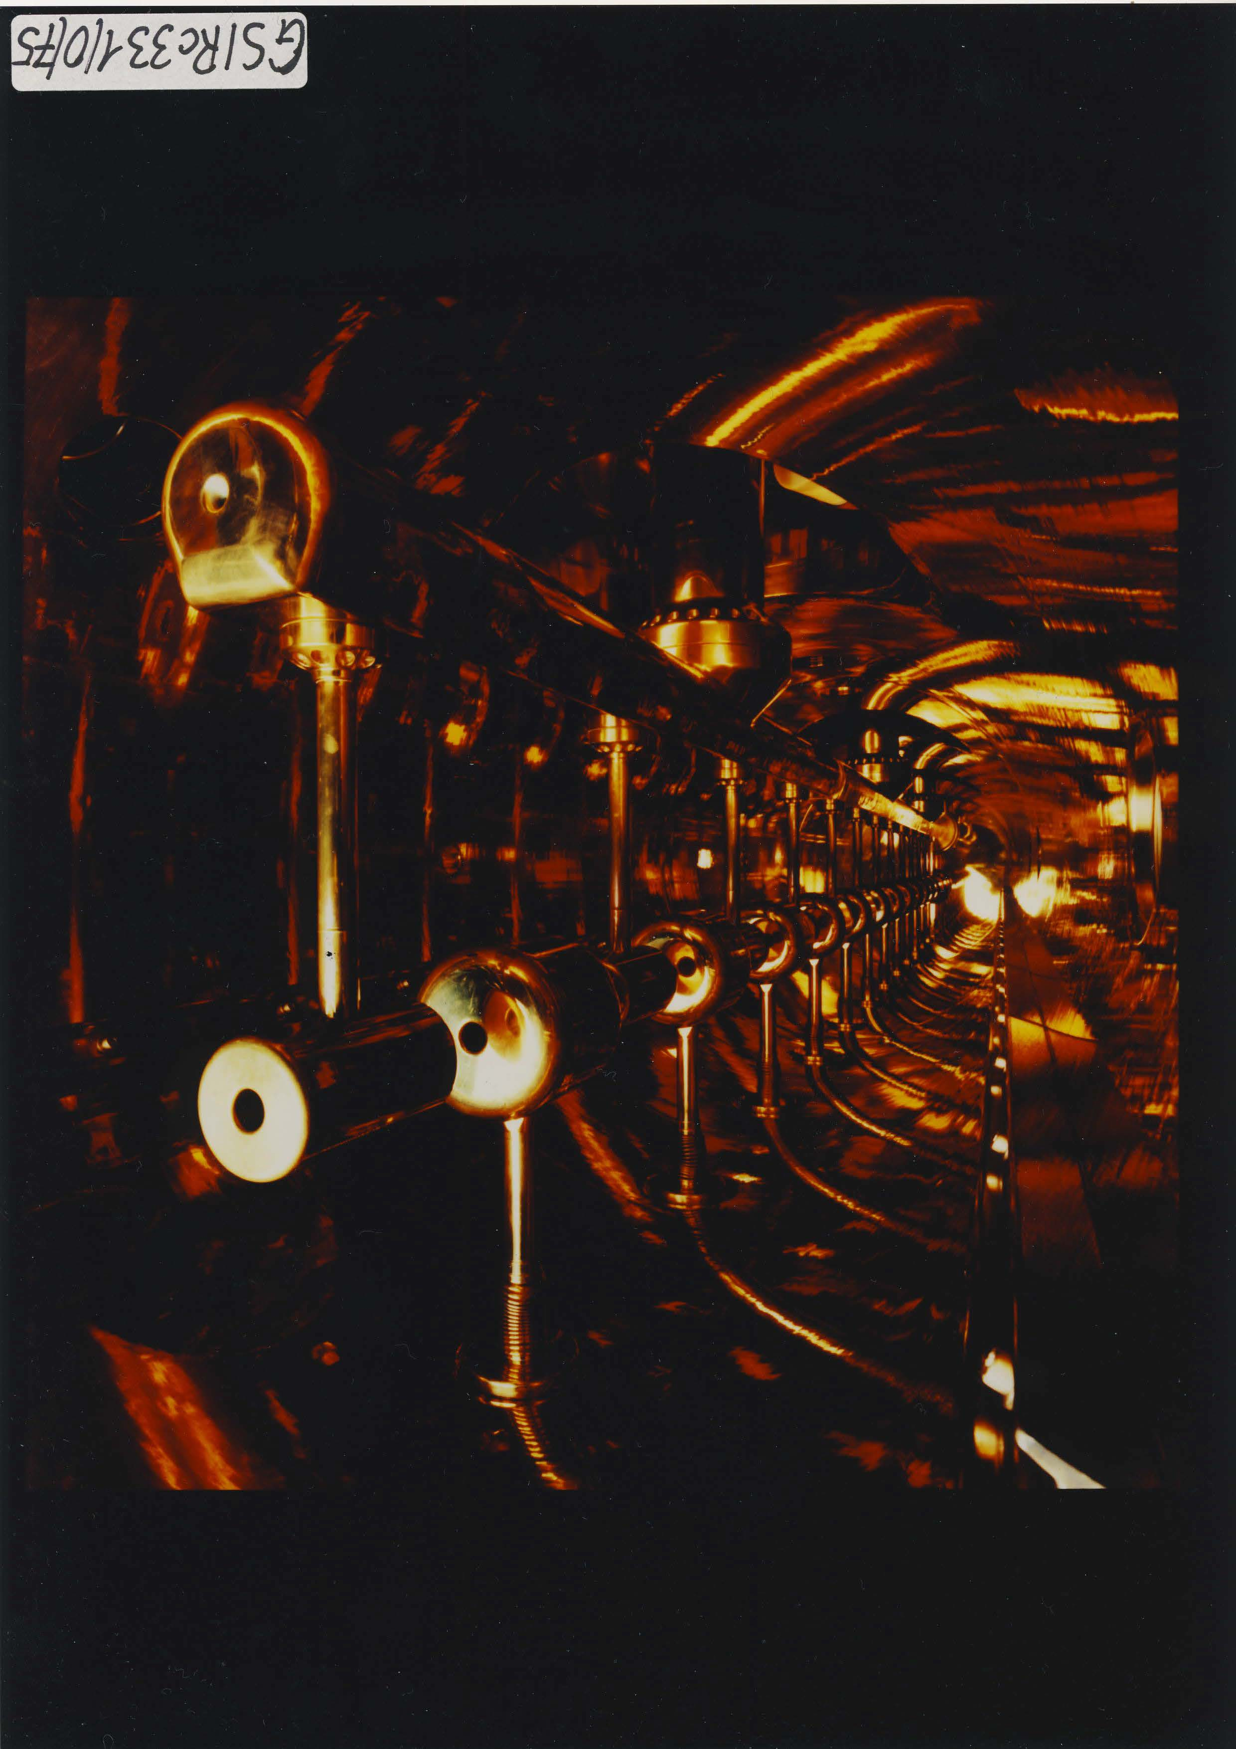
View into a 27 MHz GSI Wideroe tank

Slide 14
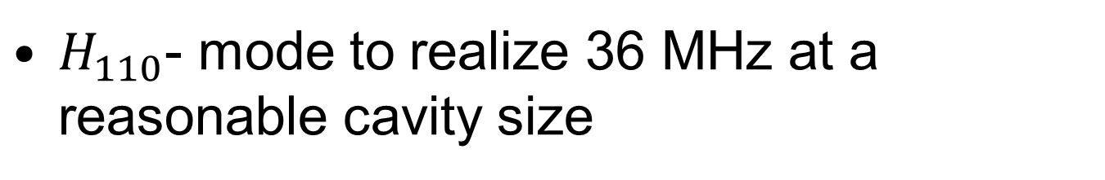
The IH – RFQ cavity
$H_{110}$- mode to realize 36 MHz at a reasonable cavity size

Slide 15
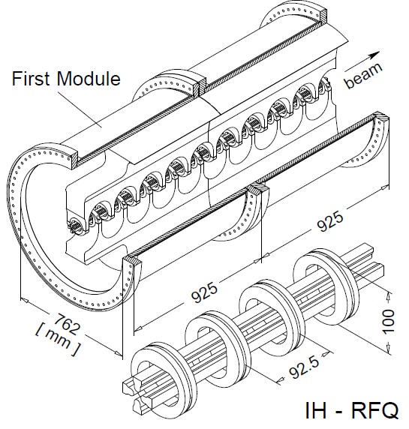
The IH – RFQ cavity
U.Ratzinger,
K. Kaspar,
E. Malwitz,
R. Tiede,
S. Minaev,
EPAC96,
Sitges,
MOO07A,
p. 304

Slide 16
HSI-RFQ Parameters
Norm. trans. em. x, y (mm mrad) 0.31

Slide 17
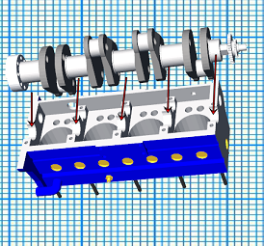
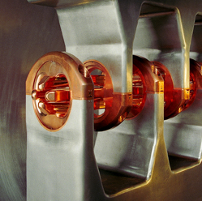
The IH – RFQ cavity
http://www.ws-technik.info/der-motorblock.html
Connecting the electrodes to the cavity stems by “crankshaft storage concept“

Slide 18
IH-RFQ MAFIA Simulations
No RF-Model was built, simulation only !!
K. Kaspar, U. Ratzinger, Proc. EPAC96, Sitges, WEP029L (p. 1973)

Slide 19
IH-RFQ MAFIA Simulations
Pre-tuning by carrier rings
K. Kaspar, U. Ratzinger, Proc. EPAC96, Sitges, MOO07A (p. 304)

Slide 20
IH-RFQ technology
Konstruktion:
E. Malwitz,
H. Gaiser
W. Bleuel
D. Svrcina
K. Dermati
Kaiser
Galvanik:
H. Gaiser
Technical detail: Carrier ring and electrode

Slide 21
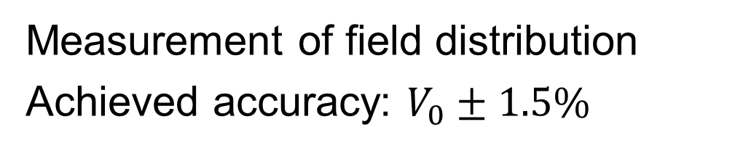
IH-RFQ technology
Measurement
and Tuning:
S. Minaev
R. Tiede
Measurement of field distribution
Achieved accuracy: $V_{0}±1.5\%$

Slide 22
HSI-RFQ
View on the installed IH-RFQ in the Unilac tunnel
RF equipm.
G. Hutter
W. Gutowski
W. Vinzenz
….
Foto: A. Zschau, GSI

Slide 23
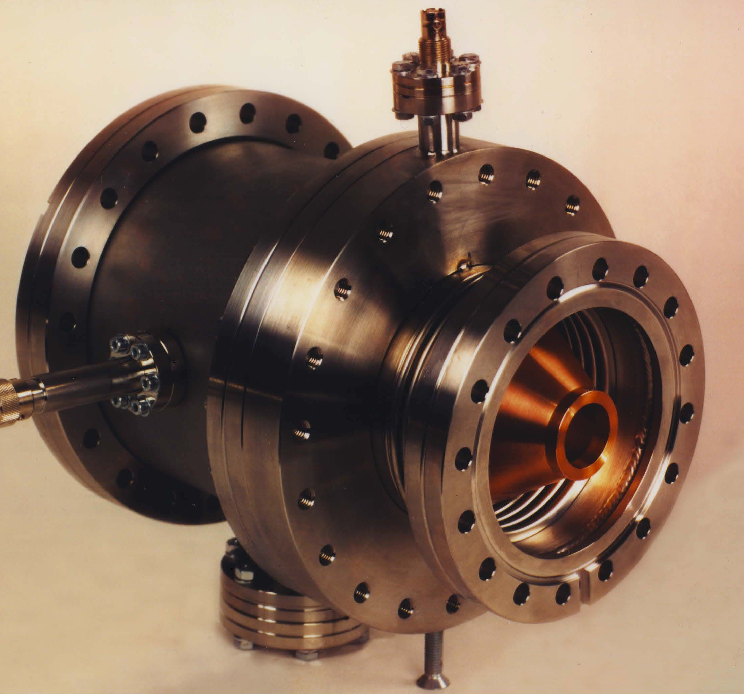
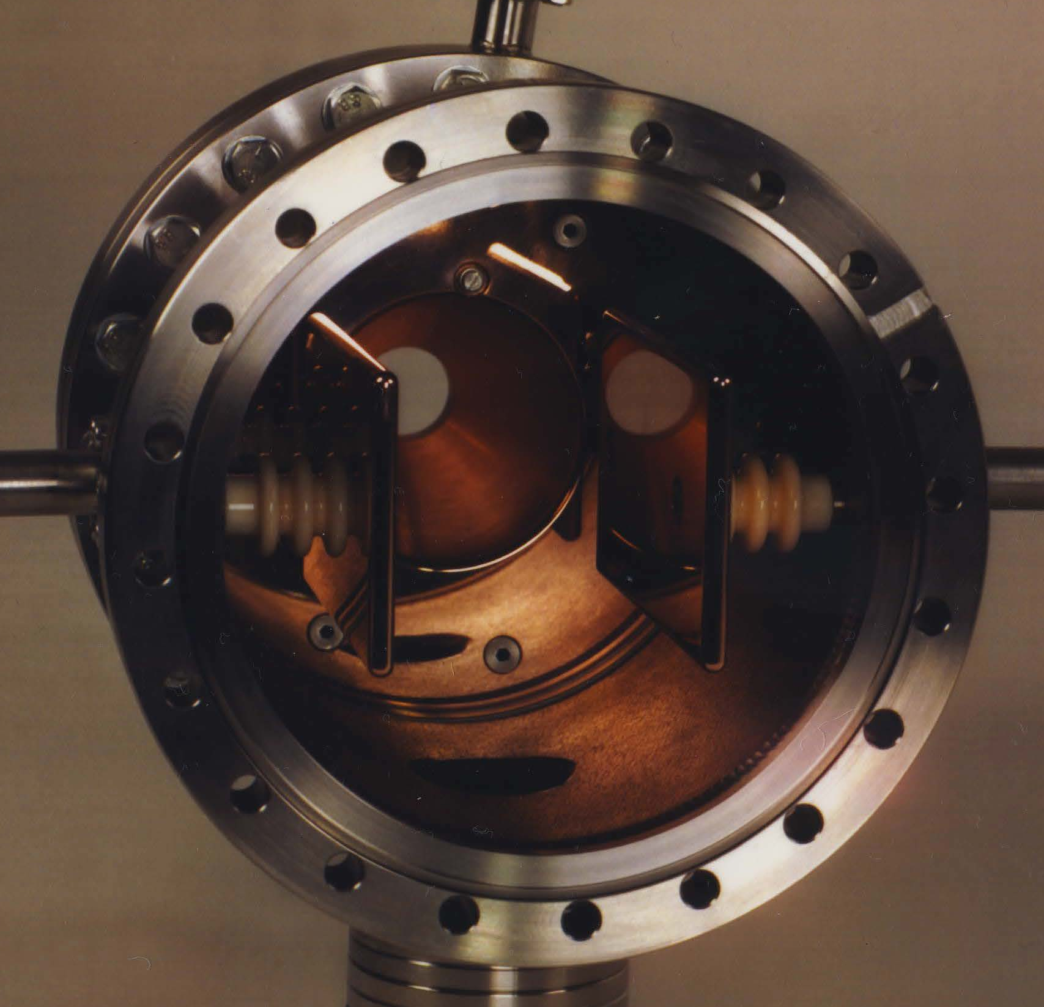
HSI-RFQ Entrance Chopper and Cone
Design: Ludwig Dahl

Slide 24
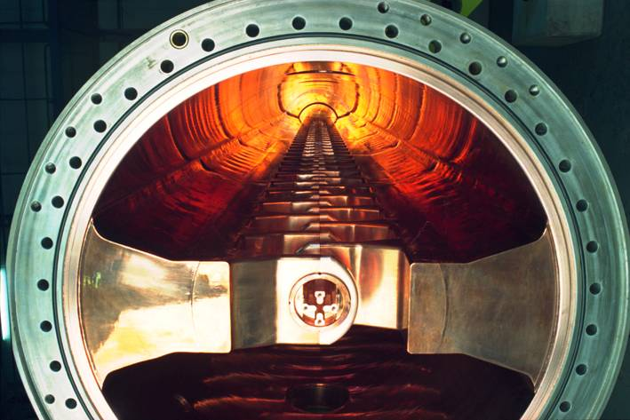
HSI-RFQ
View into the 36.136 MHz IH - RFQ
Foto: A. Zschau, GSI

Slide 25
Modular design allows electrodes exchange
HSI-RFQ
Montage:
Schwedhelm
Thurau
Mühle
…..
Foto: A. Zschau, GSI

Slide 26
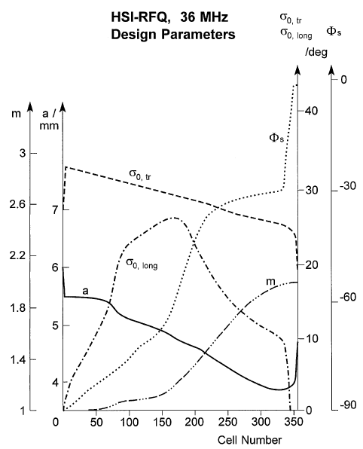
HSI-RFQ Beam Dynamics
A. Schempp, IAP, 1996

Slide 27
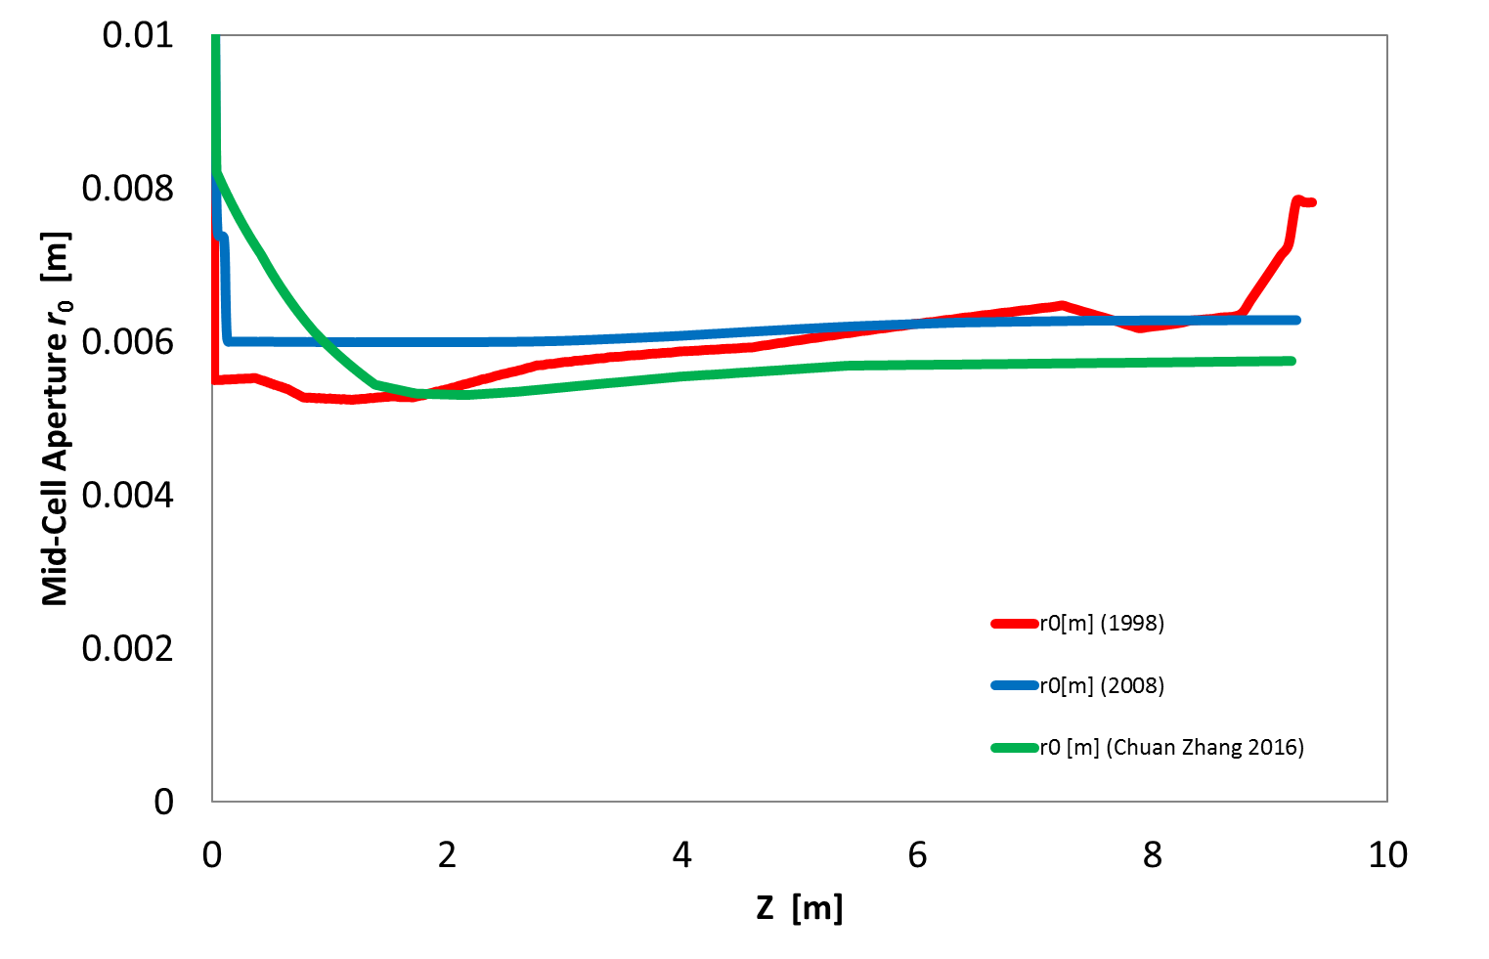
HSI-RFQ Beam Dynamics
1998___ , 2008 ___, and new___, sugg. by
C. Zhang
Source: Chuan Zhang
Riezlern seminar 2016

Slide 28
HSI-RFQ Beam Dynamics
Comparison of 3 designs
 | Design 1998 | Design 2008 | Chuan Zhang Design 2016
Input / Output Energy [keV/u] | 2.2 / 120 | 2.2 / 120 | 2.2 / 120
Inter-Vane Voltage [kV] | 125 | 155 | 125
Average Mid-Cell Aperture [cm] | 0.61 | 0.60 | 0.58
Maximum Surface E-Field [MV/m] | 31.9 | 31.2 | 30.2
Minimum Electrode Distance [cm] | 0.49 | 0.60 | 0.53
Number of Cells | 357 | 409 | 384
Length [cm] | 921.749 | 921.74 | 918.28
Input Beam Current [emA] | 16.5 | 20 | 20
Input Transv. Em. [π mm mrad] | 138 | 210 | 210
Input Transverse Twiss Alpha | 0.43 | 0.6 | 0.6
Input Transverse Twiss Beta [cm/rad] | 4.6 | 13.6 | 13.6
Transmission [%] | 89.5 | 88.5 | 94.1
Brilliance [mA / mm mrad] (80%) | NA | NA | 61.5
Source:
Chuan Zhang
Riezlern seminar 2016

Slide 29
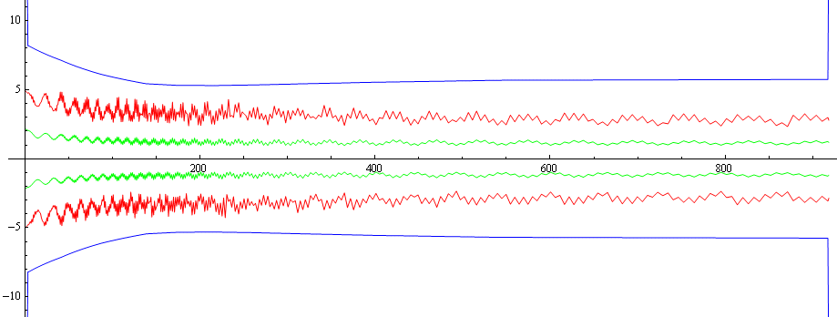
HSI-RFQ Beam Dynamics
Transverse beam size, design C. Zhang, 2016
mid-cell aperture
maximum beam size
Source: Chuan Zhang
Riezlern seminar 2016
rms beam size

Slide 30
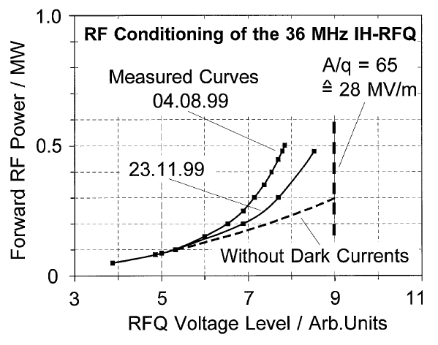
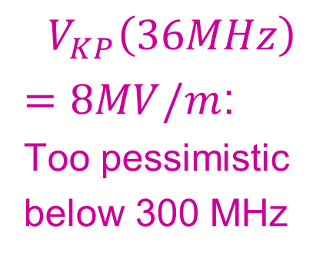
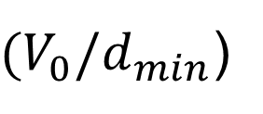
HSI-RFQ RF Conditioning
${(V}_{0}/d_{min}$)
$$V_{KP}\left(36MHz\right)$$
$=8MV/m$:
Too pessimistic
below 300 MHz

Slide 31
HSI-RFQ Frequency Tuning
K. Kaspar, U. Ratzinger, Proc. EPAC96, Sitges, WEP029L (p. 1973)

Slide 32
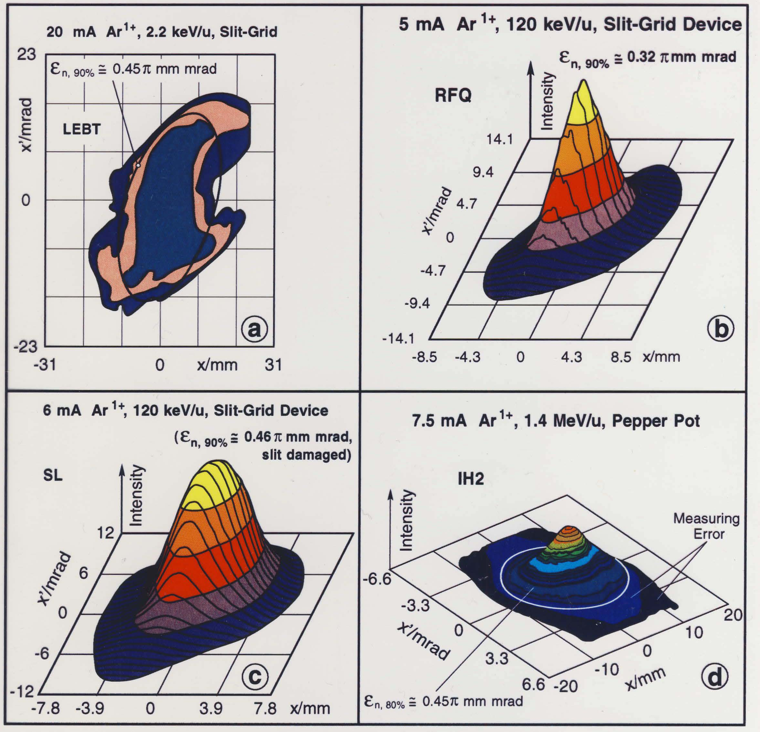
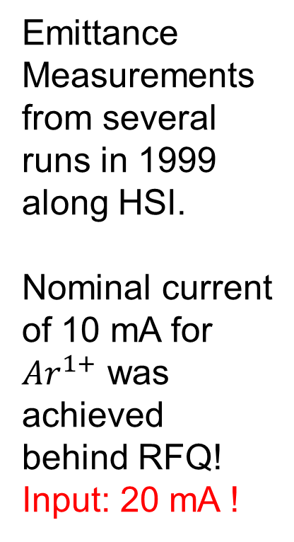
Running In with beam
Coordination:
W. Barth
Emittance
Measurements from several runs in 1999 along HSI.
Nominal current of 10 mA for ${Ar}^{1+}$ was
achieved
behind RFQ!
Input: 20 mA !

Slide 33
Running In with beam
Longitudinal measurement (P. Forck 1999)

Slide 34
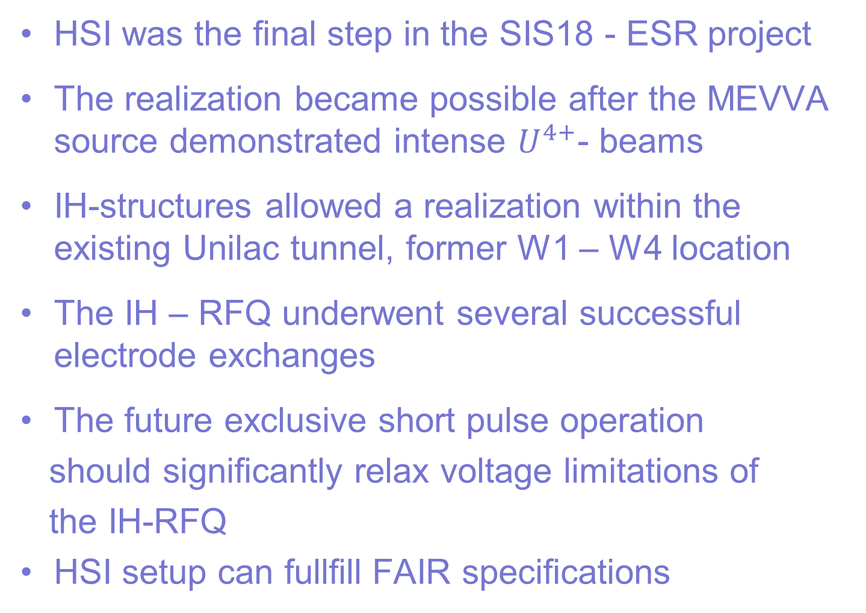
Conclusions
HSI was the final step in the SIS18 - ESR project
The realization became possible after the MEVVA source demonstrated intense $U^{4+}$- beams
IH-structures allowed a realization within the existing Unilac tunnel, former W1 – W4 location
The IH – RFQ underwent several successful electrode exchanges
The future exclusive short pulse operation
should significantly relax voltage limitations of
the IH-RFQ
HSI setup can fullfill FAIR specifications

Slide 35
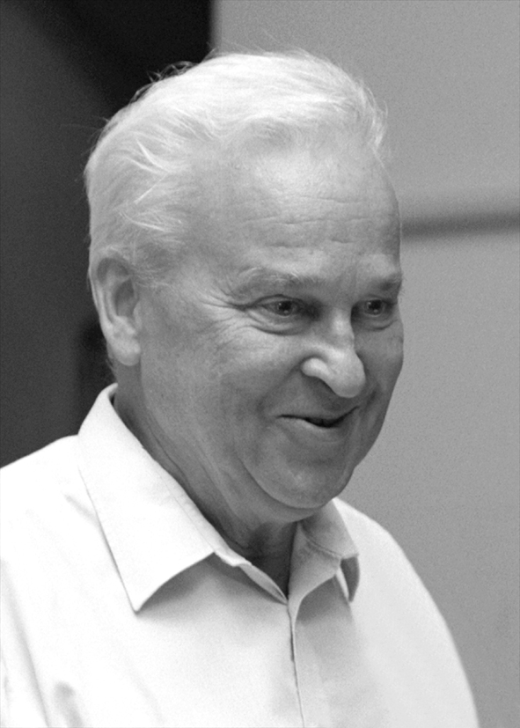
Thank you to our driving forces!
GSI Scientific Director
Hans Specht
GSI Accelerator Head
Norbert Angert
Time schedules
Dieter Bohn, FZ Jülich
HSI Project-leader
Dieter Böhne

