Slide 1
Development of C⁶⁺ Laser Ion Source &
Radio Frequency Quadrupole
Akiko Yamaguchi ^{A)}, Takeshi Takeuchi ^{A)}, Kosuke Sato ^{A)}, Kiyokazu Sato ^{A)},
Noriyosu Hayashizaki ^{B)}
^{A)} Toshiba Energy System & Solutions Corporation
^{B)} Tokyo Institute of Technology
Notes:
I‘m very glad to be here today.
My name is Akiko Yamaguchi, I’m working for Toshiba.
I’ve been in charge of accelerator engineering, recently focusing on laser ion source and ion linacs for next generation carbon cancer therapy.
Today I will report the recent development results of C6+ laser ion source and RFQ system.

Slide 2
Contents
01
Introduction
02
Laser Ion Source (LIS)
03
RFQ
04
Beam accelerating test
05
Future Plan for LIS
06
Summary
Notes:
I will make presentation about three contents.
First, I will explain the feature of our laser ion source and RFQ system and its performance test results.
After that, I will propose commercial model and it’s future plan for LIS.

Slide 3
Introduction
01
Notes:
First, I’ll talk about introduction shortly.

Slide 4
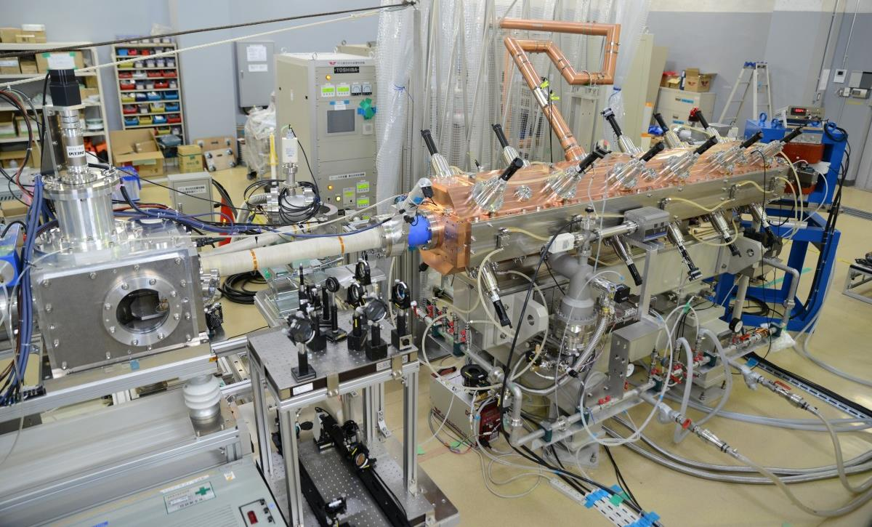
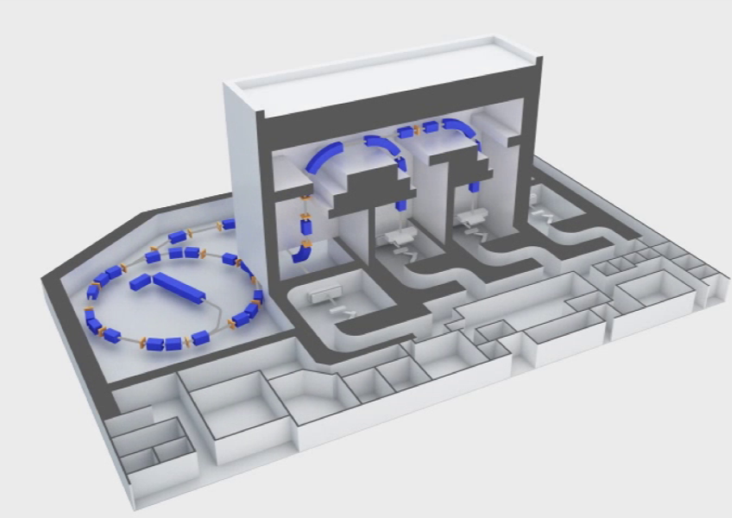
LIS & RFQ system
- Acceleration of pulse C6+ ions
- Applied for cancer therapy for next generation, neutron source, …
Next Generation injector
DTL
RFQ
Carbon cancer therapy facility
RFQ
DTL
General injector in Japan
20keV/u
4MeV/u
LIS
0.6MeV/u
RFQ
LIS
0.6MeV/u
4MeV/u
10keV/u
C Foil
LEBT
Synchrotron（C6+)
C6+
current 10mA (peak)
correspond to 1e10 particles per pulse
RF pulse 500μsec
rep. 0.3Hz
ECR
C4+
Injector（C4+）
current ~280 μA
RF pulse 500 μsec
rep. 0.3 Hz
C4+→C6+
ion-beam Radiation Oncology Center
in Kanagawa
Notes:
This system was developed for applying to the next generation carbon cancer therapy system.
The present injector system in Japan, it consists of ECR, RFQ, DTL and carbon foil stripper.
C4+ ions from ECR is accelerated by RFQ and DTL.
After DTL C4+ is changed to C6+.
This figure shows our system for next generation cancer therapy.
For carbon cancer therapy, 1 to the 10th power particles per pulse is needed.
LIS has ability to product sufficient C6+ without carbon foil stripper.

Slide 5
Laser Ion Source
02
Notes:
Next, I’ll talk about the design of laser ion source .

Slide 6
Introduction of LIS
Ion source using laser ablation plasma
Laser
Lens
Ion
Plasma
Vacuum Chamber
Target
Solenoid
Feature
- Multiply charged ions are provided.
- Pulse ion beam with high peak current is generated.
- Simple operation is realized.
- Solid target is available.
Notes:
This slide shows outline of laser ion source.
Ions are extracted from laser ablation plasma.
Laser is focused by lens system to bulk target in vacuum chamber.
Plasma go through solenoid to avoid divergence of ion beam
and also to extend ion pulse width.
The point of this LIS are
First, Multiply charged ions are provided.
Second, Pulse ion beam with high peak current is generated.
Third, Simple operation is realized.
Fourth, Solid target is available.

Slide 7
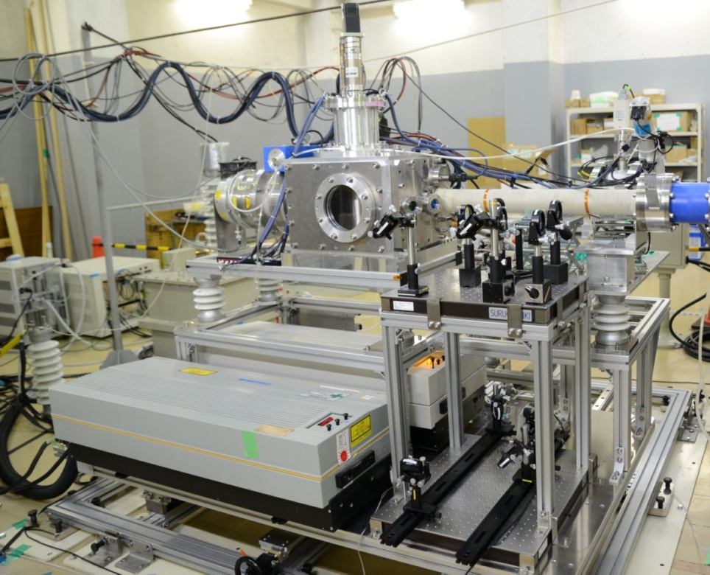
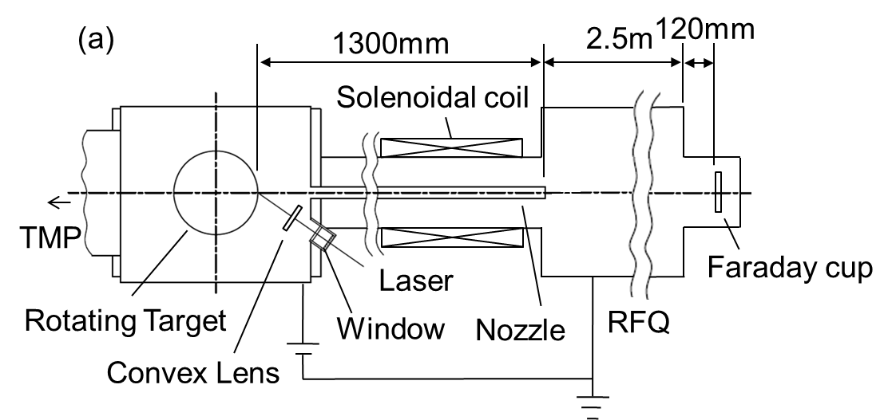
Design of LIS
Parameter | Value
Laser | Nd:YAG
Wavelength | 1064 nm
Maximum laser energy | 1.7 J
Focal length of lens | 150 mm
Target material | Graphite
Target diameter | 150 mm
Maximum voltage | 48 kV
Solenoidal coil length | 0.7 m
Notes:
Next, I’d like to talk about design of LIS.
This picture shows our laser ion source.
Chamber is applied to high voltage and isolated by insulator.
This table shows main parameters of laser ion source.
We use neodymium YAG laser of wavelength 1064 nanometers.
maximum laser energy is 1.7 Joule.
Laser beam rise up to ion beam line by mirrors and is injected into chamber through glass window.
Lens of 150 millimeters focal length is in the chamber.
Position of lens is controlled outside chamber.
This is solenoid of 0.7 meters long.
Distance between target and RFQ is 1.3 meters.

Slide 8
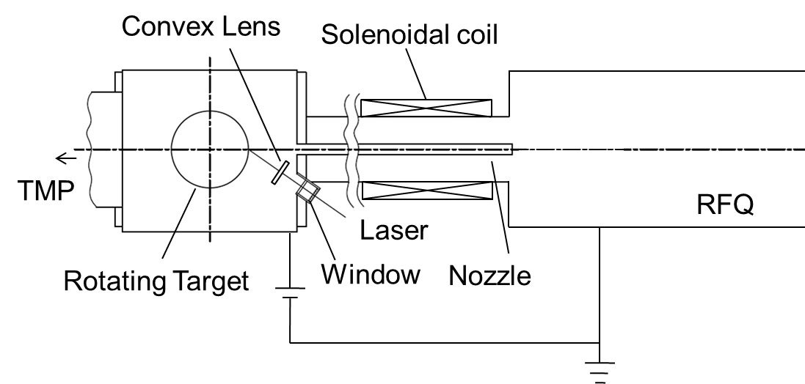
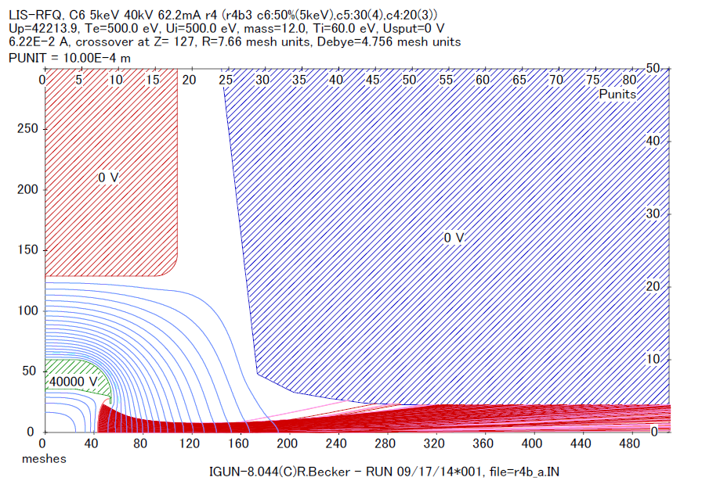
Beam simulation using IGUN
Extraction electrode (nozzle) is designed
Carbon plasma
Carbon ion
＜Condition of simulation＞
Parameter | Value
Hole diameter of nozzle | 8 mmφ
Voltage | 40 kV
Total current | 62.5 mA
Ratio
C6+:50 %, C5+:30 %, C4+:20 %
＜Injection beam condition for RFQ＞
RFQ tank
Parameter | Value
ε (1 rms) | 30 mmmrad
α | 0.16
β | 16 mm
RFQ vane
Nozzle
Notes:
We designed extraction electrode using IGUN code.
We call extraction electrode “nozzle”.
Laser ablation plasma is contained from C1+ to C6+ ions.
For simulation, we assumed ratio of carbon charge from past measurements.
Shape of nozzle was optimized by simulation to fit injection beam condition of RFQ.

Slide 9
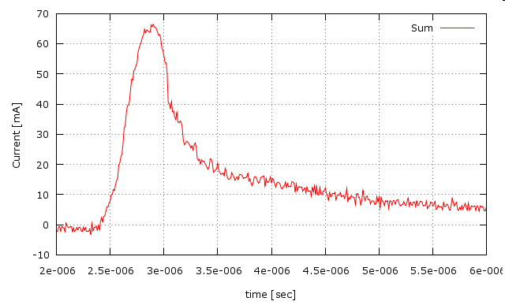
Beam measurement of LIS
Carbon ion signal contained C1+～C6+ using faraday cup
<Signal of plasma current (without HV)>
<setup for beam measurement>
35
30
25
20
15
10
5
0
solenoid
Target
33 mmφ
0.0 A
1.0 A
1.2 A
1.5 A
2.0 A
3.0 A
1432 mm
FC
I (mA)
1412 mm
120 mm
Distance between nozzle and FC : 50 mm
0 2 4 6 8
50
0
t (μsec)
with solenoid
- pulse width : about 1 μsec (FWHM)
- peak current : 32 mA (contained C1+～ C6+)
I (mA)
2 3 4 5 6
t (μsec)
Notes:
This slide shows result of LIS beam measurement.
This picture shows setup for beam measurement.
In this setup, distance between nozzle and FC is 120 millimeters.
This figure is carbon ion signal contained from C1+ to C6+ using faraday cup.
Horizontal axis is time, vertical axis is beam current.
Origin of horizontal axis is time when laser was fired.
Peak current with solenoid was 32 milli ampere, which is about 5 times as large as current without solenoid.
In this setup, we obtained that pulse width was about 1 micro second, peak current was 32 milli ampere with solenoid.
I think if distance between nozzle and FC is short, peak current will become large,
because of past measurement results that peak current was 67 mA at distance 50 mm.
Distance between nozzle and FC of 120mm is too long for injection to RFQ.

Slide 10
RFQ
03
Notes:
Next, I’ll talk about design of RFQ.

Slide 11
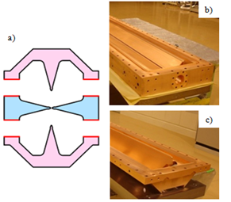
Structure of RFQ
Electrode and tank are divided into tree parts
- Three parts are combined using O rings and RF contacts.
Advantage
- Copper plating process is unnecessary.
- Assembly is simple and short.
- Q-value of tank is high because contact parts are reduced. Measured unloaded Q-value was above 90% of calculated unloaded Q-value.
a) Structure of electrode and tank.
b) middle part with two electrodes.
c) Top and Bottom parts with one electrode.
Notes:
First, I explain structure of RFQ that we adopted.
Three parts, top part with one electrode, middle part with two electrodes, bottom part with one electrode, are combined using O rings and RF contacts.
Advantages of this structure are
First, Copper plating process is unnecessary.
Second, Assembly is simple and short.
Thied, Q-value of tank is high because contact parts are reduced. Measured unloaded Q-value was above 90% of calculated unloaded Q-value.

Slide 12
Beam simulation by LINACS v02 (1)
Because of C1+ ~ C6+ mixed beam from LIS, we asked Dr. Jameson to design RFQ by LINACS v02.
＜ Requirement for simulation ＞
Parameter | Value
Frequency | 200 MHz
Vane length | ≦ 2.4m
Maximum surface field | below 1.8 kilpat.
Vane voltage | constant
Average bore radius | constant
Minimum bore radius | ≧ 2 mm
Extraction energy | 0.6MeV/u
Total current | 62.5 emA
Ratio
RF power | < 150 kW
C6+:50 %, C5+:30 %, C4+:20 %
C6+
62.5 mA × 50%
＝ 31.25 mA
Notes:
About beam simulation, we asked Dr. Jameson to calculate RFQ by LINACS v02, because of from C1+ to C6+ mixed beam from LIS.
Requirement for simulation is shown in this table.
Frequency is 200 MHz, vane length was below 2.4 m as same as general injector of carbon cancer therapy, because it could be replaced.
Minimum bore radius was above 2 mm due to machining restriction.
Input total current is 62.5 mA and C6+ ratio is 50% from past measurement results.
So input C6+ current is estimated as 31.25 mA.
RF power was below 150 kW in order to apply solid state amplifier.

Slide 13
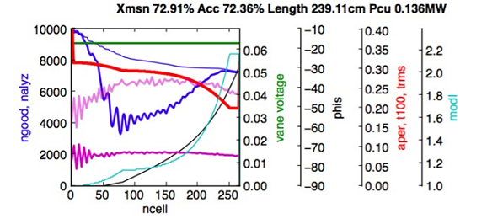
Beam simulation by LINACS v02 (2)
Results of simulation
Parameter | Value
Vane length | 2.39 m
Average bore radius | 3.17 mm
Minimum bore radius | 2 mm
Modulation | 2.17
B | 7.56
Synchronous phase | -30°
Number of cell | 269
Transmission for C6+ | 72.4 %
22.6 mA
→ 22.6 mA（peak）
→ 1.6e+10 particles per pulse
1 μsec
Target value
1e+10 particles per pulse
Notes:
This table summarizes results of beam simulation.
Vane length is 2.39 m, minimum bore radius is 2 mm.
Transmission for C6+ is 72.4%.
As input C6+ current was assumed 31.25 mA, output C6+ current is estimated as 22.6 mA.
We could convert 22.6 mA into 1.6 to the 10th power particle per pulse using pulse width 1 micro second.
It is confirmed output current is sufficient for target value 1 to the 10th power particle per pulse.

Slide 14
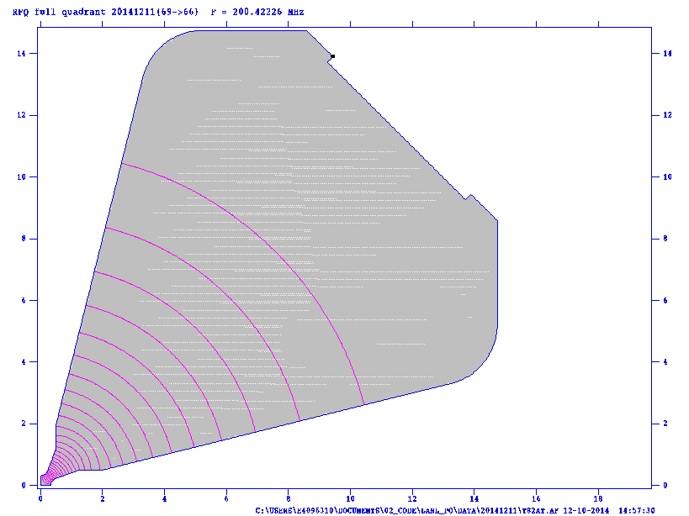
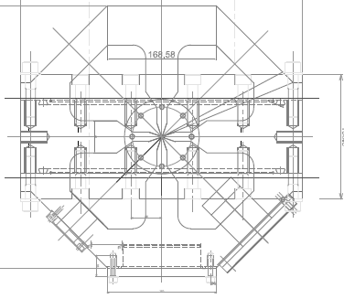
RF simulation (2D)
2D simulation using Superfish
- Tuner : 6×4 quadrant
- Adjustment range of frequency : ± 1.2 MHz
63㎜
84.7㎜
Parameter | Value
Frequency | 200 MHz
Q-value | 13400
Shunt impedance | 4318 MOhm/m
Power | 120 kW（Q-value 70 %）
Maximum surface field | 25.1 MV/m, 1.7 kilpat
Notes:
Next, we design cross section of tank and tuner using Superfish.
Q-value is 13400, power is estimated as 120 kW at Q-value 70 %.
Maximum surface field is 1.7 kilpatrik.
There are 6 tuners on each quadrant, total number of tuner is 24.
Diameter of tuner is 63 mm, stroke is plus minus 20 mm.
Ability of adjustment range of frequency is plus minus 1.2 MHz using all tuner.
Number of auto tuner for frequency tuning is 4.

Slide 15
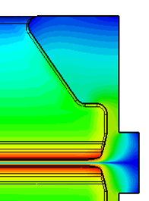
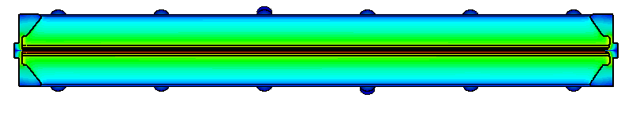
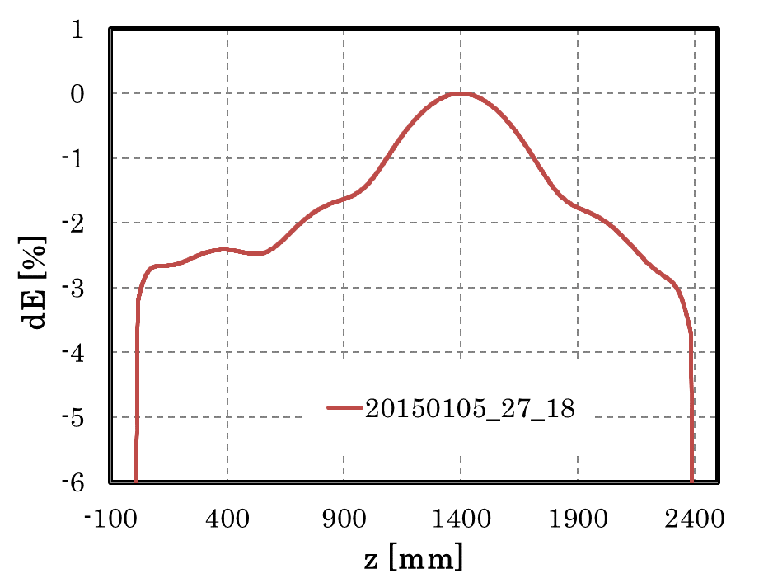
RF simulation (3D)
3D simulation using Microwave Studio
≧ 12mm (to access of cutting tool)
＜E distribution along beam axis＞
1
0
-1
-2
-3
-4
-5
-6
<Resonant frequency>
200.52 MHz
(Tuners was insert 20mm)
dE/E (%)
Target
dE/E：< 土5.0%
mesh 2.6e7
-100 400 900 1400 1900 2400
z (mm)
Notes:
Next, we design end of vane using Microwave studio.
Distance between end of vane and wall needs to be above 12 mm for machining restriction.
We optimized shape of vane end, so we obtain E distribution along z axis.
Delta E is from -3 % to 0 %, this value is within target value in plus minus 5 %.
After this 3D simulation, we started machining RFQ.

Slide 16
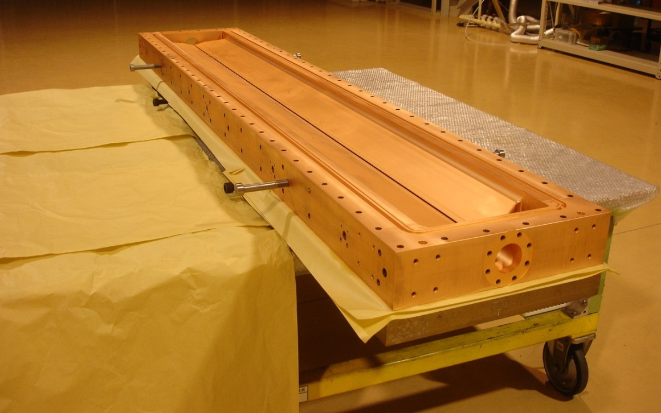
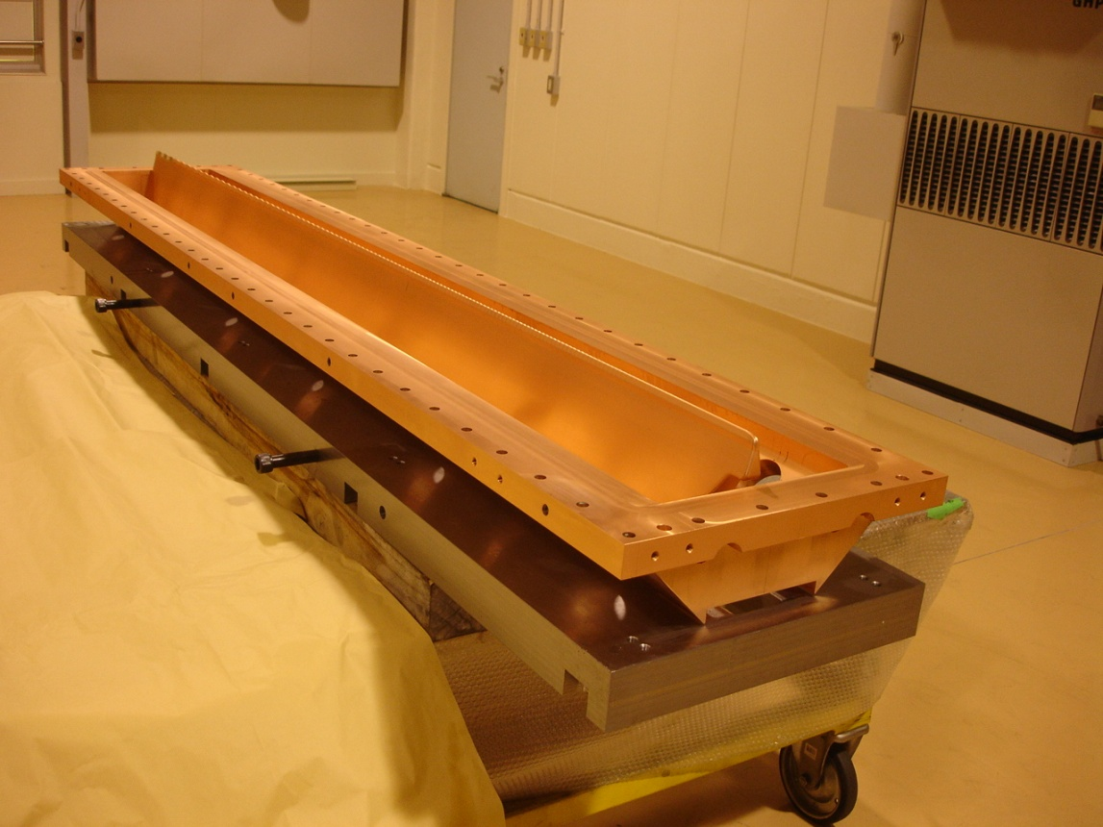
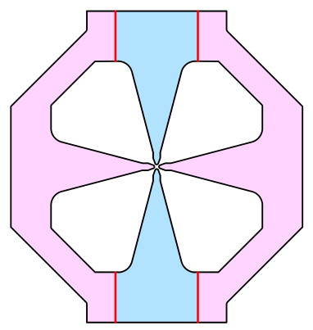
Parts after machining
Notes:
This picture shows parts of RFQ after machining.
This is bottom part.
This is middle part.

Slide 17
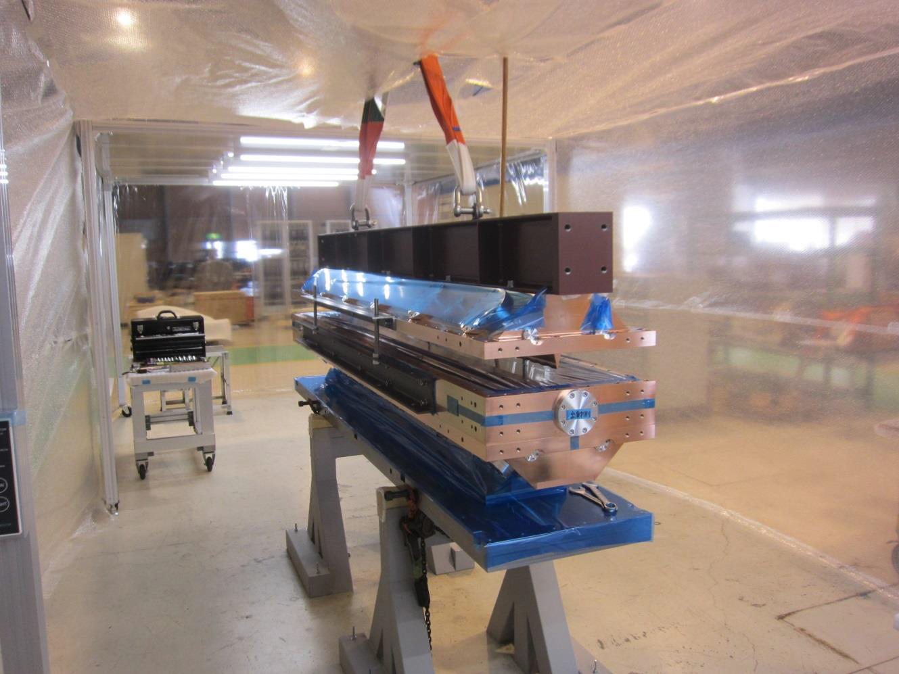
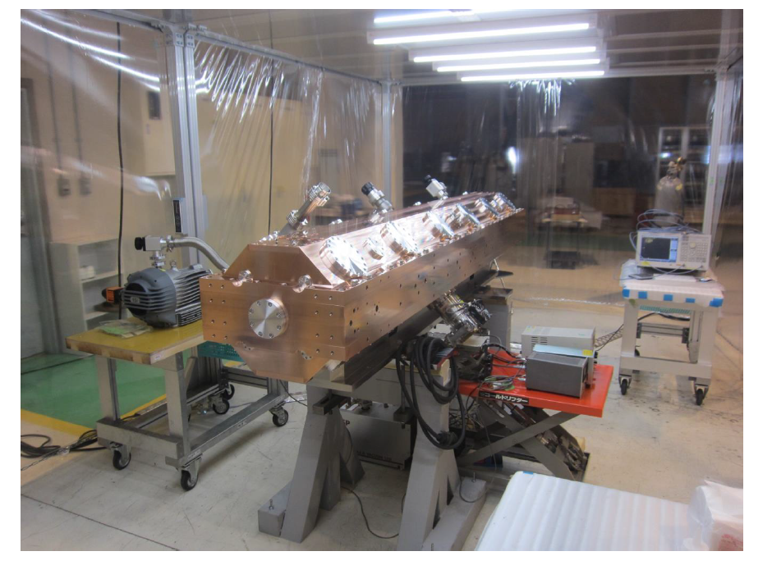
Assembly and vacuum leak test
Assembly
beam
Vacuum leak test
Notes:
This slide shows picture of assembly and vacuum leak test.
When parts were assembled, we use beam to prevent transformation by the bend.
After assembly, vacuum leak test was done with blank flange in all port.

Slide 18
Resonant frequency measurement
In vacuum
f = 198.863MHz (3D calc. 199.0 Hz)
Q = 12197 (2D calc. 13400)
Loss = -57.476dB
@ 2.5 x 10-3 Torr
In air
f=198.8317MHz
Q=12000
Loss=-57.712dB
*no tuner (with blank flange)
Notes:
This slide shows resonant frequency measurement.
In vacuum, resonant frequency measured 198.863 MHz.
Measured frequency corresponded to calculated frequency well.
The measured Q-value was 12197.

Slide 19
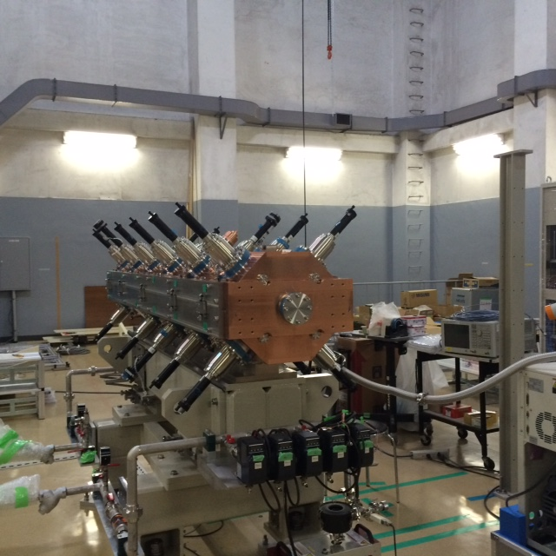
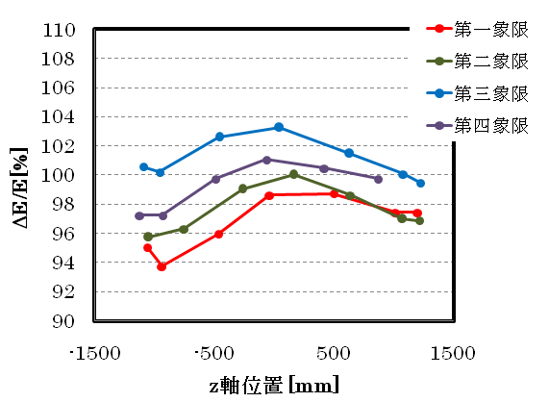
Low power test
quadrant 1
quadrant 2
quadrant 3
quadrant 4
dE/E [%]
土5.0%
Electric field measurement using Teflon piece
Teflon piece
beam axis [mm]
line
tuner (mm) | Measurement (MHz) | Simulation (MHz)
0 | 199.385 | 199.00
20 | 200.405 | 200.538
40 | 201.697 | 202.242
Target
dE/E：< 土5.0%
Position of operation
Line was sagged by weight of Teflon
Notes:
Next, this slide shows results of low power test.
This graph shows electric field distribution along beam axis.
Deviation of 4 quadrants field distribution are about plus minus 5%.
This value satisfied target value for beam simulation.
I suppose the difference of each quadrant were caused by misalignment of measurement setup.
Teflon piece is tightened by synthetic line in length of about 3 m.
I think line was sagged by weight of Teflon.
This table is frequency dependence on tuner position.
Measurement values are roughly equivalent to simulation values.
At tuner position 20 mm, 200.405 MHz is operation frequency.

Slide 20
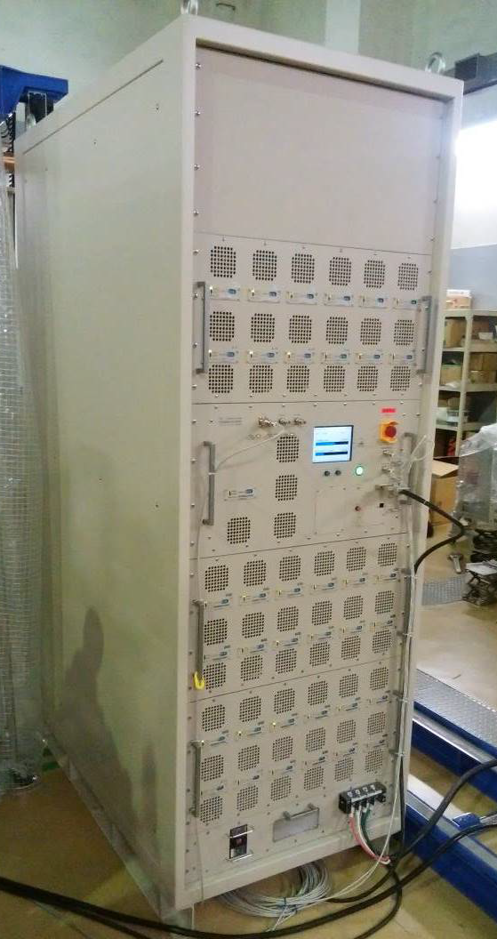
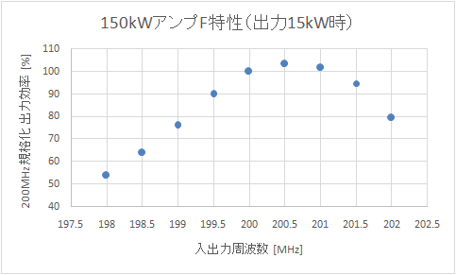
Solid state amplifier
Frequency range | 200 ± 0.2 MHz
Power | 150 kW
Max duty | 1.0 %
Size | 740×1300×2100 ㎜
Frequency characteristics (@15kW)
110
100
90
80
70
60
50
40
Efficiency (%)
operation frequency
198 199 200 201 202
Frequency (MHz)
Notes:
This picture shows the solid state amplifier.
Power is 150 kW, max duty factor is 1.0 %.
This graph shows efficiency vs. frequency.
At frequency of 200.5 MHz, the efficiency is peak value about 100%.

Slide 21
Beam accelerating test
04
Notes:
Next, I’ll talk about beam accelerating test of LIS and RFQ.

Slide 22
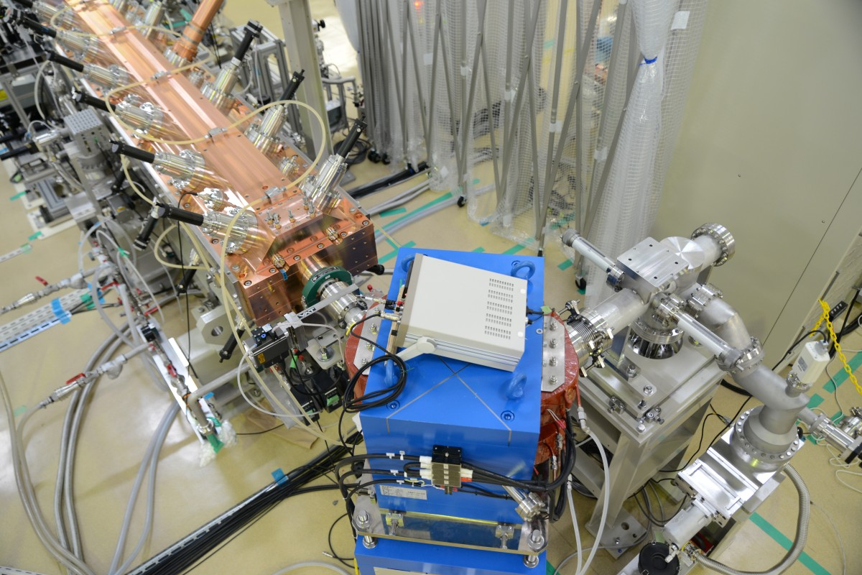
Setup for beam accelerating test
RF amplifier
RFQ
Beam Analysis section
FC
LIS
Magnet
CT
Slit
Length from LIS to RFQ : 4.5m
※without beam analysis section
Notes:
These pictures shows the setup for beam accelerating test.
For isolation between LIS and RFQ, we put nylon isolation plate.
For beam analysis, we used Current Transformer(CT) and Faraday Cup(FC).
Total current, not only C6+ but also other charge state of C ion, was measured by CT.
C6+ current analyzed by magnet field separation was measured by FC.
Length from LIS and RFQ was about 4.5 m.

Slide 23
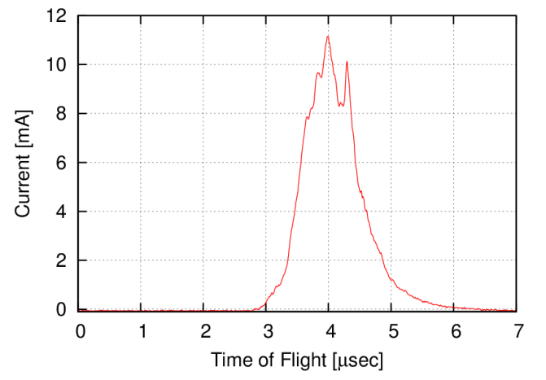
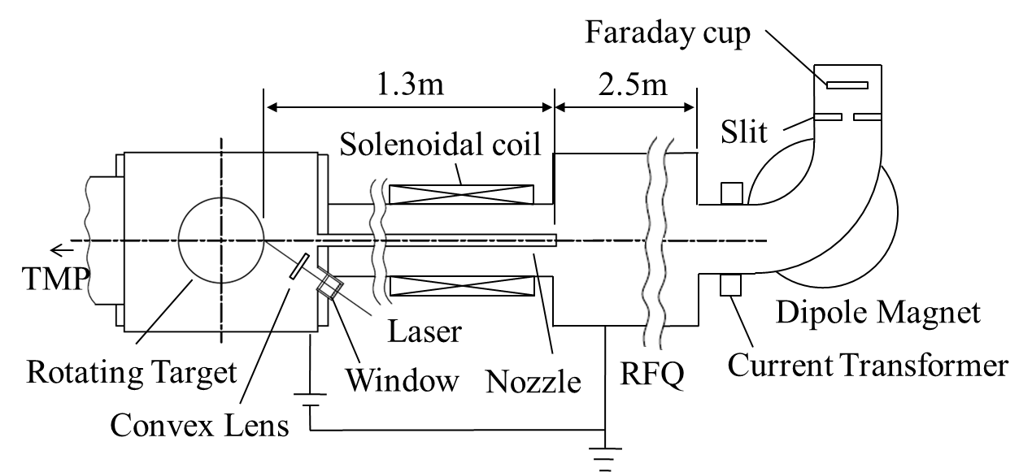
Result of accelerating test (1)
Typical C6+ signal measured by FC
C6+ @FC
Peak current of 10mA C6+ ions were accelerated by RFQ.
Notes:
Next, I’ll talk about results of accelerating test.
This figure shows the typical C6+ time of flight signal.
Horizontal axis is time, vertical axis is beam current by FC.
Origin of horizontal axis is time when laser was fired.
We confirmed peak current of 10 mA C6+ ions could be accelerated by RFQ.

Slide 24
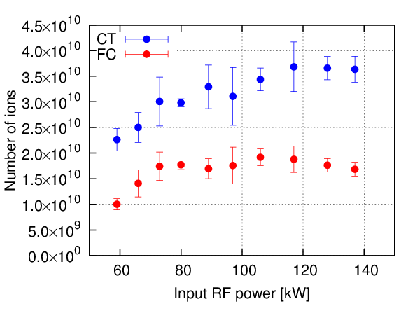
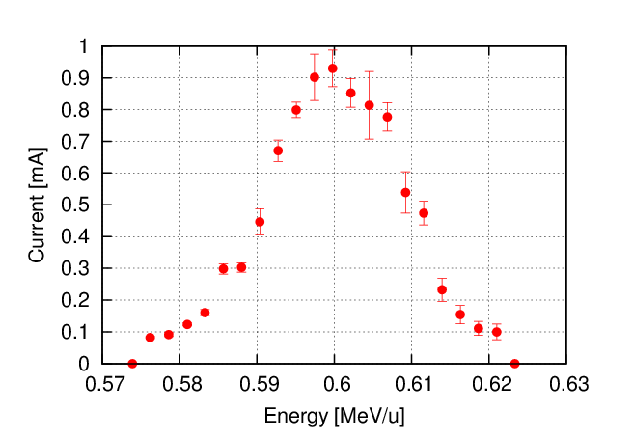
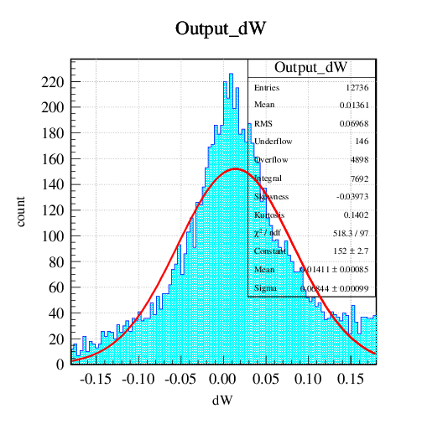
Result of accelerating test (2)
Dependence of number of ions on RF power
About 1.8e10 particles per pulse were constant above 80kW.
(∫dI×dt/e/6)
<Test condition>
Laser 1.7 J
HV 40 kV
Sol 1.2 A
Nozzle 6 ㎜Φ
Target value for
cancer therapy
(1e10 ppp)
60 80 100 120 140
input RF power [kW]
Energy distribution
good agreement with measurement and simulation
C⁶⁺
<Test condition>
LIS: Laser 1.7J
HV 40 kV
Sol 1.2 A
Nozzle 6 ㎜Φ
RF： 89kW
FC： Slit=±0.9mm
5%
5%
0.57 0.58 0.59 0.6 0.61 0.62 0.63
Energy [MeV/u]
Simulation by LINACS v02
Notes:
This slide shows 2 results of beam accelerating test.
This plot is dependence of number of ions on RF power.
Horizontal axis is input RF power, vertical axis is beam current.
Blue point shows number of ions by CT, Red point shows number of ions by FC
We converted integration of current signal into number of ions.
We obtained about 1.8 to the 10th power particle per pulse C6+, which is sufficient for cancer therapy at RF power of 80 kW.
Below figures show current of C6+ vs. beam energy.
Left figure shows the result of measurement, and right figure shows the result of simulation by LINACS v02.
We observed good agreement with measurement results and simulation.

Slide 25
Future Plan for LIS
05
Notes:
I’ll talk about present state and future plan for LIS.

Slide 26
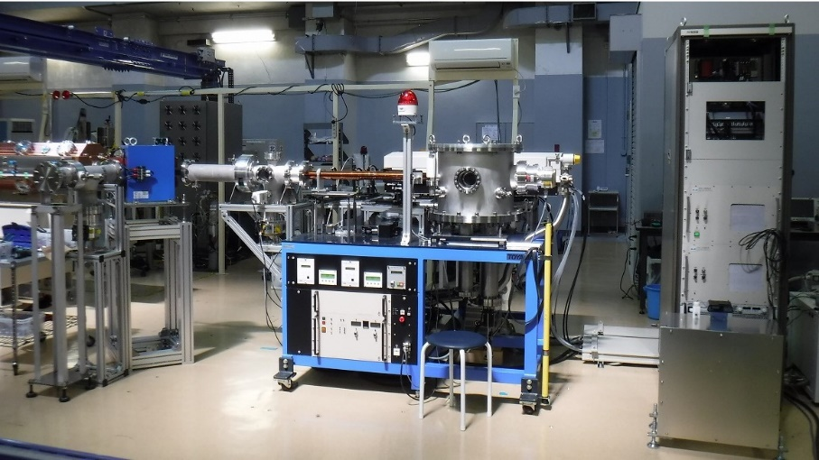
New LIS for safe and compact
remote control opanel
Parameter
Laser wave length Nd:YAG 1064 nm
Maximum laser power 1.6 J
Repetition rate 1 Hz (depend on laser repetition rate)
Focal length of lens 200 mm
Maximum accelerating voltage 40 kV (outer chamber is earth,
inner chamber is charged )
Target diameter 150 mm
Size 1500x01500x1500 mm
Notes:
After C6+ LIS and RFQ development for cancer therapy, we designed new LIS for not only carbon cancer therapy but also future commercial application.
There are some improvement.
At first, for safety use, we designed to install charged chamber inside of outer vacuum chamber with grounding.
Second, to be compact and movable use, we assembled main parts , that are plasma chamber, laser oscillator, vacuum pumps and HV power supply on common movable use.
On the other hand the laser power supply and control unit are separated with common base.
The target size is about 1500 cubic mms.
All operation parameters with interlock for new LIS system are controlled by remote control system.
Now we just start to study for various ions production except carbon,
for solid target such as, iron, copper, tungsten.

Slide 27
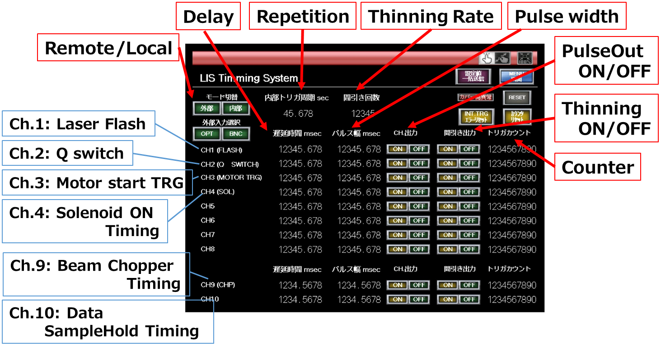
Control panel of LIS
Integrated timing system
Notes:
This shows screen of control panel.
All timing are controlled by this panel.
Timing system includes laser and move of target and excitation of solenoid and beam chopper and data samplehold.

Slide 28
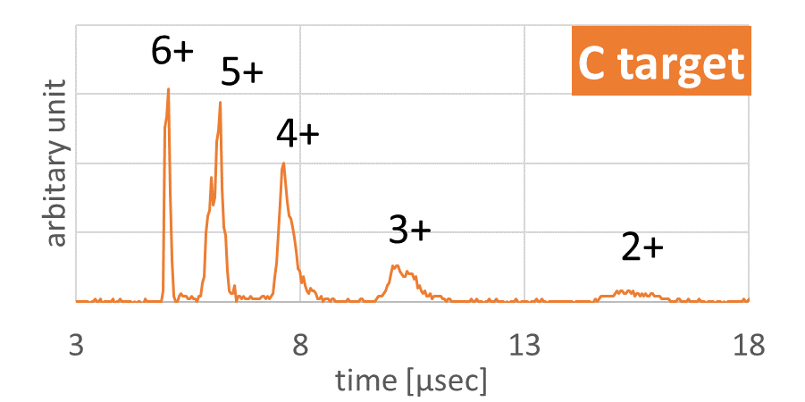
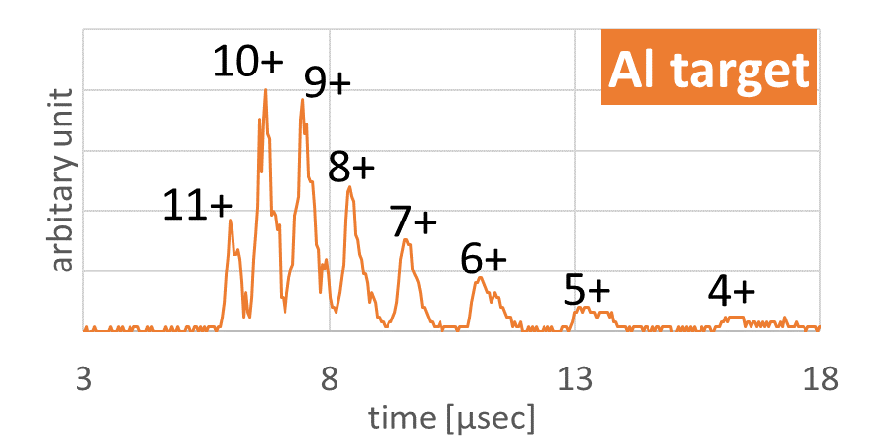
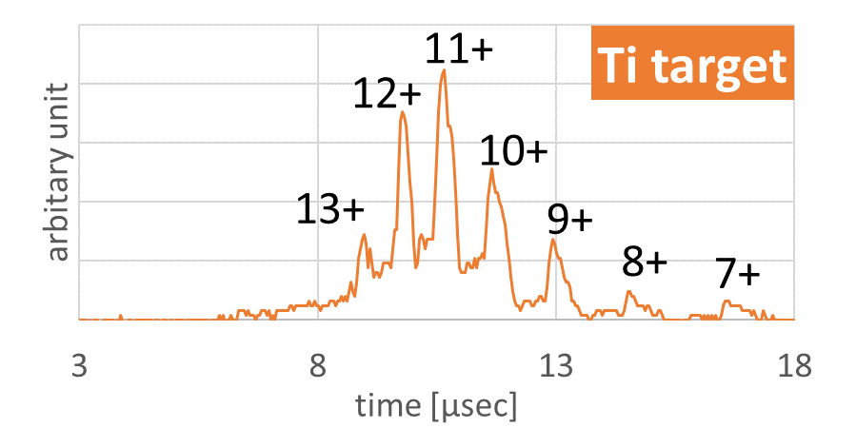
Study to generate highly charged ions
TOF signal by MCP from past measurement
Laser energy ～1.6J
We just start to study for various ion production
using new LIS.
Notes:
This figures shows typical Time Of Flight signal by Micro Plate Channel plate in our past measurement results.
We plan to measure not only charge separation spectrum but also measure possible current of each charged ion for many possible target for future application.

Slide 29
Summary
06
Notes:
Finally, I’ll summarize my talk

Slide 30
Summary
C⁶⁺ LIS & RFQ were developed for carbon cancer therapy
- LIS was applied.
- RFQ with 3 parts assembly was applied.
- Solid state amplifier was applied.
- C6+ beam was accelerated to 0.6MeV/u and with 1.8e10 particle per pulse.
We are looking for new application of LIS.
We are welcome any suggestion and proposal.
Notes:
We have developed C6+ LIS and RFQ for carbon cancer therapy.
We applied LIS, RFQ with 3 parts assembly and solid state amplifier for stable use.
In our performance test results, we carried out the data of1.8e10 particle C6+ per pulse at 0.6 MeV/u.
It is sufficient for injection to the synchrotron for cancer therapy treatment.
finally,
We are looking for new application of LIS
We are very welcome any suggestion and proposal for future application of LIS.
If you have any new idea, please let us know now or email me later.

Slide 31
Notes:
Thank you very much.

Slide 33
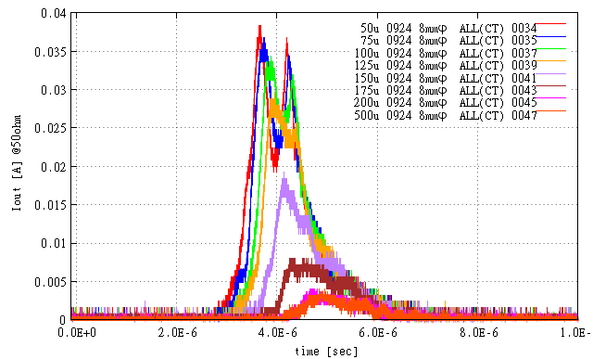
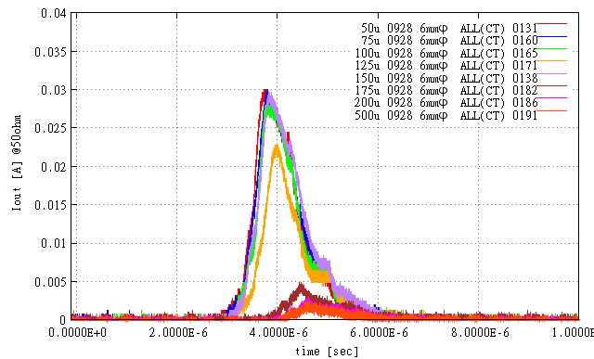
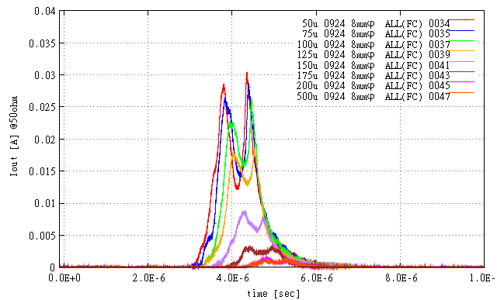
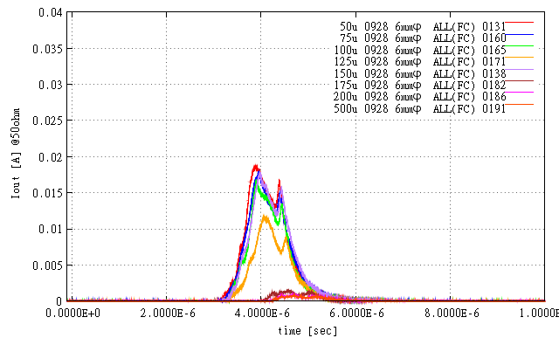
Accelerating test (3)
Dependence of current on laser energy from 0.5 to 1.7 J
Nozzle 8 ㎜φ
Nozzle 6 ㎜φ
40
30
20
10
0
40
30
20
10
0
CT
I (mA)
I (mA)
0 2 4 6 8 10
0 2 4 6 8 10
t (μsec)
t (μsec)
40
30
20
10
0
40
30
20
10
0
FC
I (mA)
I (mA)
0 2 4 6 8 10
0 2 4 6 8 10
t (μsec)
t (μsec)
Peak of signal was cut because of space charge limitation
Notes:
This slide shows dependence of ion current on laser energy from 0.5 to 1.7 J.
Top figures show signal from CT(current transformer), bottom figures show signal from FC(Faraday Cup).
Left figures show signal with hole of nozzle is 8 mm in diameter ,
right figures shows signal with hole of nozzle is 6 mm in diameter.
The ion current of nozzle hole 8 mm is larger than that of 6 mm.
and when laser energy becomes large, the ion current becomes large too.
You can see in all figures, the current of around peak decreases because of space charge effect.
In this study, our target goal for C6+ is 1e10 particles per pulse and
We successfully obtained 1.8e10 ppp which was sufficient for cancer therapy.
But for the future application to increase accelerated curret by RFQ,
we plan to optimize the shape of nozzle and also RFQ design.

