Slide 1
Beam dynamics issues in high-current RFQs
M. Comunian

Slide 2
Index
IFMIF RFQ DESIGN
RFQ input conditions ->LEBT Effects (Simulation <-> Measurements)
RFQ beam transport -> Ideal vs Real RFQ (Simulation <-> Measurements)
RFQ beam output -> MEBT Effects (Simulation <-> Measurements)

Slide 3
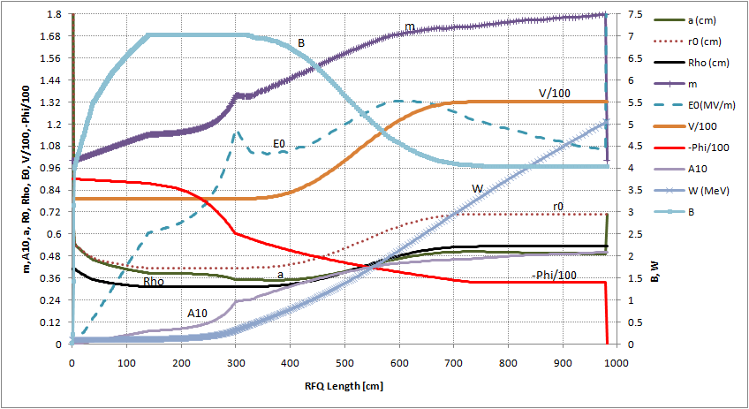
IFMIF RFQ design
Modulation “m”, average aperture “r0” [cm], small aperture “a” [cm], Voltage/100 [kV] E0 [MV/m], Acceleration factor “A10”, Energy “W”, Focusing “B”,
-Sync. Phase/100 [deg], Pole tip “rho”, along the RFQ
Shaper GB Accelerator
The voltage is increased following an analytic law
The focusing in the Gentle Buncher is strong (B=7) so to keep the tune depression above 0.4 for the best control of space charge.
Main resonances are avoided in the accelerator section
The focusing in the shaper raises from 4 to 7 to allow an input with smaller divergence.
Notes:
Accelerator section design
Designed cell by cell
Voltage and R0 are given by an analytic law.
Surface fields Es as interpolation of PARI geometry file “V2TERM.txt”.
Synchronous phase was increased in linear way cell by cell from -60 to -32 deg.
Acceptance increased up to 4.2 mm mrad norm
Accelerator section design
Designed cell by cell
Voltage and R0 are given by an analytic law.
Surface fields Es as interpolation of PARI geometry file “V2TERM.txt”.
Synchronous phase was increased in linear way cell by cell from -60 to -32 deg.
Acceptance increased up to 4.2 mm mrad norm

Slide 4
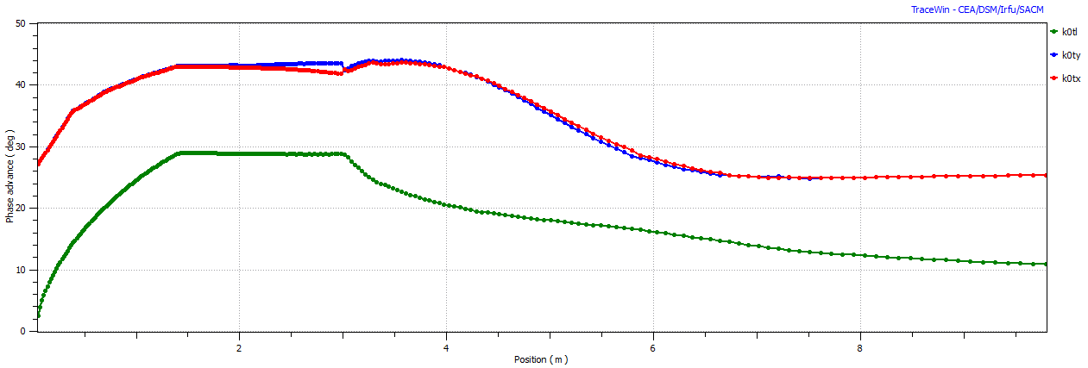
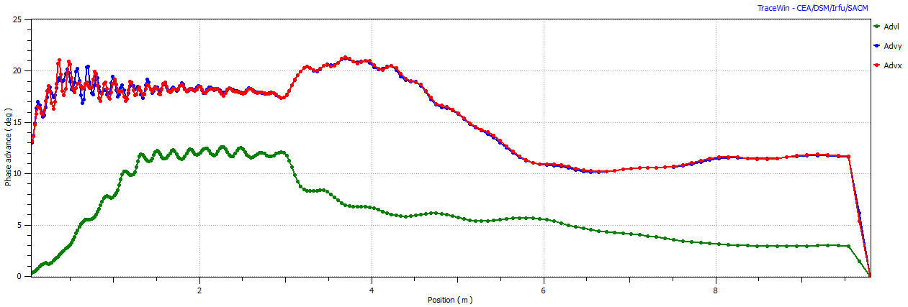
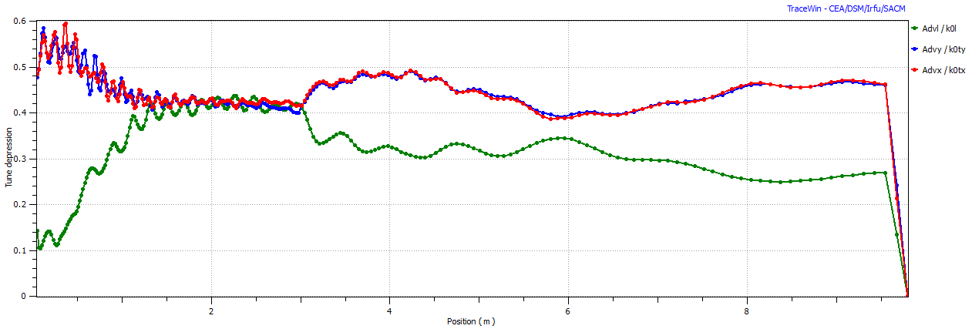
IFMIF RFQ design
Longitudinal and transverse Phase Advance along the RFQ
I=0 mA
I=130 mA
Tune depression
0.4
Shaper GB Accelerator
Notes:
Accelerator section design
Designed cell by cell
Voltage and R0 are given by an analytic law.
Surface fields Es as interpolation of PARI geometry file “V2TERM.txt”.
Synchronous phase was increased in linear way cell by cell from -60 to -32 deg.
Acceptance increased up to 4.2 mm mrad norm
Accelerator section design
Designed cell by cell
Voltage and R0 are given by an analytic law.
Surface fields Es as interpolation of PARI geometry file “V2TERM.txt”.
Synchronous phase was increased in linear way cell by cell from -60 to -32 deg.
Acceptance increased up to 4.2 mm mrad norm

Slide 5
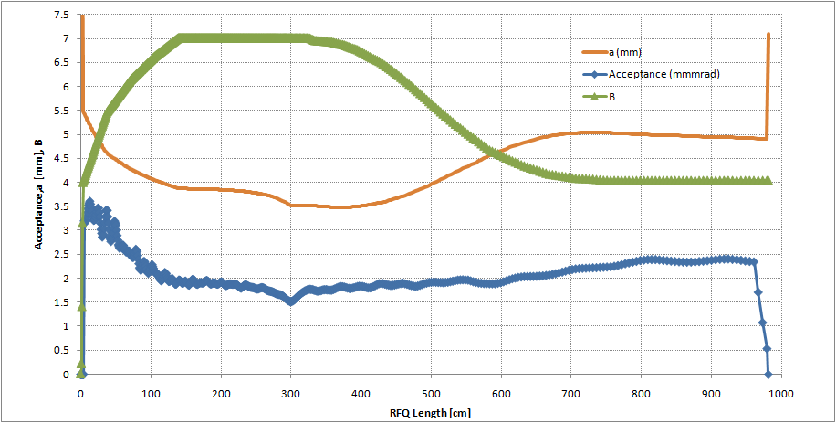
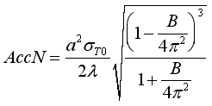
Acceptance increase in the accelerator part
IFMIF RFQ design
5 ε_{rms}
Shaper GB Accelerator

Slide 6
Beam losses
Integral 0.96 mA
To achieve Beam losses concentrated in the low energy part is very important since neutron production is proportional to Energy²
Integral 363 W
Integral 2.4 10^9 n/s
WB distribution 0.25 mm mrad rms norm

Slide 7
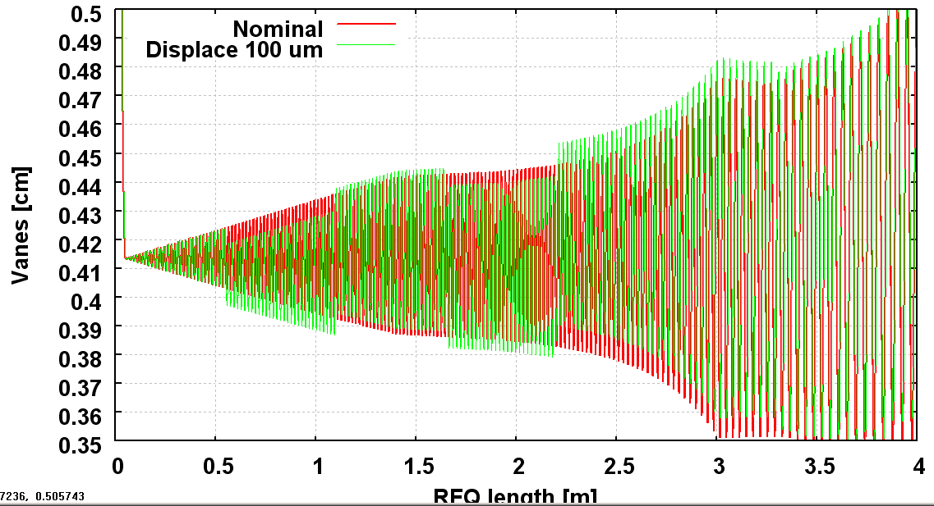
Error studies
The error study shows tolerances in beam alignment and electrode displacements of the order of 0.1 mm, while the RF field law has to be followed with an accuracy of 1-2%.
Example: displacement between two modules (9 modules)
Transmission and Power loss due to the segmentations applied with gaussian and waterbag input beam distribution.(TOUTATIS)

Slide 8
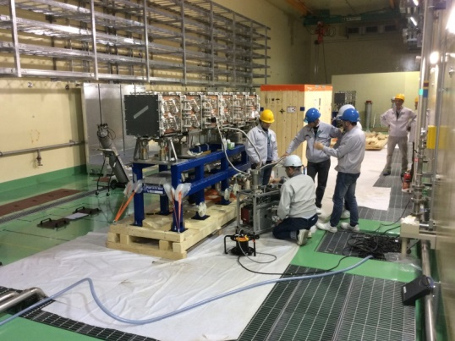
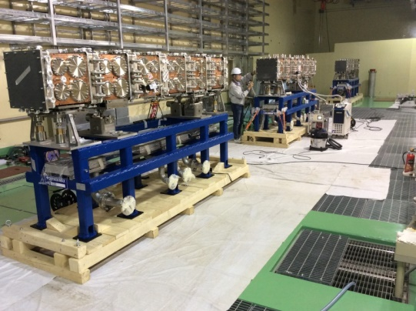
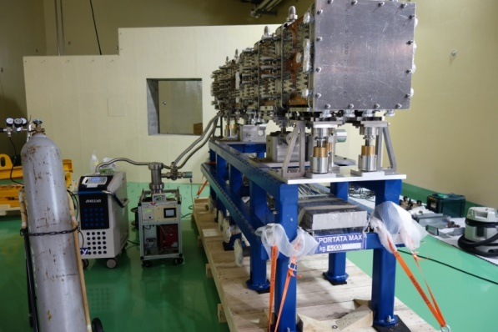
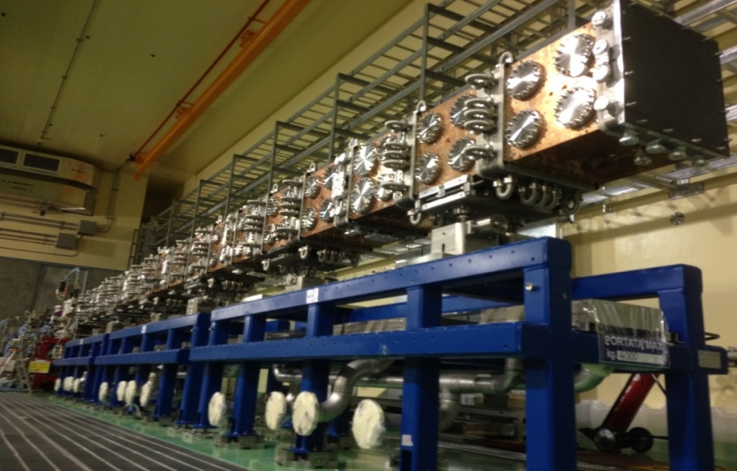
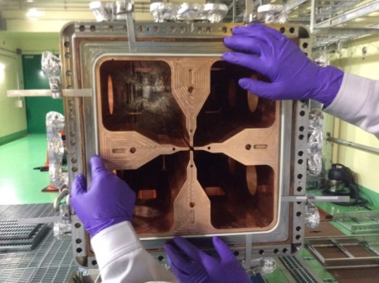
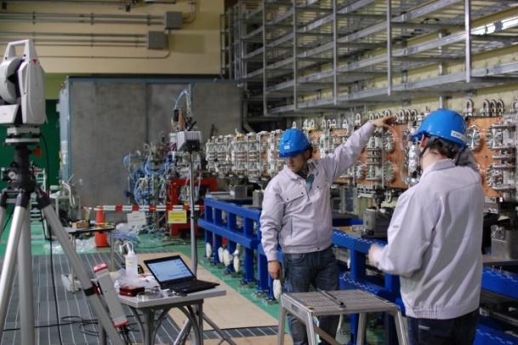
RFQ construction and installation
SOFT 2016

Slide 9
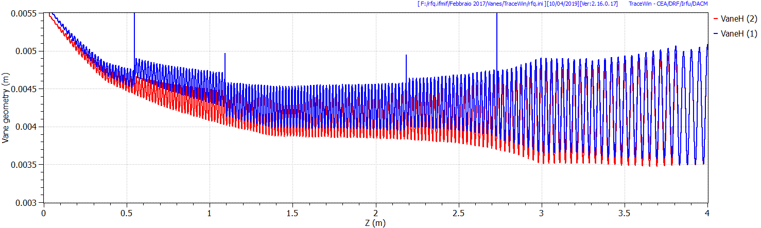
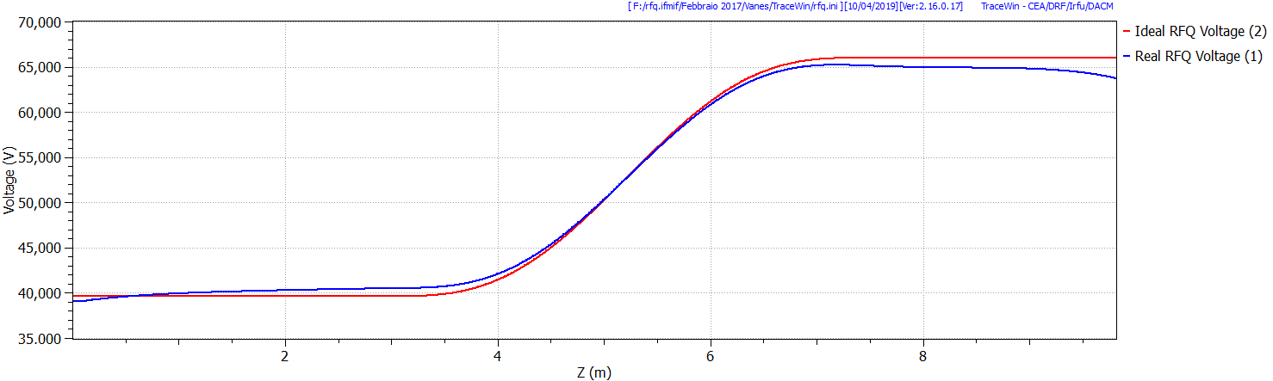
Real RFQ
Real Vane Shape
Ideal Vane Shape
-3%
The geometrical construction errors
has been introduced electrodes by electrodes
along the RFQ and the voltage tuning

Slide 10
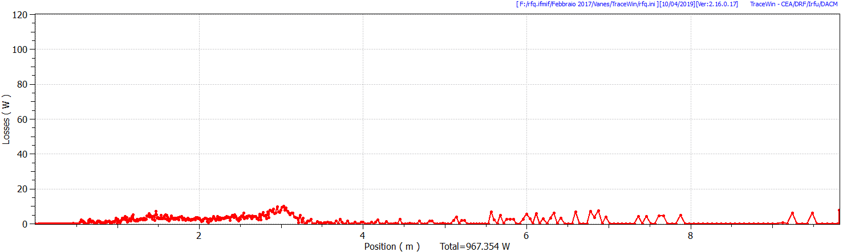
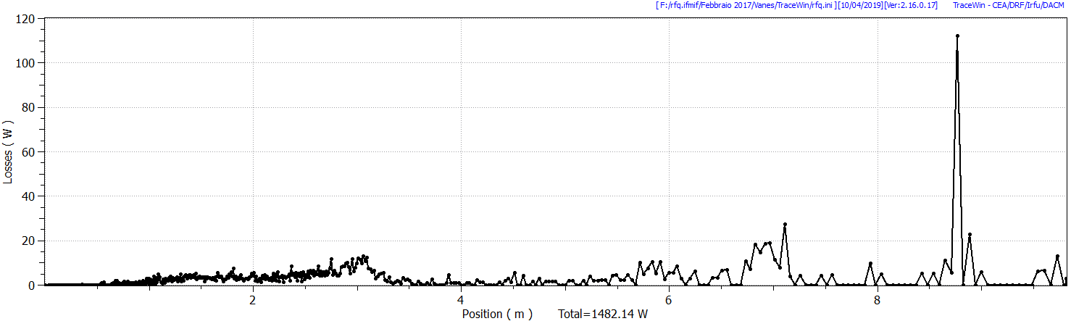
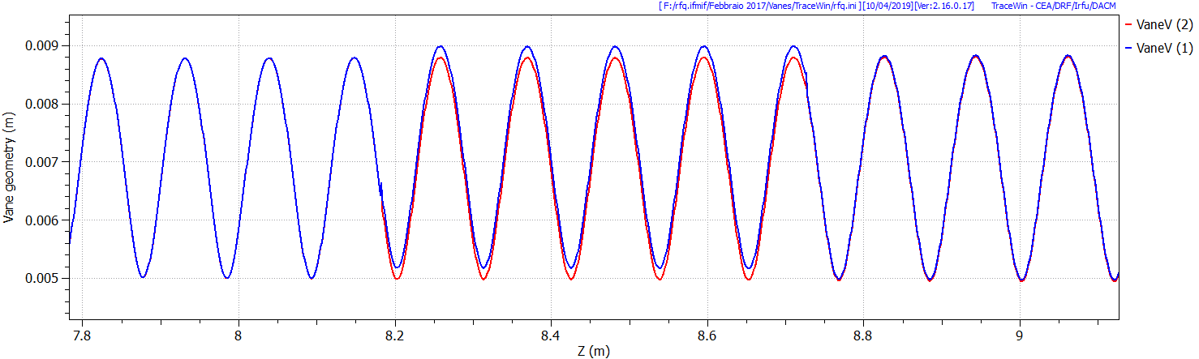
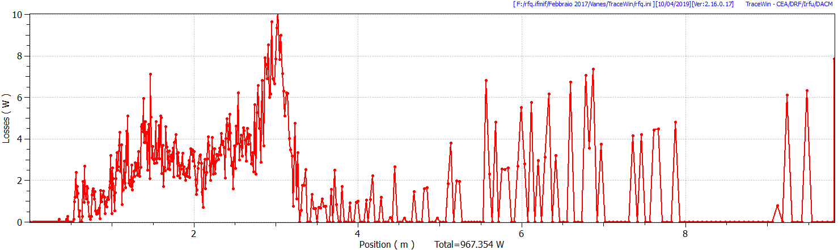
120 W
0.2 mm
Real RFQ
10 W
Power Lost=1482 W
Ideal RFQ
D+ 130 mA emit.=0.25 mmrad Gaussian dst

Slide 11
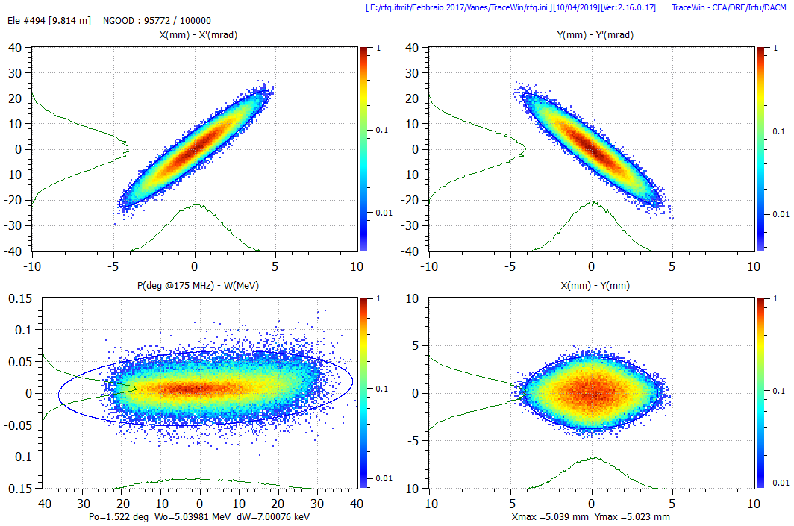
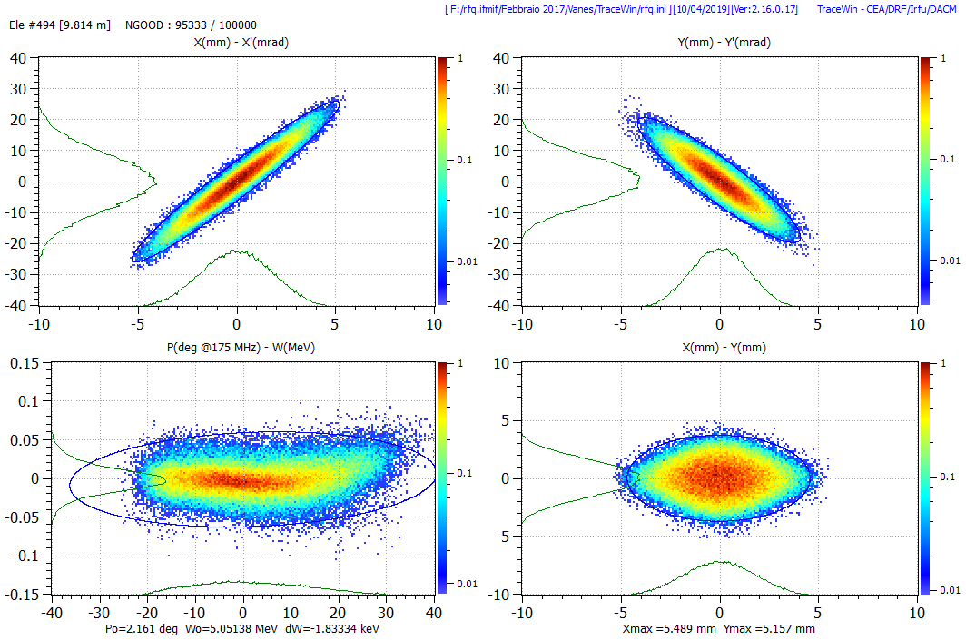
Real RFQ: Final Phase Space
Ideal RFQ
Real RFQ
Very small impact on global losses (-0.4% Transmission) and beam behavior.
+10% emit. Long.
D+ 130 mA emit.=0.25 mmrad Gaussian dst

Slide 12
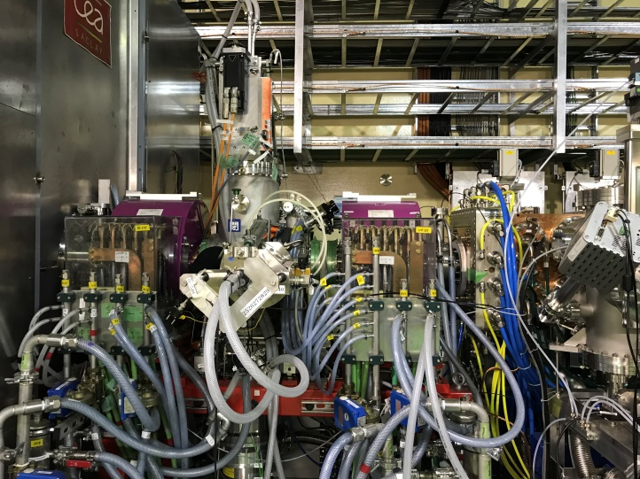
Ion Source and LEBT

Slide 13
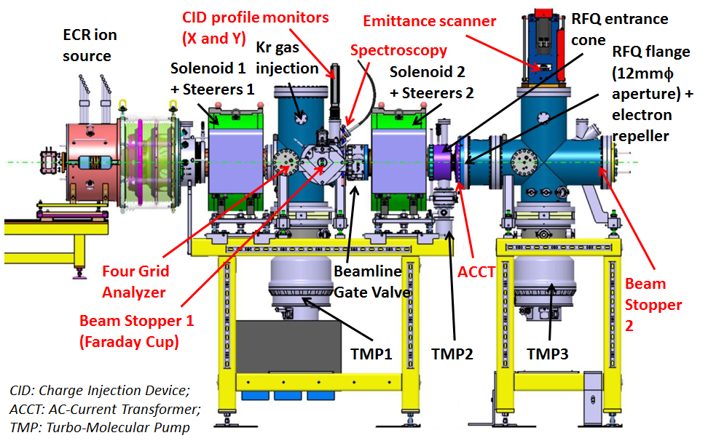
IFMIF/EVEDA LEBT installation for beam commissioning

Slide 14
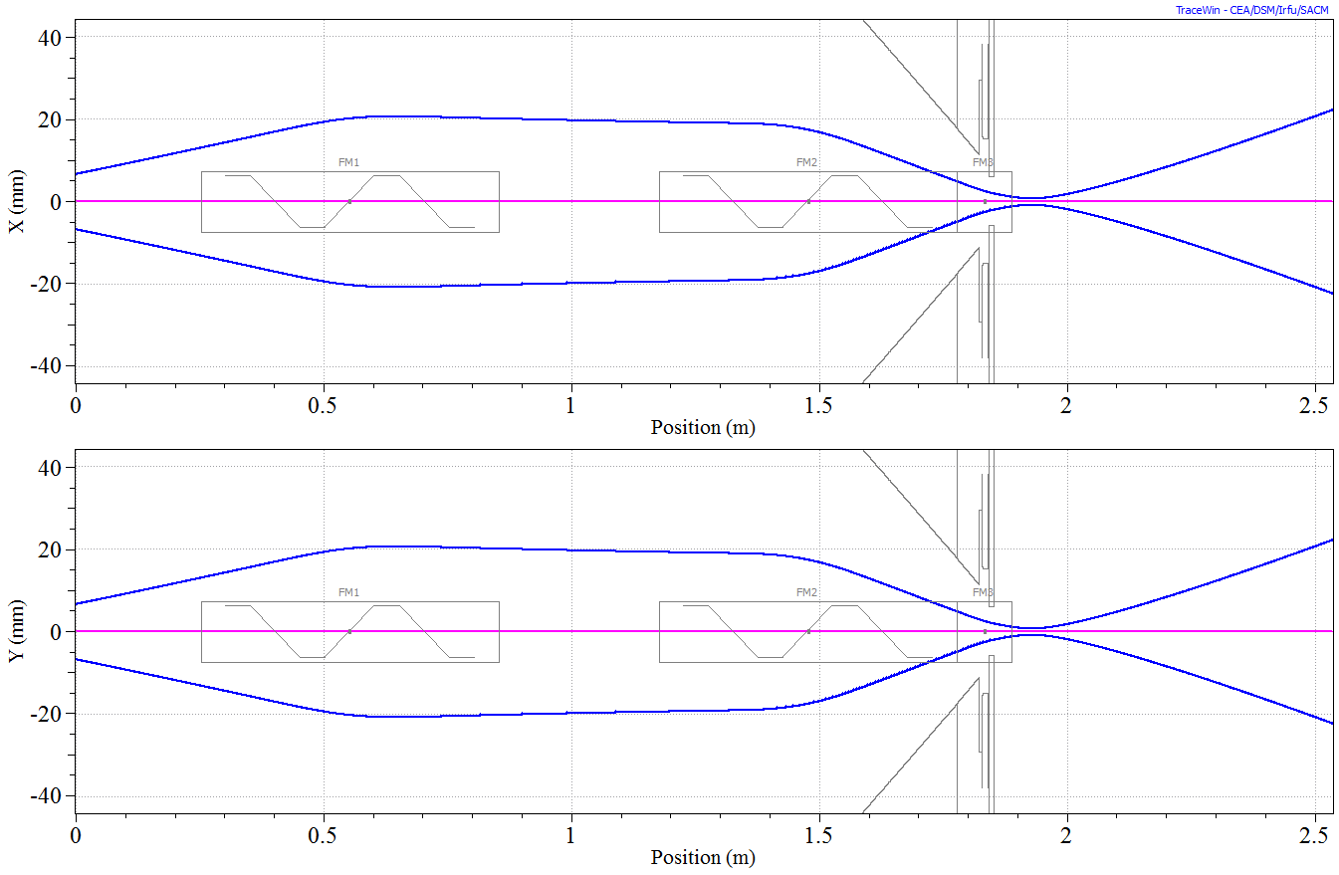
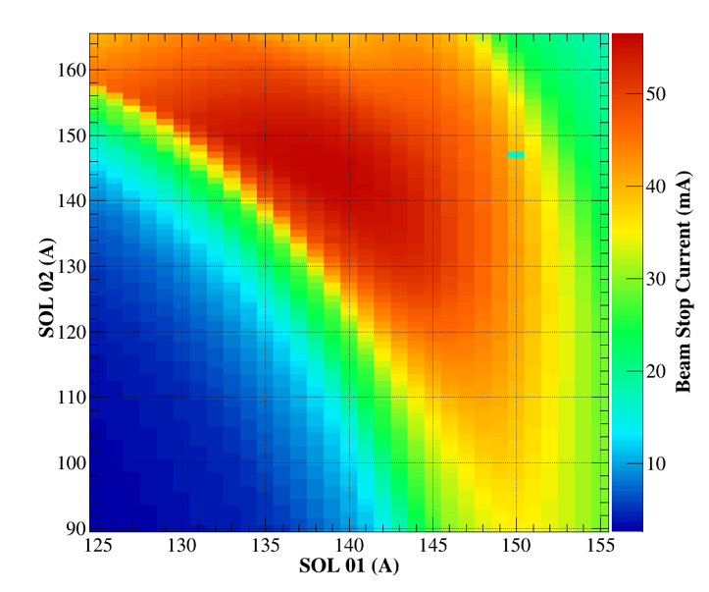
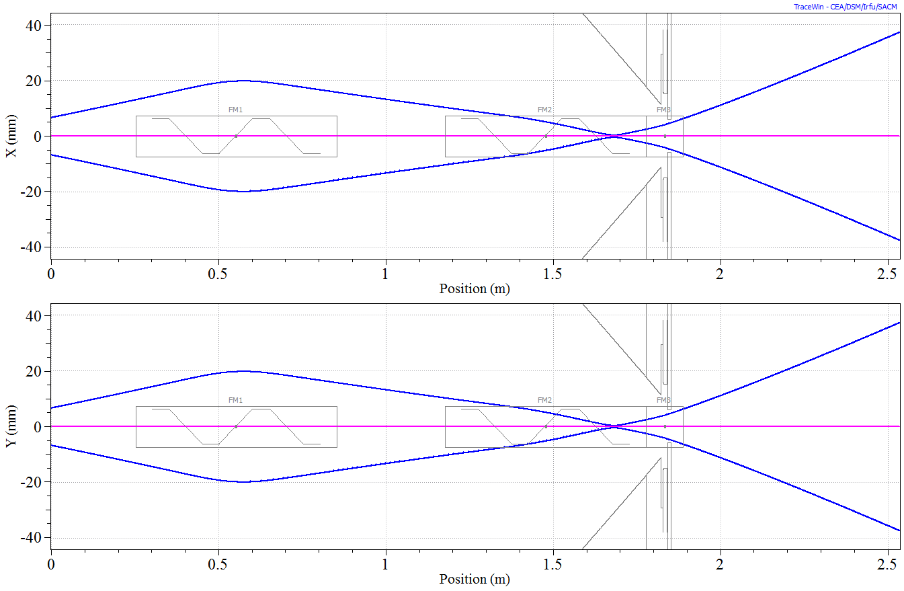
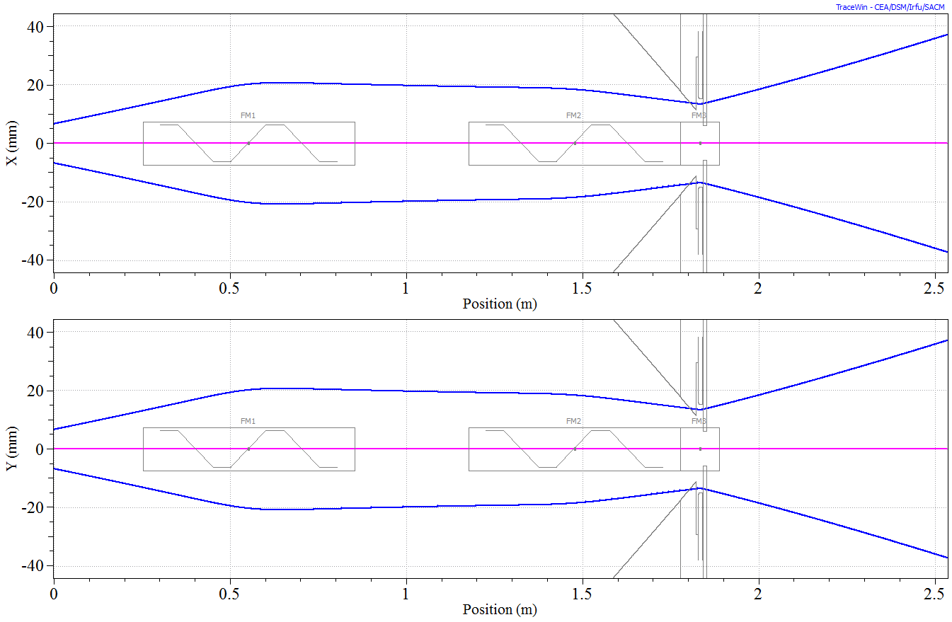
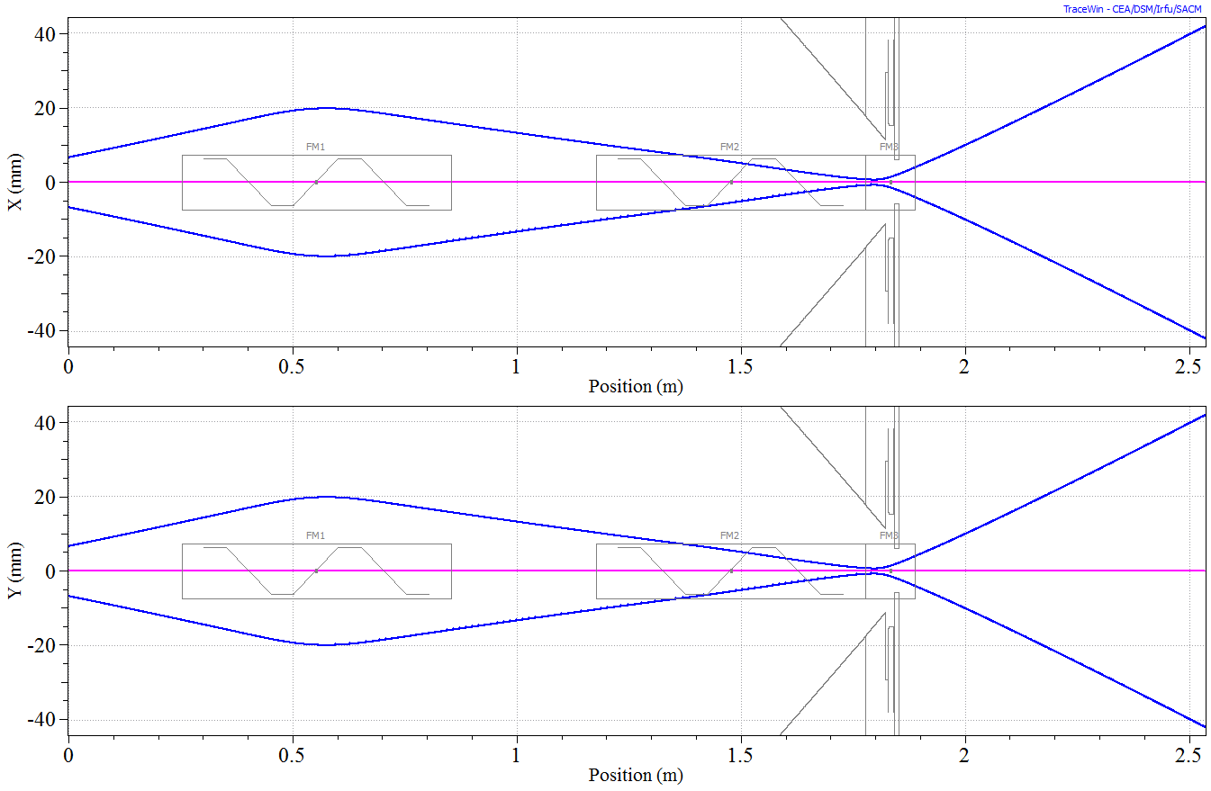
LEBT behaviour for proton in pulsed mode at about 50 mA
Match zone
for the RFQ
Focus before the cone hole
Focus after the cone hole
Strong focusing
Hyper
focusing
Larger beam size
in the cone hole
Smaller beam size
after the cone hole
Hyper
weak
focusing
Weak focusing

Slide 15








LEBT behaviour:
beam dynamics background
The neutralisation (99-90%, from FGA_H_50keV_20160324-1111.dat and trace-forward) implies after the extraction an emittance dominated beam.
The major part of the BD is dominated by the thermal term in the LEBT.
We are sensitive to a couple of percentage difference in the neutralisation, due to the fact that such difference is applied for almost 2 m.
From indirect calculation the exit of the extraction source seems to produce a too divergence beam at the first solenoid. Thus, the emittance growth is given mainly by the coupling from the solenoid nonlinearities (mainly) and space-charges. The emittance trend was confirmed experimentally (beam_report_23032016) and by simulations (COB20 presentation).
Therefore, the main objective is to reduce the beam dimensions at the first solenoid.
=0
In the LEBT:
$$r_{x}^{′′}+\frac{{(γ}_{b}β_{b})′}{γ_{b}β_{b}}r_{x}^{′}+k_{x}r_{x}−\frac{ηQ}{r_{x}}−\frac{ε_{x}^{2}}{r_{x}^{3}}=0$$
$$ε_{x}={4ε}_{x,rms}$$
$$r_{x}=r_{y}$$
$$Q$$
Generalised perveance,
$η$ neutralisation factor
$\frac{SC term}{thermal term}=\frac{η∙Q∙r^{2}}{ε_{x}^{2}}= 3.4 η$=0
0.034
$η$=0.01
even less if emittance growth occurs $ε_{x}^{ }=$ $ε_{x}^{ }(s)$

Slide 16
  Models for LEBT
Design models and simulations
Commissioning models and simulations
Approximations,
semi-empirical methods
Generally should include as much as possible all the processes involved in BD (critical for LEBT part).
Large number of macro-particles
Normally not depending on measurements
Error studies, multi-species simulations, or space charge compensation processes could require order of weeks to be performed.
Generally should include just what is really necessary to describe the physics problem (e.g. the rms evolutions along the line).
It is mandatory to reduce the time needed for getting the results (half a day maximum)
Depends on measurements. This led to the development of ad hoc methods.
Field maps for strongly non linear elements (such as buncher and solenoids) and as built RFQ model.
Gives hints for initial tuning
How to deal with S.C.C.?
Example of software: Tracewin error studies, WARP (3d simulations).
Example of software: Tracewin (normal runs), Axcel and WARP (2d simulations), Toutatis

Slide 17
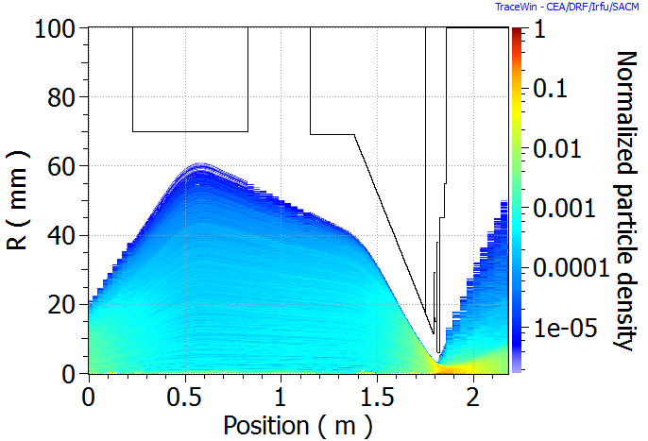
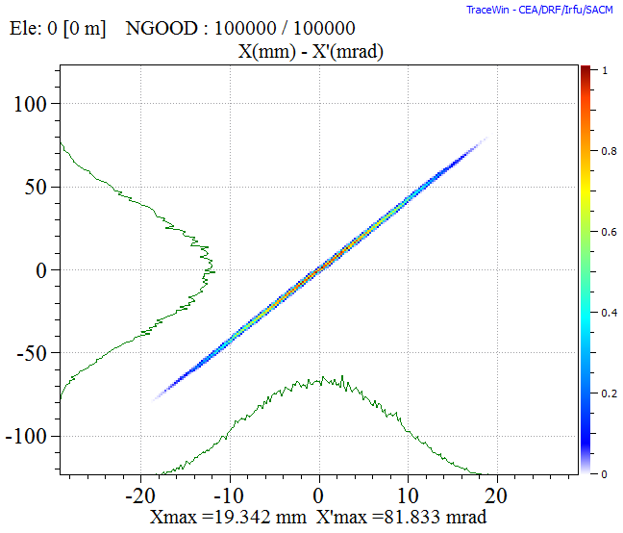
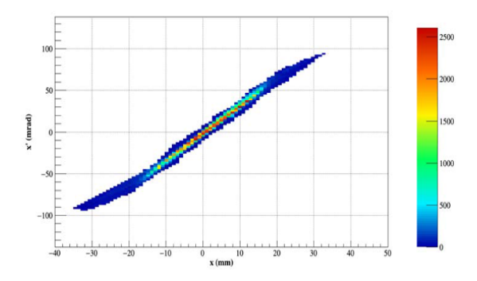


Commissioning model and trace forward method
Key points:
It takes the inputs from the measurements, trying to fix as many as possible parameters. If any error occurs in the measurement, it will be transported to the simulation
It needs the model from the simulation.
Estimate the beam input rms emittance and the Courant-Snyder parameters, via an iterative method.
Model
$ε_{rms}$ $β_{rms}$ $α_{rms}$
$ε_{rms}$ $β_{rms}$ $α_{rms}$
Rms measured input @ output:
Rms simulated output @ input:
Space charge compensation is normally a free parameter. However, the trend along z can be given by the design model simulations

Slide 18
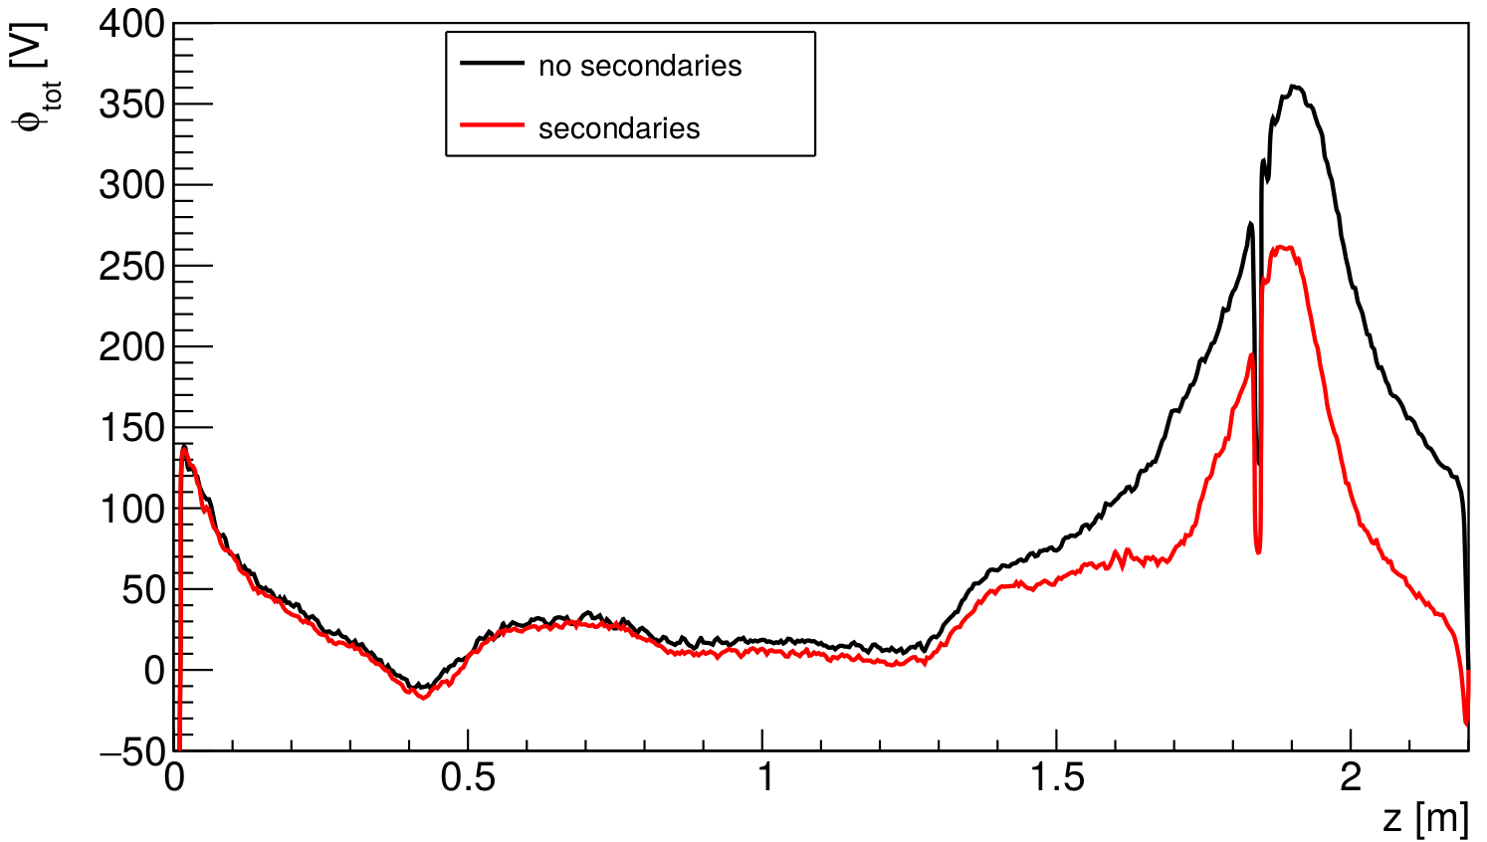
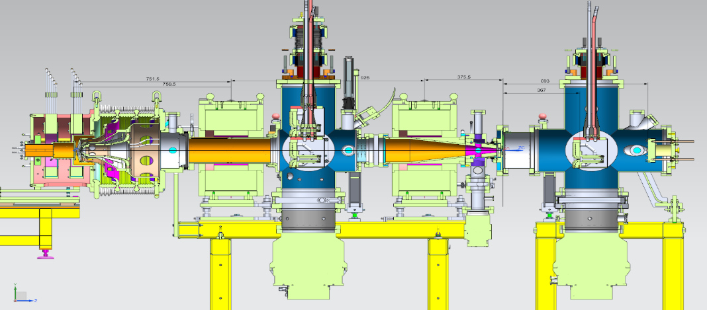



From the design model: example of residual potential of 135 mA deuteron beam at 100 keV
Copper RFQ injection cone
$$∆η\sim 20\%$$
The RFQ cone and the emittancemter changes the s.c.c. pattern!
Wolframium EMU shield
$$D_{2}$$
$$D$$

Slide 19
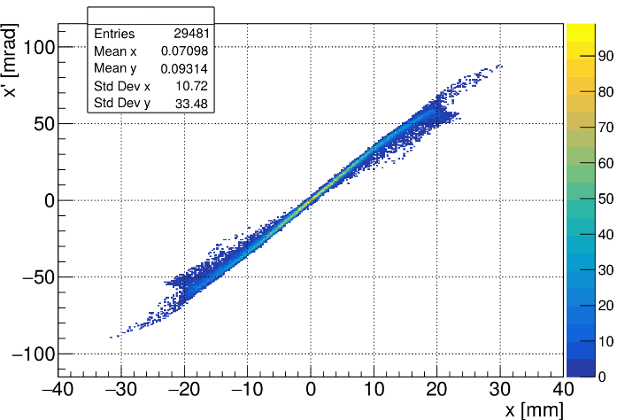
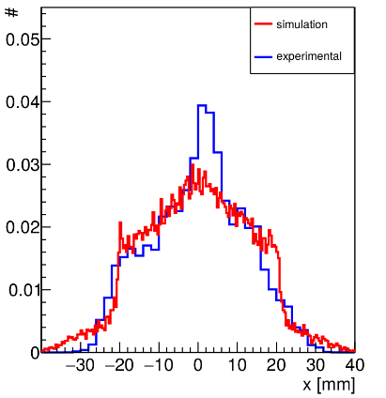
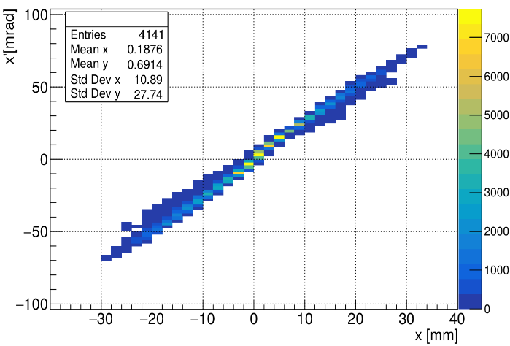
Example of results of the design model: Deuteron beam 135 mA, pulsed mode.
simulation
measurement
Phase spaces and x projection comparisons.

Slide 20
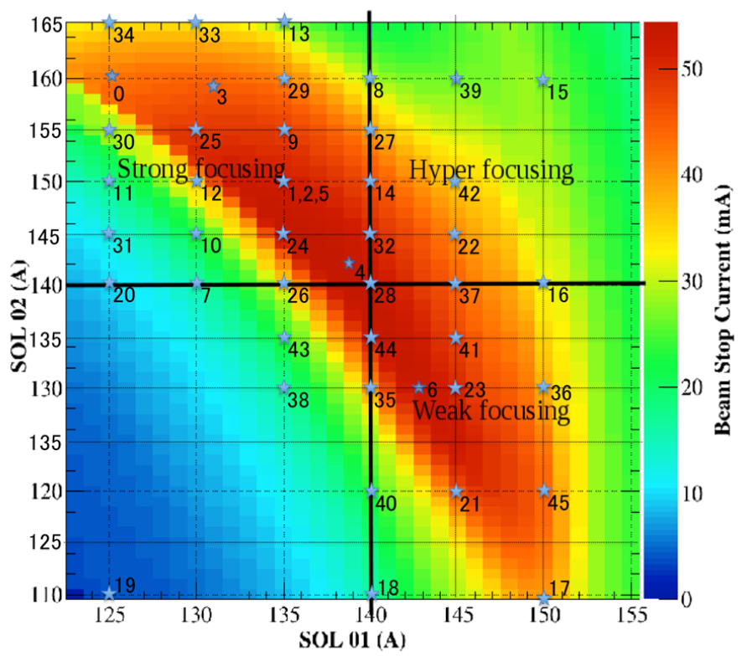




LEBT behaviour: some points along the solenoid scan.
Beam_report_23032016
Meas.
Sim.
Meas.
Sim.
Meas.
Sim.
Meas.
Sim.

Slide 21
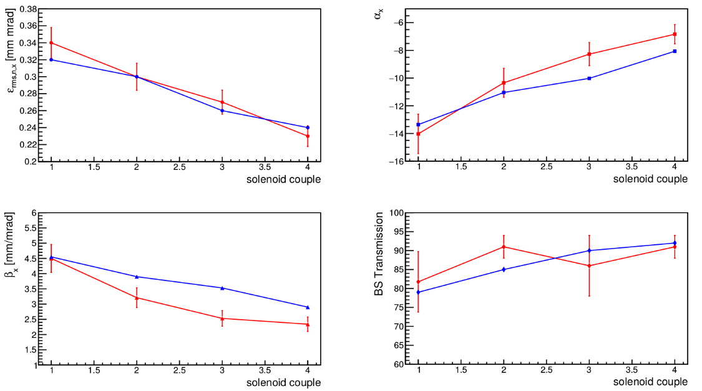
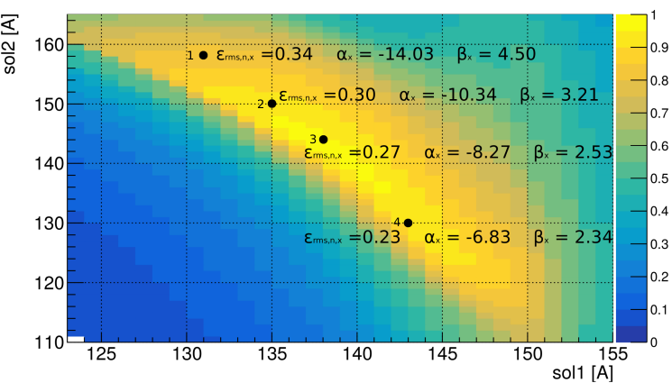
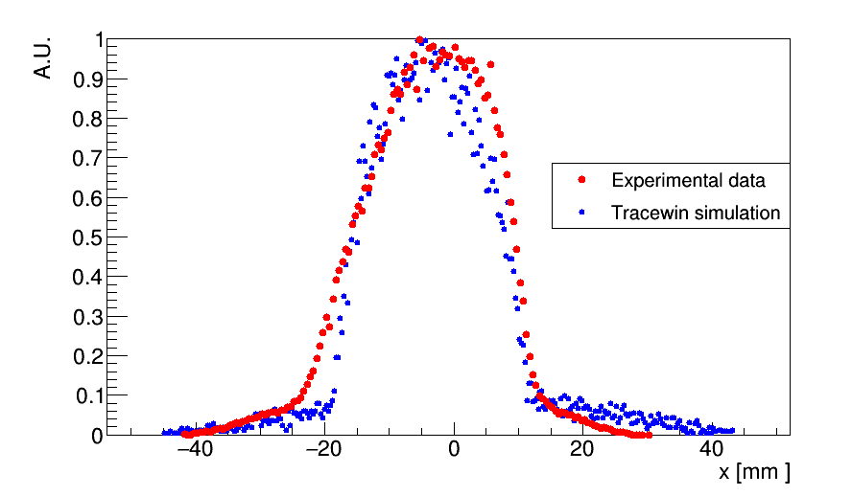
Example of results of the commissioning models: 55 - 50 mA proton beam 50 keV.
Red experimental measurement
Blu simulation
in order to check the guess on the s.c.c. and on the initial Twiss, several emittance measurements were performed with different solenoid values and used in the trace forward cycle.
there is an overestimation of the tales, but the beam profile is respected (waterbag core + gaussian)
the best match parameters are retrieved at the RFQ input point.

Slide 22
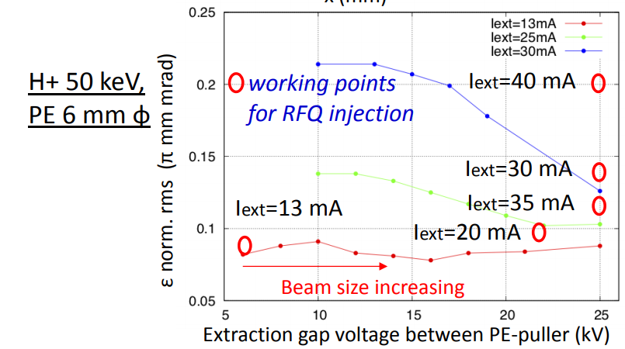
Comparing the studies and measurement we were able to give an empirical criteria* to accept or not the source+LEBT settings for injection into the RFQ
* Limit on RFQ input Emittance

Slide 23
RFQ test bench

Slide 24
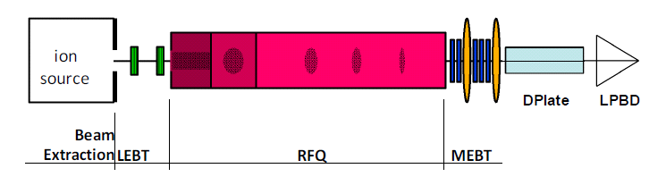
Beam commissioning strategy
Pre RFQ emittance*
Currents and BPM
Current
Emittance trans. and profiles.
Pre RFQ current
First step done: Beam at low current 6-22 mA proton @ 50 keV used as probe beam. The source PE was decreased down to 3 mm radius.
Remaining part
of the talk
From simulation RFQ can transmit >99%(@6 mA) with up to 220% mismatch at this condition.
The proton fraction will be very low (down to 50%). Large fraction of $H_{2}^{+}$ needs to be taken into account in the experimental transmission measurement.
Present step: Beam at high current 40-55 mA proton @ 50 keV used as probe beam. The source PE is 4.5 mm radius.
From simulation RFQ can transmit >95% with low mismatch at this condition.
Last Slide
The proton fraction is not bad (more than 70% ?). Same fraction of $H_{2}^{+}$ needs to be taken into account in the experimental transmission measurement.

Slide 25
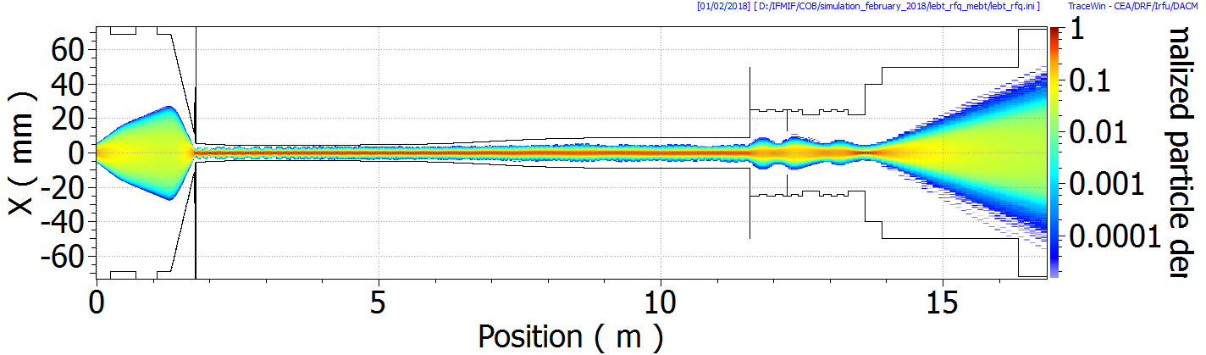
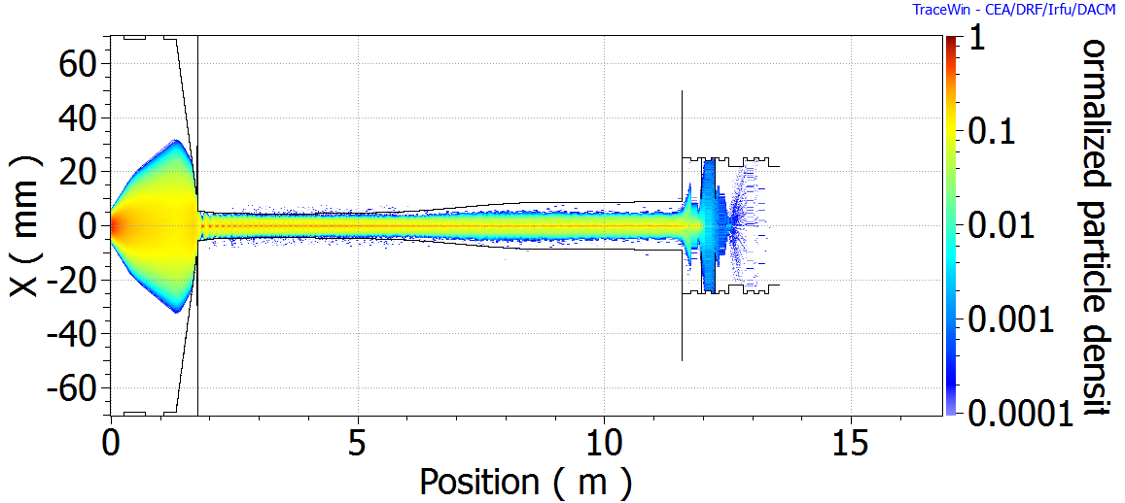



MEBT has a relatively good energy selection. It separates the $H_{2}^{+}$, the not accelerated particles from the main H+ beam at the D-plate. But a not negligible part of them will be transmitted through the RFQ.
LEBT
DPLATE
RFQ
MEBT
LPBD
$$H_{ }^{+}$$
10% Transmission
Almost all $H_{2}^{+}$ is lost
$$H_{2}^{+}$$

Slide 26

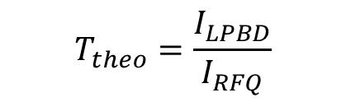



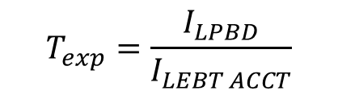

The $H_{2}^{+}$ will affect the experimental transmission
Repeller
RFQ cone
Longitudinal position of the LEBT ACCT
$$s_{LEBT ACCT}$$
$$s_{RFQ}$$
Injection point of the RFQ, Theoretical transmission starts here
From the LEBT ACCT to the injection of the RFQ a not negligible amount of H2+ is lost. 4 cm.
$$T_{exp}=\frac{I_{LPBD}}{I_{LEBT ACCT}}$$
$$I_{LEBT ACCT}=I_{H^{+}}(s_{LEBT ACCT})+I_{H_{2}^{+}}(s_{LEBT ACCT})$$
$$I_{LPBD}=I_{H^{+}}(s_{LPBD})$$
$$T_{theo}=\frac{I_{LPBD}}{I_{RFQ}}$$
$$T_{exp}≤T_{theo}$$
$$I_{RFQ}=I_{H^{+}}(s_{RFQ})$$

Slide 27
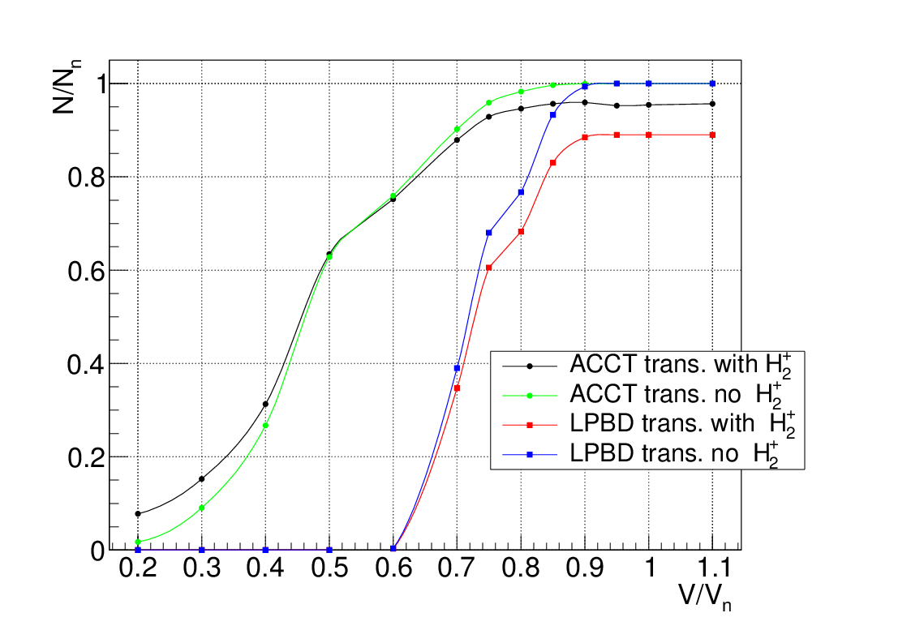
Expected trends at the LPBD
Voltage calibration curve with respect to the presence (or not) of contaminants
I_lebt=13 mA
Expected reduction of about 5%

Slide 28
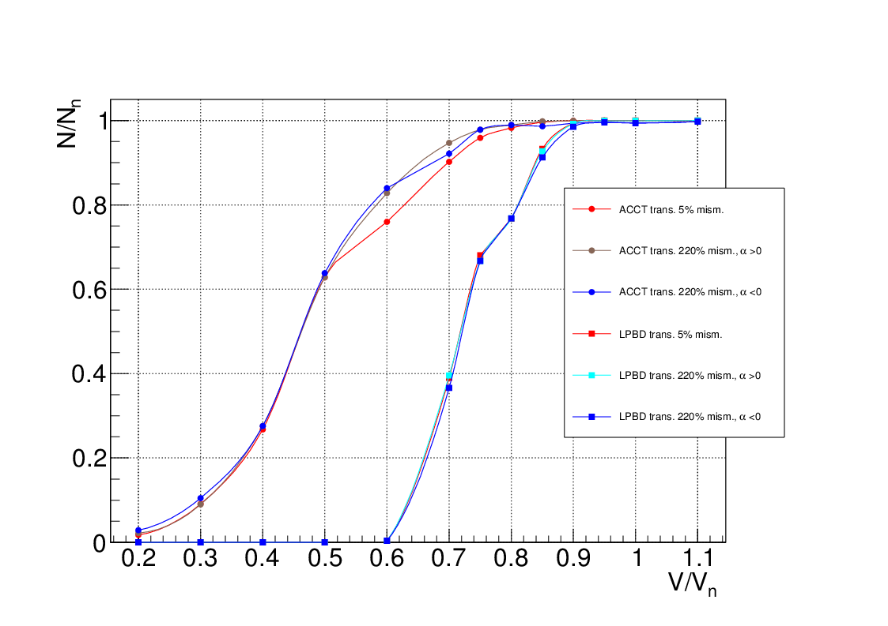
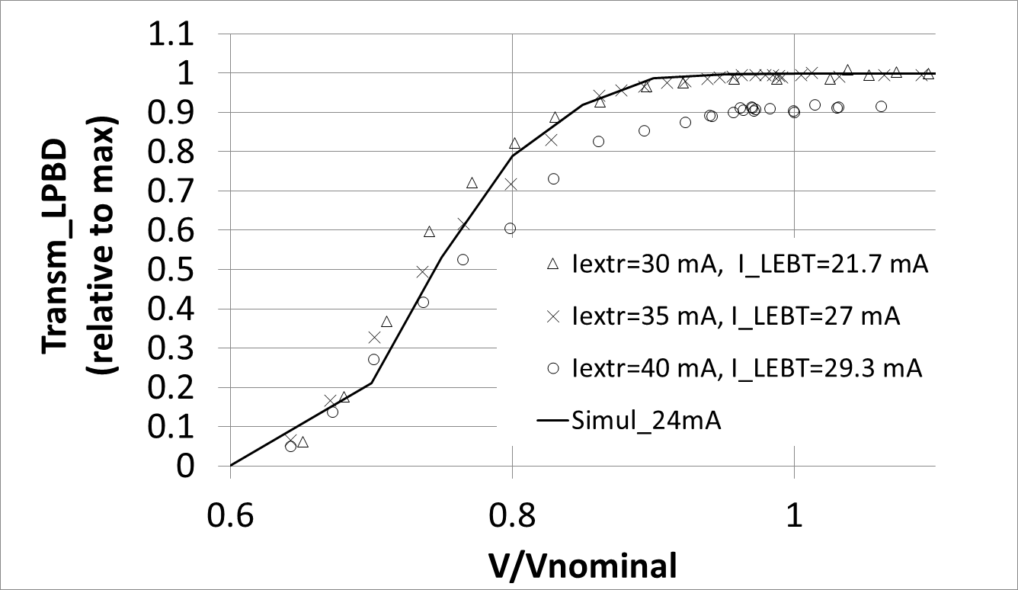
Transmission and current measurement vs RFQ Voltage
Not-removing contaminants
Removing contaminants
I_lebt=13 mA
4 % losses
Good agreement
From Enrico Fagotti paper at LINAC2018

Slide 29
Transmission and current measurement vs RFQ Voltage
Due to contaminants
Due to emittance!

Slide 30
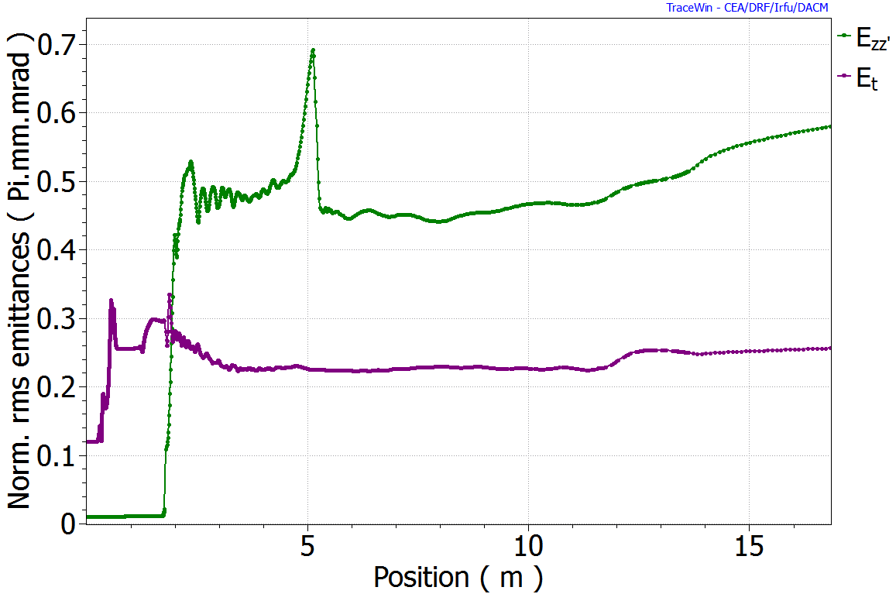


RFQ Performances Due to emittance (40 mA working point)
RFQ
> 0.3 mm mrad + mismatch
From preliminary calculation, the Losses = 10% at LPBD. 2.5 times emittance growth after solenoid 1. Mismatched beam at RFQ.
Reducing the input beam emittance of 20% the losses reduces of a factor of 2.

Slide 31




Experimental Solenoid Scan
$I_{ext}$=30 mA
$I_{ext}$=40 mA
Low Emittance
High Emittance
It was impossible to increase the transmission for the 40 mA point, confirming that the emittance was not suitable for the injection into the RFQ. It is needed to change the PE hole.

Slide 32

Post RFQ emittance measurements
The beam
30 mA beam with different solenoids couples and $V_{RFQ}$= 62 – 70 kV. 1/3 of the full beam space charge effects. Different solenoids couples.
800 $μs$ beam pulse length. Increased S/N ratio.
Bunchers OFF.
3
2
1
96% +/- 6% of experimental transmission
The simulation
Trace forward input beam from LEBT (4D-parabolic distribution). solenoid field maps. Tracewin+toutatis code.
Longitudinal space charge compensation profile from WARP code in the LEBT.
As – built RFQ model with voltage from bead pull measurement.
MEBT hard edge quadrupoles, buncher field maps.

Slide 33


The RFQ is working as predicted
Ref. | Sol1 [A] | Sol2 [A] | $$V_{rfq}[kV]$$ | $$ε_{rms,n,y, exp}$$ $$[mm mrad]$$ | $$ε_{rms,n,y, sim}$$ $$[mm mrad]$$ | $$β_{exp}/β_{sim}$$ $$[mm/mrad]$$ | $$α_{exp}/α_{sim}$$
1.1 | 135 | 160 | 66 | 0.26$±0.01$ | 0.24 | 6.0 / 7.5 | -4.1 / -5.5
1.2 | 135 | 160 | 62 | 0.25$±0.01$ | 0.24 | 7.2 / 8.1 | -4.8 / -6.0
2 | 135 | 162 | 70 | 0.23$±0.01$ | 0.23 | 5.5 / 6.3 | -3.6 / -4.3
3 | 131 | 162 | 70 | 0.243$±$0.009 | 0.28 | 5.4 / 6.0 | -3.7 / -4.5
!
Point 3 will be investigated with simulations and post analysis.
Apart for point 3 , the emittance are in very good agreement.
There are same differences in the Twiss, but the trend is completely followed. When they decrease so that the simulation etc..
We have also explored indirectly the longitudinal RFQ dynamics (change in $V_{rfq}$)
Thank you to CEA and CIEMAT colleagues

Slide 34
Recommendations
It is important to design the RFQ robust against input Twiss and mechanical /Voltage errors.
The losses cannot be completely avoid, so it is better to avoid them at high energy where they are more dangerous.
The major source of differences found up to now between the simulations and the measurements were due to wrong distances (electrodes, positions of detectors and optical elements). It absolutely mandatory to carefully check such distances in order to use the models fruitfully during commissioning.
If a difference is found between simulations or and measurements, a counter check should be made with care on BOTH sides.
Characterization of separate component is essential in order to decouple the problems: as a matter of fact, despite the physics at low current is easier with respect to high current, many complex effects can still occur (see contaminants and emittance growth). The result is a mess, or strange tuning of the machine.
The whole system proved to be quite reproducible in time. When something happens, strange results in emittance and currents, it is always advisable to check first the diagnostics.
It is important to fix the objective of the commissioning and design models: do they need to be able to predict at infinite precision the beam values? As soon as you are able to guide the commissioning and to predict the trend and with a certain error (10-20%) the quantitative values you should be happy. “It is important to be conscious of the approximations you are introducing in your model and their limits“

Slide 35
Conclusions
The characterization of the beam dynamics of the RFQ requires a carful characterization and control of the systems which came before and after.
Development of models for the commissioning is highly advisable: it is not sufficient to design the machine, but, in order to make it work it is important to follow the commissioning.
They time spent in doing such goal allows to satisfactory characterize the RFQ beam dynamics.
One of the mission of the LIPAc beam dynamics team is to find the limits of the models above cited. This work is ongoing, and we are working to the possible upgrades which can improve the physics description even at higher currents, relying less as possible on measurements.
As far as the RFQ design is concerned..
with respect to a pervance which is about 1/3 nominal perveance (i.e. 135 mA deuteron beam @ 100 kV):
The RFQ transverse dynamics was directly checked and work as expected.
The RFQ longitudinal dynamics was indirectly checked and it seems it is working as expected. It will be performed a longitudinal emittance measurement in future for a direct check.
Update: (11/4/2019) with 55 mA of proton the RFQ transmission is 96%.
Update: (12/4/2019) The RFQ has been conditioned up to 131 kV (10 us pulse).

Slide 36
BACKUP SLIDES

Slide 37

Beam Dynamics done with Comparison of Parmteqm and Toutatis
Difference 0.2 %
Plot of RFQ Transmission as function of RFQ length, The toutatis runs are made with 1’000’000 macroparticles.
In this case the 3D Finite Difference poisson solver grid in Toutatis was “65x65x65 and 17x17x17”.
The PARMTEQM runs are made with 1’000’000 macroparticles. The 2D (r-z) Scheff grid was “20x40” for the Space charge solver (Image charge on, multipoles on).

Slide 38
Gaps Effects
Gap distance [mm] | Transmission [%] Gaussian Dist. | Power Loss [W] | Max Es [Kp]* | Es Field Enhancement
0.05 | 94.4 | 1129 | 1.83 | 1.02
0.1 | 94.3 | 1136 | 1.86 | 1.03
0.2 | 94.2 | 1152 | 1.9 | 1.07
0.5 | 94.1 | 1247 | 2.1 | 1.17
1 | 93.2 | 1822 | 2.4 | 1.33
Runs with curvature r=0.5 mm
We use a gap of 40 μm with an
impact on Beam Dynamics (<0.1%) and
Surface field (<1%).
*Maximum Es=[1+d/(6*r)]*Es0
From P. Balleyguier [Linac 2000]

Slide 39

Surface Field Enhancement on the GAP
We check the Electrical Surface Fields
Enhancement by using Ansys.
The results are similar
(with an error of +/- 10%).
Case with gap=1 mm
and r=0.2 mm
Ansys=1.6 eh
Formula=1.8 eh

Slide 40


Beam dynamics Software
Software name | Used for | Developers | Time of life | Institution | License Type | Reference (Web Site)
TraceWin & Toutatis | LEBT+RFQ + MEBT | D. Uriot / R. Duperrier | 2000 - Now | CEA | Registered: No Source | http://irfu.cea.fr/dacm/logiciels/index3.php
Parmteqm | RFQ | K.R. Crandall et al. | 1980 - 2005 | LANL | Registered: No Source | https://laacg.lanl.gov/
Warp | Source + LEBT (neutralization) | D. P. Grote | 1980 - Now | LLNL/LBNL | Open Source | http://warp.lbl.gov/
IBSimu | Source | T. Kalvas | 2010 - Now | Un. of Jyväskylä | Open Source | http://ibsimu.sourceforge.net/index.html
AXCEL-INP | Source | P. Spädke | 1990 - Now | AET | Registered: No Source | https://www.aetassociates.com/index.php
Parmteqm
Warp
Axcel
TraceWin
IBSimu

Slide 41


The FEM program Ansys 10.0 was used.
The Vanes shape by the LANL program Vanes.
The total number of runs was 489 (1 week run).
The Max surface fields is 1.83 Kp by Ansys.
1.8 Kp
2%

Slide 42



Two strategies were explored in order to take into account of the space-charge compensation in the BD model:
  Design model
  Commissioning model:
Given the pressure, the cross sections of the various phenomena the software calculates the s.c.c. degree from the self-field compensation, which come from the dynamic equilibrium between the primary plasma (the beam) and the secondary plasma (residual gas ions and electrons). In this case
$$s.c.c.=f\left(r,z\right)$$
Software used:
WARP (t-code)
SOL1
SOL2
A costant factor is applied to the current of the beam, which depends with respect to the position along the LEBT.
Injection cone
$$s.c.c.=f\left(z\right)$$
Software used: TraceWin (s-code)

Slide 43


Measurement of the profiles (Wire scanner)
Sol1 = 135, Sol2 = 160. RFQ voltages 74-70-66- kV, 22 mA from the RFQ
Measure
RMS SIZE
Simulation
RFQ Out
LPBD

