Slide 1
Critical RF issues on RFQ operation from RF-power alimentation point of view
Wolfgang Vinzenz
16.04.2019

Slide 2
Introduction
After at least two decades of operating experience with RFQs, I will talk about problems not foreseeable at the time when the cavities have been developed and manufactured, as well as those that have arisen over time.
Topics:
Introductional remarks
Interesting operating details of two RFQ types
Steps to figure out the problems and their solutions
Final remarks

Slide 3
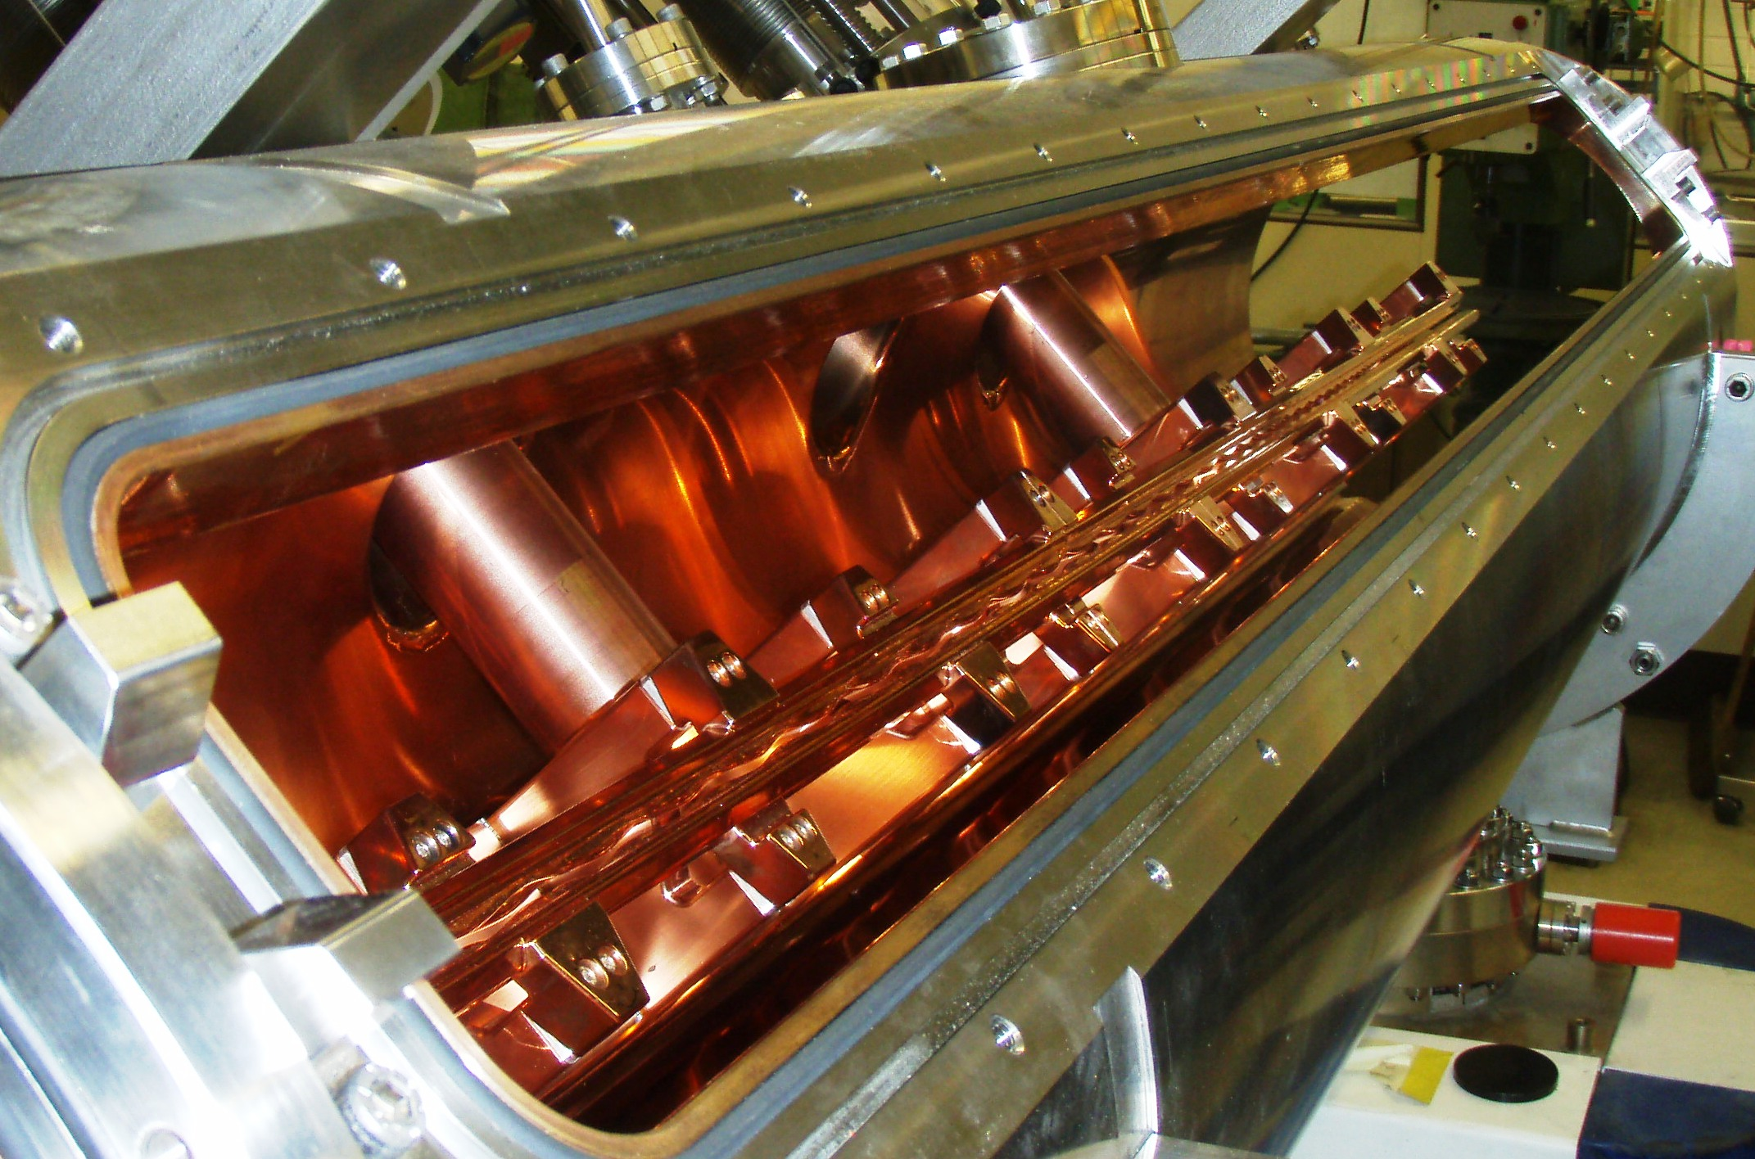
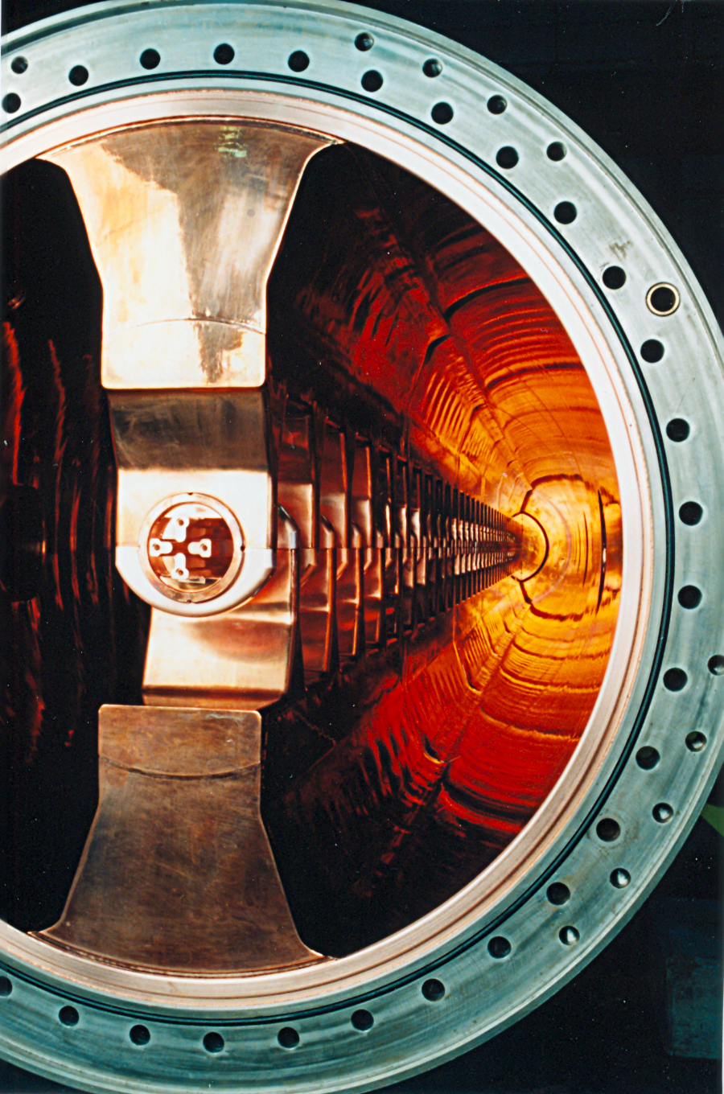
Operating details
High-charge-injector (HLI) 4-rod-RFQ (108 MHz)
High-current-injector (HSI) IH-type-RFQ
(36 MHz)

Slide 4
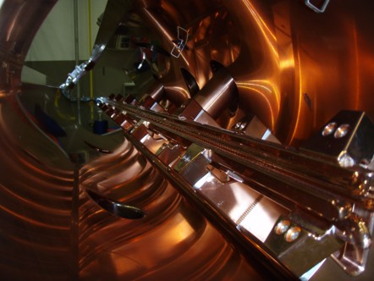
Operating details HLI-RFQ
4-rod-type RFQ 1991 80 kV 100 kW
Problems to reach higher power levels.
Automatic tuners are moving constantly as an additional detuning component changes the matching of the cavity.
Cavity operation had to be restricted in relation to
RF power, pulse repetition rate and pulse length.
By a quick and dirty method it could be figured out, that the rods are the ‘additional’ component.
~ 1,65 ms
P_{fwd} = 90 kW
= 5 ms @ 50 Hz
1,65 ms ≙ 606 Hz
Extract from a 1997 report

Slide 5
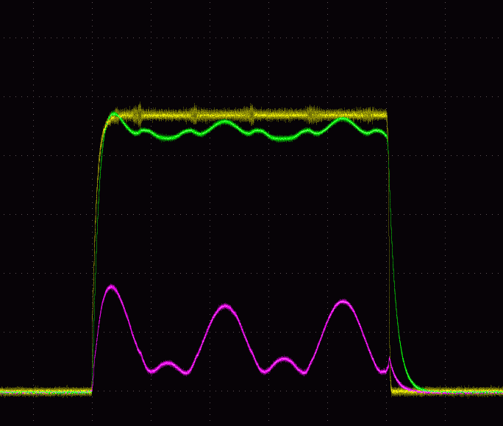
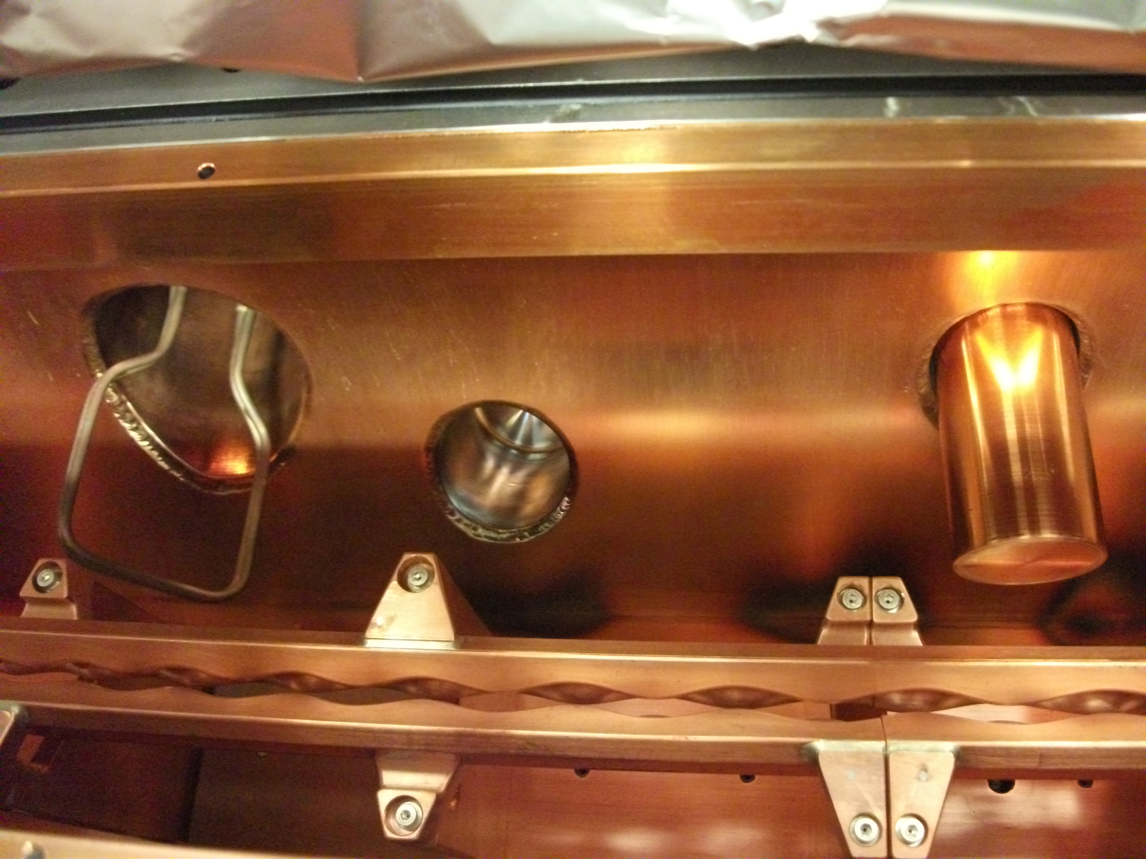
Operating details HLI-RFQ
4-rod-type RFQ 2009 78 kV 120 kW
New cavity with the same behavior.
Above a given RF power the amplitude and phase control reached their dynamic limits.
As before, cavity operation had to be restricted.
V_{cav}
P_{fwd}
Strong interaction between mech. oscillation,
matching and tuning.
P_{refl}
P_{fwd} = 40 kW
= 5 ms @ 50 Hz
1,98 ms ≙ 505 Hz

Slide 6
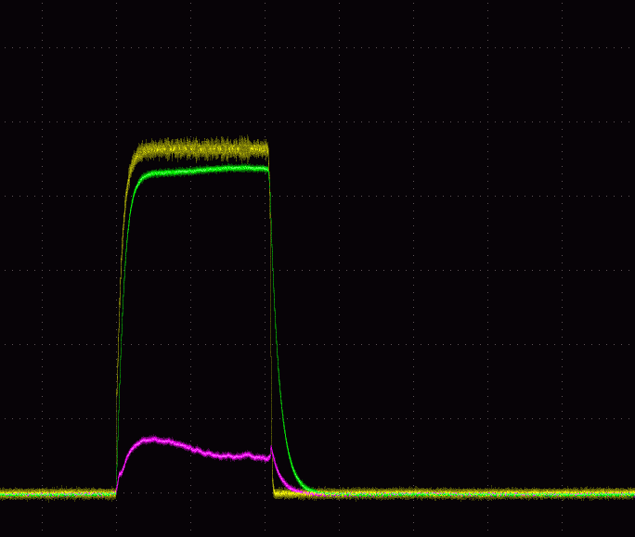
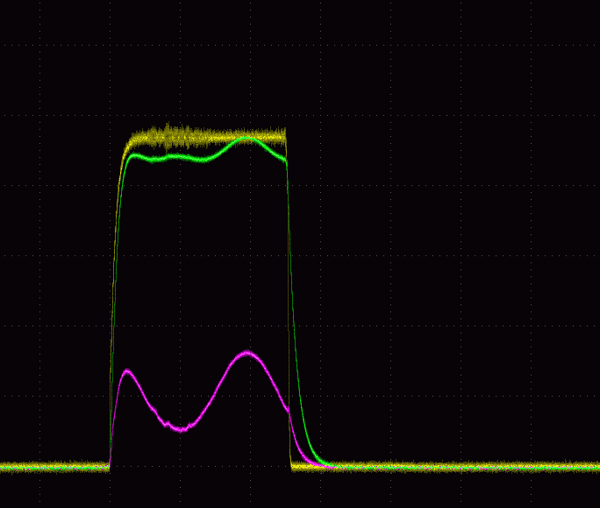
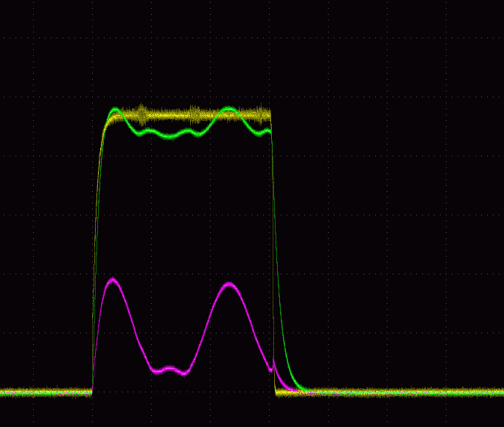
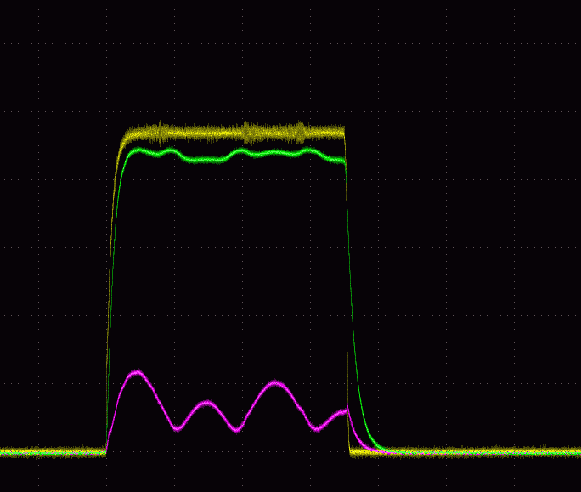
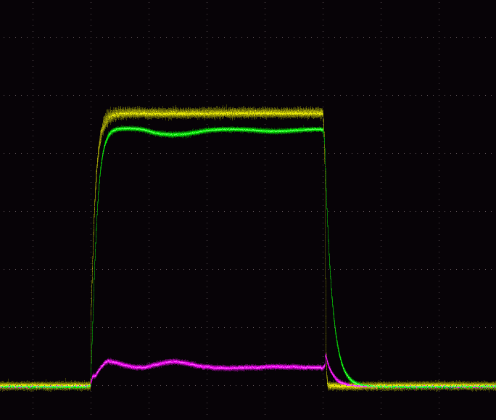
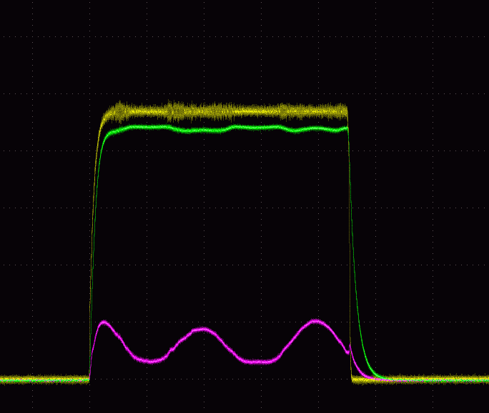
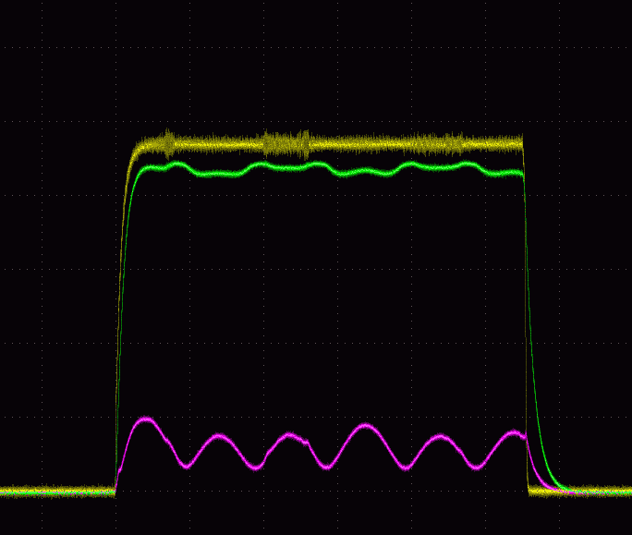

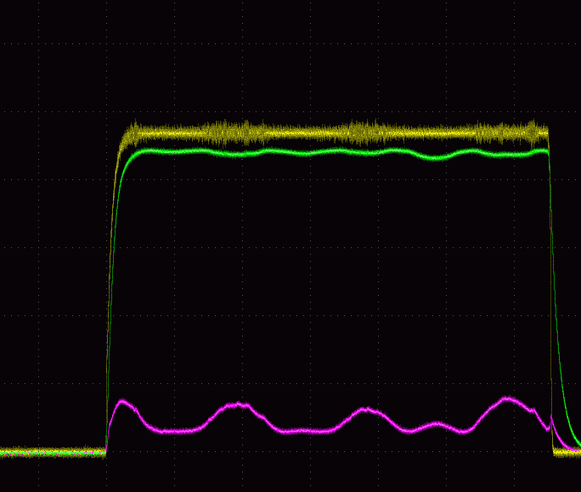
Operating details HLI-RFQ
4-rod-type RFQ 2009 78 kV 120 kW
P_{fwd} = 40 kW const. Cavity voltage = 4,7 V _{arb. unit} RF pulse length from 2 ms to 6,5 ms @ 50 Hz
= 2,0 ms
2,5 ms
3,0 ms
3,5 ms
4,0 ms
= 4,5 ms
5,0 ms
5,5 ms
6,0 ms
6,5 ms
Frequency and intensity of the mechanical ringing changes with pulse length resp. duty factor

Slide 7
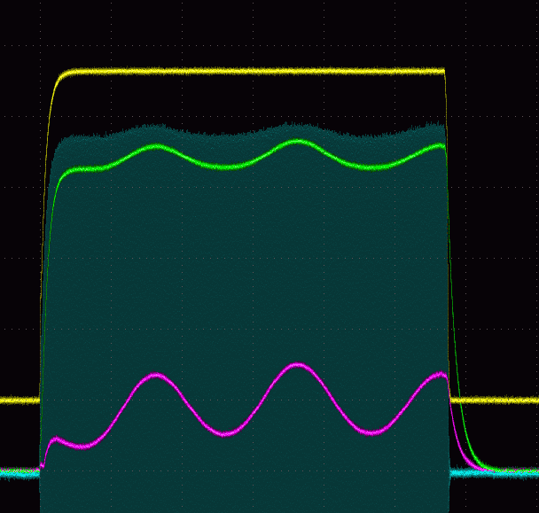
Operating details HLI-RFQ
4-rod-type RFQ 2009 78 kV 120 kW
It’s not true that we have a controlled cavity voltage better than 0,5%.
Three pick-up probes are placed along the cavity.
This value only is valid at the point where the
RF control-loop pickup is located.
Probe Nr. 3 - maximum amplitude deviation 4%
Probe Nr. 2 - maximum amplitude deviation 9%
This is beam dynamic in reality.
Where is the constant field along 3 m length?
3 probe signals and reflected power

Slide 8
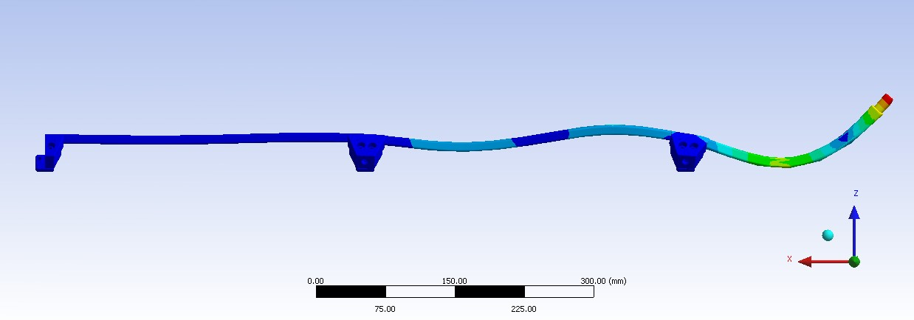
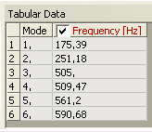
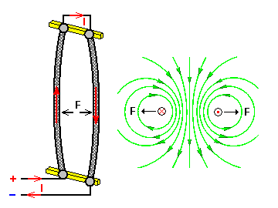
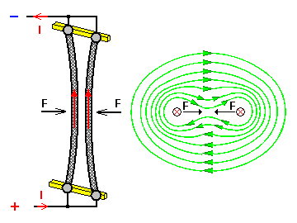
Operating details HLI-RFQ
4-rod-type RFQ 2009 78 kV 120 kW
Additionally massive cooling problems lead to detuning effects in the range of 1 kHz / 250 W avg. power.
Plunger velocity is too slow to tune the cavity within the automatic tuning mode.
Extensive low-level measurements were carried out with cooling water at different temperatures and the extreme temperature dependence could be confirmed.
505
Rough simulations with Finite Elements on campus (thanks Kalliopi Dermati) confirmed the RF measurements.
In my opinion, the cause of the excitation is in the electromagnetic force in between the rods, which is caused by the rapid change of the field (by RF current) at the raising and falling edge of the RF pulse.
This was in 2010. Later on some reports to that have been published and a detailed investigation at IAP resulted in a reasonable proposal for a solution.

Slide 9
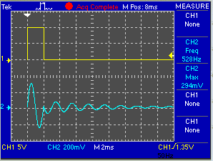
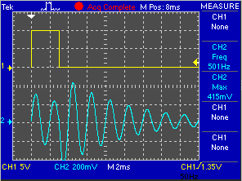
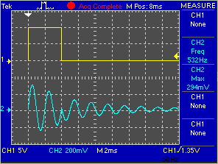
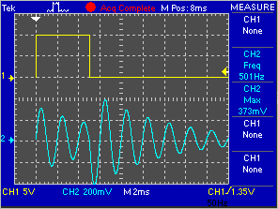
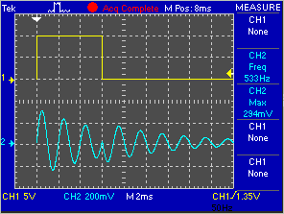
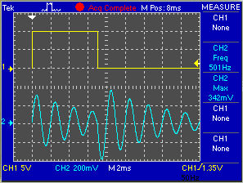
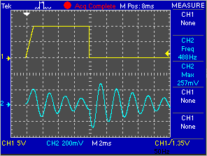
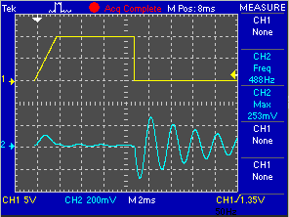
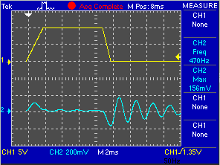
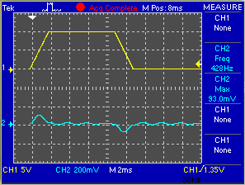
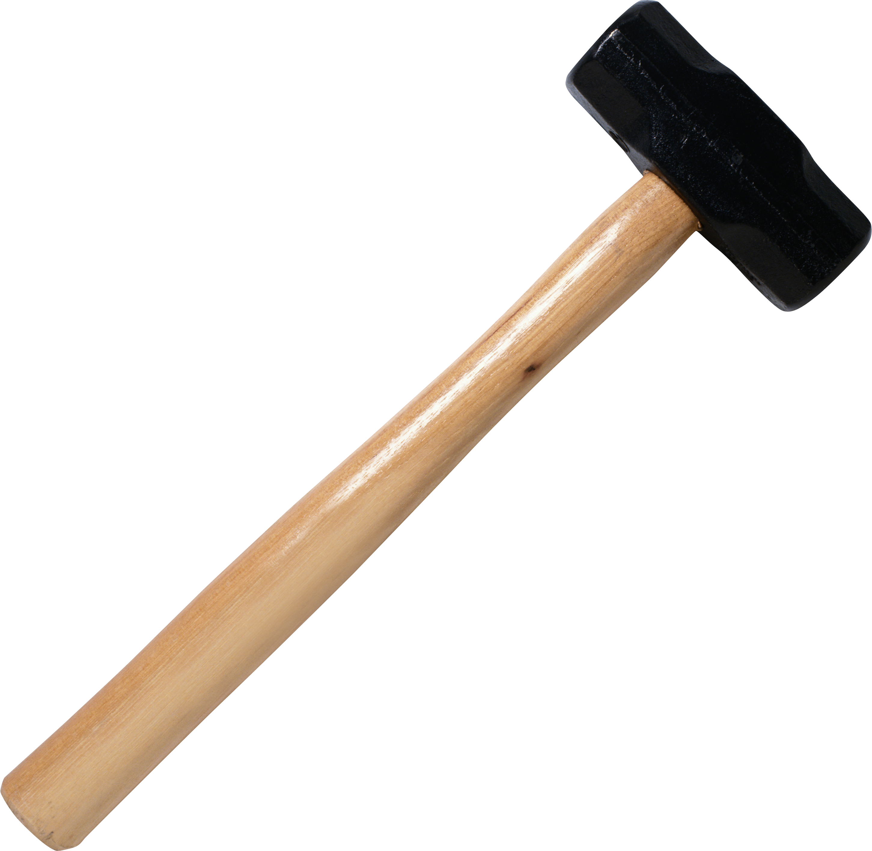

Simulations HLI-RFQ
Pulse length from 2 ms to 7 ms
This simulations shows that we can heal the problem by replacing the hard hammer by a soft hammer.
The symptom-curing solution was found.

Slide 10
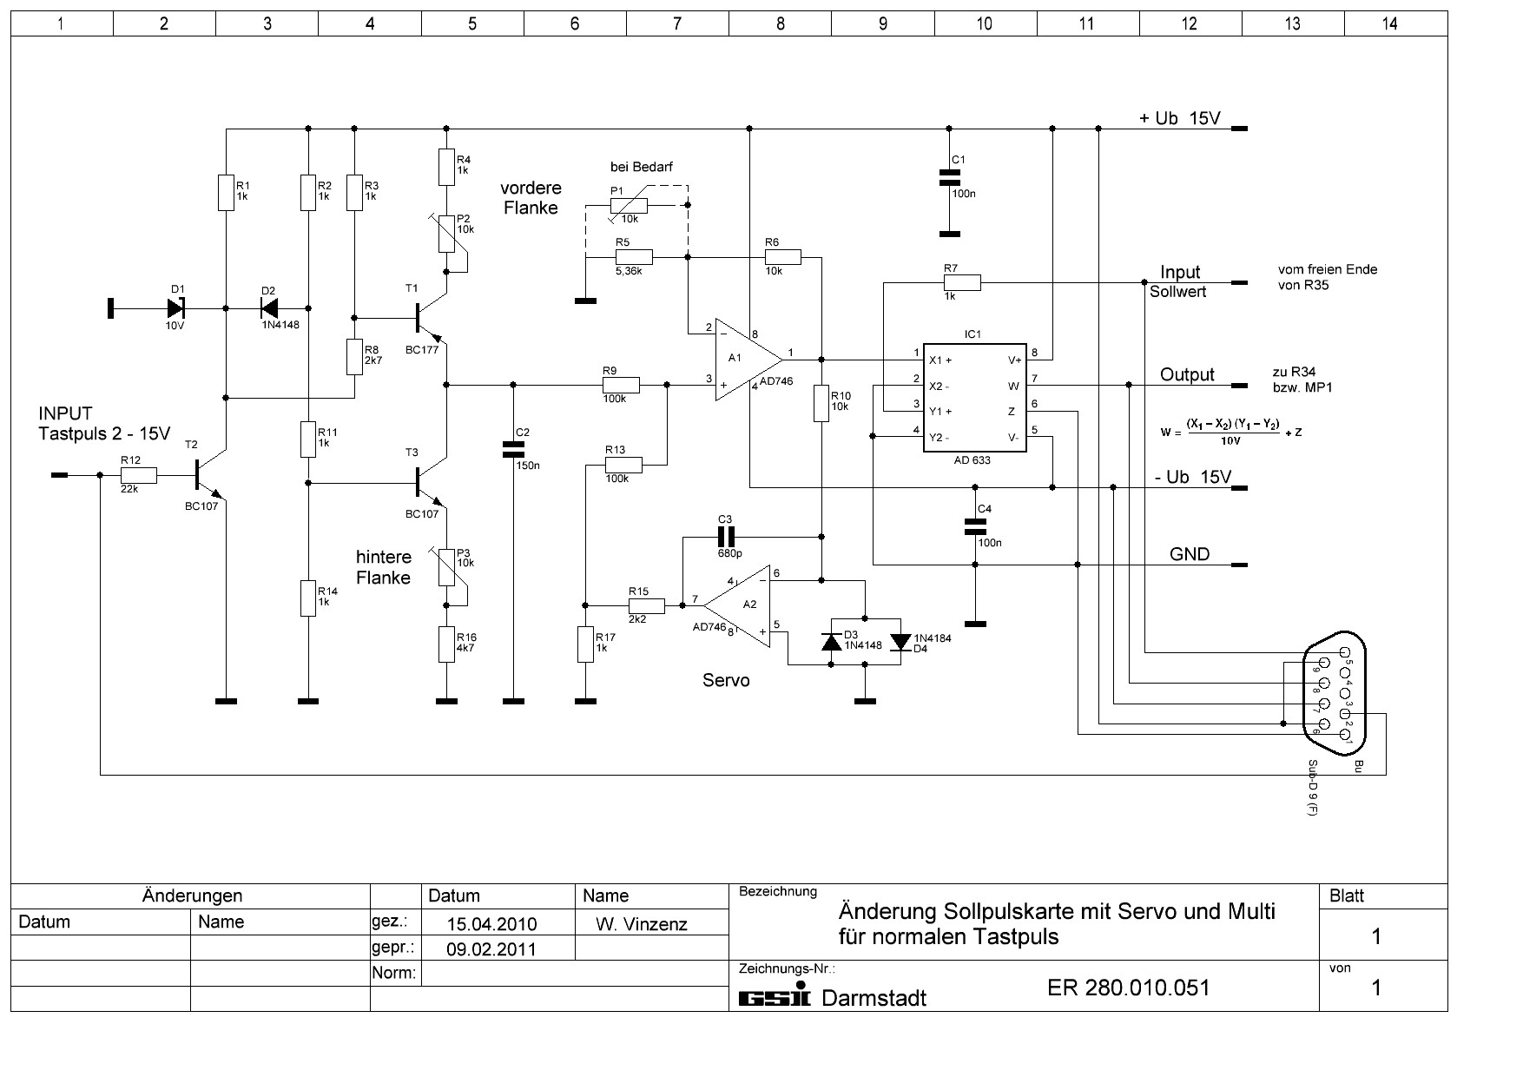
Operating details HLI-RFQ
4-rod-type RFQ 2009 78 kV 120 kW
Clever RF engineers enhanced the LLRF-electronics to make the operation of this cavity possible, until now.
We couldn't fix the problem, we only could present it and hatch out some tricks to relieve it.

Slide 11
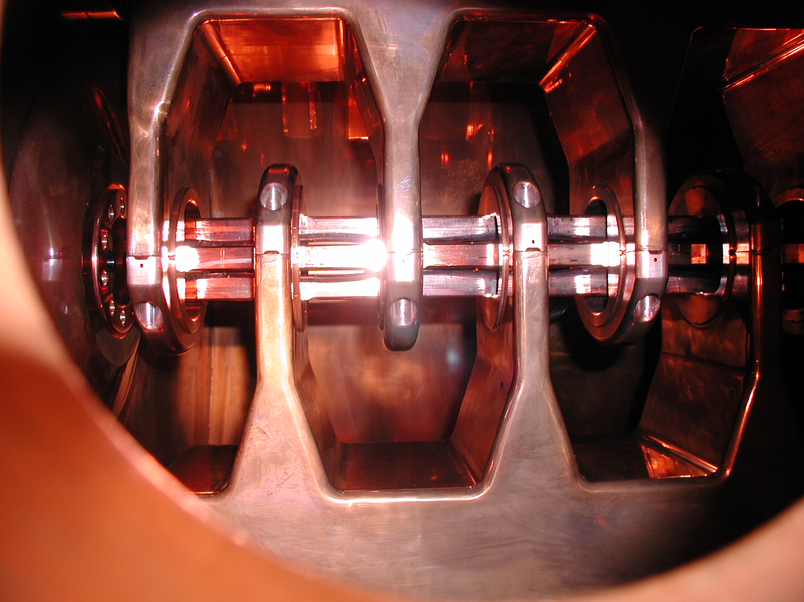
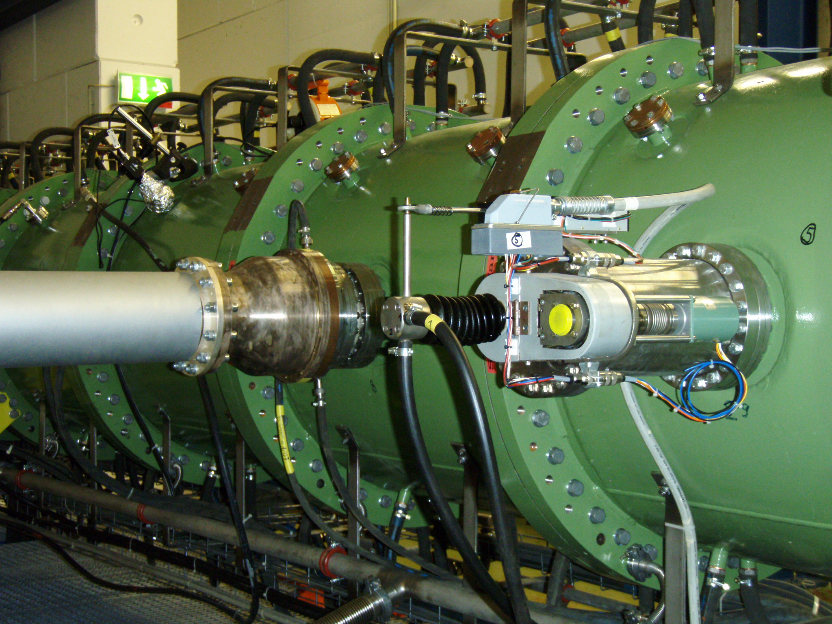
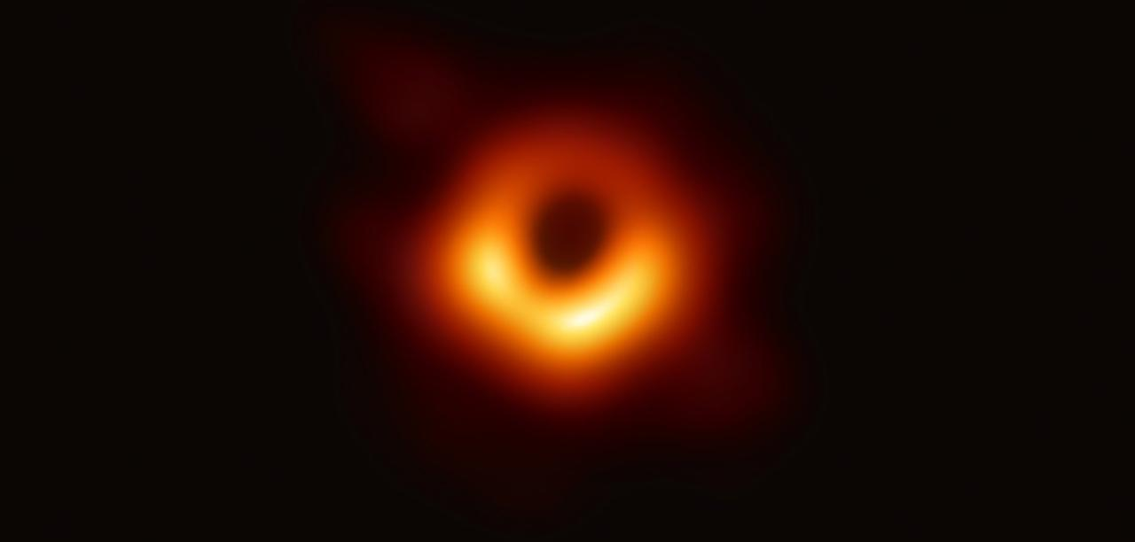
Operating details HSI-IH-RFQ
IH-type RFQ 1999 140 kV 300 kW
Quelle: dpa

Slide 12
Operating details HSI-IH-RFQ
IH-type RFQ 1999 140 kV 300 kW
Measurements from Aug 1999
Measurements from Nov 1999
P_{fwd}
Theorie
P_{refl}

Slide 13
Operating details HSI-IH-RFQ
IH-type RFQ 2009
reached by special tuning
see Note Plechov/Vinzenz
27.11.2015
What is the Reason ?
540 kW Fwd – 45 kW Refl. – 230 kW
= 265 kW hidden power
265 kW
(-45 kW incl.)
accepted, understood ?,
‘dark current’ ?
230 kW

Slide 14
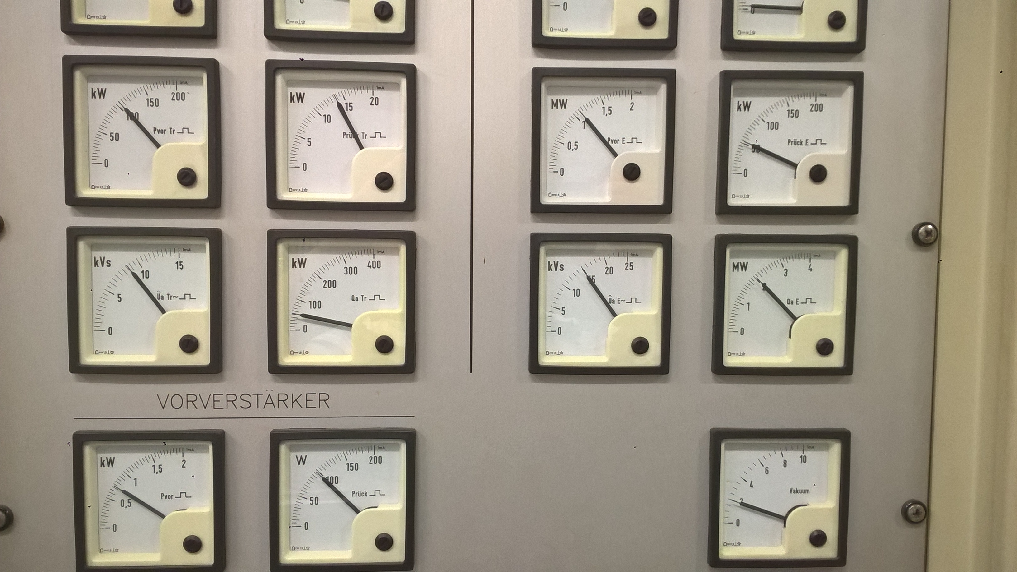
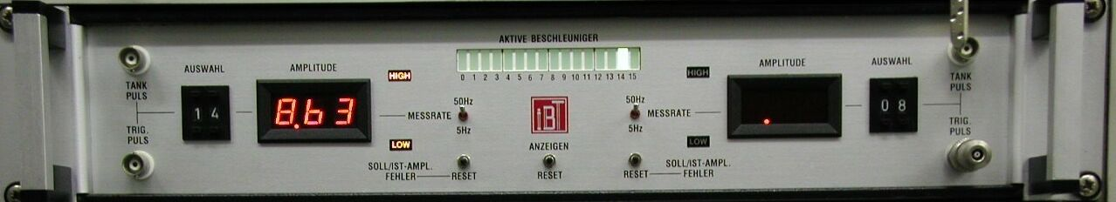

Operating details HSI-IH-RFQ
Logic and straight forward test configuration
disconnected
For a check of its proper function the RFQ amplifier has been connected to IH1.
(by Plechov/Schreiber)
Without any problem a power level
up to 1,2 MW pulse could be reached.
No difference to the operation of the IH1 cavity by it’s standard amplifier.
RFQ RF
Amplifier
RFQ
IH 1
IH 1 RF
Amplifier
disconnected

Slide 15
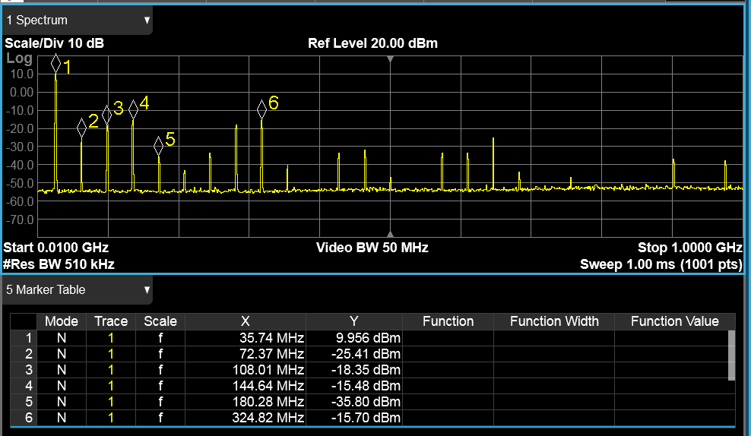
Operating details HSI-IH-RFQ
RF Spectrum
at the RFQ Amplifier output
to IH1 cavity at 800 kW
22.10.2018
..for comparison: IH Amplifier at IH cavity

Slide 16
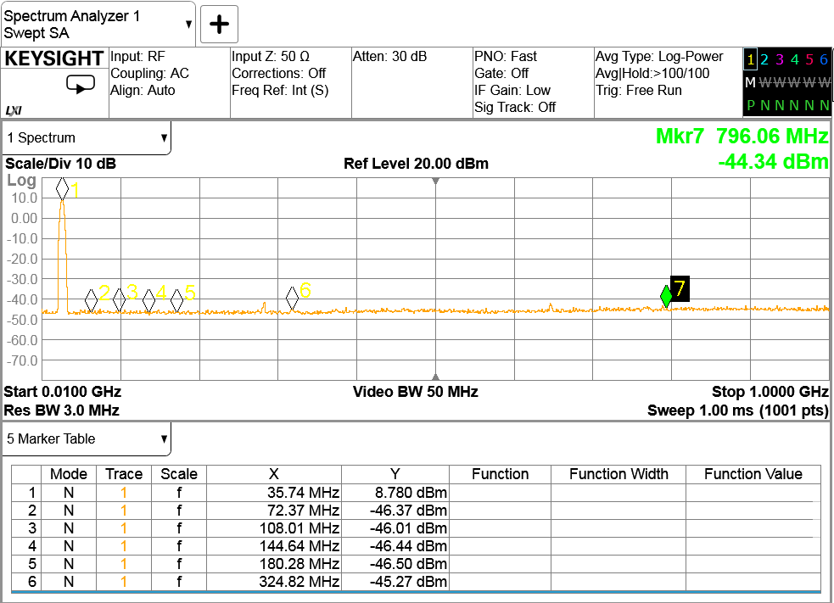
Operating details HSI-IH-RFQ
Calculated damping factor of the RFQ PHASE pick-up
compared to the incorporated RF power
Searching for higher modes inside the cavity
at the ‘critical’ point…(6,2 V)
Cavity RF spectrum probe PHASE at 6,2 V
Probe damping
-54 dB const.
actual probe damping

Slide 17
Evaluation of cavity detuning at different duty cycles up to max. 30 kW average power (that’s where the lines end up).
Automatic plunger control activated.
duty cycle
Let's watch the plungers.
They are always honest.
With regard to the IAP instruction, the maximum average power was limited at 30 kW.

Slide 18
Let's have a look at some details of the cavity
Capacitances
2C‘ 12 pF/m Capacity of the cavity
C‘_{Q} 108 pF/m Capacity of the electrodes
C‘_{QD} 23 pF/m Capacity between the carrier rings and the electrodes
C‘_{D} 43 pF/m Capacity load between the supports (stems) incl. carrier rings
locations shown on next slide
35%
Power loss distribution
4% Mini-Vanes
24% Supports (stems) incl. carrier rings → very high compared to the other cavity areas
24% Cavity fins
48% Cavity wall
Number of components
100 Carrier rings → high RF currents per ring
36 (9 x 4) Junctions (rod to rod between the cavity segments) → high contact resistance possible
Daten aus:
Habilitationsschrift
U. Ratzinger 1998

Slide 19
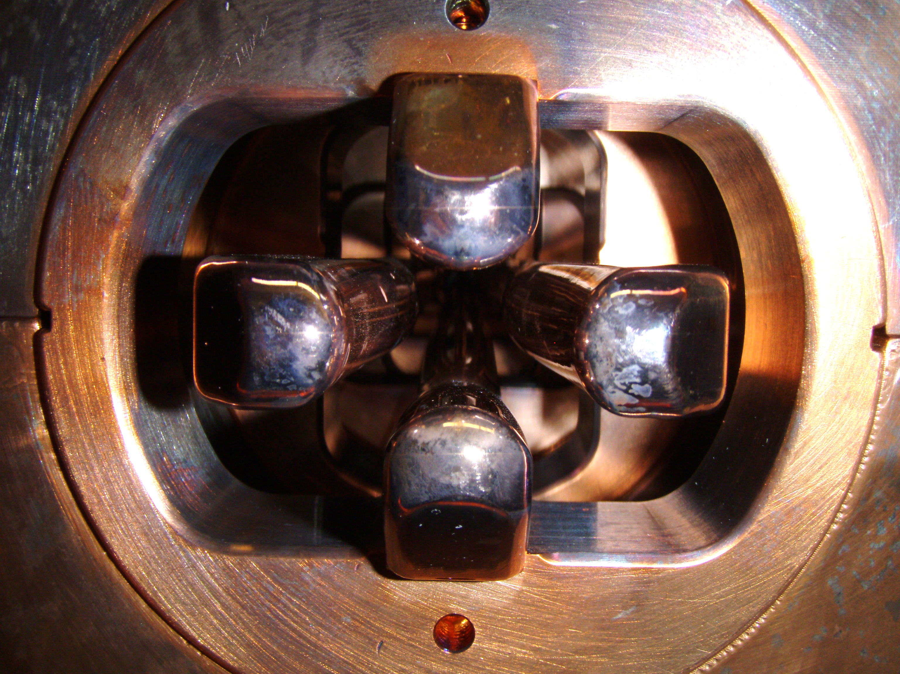
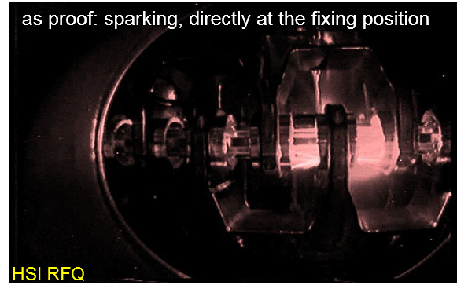
Distribution of capacities
aus Habil. U. Ratzinger 1998
C‘_{Q} 109 pF/m
C‘_{QD} 23 pF/m
109 pF/m
Superlinse
23 pF/m
12 pF/m
43 pF/m

Slide 20
Operating details HSI-IH-RFQ
Conclusion from the shown results
As the cavity is tuned inductively (H field, H110 mode) plungers are moving inwards (f_{Res} ↑, more inductance) because of warming up by the average power.
From a certain level (field level) the gradient of the detuning raises nearly exponential.
This leads to the assumption, that a growing capacity (?) or reactive current is tuning the
cavity to lower frequencies. Means, the imaginary part of the cavity impedance (-jx) is growing.
At the same average power of 30 kW the plunger moves from 30% position at 32,5% duty factor
(≙ 90 kW pulse) to 60% position at 4% duty factor (≙ 675 kW pulse).
Based on this assumption, it can be said that during the RF experiment in Nov. 2015 the capacitive part of the impedance has been inductively compensated by the changed plunger position.
Remember: 35 % of the overall capacity is located in the carrier rings.
Further on 36 connecting points (rod to rod) can have bad contact resistances, which could lead to higher resistive losses.
However, this should have been indicated also at lower power levels , as well as by a decreasing quality factor Q.

Slide 21
Future
If we talk about a new RFQ for the future:
It has to be checked which of the possible RFQ-types is able to ensure the beam parameters at a given maximum RF power of 1,8 MW.
The cavity length is limited, because we talk about a replacement.
If possible, the RF characteristics (e.g. matching, tuning, dark currents, excessive electric fields etc.) should be carefully simulated.
Thermal- and ponderomotorik stability must be ensured up to 15% above maximum thermal power.
The new cavity should not have any of the negative properties shown.
Furthermore, a simple design is preferable in order to facilitate service and repairs,
production risks will be reduced.
…we need Reliability, Functionality and Quality

Slide 22
Final remarks
Last but not least:
Remark to the procedure
Establish close and constant cooperation between the departments, institutes and companies involved
No solo runs
Constant meetings with all parties involved.
As little administration as possible, if necessary secret meetings
Thanks a lot

