Slide 1

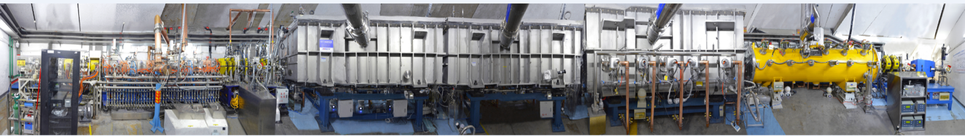
the RFQs in IMP
Yuan He
On behalf of Linac Center
Institute of Modern Physics, CAS

Slide 2
Outline
CW high-intensity RFQs activities in IMP
Structure and Conditioning of the RFQs
Problems happened to the RFQs
How to make a stable RFQ always?
Notes:
This is the outline

Slide 3
CW RFQs constructed in IMP
 | ADS RFQ injector II | CMIF-RFQ | D-RFQ-973 | LEAF | SSC-Linac
Project served | CiADS | CMIF | BisoL | HIAF | HIRFL
Freq. (MHz) | 162.5 | 162.5 | 162.5 | 81.25 | 53.67
Type | 4-vane | 4-vane | 4-vane | 4-vane | 4-rod
Dipole mode | PiMS | PiMS | window | PiMS | -
Species | Proton | Deuteron | Deuteron | HI A/q=7 | HI A/q=7
Vane V (kV) | 65 | 65 | 60 | 70 | 70
I (emA) | 10 | 10 | 50 | 2 | 0.5
Inj. E (keV) | 35 | 40 | 40 | 98 | 25
Ex. E (MeV) | 2.1 | 3.0 | 1 | 3.5 | 1
Kp | 1.2 | 1.4 | 1.68 | 1.5 | -
CW Op. (emA) | 11 | 2.5 (P) | 1.8 (H₂⁺) | 0.5 (HI) | 0.2 (HI)
First beam | Jun. 2014 | Nov. 2017 | Jun. 2018 | Feb. 2018 | Jan. 2015
Institution | IMP/LBL | IMP | PKU/IMP | IMP | IMP/PKU

Slide 4
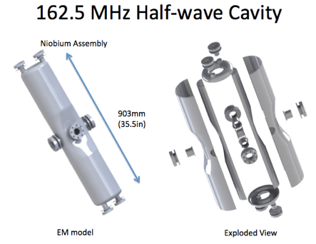
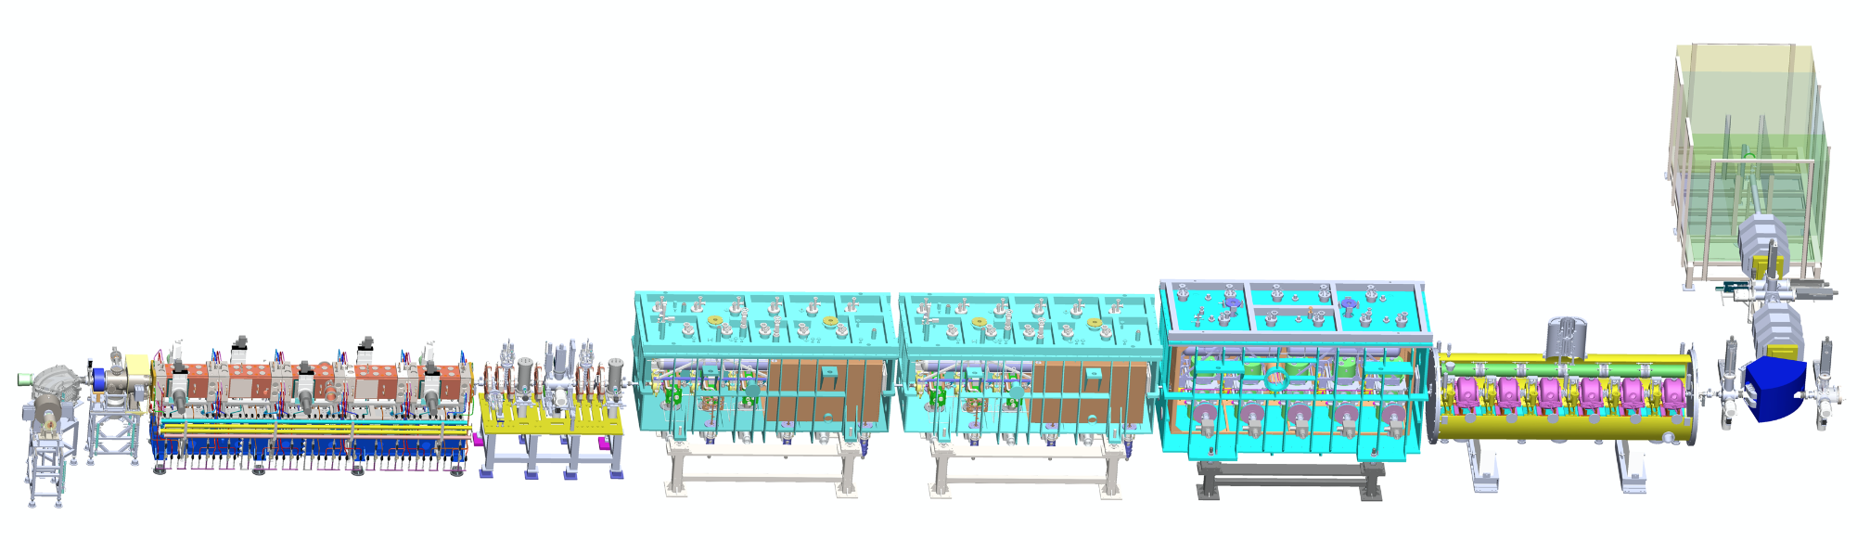
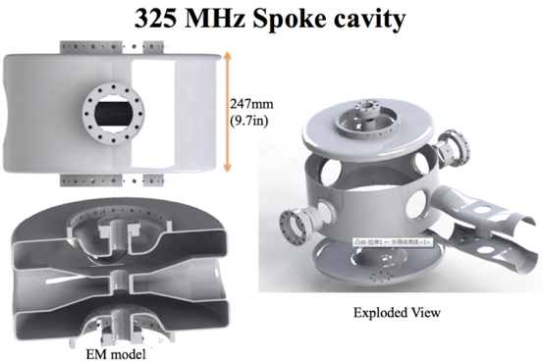
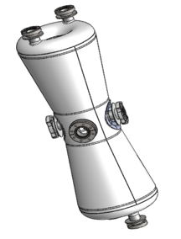
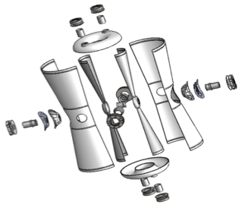
Chinese ADS Front-end Demo linac (CAFe)
Goal: to demonstrate the technology of 10 mA CW beam of superconducting front-end Linac for CiADS.
Design: 25 MeV, 10 mA, CW, 4.5K
IMP collaboration with IHEP 2011 ~ 2017
Beta=0.1
DUMP
IMP
HEBT
P, He
Beta=0.15
IMP
162.5 MHz Taper HWR
Beta=0.21
ADS RFQ：2014-2017
CMIF RFQ：2018-
IHEP
Supported by “Strategic Priority Research Program” of the Chinese Academy of Sciences.

Slide 5
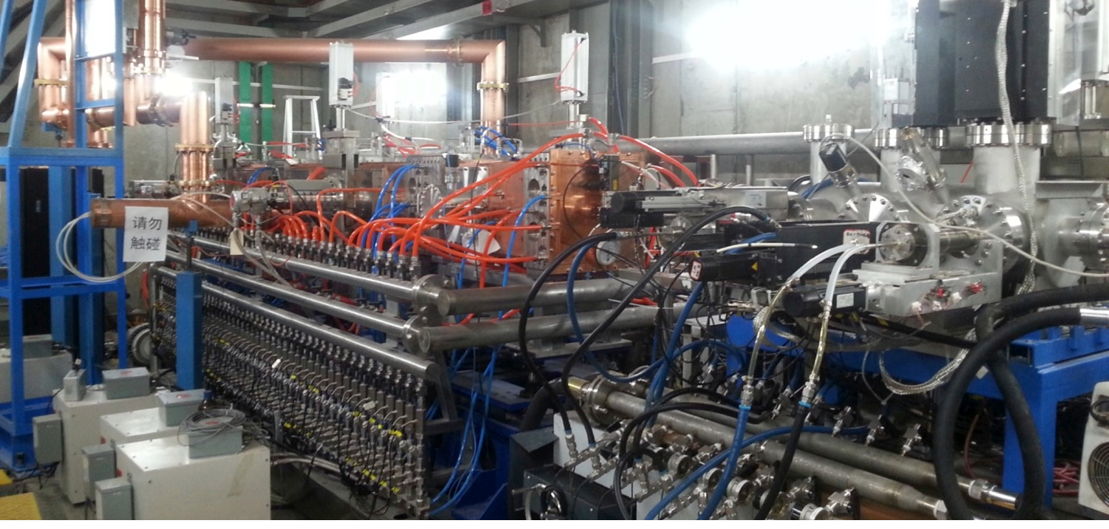
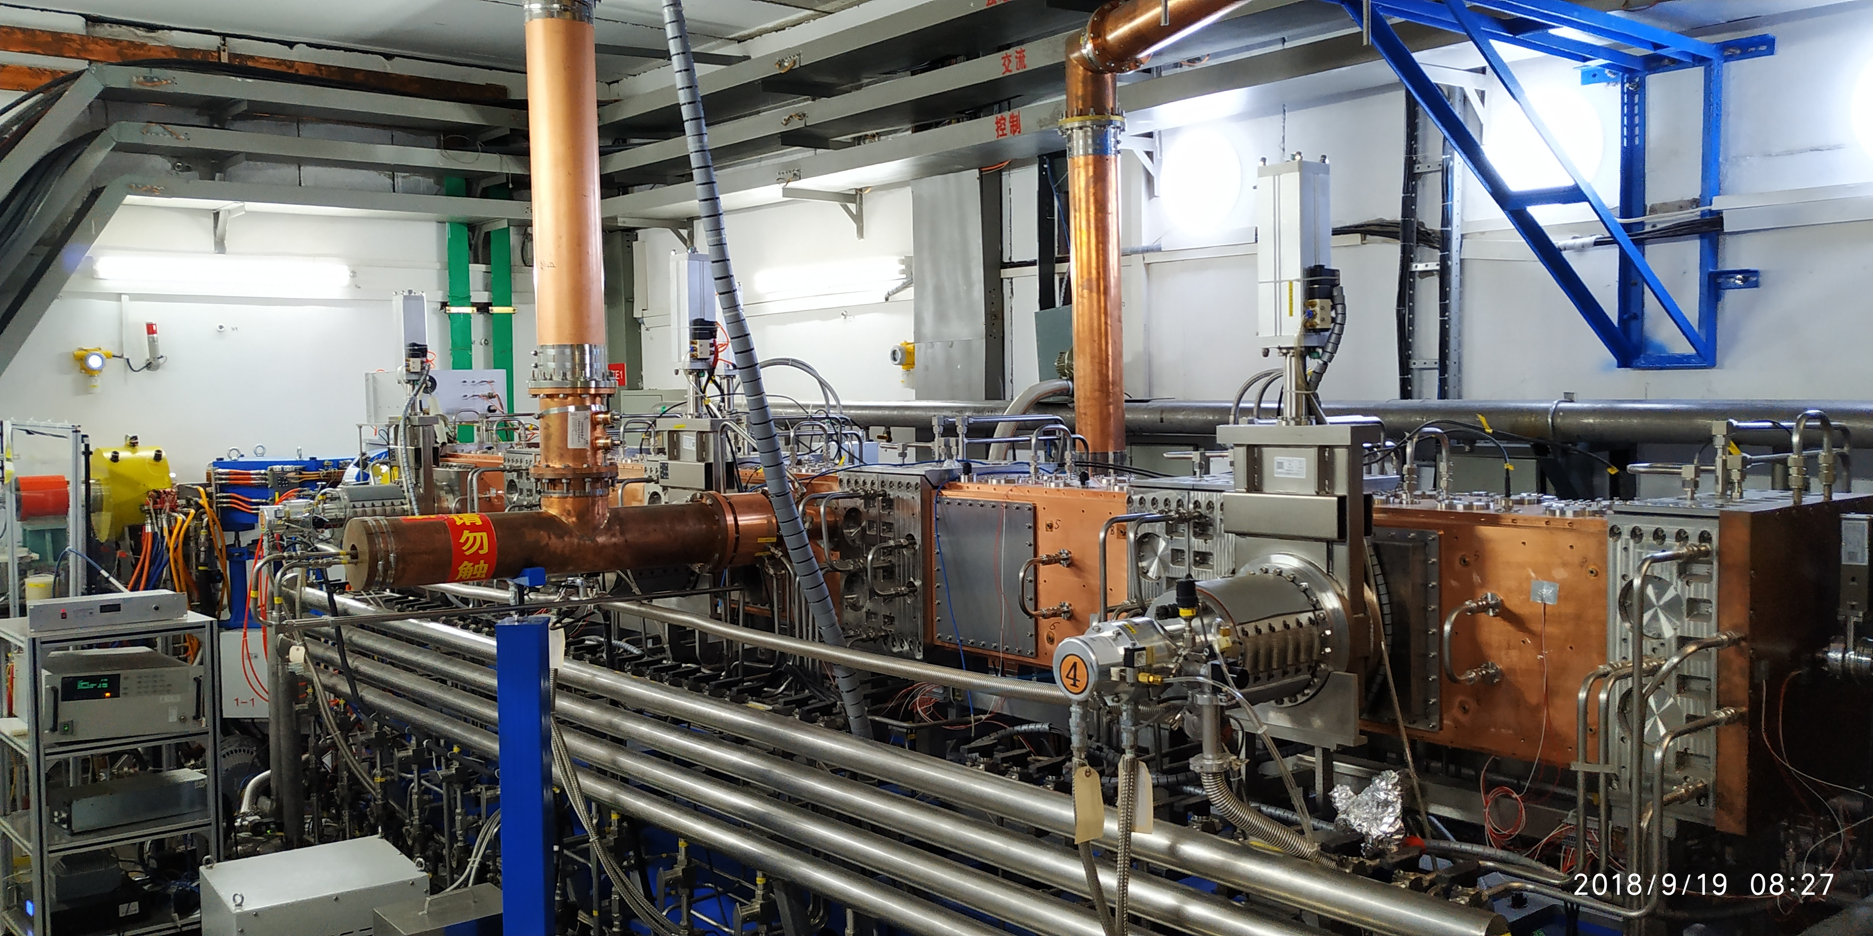
RFQs for CAFe
Apr. 17 to Jun. 6 ’14, condition to 90 kW
June 6th, 2014，the first beam, 2.16 MeV
June 21st, the first CW beam @ 2 mA
June 30th，10 mA, CW, 21 kW, 4.5 hours, transmission >97%
CW RF Operation 5904 hours
Offline in Jan. 2018
Nov. 2017, short pulse condition to 135 kW
Online in Oct. 2018
Operation from Nov. 2018, RF Operation time, pulse, 312 hours
2017.11.15, H ⁺, 3.4 mA; H₂⁺, 7.8mA
2018.12.17-19, ⁴He²⁺ , 46 hours
15
Notes:
162.5MHz ADS RFQ从设计、加工到运行历时3年。2014年6月30日达到10mA连续束设计指标，7月通过中科院组织的专家测试，到目前已累计运行900小时以上，毫安级连续束约46小时，是国际上唯一稳定运行的连续波强流RFQ。陈佳洱院士评价其为“国内第一，国际先进”。除了组织项目实施和关键技术攻关以为，还在下面四个方面做出了创新性的贡献。

Slide 6
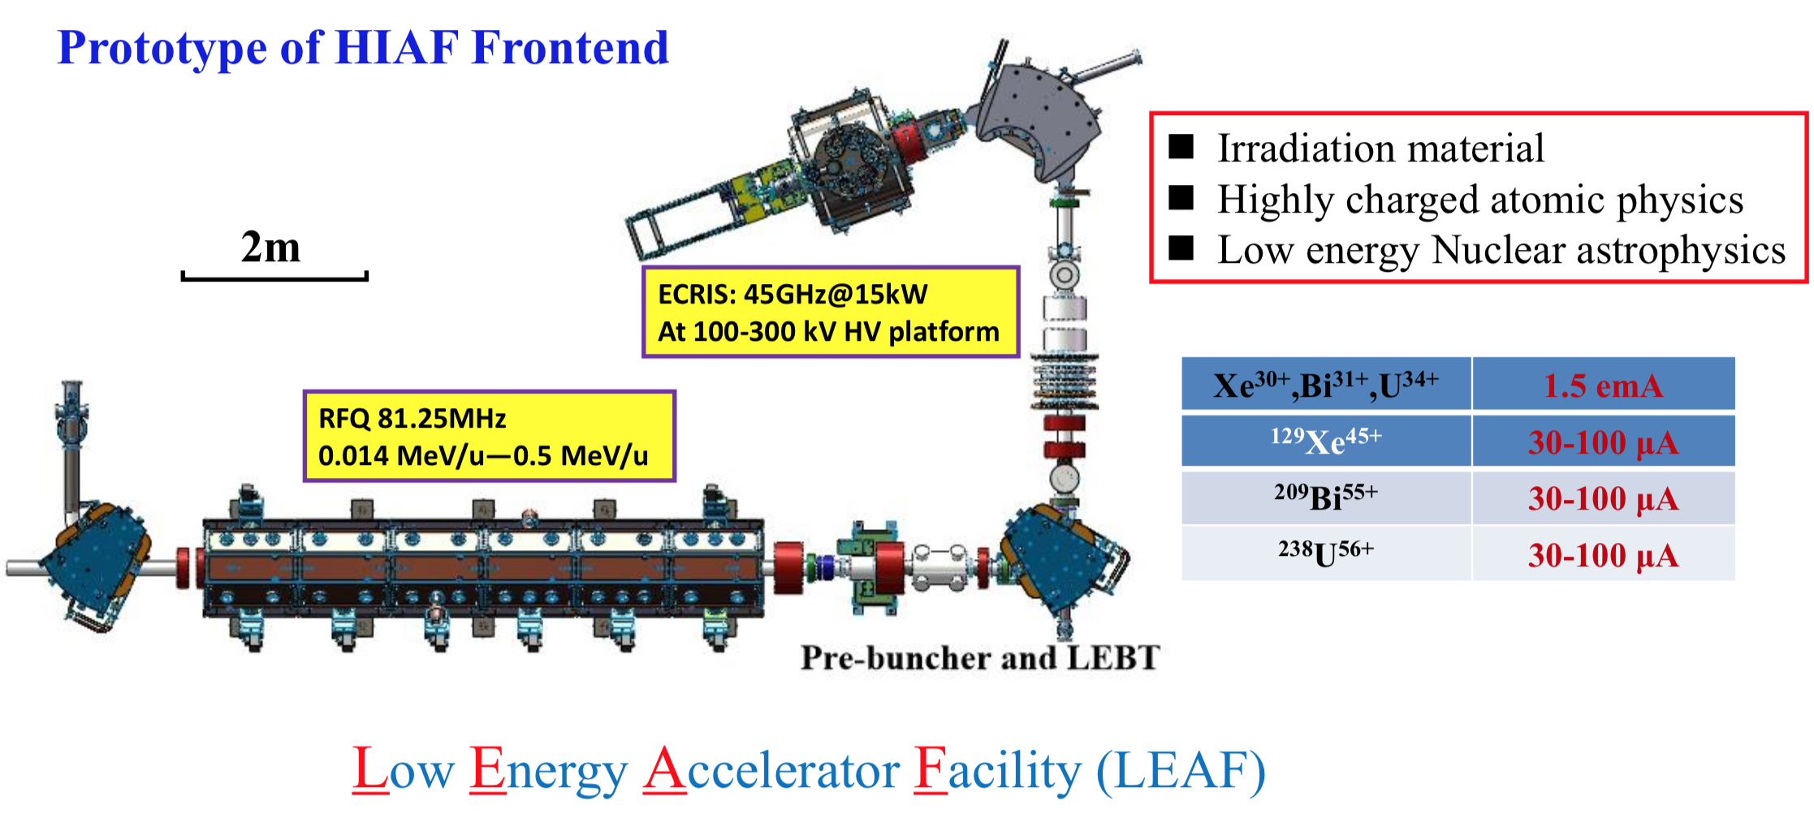
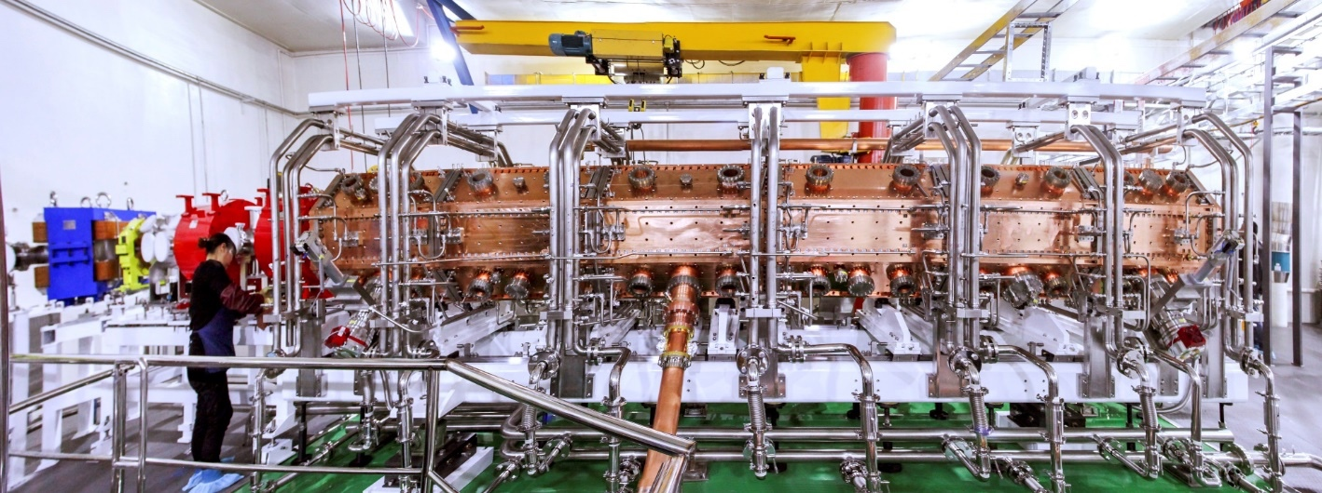
RFQ for LEAF
Feb. 2018, condition to 1.1 nominated power in 44 hours; 200 uA CW ⁴He⁺ beam，100 uA CW ¹⁴N²⁺，energy is 0.5 MeV/u
Operation time, CW, 589 hours

Slide 7
Outline
CW high-intensity RFQs activities in IMP
Structure and Conditioning of the RFQs
Problems happened to the RFQs
How to make a stable RFQ always?
Notes:
This is the outline

Slide 8
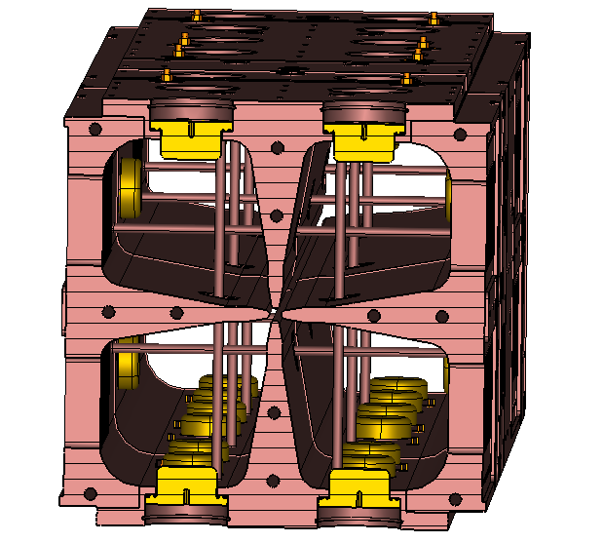
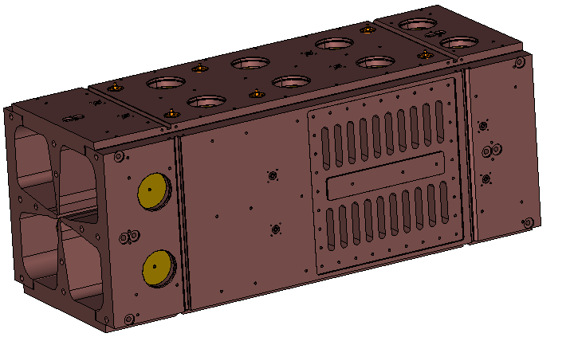
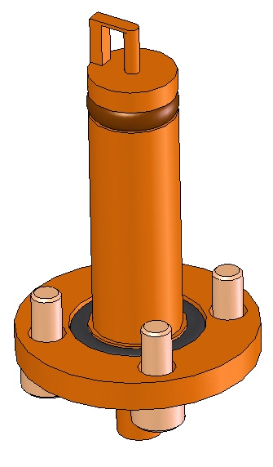
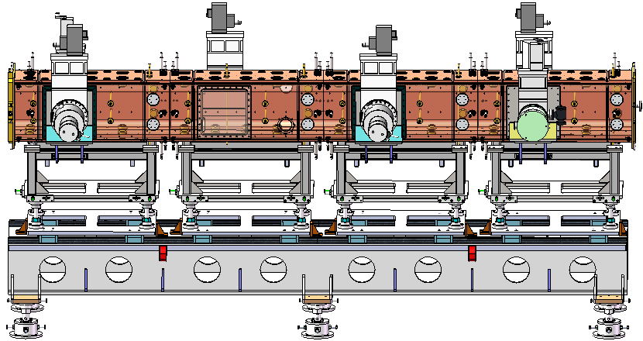
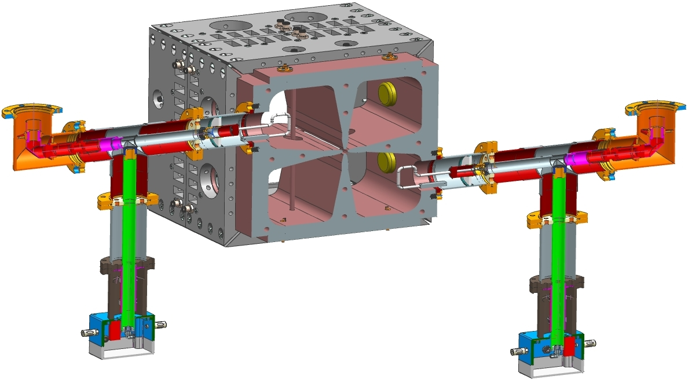
Structure of ADS RFQ
Consists of four modules, each
module is 1050mm long
80 Tuners
Equal spaced
20 per module
32 Pi-mode Rods
Equal space,
8 per module
48 sensing
loop ports, Regularly spaced
2 RF input ports
Both in Module 2
One near side, one far side

Slide 9
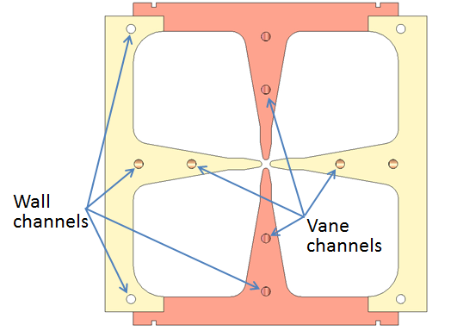
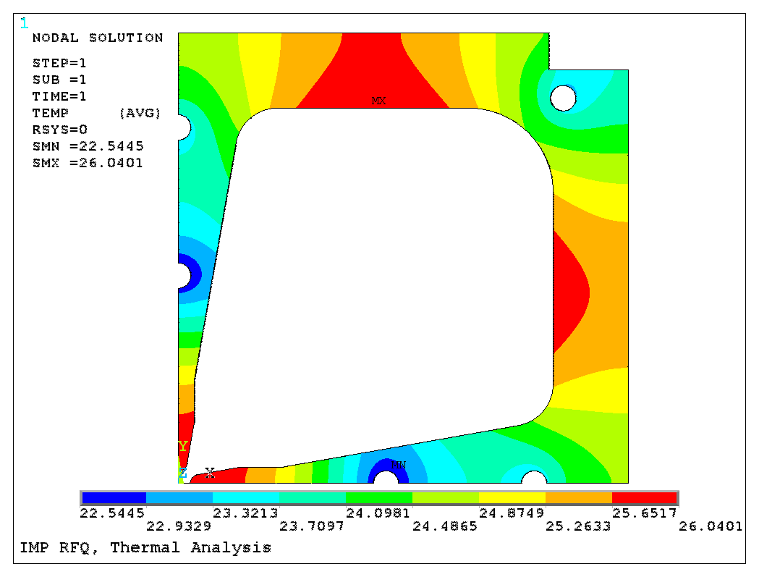
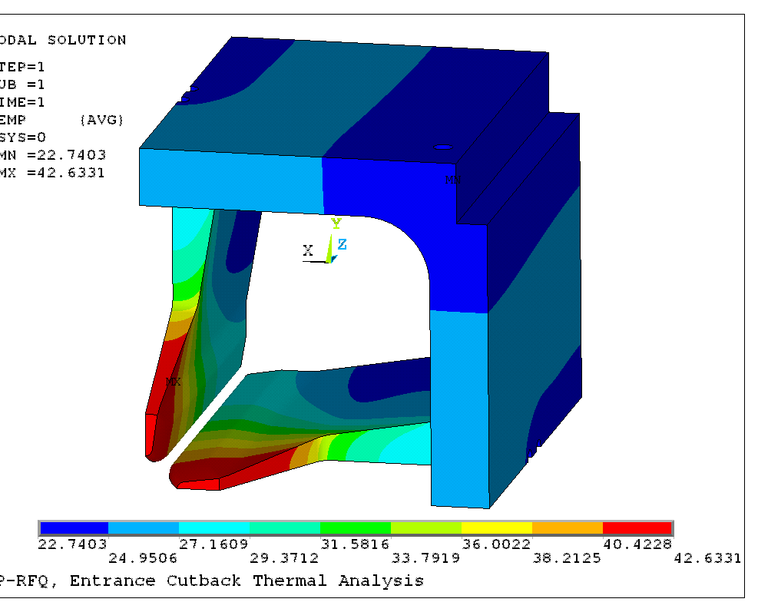
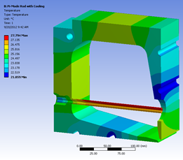
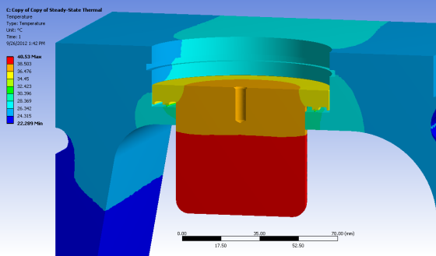
Thermal analysis of the cavity body
Cooling water 20ºC
Velocity < 2.5 m/s
Number: 8
Number: 4
Max. Temp.: 26ºC
70~105 W for each
Max. Temp.: 41ºC
Max heat flux 28.92 W/cm²;
Max temp of cutbacks 48.0 ºC
Max. Temp.: 30ºC

Slide 10
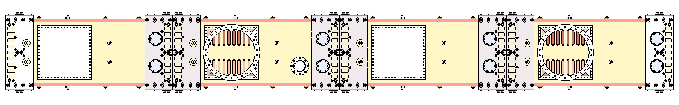
Cooling Water Loops
Chiller 1 (for vanes)
Flow monitor and temperature monitor are required to be installed at the exit of each channel
Vane: 4 Channels
in Parallel
Vane: 4 Channels
in Parallel
Vane: 4 Channels
in Parallel
Vane: 4 Channels
in Parallel
Wall：
8 Channels
in Parallel
Pi-mode rod：
8Channels
in parallel
Wall：
8Channels
in Parallel
Pi-mode rod：
8Channels
in parallel
Wall：
8 Channels
in Parallel
Pi-mode rod：
8Channels
in parallel
Wall：
8 Channels
in Parallel
Pi-mode rod：
8Channels
in parallel
Chiller 2 (for wall &
pi-mode rods)
Pressure gauge
Temperature monitor
Flow meter
Valve

Slide 11
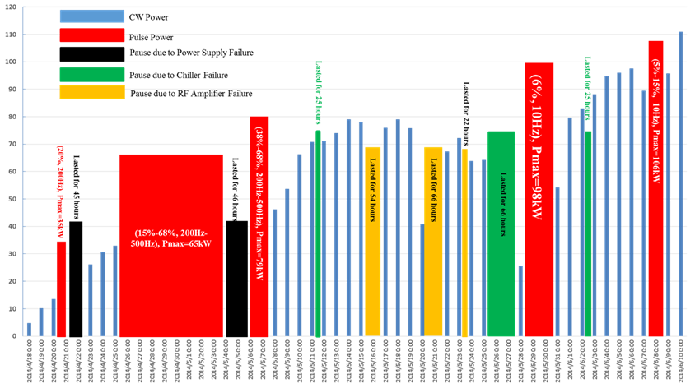
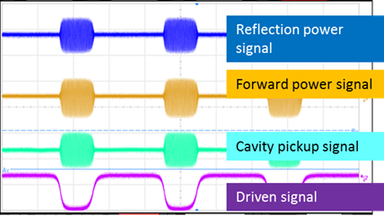
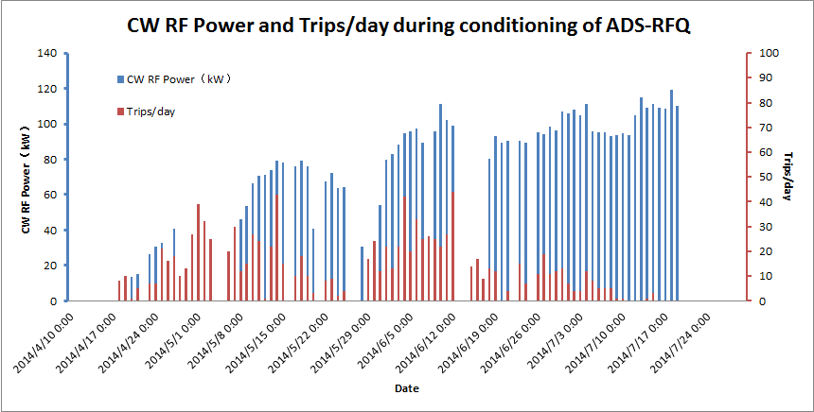
Conditioning of ADS RFQ
Pulse/CW alternatively
Pulse Beam
CW Beam

Slide 12
Operation Status
3264 hours
2638 hours
AMP change
MTBF:24.4 hours
MTBF:11.3 hours
Vacuum
Cooling
Arc
Alarm of flux meters
EMC of vacuum gauge
chiller

Slide 13
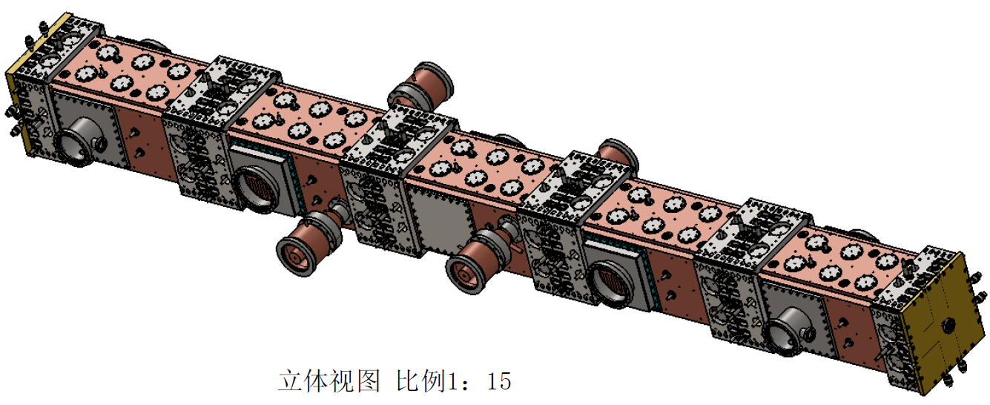
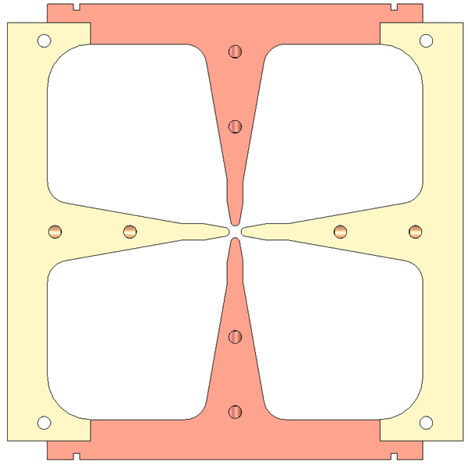
Structure of CMIF RFQ
Tmax=33℃
Tmax=30℃
Tmax=26℃

Slide 14
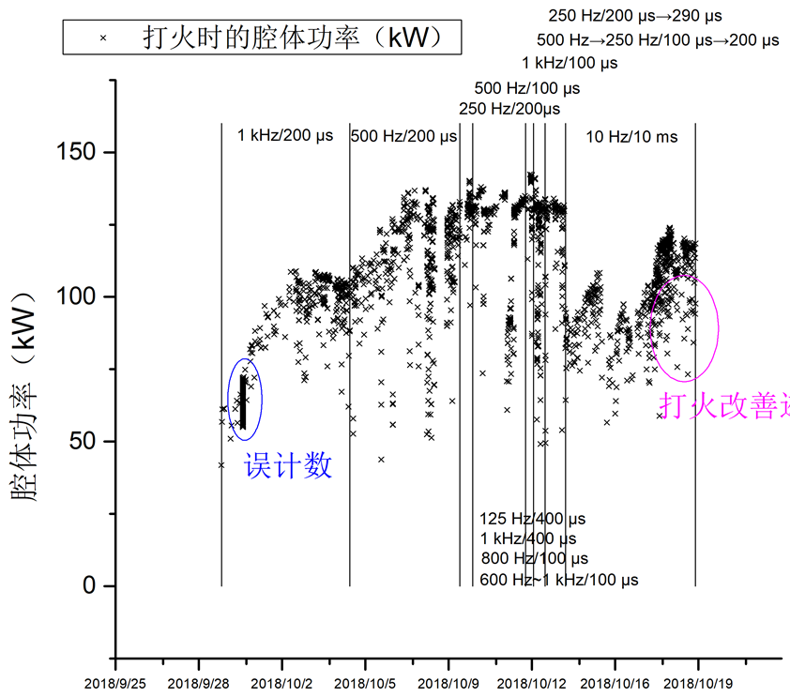
Conditioning of CMIF-RFQ
* RF Power when arcing (kW)
RF Power

Slide 15
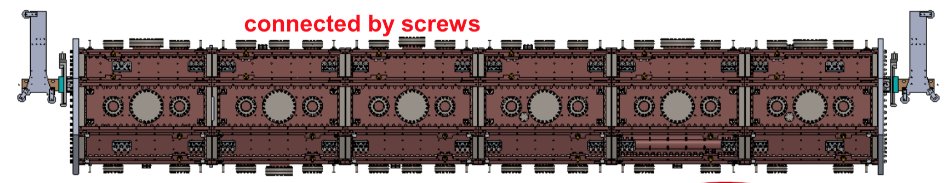
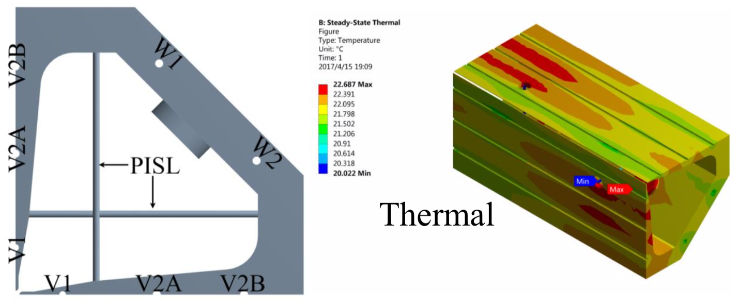
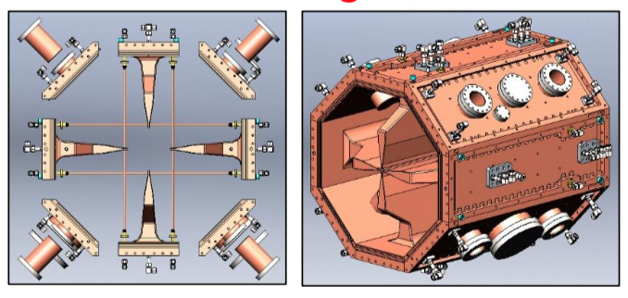
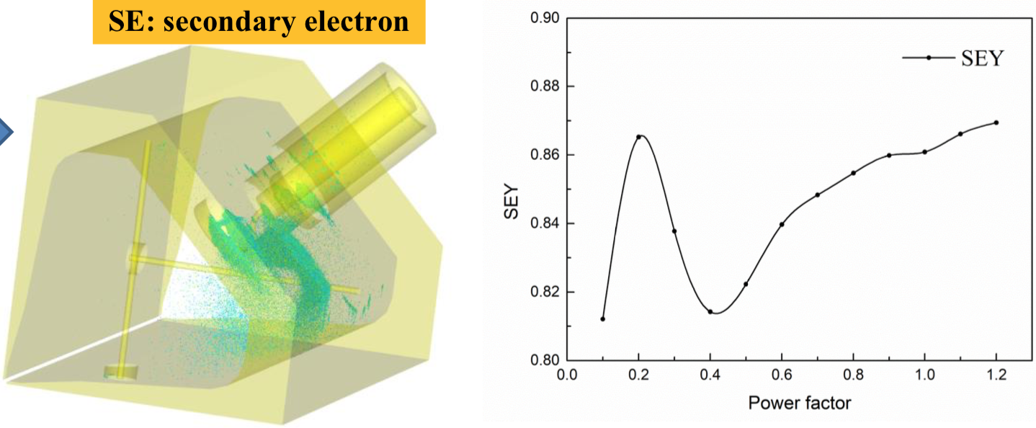
Structure of LEAF RFQ
● Max. T: 22.7°C, rised 2.7 °C
max deform.: 21.4 μm
max. stress: 10.99 MPa
SEY < 1 at coupler

Slide 16
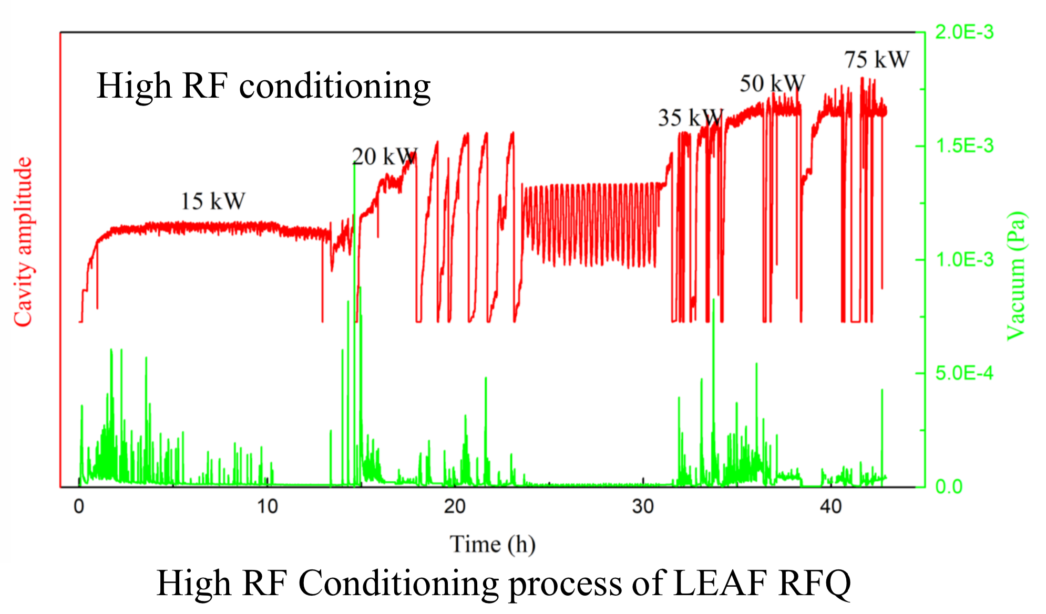
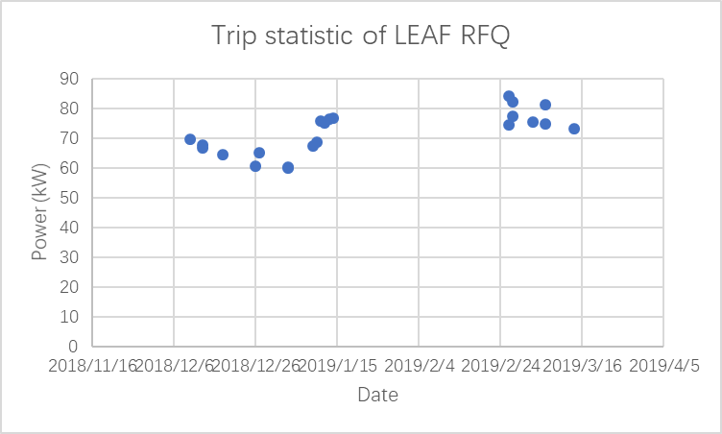
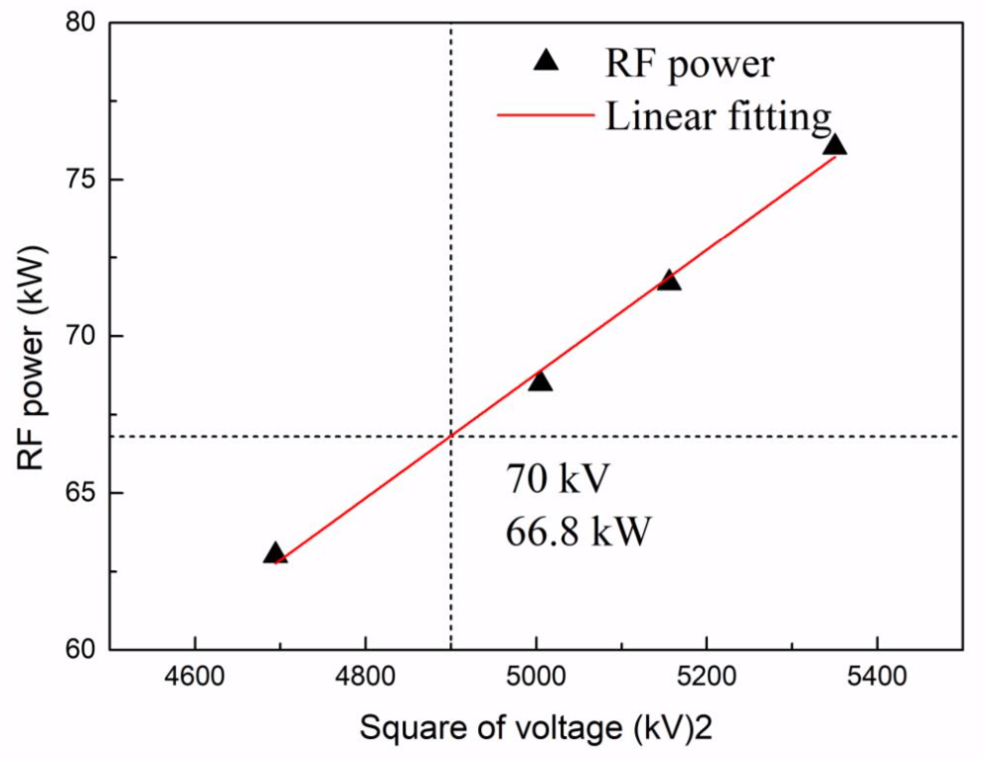
Conditioning of LEAF RFQ
Keep CW power conditioning
44 hours to nominal voltage 70 kV
Arcing when power was higher than 70 kW

Slide 17
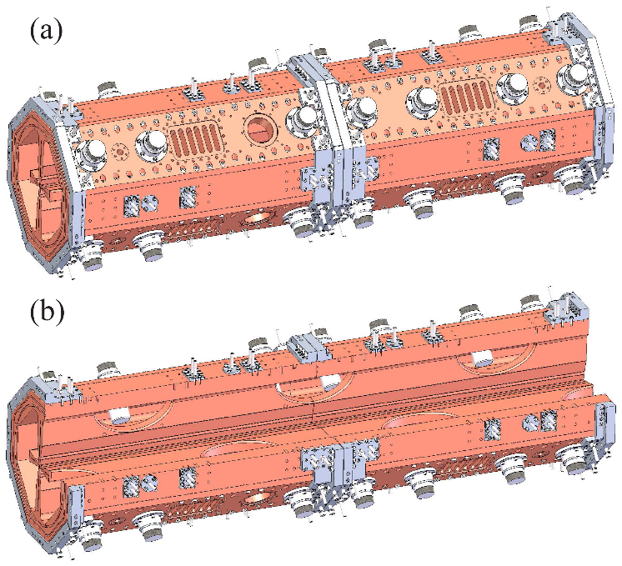
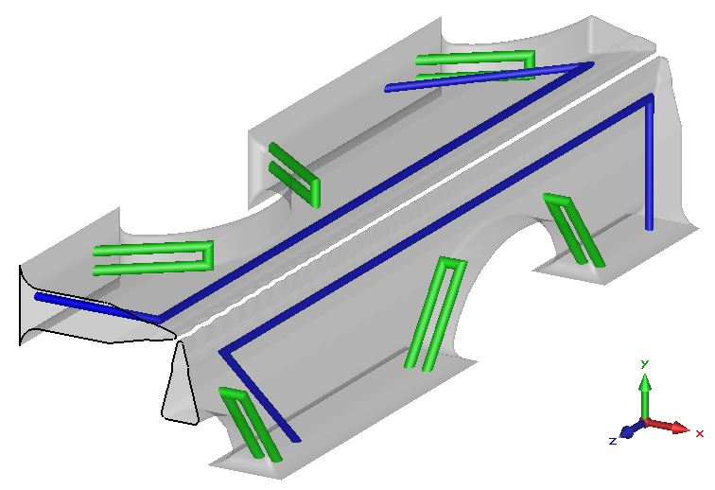
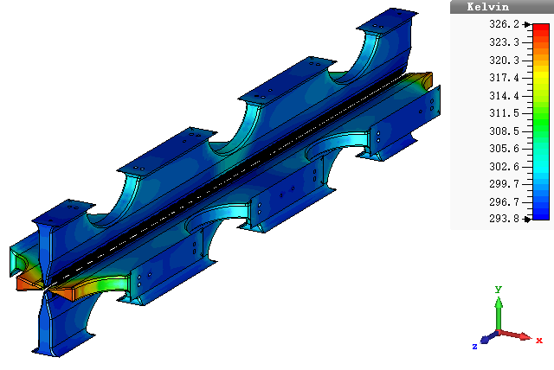
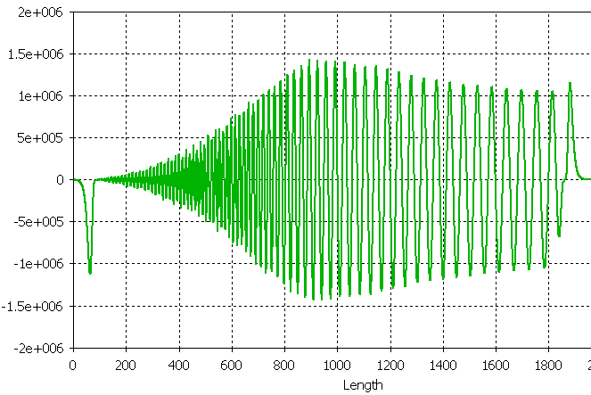
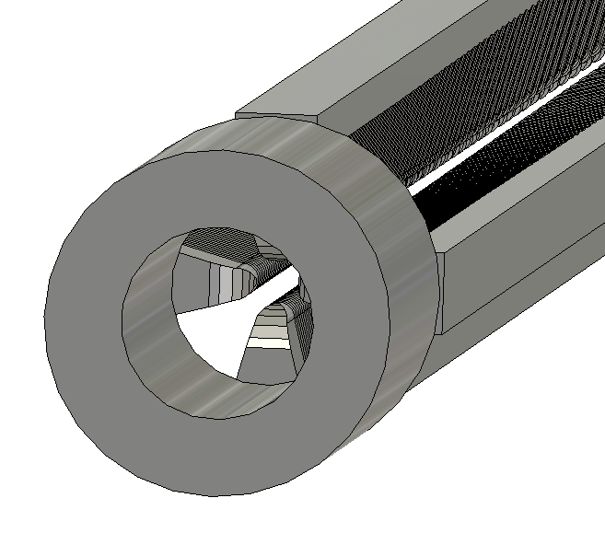
Structure of D-RFQ-973
Cooling channel
Thermal analysis
Parameters | CST | ANSYS
Water velocity /m/s | 2.3 | 2.3
Cooling water/℃ | 18 | 18
Room /℃ | 22 | 22
Power /kW | 46.5 | 52.5
Max dT /℃ | 31.39 | 32.56
Max deform/μm | 73.27 | 75.24
Aperture 40 mm

Slide 18
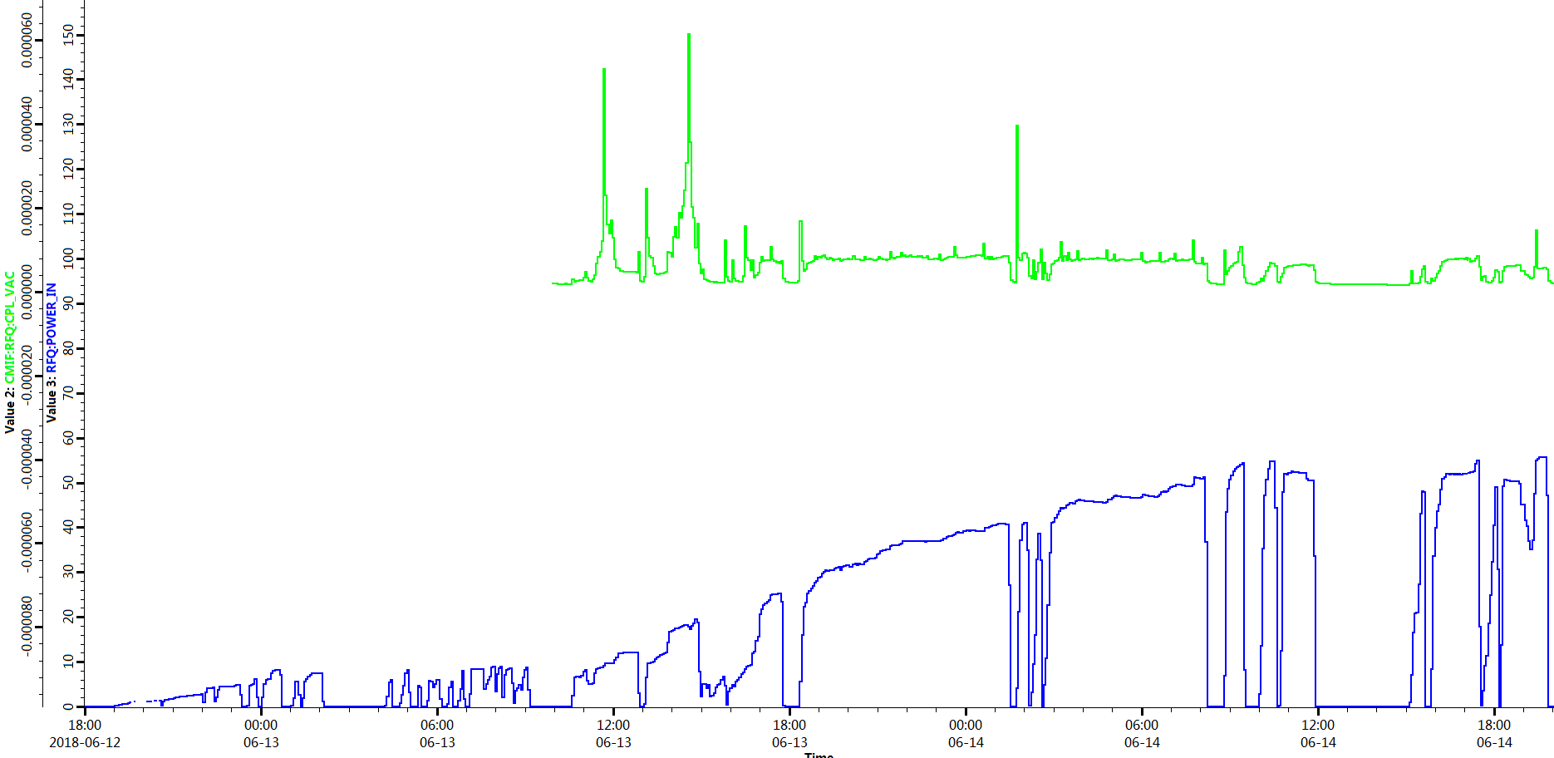
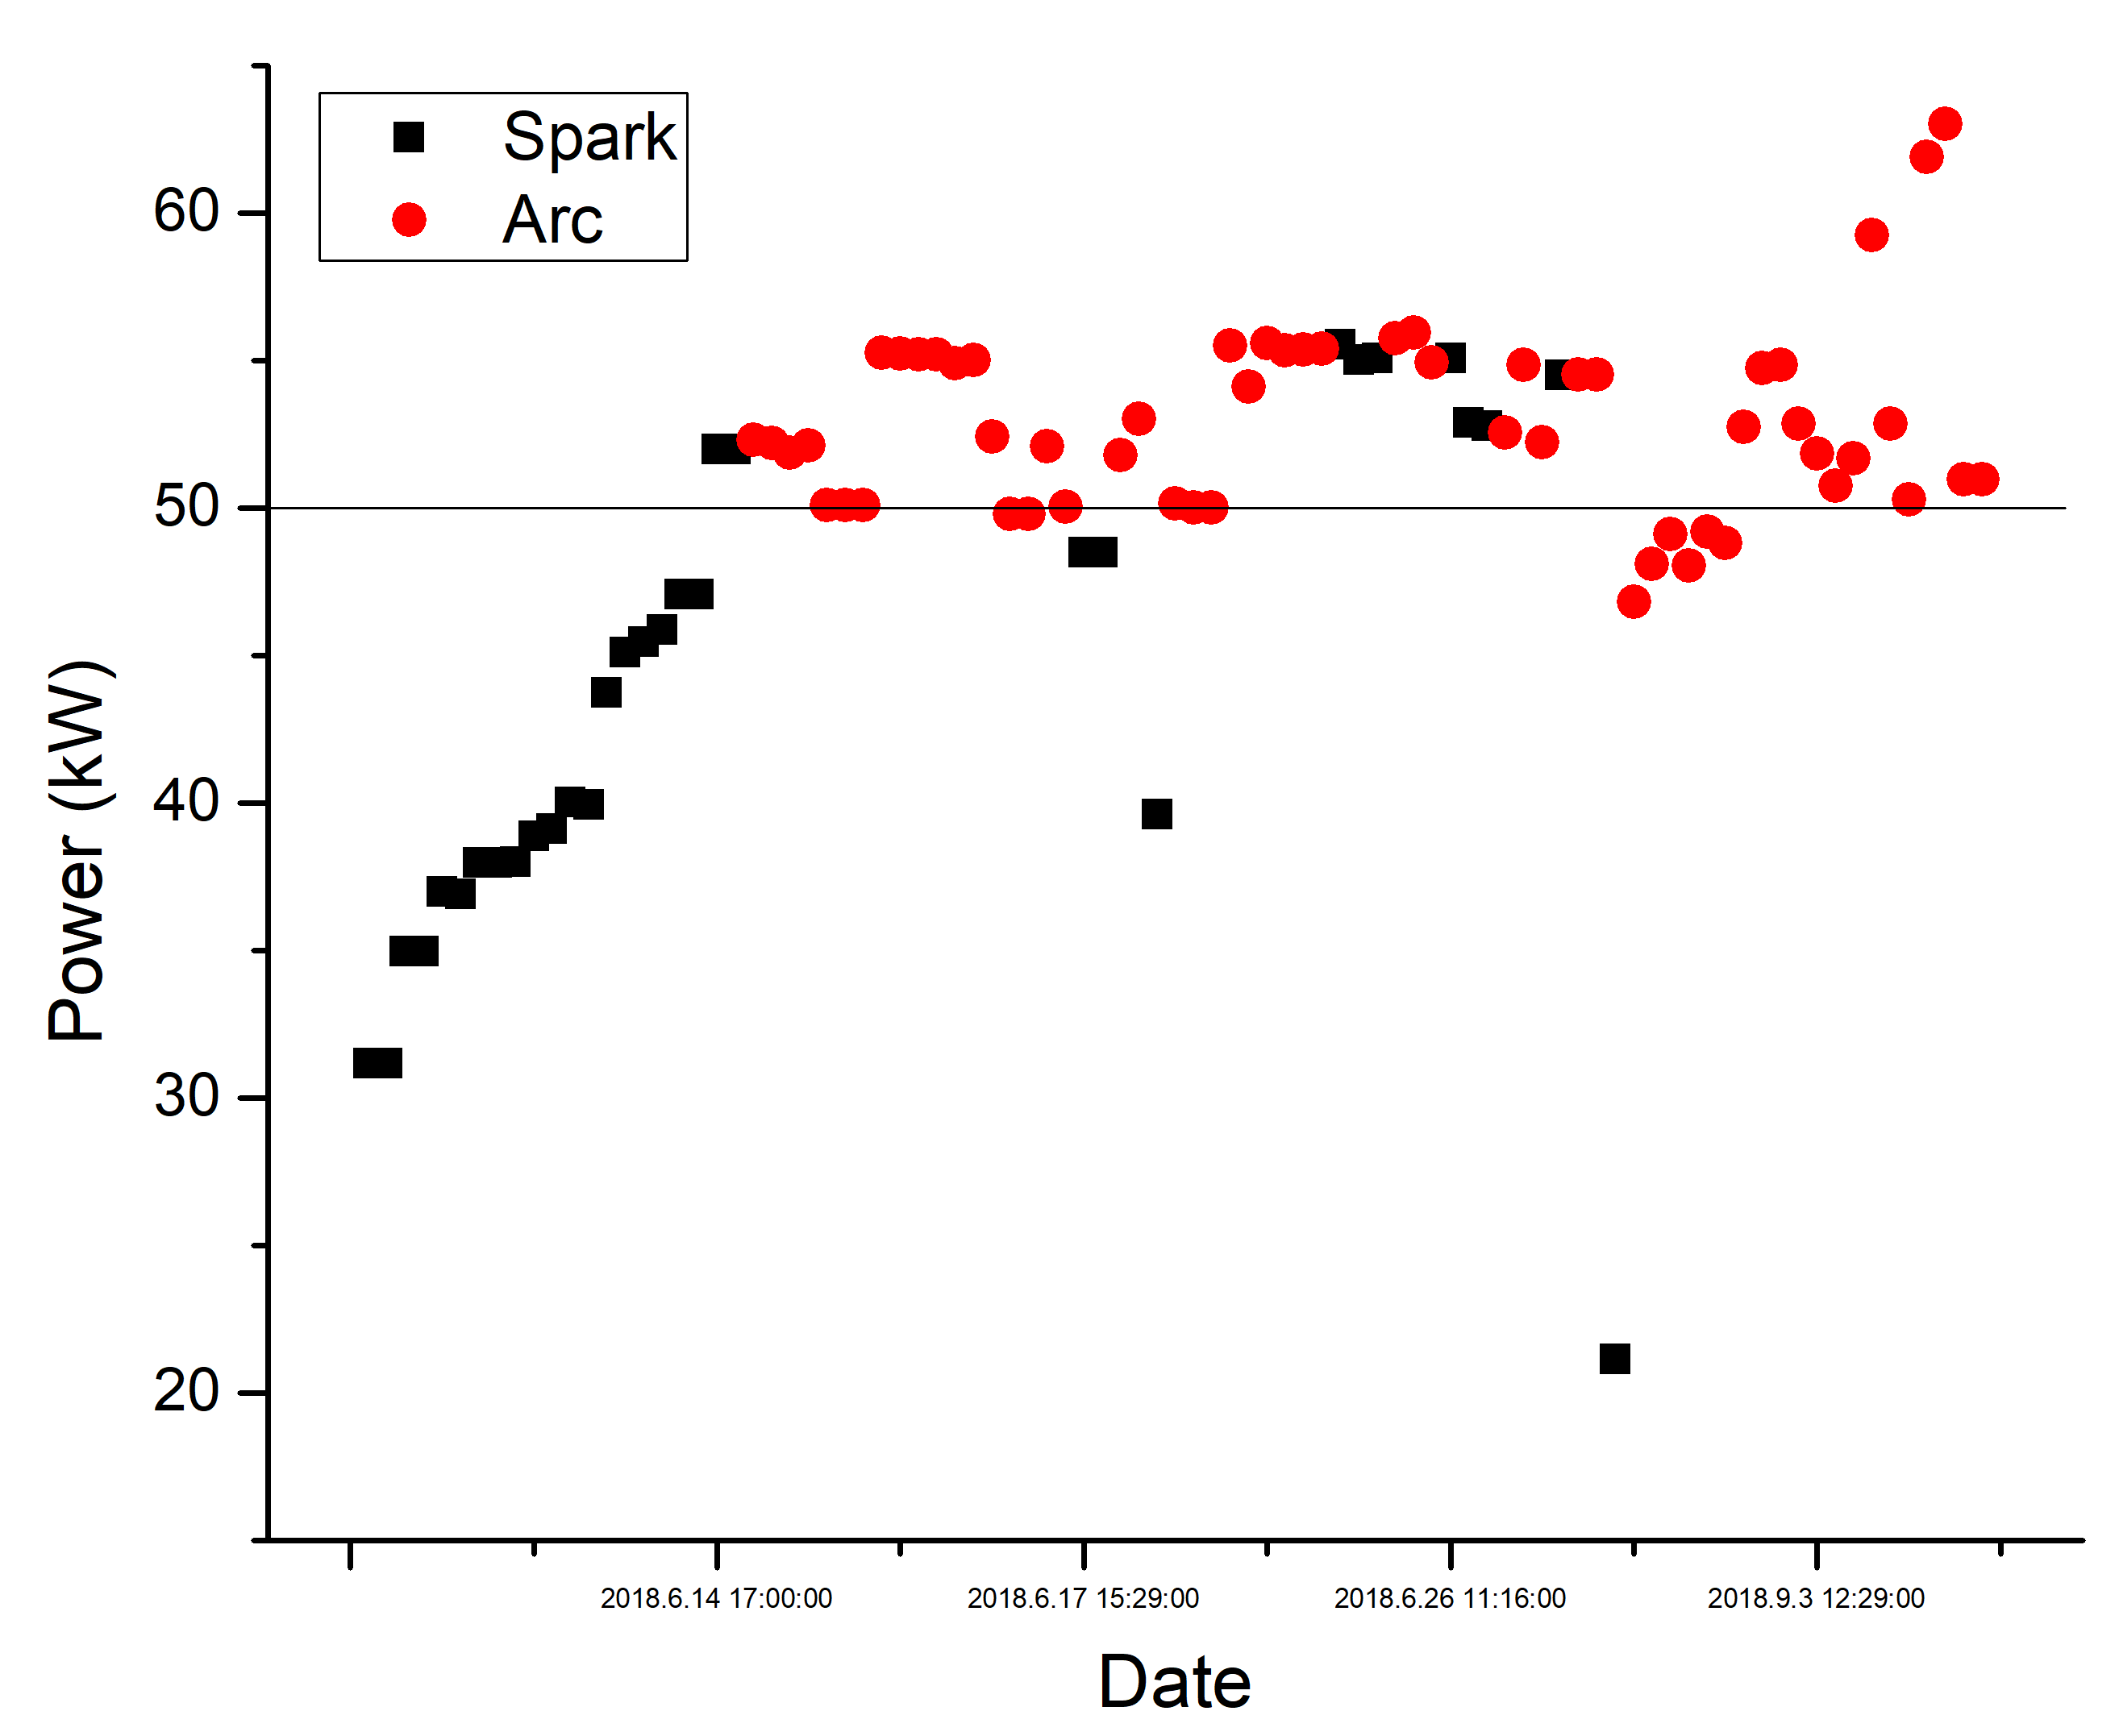
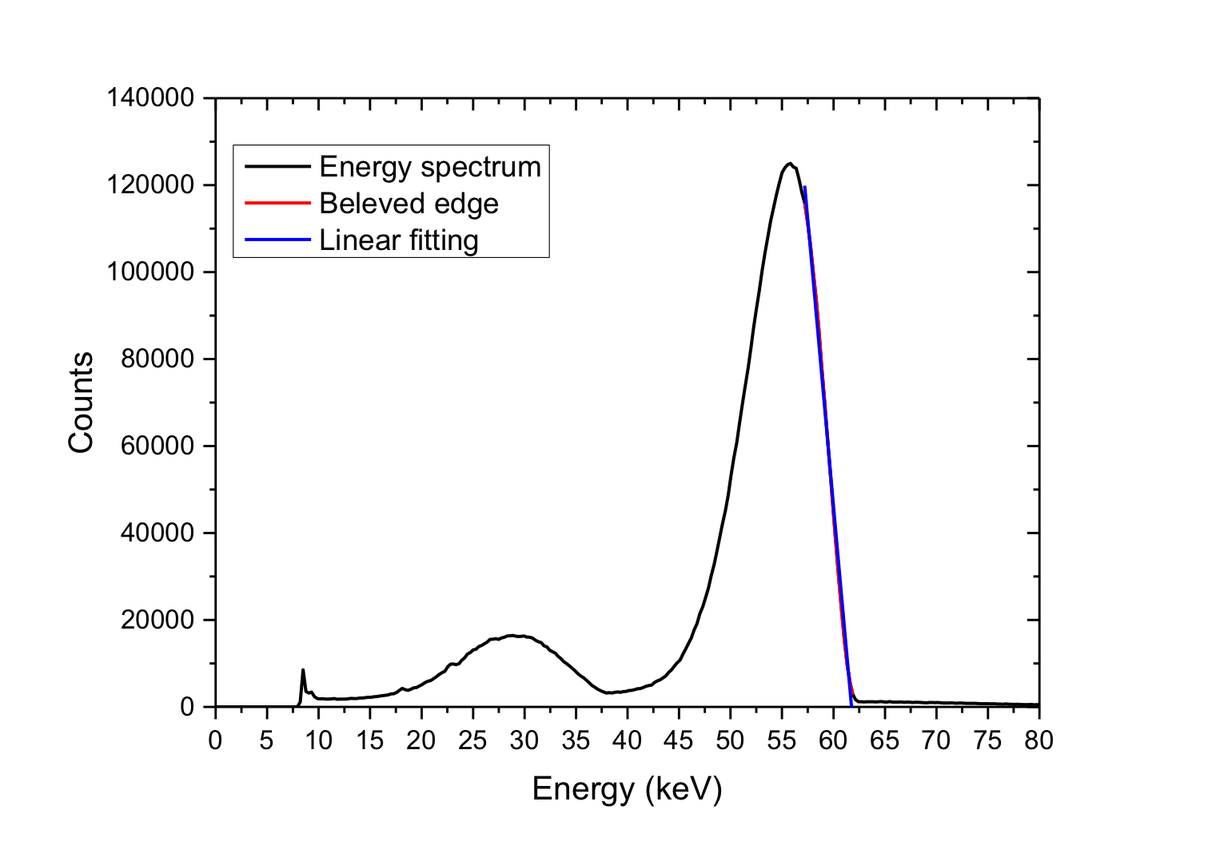
Conditioning of D-RFQ-973
Jun. 12-14, 2018
Keep CW power conditioning
47 hours to nominal voltage 60 kV
Arcing when power was higher than 50 kW
50 kW = 61.7 kV

Slide 19
Outline
CW high-intensity RFQs activities in IMP
Structure and conditioning of the RFQs
Problems happened to the RFQs
How to make a stable RFQ always?
Notes:
This is the outline

Slide 20
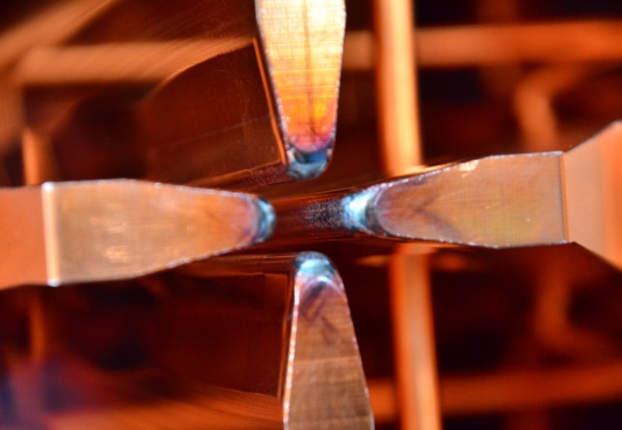
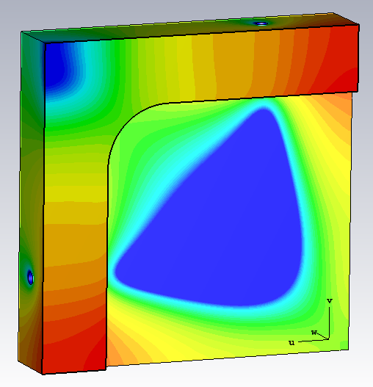
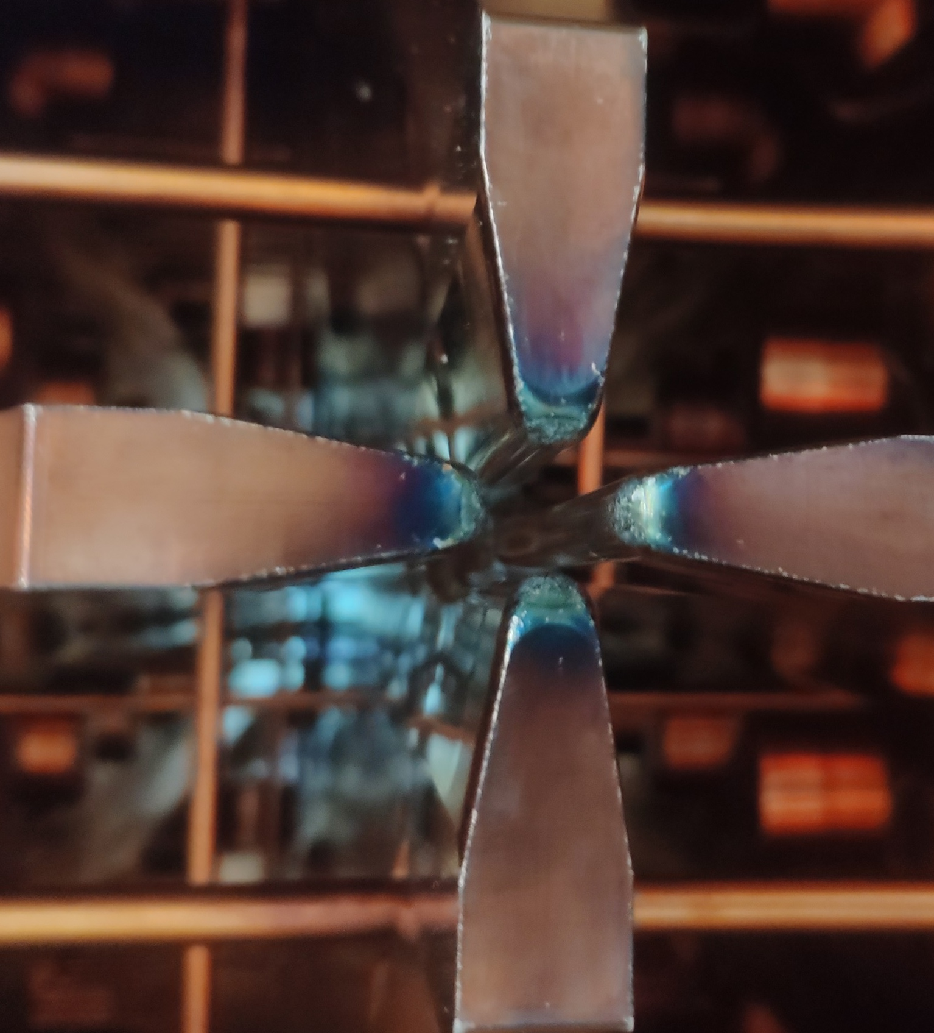
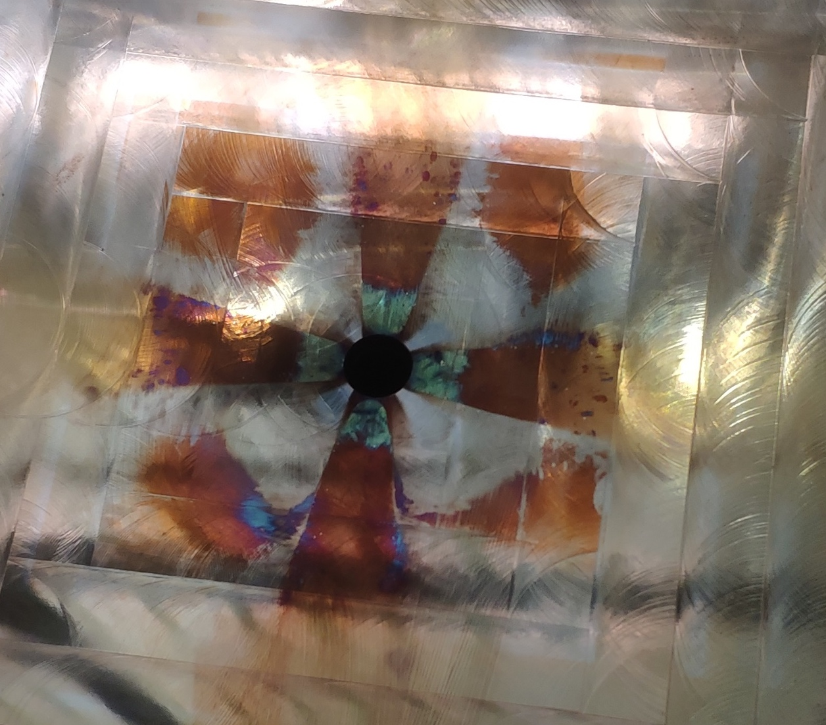
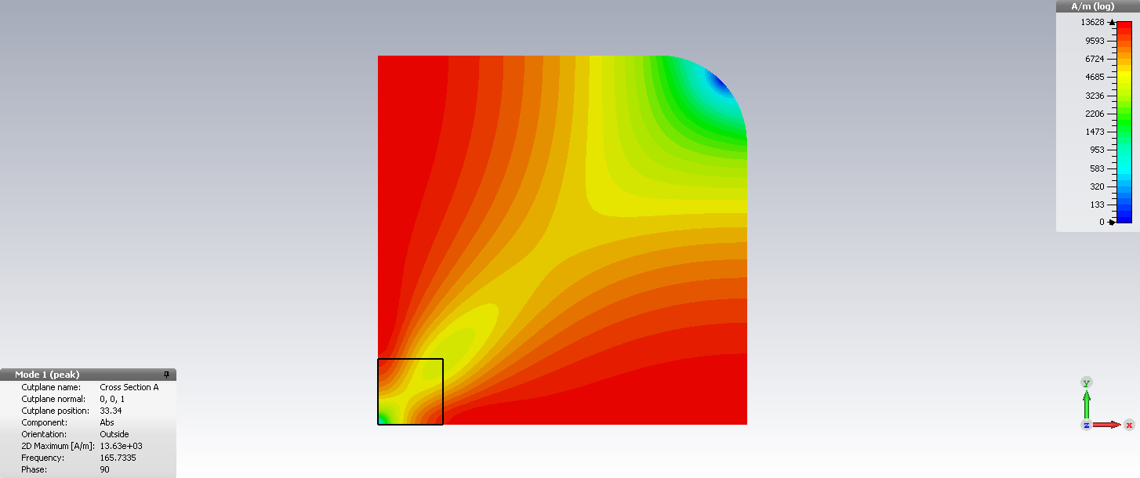
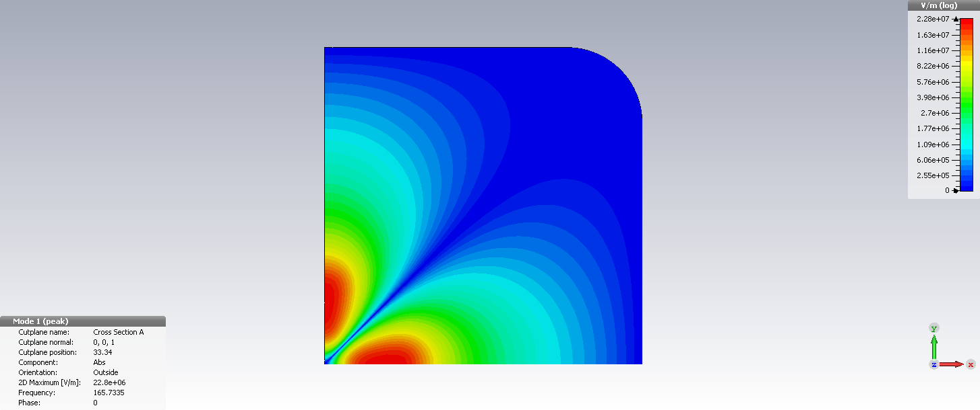
Blue Marks at the Exit of ADS RFQ
T
Aug 12, 2014, after conditioning and cw beam commissioning.
Temp. Max 21 ℃
B
E
Apr. , 2019, checking after 6000 hours operation.

Slide 21
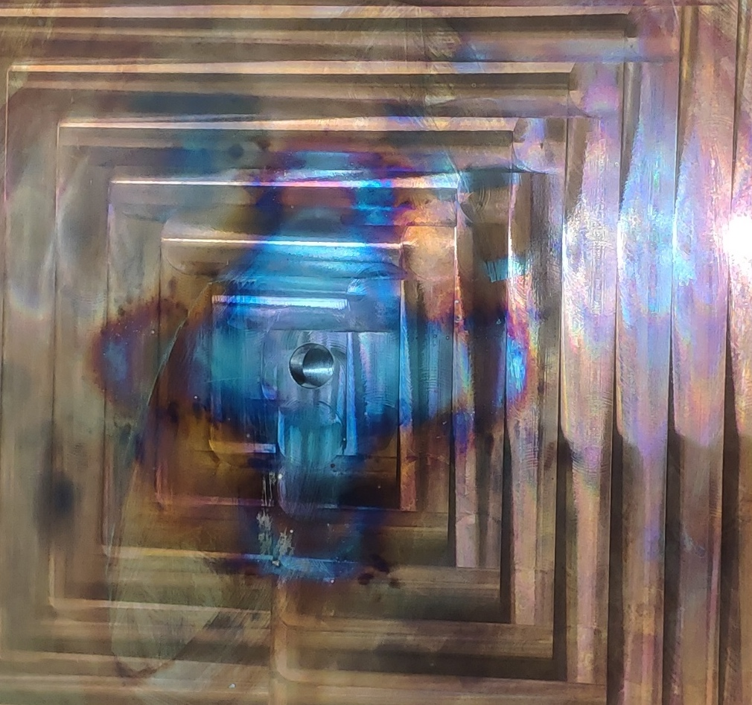
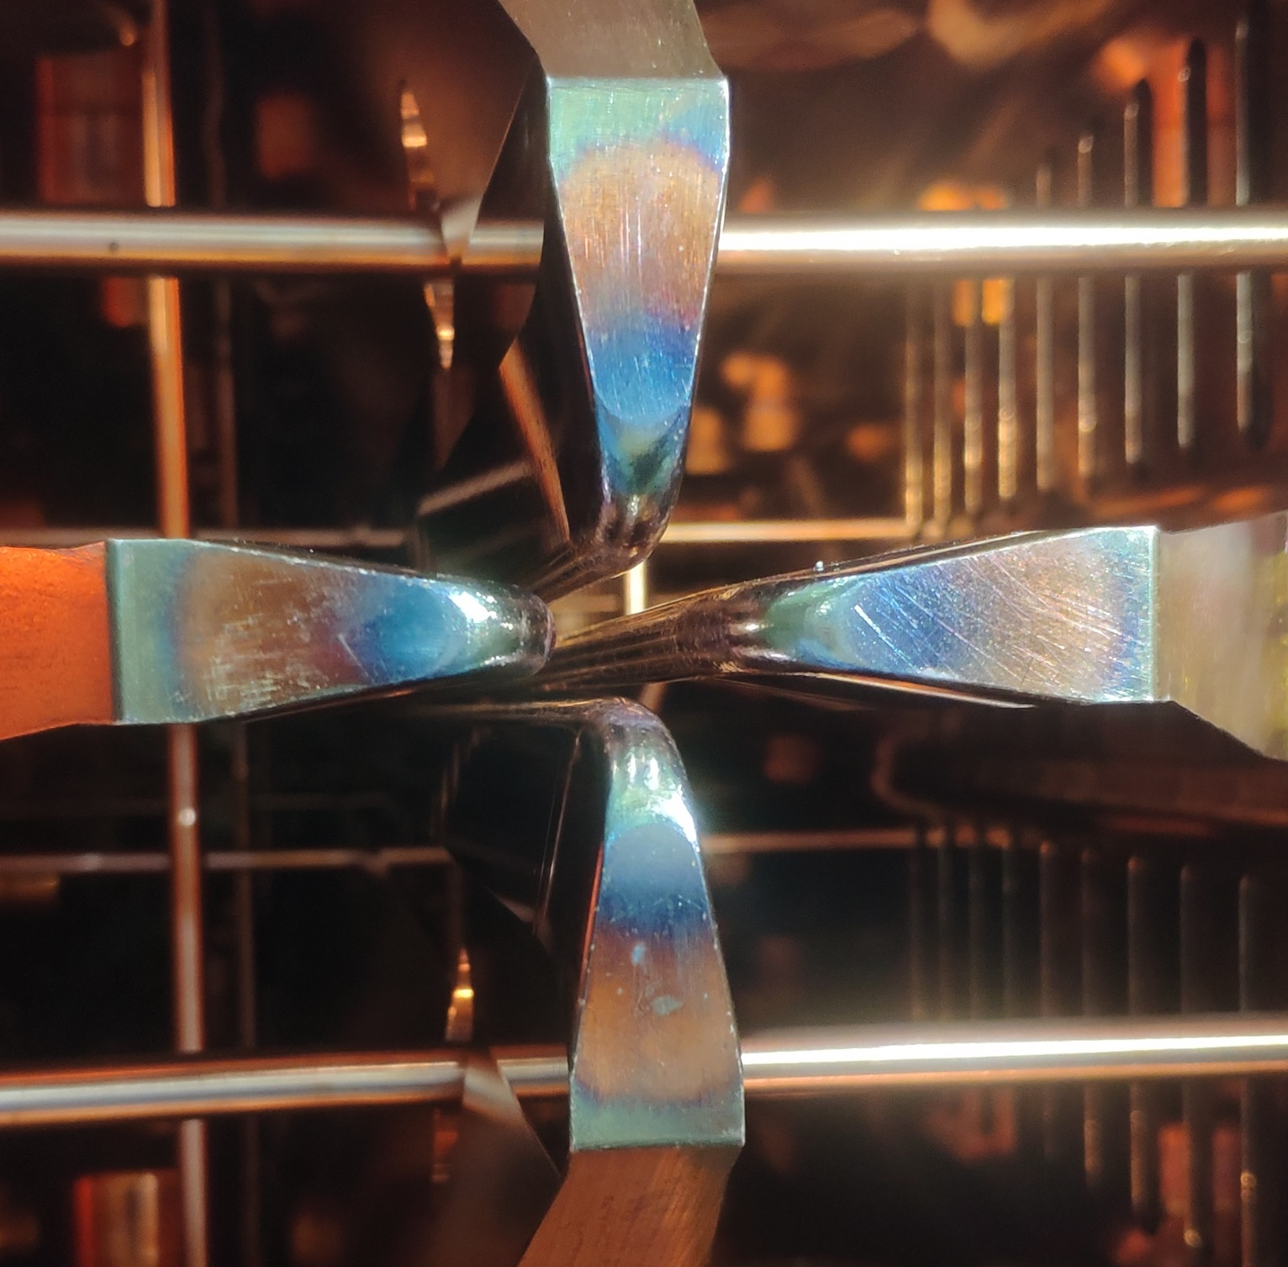
Blue Marks at Entrance of ADS RFQ
End-plate of the entrance is near two times farer from electrodes than one of the exit.
Due to beam loss of H₂⁺ and H₃⁺ , and than gas releasing?
Due to worse vacuum (1E-4 Pa) at entrance?

Slide 22




Beam Loss Simulation of H₂⁺, H₃⁺
corn
corn
5% of H2+ and H3+ are loss in the entrance of 1.5 m of RFQ, 0.1% is on the tips.

Slide 23



Blue Marks at PiMS of CMIF RFQ
ADS RFQ
Aug 12, 2014, after conditioning and cw beam.
CMIF RFQ
Can not achieve nominal field after long term conditioning.
The max CW power was 110 kW. 100 kW was relatively stable.
Heavy discharge hapend in PiMS hole.
Multipactor?
ADS RFQ
Apr. , 2019, checking after 6000 hours operation.

Slide 24







Multipactor in RFQs
Possible Multipactor in ADS-RFQ
Multipactor simulation in CMIF RFQ
3 ns
6 ns
120 ns

Slide 25






Multipactor of Coupler of ADS RFQ

Slide 26



Discharge w/o Arc (spark)
LLRF detector
Arc detector
Discharge of LEAF-RFQ（1/2hours，60 kW）

Slide 27




Something Uncertainty
ADS RFQ
Blue mark between sections
D-RFQ-973

Slide 28
Outline
CW high-intensity RFQs activities in IMP
Structure and conditioning of the RFQs
Problems happened to the RFQs
How to make a stable RFQ always?
Notes:
This is the outline

Slide 29
A little bit confuse!
 | radial matching gap （mm） | fringe-field gap （mm） | Aperture on end-plates | voltage （kV） | vendor
ADS | 10.040 | 5.987 | 10/15 | 65 | KJTJ(IMP)
CMIF | 9.704 | 5.295 | 10/15 | 65 | KJTJ(IMP)
LEAF | 11.019 | 5.579 |  | 70 | KeLin
973 | 8.011 | 7.988 | 40/40 | 60 | KJTJ(IMP)
 | R0 （mm） | a （mm） | max m | kp | vendor
ADS | 5.731 | 3.16 | 2.376 | 1.17 | KJTJ(IMP)
CMIF | 4.807 | 2.74 | 2.279 | 1.4 | KJTJ(IMP)
LEAF | 5.805 | 3.63 | 2.035 | 1.55 | KeLin
973 | 3.477-5.971 | 2.63 | 1.86 | 1.68 | KJTJ(IMP)

Slide 30
Just thinking……
Lessons from the bad experience of ADS and especially CMIF RFQ:
To optimize Bpeak/V(Eacc), Epeak/V(Eacc), especially at the corner of electrodes and end plates.
To optimize the multipactor, especially the coupler, PiMS, etc. Try to make SEY < 1.
To optimize structure of contact. RF fingers or springs will be burned due to bad contact.
To put “cleanness” on the “first” position. It is not only in the stage of assembly, tuning and installing, but also in the stage of fabrication from acid washing to brazing.
Any more……?

Slide 31



Assembly and tuning in cleanroom
The first ADS RFQ was in dirty surroundings.
CMIF and D-RFQ-973 were in clean room.

Slide 32




Optimize E_{peak} and B_{peak}
--- Varied voltage
--- Constant voltage
--- Varied voltage
--- Constant voltage

Slide 33
Acknowledgement
LBL: Derun Li, Steve Virostek, Matt Hoff, John Staples
FNAL: Sergei Nagaitsev, Gennady Romanov
PKU: Kun Zhu, Yuanrong Lu, Pinpin Gan, Qi Fu
IMP: Chenxing Li, Weiping Dou, Liang Lu, Xuejun Yin, Bin Zhang, Xiaofeng Jin, Zhijun Wang, Wei Ma

Slide 34
Thanks for your attention

