Slide 1
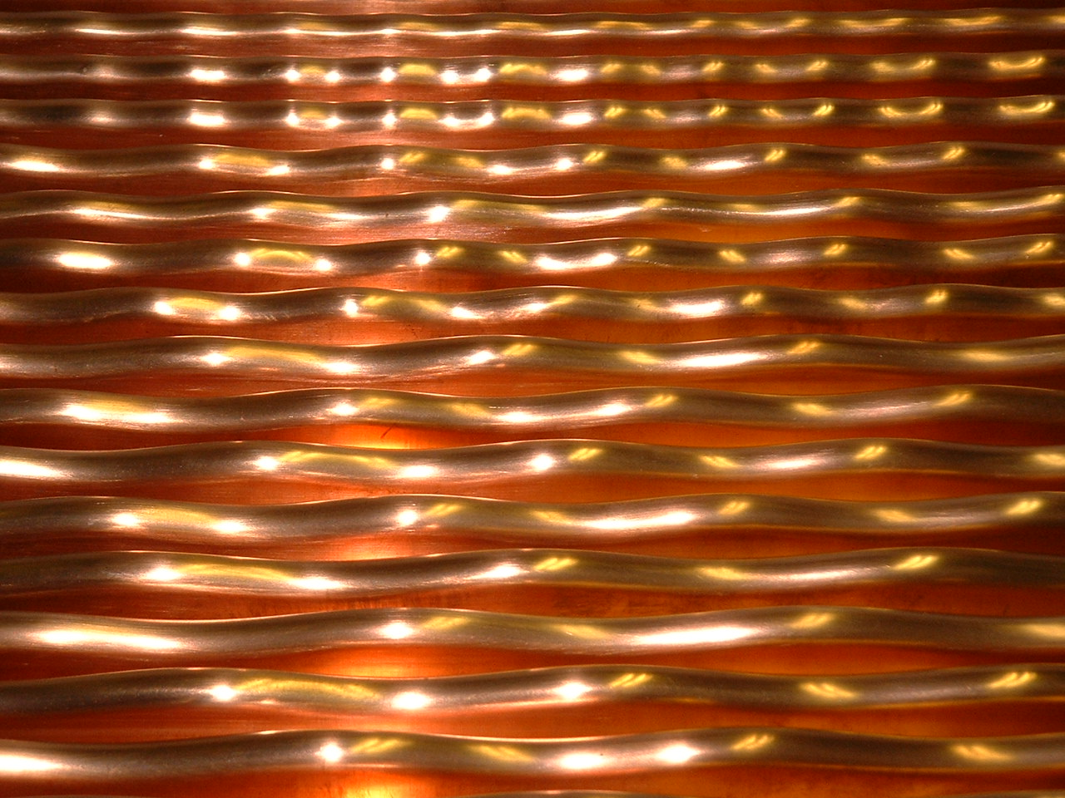
High Current Uranium Beam Measurements at GSI high in-tensity RFQ operation experience - from beam point of view
Winfried Barth, GSI&HIM
Introduction
Operation experience
HSI-commissioning (1999)
First acceleration of U⁴⁺ beam at HSI (2000)
HSI-RFQ-Upgrade I (2004)
HSI-RFQ-Upgrade II (2010)
2. Further RFQ-Optimization (2014-2016)
3. Pushing the limits for uranium beam (and p⁺) operation
4. Beam brilliance analysis
5. Summary

Slide 2
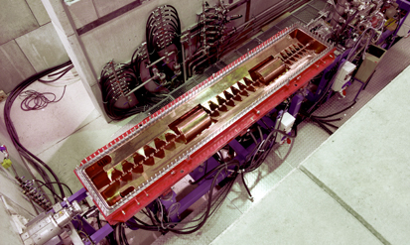
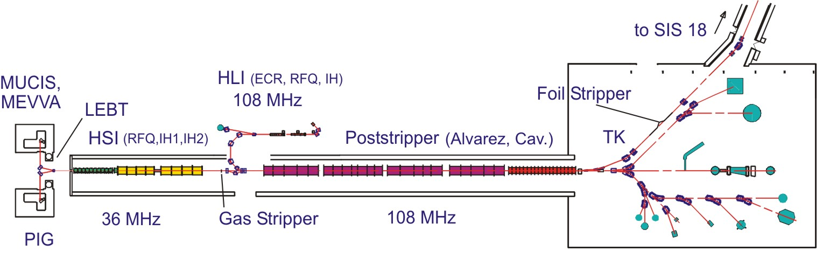
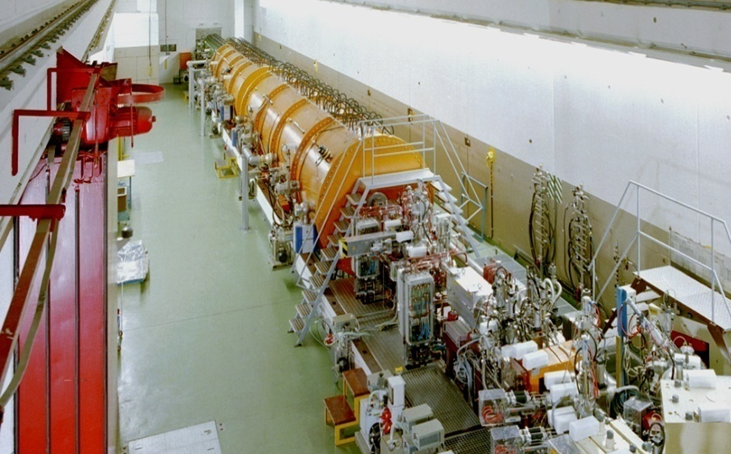
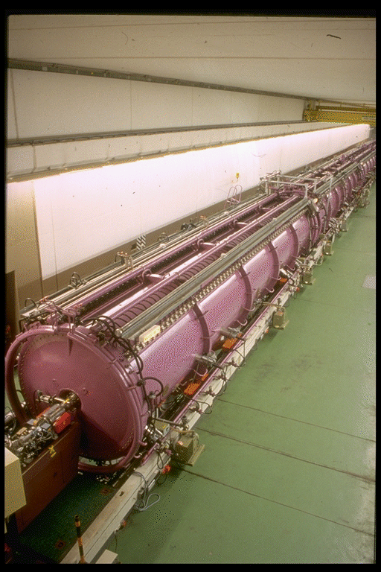
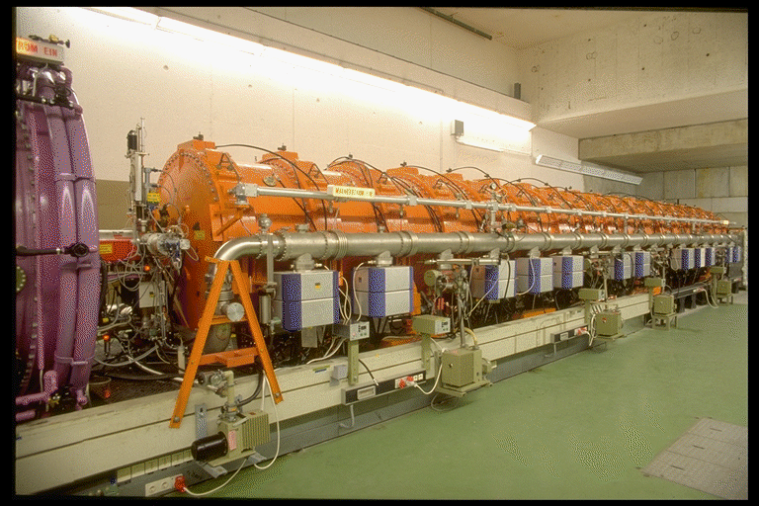
Introduction
The GSI UNIversal Linear ACcelerator
High Charge State Injector (1991)
High Current Injector (1999)
Alvarez (1975)
Single Gap Resonators (1975)

Slide 3
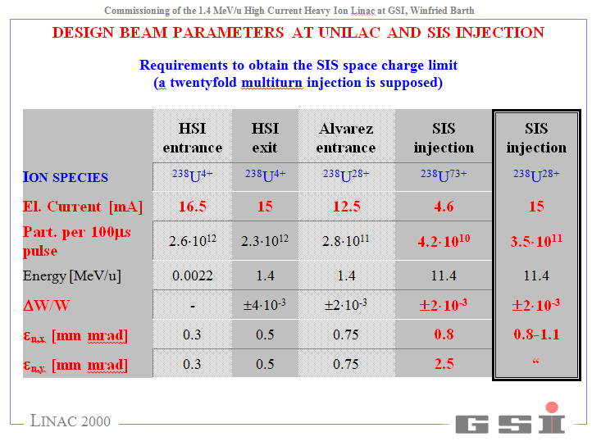
UNILAC-Design Beam Parameters
FAIR

Slide 4
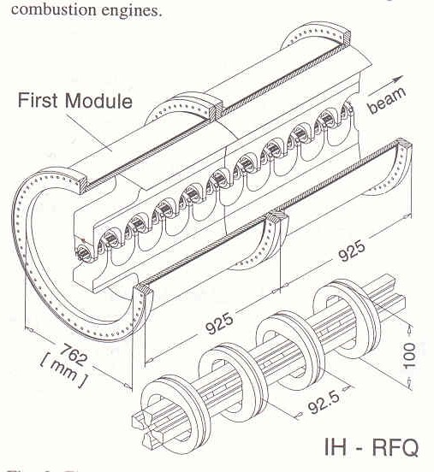
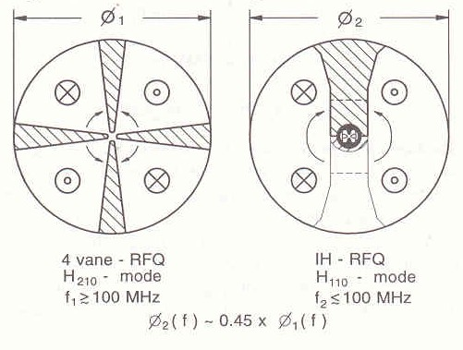
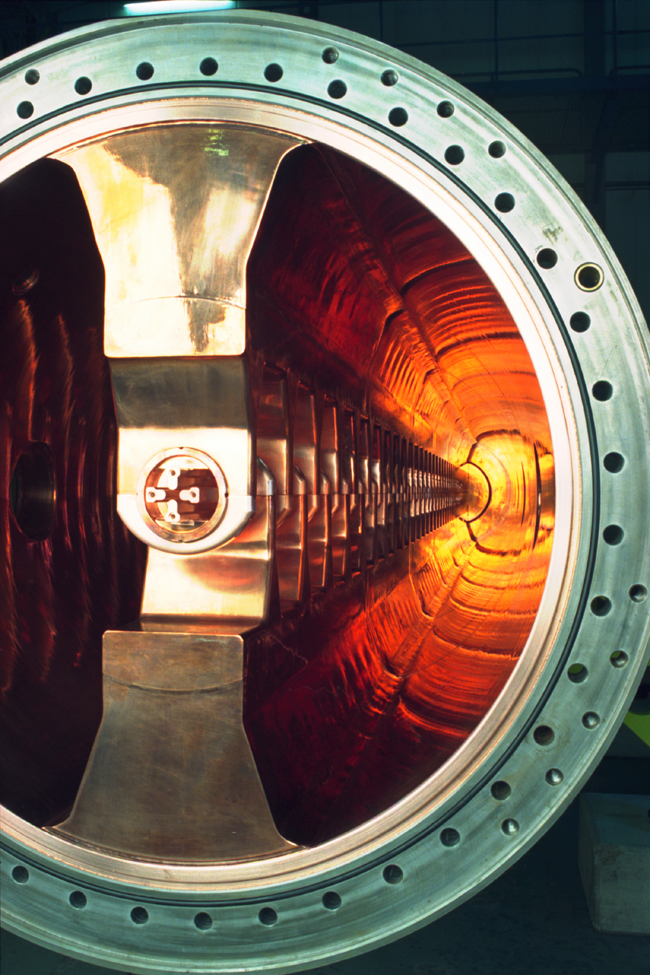
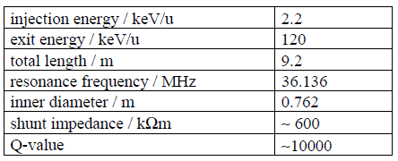
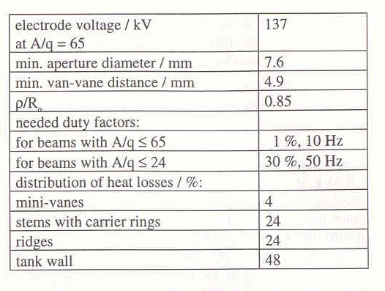
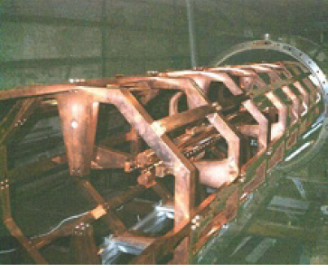
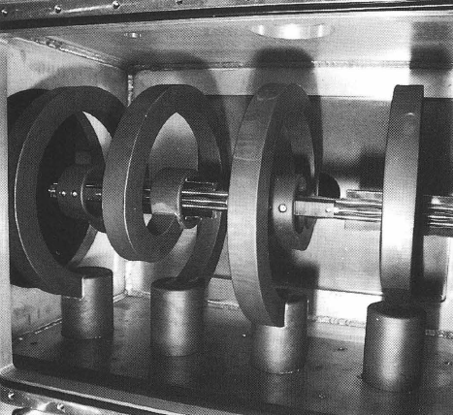
HSI-Radio Frequency Quadrupole (1999)
Für leeren Hohlraum mit R=1m, l=∞:
f(H₂₁₀)=146 MHz f(H₁₁₀)=87.9 MHz
Ring-connected resonant structure
A.A.Kolomiets, V.A.Andreev, D.A.Kashinsky, S.A.Minaev, V.I.Pershin, R.M.Vengrov, V.L.Zviagintsev, S.G.Yaramishev
27 MHz Spiral-RFQ
A. Kipper, A. Schempp

Slide 5
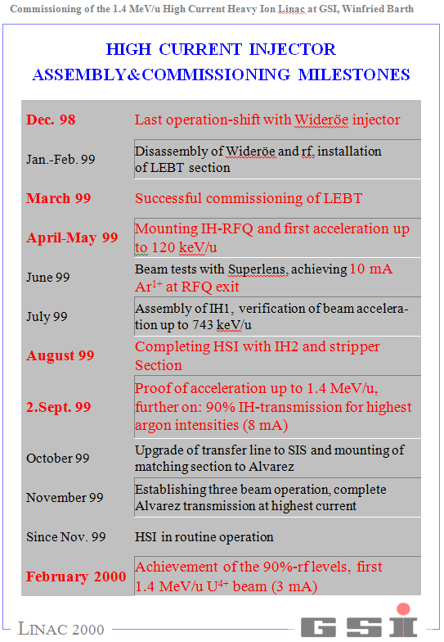
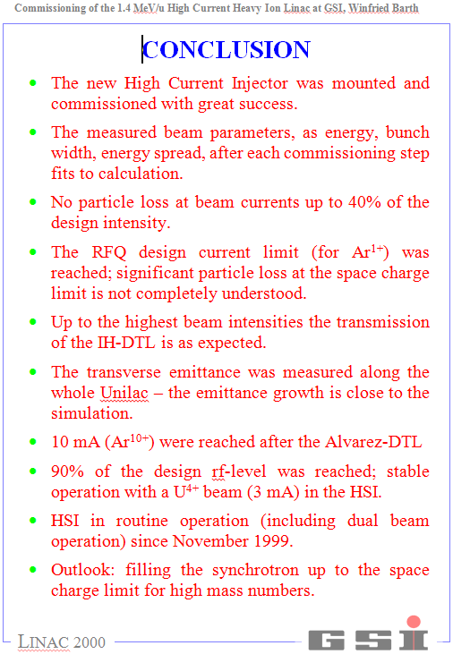
HSI-commissioning

Slide 6
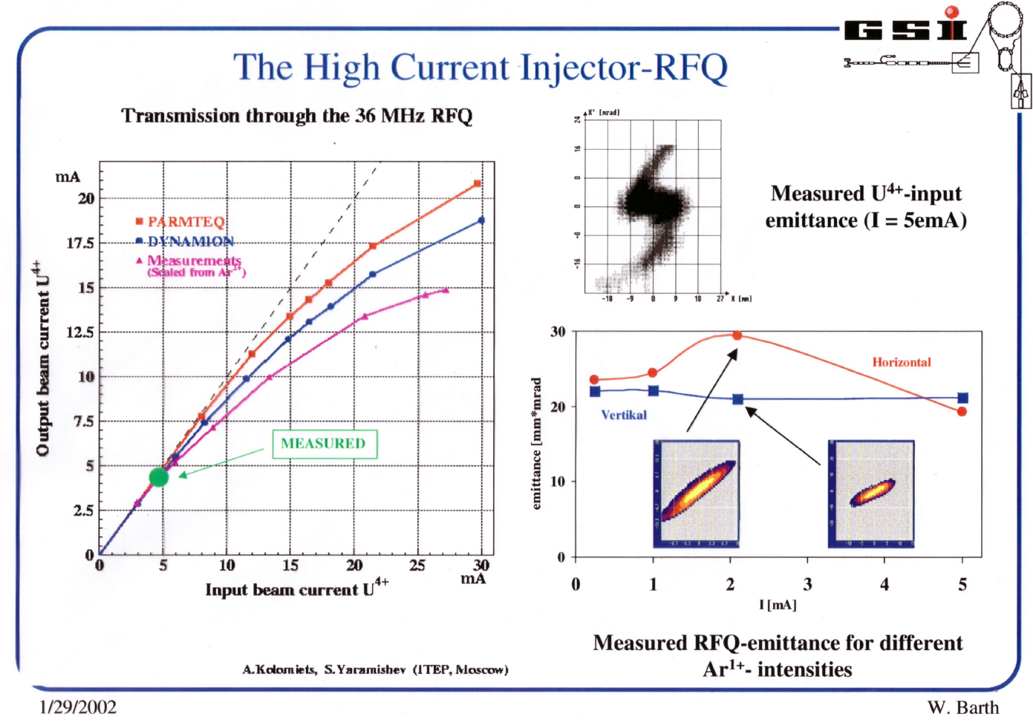
RFQ-Commissioning

Slide 7
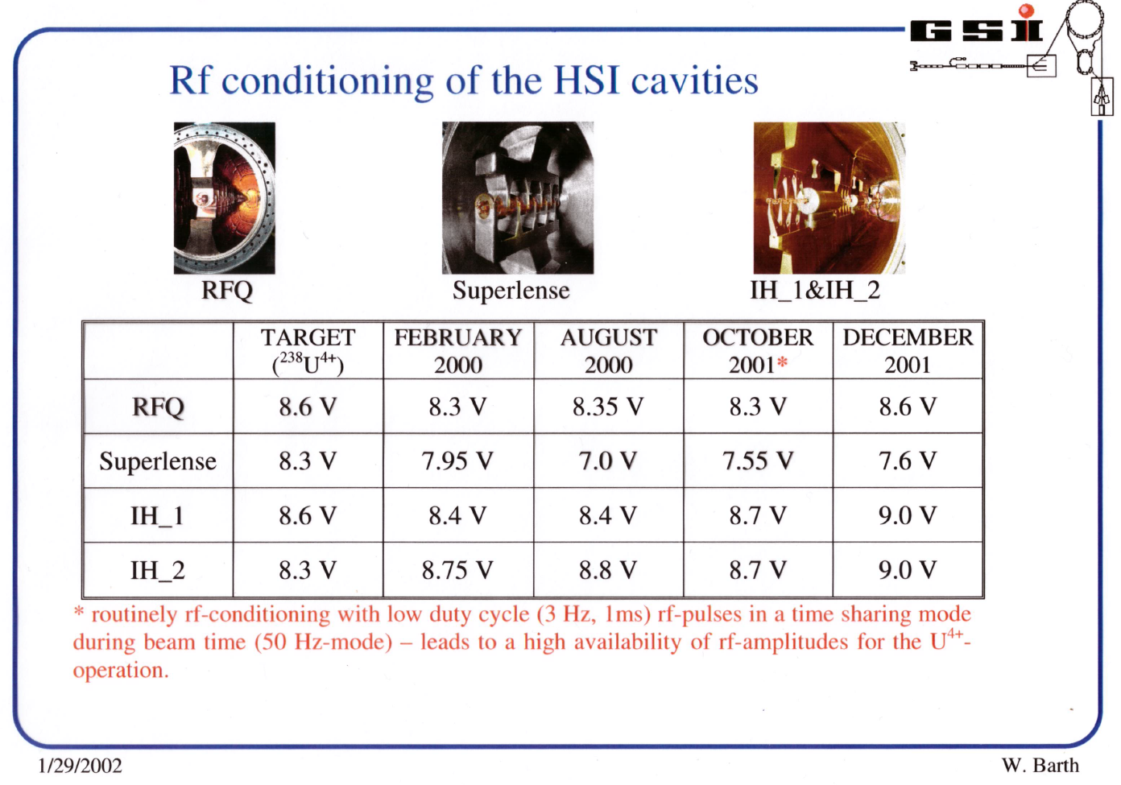
HSI-Conditioning

Slide 8
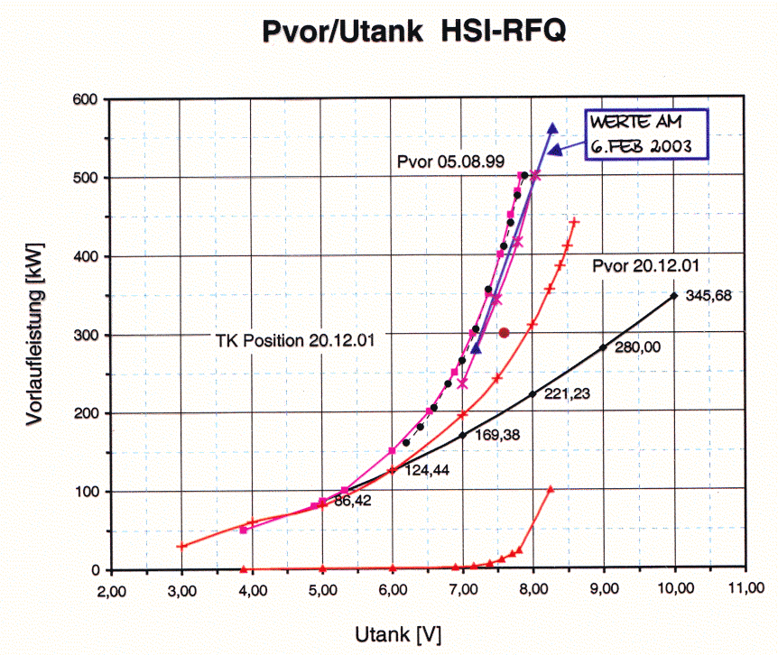
HSI-RFQ-RF-Conditioning (1999-2003)

Slide 9
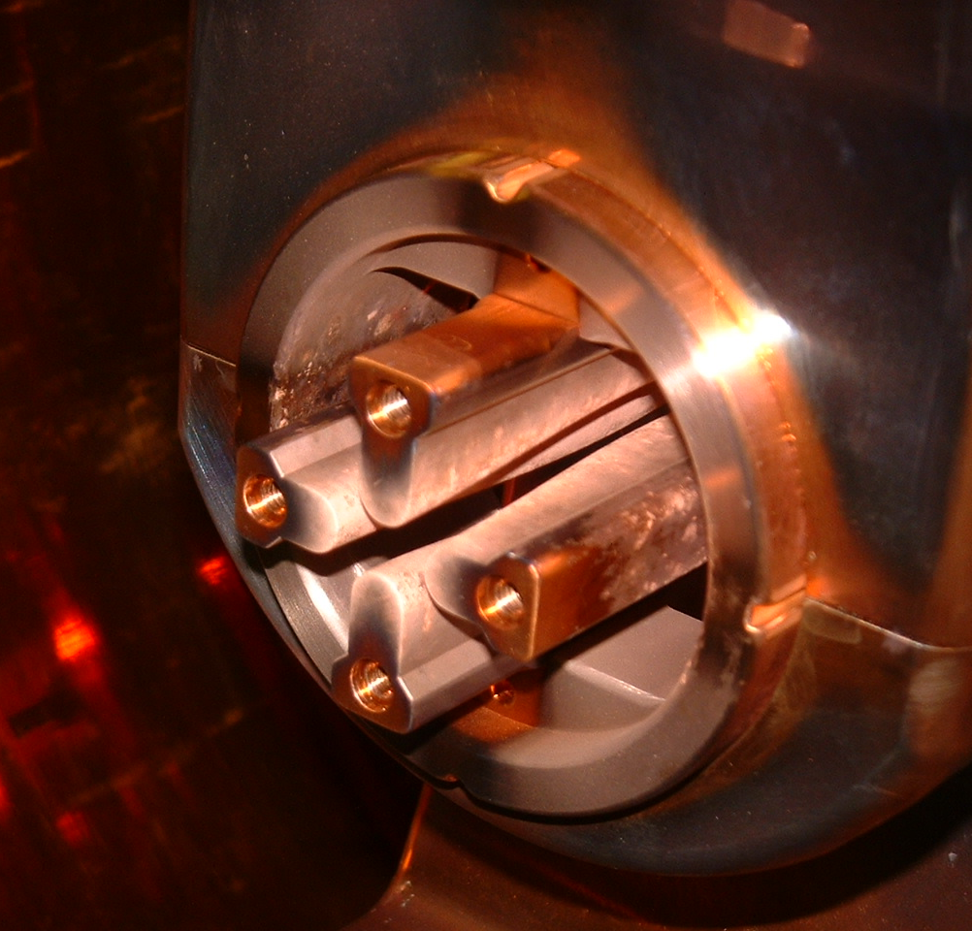
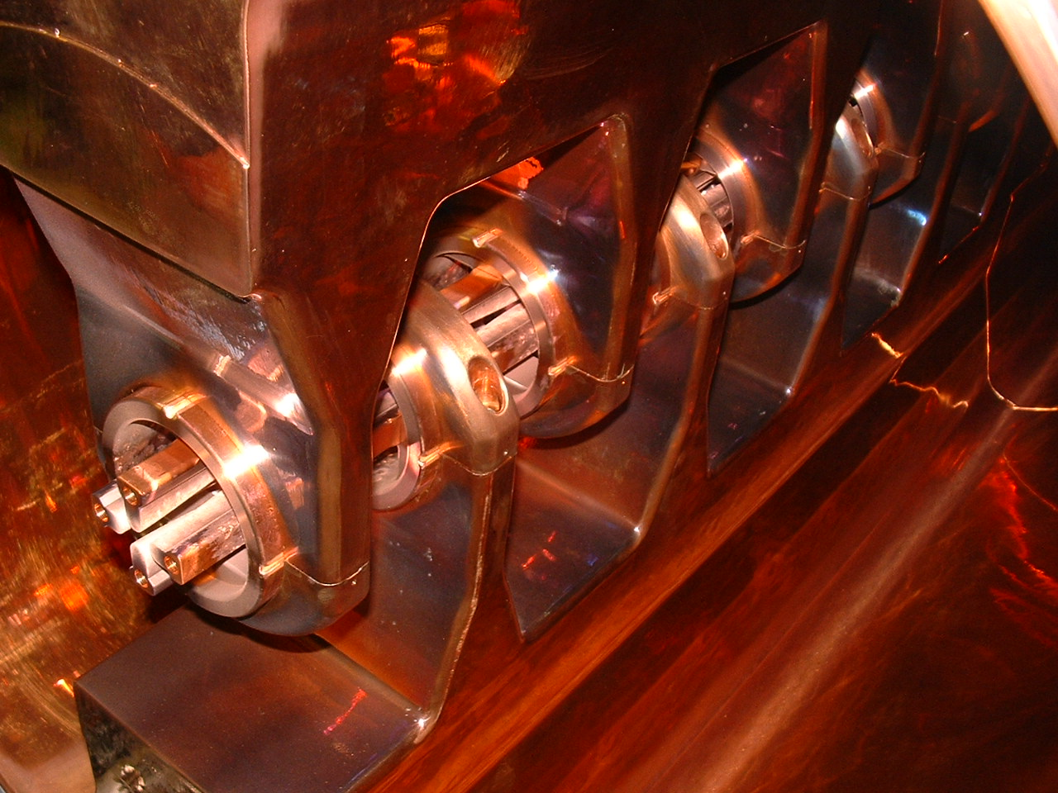
RFQ-Upgrade I (2004)

Slide 10
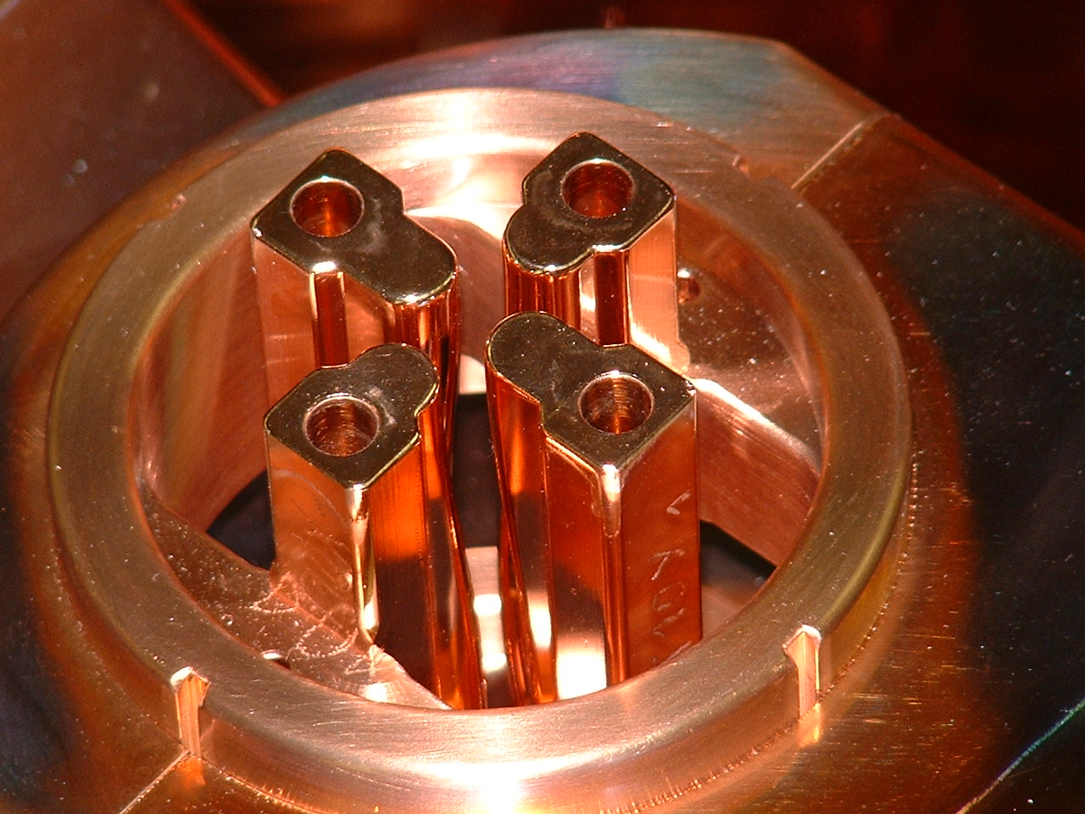
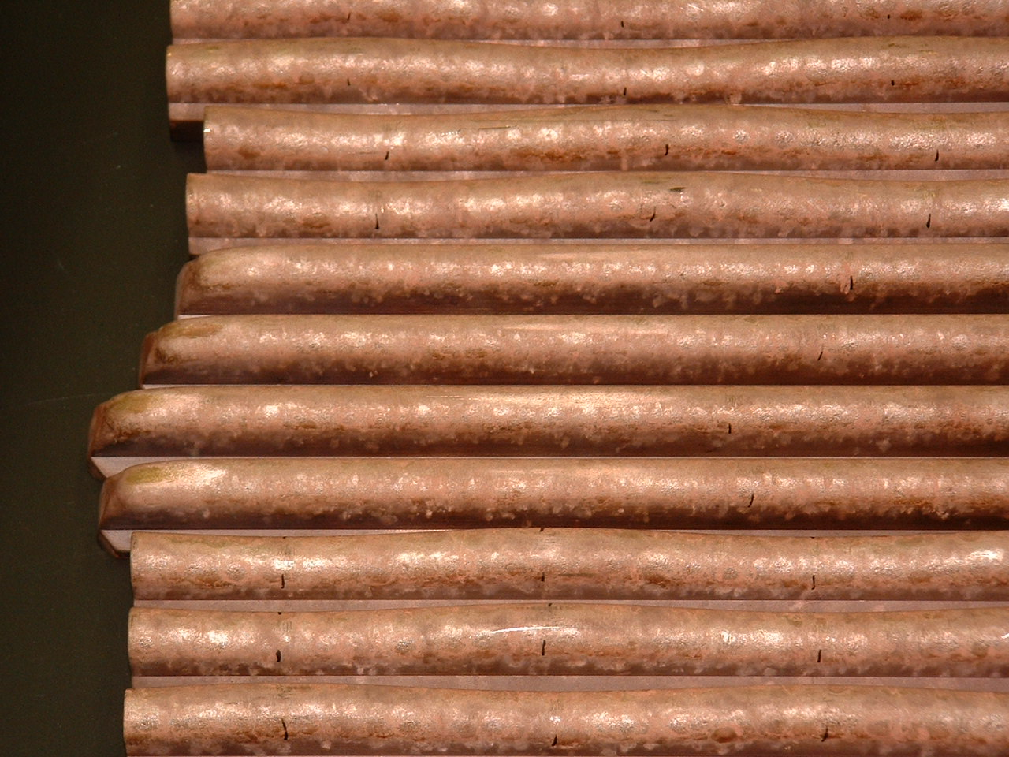
RFQ-Upgrade I: New electrodes
after assembly
after disassembly
before
copper plating

Slide 11
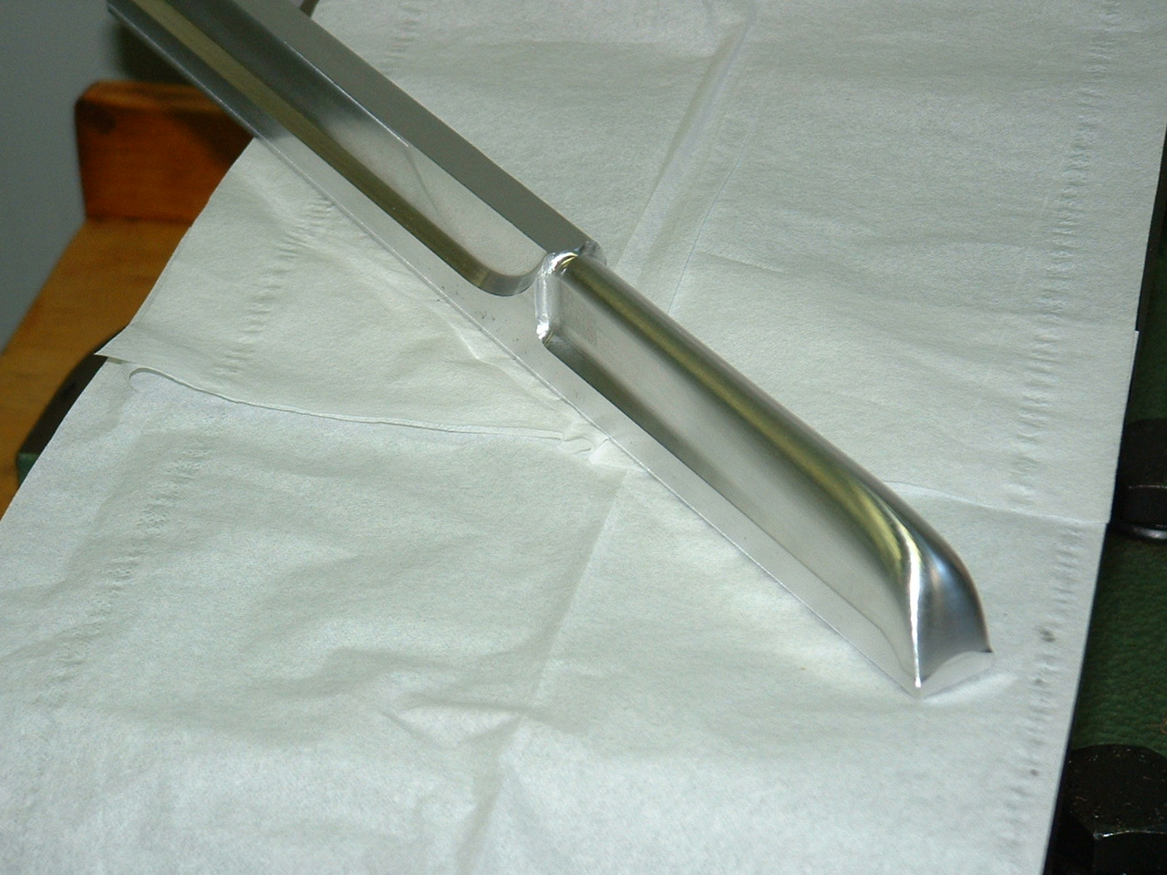
RFQ-Upgrade I: Modified IRM
Matching 99
Matching 04

Slide 12
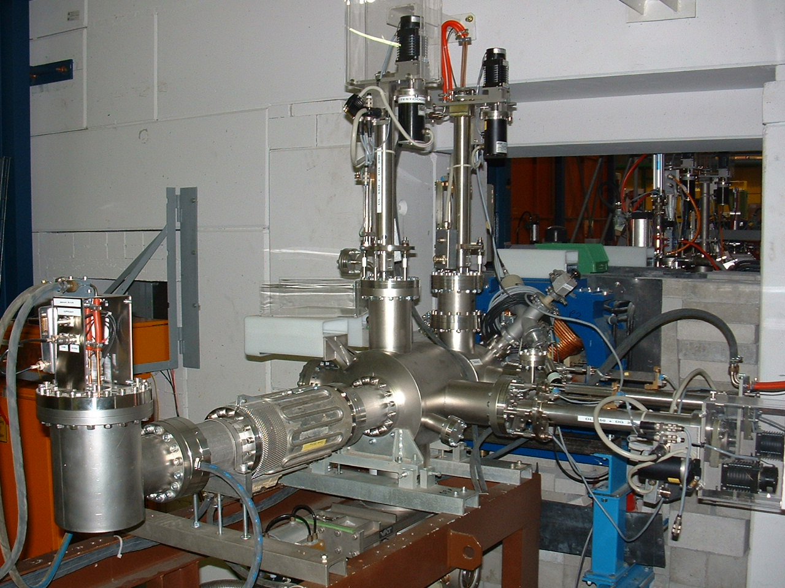
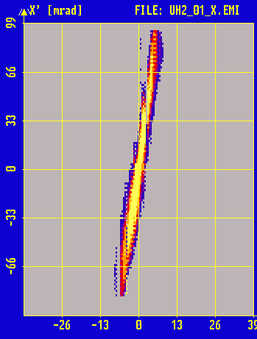
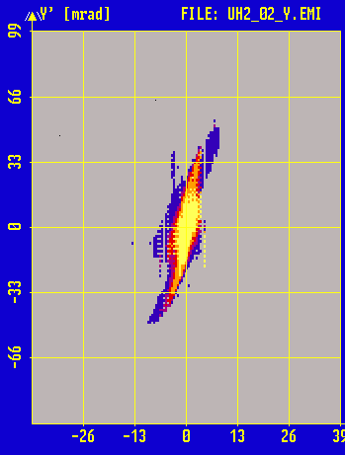
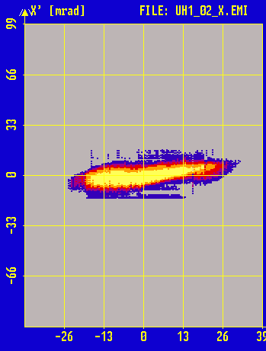
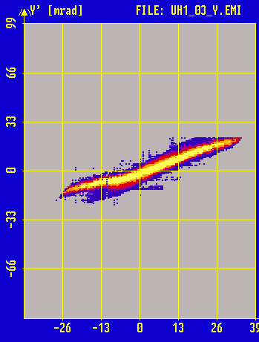
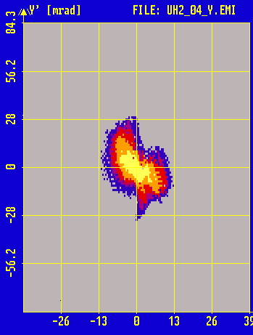
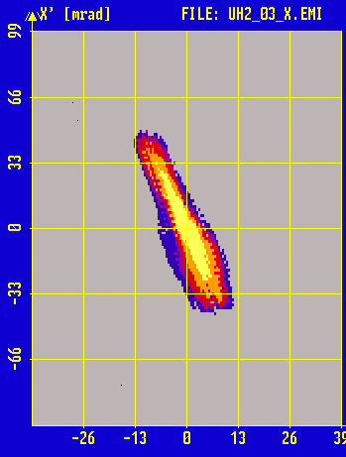
LEBT-QQ Beam Measurements
horizontal vertikal
99
Emittanzwachstum: -19 %/3 %
Transmission: 70 %/84 %
04
LEBT: ε_{x,90%} = 175 mm⋅mrad
ε_{y,90%} = 185 mm⋅mrad

Slide 13

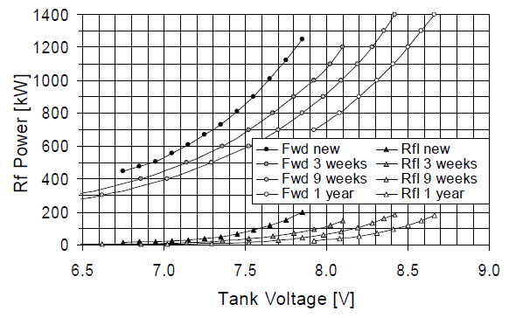
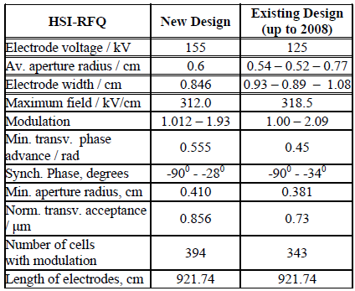
RFQ-Upgrade II (2009)
rf-voltage
(acceleration of U⁴⁺)
H. Vormann, et al., LINAC 2010

Slide 14
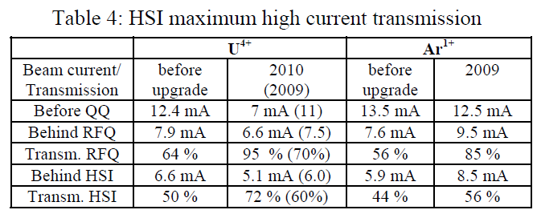
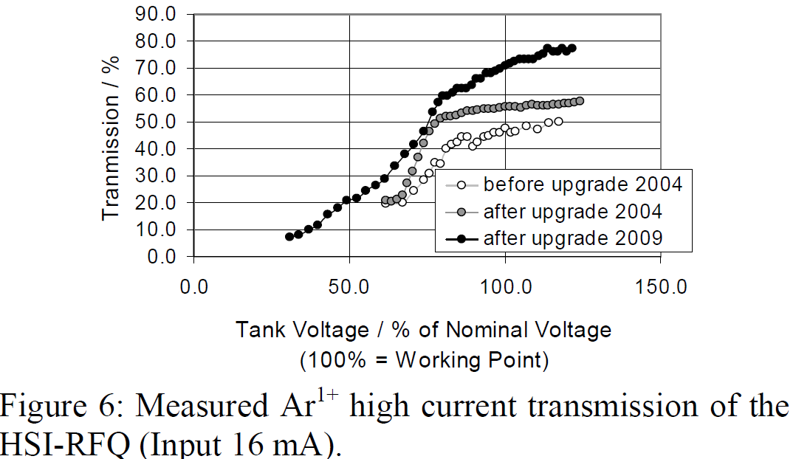
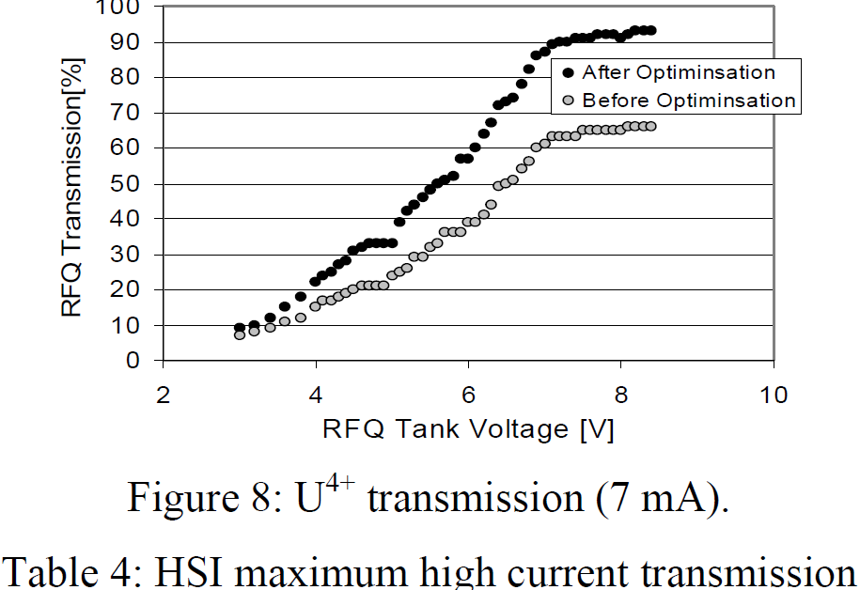
RFQ Upgrade II: Beam commissioning
H. Vormann, MOP040,
Linac 2010
100% HSI-beam transmission for low current beams from PIG ion source (long term operation)!

Slide 15
Further RFQ RF-Optimization (2014-2016)
surface degradation observed
after 3 years of operation (>2012)
rf-voltage
(acceleration of U⁴⁺)
RFQ-RF power levels (forward/reflected) 2010-conditioning periods & 2015 & 2016
2015
2016
H. Vormann, et al., LINAC 2010

Slide 16
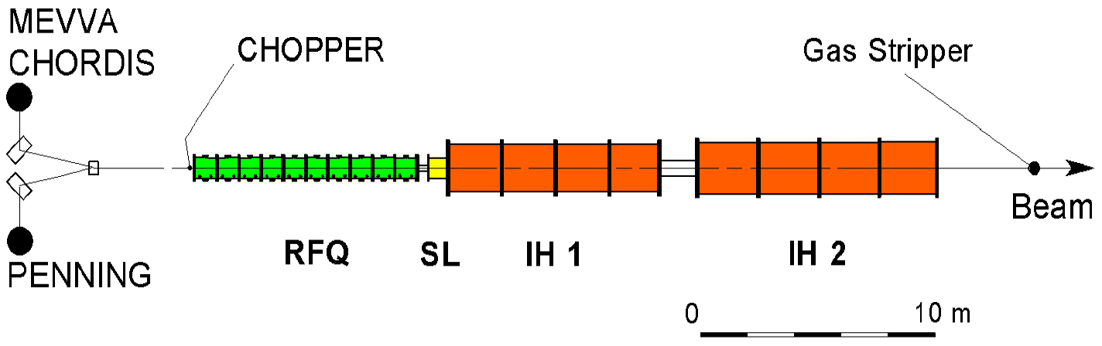
3. Pushing the limits for uranium beam operation
High Current Injector
Ion Source: Applying a multi-aperture (7-hole) extraction system at the VARIS ion source → Increased U⁴⁺-intensity and improved primary beam brilliance
Low Energy Beam Transport: Improved LEBT-performance and RFQ-Matching using high brilliance uranium beam from the VARIS → 75% RFQ-Transmission (I_{out} = 11.25 emA)
RFQ: RF optimization by adjusting plunger positions at the HSI RFQ tank and extensive rf-conditioning → Reduction of forwarded rf-power, yielding for reliable high-current uranium beam operation.
MEBT: Optimizing the between RFQ and IH DTL by increasing the transverse and longitudinal focusing strength (3%) → Reduction of beam loss, stable high current operation
1.4 MeV/u-Transport Line: Adapting the quadrupole channel (matching the gas stripper) → 90% beam transmission, U⁴⁺ beam current of 7.6 emA available for heavy ion stripping.

Slide 17
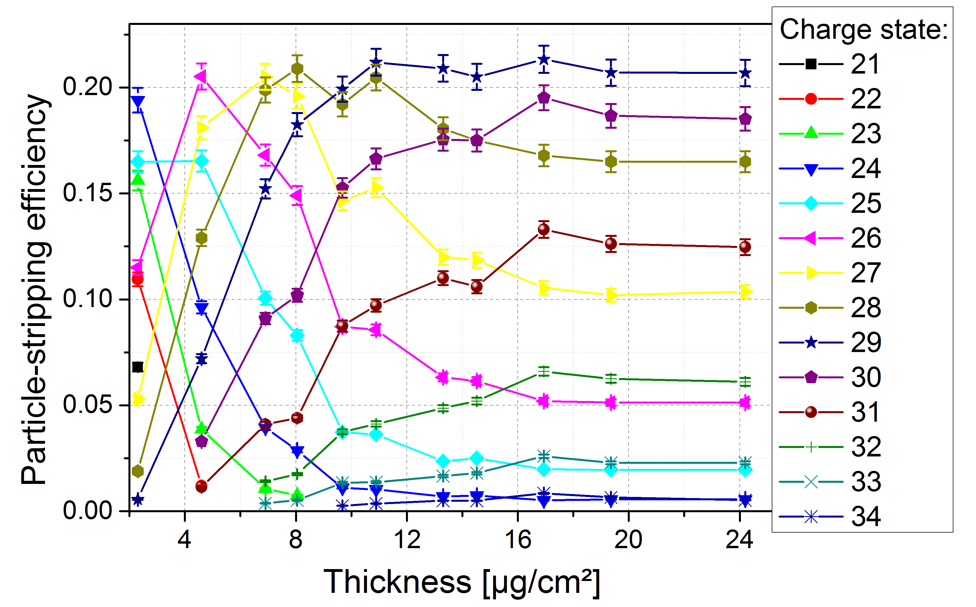
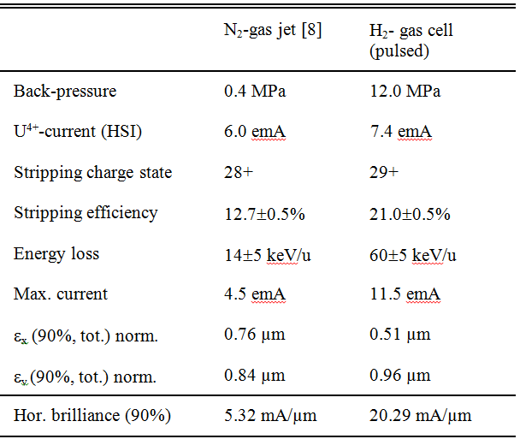
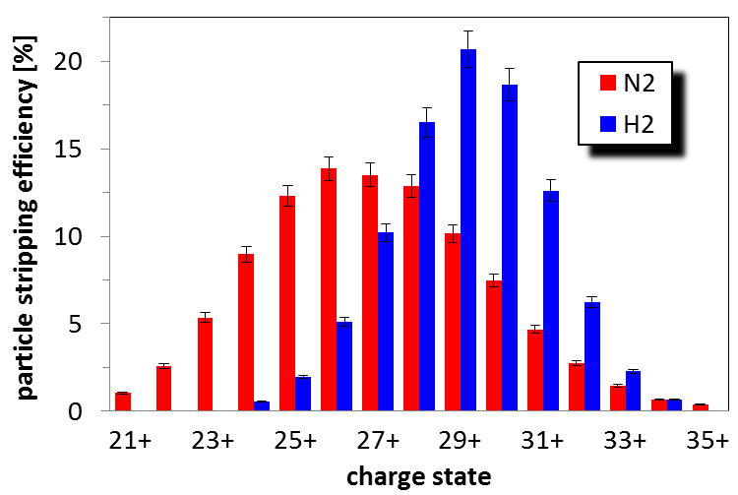
Particle Stripping Efficiency
Beam Parameters:
U²⁶⁺ → U²⁹⁺
N₂
H₂
average: 4.65 mA/µm 18.37 mA/µm
Beam Energy Loss:
U²⁸⁺ | N₂-jet (max.) | 14±5 keV/u
U²⁸⁺ | Pulsed H₂-stripper cell (7.5 MPa) | 35±5 keV/u
U²⁹⁺ | Pulsed H₂-stripper cell (12.0 MPa) | 60±5 keV/u

Slide 18
Comparison of HSI-Transmission
RFQ-Transmission: 75%
RFQ-Transmission: 60%

Slide 19
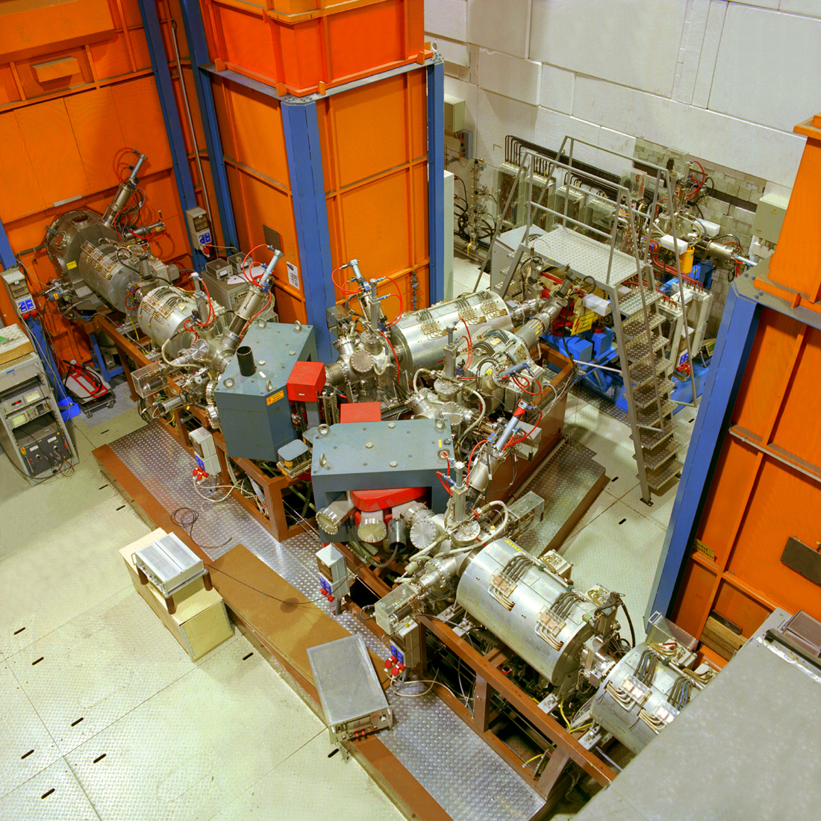
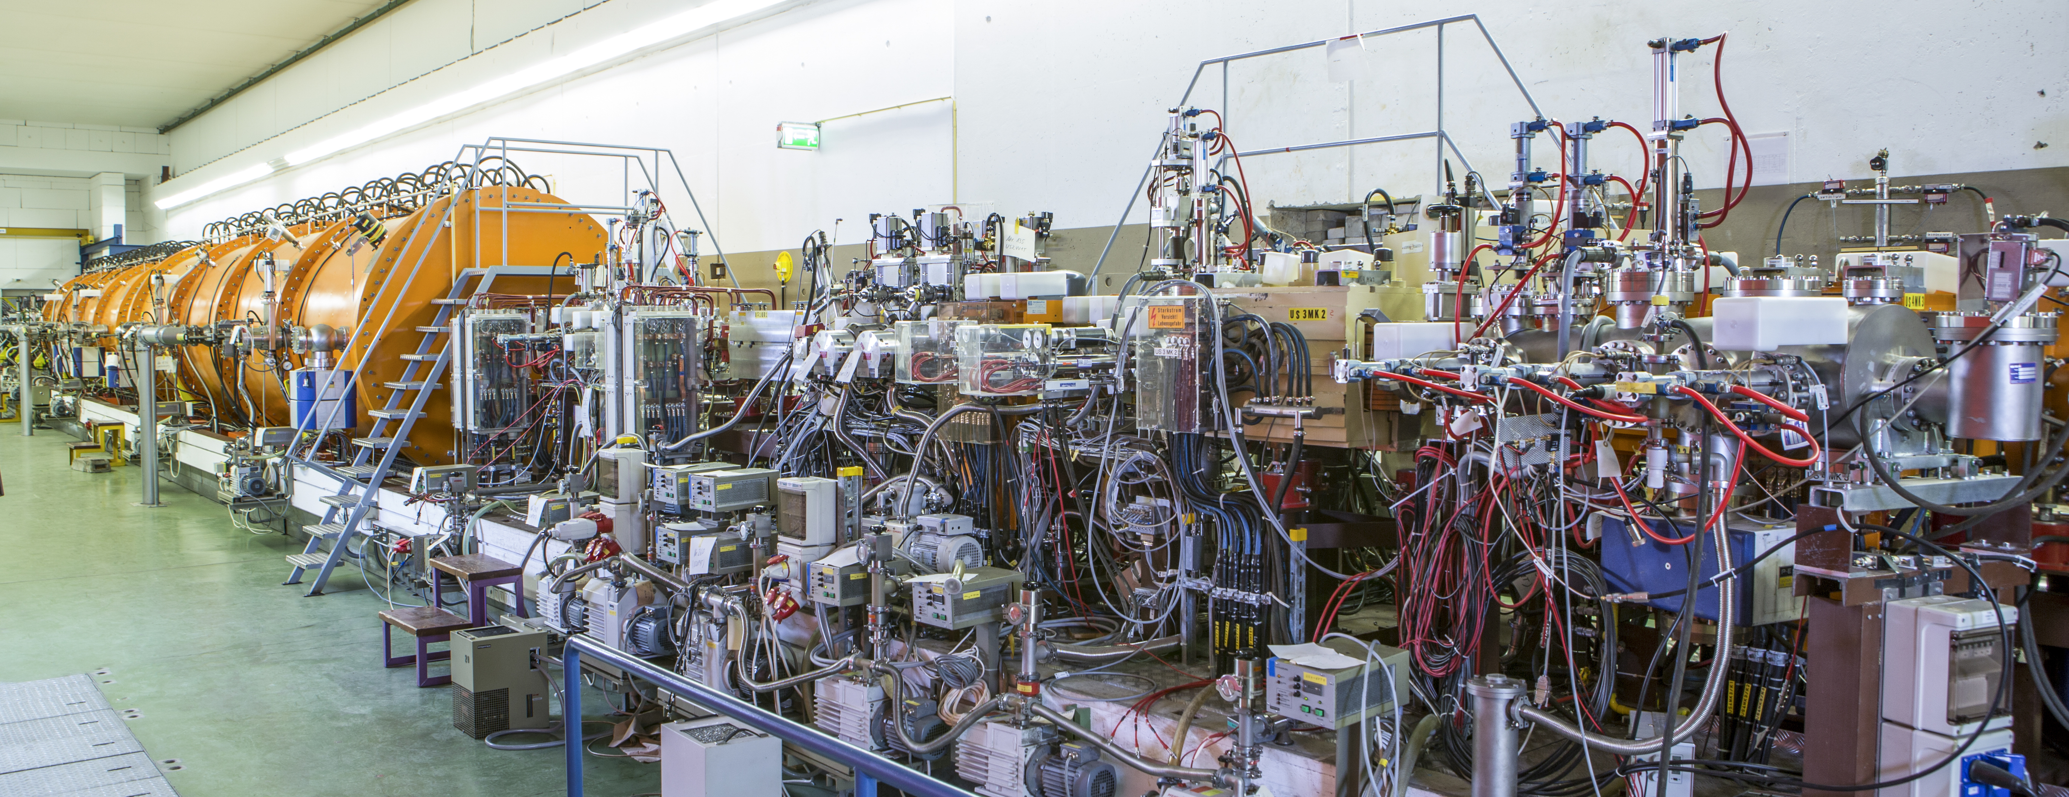
Uranium High Current Injector-Performance
W. Barth, et al., Phys. Rev. ST Accel. & Beams 20, 050101 (2017)

Slide 20
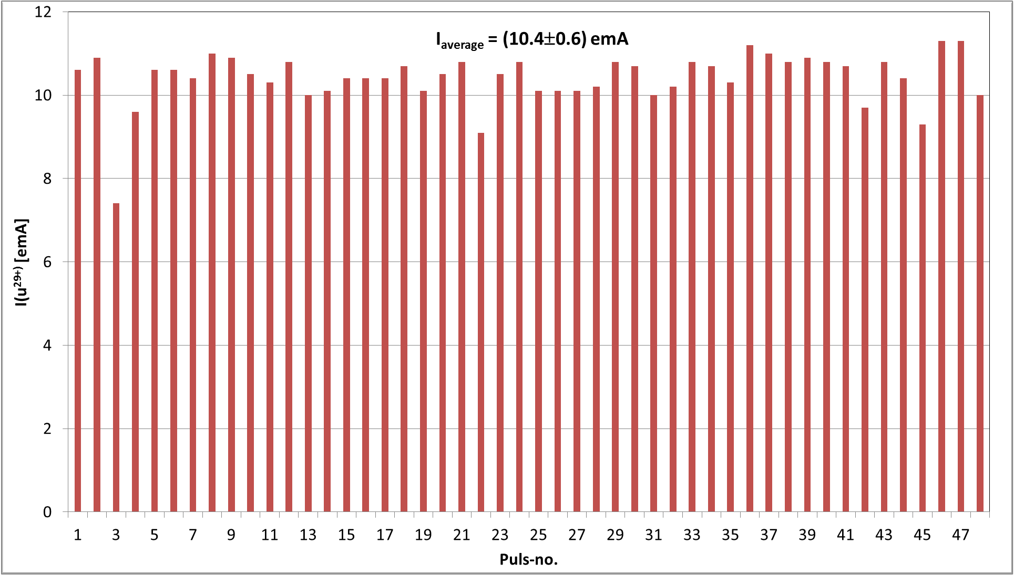
²³⁸U²⁹⁺-Current Measurements at 1.4 MeV/u

Slide 21
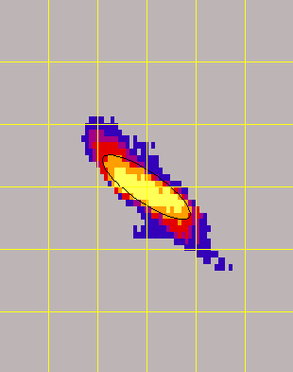
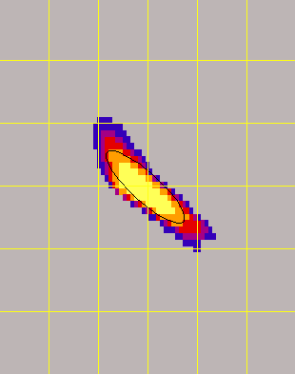


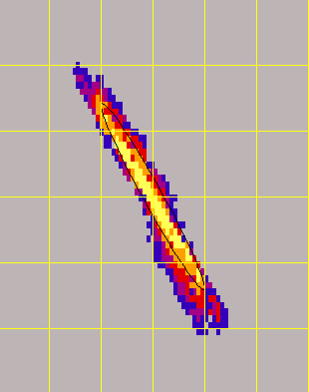
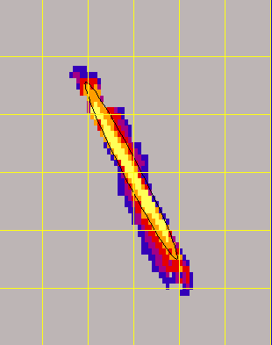
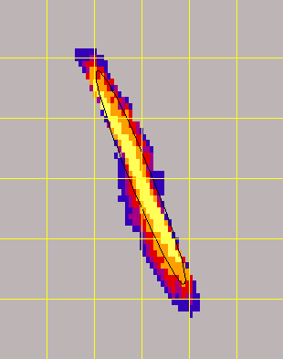
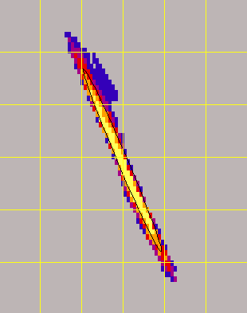
U²⁸⁺ beam emittance at 1.4 MeV/u
15
0
-15
4.5emA
(U²⁸⁺⁾
N₂
H₂
7.80emA
(U²⁸⁺⁾
H₂
9.97emA
(U²⁹⁺⁾
H₂
11.5 emA
(U²⁹⁺⁾
X‘ [mrad]
horizontal
ε_{norm.,tot,90%} = 0.51 mm⋅mrad
-20 0 20
X [mm]
-20 0 20
X [mm]
-20 0 20
X [mm]
-20 0 20
X [mm]
15
0
-15
N₂
H₂
H₂
H₂
Y‘ [mrad]
vertcal
ε_{norm.,tot,90%} = 0.96 mm⋅mrad
-20 0 20
Y [mm]
-20 0 20
Y [mm]
-20 0 20
Y [mm]
-20 0 20
Y [mm]

Slide 22
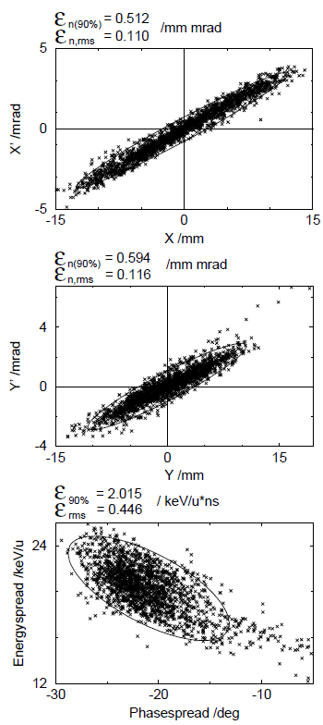


HSI-IH2-Simulationen
15
0
-15
H₂
11.1 emA
(U²⁸⁺⁾
X‘ [mrad]
ε_{norm.,tot,90%} = 0.51 mm⋅mrad
U. Ratzinger, „The New GSI Prestripper Linac for High Current Heavy Ion Beams”, LINAC96, Geneve, France, p. 288-292 (1996)
-20 0 20
X [mm]
0.026 MeV/u•deg
LINAC2000
ΔB = B_{gem}/B_{design} = 1.18

Slide 23


Beam emittance analysis
... fixed relative fraction
... fixed particle number
0.45 μm

Slide 24
Fractional Beam Brilliance for a fixed Particle Number I = 3 emA
... fixed particle number
ΔI = 1 emA → ΔB_{x} = 4.3 [mA/μm]
(for a fractional current of 3 emA)

Slide 25

Beam Brilliance analysis

Slide 26



High intensity proton beam acceleration at GSI UNILAC
How to use a heavy ion machine for acceleration of high intensity proton beams?
Ion source
C⁶⁺ acceleration (9 emA)
CH₃⁺ acceleration
Use of HSI heavy ion beam capabilies to acclerate hydro-carbon compounds
Cracking of CH-compounds
+ Stripping
p⁺ acceleration (3 emA)

Slide 27
High intensity proton beams at GSI-UNILAC
2014-2015
3 mA, p+ (UNILAC) => 1.5e12 (SIS18) => 25% of FAIR-requirement

Slide 28
Front to end emittance-measurements
17% emittance growth (rms)!
W. Barth, et al., Phys. Rev. ST Accel. & Beams 18, 050102 (2015)

Slide 29

Emittance Beam Analysis
Proton beam emittance
Uranium beam emittance
rescaled

Slide 30
Summary
RFQ-commissioning (1999) successfully accomplished with high current argon beam
First uranium (4+) beam commissioning in 2000 after careful rf-conditioning
RFQ-Upgrade I (2004) after significant surface degradation during 5 years operation; newly designed IRM; increased beam transmission
RFQ-Upgrade II (2009) after again significant surface degradation during 5 years operation; copper plated electrodes; new electrode design with increased rf-voltage and aperture and slightly reduced max. field; increased beam transmission
No electrode exchange since 10 years! Almost 18 months of shutdown (2016 - 2018).
Despite further surface degradations the RFQ RF-performance could be dramatically improved: 600kW forwarded power at U⁴⁺ voltage level.
As a result a new record RFQ high current Uranium beam intensity (11.25 emA) at sufficiently high beam transmission (75%) has been achieved in 2016.
The horizontal Uranium beam brilliance growths strongly with the beam intensity; for higher currents the core of the uranium phase space distribution perhaps remains constant during acceleration and beam transport
World record U²⁸⁺ beam intensity (11.1 emA) at low emittance (1.4 MeV/u)
The conducted high current proton beam emittance measurement throughout the UNILAC shows a loss of horizontal beam brilliance of 23%
Remark: Beam intensity attenuation concept (LEBT-QQ) => permanent particle loss inside RFQ during beam operation!

Slide 31
Thank You for Your Attention!

