Slide 1
Optical and raster electron microscopy of RFQ electrode surfaces of the GSI UNILAC high current injector RFQ after various treatments
P. Gerhard, H. Vormann, L. Groening, S. Mickat (GSI Linac Dept.)
B. Lommel, M. Bender, B. Kindler, A. Hübner, V. Yakusheva (GSI Target Lab)
T. Luckhardt (GSI Beam Diagnostics)
Workshop „High Intensity RFQ meets Reality”, Heidelberg 15.-16. April 2019

Slide 2
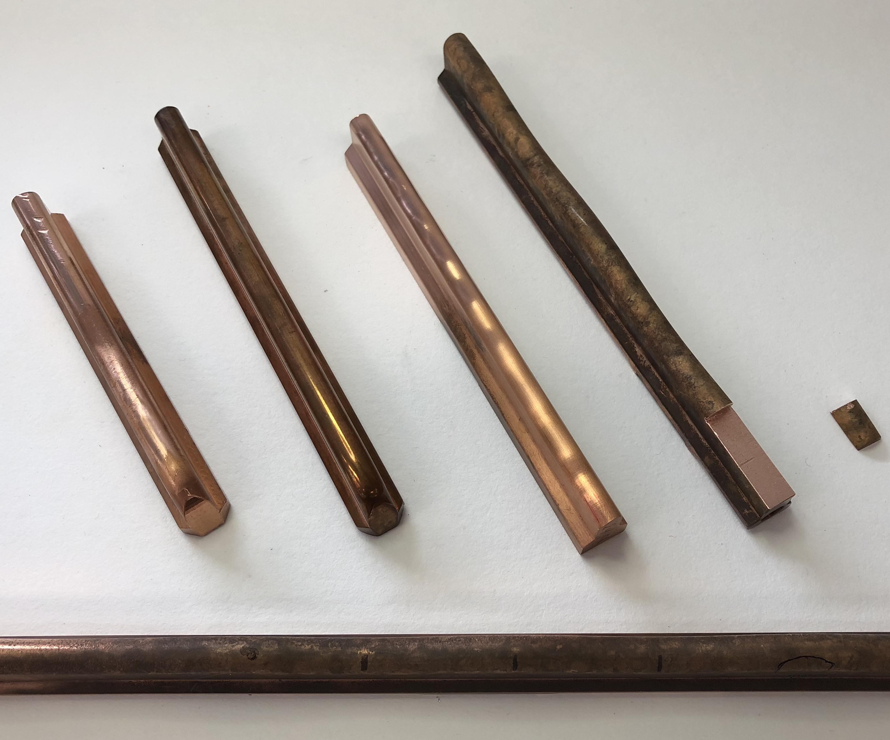
Microscopy of RFQ electrode surfaces: The samples
Candidate | Year of fabrication | History |  |  |  | Surface roughness*
 |  | Milled | Polished | Cu plated | Used | Ra /µm | Rmax /µm
S1 | 2019 | Yes | No | No | No | 0,2-0,3 | 1,9-2,6
S2 | 2019 | Yes | Yes | No | No
S2a | 1999 | Yes | Yes | No | No
S3 | 2004/09? | Yes | Yes | Yes | No | 0,2 | 3,7-4,9
S4 | 2004 | Yes | Yes | Yes | Yes | 2,5-2,9 | 25-29
S5 | 1999 | Yes | (Yes) | No | Yes | 2,5-2,9 | 25-29
From roughness measurements:
Roughness used ~ 10x new
Cu plating makes no difference
How do the surfaces look like?
S2
S2a
S3
S4
S1
S5
*: Measurements courtesy S. Mickat, taken from similar, but not necessarily the same samples/spots

Slide 3
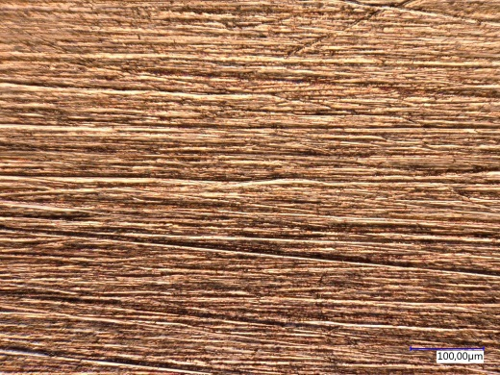
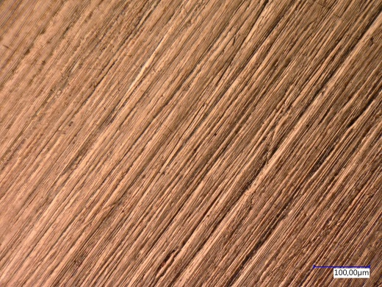
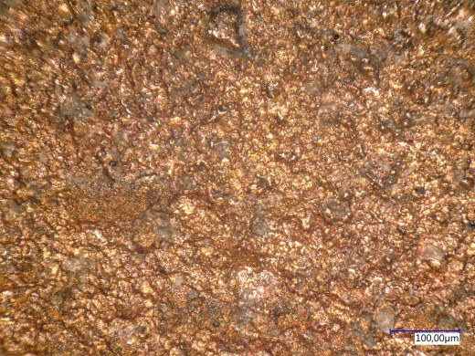
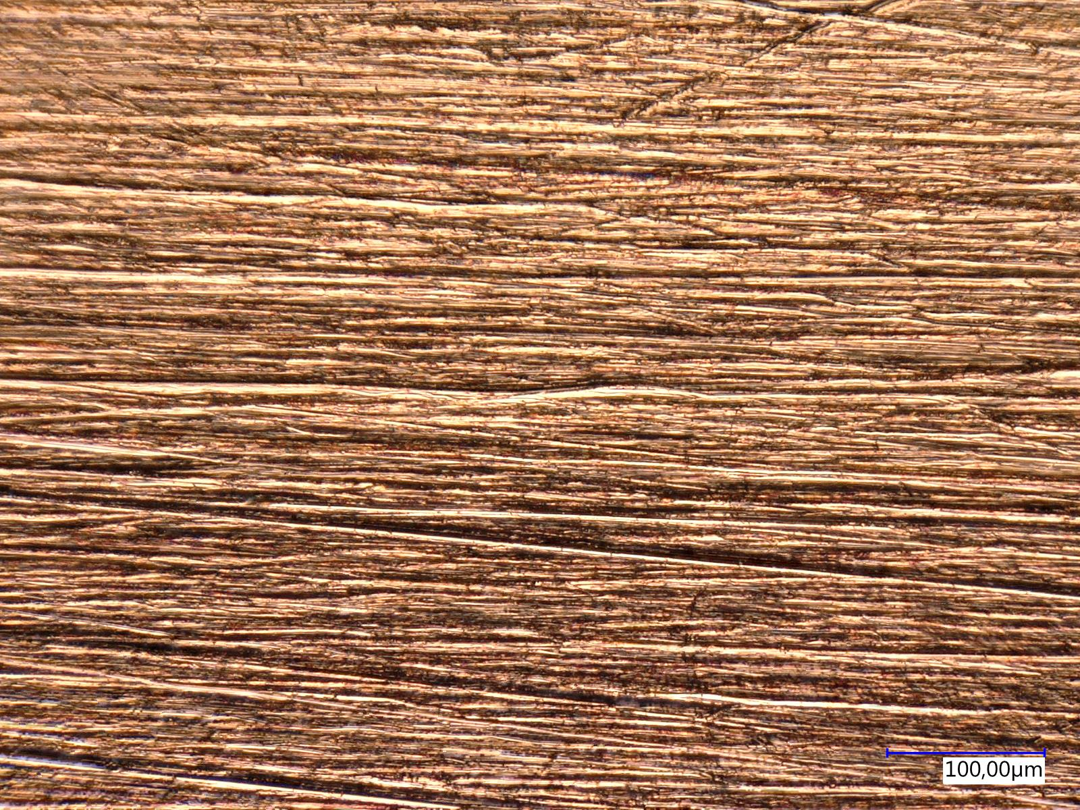
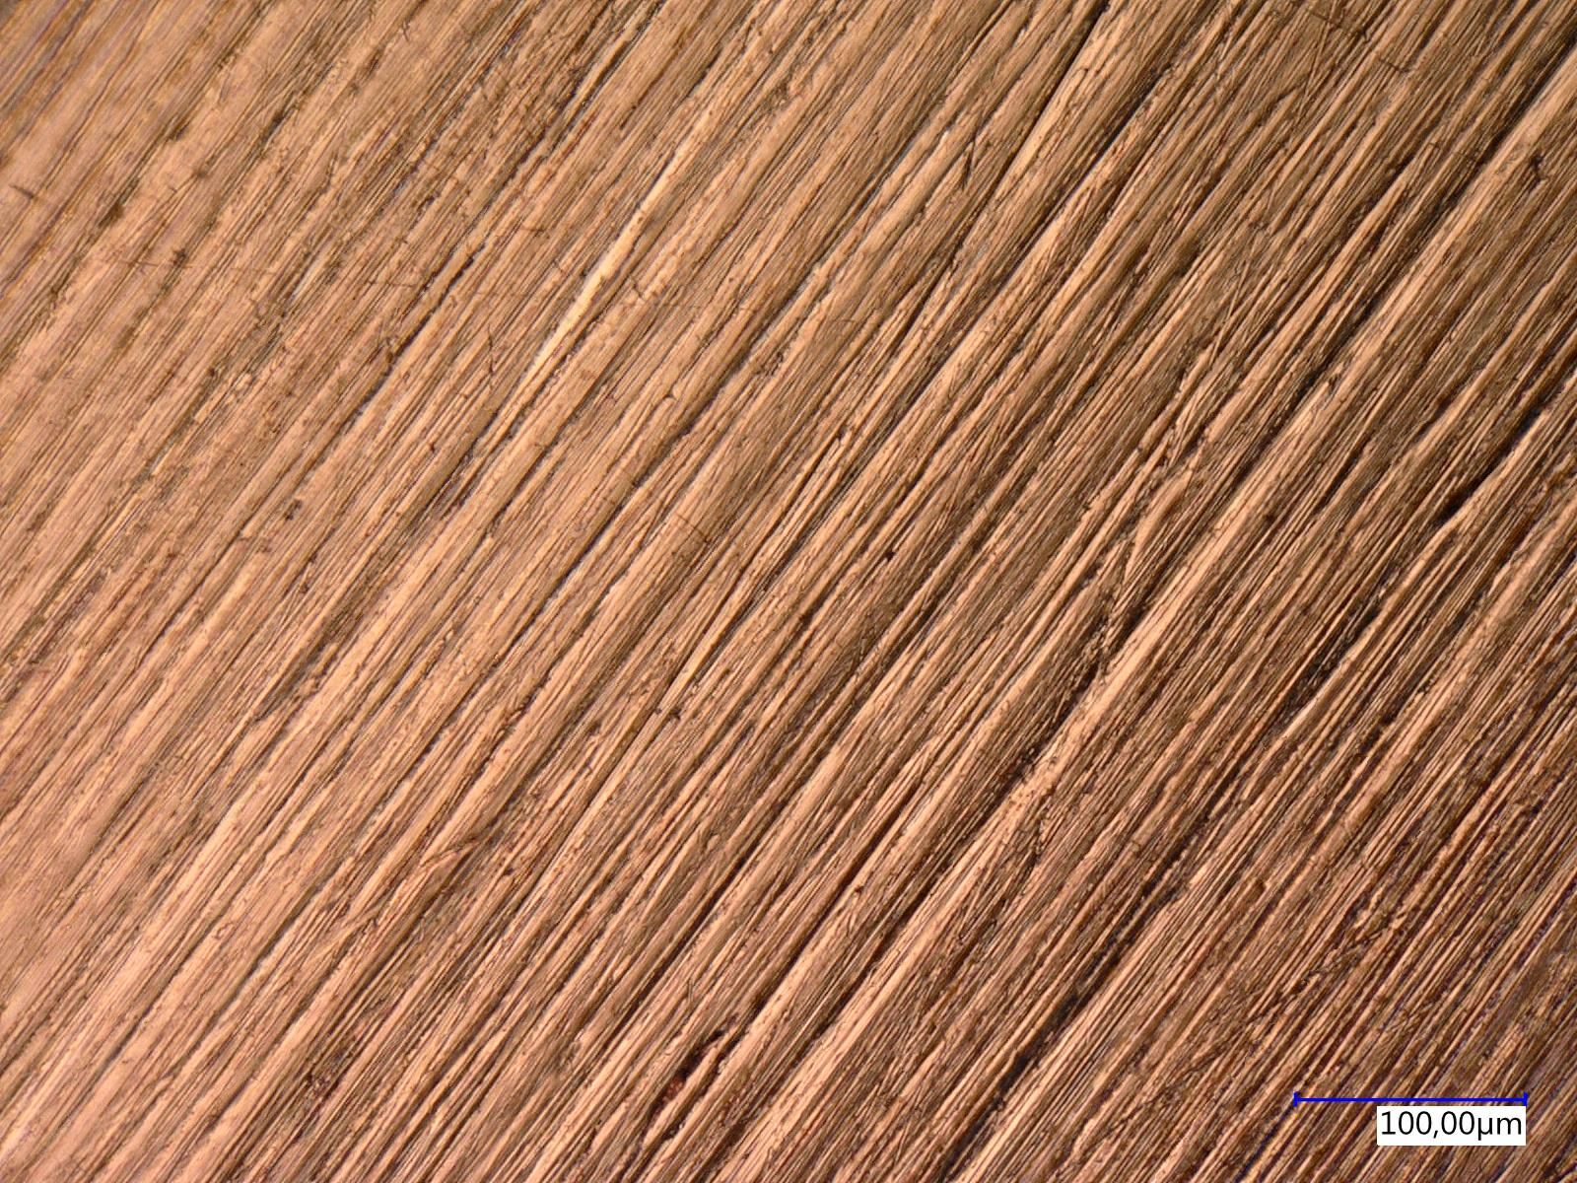
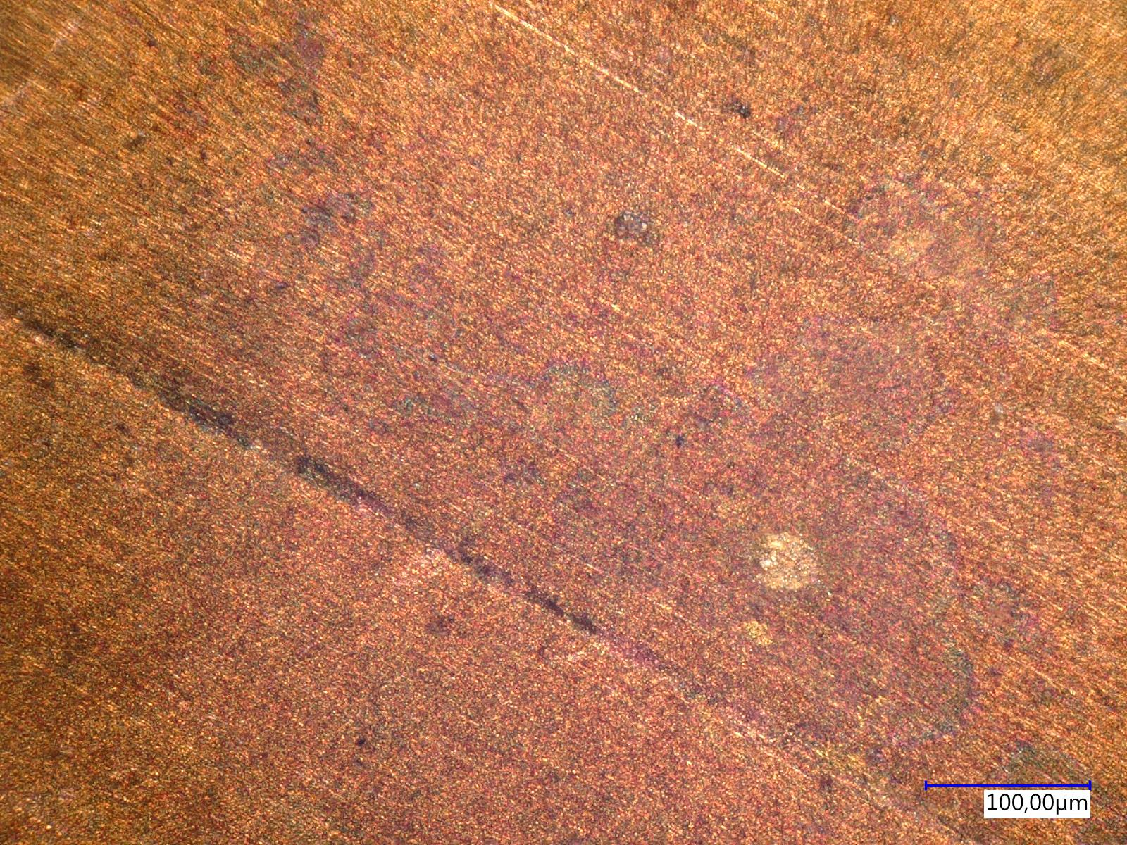
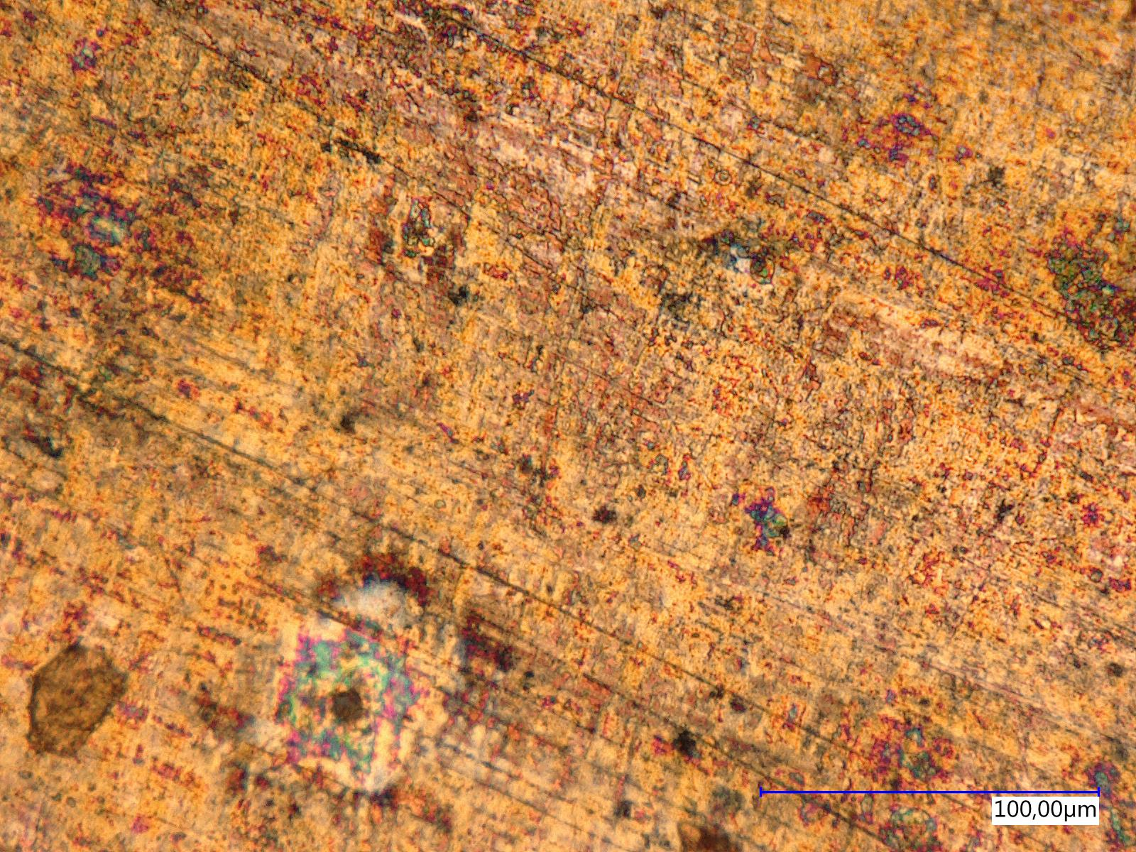
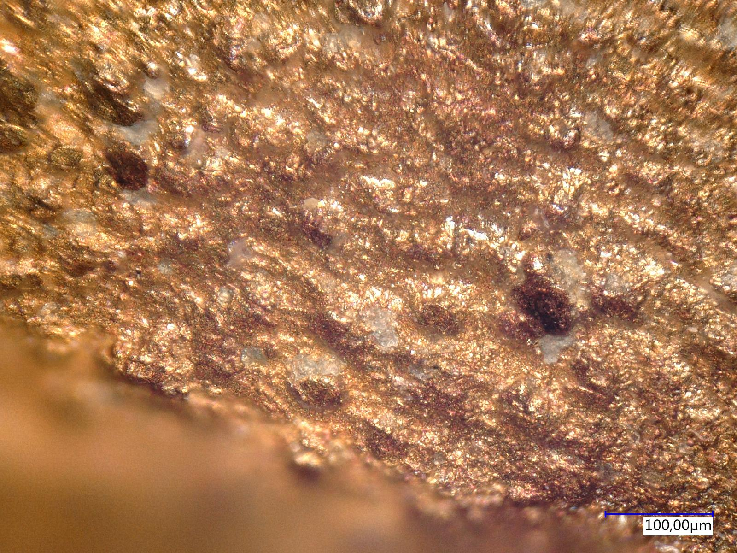
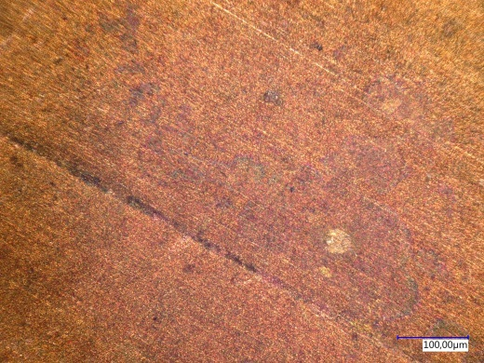
Microscopy of RFQ electrode surfaces: Milled, polished, Cu plated, and used
S1: milled
S2: milled, polished
S4: milled, polished, Cu plated, used
S3: milled, polished, Cu plated
S4: milled, polished, Cu plated, used
S3: milled, polished, Cu plated
S3: milled, polished, Cu plated
S2: milled, polished
S1: milled
S4: milled, polished, Cu plated, used

Slide 4
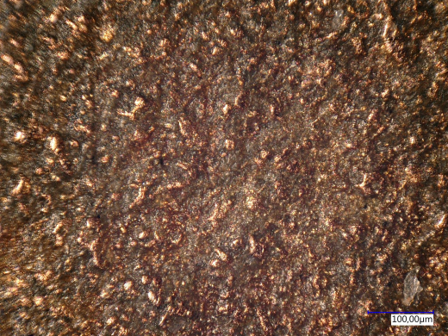
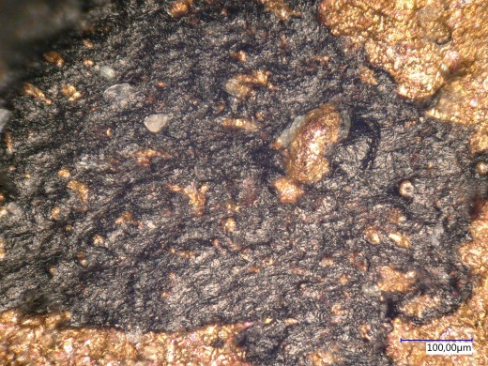
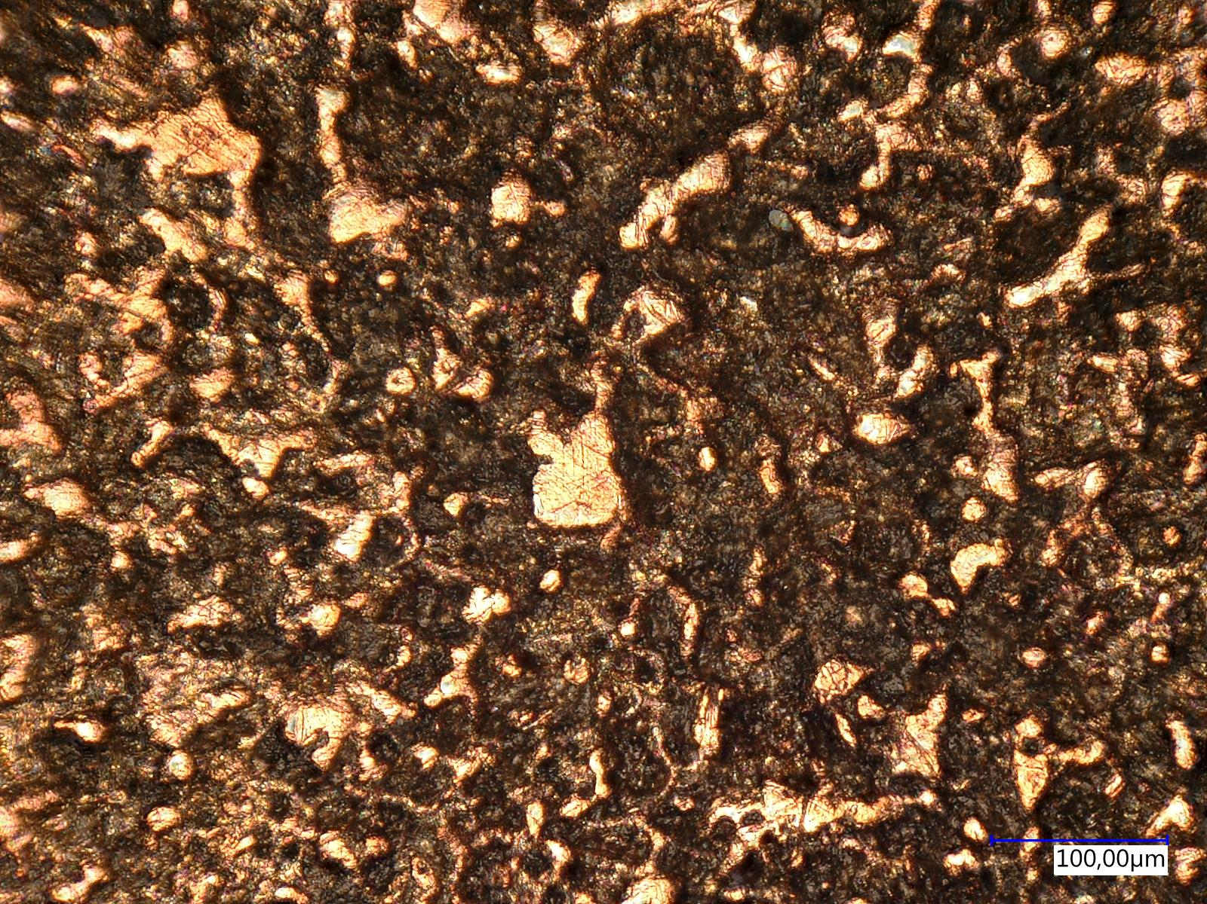
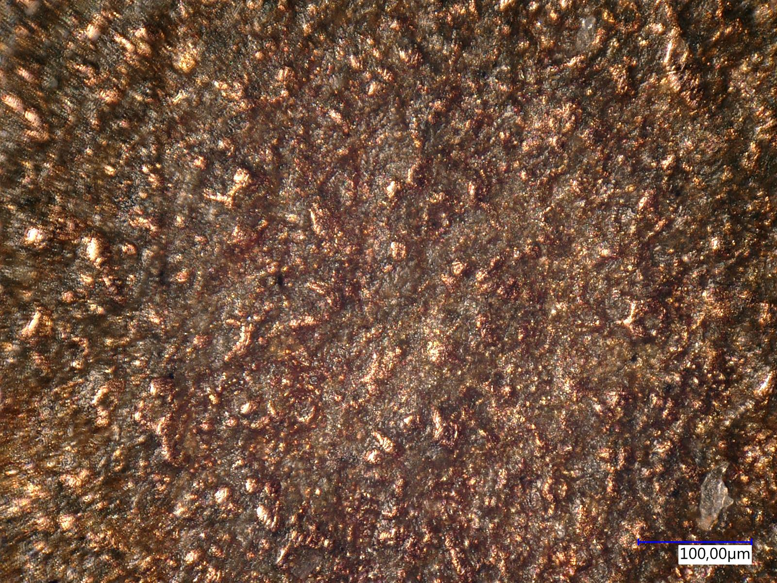
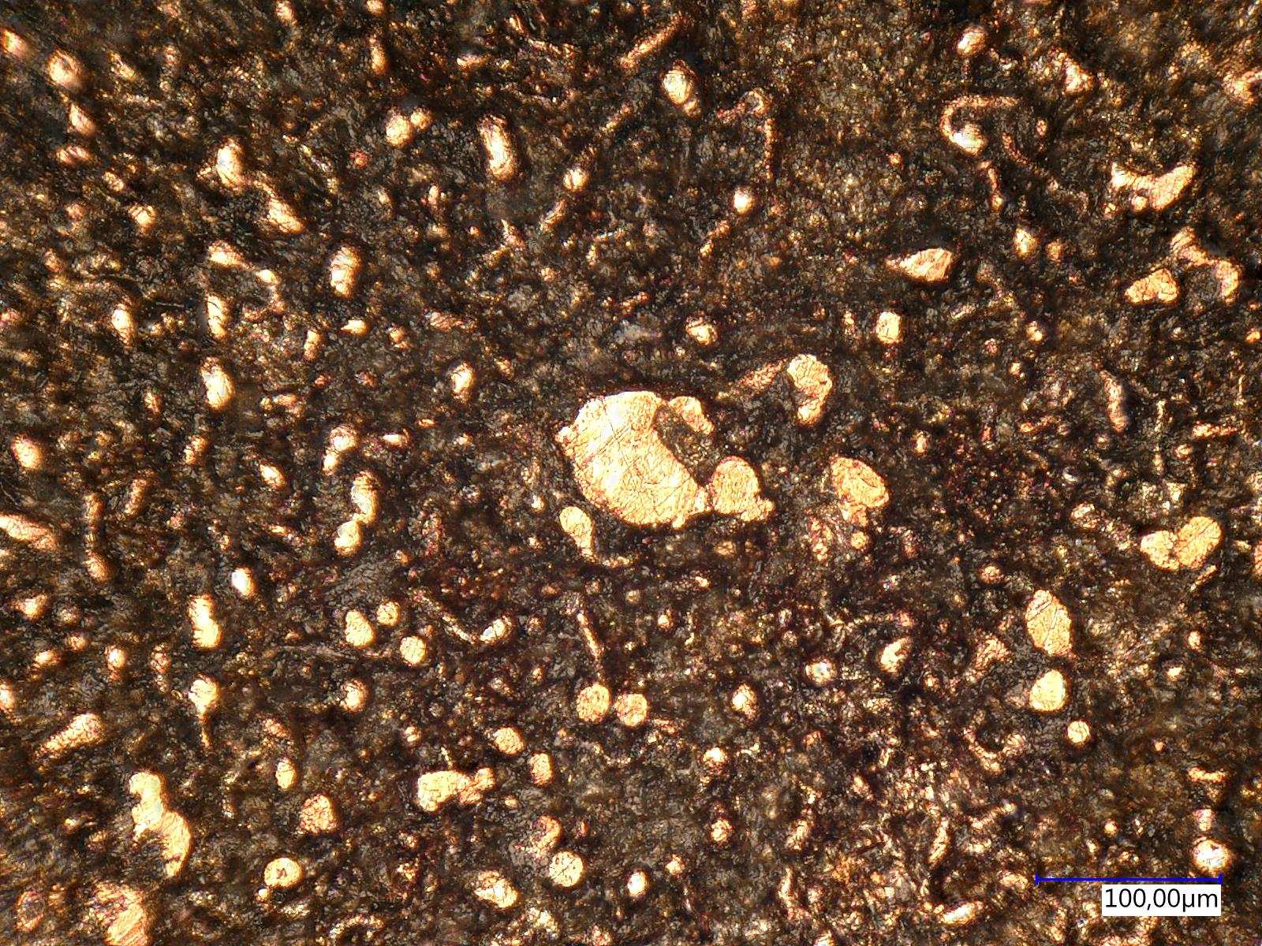
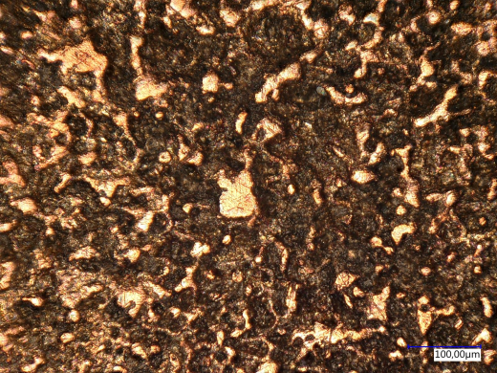
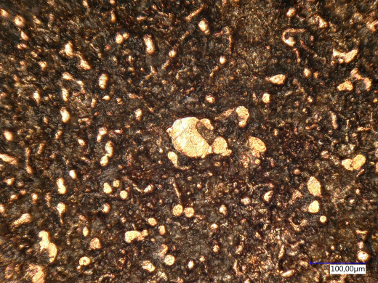
Microscopy of RFQ electrode surfaces: Cu plated vs. not Cu plated, used
S5: not Cu plated, used
S4: Cu plated, used
S4: Cu plated, used
S5: not Cu plated, used
S5: not Cu plated, used
S5: not Cu plated, used
S4: Cu plated, used
S4: Cu plated, used

Slide 5
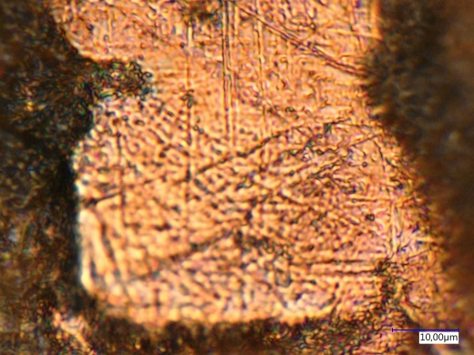
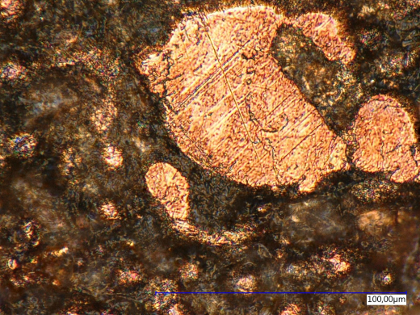
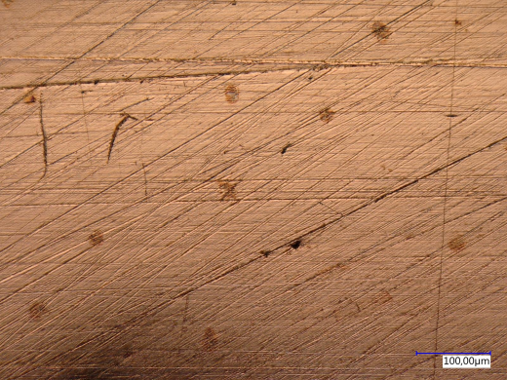
Microscopy of RFQ electrode surfaces: Not Cu plated, used (details)
S5: not Cu plated, used
S5: not Cu plated, used
S2a: not Cu plated, not used
S5: not Cu plated, used
S5: not Cu plated, used
S4: Cu plated, used

Slide 6
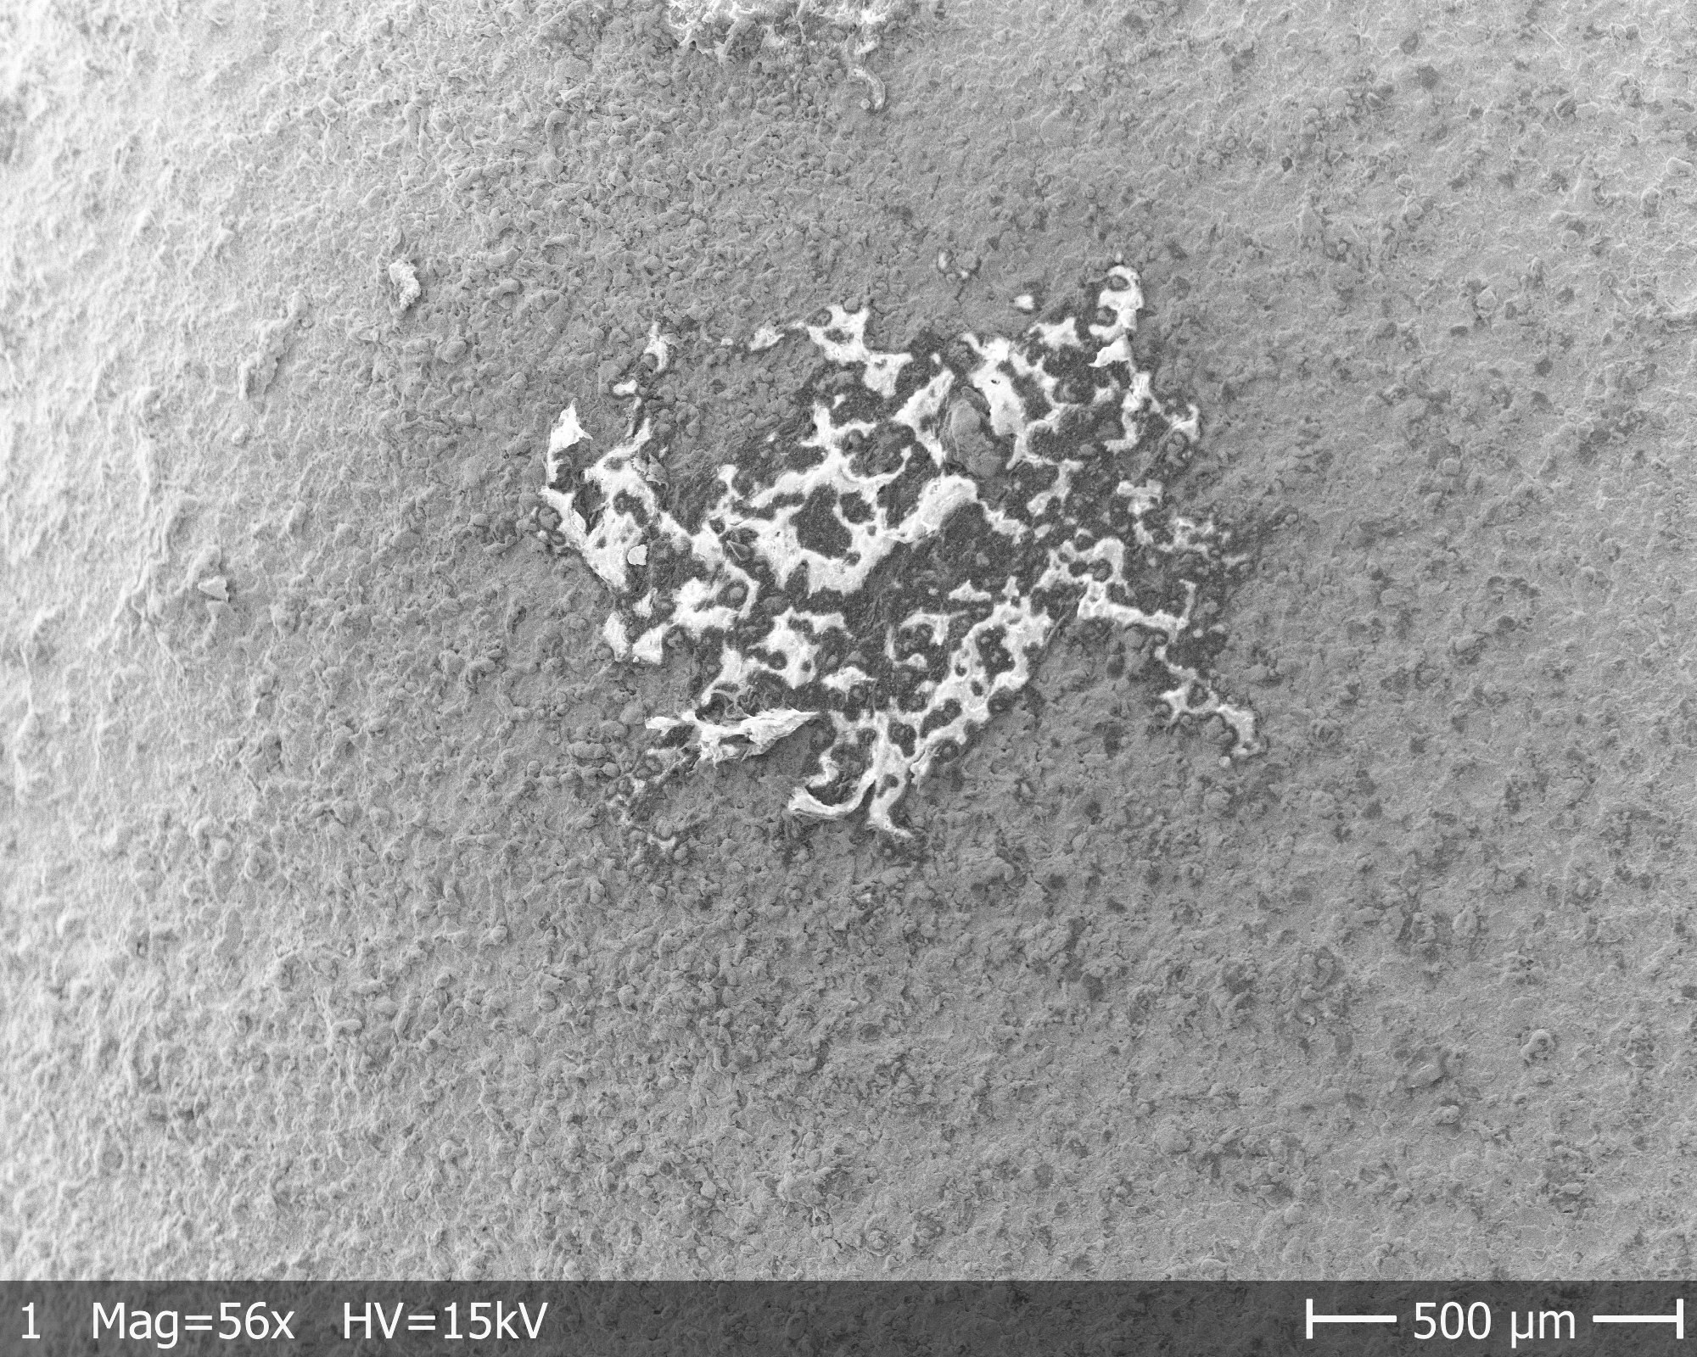
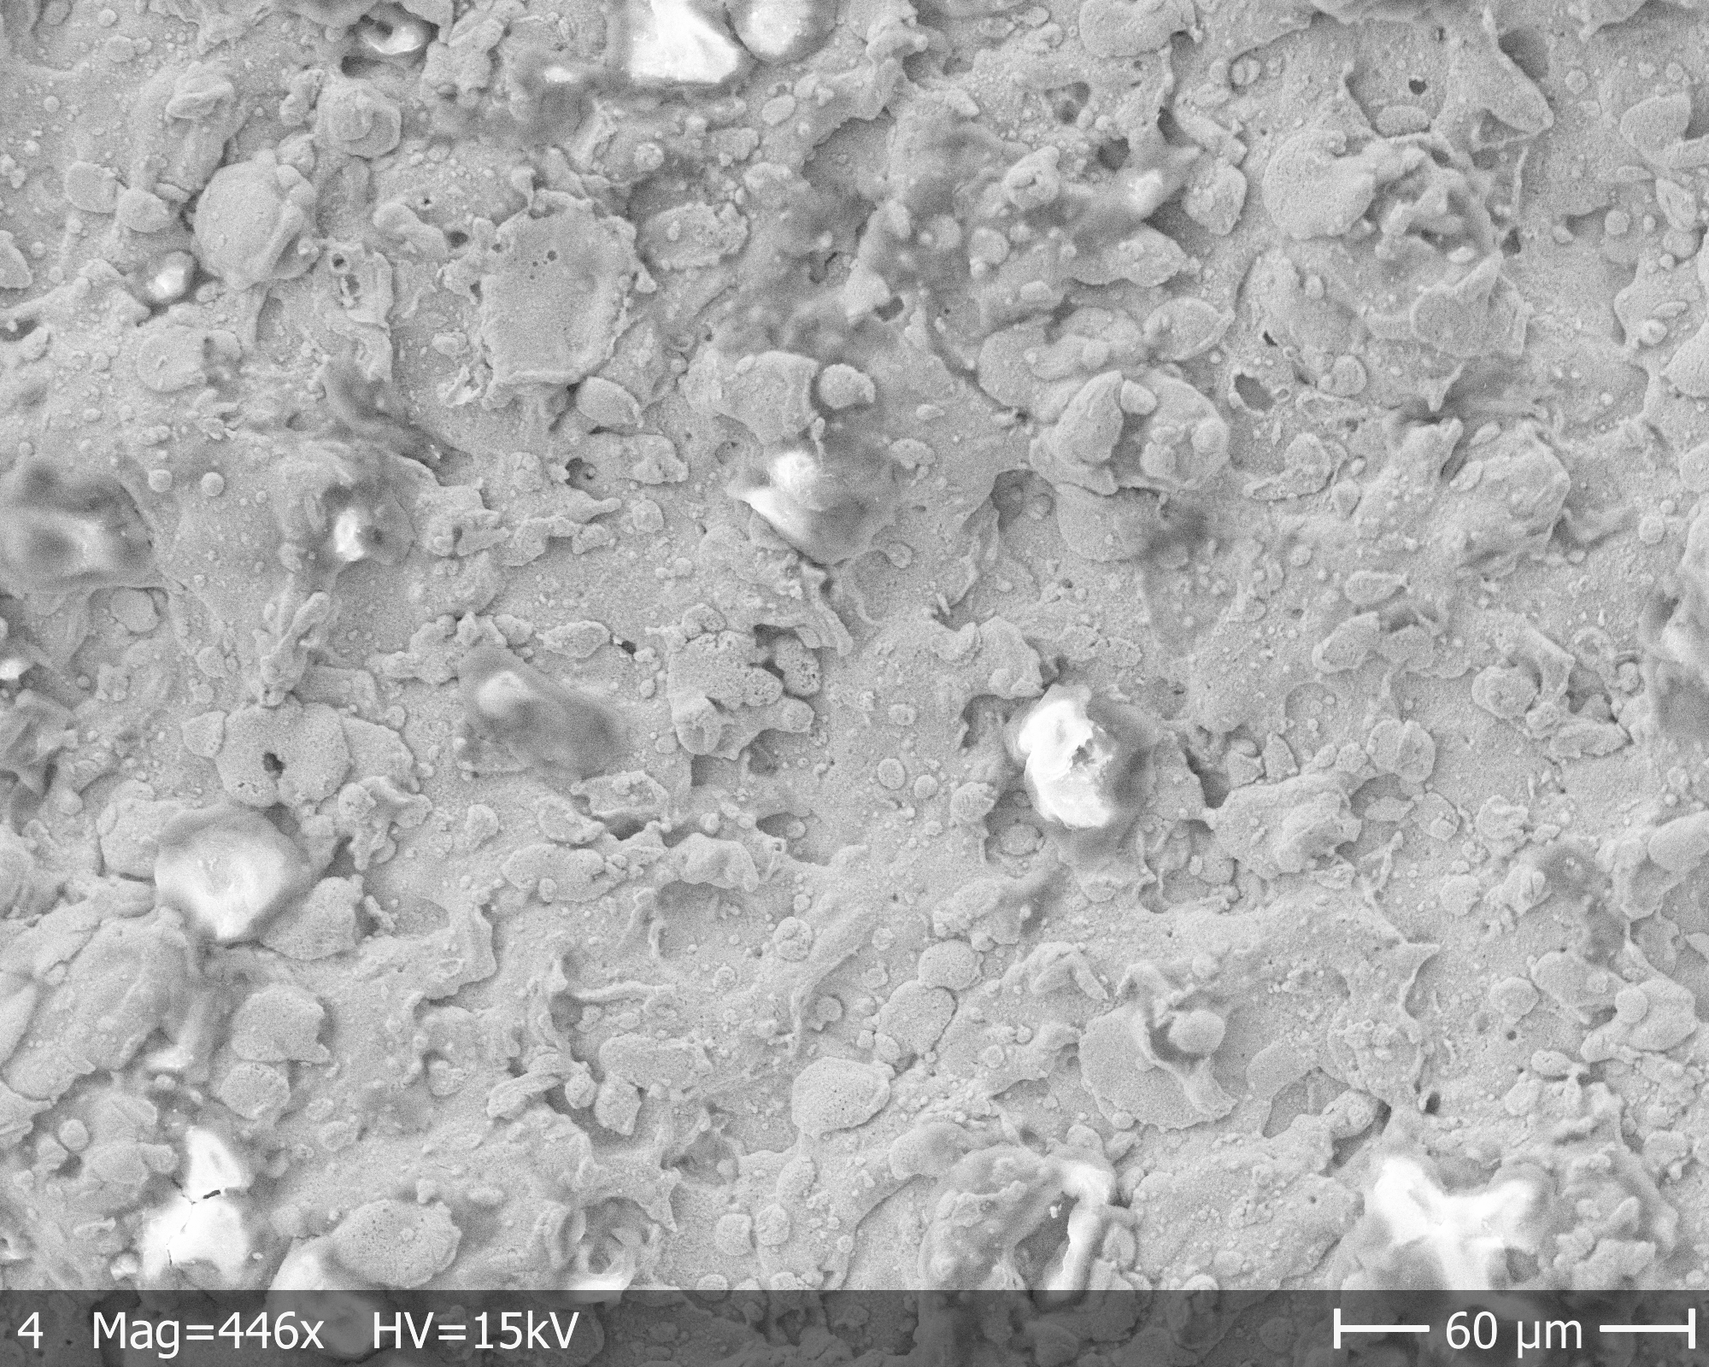
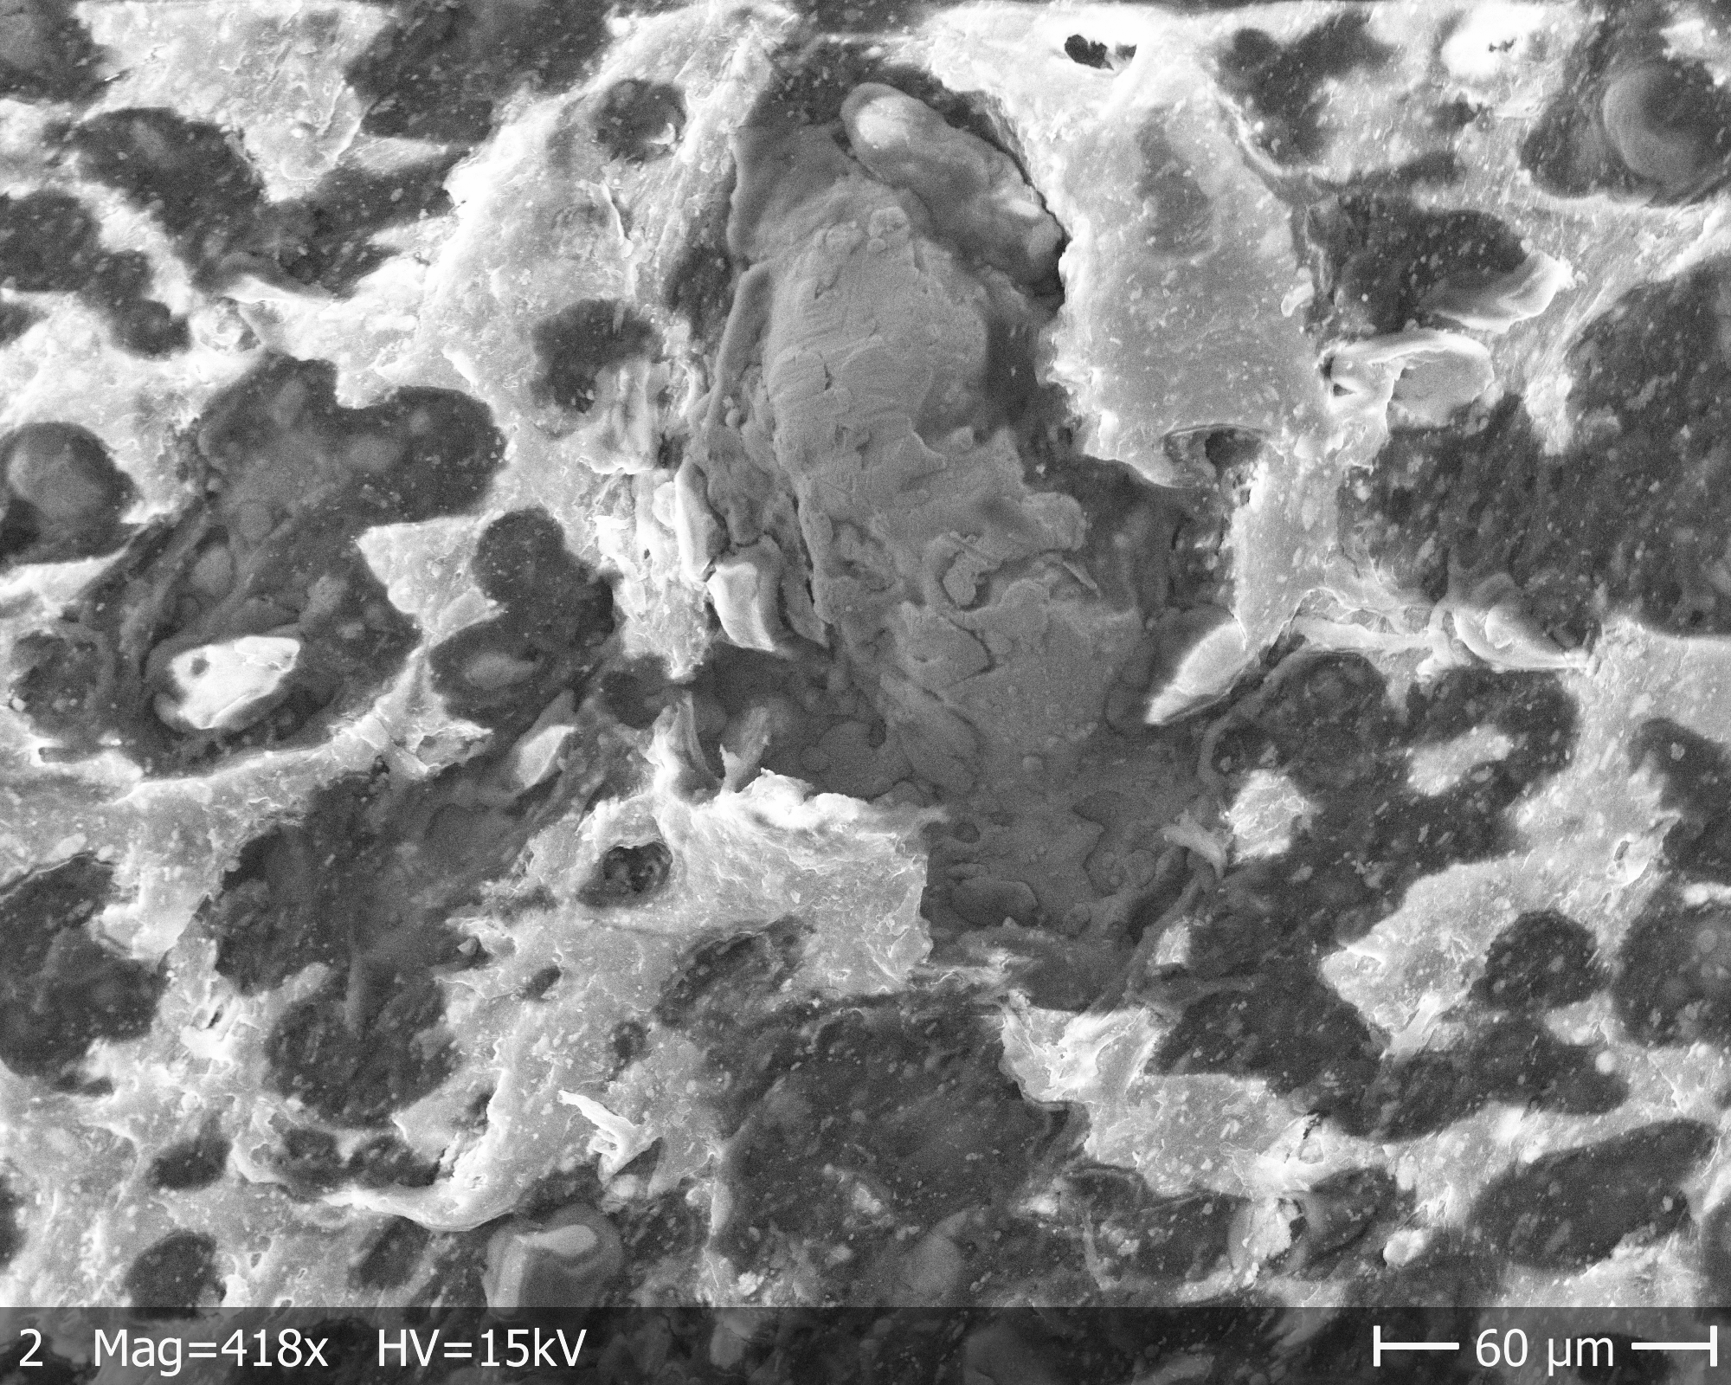
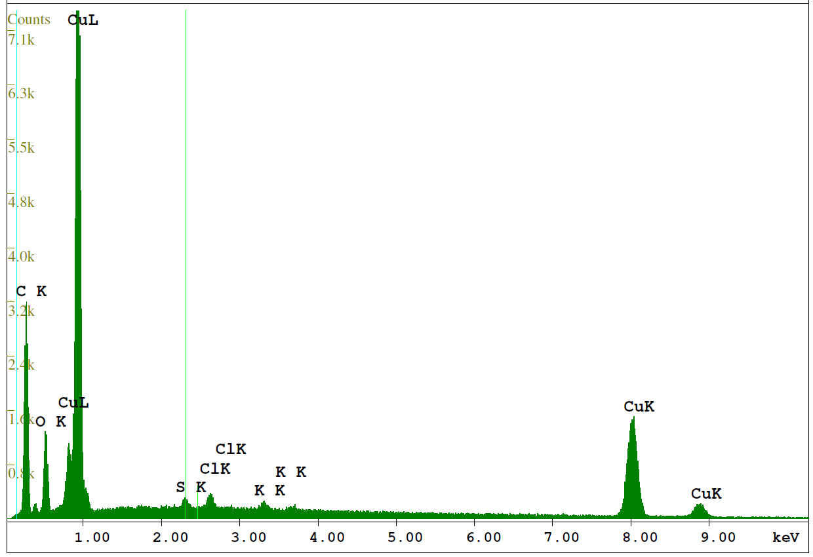
Microscopy of RFQ electrode surfaces: SEM and EDX
S4: Cu plated, used
EDX
EDX

Slide 7
Thank you!

Slide 8
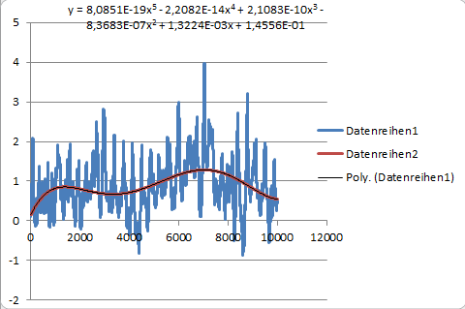
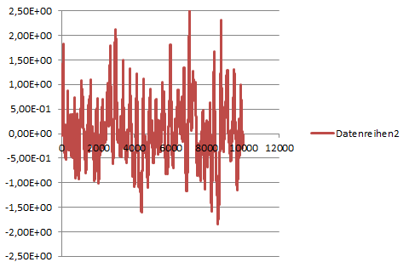
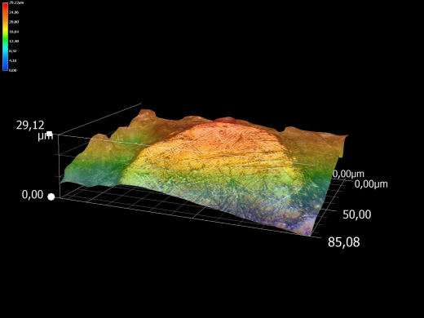
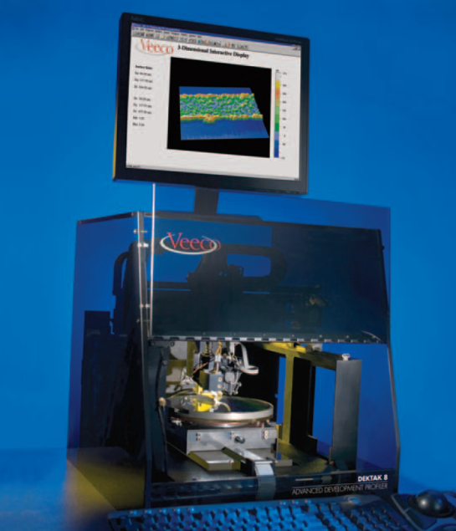
How the data was analysed?
Test1-1 - 1200
$$Ra=\frac{1}{n}\sum_{0}^{n}{\left|z−<z>\right|}=0,50µm$$
Roughness
Peak-to-valley height
Rmax = $\left|z_{max}−z_{min}\right|$ = 4,53 µm
S5: not Cu plated, used

