Slide 1
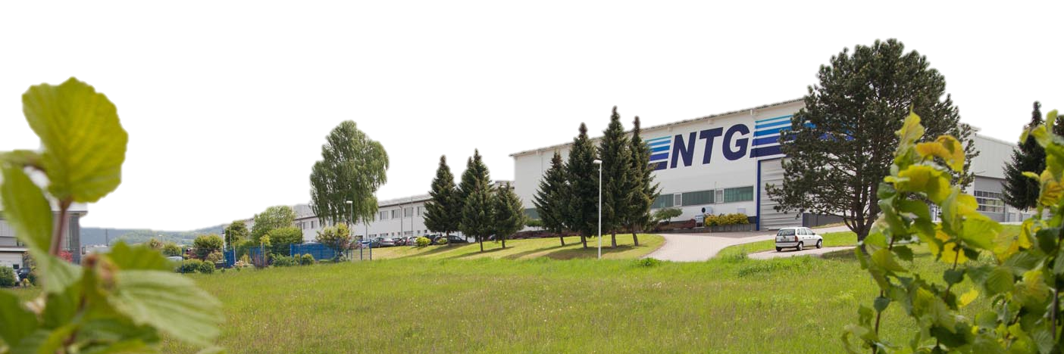
Production and Technical Challenges
Dr. Alexander Bechtold
1

Slide 2
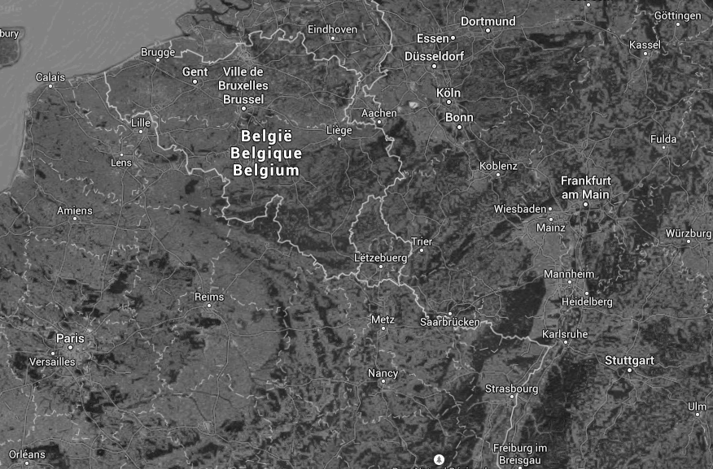
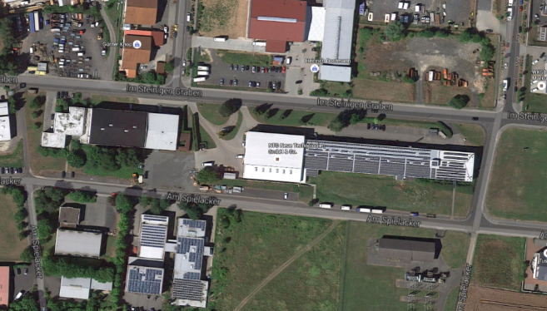
where we are

Slide 3
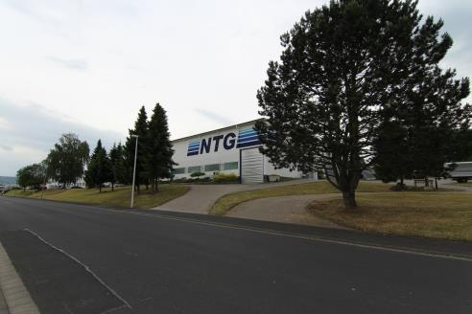
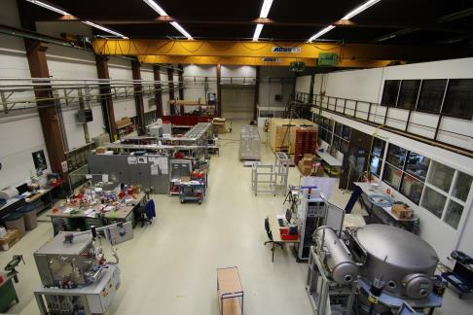
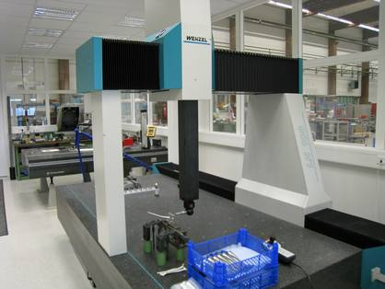
Looking inside
Mechanics Assembly
Measuring equipment

Slide 4
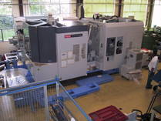
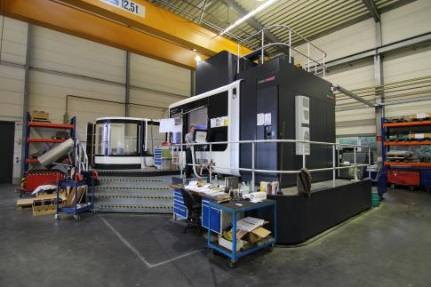
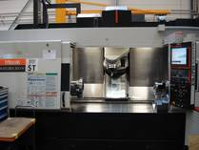
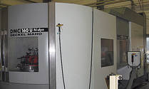
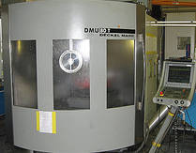
Machines
Deckel-Maho DMC 210 FD

Slide 5
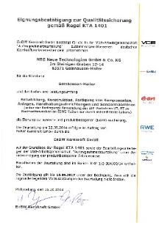
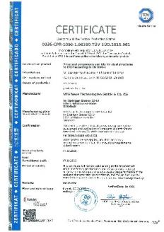
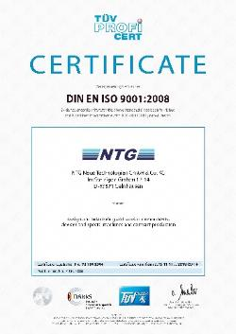
Certificates
DIN EN ISO 9001
KTA 1401
EN 1090-2 structural components and kits for steel structures to EXC4
EN 1090-3
structural components and kits for aluminium structures to EXC4
AD 2000-Merkblatt HP 0, AD 2000-Merkblatt HP-100R
pressure tanks

Slide 6
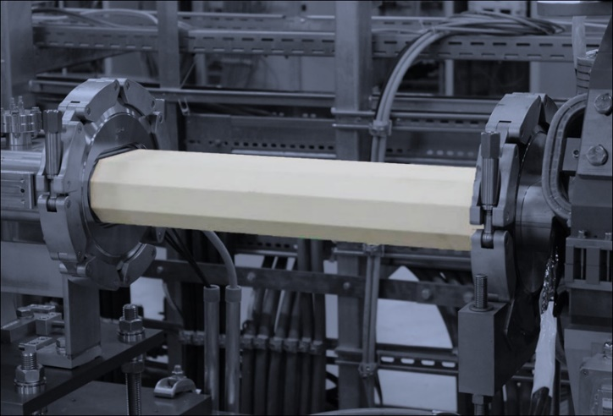
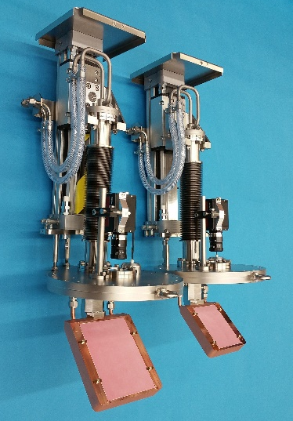
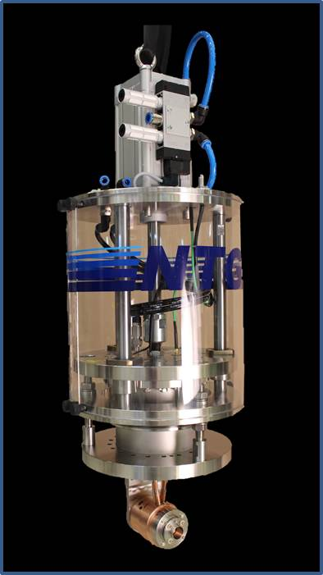
Branches
Vacuum Technology
Nanotechnology (IBF)
R&D Projects
Ceramic to Metal Assemblies
Particle Accelerators
Beam Diagnostic devices
Job-Work Production

Slide 7
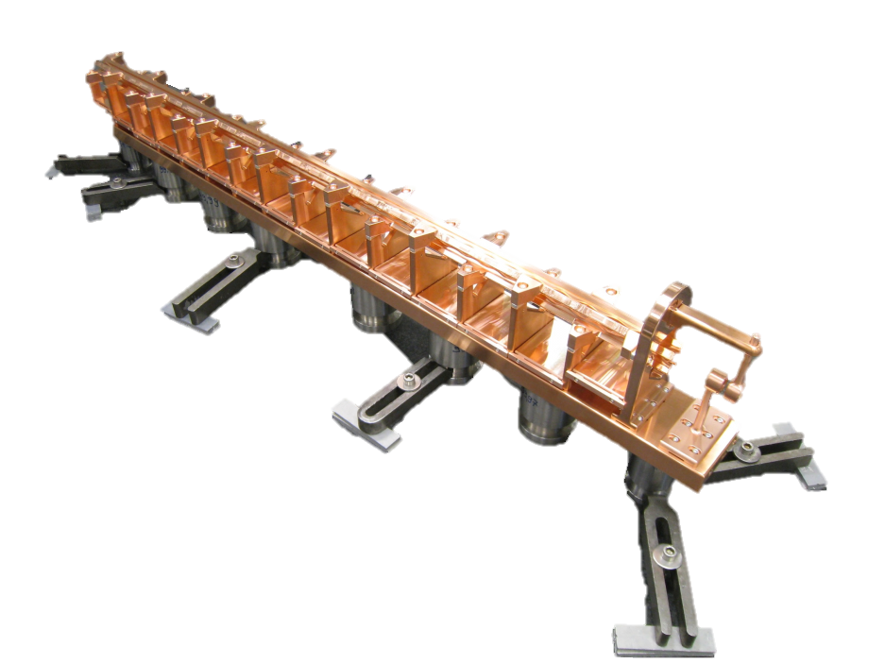
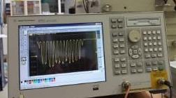
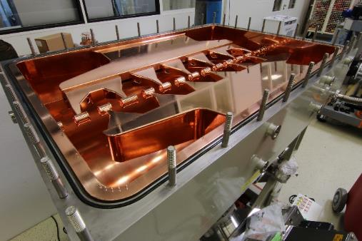
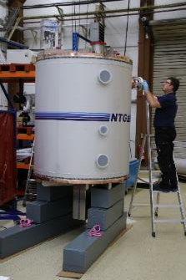
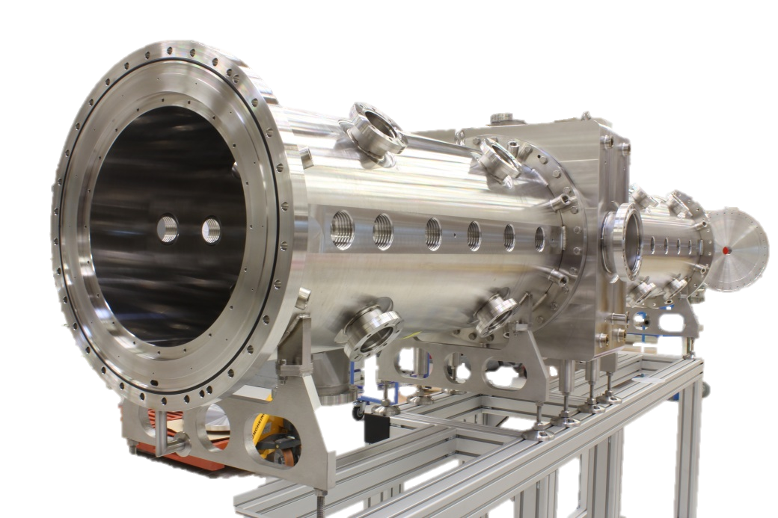
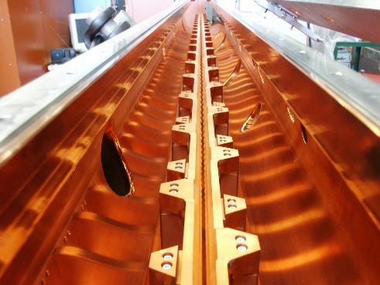
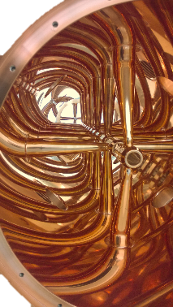
Cavities
MedRFQ
IH5 VECC
RFQ (e.g. CERN REX-ISOLDE)
DTL
Kicker Dubna
SARAF
CH p-Linac

Slide 8
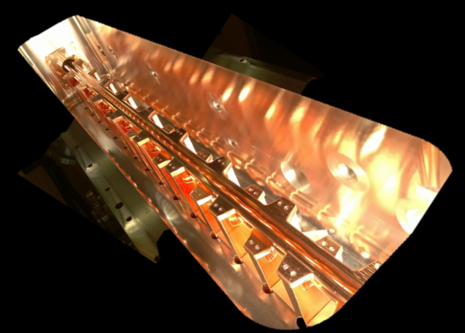
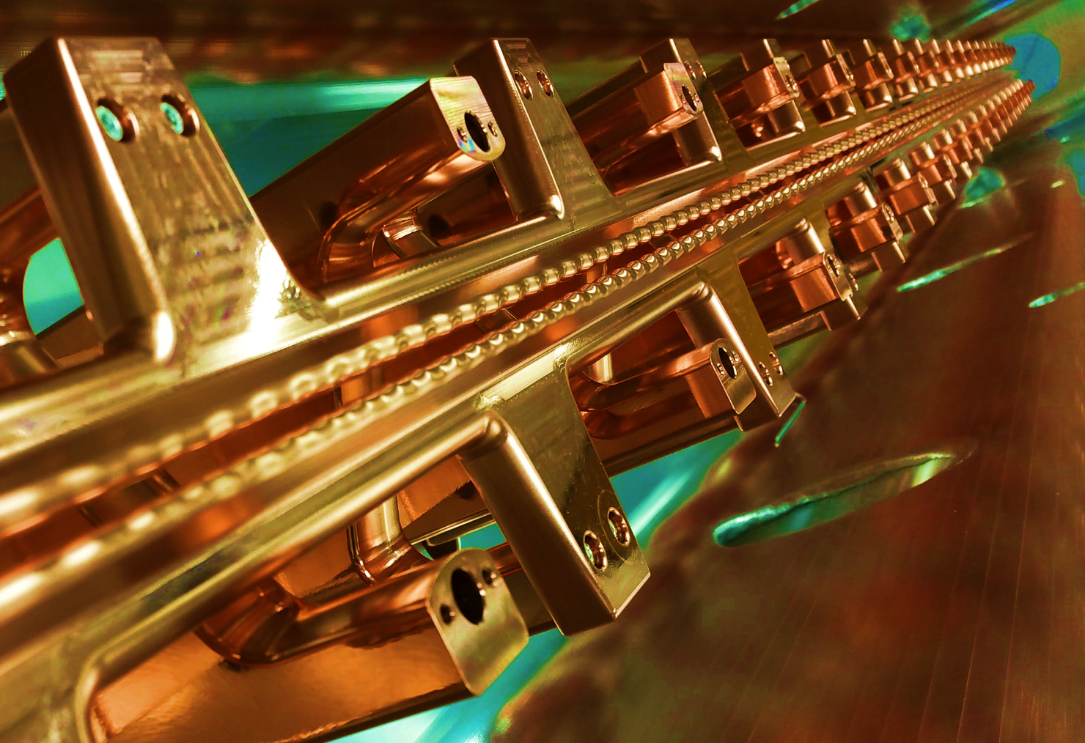
High Intensity RFQs
2005 - SARAF 50kW/m
2010 FRANZ 38 kW/m
2015 MYRRHA design 25 kW/m
Notes:
A whole variety of beam diagnostic systems. We do almost everything mostly custom made adopted to the requirements of the client with the exception of beam transformers.

Slide 9
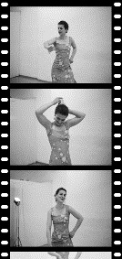
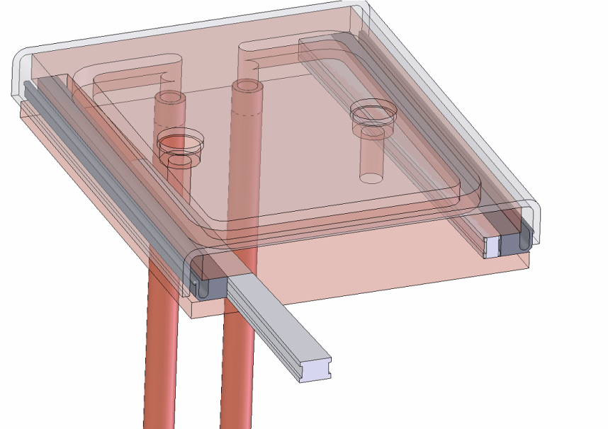
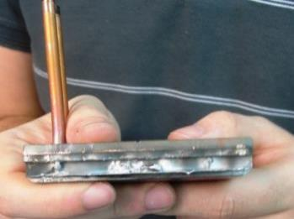
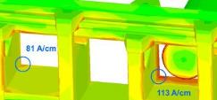
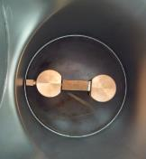
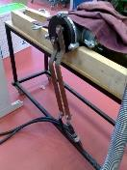
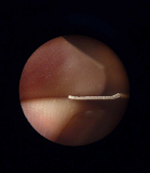
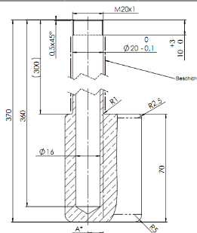
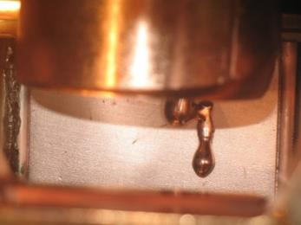
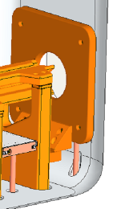
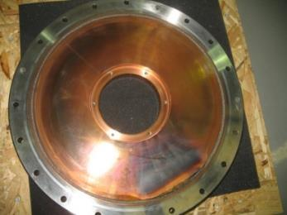
Historical Development: starting point SARAF
50 kW/m in 2009
Pure Silver Solution
Problem at 100 A/cm with copper plated INCONEL contacts
75 A/cm @ 176 MHz
Experimental Investigation
⇒
High Power TP
of NTG
Improved Cooling
Plungers: Induced eddy currents lead to power losses on the surface in the order of 20 W/cm².
⇒
Improved RF-Contacts
RF penetration can cause problems in some hidden areas of the structure.
⇒
Notes:
A whole variety of beam diagnostic systems. We do almost everything mostly custom made adopted to the requirements of the client with the exception of beam transformers.

Slide 10
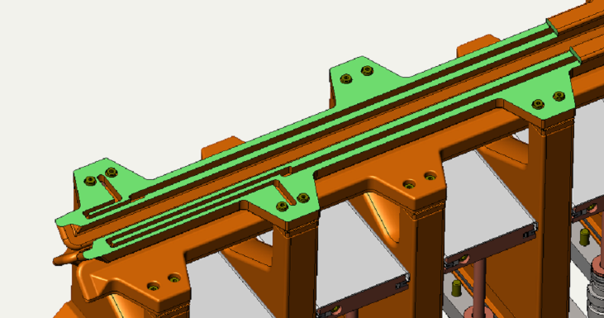
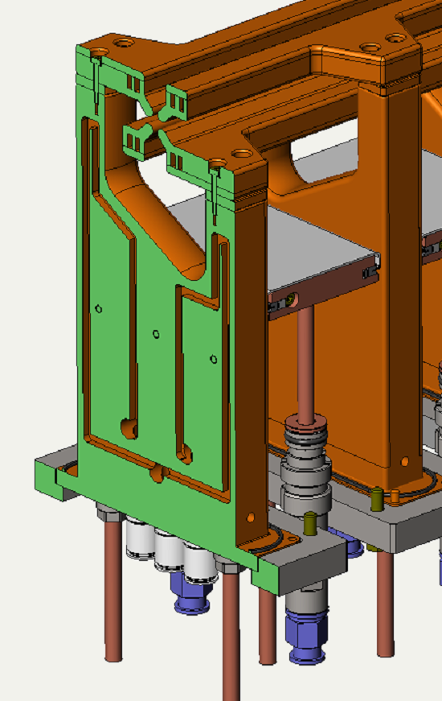
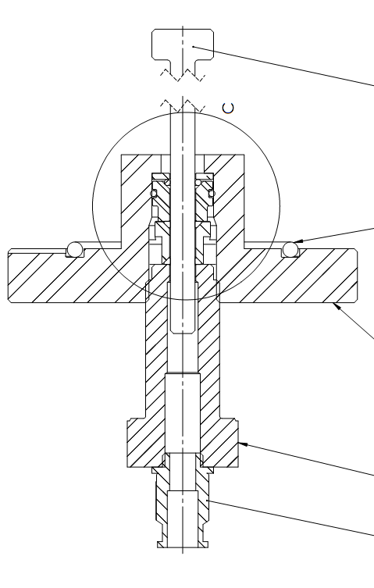
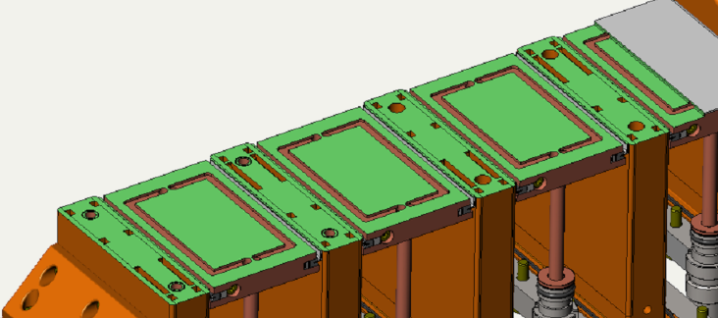
Cooling Concept evolved for FRANZ
copper electro forming
copper electro forming
brazed silver plates
Notes:
A whole variety of beam diagnostic systems. We do almost everything mostly custom made adopted to the requirements of the client with the exception of beam transformers.

Slide 11
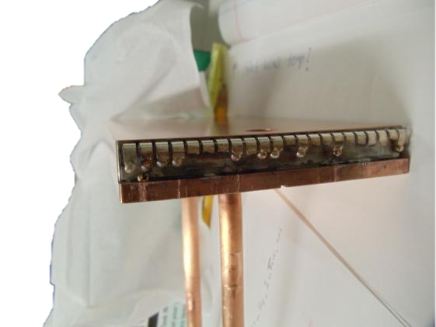
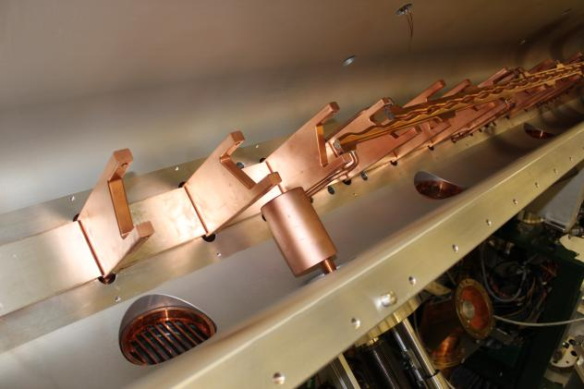
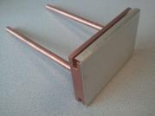
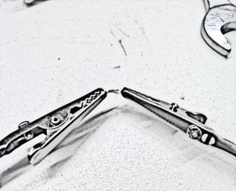
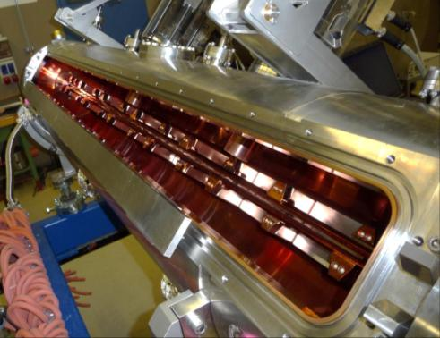
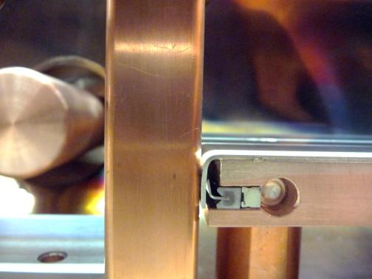
RFQ repair and improvement
CW RFQ at MSU…
…with high power TP of NTG
Conventional finger contacts made of silver plated copper-beryllium alloys can reliably withstand up to 30 A/cm. This value can be found in literature and has been repeatedly confirmed by dedicated experimental investigations similar to the ones aside accomplished by NTG at the IAP in Frankfurt and under operational conditions with 4-rod structures.
HLI RFQ GSI

Slide 12
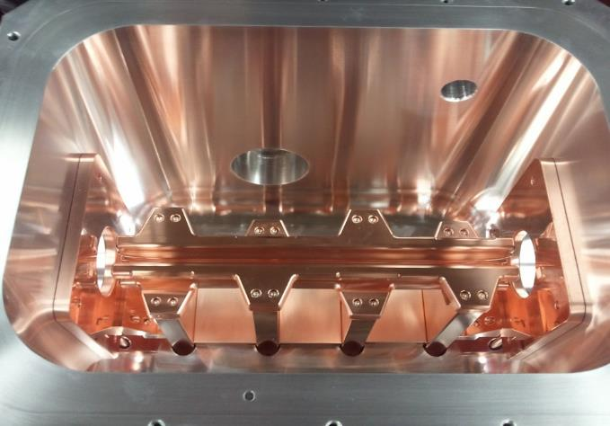
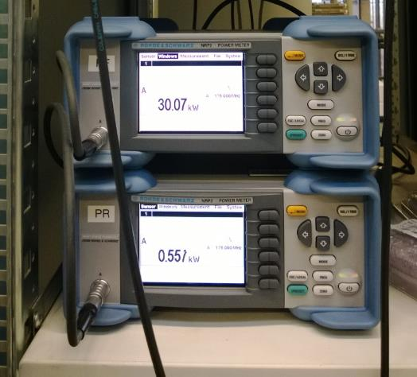
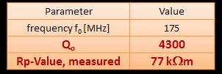
NEXT GEN HIGH POWER CW-RFQ
4-stem Model
keeps cool at even
130 kW/m, 100 kV
(limit not yet reached)
2017
Notes:
A whole variety of beam diagnostic systems. We do almost everything mostly custom made adopted to the requirements of the client with the exception of beam transformers.

Slide 13
HLI 6 Stem Model with dipole Compensation
Mechanical Resonances
D. Koser et al. IPAC 2018
Notes:
A whole variety of beam diagnostic systems. We do almost everything mostly custom made adopted to the requirements of the client with the exception of beam transformers.

Slide 14
MYRRHA 17 MeV Injector
RFQ
NC-CH
SC-CH
Parameter | MHYRRA | Unit
RF Structure | 4.Rod | ---
Frequency | 176.1 | MHz
Beam current | 5 | mA
Duty factor | 100 | %
E_{out} | 1.5 | MeV
R_{p} (4-St Model) | 77 | kΩm
RF Power | 108 | kW
Specific power | 25 | kW/m
Voltage | 44 | kV
Length | 4 | m
CW CH-Rebuncher for FRANZ
Notes:
A whole variety of beam diagnostic systems. We do almost everything mostly custom made adopted to the requirements of the client with the exception of beam transformers.

Slide 15
Design & Manufacture of MYRRHA RFQ
No. of stems: 40
Distance of Stems: 100 mm
No. of electrode sections: 3
Pumping ports: 2 + 1 DN100CF
Height of beam axis: 150 cm
No. of tuner ports: 1 + 1
Adjustable three-point-support
Notes:
A whole variety of beam diagnostic systems. We do almost everything mostly custom made adopted to the requirements of the client with the exception of beam transformers.

Slide 16
Starting Manufacture
tank body and lid
raw material for stems
Electrode cooling channels
cooling connections
Notes:
A whole variety of beam diagnostic systems. We do almost everything mostly custom made adopted to the requirements of the client with the exception of beam transformers.

Slide 17
Before and After Copper Plating
Notes:
A whole variety of beam diagnostic systems. We do almost everything mostly custom made adopted to the requirements of the client with the exception of beam transformers.

Slide 18
Measuring the Electrodes
Notes:
A whole variety of beam diagnostic systems. We do almost everything mostly custom made adopted to the requirements of the client with the exception of beam transformers.

Slide 19
Alignment Concept Stems haven been individually measured and machined to provide precise mounting seat for electrodes.
Notes:
A whole variety of beam diagnostic systems. We do almost everything mostly custom made adopted to the requirements of the client with the exception of beam transformers.

Slide 20
Electrode cooling pipe welding with circular welding machine.
Notes:
A whole variety of beam diagnostic systems. We do almost everything mostly custom made adopted to the requirements of the client with the exception of beam transformers.

Slide 21
Assembly of rods
Notes:
A whole variety of beam diagnostic systems. We do almost everything mostly custom made adopted to the requirements of the client with the exception of beam transformers.

Slide 22
Electrode error compensation at point of transition between segments
Notes:
A whole variety of beam diagnostic systems. We do almost everything mostly custom made adopted to the requirements of the client with the exception of beam transformers.

Slide 23
Alignement precision 10µm/m
Notes:
A whole variety of beam diagnostic systems. We do almost everything mostly custom made adopted to the requirements of the client with the exception of beam transformers.

Slide 24
Notes:
A whole variety of beam diagnostic systems. We do almost everything mostly custom made adopted to the requirements of the client with the exception of beam transformers.

Slide 25
dipole compensation
~4% (instead of ~20%)
Notes:
A whole variety of beam diagnostic systems. We do almost everything mostly custom made adopted to the requirements of the client with the exception of beam transformers.

Slide 26
RF-Tuning
Dummy Tuning Plate
Real one
Dummy Pates for RF Tuning
Notes:
A whole variety of beam diagnostic systems. We do almost everything mostly custom made adopted to the requirements of the client with the exception of beam transformers.

Slide 27
Matching of Coupling Loop
S₁₁< -30 dB

Slide 28
Ready For Shipping
09.08.2017

Slide 29
Status at Louvain-la-Neuve
P = 90 kW
duty = 5%
dt = 15h
10.04.2019
08.04.2019
…to be continued!

Slide 30
Thank You! a.bechtold@ntg.de

