Slide 1
Beam Dynamics Design for the Upgrade of the RFQ at GSI’s High Current Charge Injector
A. Lombardi, J.B. Lallement, J.M. Garland, V. Bencini*
BE-ABP-HSL, CERN
*vittorio.bencini@cern.ch
16th April 2019

Slide 2
Outline
Introduction
Baseline design summary
Error study
Precise vane length adjustment
Tracking ²³⁸U⁴⁺ and ²³⁸U³⁺
Conclusions

Slide 3
Outline
Introduction
Baseline design summary
Error study
Precise vane length adjustment
Tracking ²³⁸U⁴⁺ and ²³⁸U³⁺
Conclusions

Slide 4
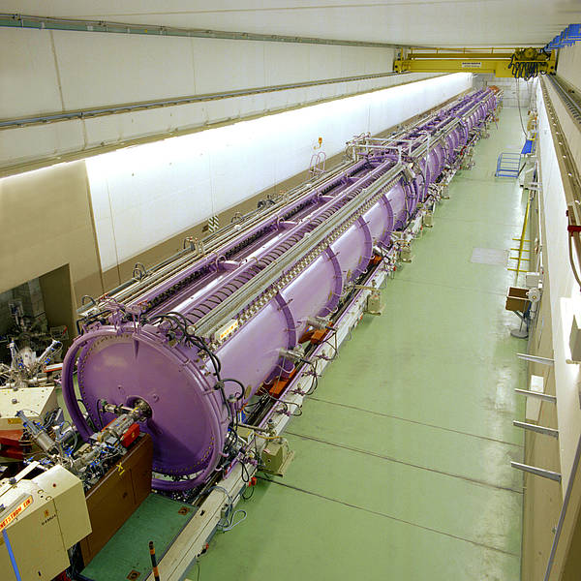
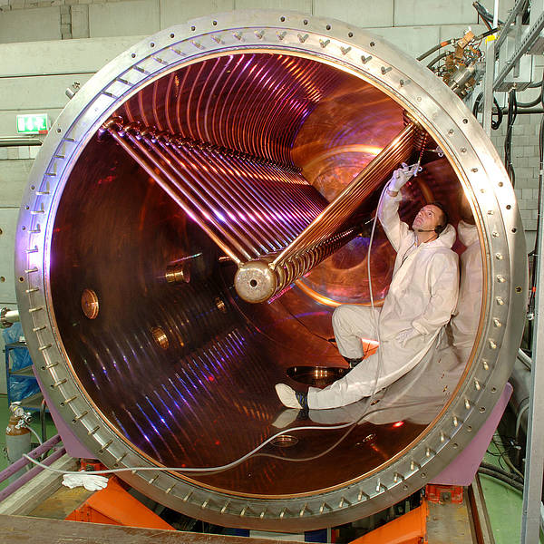
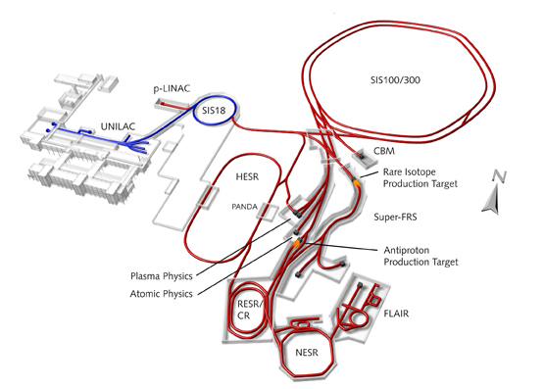
Introduction – UNILAC GSI
UNILAC is a linear accelerator at the GSI lab in Darmstadt, Germany.
Built in 1975 and upgraded several times since, it’s next primary function will be to provide heavy ions for the FAIR (Facility for Anti-proton and Ion Research).
High intensity and beam quality will be required and hence an upgrade of the RFQ is necessary.

Slide 5
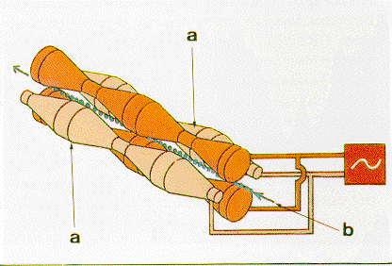
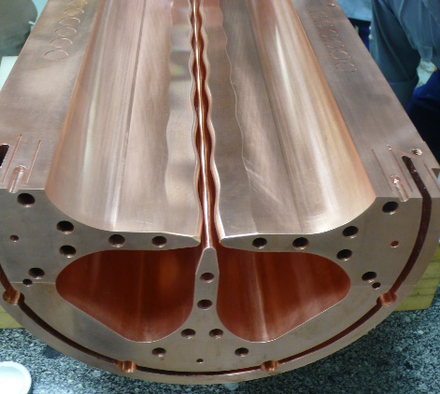
Introduction – UNILAC RFQ
Current RFQ is like a cross between rod-type and vane-type RFQ
Potential distributed like ‘rod-type’ ->
Parameter | Value
Ion | U238 4+
Current | 20 mA
Length | 9.25 m
Frequency | 36.136 MHz
Electrode voltage | 155 kV
EK_in / EK_out | 0.526 / 28.56 MeV (total)
R0 (average aperture) | 6.0 mm (fixed)
rho | 4.2 mm
modulation | 1.0 – 1.95
rho
R0
If a = min aperture and
R = max aperture => R = ma
Vane-tip more like ‘vane-type’ ->

Slide 6
Introduction - Constraints
Study a new RFQ design where the mini-vane parameters could be modified, taking into consideration:
Lower inter-vane voltage, back to around 125 kV
Maximum surface field < 33 MV/m
Constant transverse radius of curvature, rho
Average radius r0 ≥ 0.53 cm
And no change in major parameters:
Length | 925 cm
Frequency | 36.136 MHz
In/out tot. kin. energy | 0.5236 / 28.56 MeV
Max in/min out current | 20 / 15 mA
Ion species | U238 (4+)

Slide 7
Introduction
Major steps in design progression:
1. Two designs made initially with constant r0 and one RMS stage (didn’t have GSI tracked beam at this stage):
One at 125 kV ~80% transmission with Es < 33 MV/m ✓ selected
One at 140 kV ~85% transmission with Es < 33 MV/m ✗
2. Beam could not be matched to selected design. RFQ design beta too high. Created new two-stage matching section to better match beam.
125 kV with GSI beam: 78% transmission with Es < 33 MV/m
3. Average r0 was too small. Increased vane separation, variable aperture along RFQ. Also adjusted length and matching sections for precise length.
123 kV (nominal transmission 129 kV): 75% transmission with Es < 33 MV/m

Slide 8
Outline
Introduction
Baseline design summary
Error study
Precise vane length adjustment
Tracking ²³⁸U⁴⁺ and ²³⁸U³⁺
Conclusions

Slide 9
Baseline summary - input
Input design parameters defined in the past months
(before vane length adjustment)
Ion | U238 4+
Inter-vane voltage (nominal design value) | 123.3 kV
Maximum surface field Es (for nominal design voltage) | 32 MV/m
Total length (inner wall to inner wall) | 9250 mm
Total electrode length | 9231 mm
Total fringe-field length | 19 mm
Rho (transverse radius of curvature) | 4 mm
r0 (average aperture) | 5.15 – 6 mm (excluding RMS)
a (minimum aperture) | 5.15 – 3.4 mm (excluding RMS)
Minimum longitudinal radius of curvature | 4.3 mm
Modulation m | 1.0 – 2.04
Focusing parameter B (after RMS) | 5.6 – 4.2 (excluding RMS)

Slide 10
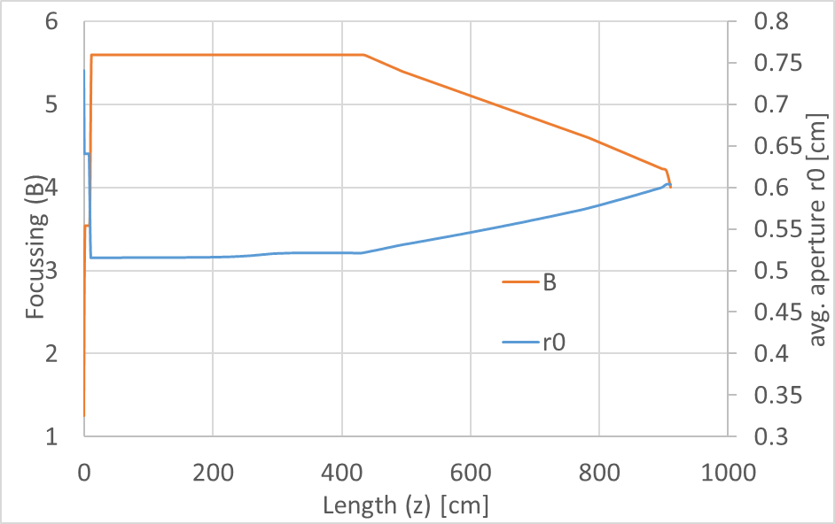
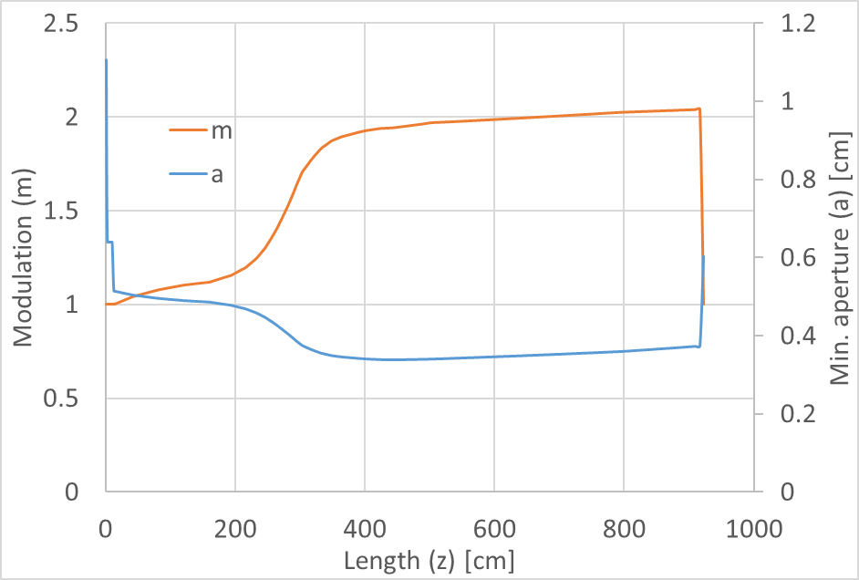
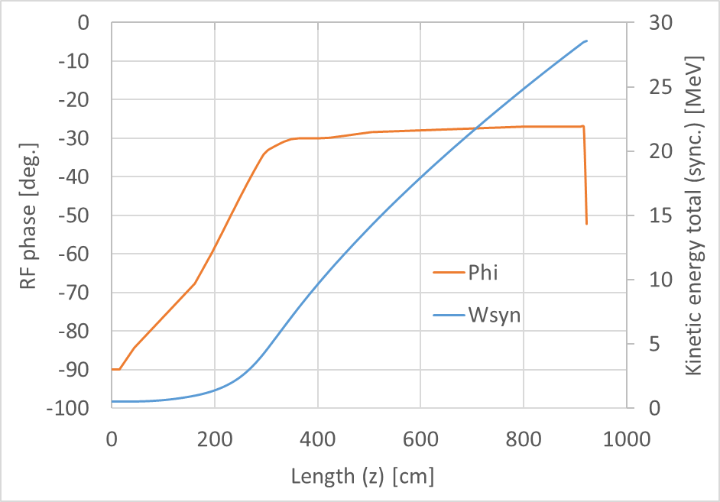
Baseline summary - output
~129 kV inter-vane voltage | Measured – 20 mA | Gaussian – 20 mA
Out trans. emit. 95% norm.(x, y) | 0.50, 0.52 π.mm.mrad | 0.61, 0.61 π.mm.mrad
Out long. emit. 95% norm. | 8.9 π.deg.MeV | 9.1 π.deg.MeV
Transmission/Current | 78% / 15.6 mA | 84% / 16.8 mA
All parameters respect the requirements

Slide 11
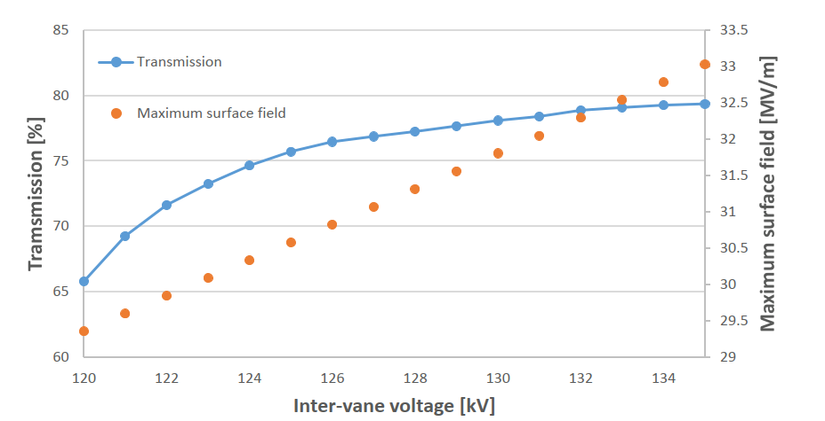
Baseline summary - output
RFQ designed for 123 kV with the aim of operating at 129 kV

Slide 12
Outline
Introduction
Baseline design summary
Error study
Precise vane length adjustment
Tracking ²³⁸U⁴⁺ and ²³⁸U³⁺
Conclusions

Slide 13
Error study
Three error categories were investigated:
Machining errors
Transverse electrode curvature radius
Longitudinal profile
Displacement errors
Electrode displacement (parallel, perpendicular, longitudinal)
Segment displacement (parallel, perpendicular, longitudinal)
Tilt errors
Electrode tilt (parallel, perpendicular, longitudinal)
Segment tilt (parallel, perpendicular, longitudinal)

Slide 14
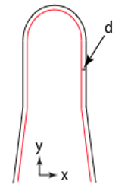
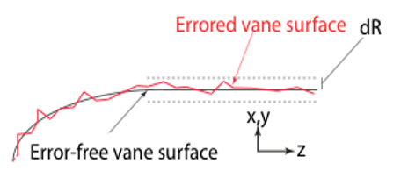
Error study
Three error categories were investigated:
Machining errors
Transverse electrode curvature radius
Longitudinal profile
Displacement errors
Electrode displacement (parallel, perpendicular, longitudinal)
Segment displacement (parallel, perpendicular, longitudinal)
Tilt errors
Electrode tilt (parallel, perpendicular, longitudinal)
Segment tilt (parallel, perpendicular, longitudinal)

Slide 15
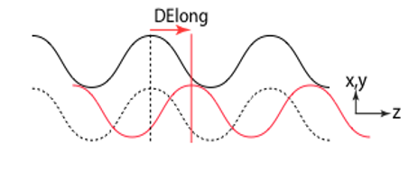
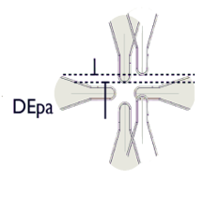
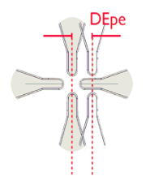
Error study
Three error categories were investigated:
Machining errors
Transverse electrode curvature radius
Longitudinal profile
Displacement errors
Electrode displacement (parallel, perpendicular, longitudinal)
Segment displacement (parallel, perpendicular, longitudinal)
Tilt errors
Electrode tilt (parallel, perpendicular, longitudinal)
Segment tilt (parallel, perpendicular, longitudinal)

Slide 16
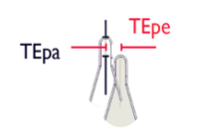
Error study
Three error categories were investigated:
Machining errors
Transverse electrode curvature radius
Longitudinal profile
Displacement errors
Electrode displacement (parallel, perpendicular, longitudinal)
Segment displacement (parallel, perpendicular, longitudinal)
Tilt errors
Electrode tilt (parallel, perpendicular, longitudinal)
Segment tilt (parallel, perpendicular, longitudinal)

Slide 17
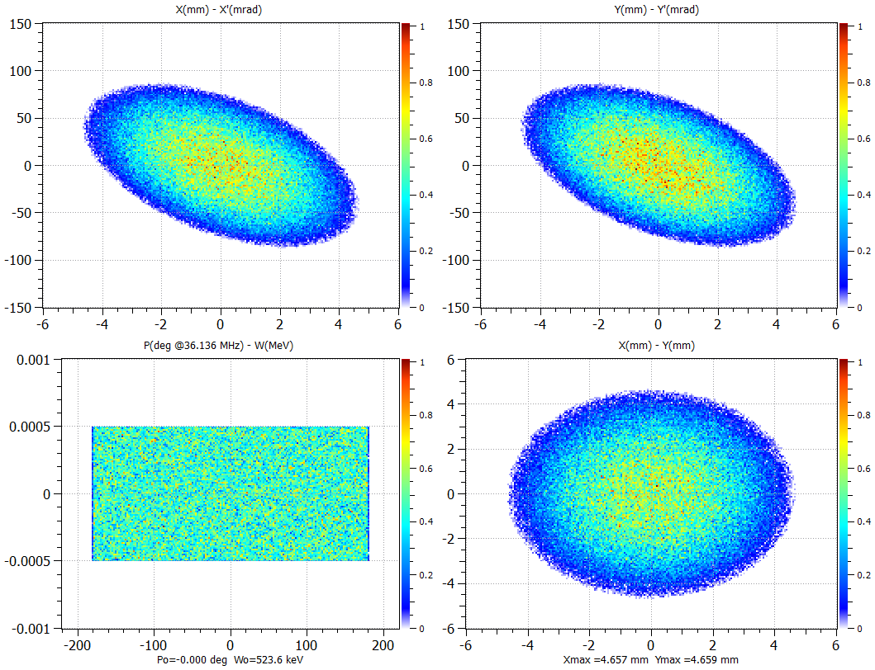
Error study
Random error magnitude from a uniform distribution within given values
Input distribution Gaussian matched with RFQ
Two sets of limits were established with different parameter tolerances, we will refer to these as tolerance limit 1 (higher tolerance) and tolerance limit 2 (lower tolerance).

Slide 18
Error study
Parameter | Description | Tolerance limit 1 (μm) | Tolerance limit 2 (μm)
d | Transverse electrode curvature radius | ±20 | ±40
dR | Longitudinal profile | ±20 | ±40
TEpe | Perpendicular electrode tilt | ±30 | ±60
TEpa | Parallel electrode tilt | ±30 | ±60
DEpe | Perpendicular electrode displacement | ±30 | ±60
DEpa | Parallel electrode displacement | ±30 | ±60
DELong | Longitudinal electrode displacement | ±30 | ±60
TSVerti | Segment vertical tilt | ±30 | ±60
TSHori | Segment horizontal tilt | ±30 | ±60
DSVerti | Segment vertical displacement | ±30 | ±60
DSHori | Segment horizontal displacement | ±30 | ±60
DSLong | Segment longitudinal displacement | ±30 | ±60

Slide 19
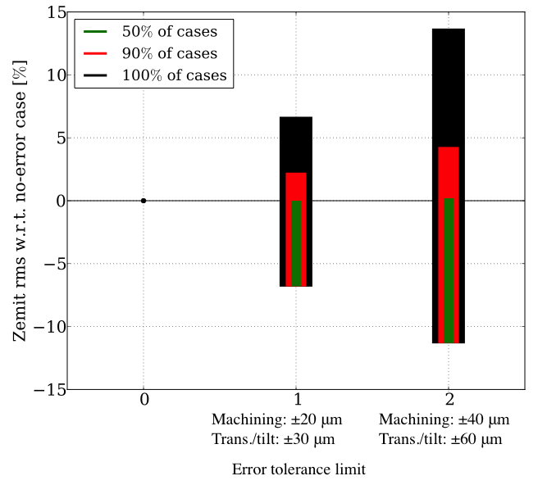
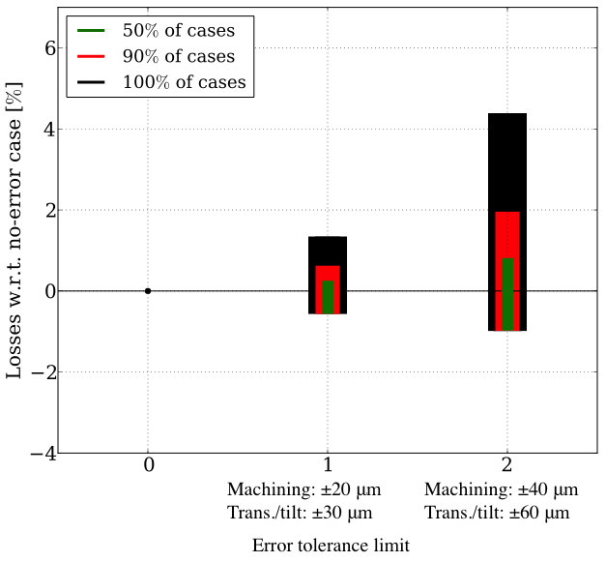
Error study - results

Slide 20
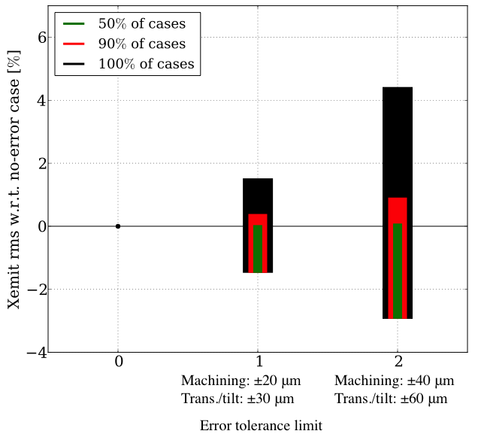
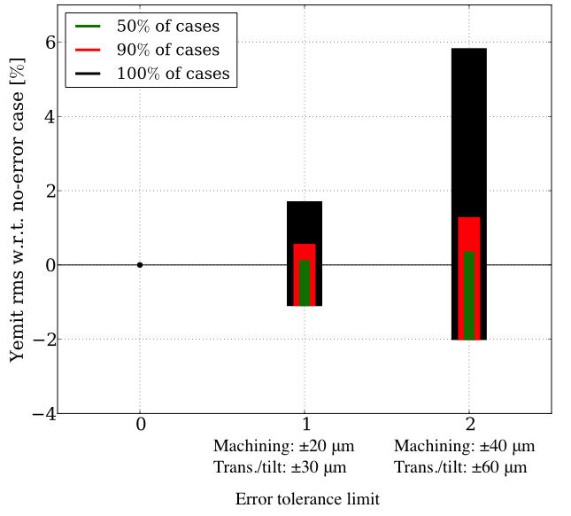
Error study - results

Slide 21
Error study - results
Emittance plane | Maximum growth [%] in limit 1 | Maximum growth [%] in limit 2
Horizontal | 1.4 | 4.4
Vertical | 1.6 | 5.5
Longitudinal | 6.5 | 13.4
Losses | 1.25 % | 4.5 %

Slide 22
Outline
Introduction
Baseline design summary
Error study
Precise vane length adjustment
Tracking ²³⁸U⁴⁺ and ²³⁸U³⁺
Conclusions

Slide 23
Precise vane length adjustment
The presented design considers electrodes with a slight length difference (5.18 mm) w.r.t. the length of the RFQ tube pipe.
The electrode length was modified keeping the other design parameters unchanged.
Particle tracking in Toutatis was performed with the adjusted electrodes in order to quantify the differences with the presented design.
 | Initial vane | Cut vane
Gap RMS | 10.47 mm | 16.02 mm
Gap FFS | 8.53 mm | 16.02 mm
Total vane length | 9231.0 mm | 9217.96 mm

Slide 24
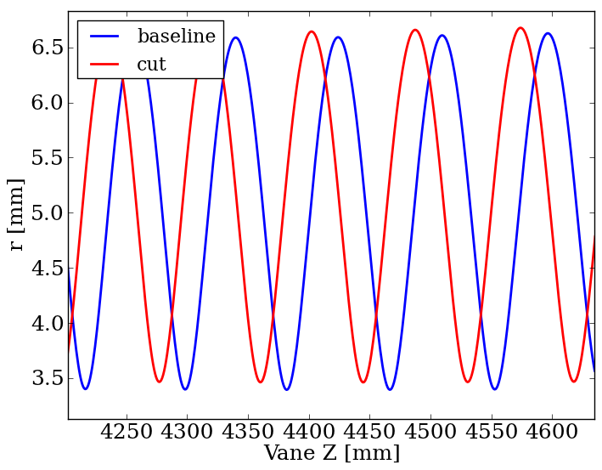
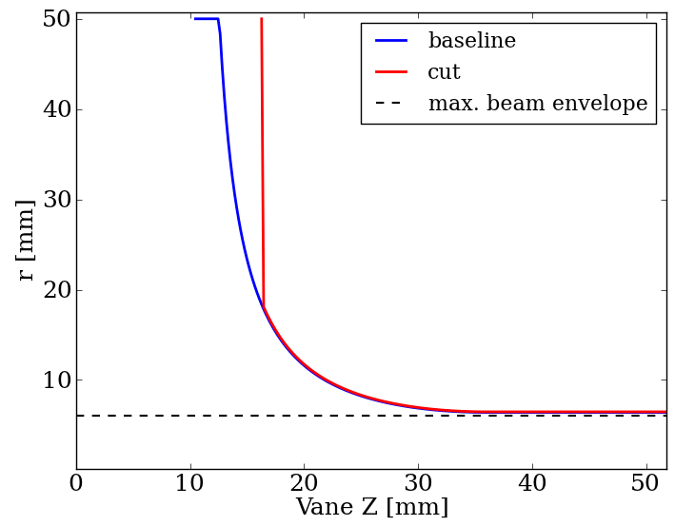
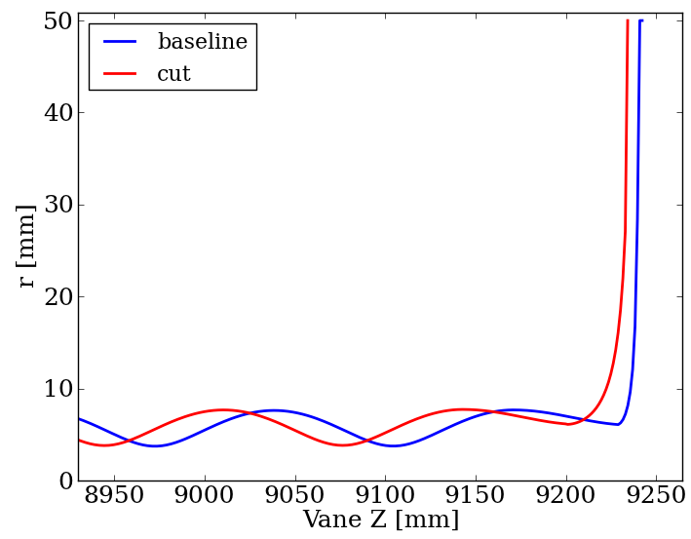
Precise vane length adjustment

Slide 25
Precise vane length adjustment
A comparison between the unmodified and the modified cut shows that the difference is negligible
129 KV
Electrode | Initial – uncut | Final - cut
Output trans. emit. 95% norm. (x, y) | 0.53, 0.53 pi.mm.mrad | 0.54, 0.54 pi.mm.mrad
Output long. emit. 95% norm. | 8.87 pi.deg.MeV | 8.5 pi.deg.MeV
Transmission (accelerated) | 78% (Toutatis) | 78% (Toutatis)

Slide 26
Outline
Introduction
Baseline design summary
Error study
Precise vane length adjustment
Tracking ²³⁸U⁴⁺ and ²³⁸U³⁺
Conclusions

Slide 27
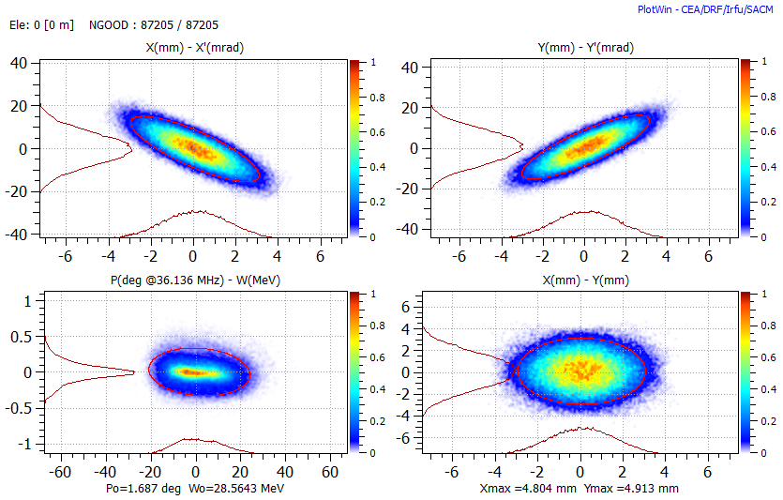
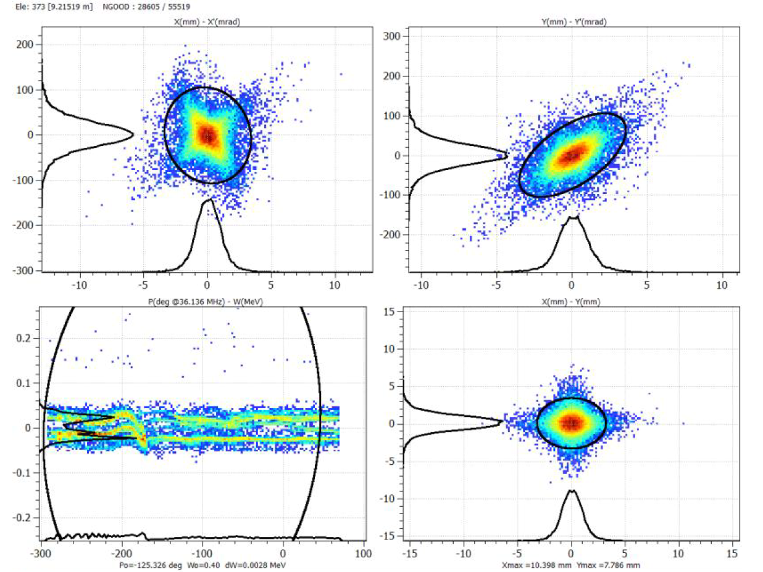
Tracking ²³⁸U⁴⁺ and ²³⁸U³⁺
77.4%
51 %
Not Accelerated!

Slide 28
Outline
Introduction
Baseline design summary
Error study
Precise vane length adjustment
Tracking ²³⁸U⁴⁺ and ²³⁸U³⁺
Conclusions

Slide 29
Conclusions
The RFQ was successfully redesigned fulfilling all the requirements and constraints.
Error studies show that even with a worst-case scenario, we can still just meet the requirements.
Adjusting the length of the vanes to fit to the new requirement, the differences on the output beams at 129 KV are negligible, validating the results of the error study
²³⁸U³⁺ are transmitted to the RFQ without acceleration with a transmission of 27.3%

Slide 30
Thank you for your attention!

Slide 31
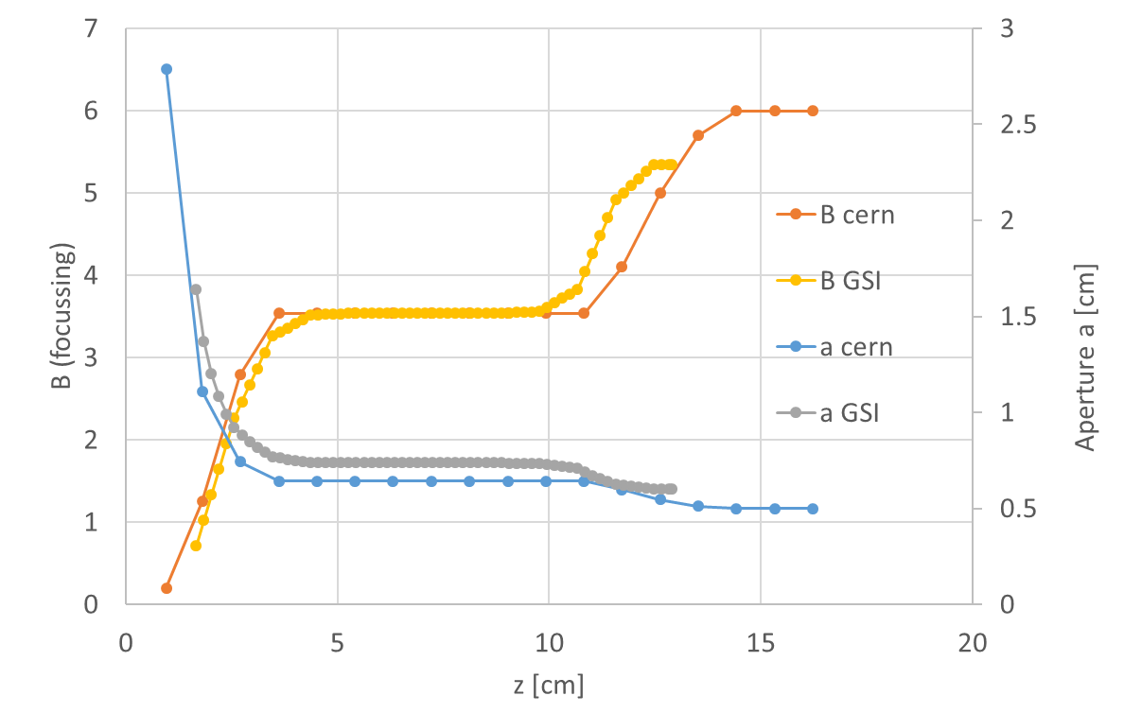
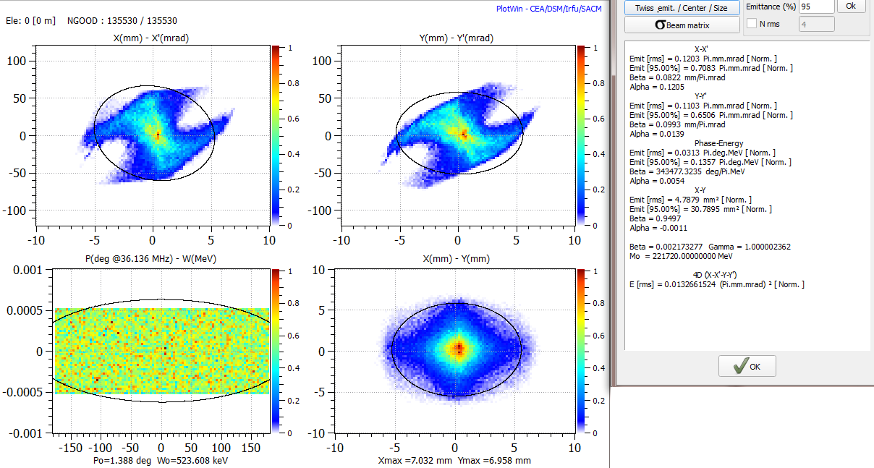
Baseline summary - input
We studied the beam sent to us by GSI which has been matched roughly to the RFQ acceptance using the UNILAC LEBT.

Slide 32
Baseline summary - input

