Slide 1
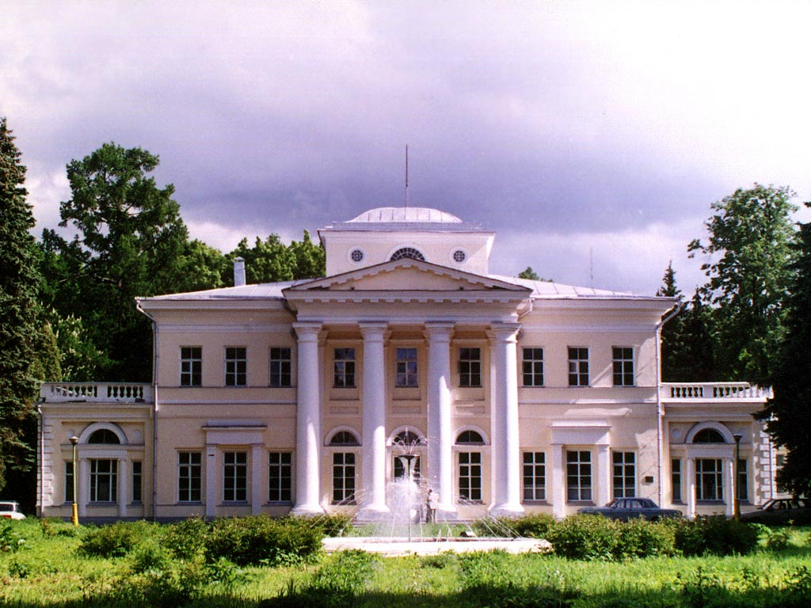
High power cw-linac RFQ development at Russia historical considerations for the 100th birthday of I. M. Kapchinskiy
T. Kulevoy
NRC “Kurchatov institute” - ITEP

Slide 2
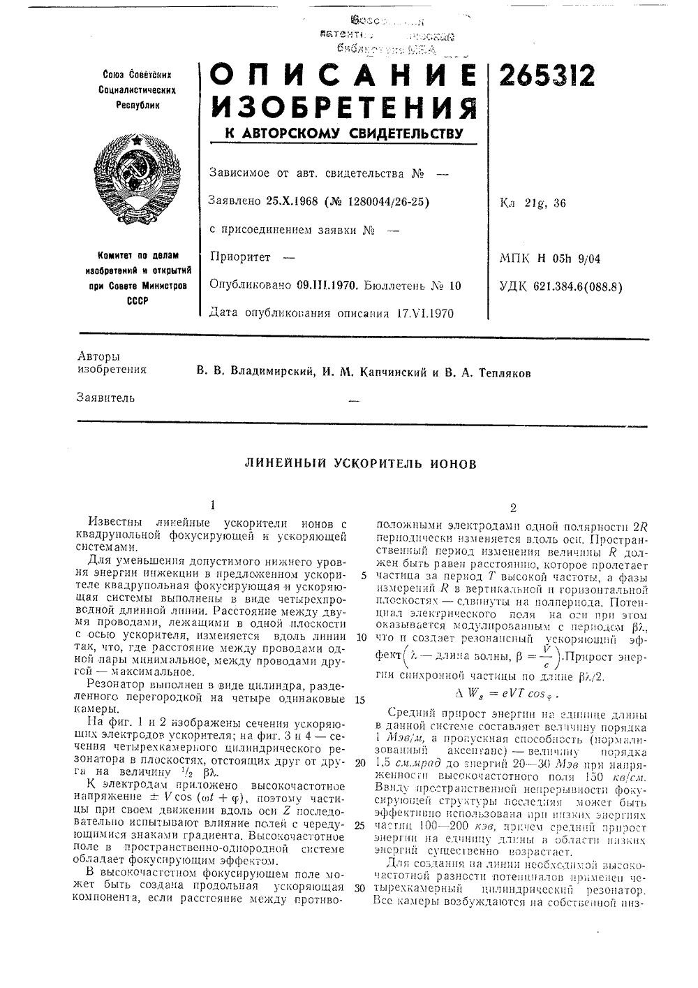
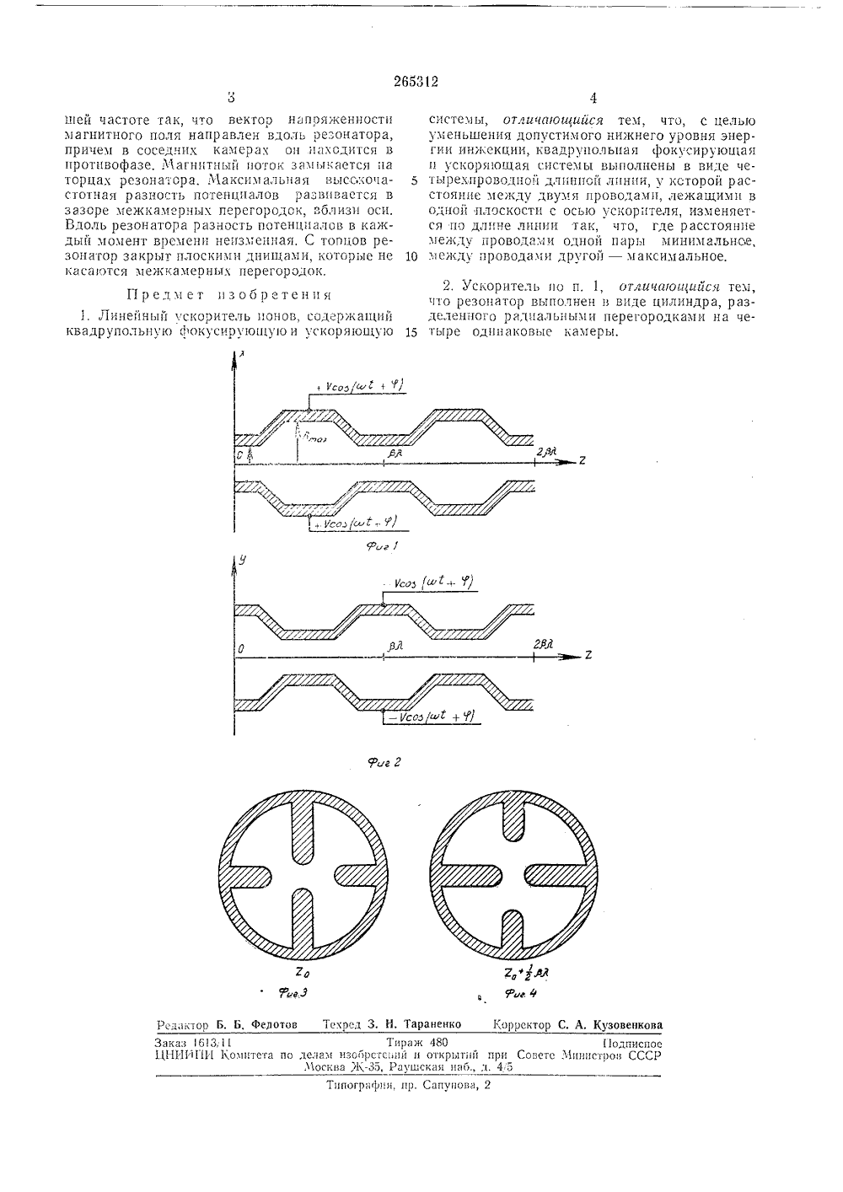
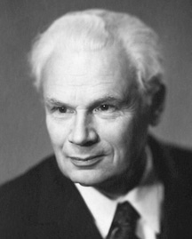
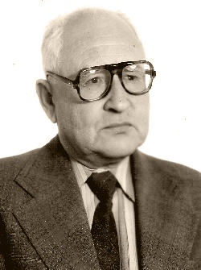
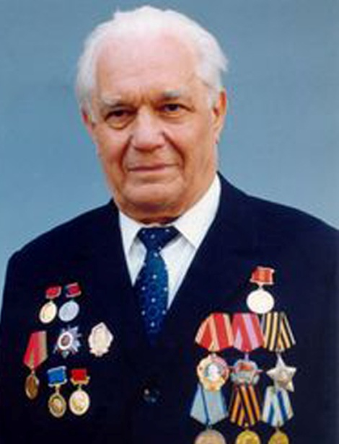
25.X.1968
Vasiliy
Vladimirskiy
1915-2008
Ilia
Kapchinskiy
1919-1993
Vladimir
Teplyakov
1925-2009

Slide 3
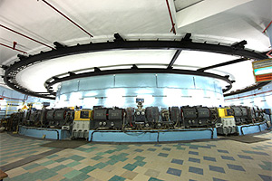
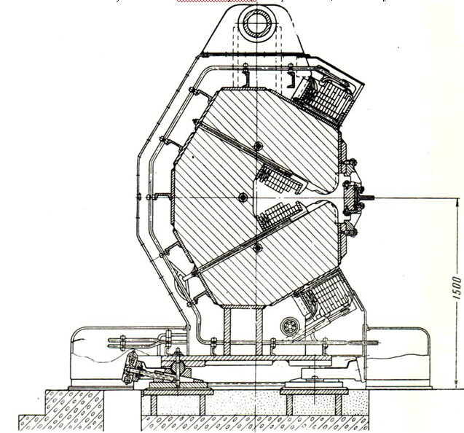
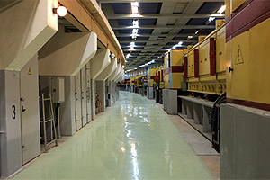
First Euro-Asian accelerator facility
with strong focusing system
Abram Alikhanov
Vasiliy Vladimirskiy
Ученый Совет к 70-летию института

Slide 4
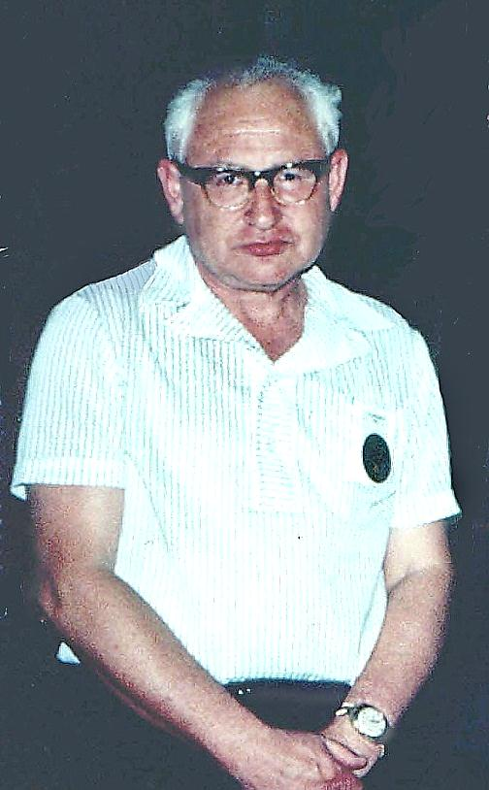
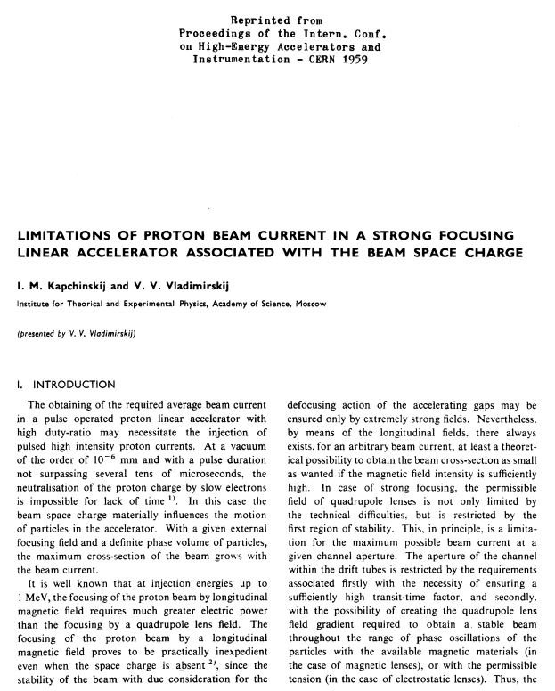
KV- distribution

Slide 5
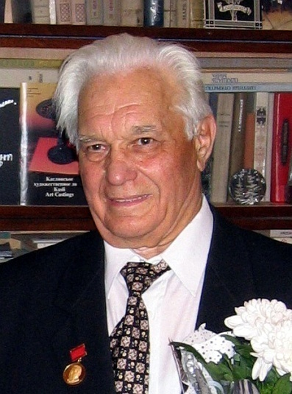
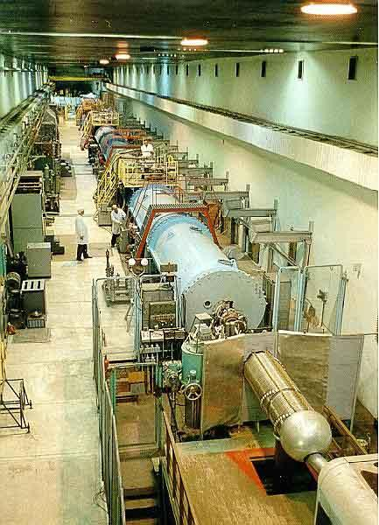
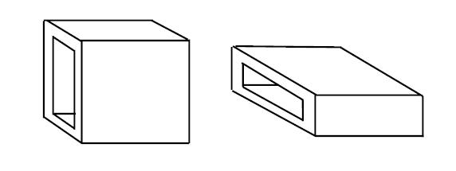
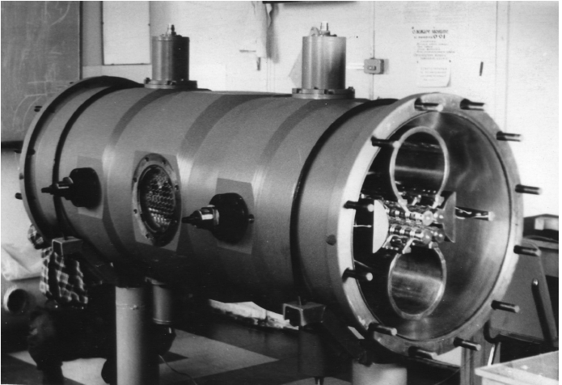
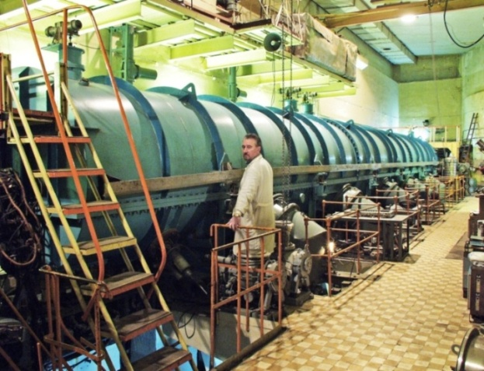
Serpukhov Linac - Two Giants meeting
I-100, IHEP
match boxes
Ilia
Kapchinskiy
Vladimir
Teplyakov
Alvarez linac with rectangular apertures
I-2, ITEP

Slide 6
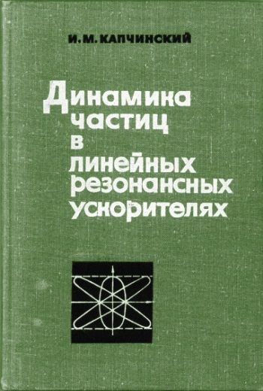
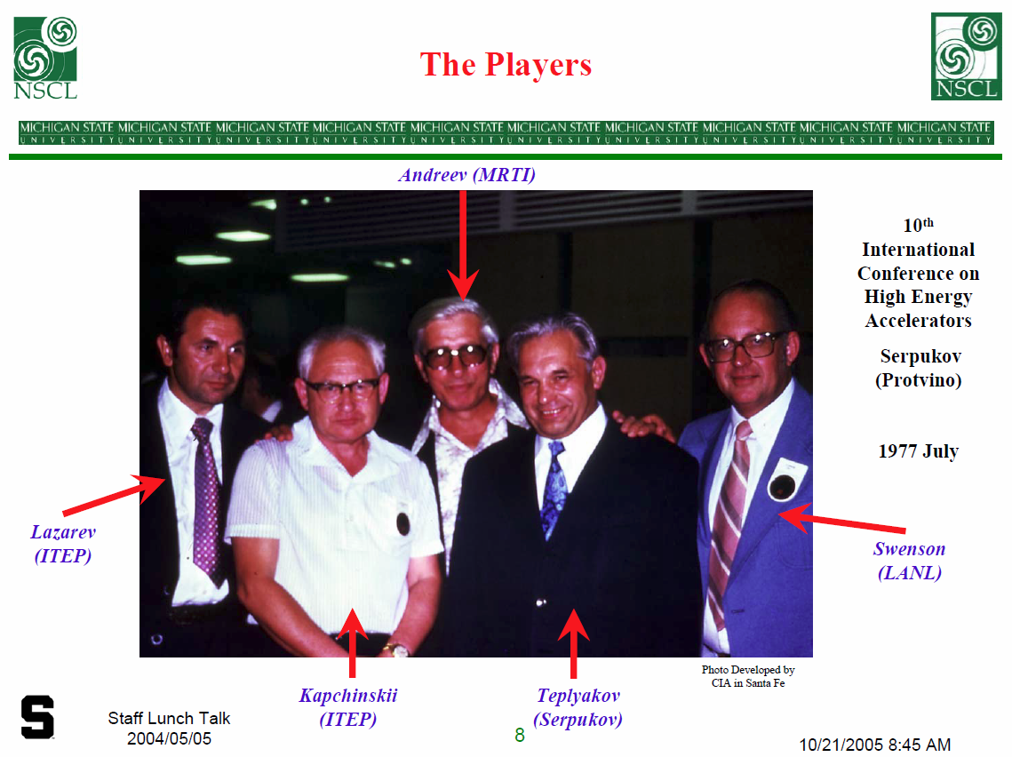
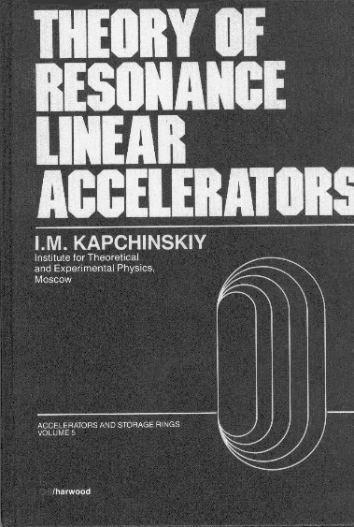
RFQ begins it’s
march through the world
M. Kapchinskii and V. A. Teplyakov, “Linear Ion Accelerator with Spatially Homogeneous Strong Focusing,” Pribory i. Tekhnika Eksperimenta, 119, No. 2, pp. 19-22, March-April 1970.

Slide 7
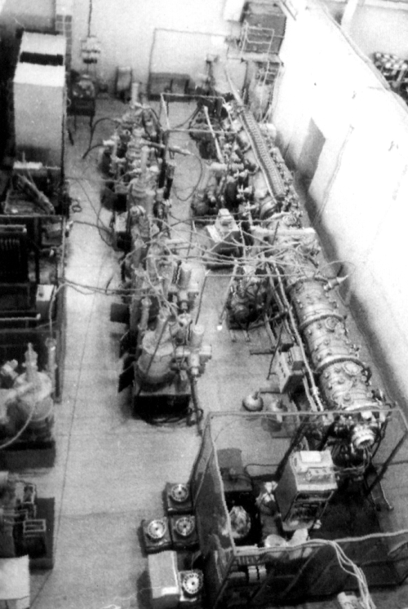
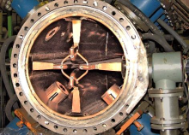
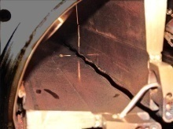
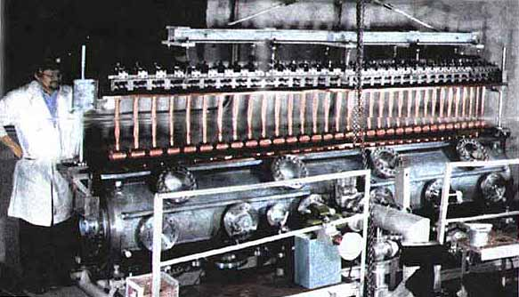
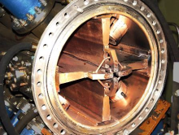
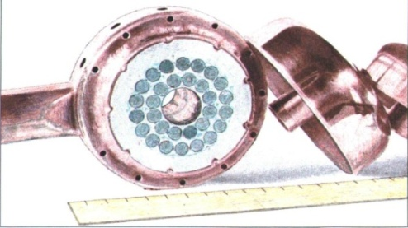
High current Linac ISTRA-56
First RFQ with 4-wane resonator.
Parameter | RFQ | DTL1 | DTL2 | DTL3
Energy, MeV | 0.08-3.0 | 3.0-10.3 | 10.3-36.3 | 36.4-56,6
Frequency, MHz | 148.5 | 297
Length, m | 4.5 | 3.9 | 11.7 | 9.2
Diameter, mm | 449 | 650 | 630 | 580
DT diameter, mm | - | 100 | 85 | 85
Aperture diameter, mm | 15 | 18 | 18 | 24
Beam current, mA | 200
Repetition tate, pps | 25
Average current, μA | 500
DTL-1 with permanent magnet quadrupoles
Drift tube with permanent magnet
Second version

Slide 8
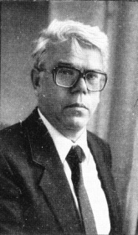
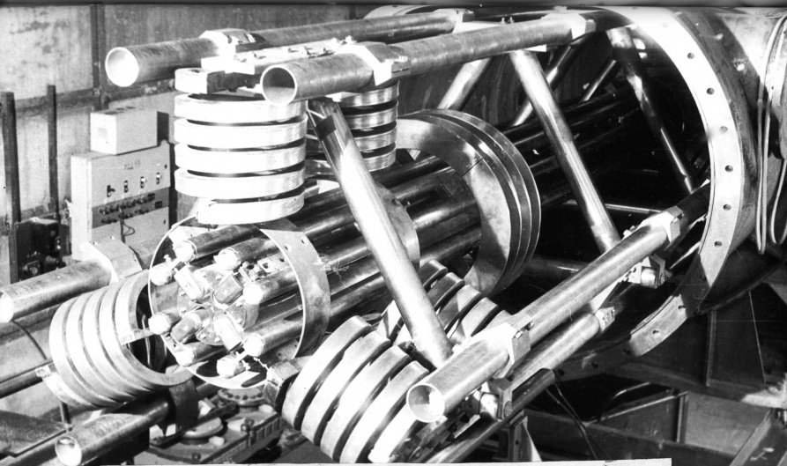
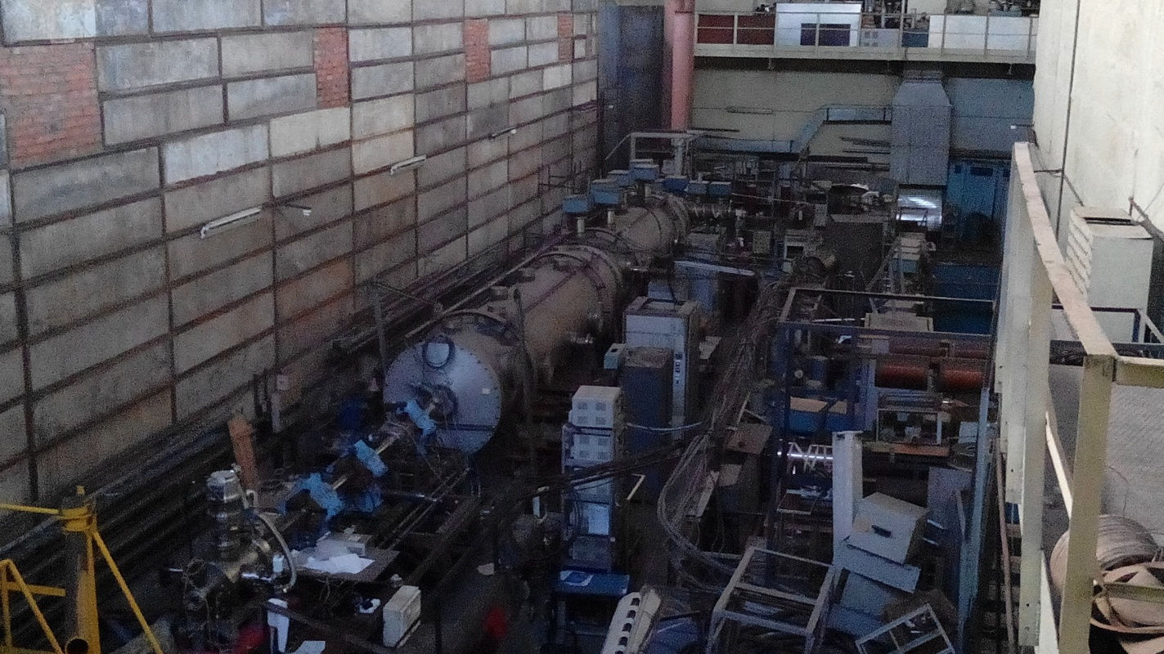
Heavy ion prototype for inertial fusion
Viktor Kushin
Z/A | ≤1/92
Input energy, keV/nuclon | 0.95
Output energy, keV/nuclon | 36
Frequency, MHz | 6.19
Length, m | 12
Inner diameter, m | 1.2
Radius of aperture, mm | 14.67
Accelerating efficiency at30 mА, % | 96
Pilse length, μs | 15 - 150
Average current, μA | 1.1

Slide 9
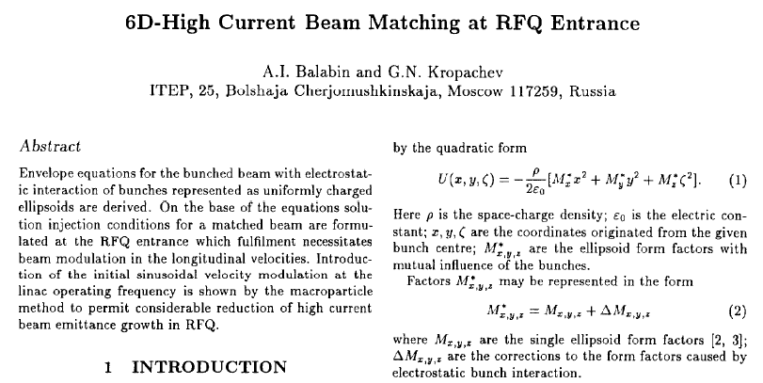
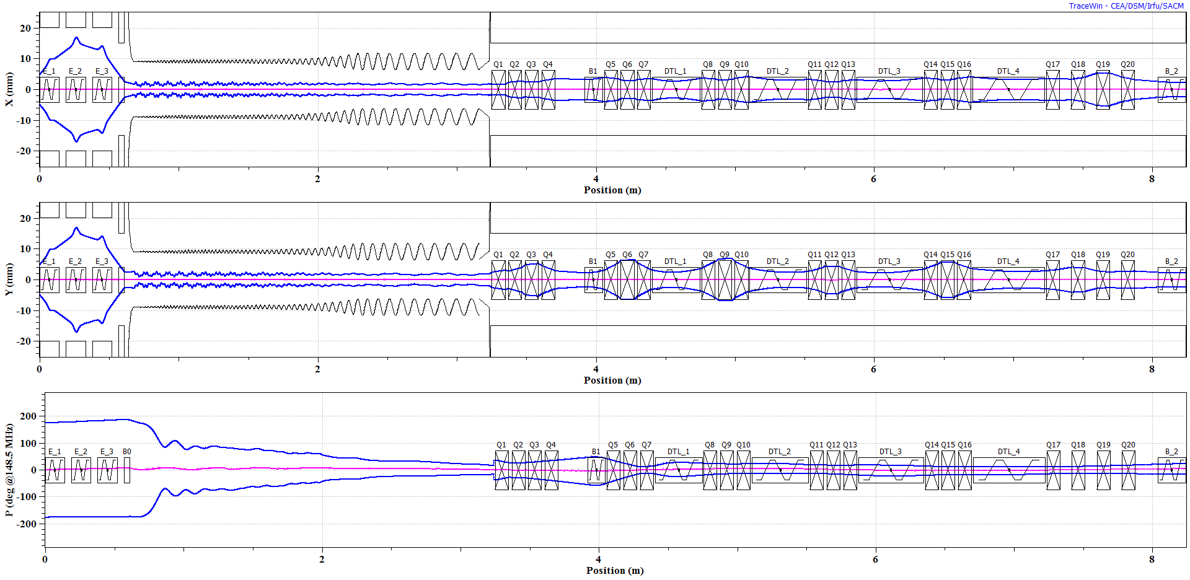
Several basic ideas
Simultaneous acceleration ions
with different A/Z
A.I.Balabin, On the possibility of simultaneous acceleration of ions with different charge to mass ratio in a RFQ, NIM A, V. 348, Iss.1, 1994, Pp. 1-2
V.Batalin, Y. Volkov, T. Kulevoy, S.Petrenko “The acceleration of different specific charge ions in the heavy ions RFQ linac”, LINAC-96, 1996, Geneva, pp.719-721
6-D matching with RFQ
http://accelconf.web.cern.ch/AccelConf/e94/PDF/EPAC1994_1180.PDF
Transmission up to 98%
Decrease of emittance growth more than 2 times

Slide 10
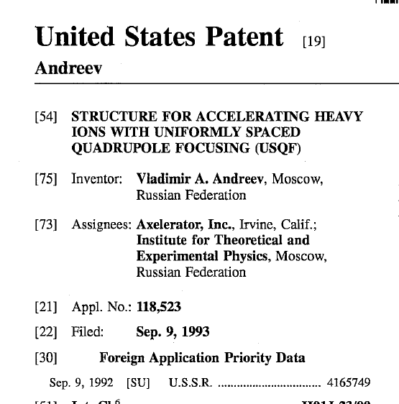
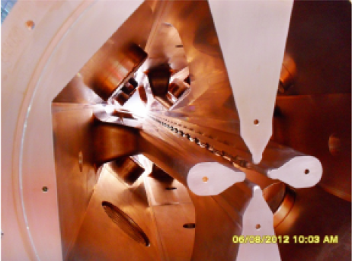
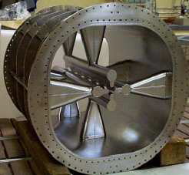
RFQ
shifted coupling windows
ATLAS RFQ
Photo- P.Ostroumov
HIAT2012
LNL-INFN SC RFQ
Photo – G.Bisoffi
http://accelconf.web.cern.ch/accelconf/e02/TALKS/WEBLA001.pdf

Slide 11
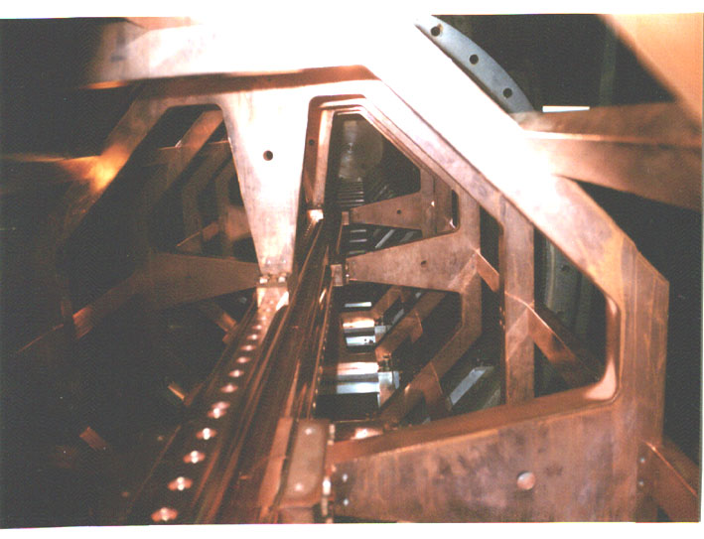
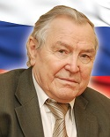
Heavy ion RFQ HIPr
(Heavy Ion Prototype)
Total length, m 12
Inner diameter of the tank, m 1.2
Ring number 21
Maximum outer ring size, mm 880
Ring thickness, mm 50
Cross-section of the bars, mm² 50x25
Frequency of quadrupole mode, MHz 27.7
Frequency of dipole mode, MHz 36.0
Q-factor, (measured) 5600

Slide 12
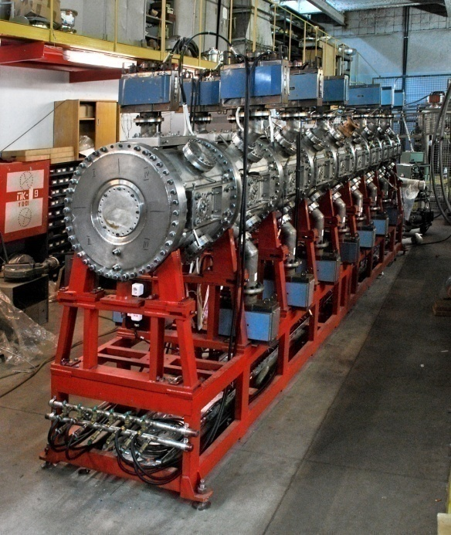
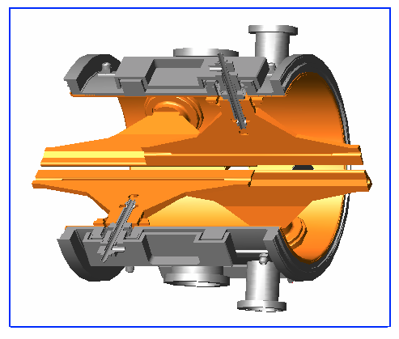
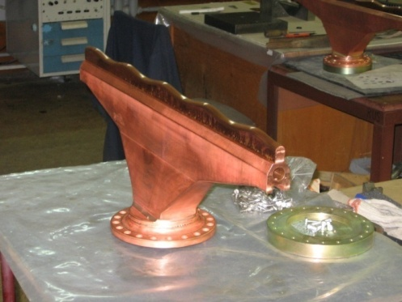
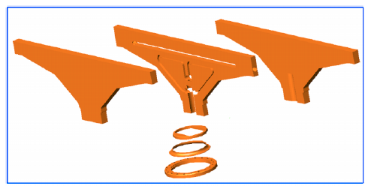
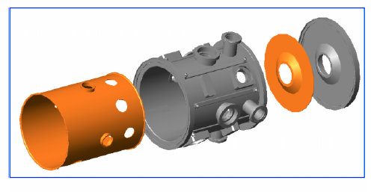
Heavy Ion RFQ I4
Parameter | Unit | Value
Operating frequency | MHz | 81.36
Charge to mass ratio |  | 1/3
Input/output energy | MeV/u | 0.02/1.566
Average radius | cm | 1.0
Vane tip radius | cm | 0.7
Voltage | kV | 182.5
Input emittance (norm) | mm*mrad | 3.2765
Input current | mA | 70
Length of the RFQ vanes | m | 6.258
Inner cavity diameter | m | 0.564
Quality factor |  | 11000
Pump’s flange
Plunger’s flange
Different layers of the vacuum tank and end flange
The regular cell of the RFQ.
channels in vane for cooling and alignment

Slide 13
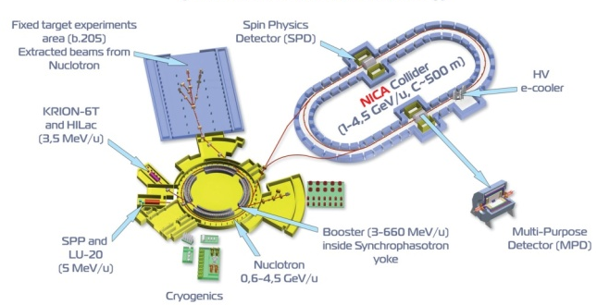
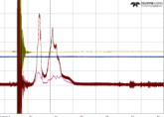
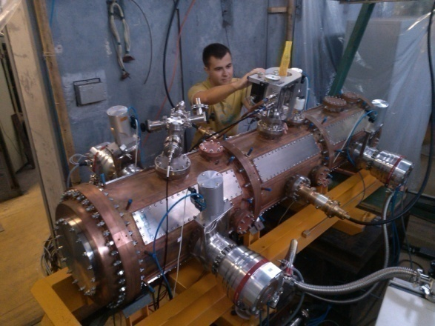
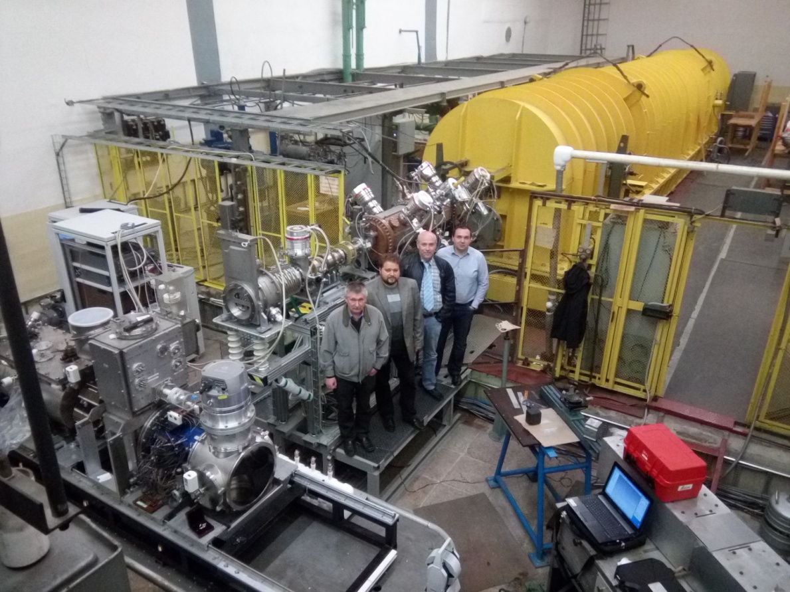
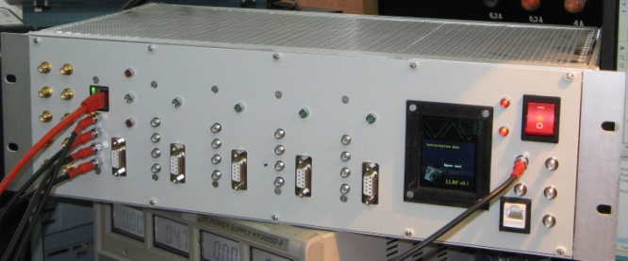
LINACs for NICA project
RFQ – for-injector for
polarized ion beam program

Slide 14
Recent international activity in
frame of CW-Linac development
CW RFQ development in a collaboration
with GSI and MEPhI
Sergey Polozov, Winfried Barth, Florian Dziuba, Timur Kulevoy, Stepan Yaramyshev, Yury Lozeev, "Beam Dynamics Study for the New CW RFQ", RuPAC'16 (2016)
Sergey Polozov, Winfried Barth, Timur Kulevoy, Stepan Yaramyshev*, "Beam Dynamics Simulations and Code Comparison for a New CW RFQ Design", HB'16 (2016)
M. Schwarz, S. Yaramyshev and K. Aulenbacher, W. Barth, M. Basten, M. Busch, T. Conrad, V. Gettmann, M. Gusarova, M. Heilmann, E. Khabibullina, K. Taletskiy, T. Kulevoy, T. Kuerzeder, M. Miski-Oglu, H. Podlech, S. Polozov, A. Rubin, A. Ziiatdinova, "Reference Beam Dynamics Layout for SC CW Heavy Ion HELIAC at GSI", (to be published)

Slide 15
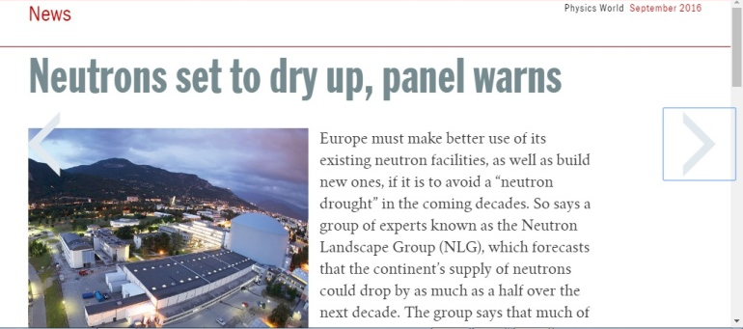
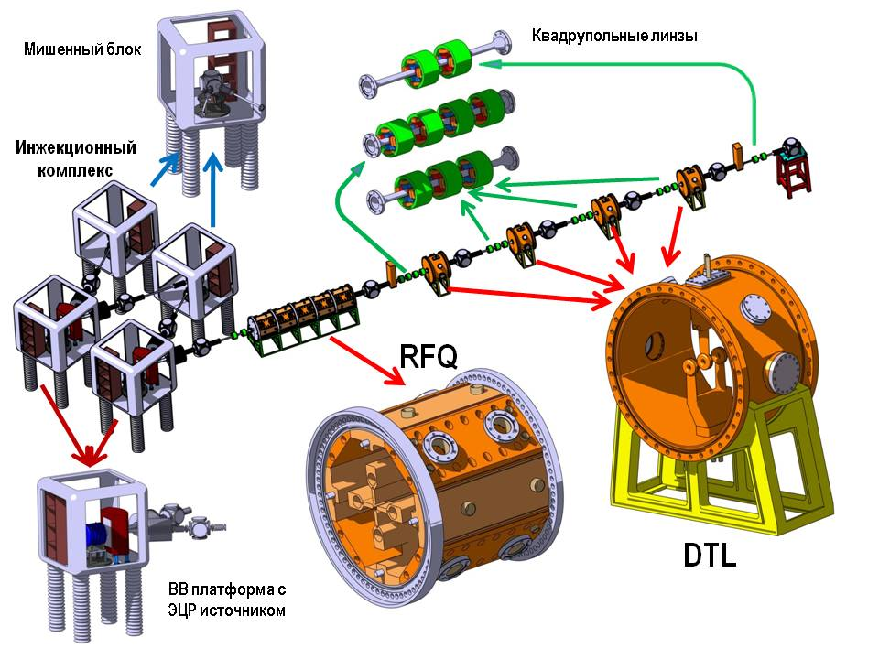
Neutron sources forth of strongest one is over if weak ones don’t support him every day
BELA
Target HV platform
Focusing elements
Injector facility
The expert group says, however, that neutron levels could be kept at up to two-thirds of today’s values until 2030, providing that the ILL is operated at full power until then, and that the ESS works at its planned power and is given 35 instruments instead of 22.
Ion source HV platform
Neutron generators based on LINAC
FRANZ, SARAF, IFMIF – EVEDA
DARIA

Slide 16
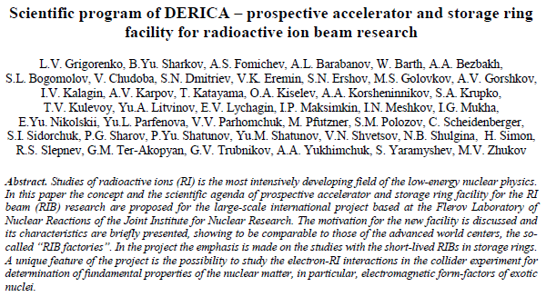
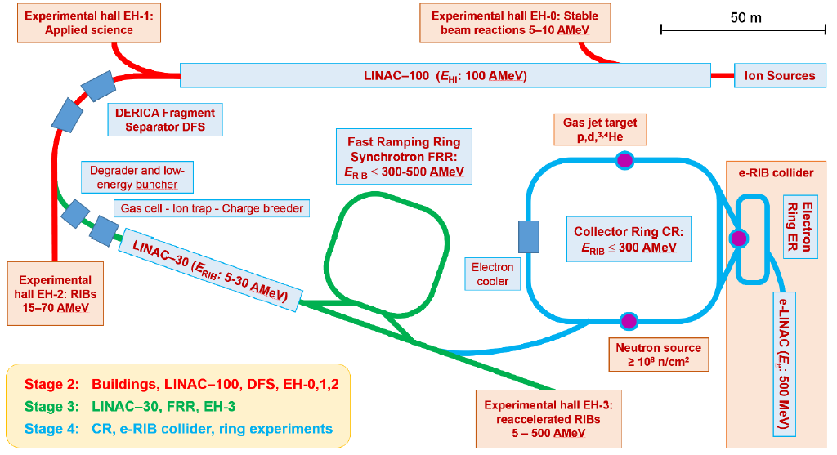
Concept of DERICA project (Dubna Electron – Radioactive Ion Collider fAcility)

Slide 17
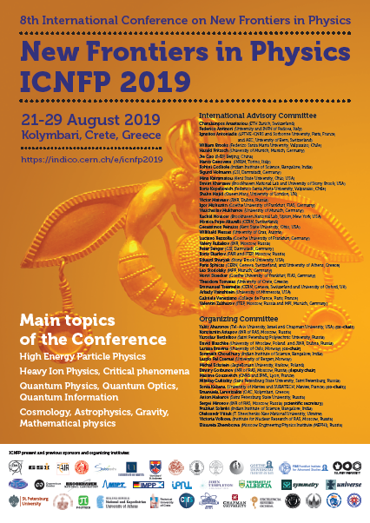
Concept of DERICA project (Dubna Electron – Radioactive Ion Collider fAcility)
Workshop on
Physics of Exotic Nuclei
22-23 August 2019
The workshop is organized in the framework of the ICNFP 2019 –
8th International Conference on New Frontiers in Physics.
The workshop should provide platform for discussions on physics of exotic nuclei in long-term prospect (years 2024-2030 and beyond) especially in relation with long-term strategic scientific planning at JINR, Dubna (Russia).
Scientific Topics of the meeting will be focused on:
Radioactive ion beam (RIB) physics
Generation of exotic nuclei by modern accelerator techniques
Specific of storage ring RIB physics
Electron-RIB scattering studies in collider experiments
Concept of Dubna Electron – Radioactive Ion Collider fAcility DERICA
https://indico.cern.ch/event/754973/page/14593-workshop-on-physics-of-exotic-nuclei
Technical meeting on conceptual design of prospective high-current heavy-ion cw-LINAC for RIB research at
JINR International Conference Hall, JINR, Dubna,
7-8 February 2019

Slide 18
Per aspera ad astra
Thank You for attention!

