Slide 1
SARAF RFQ - past and future
L. Weissman on behalf of SARAF team
Outline:
Brief introduction of SARAF Phase I
Brief chronicles of SARAF RFQ:
Problems/Failures -Improvements/Modifications
Plans for future in the context of Phase II

Slide 2
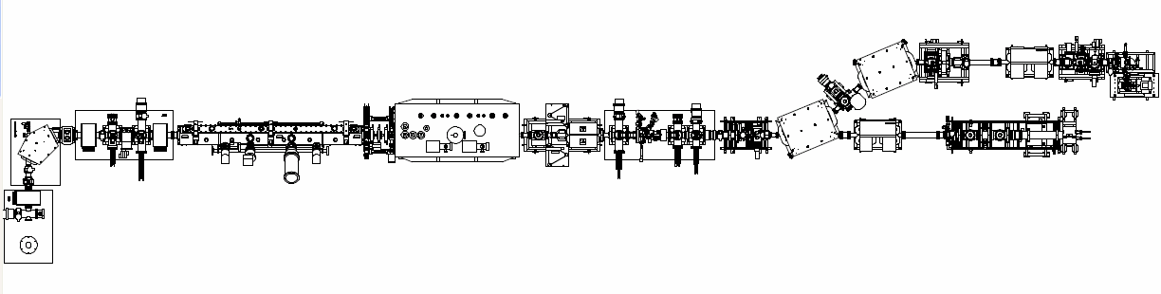

SARAF now
Phase I - 2012
Beam line - 2012
targets
MEBT
LEBT
RFQ (176 MHz)
PSM
D-plate
EIS
designed
specs
2 mA
Beam dumps
2 mA
D. Berkovits LINAC 2012
SARAF is operated with CW/pulsed protons and pulsed deuterons
CW proton beam – almost routinely : 1-2 mA at ~1.9-3.7 MeV (over 250 mA∙h)
CW deuteron beam –demonstration : 1.1 mA ~ 2.6 MeV ( < 1 mA∙h )
SARAF is used for:
  Collecting expertise with high intensity beams
  Development of high intensity targets
  Research in nuclear astrophysics, nuclear physics, material science and medicine
  I. Mardor et al. Eur. Phys. J. A (2018)
Notes:
2
2

Slide 3
Phase I operation
target room/
experimental
infrastructure/
operator training
control group/
2nd operator
Phase II
ramp
LiLiT2
ramp
LiLiT1
LiLiT1
failure

Slide 4
SARAF tomorrow
targets
Phase II linac, IRFU/CEA - 2022
Phase II, CEA- 2022
Phase I - 2012
MEBT
Beam line - 2012
LEBT
PSM
RFQ
40 MeV, 5 mA, CW protons and deuterons.
Contract CEA/Saclay
N. Pichoff IPAC2018
D-plate
EIS
2 mA
Beam dumps
2 mA
LINAC 2012
The Phase I components EIS/LEBT/RFQ will serve as injector for Phase II
RFQ - 5 mA CW protons/deuterons
Notes:
4
4

Slide 5
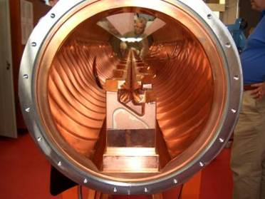
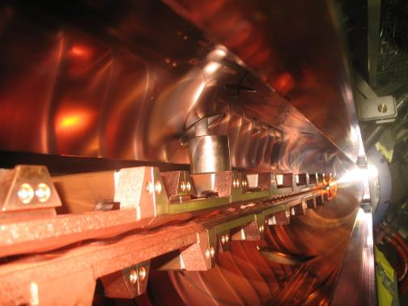
Radio Frequency Quadruple injector
4 rods structure traps and transport
the low-energy beam
Acceleration and bunching is performed
by sophisticated modulation of the rods
built by NTG/U. Frankfurt
RFQ worked, but ….

Slide 6
RFQ conditioning (early years)
Deuterons CW (65 kV)
Protons CW (32 kV)
Stable operation of deuterons only at low DC(<20%)
L. Weissman LINAC2010

Slide 7
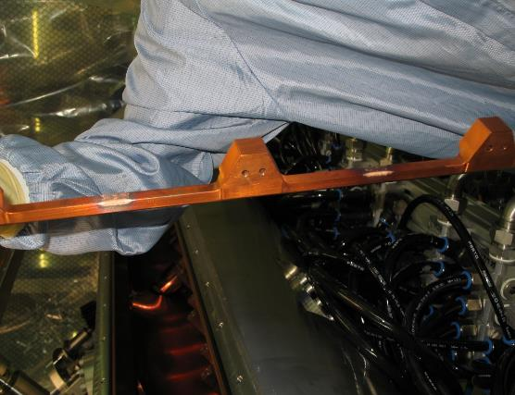
Discharge rods v.s. stems (~2008)
Part of input power lost to discharge
High X-ray rates observed at high power
Discharge marks observed between back side of rods and stems of adjacent rods
Rods modified to enhance distance to stems
Modification changed capacity, which in turn changed resonance frequency and compromised field homogeneity

Slide 8
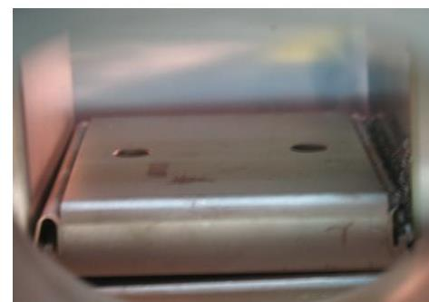
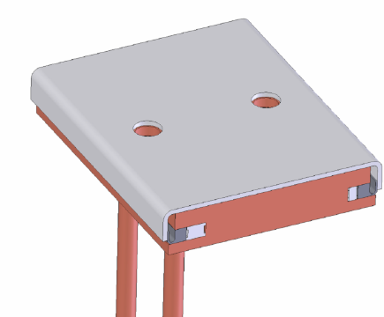
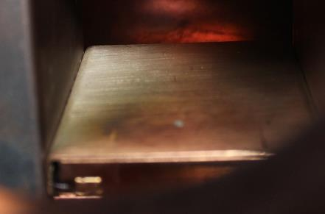
Burning of tuning blocks (2009)
Burning contact springs of the tuning blocks
2nd generation of tuning blocks (NTG, 2011):
massive silver plate
better current and thermal conductivity.
splint system for good mechanical contact.
3^{d} generation (NTG, 2015):
no screws for connecting to the base plate

Slide 9
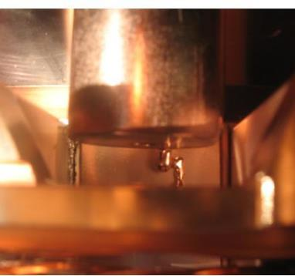
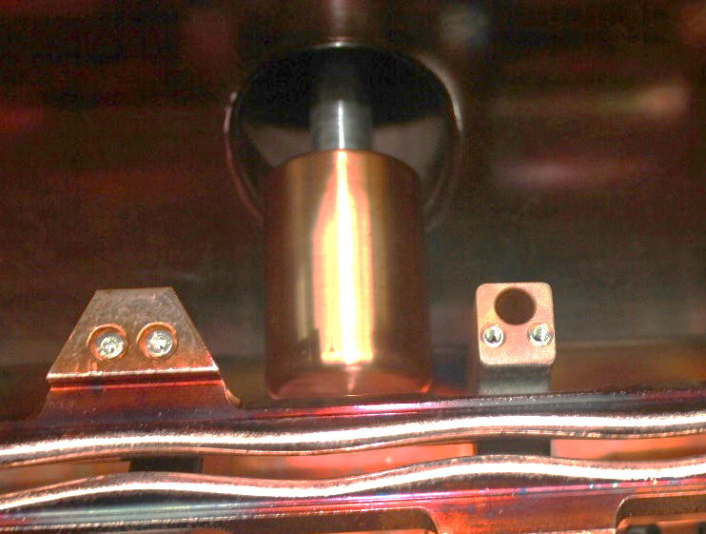
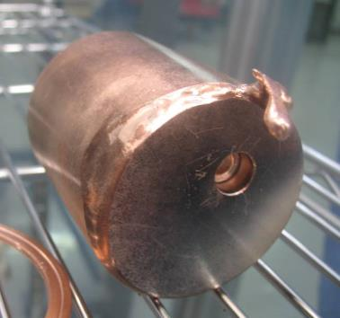
Melting of the tuning plunger (2009)
A plunger electrode has been melted together with the neighboring tuning block.
2nd generation plunger:
smaller but massive plunger
better cooling capacity (plunger & shaft made from one block)

Slide 10
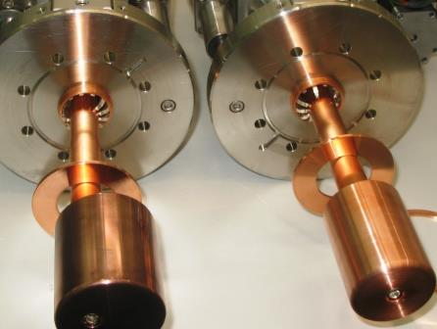
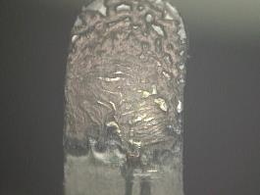
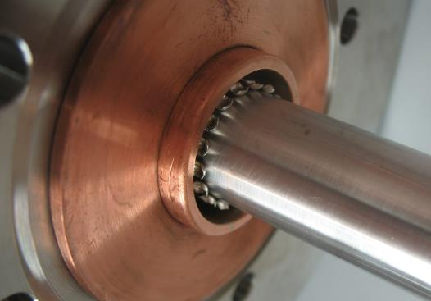
Sliding RF finger of plungers (2009)
Damaged and broken RF sliding contacts,
Sings of melting of contact surface
2nd generation plunger(NTG):
more rigid fingers
larger contact area
rhodium plated shaft

Slide 11
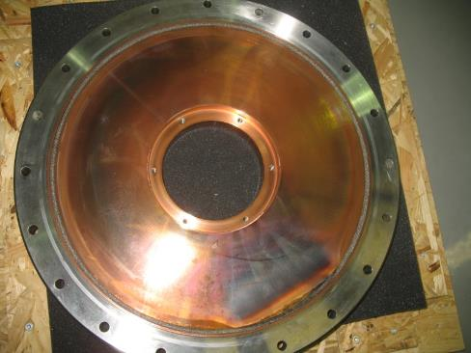
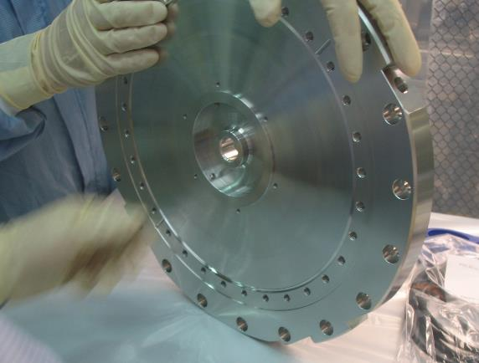
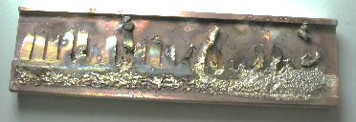
RFQ end flanges (2009)
RFQ end flanges :
strong warming (no water cooling)
signs of colorations
the RF contacts to the base plate damaged
2nd generation end flanges:
water cooling
improved RF contacts

Slide 12
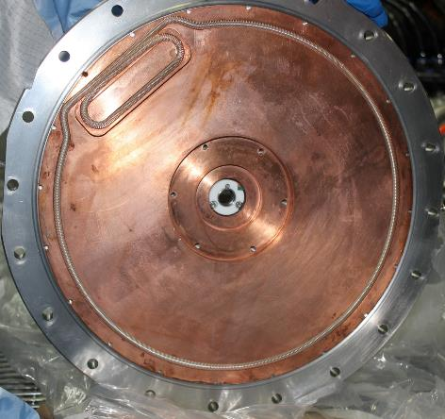
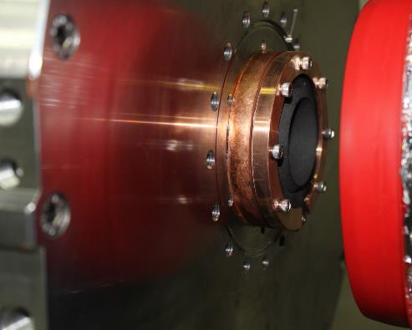
3^{d} generation end flange (2014)
New upstream end flange:
better cooling
better RF contact
insulated cooled graphite collimator
suppressor electrode
J. Rodnizki, SNRC report 4516 (2014)

Slide 13
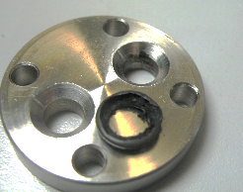
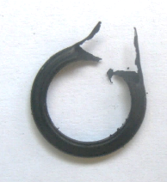
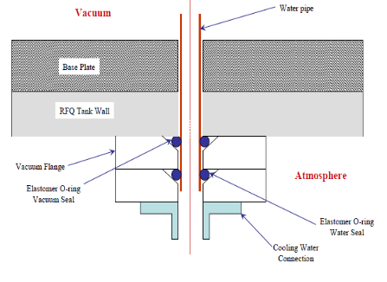
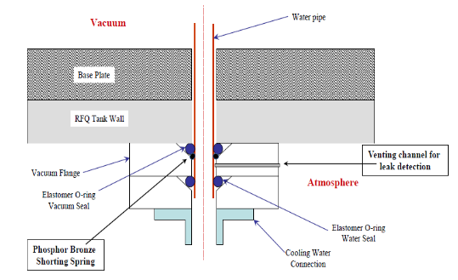
Vacuum seals of cooling lines
Hundreds of elastomer o-rings
Experienced number of events when
o-rings were severely damaged
Intermediate solution (Lampert, 2011):
spring for electrical contact
channel for discovery virtual leaks

Slide 14
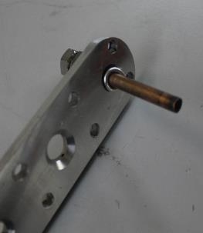
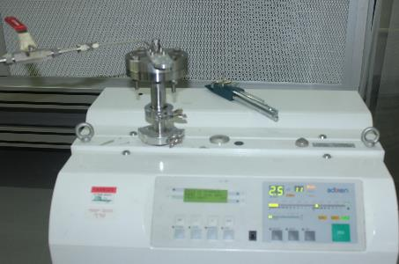
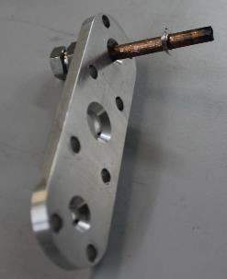
Indium seals option
In 2018 it was demonstrated indium seal perform well with RFQ water flanges
Replacement of all o-rings to indium seals is considered
Such replacement will solve problem of o-ring damage and improves RFQ vacuum pressure (o-rings permeation)

Slide 15
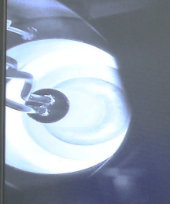
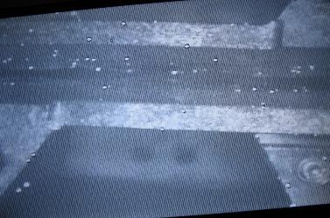
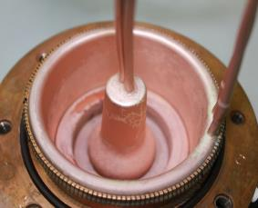
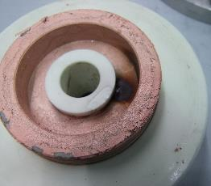
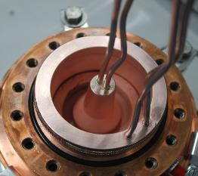
Problem with the couplers
After many improvements it become evident the last weak point is the RFQ coupler
Over 2013-2019 we had number of events associated with the coupler.
discharge in the coupler
region caught on the camera (2013)
“hot spots” on electrodes associated with coupler events
observed in 2013-14
Copper painted ceramics
2013
2015
2019
In 2015 we produced 3 couplers and ordered 2 (NTG) and ordered 8 ceramics. (J. Rodnizki)

Slide 16
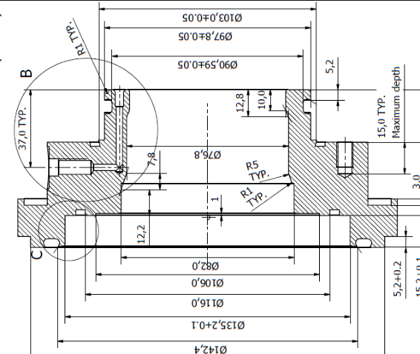
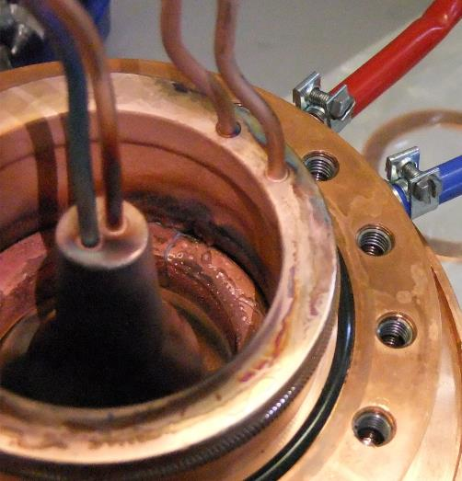
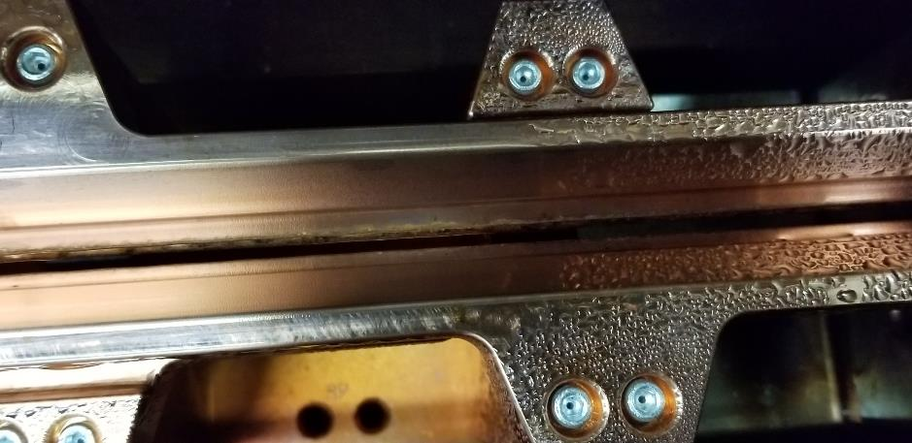
The recent failure (2019)
A dramatic event when significant amount of water was introduced into RFQ
The water leak was in the coupler based due to manufacturing defect

Slide 17
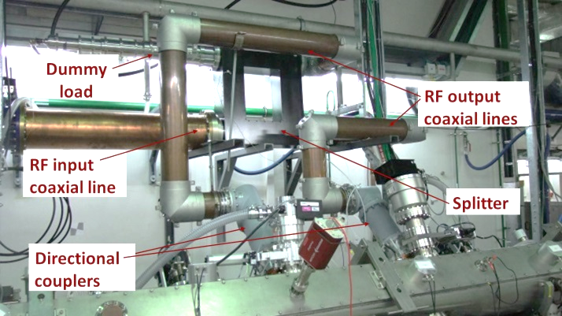
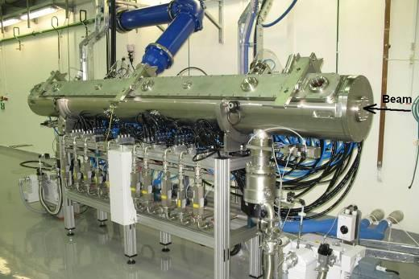
RF power splitting (2015)
Two couplers
J. Rodnizki, B. Kaizer, LINAC 2016
The RF load on each coupler is reduced by 50%

Slide 18
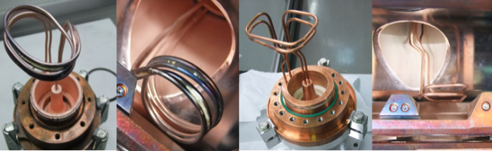
2nd generation coupler (2015)
Did not observed “hot spots” anymore
J. Rodnizki

Slide 19
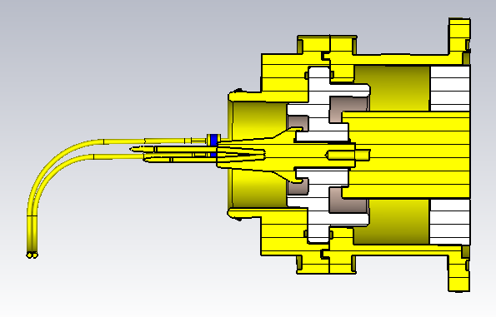
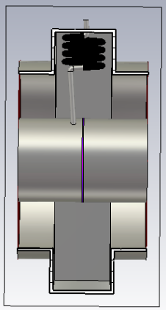
DC bias on coupler (2019)
DC HV
DC break
in the antena
DC break
in coaxial line
B. Kaizer (2019)

Slide 20
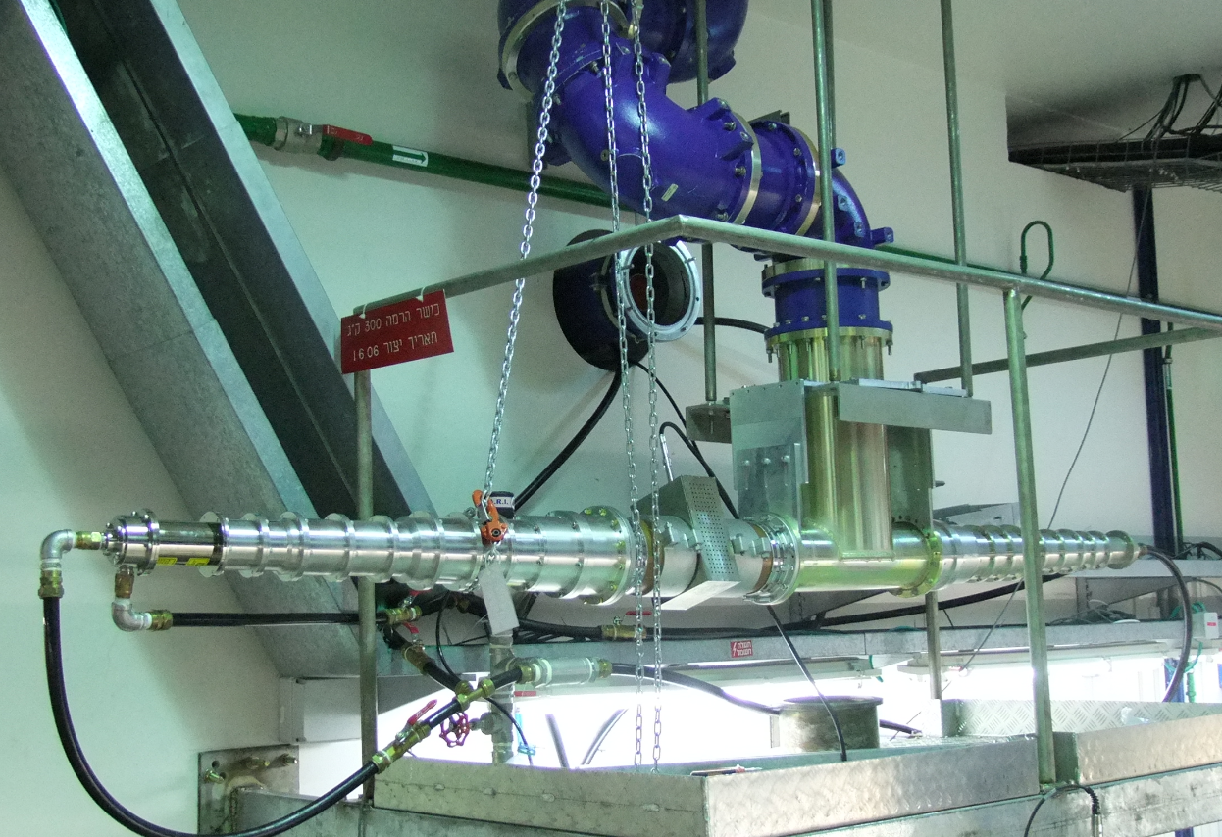
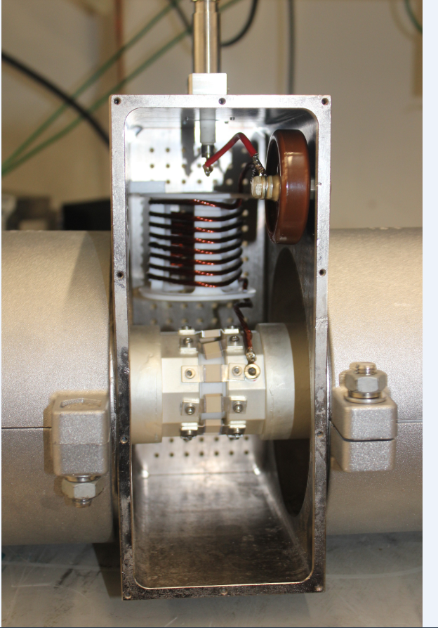
Test DC bias block (April 2019)
120 kW for 6 hours
B. Kaizer (2019)

Slide 21
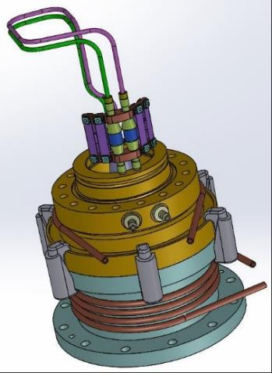
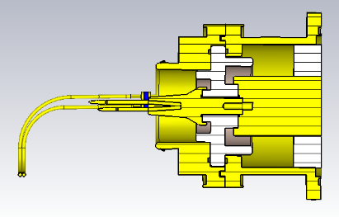
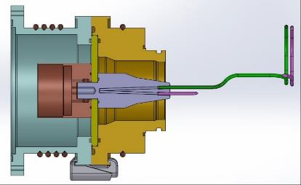
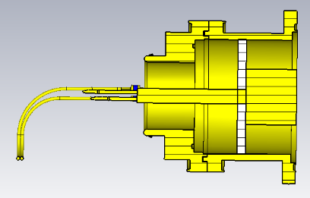
3^{d} generation coupler (2019)
DC break
cooling
copper
base
simple shape
of ceramics
To reduce chance of arcing/discharge:
DC bias
optimized shape of ceramic and antenna
TiN coating of ceramic
better cooling
TiO layer on
ceramic
B. Kaizer (2019)

Slide 22
Modification of RFQ (2017)
New modulation with lower inter- electrode voltage has been designed
Reduction of power required for deuteron operation below 200kW
Scale down of existing solution, same transverse focusing
new | old
185 | 250 | Power/deuterons (kW)
56 | 65 | Voltage (kV)
1.52 | 1.54 | Kilpatrick
1.28 | 1.50 | Exit energy (MeV/u)
2 | 1 | RF couplers
A. Shor, J. Rodnizki, SNRC 4517 report (2014)
A. Shor, A. Perry, SNRC 4815 report (2017)

Slide 23
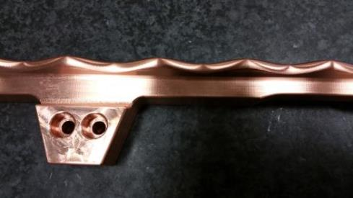
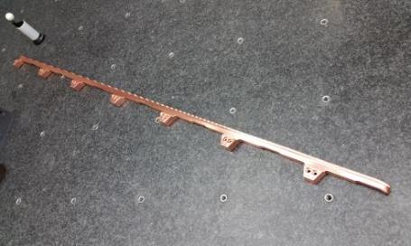
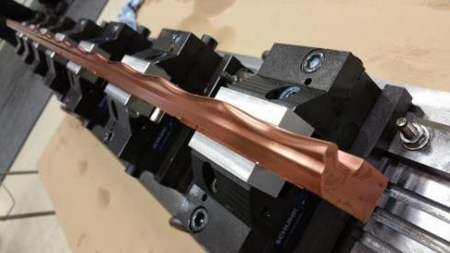
Modified rods (2nd generation)
New rods modulation designed by A. Shor fabricated by NTG
Details on installation, power conditioning and commissioning with beam in
L. Weissman et al , JINST 13 T05004 (2018)

Slide 24
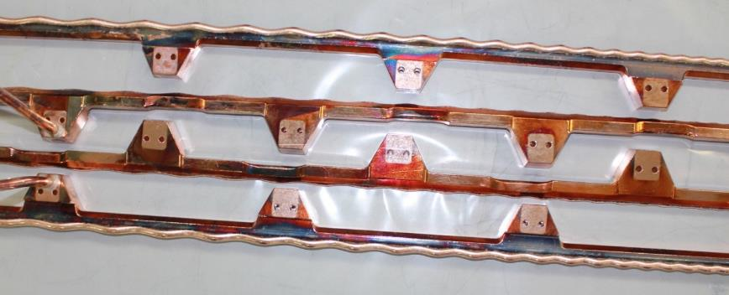
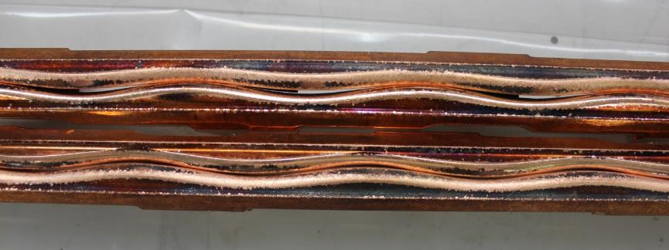
Disassembly of the old rods
operation since 2009
more than 200 mA h

Slide 25
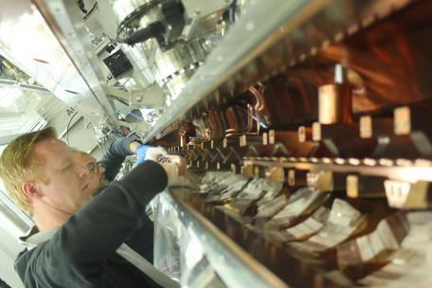



Assembly of the new rods

Slide 26


High power conditioning
180 kW ~6 h w/o trip
Conditioning to 180 kW (36 net hours)
Another 35 net hours
205 kW ~1 trip/h
In fact, had to vent RFQ 3 times:
Vacuum problems and rearrangement
of the tuning range of the plungers
In terms of the electrical field:
200 kW with new rods corresponds
to 260 kW of the old rods RFQ

Slide 27


Reflection events protection
2nd generation “reflection box”.
A. Perry, B. Kaizer, H. Dafna (2017)
Reflected
power event
t
3^{d} generation:
H. Dafna, A. Perry (2019)
Trigger to
the amplifier

Slide 28


Energy measurement
Si detector:
RBS
monitor
¹⁴⁸Gd ²²⁸Th
Scattered particles
pilot beam
50 μg/cm² gold on
0.5 mg/cm² carbon
Detector is carefully calibrated in-situ
with ¹⁴⁸Gd and ²²⁸Th alpha sources
protons
deuterons

Slide 29


Demonstration deuteron CW operation (2017)
MEBT BPMs
RFQ at pseudo CW 99.5 %
at 190 kW
1.15 mA low duty cycle pulsed
deuteron beam to the dump
Increased beam DC to 98 %
and kept beam on the dump
for ~ 30 min
Neutron dosimeter ~10 m away from the beam dump
First deuteron CW beam !

Slide 30
Summary of the RFQ specifications
Parameter | Designed value | Measured value
Energy (MeV/u) | 1.275 | 1.275(5)
Working power protons (kW) | 46.5 | 45-50
Working power deuterons (kW) | 186 | 180-190
Transmission protons (%) | 93 | 60 (for 5 mA)
Transmission deuterons (%) | 93 | 70 (for 5 mA)
Transversal emittance protons (p∙mm∙mrad) | 0.2 | ≤0.2 (for 5 mA)
Transversal emittance deuterons (p∙mm∙mrad) | 0.2 | ≤0.2 (for 5 mA)
Longitudinal emittance protons (π keV/u nsec) | 0.85 | 1.1 (low current)
Longitudinal emittance deuterons (π keV/u nsec) | 0.85 | non measured yet

Slide 31
Transmission vs LEBT current; new vs old
Some improvement in spite
the fact that the geometrical
aperture between rods was
reduced by 30 %

Slide 32
Original RFQ limited transmission
Why RFQ transmission is not sensitive, in a wide range, to LEBT beam optic,
LEBT vacuum and entrance flange electron suppressor voltage?
Protons are more sensitive to space charge. What is the LEBT space charge effect?

Slide 33



RFQ entrance (new flange)
New RFQ entrance flange (2104)
Metallic vacuum seals
Better RF contacts
Better cooling
Insulated collimator
Bias suppressor electrode
RFQ side
RFQ
LEBT
pulsed current
RF ON
pulsed current RF OFF
downstream RFQ
on the collimator

Slide 34


RF field effect vs proton energy
RFQ entrance collimator beam current
The effect depends on LEBT beam energy indicating its space-charge nature.
Most likely it is associated with compromising beam neutralization at the LEBT end
L. Weissman et al., ICIS 2017

Slide 35

RF field effect
Field amplitude at RF power ~ 1 kW
Plotted value is for 2 mm off axis position
red points - initial electron distribution
blue points – distribution 35 ns after switching the RF field
A. Perry

Slide 36
Loss of neutralization at the LEBT end
A. Shor
Need somehow to preserve neutralization at the LEBT end

Slide 37


LEBT matching to RFQ
0.34 T
w/o and with
space charge
Stepan Yaramyshev

Slide 38




The gentle quadrupole
98.5% inside acceptance
92% inside acceptance
Gentle Quad 275 Gauss
(Pole tip field, Y focusing)
96.5% inside acceptance
84% inside acceptance
Gentle Quad 0 Gauss
A. Perry

Slide 39
Summary
Number of modifications (including conceptual ones) were implemented over the decade 2009-2019:
2nd generation plungers
2nd and 3^{d} generation tuning blocks
2nd and 3^{d} generation of the end flanges
Improvement of vacuum barriers for the water cooling lines
Two additional turbo pumps
Improvement of cooling of the RFQ chamber in the coupler region
2nd generation of RF coupler
Splitting RF coaxial line and introduction of the second coupler
2nd generation rod structure for reduction of the required RF power
Additional important modifications will be introduced in the next future 2019-2020:
HV Bias of the coupler antennas
3^{d} generation of couplers
Indium seal for vacuum barriers of the cooling line
Addition of up to 5 getter pumps
Addition of gentle quad to LEBT
Commissioning 3^{d} generation reflection box
Addressing of space charge situation at the entrance of RFQ
Intense campaign with deuteron beams is planned prior the end of Phase I (2019)
Commissioning of RFQ to Phase II requirements (up to 5 mA CW protons/deuterons) will take place in 2020

Slide 40
People involved
SNRC – J. Rodnizki, B. Kaizer, A. Shor, A. Perry,
D. Berkovits, Y. Lunner, H. Dafna, A. Grin, I. Fishman,
T. Zchut, N. Tamim, D. Kijel, A. Barak, G. Lampert,
T. Horovits, D. Rubin, I. Gertz, I. Silverman, A. Kreisler
I. Gavish, T. Zaharony
NTG – A. Bechtold and colleagues
Univ. Frankfurt – Prof. A. Schempp, Ph. Fisher and colleagues
GSI- S. Yromyshev

Slide 41
SPARE SLIDES

Slide 42

Shim
Tuning block

Slide 43


Results of the alignment measurements
TOP
SIDE
Series 3
Series 4
Series 1
Series 2

Slide 44

Arrangement of the tuning plates
Introduction of dummy TB in the precalculated positions
Establishing the couplers positions to obtain good coupling
Measuring the field homogeneity using perturbation method
Optimizing the resonance frequency and field homogeneity
by shifting dummy TB heights (iterative process)
Exchanging the dummy TB to high power ones (critical point : cutting the
the water tubes)
Final measurement and tuning
Field homogeneity std dev =1.8 %, res. freq. 175.943 MHZ (air)
In the old rods std dev =2.7 %

Slide 45

Elements used for RFQ beam characterization
D-plate
slits/wires
phase probes
RBS/BEM
FFCs
LEBT
Aperture
FC/slits/wire
Slow chopper
RFQ
Entrance col.
X-rays det
cameras
theromocouples
MEBT
BPMs
BB/col.
wires
EIS
BB
Beam dump
FC/col
PSM

Slide 46


First beam through new RFQ
3 mA proton pulse
Measurements MEBT BB
cryomodule on maintenance
Beam current sensitive to
non accelerated particles
BPM signal
sensitive to beam bunching
The optimum
FP is ~ 45 kW

Slide 47


Beam loading, high intensity beam
BPM signal
5 mA beam loading on RF field
pick up signal
Without analog loop
With analog loop locked
Operation of RFQ w/o analog loop effectively requires higher average RF power

Slide 48
Transmission studies; beam loading effect
Protons
3.5 mA
4.6 mA
5.5 mA
Deuterons
with loop
w/o loop

Slide 49
Transmission vs LEBT current; new vs old
The measurements with old rods
was made in Dec 2015 in the same manner:
MEBT measurements,
similar LEBT optics,
the LEBT current was changed only
by varying RF power of the ion source
Some improvement in the transmission in spite the fact that the geometrical
aperture between rods was reduced by 30 %

Slide 50






Transversal emittance
x-x’
y-y’
0.15 π mm mrad
0.20 π mm mrad
Protons 4.3 mA
0.16 π mm mrad
0.20 π mm mrad
Protons 5.5 mA
0.14 π mm mrad
0.23 π mm mrad
Deuterons 5.0 mA
Transversal emittance is within the specification

Slide 51
Profiles at the RFQ exit new rods
MEBT profiles
New rods
MEBT profiles
Old rods
Do not observe power related steering effects

Slide 52

Energy measurement
Si detector:
RBS
monitor
¹⁴⁸Gd ²²⁸Th
Scattered particles
pilot beam
50 μg/cm² gold on
0.5 mg/cm² carbon
Detector is carefully calibrated in-situ
with ¹⁴⁸Gd and ²²⁸Th alpha sources
protons
deuterons

Slide 53



Measurement longitudinal emittance
RBS measurements have some sensitivity to energy spread
Attempt measurement of longitudinal emittance
by variation of longitudinal focusing with a cavity
Tune: HWR1 300 kV -90º
HWR2 500 kV +40º
HWR4 0-300 kV -130º
This tune should not increase too much
(~ 20%) the original emittance at RFQ exit
The energy and bunch profiles are
measured for different HWR4
bunching voltages

Slide 54

Measurement method
From RBS measurements
we know that RMS emittance
is bond in the limits at the
measuring position
We approximately matrix
transformation and can
calculate how thes boundary look like at HWR4
Making this transformation
for different bunching
HWR4 voltages we find
the limits of the RMS
emittance at HWR4 position
‘Beam Instrumentation and Diagnostics’,
P. Strehl. Pg. 267 & 325

Slide 55

Results protons
ε_{z} [RMS, π keV/u nsec] | 1.3
α_{z} [rad] | 2.2
β_{z} [deg/(%ofΔw/w)] | 19
resolution RBS 15 keV
The RBS results for emittance RMS ~ 1.3 [π keV nsec] at HWR4 pos.
Emittance at RFQ exit is 23 % lower ~1.1 [π keV nsec]
According to simulations emittance is ~1.3 [π keV nsec] for low current
~0.85 [π keV nsec] for high current
analysis by A. Perry

Slide 56


Insight into beam loss in RFQ
RFQ power
optimization LEBT
Vacuum pressure
increase current
increase current
Rate 2
det4
det3
det2
det5
det1
accordance to simulations
by B. Bazak
beam

Slide 57


RFQ overall leak tests

Slide 58
RFQ vacuum
RFQ base vacuum 2 10⁻⁷ mbar
With 1 mA CW beam at the exit the vacuum level is 10⁻⁶ mbar
What will be the vacuum level at 5 mA at the exit (9-8 mA at the entrance for
the present RFQ transmission) ?
And how this pressure affects RFQ operation at 200 kW ?
Need to be prepared to better pumping speed
Problems: availability of ports and pumping hydrogen (TP is less efficient)

Slide 59



New getter
pumps
capaciTorr HV 200

Slide 60

5 CF63 flanges on the RFQ lids are available for CapaciTorr HV 200 pumps
Propose not to use valves and switch the pumps off in the case of venting
In the case of pressure jump the pump heaters should be switched off
The pump can be vented more than 100 times
Installation of five pumps improves pumping of H₂ at least by a factor 2

Slide 61

Pumps or diagnostics
X-ray +Camera
Getter pump
At the moment the flanges are used for visual observations or x-ray detectors
The both are important
Compromise solution with some reduction of pumping and leaving diagnostics functionality
Improvement of diagnostics :
combining cameras and x-ray detectors
TV matrix with simultaneous observation of 7 video channels

Slide 62


LEBT simulation
Twiss parameters as function of space charge
simulated
Solenoid #2 @ 70 A
measured
zero beam neutralization
full beam neutralization
Simulation input:
4D Waterbag 5 mA protons @ 20 keV

Slide 63

LEBT simulation
Twiss parameters as function of focusing
Simulated with 100% beam neutralization
Beam is fully neutralized at the LEBT @ ~1x10⁻⁶ mbar
➔Beam focusing at RFQ entrance is not a direct cause for RFQ transmission reduction

