Slide 1
CR Status
Dmitry Shwartz
Ivan Koop
2nd BINP-FAIR Collaboration Coordination Workshop, FAIR, 20-25 May 2019

Slide 2
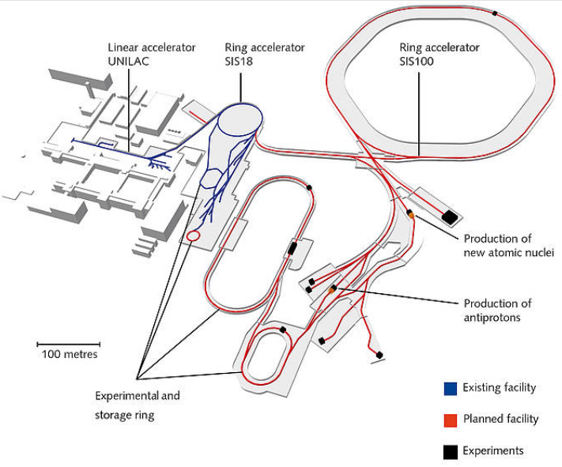
Collector Ring @ FAIR Project
HESR
CR

Slide 3
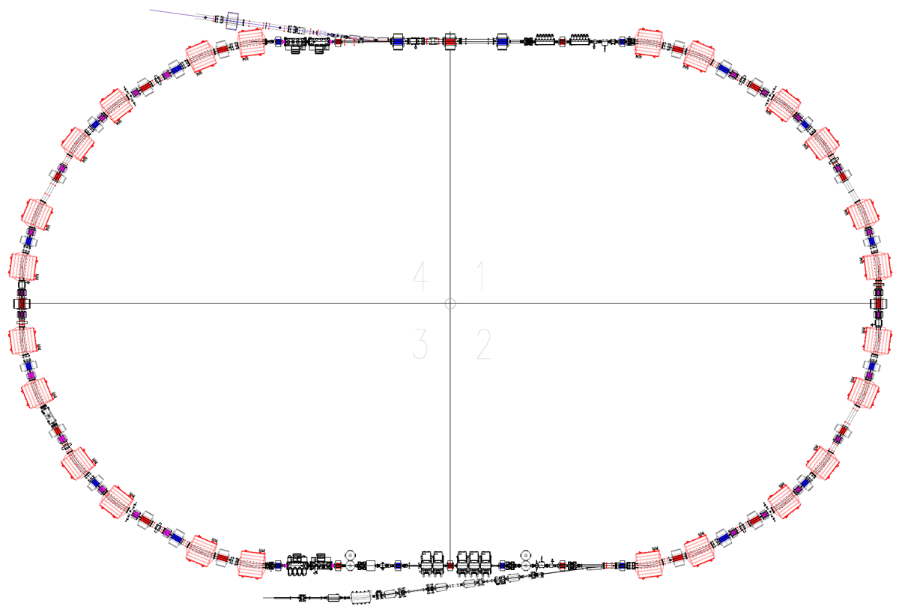
CR Layout
Injection from
P_bar separator
or SFRS
Space reserved for five
RF-cavities for future upgrade
Stochastic cooling
Kickers
Injection Kicker
magnets
 | Antiprotons | Ions
Perimeter, П | 221.451 m
Rigidity, Bρ | 13 T⋅m
Number of particles, N | 10⁸ | 10⁹
Kinetic energy, K | 3 GeV | 740 MeV/u
Velocity, v | 0.971c | 0.830c
Relativistic factor , γ | 4.20 | 1.79
Betatron tunes, ν_{x}, ν_{y} | 4.39, 3.42 | 3.40, 3.44
Revolution frequency, ω₀ | 1.35 MHz | 1.16 MHz
RF harmonic, q | 1
Stochastic cooling
Pickups
RF – cavities
Extraction
to HESR
ToF System

Slide 4
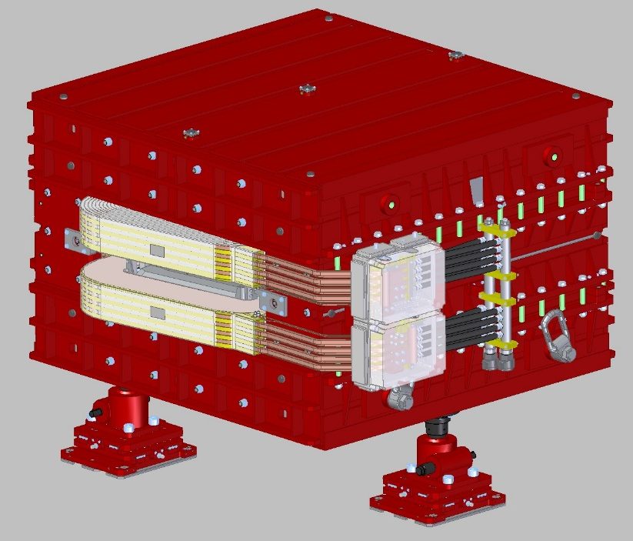
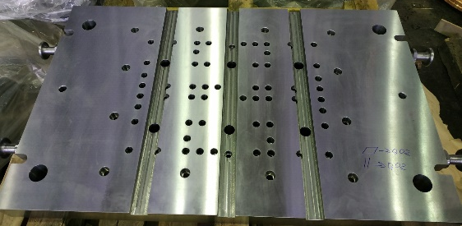
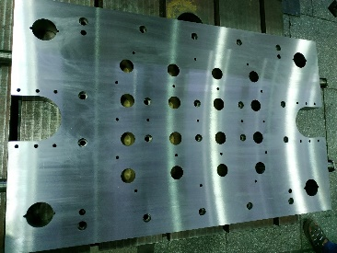
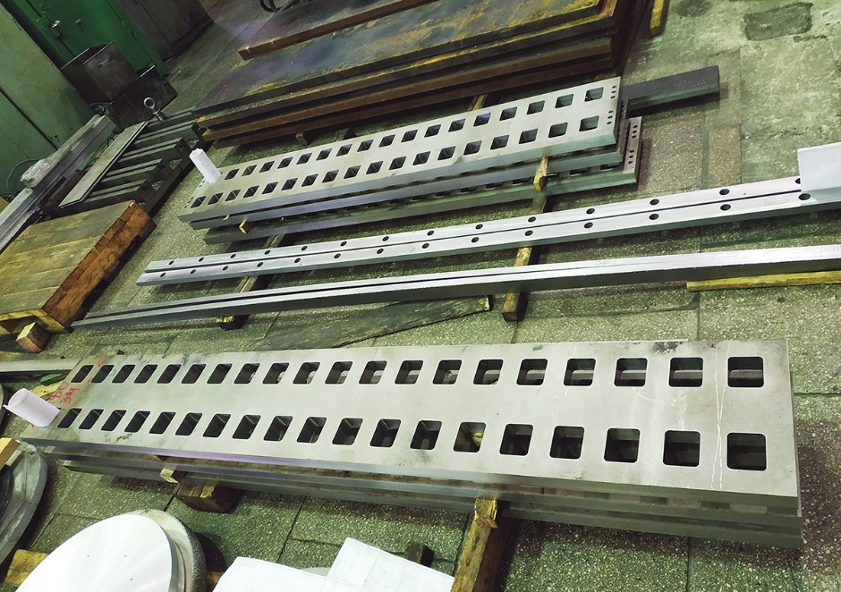
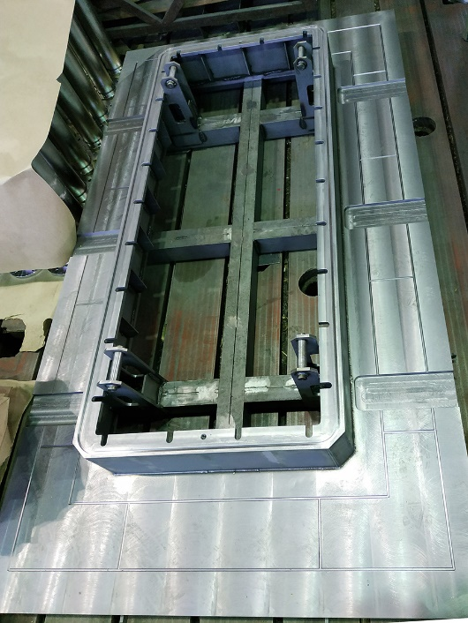
Magnets: Dipole
Status: CDR, FDR are released; FoS production is in progress
Parts of stamping tool for side spacers laminas
Parts of FoS dipole
Tooling for coils impregnation

Slide 5
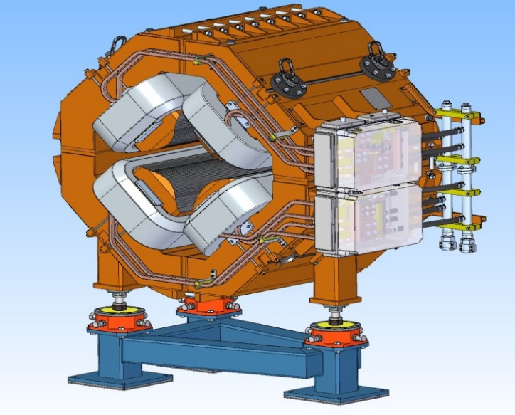
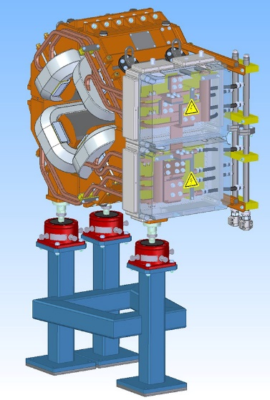
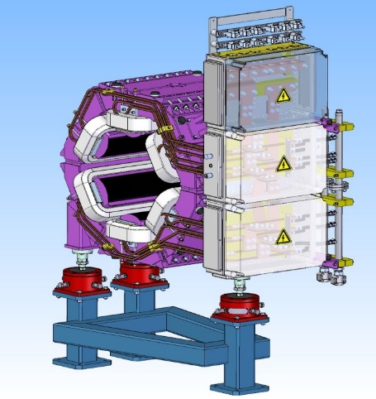
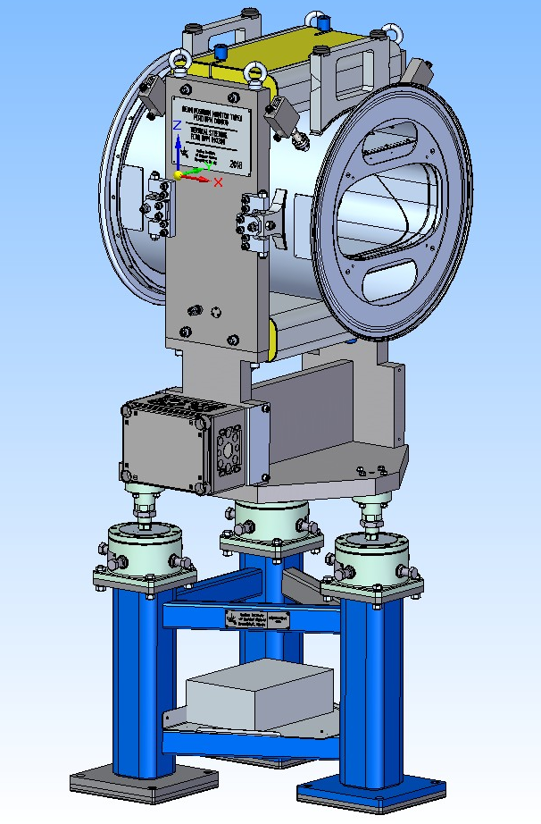
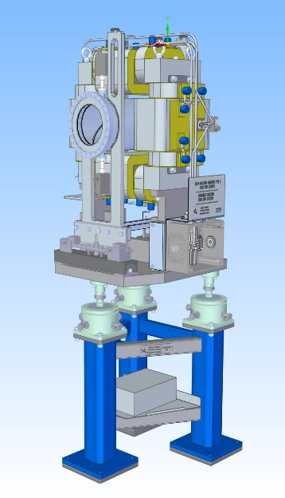
Magnets (2)
Quads: design is in progress, WQ CDR docs are ready
Sextupoles: design is in progress, CDR docs are ready
Steerers: design is ready, CDR is ready, materials procurement started
Octupoles: design is in progress
Decapoles: not in contract, desired by ILIMA, feasibility study is ongoing

Slide 6
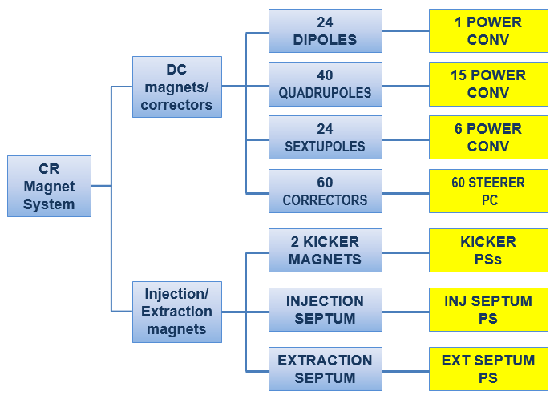
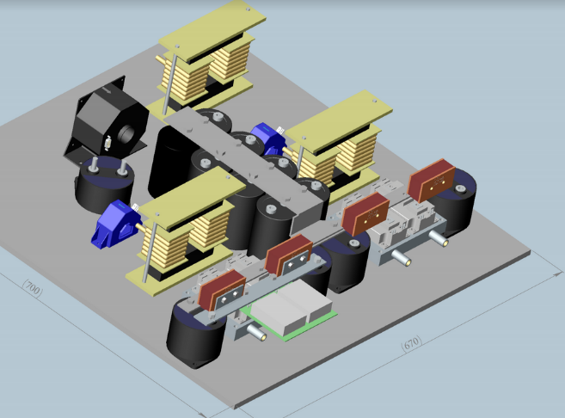
Power Converters
Status: Conceptual design in progress. Quads PC prototyping in progress.

Slide 7
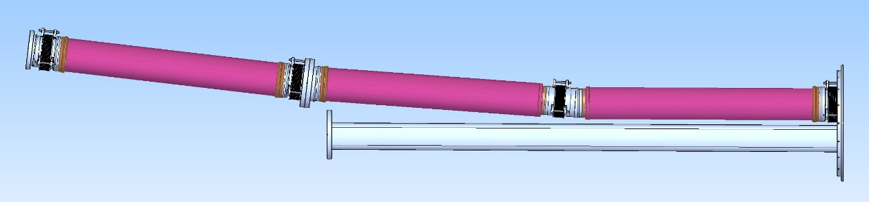
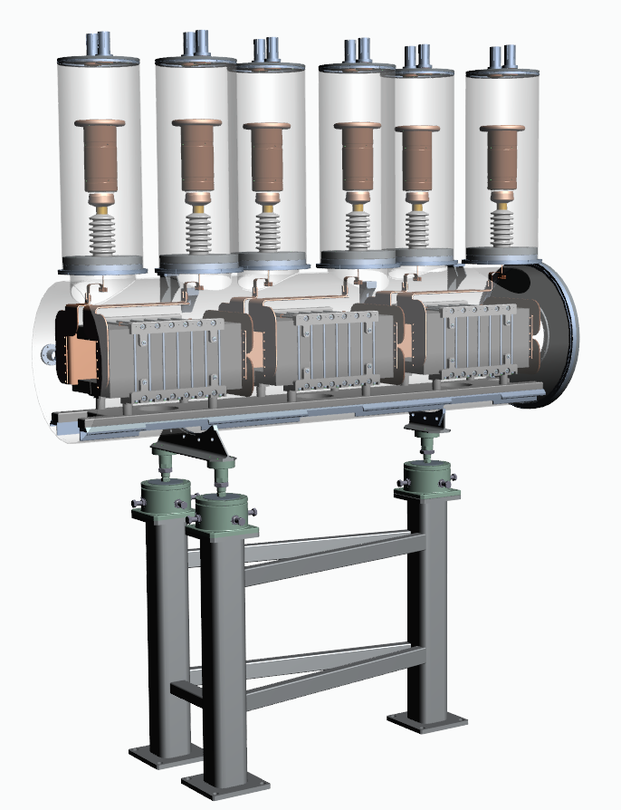
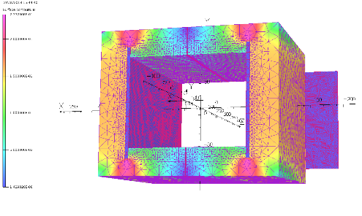
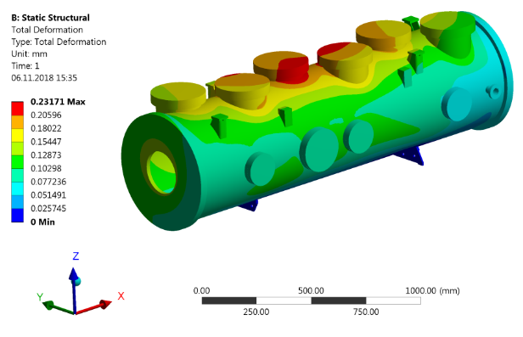
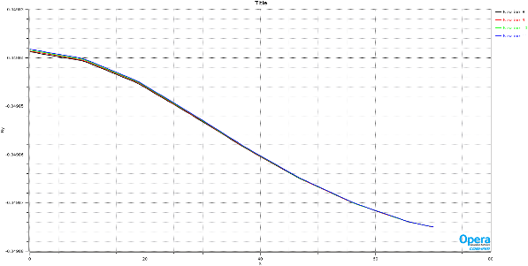
Injection/Extraction
Injection septa: design in progress, prototype of ceramic vac.chamber procurement ongoing.
Kickers: vacuum tank and magnets design nearly finished. PC conceptual design in progress. “HV cable problem” solved: procurement of halogen-free cable is feasible. Unclear questions: procurement of cables and ferrite via FAIR; assembling and testing of whole series @ FAIR?
dB/B=7*10⁻⁴

Slide 8
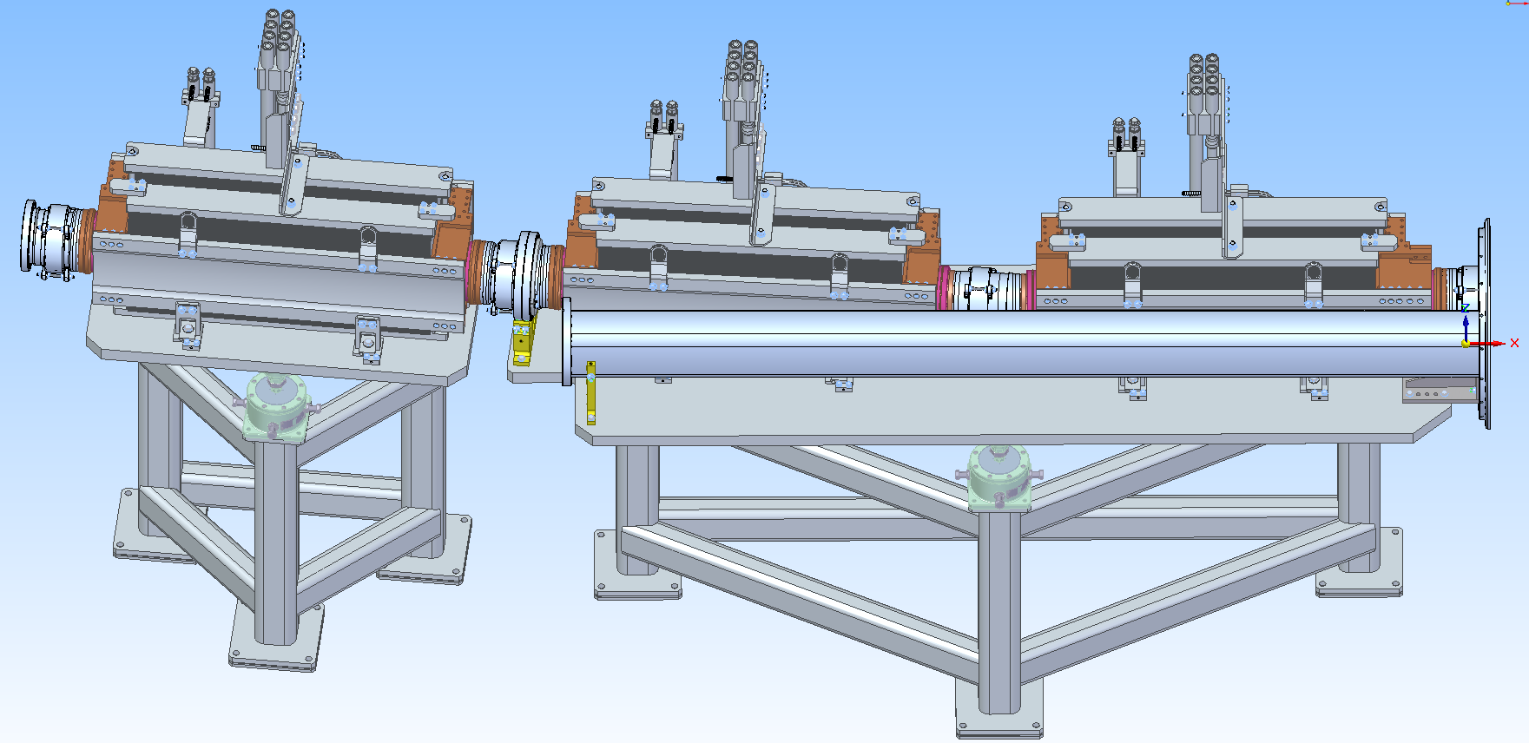
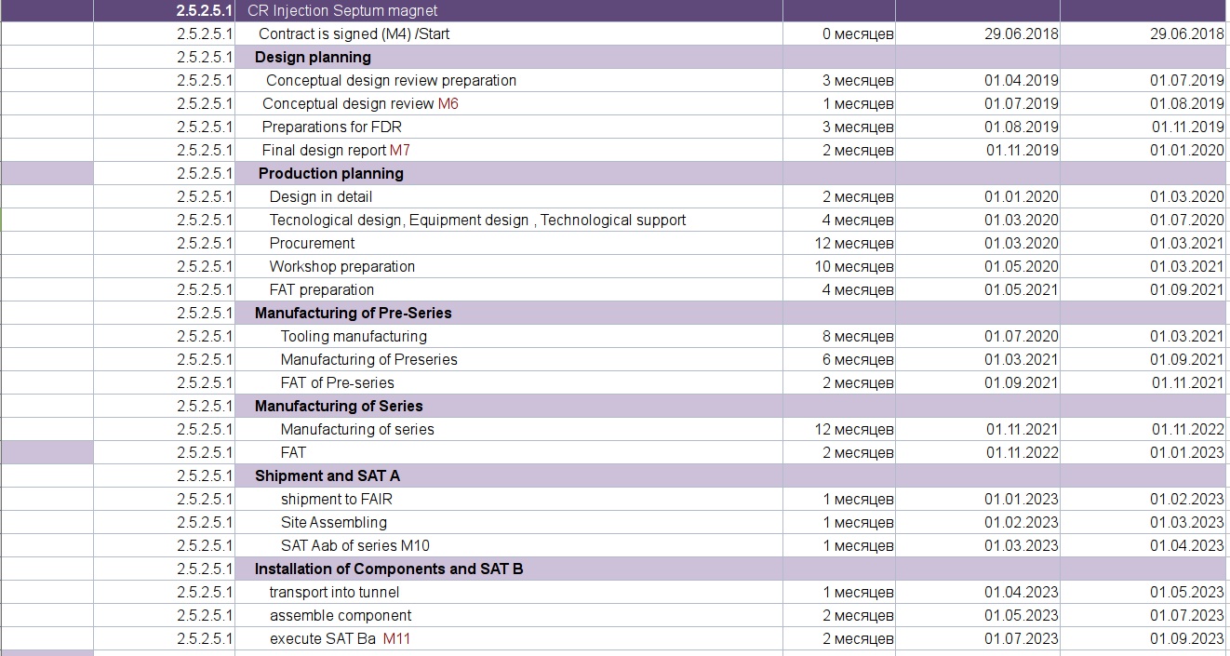
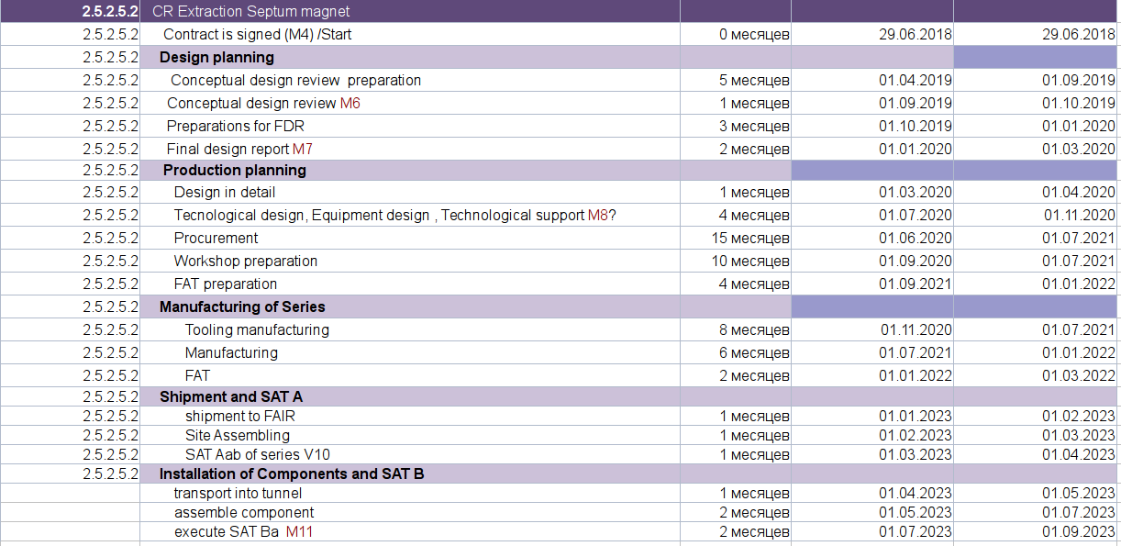
Injection/Extraction Septum Magnets
Injection
Extraction
CDR → June/July 2019
FDR → End of 2019
CDR → September 2019
FDR → End of 2019

Slide 9
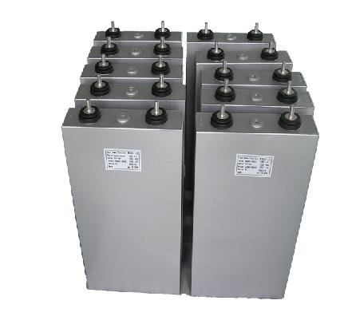
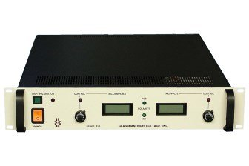
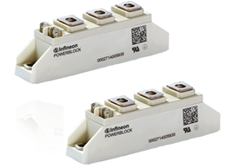
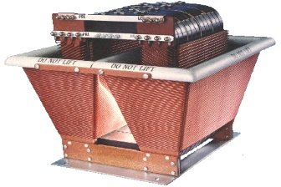
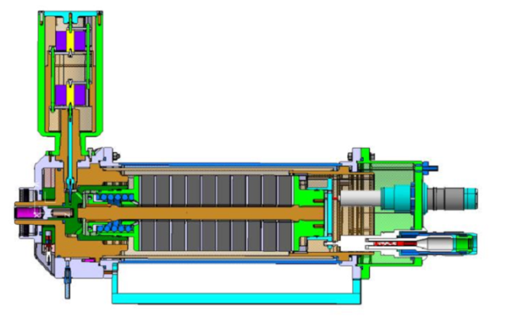
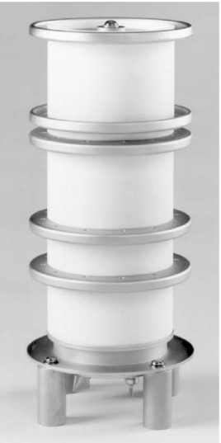
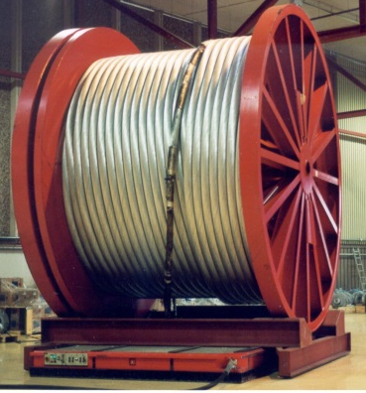
Kickers PC concept
ET1R2000
Uout = 0-1,5kV
Imax = 2 A
Capacity 1,6 mF
Umax=1500V
Fast Thyristor
Imax=32kA
TT120N16SOF * 21pcs
HV Transformer
U input=1kV
U output=70kV
Two chargers, for injection and for extraction!
Thyratron CX2593X
PFN DS-2335
Compensation load
Kicker magnet
Two power supply line for + and – current polarity
A.Kasaev

Slide 10
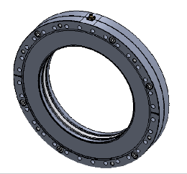
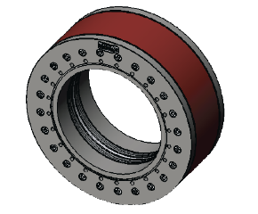
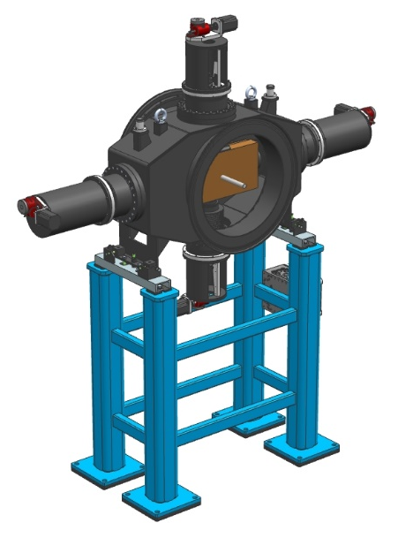
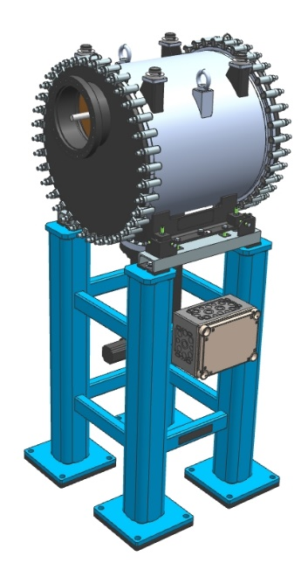
Diagnostics
Pickups: types-1,2 designed, type-3 design is ongoing. CDR is ready. Unclear solution for pre-amplifier: low signal (10 uV @ 10^7 antiprotons, noise ~4-5 uV), radiation resistance (1-2 kGy/year near vacuum chamber for LNA).
Preliminary: VGA=Amplifier-110 (Slovenia), LNA=?? Juelich or BINP?
Pickups Test Bench: Conceptual design of mechanics not finished, DAQ Libera will be delivered (1 pcs, September 2019) by GSI for test, Software for tests (FESA, LSA etc.) not clear.
FCT, DCCT: CDR is ready. To be procured via FAIR form Bergoz: DCCT + Analog Electronics (included 2 pcs), FCT + Pream. (to be bought, FEMTO DUPWA 1-70).
Beam scrapers: design is finished, CDR is ready.
Beam stoppers: design is finished, CDR is ready. (Can be used as Faraday Cup for ion beams, preamplifier required, who will pay?)
Scintillating screens: design is in progress. CDR released. (Two solutions: stepper driver, pneumatic drive - preferred).
RGM: conceptual design is in progress.

Slide 11
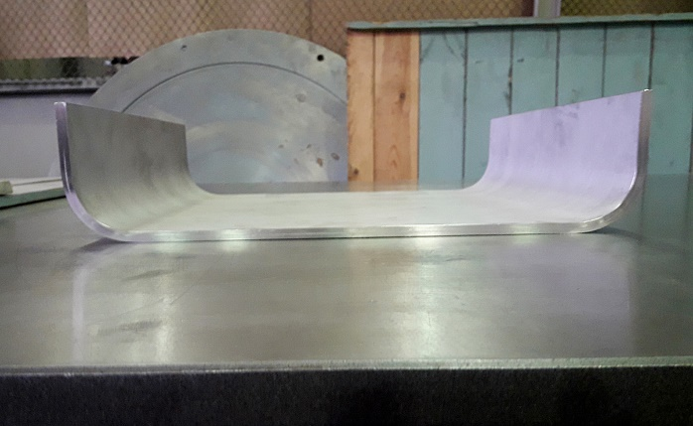
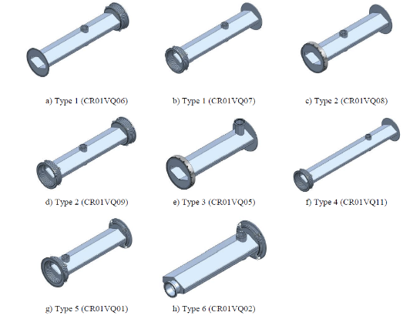
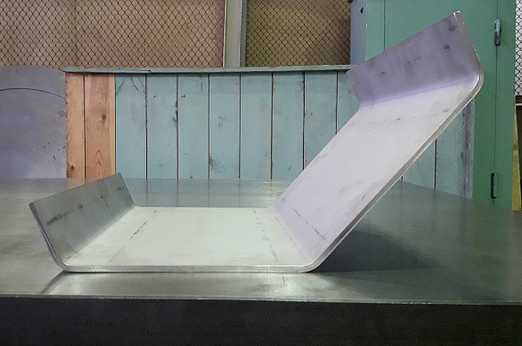
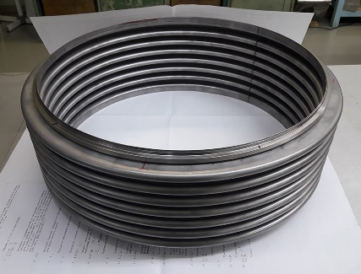
Vacuum
Dipole chamber: CDR released. Prototyping is in progress.
Quadrupole-sextupole chambers: CDR is ready. Prototyping is in progress.
Round wide tubes: spec is ready. Procurement is ongoing.
Round narrow tubes: spec is not ready.
Bellows: spec is in progress.
Pumps, valves, roughing stations: the list is prepared and sent for procurement via FAIR.

Slide 12
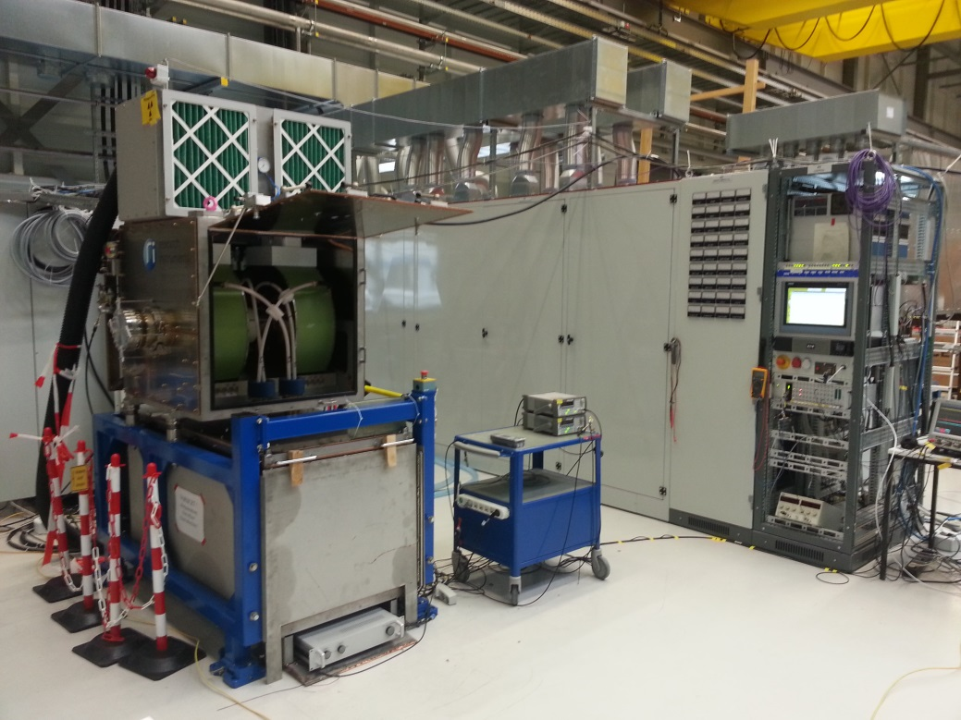
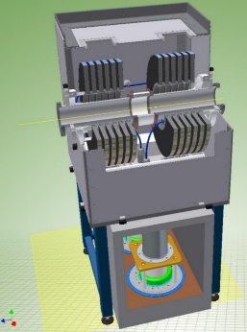
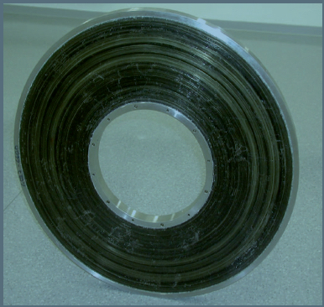
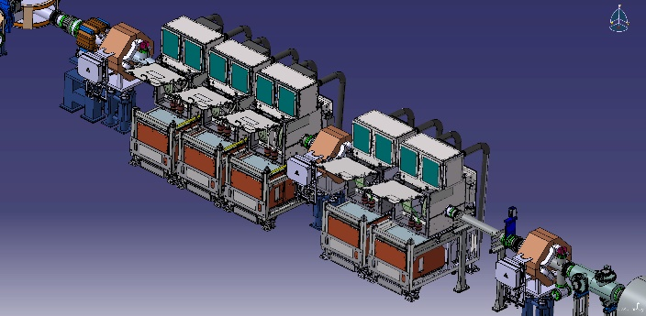

RF system
Two inductively loaded coaxial quarter wavelength resonators working on a common ceramic gap
Ring core of cobalt-based magnetic alloy
Max. voltage 40 kV/unit
Number of units 5
Frequency range 1.1 – 1.5 MHz
Inner pipe diameter 150 mm
First of Series CR debuncher during commissioning at GSI.
First of series RF system accepted in 2017
FAT of all 5 RF cavities done. SAT ongoing
FAT of 4 Power Supplies done. SAT ongoing
More details in talk by U.Laier

Slide 13
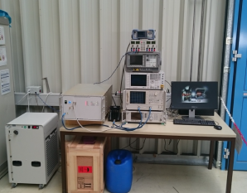
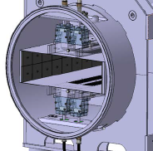
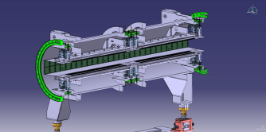
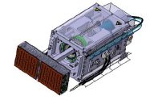
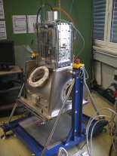
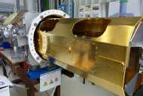
Stochastic cooling system
Power Amplifiers
SAT FoS done in Q2/2018.
Series production ongoing
Palmer Pick-up
RF concept + engineering ready Mechanical integration with BINP flanges/bellows. Spec + manufacturing drawings ready for tendering the vacuum tank
Cryogenic Plunging Pick-Up
Testing of the full cryo-plunging concept in the GSI prototype tank ongoing.
Engineering/mechanics/assembly activities ongoing.
Long-time mechanical durability tests of the plunging foils ongoing.
Vacuum-compatibility tests of materials.
Electrode module re-design, contacts with providers.

Slide 14
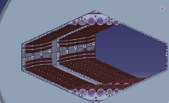
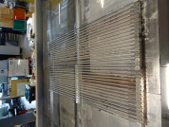
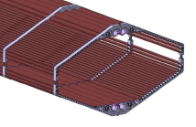



Stochastic cooling system
Microwave Damping- Coated Ceramic Absorbers
Draft engineering concept ready.
First batch of Al2O3 tubes for prototyping coated (by NiCr-sputtering at ISE Freiburg).
UHV test done (outgassing rate acceptable). RF test planned.
2019: Procure and store series of tubes.
assembly and full damping tube concept test after delivery a prototype chamber by BINP.
Procurement of the series of holders is tested successfully.
Microwave Damping-Ferrite Absorbers
Ferrite design ready.
UHV test done (outgassing rate acceptable).
Ferrite tiles purchased for all pick-ups
More details in talk by C.Zhang

Slide 15


Infrastructure
Feb 4-5 – first workshop BINP – FSB on the CR building.
Feb 7 - first meeting BINP – Mueller & Bleher.
Water pipes distribution
Pressurized air distribution

Slide 16



Infrastructure (2)
Tables with coordinates of water and air connections prepared
Cables connectors info uploaded to Cable Data Base

Slide 17


Assembling, Testing, Installation
Estimations of time and manpower are done.
LCM workshop (Tue, May 21)

Slide 18
PLM for CR
Generated CIDs: 256
Assigned AIDs: 48
The CDR documentation have been uploaded for all this AIDs.
Working on the following Technical systems at present:
Vacuum
Beam Diagnostics
Magnets
Target Technical systems for the nearest future:
Injection/Extraction
Power Converters

Slide 19
CDR docs uploaded to EDMS (M6)
Vacuum, WPL Alexander Krasnov
Wide quadrupole & sextupole vacuum chambers
Magnets, WPL Alexandr Starostenko
Vertical Steering Magnets
Combined Steering Magnets
Sextupole Magnets
WQ Quadrupole Magnets
Beam Diagnostics, WPL Yury Rogovsky
Beam Position Monitor System
DC Current Transformer (DCCT)
Fast Current Transformer (FCT)
Beam Stopper
Beam Scraper

Slide 20
Specifications (M3)
13/18 specs to be finalized:
1 item – TCR1 magnets (steerer)
6 items – CR vacuum (1 uploaded to EDMS for engineering check)
? 3 items – CR vacuum standard equipment
6 items – TCR1 vacuum
? 2 items – TCR1 vacuum standard equipment

Slide 21
Thank you!

