Slide 1
pbar Power Converters
Ute Clausen

Slide 2
Power Converter Quantity
 | PSP | Typ | Magnet type | Nomenklatur | EDMS
1x | 2.9.3.1.1.1 | pB.D1 | Dipol | PS01MH01 | 2088857
8x | 2.9.3.2.1.1.1 | pB.Q1 | wide Quadrupole | PS01QS04-11 | 1829136
1x | 2.9.3.2.1.1.3 | pB.Q2 | wide Quadrupole, radiation hard | PS01QS03 | 2026129
2x | 2.9.3.2.2.1 | pB.Q4 | narrow Quadrupole, radiation hard | PS01QS01-02 | 2026129
4x | 2.9.3.3.1.1 | pB.C1 | Sextupole | PS01KS01-04 | 1770615
7x | 2.9.3.4. | pB.C2 | Steerer | PS01KH01-03, PS01KV01-04 | 1905164
11.02.2019 U.Clausen

Slide 3
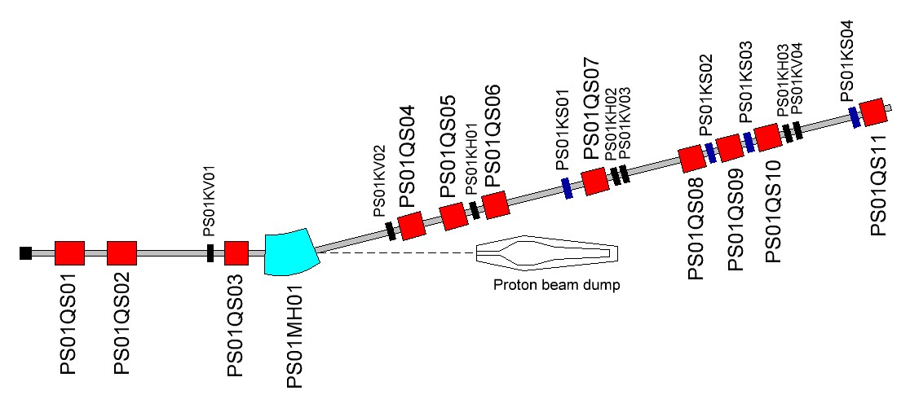
pbar Beamline
11.02.2019 U.Clausen

Slide 4
Basis of power supply calculation
Magnet type | Nomen | Imax [A] | R [mΩ] | L [mH] | Current rate [kA/s]
Dipol | PS01MH01 | 1421 | 62,44 | 480 | 0,047
wide Quadrupole | PS01QS04-11 | 1470 | 26,31 | 59 | 0,049
wide Quadrupole, radiation hard | PS01QS03 | 1470 | 26,31 | 59 | 0,049
narrow Quadrupole, radiation hard | PS01QS01-02 | 1210 | 10,1 | 9 | 0,04
Sextupole | PS01KS01-04 | 500 | 34,56 | 5,9 | 0.016
Steerer | PS01KH01-03, PS01KV01-04 | 520 | 210 | 6,2 | 26
11.02.2019 U.Clausen

Slide 5
Information passed on to FSB
PC-Typ | Floor space H=2.2m | Cooling water [l/min] | Smax [kVA] | Seff PC spec [kVA] | Seff @std op [kVA] | Loadcable [mm²]
pB.D1 | 2.4x0.8 | 14 | 242,33 | 188,6 | 161,68 | 4x185
pB.Q1 | 2.4x0.8 | 12 | 19,86 | 16,82 | 16,82 | 2x185
pB.Q2 | 2.4x0.8 | 12 | 18,52 | 15,67 | 15,67 | 2x185
pB.Q4 | 2.4x0.8 | 12 | 9,02 | 7,64 | 7,64 | 2x150
pB.C1 | 0.8x0.8 | 10 | 21,82 | 17,27 | 17,27 | 2x150
pB.C2 | 0.8x0.8 | 8 | 0,72 | 0,61 | 0,61 | 1x50
13.05.2019 U.Clausen

Slide 6
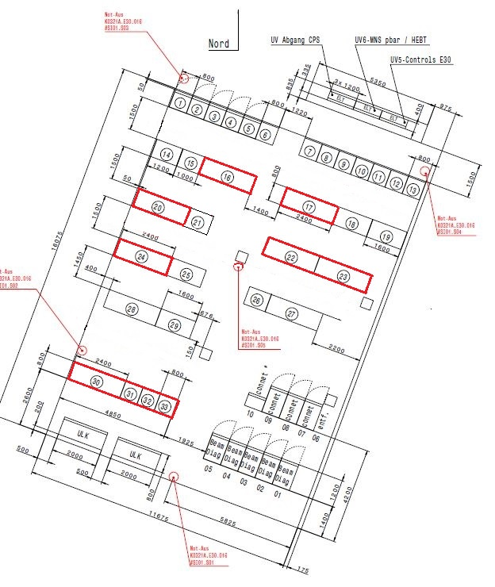
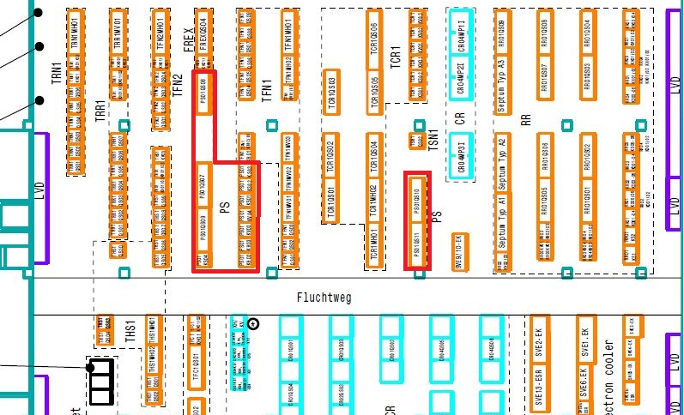
Buildings
K0321A E30
H0209A E20
11.02.2019 U.Clausen

Slide 7
Specification of power supply
PSP | Nomen | Imin [A] | Imax [A] | Cycle [ms] | Flat [ms] | T rise [ms] | Current rate [kA/s]
2.9.3.1.1.1 | PS01MH01 | 1000 | 1500 | any | any | 30000 | 0.048
2.9.3.2.1.1.1 | PS01QS04-11 | 320 | 1500 | 5000 | 5 | 1000 | 1.5
2.9.3.2.2.1 | PS01QS03 | 320 | 1500 | 5000 | 5 | 1000 | 1.5
2.9.3.2.1.1.3 | PS01QS01-02 | 240 | 1210 | 5000 | 5 | 1000 | 1.21
2.9.3.3.1.1 | PS01KS01-04 | ±12 | ±500 | any | any | 30000 | 0.016
2.9.3.4. | PS01KH01-03, PS01KV01-04 | ±52 | ±550 | 5000 | 10 | 20 | 27.5
11.02.2019 U.Clausen

Slide 8
Thank you for your attention!
11.02.2019 U.Clausen

