Slide 1
HEPTech Online Platform

Slide 2
Online Platform – Benefits
quick exchange of information
excellent overview of technologies, collaboration requests, contract research offers and knowledge
promotes cooperation between the members and also research and industry
simple process in a complex environment (in the search for suitable partners)

Slide 3
Member Exchange Tool
Node information:
contact persons
status (independent, affiliated (parent institution))
Fields of activity / Priorities / main tasks - with focus: technology transfer, training, IP consulting
Expertise – based on at least 5 years of experience
Experience of the staff – IP, TT, training entrepreneurship, start-ups
Recent R&D projects (for the last 3 years) – project title, funding, outcomes, application areas, impact
Technologies (for the last 3 years) – name, description, TRL, application areas, level of implementation (implemented by the company XXXX)
Service offers – type of service (training, TT, IP consulting, project management), potential users, service charges (free or paid)
Events hosted by the node - permanent annual events and also ad hoc events (link to the HEPTech web-site http://heptech.web.cern.ch/members-events)
Recent publications (if any)

Slide 4
Member Exchange Tool
Data base ‘Industry contacts’ – AIMEs Sponsors and Co-organizers:
contact persons
industry sector
what AIME was supported? As Sponsor or Co-Organizer
Date Base ‘AIMEs’
List of all HEPtech AIMEs with title, venue, Co-organizers, Sponsors, members of Organizing and scientific committee, Indico Links….
Collaboration requests
requests of members for partners for a third-party funded project, for proposals, development/validation projects…

Slide 5
HEP Technology Market - Concept
Technology / Service Offer /
Partnering Opportunities
category
sector
content
contact

Slide 6
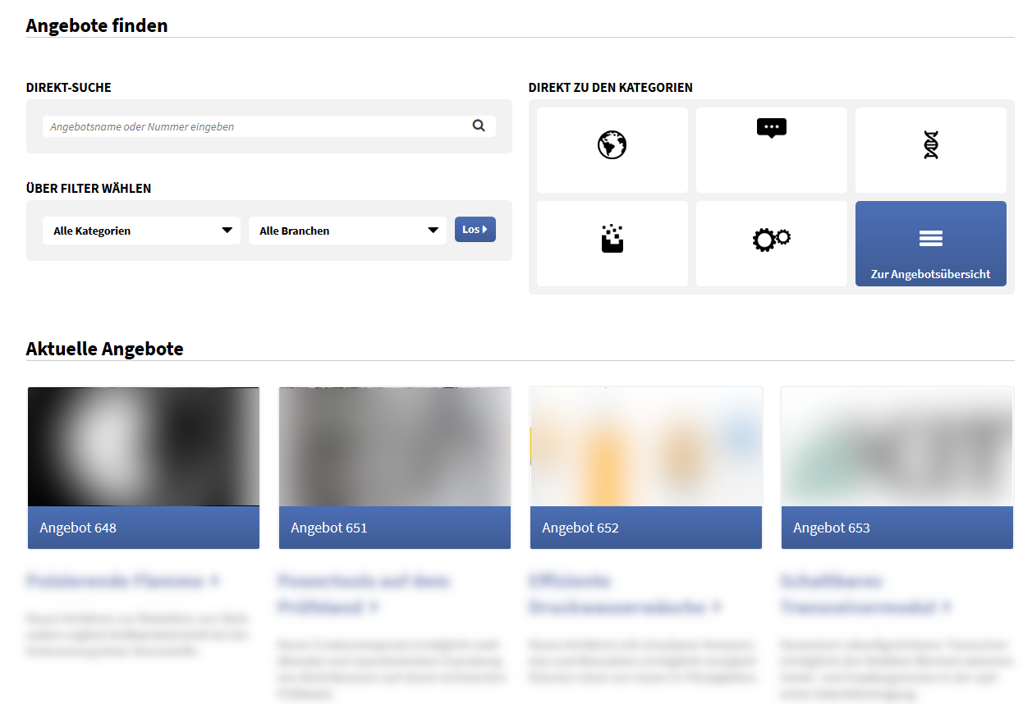
HEP Technology Market - Possible Design

Slide 7
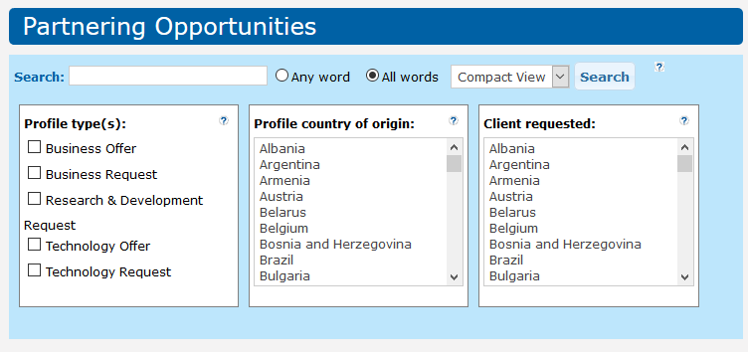
HEP Technology Market – Possible Expansions
Personal
support
Newsletter
Exclusive Information about events and meetings
Registration / Membership

