Slide 1
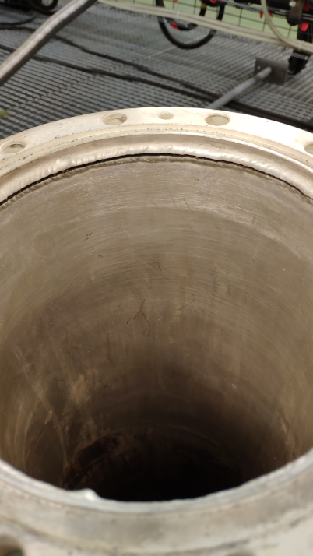
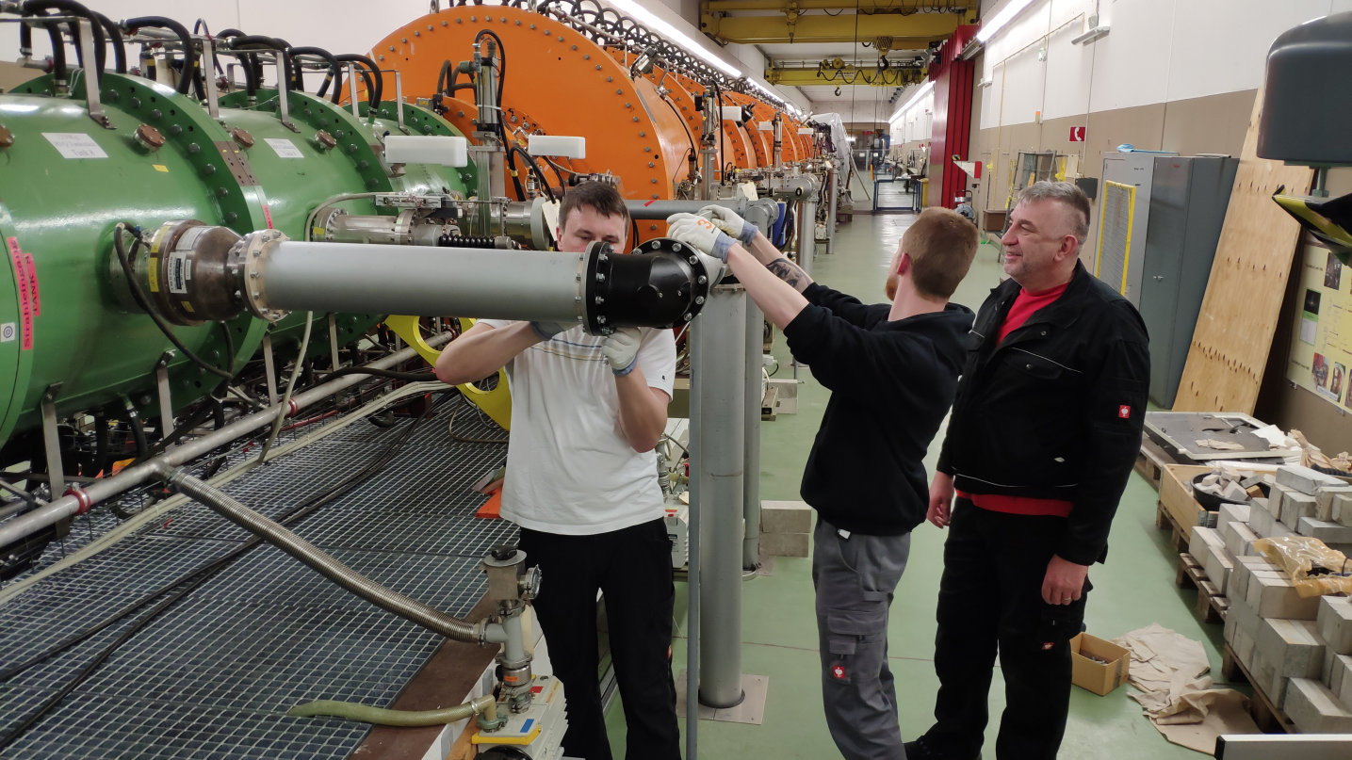
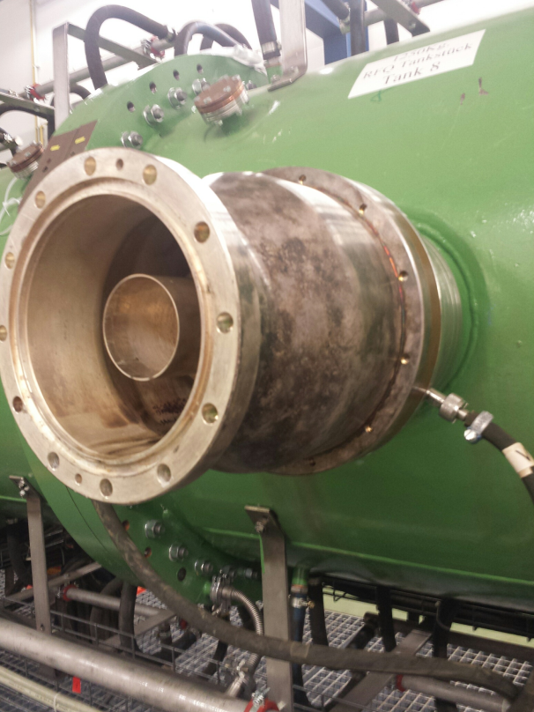
Machine meeting 05.02.19 - UNILAC
UNILAC:
RF conditioning running
Coupling loop HSI-RFQ had water leak to rf line
Long part of rf line flooded, damaged, replaced/repaired
in operation since Friday
Turbopump: Bearing defect
Pressurized air oiler: Broken

Slide 2
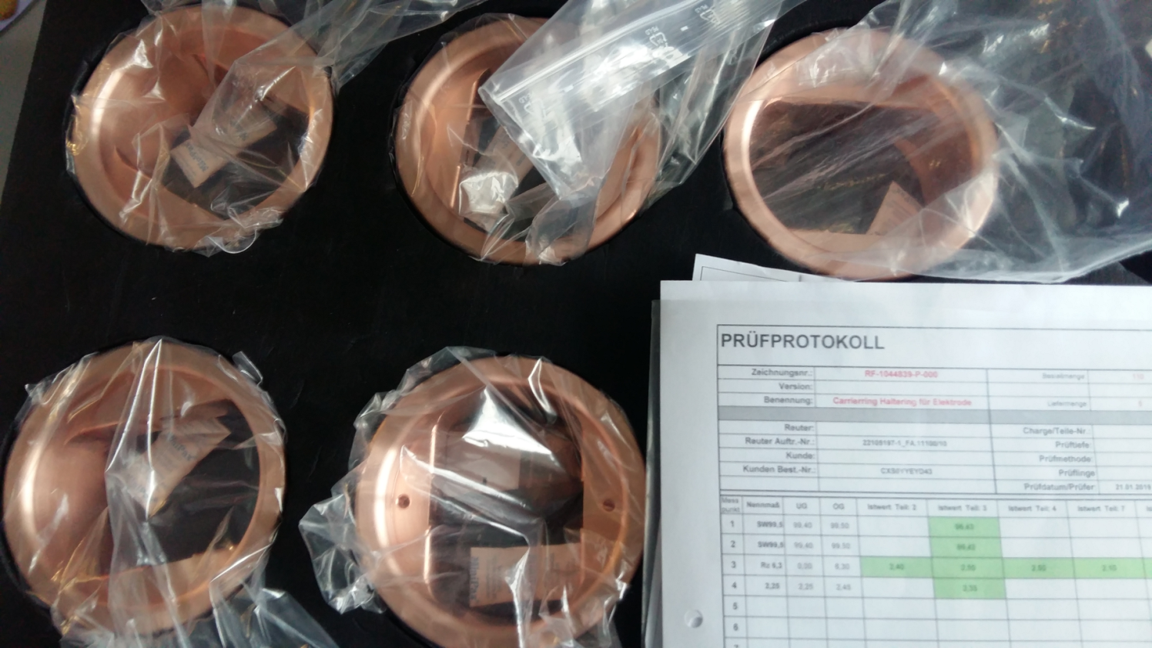
Machine meeting 05.02.19 - UNILAC
HSI RFQ:
electrodes: tank section 2-10 all electrodes produced, section 1 all radial matcher section produced
carrier ring reproduction: second set of samples approved, series production released
RF: SAT new plunger drives by RF

Slide 3
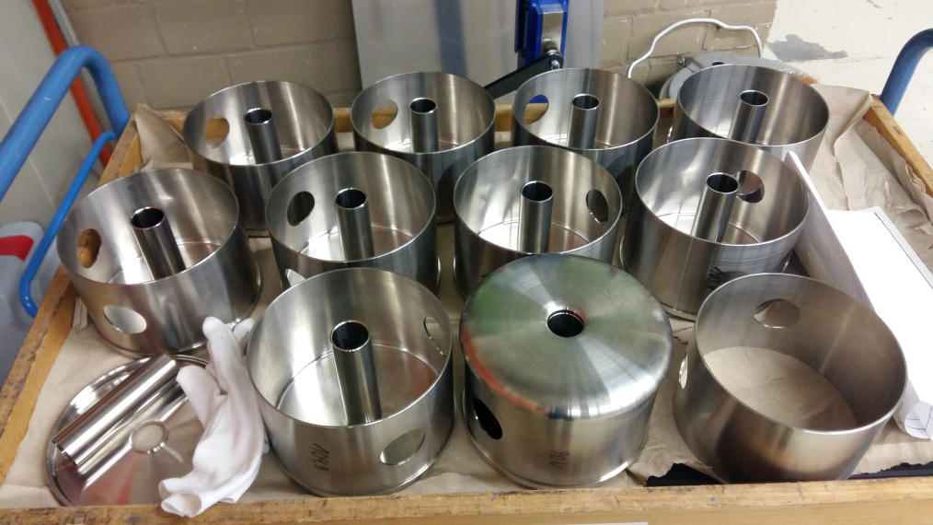
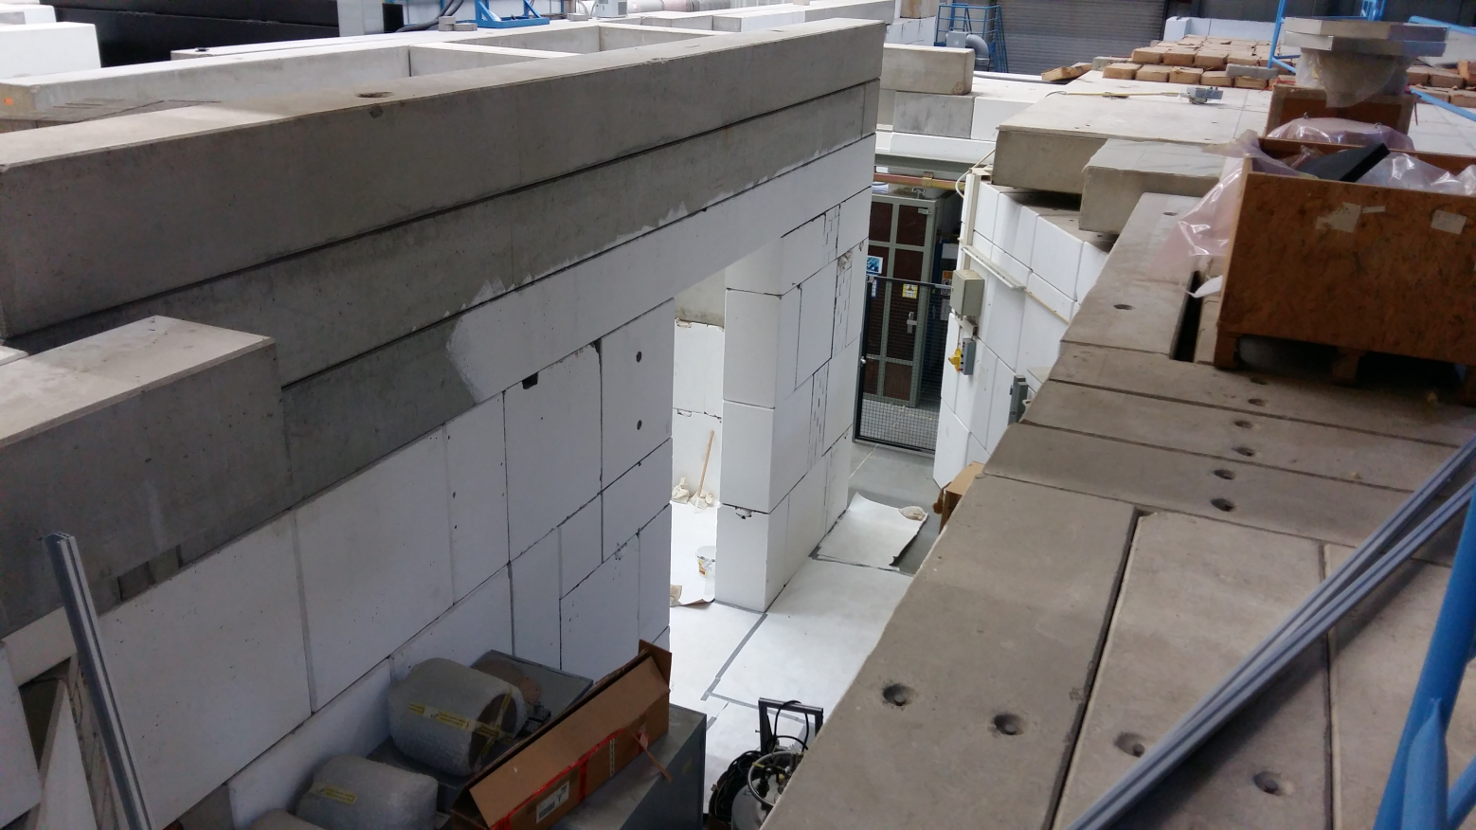
Machine meeting 05.02.19 - UNILAC
FOS:
Z7 is almost vacated
construction of cave started
drift tube production ongoing
UHV controls upgrade:
project on track, kick-off 28.01.19

Slide 4
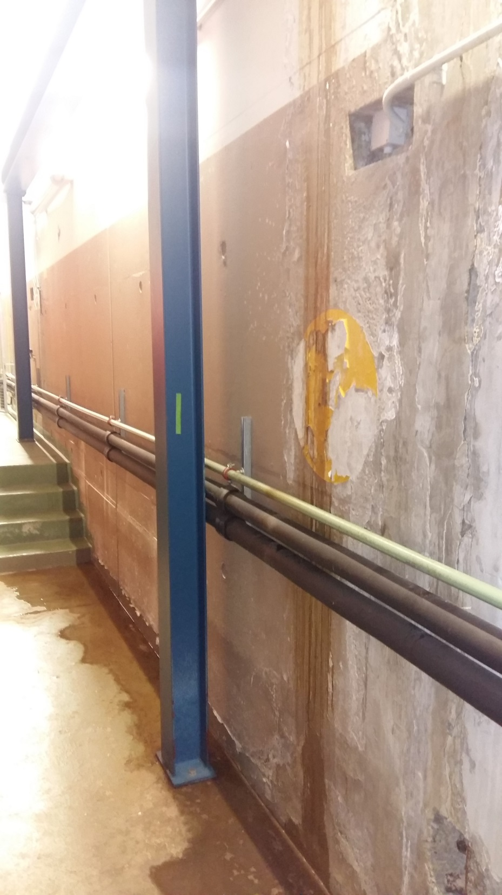
Machine meeting 08.01.19 - UNILAC
during my routine control walk I found a rain water leak at the joint of TU and EH
Mrs. Heise and Mr. Reckziegel of GA Bau are informed and are working on a workable but rapid solution

