Slide 1
HEST Betrieb
M.Sapinski@gsi.de
Operateurschulung, January 15, 2019

Slide 2
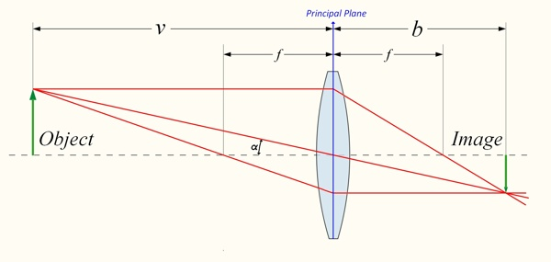
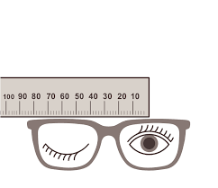
Outlook
HEST overview.
Outcome of Engineering Run 2018.
HEST section in paramodi.
What is beam optics?
Optics tools. Where is MIRKO expert?
Model quality.
Trajctory response matrix.
Optics measurements.
Summary.
M.Sapinski@gsi.de /2

Slide 3
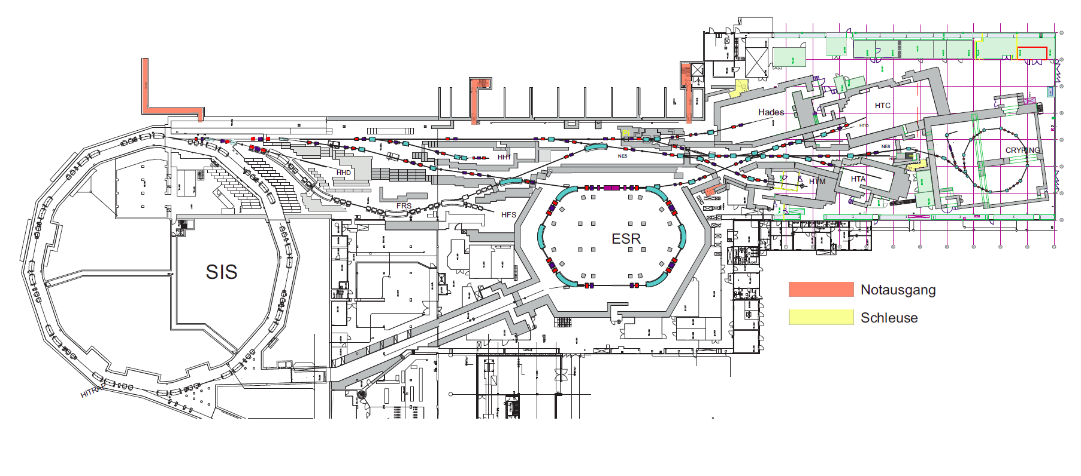
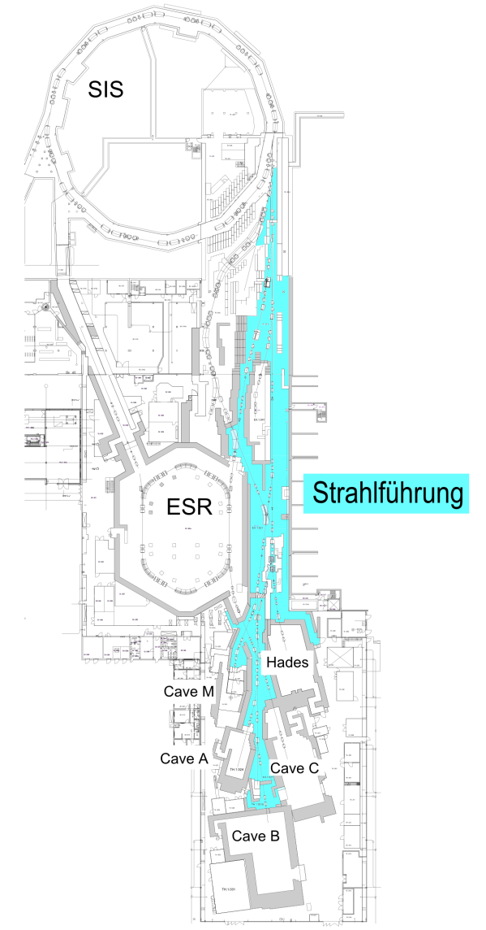
HEST overview (I)
MK: M. Sapinski
(previous: C. Kleffner – special thanks for help)
STV: P. Schuett
deputy for both: S. Reimann
About 500 meters of beam transfer lines.
Role: bring beams from SIS18 to Caves A, C, M, ESR, HADES, CryRing, HFS, HTD, HHT and beam dump (HHD).
Also from ESR to Cave C, Cryring.
Areas: NE3, NE5, NE8.
Close collaboration with experiments.
Documentation: http://sapinski.web.cern.ch/sapinski/physics/HEST/index.html

Slide 4
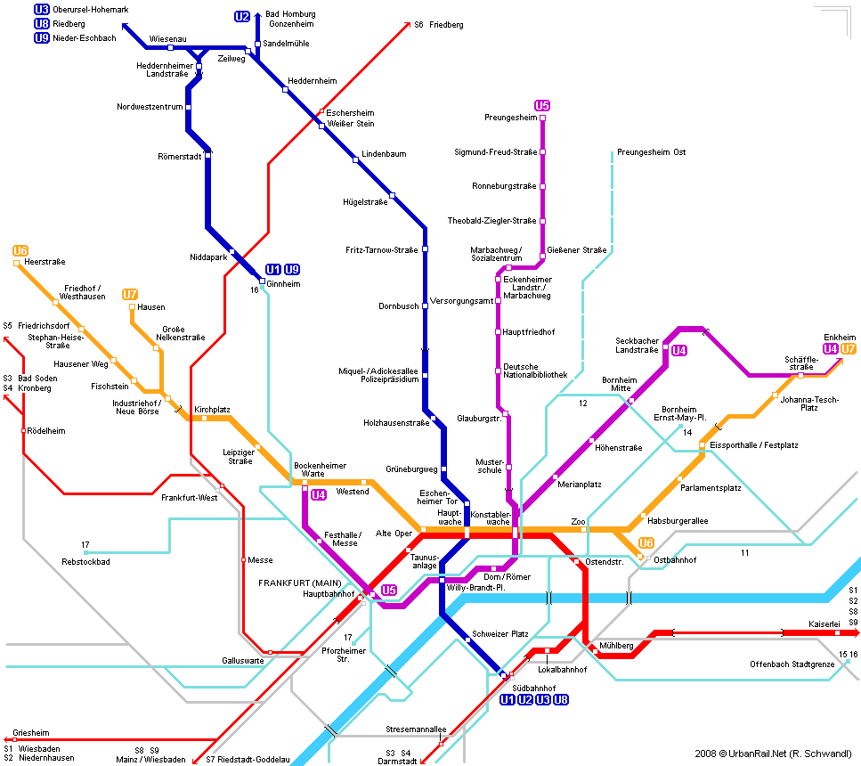
HEST overview (II)
lots of particle types, ~20 different beam paths made of segments
→ protons ... uranium, RIPs, pions
HHD ions from SIS - beam dump
HFS RIPs from FRS
HHT ions from SIS
HTM ions from SIS
ESR ions/RIPs from SIS, FRS
HTA ions from SIS or ESR
HTA ions from SIS or ESR
HTB ions/RIPs from SIS, FRS or ESR
HTB π⁻ π⁺ from π-target
HTC,D ions/RIPs from SIS, FRS or ESR
HTC,D π⁻ π⁺ from π-target
HTP ions from SIS, ESR
HADES ions from SIS
HADES π⁻ π⁺ from π-target
U-bahn plan by B. Schlei
M.Sapinski@gsi.de /4

Slide 5
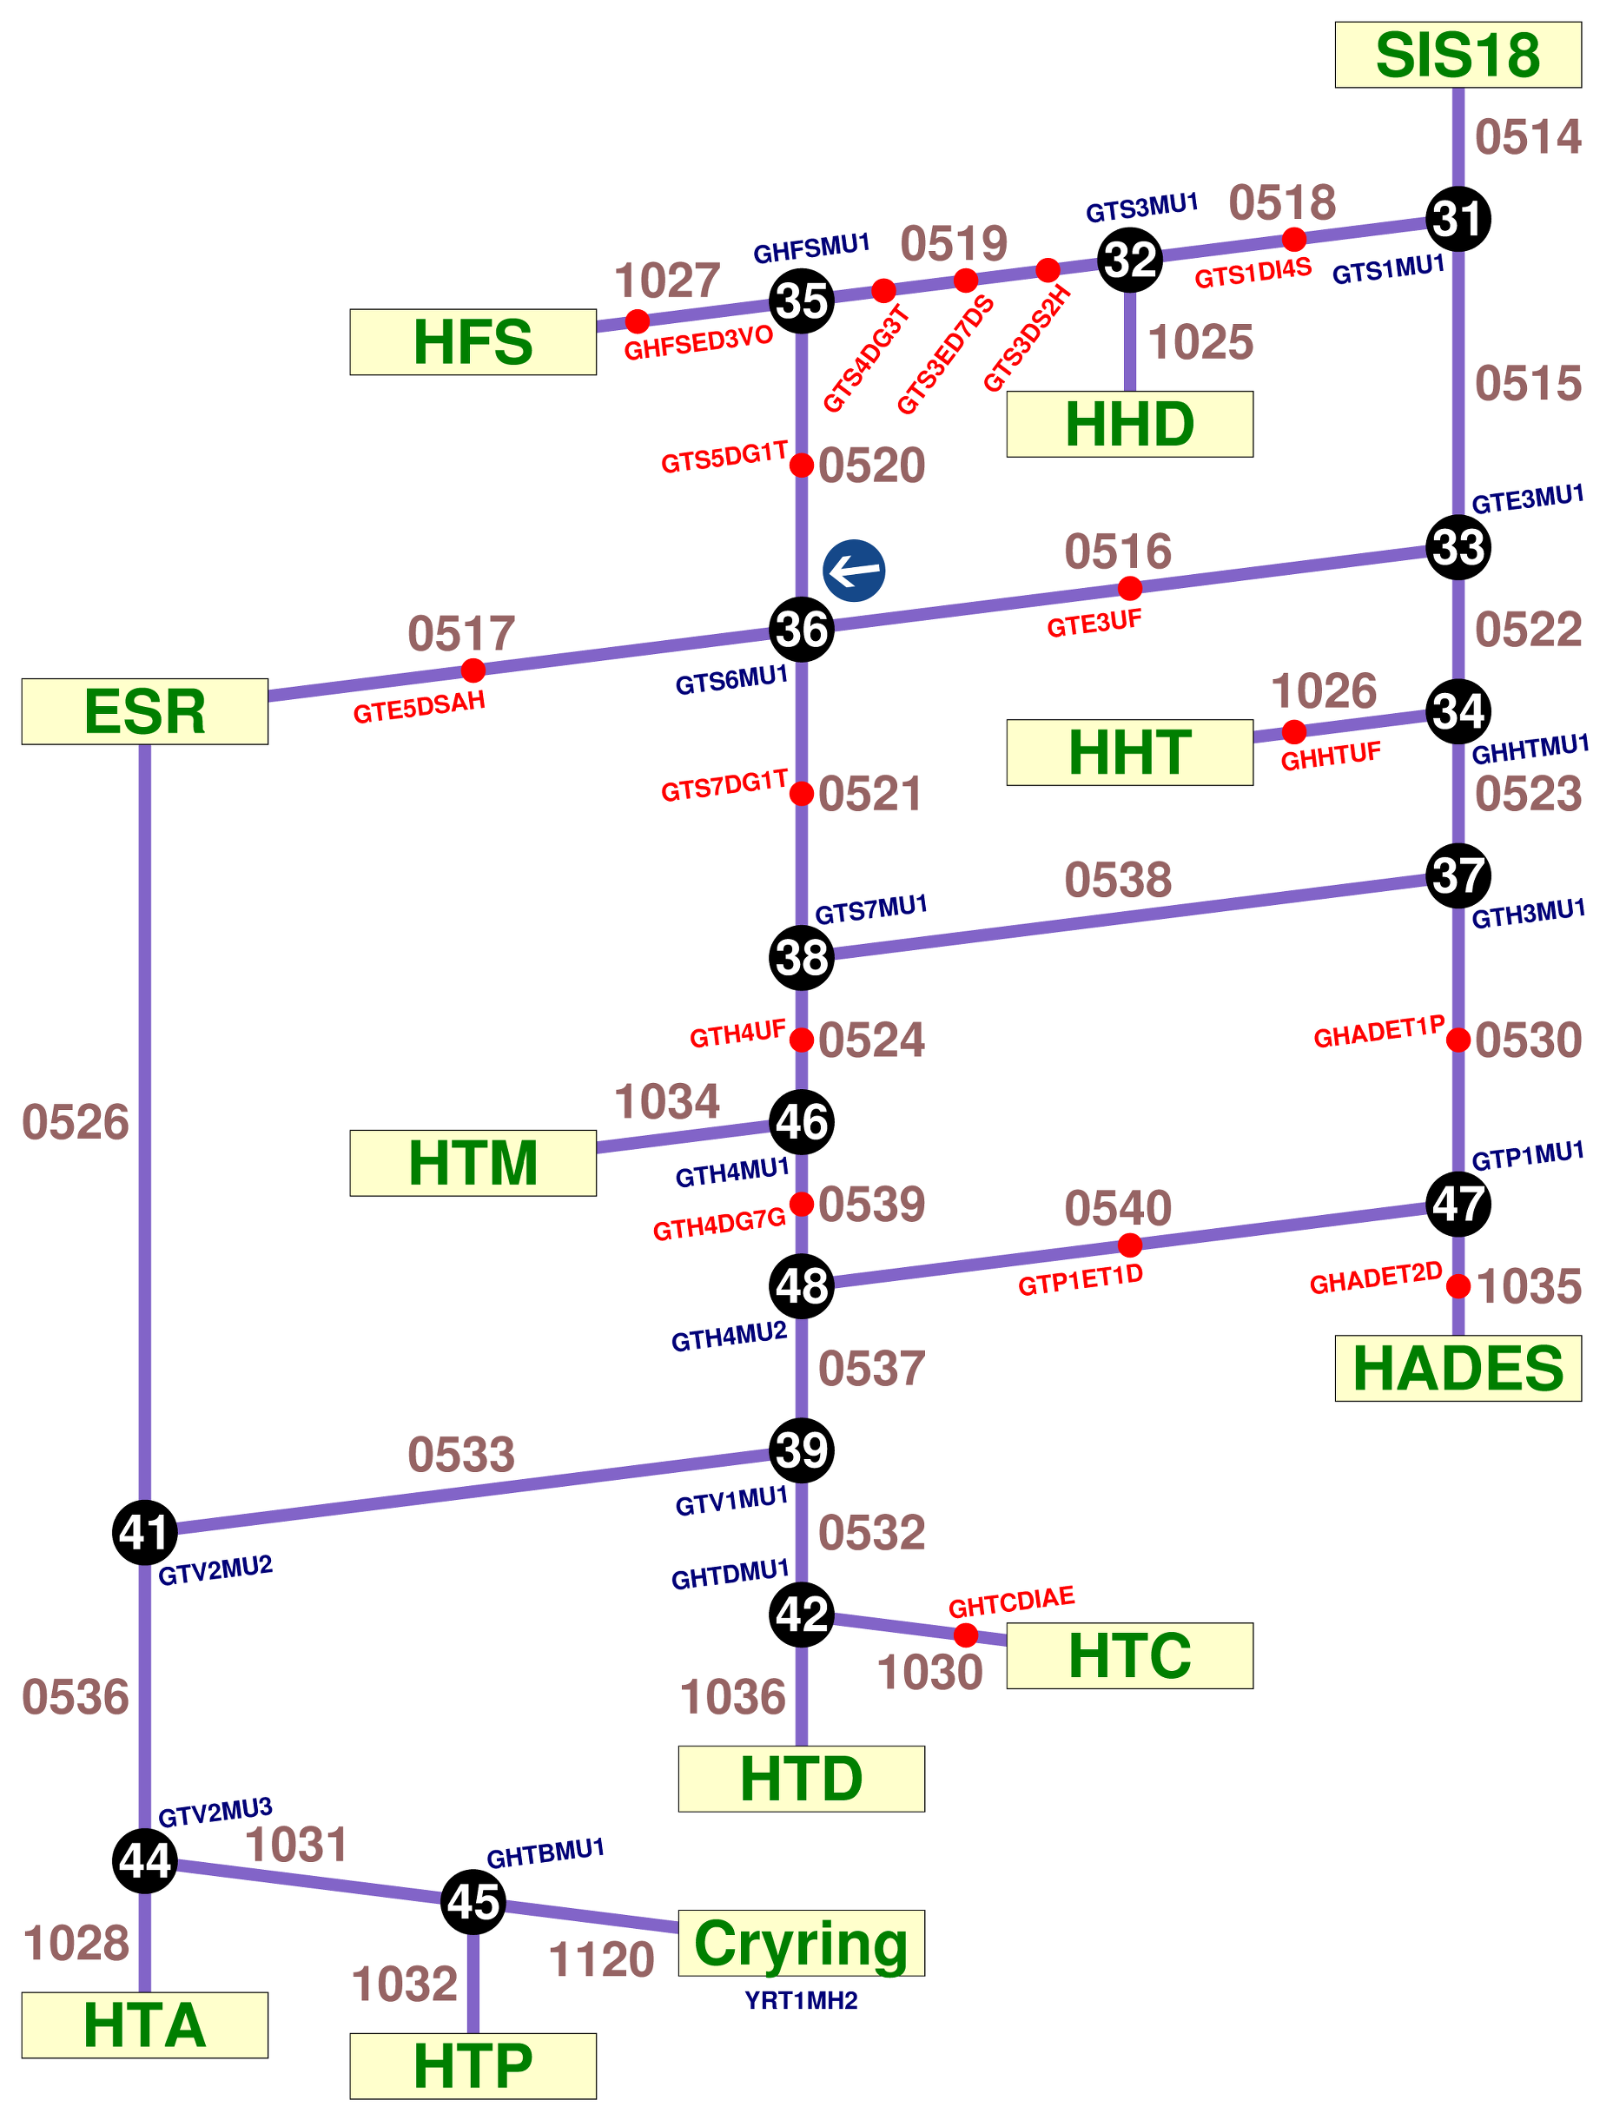
HEST overview (II)
lots of particle types, ~20 different beam paths made of segments
→ protons ... uranium, RIPs, pions
HHD ions from SIS - beam dump
HFS RIPs from FRS
HHT ions from SIS
HTM ions from SIS
ESR ions/RIPs from SIS, FRS
HTA ions from SIS or ESR
HTA ions from SIS or ESR
HTB ions/RIPs from SIS, FRS or ESR
HTB π⁻ π⁺ from π-target
HTC,D ions/RIPs from SIS, FRS or ESR
HTC,D π⁻ π⁺ from π-target
HTP ions from SIS, ESR
HADES ions from SIS
HADES π⁻ π⁺ from π-target
U-bahn plan by B. Schlei
accelerator zone
particle transfer (same timing zone)
M.Sapinski@gsi.de /4

Slide 6
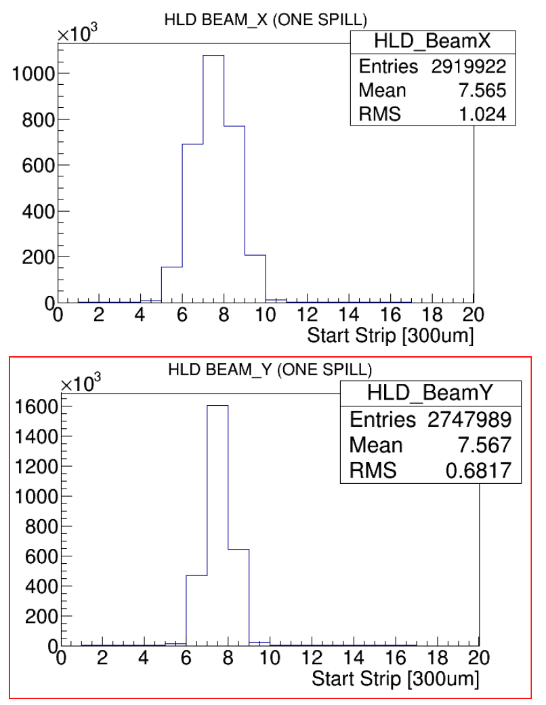
Outcome of Engineering Run 2018
Test of control system, operational tools, settings, etc.
Beam lines tested: HADES, Cave C and D, Cave A and M.
Injection to ESR.
Lot of time spend on HADES, very nice example of collaboration when HKR was using experiment’s detector to optimize the beam quality.
Spill structure optimization study.
The features most missing for efficient operation:
potiboard (November 21st shift: Christian, Marcus, Henning, GHADMU1 sign)
online model (MIRKO expert)
Control system hugely improved with respect to June 2018.
beam on HADES target
courtesy J. Pietraszko
M.Sapinski@gsi.de /5

Slide 7
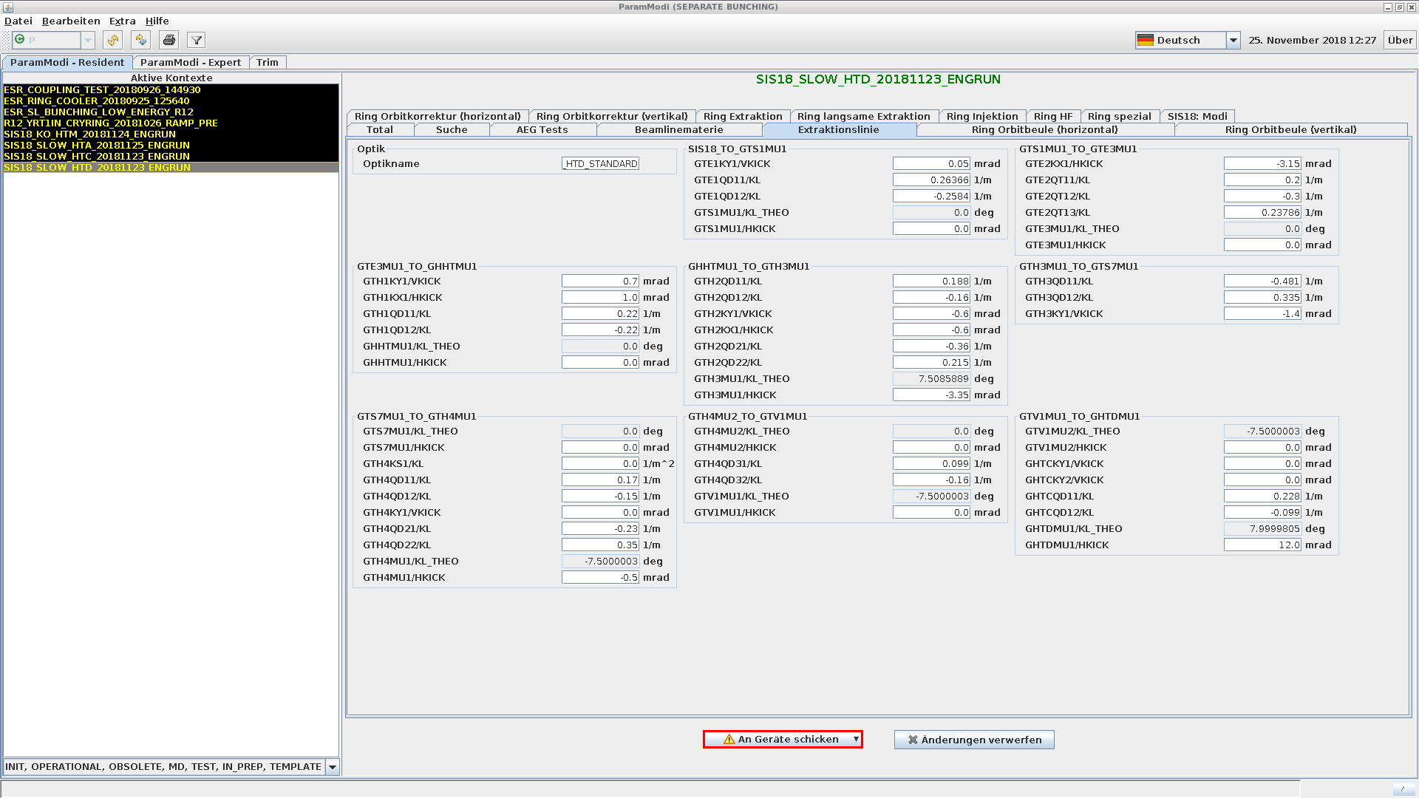
Beam line in paramodi
Assumption: UNILAC and SIS-18 are setup correctly.
Extraction line settings: kL-values for quadrupoles, deflection angle for dipoles (correction to default), angle for steerers.
M.Sapinski@gsi.de /6

Slide 8
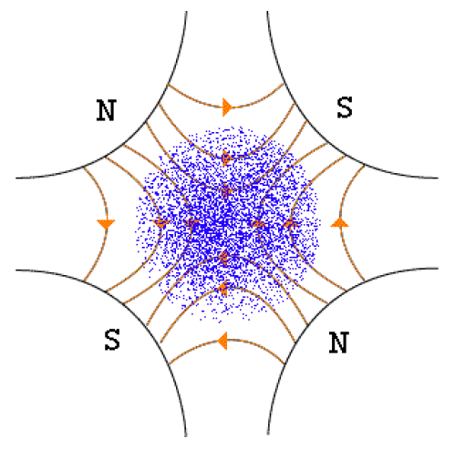
Setting the beam line optics
k-value and magnet focal length: $f=1/{kL} [m]$ (independent on beam energy).
k-value and field gradient: $k=\frac{g}{p/q}$, where
g – quadrupole gradient (T/m),
p/q – beam rigidity (Tm); unit of k is 1/m².
initial k-values are determined using optics programs (MADX or MIRKO):
input: sequence of magnets (positions), beam parameters at extraction from SIS18
constraints:
maximum strength of the magnets,
beam parameters at synchrotron extraction,
beam parameters on target (eg. spot size, …),
beam size along the beam line (minimization of beam losses),
other constrains, eg. phase advance, dispersionless regions, etc, etc…
method: various optimization algorithms are available; optimization is multi-objective
output: a set of k-values (called optics); usually there are many solutions for optics, the final choice is a compromise between various objectives.
the optics is sensitive to small drifts in magnet positions, k-values errors (due to magnetic hysteresis), etc, etc. It is also sensitive to beam changes at SIS18 extraction. ‘Nachoptimirung’ is almost always needed!
Distribution of β (optical function) along the beam line is most often used to illustrate optics.
M.Sapinski@gsi.de /7

Slide 9
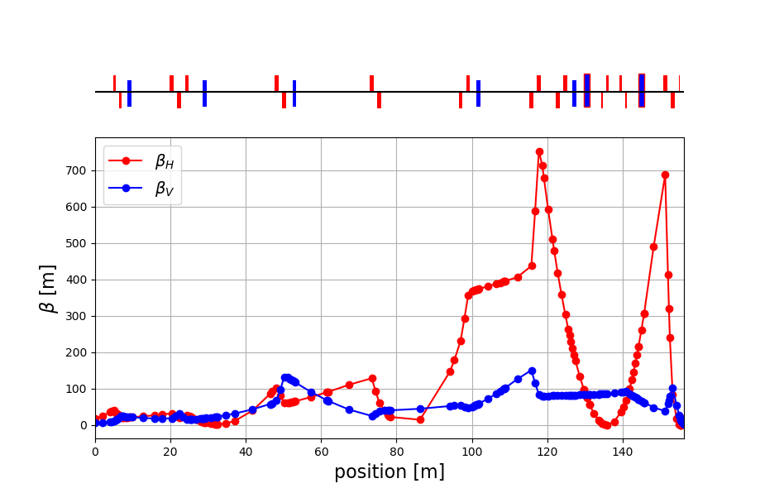
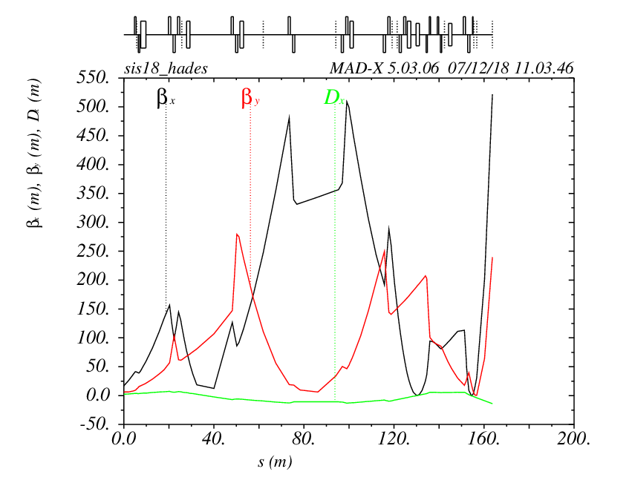
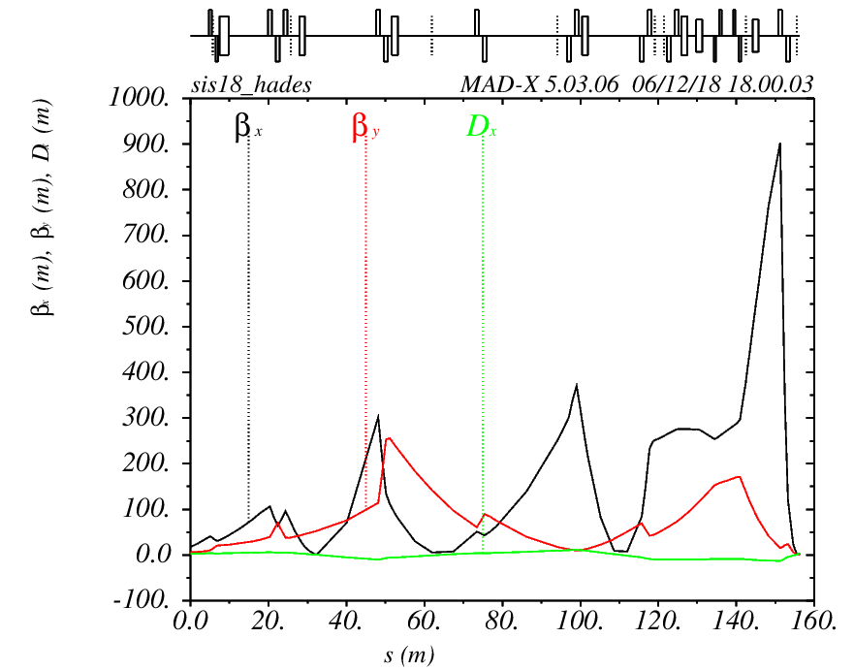
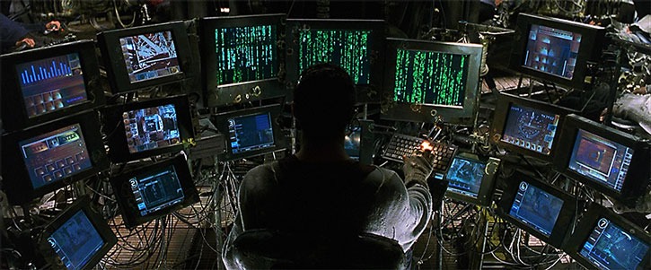
Example: HADES
June: MIRKO optics from svn archive found not good, suggested to use settings from 2012.
rather large horizontal beam size
step focusing – good but beam is divergent after target
October: new solution proposed, with more ‘telescopic’ focus on target.
Other solutions proposed by S. Ratschow, S. Appel, D. Vilsmeier, some tested – ok.
2012 settings
(Au+Au)
Remark: theory optics always needs tuning, but mainly with correctors (orbit to magnetic centers of quadrupoles), not too much with quadrupoles.
For example, in case of Max’s optics, a few minutes of tuning gave good focus.
Dominik/Artificial Intelligence
M.Sapinski@gsi.de

Slide 10
Where does the optics come from?
MADX/MIRKO
MADX available on HKR computers: HESTools/
Theory
(LSA table)
paramodi/trim
paramodi saves
online model
before: MIRKO expert, new version from OP expected in 2020
LSA
IBHS saves (since 2002)
converted, available on HKR computers: ibhs2paramodi/
LSA – LHC Software Architecture
IBHS – old control system application
magnets
screens/grids
M.Sapinski@gsi.de

Slide 11
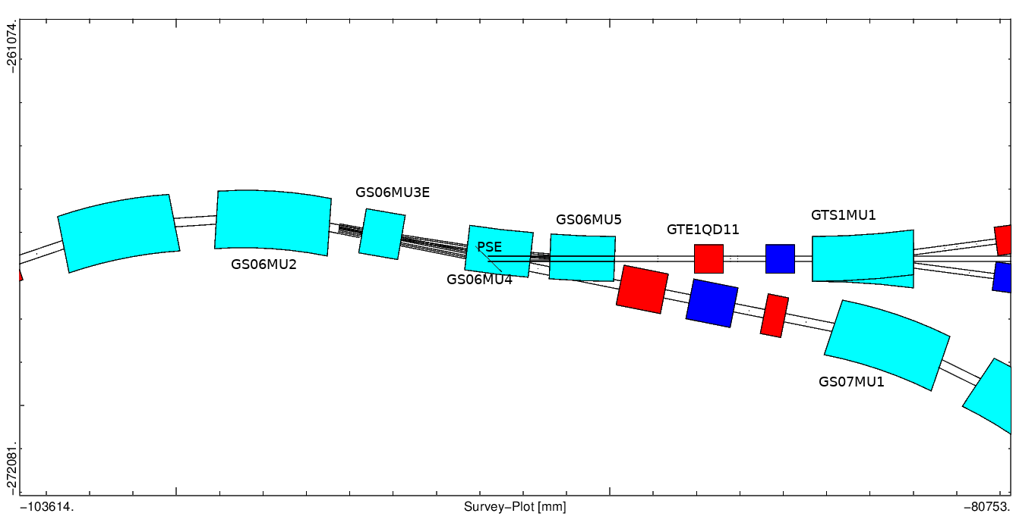
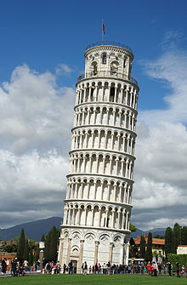
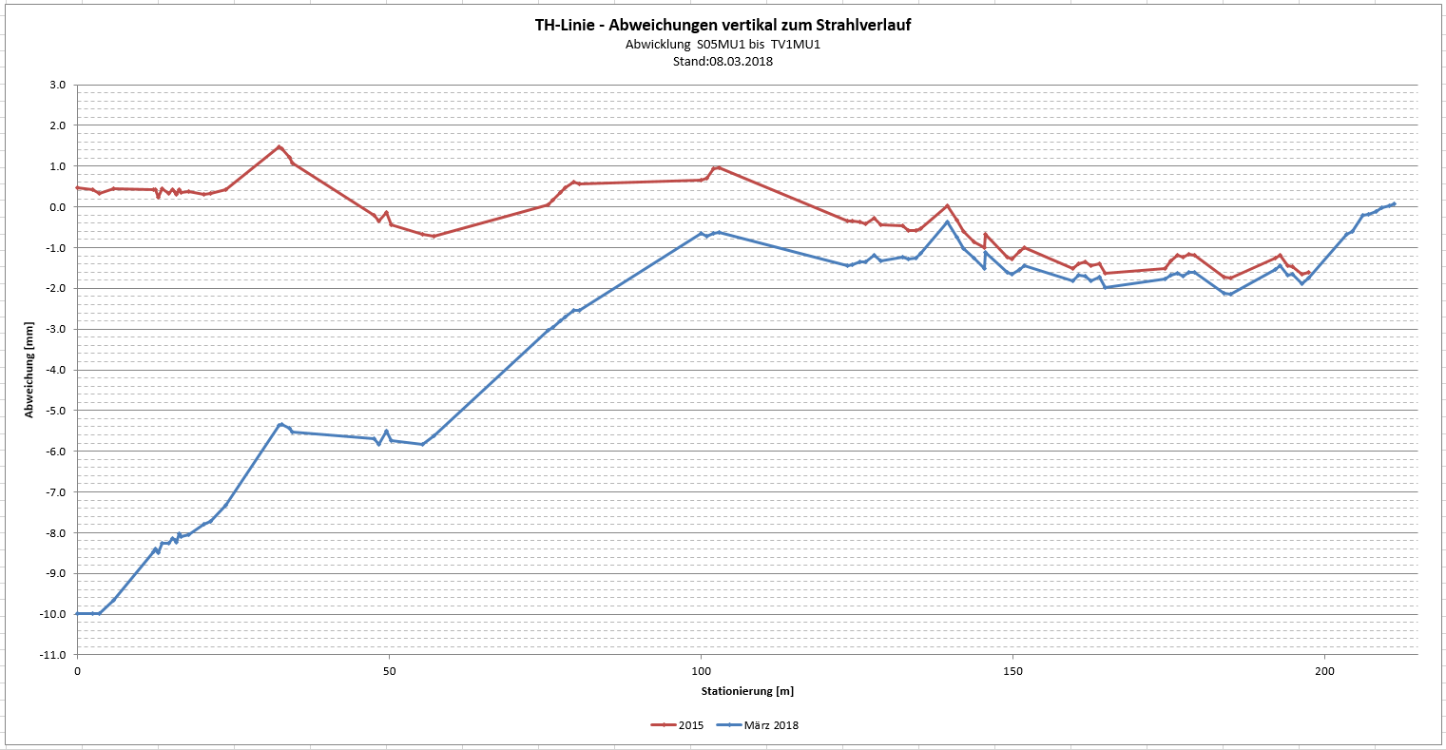
Quality of the optics models
Two groups of uncertainties:
SIS18 extraction parameters
a set of parameters, established by Benno, not changed since years, the same for fast and slow extraction, probably measured, but this measurement is not documented.
Positions of magnets, alignment, field gradient errors, fringe fields.
Benno:MIRKO settings – very good, verified and tuned over years.
Translation to MADX is quite tricky, probably some errors introduced during this translation.
β_{H,V}, α_{H,V},D_{H,V},D’ _{H,V},x,x’,y,y’
almost 100 µrad tilt of TH line due to FAIR construction
(Pisa tower almost 1000x more)
M.Sapinski@gsi.de /10

Slide 12
Model verification – response matrix
Trajectory response matrix (TRM)
MADX simulation, horizontal plane only:
Comparison of simulated and measured TRM allows to measure model errors of beam line elements, without extraction parameters!
angle Δφ
position change Δx
TRM element = Δx/Δφ [m/rad]
steerer … magnets … screen
(horizontal and vertical planes can be coupled!)
this won’t work for slow extraction
mag\grid | GTH1DG2G | GTH1DG4G | GTH2DG2 | GHADDG1G | GHADDG4G
GTE2KX1 | 7.4271 | 6.3019 | -3.3422 | 4.2328 | -1.2284
GTH1KX1 | 4.734 | 14.028 | 14.569 | -30.326 | -1.1712
GTH2KX1 | 0 | 0 | 0 | 21.959 | 2.0856
GHADKX1 | 0 | 0 | 0 | 0 | -5.3911
GHADMU1 | 0 | 0 | 0 | 0 | -1.6931
GHADMU2 | 0 | 0 | 0 | 0 | 3.0659
thanks Martin for implementing grid data saving
steerers do not affect upstream screens
M.Sapinski@gsi.de /11

Slide 13
Response matrix measurement (I)
measurement on November 27, using Oksana’s COCO* application (but paramodi can also do the job)
horizontal plane
mag\grid | GTH1DG2G | GTH1DG4G | GHADDG1G | GHADDG4G
GTE2KX1 | -5.25 | -1.5 | 0 | 32.25
GTH1KX1 | -3.75 | -12 | 9.75 | -4.5
GTH2KX1 | 0 | 0 | -10.5 | -26.25
GHADKX1 | 0 | 0 | 0 | -12
GHADMU1 | 0 | 0 | 0 | 18.75
GHADMU2 | 0 | 0 | 0 | -17.25
measurement simulation
mag\grid | GTH1DG2G | GTH1DG4G | GHADDG1G | GHADDG4G
GTE2KX1 | 5.302 | 3.285 | 1.104 | 20.718
GTH1KX1 | 4.734 | 14.028 | -9.834 | -1.799
GTH2KX1 | 0 | 0 | 10.72 | -21.052
GHADKX1 | 0 | 0 | 0 | 25.16
GHADMU1 | 0 | 0 | 0 | 1.528
GHADMU2 | 0 | 0 | 0 | -2.651
preliminary
good agreement if sign change (left-right definition)
wrong beam line layout towards the end
(*) COCO is an application to perform various orbit corrections (local, global) based on TRM measurement. For the moment it is an expert tool.
M.Sapinski@gsi.de /12

Slide 14
Response matrix measurement (II)
vertical plane
measurement simulation
mag\grid | GTH1DG2G | GTH1DG4G | GHADDG1G | GHADDG4G
GTE1KY1 | 21.75 | 36.75 | -27.75 | -1.5
GTH1KY1 | 4.5 | 12.75 | -4.5 | -0.75
GHADKY1 | 0 | 0 | 0 | 0
GHADKY2 | 0 | 0 | 0 | 0
GHADKY3 | 0 | 0 | 0 | 0.75
GHADKY4 | 0 | 0 | 0 | 0.75
mag\grid | GTH1DG2G | GTH1DG4G | GHADDG1G | GHADDG4G
GTE1KY1 | 25.355 | 35.485 | -73.513 | -75.37
GTH1KY1 | 5.234 | 14.528 | -10.562 | -6.177
GHADKY1 | 0 | 0 | 0 | -22.572
GHADKY2 | 0 | 0 | 0 | 42.89
GHADKY3 | 0 | 0 | 0 | 12.88
GHADKY4 | 0 | 0 | 0 | 1.38
preliminary
good agreement
wrong beam line layout towards the end: recheck during shutdown!
factor 2?
M.Sapinski@gsi.de /13

Slide 15
Optics measurement
other methods to measure the twiss parameters (what includes assumption about SIS-18 twiss parameters at extraction point):
dispersion measurement
multiple screen method
quadrupole scan
beam tomography
…
we have relatively good agreement between measured and simulated TRM at the beginning of the beam line, so we could in principle extrapolate twiss parameters to SIS-18 extraction point.
M.Sapinski@gsi.de /14

Slide 16
Dispersion measurement (I)
Dispersion measures transverse change of beam position with relative momentum change: $D=\frac{∆x}{dp/p}$ [m].
Dispersion is generated by dipoles, so it is small in vertical plane.
Dispersion-free regions can be required by experiments (dispersion contributes to the beam size) or to simplify measurement of beam properties (see quadrupole scan).
Measurement od December 14th
M.Sapinski@gsi.de /15

Slide 17
Dispersion measurement (II)
Initially planned to measure dispersion at all screens and grids on HADES beam line, but measurement lead to high beam losses and radiation alarms, finally data was taken only for screen GTH2DFA.
trimming RF frequency f
screen camera connected to frame grabber, video streams registered
Remark: orbit change due to f change can also affect beam position in the beam line!
thanks Beata!
Analysis: video file (mpeg) split into frames. For a subseries of frames (manually selected, spill length depends on frequency trim) with reasonable signal horizontal profiles created and added. Gaussian fit performed, mean value determined.
M.Sapinski@gsi.de /16

Slide 18
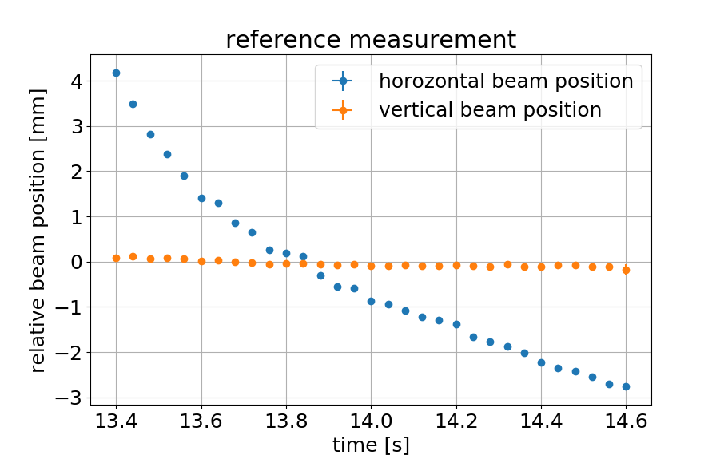
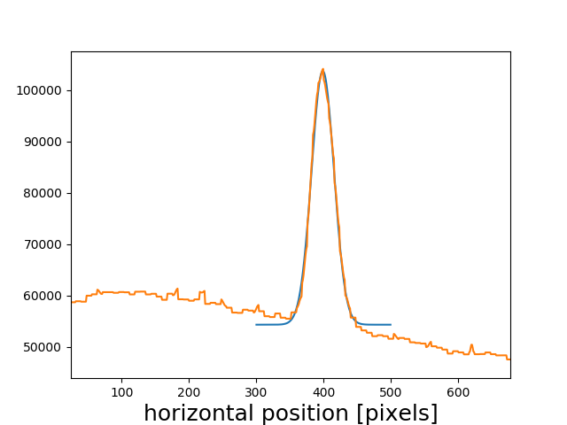
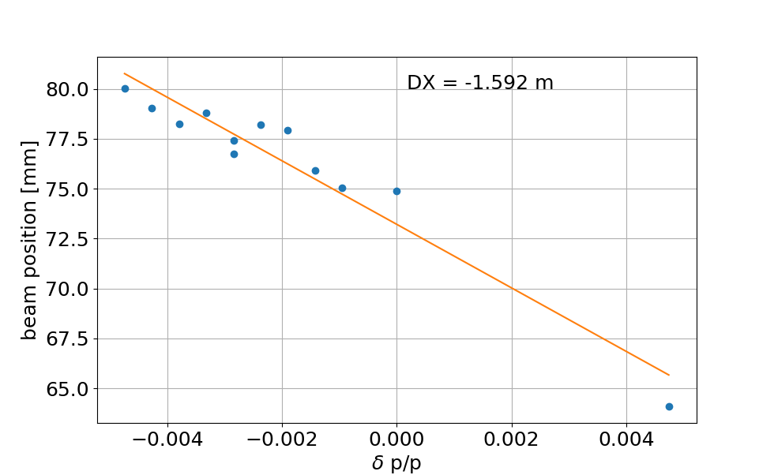
Dispersion measurement (III)
The beam moves horizontally during the spill, we find the average position for various Δf/f
$\frac{∆p}{p}=−\frac{1}{η} \frac{∆f}{f}$ where η is slip factor: $η=\frac{1}{γ_{tr}^{2}}−\frac{1}{γ^{2}}$, ${ γ}_{tr}^{1}$=5.58
result: 1.6 m, but MADX model gives 10 m and MIRKO 4 m (Petra).
for Δf/f
=-4.5 •10⁻⁴
goal of the fit: find position of maximum
(averaged over spill)
“to be investigated”
M.Sapinski@gsi.de /17

Slide 19
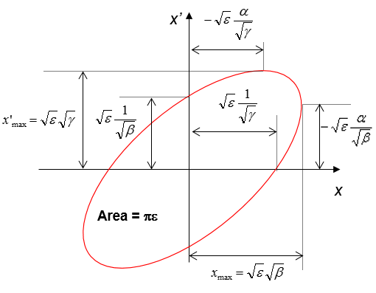
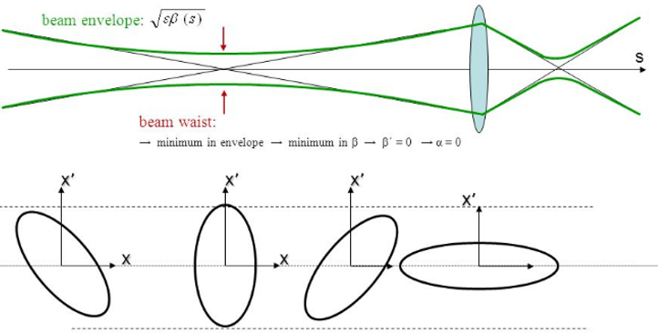
Quadrupole scan - theory
Beam ellipse = region in phase space containing the beam particles (not always ellipse).
Ellipse parameters are related to twiss parameters.
It is easy to measure beam size, but rather difficult to measure distribution of angle of beam particles.
Ellipse rotates in phase space as beam propagates.
Rotation is affected by upstream quadrupoles.
Changing the quad strength and measuring the beam size we obtain various projection of the beam phase space ellipse.
From those projection we can reconstruct emittance and twiss parameters in the location of quadrupole.
the same ellipse as in Giuliano’s lecture
M.Sapinski@gsi.de /18

Slide 20
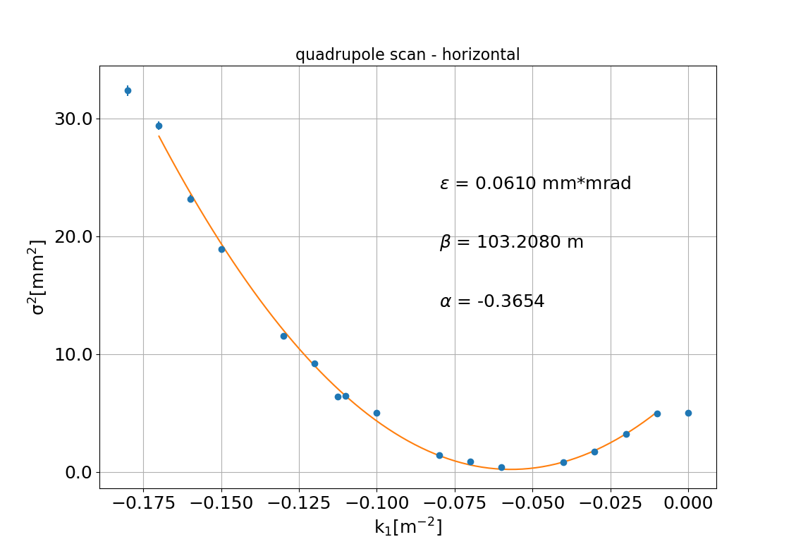
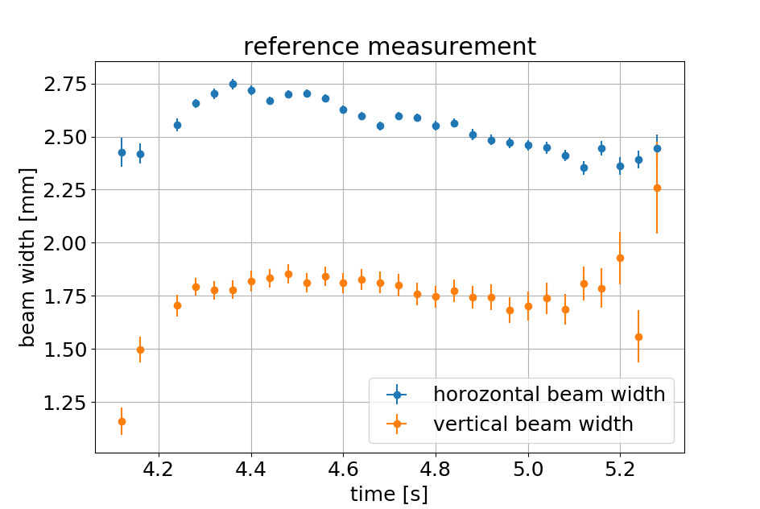
Example of quadrupole scan
Preliminary results for HADES beam line optics used for physics test.
Location of the measurement is not dispersion free.
However dp/p for quadrupolar slow extraction is very small, so dispersion effect should be small.
Beam size varies during spill by ~10%
MADX model gives:
β_{x} = 136.5 m
α_{x} = 14.15
Emittance, typical value rumor: 0.25 mm*mrad (factor 4 larger)
magnet
GTH2QD12:
M.Sapinski@gsi.de /19

Slide 21
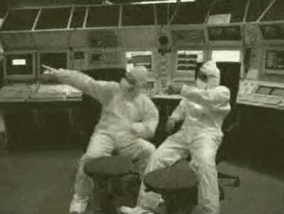
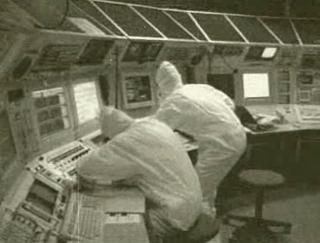
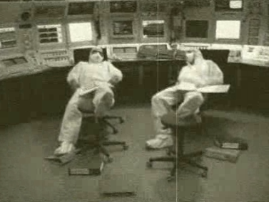
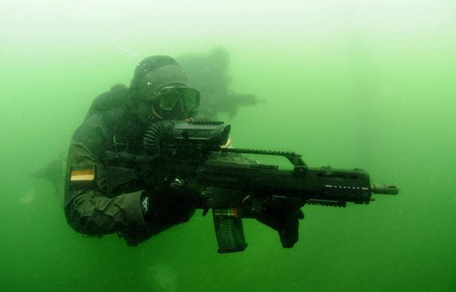
Summary
Goals of the Engineering Run achieved, HEST is under control.
Lot of interesting measurements done (many not discussed here, zBs: beam loss monitors, particle counters, knob tests, etc, etc.)
Still a lot of work for modelling! Models contain errors.
We need online model application and it will be written.
Acknowledgements: C. Kleffner (previous MK), B. Schlei (LSA hierarchy for HEST), O. Geithner (TRM), S. Ratschow (support in optics), B. Walasek-Hoechne, Ch. Schmidt (Leuchtargets), P. Boutchakov (BLMs, PDCs), M. Stein (grids software), J. Pietraszko (HADES), Ch. Hessler and others.
And last but not least thank YOU: THE OPERATRION CREW
M.Sapinski@gsi.de /20

