Slide 1
Accelerator Availability: status quo and challenges ahead
O Geithner
ACC Operation Department

Slide 2
Content
Calculation of the ACC availability in OLOG
PHYS RUN 2018: Operation Performance and Failure Statistic
ENG RUN 2018: Operation Performance and Failure Statistic
Challenges ahead

Slide 3
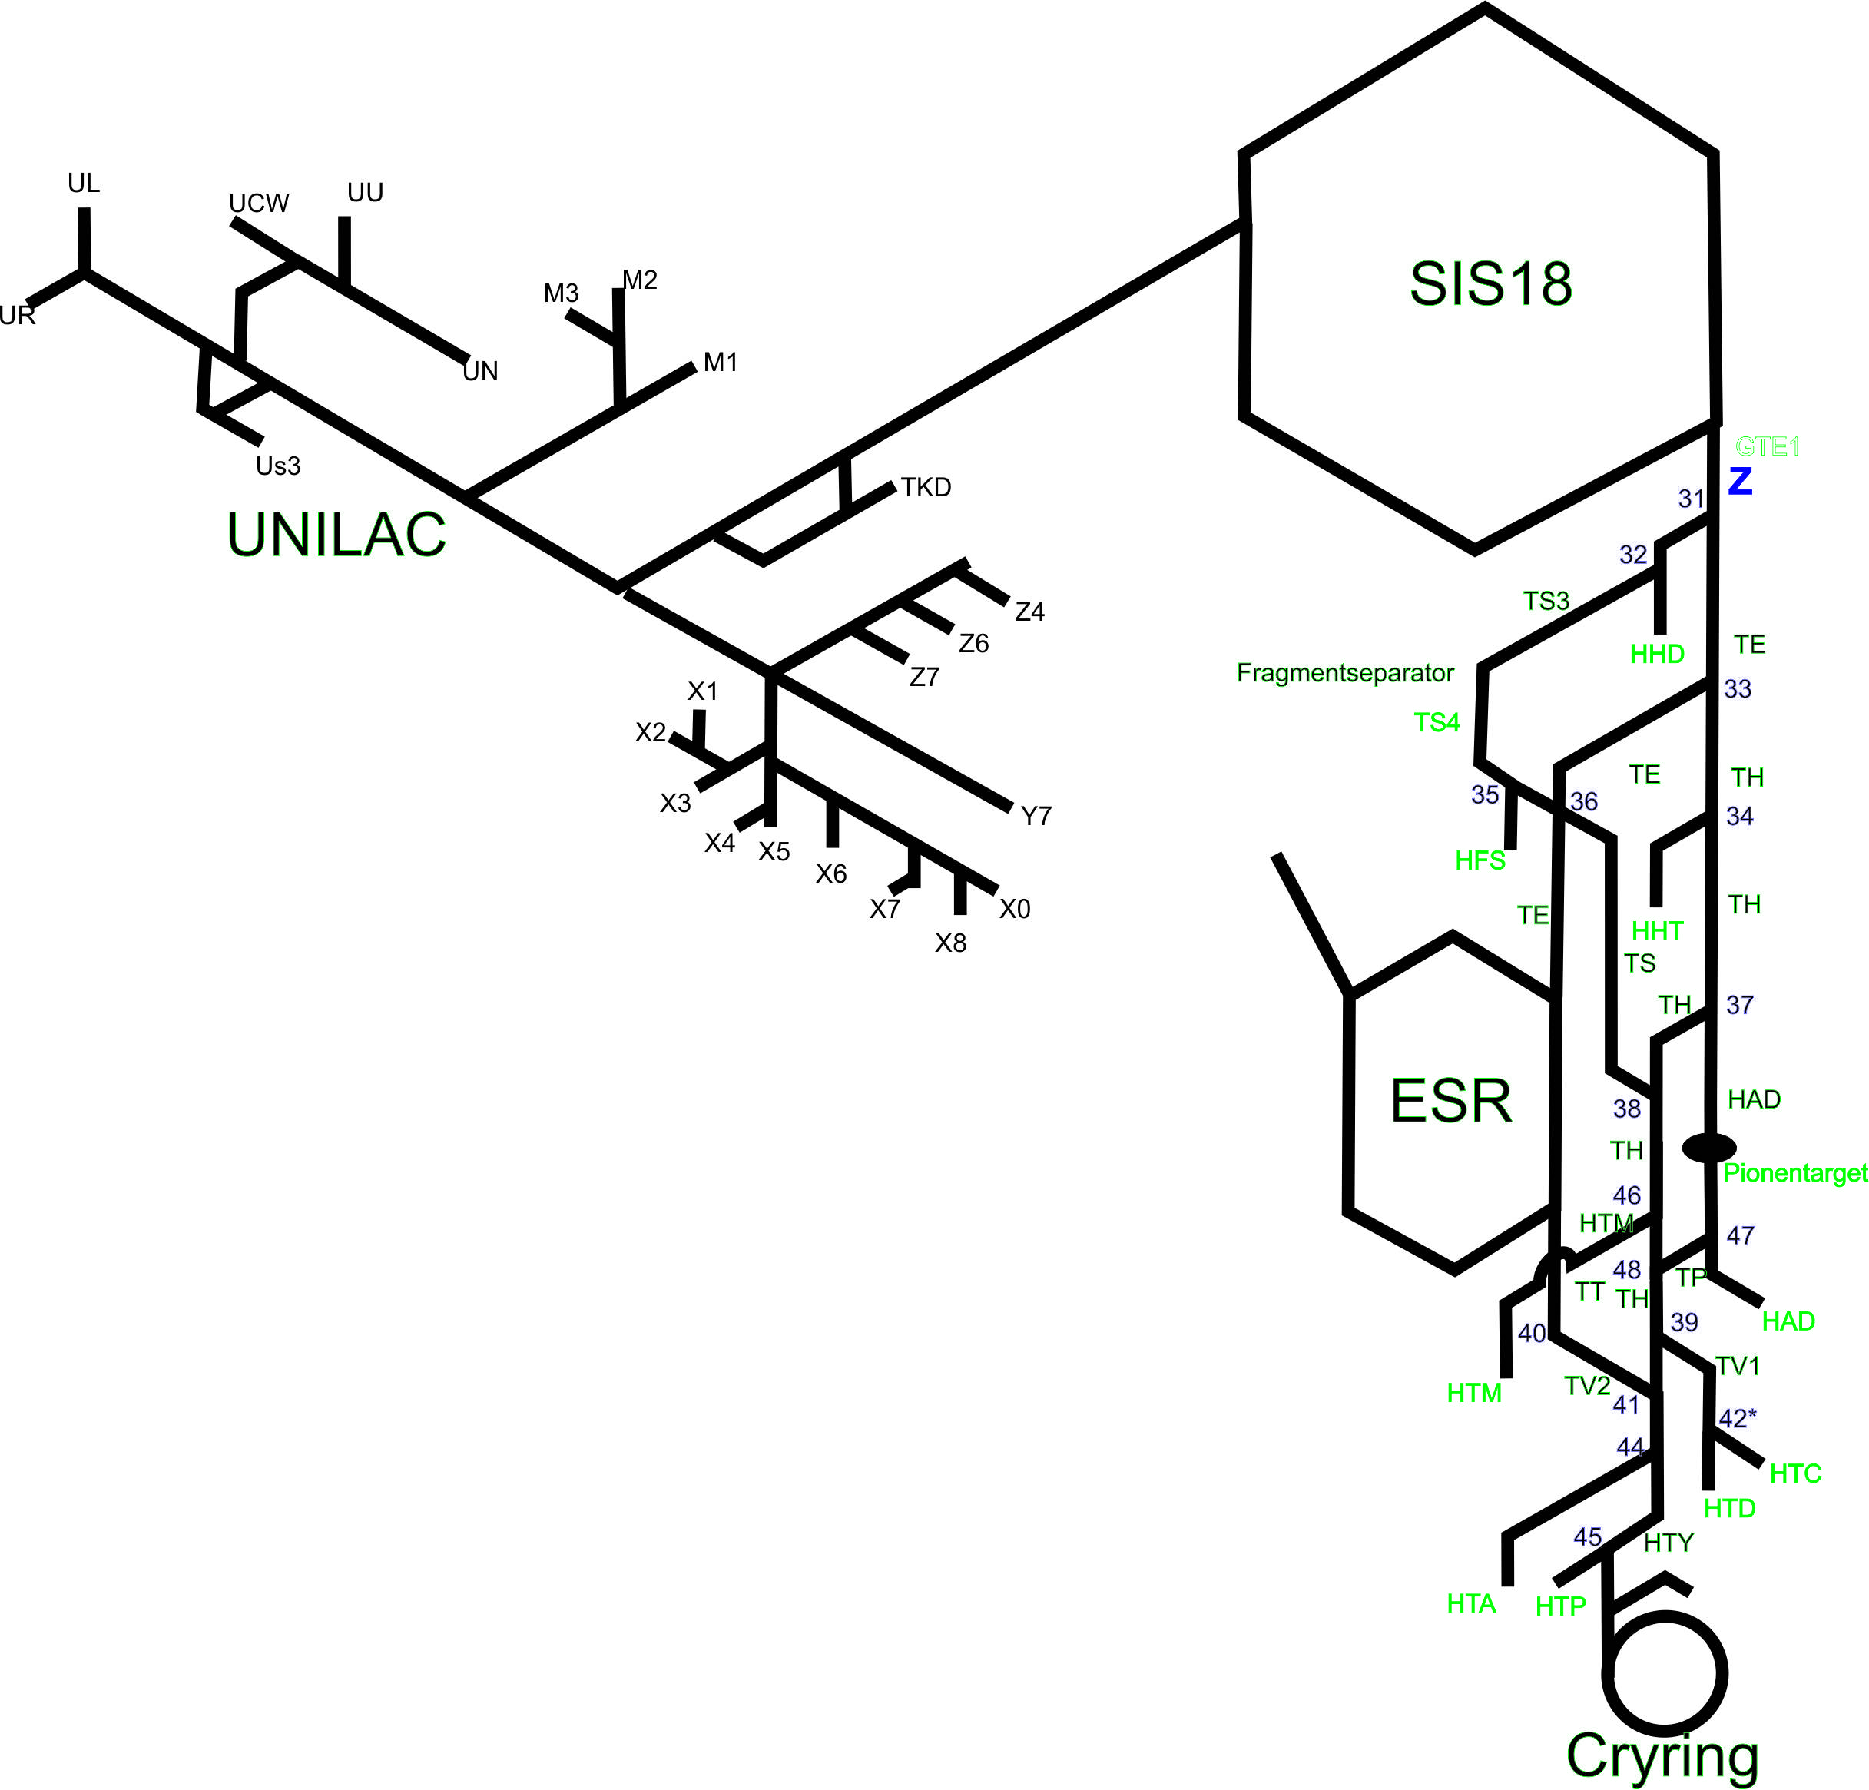
Calculation of the Machine Availability
in OLOG
Availability of the machines in 2 regimes:
1) availability for the local experiments
2) operation as part of the production chain
${AACC=\sum_{k=1}^{n}{\frac{1}{n}\left(\frac{TIME beam on}{TIME sheduled}\right)}}_{EXP_k}$

Slide 4
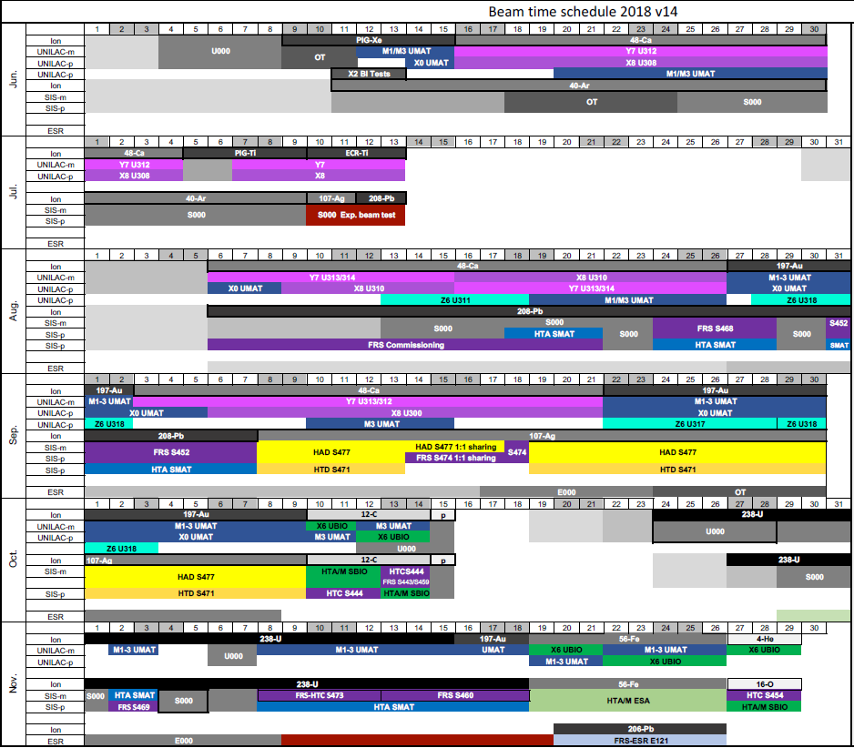
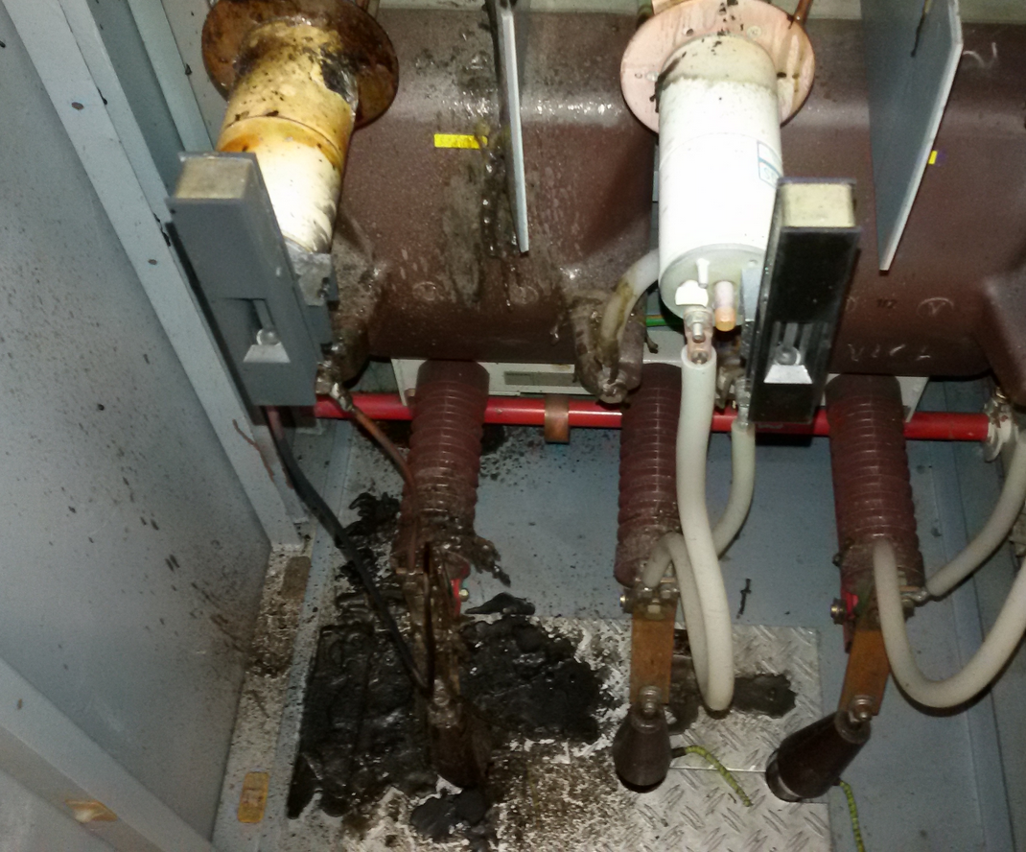
Beamtime Schedule 2018

Slide 5
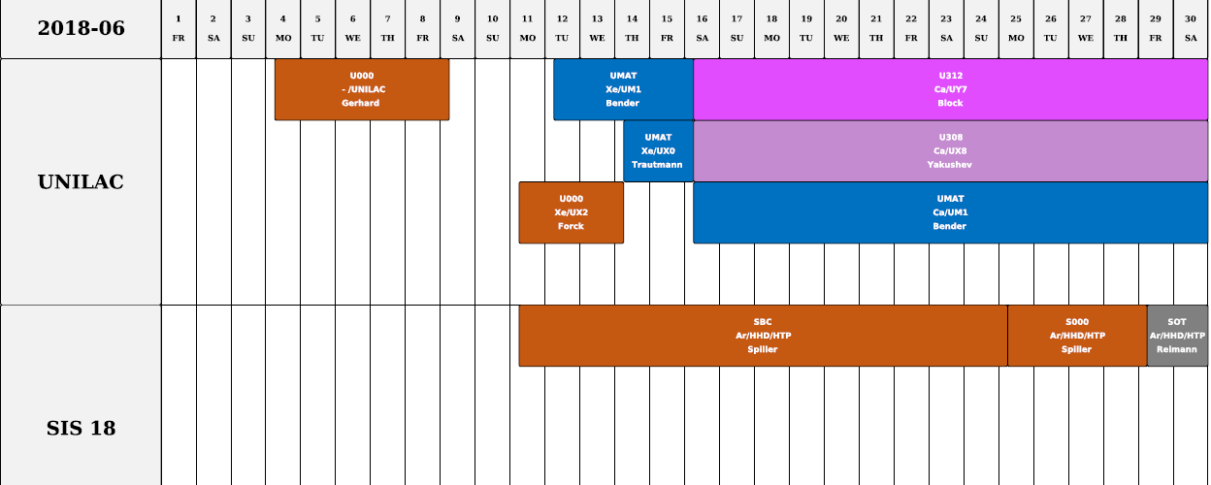
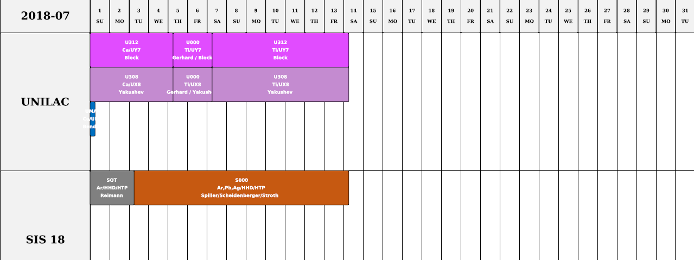
PHYS RUN 2018

Slide 6
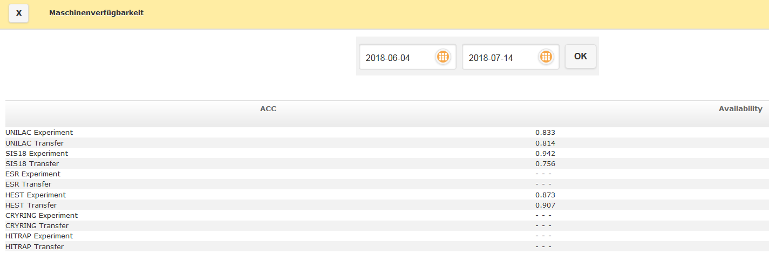
PHYS RUN 2018: Machines Availability
Events Chart für jede Maschine fehlt noch

Slide 7
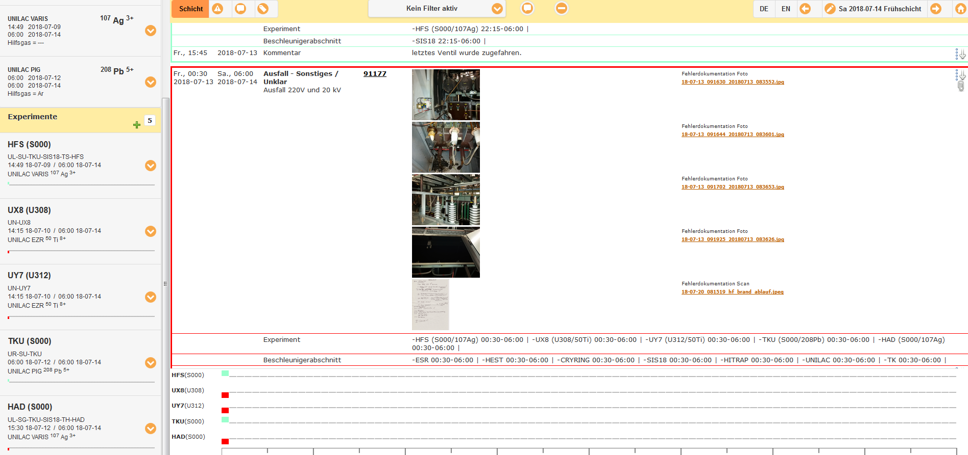

Slide 8
PHYS RUN 2018: Events Overview

Slide 9
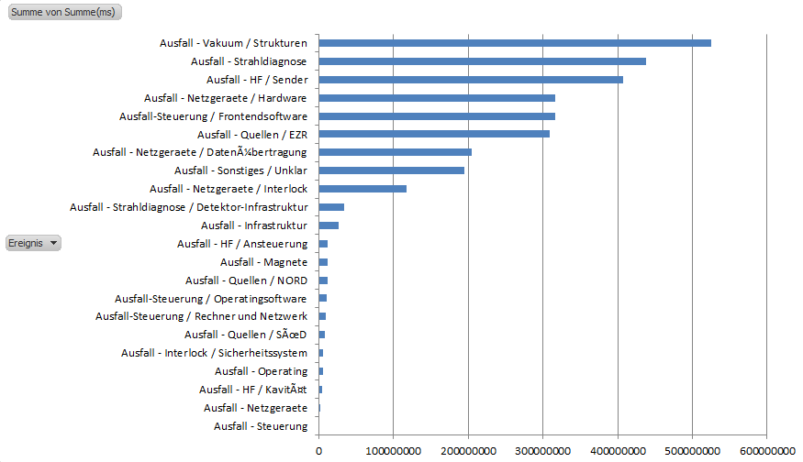
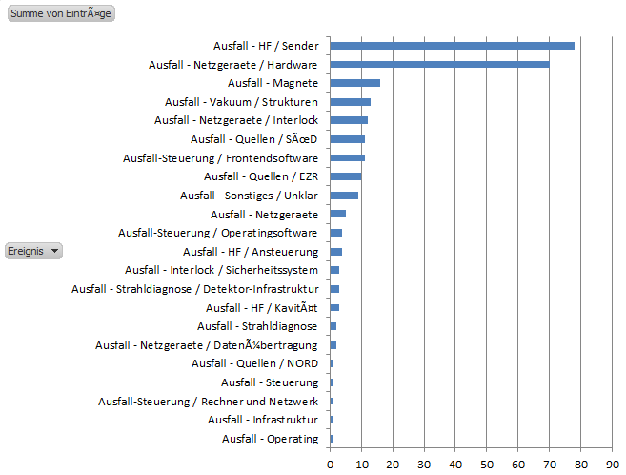
PHYS RUN 2018: General Failures Statistic
[ms]

Slide 10
PHYS RUN 2018: Failures Statistic
[ms]

Slide 11
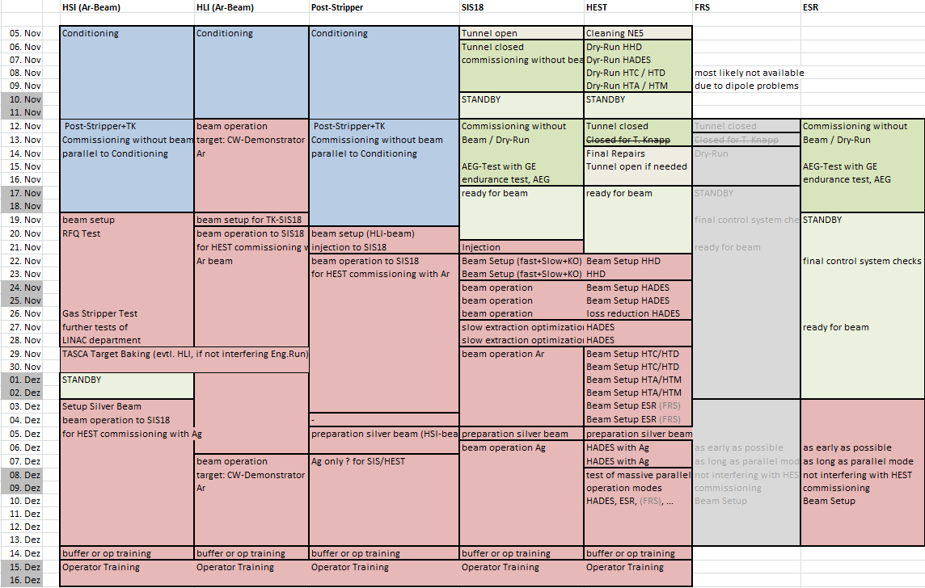
ENG RUN 2018

Slide 12
ENG RUN 2018: Machines Availability

Slide 13
ENG RUN 2018: Events Statistic
ENG RUN
PHYS RUN

Slide 14
Calculation of the availability in the future
Possibilities for the accounting:
1) Manually (OLOG)
2) „Automatic“ (Arch. System)

Slide 15
Issues for the failure analysis
Failure Analysis: poor quality of existing data
OLOG: Update of the Failure root cause in OLOG Event after its clarification
Arch. System: intelligent Data Mining

Slide 16
Automated Availability Tracking: CERN
<2012: generally poor data
2012: Availability Working Group (AWG) launched
Goal to produce data for “avail-sim” – SLAC
2013: AWG proposed Accelerator Fault Tracker (AFT) to solve data issues
“downtime tracker” – Fermilab – ARW 2011
“stick the numbers on a popular notice board” – P. Sampson – ARW 2013
board”
2014: AFT launched
2015: AFT extensively used for data analysis
Finding your “best bang for your buck” – D. McGilvery – ARW 2015
2016: AWG began LHC periodic reporting for LHC
2017: AWG began data capture for injectors
Find your “Happy User Index” – A. Luedeke – ARW 2013
2017: Founding of Machine Availability and Reliability Panel – organization level

Slide 17
Automated Availability Tracking: DESY
A new functionality in CS generates the statistics automatically according to predefined rules. The key components are:
Beam Operation Calendar for definition of the planned machine status. Defines the nominal machine state with 1 hour resolution, specifies the nominal beam parameters
The State Server to generate the actual machine state (10Hz upgrade rate). Based on many predefined machine states: UserRun, UserRun out of specs, UserRun low beam current, Test Run, Maintenance, Studies etc
Central Alarm System collects alarms for each subsystem. Three types of alarm severity is pre-defined for every subsystem. If there is at least one FATAL alarm in one subsystem then the current ACC state is set to FAILURE.
OperationHistoryViewer to view the history of machine states and alarms for any time interval, zooming down to seconds. Accelerator availability and MTBF calculation for the selected time interval
Offline state corrections are still frequently done if the machine state is incorrectly defined or incorrect alarm definition/severity. The goal is to minimize the offline corrections. It is an ongoing iterative process to identify incorrect states and alarms where machine coordinators and operation team are highly involved.

Slide 18
Definitions 2
Mean Time Between Failure (MTBF) – mean time between the start of 2 failures
Mean Time To Failure (MTTF), Mean Time To Repair (MTTR) MTBF = MTTF + MTTR
MTBF
Operation
Operation
Failure
(diagnose,repair/
replace, heat up...)
MTTR
MTTF
Availability – fraction of time during which a system meets its specification (is the percentage of time that the beam was really delivered to the Users devided by the time is was initially scheduled to be delivered)
$Availability=\frac{Real delivery time}{Scheduled time}$ = $\frac{Real delivery time}{Real delivery time+Failure time}$ = $\frac{MTTF}{MTTF+MTTR}$

Slide 19
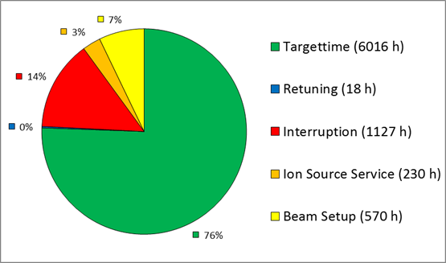
Details on Accounting
Total operation time consists of:
Targettime: ‚beam on target‘ time, when all required machines (in production chain) are running and the planed experiments are served with beam
Retuning: planed targettime interruption in order to improve the beam performance (mostly requirement from experiments)
Interruption (Failure): unplaned targettime interruption. Includes failure diagnose, repair/replace, heat up, conditioning, etc...
Ion Source Service: planed targettime interruption in order to exchange the cathodes
Beam Setup: planed targettime interruption in order to setup the maschine for the new projectile or new production chain
Stand by: planed targettime interruption when either a) experiments cannot take the beam or b) another machine in the production chain gets failure or c)ion source service takes place or d) retuning of the another machine in the production chain takes place

Slide 20
Details on Accounting
As the machine availability represents the ratio of failure-free time (targettime) to the
sheduled time, one has to subtract retuning, Ion Source Service, Beam Setup and Standby
times from the Total time.
Though the Beam Setup, Retuning and Ions Source Service time will not be reflected in the
availability statistics, they shall be kept reasonably low.

Slide 21
Our goal
Statistics example from ESRF shows that investing man power and money into
improvement of the availabilty pays back!
Blue balks: Beam on target time (MTTF) left axis [0, 7000] increases
Red line: Number of Failures right axis [0, 300] decreases

