Slide 1
Planned Experiments: Overview for 2019
Daniel Severin
Beam time coordinator

Slide 2
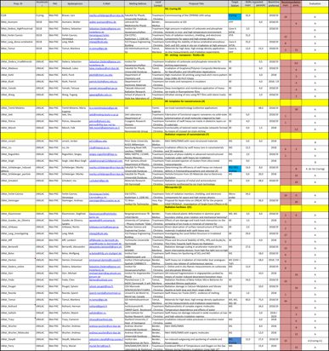
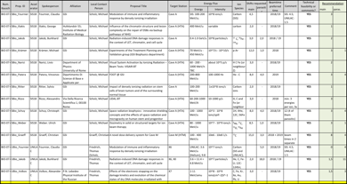
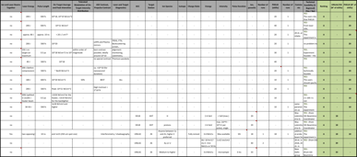
PAC Results
G-PAC
31 Proposals granted
UNILAC: 98 days
SIS18: 100 days
ESR/Cryring: 63 days
Mat-PAC
43 Proposals granted
UNILAC: 50 days
SIS18: 8 days
Bio-PAC
14 Proposals granted
UNILAC: 2 days
SIS18: 11 days
Plasma-PAC
5 Proposals granted
UNILAC: 30 days parasitic
SIS18: 12 days parasitic

Slide 3
PAC Results
G-PAC
31 Proposals granted
UNILAC: 98 days
SIS18: 100 days
ESR/Cryring: 73 days
Mat-PAC
43 Proposals granted
UNILAC: 50 days
SIS18: 8 days
Bio-PAC
14 Proposals granted
UNILAC: 2 days
SIS18: 11 days
total
93 Proposals granted
UNILAC: 153 days
SIS18: 120 days
ESR/Cryring: 63 days
Plasma-PAC
5 Proposals granted
UNILAC: 30 days parasitic
SIS18: 12 days parasitic

Slide 4
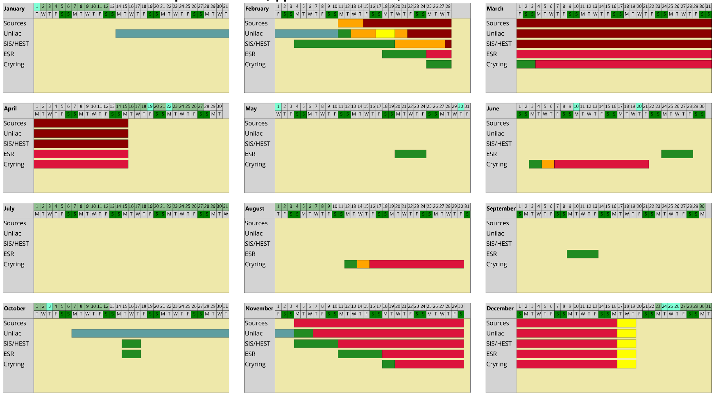
Operation 2019

Slide 5
Operation 2019
Available beam time for physics program 2019:
UNILAC: 52 days
SIS18: 50 days
ESR/Cryring: 0 days

Slide 6
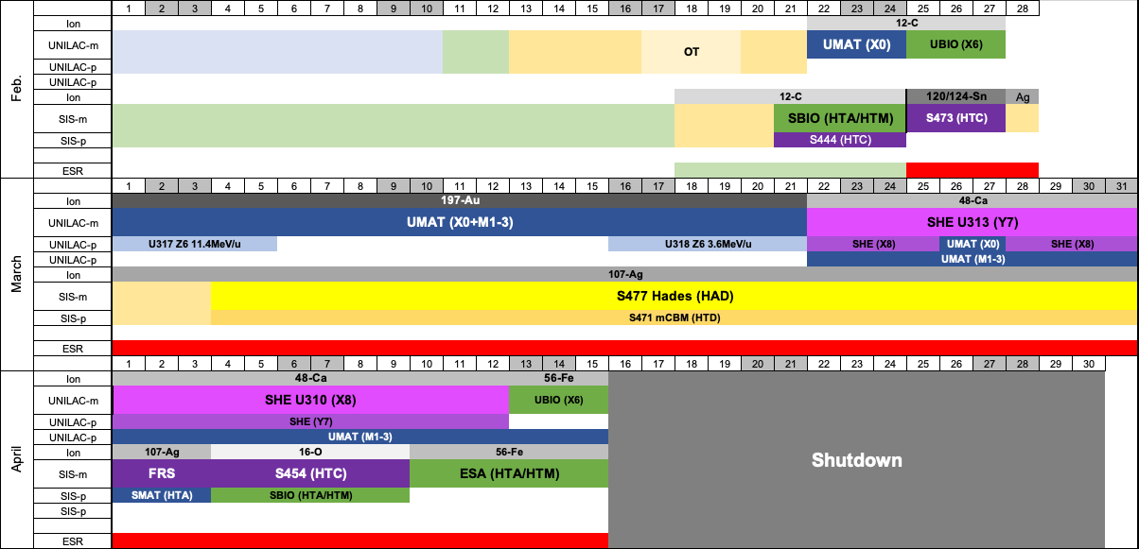
Beam time schedule 2019

Slide 7
UNILAC

Slide 8
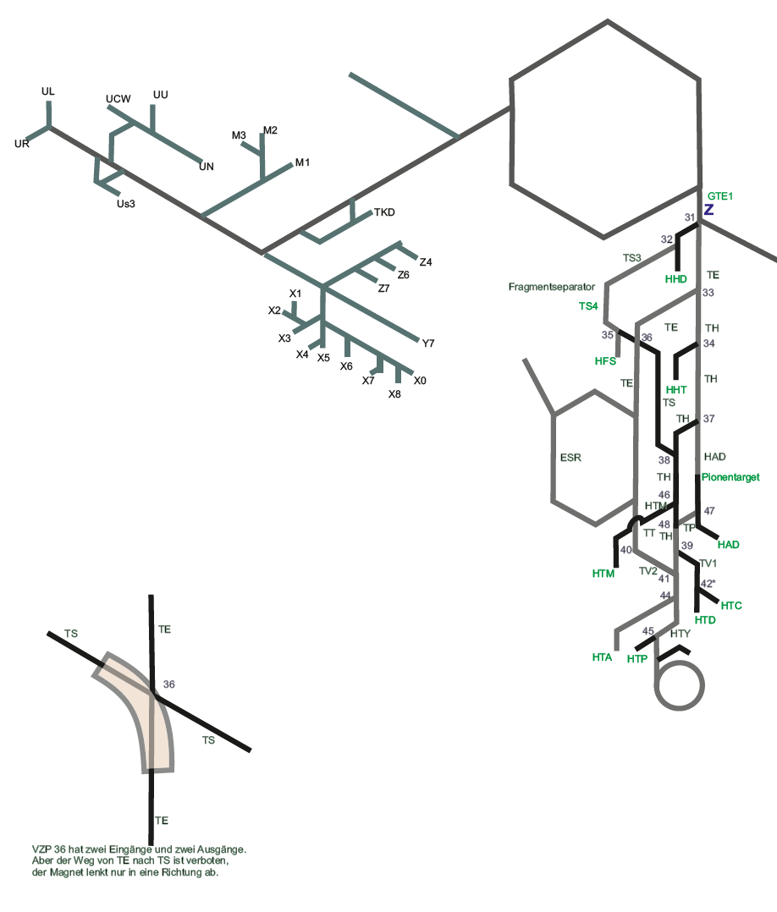

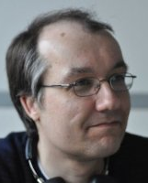

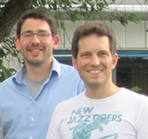
Materials Research
UNILAC M1/M2/M3/X0 12-C, 48-Ca,197-Au, 238-U
Christina Trautmann
Kay-Obbe Voss
Eugenia Toimil
Hausmeister
Markus Bender

Slide 9
Materials Research
UMat_Apel G-PAC42 | Mat | Apel, Pavel | Trautmann, Christina | Asymmetric nanopores for molecular sensors
UMat_Bender G-PAC42 | RH | Bender, Markus | Bender, Markus | Heavy ion-induced molecular desorption and sputtering from cryogenic surfaces
UMat_Bolse G-PAC42 | Mat | Bolse, Wolfgang | Trautmann, Christina | Swift heavy ion sputtering of SiO₂ and Nio
UMat_Breuer G-PAC42 | Mat | Breuer, Lars | Severin, Daniel | MeV/SIMS/SNMS with organic molecules
UMat_Dartois G-PAC42 | Mat | Dartois, Emmanuel | Severin, Daniel | Swift heavy ion irradiation of interstellar dust analogues: Cosmic rays release of carbonaceous species
UMat_Dürr G-PAC42 | Mat | Dürr, Michael | Severin, Daniel | Modification of silicon surfaces induced by electronic excitation - investigation by means on ion-induced desorption of hydrogen from H/Si(001)
UMat_Ferlet-Cavrois G-PAC42 | Mat | Ferlet-Cavrois, Véronique | Trautmann, Christina | Micro-probing of electronic components for space and high energy physics applications
UMat_Ferry G-PAC42 | Mat | Ferry, Muriel | Severin, Daniel | Radiolysis of polymers: Temperature effect
UMat_Iwase G-PAC42 | Mat | Iwase, Akihiro | Trautmann, Christina | CeO₂ sintered bulk specimens (8 pieces) dimension: 4mmx4mmx0.7mm
UMat_Kluth G-PAC42 | Mat | Kluth, Patrick | Trautmann, Christina | Fundamental properties and applications of ion tracks in insulators
UMat_Lang G-PAC42 | Mat | Lank, Maik | Trautmann, Christina | Investigation of the nature of defect behavior and disorder in irradiated complex oxides
UMat_Mecartney G-PAC42 | Mat | Mecartney, Martha | Trautmann, Christina | Radiation damage in multiphase ceramics and the effect of grain size
UMat_Neumeier G-PAC42 | Mat | Neumeier, Stefan | Trautmann, Christina | Investigation on (La,Gd)PO₄ solid solutions under swift heavy ion irradiation
UMat_Rogozhkin G-PAC42 | Mat | Rogozhkin S.V. | Trautmann, Christina | Analysis of oxide particles stability in advanced ODS steels under swift heavy ion irradiation
UMat_Rothard G-PAC42 | Mat | Rothard, Herrmann | Severin, Daniel | Radiolysis of organic molecules in solid phase
UMat_Schleberger Graphene G-PAC42 | Mat | Schleberger, Marika | Severin, Daniel | Irradiation of graphene/polymer-composite-membranes fort nanofluidics and ultrafiltration applications
UMat_Schleberger_In-situ investigation G-PAC42 | Mat | Schleberger, Marika | Severin, Daniel | In-situ investigation of two-dimensional materials
UMat_Sequeira G-PAC42 | Mat | Sequeira, Miguel | Trautmann, Christina | Understanding ion-solid interactions in functional wide bandgap semiconductors
UMat_Steininger G-PAC42 | Mat | Steininger, Andreas | Voss, Kay-Obbe | Investigation of single event effects in 65 nm CMOS by microbeam experiments
UMat_Toimil-Molares G-PAC42 | Mat | Toimil-Molares, M.E. | Toimil-Molares, M.E. | Ion-track nanotechnology (collective application)
UMat_Tomut G-PAC42 | RH | Tomut, Marilena | Tomut, Marilena | Materials for high dose, high energy density application - on-line measurements and irradiation experiments
UMat_Wang G-PAC42 | Mat | Wang, Yugang | Trautmann, Christina | Selective ionic transport through PET films with latent tracks
UMat_Wucher G-PAC42 | Mat | Wucher, Andreas | Severin, Daniel | MeV-SIMS
UMat_Zhang G-PAC42 | Mat | Zhang, Yanwen | Trautmann, Christina | Ion-Track Formation in Complex Alloys and Ceramics

Slide 10
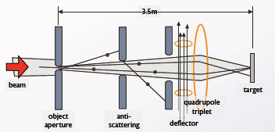
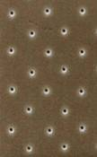
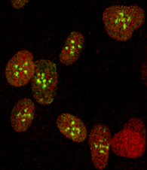
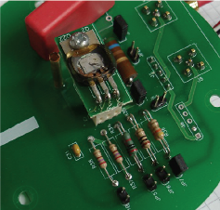
MAT Microsonde
Zielgenauigkeit ca 1 µm
Schreibrate ca. 1000 Ionen/s
1
ESA: Strahlenschäden in elektronischen Bauteilen
2
Biophysik: gezielter Beschuss von Zellkernen

Slide 11
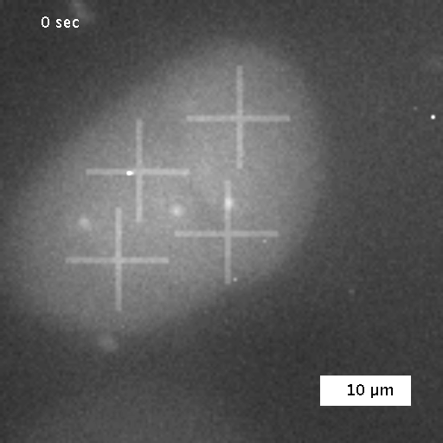
MAT Microsonde

Slide 12
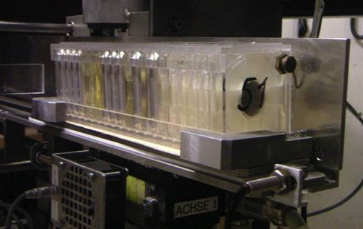
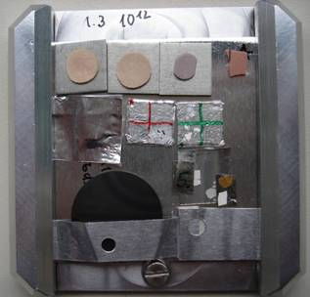
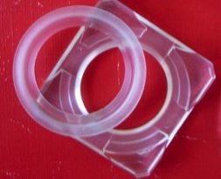
MAT X0
Probenhalter
(5x5 cm²)
ferngesteuerte Probenschleuse
Folienhalter
Magazin mit 20 Probenhalter

Slide 13
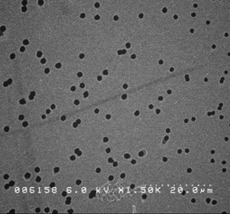
Nanotechnologie mit Ionenspuren
Bestrahlung
mit Ionen
Ätzbad
(z.B. Natronlauge)

Slide 14
Nanotechnologie mit Ionenspuren
1 Ion → 1 Pore
Bestrahlung → Zahl der Poren (1-10¹⁰ cm⁻²)
Ätzung → Porendurchmesser (einige nm - µm)

Slide 15
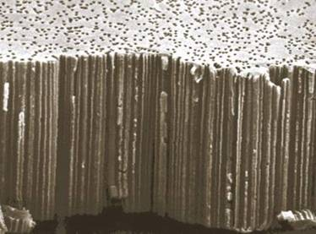
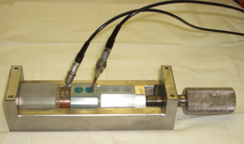
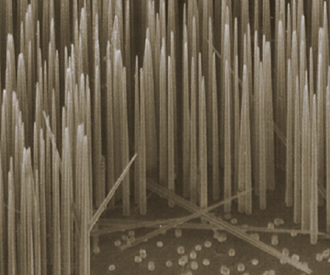
Ionenspurmembran als
Schablone für Nanodrähte
anode
cathode
SO₄⁻⁻
Cu⁺⁺
CuSO₄ + H₂O
10 µm
Ionenspurmembran
galvanisches Füllen der Kanäle
Auflösen der
Polymerfolie
freistehende Nanonadeln

Slide 16
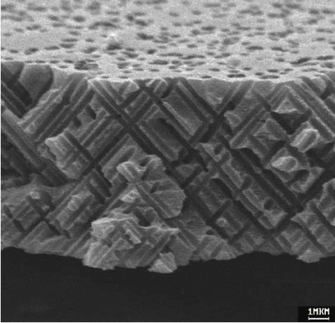
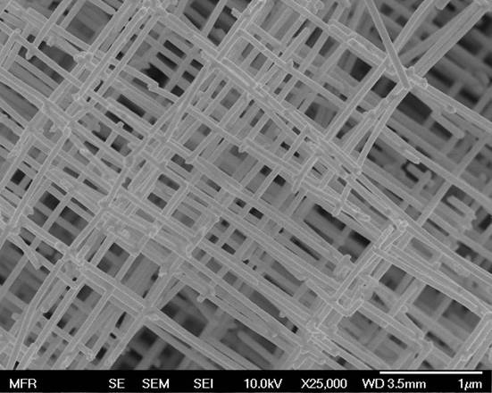
Nanostrukturen
Ionenbestrahlung unter schrägem Winkel
stabile Nanonetzwerke mit
extrem hoher Oberfläche

Slide 17
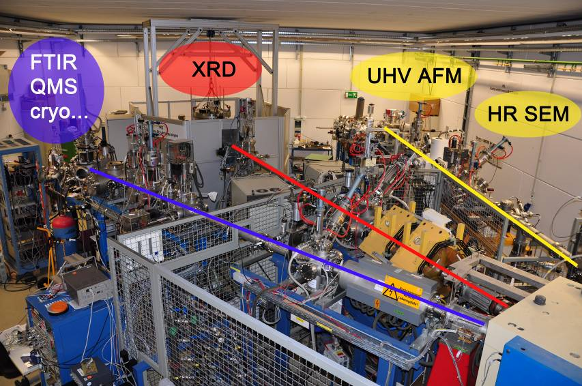
M-Branch Overview
XRD
GeV
SIMS
Multi-purpose
chamber
- In-situ spectroscopy
(IR, UV-vis, Raman)
- RGA
- T Stages, etc.
HRSEM
M2
M1
M3
Charge selective beams

Slide 18
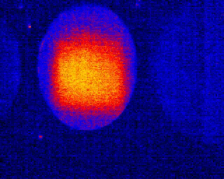

Untersuchung von Strahlenschäden
Online (Untersuchung während der Bestrahlung)
  Thermisches Abbild des Strahls auf der Probe
  Mechanisches Fließen (Kriechen) der Probe
  Optische Spektroskopie
  Röntgen-Strukturanalyse
  Ausgasen der Probe
  Widerstandsänderung

Slide 19
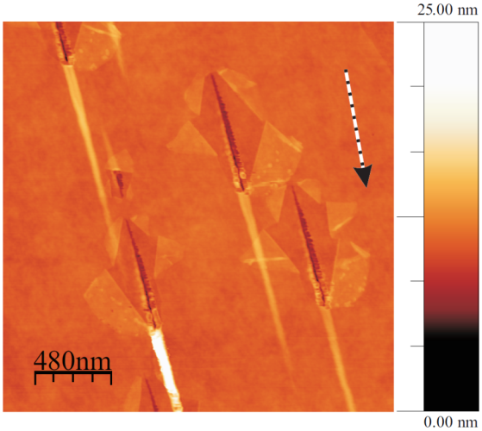
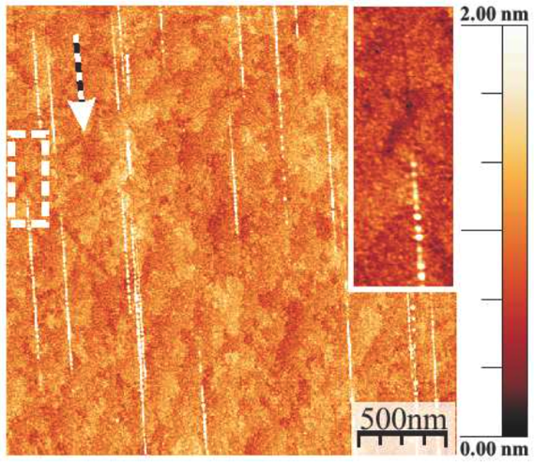
Untersuchung von
Strahlenschäden
Offline (Untersuchung nach der Bestrahlung)
  Thermische Leitfähigkeit
  Mechanische Festigkeit und Härte
  Optische Spektroskopie
  Mikroskopie
SrTiO₂
Graphen
Notes:
Rastersonden-Mikroskopie: Atomar feine Spitze tastet die Oberfläche ab, Abbildung einzelner Atome möglich.

Slide 20
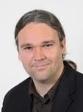
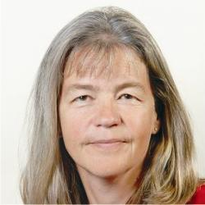

Biophysics
UNILAC X6/X0 12-C, 197-Au
Thomas Friedrich
Claudia Fournier
Burkhard Jakob
BIO-07-012 | Fournier, Claudia | Modulation of immune and inflammatory response by densely ionizing irradiation | X6
BIO-07-013 | Jakob, Burkhard | Radiation-induced DNA damage responses in the context of LET, chromatin, and cell cycle | X6, X0

Slide 21
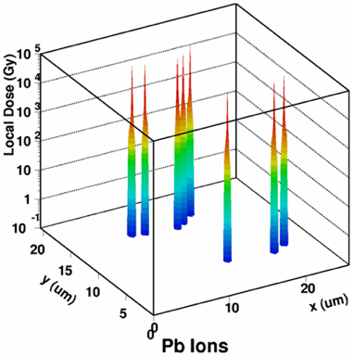
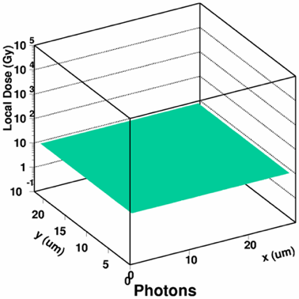
Stopping Mechanism
nuclear stopping
electronic stopping

Slide 22
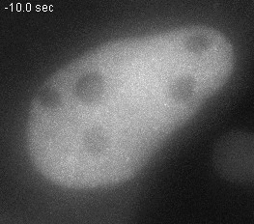
(B. Jakob, G. Taucher-Scholz)
Cosmic rays in a human cells
© GSI
Notes:
Animated gif

Slide 23
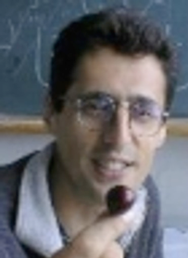
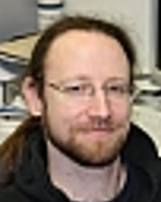
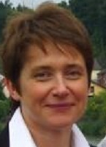
Plasma Physics
UNILAC Z7, 48-Ca, 12-C, 197-Au
Abel Blaszevic
Denis Schumacher
Olga Rosmej
U317 | X-ray mapping of the heavy ion beam intensity distribution and the ion beam energy loss in the plasma physics experiments at FAIR | Rosmej, Olga N.
U318 | Investigation of charge state and energy loss of heavy ions after interaction with inductively coupled plasma. | Cistakov, Konstantin

Slide 24
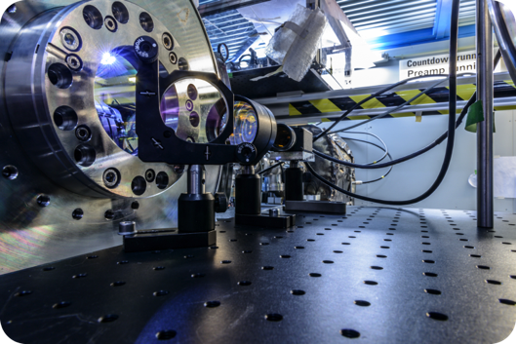
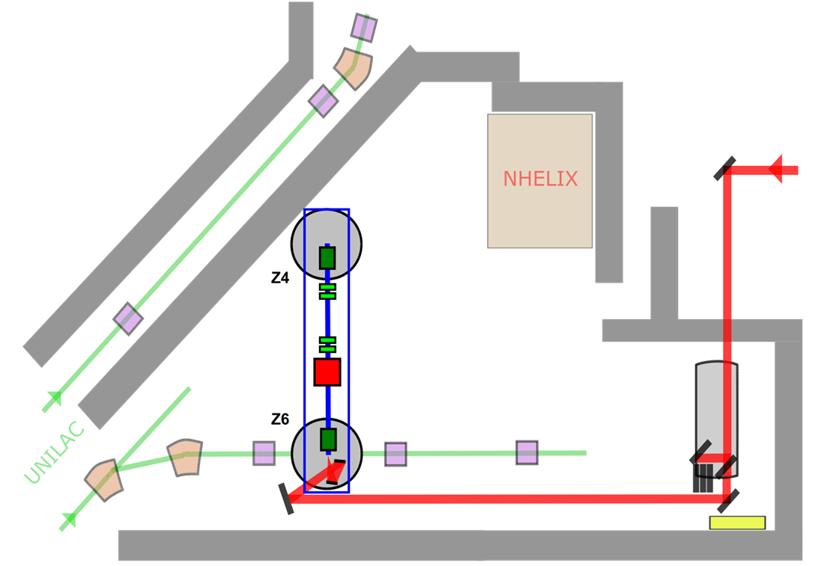
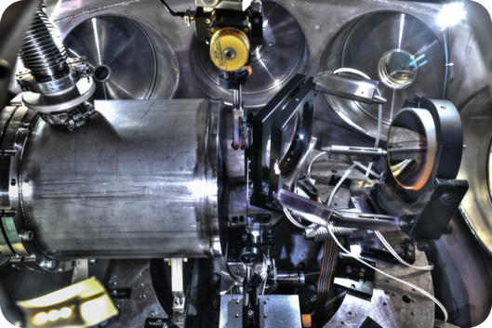
Plasma Physics
Resonator
PHELIX
50 J in 500 fs
Kompressor
Laserdiagnostik
Fokussierparabel
Solenoid

Slide 25
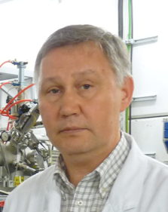
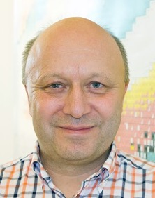
Nustar SHE-TASCA
UNILAC X8, 48-Ca
Sacha Yakushev
Dirk Rudolf
U308 | Yakushev, Alexander | First chemical study of element 113 behind TASCA
U310 | Rudolph, Dirk | Spectroscopy of Flerovium Decay Chains & Discovery of ²⁹⁰Fl

Slide 26
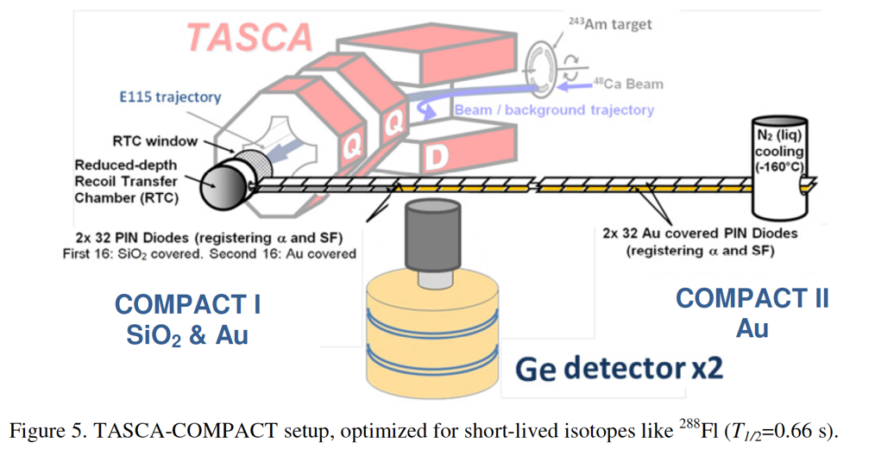
Nustar SHE-TASCA
U308 | Yakushev, Alexander | First chemical study of element 113 behind TASCA
UNILAC X8, 48-Ca

Slide 27
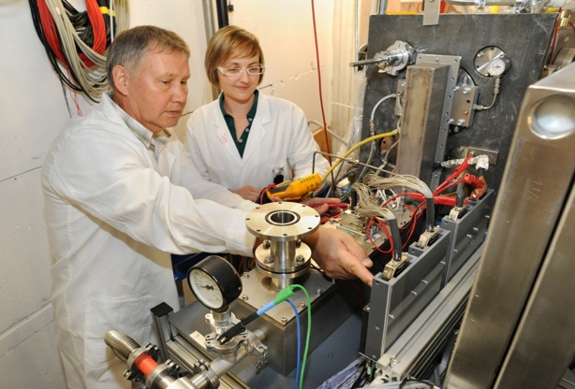
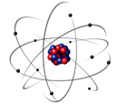
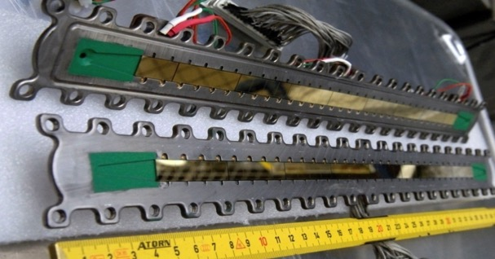
Nustar SHE-TASCA

Slide 28
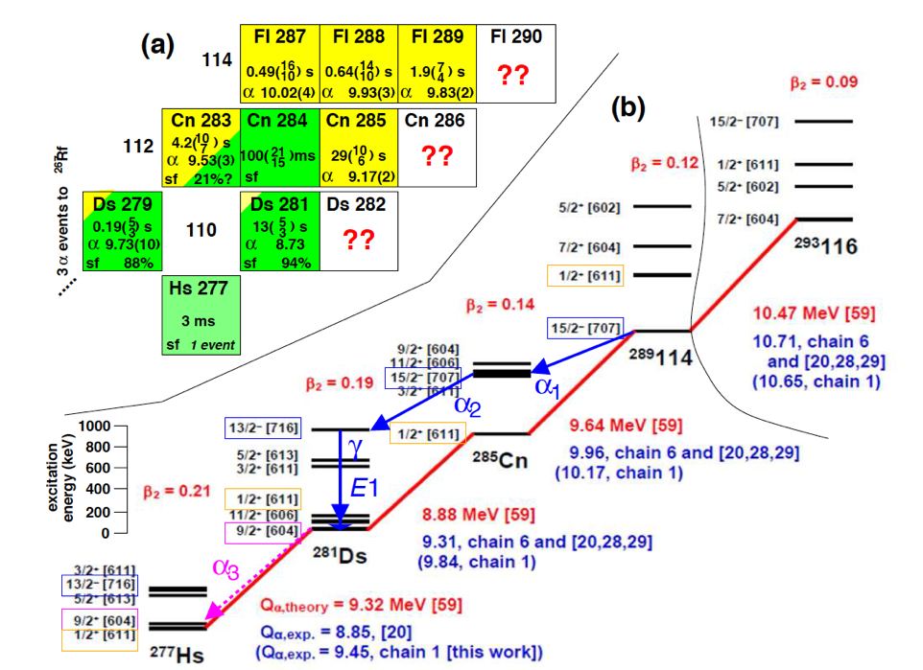
Nustar SHE-TASCA
U310 | Rudolph, Dirk | Spectroscopy of Flerovium Decay Chains & Discovery of ²⁹⁰Fl
UNILAC X8, 48-Ca

Slide 29
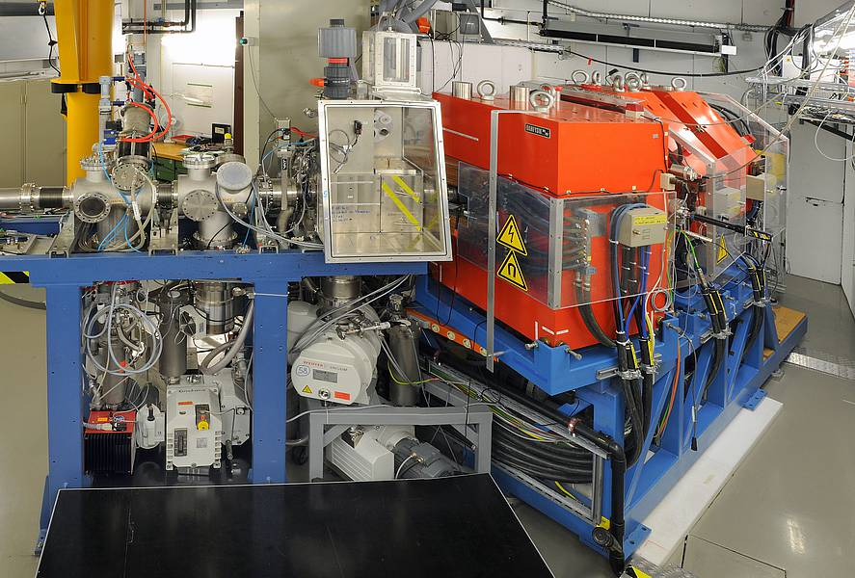
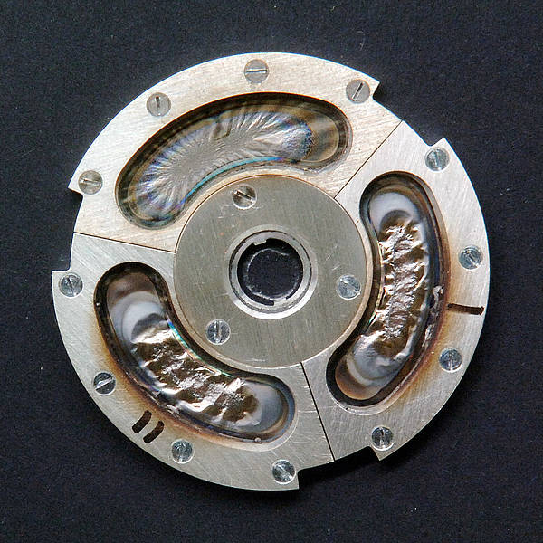
Nustar SHE-TASCA

Slide 30
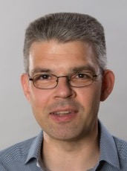

Nustar SHE-SHIP
UNILAC Y7, 48-Ca
Michael Block
Mustapha Laatiaoui
U312 | Block, Michael | Direct mass measurements and investigations of isomeric states in Lr and Rf isotopes around the deformed neutron shell closure at N = 152 with SHIPTRAP
U313 | Laatiaoui, Mustapha | Laser spectroscopy of nobelium and lawrencium

Slide 31
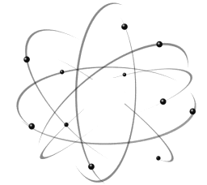

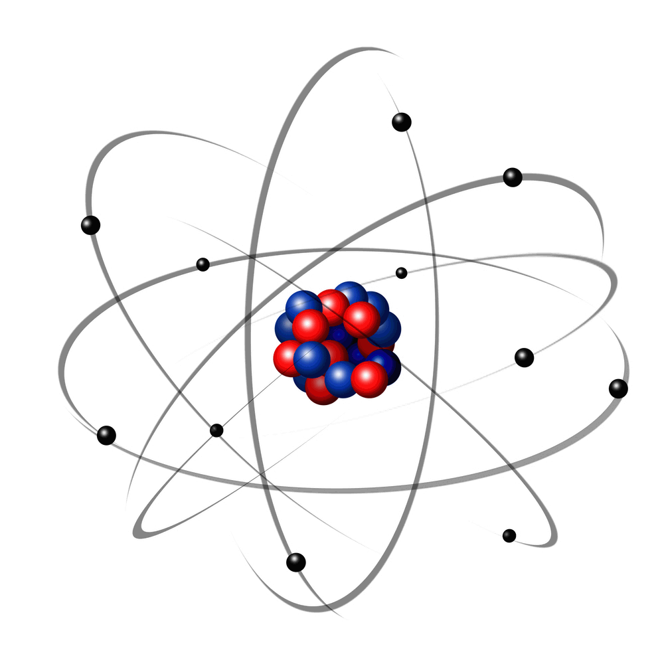

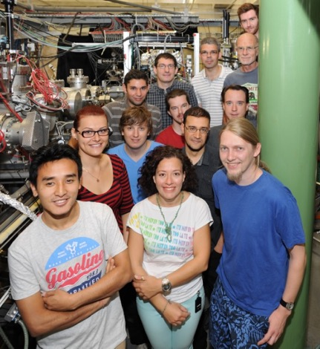
Nustar SHE-SHIP
Laser1
Laser2
λ₂
λ₁
Heizbares Filament (bis 1200 C)
+
+
°
-
²⁵⁴No von SHIP
-
α-Detektor
Suche nach atomaren Zuständen durch Scannen von λ₁
Laserspektroskopie schwerster Elemente
M. Block, M. Laatiaoui et al.

Slide 32


Nustar SHE-SHIP
UNILAC Y7, 48-Ca

Slide 33
SIS18
ESR

Slide 34



APPA Biophysik SBIO/ESA
SIS18, HTA/HTM, 12-C, 56-Fe, 4-He
Christian Graeff
Uli Weber
Christoph Schuy
Fournier, Claudia | Modulation of immune and inflammatory response by densely ionizing irradiation
Iliakis, George | Influence of the chromatin structure and lesion complexity on the repair of DSBs via backup pathways of NHEJ
Jakob, Burkhard | Radiation-induced DNA damage responses in the context of LET, chromatin, and cell cycle
Krämer, Michael | Experiments of the Treatment Planning and Validation group (GSI Biophysics department)
Narici, Livio | VIsual System Activation by Ionizing Radiation – Beam Tests: VISAIR-BT
Patera, Vincenzo | FOOT @ GSI
Ritter, Sylvia | Impact of densely ionizing radiation on stem cells of brain tumors and of the surrounding normal tissue
Rizzo, Alessandro | LIDAL-BT
Schuy, Christoph | Space radiation biophysics - innovative shielding concepts and the effects of space radiation and microgravity on human stem and progenitor cells
Weber. Ulrich | Dosimetry in solid or structured targets for ion beam therapy
Graeff, Christian | A novel dose delivery system for Cave M

Slide 35



Nustar R3B 444/473
SIS18, HTC, 12-C, 120-Sn
Haik Simon Daniel Körper Tom Aumann
S444 | Gernhäuser, Roman | R3B - 2018 COMMISSIONING (CALIFA, L3T, GLAD, NeuLAND & Tracking)
S473 | Aumann, Thomas | Constraining energy-density functionals and the density-dependence of the symmetry energy by measurements of accurate cross sections with large acceptance at R3B

Slide 36

Nustar R3B 444/473

Slide 37



Hades S477
SIS18, HAD, 107-Ag, max. E
Joachim Stroth
Michael Traxler
Jerzy Pietraszko
S477 | Stroth, Joachim | Properties of hadron resonances and baryon rich matter

Slide 38

Hades S477

Slide 39


mCBM S471
SIS18, HAD, 107-Ag, max. E
Christian Sturm David Emschermann
S471 | Herrmann, Norbert | mCBM @ SIS18 - A CBM full system test-setup for high-rate nucleus-nucleus collisions at GSI / FAIR

Slide 40

mCBM S471
SIS18, HAD, 107-Ag, max. E

Slide 41



Nustar FRS commissioning
SIS18, HFS, 107-Ag
Ch. Scheidenberger
Helmut Weick
Emma Haettner
Stephane Pietri

Slide 42

Nustar FRS
SIS18, HFS, 208-Pb

Slide 43

Nustar FRS
SIS18, HFS, 208-Pb

Slide 44
APPA
Materialforschung SMAT
SIS18, HTA, HTP,107-Ag, 56-Fe
Christina Trautmann
Kay-Obbe Voss

Slide 45




APPA
Materialforschung SMAT
2 mm
Raman signal
high energy
Au, Pb, U ions
diamond anvil cell
10-1000 kbar
x-ray diffraction
Extreme Environments
synthesis and stabilization of new materials
nanoscale manipulation of materials properties
recover exotic high-pressure phases
simulate radioactivity effects within Earth’s interior

Slide 46


APPA
Materialforschung SMAT
5 cm
Merrill-Bassett-type DAC

Slide 47
Beam time schedule

Slide 48
Beam time schedule 2019

Slide 49

Beam time schedule 2019

Slide 50
Nach der Mittagssitzung BK + Strahlzeitkoordinator im HKR
Experimentanforderungen (welche Parameter?)
Zeitfenster bei Schichtübergabe heilig!!!
Statusdokumentation wichtig! Viele Experimentatoren nutzen diese Info

Slide 51


Slide 52


Slide 53
END

Slide 54



APPA Materialforschung SMAT
relativistic ions (e.g., Au, Pb, U
200 MeV/u
40 GeV
Notes:
54

Slide 55

APPA Materialforschung SMAT
Zirconiumdioxid ZrO₂
1.5×10¹¹ U/cm²
monoklin
monoklin
P=11 Gpa
(relaxed after 2 weeks)
monoklin
1.5×10¹¹ U/cm²
P = 11 GPa
(relaxed after 2 weeks)
pressure
tetragonal
Notes:
55

Slide 56


Nustar Despec 452/470/460
SIS18, HFS, 208-Pb, 238-U
Jürgen Gerl Magdalena Gorska-Ott
S452 | Witt, Waldemar | The Oblate-Prolate Shape Transition around A~190
S470 | Pietri, Stephane | Test of an HISPEC TEGIC detector for Low Energy Branch experiments
S460 | Morales López, Ana Isabel | Investigation of 220-A-230 Po-Fr nuclei lying in the south-east frontier of the A~225 island of octupole deformation

Slide 57

Nustar Despec 460
SIS18, HFS, 208-Pb, 238-U

Slide 58

APPA/Nustar ILIMA E121
SIS18, HFS-ESR, 206-Pb
Yuri Litvinov
E121 | Litvinov, Yuri | Measurement of the bound-state beta decay of bare ²⁰⁵Tl ions

