Slide 1



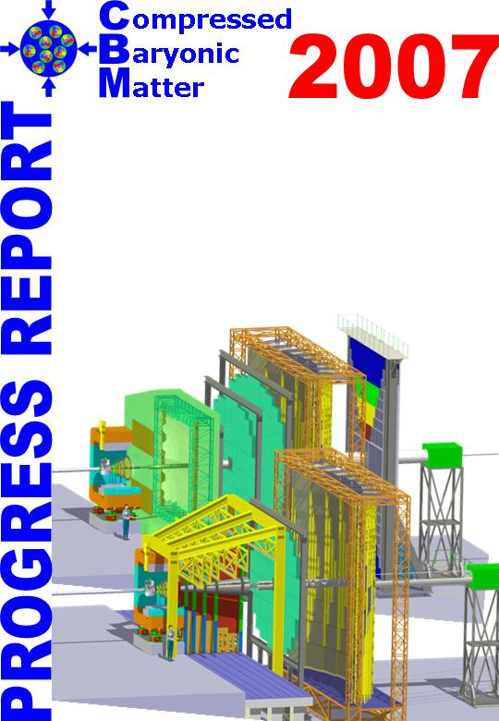
The beam halo requirements of CBM
… and what is being done to relax them.
M. Deveaux, Goethe University Frankfurt
on behalf of the CBM collaboration.

Slide 2
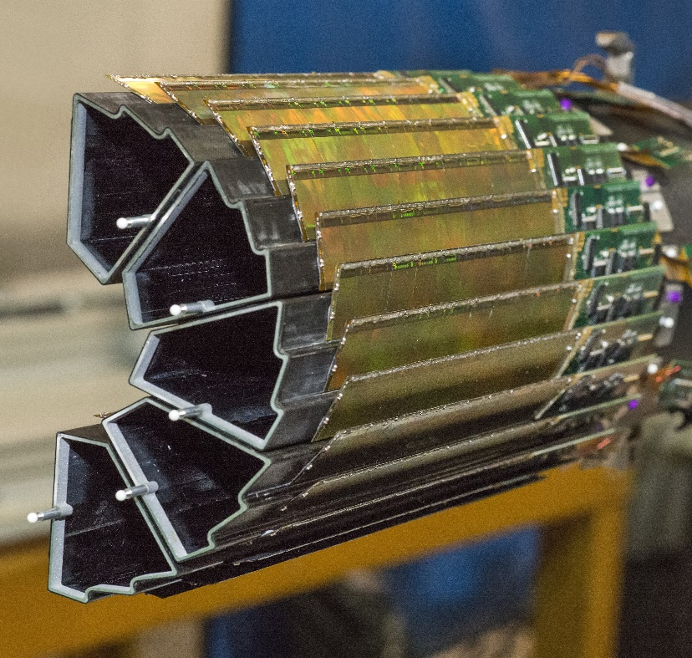
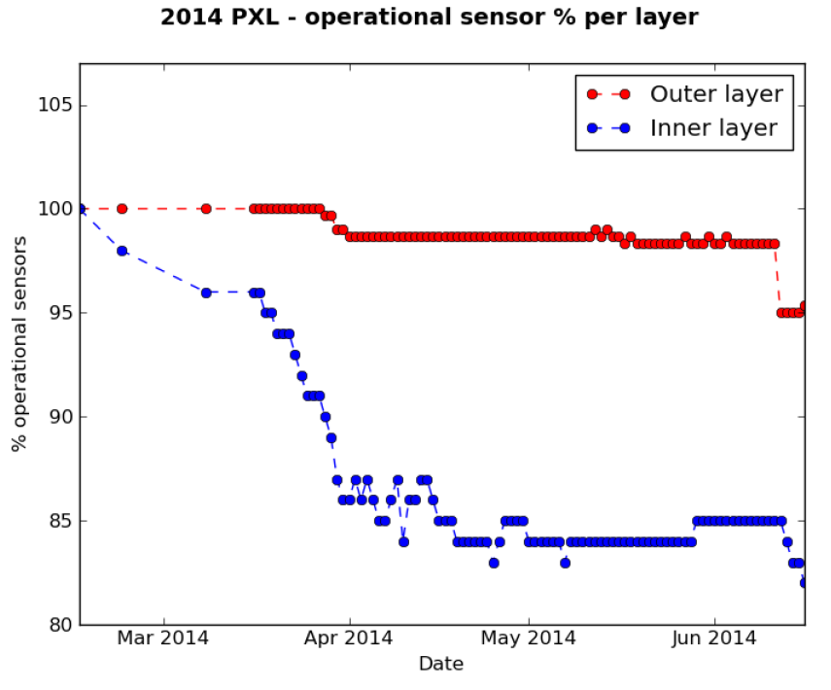
Introduction: Beam damage in the STAR-PXL
Beam
2014
G. Contin, the STAR collaboration, 2016 JINST 11 C12068
One half of The STAR-PXL detector.
Operation experience with the STAR-PXL (2014):
Loss of 14% of sensors (inner layer) within 2 weeks.
Anticipated origin: Impact of heavy beam ions (halo).
Solved by modifying existing protection system.
Related system tests and existing latch-up protection strategy did not avoid incident.

Slide 3
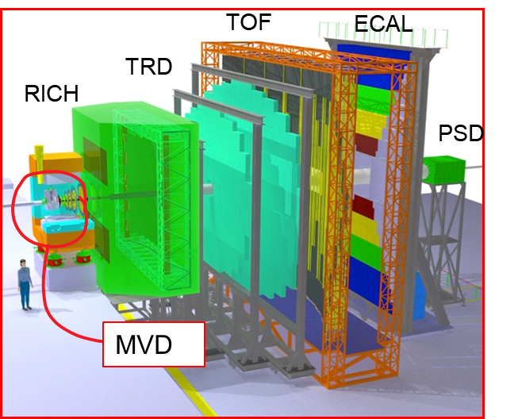
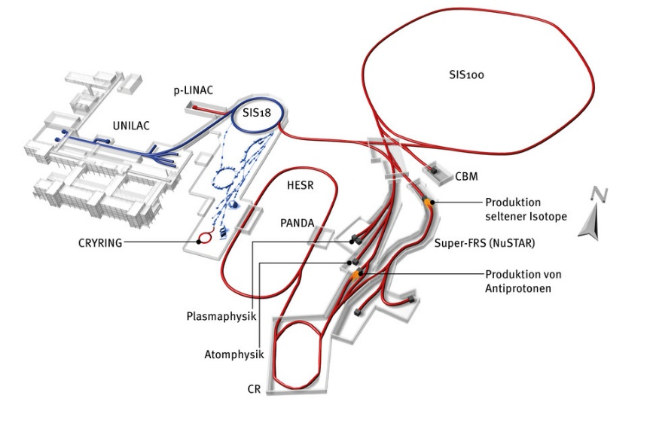
Outline
The CBM-MVD: Geometry and sensors.
Ion radiation damage in CMOS devices.
MVD sensor protection strategy.
Requirements on the beam.

Slide 4
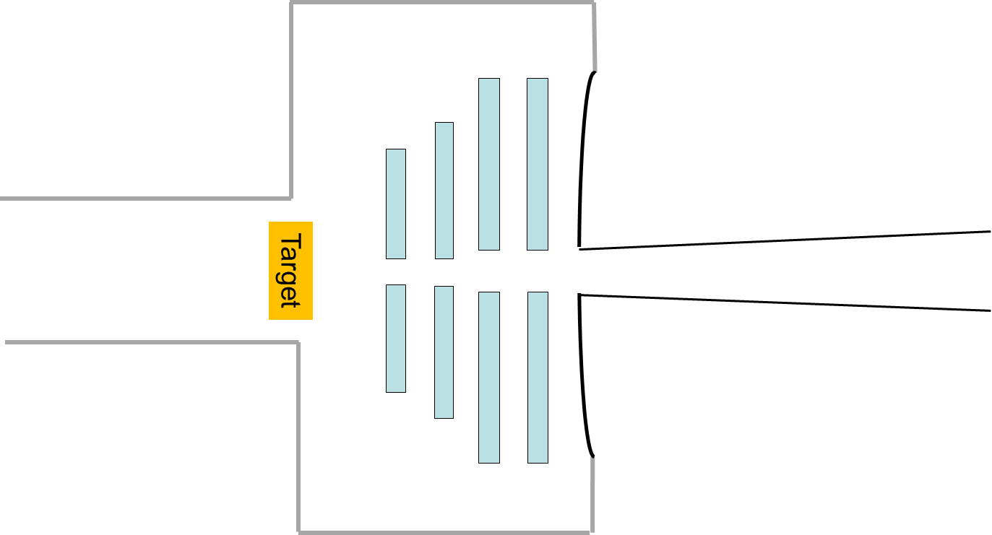
The MVD region (not to scale)
z=12 cm
Vacuum window
Electronics
Silicon tracking system
MVD-stations
Beam pipe
Beam pipe
Target
Silicon tracking system
Main concern:
Radiation damage in sensors.
Worst case:
Sudden death of sensors.
Main concern:
Secondary reactions
Worst case:
See secondaries instead of physics
Our topic today

Slide 5
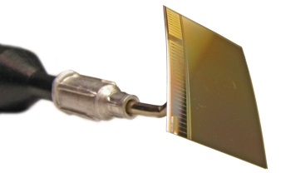

CMOS Monolithic Active Pixel Sensor (MAPS)
 | MIMOSIS design goal
Spatial resolution | ~5 µm
Time resolution | 5 µs
Pixel Pitch | 30x27µm²
Thickness | 50 µm
Rad. tolerance | ~ 3Mrad
 | 3 x 10¹³n_{eq}/cm²
MIMOSA-26
Pixel
Sensitive to integrated radiation damage.
On-chip computer (etc.)
Mostly sensitive to sudden (Single Event) Effects.
Radiation hardening techniques exist in both fields…
… but will not do miracles.

Slide 6
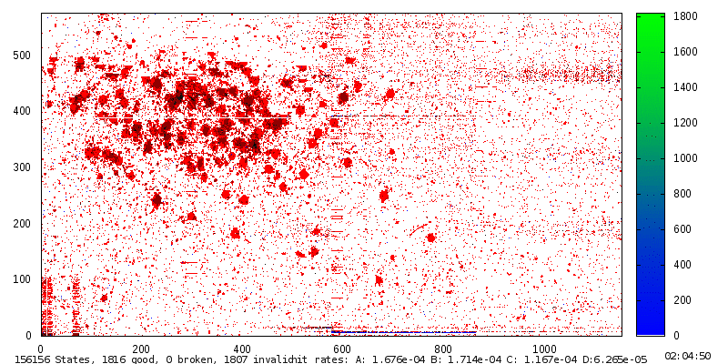
Using a MAPS as beam monitor…
Test carried out by the NA61/SHINE collaboration.
SPS primary beam (30 AGeV Pb)
~2x2 mm
574 pixel, 1.1 cm
Heavy ion:
~200 pixels
MIP (proton)
~2 pixels
1152 pixel, 2.1 cm
An Au-ion creates ~6200 x more ionization than a proton.
More radiation damage.
More charge at unwanted places (e.g. in memory cells)

Slide 7
On “sudden damage”
“Sudden damage” in digital electronics
Latch up
Single event effect
Single event upset
(e.g. bit flip)
Impact of ions
Ionizing (TID)
Integrated damage
Non-Ionizing
“Slow damage” in sensors

Slide 8
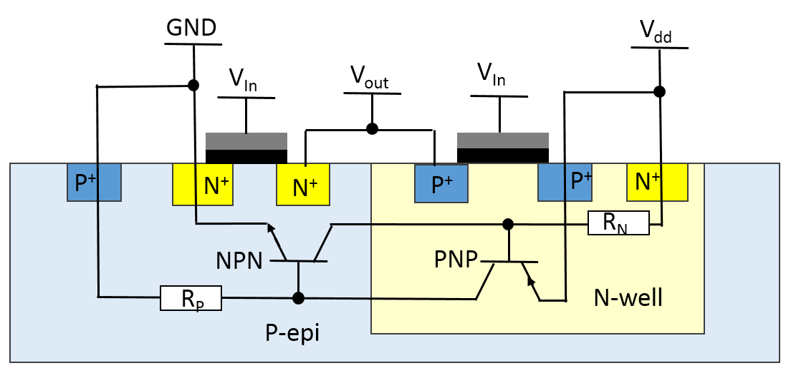
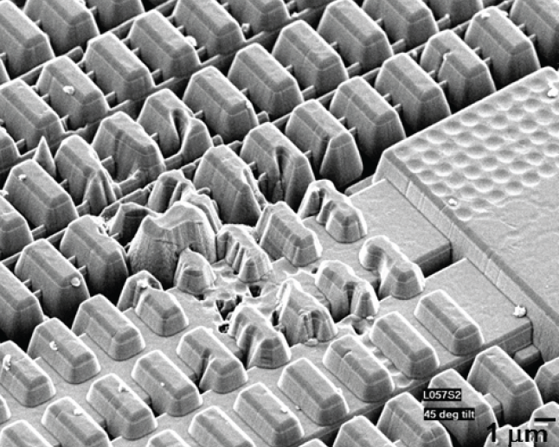
What do we know on latch up?
Latch up:
Ion creates short circuit in vulnerable CMOS-structures.
Reversible, may be cured by power cycling.
No power cycling => Thermal destruction of the device.
Created the STAR-incident.
  Automatic power cycling installed but initially too high reaction threshold.
  Reason: Thin sensors more vulnerable than the thick ones used for test.
Vulnerable structure: e.g CMOS inverter.
G. Contin, 2016 JINST 11 C12068
Situation at CBM:
MIMOSIS might be immune to this (operates at 1.8V instead of 3.3V).
MVD will be equipped with improved latch-up protection hardware.
Should avoid sensor losses. Still system up-time might be affected.

Slide 9
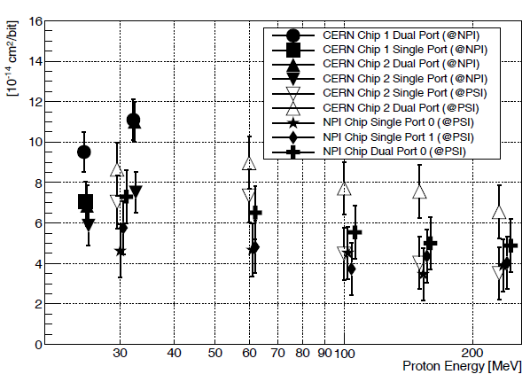
What do we know about bit-flips?
Bit flips in CMOS devices
Vulnerability depends on CMOS
process and memory design.
Results for MIMOSIS-like devices
exist for protons.
Tests for ions pending. Expect higher rates.
B Abelev et al and The ALICE Collaboration 2014,
J. Phys. G: Nucl. Part. Phys. 41 087002
What is done about it at CBM:
All important steering units of MIMOSIS will be carried out in triple-vote-logic.
Sensor may detect and correct individual bit flips e.g. by reset.
Data memories are not protected
Data may be corrupted. Impact on over all data quality is marginal.
Should avoid system fail. Still system down-time for recovery may add up… .

Slide 10
“Slow” radiation damage
“Sudden damage” in digital electronics
Latch up
Single event effect
Single event upset
(e.g. bit flip)
Impact of ions
Ionizing (TID)
Integrated damage
Non-Ionizing
“Slow damage” in sensors

Slide 11
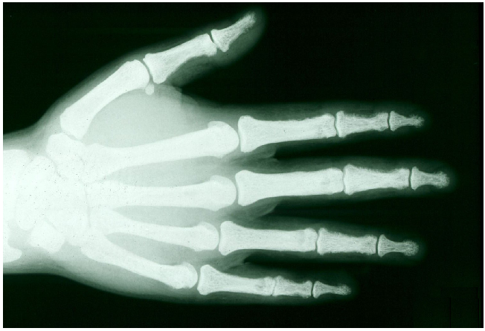
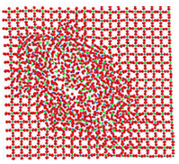
Integrated damage
To be measured and improved: Radiation hardness against…
Ionising radiation:
Energy deposited into the electron cloud.
May ionise atoms and destroy molecules.
=> Damage in transistors and photo diodes.
Non-ionising radiation:
Energy deposited into the crystal lattice.
Atoms get displaced.
=> Damage in photo diodes.
Farnan I, HM Cho, WJ Weber, 2007. "Quantification of Actinide α-Radiation
Damage in Minerals and Ceramics." Nature 445(7124):190-193.
Both damage mechanisms add up.
=> Must validate immunity to each individual damaging mechanism.

Slide 12
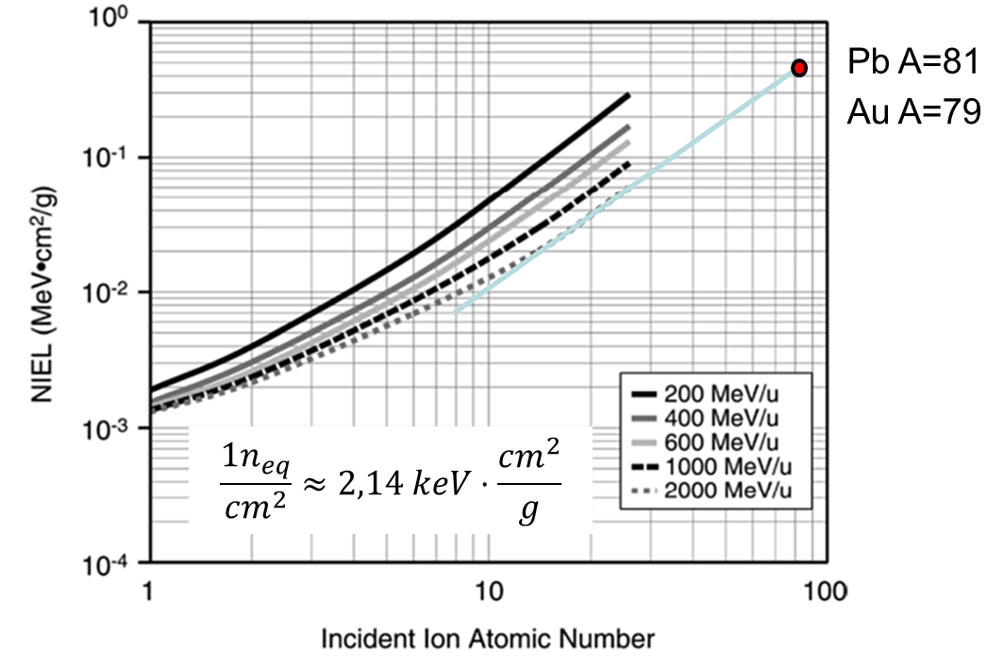
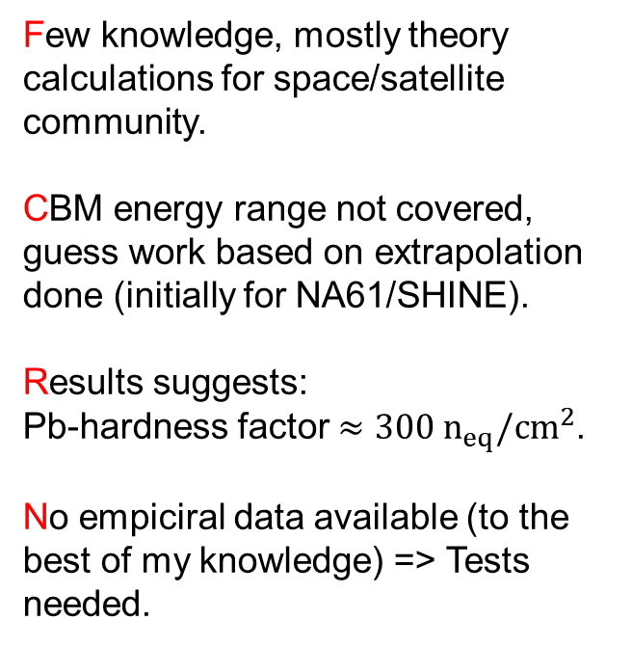
Integrated damage (non-ionizing)
Few knowledge, mostly theory calculations for space/satellite community.
CBM energy range not covered, guess work based on extrapolation done (initially for NA61/SHINE).
Results suggests:
Pb-hardness factor $≈300 n_{eq}/cm^{2}$.
No empiciral data available (to the best of my knowledge) => Tests needed.
M. A. Xapsos, et al., IEEE TNS
Vol. 51 (2004), P. 3250-3254
=> Test campaing started together with NA61/SHINE at the CERN/SPS

Slide 13

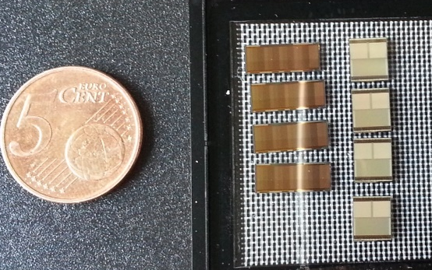
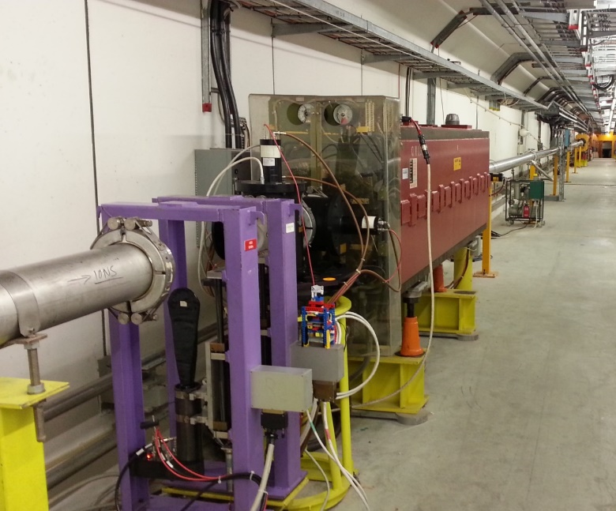
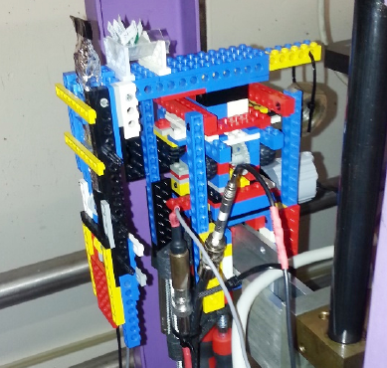
Integrated damage (non-ionizing)
MIMOSA-34THR
Tower/Jazz 0.18µm CMOS
Location:
200m upstream
NA61 target.
Dosimetry:
4x4mm² scintillator
Dose reached:
1.2x10¹⁰ Pb/cm² (30A GeV/c)
Radiation tolerant positioning table
Result: Conversion factor confirmed (1 Pb-Ion < 300 n_{eq}/cm²)

Slide 14
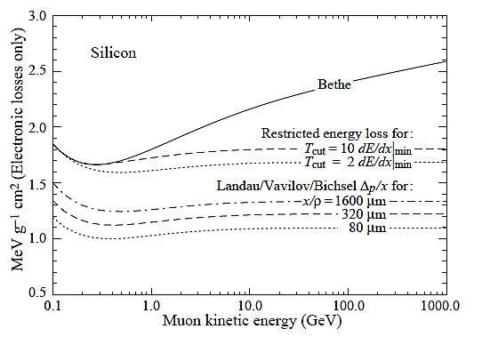
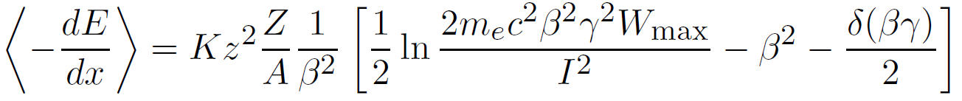
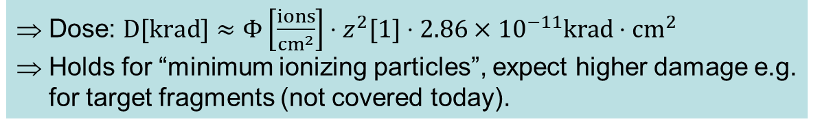
Integrated damage (ionizing)
Idea:
Rely on Bethe-Bloch-Equation.
Projectile charge
Dose: $D[krad]≈Φ\left[\frac{ions}{{cm}^{2}}\right]⋅z^{2}[1]⋅2.86×{10}^{−11}krad⋅cm^{2}$
Holds for “minimum ionizing particles”, expect higher damage e.g. for target fragments (not covered today).

Slide 15
Maximum halo rates allowed (normal operation)
Most exposed detector – MVD:
Max. 100 kHz Au-Au or 10 MHz p-Au (collision rate).
=> Beam intensity 10⁷ Au/s, 10⁹ p/s with 1% interaction target.
Integrated damage must not exceed 30% of projected sensor radiation tolerance within 1 year of operation.
 | Protons | Au-ions
Max. flux (to respect ioninzing dose limit). | 60 kHz/mm² | 10 Hz/mm²
Max. flux (to respect non-ioninzing dose limit). | 1.8 kHz/mm² | 60 Hz/mm²
Limit | 1.8 kHz/mm² | 10 Hz/mm²
Must be fulfilled for r=5mm from the nominal beam axis at z=5-12 cm behind the CBM target. Also in case the beam moves!

Slide 16
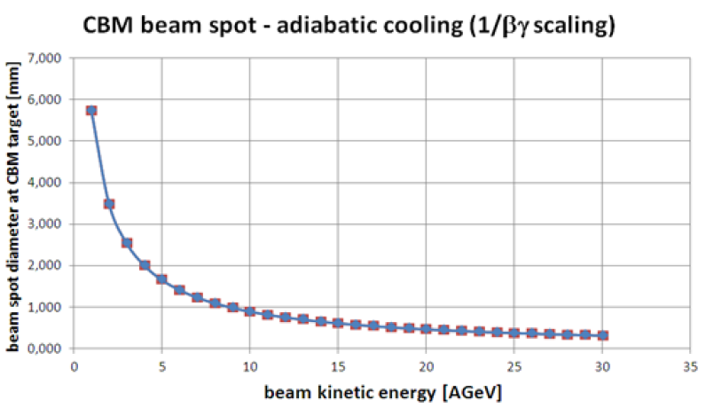
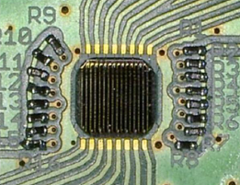
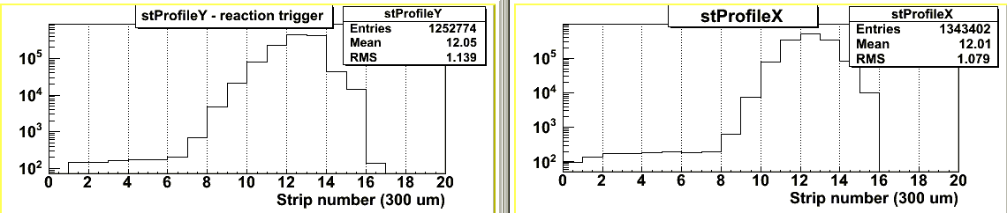
Requirement vs. information on beam
J. Pietraszko: “CBM+HADES in FAIR Beam Parameter Booklet”, CBM Technical Board, 4. Sept. 2018.
Beam diameter 2mm @ 4 AGeV
Assume Gaussian profile.
J. Pietraszko, The Slow Extraction Workshop, Darmstadt, 1-3 June 2016
SIS18, HADES beam monitoring.
Note: Option of additional collimation (next talk) ignored.

Slide 17
Why I got worried…
Uncertainties:
About factor 3
Gauß
Scaled to 10 MHz Au beam.
Sensor
Sensor
Extrapolation
Width of sensor
Radiation from
CBM physics
Radiation from beam
as requested.
Radiation doses in both scenarios exceed the limit by orders of magnitude.
Beyond reach of sensor design => Help from accelerator community needed.

Slide 18
Beam loss to detector
Vacuum window
Silicon tracking system
MVD-stations
Beam pipe
Beam pipe
Beam
Target
Silicon tracking system
The worry:
Beam steering fail => Detector is hit by full beam.
Consequences => Somewhat unknown (nothing to permanent fail).

Slide 19
Measures for beam loss protection (beam tuning)
Vacuum window
Silicon tracking system
MVD-stations
Beam pipe
Beam pipe
Target
100 mm
Silicon tracking system
MVD will be equipped with moving engine:
Power down and move out sensors during beam tuning.
Movement will be slow (few minutes).
Path to safe position should be minimized (major space concern).

Slide 20
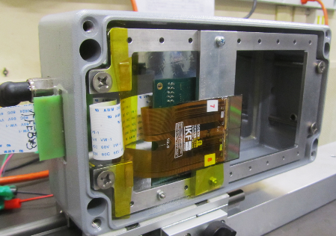
Sensors – reaction to beam
MIMOSA-26 operated in direct SPS 30 AGeV Pb beam for ~24h
Observation @few kHz beam intensity:
No obvious loss of functionality.
Observed 3 latch-ups. One persisted several hours before discovery. Chip recovered after power cycling.
Sensor surprisingly robust. But test represents ~1 spill CBM.
=> Need to scale to CBM.

Slide 21
Beam impact studies (emergency stop)
Idea:
Sensor tolerates charge of one ion at any point.
Assume no charge evacuation (time scale unknown).
Avoid overlaping hits by emergency beam stop.
Open issue:
To what surface is the charge of an ion distributed?
Input:
Rough estimate: Most ion charge is concentrated in r=15µm.

Slide 22
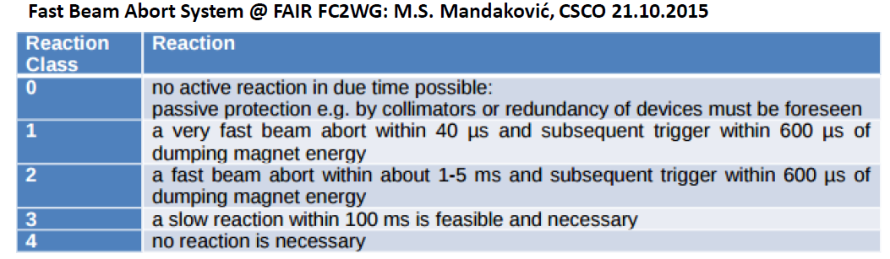
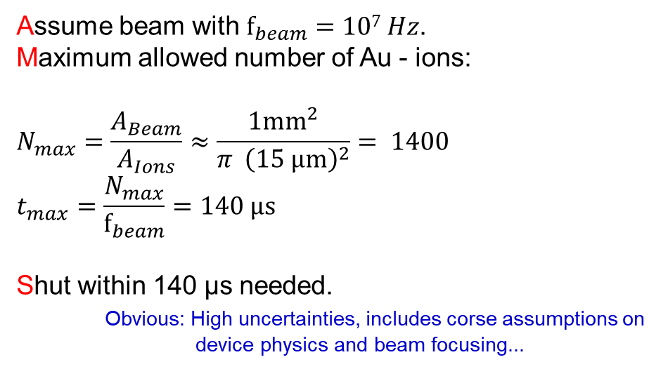


Beam impact studies (emergency stop)
$A_{ion}$
Assume beam with $f_{beam}=107 Hz$.
Maximum allowed number of Au - ions:
$$N_{max}=\frac{A_{Beam}}{A_{Ions}}≈\frac{1mm^{2}}{π {\left(15 μm\right)}^{2}}= 1400$$
$$t_{max}=\frac{N_{max}}{f_{beam}}=140 µs$$
Shut within 140 µs needed.
Obvious: High uncertainties, includes corse assumptions on
device physics and beam focusing...
$A_{beam}$
Preliminary conclusion: Very fast beam abort system is required.
Note: Collimator, which defocuses/fragments the beam would already help (reduces z)

Slide 23
Summary and conclusion
Requirements on beam parameters (halo) were presented:
Numbers driven by needs of CBM-MVD (avoid destruction).
Numbers account for design safety features of MVD:
  Advanced tolerance of sensors to integrated damage.
  Latch-up protection system.
  Triple vote logic for important sensor sub-systems.
  Option to move sensors to safe position during beam tuning.
Beam halo limits for regular operation (r=5mm from beam axis):
 | Protons | Au-ions
Limit | 1.8 kHz/mm² | 10 Hz/mm²
Resonable precision
Poor precision
Reaction time for beam loss to detector: ~100 µs
Options of the detector community are mostly exhausted
=> Help from accelerator community is required.
Try to hit the target… and nothing else ☺

Slide 24
Radiation damage by ions in CMOS sensors
“Sudden damage” in digital electronics
Latch up
Single event effect
Single event upset
(e.g. bit flip)
Impact of ions
Ionizing (TID)
Integrated damage
Non-Ionizing
“Slow damage” in sensors

