Slide 1
Common data base and model interface (for FAIR and GSI energies) open discussion

Slide 2
Goals:
Data base
Easy and fast comparison between:
Different Experiments
Theory and Experiment
Benchmark for Models
Interface
Model Hub

Slide 3
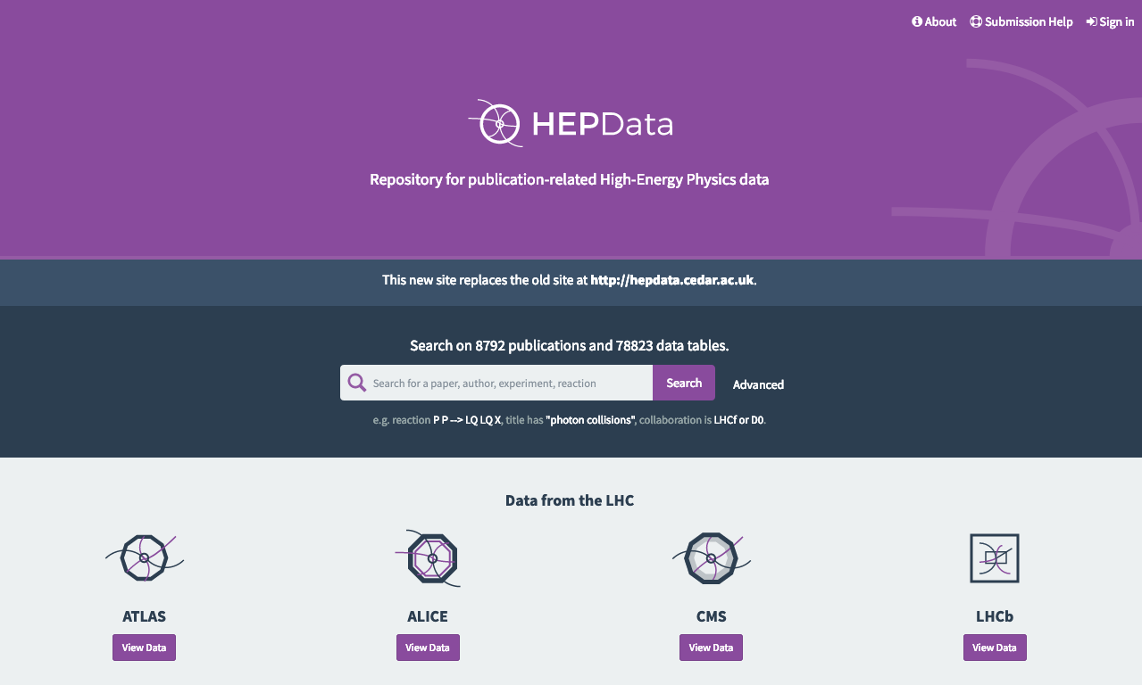
hepdata.net as common data base
Frequently used by LHC experiments
Existing since more than 30 years
Not many data points from FAIR and GSI energies included yet
Data base

Slide 4
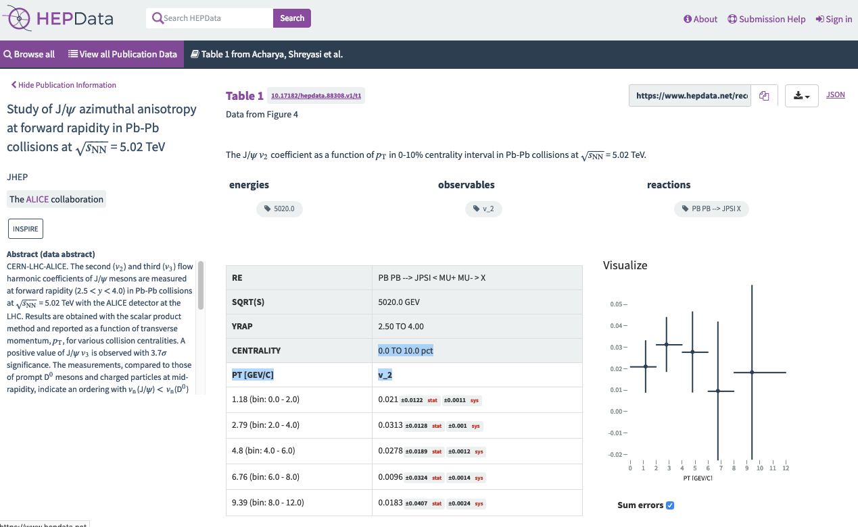
hepdata.net as common data base
What should be stored?
Figures included in the paper
Corrected data as function of pt,y in addition?

Slide 5
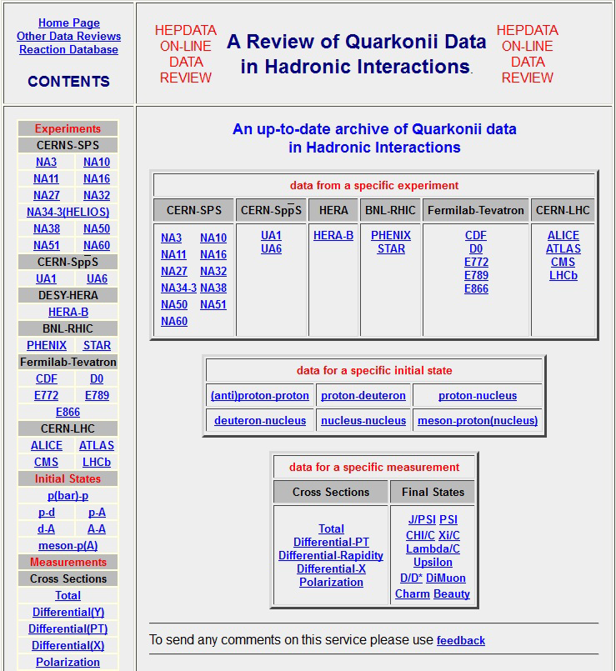
hepdata.net as common data base
Umbrella data base
e.g. on Quarkonii Data

Slide 6
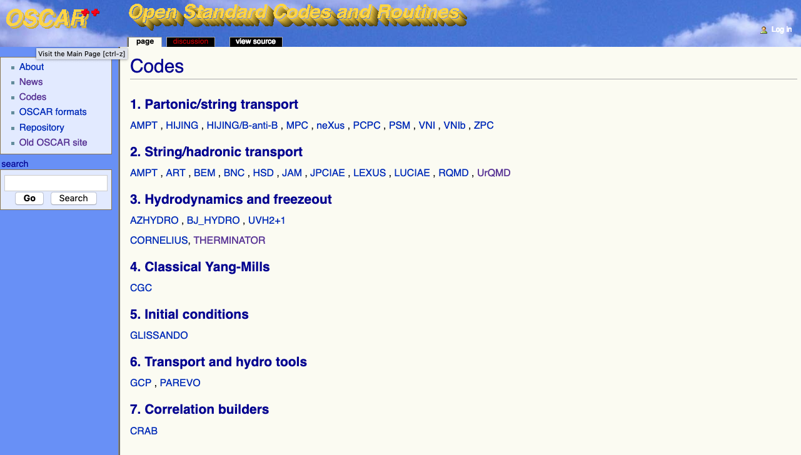
OSCAR (Open Standard Codes and Routines)
Needs constant maintenance
Model Hub

Slide 7
RIVET (Robust Independent Validation of Experiment and Theory )
Input format for models:
hep mc format
Interface

Slide 8
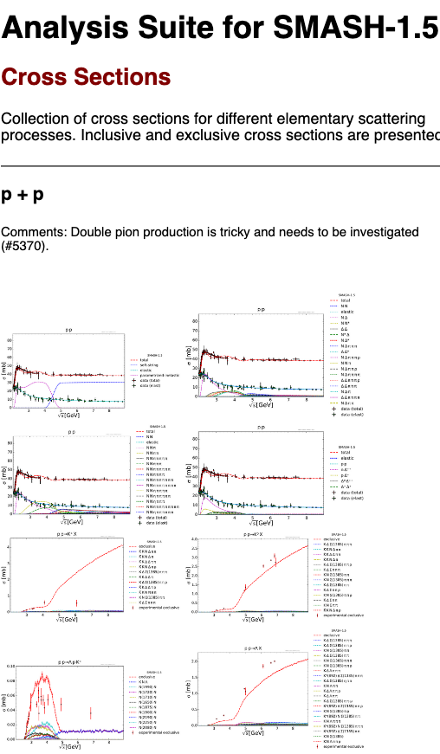
Benchmark for models, example: Analysis Suite SMASH
Python script machinery will be publicly available soon
impossible to keep up within single groups, therefore create synergies
join community effort (Rivet-HI) instead of island solution?

