Slide 1
Marina Dolinska
22nd January, 2019
Time domain approach for
Stochastic cooling study

Slide 2
Outline
Basic principle of stochastic cooling
Time domain method
Time domain approaches
Signal response on kickers
Noises
Example of cooling simulations at the CR

Slide 3
Let us consider the basic principle of stochastic cooling
This principle happens in real cooling process
Time-domain method can reproduce this process very closely to reality.

Slide 4
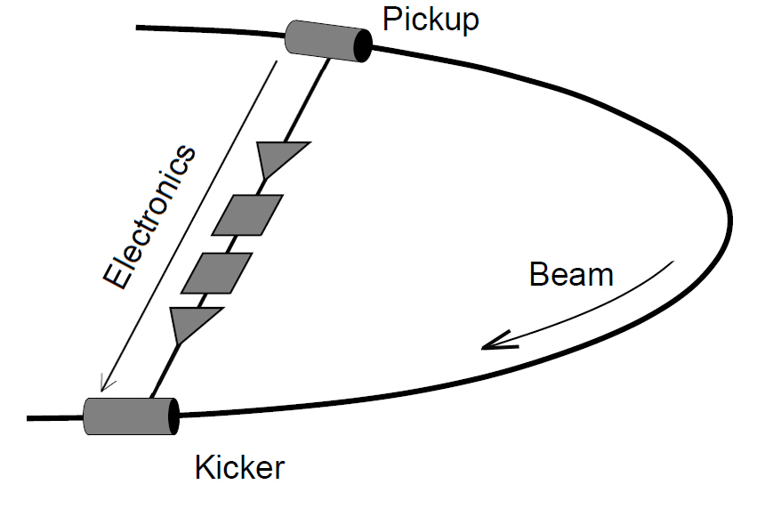
Stochastic cooling system
Pickup – detect the beam parameters
Electronics – transfer signal, filter, amplify
Kicker – correct
These devises are places in storage ring, which parameters are important for stochastic cooling system

Slide 5
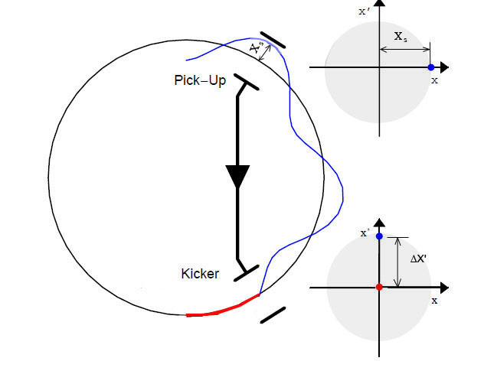
Basic principle of stochastic cooling
One particle consideration
Measure position and apply a correction.
One particle passing with maximal position at PU
Requirement: particle crossing the reference orbit at kicker with maximal angle
Closed orbit of the ring
(trajectory of the ideal particle)
Trajectory of not ideal particle
ΔX‘=gX_{s},
g – normalized gain
[0<g≤1]
Kicker eliminates angle deviation

Slide 6
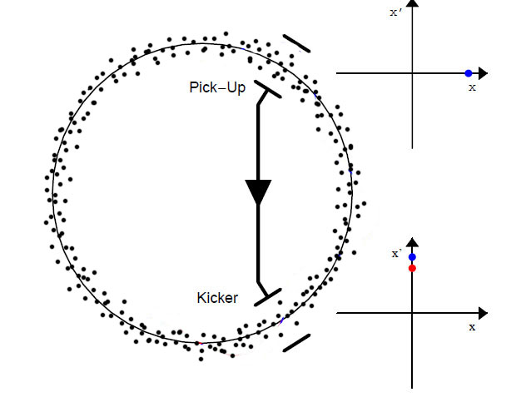
Basic principle of stochastic cooling
In the real process one has up to 10¹³ particles.
In ideal case it would be good to
recognize each particle and then
correct it. But one needs a very fast
(high speed) system with a frequency
10¹⁰-10²⁰ Hz. This is practically
impossible.
In this case the system considers small groups (ensemble) of particles.
The number of particles in one group is defined by frequency characteristic
of SC system.

Slide 7
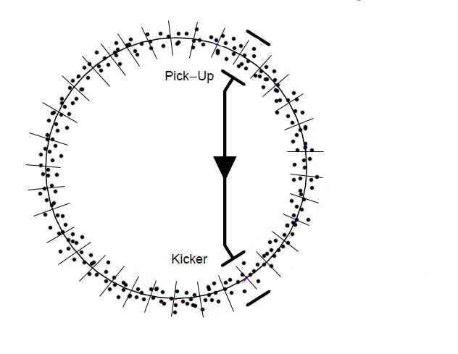
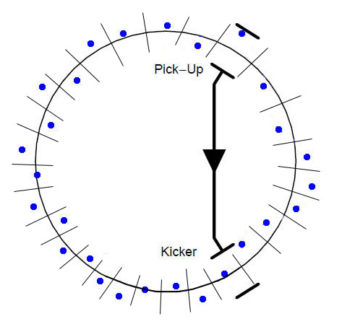
Basic principle of stochastic cooling
The coasting beam is sampled. The number of samples and its time length
is defined by frequency range [f₁ ; f₂] of SC. Bandwidth W=f₂-f₁
Example: nominal value of W for the CR W=1 GHz
t_{s}=1/(2W)
Mean value of sample
samples
Center of gravity of one sample Position with respect to the reference orbit. Pick-up detects the value of this displacement and forms the signal.
The number of samples is n=T_{rev}/t_{s} (for the CR it is about 1500).
The injected number of particles is around 10⁸. This means, one sample contains of 6.7*10⁴ particles.

Slide 8
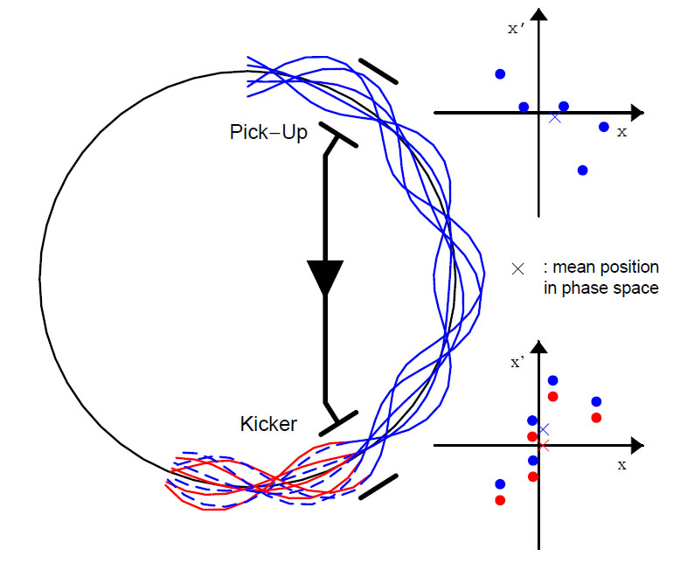
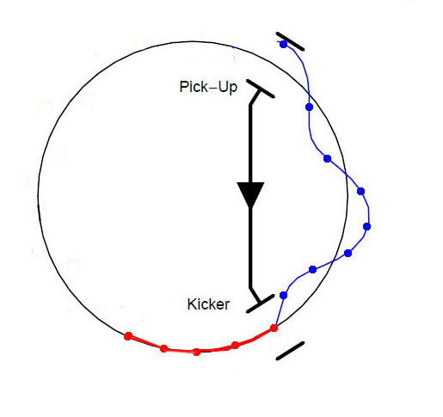
Basic principle of stochastic cooling
The sample of particles passing the kicker gets correction of the mean position. The individual particle coordinate is reduced by the mean value of ensemble.
After one turn one has not full cooling. “Stochastic” behavior of samples must be considered in the full time interval. The mean value of each sample is changed during one turn.

Slide 9
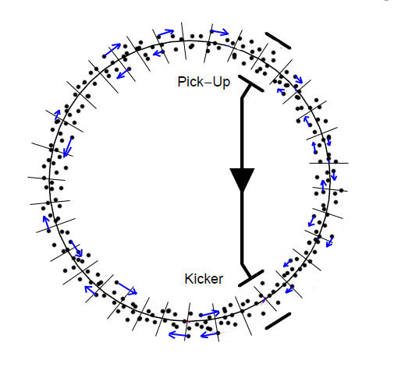
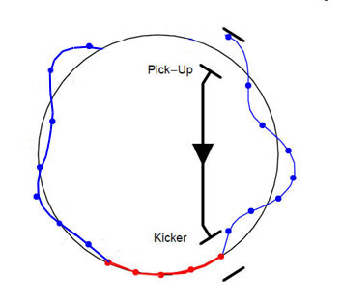
Mixing
All particles migrate from one sample to another one because of energy deviation from reference energy. This particle migration is called “mixing”.
mean value evolution of one sample
mean value appears
Because of mixing the new mean value of sample is formed.
At the next turn the pick-up detects this value and then the kicker corrects it again
For quantitative description of this process the time domain consideration can be used.

Slide 10
The time domain approaches
The beam dynamic is calculated particle by particle and turn by turn
Beam sampling (or binning) is applied in the timeline.
Mixing is calculated like in the real cooling process.
Pick-up and Kicker action (considering noises and kicker signal response)

Slide 11
The computer code has been written
The main ideas of this code:
Several number of samples is taken to study cooling process.

Slide 12
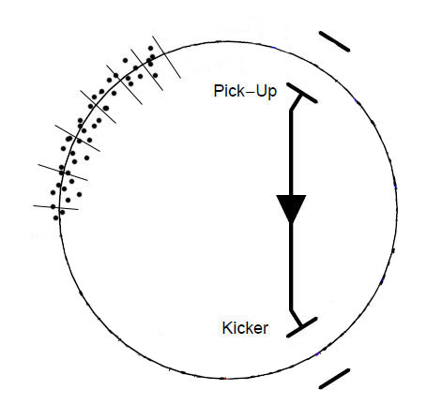
Approximation 1: number of samples
It is not necessary to track all samples like in the real process.
One can consider only few samples (for example 5).
Example CR : The number of samples is 1500 (n=T_{rev}/t_{s}). One sample contains 6.7*10⁴ particles.

Slide 13
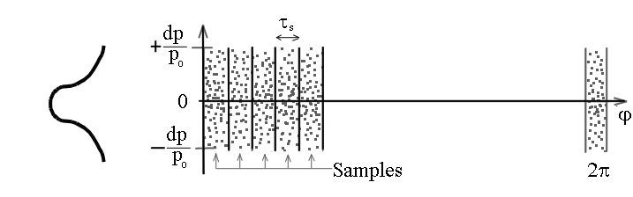
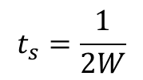
Particle generation in longitudinal phase space
T_{w}
T_{w}
Revolution time
The particles are generated in a certain time-window: T_{w}=n_{s}t_{s}
Number of samples can be n_{s} = 5 - 10
The initial momentum deviation in the frame [–dp/p : dp/p] is defined for each particles.
The initial time in the frame [0 : T_{w} ] is defined for each particle.
The samples are structured (depending on time the particle is assigned
to certain samples)
The history (variation of coordinates x, x’, y, y’, dp/p, t) of this sample is
calculated turn by turn.
(T_{w} =2.5 -5 ns)

Slide 14
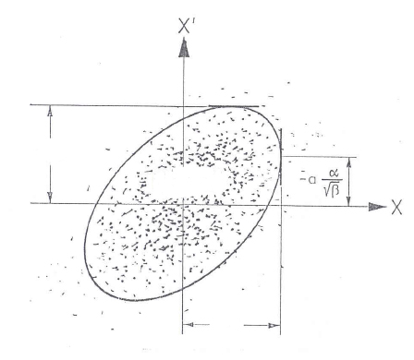
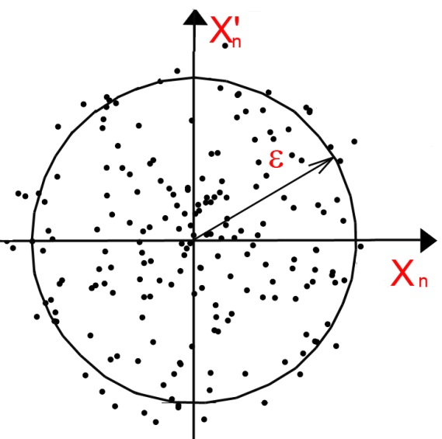
Particle generation in transversal phase space
transformed to normalized phase space
simulation becomes simpler
Finally the ensemble of N particles is generated in 6D phase space.
Each particle has the six coordinates (x, x‘, y, y‘, Δp/p, t)

Slide 15
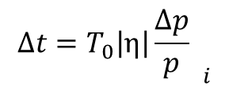
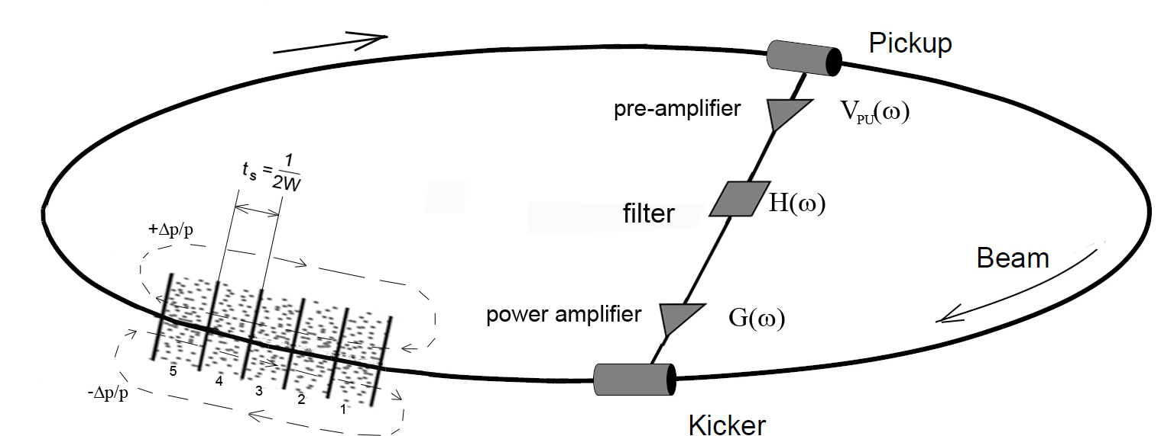
Approximation 2:
Mixing
We consider the “bunch” (several samples) with the time length from 0 to T_{w}
Mixing: the particle migration is performed inside this “bunch”.
Every turn the time of each particle is changed by value of
(x, x‘, y, y‘, Δp/p, t)
t_{i+1} =t_{i} + Δt_{i}
T₀ revolution period
η – ring parameter

Slide 16
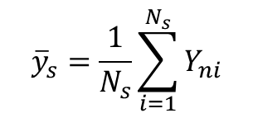
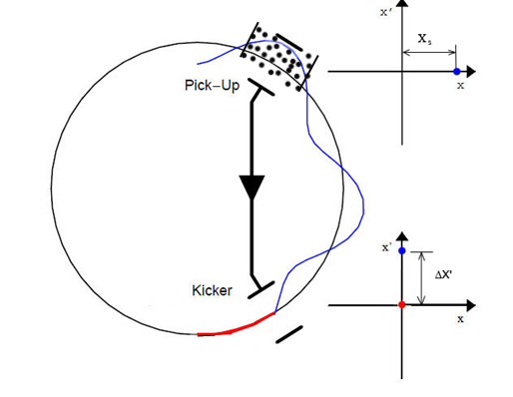
Approximation 3:
Pick-up action
At the Pick-up the mean value of each sample is calculated
s - sample number (max n_{s})
N_{s} – number of particles in one sample

Slide 17
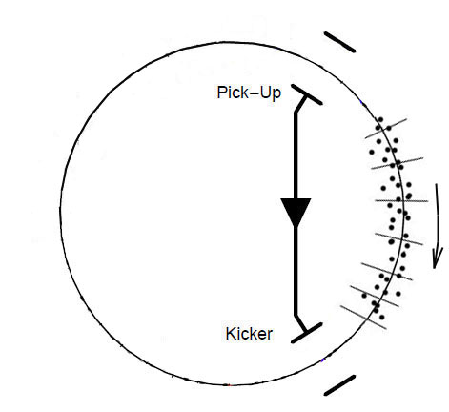


Mixing on the way from
Pick-up to Kicker
On the way from Pick-up to Kicker mixing takes place.
The particles migrate from sample to sample, which means the time coordinate of each particle is changed by Δt
bad mixing
-0.011 (pbar optics)
0.18 (RIB optics)
D(s) - dispersion function
ΔL – path length
ρ – bending radius of dipole

Slide 18
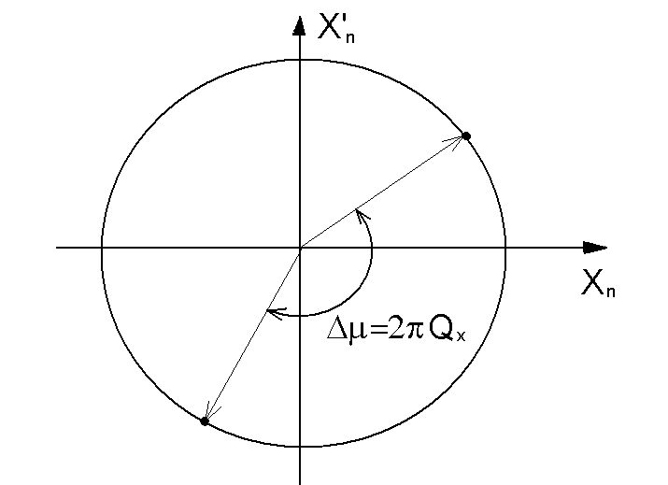
On the way from Pick-up to Kicker
Betatron oscillation
The particle coordinate in the transversal phase space is changed due
to betatron oscillation in the ring.
In the normalized transversal phase space it is simple rotation
The phase advance Pick-up→Kicker

Slide 19
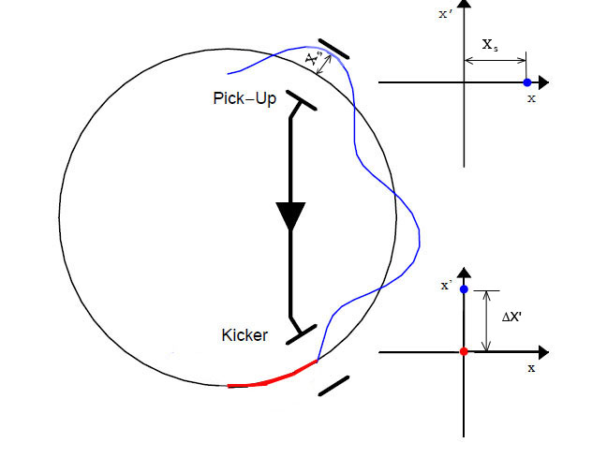

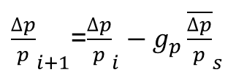
Kicker action
At the kicker correction is applied. All particles of sample get the kicker correction and energy change
g – is a normalized “gain” parameter
[0 < g ≤ 1]

Slide 20

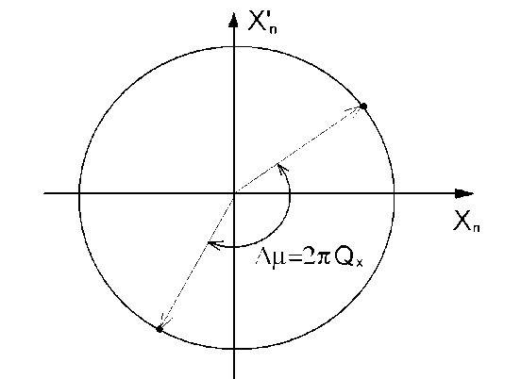
Mixing on the way from Kicker to Pick-up
Mixing takes place. The particles migrate from sample to sample, which means the time coordinate of each particle is changed by Δt
∆t >>0
good mixing
In transverse plane the coordinates are recalculated
Here Δµ can be any

Slide 21
Time domain approach
One turn
Lattice and SC system parameters
Particle generation
Analyses of distributions ( Δp/p_{rms} and ε_{rms} )
Pick-up action
Mixing on the way Pick-up – Kicker
Kicker action
Mixing on the way Kicker – Pick-up
Stop after N turns
one turn

Slide 22
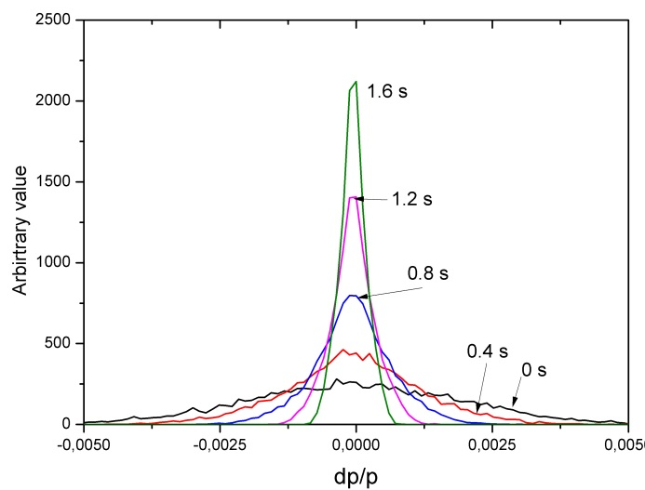
cooling effect in time domain treatment
cooling effect in ideal case is calculated by simple formulae:
In reality one has to take into consideration the electronic noises and
kicker signal response. Noises and kicker response are the specific
characteristics of all SC components.
Then the given formulas must be modified according to this SC system .
Let‘s look how the signal is proceed in the SC system.

Slide 23
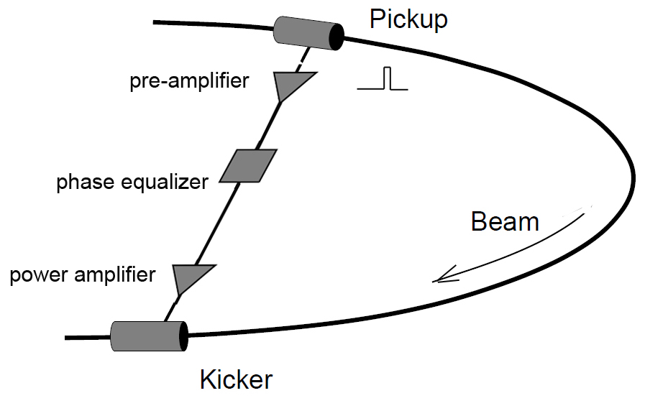
Noise of signal
δ_{noise}
Noise in the time domain treatment
is still a subject of study :
how to calculate δ_{noise}
Up to now the analytical approach is used

Slide 24

Noise of signal
factor α is introduced in the formulae
D.Möhl, Stochastic Cooling of particle beams, Springer-Verlag 2013.

Slide 25

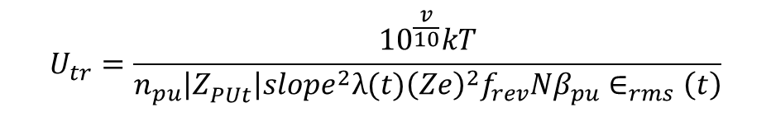
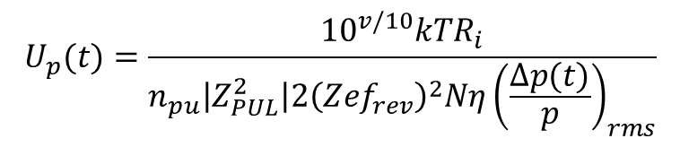
noise-to-signal ratio
noise-to-signal ratio :

Slide 26
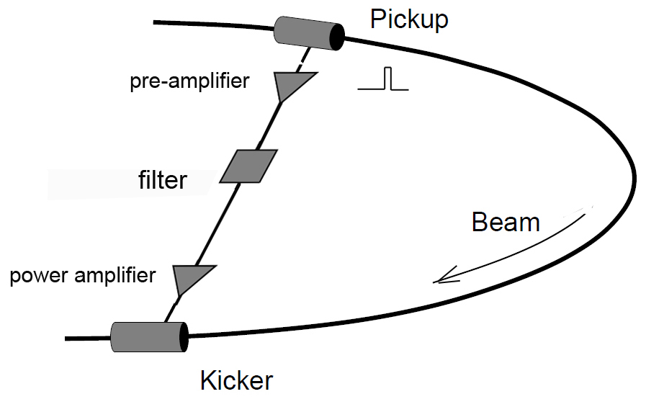
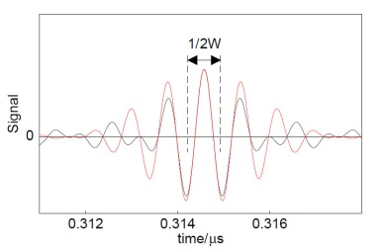
Kicker response
inverse Laplace transformation

Slide 27
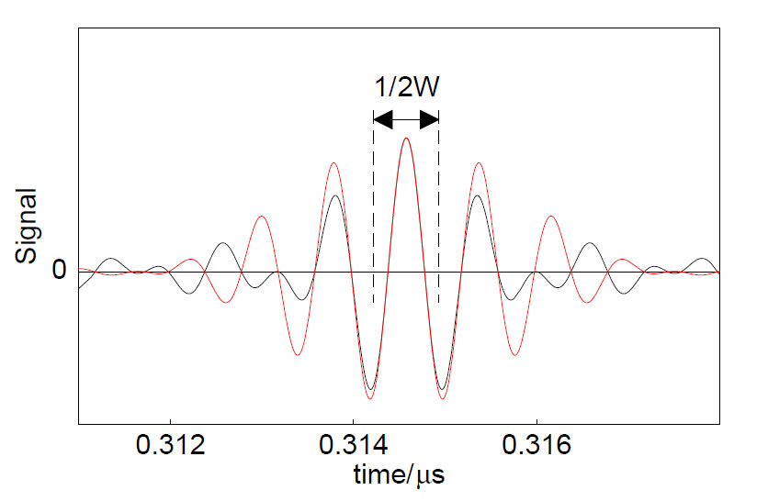
Kicker Response
inverse Laplace transformation
signal shape at kicker
1
s(t)
the normalized gain is transformed according to shape of signal at the kicker.
s(t) – is normalized function (max is 1)

Slide 28
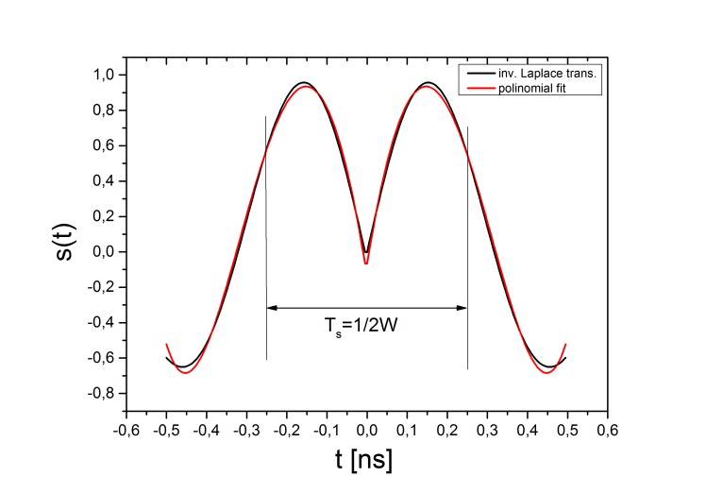
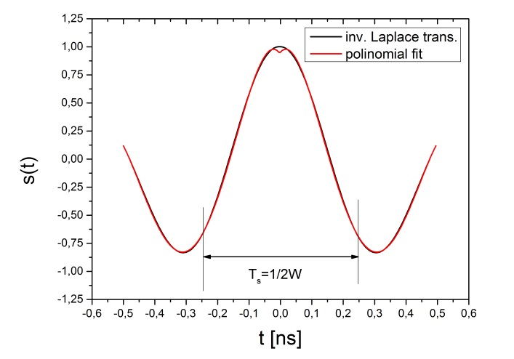
Kicker response of CR SC System
signal shape at kicker (notch filter)
inverse Laplace transformation
0
In both cases we normalize the max. responses to unity. The used time signal (real part of the inverse Laplace transformation) is antisymmetric with respect to t=0
t=0 is the center of sample
in the code after Laplace transformation the obtained curves are represented by
simple formulas of polynomial of 4th order.
signal shape at kicker (Palmer)

Slide 29
cooling effect in time domain treatment
These formulae for calculation of cooling in time domain approach

Slide 30
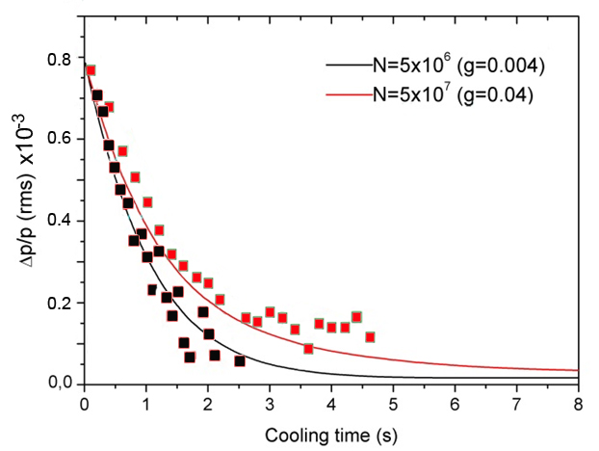
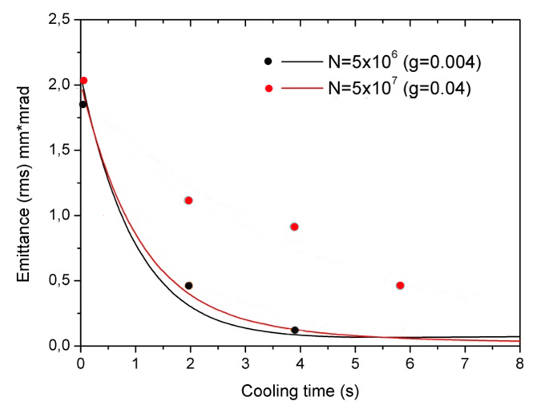
Benchmarking of MPT-6D
Measured emmitance and Δp/p at ESR (PALMER cooling)
Argon beam : ³⁶Ar¹⁸⁺,
E=400 MeV/u
W=0.8 GHz
η = 0.31
gain g and parameter of noise α are adjusted
MPT-6D calculations
measured
calculated
F. Nolden, et. al. Proceedings of EPAC 2000,conference

Slide 31
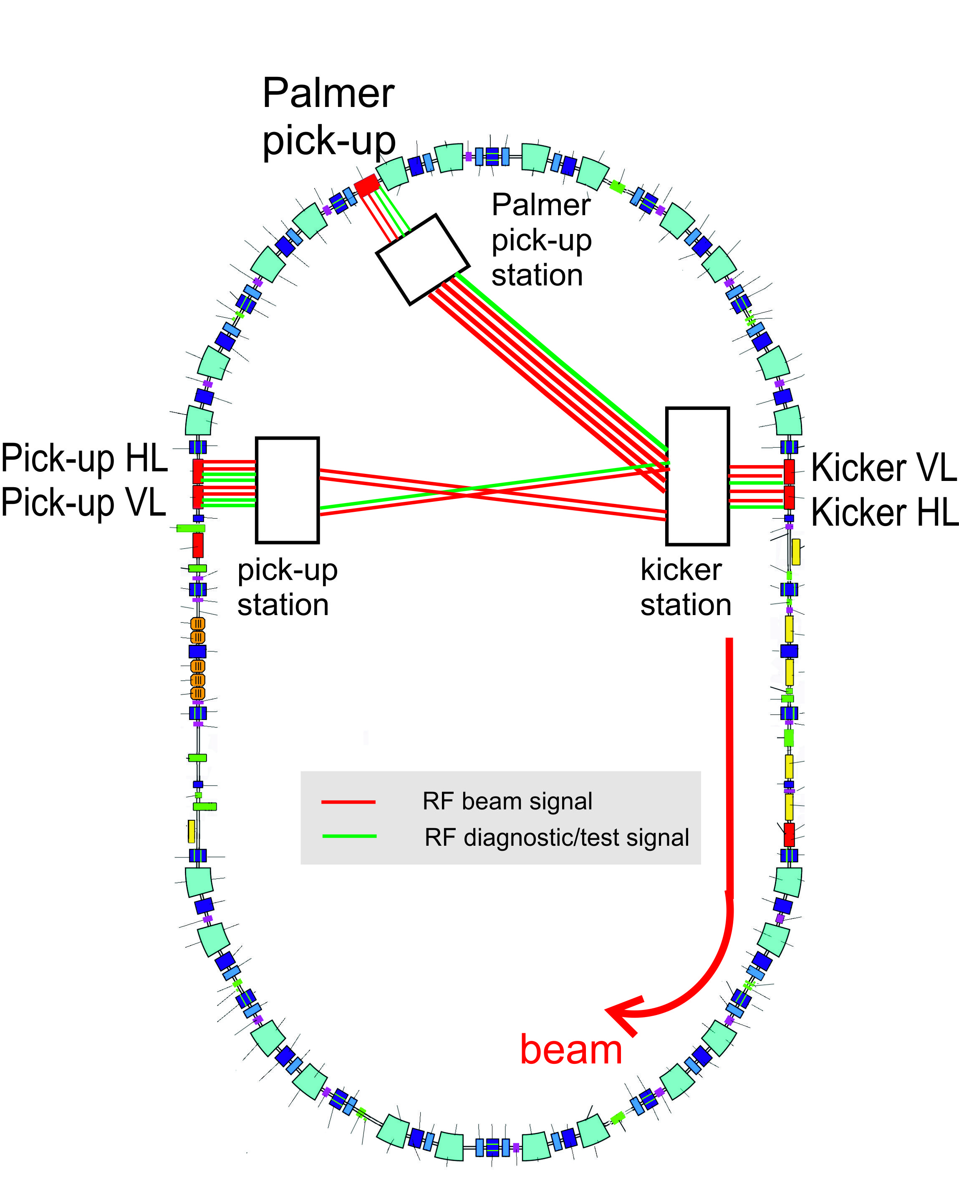
Cooling of ions at CR
Palmer method
System bandwidth W= 1 GHz
Uranium beam ²³¹U⁹²⁺
Energy 740 MeV/u
η=0.17

Slide 32
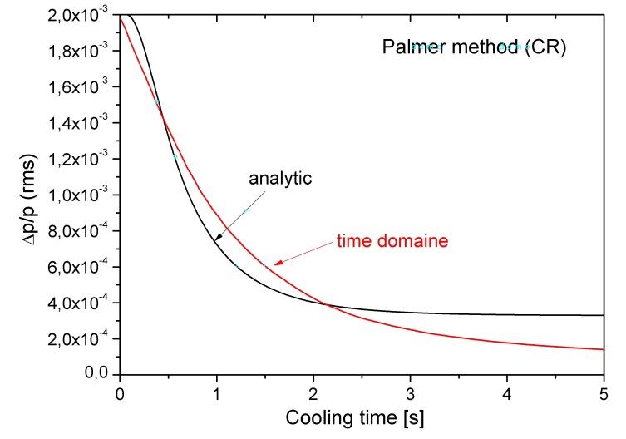
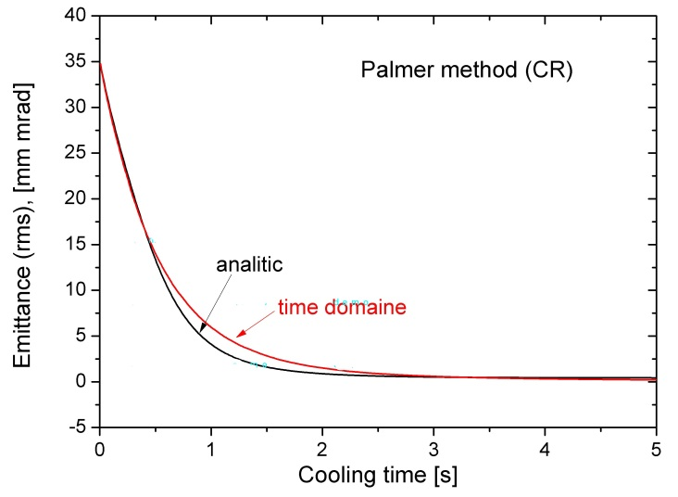
Cooling of ions at CR
MPT-6D and analytical calculation of cooling with Palmer method
N=10⁴ macro-particles
n_{s}=5 number of samples

Slide 33
Cooling of antiprotons at CR
Notch filter method
System bandwidth W= 1 GHz
Antiprotons
Energy 3000 MeV/u
η=0.011

Slide 34
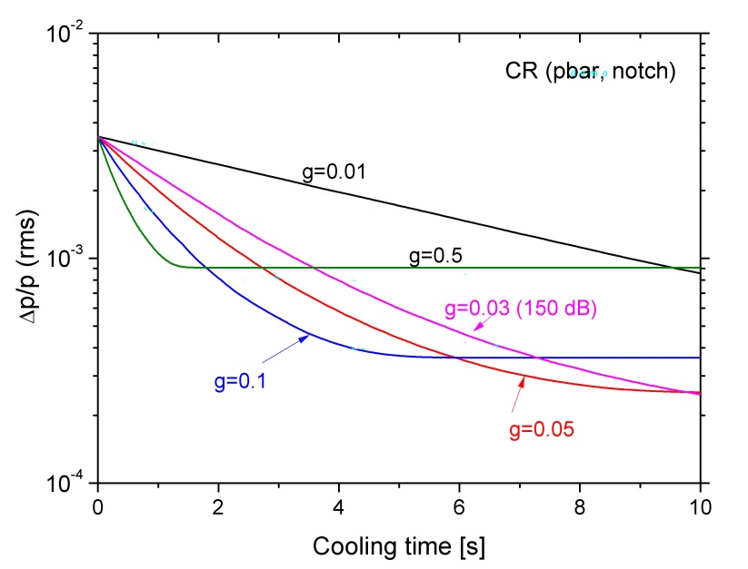
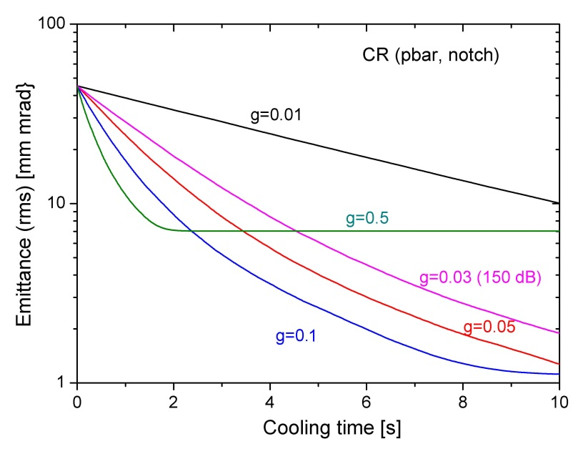
Cooling of antiprotons at CR
Gain parameter is varied to find optimal value
2.5x10⁻⁴
1.2 mm*mrad

Slide 35
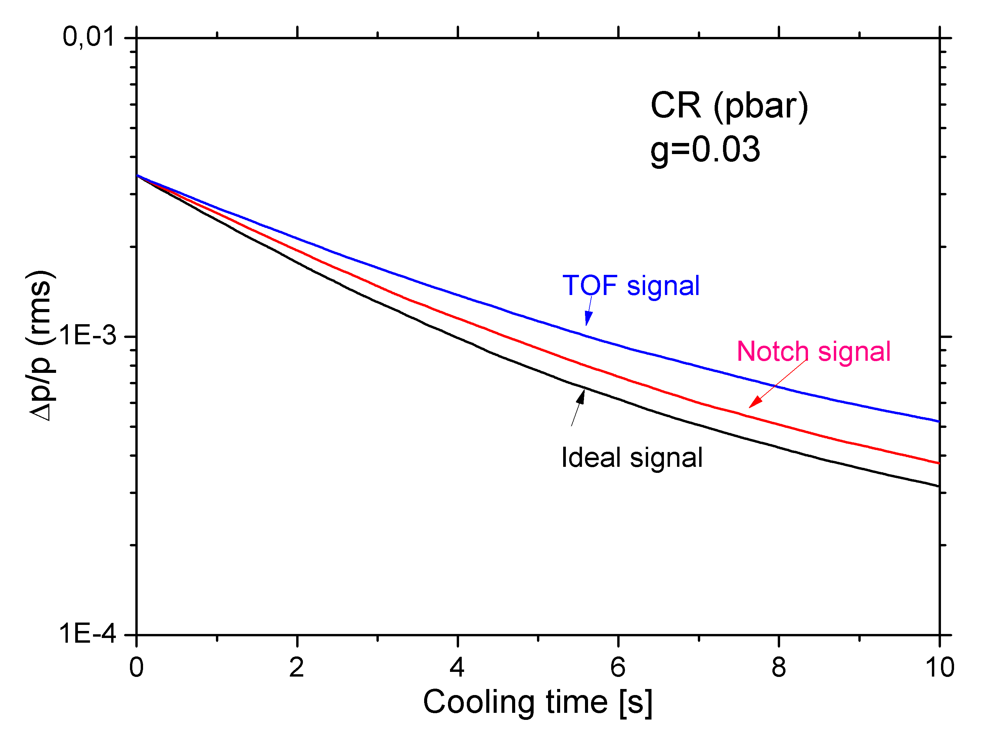
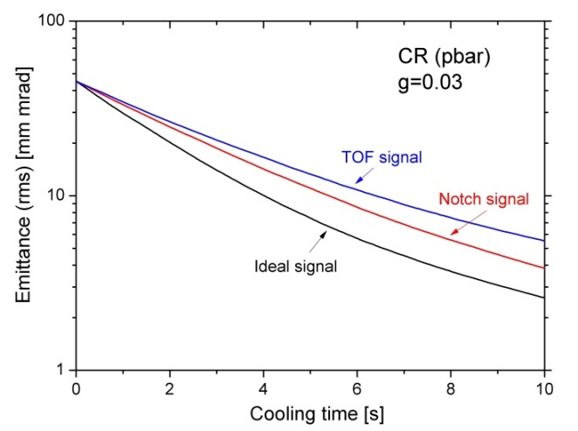
Cooling of antiprotons at CR
MPT-6D code. Test of Kicker response, where
the given analytical formulae are used for calculation of cooling
N=10⁴ macro-particles
n_{s}=5 number of samples

Slide 36
Conclusion
Time domain approach is more advanced method
(simpler, multi-dimension, mixing simulation close to reality, other effects can be easy integrated, simulation time is reasonable (10-30 min depending on N)
Next steps:
Frequency characteristic of electronics
Plunging of electrodes
Combination of different methods (Palmer + Filter for ions)
Other effects can be included (IBS, target effect, RF-cavity (bunch rotation, barrier bucket), other...?).

