Slide 1

Progress of stochastic cooling on SRing of HIAF
Junxia Wu, Guangyu Zhu, Ze Du, Xuejing Hu, Yuan Wei
IMP, Lanzhou, China

Slide 2
Outlines
Progress of stochastic cooling on SRing (Spectrometer Ring) of HIAF (High Intensity heavy-ion Accelerator Facility)
  Purpose and requirements of the stochastic cooling on the SRing
  SRing pickup/kicker simulation, optimization and test with beam on CSRm
  Stochastic cooling of ions in the SRing simulated in the time-domain

Slide 3
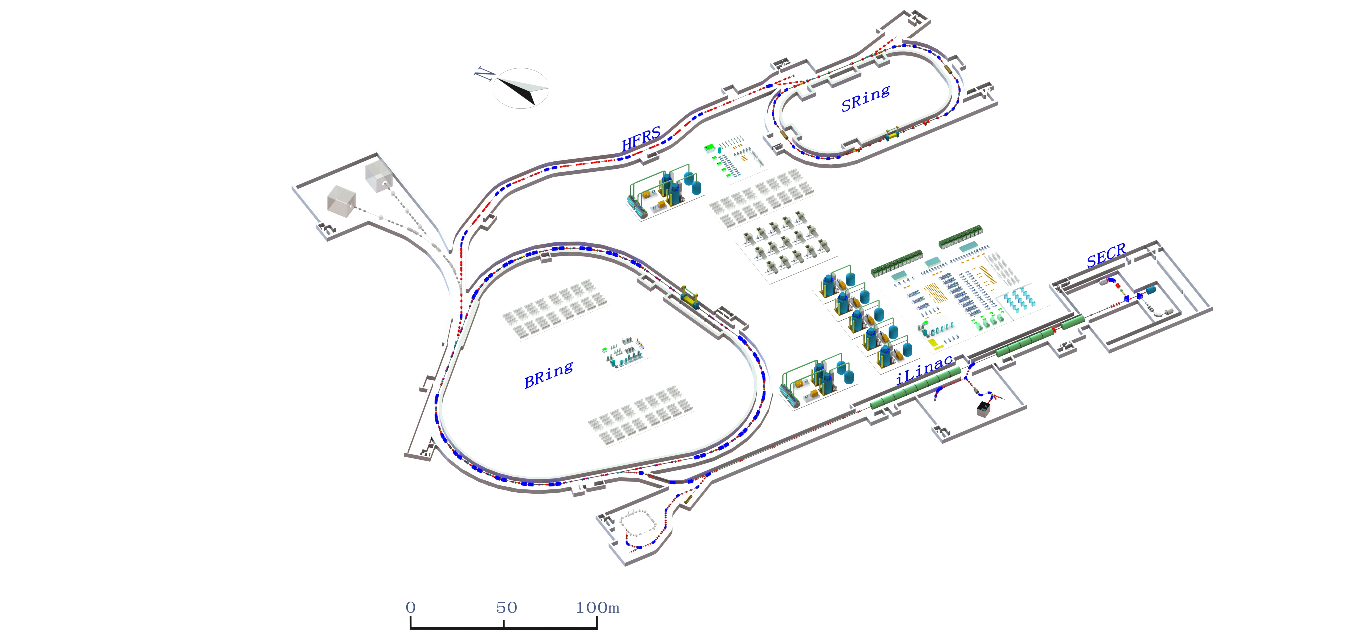
Layout of HIAF
SRing: Spectrometer Ring
SRing
mass measurements of short-lived exotic nuclei, Rare Isotope Beam (RIBs) experiments, the internal target experiments.
HFRS
SECR
BRing
iLinac: Superconducting linac
Notes:
This is the layout of HIAF. Stochastic cooling will be built on Sring.

Slide 4
Normal stochastic cooling operation mode on SRing
after injection
after bunch rotation
after compression
BRing
after the target
HFRS
SRing
Δp/p
Δp/p
Δp/p
Δp/p
±0.36%
±2.0%
±1.5%
±0.4%
L
L
L
L
extraction
injection
0.26 μs
0.26 μs
0.26 μs
1.10 μs
Δp/p ε_{x}/ε_{y} 3σ
total cooling time<2.3 s
precooling
Electron-Cooling
SRing
Stochastic Cooling
SRing
Δ p/p: ±0.025% → ± 0.001%
ε_{x}/ ε_{y}: 5 π mm·mrad → 0.1 π mm·mrad
Δ p/p: ±0.40% → ±0.025 %
ε_{x}: 120 π mm·mrad → 5 π mm·mrad
ε_{y}: 40 π mm·mrad → 5 π mm·mrad
electron cooling
cooling time<1.0 s
cooling time<1.2 s
Notes:
The RI beams from HFRS after the production target will have large momentum spread of ±1.5×10⁻² (2σ). If stochastic cooling is used for such kind beams, the cooling frequency should be small to have large acceptance. However bunch rotation is proposed to decrease the momentum spread to ±4.0×10⁻³ (2σ) at first. Then stochastic cooling will be performed to reduce the emittance to less than 5 p mm.mrad, and Dp/p of 4.0e-3 to 2.5e-4 within 1 s for these RI beams. After the stochastic pre-cooling, the subsequent electron cooling will further cool down the emittance and Dp/p within 1 s to get extremely well-cooled beams.

Slide 5
Purpose and requirements of the stochastic cooling on the SRing – Nuclear physics
Precooling of the radio isotope beams
Beam energy: 400 MeV/u (β = 0.71)
Number of particles: <1.0e5
Mass number: 100-200
Atomic number: 40-80
Lifetime: seconds
Before cooling: εH=200 π mm mrad, εV=40 π mm mrad,
Δp/p=±4.0e-3 (±3σ)
After cooling: εH,V=6.25 π mm mrad, Δp/p=±3.6e-4 (±3σ)
εH,V=1.25 π mm mrad, Δp/p=±6.0e-5 (1 σ)
Cooling time < 1 s
Notes:
For the nuclear physics, St cooling will be used to provide a fast precooling technique for radioactive fragment beams with a large phase space, which is very similar to CSRe. For the energy range, they changed from the energy range of 0.8-0.85 to below 400 MeV/u now. For our design, we consider all those energies, from 400 MeV/u to 800 MeV/u. …….

Slide 6
Purpose and requirements of the stochastic cooling on the SRing – atomics physics
DR pilot experiment with the radioisotopes
6.25×10⁹ ²³⁸U³⁴⁺ → C-target → ^{235,237}U^{91+,89+}
Initial energy (MeV/u) | Thickness of the target | ²³⁵U |  |  | ²³⁷U
 |  | Output energy (MeV/u) | Ion production rate(pps) |  | Output energy (MeV/u) | Ion production rate(pps)
 |  |  | H-like | Li-like |  | H-like | Li-like
500 | 3g/cm² | 171 | 2.34e6 | 1.61e6 | 173 | 2.25e6 | 1.45e6
600 |  | 311 | 5.53e6 | 5.08e5 | 313 | 5.19e6 | 4.56e5
700 |  | 433 | 6.87e6 | 2.05e5 | 434 | 6.39e6 | 1.89e5
800 |  | 546.5 | 7.18e6 | 9.69e4 | 548.5 | 6.67e6 | 8.95e4
900 |  | 656.5 | 6.96e6 | 4.92e4 | 658 | 6.47e6 | 4.55e4
1000 |  | 764 | 6.51e6 | 2.7e4 | 765 | 6.03e6 | 2.46e4
1100 |  | 869 | 5.96e6 | 1.52e4 | 870 | 5.53e6 | 1.39e4
600 | 4g/cm² | 187 | 3.02e6 | 1.57e6 | 190 | 3.06e6 | 1.37e6
700 |  | 330 | 6.48e6 | 4.94e5 | 333 | 6.07e6 | 4.41e5
800 |  | 454.5 | 7.82e6 | 1.98e5 | 456.5 | 7.24e6 | 1.84e5
900 |  | 570 | 7.99e6 | 9.54e4 | 572 | 7.42e6 | 8.6e4
1000 |  | 681 | 7.64e6 | 4.64e4 | 683 | 7.09e6 | 4.16e4
1100 |  | 789.5 | 7.13e6 | 2.58e4 | 791.5 | 6.61e6 | 2.38e4
Notes:
lithium ['liθiəm]
For the atomic physics, they want to do the DR pilot experiment with the radioisotopes. But for the Li-like beam, the ion production rate is decreased when the beam energy is increased, so they prefer the energy around 400 MeV/u .

Slide 7
Momentum acceptance for TOF and notch filter cooling 400 MeV/u
So for the beam energy below 400 MeV/u, 1-2 GHz can not be used, the cooling frequency should be below 1.2 GHz.
Bandwidth: 0.6-1.2 GHz
Notes:
But for the low energy beam, for 400 MeV/u, the acceptance of tof cooling is smaller than the beam momentum spread if the cooling bandwidth is 1-2 GHz. So we changed to 0.6-1.2 GHz where the beam spread fits inside the acceptance of the TOF cooling system

Slide 8
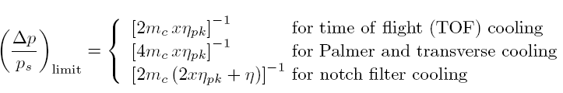
Longitudinal cooling methods choice
Notes:
As TOF cooling has the maximum acceptance among the various methods applied or proposed for longitudinal stochastic cooling, it will be used for SRing longitudinal cooling for beams with large momentum spread. Then notch filter cooling will be switched on in the last cooling stage once the momentum spread is small enough to fit into the filter cooling acceptance by TOF cooling. Here we did not use the Palmer cooling because TOF is a little bit faster than Palmer cooling from the simulation.

Slide 9
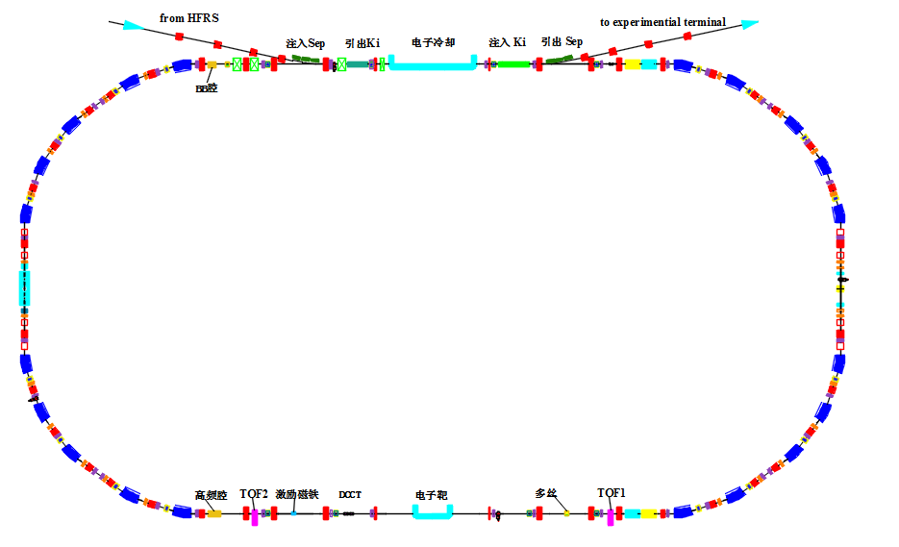
Layout of the PU and kicker of SRing stochastic cooling
2m+2m
PU1
PU2
Circumference： 273.5m
H cooling
V cooling
combiner
L cooling
μ _{pu-k H} | μ _{pu-k V}
453° | 452°
2m+2m
Notes:
This is the layout of the Sring stochastic cooling. Not like CSRe stochastic cooling, this time space is reserved in advance for SRing stochastic cooling, 4 m for pickups and 4 m for the kickers. All of them are in straight sections without dispersion. This can prevent the coupling between the phase subspaces, especially the transverse heating due to the longitudinal kicks. It is planned to have 2 pickup tanks and 2 kicker tanks which can perform both transverse and longitudinal cooling. The betatron advances from pickup to kicker are almost 90 degree for both horizontal and vertical cooling.

Slide 10
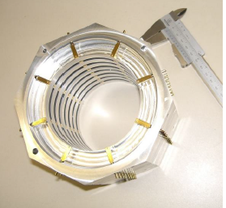
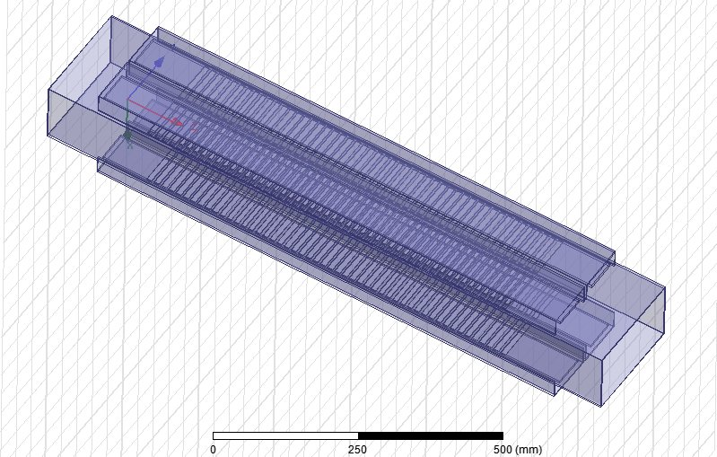
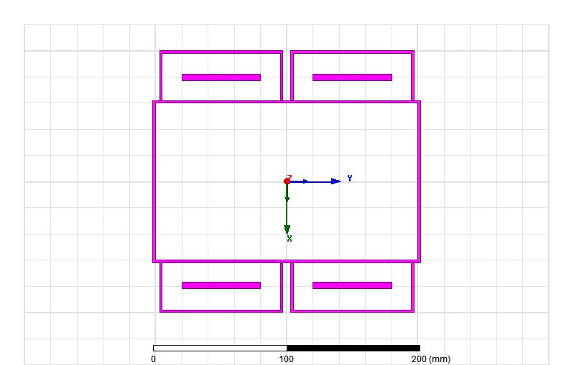
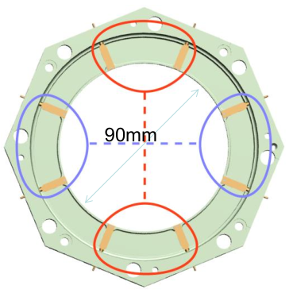
Pickup/kicker structure considered
Slot-ring structure (standing wave)
Used in HESR stochastic cooling
Faltin structure (travelling wave)
Aperture

Slide 11
Faltin structure longitudinal kicker impedance simulation
200 mm
120 mm
cross section
A full HFSS simulation model with rectangular aperture 200*120 mm, slot section=0.75 m

Slide 12
Faltin structure longitudinal kicker impedance simulation
d = 15 mm
(distance from
electrode to slot)
kicker HFSS simulation
d = 12 mm
Longitudinal Zk for 0.75 m Faltin
kicker when d=15 mm, sl=95 mm
Longitudinal Zk for 0.75 m Faltin
kicker when d=12 mm, sl=95 mm

Slide 13
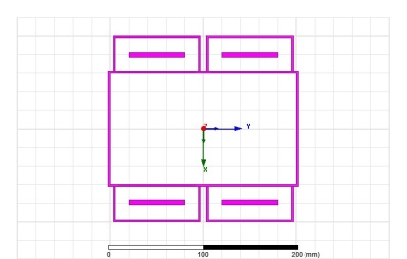
Faltin structure transverse kicker impedance simulation
Horizontal
x
y
Vertical
Horizontal shunt impedance for 0.75 m Faltin kicker when d=15 mm,
sl=95 mm (x=0, y=1)
Vertical shunt impedance for 0.75 m Faltin kicker when d=15 mm,
sl=95 mm (x=1, y=0)

Slide 14
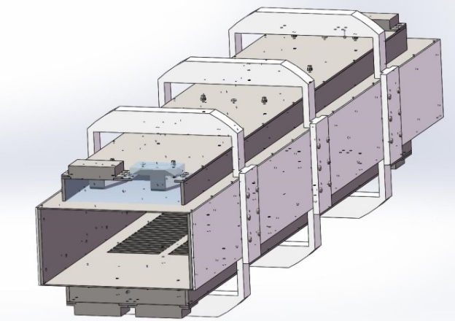
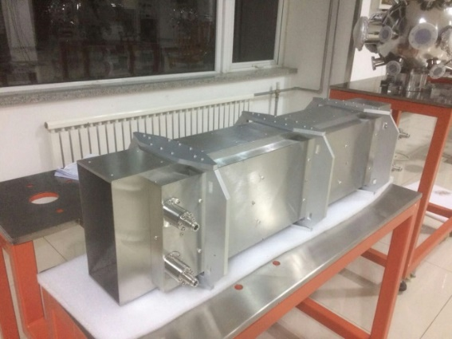
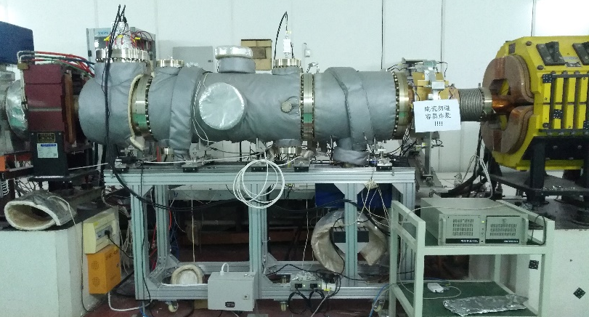
PU shunt impedance measurement for Faltin structure
0.75 m Faltin pickup prototype
Faltin prototype
Faltin 3D model
Slot region
Faltin type install on CSRm for test

Slide 15
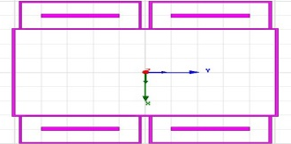
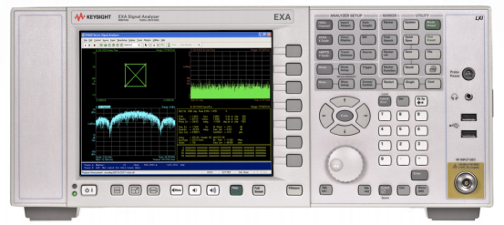
PU shunt impedance measurement for Faltin structure
Longitudinal measurement setup on CSRm
Upstream: 50 Ω load
Downstream: pickup signal
B&Z LNA
Gain=34 dB
NF=0.6 dB
Freq=0.5-3GHz
30 m coaxial cable
Beam
SUM
SPA

Slide 16
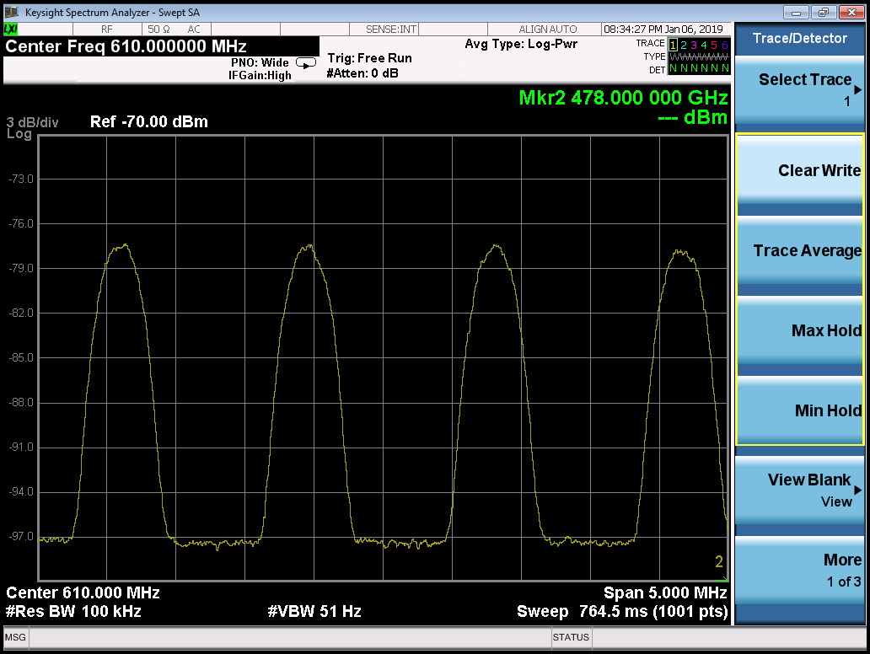

PU shunt impedance measurement for Faltin structure
Faltin pickup Schottky band measurement results on CSRm
Beam: 86Kr³⁰⁺
f_{rev} = 1.39289 MHz
Longitudinal
CF = 0.61 GHz , 472 MeV
CF = 1.108 GHz , 472 MeV
20 dB
Notes:
Krypton /'krɪp'tɑn/

Slide 17

PU shunt impedance measurement for Faltin structure
Faltin pickup measurement results when Beta=0.75 (472 MeV/c)
Spectrum analyzer setup:
RBW：51 kHz
VBW: 30 Hz
Span: 1.5 MHz
Attenuation: 0 dB
Pickup shunt impedance Z_{pu} :
P_{pu} : power from the pickup
I_{b} : the beam current
The n^{th} Shottky band power proportional to N

Slide 18
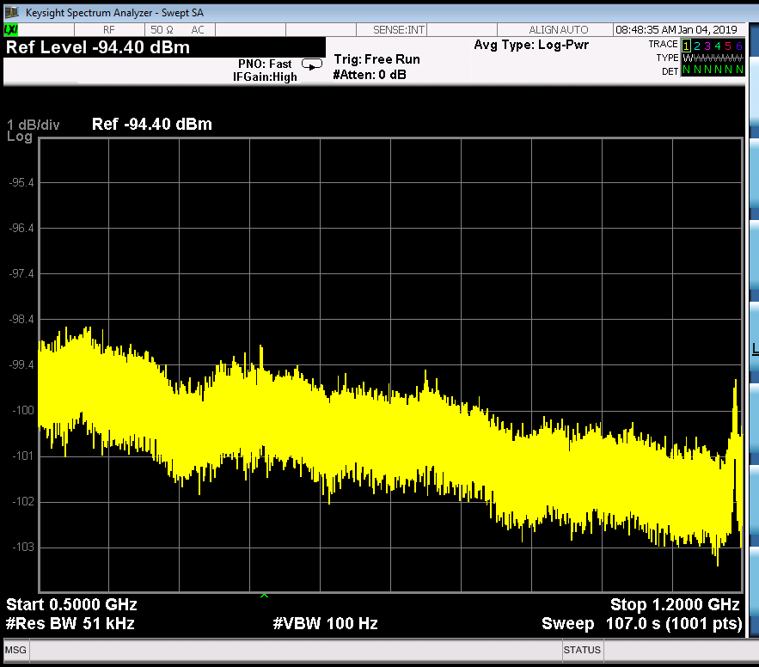
PU shunt impedance measurement for Faltin structure
Faltin pickup measurement results when Beta=0.63 (268 MeV/c)
Spectrum analyzer setup:
RBW：51 kHz
VBW: 30 Hz
Span: 1.5 MHz
Attenuation: 0 dB
No beam (noise floor)
EMI from beam pipe ?

Slide 19
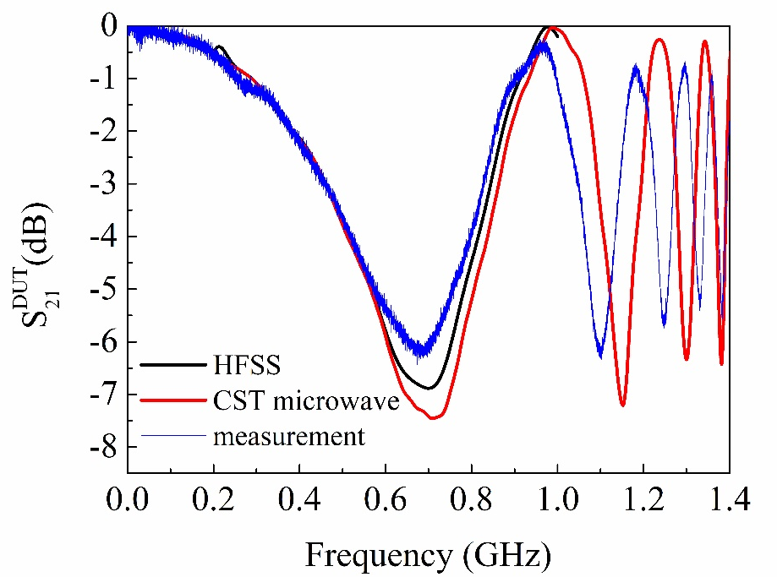
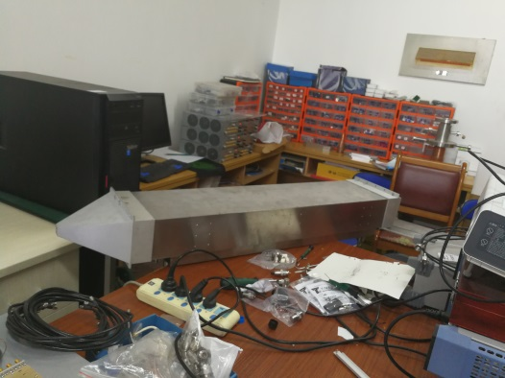
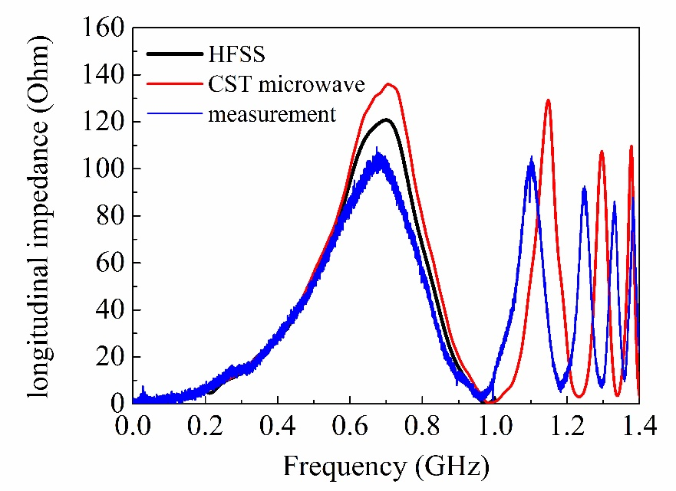

Faltin type longitudinal beam coupling impedance
Wire simulation and measurement by HFSS and CST microwave
Longitudinal Instability
HFSS simulation model
50 Ω structure
700 MHz
Reference prototype
Lumped element formula:

Slide 20
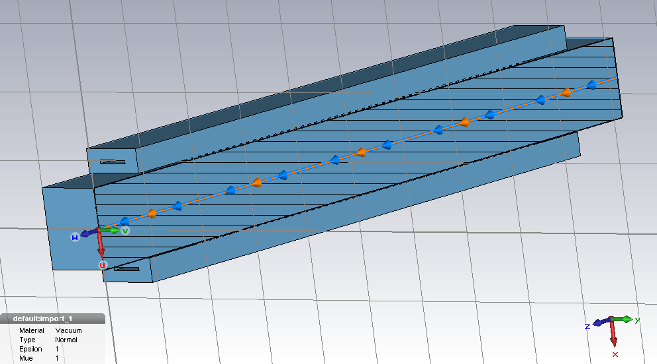
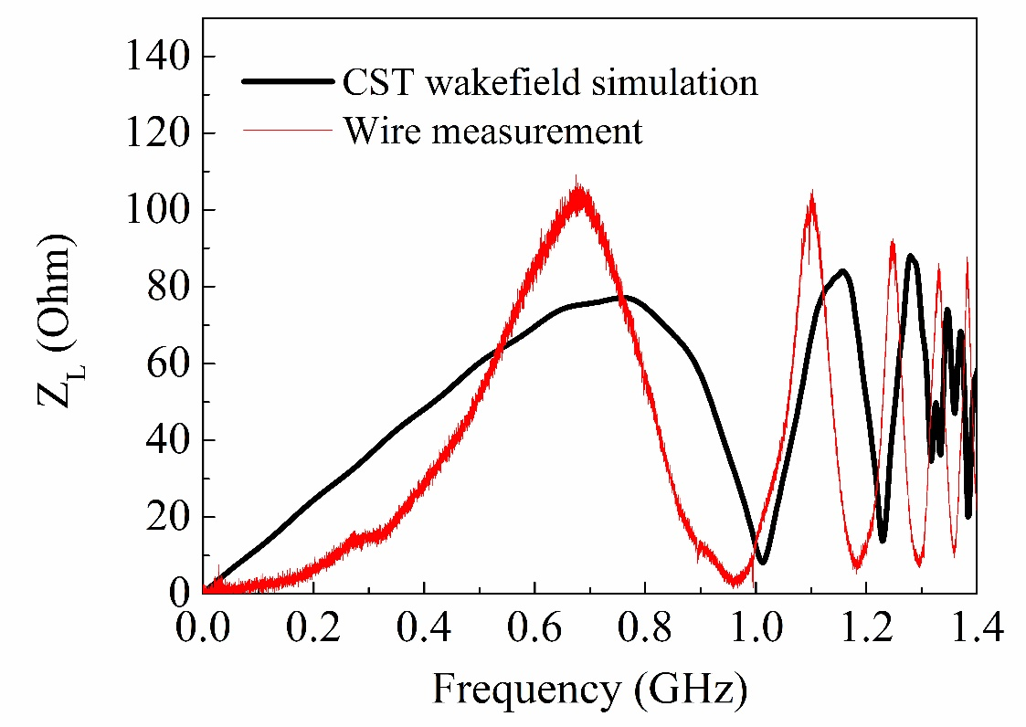
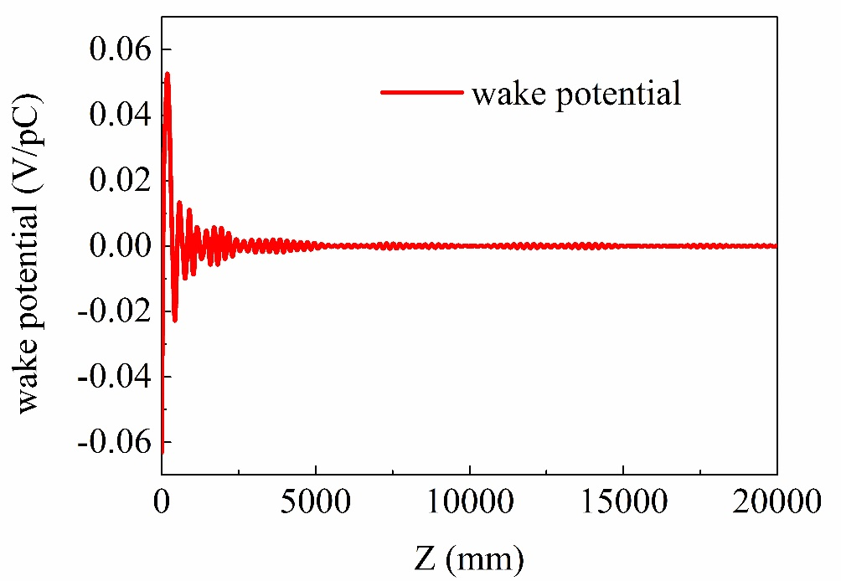
Faltin type longitudinal beam coupling impedance
CST wakefield simulation
Charge: 1e-9 C
Bunch length: 60 mm (sigma)
Wake length: 20000 mm
Boundary conditions:
X/Y: electric
Z: two open + eight waveports

Slide 21
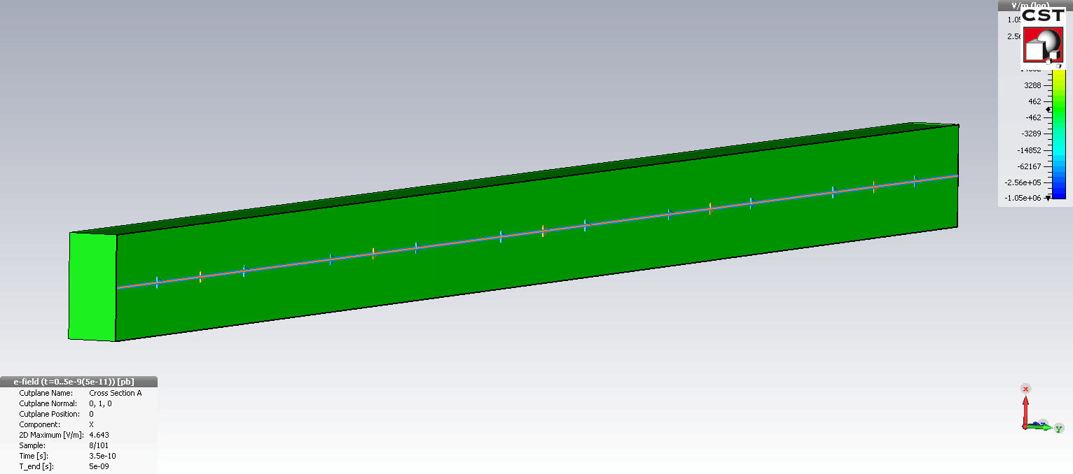
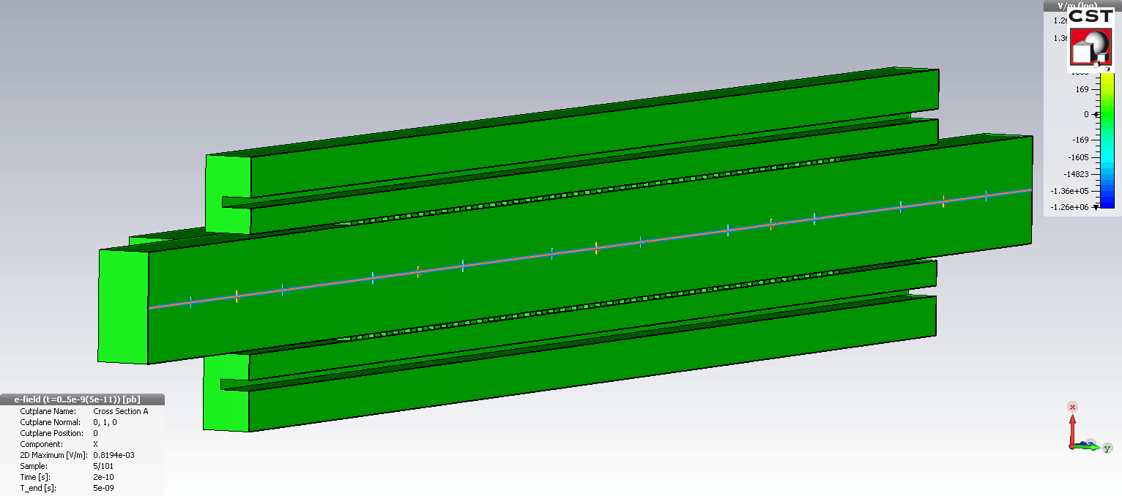
Faltin type longitudinal beam coupling impedance
Longitudinal beam coupling impedance movie:
Smooth tube:
Faltin type:
(Periodic slots)

Slide 22
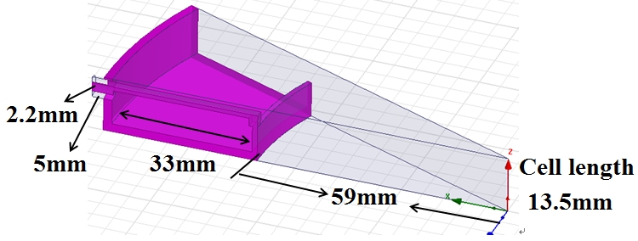
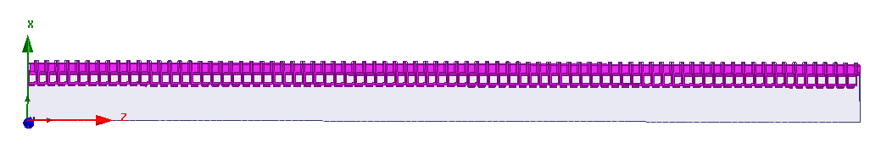


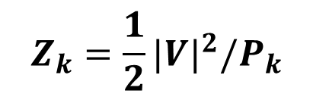

Slot-ring longitudinal kicker impedance simulation
$$Z_{k}=\frac{1}{2}{|V|}^{2}/P_{k}$$
Beam direction
$$V：beam voltage$$
$P_{k}：$input power
Slot-ring depth: t
Powered $P_{k}$ in the middle cell
t=
The dimension of one sixteenth cell
HFSS Simulation model

Slide 23
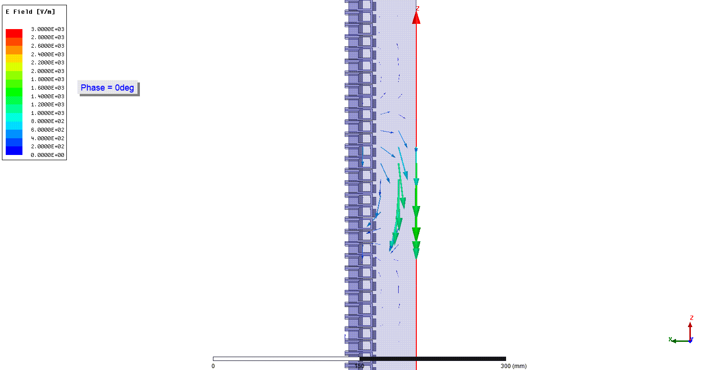
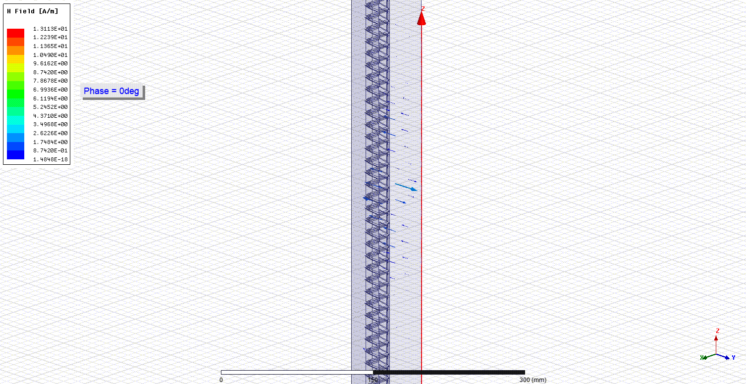
Slot-ring longitudinal kicker impedance simulation
Powered 1W in the 44th cell
Beam direction
The Vector-electric field
The Vector-magnetic field
As we can see, quasi-TM010 mode is excited, there is only longitudinal electric field which is deflecting field along beam direction

Slide 24
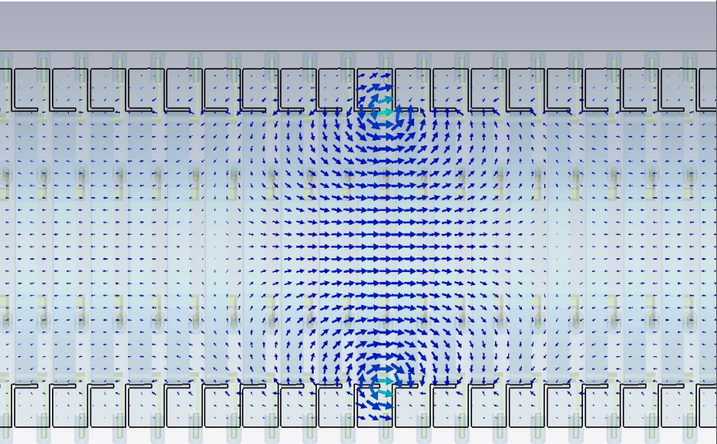
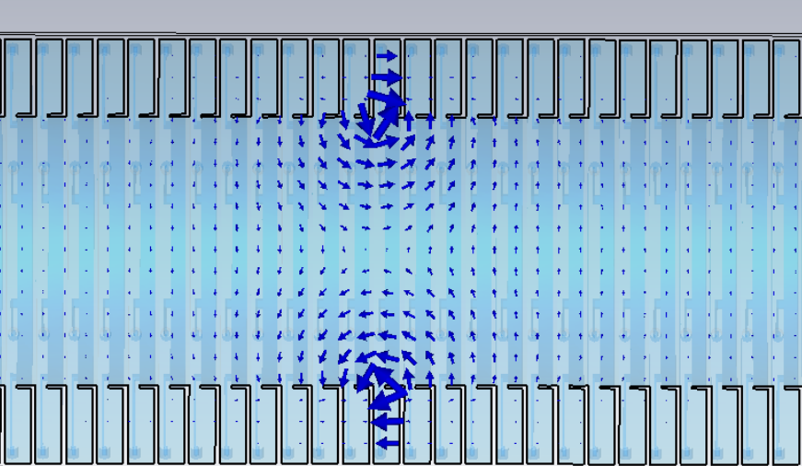
Slot-ring longitudinal kicker impedance simulation
Longitudinal E-field distribution
Sum mode
Transverse E-field distribution
Difference mode
+
+
_
+
quasi-TM₀₁₀ mode is excited
quasi-TM₁₁₀ mode is excited

Slide 25
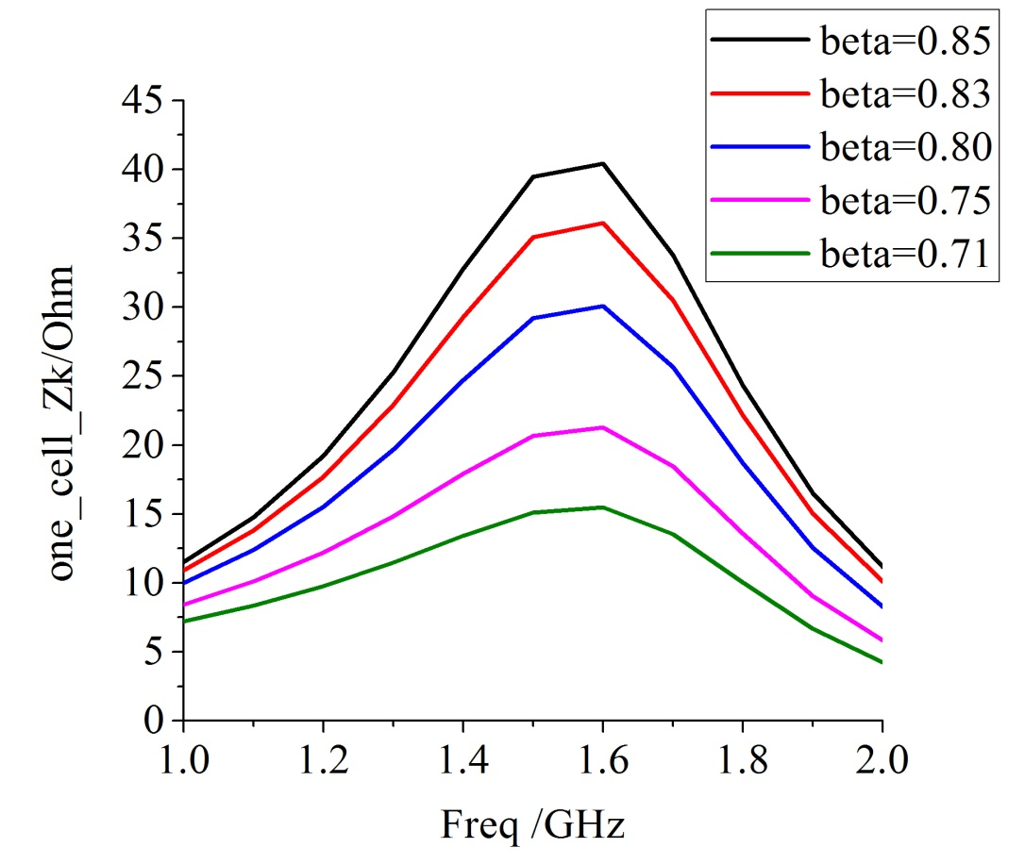
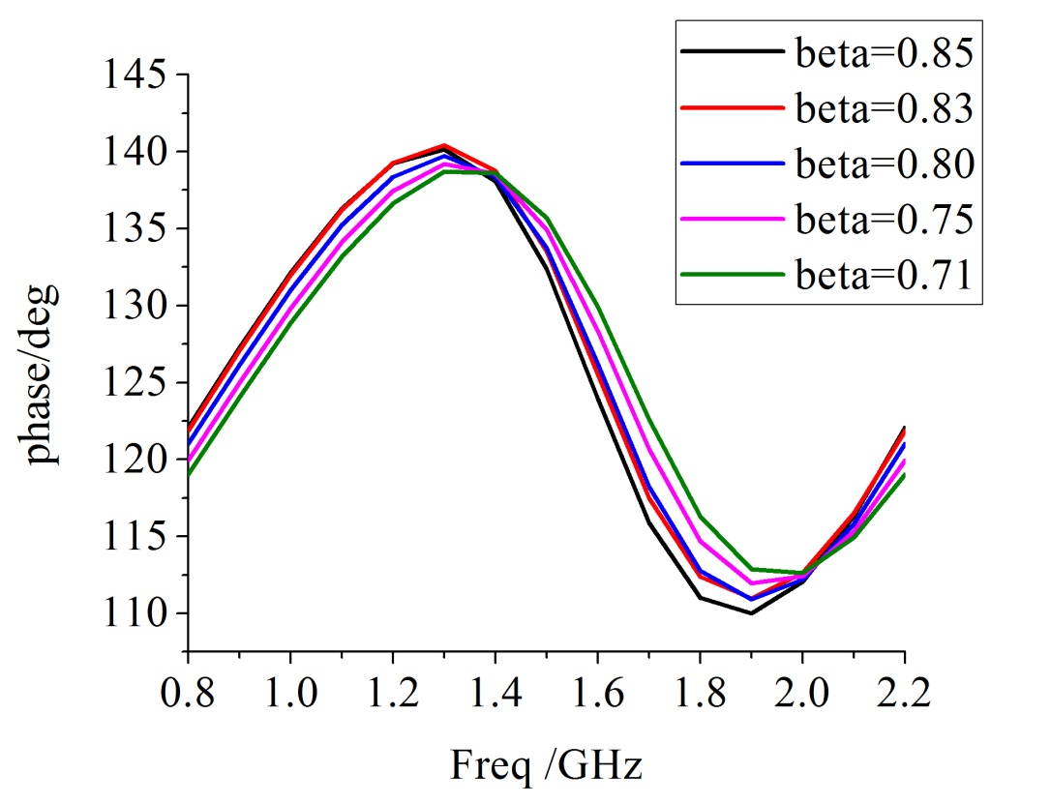
Slot-ring longitudinal kicker one cell impedance simulation results
Aperture Ø=118 mm
without ceramic
Phase: ±15⁰
slot-ring depth t=33 mm
One cell longitudinal shunt impedance Zk for different beta values
Phase behavior of the slot-ring structure

Slide 26
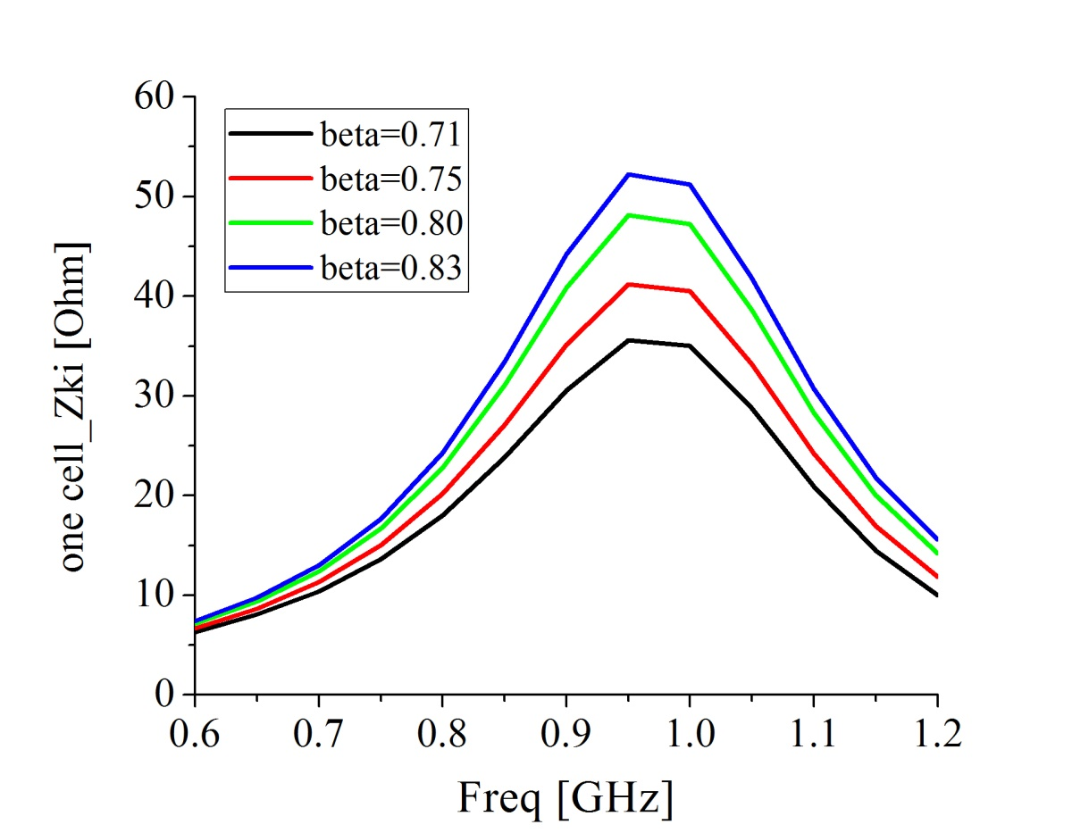
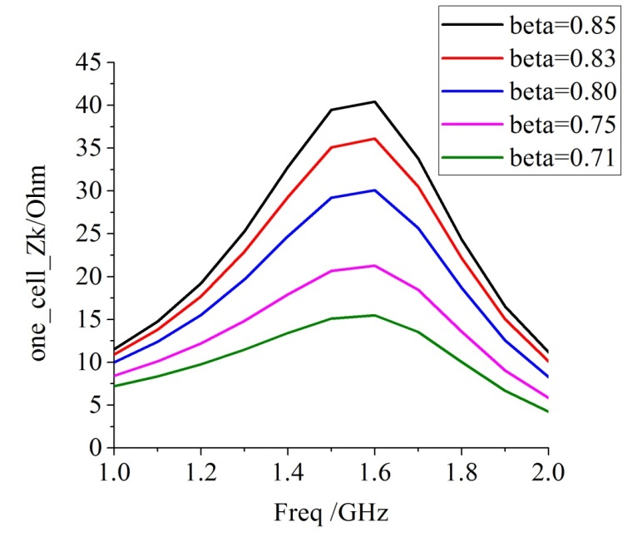
Slot-ring longitudinal kicker one cell Zk impedance simulation results
Ceramic thickness 5 mm
Aperture Ø= 118 mm
with ceramic
35 Ω @ 0.95 GHz
Ø=118 mm
Double Zk than
without AI₂O₃
One cell model with ceramic tube
Aperture Ø=118 mm
without ceramic
slot-ring depth t=33 mm
16 Ω @ 1.5 GHz
One cell longitudinal shunt impedance Zk for different beta values with ceramic tube
slot-ring depth t=33 mm
《A microwave Cerenkov pick-up for stochastic cooling》
-----by E. Brambilla

Slide 27
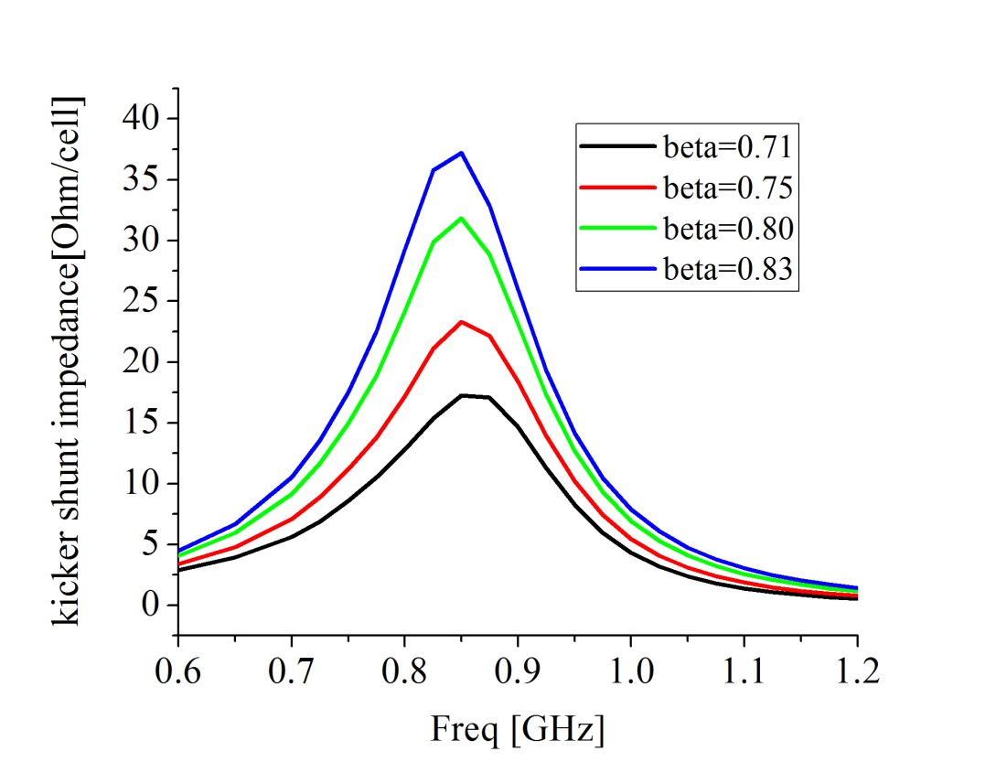
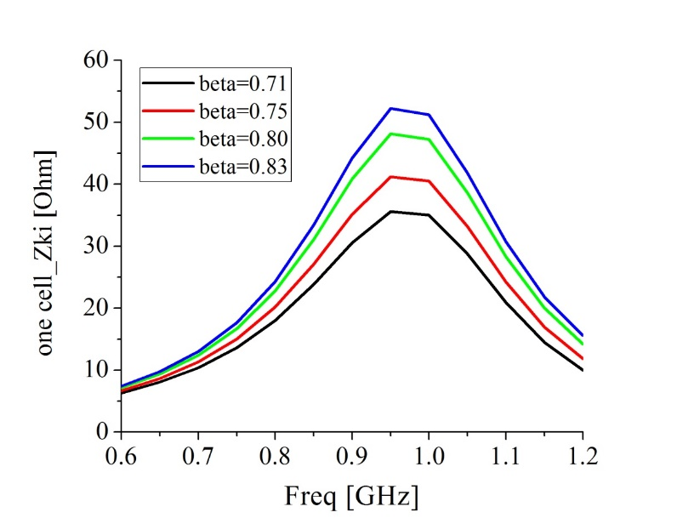
Slot-ring longitudinal kicker one cell impedance simulation results
Ceramic thickness 5 mm
Aperture Ø= 200 mm
with ceramic
Ø=200 mm
17 Ω @ 0.85 GHz
Half Zk than
Ø = 118 mm
slot-ring depth t=33 mm
One cell model with ceramic tube
35 Ω @ 0.95 GHz
One cell longitudinal shunt impedance Zk for different beta values with ceramic tube
Aperture Ø= 118 mm
with ceramic

Slide 28
Slot-ring transverse kicker shunt impedance simulation result for one cell
Aperture Ø= 200 mm
with ceramic
slot-ring depth t=33 mm
One cell transverse shunt impedance for different beta values with ceramic tube

Slide 29
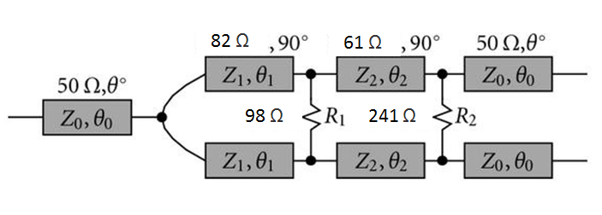
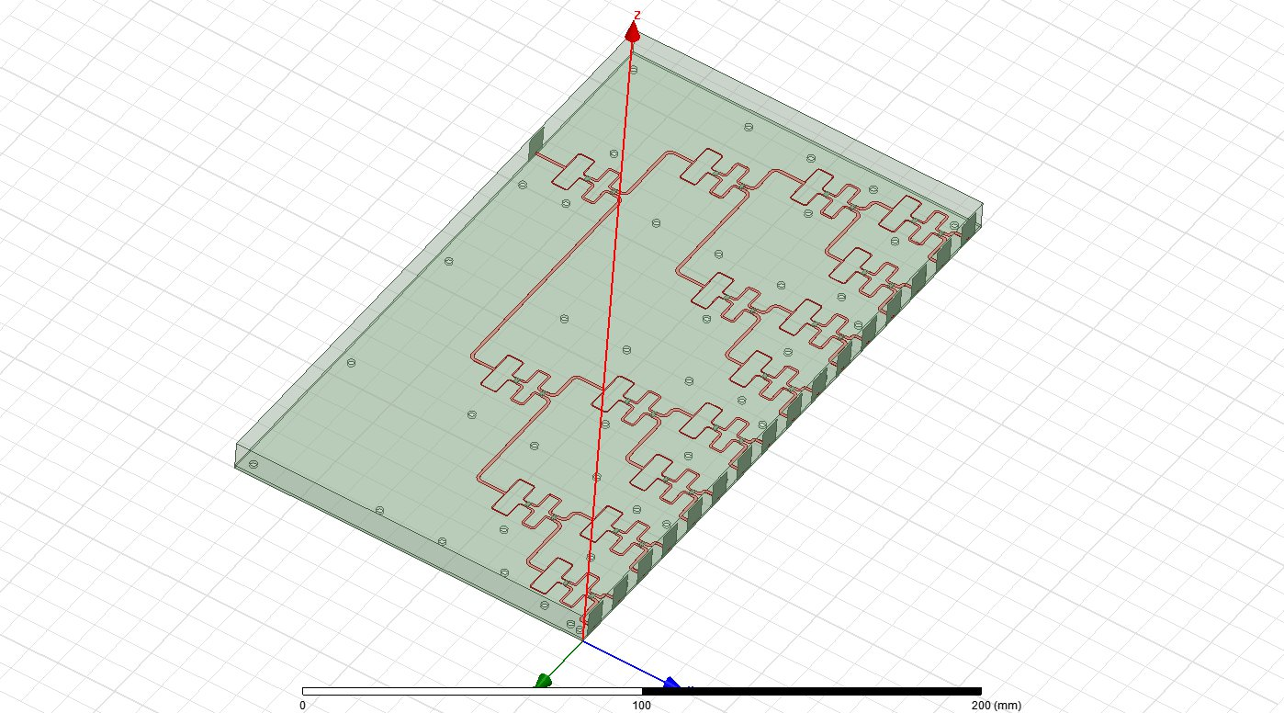
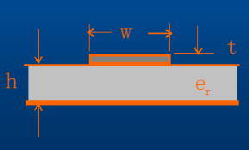
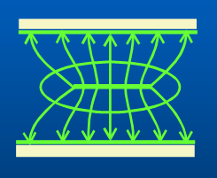
16 way Wilkinson Splitter/Combiner for Slot-ring structure
Bandwidth：0.6-1.2 GHz
Insertion loss: <= 1.0 dB
Isolation：>= 15dB
《A class of broadband three-port TEM-mode hybrids》
----Seymour B. Cohn, IEEE MTT, 1968
Beta= 0.71
Micro-stripline
√
Beam direction
Stripline

Slide 30
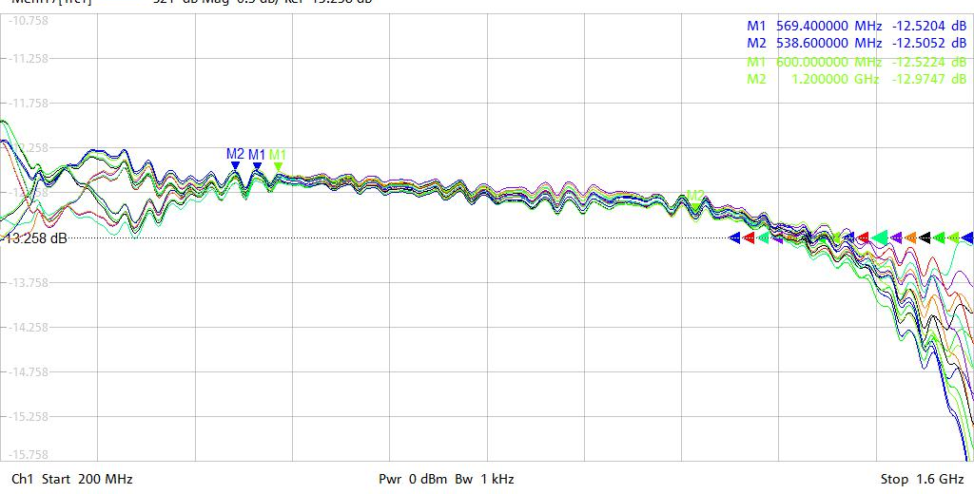
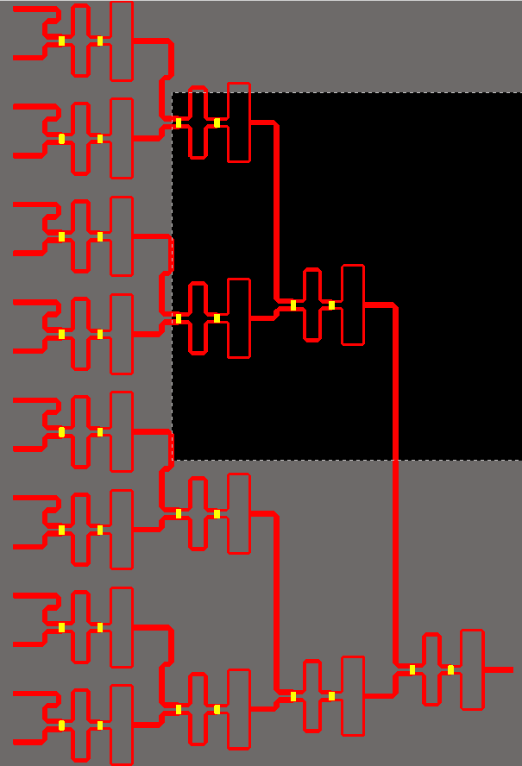
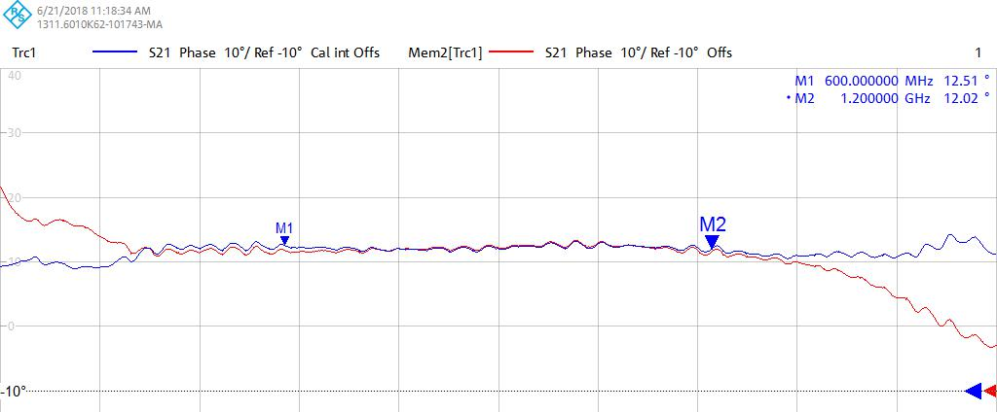
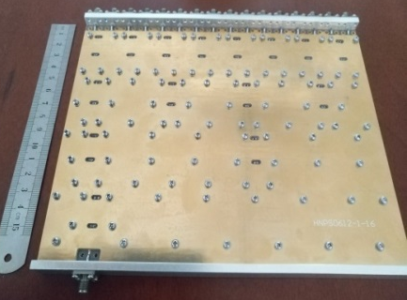
16 way Wilkinson Splitter/Combiner for Slot-ring structure
16 way Wilkinson
combiner
Insertion loss
-12.52dB@0.6GHz
-12.97dB@1.2GHz
Phase deviation
12.5⁰ @0.6GHz
12.0⁰ @1.2GHz
16 way combiner prototype

Slide 31
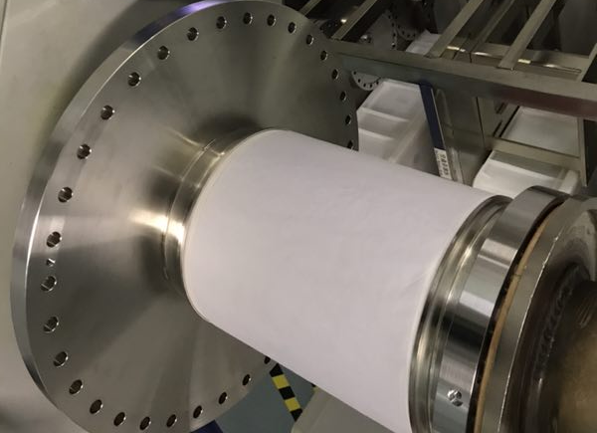
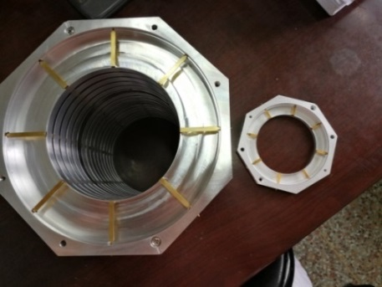
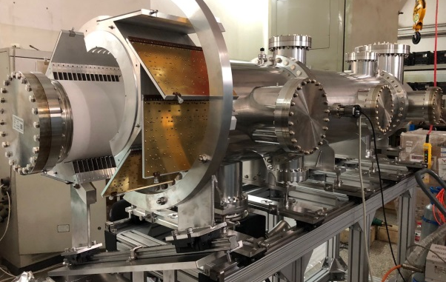
PU shunt impedance measurement for Slot-ring structure
Diameter: 200 mm
Ceramic thickness: 8 mm
220 mm
260 mm
Slot-ring prototype
Ceramic tube prototype
Faltin
16 way combiner
99% AI₂O₃ tube
Slot-ring

Slide 32
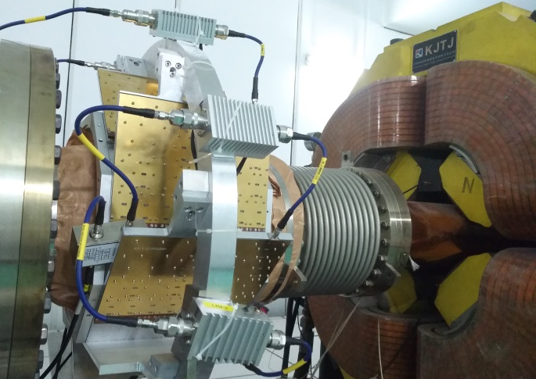
PU shunt impedance measurement for Slot-ring structure
Longitudinal measurement setup on CSRm
30 m coaxial cable
SUM
B&Z LNA
Gain=34 dB
NF=0.7 dB
Freq=0.1-2 GHz
SPA
16 way
16 way
Combiners in the air
16 way
16 way
SUM
16 cells
SUM
SUM
16 way
16 way
16 way
16 way
SUM
RF shielding

Slide 33
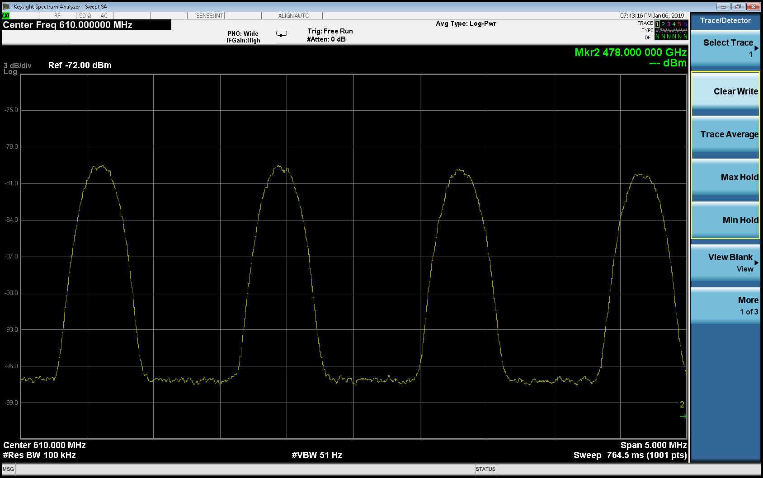

PU shunt impedance measurement for Slot-ring structure
Slot-ring pickup Schottky band measurement results on CSRm
Beam: 86Kr³⁰⁺
f_{rev} = 1.39289 MHz
Longitudinal, CF = 610 MHz, 472 MeV
Longitudinal, CF = 801 MHz , 472 MeV
24 dB

Slide 34
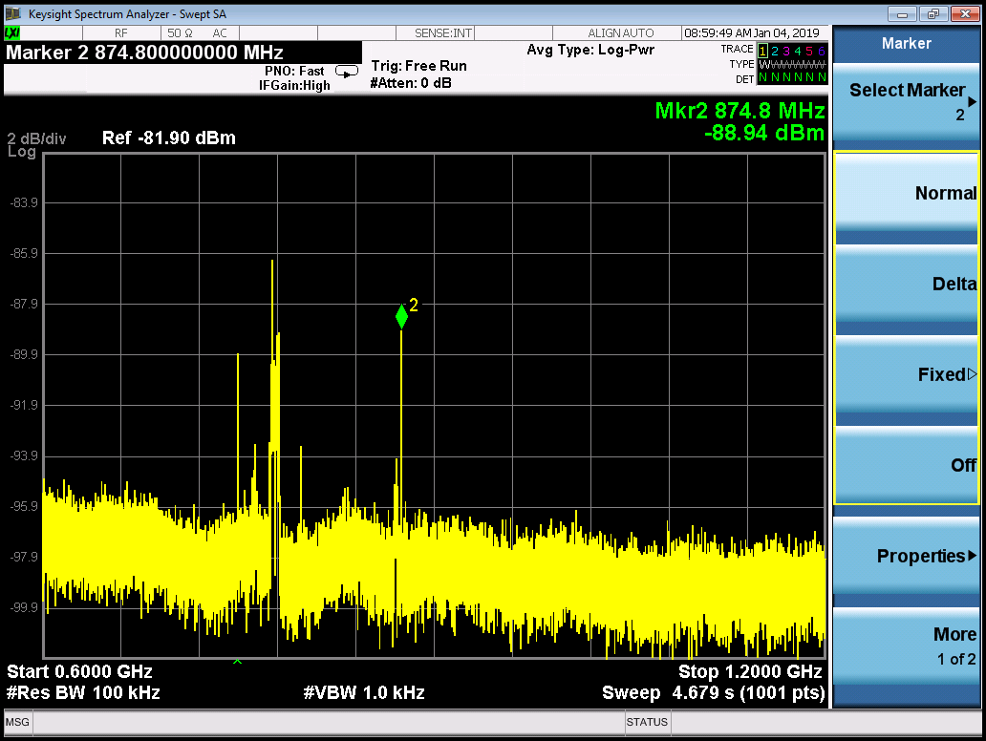
PU shunt impedance measurement for Slot-ring structure
Slot-ring pickup measurement results when Beta=0.75 (472 MeV)
Spectrum analyzer setup:
RBW：51 kHz
VBW: 30 Hz
Span: 1.5 MHz
Attenuation: 0 dB
Pickup shunt impedance :
P_{pu} : power from the pickup
I_{b} : the beam current
The n^{th} Shottky band power proportional to N
EMI from the air
Due to the interference signal
No beam

Slide 35
PU shunt impedance measurement for Slot-ring structure
Slot-ring pickup measurement results when Beta=0.63 (268 MeV)
Spectrum analyzer setup:
RBW：51 kHz
VBW: 30 Hz
Span: 1.5 MHz
Attenuation: 0 dB

Slide 36

0.75 m PU shunt impedance and phase of the two structures

Slide 37
Time domain simulation for SRing stochastic cooling
Many thanks Lars Thorndahl
The method consists in cascading all elements in the complex frequency plane and to perform the inverse Laplace transformation on the product and integrating over the frequency range (in our case 0.6 to 1.2 GHz).
There are thus 6 elements, the first one being the Dirac function, representing the single particle.
TOF and betatron cooling lay-out, the usual arrangement of horizontal and sum pickup, preamplifiers, phase equalizer, power amplifier and kicker
Notes:
This is the simulation parameters…..

Slide 38

Time domain simulation for SRing stochastic cooling
Note that :
For the TOF and filter cooling : prior to inverse Laplace transformation a phase offset by 90 degrees is introduced to obtain the correction sign reversal at the nominal rev. frequency.
For horizontal cooling no such phase offset is necessary (symmetric green curve)
Single-ion coherent correction time-pulses (momentum and betatron) at the kickers obtained via inverse Laplace transformation of Dirac functions times the 5 cooling components.
Notes:
This is the simulation parameters…..

Slide 39

Simulation parameters for SRing stochastic cooling
The listing of the 27 input parameters used in a typical simulation divided into 3 parts: 15 beam parameters, 9 SRing parameters and 3 simulation parameters
Notes:
This is the simulation parameters…..

Slide 40
Pickup/kicker shunt and transfer impedance – Faltin type
Simulation parameters for SRing stochastic cooling
Faltin, rectangular shape, dimension: 200 mm * 120 mm
Longitudinal kicker shunt impedance
for 0.75 m when d=15 mm, sl=95 mm
Horizontal pickup transfer impedance for 0.75 m Faltin structure when d=15 mm, sl=95 mm (x=0, y=1)

Slide 41

Time domain simulation for SRing stochastic cooling
------first provisional results
Cooling of 1E8 ions
Gnuplot (name: rms) showing for above parameter set the TOF and the betatron cooling. After 5 s a small TOF instability occurs, slowing also the betatron cooling. After 10 s TOF switchoff and the betatron cooling improves. H = 0.5 i.e., only half of the ring circumference contains the 2000 sim. ions.
Notes:
This is the simulation parameters…..

Slide 42

Time domain simulation for SRing stochastic cooling
Cooling of 1E8 ions
Same case as last figure, but obtained with 4000 simulation ions filling only half the ring circumference, H = 0.5. The computation time is 4 times longer. (gnuplot name:rms)
Notes:
This is the simulation parameters…..

Slide 43


Time domain simulation for SRing stochastic cooling
Cooling of 1E8 ions
longitudinal distribution at end
SRing power levels during above cooling process
Notes:
This is the simulation parameters…..

Slide 44


Time domain simulation for SRing stochastic cooling
Cooling of 1E8 ions
Horizontal phase plane at the end
SRing power levels during above
cooling process
Notes:
This is the simulation parameters…..

Slide 45

Time domain simulation for SRing stochastic cooling
Cooling of 1E8 ions
SRing fully filled, H = 1, 6000 sim. ions. TOF switched off after 10 s
Parameters as in list of right figure except that initial dp/p = 0.0015 and initial betatron amplitude 0.036 m (instead of 0.0013 and 0.025 m)
Notes:
This is the simulation parameters…..

Slide 46

Simulation parameters for SRing stochastic cooling
A typical parameter set for the 1E5 case, where the beam feedback effect is small compared with the 1E8 situation. The el. gain is here 10 times higher but the ANPsr 1000 times smaller. So there are no longitud. instabilities!
Notes:
This is the simulation parameters…..

Slide 47

Simulation parameters for SRing stochastic cooling
------first provisional results
Cooling of 1E5 ions
The result should be precise enough with H=0.5 and NP = 1000
Notes:
This is the simulation parameters…..

Slide 48

Signal transmission
PU station
Combiner station
Kicker station
Diagnostics

Slide 49


Control - PLC
Interface
PLC
Notes:
For the control, we will use PLC control, just like CSRe stochastic cooling, which is very reliable and easy to handle.

Slide 50
acknowledgements
My acknowledgements to the colleagues who helped us a lot those years for the stochastic cooling:
Fritz Caspers
Lars Thorndahl
Fritz Nolden
Rolf Stassen
Takeshi Katayama
Wolfgang Hofle
……

Slide 51
Thank you for your attention!
Any comments welcomed!

Slide 52
Second case- slot ring structure with ceramic inside
Slot ring: pickup-64 rings, kicker-128 rings
Coupling impedance: for slot ring it is one cell kicker shunt impedance,
Beam energy, 740 MeV/u, 400 MeV/u, Vacuum aperture: 118 mm

Slide 53
SRing TOF cooling simulation-second case

Slide 54

Relations between Pickup and kicker
Kicker shunt
impdance
PU transfer impedance
PU shunt impedance= ¼ kicker shunt impedance

Slide 55

Transverse signal measurement for Faltin type on CSRm
We have estimated the transverse signal is about -145 dBm, is much below the noise floor, the main reason is the beam size is very small due to the electron cooling
So we did not see the transverse signal on the spectrum analyzer

