Slide 1
Design of Pick-up and kicker for hesr
January 21st, 2019 I Bernd Breitkreutz

Slide 2
OUTLINE
Detailed look on the construction of HESR pick-ups and kickers
Electromagnetic simulation of the structures with CST Microwave Studio
Comparison to the anticipated design performance
and measurement results at COSY
PU
${\underline{Z}}_{P}$, ${\underline{Z}}_{P}^{′}$
KI
${\underline{K}}_{‖}$, $R_{‖}$
${\underline{K}}_{⊥}$, $R_{⊥}$

Slide 3
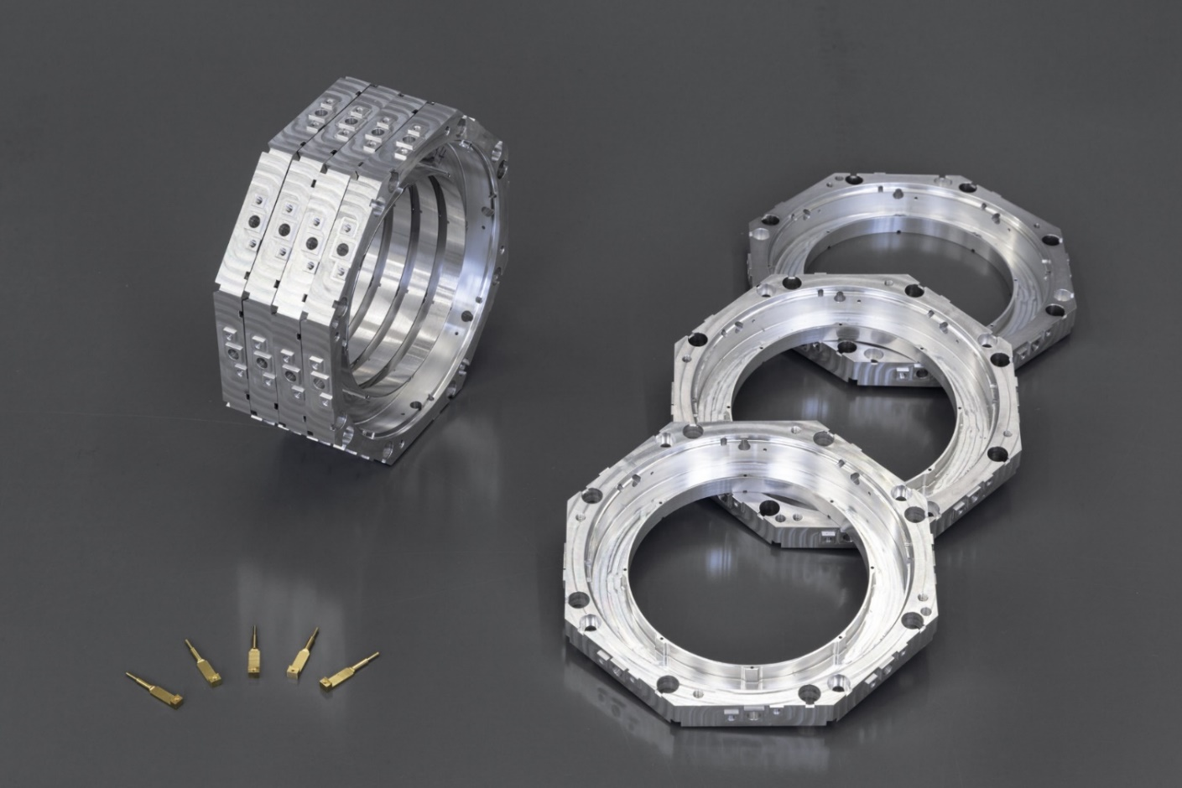
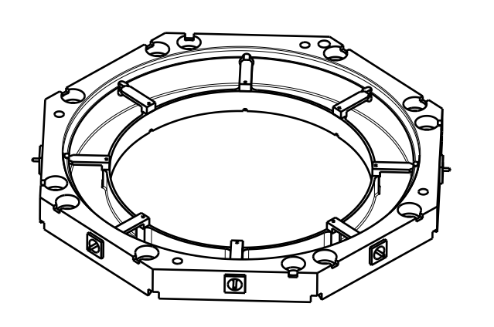
The slotring couplers
Developed by L. Thorndahl and R. Stassen for HESR
Compact, since all three planes in one device
Hardly error-prone due to a lack of moving parts. Very rigid geometry.
Optimized for the 2-4 GHz band
aperture = 90 mm
h = 12.5 mm
Notes:
The devices consist of such octagonally shaped slot-rings as shown in the scetch

Slide 4
Longitudinal vs transverse
Vertical position:
Differential signal on red electrodes
Horizontal position:
Differential signal on blue electrodes
Longitudinal position:
Sum signal of one or both planes
Notes:
This is the top view of one slot-ring
The signal is sensed by eight electrodes

Slide 5
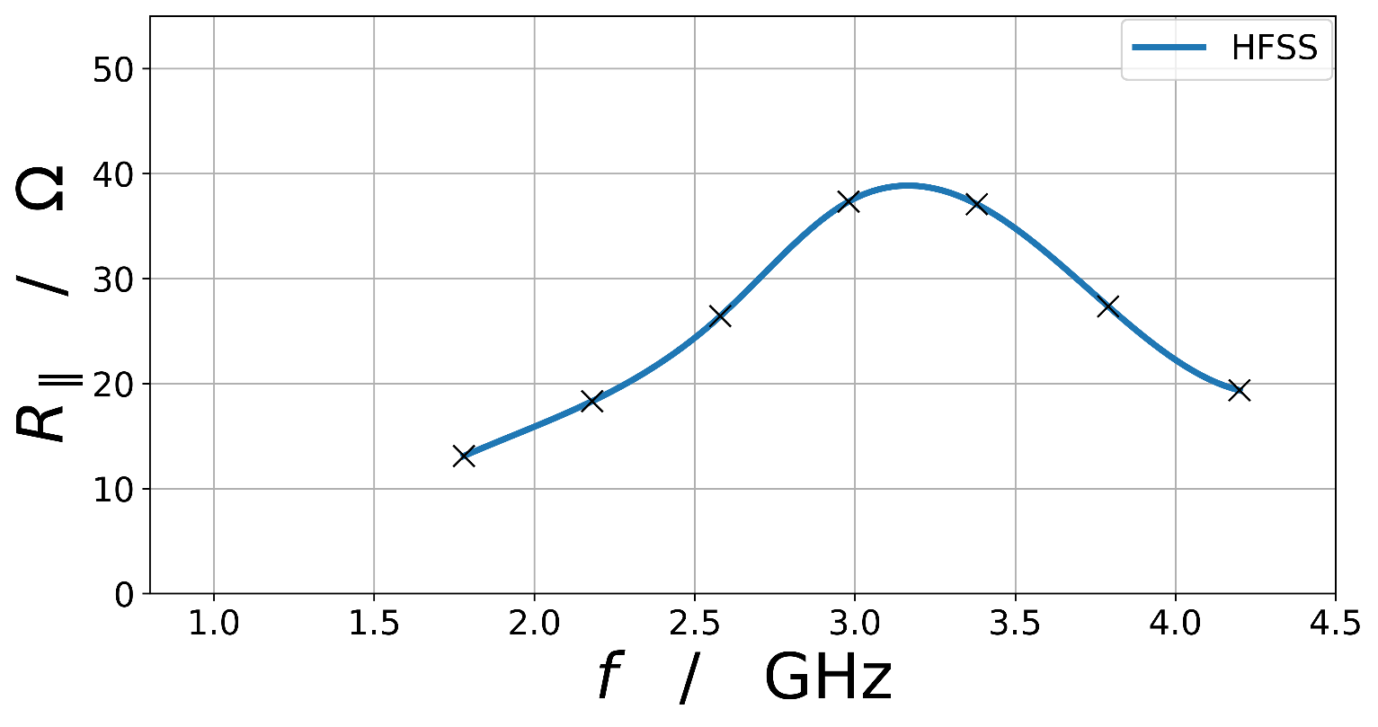
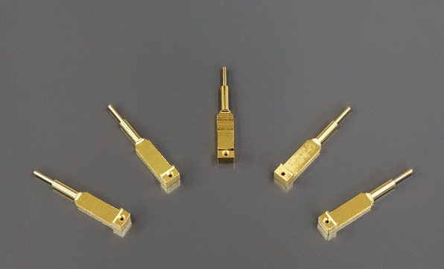
couplers – working Principle
Beam Current
Voltage Drop
50Ω Microstrip
Mirror Current
Shunt impedance (from design phase)
50Ω Koax
More electrodes
= broader
Signal
Output Power
f
f₀
HFSS results from: L. Thorndahl, "Fixed 90 mm Full-Aperture Structures with TM10-Mode Propagation for Stochastic Cooling in HESR", p. 17 (beta=0.97)
Notes:
In order to understand how the slot-rings work, we have a look at the cross-section of a pick-up

Slide 6
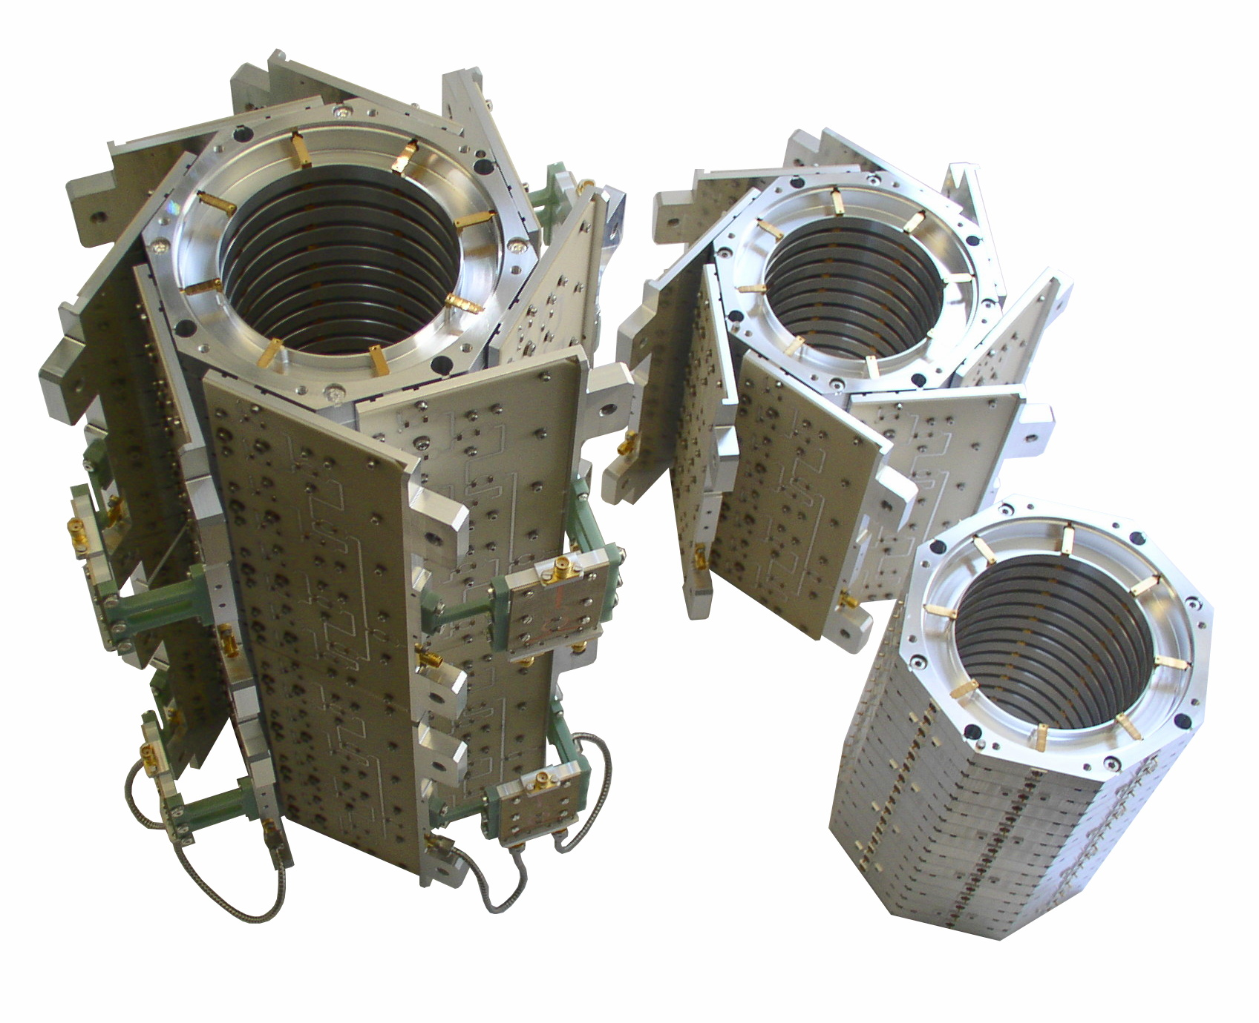
Stacking of slotring couplers
II)
8 16-to-1 combiner-boards are connected to the electrode rows
III)
Additional 2-to-1 Wilkinson combiners to reduce number of terminals to 4 (“Up”, “Down”, “Left”, “Right”)
I)
16 rings are screwed to one group
IV)
Four groups are screwed to one shaft (two on image)
Notes:
Each SC tank of HESR consists of 64 of those slot-rings to increase the total impedance.
This figure shows, how they are assembled

Slide 7
Combiner-board
2-to-1 combiner
8T
4T
2T
T
1
2
3
4
5
6
7
8
9
10
11
12
13
14
15
16
Beam velocity: $βc_{0}$
Notes:
This is a picture of a combiner board of a pick-up
The ceramic board is screwed onto a metal plate that serves as a heat sink
In case of a kicker, the board is glued as well, because the thermal stress is smaller
The single combiners are two-stage Wilkinson combiners -> good flatness from roughly 1.5 to 5.5 GHz

Slide 8
The assembled pick-up shaft
Thermal connectors
Beam
Notes:
This is what the complete shaft of a pick-up with its four groups looks like
The resistors of the Wilkinson combiners are a source for thermal noise
This is why they are cooled down to under 20 Kelvin
copper ribbons
aluminum heat sinks

Slide 9
HESR SC pick-up tank
Cooling heads
Suspensions of the shaft
Thermal
Shield with Multilayer Insulation Foil
Not shown:
- RF Grid
- Ferrites
Cable outlets
Flange to ion pump
Notes:
This is how the shaft of the pick-up is installed in its tank
Combiner boards are under 20K
Outside of the shield are approximately 70K
Knobs: benchmarks for geodesy

Slide 10
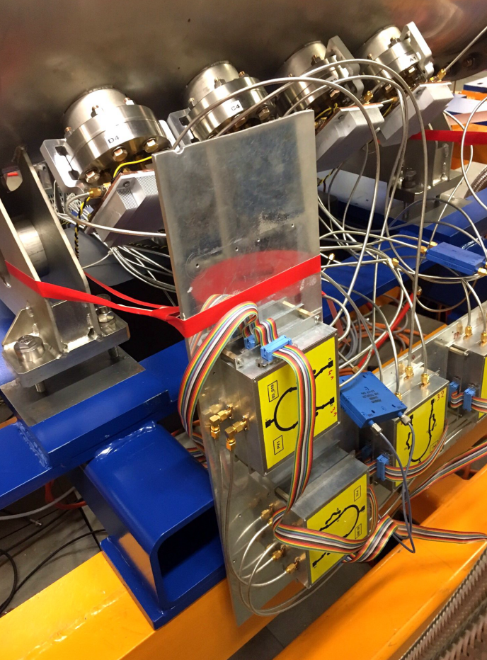
Pick-up outlets (in cosy)
4 x 4 SMA connectors
LNAs
Switchable delays
between groups
Notes:
This is the RF-cabling as it is currently installed at COSY
The final version for HESR will look a little tidier

Slide 11
Kicker shaft
Notes:
This is the kicker
The design is very close to that of a pick-up
Differences:
Combiner delays are oriented in the opposite direction
Most of 250W power is reflected and dissipated in the resistors
-> water cooled copper rings

Slide 12
Simulation strategy
Thanks to reciprocity, one only needs to simulate pick-ups or kickers
Kickers are much easier to calculate, since a broadband excitation at the port directly leads to the beam voltage on axis for all frequencies
Pick-up simulations have been done with a wakefield-simulation procedure for verification
Simulate kickers, either in longitudinal or in transverse excitation
Optimize geometry for shunt impedance: high, symmetric, constant over frequency
Check phase behavior of kicker constant
Simulation | optimize for | check phase of
Longitudinal kicker | $$R_{‖}$$ | $${\underline{K}}_{‖}$$
Transverse kicker | $$R_{⊥}$$ | $${\underline{K}}_{⊥}$$
$${\underline{Z}}_{P}$$
$${\underline{Z}}_{P}^{′}$$
Reciprocity theorem
Notes:
Before getting to the electromagnetic properties of the devices,
I would to say a few words about the simulation process of pickups and kickers in general

Slide 13
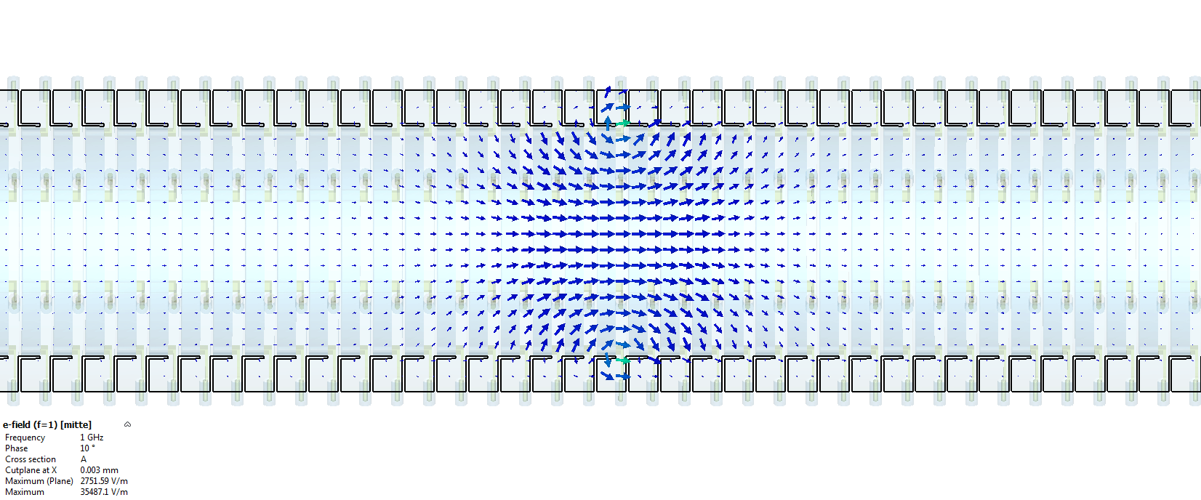
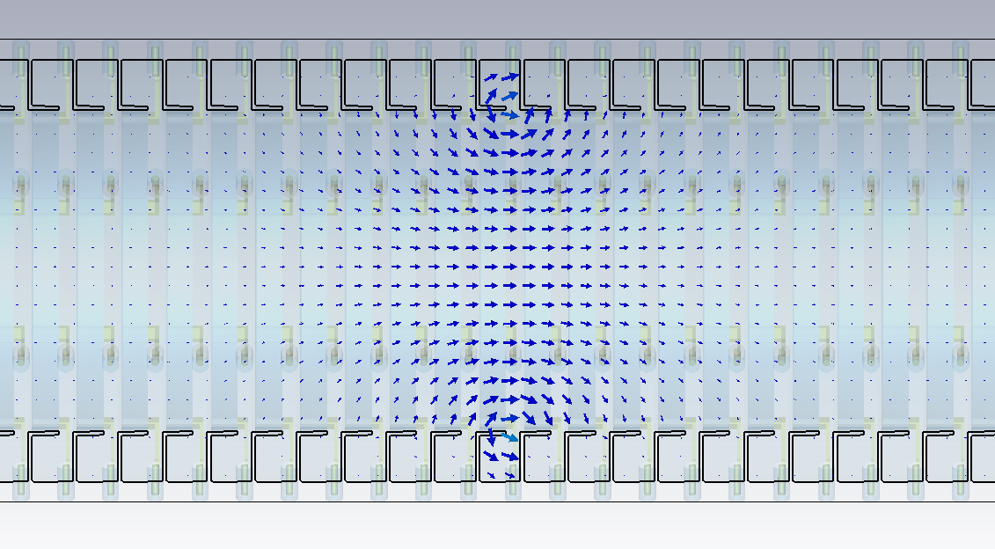
HESR KI at low frequencies
Simulation of kickers with CST
Excitation of one single cell in the middle of the structure
Electric field at 1 GHz
Notes:
Here we see the electric field of a kicker at 1 GHz.
One cell is excited longitudinally. That means that all electrodes are of the same phase.
One can see the longitudinal field in the center of the structure
We only simulate one single cell -> linearity…
Influence of the ends of the structure need to be checked

Slide 14
Beampipe Modes
The HESR Aperture is 89 mm. This is partially above cut-off in the 2-4GHz band!
TE₁₁
f_{c} = 1.95 GHz (occurs only by transverse excitation)
TM₀₁
f_{c} = 2.55 GHz
Notes:
At higher frequencies, an additional problem occurs.

Slide 15
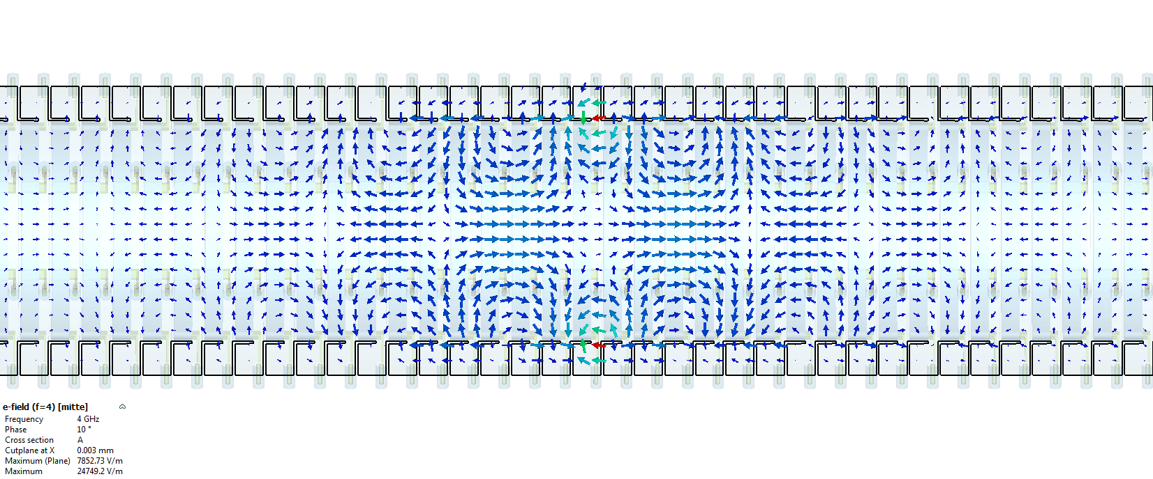
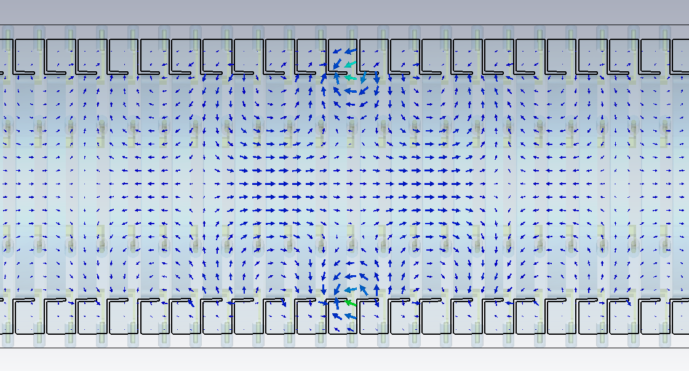
HESR KI at high frequencies
The multicell structure itself behaves as a heavily loaded waveguide.
Electric field at f = 4 GHz
Power flow
Notes:
This is why the field pattern differs dramatically at higher frequencies
The structure itself acts as a heavily loaded waveguide

Slide 16
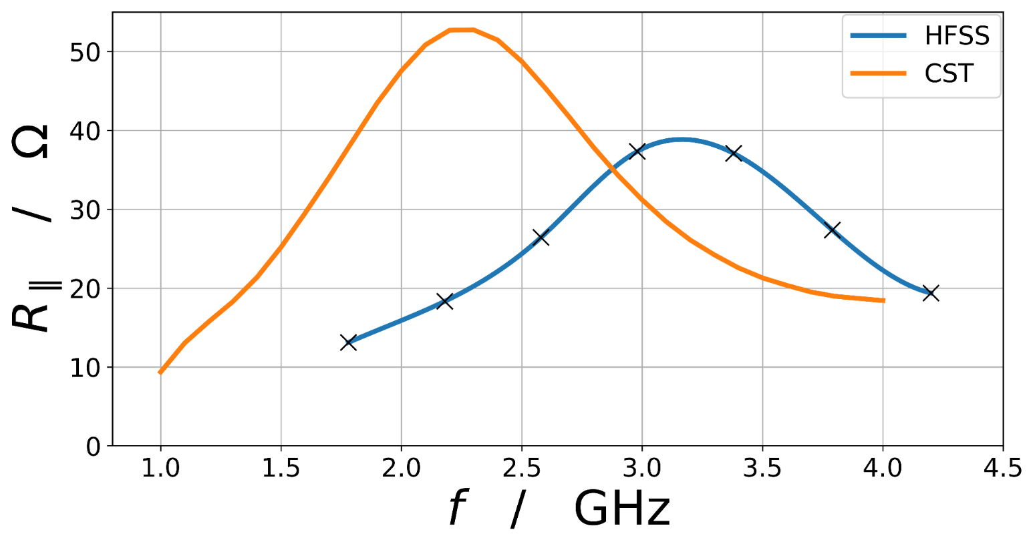
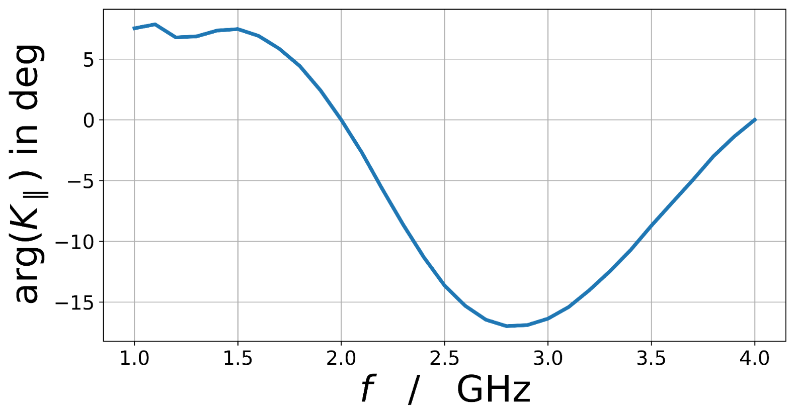
Simulation results - longitudinal
Geometry was designed with HFSS for symmetric shunt impedance around 3 GHz.
CST results differ from that: Travelling wave effects clearly visible
But still reasonable impedances in the cooling band
Maximum phase change about 17°.
Notes:
So lets have a look at the resulting shunt impedance
Once again the impedance from HFSS with its symmetric behavior around 3 GHz

Slide 17
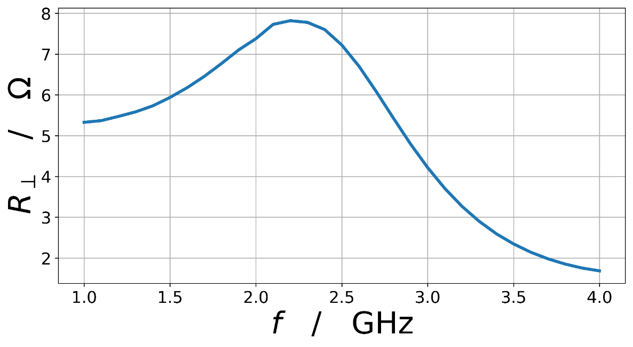
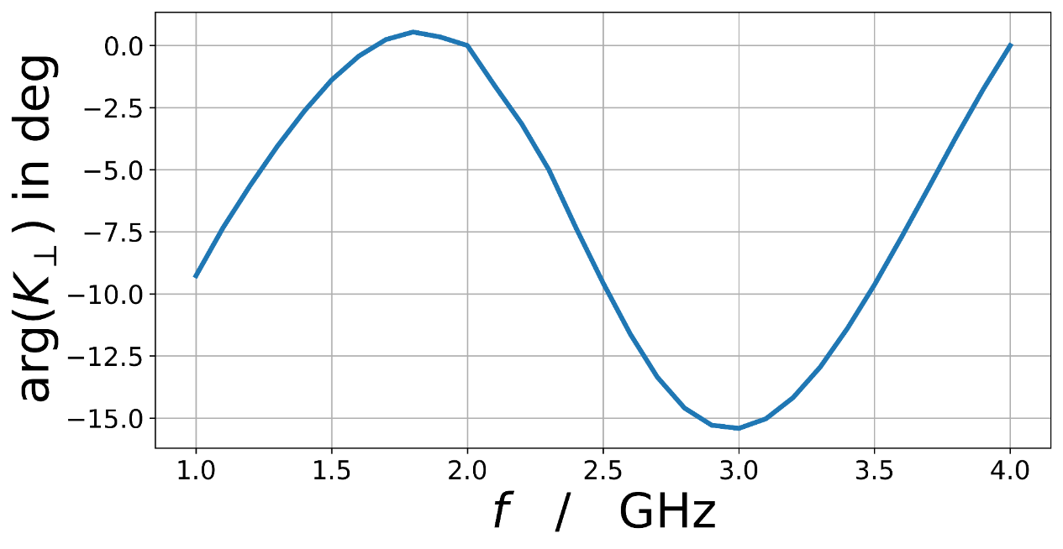
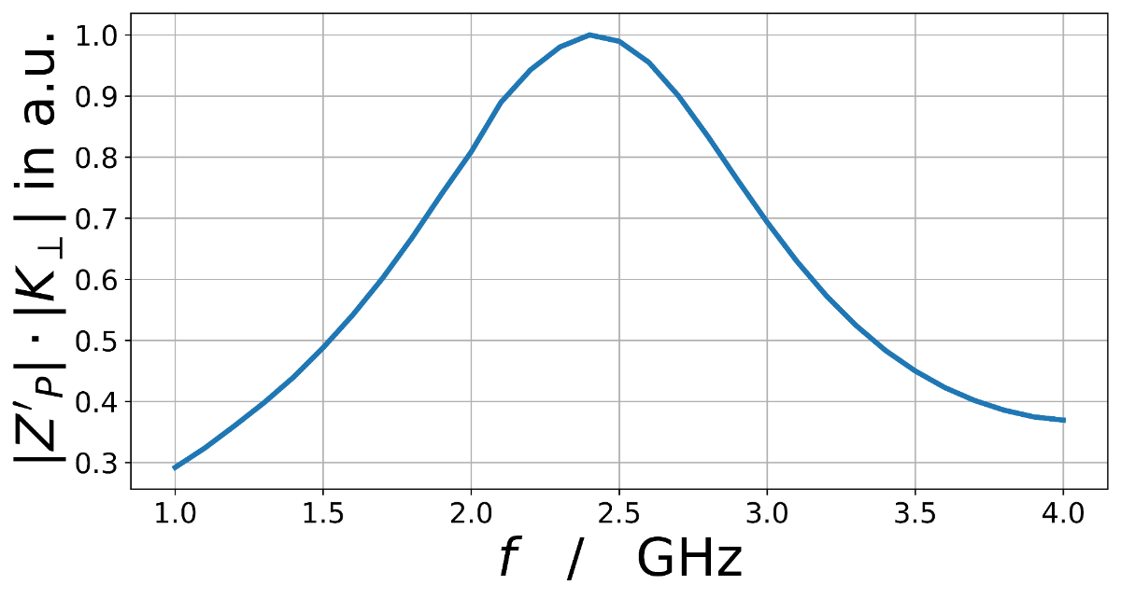
Simulation results - transverse
Transverse impedance drop roughly at the same position, despite the cut-off frequency of TE₁₁ at 1.95 GHz.
Maximum phase change: 16°.
HTF drop of about 60%.
Notes:
These are the results for the transverse case
Surprisingly, the shunt impedance is pretty close to the longitudinal one …

Slide 18
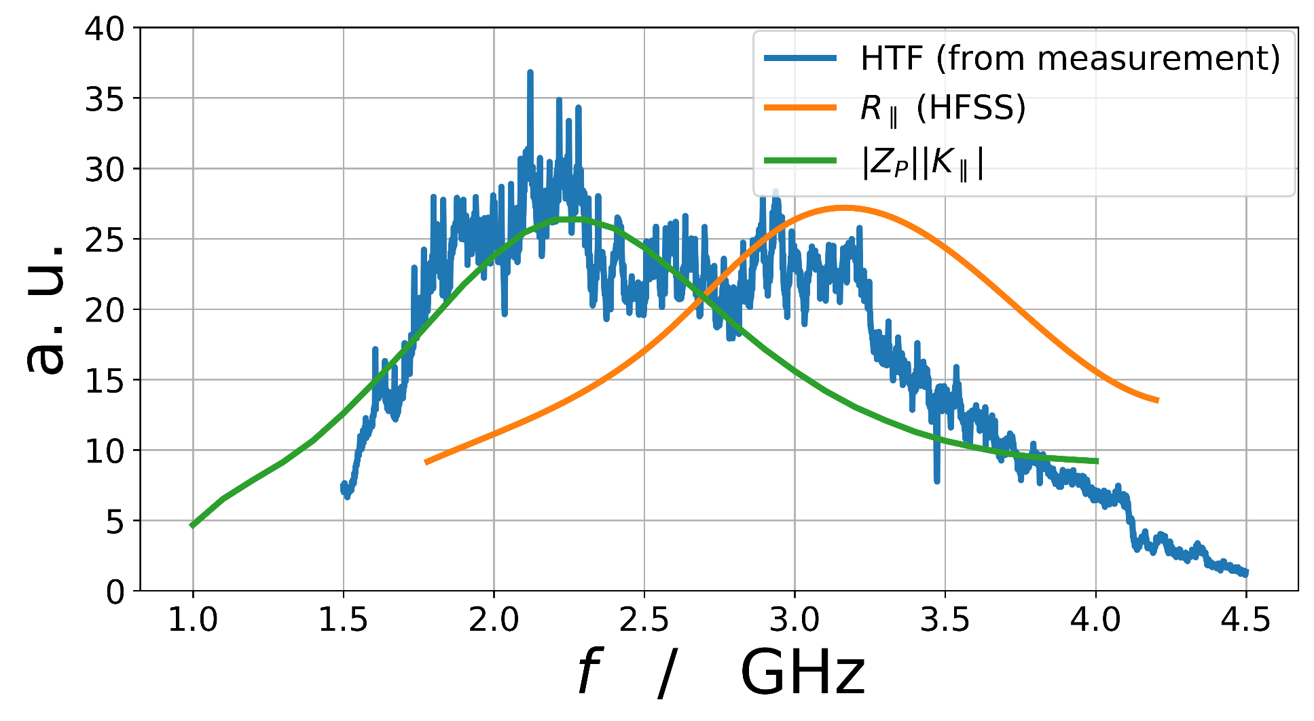
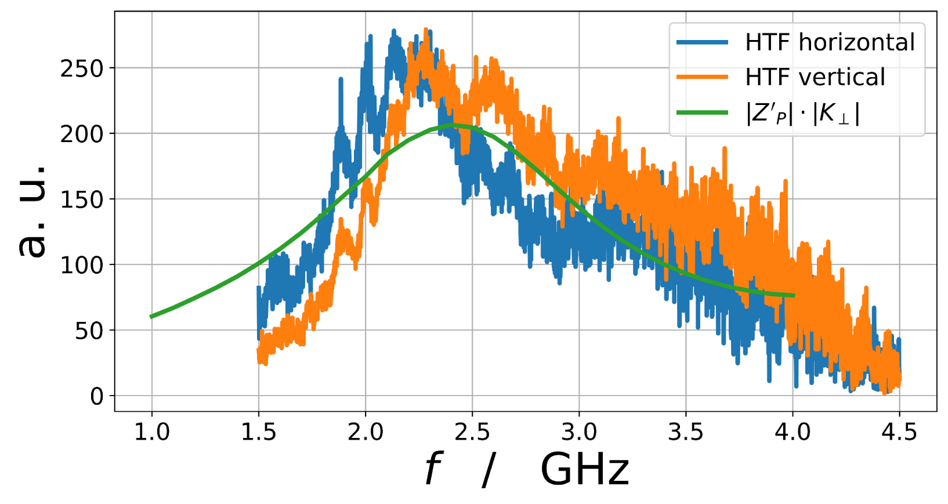
Comparison with Measurement
longitudinal
transverse
Notes:
Here we see HTF we measured at COSY
Of course it is not easy to compare since it is a collection of all effects…

Slide 19
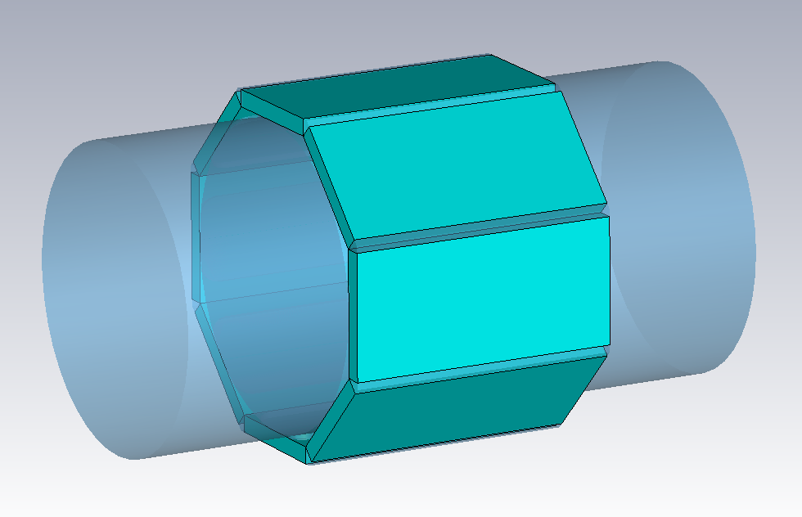
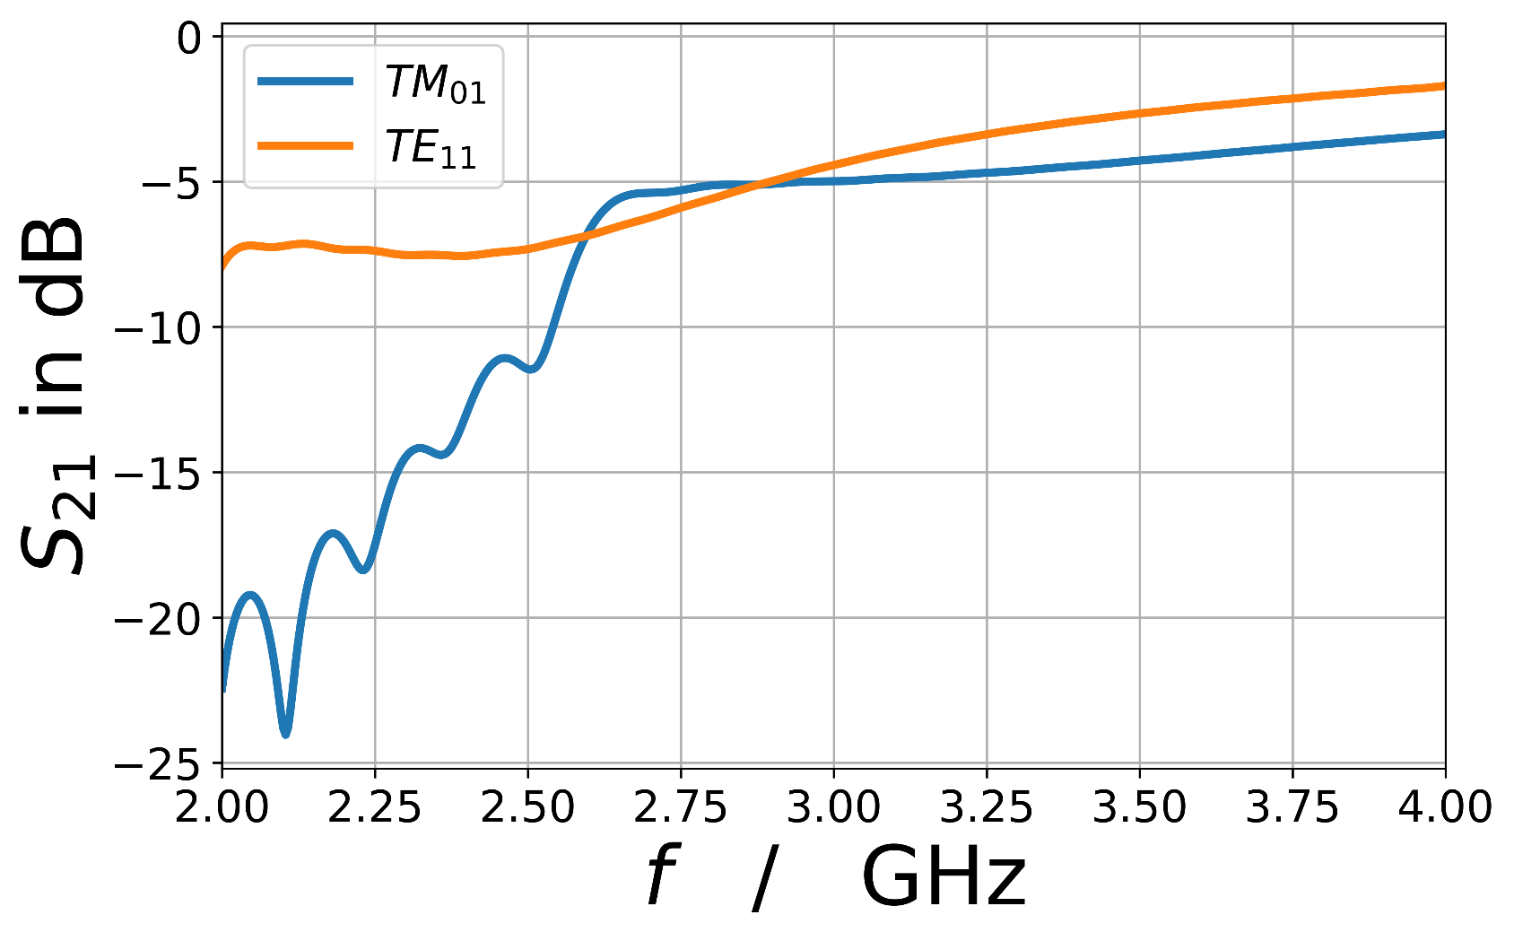
Ferrites
Material: TT2-111R
Ferrite plates with resistive coating
80 mm long, 5 mm thick
$μ′(f)$, $μ′′(f)$from Oscar Frasciello et al. “Test simulations of TT2-111R lossy dispersive material properties”
$ε=12$ from Shemelin et al. „Characterization of ferrites at low temperature and high frequency“
Damping apparently not sufficient, additional damping elements needed
Notes:
I still owe you the influence of the end-effects of the structure.
Up to now, we only had single rings in the middle of the kicker.
Both ends of the tank contain such ferrite rings…
Mu in good agreement with “C. Völlinger & F. Caspers “Material Measurement of TT2-111R” (slides from 2012)

Slide 20
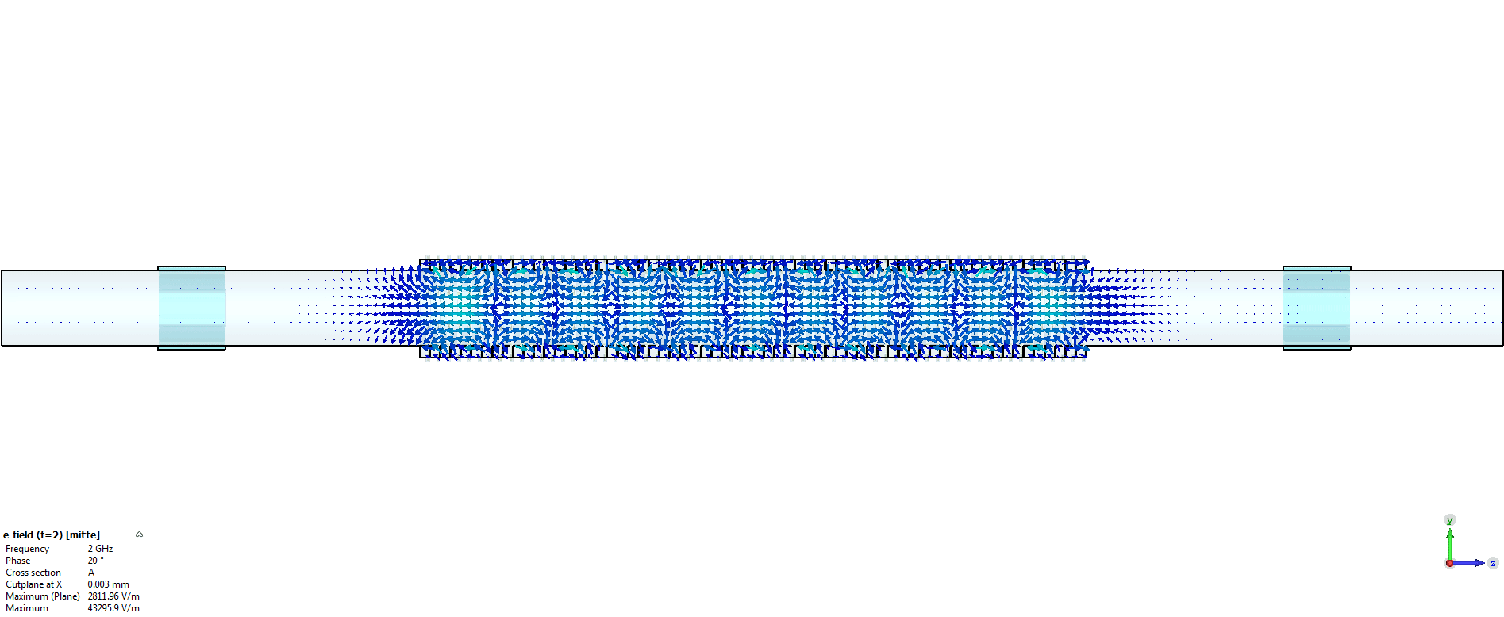
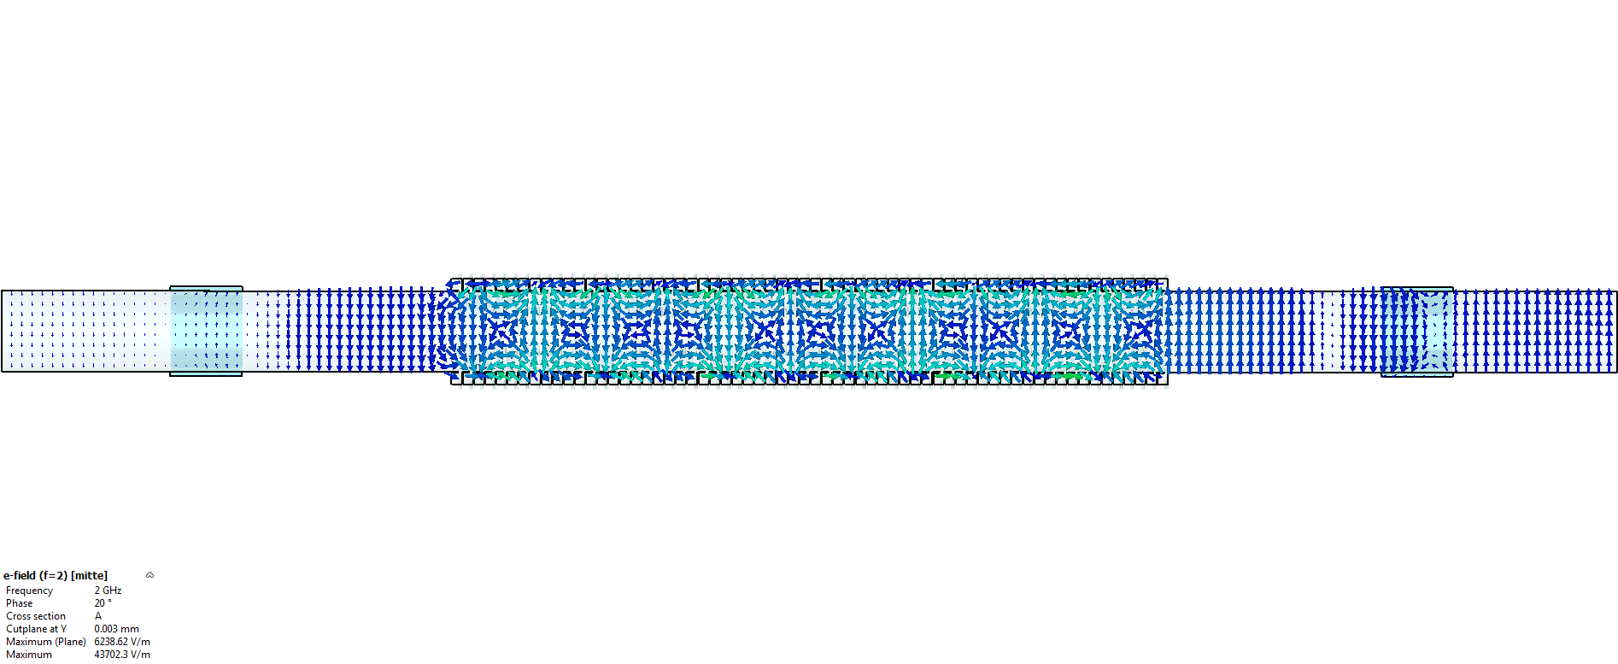
Complete HESR kicker
$\vec{E}$ at 2 GHz
Longitudinal excitation
Transverse excitation
Notes:
Here you can see what it looks like when all cells are fired.

Slide 21
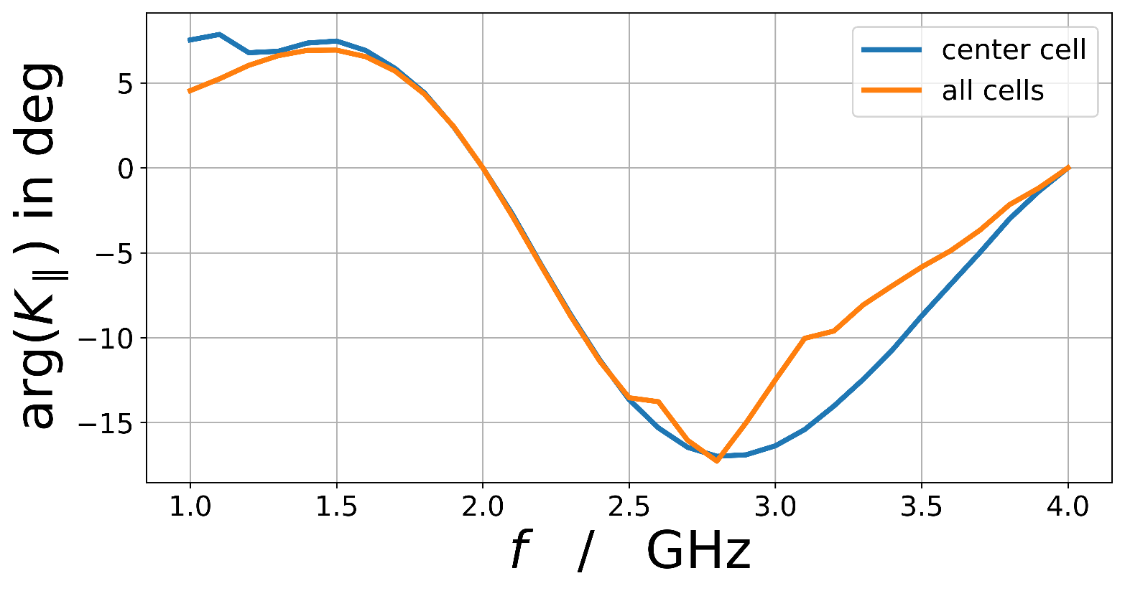
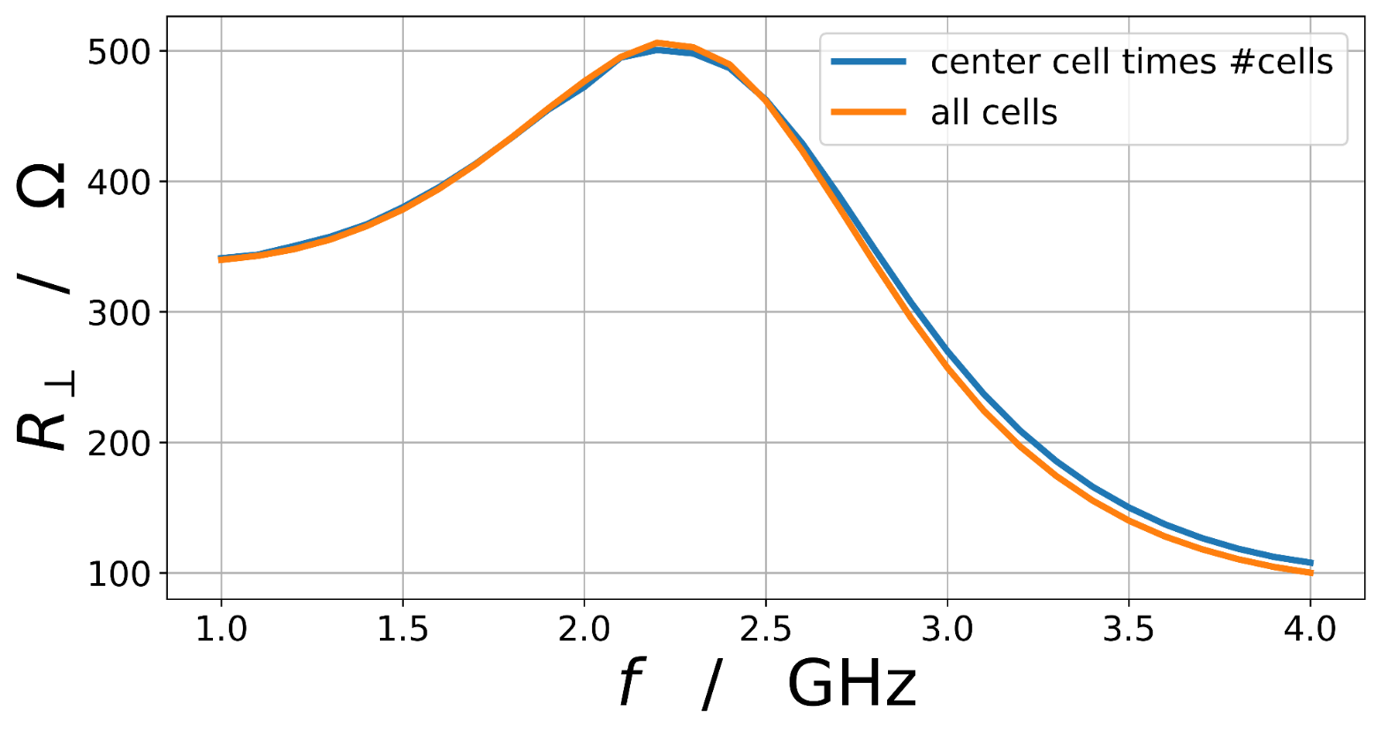
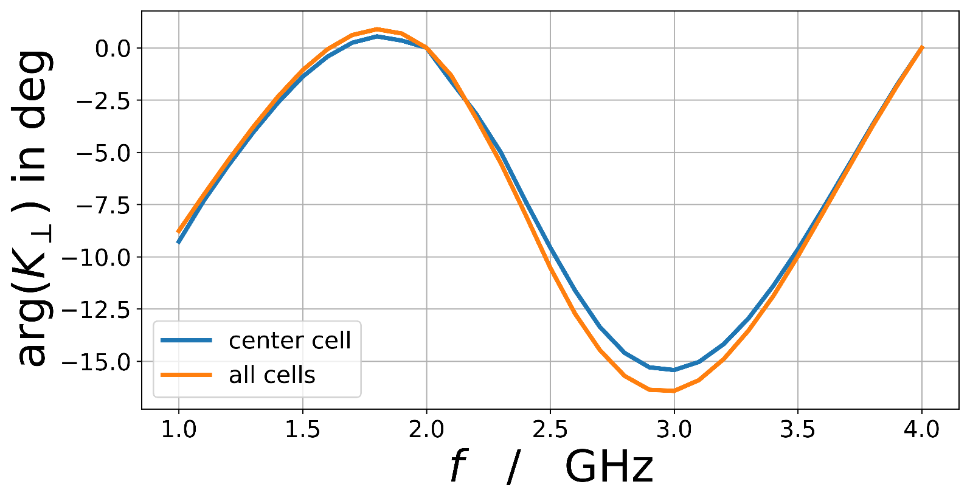
Complete structure - Performance
Notes:
This is the performance of the whole structure in comparison to 64 times a single cell
Edge cells have no big drop in performance, simulating one cell is sufficient indeed.
“Edgy” behavior is due to integration boundaries in not field free regions.

Slide 22
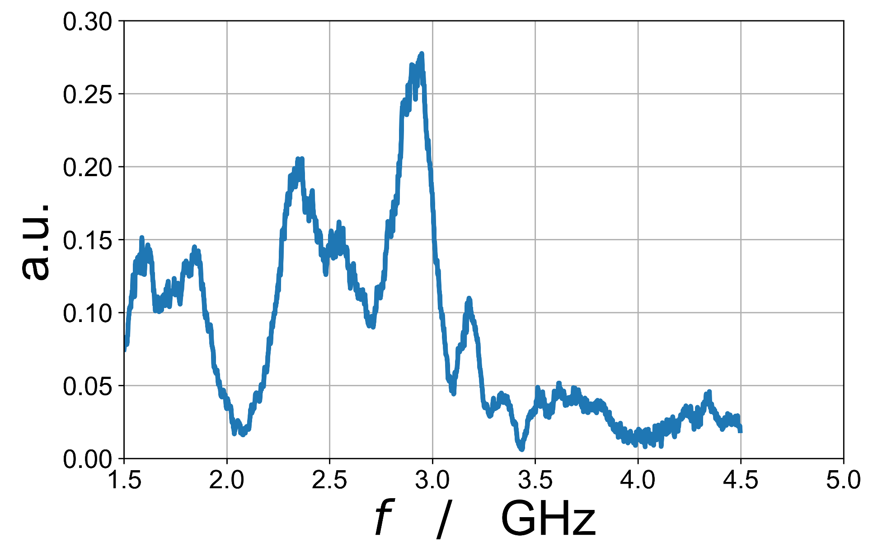
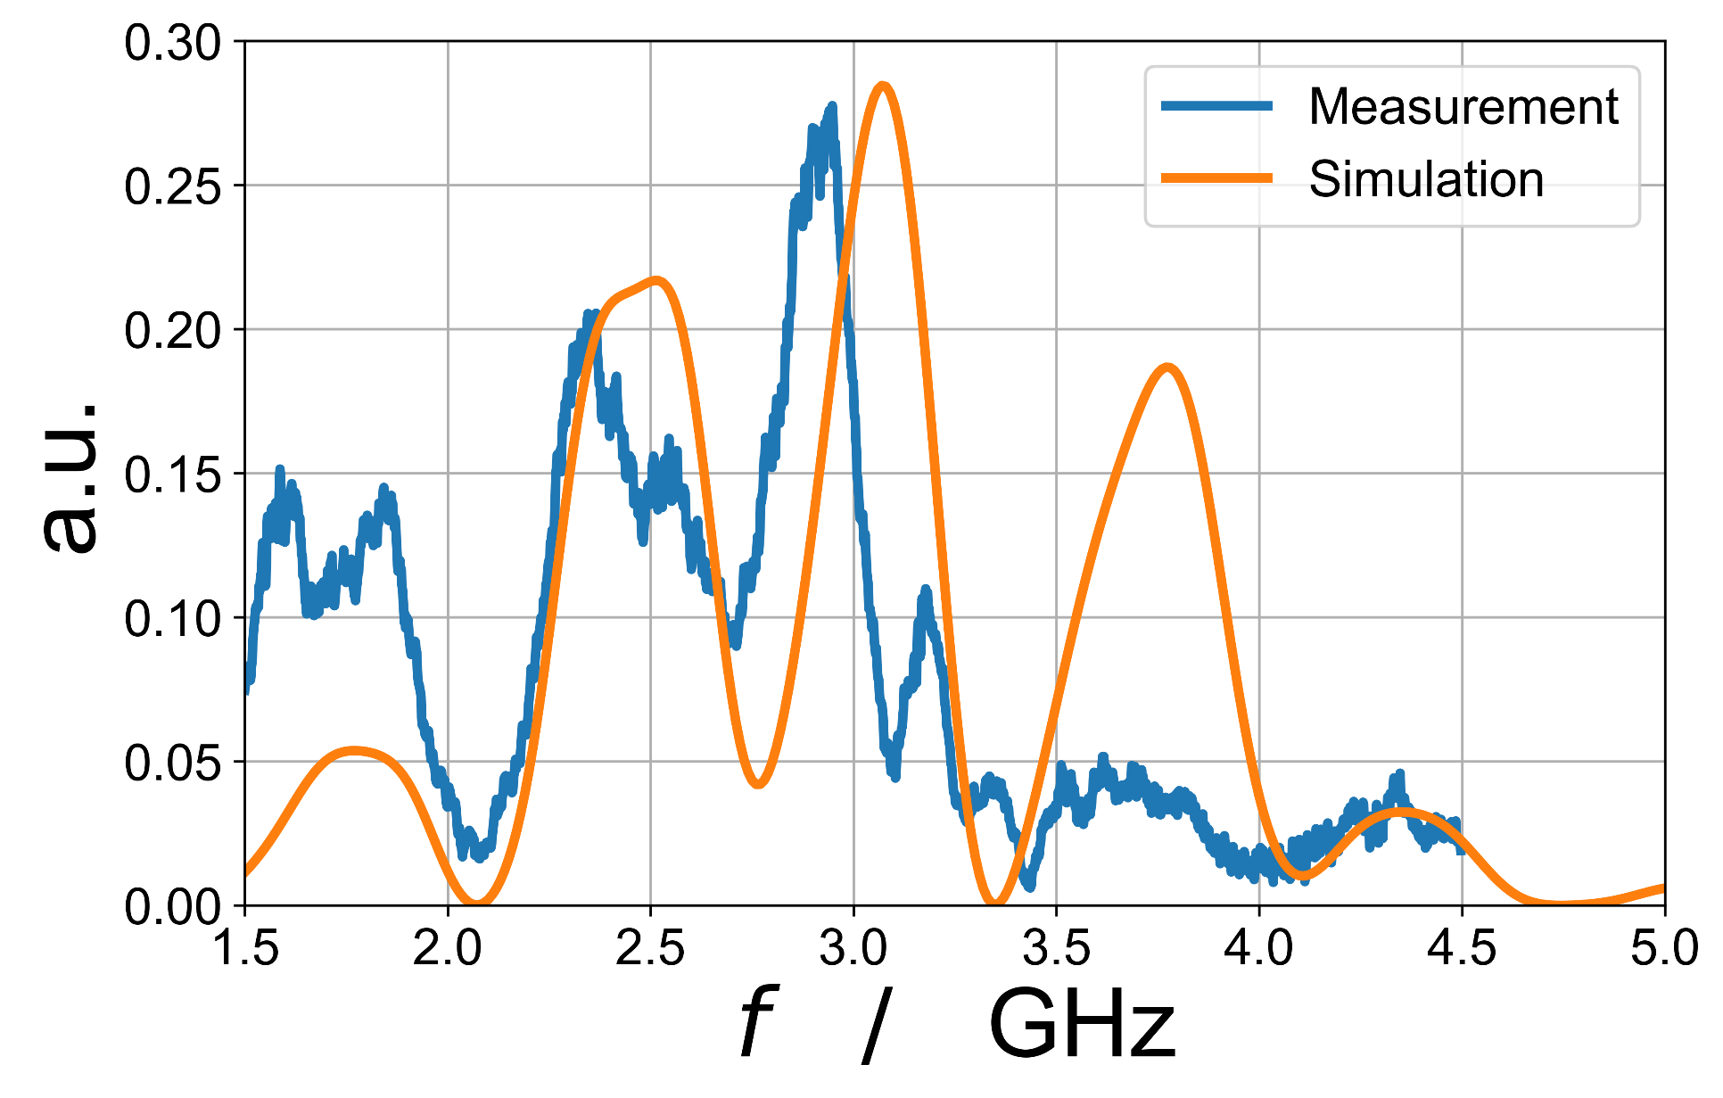
First beamtime of HESR SC @ COSY
Achieved some cooling, but not yet with the anticipated performance
HTF resembled a mountain range
Tried to reproduce the effect with EM-simulations of the whole structure with combiner-boards.
Instantly found similar patterns in the simulation.
The simulation turned out to be faulty: The beam had the wrong orientation.
It turned out that we installed the kicker the wrong way around.
Notes:
I would like to end the presentation of the HESR pickups and kickers
with an anecdote from our first beam time
with the freshly installed HESR stochastic cooling setup at COSY.
We achieved some cooling, but beyond expectations.

Slide 23
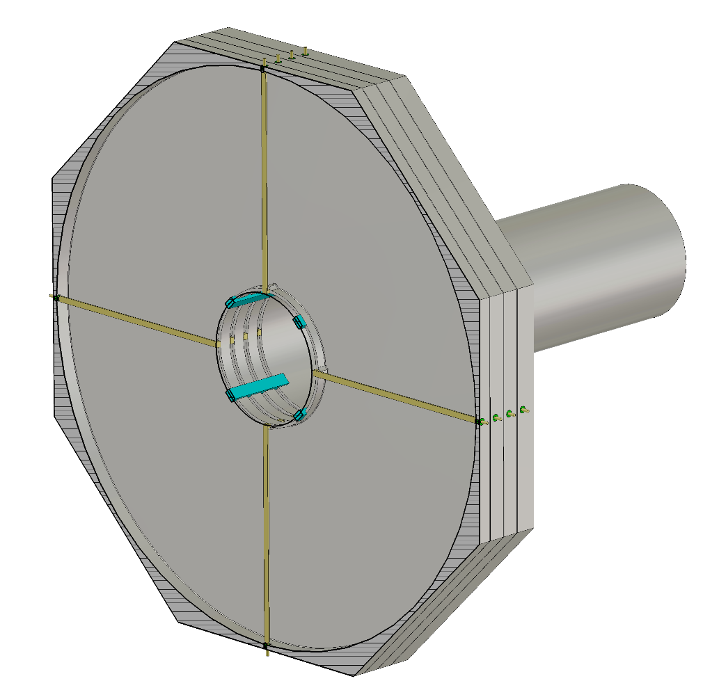
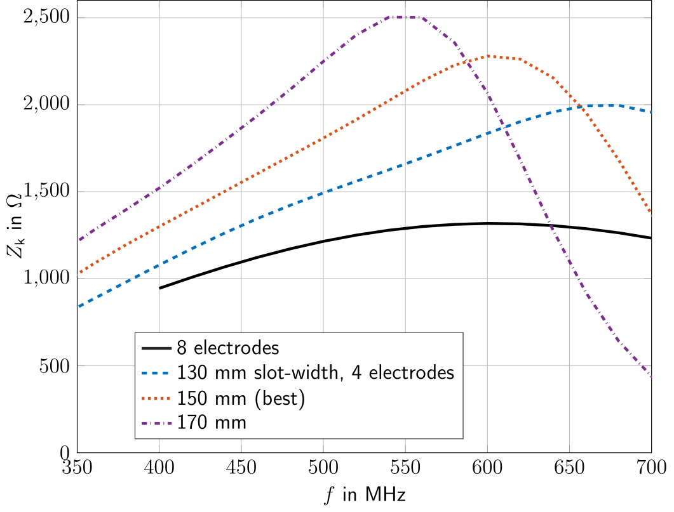
OUTlook: Low energy Cooling at COSY
Especially for 970 MeV/c deuterons (electric dipole moment investigations)
40 cm in diameter
350 to 700 MHz
Far below cut-off, no propagating modes
First prototypes will be available at February
Notes:
To finish my talk, here a short outlook
what we are planning next with such slotring sructures.

Slide 24
Thank you for your attention!
Special thanks to Rolf and Nikolay, among other things for the measurement results,
Ralf Greven for many pictures and in-depth explanations of the hardware
and Lars Thorndahl for the discussions on kicker simulations.

Slide 25
Conclusion
The measured BTF of the HFSS SC-system could be explained by field simulations of the kicker and pick-up to some extend.
Propagating waves have larger impact on the shunt impedance as anticipated. It is planned to flatten the shunt impedance with an equalizer to further improve the performance of the system.
The built-in ferrite absorbers are probably not sufficient to suppress an unwanted feedback by beam-pipe modes on HESR. Additional damping devices or mode couplers will be installed.

Slide 26
Pick-Ups and Kickers in SC
Cooling rate and equilibrium emittance depend on the sensitivity of the pick-up and kicker.
parameters of interest:
${\underline{Z}}_{P}$: pick-up impedance (terminal voltage per beam current)
${\underline{K}}_{‖}$: kicker constant (beam voltage per terminal voltage)
$R_{‖}$: kicker shunt impedance (beam voltage for a given terminal power)
${\underline{Z}}_{P}^{′}$, ${\underline{K}}_{⊥}$, $R_{⊥}$: equivalent transverse quantities (sensitive to beam displacement, apply transverse kick)
Electrically designing a KI/PU is mostly about optimizing these parameters.
$$HTF \sim {\underline{Z}}_{P}{\underline{K}}_{‖}$$
$$HTF′ \sim {\underline{Z}}_{P}^{′}{\underline{K}}_{⊥}$$
PU
${\underline{Z}}_{P}$, $R_{‖}^{P}$
${\underline{Z}}_{P}^{′}$, $R_{⊥}^{P}$
${\underline{K}}_{‖}$, $R_{‖}$
${\underline{K}}_{⊥}$, $R_{⊥}$
KI
Notes:
Lets start with what we mean by “performance” of a pickup or kicker.
ZP, K, ZK are complex, contain phase information
Rs is real-valued and the quantity to optimize, since it cannot be changed by a simple impedance transformation
Design goals:
Sufficiently large for reasonable gain and good snr
Flat
Linear phase

Slide 27
Shunt impedance - Definition
Shunt impedance of a kicker: A measure for the voltage applied to the beam for a given input power.
$$P$$
$$\vec{β}c$$
$$\underline{\vec{E}}$$
$$\underline{V}=\int{{\underline{E}}_{z}e^{i\frac{ωz}{βc}}dz}$$
$$P=\frac{1}{2}\frac{|\underline{V}|²}{R_{‖}}$$
Beam Voltage:
Shunt Impedance:
Notes:
Immutable in contrast to kicker constant (which can be simply transformed)
Thus quantity to optimze

Slide 28
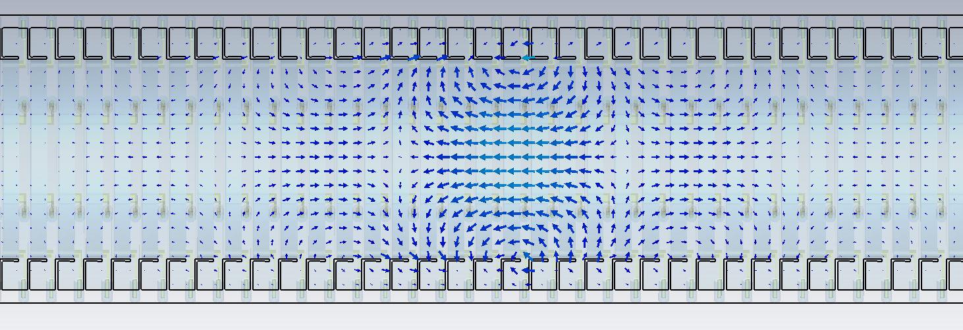
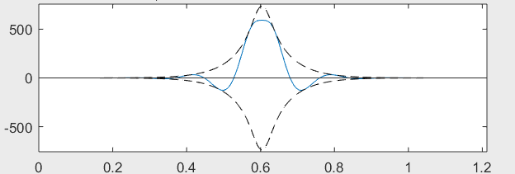
HESR KI at high frequencies
f = 3 GHz
on axis:
|E_{z}|
Re{E_{z}} at t=0

Slide 29
HESR Kicker Voltage
beta=0.92, i.e. optimum energy of HESR Combiner Board

