Slide 1

RIB Production at Super-FRS
Helmut Weick, GSI Helmholtzzentrum
Stochastic Cooling Workshop, 21st Jan. 2019
Motivation
Production Reactions and Kinematics
Rare Ion Separation
Super-FRS System
Emittance Modification
Beam Diagnostics

Slide 2
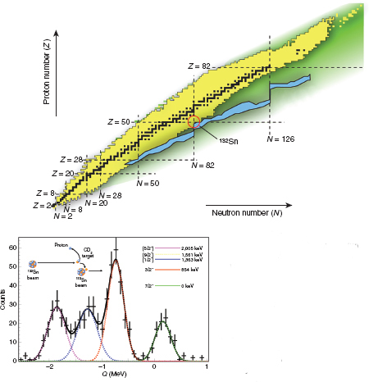
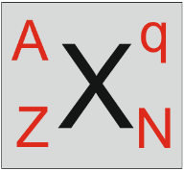

Rare Isotopes in Rings
Chart of nuclides has:
~ 2200 with τ > 1 ms
~ 1100 with τ > 1 min
some τ = 10^{n} years
➔ Lifetime long enough for
cooling and accumulation
Look at rare decays and transitions - ILIMA
When lifetime is years we need many ions in ring (e.g. ²⁰⁵Tl case)
or β-decay followed by neutron emission
(trace mother and daughter ions in ring)
Reactions with gas jet target - EXL
Luminosities of 10²⁴ – 10²⁸ /(cm². s) require 10⁵ – 10⁹ cooled ions in ring
Collider with electrons - ELISe

Slide 3
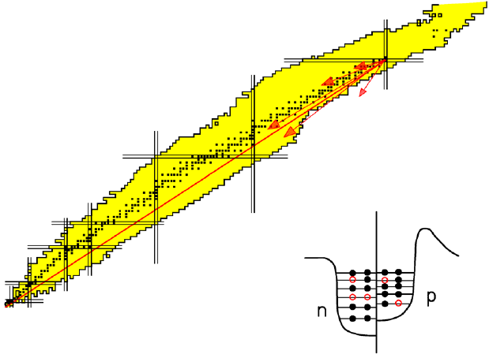
How to produce Rare Isotopes ?
Fragmentation
Removal of nucleons in quasi-free nucleon-nucleon collisions
protons (Z)
neutrons (N)

Slide 4
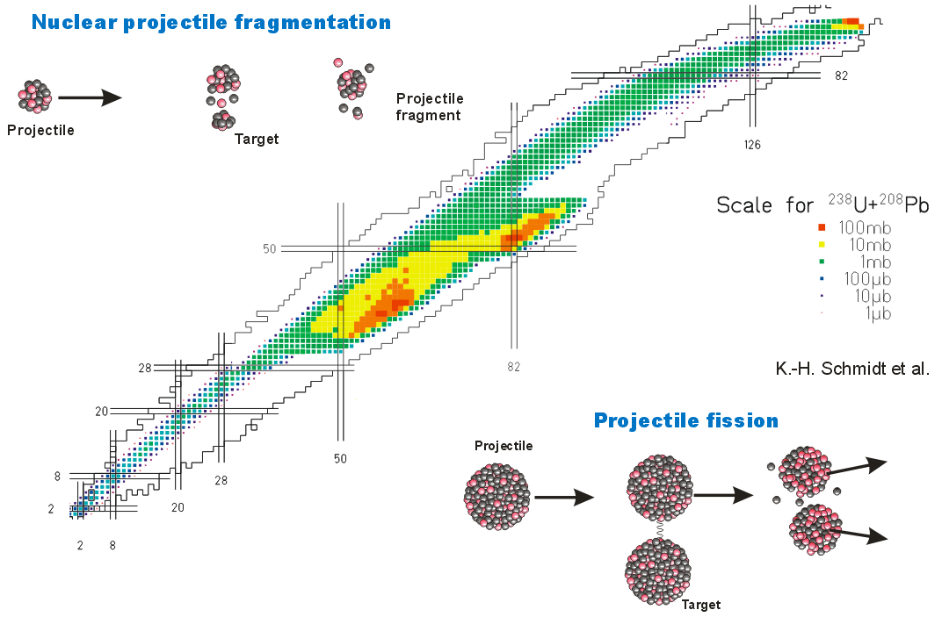
Distribution of Fragments
at 1 GeV/u
Uranium on Pb target
Z
N

Slide 5
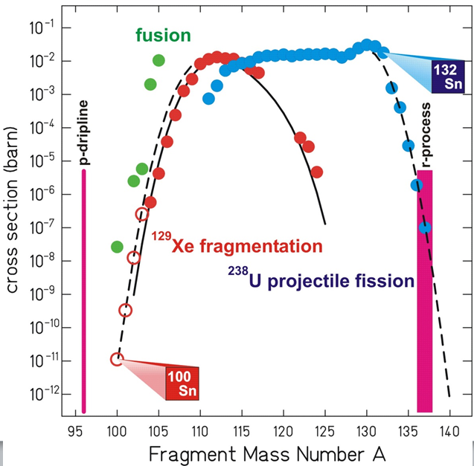
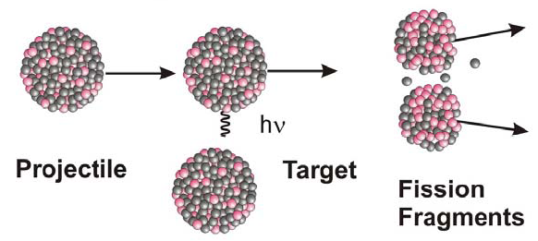
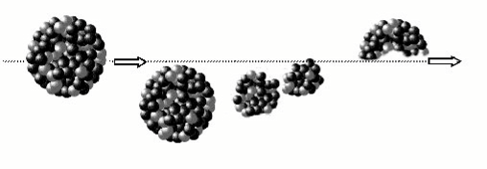
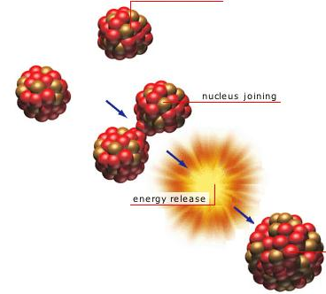
Production Cross sections
Projectile fission
Tin isotopes by different methods
²³⁸U
Projectile fragmentation
Projectile ¹²⁹Xe
Main Fragment
Target
Fusion (only at lower velocity)

Slide 6
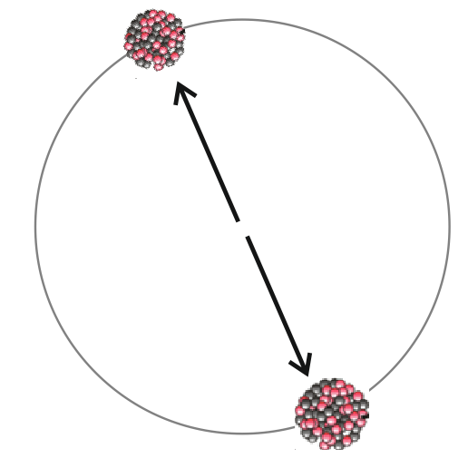
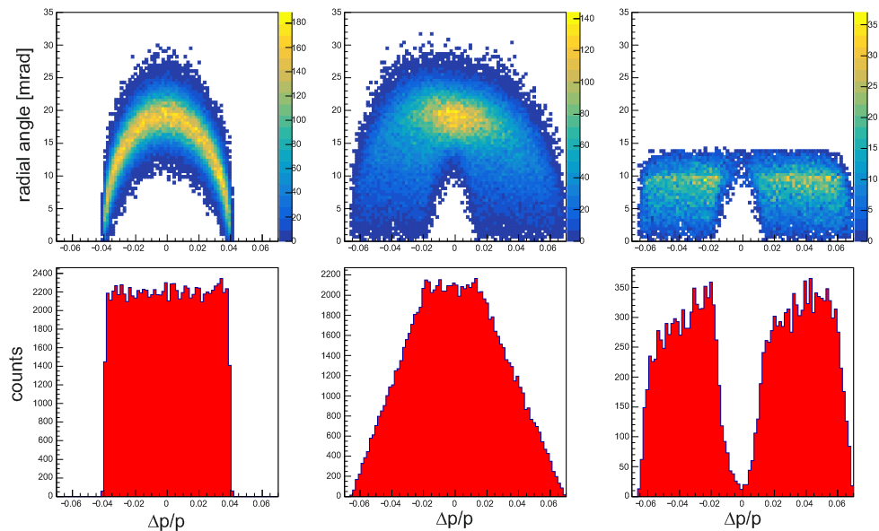
Fission Kinematics
in
CoM:
200 MeV
in Uranium fission ~200 MeV are released
with thick target
with angular acceptance
in Lab:
¹³²Sn from
²³⁸U beam
at 1 GeV/u
|θ| < 10 mrad
MOCADI
simulation

Slide 7

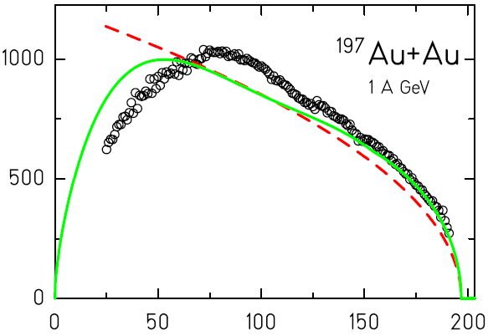



Momentum Distribution in Fragmentation Reaction
Fermi momentum of bound nucleons
Mom. transfer by evaporated nucleons
Coulomb expansion in multi fragment.
Bacquias’ model
Experiment FRS@GSI
Morrissey
A. Bacquias, Phys.Rev.C 85, 024904 (2012)
exp. data V. Henzl, thesis 2005, U. Prague

Slide 8
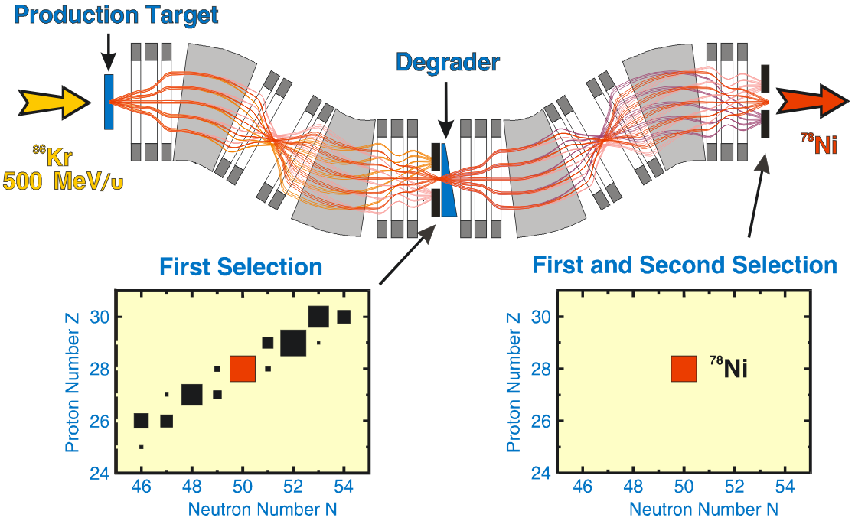

Bρ-ΔE-Bρ Separation Method
scheme of FRS @ GSI, L=72m
ΔE Z²
⁷⁸Ni

Slide 9
Bρ-ΔE-Bρ Separation Method
Overall achromatic system,
keep achromatic with
shaped degrader.
Δp/p₁ = Δp/p₂
with p₁ > p₂ → cooling ?
Non-Liouvillean system.
Coupling of longitudinal and transverse emittance,
Δp → Δp / f (f>1), but ε_{x} → ε_{x} * f
In addition angular and energy-loss straggling.
⁷⁸Ni

Slide 10
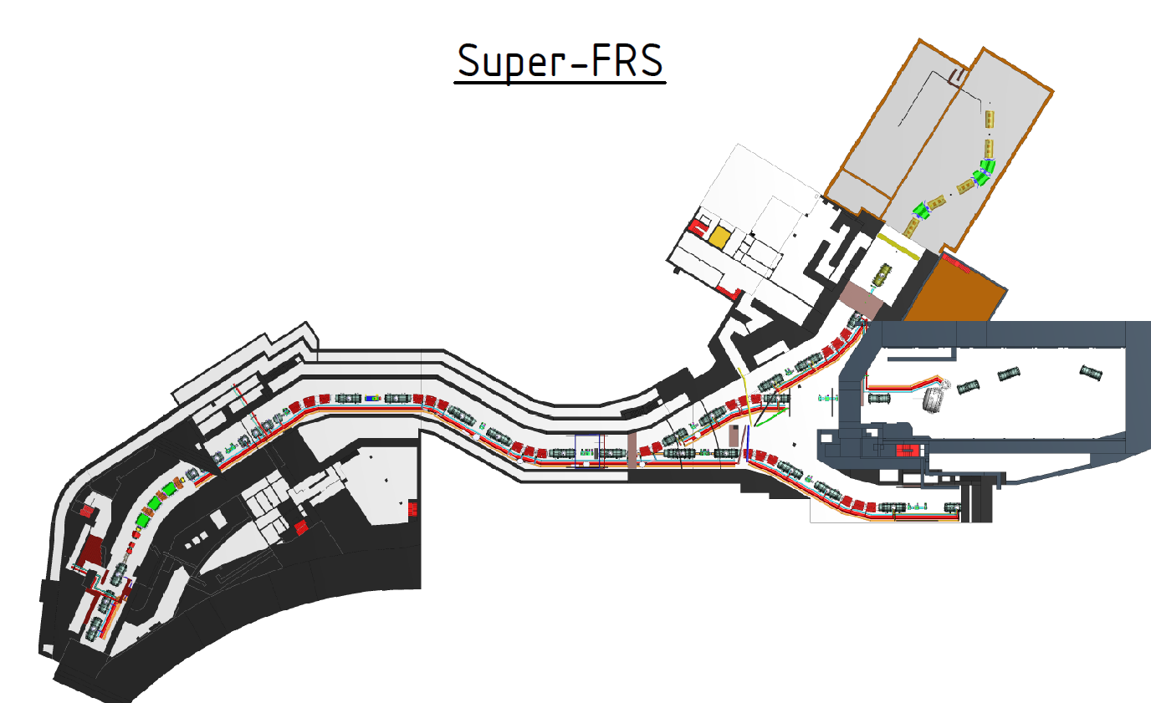
Super-FRS
beam spot on target
~ 1 – 20 mm²
initial acceptance:
ΔA = ± 40 mrad
ΔB = ± 20 mrad
Δp/p = ± 2.5%
after thick shaped degraders
ΔA, ΔB ~ 20 mrad, Δp/p = ±2.5%
but ε_{x,y} ~ 100-300 mm mrad
Bρ_{max} = 20 Tm
Bρ_{min} = 2 Tm
740 MeV/u
to CR
max. 1x10⁸/spill
target
degrader
Bρ_{max} = 13 Tm
Bρ_{min} ~ 9 Tm
²³⁸U²⁸⁺ 0.8 - 2 GeV/u

Slide 11
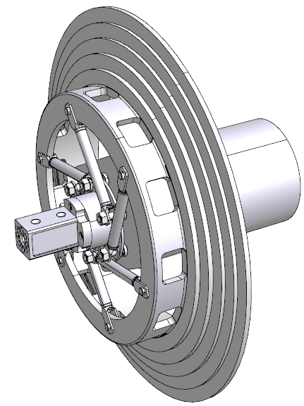
Super-Conducting Magnets
+ High intensity Target
8 short + 25 long multiplets
(triplets + sextupoles and octupoles)
Graphite target wheel
energy deposited in 50-100 ns.
first short ready, last installed 2024
r_{aperture} = 19 cm
d=0.45m
7 m
5x10¹¹ U/s on 1 cm²
--> E/m = 1.4 kJ/g
Most materials melt, or
thermal stress damage,
mm² spot not possible
≈60 ton
SC-dipoles divided
into 3 parts -> 30
2.4 m

Slide 12
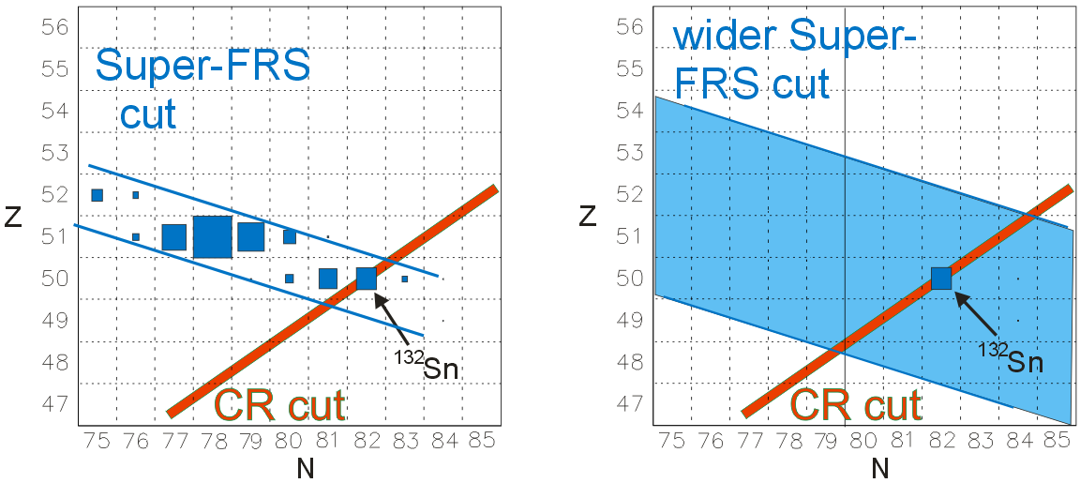
Separation in Storage Rings
Worst case fission: No pure isotopes
even with small beam spot at the target.
With large spot even more nuclides
After cooling only |Δ(m/q)| < 10⁻³ should survive,
combined with cut by Super-FRS good separation.
Problems only for low integer ratios, like m/q = 2 or 2.5

Slide 13
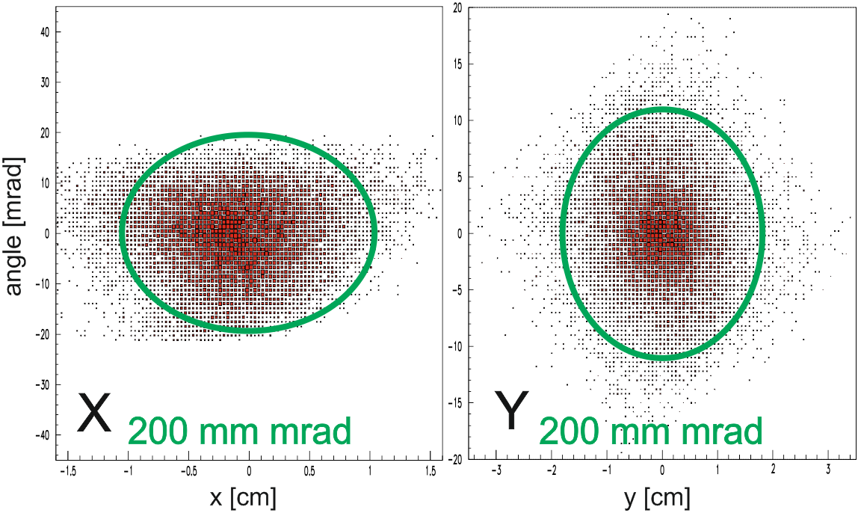
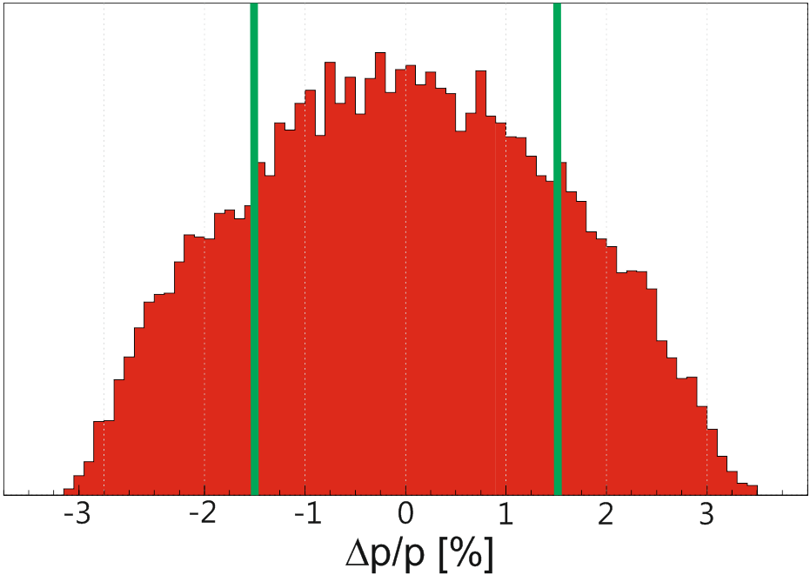
Emittance
Depends on:
initial spot size
target thickness
nuclear reaction
degrader thickness
Here 1.5 GeV/u 238U on
4 g/cm² C target, fission to
¹³²Sn with 740 MeV/u
at exit of Super-FRS.
Too large momentum spread
can be cut with slits in
dispersive focal plane of
Super-FRS.
Δp/p [%] = x at FMF2 [cm] / 5.8 cm/%

Slide 14
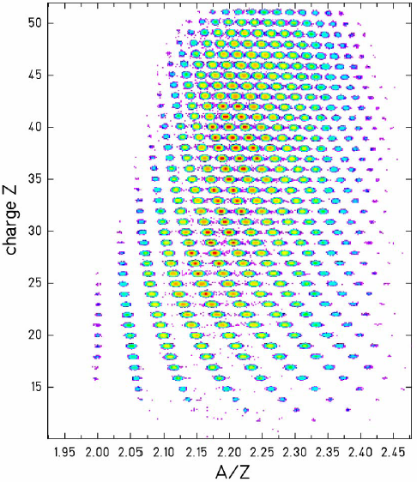
Identification In-Flight
Bρ = m/q βγ c₀
Bρ from magnet setting and
position detectors at dispersive
focal planes (e.g. TPCs, MWPCs).
Velocity (βγ) from ToF over
larger distance (20-100 m)
mostly by plastic scintillators
Z from ΔE in
ionization chamber
²³⁸U on H target, FRS@GSI
But only with quasi DC beam !
= m [amu] / q [e]
thesis V. Henzl, CTU Prague 2005.

Slide 15
Diagnostics for RIBs
Super-FRS has particle detectors for full A, Z identification
(ionization chambers for ΔE, x position x, ToF -> velocity)
of each ion at rates up to MHz --> not useful for fast extraction.
Adjust separation with slowly extracted beam, afterwards only
beam profiles (sometimes with intense peaks for guidance).
Go in steps from stable beam to extreme RIBs.
Use Schottky diagnostics in CR (resonant Schottky by ILIMA).
Resolution only after cooling, only as good as cooling.
Mass number identification requires Δv/v < 10⁻³.
Fine differences to identify also within isobars require Δv/v < 10⁻⁵,
only possible in isochronous mode (uncooled).
No electron cooler, also not in HESR for beginning.

Slide 16
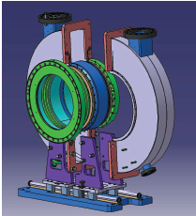
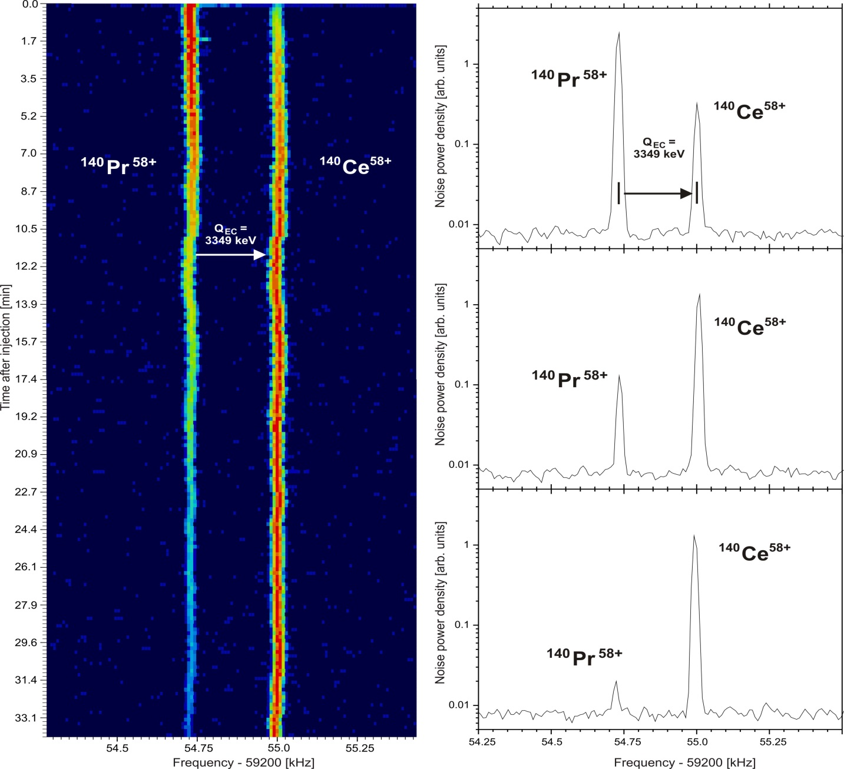
Schottky Diagnostics in the Ring
Measure revolution
frequency from noise
of pick-up.
Very sensitive down to
single ions.
Example from ESR at GSI
(electron cooled beam)
relative mass difference
Δm/m = 2.6x10⁻⁵
Intensity changes with time
because of EC decay of
¹⁴⁰Pr into ¹⁴⁰Ce.
time after injection [min]

Slide 17
Summary
RIBs are an essential part of FAIR physics program,
some experiments with cooled beam directly in CR others in HESR.
Primary beam 5x10¹¹/spill → fragmentation or fission in flight,
production rates for cooling in range: 1000 – 10⁸ /spill,
for many experiments accumulation will be needed.
Emittance at end of Super-FRS depends on case (100-300 mm mrad),
good Bρ collimation possible.
Separation by Super-FRS not sufficient due to large Δp/p of fragments,
worse than for slow extraction due to enlarged beam spot on target.
RI beam can contain ions with different Δ(m/q) up to few %.
Intensity ratio can be up to 1:10 in favor of others.
→ Separation during cooling or with scrapers after cooling can help.

Slide 18

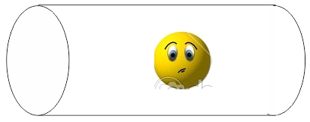
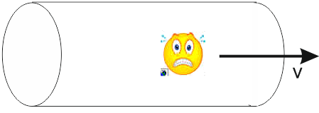

The fate of accelerated ions
Yeah, I am an
accelerated ion.
By the way, what
do you do with accelerated ions?
Aaarrgh !

Slide 19
Emittance Growth with Targets
Interaction with Matter (Targets)
Momentum transfer by reaction in target increases transverse momentum spread,
but in a thin target x does not change much.
p_{x}
α
p_{z}
p_{z}
primary particle
secondary particle
Make small beam spot to avoid large emittance for secondary beam
tan(α) =p_{x/}p_{z}
tan(α)
x
x

Slide 20

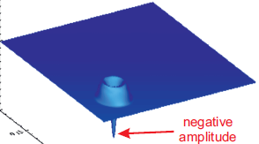

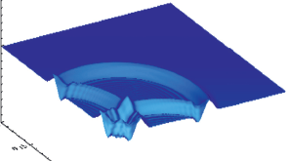

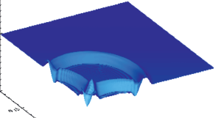
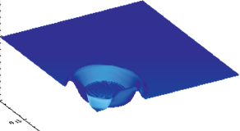
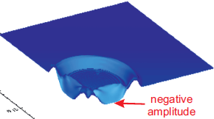
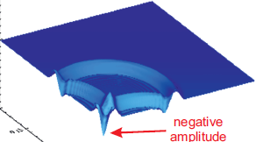
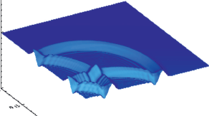




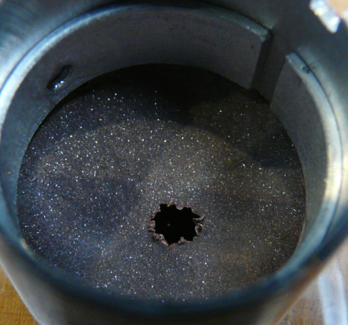
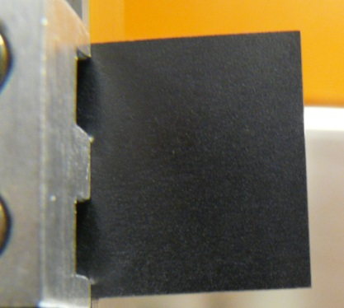
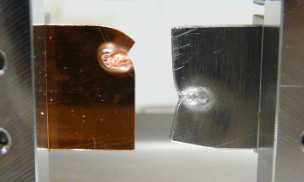
Limits by Targets
Simple temperature and stress calculation
Instantaneous energy deposition
pressure
melting?
Initial compressive pressure P, wave propagates
(v_{sound}) to target boundary → tensile stress.
P > spall strength, plastic deformation, P > yield strength ?
not exactly elastic, cyclic stress, cracks ?
Cu diamond
Example (FRS at GSI):
10¹⁰ U/spill at 125 MeV/u on 1mm² spot,
→ dQ/dm = 2 kJ/g, ΔT = 4000 K (in Cu)
1mm thick plates
Cu
Al
graphite
Super-FRS at FAIR 5x10¹¹ U ions/spill
use graphite, but requires enlarged spot.
20mm

Slide 21
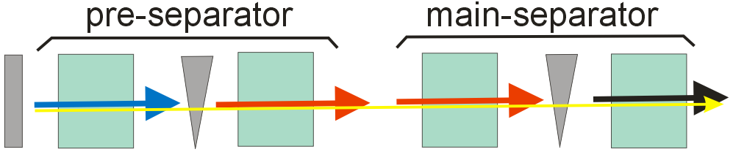
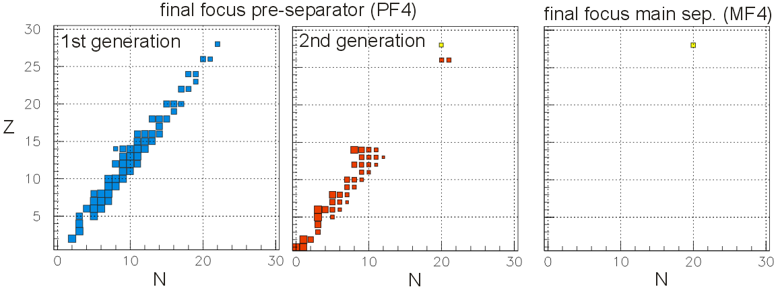
Two-Stage Separation
Problem: contamination from reactions in degrader
Example: ⁴⁸Ni from ⁵⁸Ni primary beam with two thick degraders (d/R=0.5)
Solution: two degrader stages.
2x10⁷/s at
10¹²/s primary
Simple analytical transmission program verified by
MOCADI simulation with 1400 input files and 5*10⁸ ions.

Slide 22
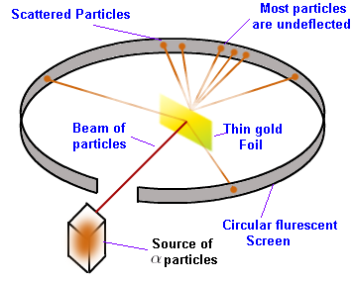
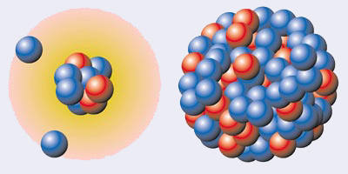
Why ?
Reactions with Rare Isotopes
Proton scattering is a technique to learn about matter distribution.
Like once Rutherford with α particles on gold foil,
with ~ 1 GeV proton beam on target made of material of interest.
Extremes of matter distribution inside nuclei
¹¹Li ²⁰⁸Pb
Shape of nucleus follows from
shape of scattering distribution.
Not possible for short lived radioactive nuclides.
➔ Reverse role of target and beam, shoot RIB on hydrogen target.
A very clean way and sensitive way is inside a storage ring.

Slide 23
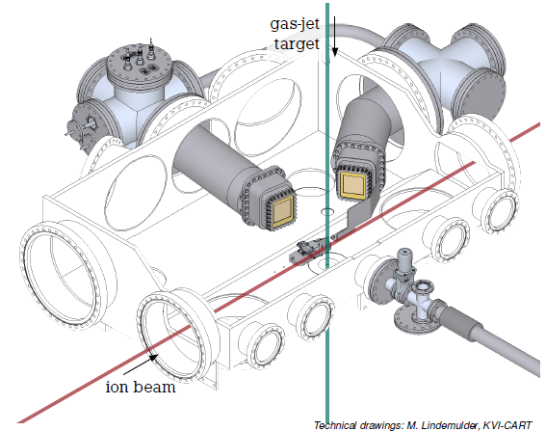
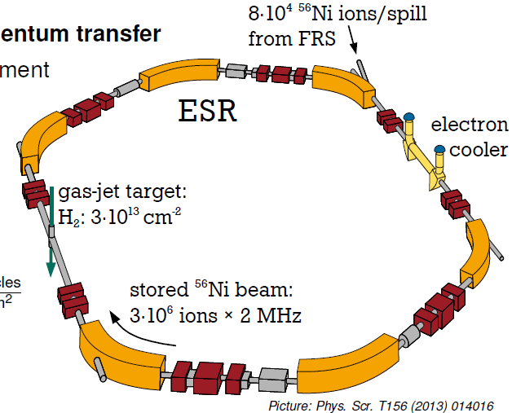

Scattering of RIB on Hydrogen Target
measure position and energy with Si detectors

Slide 24
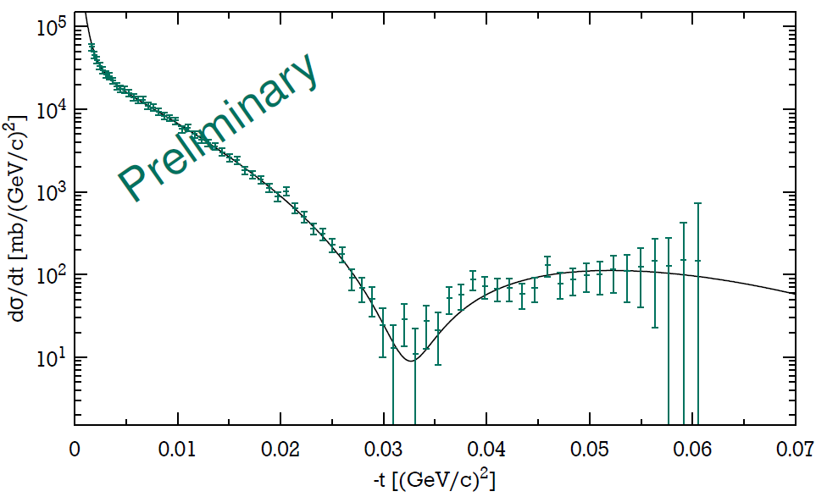
⁵⁶Ni(p,p) scattering distribution
Diffraction Pattern (like for a wave after a single slit).
Extract radius of nucleus by fitting theory with parameters.
→ RMS radius of ⁵⁶Ni = 3.76 ± 0.08 fm
EXL collaboration, first such investigation for RIBs.
Physica Scripta T116 (2015) 014005.

Slide 25
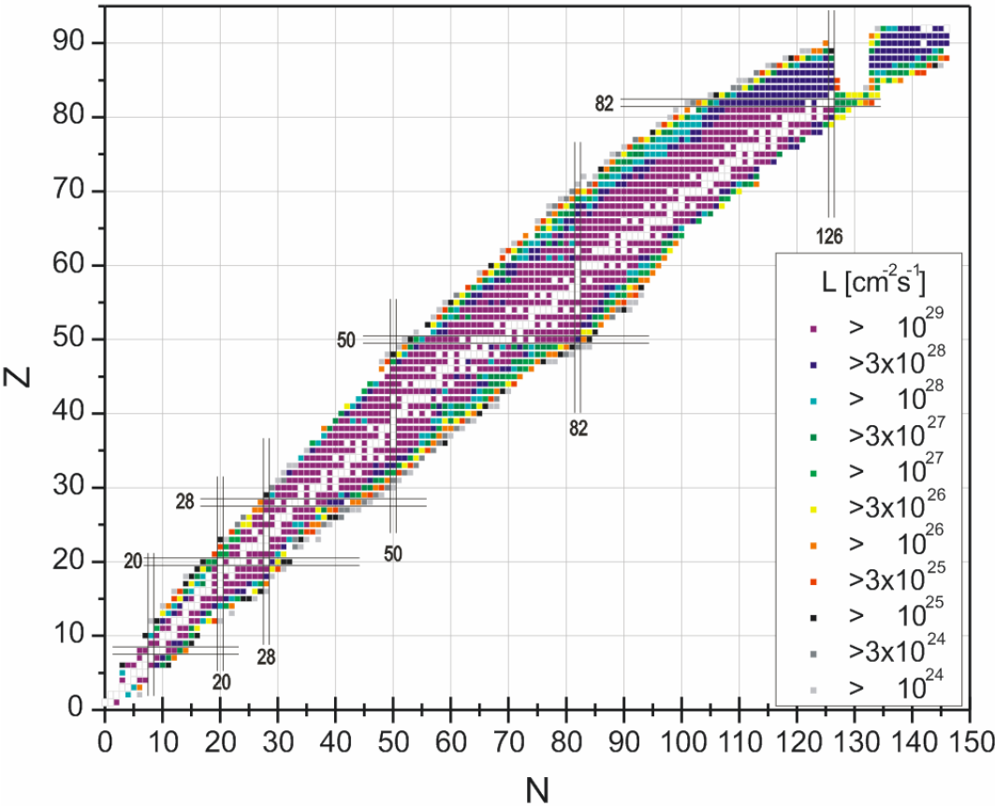
Luminosity with gas jet target
EXL technical proposal 2008

