Slide 1
The Collector Ring @ FAIR
Oleksii Gorda
21 January 2019
GSI/FAIR Workshop on Stochastic Cooling

Slide 2
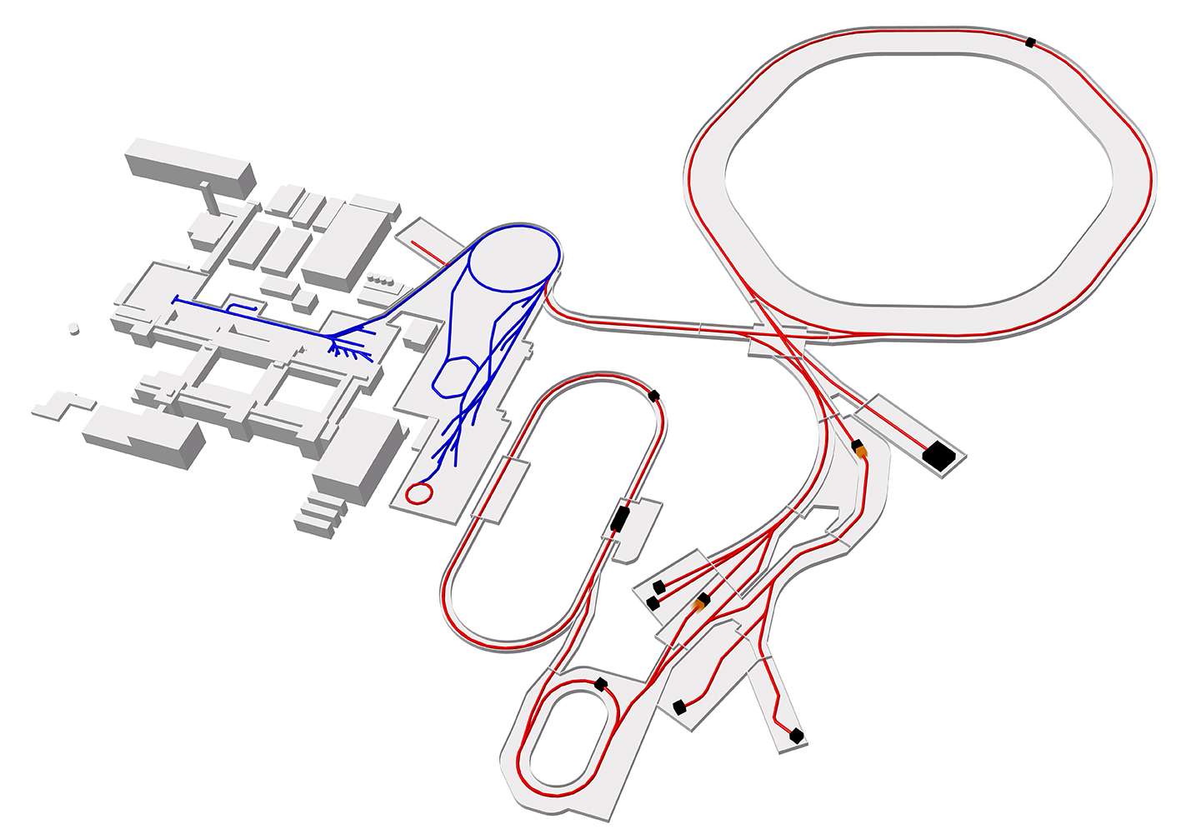

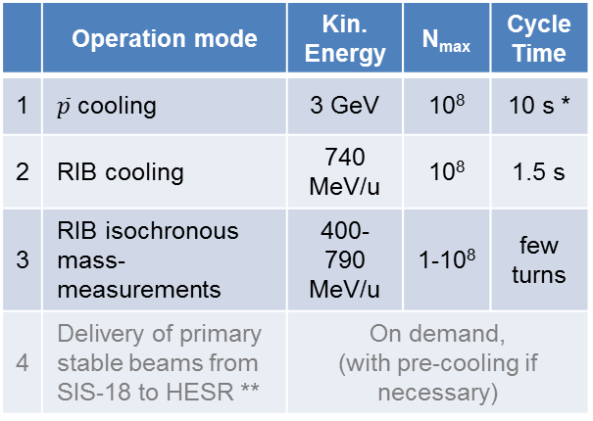
Tasks of the Collector Ring (CR)
SIS-100
SIS-18
 | Operation mode | Kin. Energy | N_{max} | Cycle Time
1 | $\overline{p}$ cooling | 3 GeV | 10⁸ | 10 s *
2 | RIB cooling | 740 MeV/u | 10⁸ | 1.5 s
3 | RIB isochronous mass-measurements | 400-790 MeV/u | 1-10⁸ | few turns
4 | Delivery of primary stable beams from SIS-18 to HESR ** | On demand, (with pre-cooling if necessary)
HESR
Rare Isotope
Beam (RIB)
production target
extraction to HESR *
extraction to HESR *
Antiproton
production
target
CR
in-ring
extraction to HESR **
Existing facilities
Planned facilities
* within the Modularized Start Version (MSV) of the FAIR project
** option presently under consideration

Slide 3
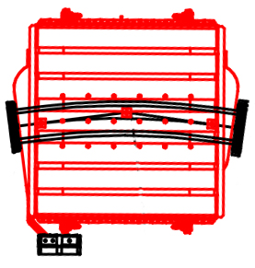
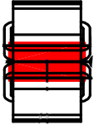
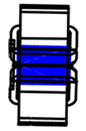


CR general overview
Antiprotons
ε_{x,y} = 240 mm mrad
δp/p = ± 3%
Designed specially for stochastic cooling of antiproton or rare isotope beams
Flexibility in ion-optical settings for the different operation modes essential
Large transverse/momentum acceptance to accommodate hot beams coming directly from separators
Bunch rotation by the RF-system to reduce the momentum spread prior to stochastic cooling
Matching of the beam parameters between CR and HESR
from $\overline{p}$-separator
from Super-FRS
RIBs
ε_{x,y} = 200 mm mrad
δp/p = ± 1.5%
to HESR
Dipole
Quadrupole
Sextupole
Circumference 221.45 m
Max. magnetic rigidity 13 Tm

Slide 4
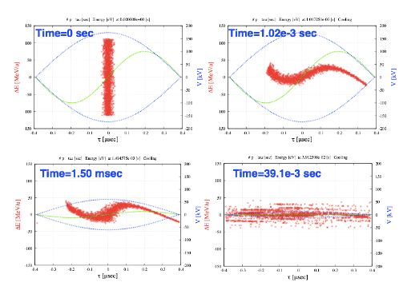
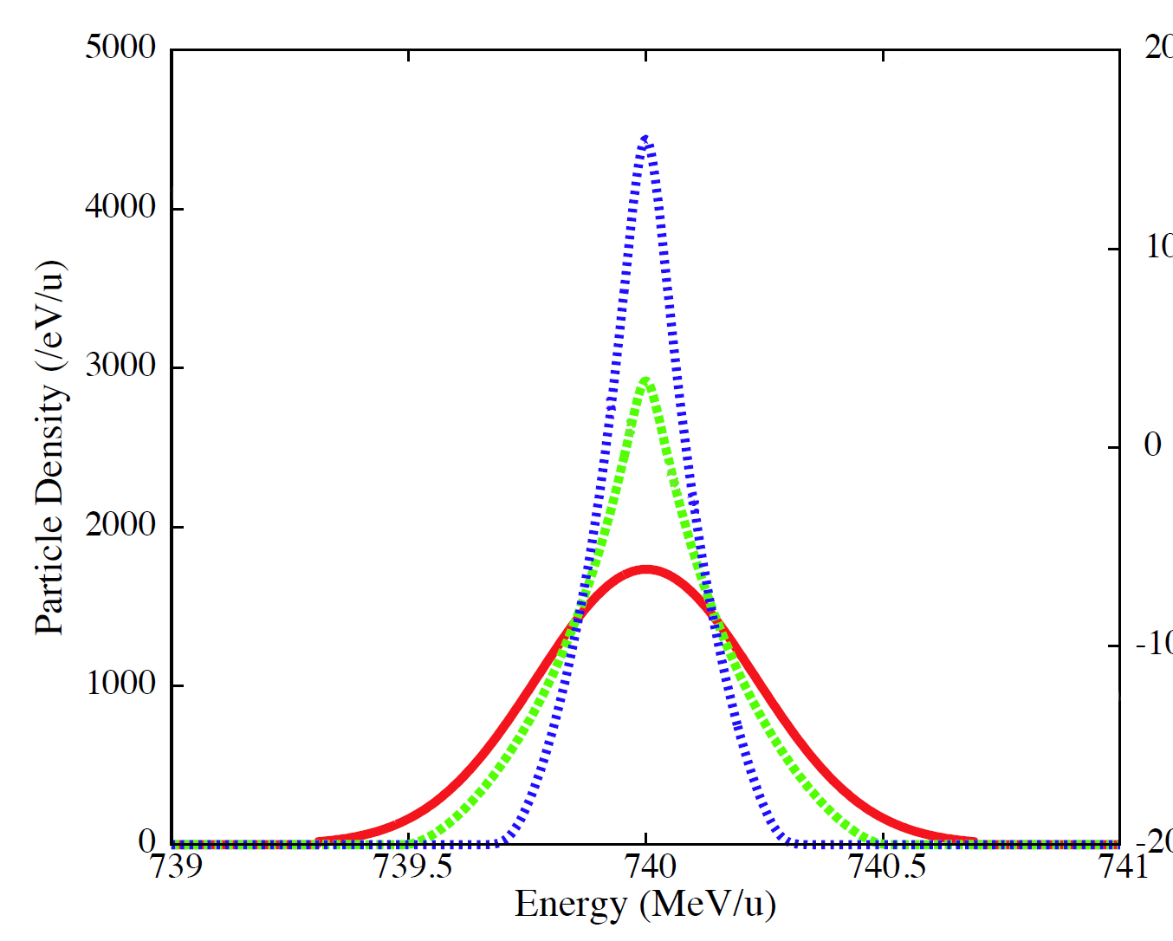
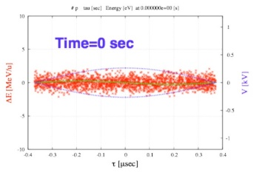
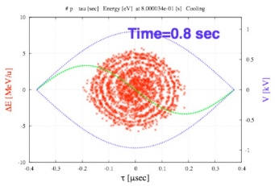
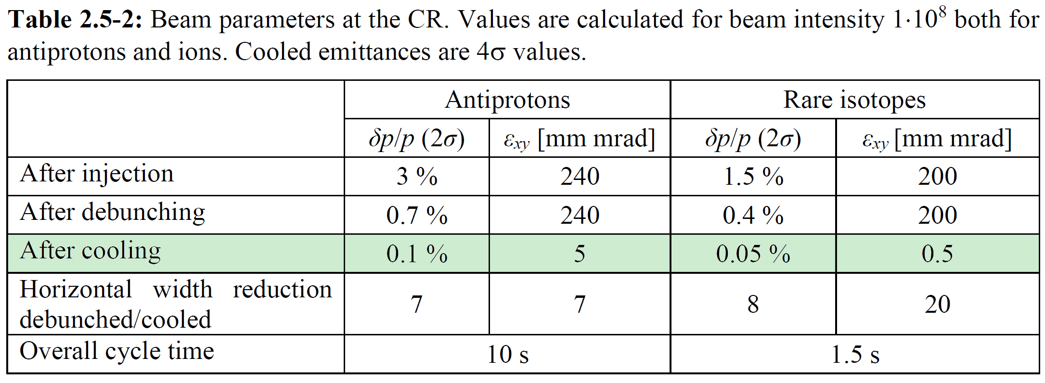
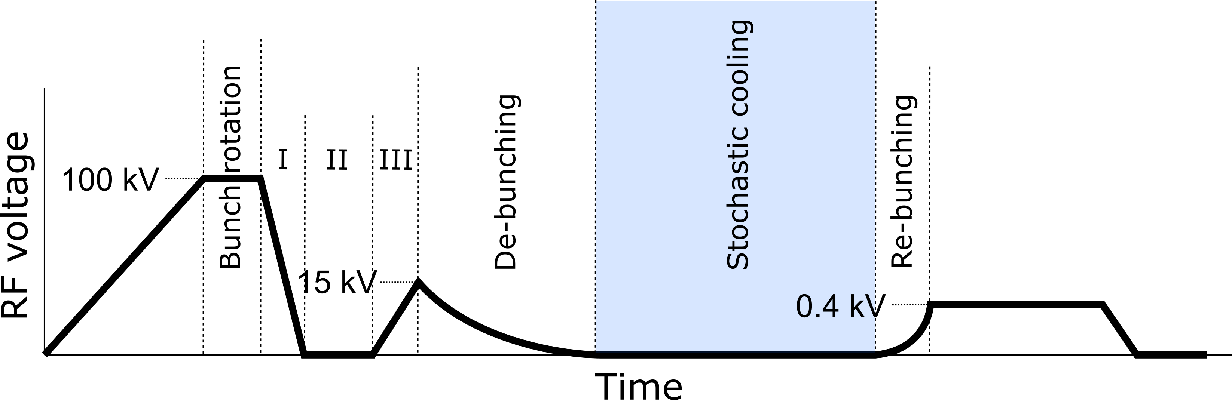
CR cooling cycle
Injection
single-turn
Bunch rotation & de-bunching
Max. RF voltage of 200 kV required for bunch rotation.
Stochastic cooling
Re-bunching
Extraction
Re-excite RF voltage for re-bunching
Simultaneous 3D cooling by Filter, TOF or Palmer method
to HESR
injected bunch length σ_{b} ~ 50 ns.
Schematic RF pattern for antiprotons **
*
** not true to scale
* CR Technical Design Report, v.7.6.1 (2016)

Slide 5
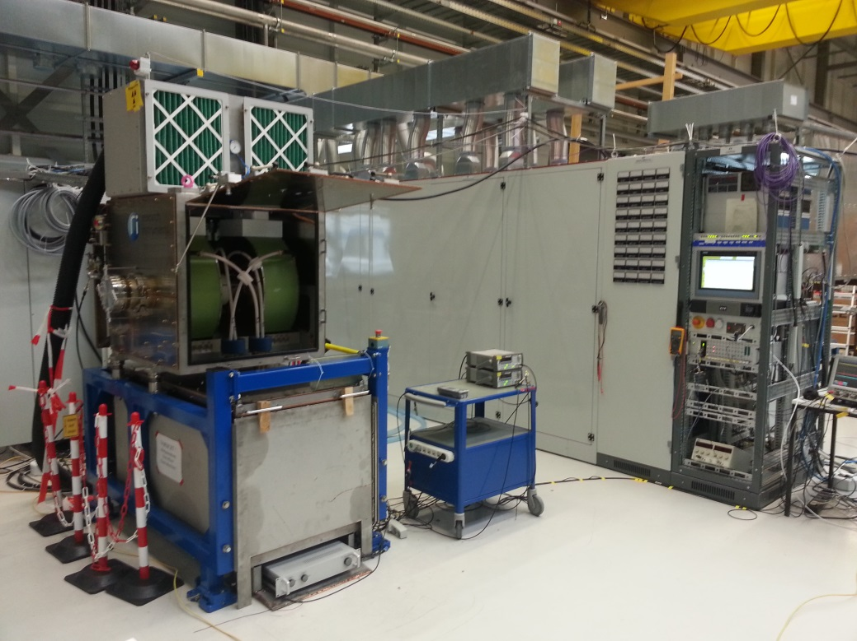
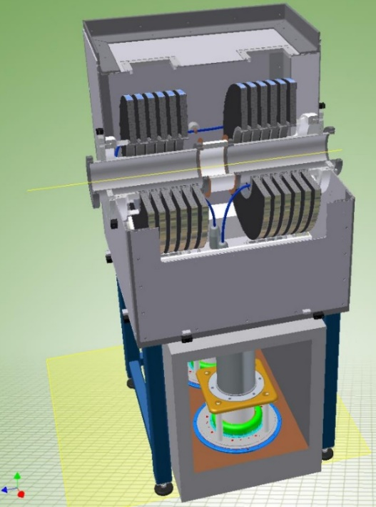
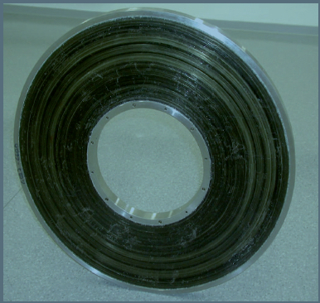
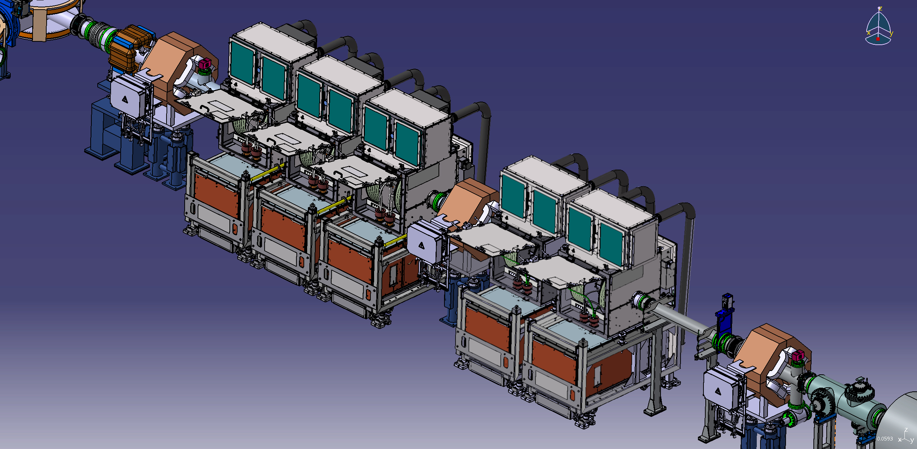
RF system
Two inductively loaded coaxial quarter wavelength resonators working on a common ceramic gap
Ring core of cobalt-based magnetic alloy
Max. voltage 40 kV/unit
Number of units 5
Frequency range 1.1 – 1.5 MHz
Inner pipe diameter 150 mm
First of Series CR debuncher during commissioning at GSI.
First of series accepted in 2017
FAT/SAT of series cavities ongoing

Slide 6
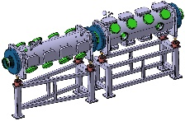
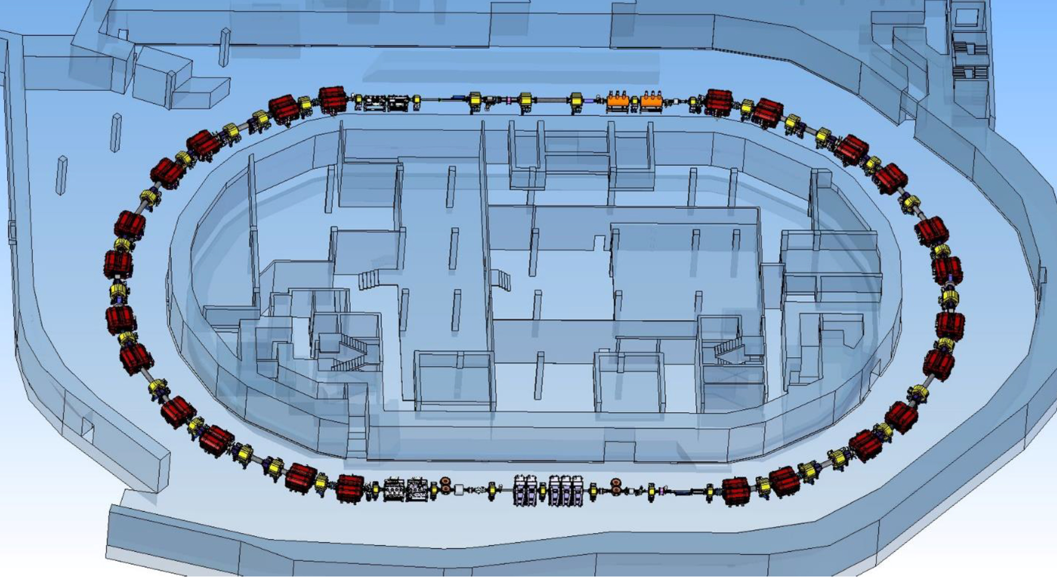
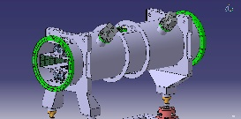
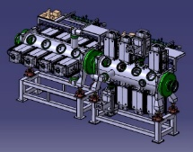
Stochastic cooling system
Kickers
Palmer Pick-Up
3D cooling by Filter, Palmer or TOF method
System bandwidth 1-2 GHz
Slot-line pick-ups with movable (plunging) electrode modules at cryogenic temperature (20-30 K) to improve signal-to-noise ratio for antiprotons
Palmer pick-up for pre-cooling of hot radioactive ion beams
Slot-line double Pick-Up

Slide 7
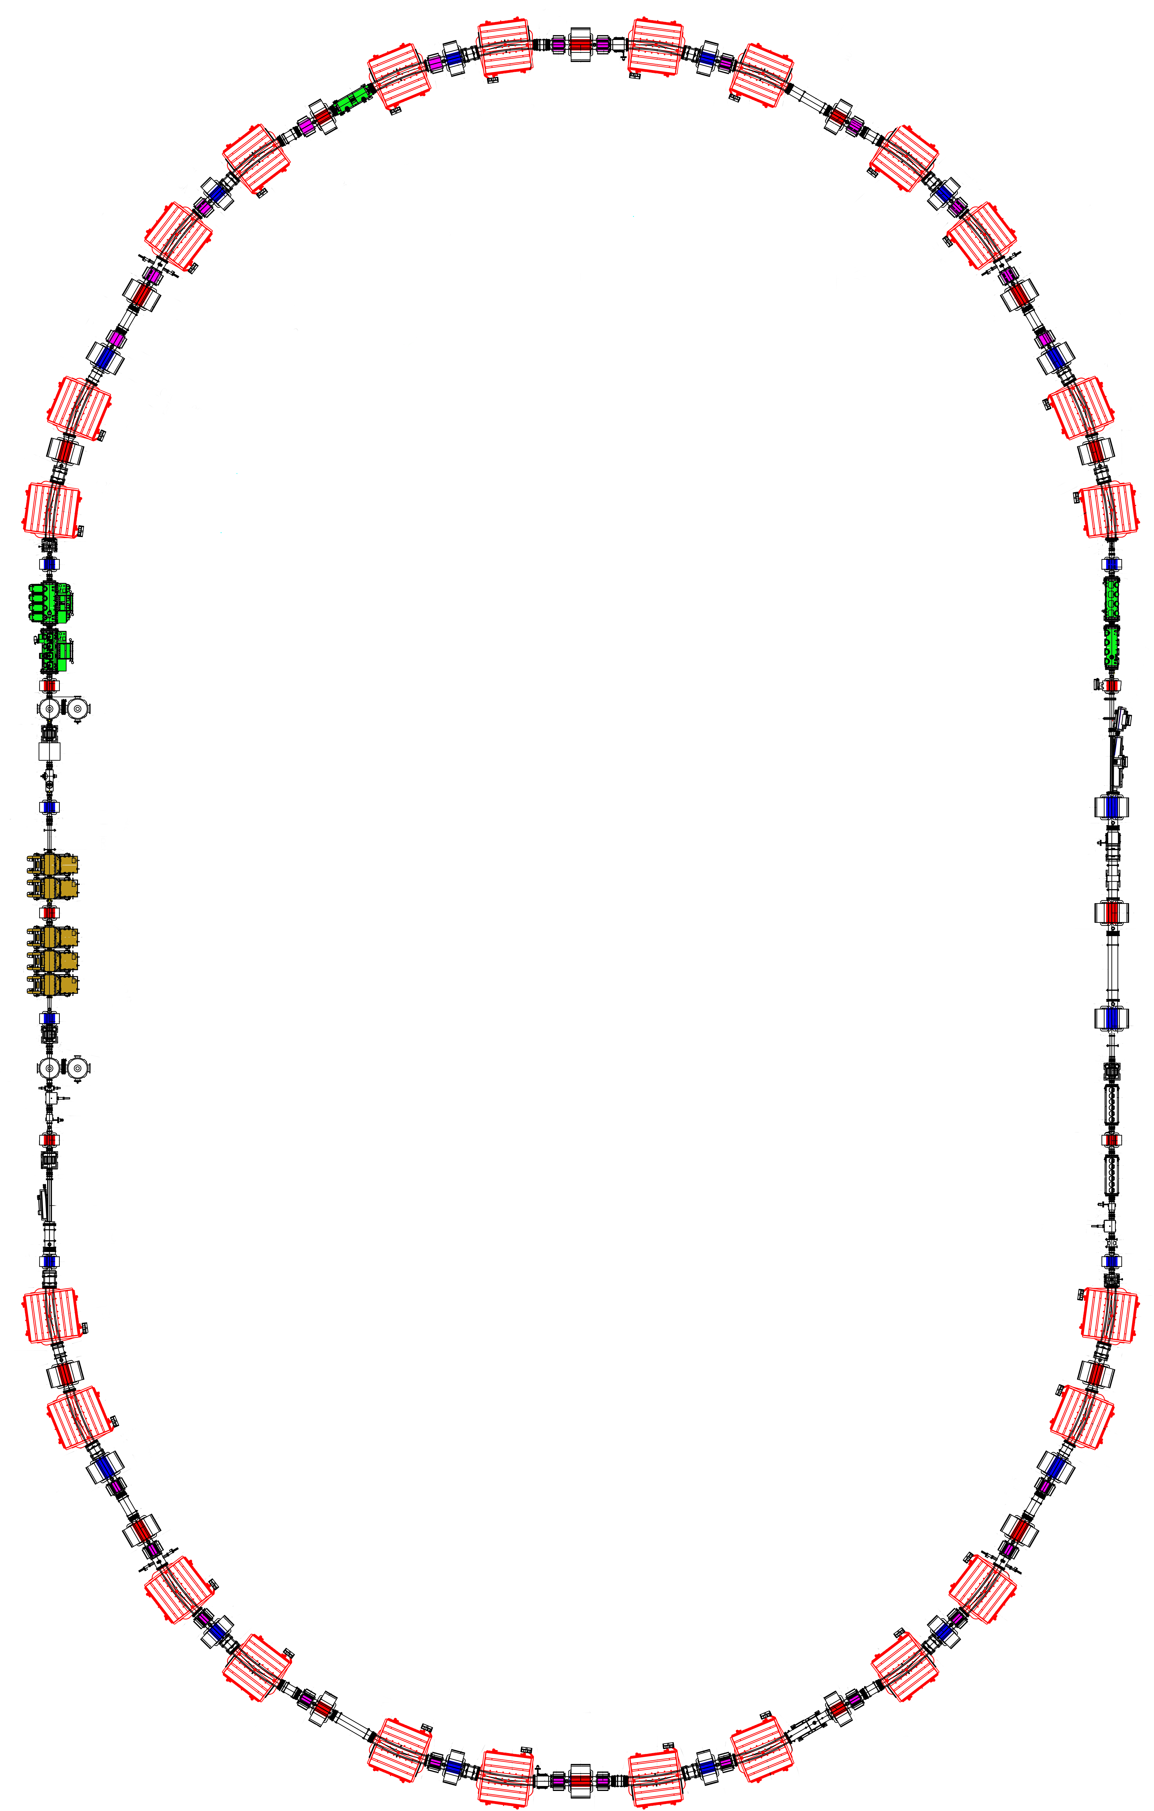
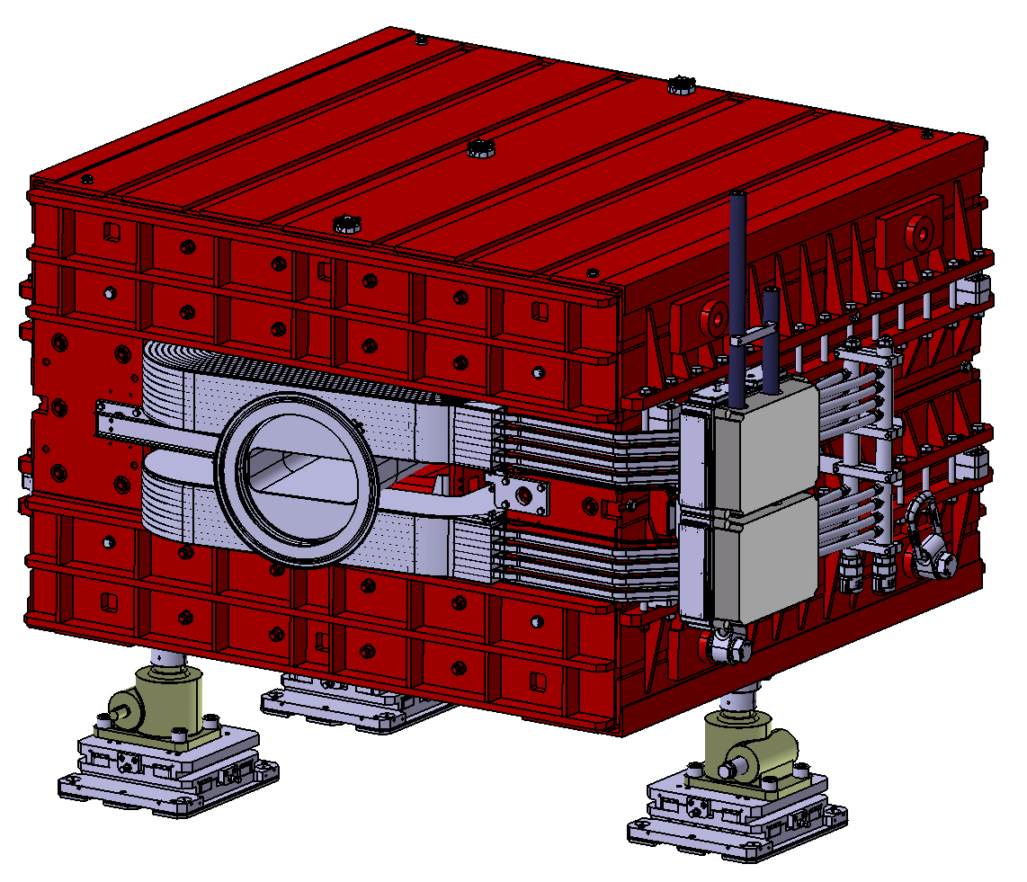
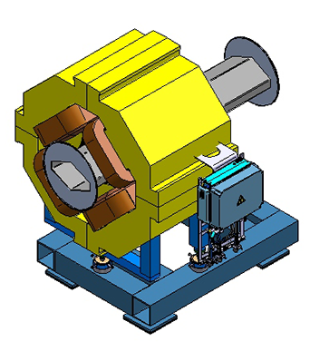
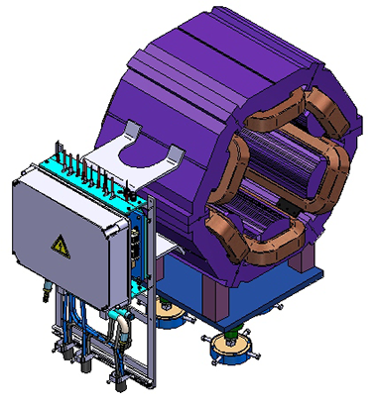
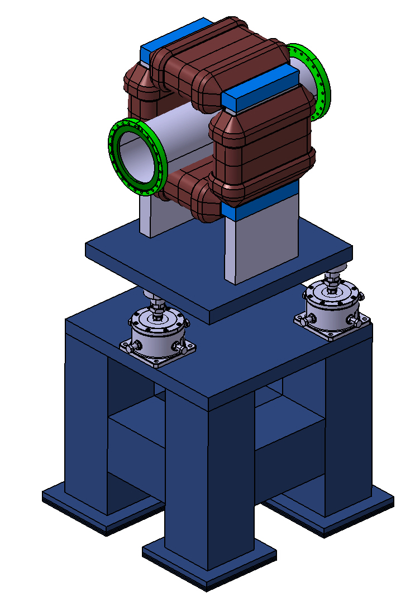


Magnets
dipole
Quadrupole
quadrupole
Dipole
Sextupole
sextupole
Num. of magnets 40
Num. of types 4
Number of families 15
Max. ramping rate 1 T/m/s
Useful aperture 380$×$140 mm²
Field homogeneity ±5·10⁻⁴
Num. of magnets 24
Number of families 6
Yoke length 50 cm
Pole inscribed radius 201 mm
Num. of magnets 24
Max. field 1.6 T
Bending radius 8.125 m
Useful aperture 380$×$140 mm²
Field uniformity ±1·10⁻⁴
Weight 59.8 t
Embedded horizontal correction coils
Orbit corrector
Max. field 0.067 T
Correction angle ±1.5 mrad
Length with coils 39 cm
CR magnet polarity change within 60 s

Slide 8
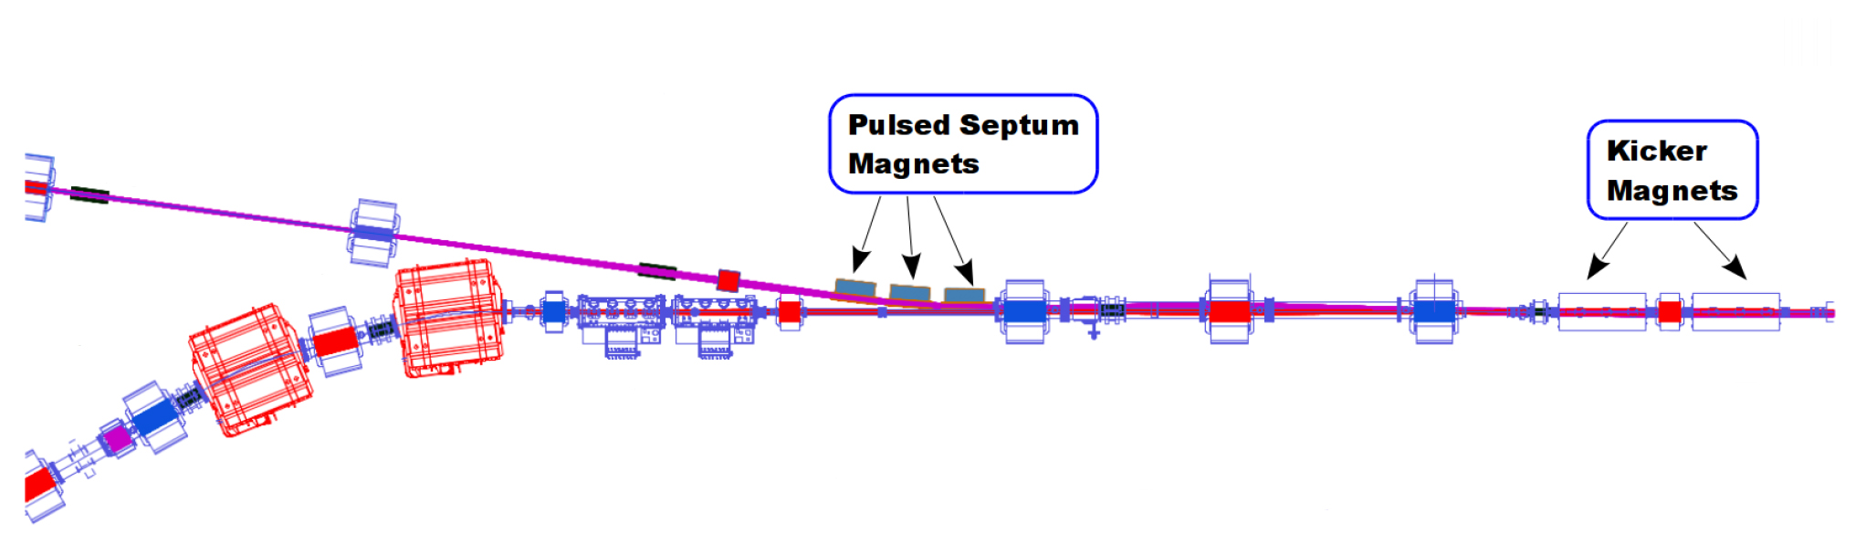
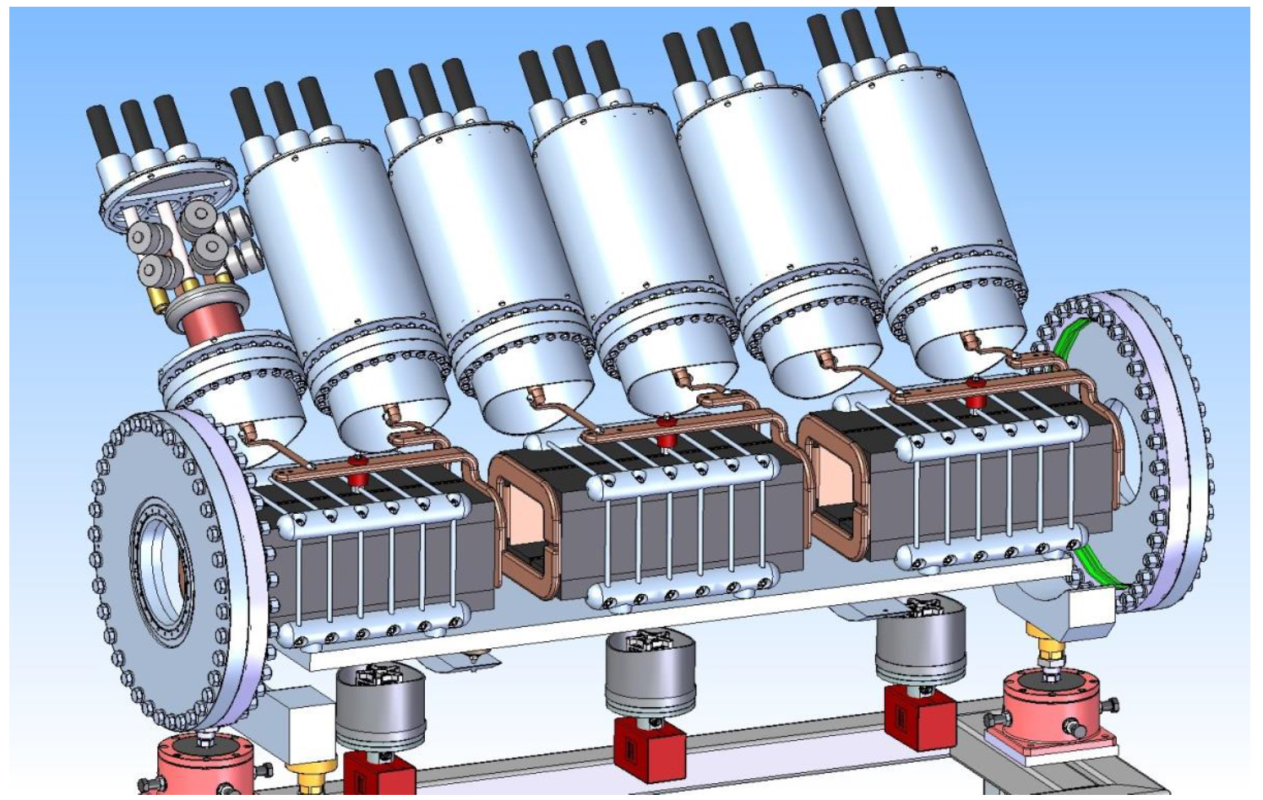
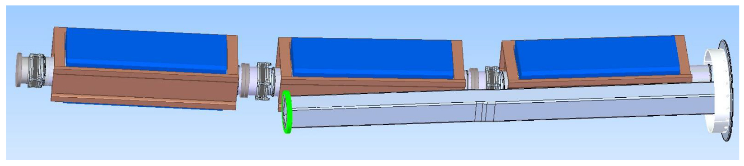
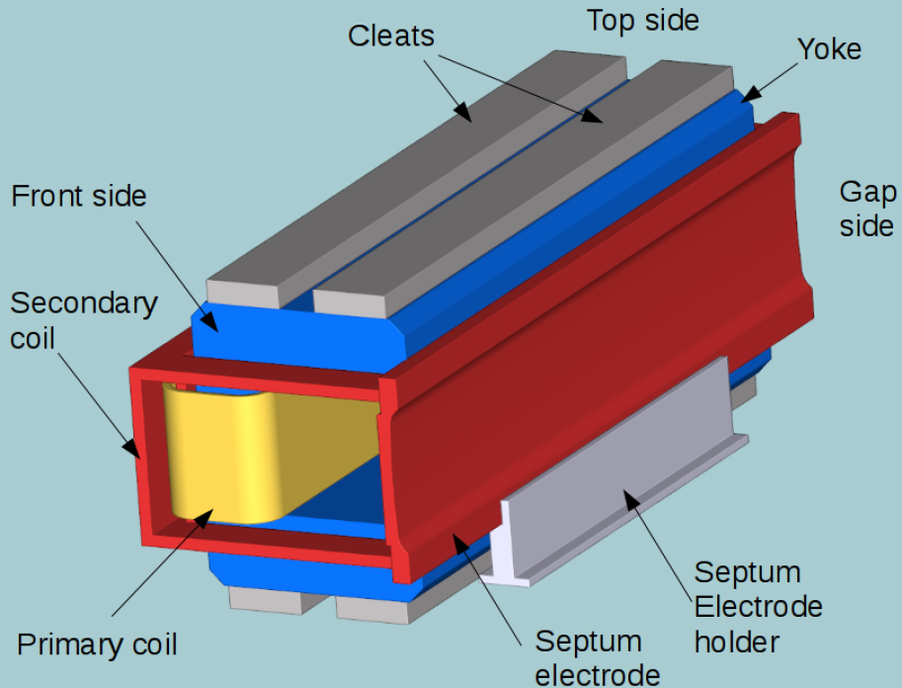
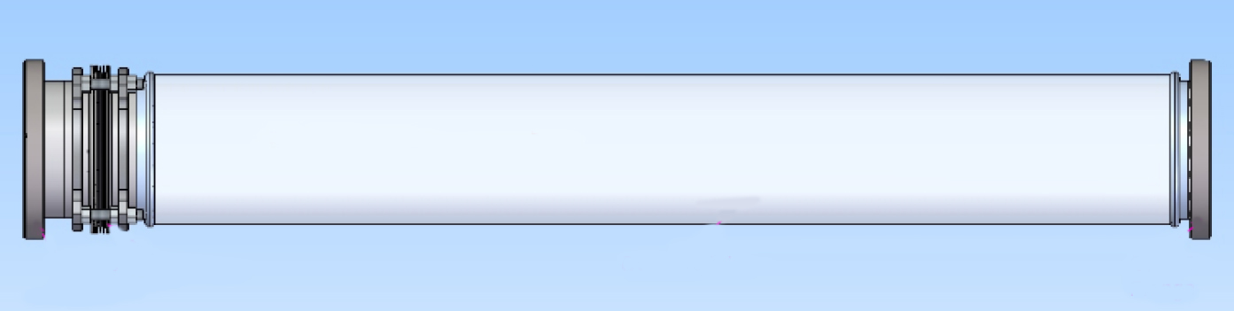
Injection/Extraction
Single turn injection by 3 pulsed septum magnets and 6 fast kicker magnets
Same kickers and 1 extraction septum magnet for fast extraction
Injected beam
Ceramic vacuum chamber
Num. of kicker units 6
Max. field 0.054 T
Kicker unit length 0.47 m
Rise/fall time 318 ns
Flat top length 0.05 - 1.5 µs
Inner diameter 150 mm
Max. field 0.6 T
Magnet length 0.952 m
Pulse duration 3 ms

Slide 9
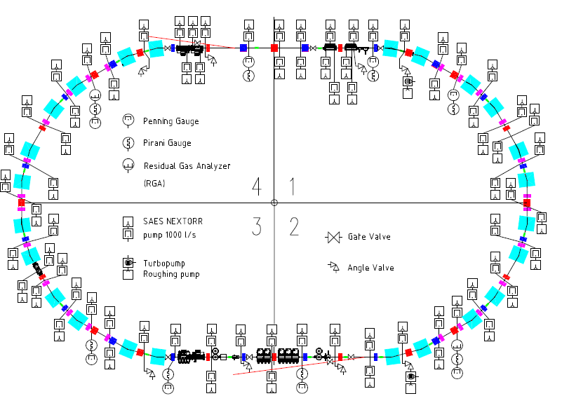
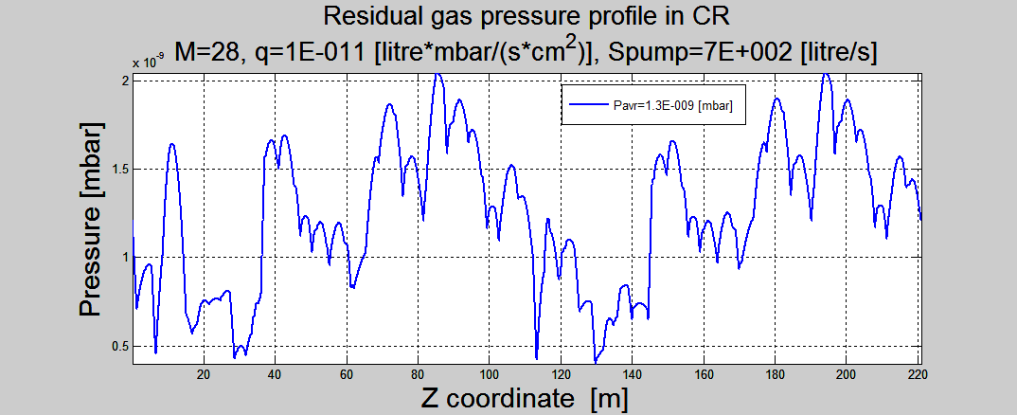

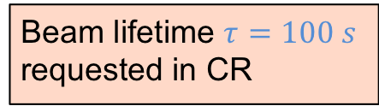
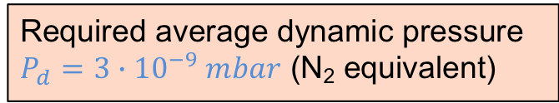
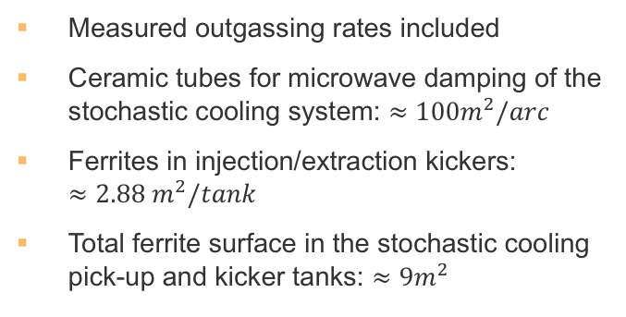
Vacuum system
Beam lifetime $τ=100 s$ requested in CR
Required average dynamic pressure $P_{d}=3∙{10}^{−9} mbar$ (N₂ equivalent)
$1.4∙{10}^{−9} mbar$
Component | Quantity | Remark
Roughing pumps | 2 | Mobile in the Ring
Ion/getter pumps | 75 | Hydrogen pumping speed of 1000 l/s; DN 100 CF
Sector / Gate valves | 6 | DN 200 CF
Angle valves | 8 | DN 160 CF for roughing stations
Cold cathode gauges | 12 | Two gauges in each vacuum sector
Pirani gauges | 12 | Two gauges in each vacuum sector
Residual gas analyzers | 2 | Installed either temporarily or permanently, connected via a DN 40 CF angle valve.
Measured outgassing rates included
Ceramic tubes for microwave damping of the stochastic cooling system: $≈100m^{2}/arc$
Ferrites in injection/extraction kickers: $≈2.88 m^{2}/tank$
Total ferrite surface in the stochastic cooling pick-up and kicker tanks: $≈9m^{2}$
1.4

Slide 10
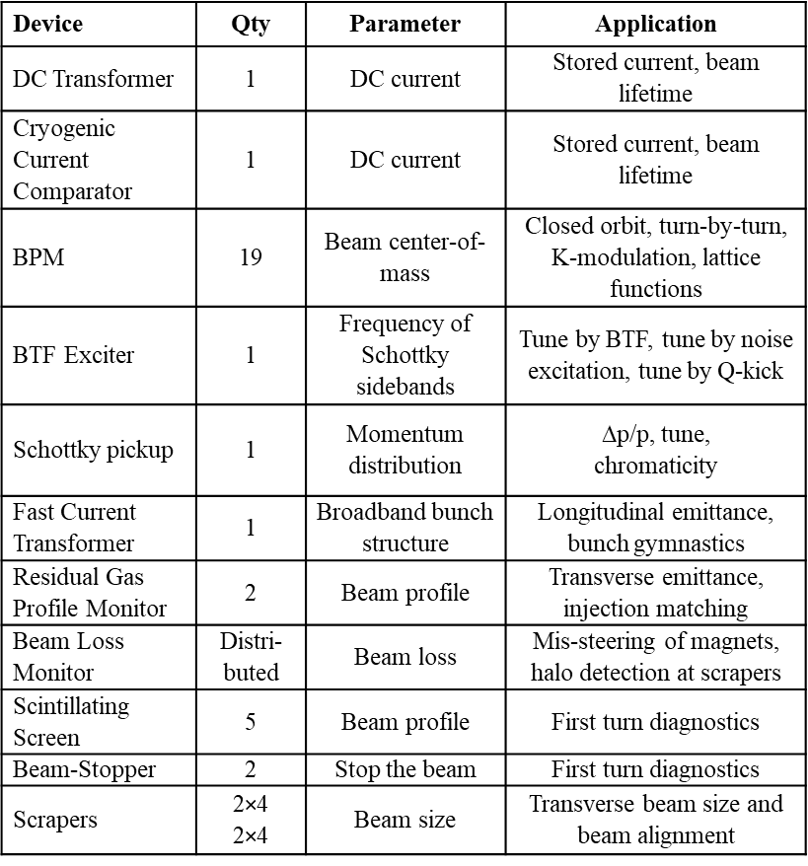
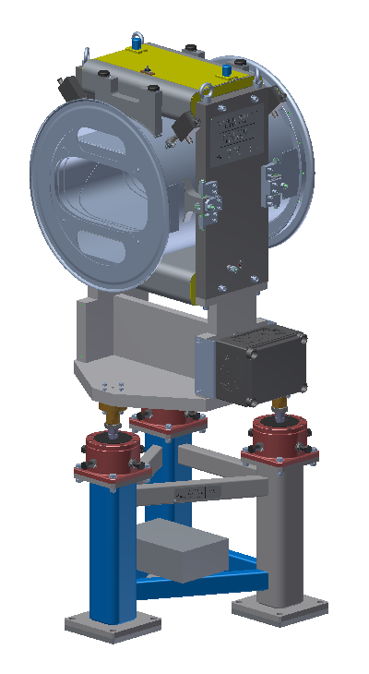
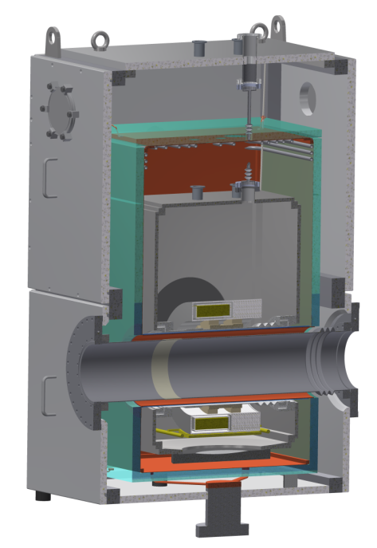
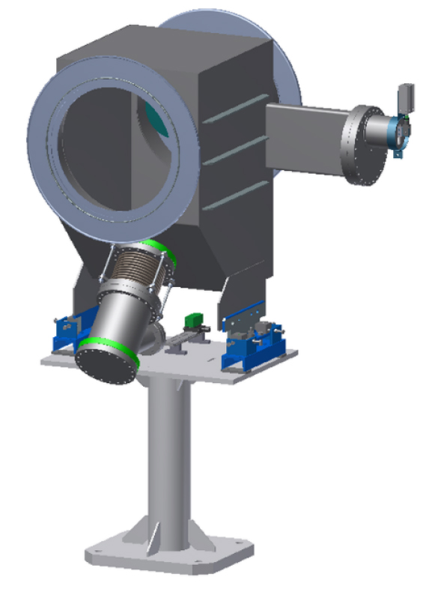
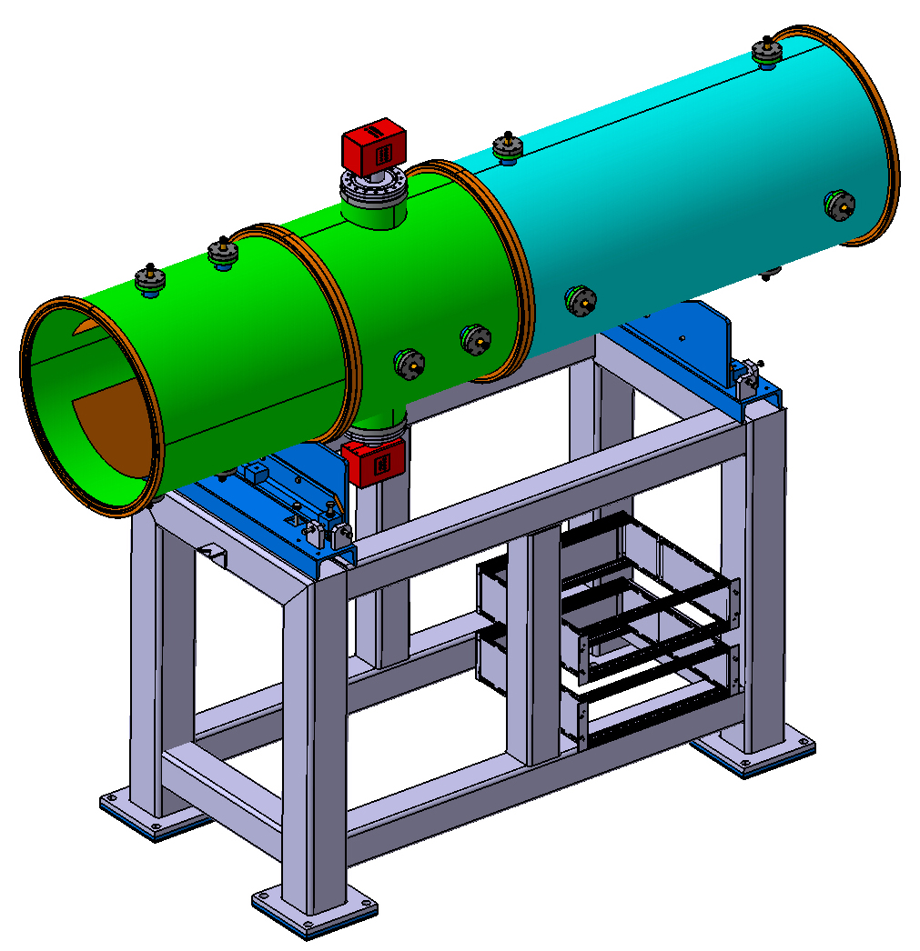
Beam diagnostics
Cryogenic
current
comparator
BPM
Residual gas monitor
Scintillation
screen
Schottky
pick-up
BTF

Slide 11
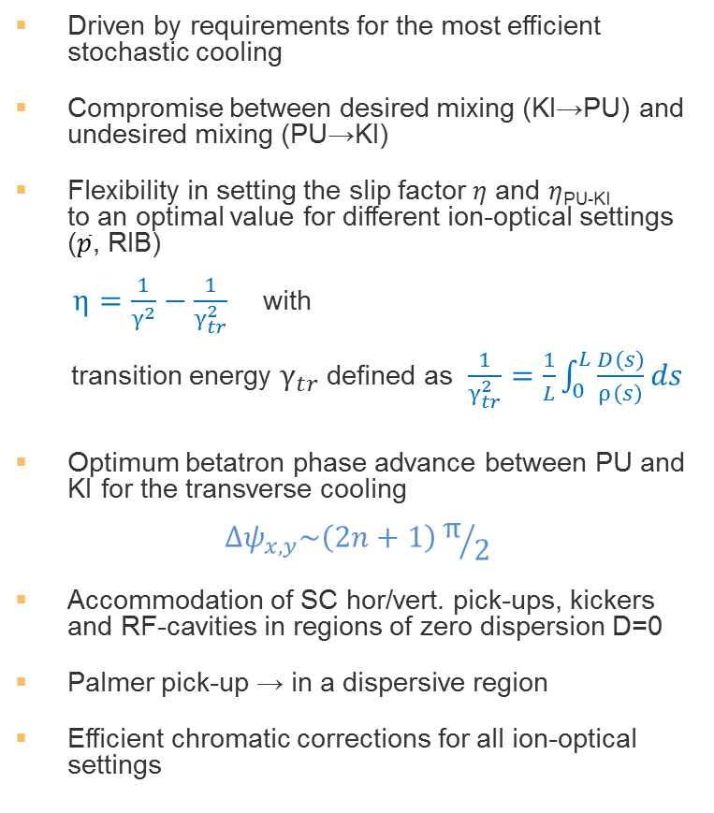
Ion-optical design
Driven by requirements for the most efficient stochastic cooling
Compromise between desired mixing (KI→PU) and undesired mixing (PU→KI)
Flexibility in setting the slip factor $η$ and $η$_{PU-KI} to an optimal value for different ion-optical settings ($\overline{p}$, RIB)
$η=\frac{1}{γ^{2}}−\frac{1}{γ_{tr}^{2}}$ with
transition energy $γ_{tr}$ defined as $\frac{1}{γ_{tr}^{2}}=\frac{1}{L}\int_{0}^{L}{\frac{D\left(s\right)}{ρ\left(s\right)}ds}$
Optimum betatron phase advance between PU and KI for the transverse cooling
$${Δψ}_{x,y}\sim \left(2n+1\right)π/2$$
Accommodation of SC hor/vert. pick-ups, kickers and RF-cavities in regions of zero dispersion D=0
Palmer pick-up → in a dispersive region
Efficient chromatic corrections for all ion-optical settings
Palmer PU
Beam
PU_{x}
KI_{y}
PU_{y}
KI_{x}
Mirror-symmetry plane
RF
cavities
24 dipoles
40 quadrupoles
24 sextupoles
Circumference 221.45 m
Max. magnetic rigidity 13 Tm
Super-periodicity 1

Slide 12
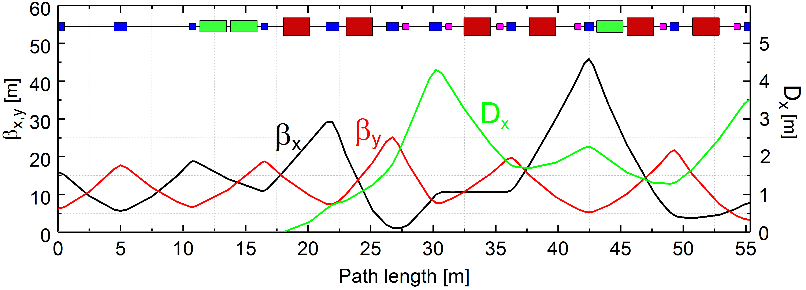
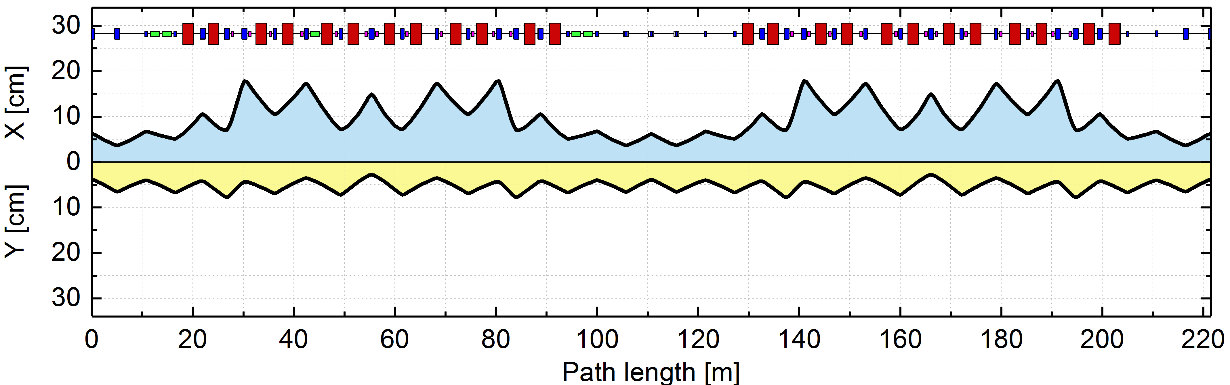
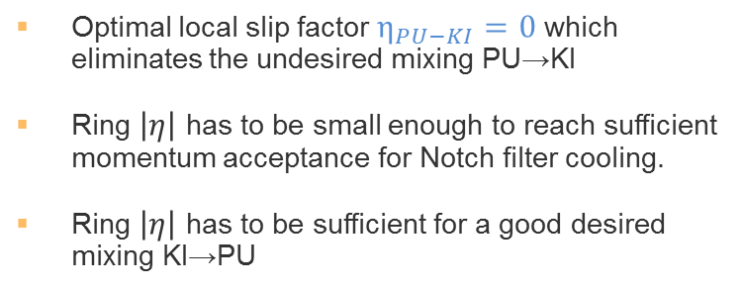

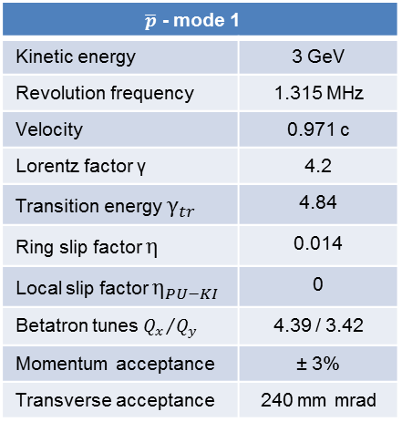

Antiproton optics (I)
Optimal local slip factor $η_{PU−KI}=0$ which eliminates the undesired mixing PU→KI
Ring $\left|η\right|$ has to be small enough to reach sufficient momentum acceptance for Notch filter cooling.
Ring $\left|η\right|$ has to be sufficient for a good desired mixing KI→PU
PU/KI
Palmer PU
$\overline{p}$ - mode 1
Kinetic energy | 3 GeV
Revolution frequency | 1.315 MHz
Velocity | 0.971 c
Lorentz factor γ | 4.2
Transition energy $γ_{tr}$ | 4.84
Ring slip factor $η$ | 0.014
Local slip factor $η_{PU−KI}$ | 0
Betatron tunes ${Q_{x}}/{Q_{y}}$ | 4.39 / 3.42
Momentum acceptance | ± 3%
Transverse acceptance | 240 mm mrad
Average dispersion
in arcs $D_{x}≈2 m$
Beam size at slot-line PU:
$$r≈6 cm$$

Slide 13
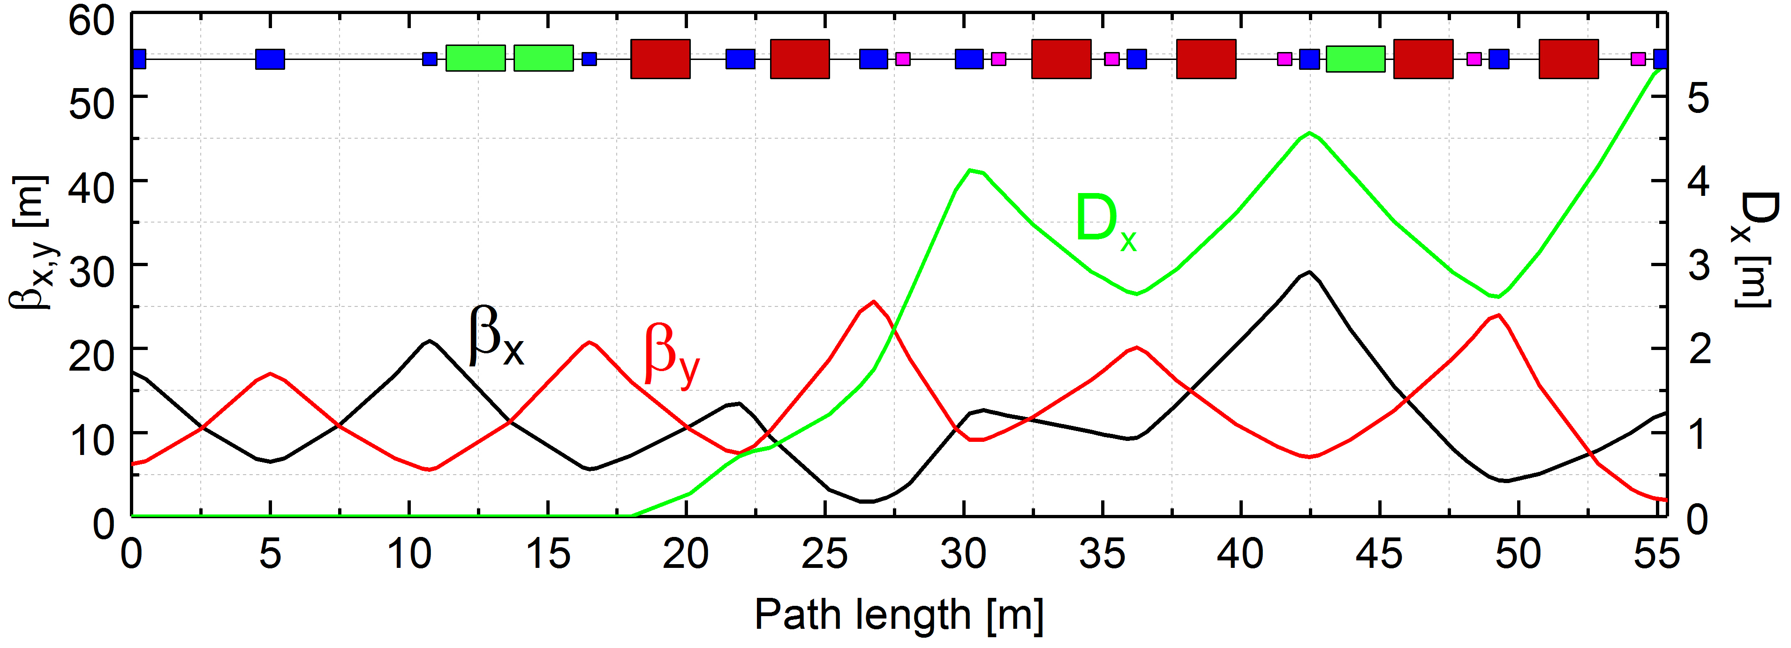
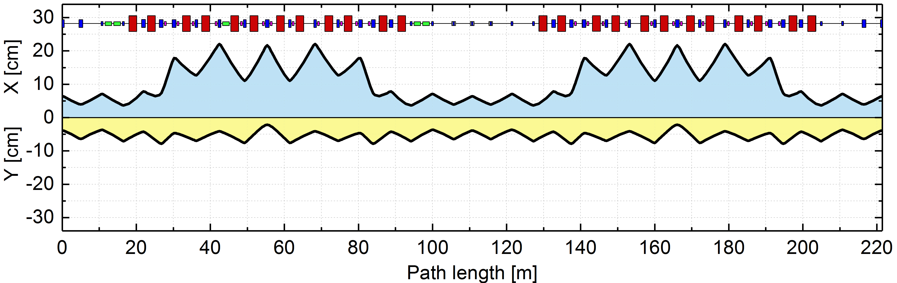
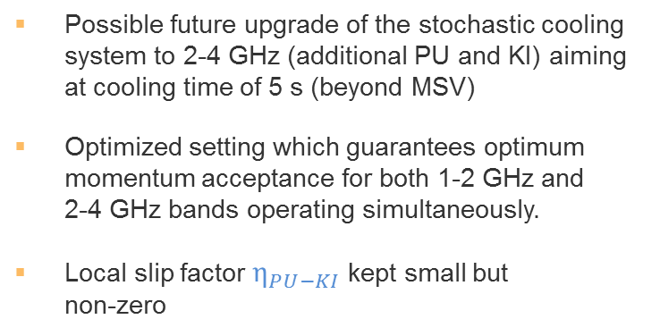

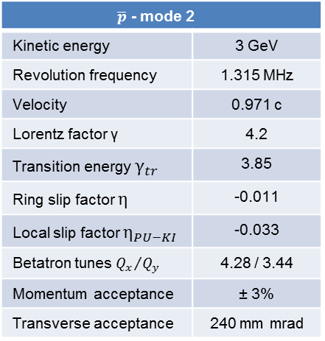
Antiproton optics (II)
Possible future upgrade of the stochastic cooling system to 2-4 GHz (additional PU and KI) aiming at cooling time of 5 s (beyond MSV)
Optimized setting which guarantees optimum momentum acceptance for both 1-2 GHz and 2-4 GHz bands operating simultaneously.
Local slip factor $η_{PU−KI}$ kept small but non-zero
Average dispersion
in arcs $D_{x}≈3 m$
$\overline{p}$ - mode 2
Kinetic energy | 3 GeV
Revolution frequency | 1.315 MHz
Velocity | 0.971 c
Lorentz factor γ | 4.2
Transition energy $γ_{tr}$ | 3.85
Ring slip factor $η$ | -0.011
Local slip factor $η_{PU−KI}$ | -0.033
Betatron tunes ${Q_{x}}/{Q_{y}}$ | 4.28 / 3.44
Momentum acceptance | ± 3%
Transverse acceptance | 240 mm mrad

Slide 14





Eta-variation during $\overline{p}$ cooling
Coherent term of the filter cooling system is proportional to the ring slip factor $\left|η\right|$
Momentum cooling efficiency can be improved by a linear $\left|η\right|$ increase during the cooling process while momentum spread is shrinking.
Control of betatron tunes, phase advance between pick-ups and kickers during the quadrupole ramping
Keeping zero-dispersion in the straight sections
Variation of transition energy 3.85 ≥${ γ}_{tr}$≥ 3.35 or 0.011 ≥ $\left|η\right|$ ≥ 0.033
Max. required gradient 0.24 T/m/s for eta-variation during 5 s

Slide 15






RIB optics
Momentum acceptance for RIB filter cooling is limited by undesired mixing PU→KI
Transition energy $γ_{tr}$ must be chosen as small as possible by increasing dispersion in the arcs
Hot RIBs have to be cooled first by Palmer method which has a larger momentum acceptance
Average dispersion
in arcs $D_{x}≈6 m$
RIB mode
Kinetic energy | 740 MeV/u
Revolution frequency | 1.124 MHz
Velocity | 0.830 c
Lorentz factor γ | 1.79
Transition energy $γ_{tr}$ | 2.73
Ring slip factor $η$ | 0.178
Local slip factor $η_{PU−KI}$ | 0.134
Betatron tunes ${Q_{x}}/{Q_{y}}$ | 3.40 / 3.44
Momentum acceptance | ± 1.5%
Transverse acceptance | 200 mm mrad
Beam size at Palmer PU:
$$x≈15 cm$$

Slide 16





Ion-optical optimizations
Orbit corrections
Chromaticity corrections
Correction of closed orbit distortions due to dipole field errors and magnet alignment tolerances
Dipole field error δB/B = 5·10⁻⁵ (rms)
Magnet displacement error Δx,Δy,Δz = 0.3 mm
Magnet rotational error Δφ,Δθ,Δψ = 0.3 mrad
29 horizontal and 19 vertical correctors available
Compensation of betatron tune Q_{x,y} variation with momentum
Reduce tune spread to avoid crossing dangerous resonances
6 families of sextupoles are used
Dynamic aperture control
Impact of nonlinear field errors on beam stability, can be critical for beams with large momentum spread
Compensation schemes for improving dynamic aperture and reducing possible beam losses
Aim: preserve beam intensity &
prepare optimal pre-conditions for the most efficient stochastic cooling
Peak-to-peak (rms)
before correction: ~10 mm
Peak-to-peak (rms)
after correction: ~1.5 mm

Slide 17
Thank you for
attention!

