Slide 1


Slide 2
Oleksiy Dolinskyy
January 21, 2019
FAIR Project status

Slide 3
Outline
FAIR Performance
Highlight and Progress of FAIR Subprojects
- SIS18 / SIS100
- Proton-Linac
- Super-FRS
- CR
- HESR
- Commons (HEBT)
Civil construction
Time schedule

Slide 4
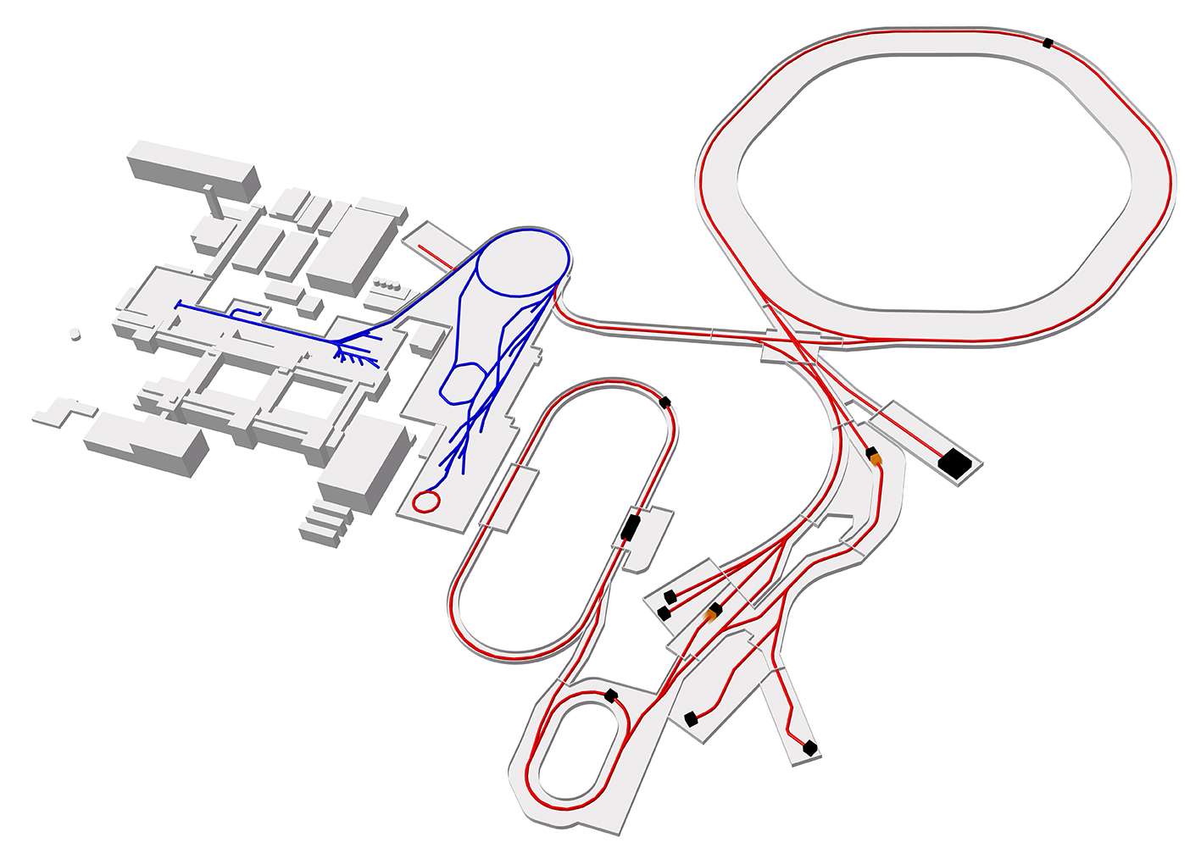
FAIR facility
Proton Linac
SIS100
SIS18
UNILAC
CBM
PANDA
Super-FRS
HESR
100 meters
Production
of antiprotons
Stochastic Cooling Systems
Existing facility
CR
Planned facility
Experiments

Slide 5
FAIR Accelerator Performance
5

Slide 6
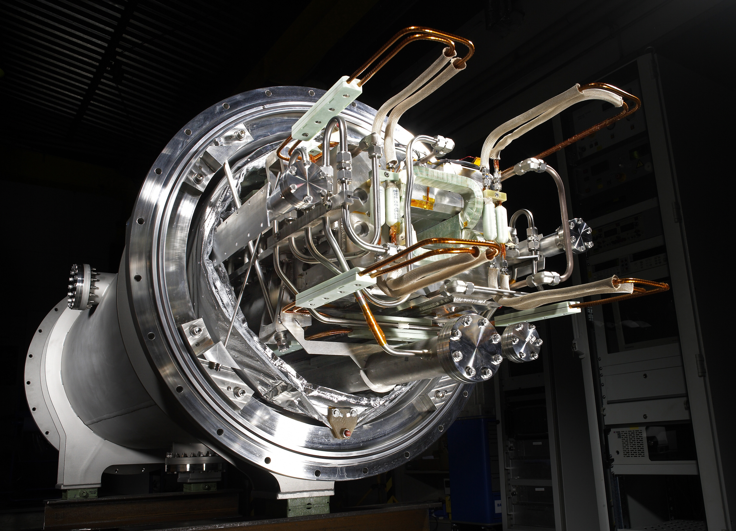
FAIR Accelerator Sub-Projects
Highlights and Progress

Slide 7
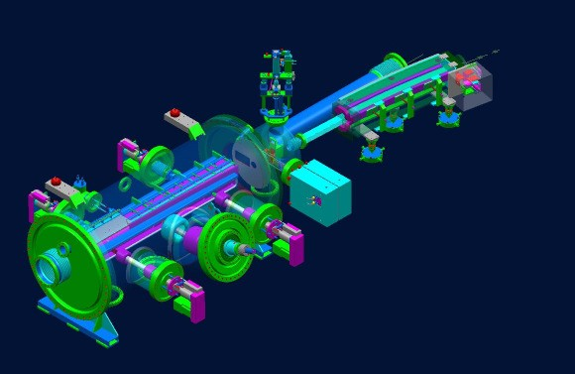
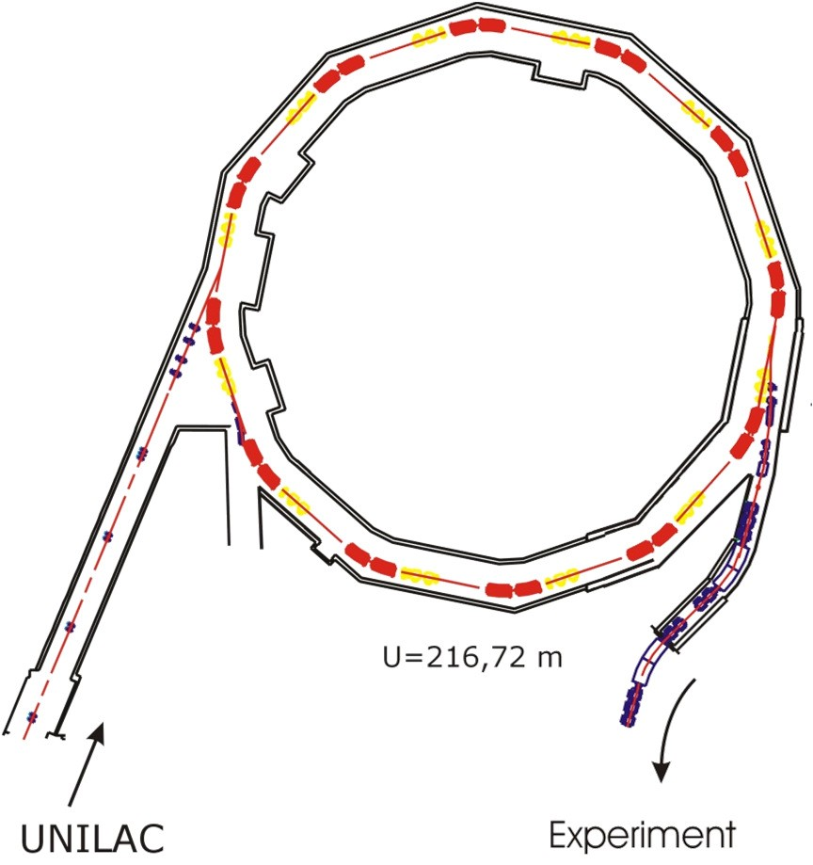
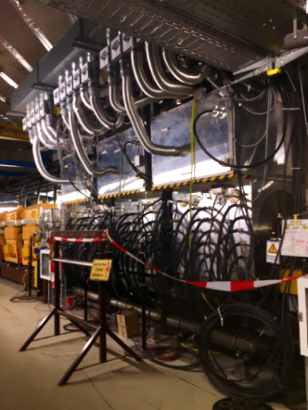
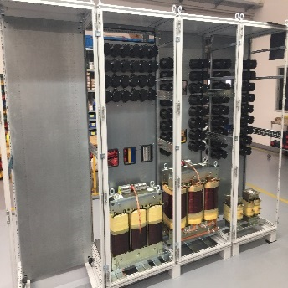
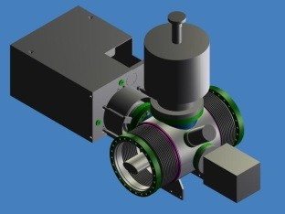
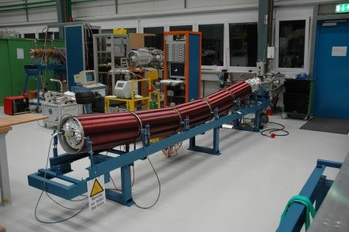
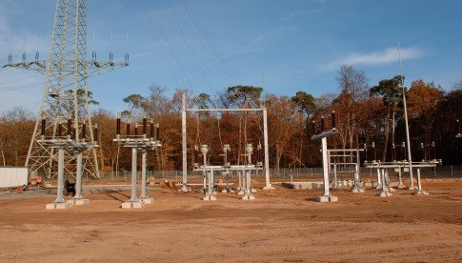
SIS18 Upgrade for FAIR
The SIS18 has been upgraded aiming booster operation with low charge state heavy ions.
Re-commissioning of SIS18 with beam took place in May 2018
Injection system for low charged state heavy ions
Three new RF MA acceleration cavities installed and commissioned with beam. h=2 acceleration cavities for faster ramping
New Power Converters for dipole with a maximum ramp 10 T/s with the new transformer station have been installed and tested
Concrete and ground works for SIS18 building completed
Scrapers and NEG coating for pressure stabilization
Power grid connection

Slide 8
SIS100
Lattice parameters
Reference beam parameters
Circumference | 1083.6 m
Super-periodicity | 6
Magnetic rigidity | 100 Tm
Cells per period | 14
Number of super-ferric dipoles (1.9 T) | 108
Ramping rate | 4 T/s
Number of super-ferric quadrupoles (27.8 T/m) | 168
Slow extraction mode | up to 10 s
Fast extraction mode | 1-8 bunches
Acceleration | From p up to U
Time structure | Single compressed bunch / slow extraction
Number ions per cycle protons ions | 2 x 10¹³ 5 x 10¹¹
Harmonic number | 10
Energy range Protons Ions | 4 - 29 GeV 0.2 – 2.7 GeV/u
Emittance (2σ) Injection Extraction | 5 – 30 mm mrad 0.5 – 6.3 mm mrad
Repetition rate | 0.1 – 0.45 Hz
Momentum spread (2σ) | < ±10⁻³
Compressed bunch length | 10 - 70 ns

Slide 9
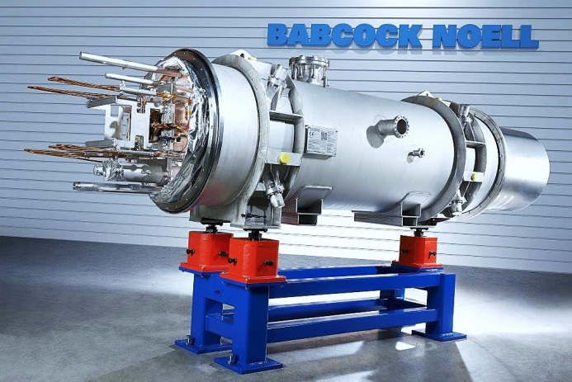
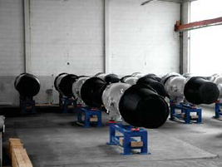
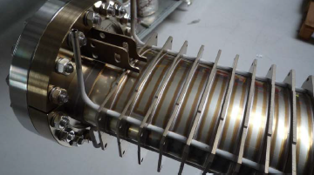
SIS100
Fast Ramped Superconducting Dipole Magnets (BNG, Germany)
Status November 2018
40 Dipole Magnets manufactured at BNG
• 23 Dipole Magnets delivered to GSI
• 22 Dipole Magnets cold tested
• Excellent reproduced geometry of aperture
• Excellent reproduced field harmonics
First series chambers expected for February 2019 (4 chambers/month) by PINK company
Vacuum chamber: Thin - wall LHe - cooled

Slide 10
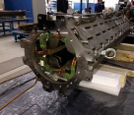
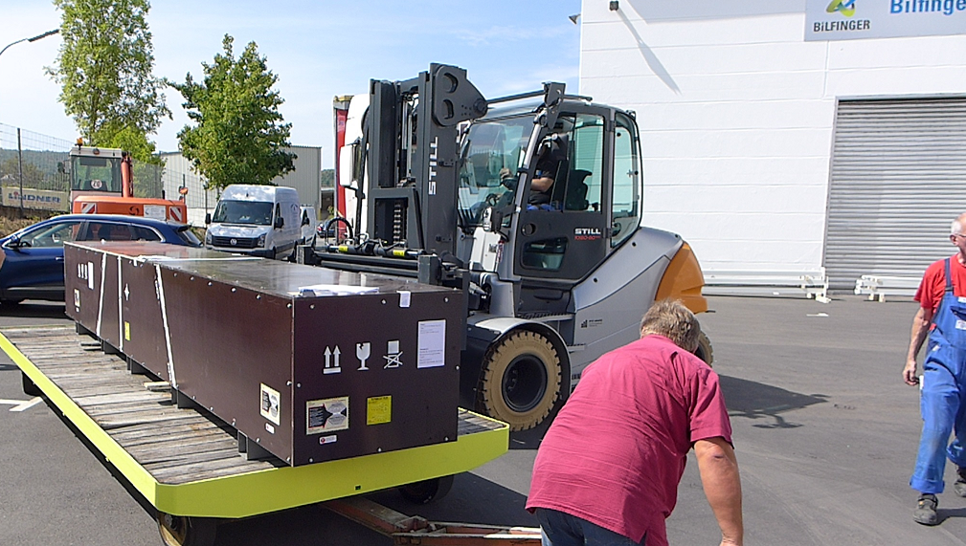
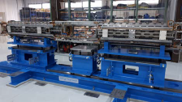
SIS100
  Quadrupole (QP) modules:
        FoS QP units shipped from JINR (Russia) to BNG (Germany) for integration into FOS QP module
        Contract for series testing of QP units @ JINR signed on 26th October 2018
        Integration into QP modules by company BNG in Germany
        QP module testing @ INFN, Salerno (Italy) – development of agreement
Quadrupole unit
QP Unit @ BNG
Quadrupole module at BNG

Slide 11
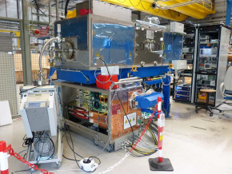
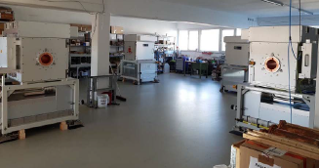
SIS100: RF Stations
RF acceleration systems (14 required)
FoS including power converter is ready.
The series production started by RI company.
RF Bunch Compression Systems (9 required):
All cavities done by AURION company.
Power supplies are still under production by OCEM company

Slide 12
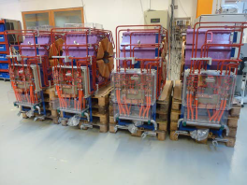
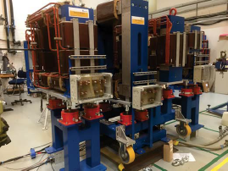
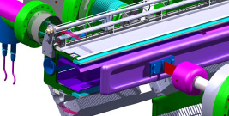
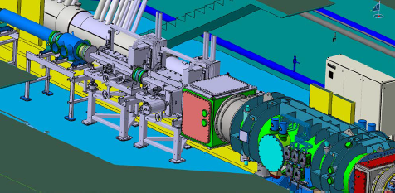
DANFYSIK for SIS100
Sextupole Magnets
Series production completed
2 IPM with magnet system for SIS18 and SIS100: Manufacturing of both magnet systems completed
Vacuum chamber and PS under production.
Production of electrostatic extraction septum and Injection Septum Magnets started

Slide 13
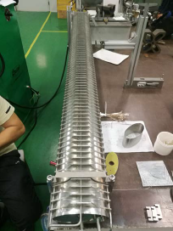
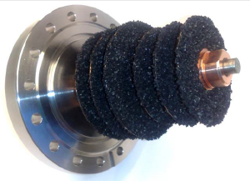
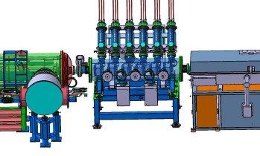
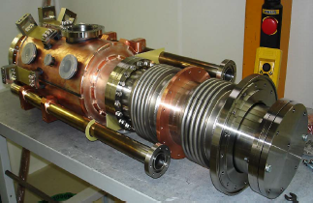
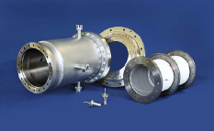
SIS100:
other components under production
SIS100 quadrupole chambers with elliptical cross section (required 185 pieces)
FoS quadrupole chamber done at JJVAC
Small series (four pieces) ordered at RI
SIS100 Adsorption Pumps (78 pieces)
Series production started by ILK
Production of injection kicker started by PPT/AMPEGON company
Cryogenics Beam Position Monitor
Prototype cryogenic BPM (made by
Kyocera) tested successfully
Series contract awarded to Friatec.
FoS BPM delivered and tested.
Cryo-Catcher System
FoS is ready.
Series production started by TRINOS company

Slide 14
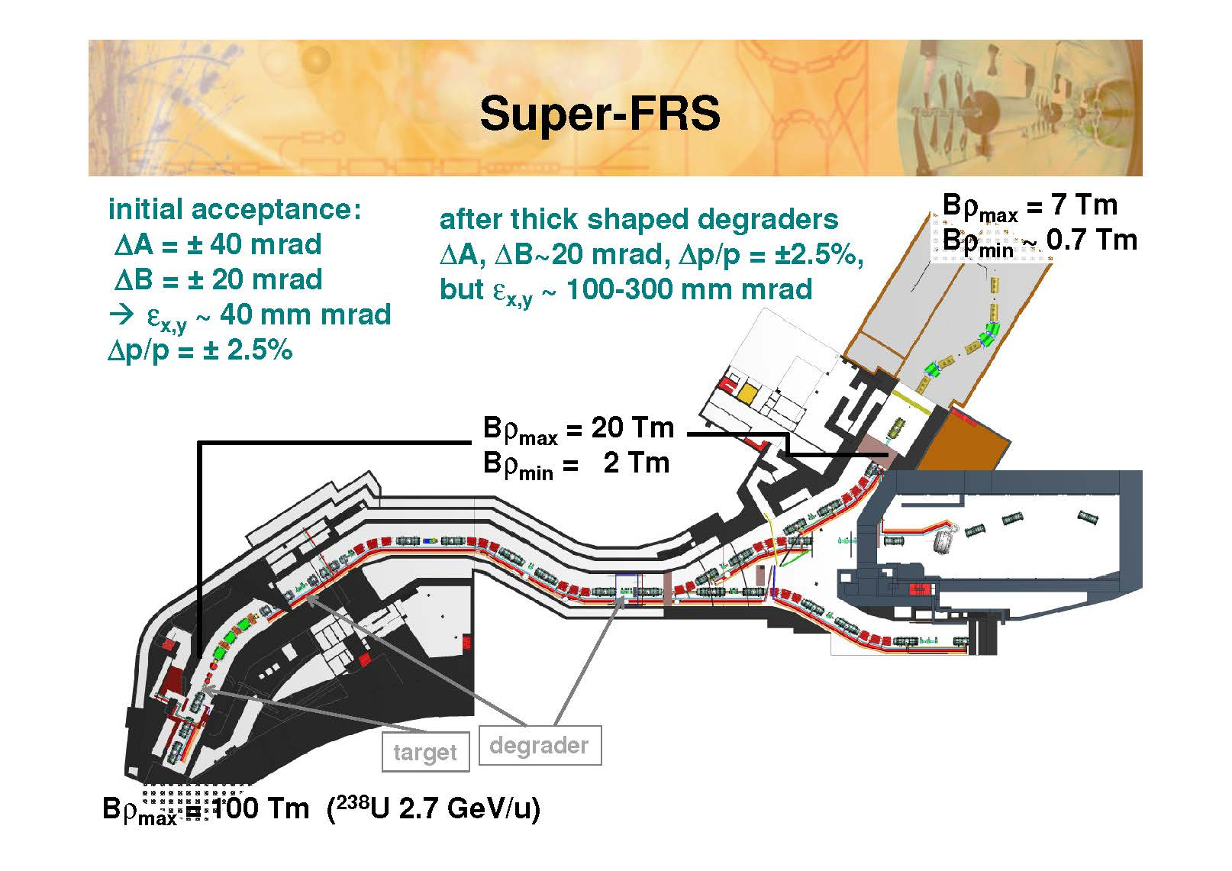
Super-FRS
RI up to 10⁸ to CR
50 ns bunch length
200 mm mrad
dp/p=±1.5 %

Slide 15
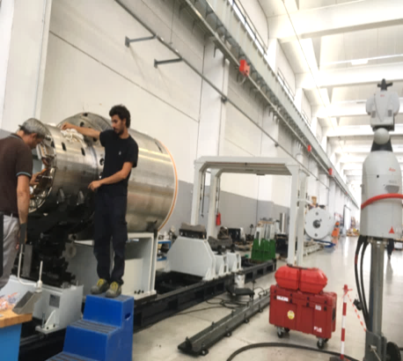
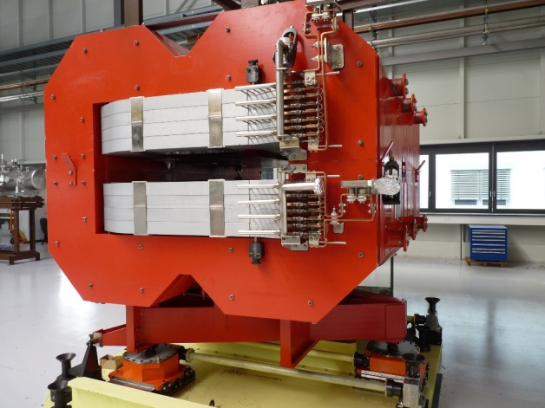
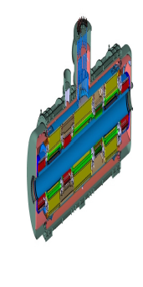
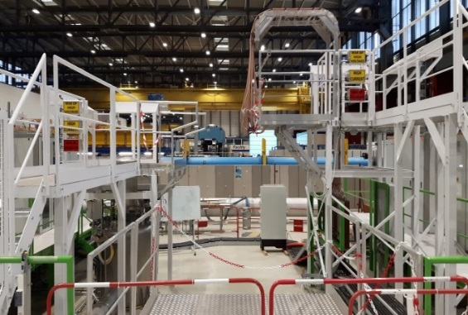
Super-FRS
  FoS radiation hard dipole magnet done by BINP
  Production of FoS sc short multiplets running.
  Production of FoS sc long multiplet started
Testing Facility for sc magnets at CERN is ready for use
Various IKC for detector systems drafted (beam profiler, tracking detectors, scintillators, drives, etc.) and in negotiation with in-kind partners
Test facility
SC multiplets including some sextupoles
Radiation hard dipole magnet at GSI

Slide 16
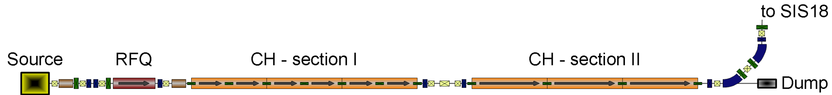
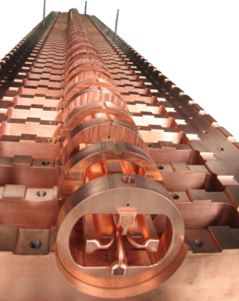
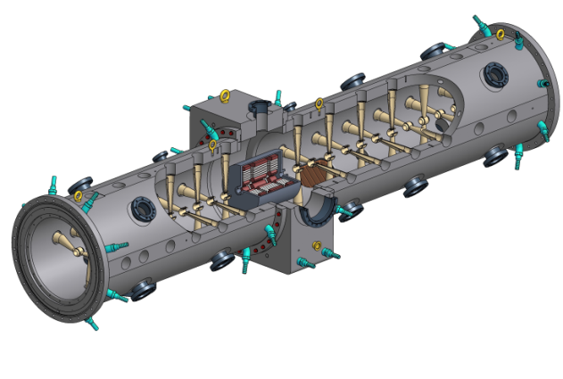
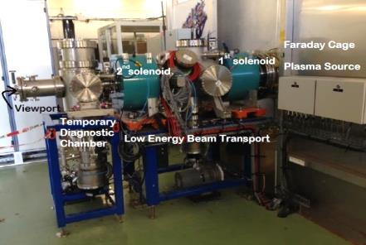
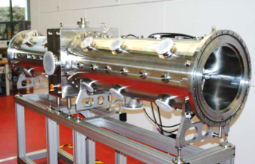
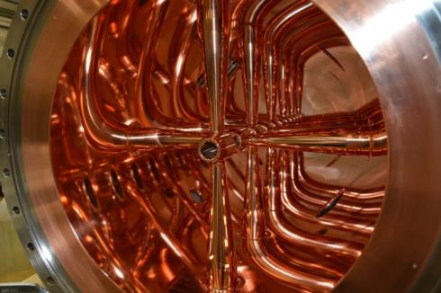
The proton-LINAC
One needs 10⁵ proton to get 1 antiproton. The task of p-Linac to provide high intensity proton beam
70 MeV, 68 mA
  Status:
  Commissioning of ion source at CEA in progress
  First low level RF test for ladder-RFQ performed. Excellent agreement with theoretical predictions
  CH cavity prototype tested. Tendering starts 2020.
  Seven klystrons on site. Testing progressing. Prototype modulators in work.
16

Slide 17
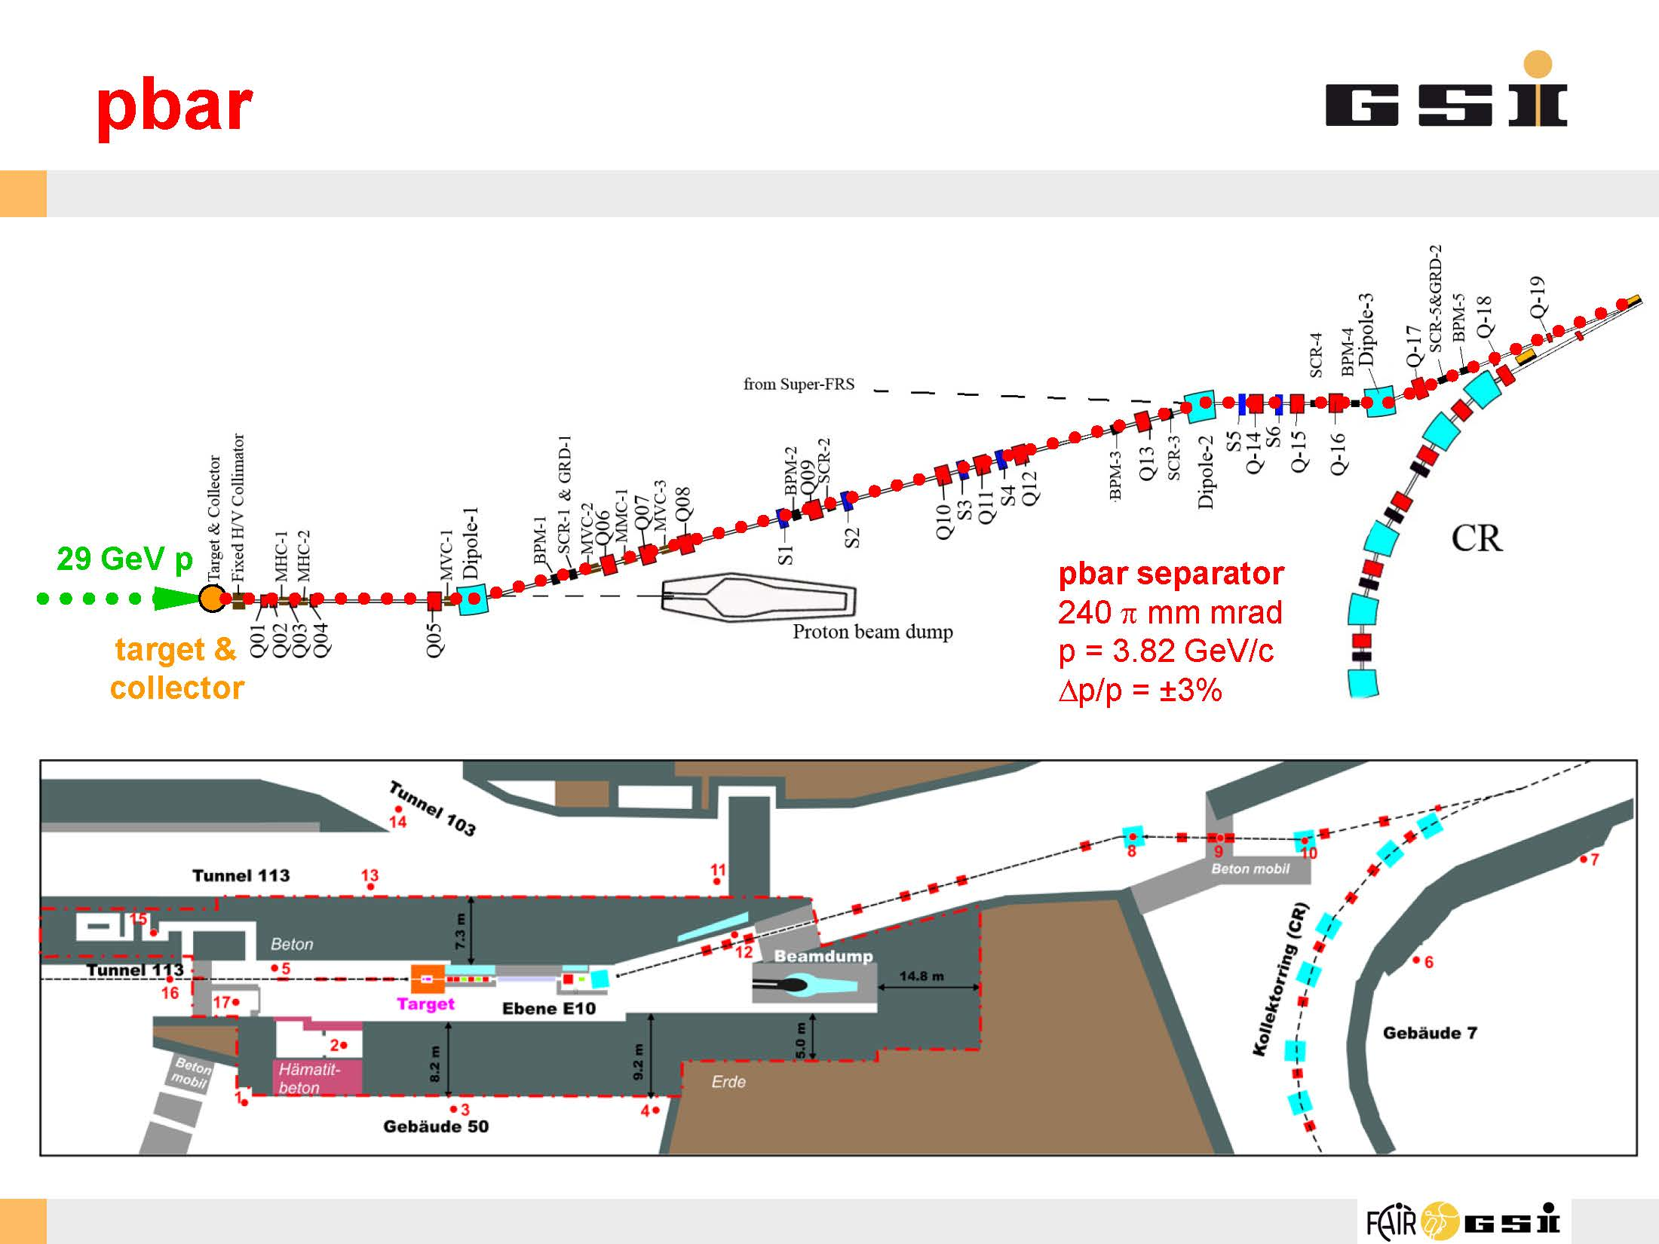
Antiproton target and separator
The goal to have more than 10⁸ antiprotons at injection into CR

Slide 18
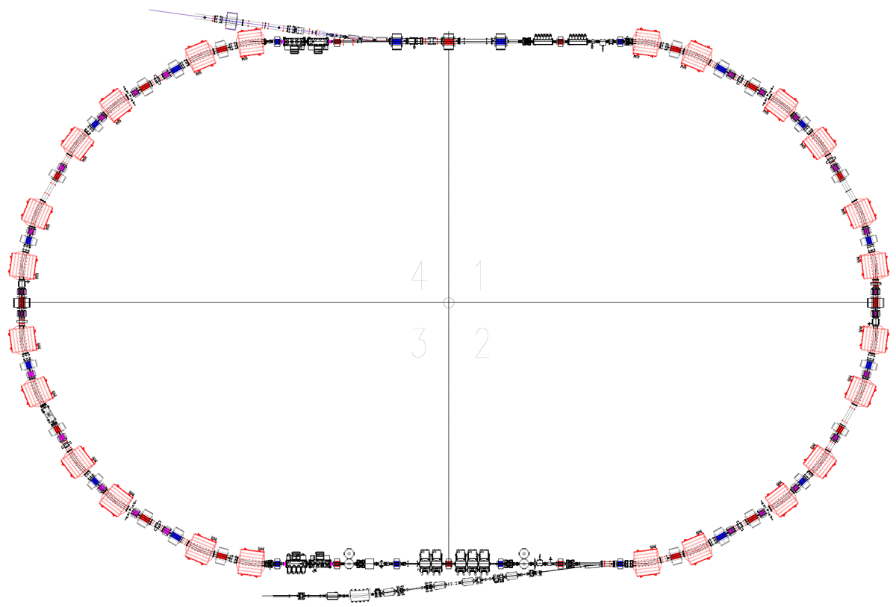
Collector Ring
Injection from
P_bar separator
or SFRS
Stochastic cooling
Kickers
Injection Kicker
magnets
Main task: Cooling hot secondary ions coming from separators.
 | Antiprotons | Ions
Circumference, C | 221.451 m
Rigidity, Bρ | 13 T⋅m
Number of particles, N | 10⁸ | 10⁹
Kinetic energy, K | 3 GeV | 740 MeV/u
Velocity, v | 0.971c | 0.830c
Relativistic factor , γ | 4.20 | 1.79
Betatron tunes, ν_{x}, ν_{y} | 4.39, 3.42 | 3.40, 3.44
Revolution frequency, ω₀ | 1.35 MHz | 1.16 MHz
RF harmonic, q | 1
Stochastic cooling
Pickups
RF – cavities
Extraction
to HESR

Slide 19
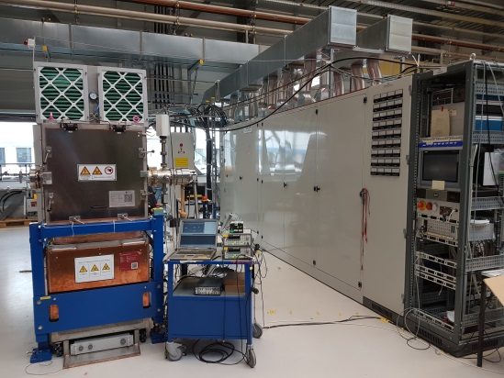
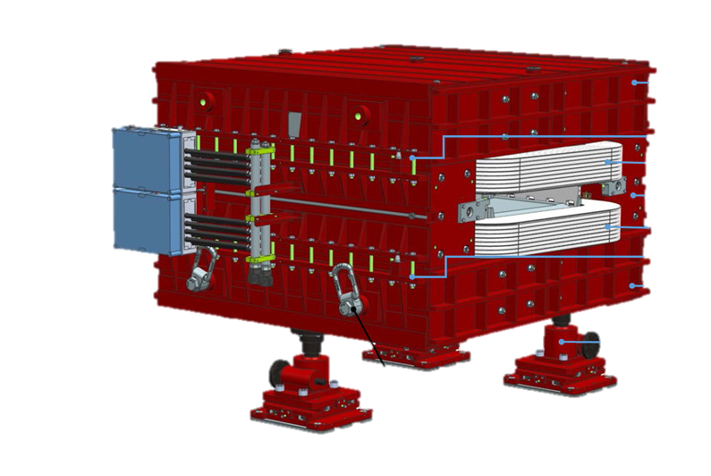
Collector Ring
  The series production of 5 RF – debunchers systems completed by RI and OCEM.
  Power amplifier prototype for Stochastic Cooling system has been produced. Series production started.
  CR dipole magnets under production at BINP
  90 % of all CR specifications has been released
RF cavity with PS
CR dipole magnet

Slide 20
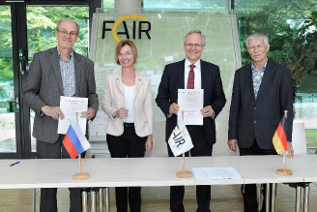
Collector Ring
  Contract with BINP for production of major part of CR components has been signed in June 2018
BINP produces all magnets; vacuum system; power supplies;
major part of diagnostic elements; injection/extraction components.

Slide 21
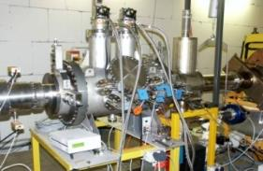
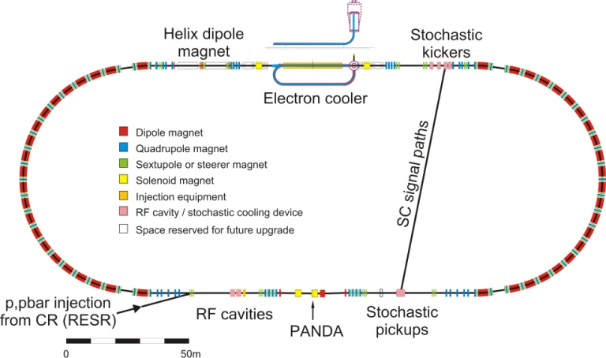
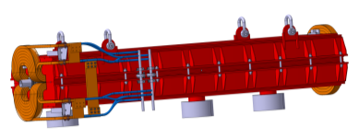
HESR
The High Energy Storage Ring
The main tasks:
PANDA - experiments with antiprotons.
SPARC - experiments with ions.
Basic Data of HESR
Circumference 574 m
Magnetic rigidity: 5 – 50 Tm
Injection from CR at 13 Tm
Maximum dipole field: 1.7 T
Dipole field at injection: 0.4 T
Dipole field ramp: 0.025 T/s
Length 575 m
Arc 132 m
Straight 155.5 m
21

Slide 22
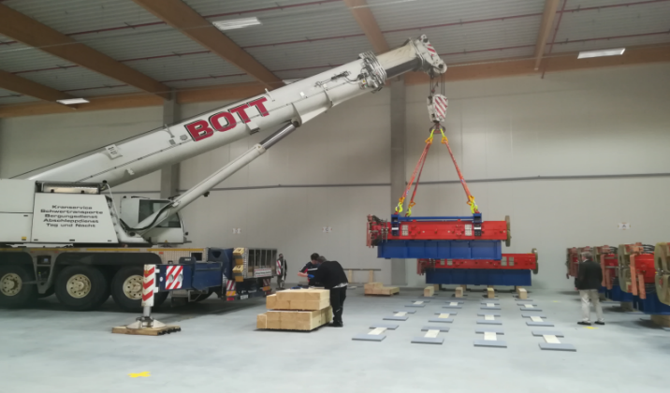
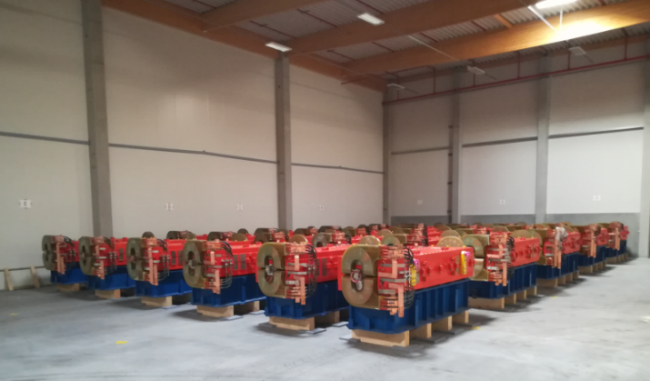
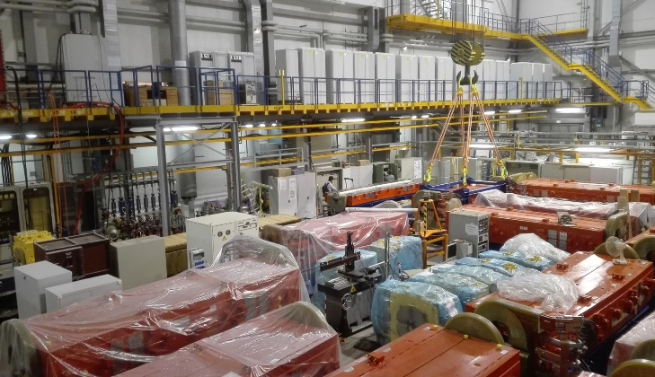
HESR
  All Dipoles are produced, in Jülich and 65% are delivered to FAIR
  All Quadrupoles (QP) are produced in Jülich

Slide 23
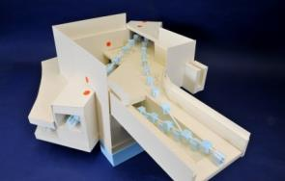
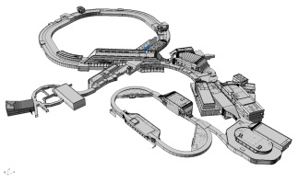

HEBT
High Energy Beam Transfer lines
Central Transfer Building H0705A
branching and crossing point for 8 beam lines (full version)
several beam lines inclined
components of many other beam lines are transported through this building
pbar, APPA
SIS18
SFRS
CBM
SIS100/300
SIS100/300
23

Slide 24




HEBT
  HEBT production divided in 3 batches.
  1st batch
  Serial production of dipole magnets is ongoing by Efremov Institute in Russia.
  21 of 51 dipoles delivered to GSI.
  51 vacuum chambers delivered to GSI from BINP, Russia.
  FoS Power Converter delivered to GSI from ECIL, India (6 needed)
  2nd and 3rd batches:
  Contacts with BINP signed. Series production is ongoing
dipole and quadrupole magnet at BINP
2nd and 3rd batches
dipole and vacuum chamber. 1st batch

Slide 25
FAIR Machines
Status November 2018

Slide 26

FAIR CIVIL CONSTRUCTION

Slide 27
Civil construction
Presently 5 companies ABN consortium, PORR, ZÜBLIN, TAG, GAT perform:
Excavation Building Area „North“
Building Shell Construction Area „North“
Site Logistics and Temporary Services
Elevators
Site Power Supply and Site Security
Other 10 companies will be awarded during next 2 years to perform:
Building Shell Construction Area „South;
Cranes;
Ventilation; Sanitary / Technical Gases;
Heating/ Cooling;
Electrotechnical Facilities;
Safety and Security Systems;
Firefighting Systems;
Building & Process Automation Systems

Slide 28



Civil Construction
Excavation Pit 1 area north
•Concrete pouring of 1st section ground slab - 2nd August 2018
•Continuous pouring of further sections

Slide 29



Civil Construction
Excavation Pit 2 area north
2nd section of excavation pit 2 in handed over to company PORR

Slide 30
Time schedule FAIR Machines
 | 2019 | 2020 | 2021 | 2022 | 2023 | 2024 | 2025 | 2026
SIS100
Commons
SuperFRS
Plinac/Pbar
CR
HESR
civil construction
installation
commissioning

Slide 31

FAIR – Facility for Antiproton and Ion Research
GSI Helmholtzzentrum für Schwerionenforschung
Thank you!

