Slide 1
The FAIR Antiproton Target
Production Target &
Magnetic Horn
Civil Construction &
Radiation Protection

Slide 2
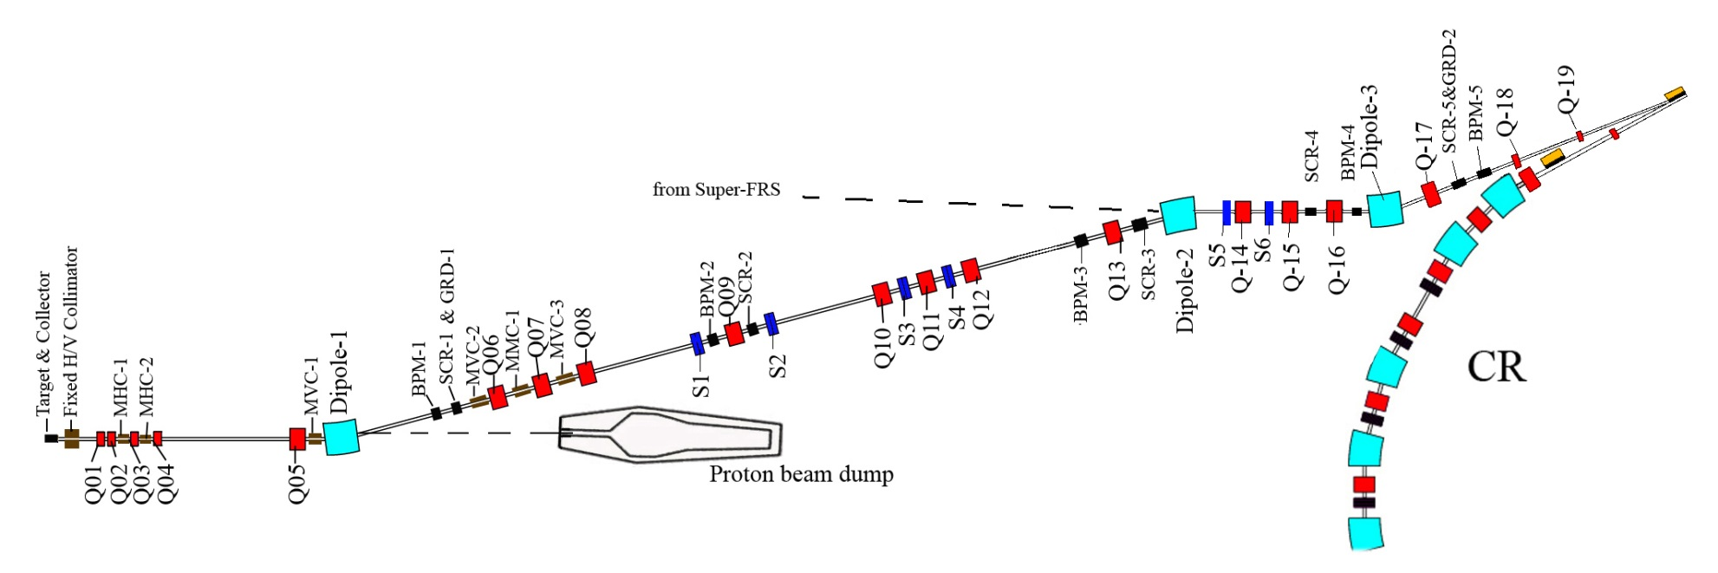
The pbar separator
pbar separator
240 π mm mrad
p = 3.82 GeV/c
Δp/p = ±3%
target &
collector
29 GeV p from SIS 100

Slide 3
Creation of antiprotons
c.m.
p, > 1 GeV
p
p
p, > 1 GeV
p
m = E / c²
m_{p} = m_{pbar} ≈ 1 GeV / c²
pbar
lab
p at rest
p
p
p, > 6 GeV
pbar
p
m = E / c²
T_{pbar} > 6 GeV

Slide 4
FAIR / CERN / FNAL pbar Sources
 | FAIR | CERN (AC+AA) | FNAL
E(p), E(pbar) | 29 GeV, 3 GeV | 25 GeV, 2.7 GeV | 120 GeV, 8 GeV
acceptance | 240 π mm mrad | 200 π mm mrad | ≈ 30 π mm mrad
protons / pulse | 2 × 10¹³ | 1 - 2 × 10¹³ | ≥ 5 × 10¹²
pulse length | single bunch (50 ns) | 5 bunches in 400 ns | single bunch 1.6 µs
cycle time | 10 s | 4.8 s | 1.5 s

Slide 5
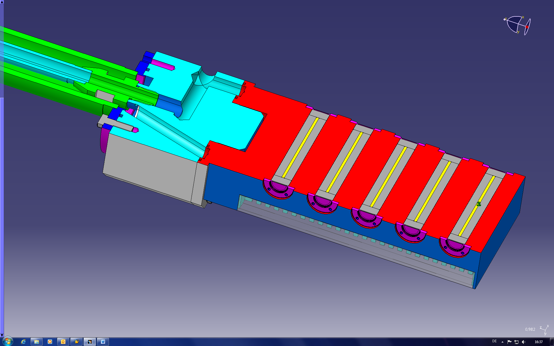
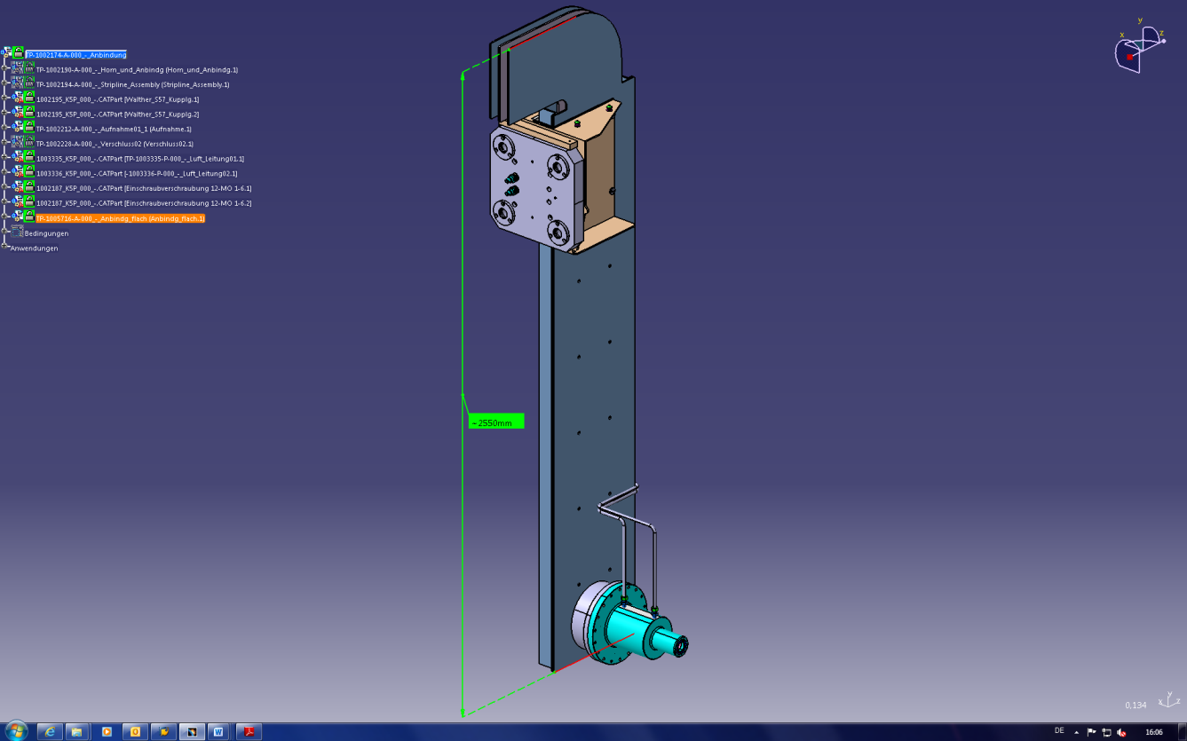
pbar Target and Magnetic Horn
air-cooled AL block
graphite
Ni rod, 110 mm, d = 3 mm

Slide 6
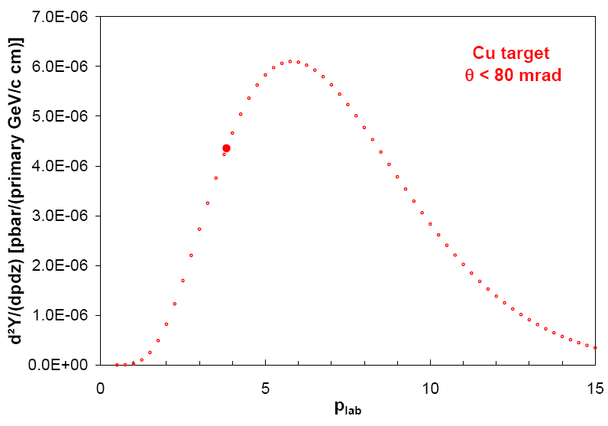
pbar Distribution After the Target
E_{p} = 29 GeV
y / cm
z / cm
p_{pbar} = 3.82 GeV/c ± 3%
From ~ 2.5 × 10⁻⁴ pbar / (p cm target) ~ 5 × 10⁻⁶ (or 2 %) are "collectable"
R.P. Duperray et al., Phys. Rev. D 68, 094017 (2003)

Slide 7
Collecting pbars: Magnetic Horn
B ∼ 1/r
primary beam does not hit the horn
reaction products

Slide 8
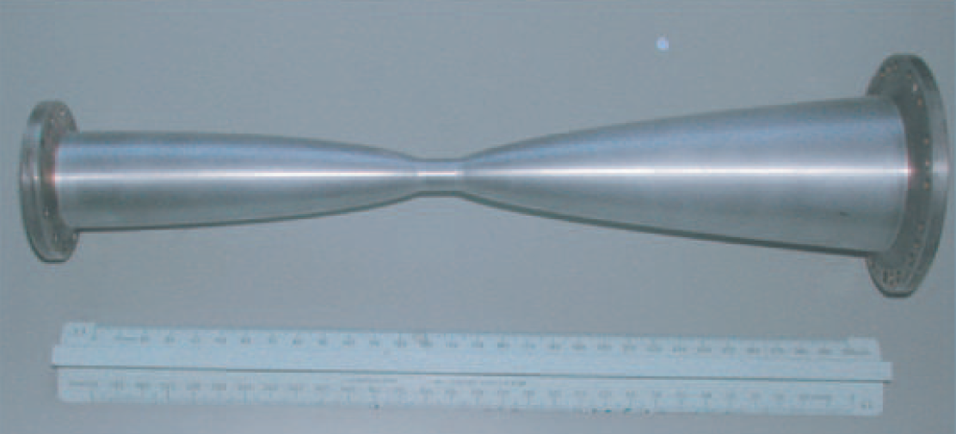
Collecting pbars: Magnetic Horn
CERN ACOL Horn, I = 400 kA
Negotiations for
the power pulser
in progress
(switches!)

Slide 9
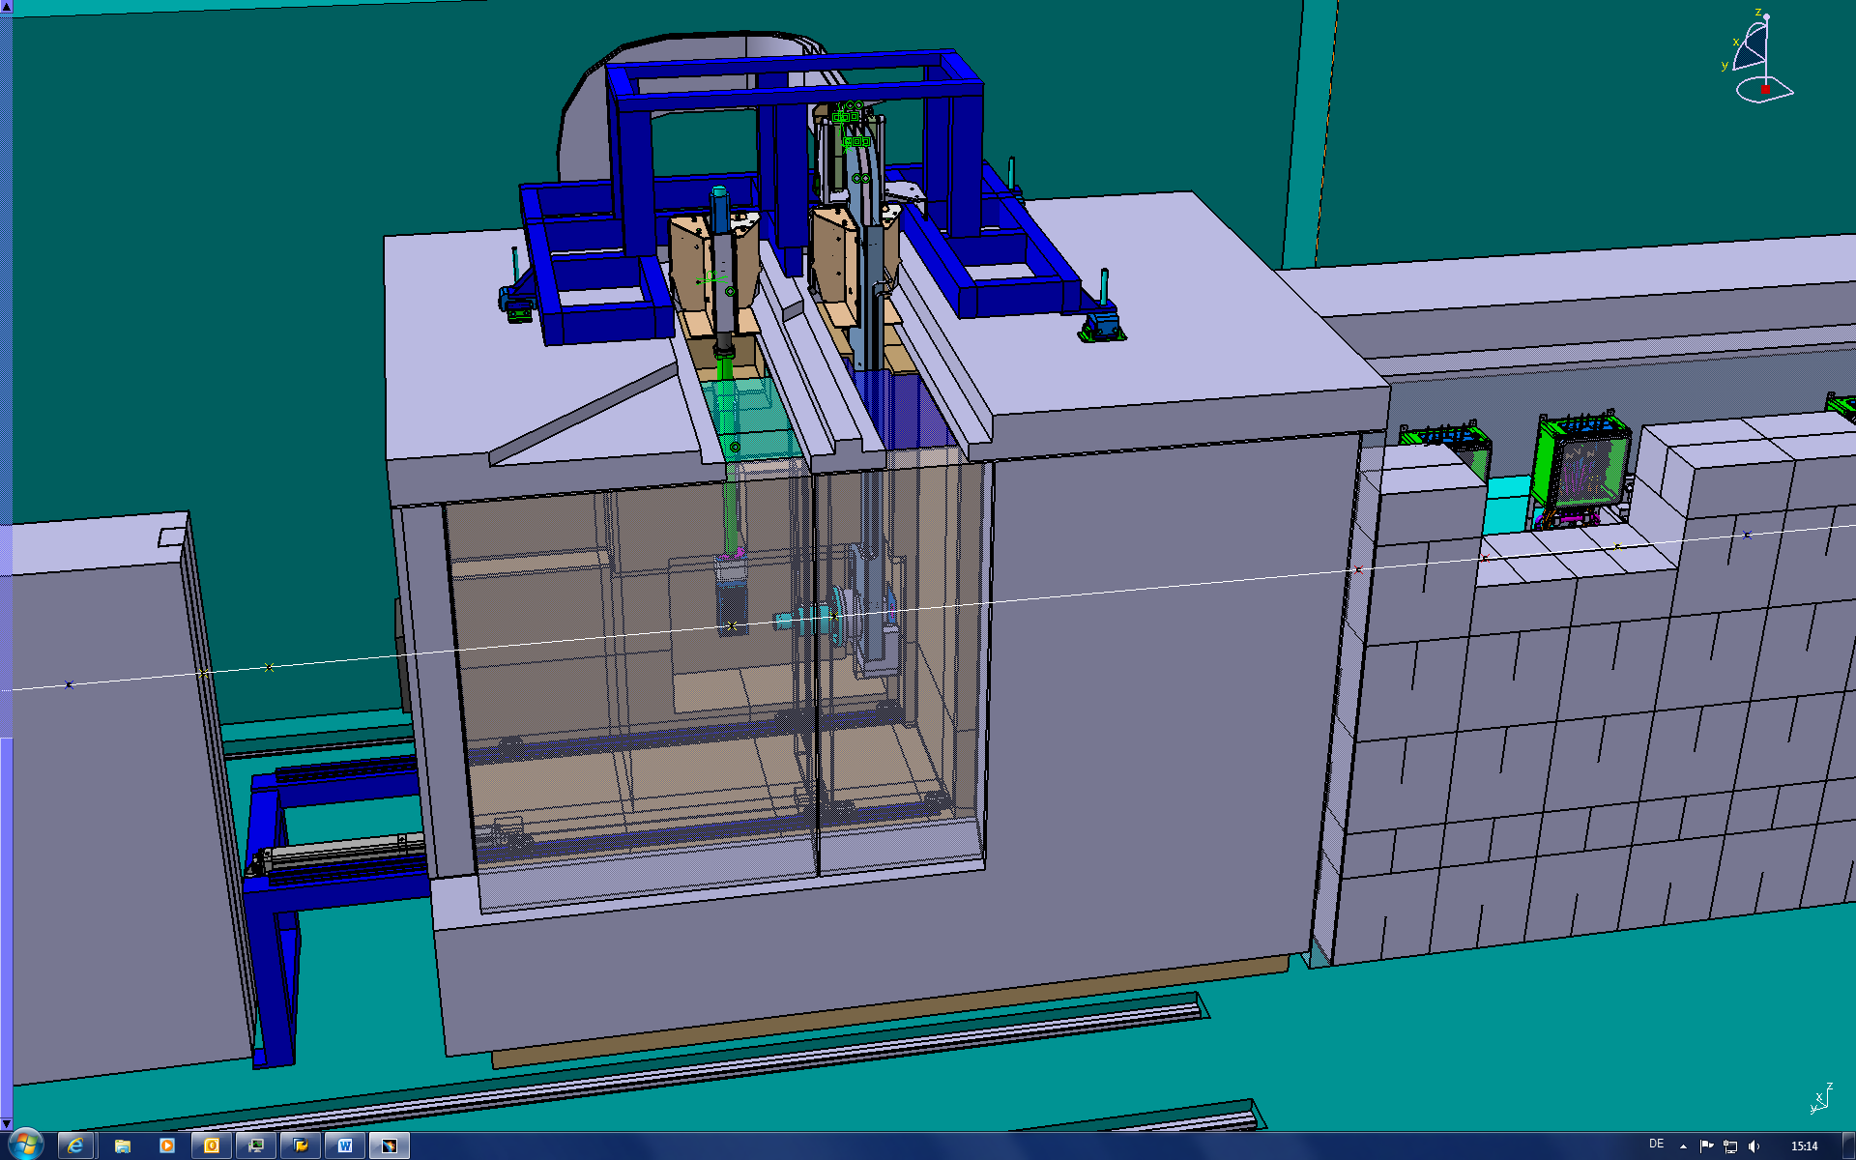
pbar Target station
BEAM
m = 200 t

Slide 10
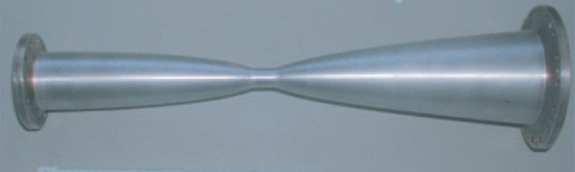
Collectible pbars
Emax SIS 100
y / cm
E_{p} = 29 GeV
magnetic horn
CR max. 13 Tm
z / cm
acceptance separator/CR
p_{pbar} = 3.82 GeV/c ± 3%
0 < p_{pbar} < 80 mrad
From ~ 2.5 × 10⁻⁴ pbar / (p cm target) ~ 5 × 10⁻⁶ (or 2 %) are "collectible"

Slide 11
Collectible pbars

Slide 12
Collectible pbars: Self Absorption
p
pbar
Cu: σ_{pbar} = 0.8 b

Slide 13
Collectible pbars: MARS/FLUKA
p
pbar
Cu: σ_{pbar} = 0.8 b

Slide 14
Collectible pbars: MARS
p
pbar
Cu: σ_{pbar} = 0.8 b

Slide 15
Collectible pbars: Graphite Surrounding
p
pbar
Cu: σ_{pbar} = 8.8 b
C: σ_{pbar} = 0.42 b

Slide 16
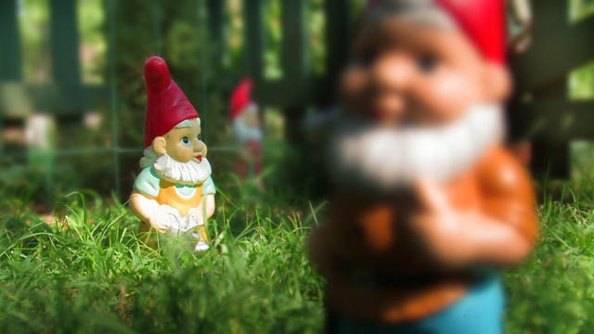
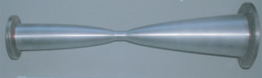
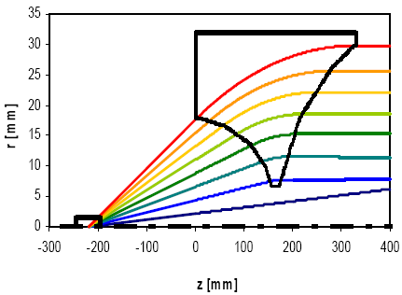
pbar Yield:
Collection efficiency of the magnetic horn
pbars in the ellipse
yield =
primary protons

Slide 17
pbar Yield: Comparison to CERN Data
To injection orbit of collector ring:
pbar/p ≈ 2×10⁻⁵ × 0.8 × 0.5 = 0.8×10⁻⁵
scattering losses/annihilation in air/aluminum losses in separator / during injection
Exp. data from CERN (Baird 1998) to injection orbit:
pbar/p = 0.45×10⁻⁵ × 1.5 = 0.7×10⁻⁵
correction for different energies and emmitances

Slide 18
Bottleneck: pbar Yield
For 1 antiproton in the CR at least
10⁵ primary protons on the target are needed.
I do not see room for significant improvements.
All optimization steps I can imagine are in the order of <20 %.
These numbers are for 400 kA horn current.
A reduced current will lead to a significantely lower yield!
Decreasing yield due to target damages?
Tuning of the separator with pions (I[π] = 100 I[pbar]),
different energy and angular distribution.

Slide 19
Prompt dose rates:
Construction permit 

Slide 20
Dose rates during operation (FLUKA):
Construction permit 
170 m

Slide 21
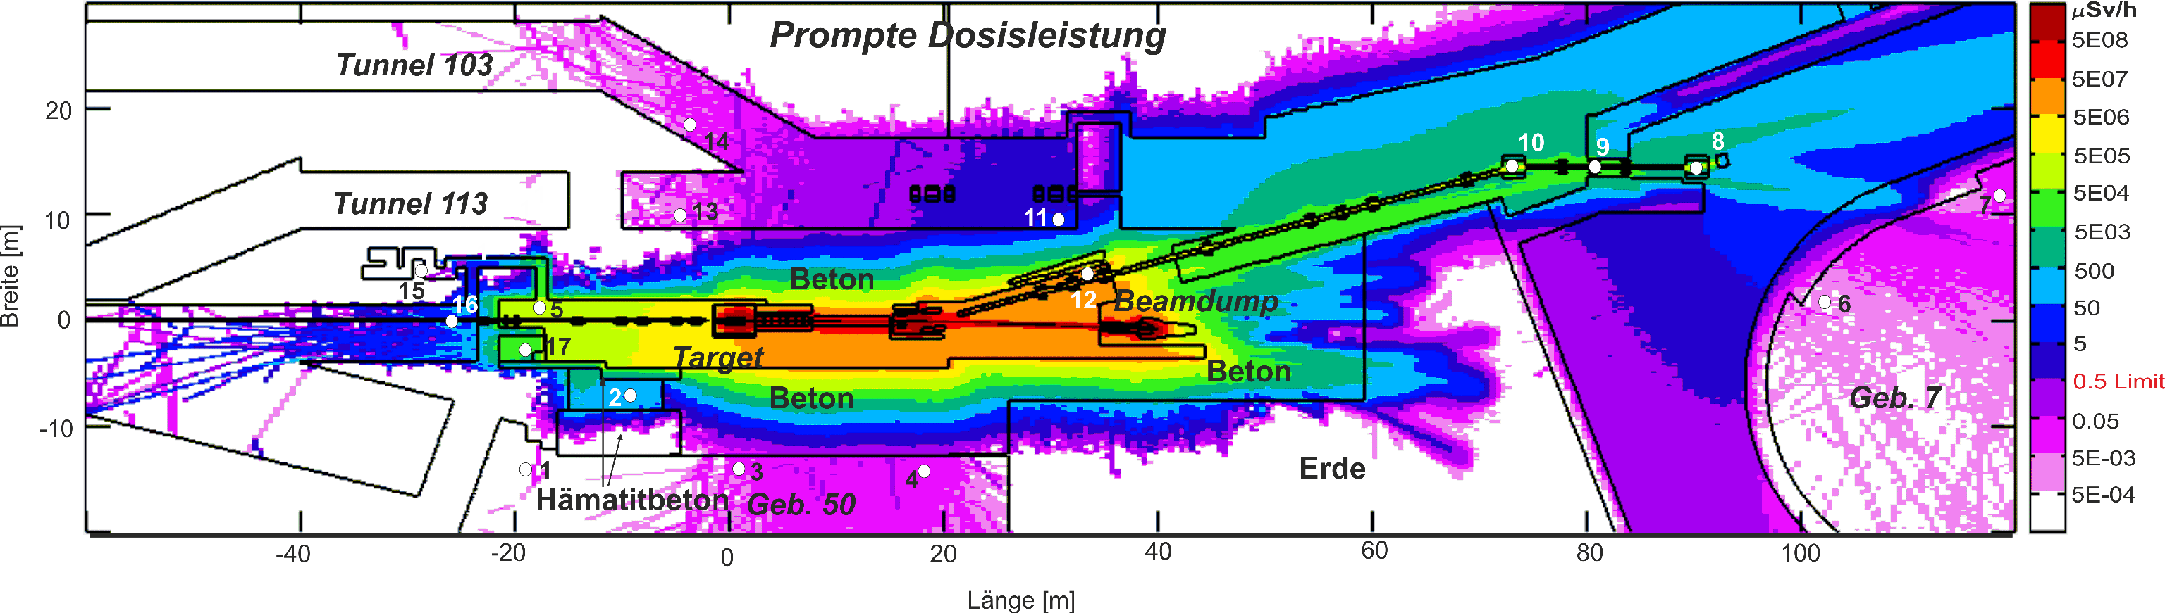
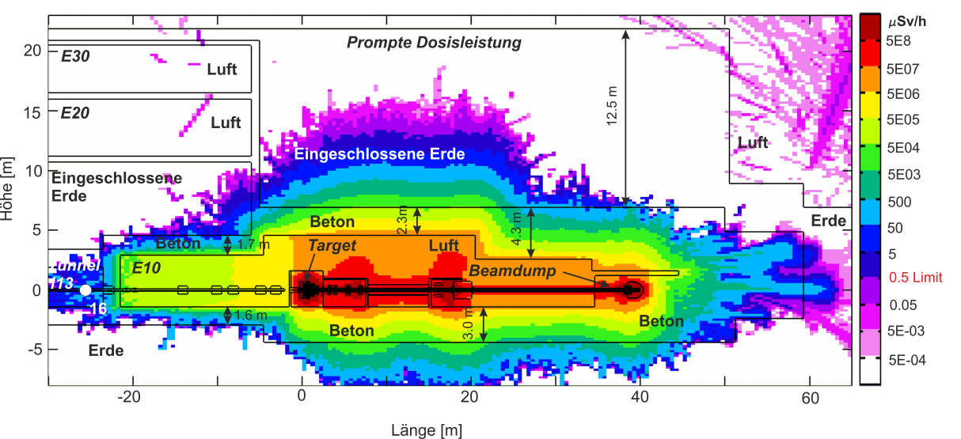
Dose rates during operation (FLUKA):
Construction permit 
horizontal cut
vertical cut

Slide 22
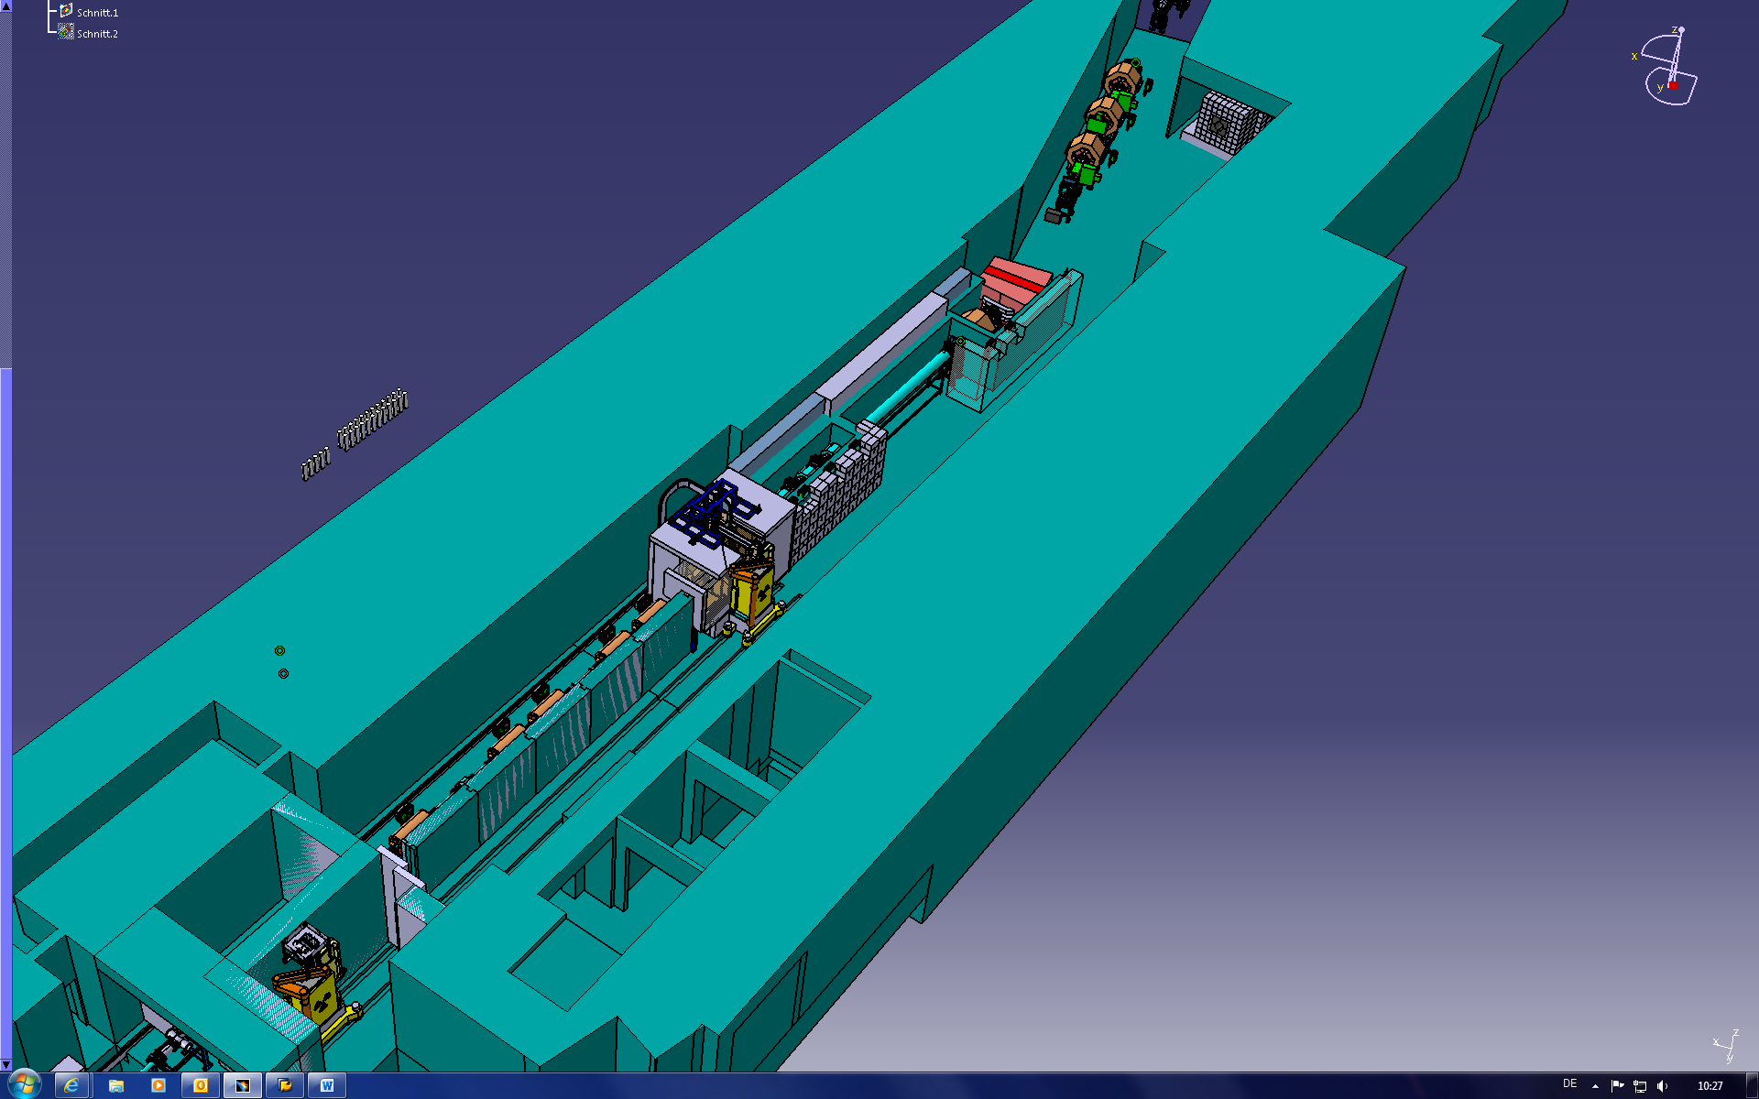
The pbar building
dump
target
7 m concrete walls

Slide 23
Residual dose rates:
Operation permit (in work)

Slide 24
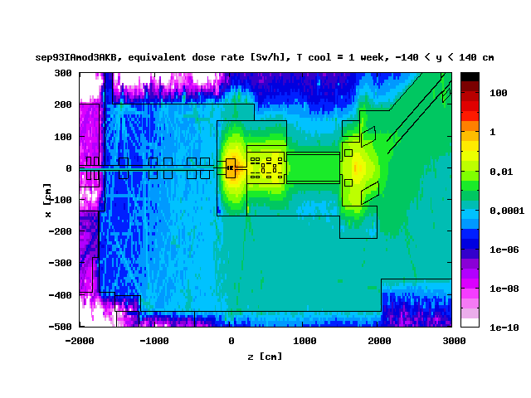
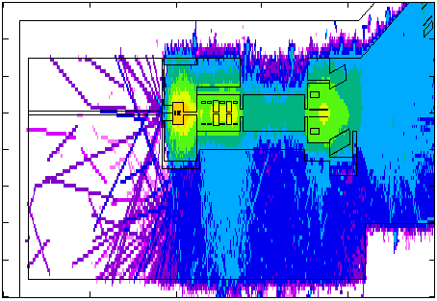
Residual dose rate around target station
Determination of residual dose rate important for operation permission!
BEAM
Input parameters: 5e12p/s,
irradiation time: 3.16E7 s
concrete
iron
Restricted area („Sperrbereich“)
concrete
Controlled area („Kontrollbereich“)
Handling Area
Monitored area
(„Überwachungsbereich“)
max. 0.5 µSv/h
air

Slide 25
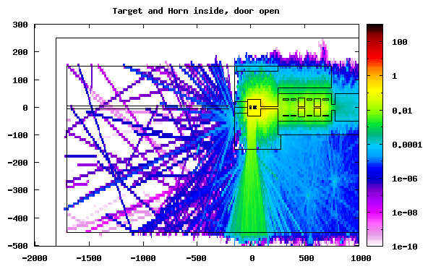
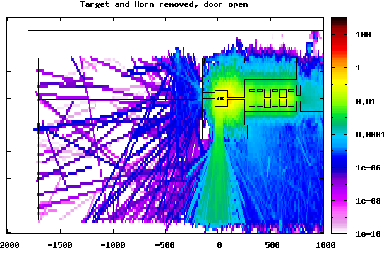
Residual dose for the open target station
Input parameters: 5e12p/s, irradiation time: 3.16E7 s, cooling time: 1 week
Target and magnetic horn inside
[Sv/h]
Target and magnetic horn removed
[Sv/h]
Door
[cm]
Irradiation with closed door THEN door is opened:
*...+....1....+....2....+....3....+....4....+....5....+....6....+....7....+....8
ASSIGNMA IRON Door VACUUM
THEN target and magnetic horn are set in the same way. (Not visible in geometry plot!)

Slide 26
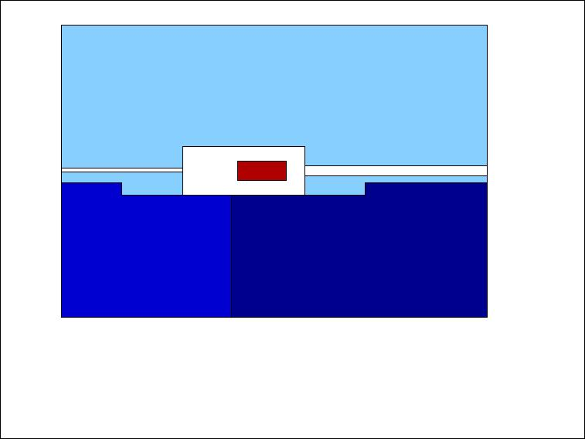
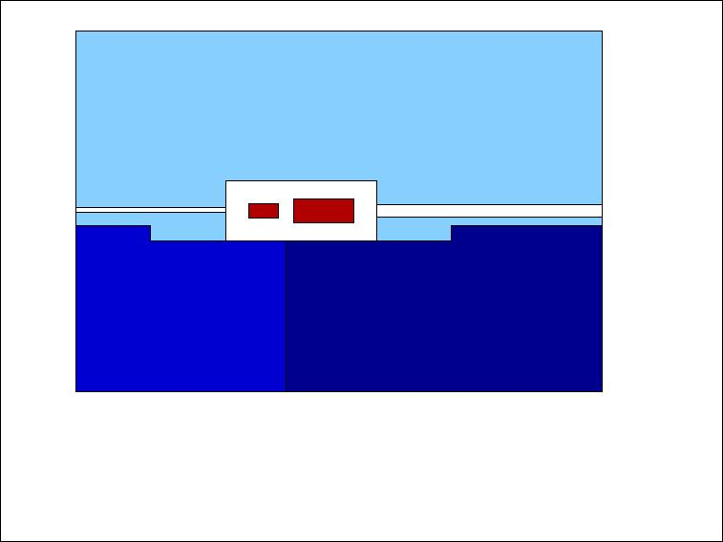
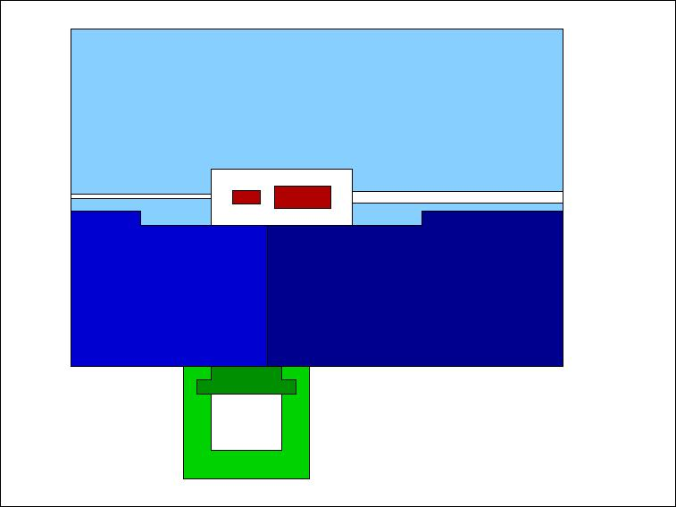
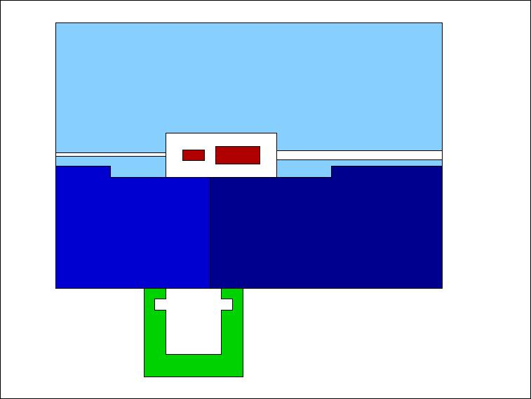
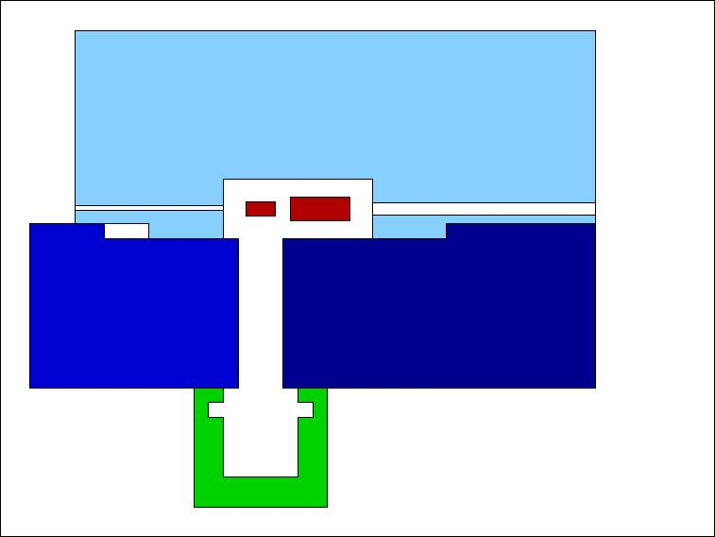
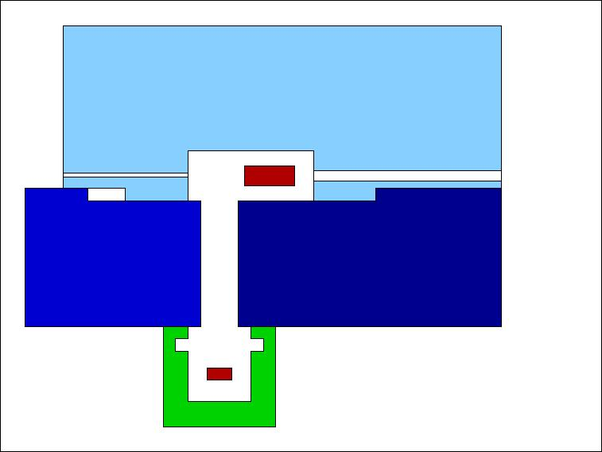

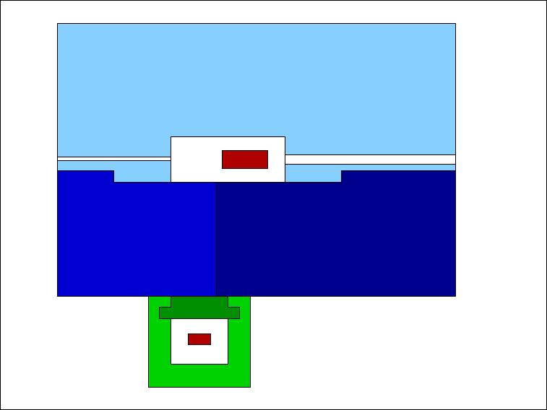
Bring the target out of the target station
Top view, beam from left to right. Inner part of target station is always shielded

Slide 27
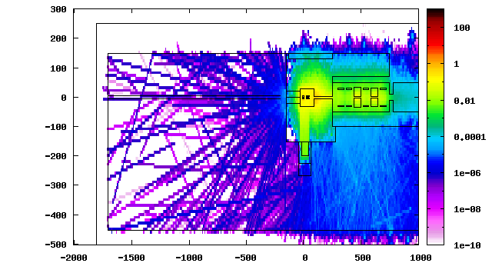
Residual dose during handling:
Transport container in front of target station
Input parameters: 5e12p/s, irradiation time: 3.16E7 s, cooling time: 1 week
[Sv/h]
Irradiation:
target station is closed,
container not placed.
THEN door of target station is opened with container in front (subsidiary region around container).
Door
Container
(iron)
[cm]
*...+....1....+....2....+....3....+....4....+....5....+....6....+....7....+....8
ASSIGNMA IRON Door VACUUM
ASSIGNMA BLCKHOLE Cont VACUUM

Slide 28
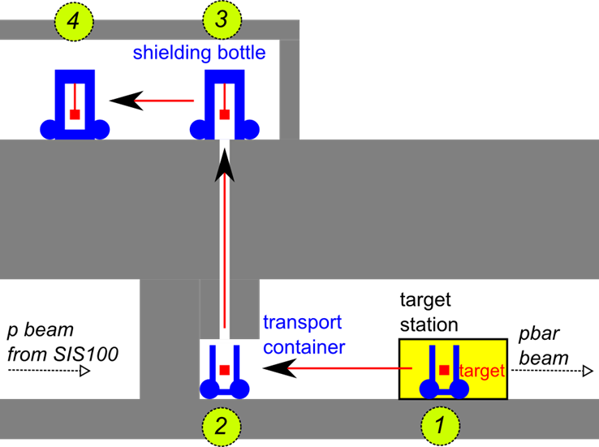
Transport concept in building 6c:
Operation Permit (in work)
Transport container moves to the shaft (1-2).
Crane of carrying frame of the shielding flask lifts up the component (3).
Preliminary, but very positive
statment from authorities obtained already.

Slide 29
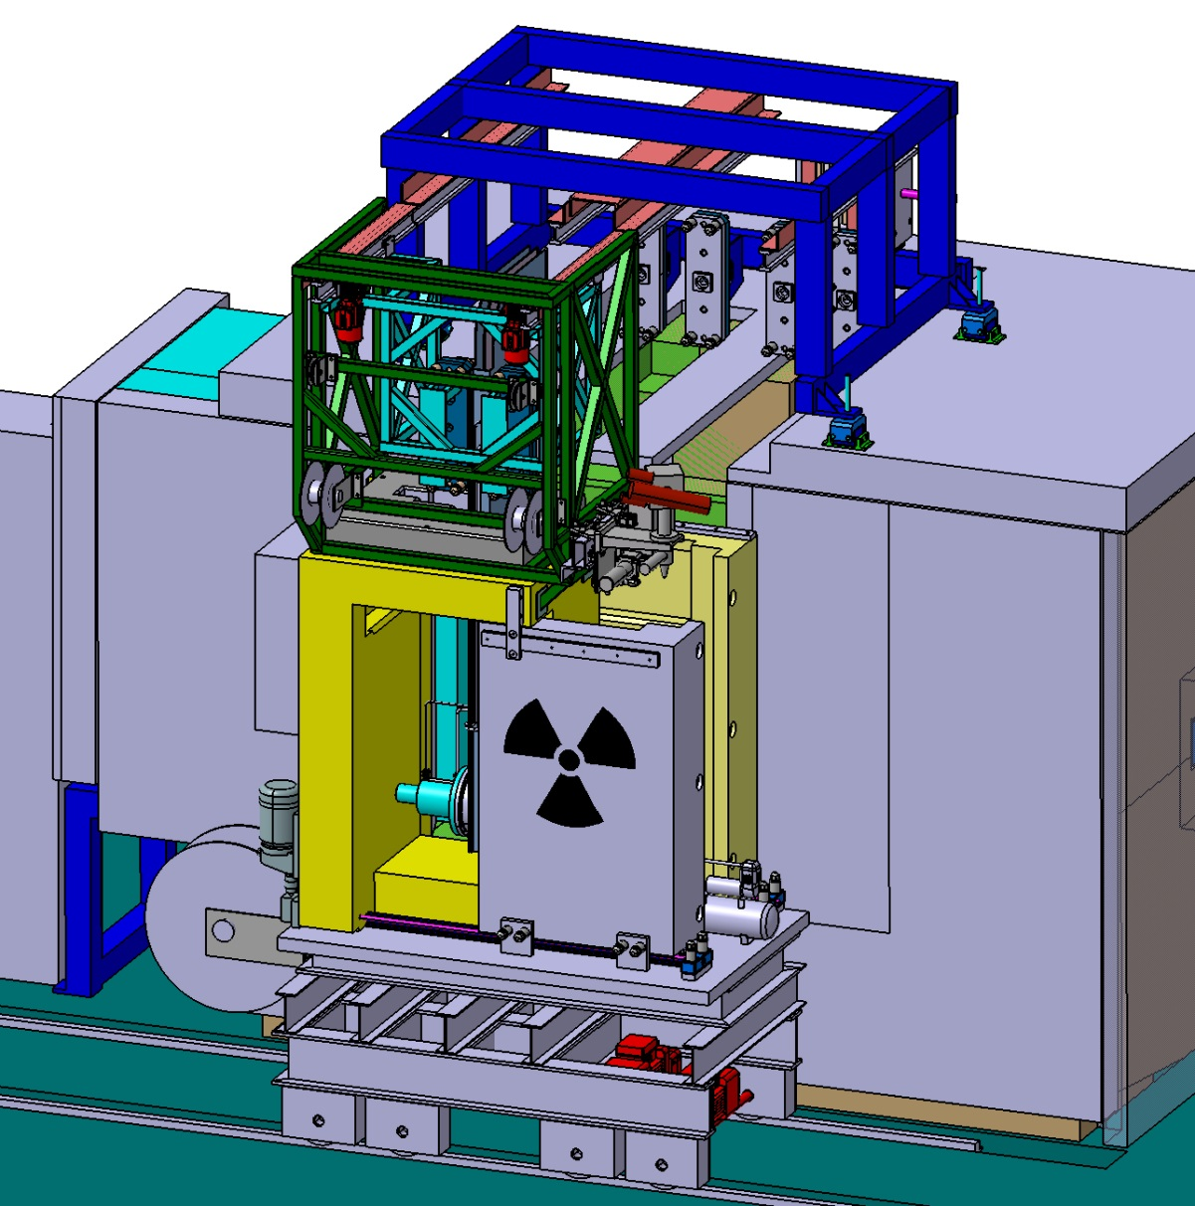
Target station and transport container
Rail system
Transport container is placed in front of target station.
Door of target station and transport container are opened.
Component is gripped by a quick coupling system.
Trolley moves the component via rail system into the transport container.
Doors are closed.
Coupling
system
Trolley
Inner door
Front door (for
intervention only)

Slide 30
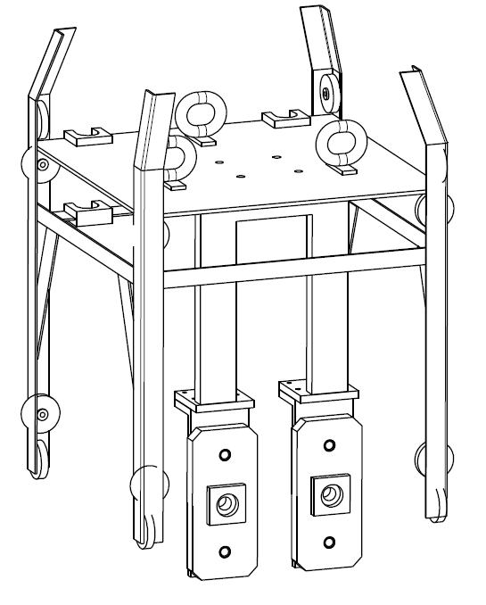
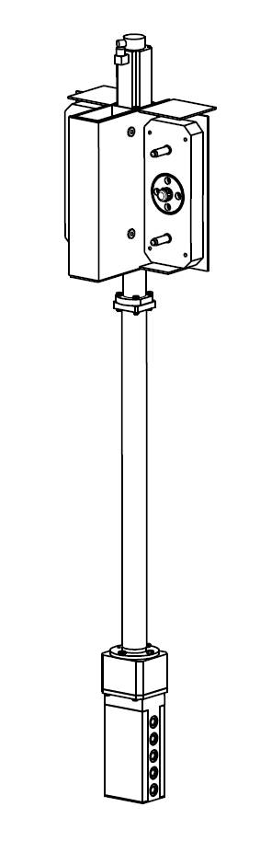
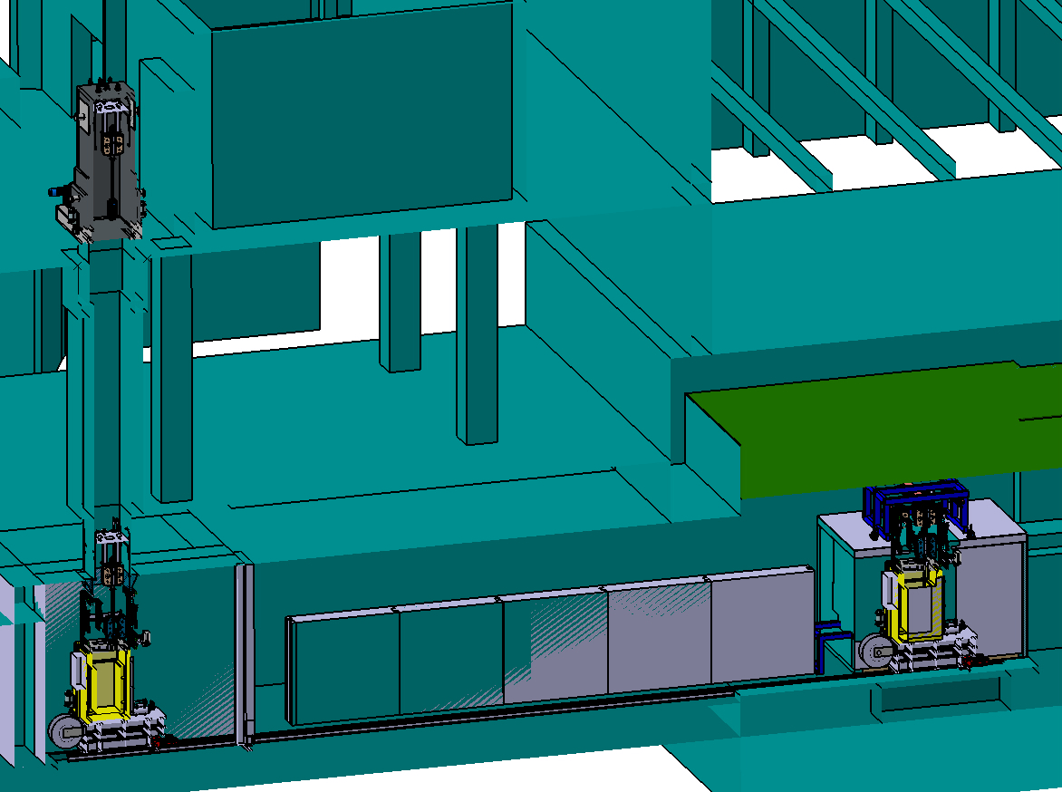
Overview of transport
3
1
2

Slide 31
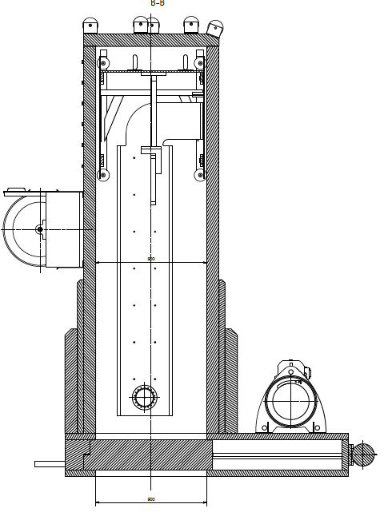
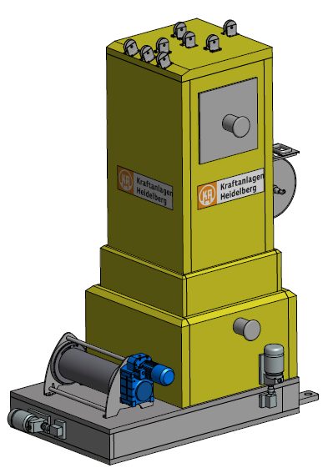
pbar shielding flask: technical design
weight: 25 tons

Slide 32
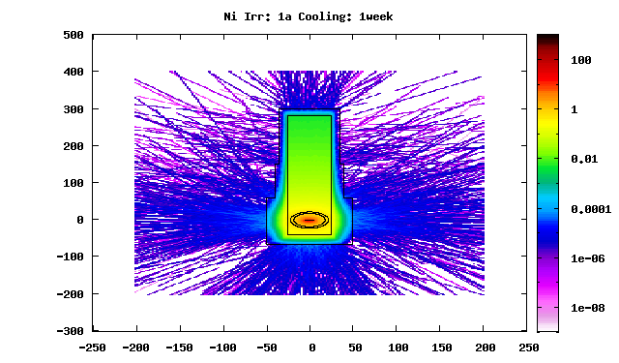
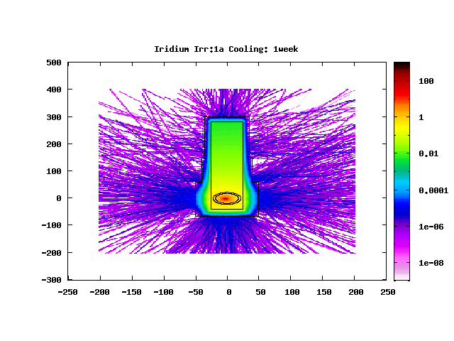
Dose rate calculations for the shielding flask
Agreement: Design according to a dose rate at the surface of max.100 µSv/h.
[Sv/h]
Nickel target
Primary beam activates target
directly inside of shielding,
but does not hit the flask
Iridium target
[cm]
Cross-check with Microshield *)
1250-3000 mm | max. 98 µSv/h
850-1250 mm | max. 95 µSv/h
0-850 mm | max. 72 µSv/h
[cm]
*) Kraftanlagen Heidelberg

Slide 33
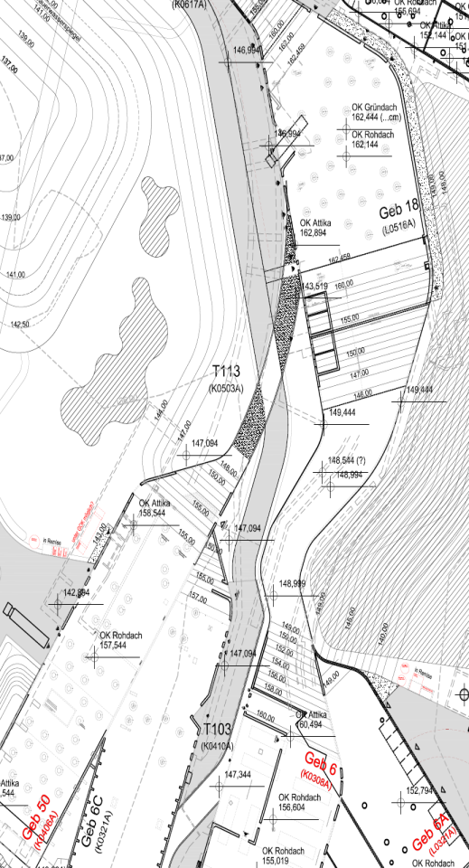
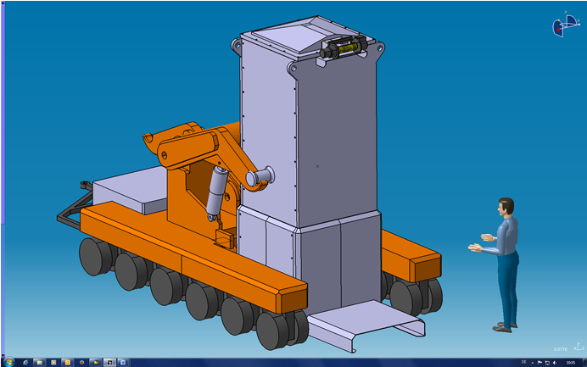
Transport outside of the building
200 m
flat surface
Special design for trailer necessary;
no standard vehicle avaliable.
First positive statement of authorities for transportation concept is already obtained.

Slide 34
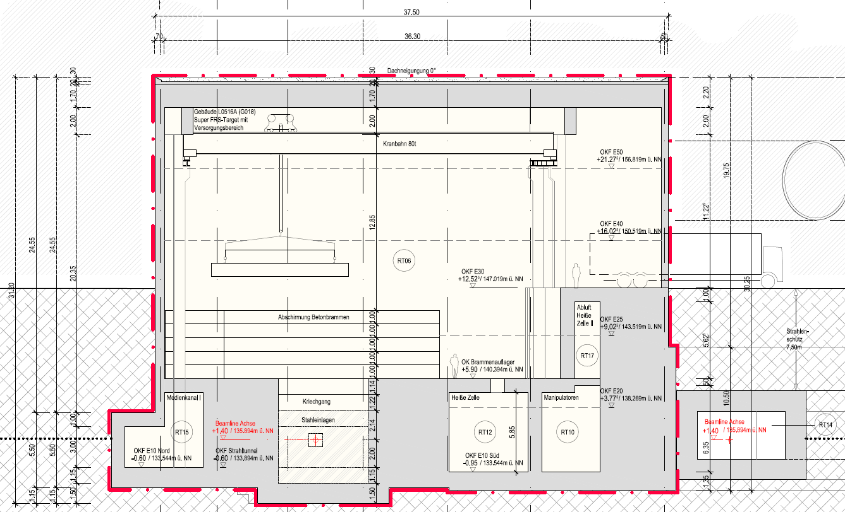
Hot cell in
SuperFRS building
6 m (!)

