Slide 1
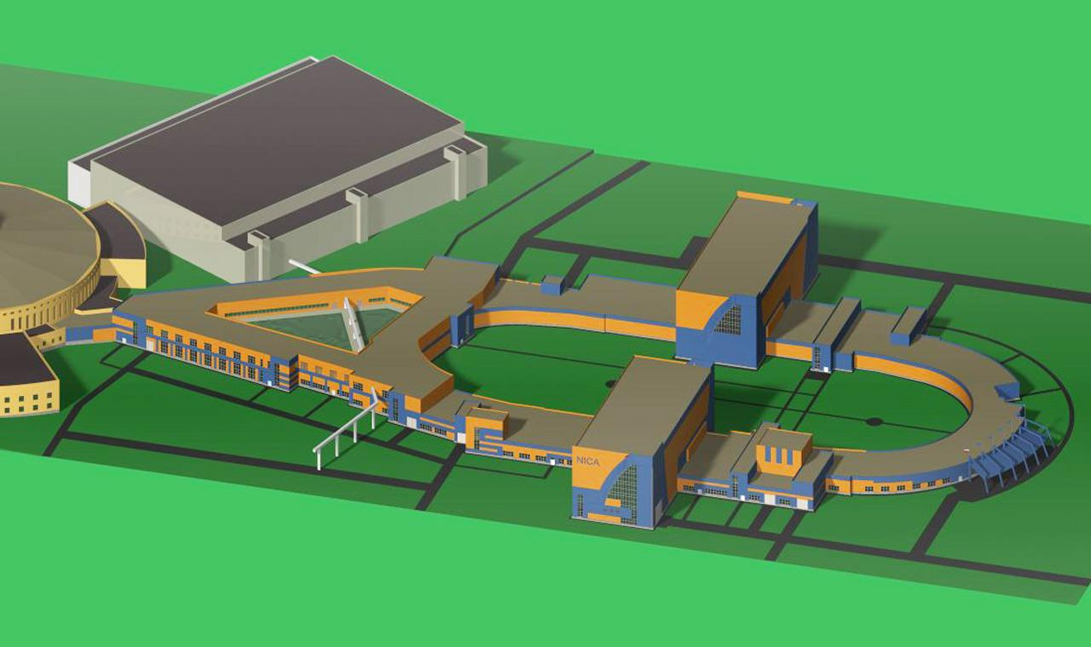
Stochastic cooling at NICA
GSI/FAIR Workshop on Stochastic Cooling
Monday 21 January 2019 - Wednesday 23 January 2019
A.Sidorin
For NiCA team

Slide 2

Contents
Role of the stochastic cooling
Requirements to cooling system
Location at the collider
Design of pick-ups and kicker
Strategy of the realization

Slide 3
Role of the stochastic cooling
The cooling is applied during:
Beam stacking
beam bunching
during collisions

Slide 4
Beam stacking
The stacking is provided in longitudinal phase space
using moving barriers
The stack length is kept constant ~ half of the ring circumference
Addition of a new injection portion leads
to increase of the stack momentum spread
Between the injection pulses (10 sec)
the longitudinal cooling has to compensate this increase
Expected transverse emittance at injection
is less than required at collisions by about 4 times:
transverse cooling (if necessary) has to limit the emittance growth
Deep longitudinal cooling has to be avoided to prevent
microwave instability

Slide 5
Beam bunching
Before the bunching the beam occupies total circumference
RF amplitude is increased adiabatically:
Longitudinal cooling is necessary to decrease the bunch length
Transverse cooling (if necessary)
stabilizes the beam emittance at required value
The momentum spread increases

Slide 6
Cooling during collisions
The stochastic cooling is operated in IBS dominated energy range
Cooling has to compensate the IBS heating
Minimum heating rate corresponds to
thermal equilibrium between degrees of freedom
Requirements for cooling id weaker at larger emittance
The cooling has to stabilize
the emittance at acceptance limit (~ 1 π⋅mm⋅mrad)
the momentum spread at thermal equilibrium (~ 10⁻³)

Slide 7
Requirements to cooling system
Most critical is longitudinal cooling
In all the regimes the cooling is operated at large momentum spread:
one needs to provide large cooling acceptance
That restricts a choice of the cooling method
The expected heating times are in the range 500 – 1800 sec

Slide 8
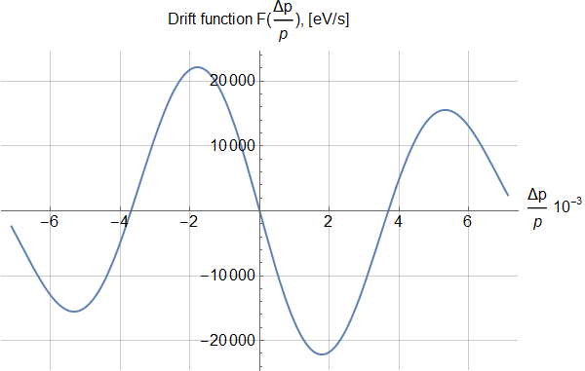
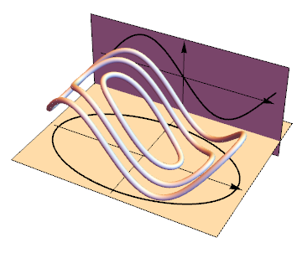
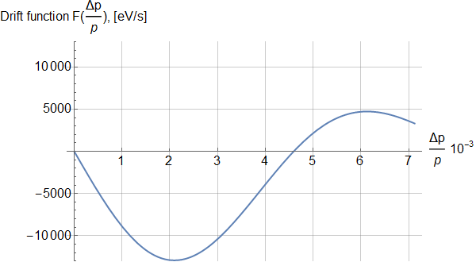
Cooling acceptance for bunched beam
Filter cooling, Au 3.4 GeV/u
Coasting beam
For bunched beam the variation
of the oscillation amplitude is calculated
by averaging over phase trajectory.
Estimate assuming elliptical trajectory:
Drift term for amplitude of longitudinal oscillations
For the bunched beam the acceptance about 30% wider

Slide 9
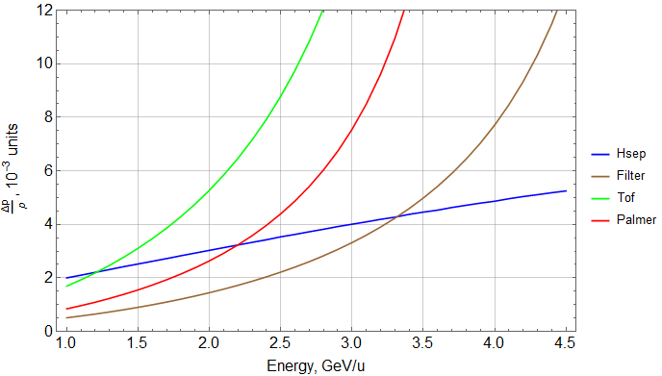
Cooling acceptance for bunched beam
SC region

Slide 10
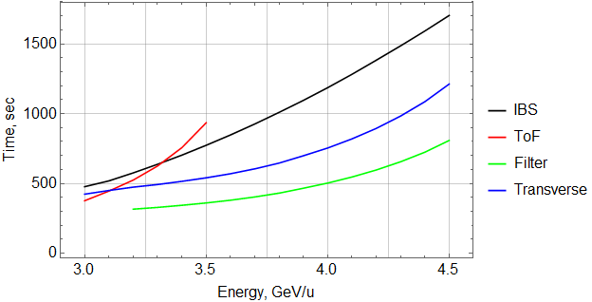
Cooling times

Slide 11
Longitudinal cooling
The filter cooling provides required cooling times (with reserve),
However in the range 3 – 3.3 GeV/u the acceptance
is less than separatrix height
In the range 3 - 3.3 GeV/u TOF provides
required acceptance and required cooling times
The base line is to use Filter at large energies
and TOF at small energies
Palmer method is kept as a reserve option:
-it requires two pick-ups (because of small dispersion and large emattance)
we have limited space in arcs
complicated design

Slide 12
General parameters of the SC system
Energy range | 3 – 4.5 GeV/u
Band width | 2 – 4 GHz
Pick-up impedance | 288 Ω
Peack/mean power at the pick-up output | 30/2 nW
Kicker impedance | 576 Ω
Mean power at the kicker | 500 W
Gain (without additional losses) | 110 дБ

Slide 13
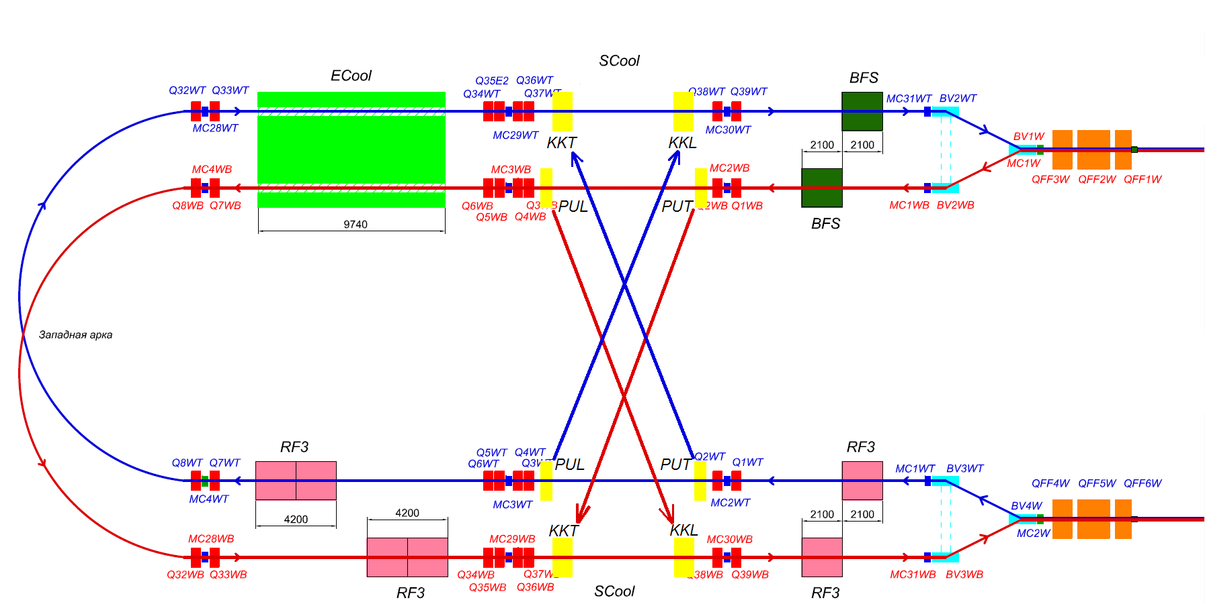
Location at the collider
Half of the ring

Slide 14
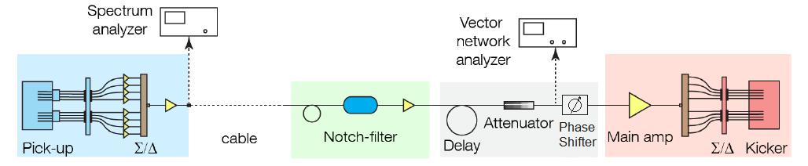
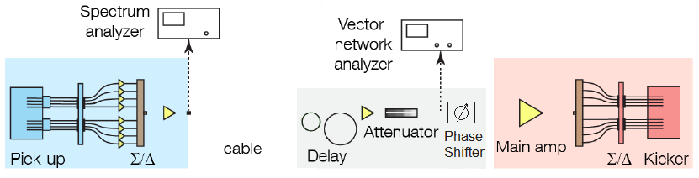
RF scheme
Longitudinal
Transverse
Diagnostics
Spectrum analyzer | Rohde&Schwarz FSV7 | Schottky measurements
Vector analyzer | Rohde&Schwarz ZNB4 | BTF measurements
Power meter | Rohde&Schwarz NRT + Z43 | Amplification

Slide 15
Pick-up and kicker design
The prototype is HESR design (R.Stassen)
Ring slot-coupler
Basic structure – 16 rings
Aperture - 90 mm
Impedance of 1 ring – 9 Ω
Length – 200 mm
NICA aperture is 100 mm
To obtain UHV conditions (10⁻¹¹ Torr) can be a problem

Slide 16
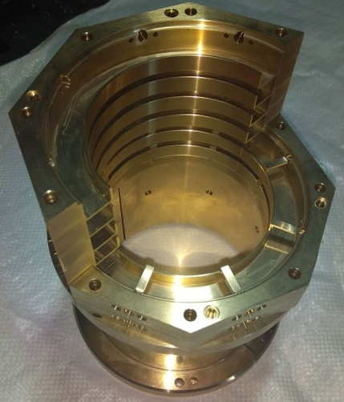
Pick-up and kicker design
NICA solution:
Cut ring slot-coupler assembled around ceramic vacuum chamber
The dimensions are recalculated for 100 mm aperture
Pick-up – two basic structures plus HOM suppressors, Kicker - 4

Slide 17
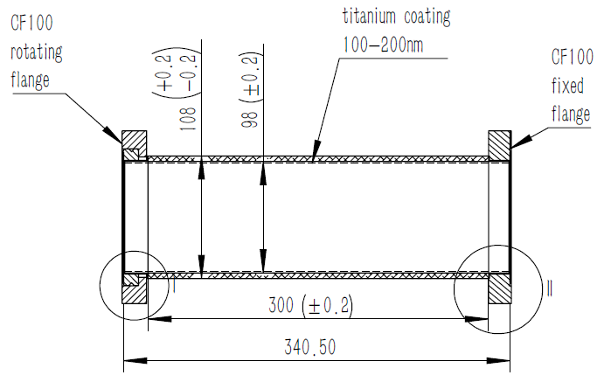
Vacuum chamber
Negotiations with
Kunshan Guoli electronic technology Co., Ltd
Material – Aluminium Oxide | Al₂O₃; ≥99,0%
Average Size of Crystallites, mkm | ≤ 10
Porosity, % | 0
Dielectric Constant | ≤ 10
Side Flanges | CF100
Inner metallization | Titanium, 100-150nm
Electric contact of inner layer with outer flanges | +
Leaking Rate | ≤10⁻¹⁰
Heating while decontamination treatment | Up to 250⁰С * 48 hours

Slide 18
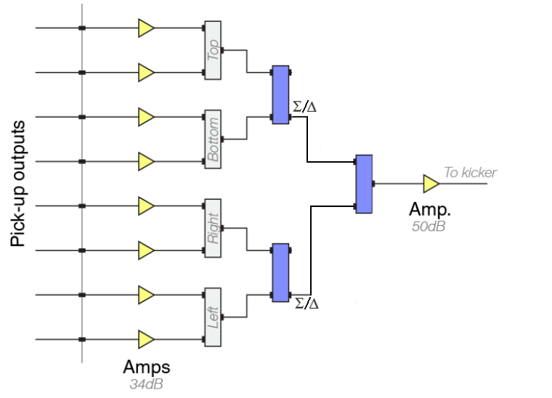
Low level RF
Amplifier 34 dB | Miteq JS-2-02000400-05-10P
Combiner 0 ̊ | Lynx 111.A0232
Combiner 180 ̊ | Anaren 10016-3
Amplifier 50 dB | Miteq AMF-4F02000400-05-10P

Slide 19
Notch filter
Optic platform with laser (10 mW, 1550 nm), divider and attenuators (0-70 dB) | Viavi MAP-200
Modulator (1550 nm, 12 GHz) | Photline Technologies MXAN-LN-10-00
Photodetector (1280-1620 nm, 20 GHz) | Gooch&Housego EM169-03
Total gain | 12 dB
Total delay | 47,1 ns
Variable attenuator 0-55 dB | Aeroflex Weinschel 3406-55
Variable optical delay15,5 ns step 0,5 ns | Agiltron SSTD 525111303
Variable optical delay 250/330/560 ns, step 1 ps | General Photonics MDL-002

Slide 20
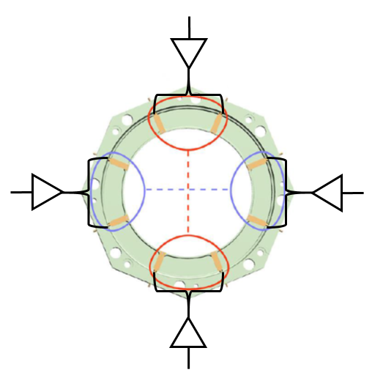
Kicker design
Four basic structures + HOM suppressors
Length – 1200 mm
Impedance ~ 576 Ω
Four 30 W amplifiers for each basic structure
Amplifiers:
Rohde&Schwarz BBA-150-D30
or OKB TSP Minsk
Splitter
Lynx 111.A0232
Peak power per kicker 480 W

Slide 21
Strategy of realization
Test experiment at the Nuclotron (2013)
Investigations at the Nuclotron
Test bench studies for technology development (2018)
Test of pick-up at the Booster (2019)
Assembly at the collider (2020)
Start-up mode (longitudinal cooling only) 2021
Project configuration (3D cooling) 2022?

Slide 22
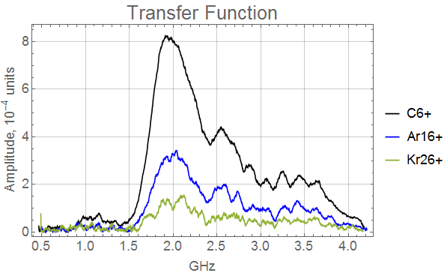
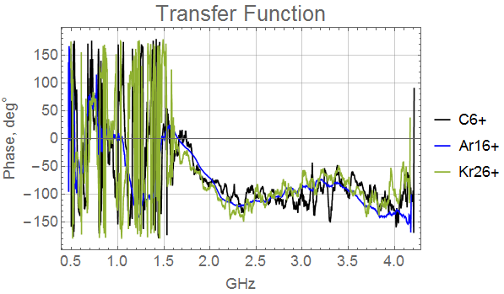
Nuclotron
Run #55 (2018)
Measurements with two amplifiers
in parallel

Slide 23
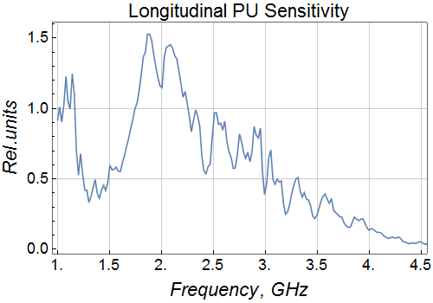
Nuclotron
Run #55 (2018)
Measurements with two amplifiers
in parallel
Measurements with deuterons

Slide 24
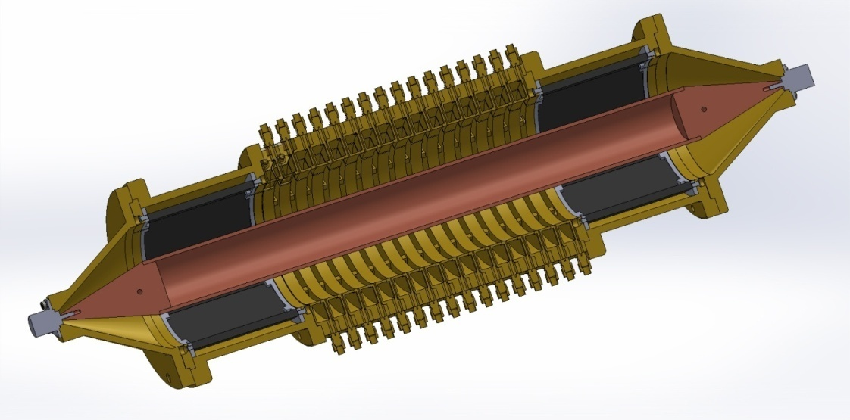
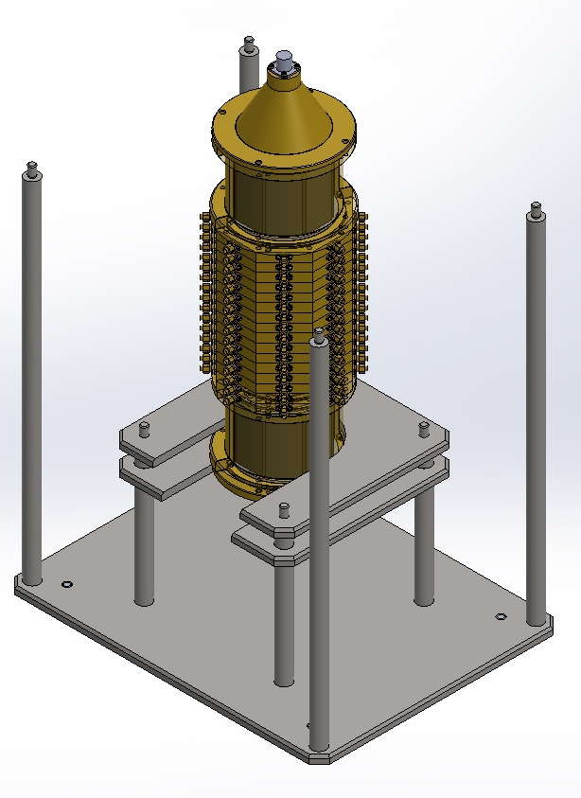
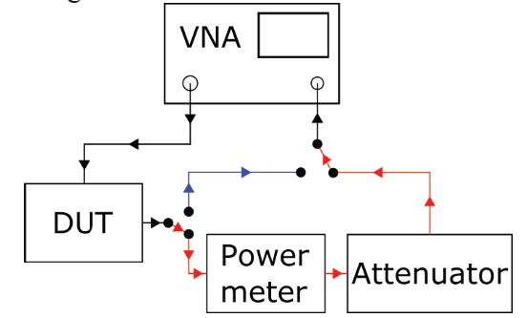
Pick-up test bench
First stage – HESR geometry but new technology
Second stage – prototype at recalculated geometry (under manufacturing)

Slide 25
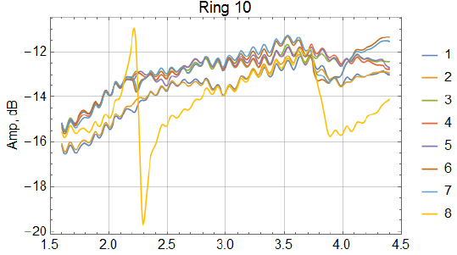
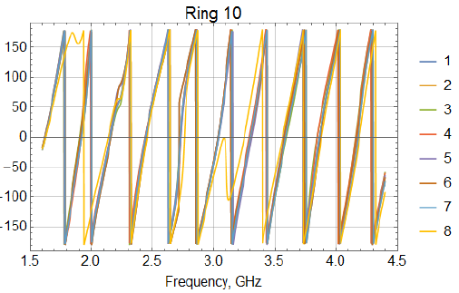
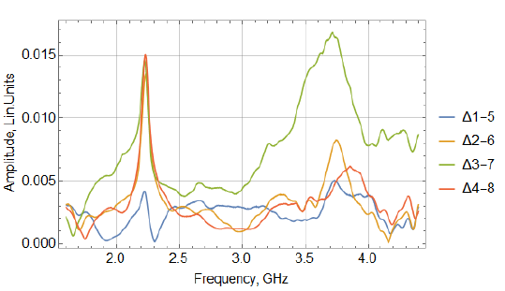
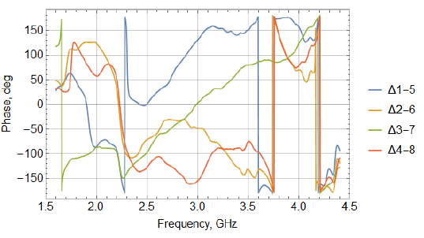
Example of measurements
Sensitivity of the loop
Electrical center position

Slide 26
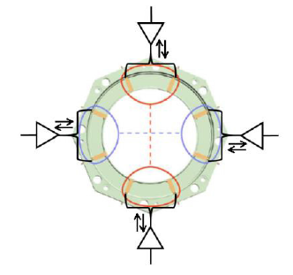
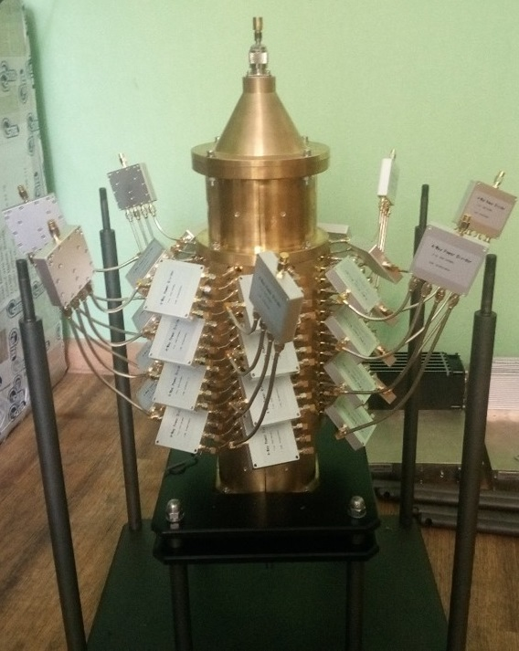
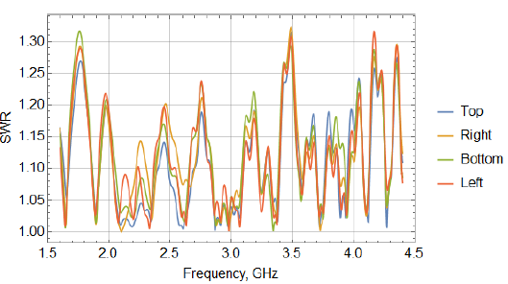
Example of measurements
Kicker SWR

Slide 27
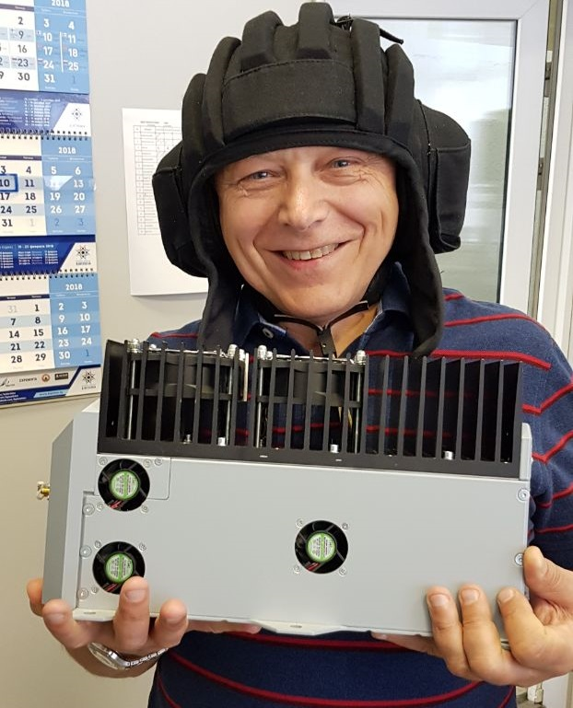
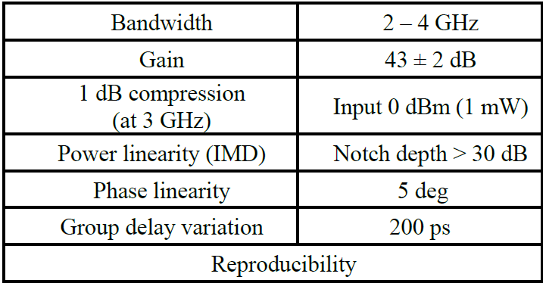
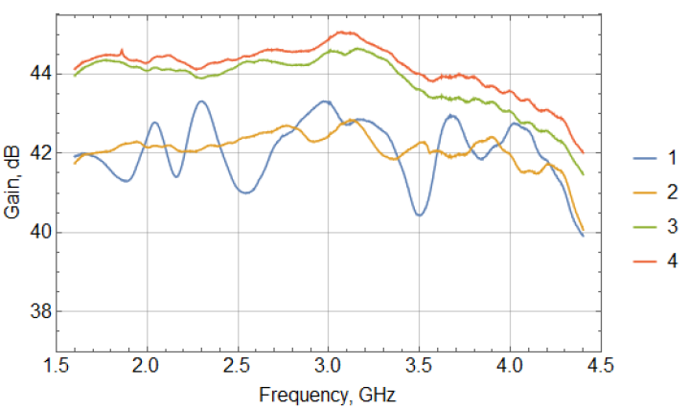
Amplifiers OKB TSP

Slide 28
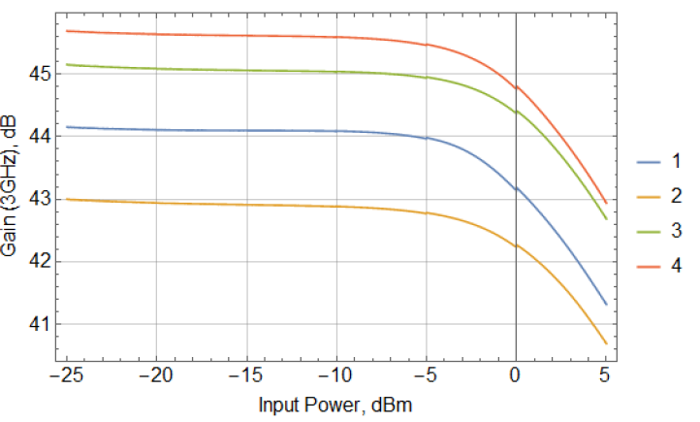
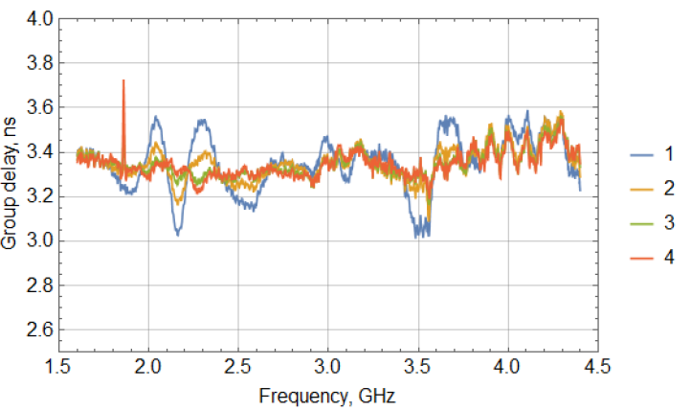
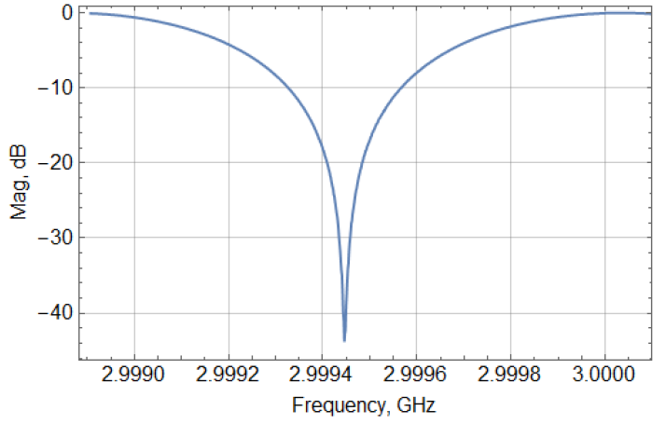
Amplifiers OKB TSP
Gain as function of input pover
Group delay
Notch depth with amplifier

Slide 29
Test at the Booster
The Booster magnetic rigidity is 25 T⋅m – Energy of C⁺⁶ ~ 3 GeV/u
Pick-up with aperture of 100 mm is under manufacturing and
will be installed at the Booster straight section
During first Booster run with a beam we plan to measure
longitudinal and transverse signal for coasting and bunched beams

Slide 30
Conclusions
R&D for PU and amplifiers is in the final stage
(preliminary results are satisfactory)
Technical design is completed
Purchase of the equipment in accordance with schedule
Start of operation 2021

Slide 31
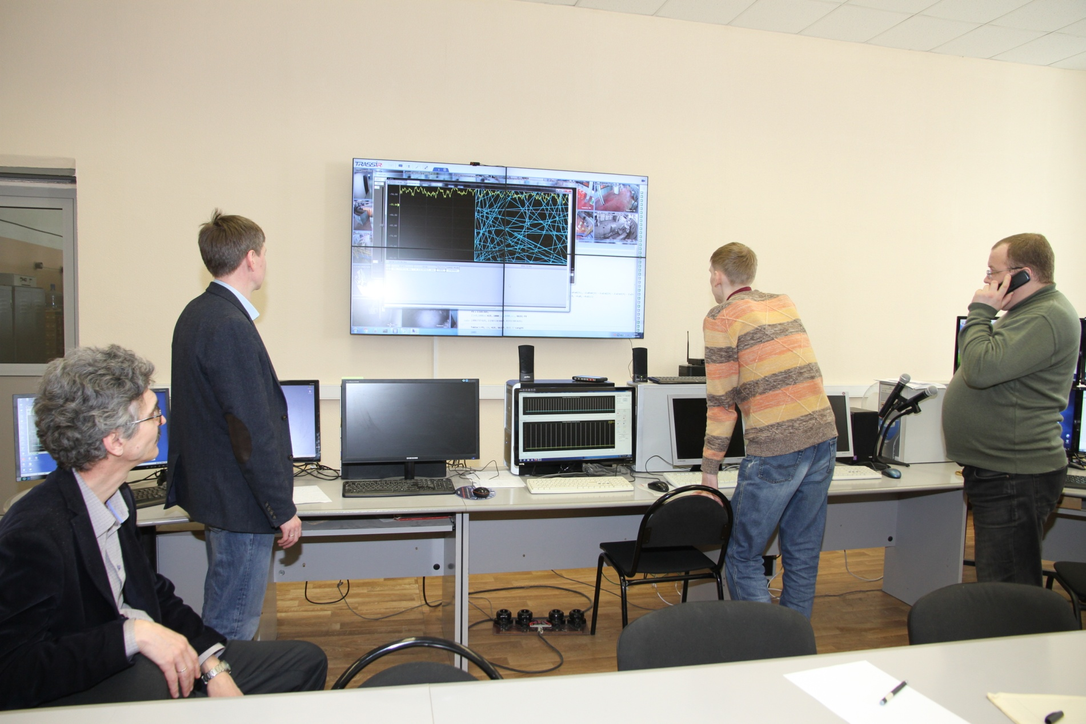
Thank your for attention

Slide 32
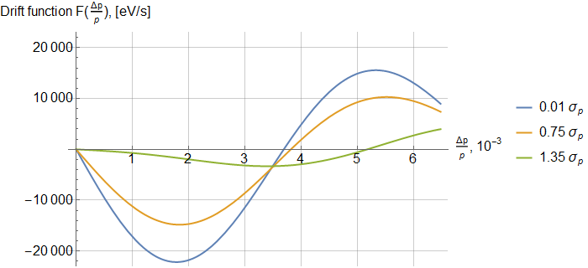
Cooling acceptance for Barrier Bucket
Filter cooling, Au 3.4 GeV/u
The filter frequency is shifted from revolution frequency (determined by RF)
Extra slide

