Slide 1
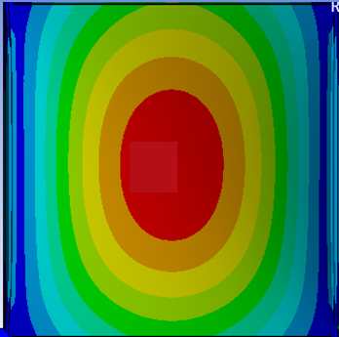





Preliminary results of the structural analysis of the Bucharest TRD Module Type 1 (Buch-TRD)
Laura Radulescu for CBM-TRD Bucharest team
CBM-TRD Retreat, 27-29 March, 2019

Slide 2
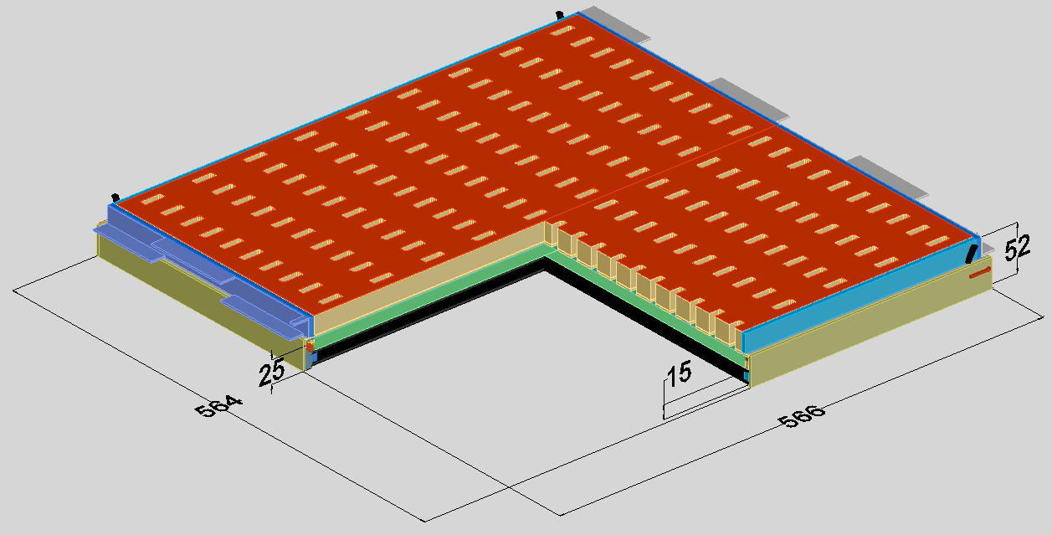
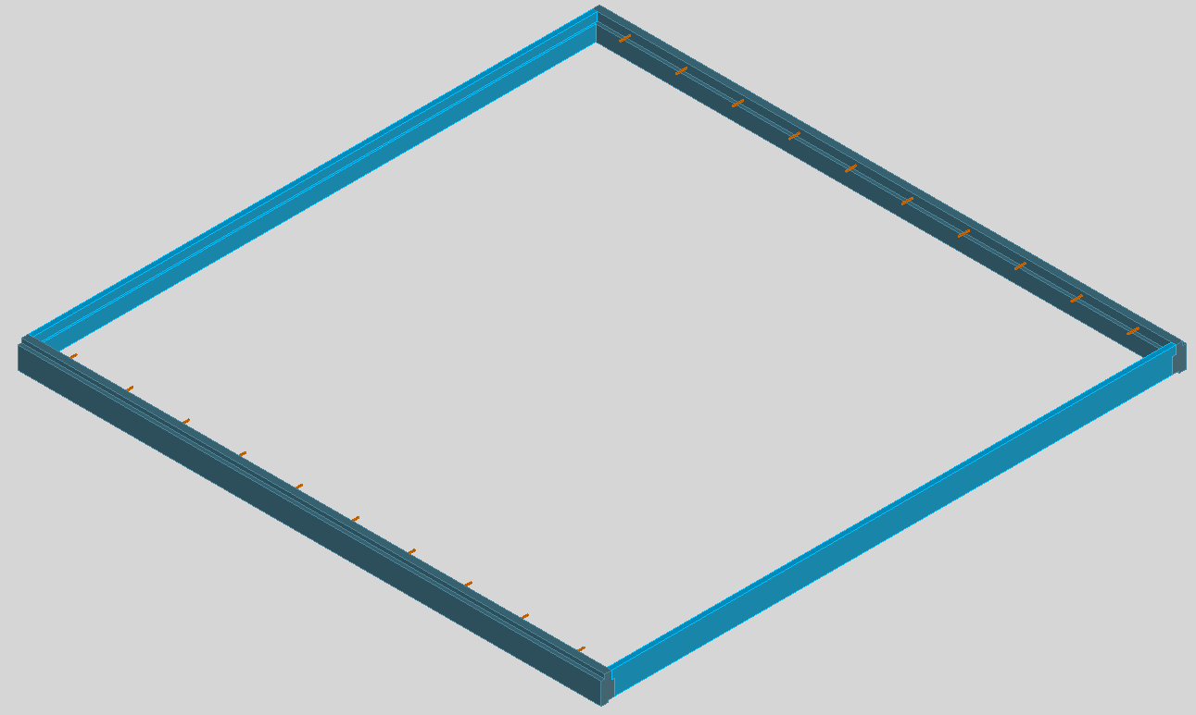
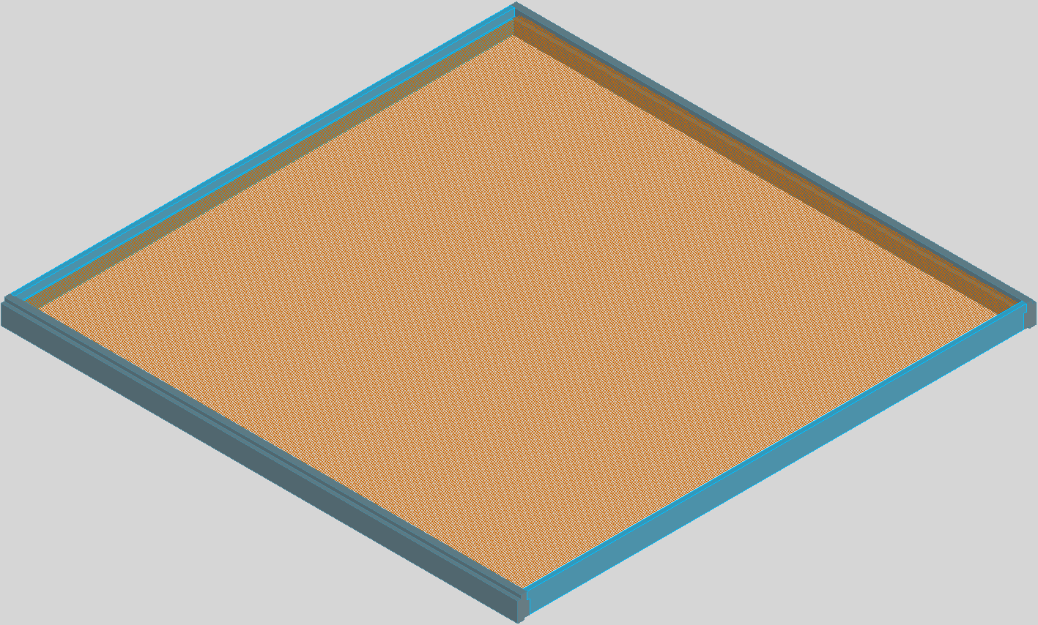
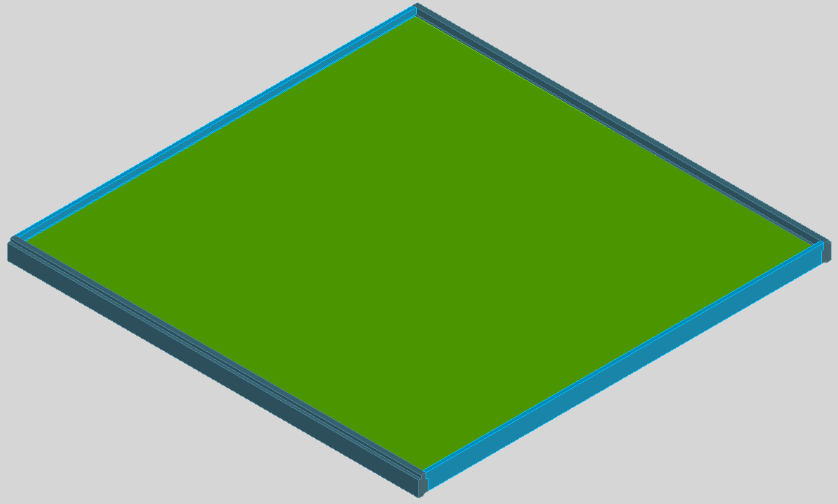
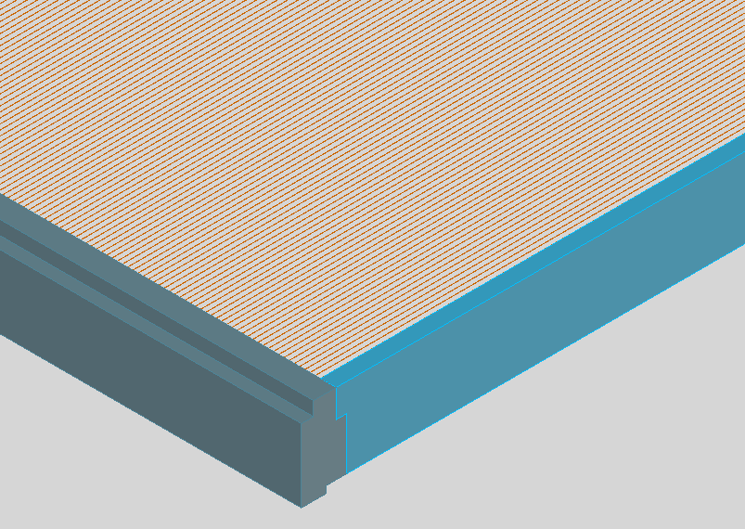
Motivation and Outlook
Based on ALICE-TRD experience (see Mariana’s presentation)
chamber frames suffer a deformation induced by wires tension
pad plane (and entrance window) could suffer deformation during operation/construction
Frame behavior under the wires tensions
Simplified
Studying static chamber deformation based on ANSYS
Wires tensions variation
Entrance window deformation under the wires tensions

Slide 3
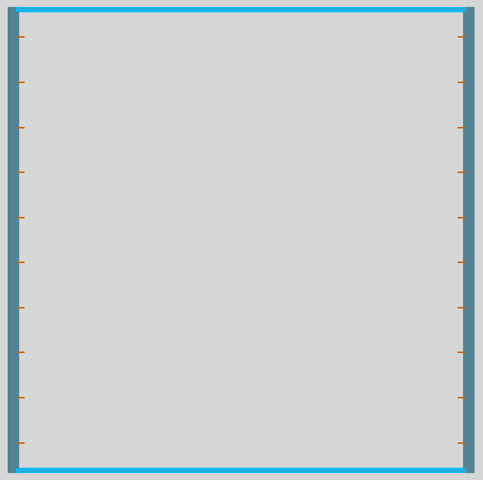
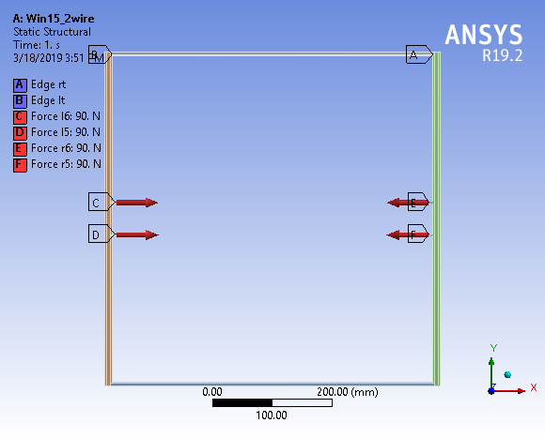
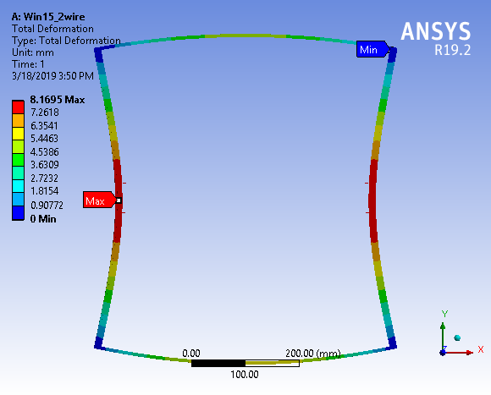
The ANSYS Simulation Model – hypothesis
1. Modelling tension distribution on wires rods
ONLY Frame behavior under the wires tensions
No entrance window (toy model) !

Slide 4
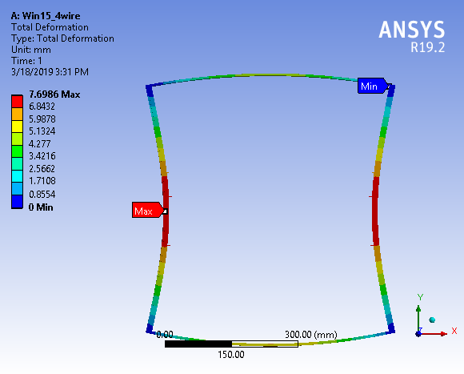
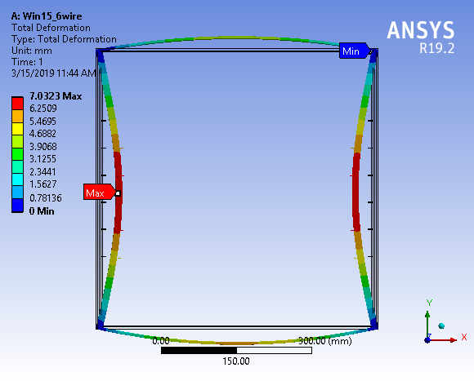
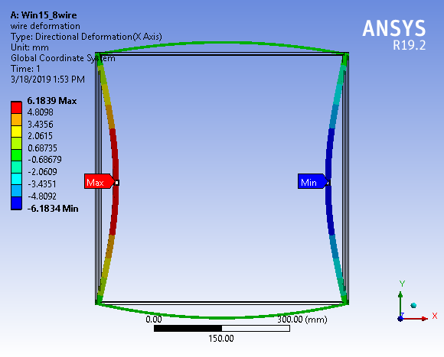
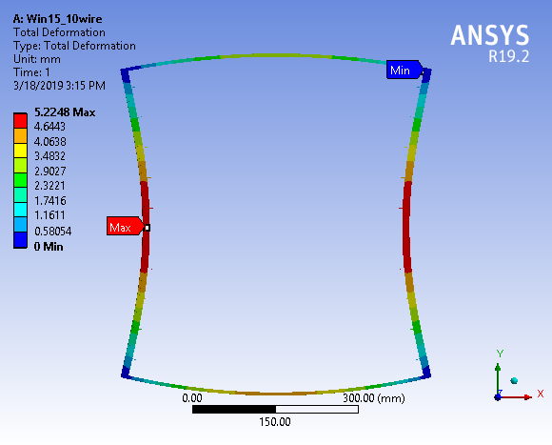
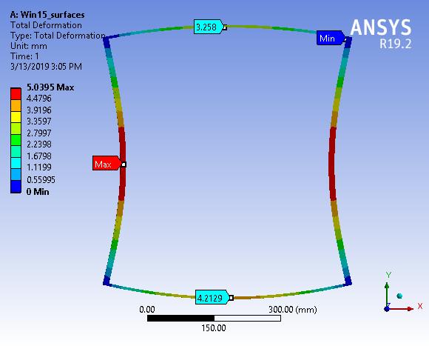
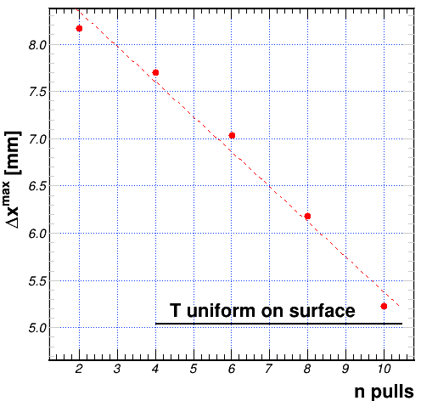

Slide 5

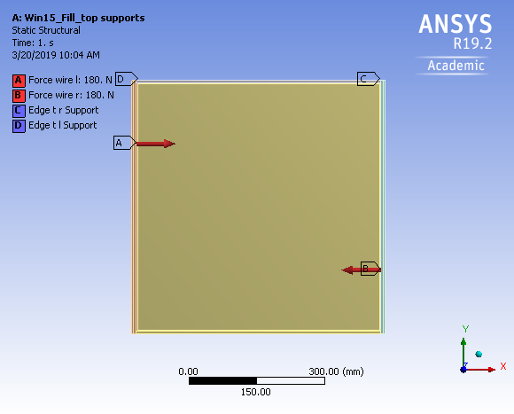
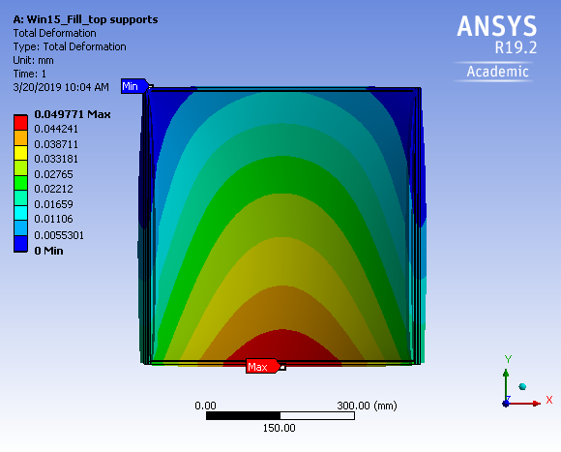
The ANSYS Simulation Model – hypothesis
2. Modelling the supports: type and position

Slide 6
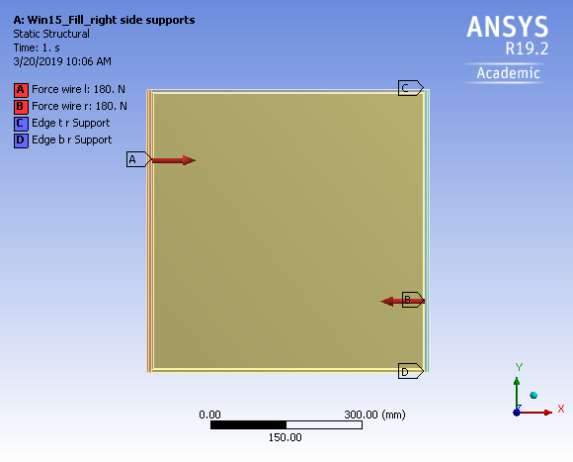
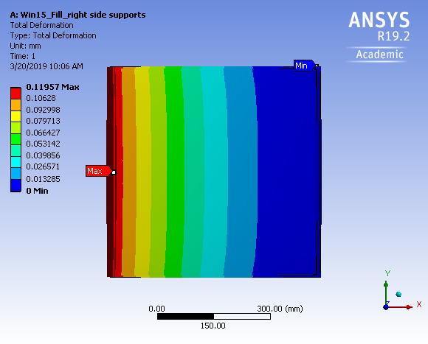
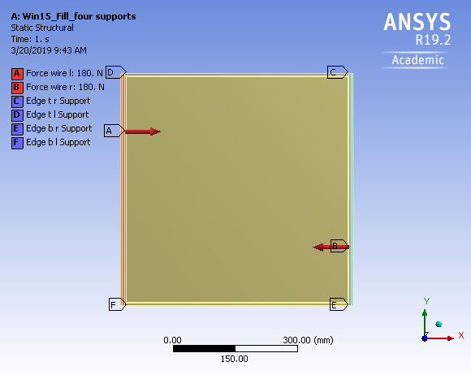
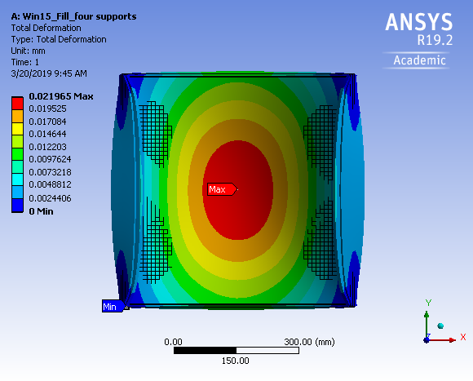

Slide 7
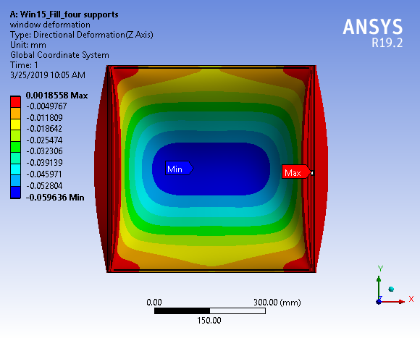
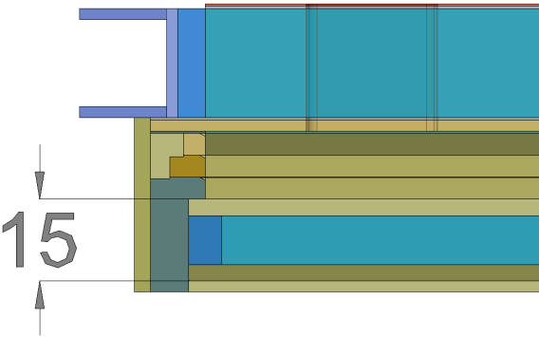
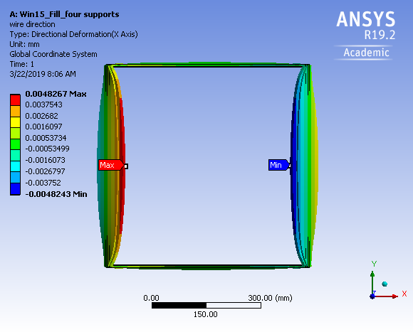
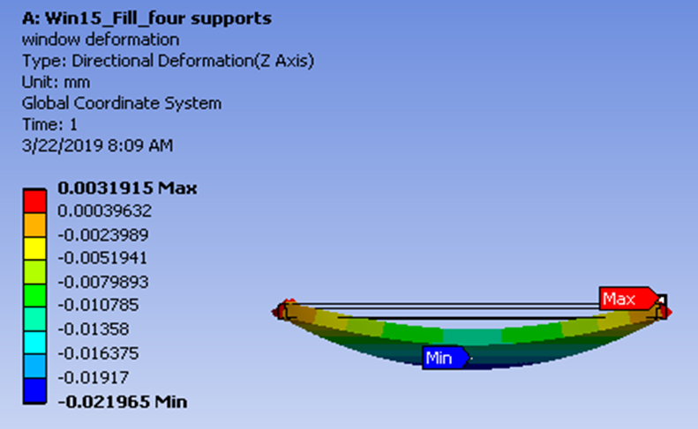
The ANSYS Simulation Model – results for Chamber Deformations
1. Entrance Window Thickness = 15 mm
Dx [mm] | Window type_15mm
4.8 x 2 | 15_full fill
93.4 x 2 | 15_without Cfibber in
11.1 x 2 | 15_without Cfibber out
Dz [mm] | Window type_15mm
22 | 15_full fill
346 | 15_without Cfibber in
59 | 15_without Cfibber out

Slide 8
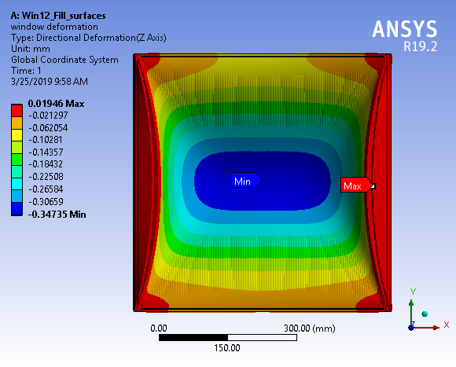
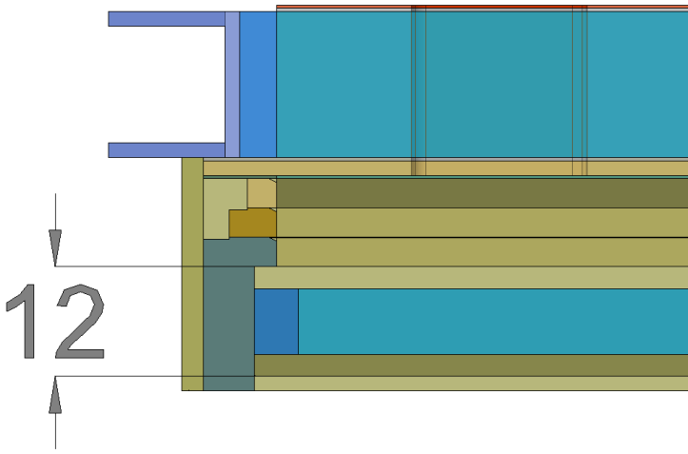
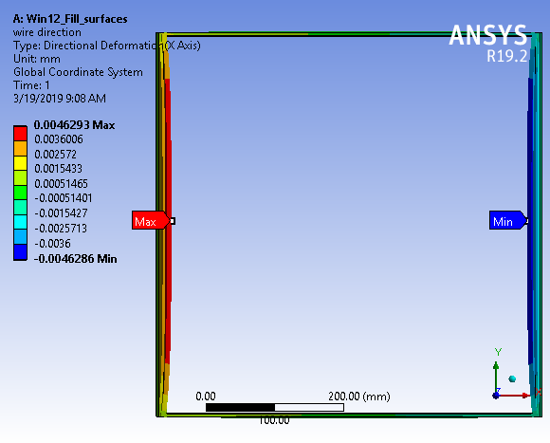
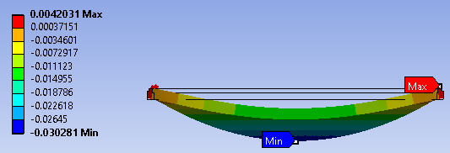
The ANSYS Simulation Model – results for Chamber Deformations
2. Entrance Window Thickness = 12 mm
Dx [mm] | Window type_12mm
4.6 x 2 | 12_full fill
88.6 x 2 | 12_without Cfibber in
12.6 x 2 | 12_without Cfibber out
Dz [mm] | Window type_12mm
30.3 | 12_full fill
347 | 12_without Cfibber in
102 | 12_without Cfibber out

Slide 9
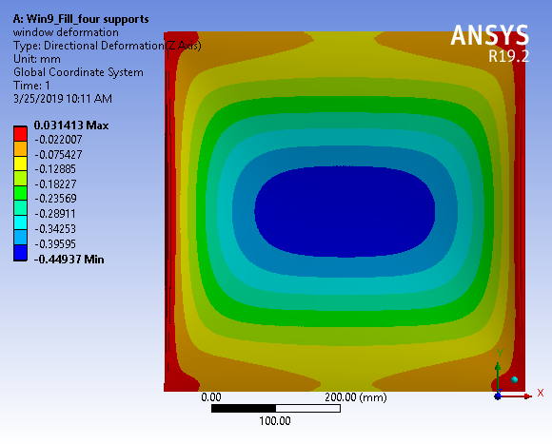
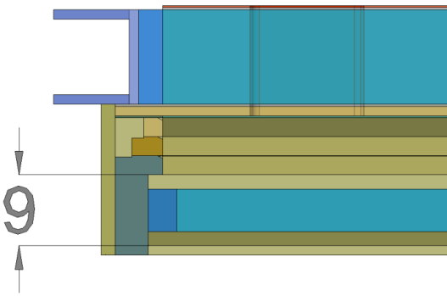
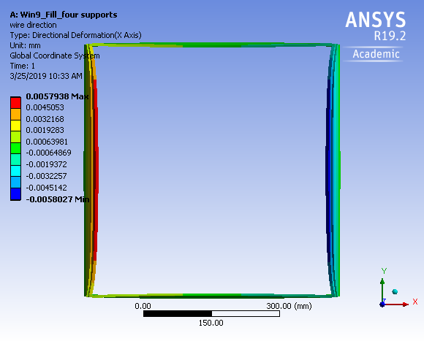
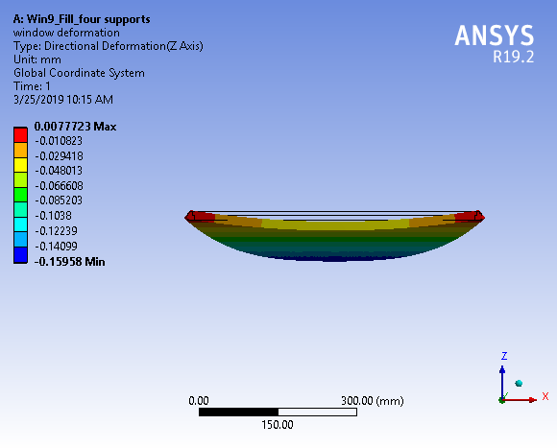
The ANSYS Simulation Model – results for Chamber Deformations
3. Entrance Window Thickness = 9 mm
Dx [mm] | Window type_9mm
5.8 x 2 | 12_full fill
90 x 2 | 12_without Cfibber in
16.6x 2 | 12_without Cfibber out
Dz [mm] | Window type_9mm
44 | 12_full fill
449 | 12_without Cfibber in
159.5 | 12_without Cfibber out

Slide 10
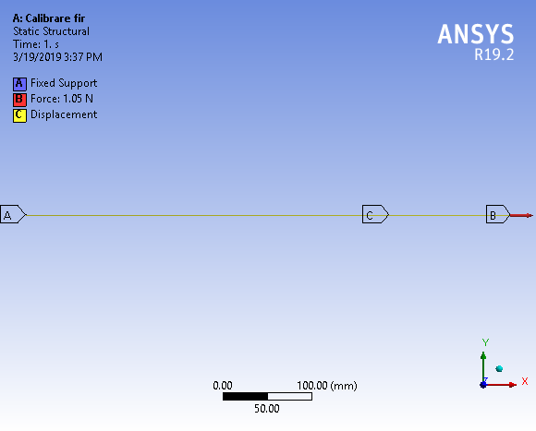
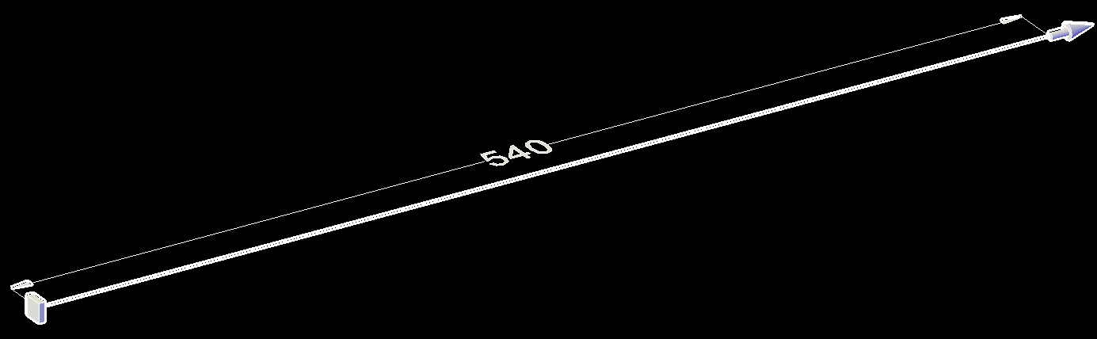
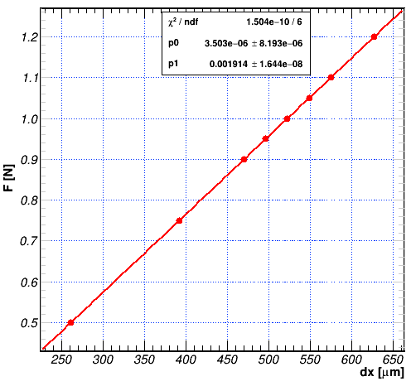
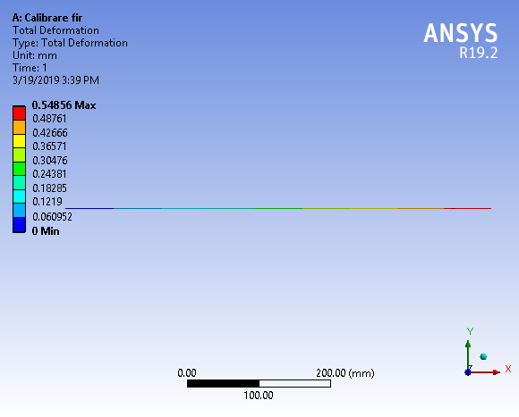
The ANSYS Simulation Model – Wire tension variations
Realistic simulation of the cathode wire geometry
F(x) agrees with elastic deformations
Elastic constant found to be 1.9e-3 N/mm

Slide 11
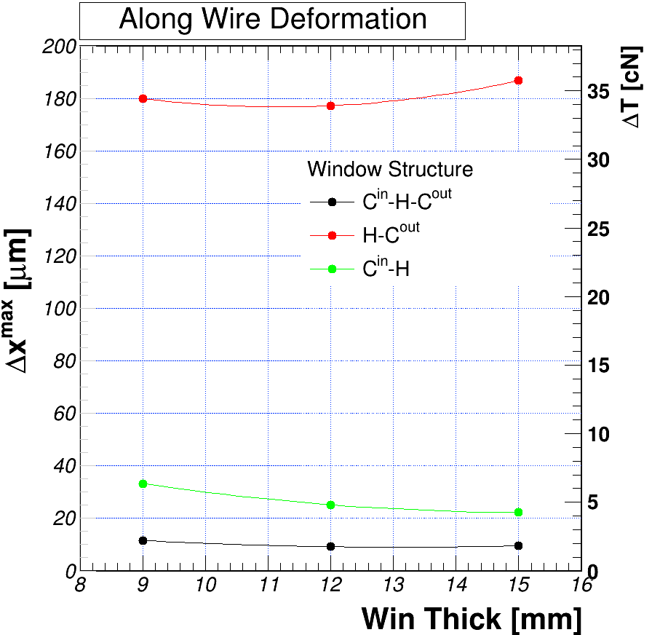
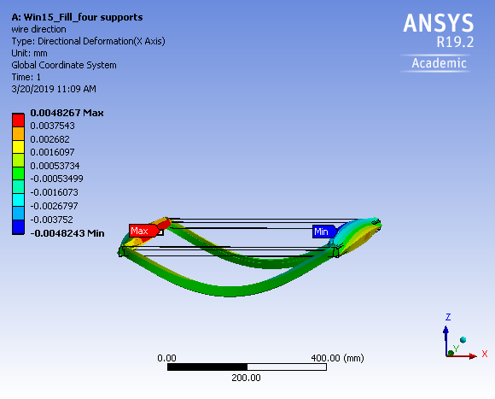
The ANSYS Simulation Model – results Cathode Wire Tension
4. Systematics with Entrance Window Structure
Very preliminary results for the variation of the wires tensions taking into account the rods and entrance window deformations

Slide 12
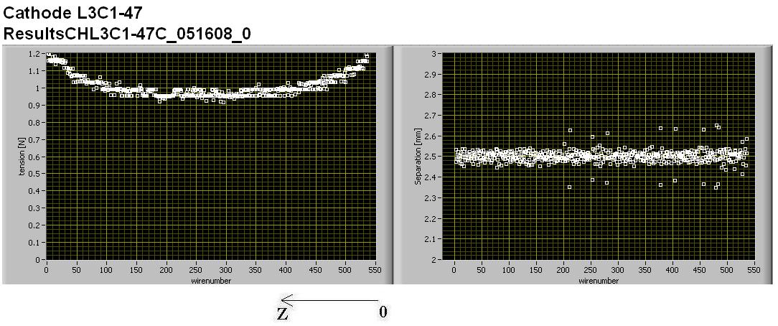
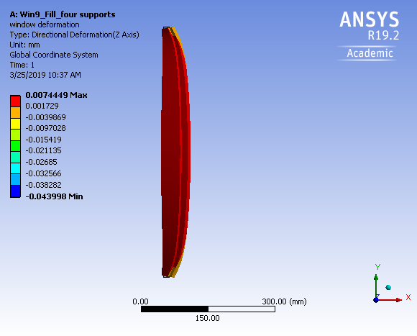
Model sustain by measured deformations
Nominal Cathode tension (CT) ~ 100 cN
Wire elasticity limits 80 cN< CT <120 cN
Observed DT_{max} = 20 cN
Comparison between ALICE-TRD measured deformation (Tension variation) agrees qualitatively with ANSYS simulations

Slide 13
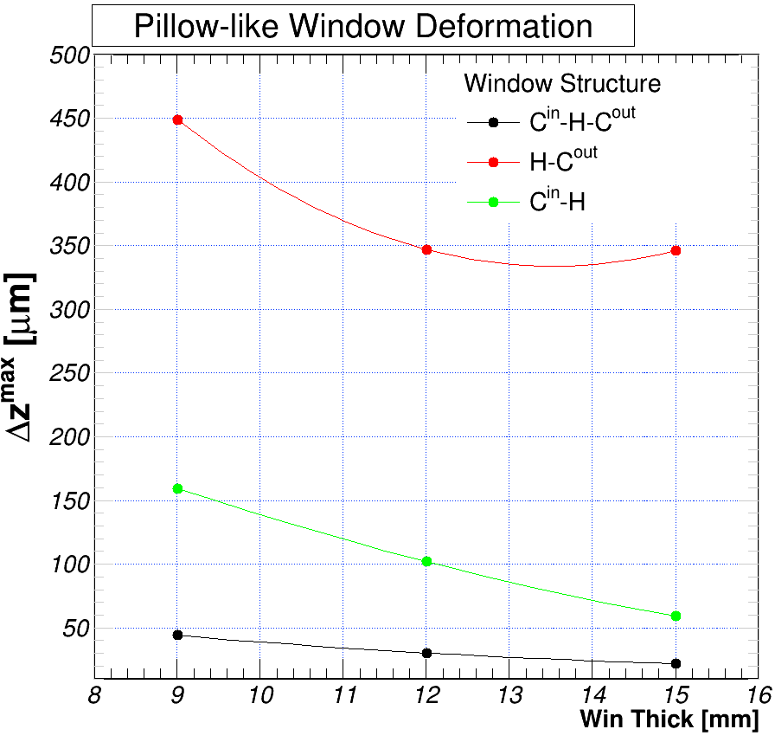
The ANSYS Simulation Model – results Entrance Window Concavity
5. Systematics with Entrance Window Structure
Entrance window deformations may also affect the pad plane planarity and gain uniformity! To be followed!

Slide 14
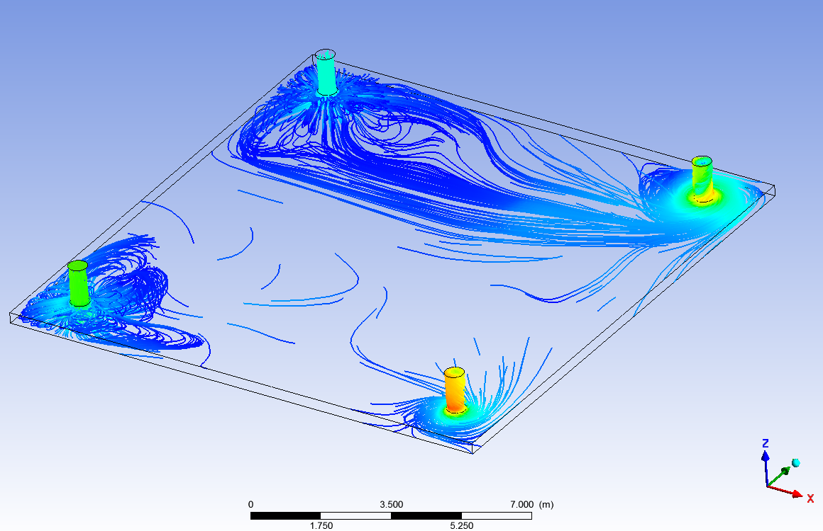
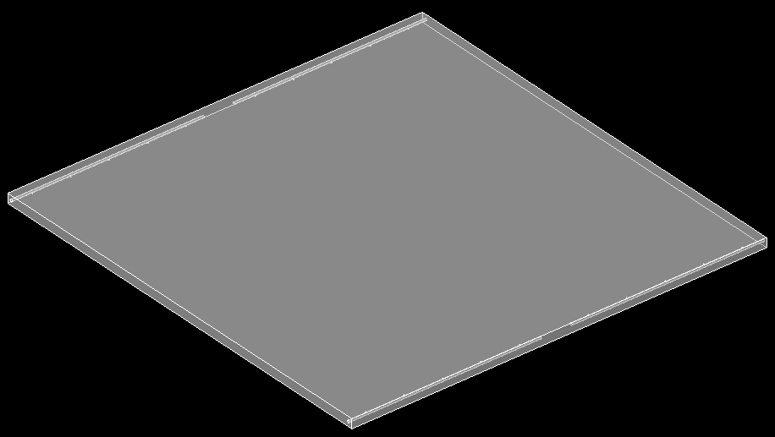
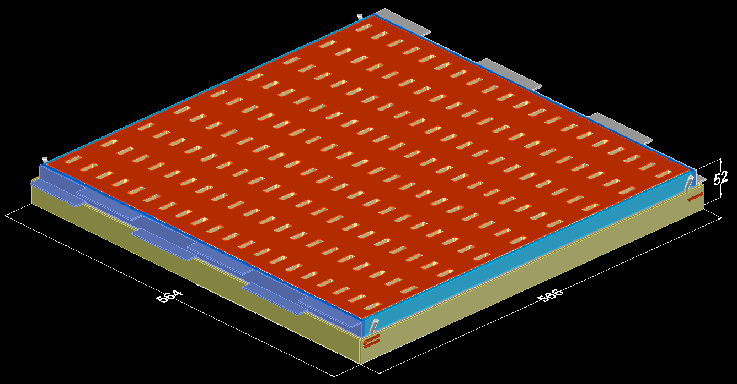
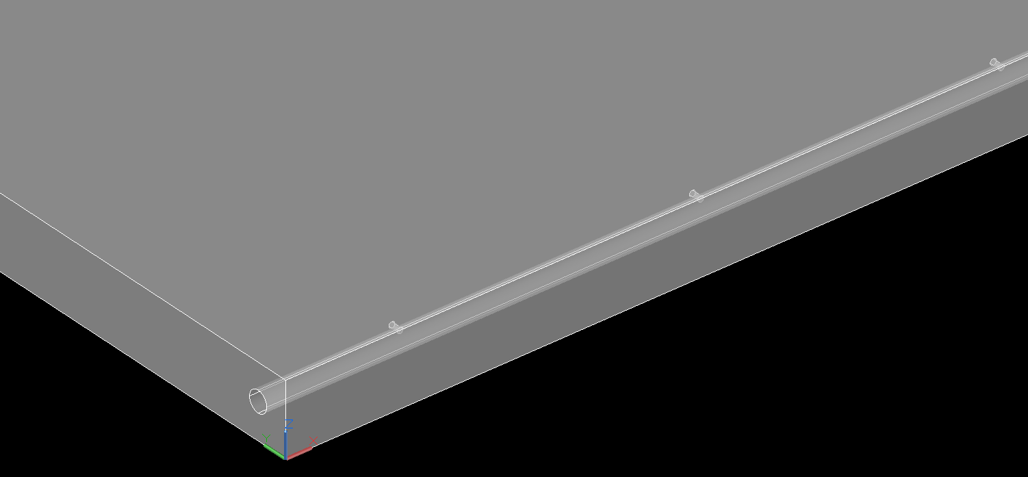
The ANSYS Simulation Model – Gas Flow Studies
Studying Inlet/Outlet geometry
Current gas flow geometry relies on 2 inlet and 2 outlets
Possible gas flow patterns in TRD12
Ways to obtain an uniform flow
Optimal solution - in progress

Slide 15
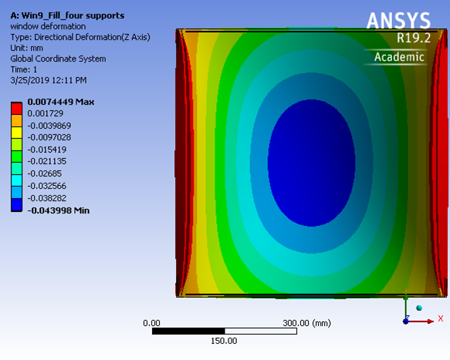
CBM-TRD HPD Bucharest team
Alexandru Bercuci, Valerica Aprodu, Daniel Bartos, Gheorghe Caragheorgeopol, Vasile Catanescu, Viorel Duta, Mariana Petris, Mihai Petrovici, Lucia Prodan, Andrei Radu, Claudiu Schiaua, Victor Simion
Thank you!

