Slide 1
Equilibration of
Higher-order Cumulants
Masakiyo Kitazawa
(Osaka U.)
GSI Workshop on
Probing the Phase Structure of Strongly Interacting Matter: Theory and Experiment
GSI, Darmstadt, 26/Mar./2019

Slide 2
Equilibration of
Higher-order Cumulants
Non-
Masakiyo Kitazawa
(Osaka U.)
GSI Workshop on
Probing the Phase Structure of Strongly Interacting Matter: Theory and Experiment
GSI, Darmstadt, 26/Mar./2019

Slide 3



QCD Phase Diagram
T
Early Universe
Quark-Gluon Plasma
150MeV
ＱＣＤ Critical Point
Hadron Phase
(confined)
Color SC
Compact
Stars
~10¹⁵g/cm³
μ
Our Universe

Slide 4
Beam-Energy Scan Program in Heavy-Ion Collisions
T
high
Quark-Gluon Plasma
beam energy
150MeV
ＱＣＤ Critical Point
low
Hadron Phase
(confined)
Color SC
~10¹⁵g/cm³
μ
Our Universe

Slide 5


Higher-Order Cumulants
STAR
2010~
Enhancement
Non-zero non-Gaussian cumulants
have been established!
General Review:
Asakawa, MK, PPNP (2016)

Slide 6
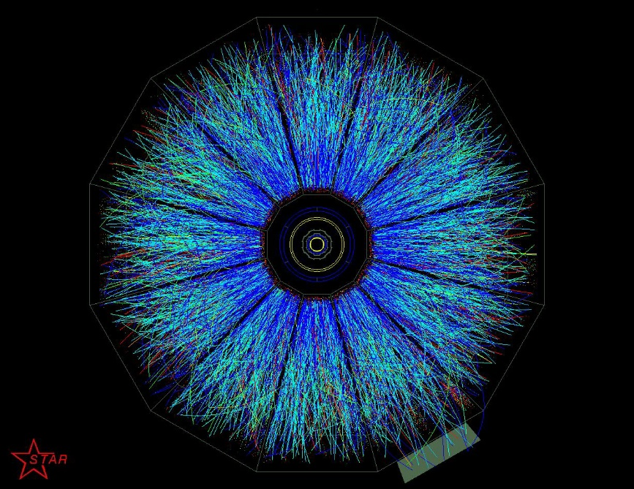
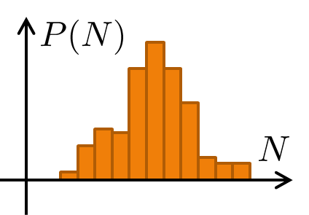
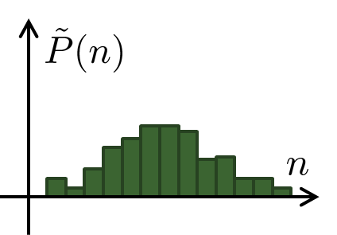
Detector-Response Correction
True distribution
Efficiency loss
Particle missID
Observed distr.
Correction assuming a binomial response
Bialas, Peschanski (1986);
MK, Asakawa (2012); Bzdak, Koch (2012); ….
But, the response of the detector is not binomial…

Slide 7
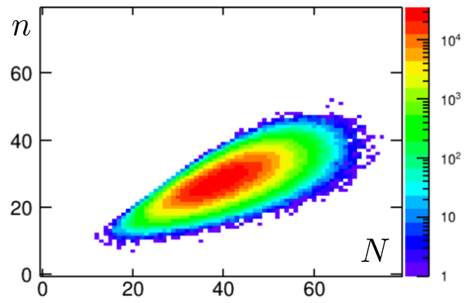
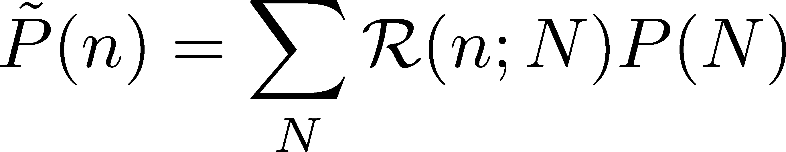
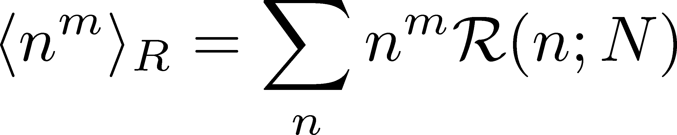
Non-Binomial Correction
Nonaka, MK, Esumi (2018)
Response matrix
Reconstruction for any R(n;N)
with moments of R(n;N)
Caveats:
R(n;N) describes the property of the detector.
Detailed properties of the detector have to be known.
Multi-distribution function can be handled.
Huge numerical cost would be required.
Truncation is required in general: another systematics?

Slide 8
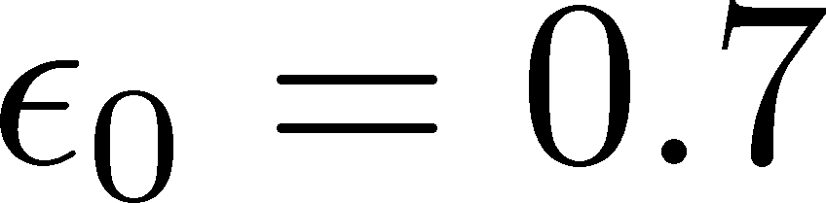
Result for Toy-Model
Binomial w/ multiplicity-dependent efficiency
Nonaka, MK,
Esumi (2018)
Holtzman, Bzdak,
Koch (16)
Reconstructed cumulants
Input P(N):
Poisson(λ=40)
Red:
true cumulant
True cumulants are
reproduced within
statistics!

Slide 9
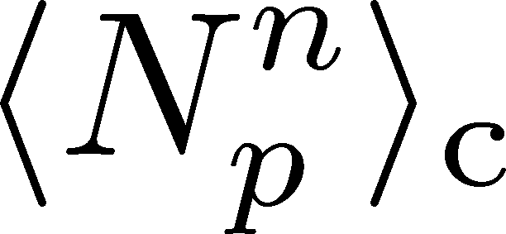
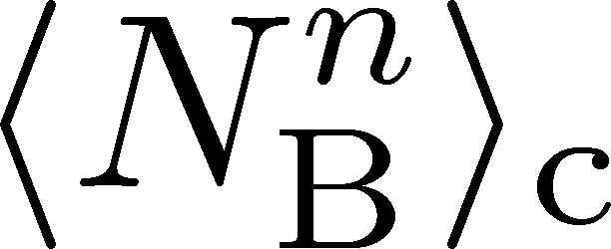
Proton vs Baryon Cumulants
MK, Asakawa, 2012; 2012
Experiments
proton number cumulants
Many theories
baryon number cumulants
measurement with
50% efficiency loss
Clear difference b/w these cumulants.
Isospin randomization justifies the reconstruction of <N_{B}^{n}>_{c} via the binomial model.
Similar problem on the momentum cut…

Slide 10
Equilibration of
Higher-order Cumulants
Non-

Slide 11

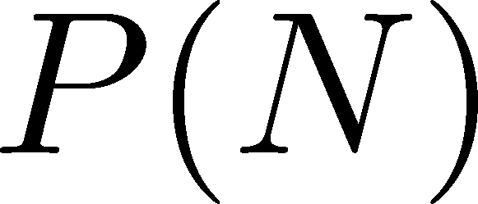




Time Evolution of Fluctuations
Detector
Hadronic
Distributions in ΔY and
Δy are different due to
“thermal blurring”.
Ohnishi, MK, Asakawa, PRC(2016)
QGP
Fluctuations in ΔY continue
to change until kinetic f.o.

Slide 12
Critical Fluctuation
①
Growth of critical fluctuation
Critical slowing down
T
②
Decay by diffusion
①
③
At 1st order transition
domain formation
②
③
Hadrons
0
μ

Slide 13
Contents of
Evolution of Fluctuations
in Hadronic Stage
  MK, Ono, Asakawa, PLB (2014); MK(2015)
around the Critical Point
  Sakaida, Asakawa, Fujii, MK (2017)
at First Order Transition
  Nonaka, MK, Akamatsu, Bluhm, Nahrgang, in prep.

Slide 14
Time Evolution of Fluctuations
Asakawa, Heinz, Muller, 2000
Jeon, Koch, 2000
Shuryak, Stephanov, 2001
Detector
Hadronic
QGP
Fluctuations in ΔY continue
to change until kinetic f.o.

Slide 15


(Non-Interacting) Brownian Particle Model
Initial condition (uniform)
cumulants:
random
walk
diffusion master equation: MK+, PLB(2014)
probabilistic argument: Ohnishi+, PRC(2016)

Slide 16

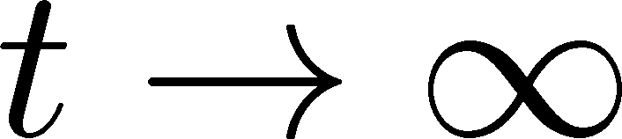
(Non-Interacting) Brownian Particle Model
Initial condition (uniform)
cumulants:
diffusion
distance
random
walk
Study ΔY dependence
Poisson distribution
diffusion master equation: MK+, PLB(2014)
probabilistic argument: Ohnishi+, PRC(2016)

Slide 17



Baryons in Hadronic Phase
time
chem. f.o.
hadronize
10~20fm
kinetic f.o.
Baryons behave like
Brownian pollens in water
mesons
baryons

Slide 18
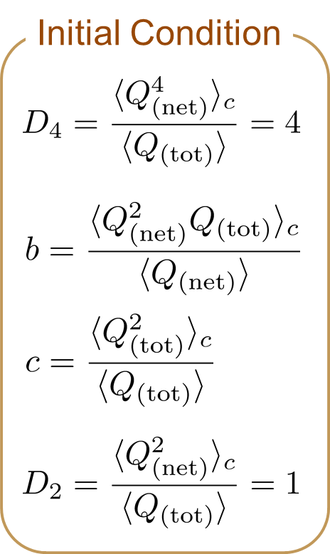

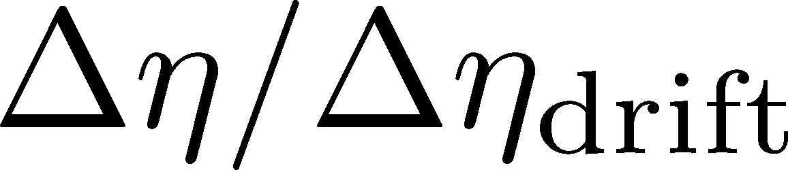
4th Order Cumulant
MK+ (2014)
MK (2015)
Before the diffusion

Slide 19

4th Order Cumulant
MK+ (2014)
MK (2015)
After the diffusion
(rough estimate)
Cumulant at small Δη is modified toward a Poisson value.
Non-monotonic behavior can appear.

Slide 20
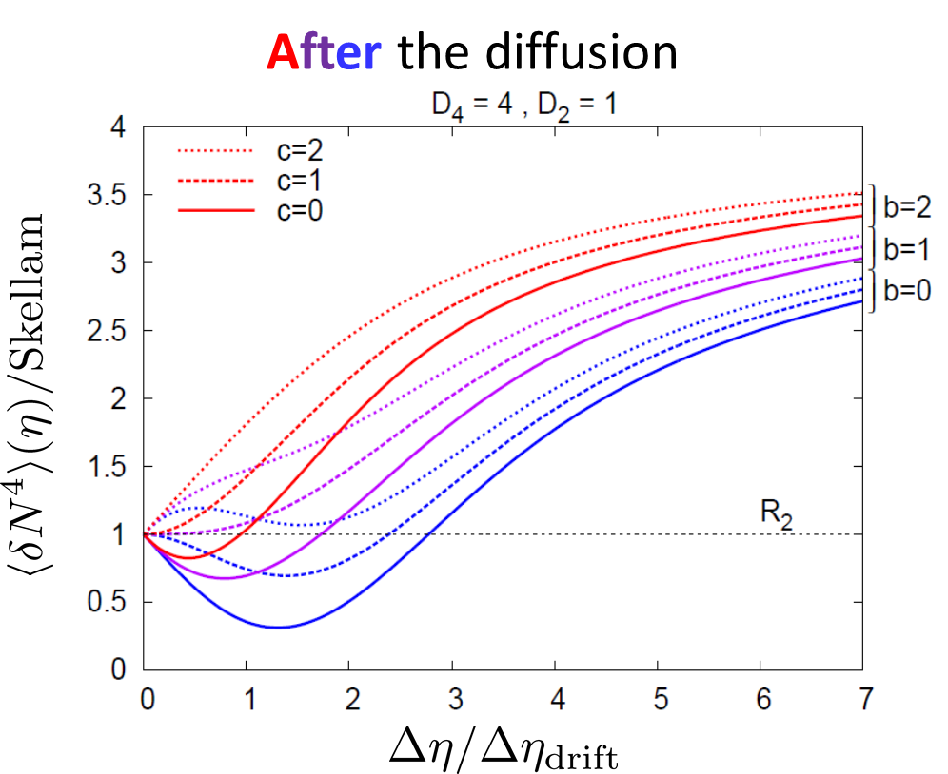
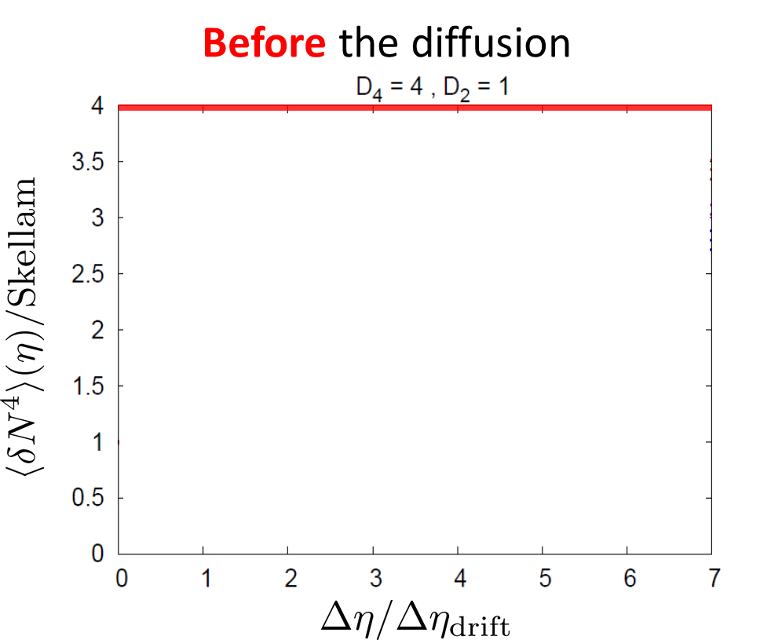
Time Evolution of Fluctuations
Detector
Hadronic
As a result of a simple random walk…
QGP

Slide 21
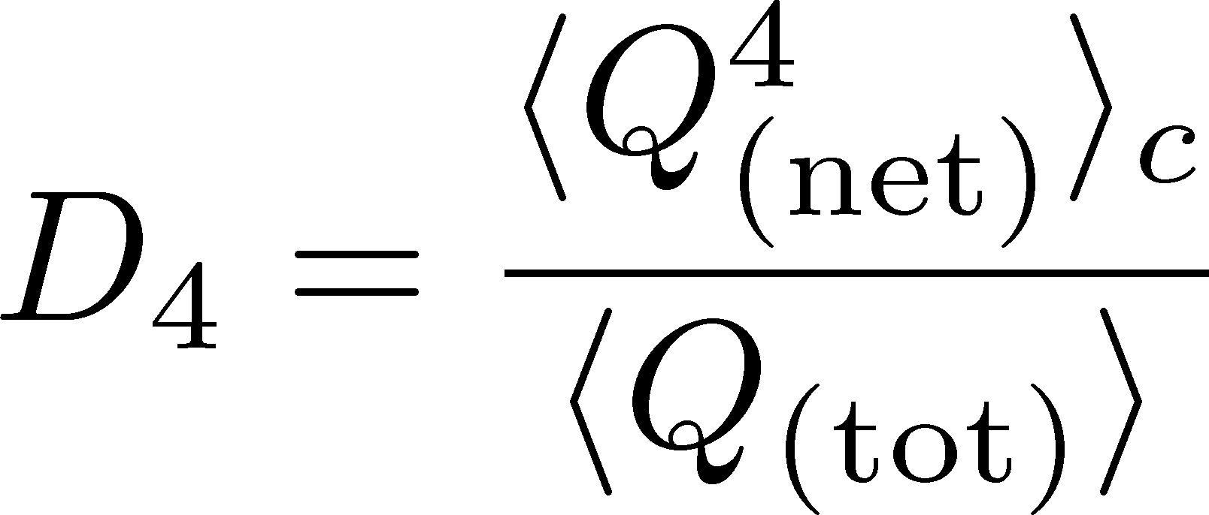




Rapidity Window Dep.
Initial Conditions
4th-order cumulant
MK+, 2014
MK, 2015
STAR Collab. (X. Luo, CPOD2014)
Is non-monotonic Δη dependence already observed?
Different initial conditions give rise to different characteristic Δη dependence. → Study initial condition
Finite volume effects: Sakaida+, PRC90 (2015)

Slide 22
Contents of
Evolution of Fluctuations
in Hadronic Stage
  MK, Ono, Asakawa, PLB (2014); MK(2015)
around the Critical Point
  Sakaida, Asakawa, Fujii, MK (2017)
at First Order Transition
  Nonaka, MK, Akamatsu, Bluhm, Nahrgang, in prep.

Slide 23
Dynamical Evolution of Critical Fluctuations
Evolution of spatially uniform “σ” mode
Berdnikov, Rajagopal (2000)
Asakawa, Nonaka (2002)
Mukherjee+ (2015)
…
Model A
Model B
THIS STUDY
Evolution of conserved charge fluctuations
Sakaida+, PRC2017; Murata, MK, in prep.
Conserved charges are directly observable.
Soft mode at QCD-CP is a conserved mode.
See also, Kapusta, Torres-Rincon (2012); Herold, Nahrgang, … (2015); …

Slide 24

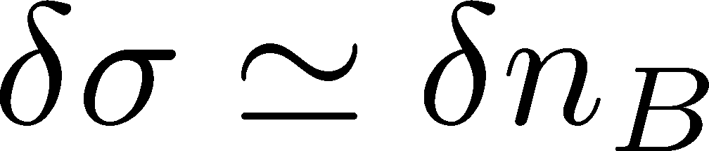
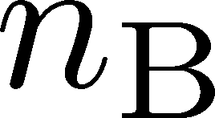
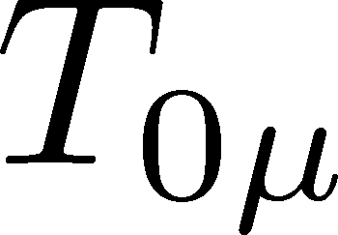
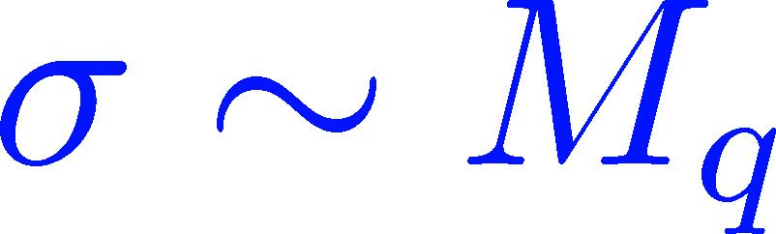
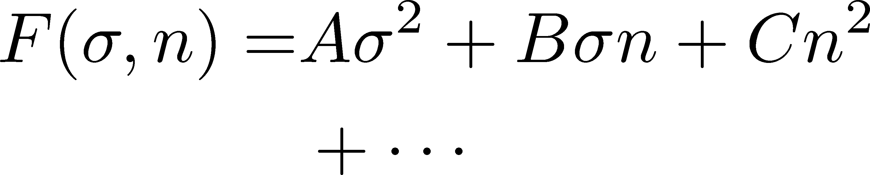


Soft Mode of QCD-CP = Conserved Mode
Fujii 2003; Fujii, Ohtani, 2004; Son, Stephanov, 2004
critical
soft mode
Fluctuations of σ and n_{B} are
coupled around the CP!
σ: fast damping

Slide 25
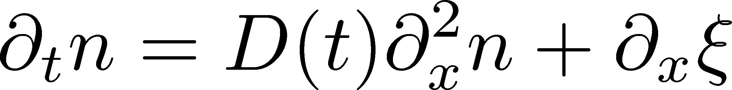
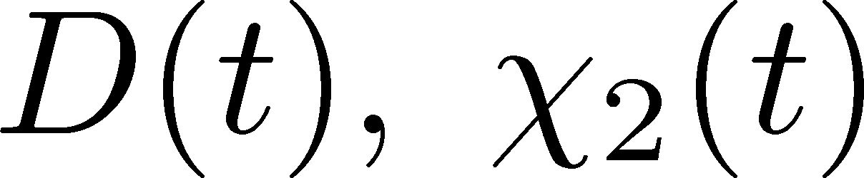
Analysis of 2nd-order Cumulant
Sakaida+ (2017)
Evolution of baryon number density
Stochastic Diffusion Equation
:parameters characterizing criticality
Analytic solution is obtained.
Study 2nd order cumulant & correlation function.
Our Main Conclusion
Non-monotonicity in
cumulants or correlation func.
=
Signal of
QCD-CP

Slide 26
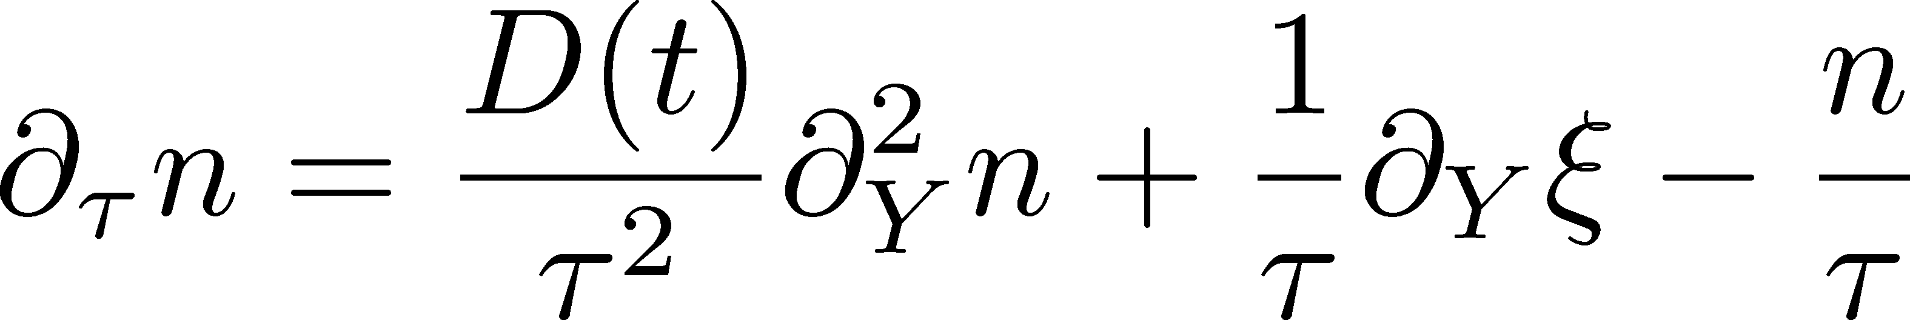
Bjorken Expansion
Cartesian coordinates
Hadronic
QGP
Milne coordinates
suppression
of diffusion
density
reduction

Slide 27
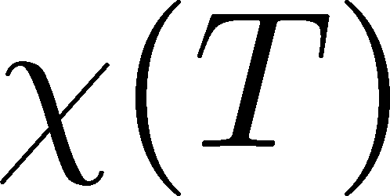
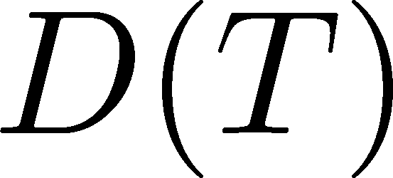
Parametrizing D(τ) and χ(τ)
Critical behavior
(critical point)
3D Ising (r,H)
model H
Berdnikov, Rajagopal (2000)
Stephanov (2011); Mukherjee+(2015)
Temperature dep.
critical
slowing
down
critical
enhancement

Slide 28
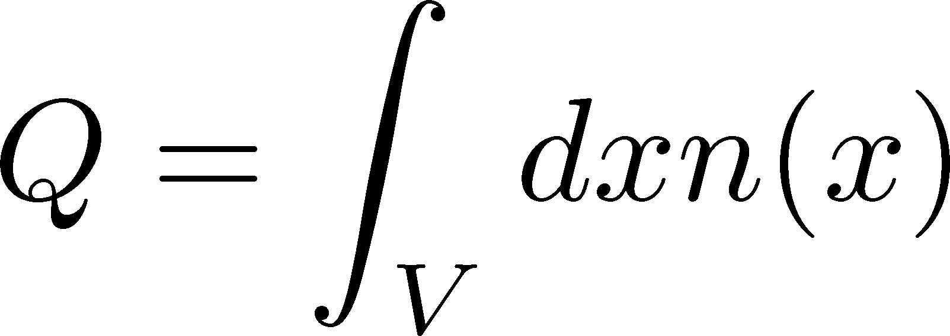
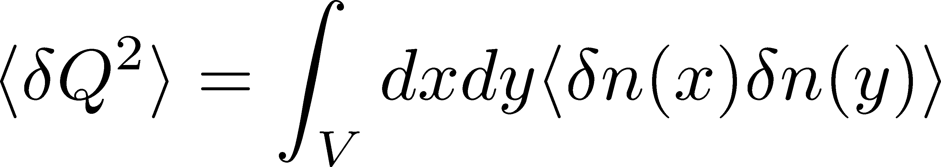
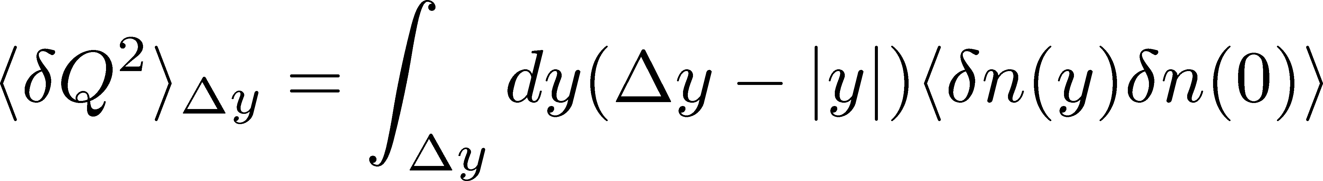
Cumulants and Correlation Function
total charge
charge density
2nd order cumulant
(fluctuation)
correlation function
1-to-1 correspondence
1-dim case

Slide 29
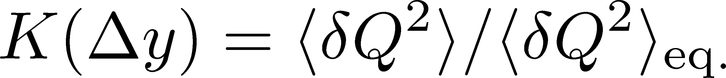

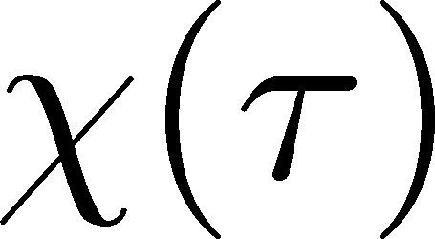
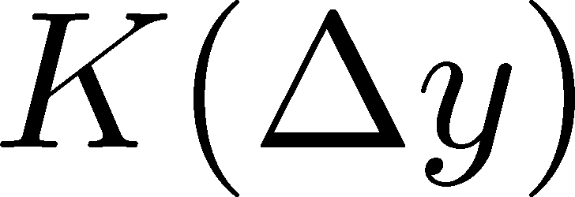
Crossover / Cumulant
ALICE
PRL 2013
monotonically decresing
Analytic
result
monotonically
increasing
monotonically
decreasing

Slide 30
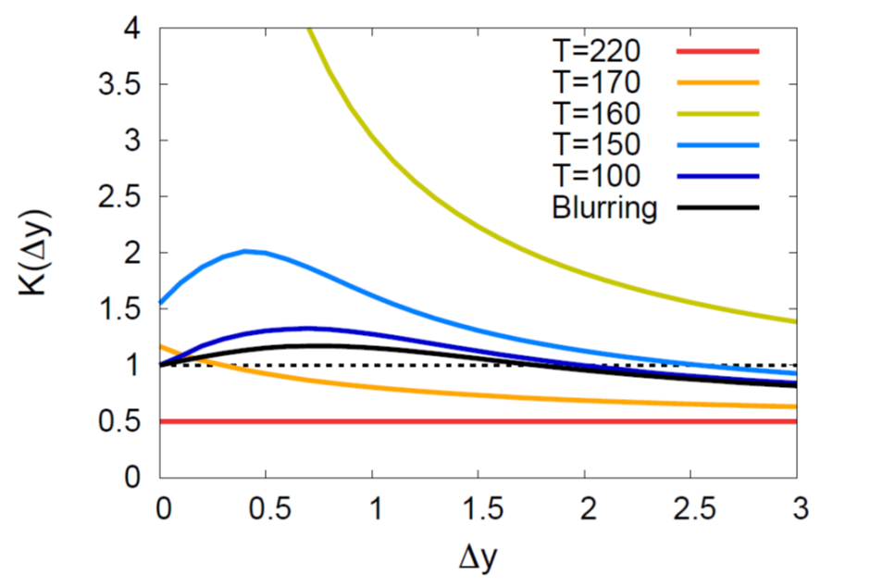
Critical Point / Cumulant
non-monotonic Δy dep.
Analytic
result
See also,
Wu, Song
arXiv: 1903.06075
non-monotonic
non-monotonic

Slide 31
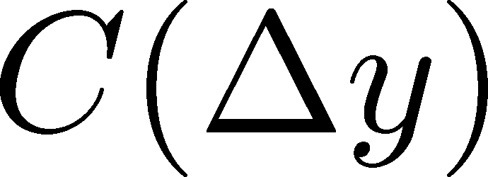
Criticap Point / Correlation Func.
non-monotonic Δy dep.
Analytic
result
See also,
Wu, Song
arXiv: 1903.06075
non-monotonic
non-monotonic

Slide 32
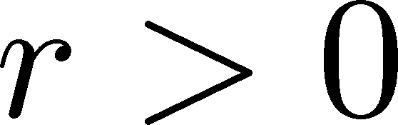

Away from the CP
(critical point)
Signal of the critical enhancement can be clearer on a path away from the CP.
Away from the CP → Weaker critical slowing down

Slide 33
Contents of
Evolution of Fluctuations
in Hadronic Stage
  MK, Ono, Asakawa, PLB (2014); MK(2015)
around the Critical Point
  Sakaida, Asakawa, Fujii, MK (2017)
at First Order Transition
  Nonaka, MK, Akamatsu, Bluhm, Nahrgang, in prep.

Slide 34
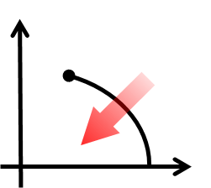
1st-Order Transition
T
μ
Domain formation
Non-uniform system
Herold, Nahrgang, et al. (2011~); Steinheimer, Randrup (2012; 2013)

Slide 35
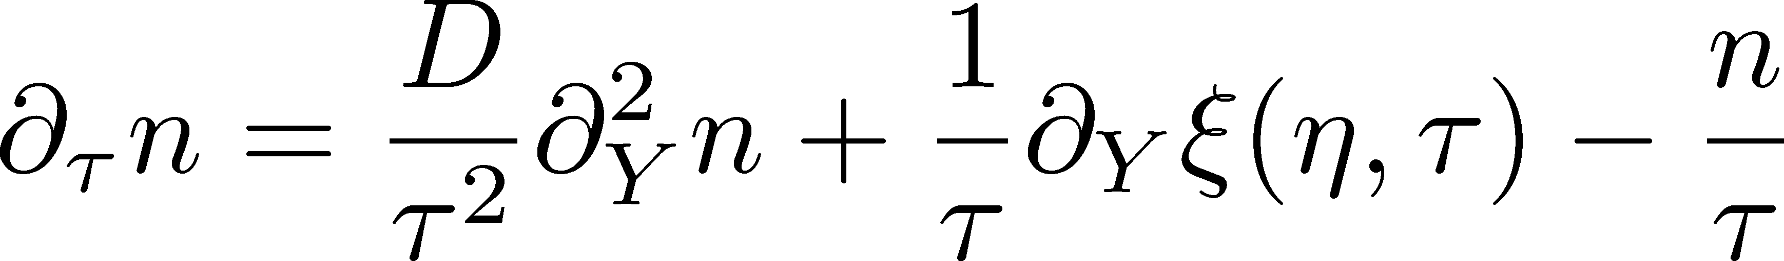
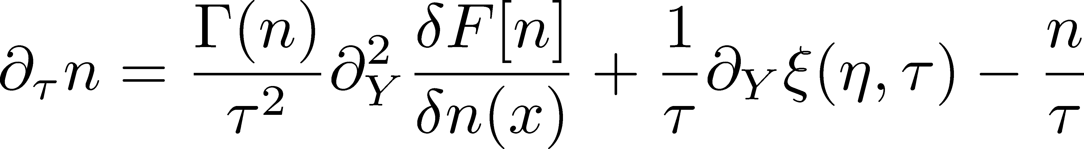
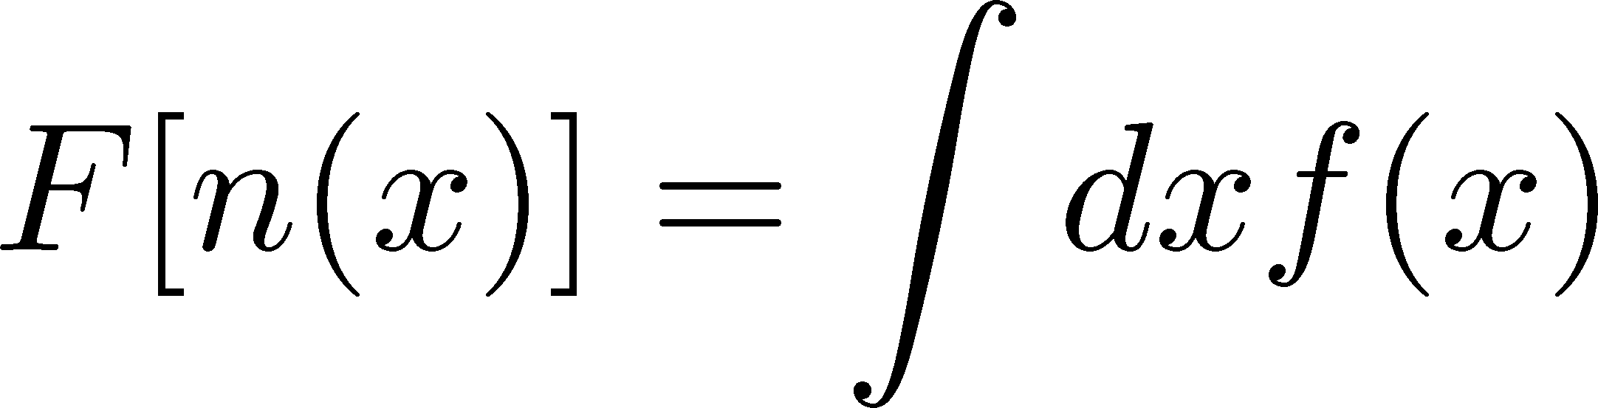
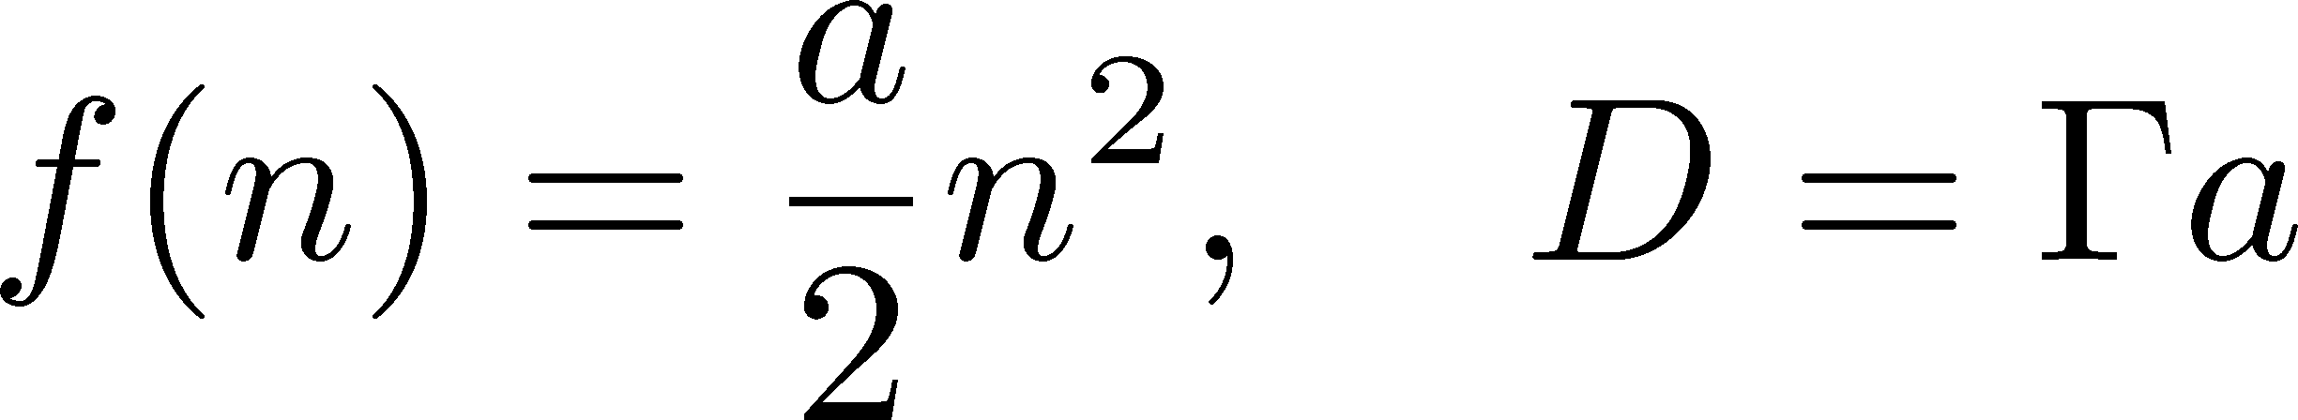
Including Non-Linearity
Nahrgang, Bluhm,
Schafer, Bass (2018)
Include non-linear effects
Diffusion equation:
solve numerically

Slide 36
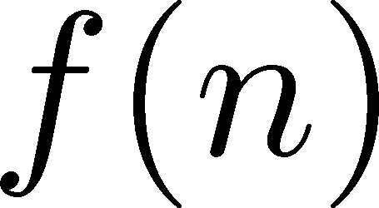

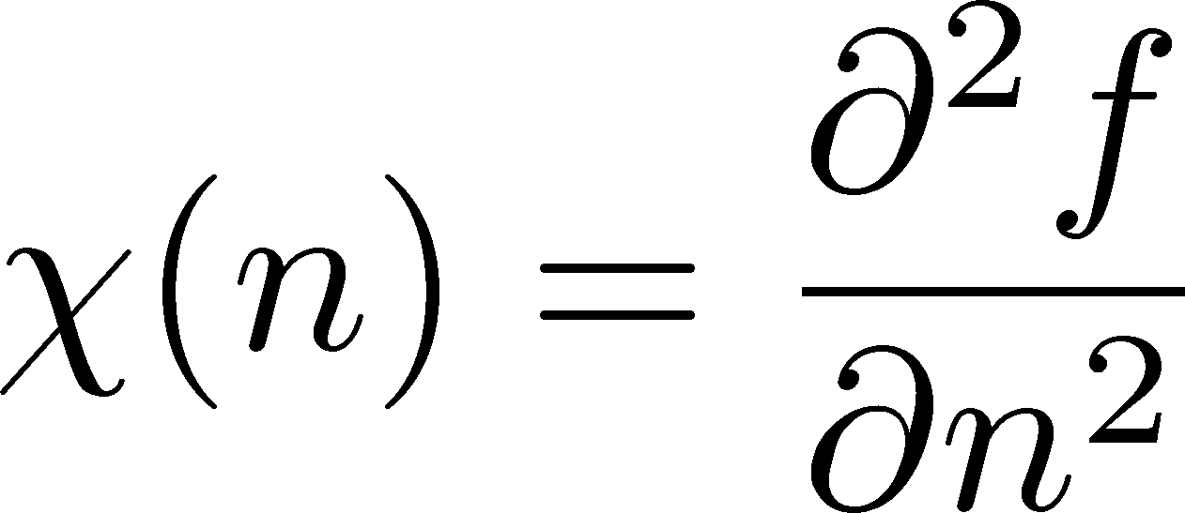
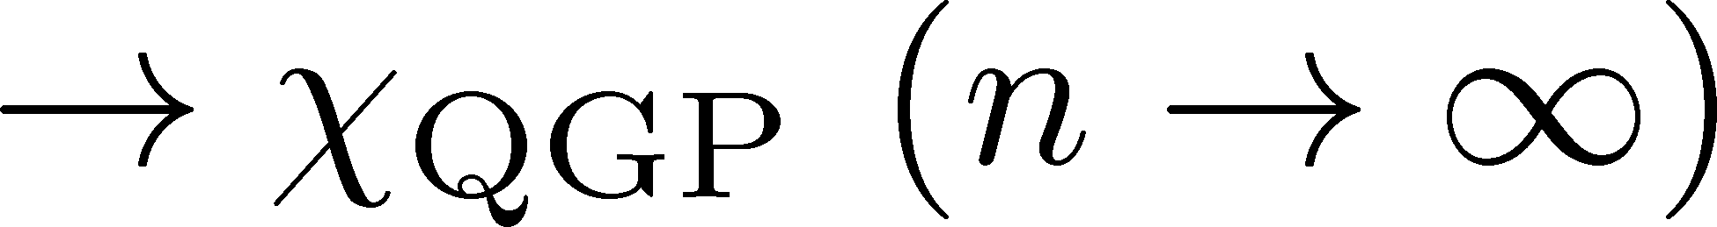
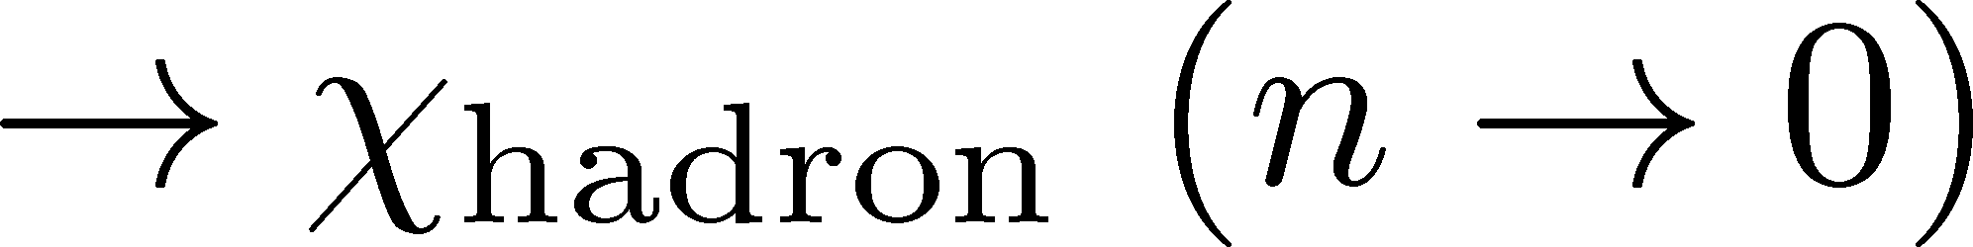
Free Energy
At 1st transition point
Large and small n
Poisson

Slide 37

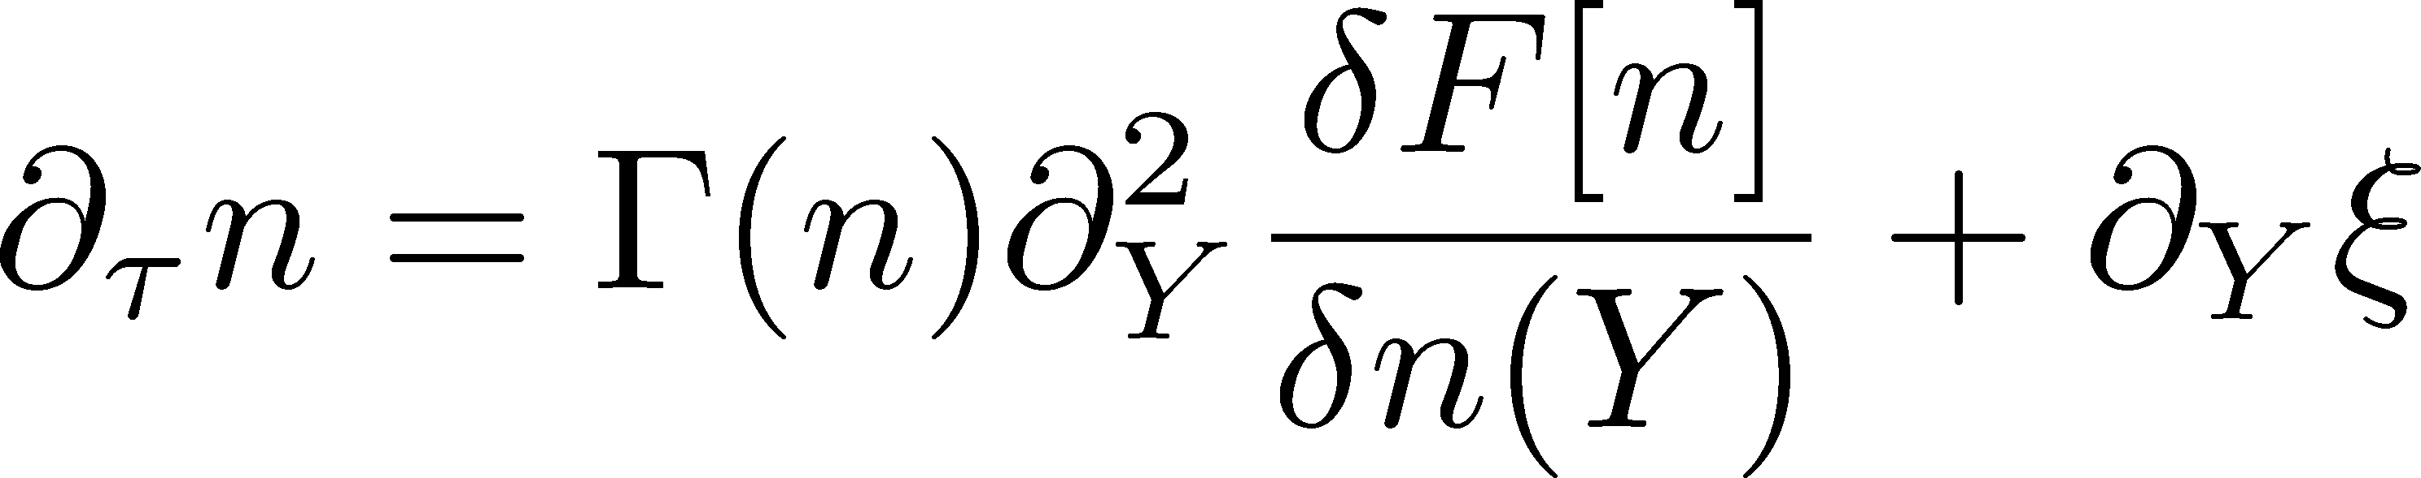

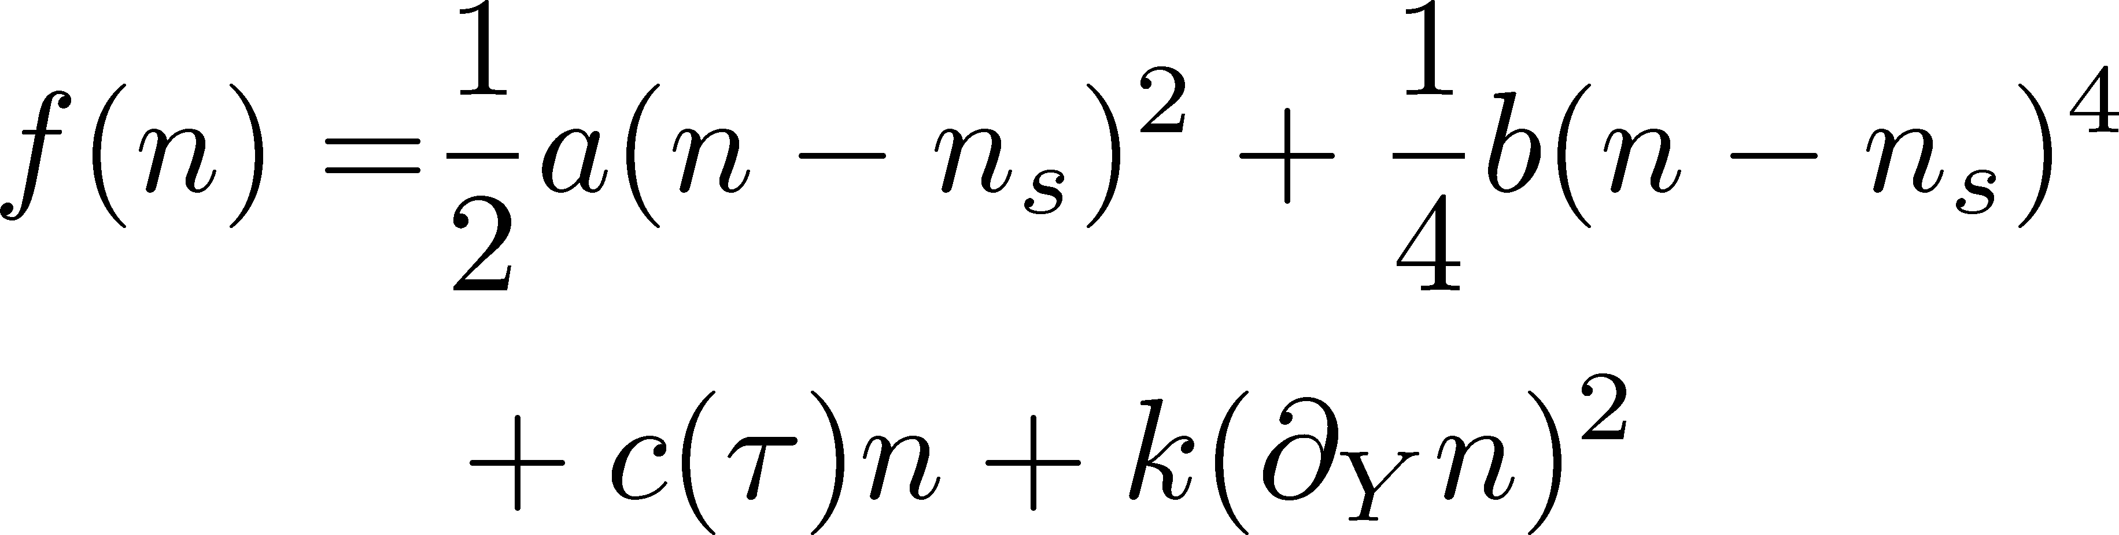
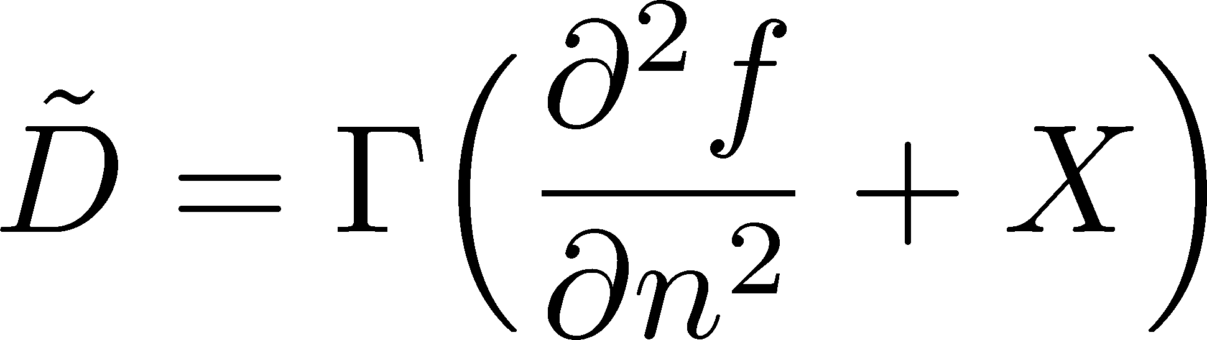
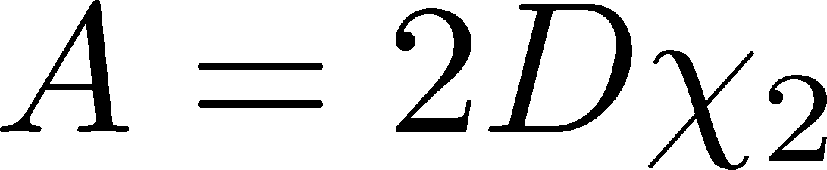
Modeling 1st Transition
Γ: positive
adjust Γ and A to reproduce the behavior of D at small and large n

Slide 38
Configurations in Equilibrium
Domain formation
Surface: thickness √(2k/a), surface tension

Slide 39
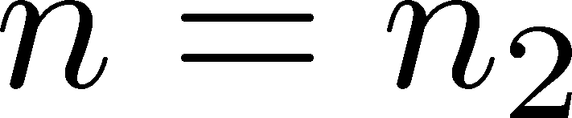
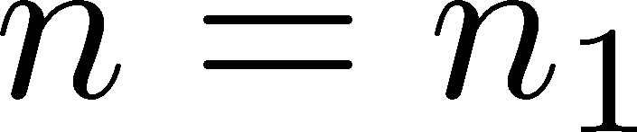



Time Evolution
initial
Dynamical domain formation
Domains survive even after 1st transition
rapidity

Slide 40
Time Evolution
Weaker 1st transition can also lead to formation of domains.

Slide 41
Correlation Function
Correlation Function
τ= 2fm
τ= 5fm
τ=10fm
τ=20fm
Peak
structure
rapidity gap Δy
Domain leads to a peak structure in C(y).
The peak can survive even in the final state.

Slide 42

C(y) and Phase Diagram
Critical point/ crossover
1st order transition
Both critical phenomena & 1st transition lead to a minimum of the C(y) with different mechanisms.

Slide 43
Summary
Fluctuations observed in HIC are not in equilibrium.
Plenty of information in rapidity window dependences of higher-order cumulants.
2nd-order cumulant (correlation function) already contains interesting information.
Future
  Evolution of higher-order cumulants around the critical point / 1st transition
  combination to momentum (model-H)
  more realistic model (dimension, Y dependence, …)

Slide 44



Translating Languages
Brownian particle model
From Bzdak’s talk

