Slide 1
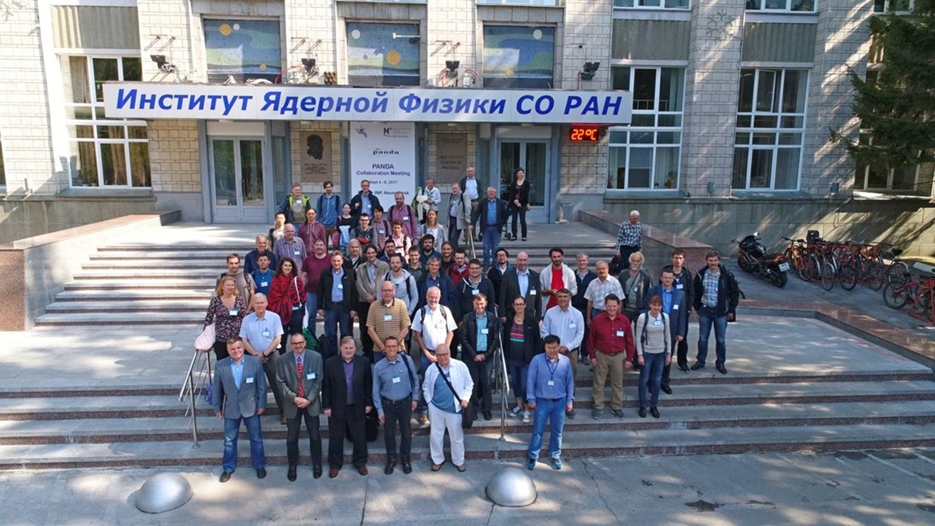
Status of the PANDA Solenoid Magnet Production in BINP

Slide 2
The main milestones of production of the PANDA solenoid magnet
The scope of delivery includes:
Magnetic and engineering design of the magnet including tools and support;
Production and delivery of the magnet (consisting of yoke, cold mass and cryostat, alignment components, proximity cryogenics, support frame and platform beams) and all tools;
Power converter and quench protection and instrumentation.
Item | Date
Start contract | 03/2017
Control assembling of the Yoke of solenoid at the BINP site | 09/2019
Magnetic tests of the PANDA solenoid including safety system and electrical components at BINP (additional contract) | 07/2020 - 05/2021
Assembling and tests at the FAIR site
Assembling of the Yoke at Darmstadt | 11/2021
Acceptant tests at FAIR | 08/2022
Installation of the PANDA solenoid magnet at worked position and start final acceptance tests | 01-05/2023
Table 1. The main milestones.

Slide 3
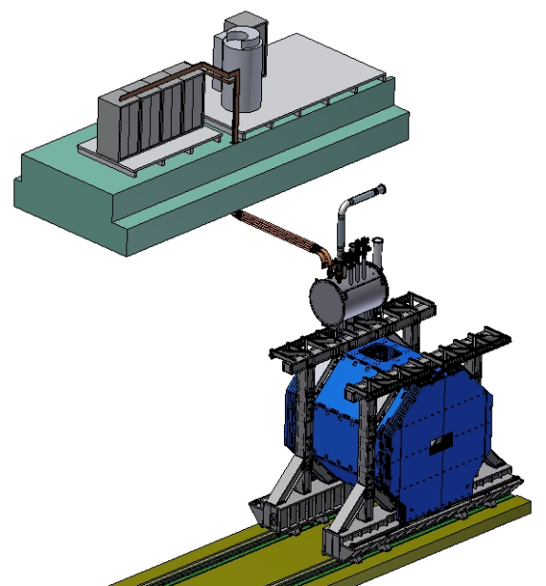
PANDA solenoid magnet, BINP responsibility
Power supply and energy extraction system
Control Dewar box
Cable channel
Solenoid and yoke
Frame of solenoid
Figure 1. Arrangement of the components of the PANDA solenoid.

Slide 4
Questions cable channel installation
Preferable to input cable in bottom part of racks (+;-).
BINP suggest to install flexible cables
To fix location of
Power supply and energy extraction system racks
Install 2-3 hand winches under ceiling
Control Dewar box
To define supports for
Cable channel and if possible fastening system in concrete blocks
Figure 2. Arrangement of the components of the PANDA solenoid.

Slide 5
Development of the PANDA solenoid magnet
Name of item | Status of work
Yoke and frame | Design is ready, start production
Cryostat of solenoid | Design is ready, FDR 46th week 2018
Cold mass | Design is ready, FDR 46th week 2018
Conductor purchasing | Development work
Control Dewar box | Design in progress
Cable channel | Design in progress
Power supply and energy extraction system | Detail design is ready, FDR – 12/2018
Magnet safety system | Start discussing 11th week 2018 in process
Table 2. Status of work of the PANDA solenoid production.

Slide 6
The main milestones of the yoke production
Name of milestone | Date 2017/10
PDR of the yoke | 04-07/10/2017
FDR of the yoke | 20-25/11/2017
Contract with SibMash (SET), signed | 2/11/2017
Purchasing raw materials (1st batch, 60 t) | 26/12/2017
Start of production of the 1st octant | 01/2018
Status production
Manufacturing parts of tooling for assembly of octants | 09/2018
First octant production | ready
Cutting sheets of the 2st octant | ready
Start assembling of the 2st octant | 47th week 2018
Control of the 1st octant 3D measurements | October 17 and 30, 2018
Delivery raw material to SibMash (SET) | 12/2018
Assembling 3rd and 4th octants | November 2018
Assembling 5th and 6th octants | December 2018
Table 3. The main milestones of the yoke production.

Slide 7
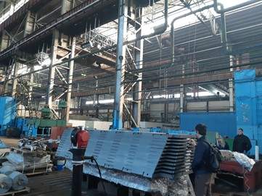
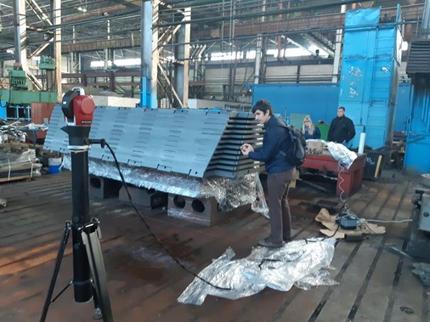
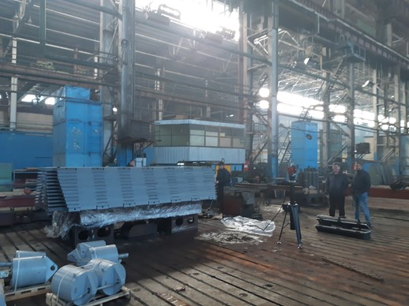
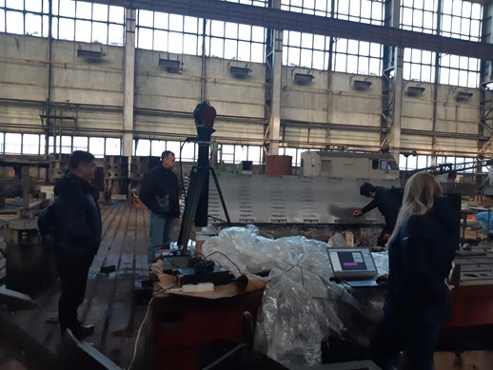
Status of the PANDA yoke and frame production. 3D measurements.

Slide 8
Status of the PANDA yoke and frame production. 3D measurements.
Device: Laser tracker API Radian
Soft: SpatialAnalyzer 2018.02.16_36977 ( x64 ).

Slide 9
Status of the PANDA yoke and frame production. 3D measurements.
Device: Laser tracker API Radian
Soft: SpatialAnalyzer 2018.02.16_36977 ( x64 ).
Measurements:
Angles between surfaces
Surfaces | Angle
 | measured | Drawing
bottom plane - side plane 1 | 67° 26' 26.0916 | 67° 30' +9'
bottom plane - side plane 2 | 67° 28' 16.5941 | 67° 30' +9'
bottom plane - obverse plane | 89° 59' 53.5835
bottom plane - reverse plane | 89° 59' 58.8290
Dimensions between built surfaces
Surfaces | Distanse (mm)
 | measured | Drawing
bottom1-botoom2 | 1233,5 | 1234 ₋₁
bottom3-botoom4 | 1233,24 | 1234 ₋₁
bottom1-botoom3 | 4068,22 | 4070₋₁
bottom2-botoom4 | 4068,09 | 4070₋₁
top1-top2 | 1901,98 | 1900 ₋₅
top3-top4 | 1901,17 | 1900 ₋₅
top1-top3 | 4068,22 | 4070₋₁
top2-top4 | 4068,1 | 4070₋₁

Slide 10
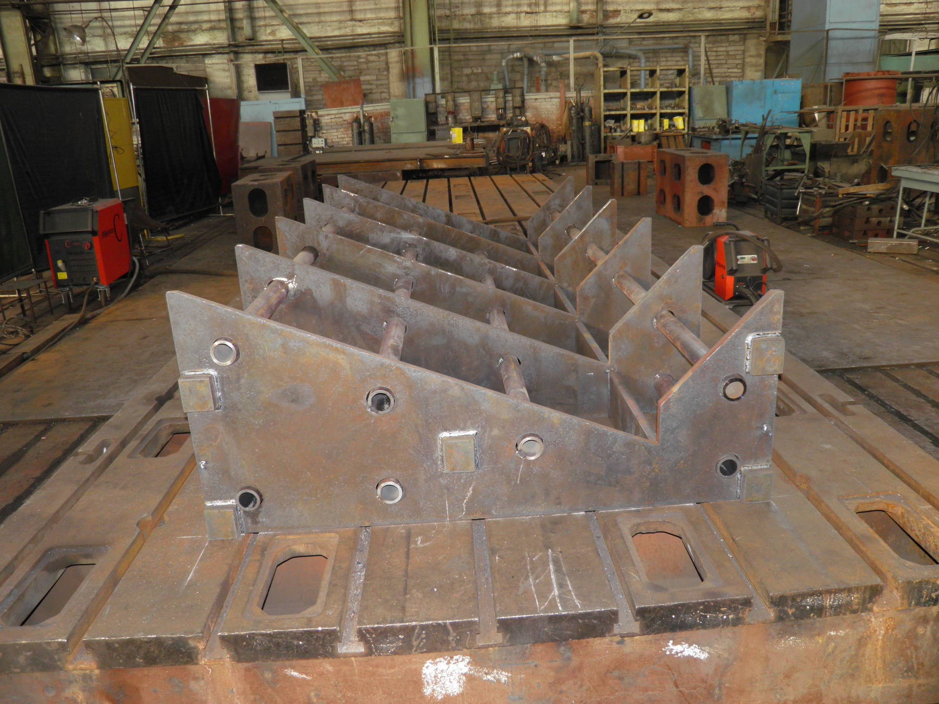
Status of the PANDA yoke and frame production

Slide 11
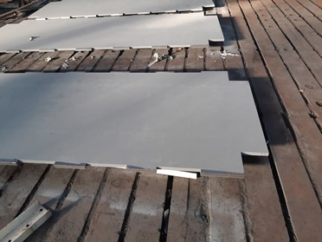
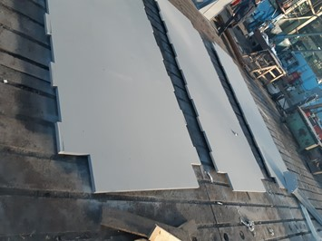
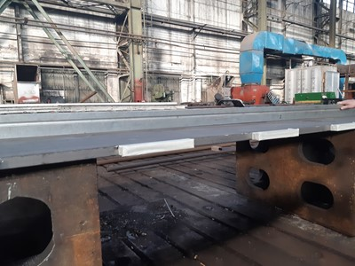
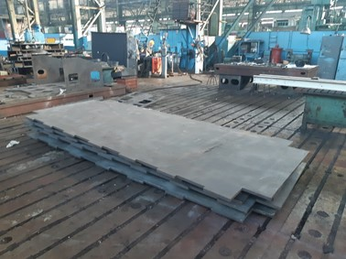
Status of the PANDA yoke and frame production
Module sheets by cutting

Slide 12
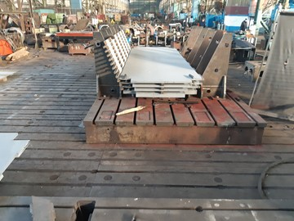
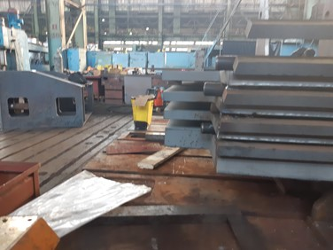
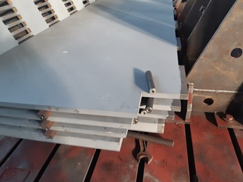
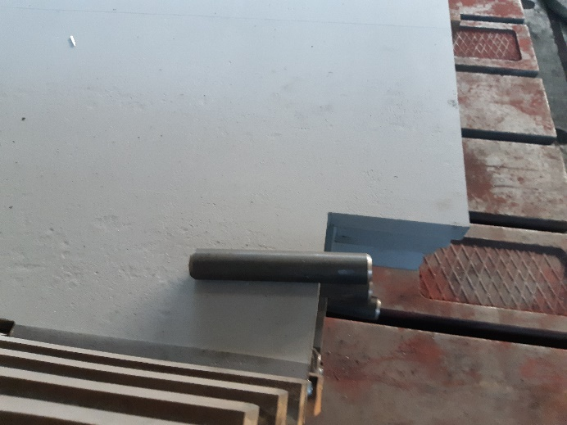
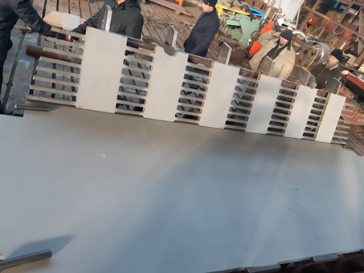
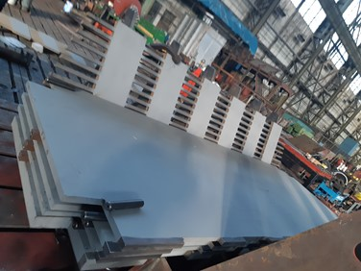
Status of the PANDA yoke and frame production
Assembling of the second vertical octant W6

Slide 13
The main milestones of the yoke production
Name of milestone | Date 2017/10
Production of the all barrel octants | 02/2019
Production of the frame and beams | 04/2019
Production of the doors | 05/2019
Control assembling at SET | 06/2019
Finalization of the parts | 07/2019
Assembling of the Yoke at BINP | 09/2019
Table3. The main milestones of the yoke production.

Slide 14
Status of the PANDA conductor development/ procurement

Slide 15
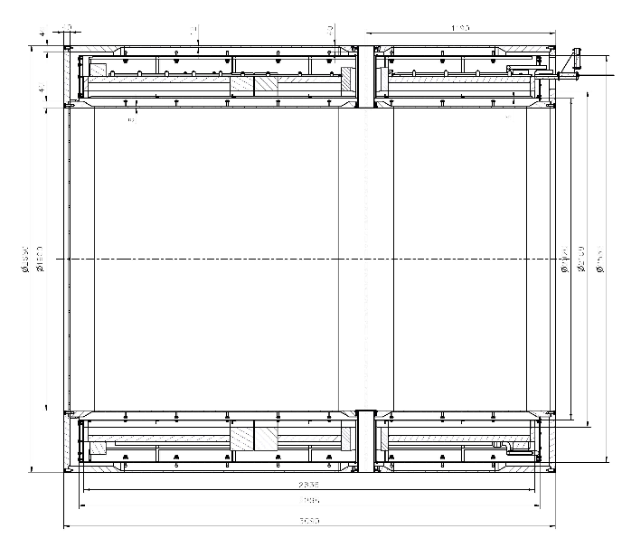
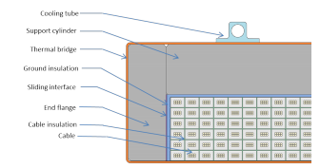
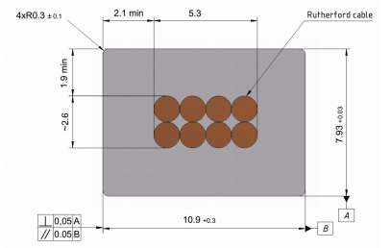
Main risks
Purchasing super conductive conductor - lack of a manufacturers
Rutherford cable, 8 strands, extruded in Al matrix
Thickness (after cold work) at 300 K | mm | 7.93 | ± 0.03
Width (after cold work) at 300 K | mm | 10.95 | ± 0.03
Critical current (at 4.2 K, 5 T) | A | > 14690
Critical current (at 4.5 K, 3 T) | A | > 16750
Overall Al/Cu/sc ratio |  | 10.5/1.0/1.0
Aluminum RRR (at 4.2 K, 0 T) |  | > 1000
Al 0.2% yield strength at 300 K | MPa | > 30
Table 4. Conductor mechanical and electrical parameters.
Figure 4. Longitudinal section of the cryostat with cold mass.
Figure 6. Drawing of the conductor.
Figure 5. Cold mass cross-section.

Slide 16
Status of the PANDA conductor production
Figure 2. Conductor cross section.

Slide 17
Status of the PANDA conductor production
A.A. BOCHVAR HIGH-TECHNOLOGY SCIENTIFIC RESEARCH INSTITUTE FOR INORGANIC MATERIALS (VNIINM), Russia
– strands - according to CERN specification - ?
Max. length of a strand – 20 000 m
For development
Manufactured strand:
Diameter – 1,4 mm;
Length - 1700 m.
Strands are ready

Slide 18
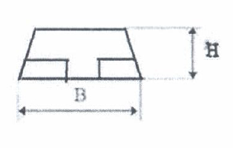
Status of the PANDA conductor production
Weight loss production rod Ø55 mm - 51 %
Contract between VNIINM/VNIIKP and BINP for production rods in progress

Slide 19
Status of the PANDA conductor production
VNIIKP
Russian Scientific Research Design and Technological
Institute of Cable Industry
Adjustment and fitting machine to produce Rutherford cable (max. 28 strands) - according to CERN specification
Contract for development work is signed.
Rutherford cable 108m long is ready
Rutherford cables from Cu 2x108m are ready and in Sarko.

Slide 20
Sarko Pure Al co-extrusion/ plating
Two lines (China and England production) about 100 m length are working on today. Two additional lines are in process of shipping and preparation for montage. The development of parameters of extrusion is our aims at the present time. Lines work in automatic conditions with control temperatures, pressures and velocities of steel pipe/wire and Al rod moving. The parameters possible to regulate in the ranges:
temperatures of steel pipe/wire - 300-450 degrees
Celsius temperatures of extrusion volume - 300-450 degrees Celsius
heating medium - N2
pressures of extrusion volume - 20-50 bars
diameter Al rod - 9.5 mm
quantity of inlet of Al rods – 2
velocity of pipe/wire - 30-100 m/min
velocity of pipe/wire - depend.
Used centering tooling, tolerance of non-centers smaller than 0.1 mm for standard process, for Rutherford cable - ?

Slide 21
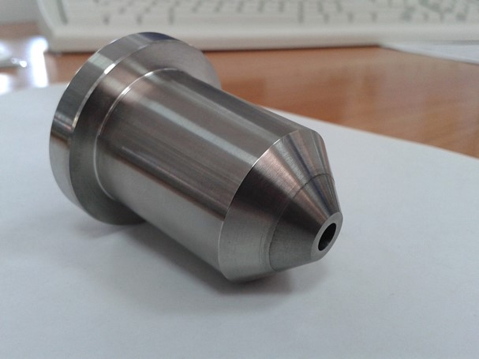
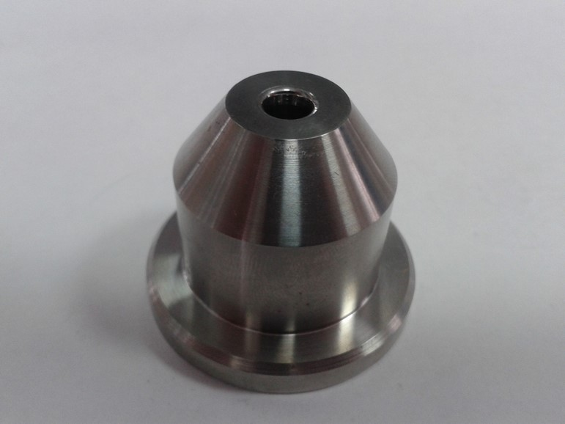
Sarko
Matrices for pipe and plating Al alloy.

Slide 22
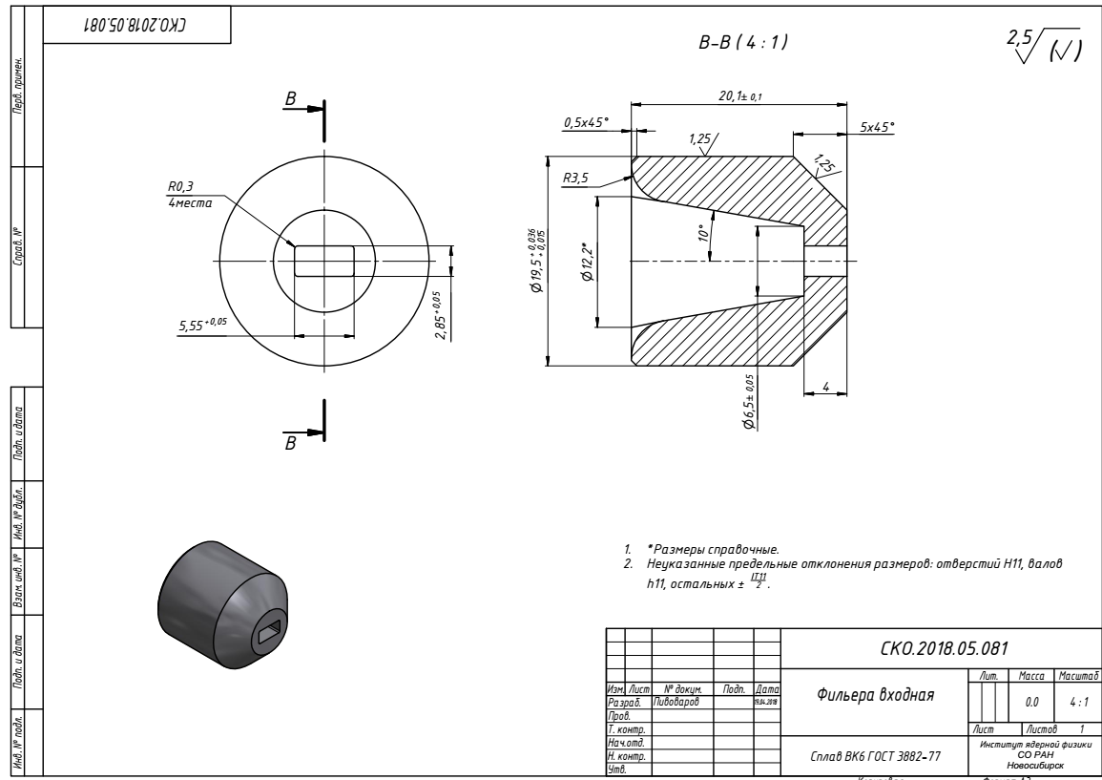
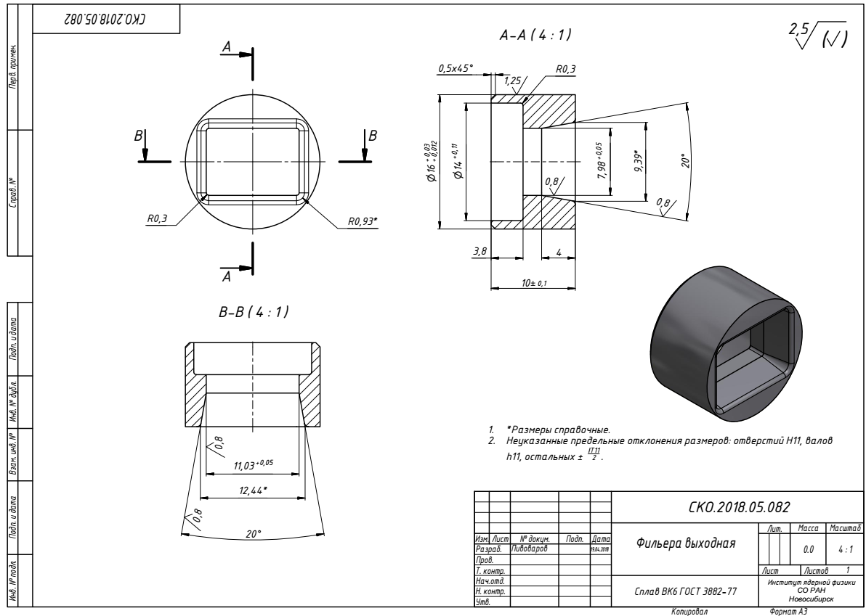
Sarko
Matrices for Rutherford cable and plating Al alloy.

Slide 23
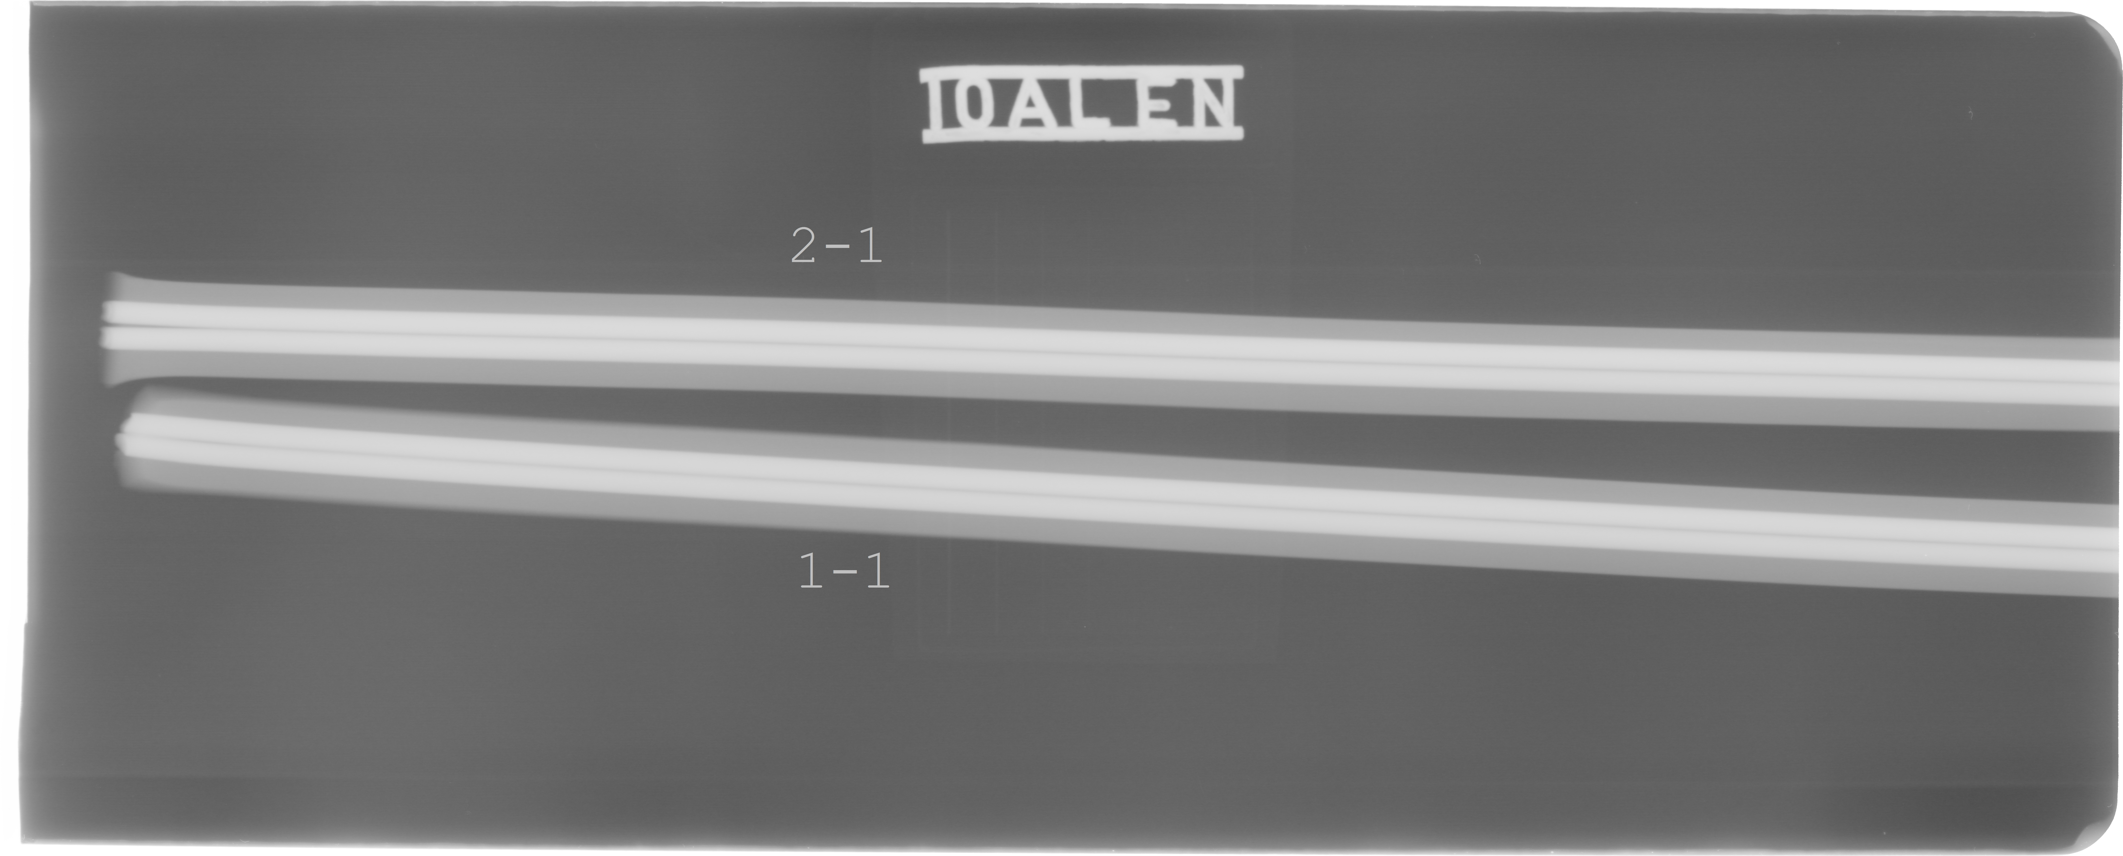
Sarko
First tests of production
Al conductor was produced in Sarko September 20 about 50m long. Two steel wires 2,66mm diameter were used instead a Rutherford cable.
It was checked a possibilities of conductor production in Sarko.
T _{extrusion} = 380°C
V ≤ 5 m/sec
X-ray control of wires position inside an Al matrix.
Measurement of shear stress between cable and aluminum and Al 0.2% yield strength
at 300 K in process.

Slide 24
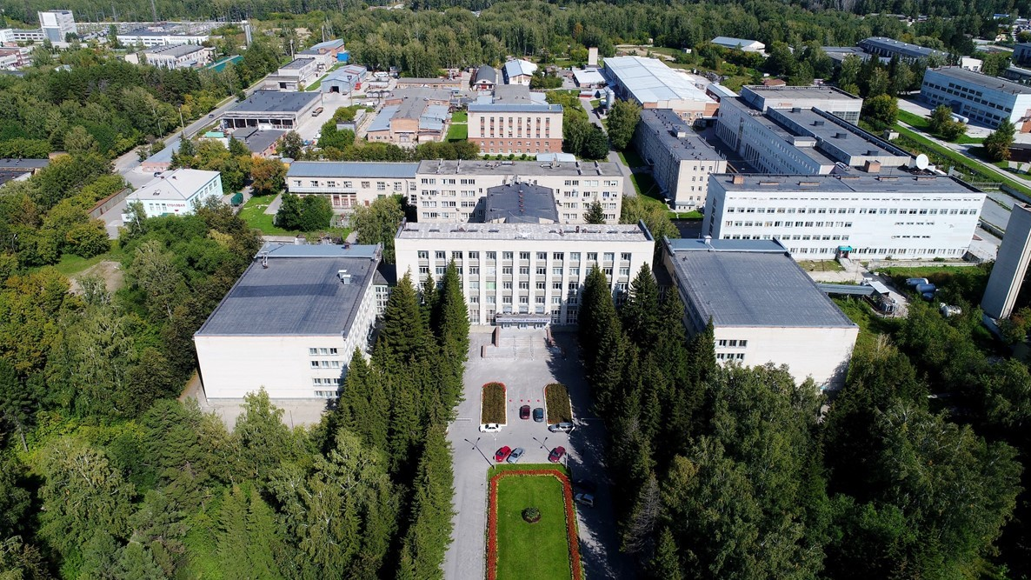
Thank you for your attention

