Slide 1
PANDA COLLABORATION MEETING 18/3
5-9 November 2018
GSI, Darmstadt, Germany
Forward Spectrometer Dipole Magnet

Slide 2
Specification for Dipole magnet
Field integral along beam axis (z-direction) 2.0 T·m
Field integral in midplane (y=0) along x= 75 cm > 1.70 T·m
Total length ≤ 2.52 m
Gap opening (H x W) (0.8-1.01 m) x 3.1 m
Dimensions according to model https://edms.cern.ch/document/1064100/1
Lamination of yoke ~ 10 cm
Mass of yoke with field clamp and support structure 210 tons < m < 220 tons
Steel quality of yoke St-10
Coil Resistive, water cooled
Conductor current 2.0…2.2 kA
Coil inclination ± 3°… 4°
Total weight of both coils ≤ 20 tons
Total dissipated power ≤ 400 kW
Water temperature rise ≤ 25 K
Allowable pressure drop 10 bars

Slide 3
Issues to be solved
Magnetic field integral is not less than 2 T x m
Yoke separation to avoid eddy currents
Tolerance and deformation/sag as acceptable values (0.2 mm or so)
Alignment of dipole for vertical and horizontal planes as +/- 5 mm
Power consumption is less than 400 kW
Possibility of assembling at the PANDA site
Seismic stability

Slide 4
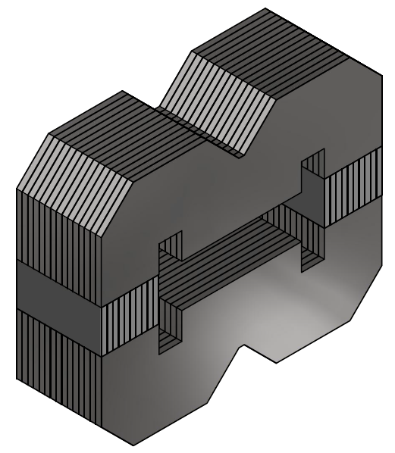
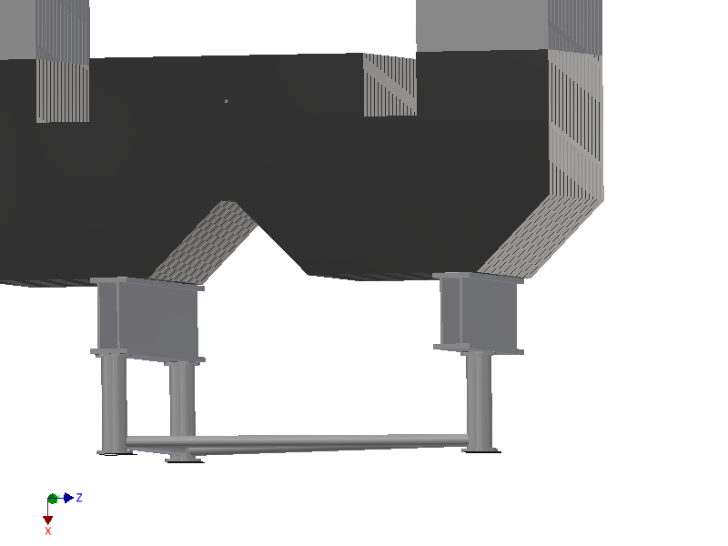
Design of Dipole Magnet - Yoke
Two types of separation for central installations in yoke:
1) Parallel to main plates
2) Perpendicular to main plates
Rigidity vs. easy machining and saving steel material

Slide 5
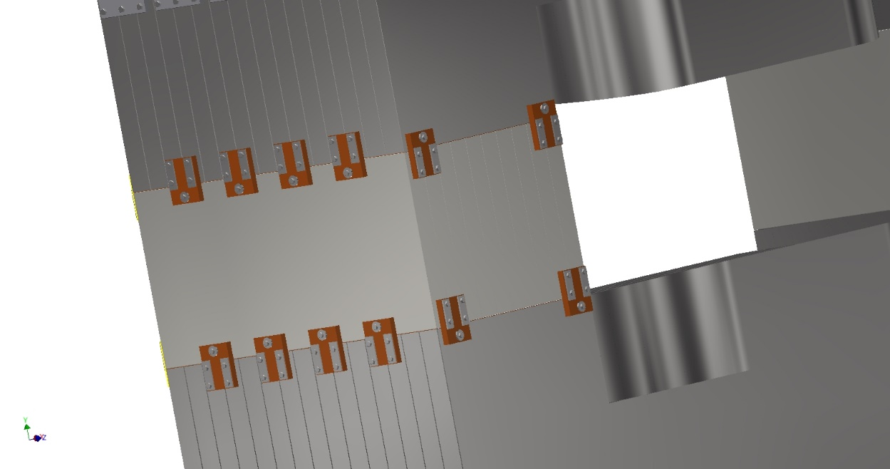
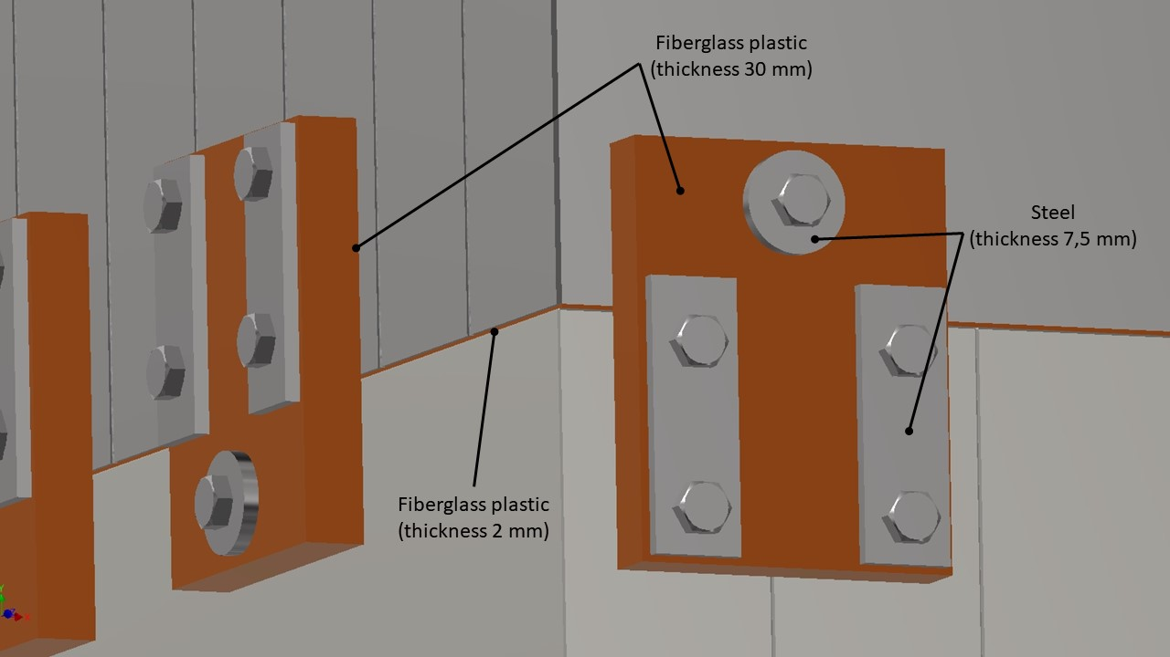
Design of Dipole Magnet - Yoke
Connecting parts must be
insulated!

Slide 6
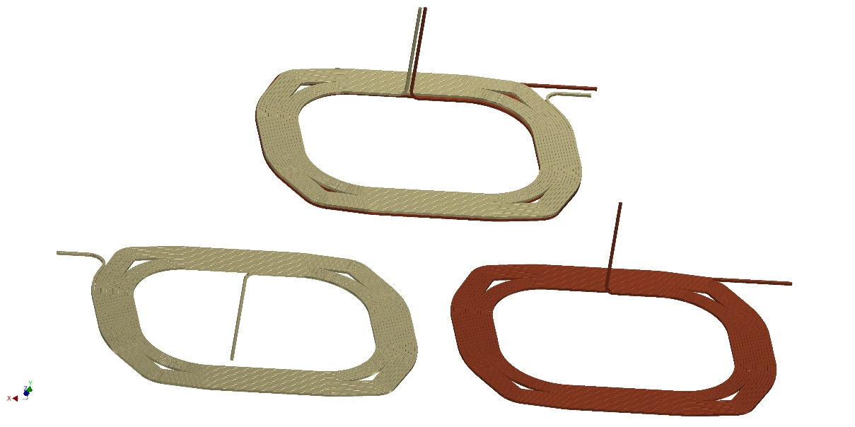
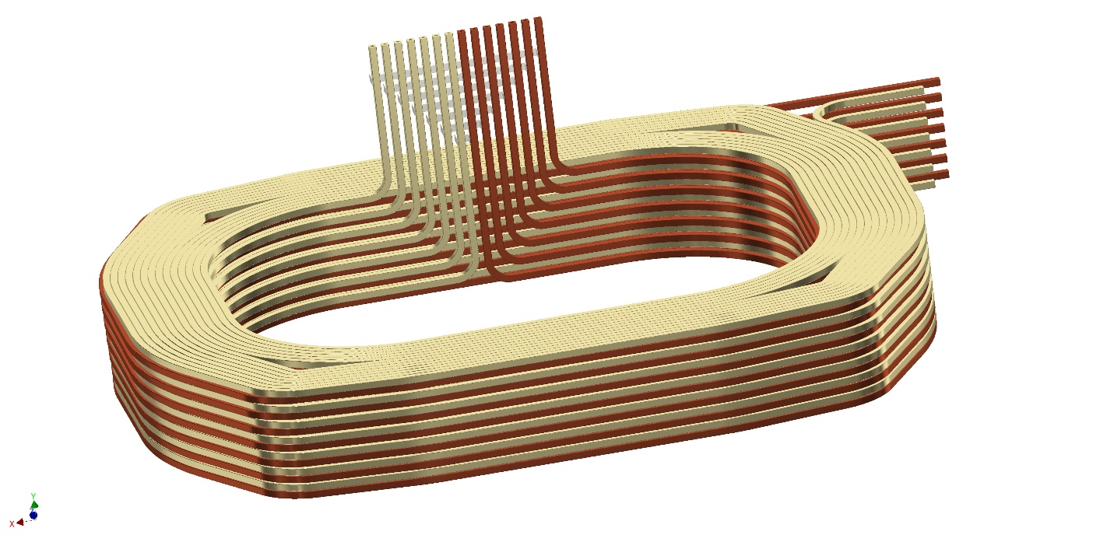
Design of Dipole Magnet - Coil
Coil section is double pancake
with individual cooling of each winding
Total coil is made as 7 sections/14 windings
Copper conductor is 26 x 26, dia. 13 mm.
Thus temperature rise is 10 deg. for 10 bars

Slide 7
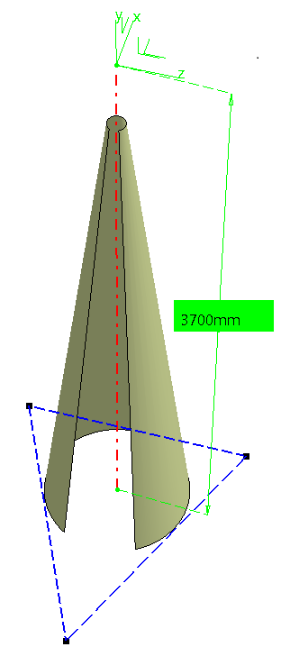
Design of support structure and stability
centre-of-gravity
foot
foot
Radius at floor level 444mm
foot

Slide 8
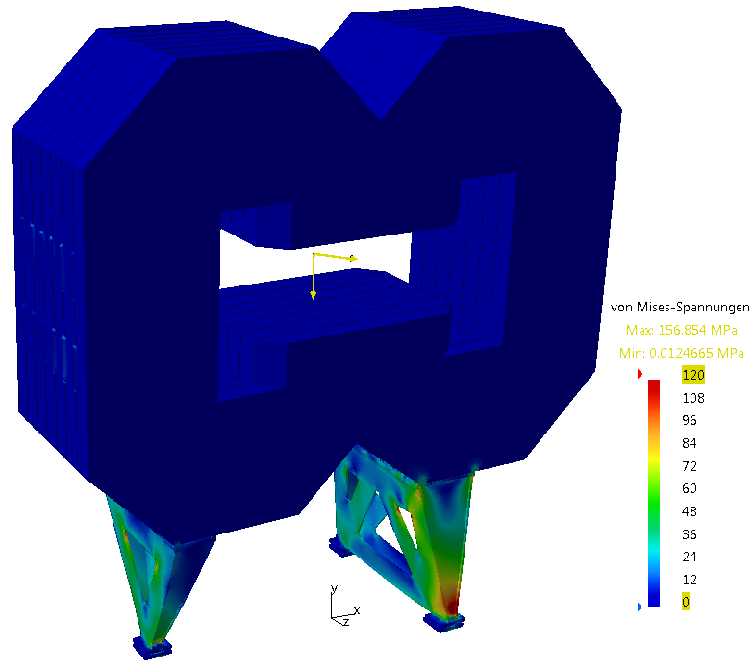
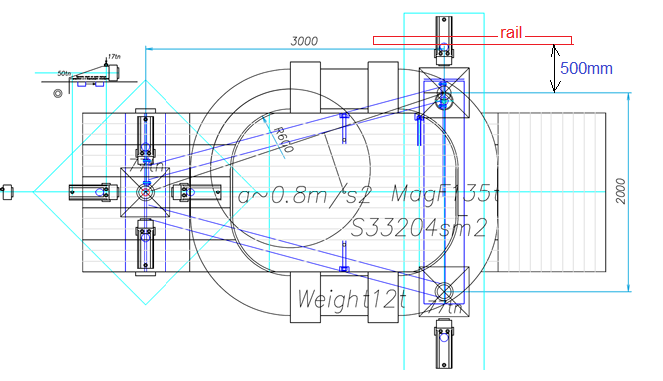
Design of support structure and stability
total weight (240 tons) applied in centre-of-gravity,
horizontal load 8% of weight
highest support load in the direction of the horizontal force (see yellow force vector in the centre of gravity)

Slide 9
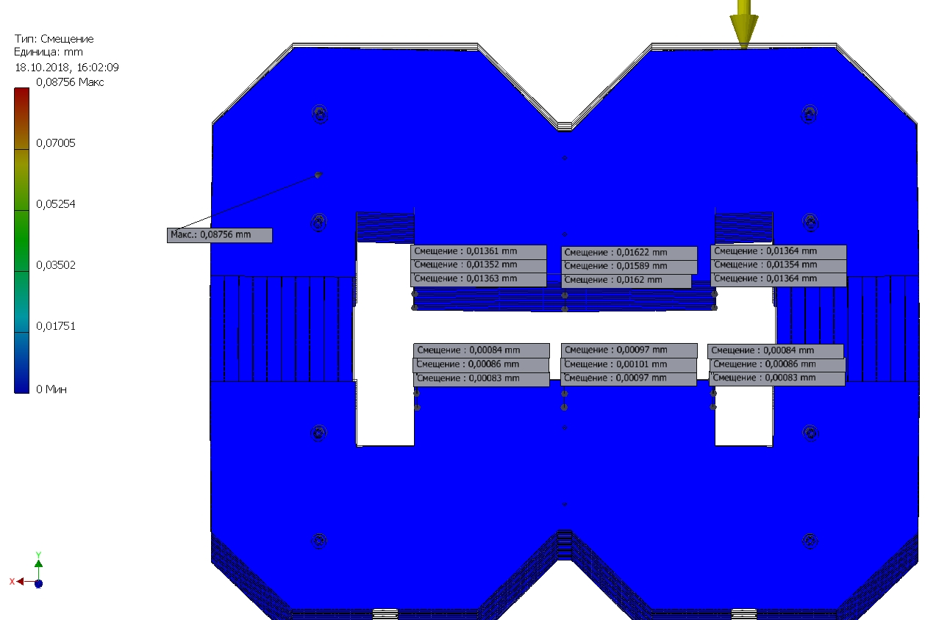
Deformation and stability
Magnet placed for rigid base
has very small deformation
(about 15 microns).
So steel lamination plate is very
rigid itself.
Then deformation is defined by
design of support structure and
position of center of gravity.

Slide 10
Deformation and stability
Deformation for parallel and perpendicular installations are the same.
But asymmetric as left-right.

Slide 11
Deformation and stability
Deformation of pole surface for parallel and perpendicular installations are the same.
The dipole gap has asymmetry as inclination.
But pole surfaces remain parallel => they can be aligned easily by adjustment tool.

Slide 12
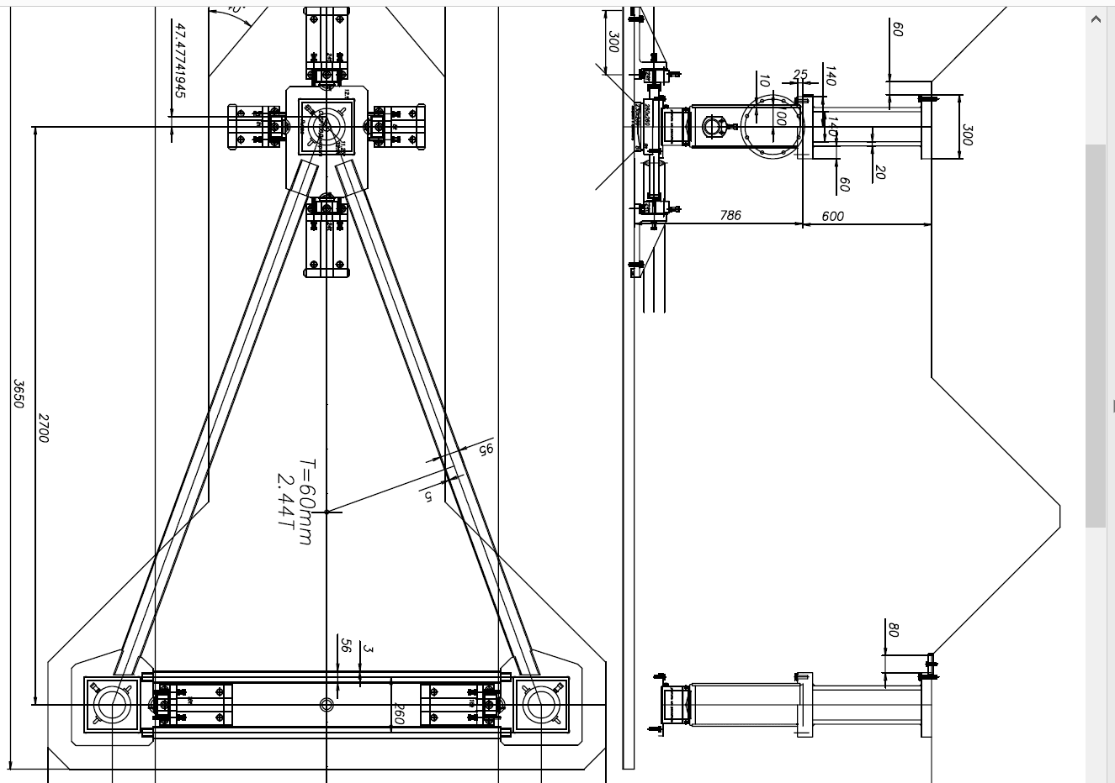
Deformation and stability – alignment

Slide 13
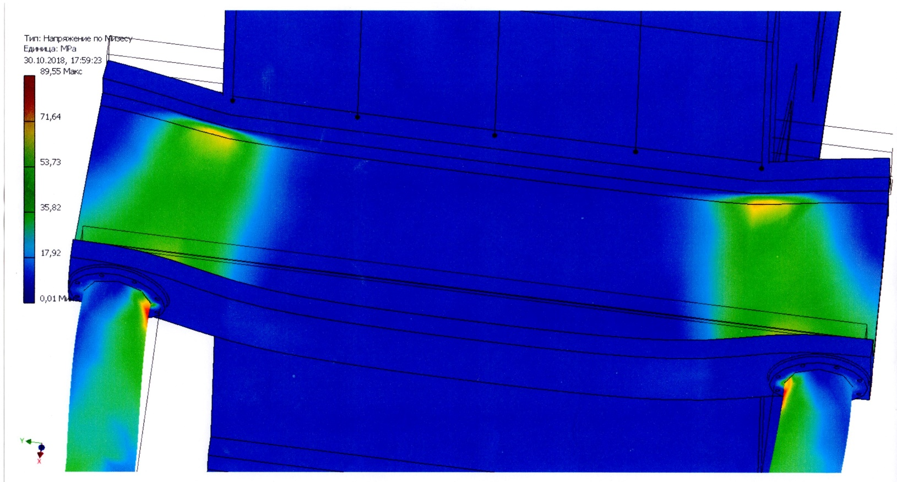
Deformation and stability
Deformation of support structure is defined by foot deformation.
Foot bending contributes 0.4 mm, meantime double-T profile contributes 0.15 mm.
Thus proper design of foots and their positions should be found following
the correct location of center of gravity.

Slide 14
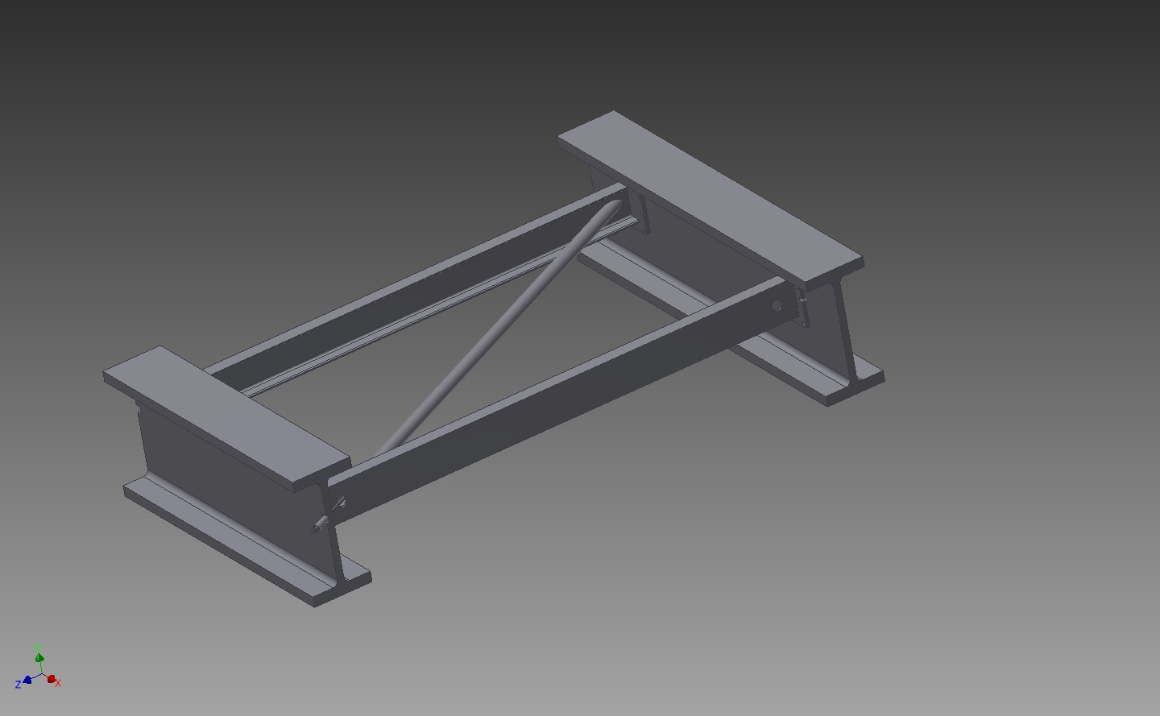
Support structure
36 mm thickness T-shape profile

Slide 15
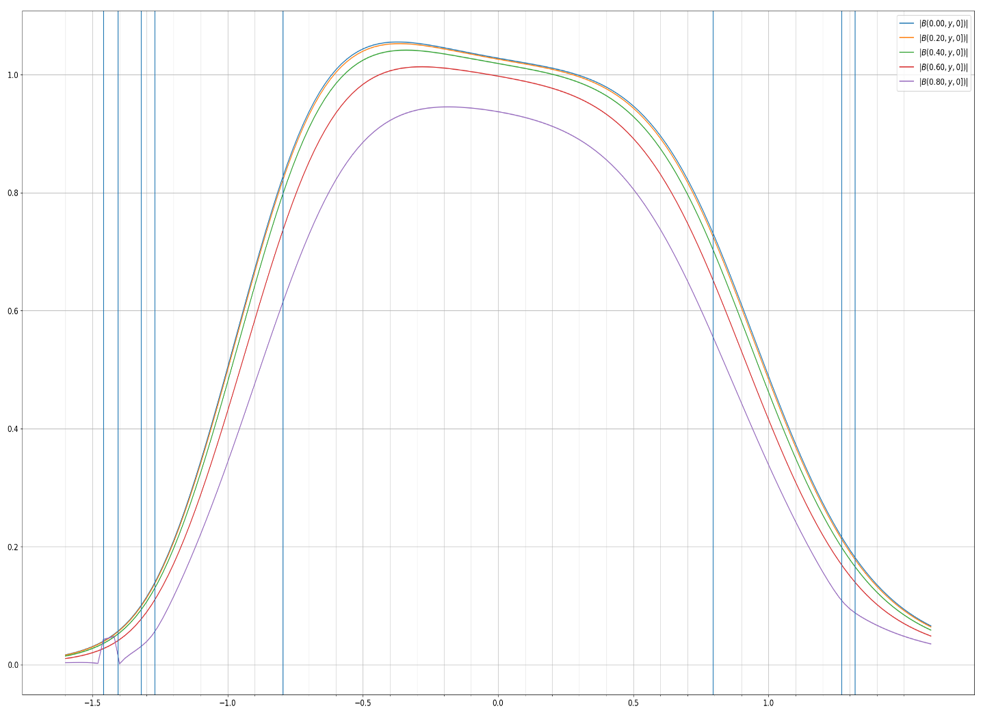
Magnetic field simulations
Field distribution along dipole magnet.
Field integral is 2.1 T x m.

Slide 16
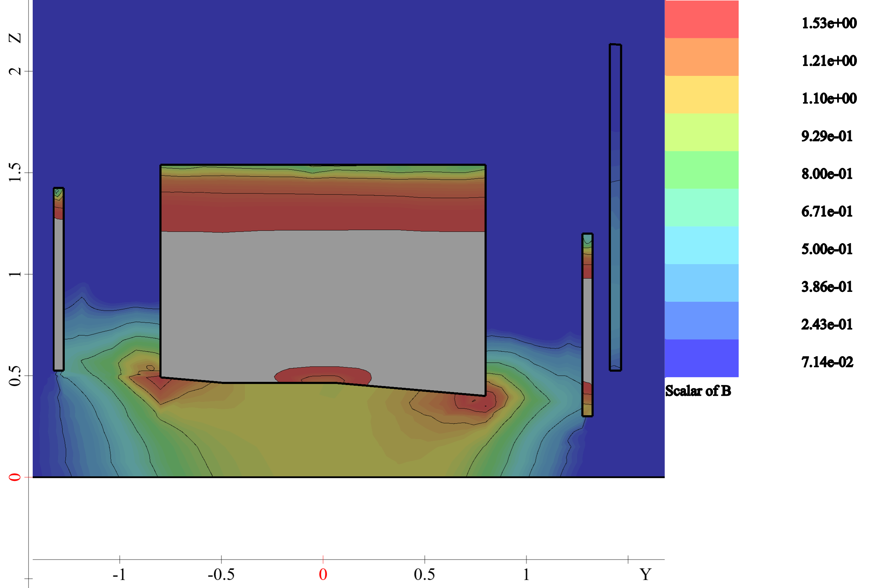
Magnetic field simulations.
Field map for the plane X=0.

Slide 17
Magnetic field simulations – eddy currents
Magnetic field rise vs. current
106 mm thickness plate is selected

Slide 18
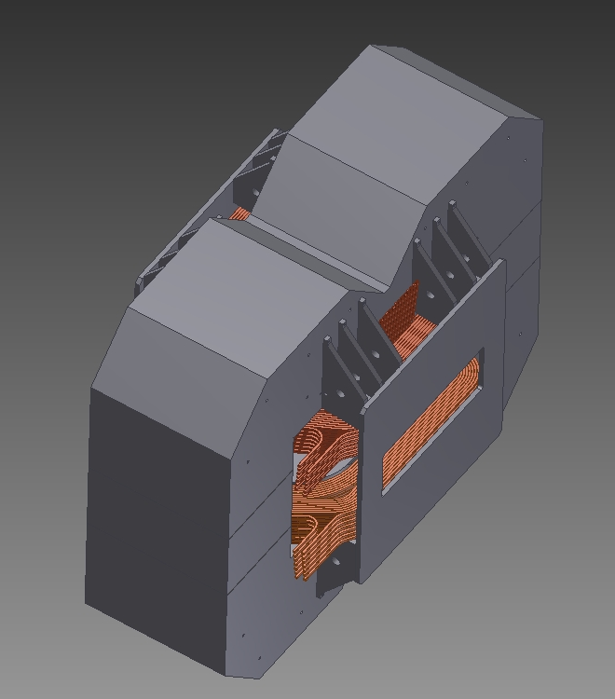
Remaining issues:
Center of gravity
Design of plates
Design of support structure
Checking with magnetic forces
Machining technology development
Checking eddy currents for whole
magnet including all connecting parts

