Slide 1


Simulation of cooling system for PANDA electromagnetic calorimeter using CFD
FACULTY OF MECHANICAL
ENGINEERING
UNIVERSITY
OF WEST BOHEMIA
PANDA Collaboration Meeting
Darmstadt, November 2018
Ing. Michal VOLF
volfm@kke.zcu.cz
+420 608 282 562

Slide 2
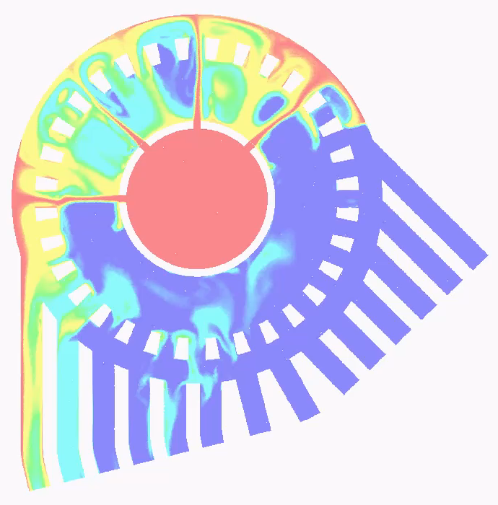
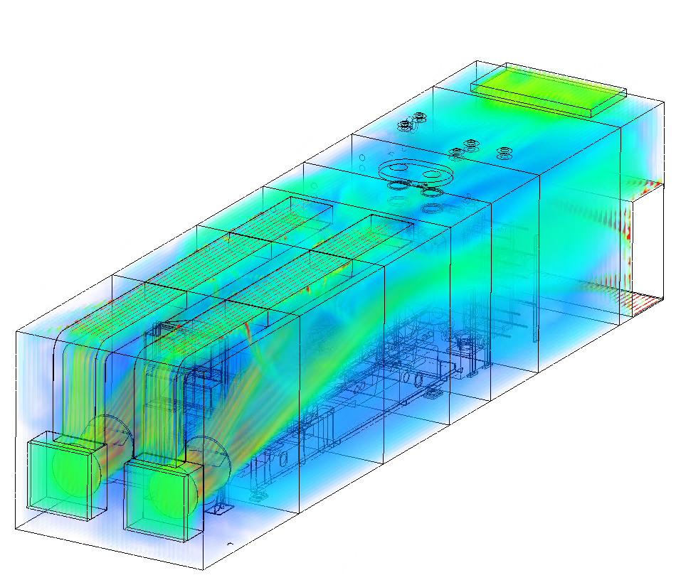
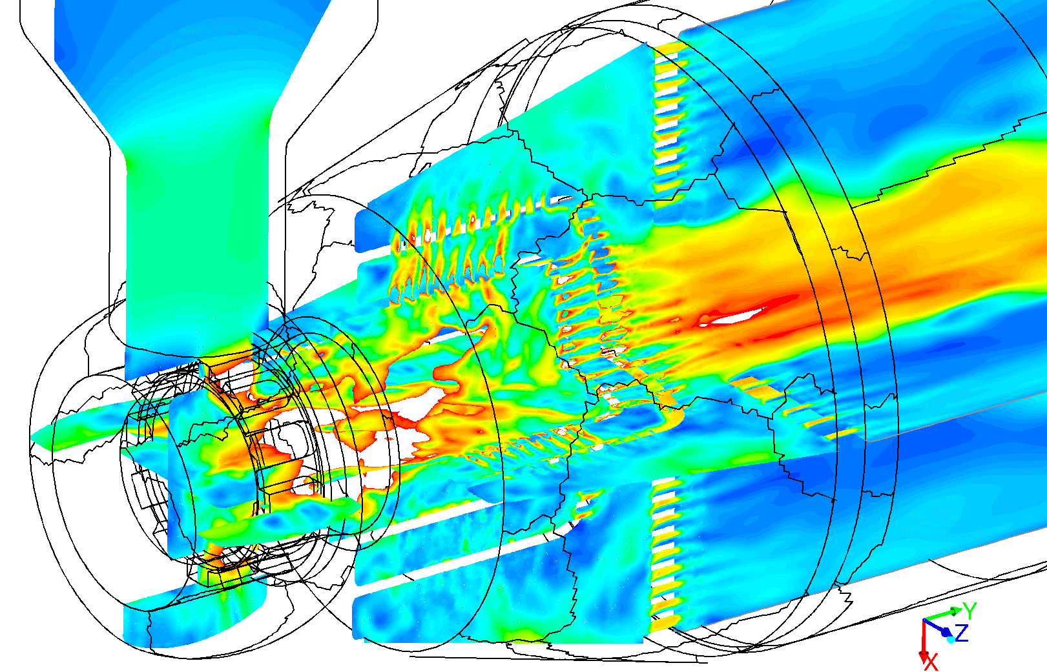
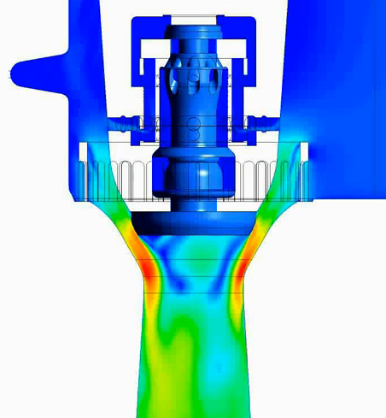
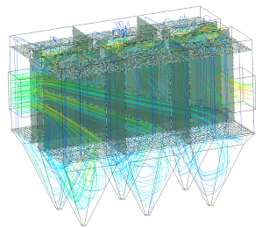
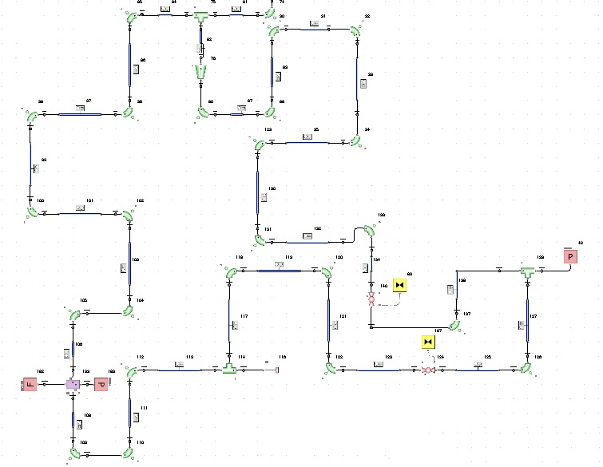
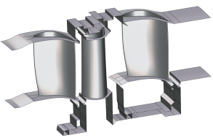
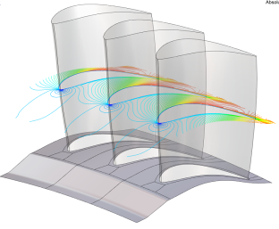
Department of Power System Engineering - CFD
Ammonia-water solution-based heat exchangers
Cogeneration units
Complex geometries (reduction cages)
Complex geometries (valves)
1D & 3D analysis (Nuclear Power Plant)
Electrostatic precipitators of flue dust
Turbomachinery

Slide 3
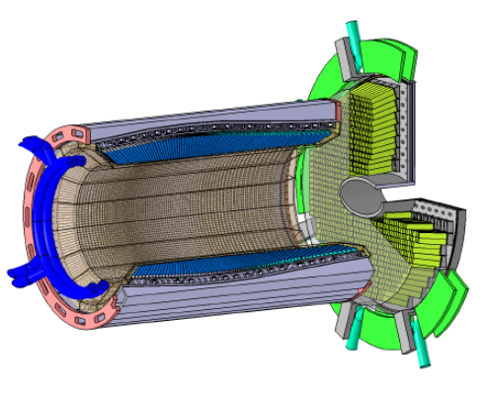

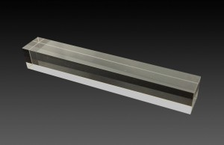
Introduction
PbWO₄ light yield ↑↓ temperature
lower temperature is better
temperature stability
among all crystals ≈ 1 K
within a single crystal ≈ 0.1 K
How can this be achieved?
? number of cooling tubes
? shape of cooling tubes
? mass flow rate of cooling medium
? inlet temperature of cooling medium
! limited space for cooling circuits
! crystals cannot be cooled down directly
! homogenous temperature field
! different pressure losses in each cooling circuit

Slide 4
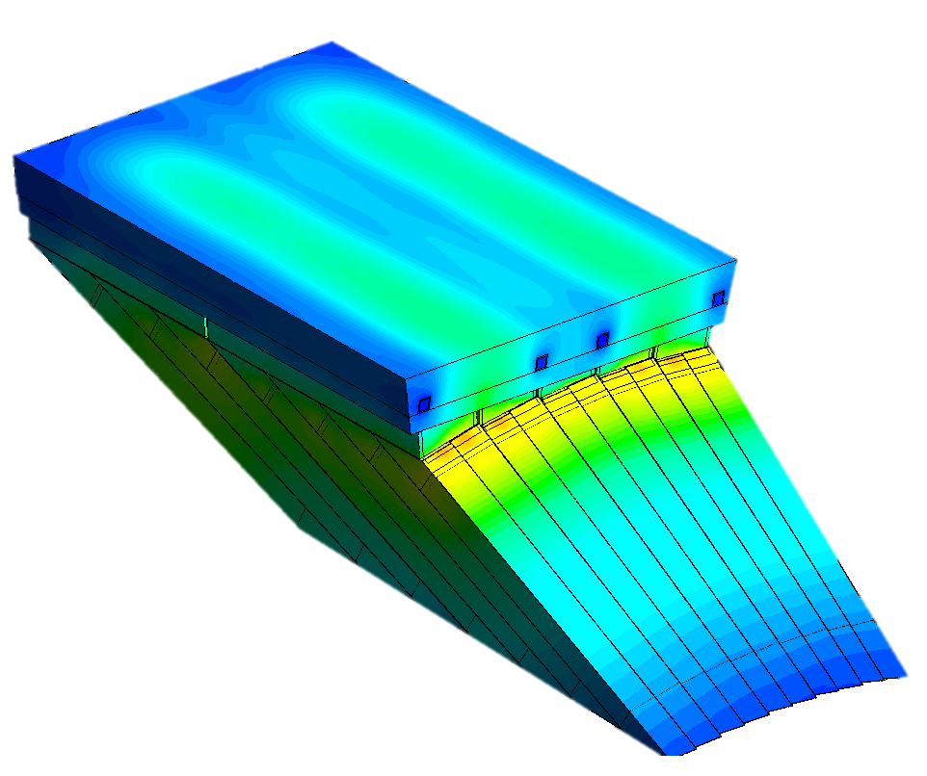
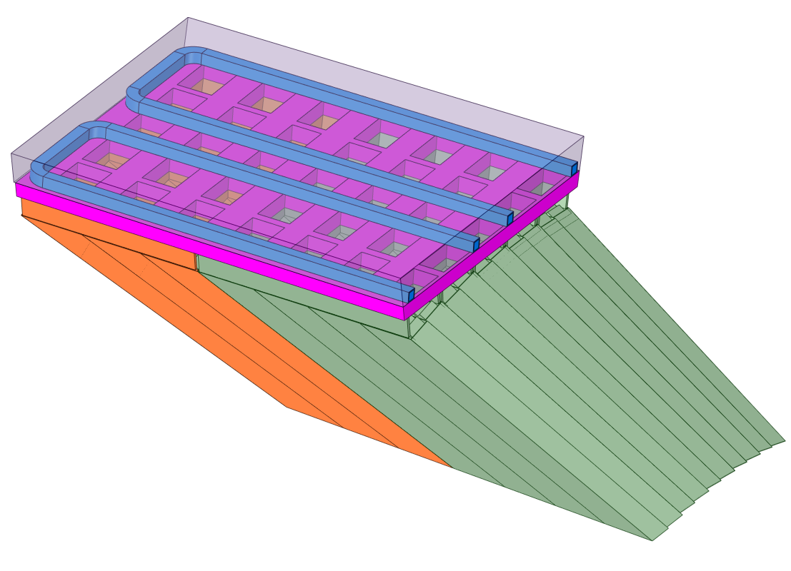
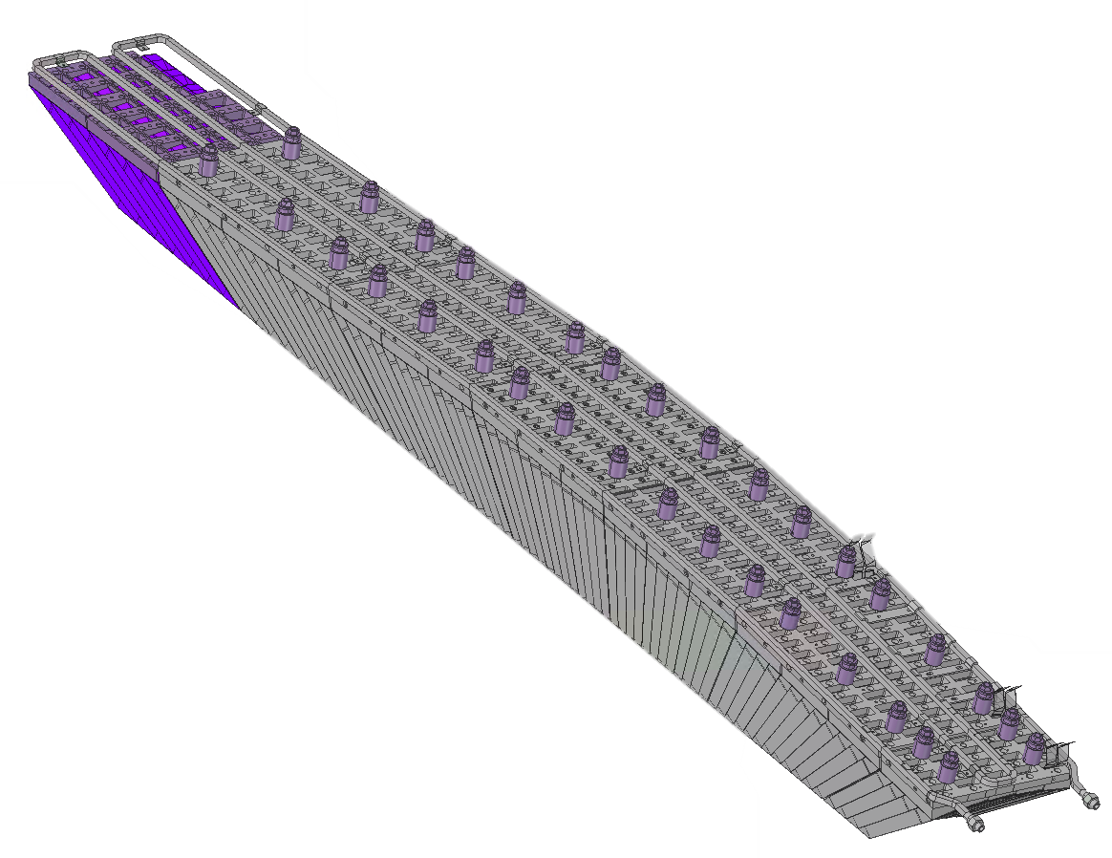
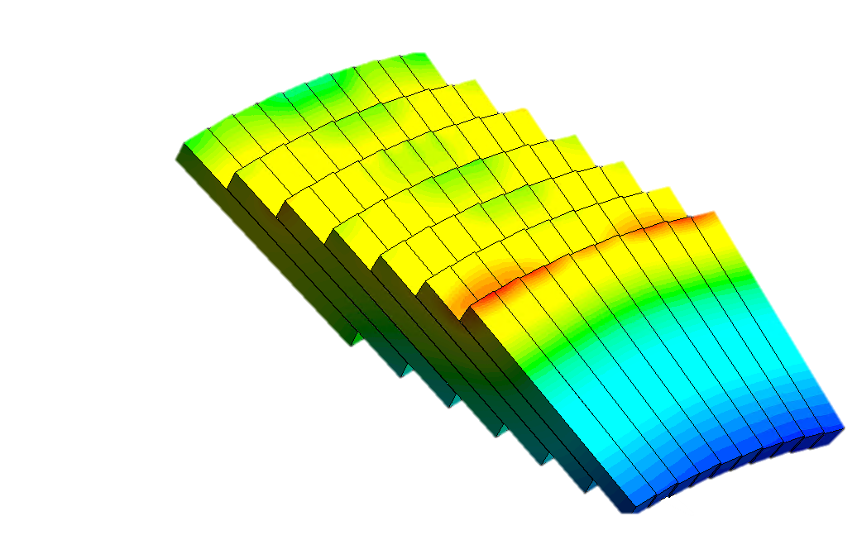
First approach
partial geometry is used for simulation in order to:
  decrease pre-processing time
  decrease computational time
influence of fluid flow turning
FOAM
COOLING TUBES
influence of fluid flow turning
SUPERMODULE7
MODULE 11
„representative“ crystals
MODULE 10
numerical error
computational domain should be extended to increase the number of „representative“ crystals

Slide 5
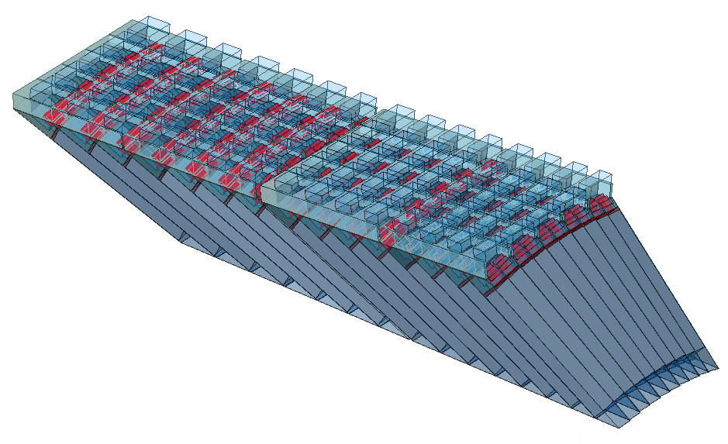
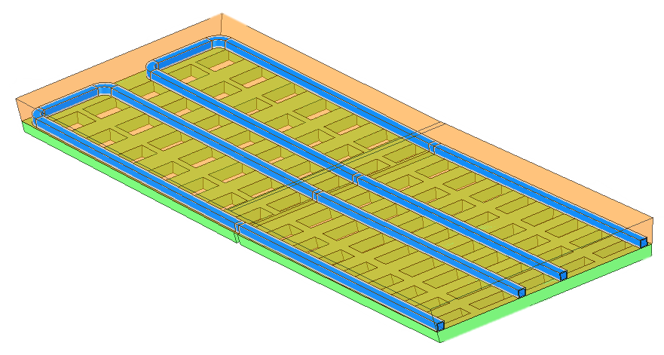
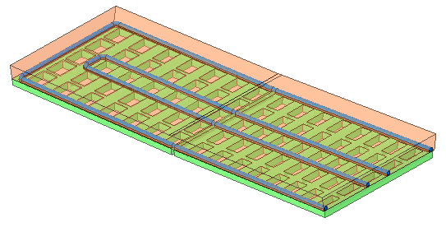
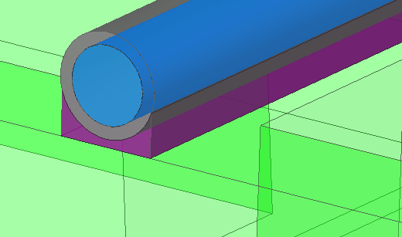
Computational domain
ccomputational domain has been divided to two parts: base domain (crystals etc.) and cooling system
  simplifies the procedure of testing multiple cooling systems
  ensures the base domain is not influenced by changes in computational mesh
BASE DOMAIN
COOLING SYSTEMS
rectangular tubes
inner dim. 8 x 8 mm
two separate circuits
round tubes
inner diam. 8 mm
two separate circuits
SUPERMODULE 6 & 7 (modules 8 – 11)
  domain consists of 150 crystals
  100 of them are considered as representative for the rest of SLICE
connection

Slide 6
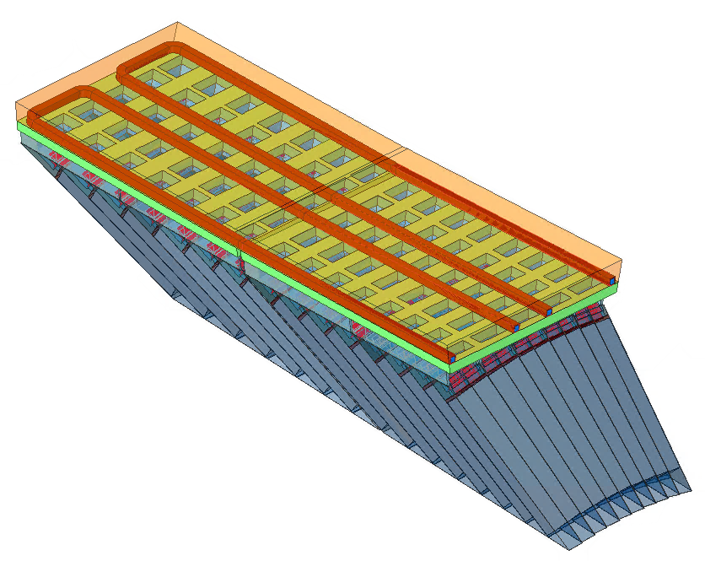
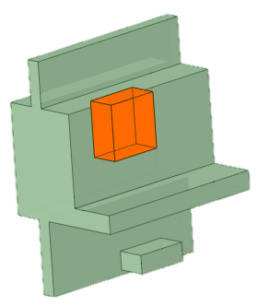
Numerical simulation setup
heat transfer from ambient air
applied as ambient temperature + heat transfer coefficient (≈50 W/m²)
Heat sources: ambient temperature 25 °C
read-out electronics
heat conduction in cables
3D simulation
Cooling fluid: -28 °C, 0.4 kg/s at inlet
pressure of 1 atm at outlet
mixture of water/methanol (40/60)
back wall is considered to be adiabatic
1D simulation
heat conduction in cables (≈200 mW)
heat source from the chip (≈150 mW)
symmetry specified on side walls
outlet
inlet 2
outlet
inlet 1
fixed temperature of -25 °C
adiabatic wall

Slide 7
Material properties
Component | Material | Specific heat capacity [J kg-1 K⁻¹] | Thermal conductivity [W m⁻¹ K⁻¹] | Density [kg m⁻³] | Other
Crystals | PbWO4 | 262 | 3.22 | 8280 | Ref. temp. 30 °C
Crystal casings | Carbon fibres | 1100 | 78.8 | NaN | Ref. temp. 120 °C
Crystal connections | Duralum | 920 | 147 | 2900 | Ref. temp. 25 °C
APFEL asics | Aluminium | 903 | 237 | 2702 | Ref. temp. 25 °C
Electronic board holders | Duralum | 920 | 147 | 2900 | Ref. temp. 25 °C
Intermediate plates | Duralum | 920 | 147 | 2900 | Ref. temp. 25 °C
Supermodule plate | Duralum | 920 | 147 | 2900 | Ref. temp. 25 °C
Foam | HOCOTOL | 880 | 154 | 2830 | Ref. temp. 25 °C
Cooling tubes | Copper | 385 | 401 | 8933 | Ref. temp. 25 °C
Cooling medium | Water/methanol (40/60) | 3151 | 0.341 | 930 | Ref. temp. 25 °C Ref. pressure 1 atm
Ambient medium | Ideal gas | - | - | - | -
Material properties are NOT defined for operating temperature
General values are taken since we do not have specific material sheets available
needs to be reviewed

Slide 8
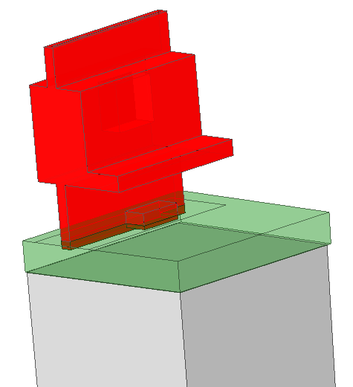
Material properties
crystal connections
the connection was modeled since there was no direct connection in the default geometry

Slide 9
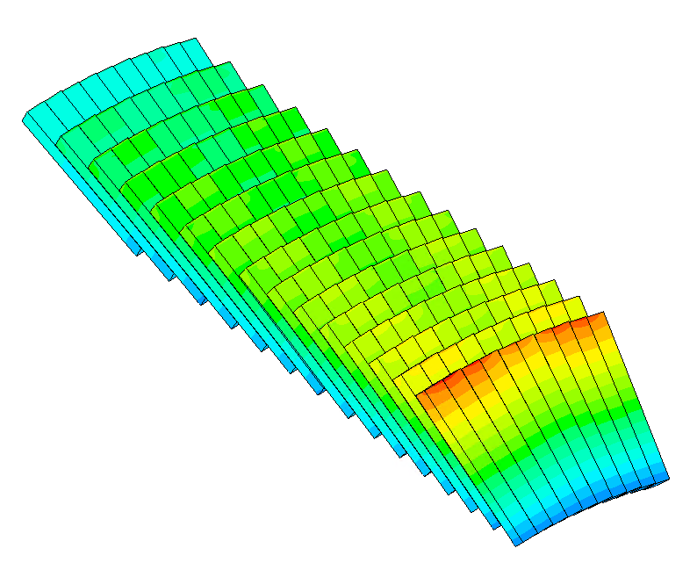
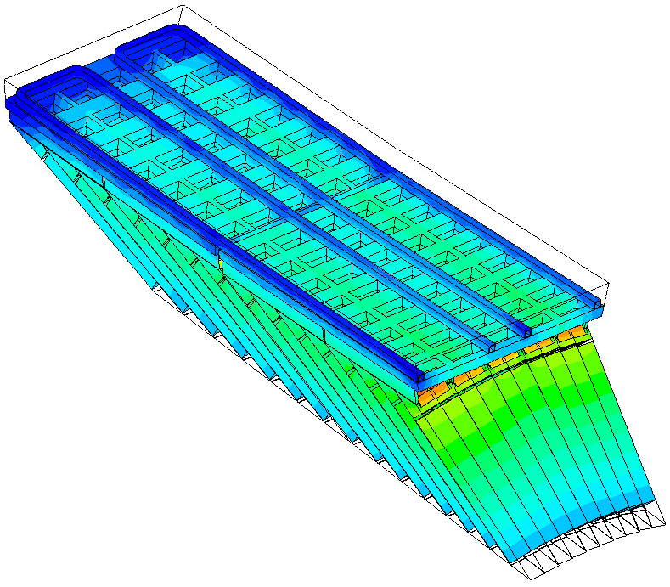
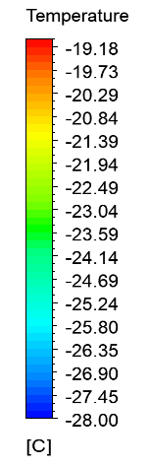
Preliminary results
Temperature field – surface of the domain (without foam)
Temperature field – surface of the crystals

Slide 10
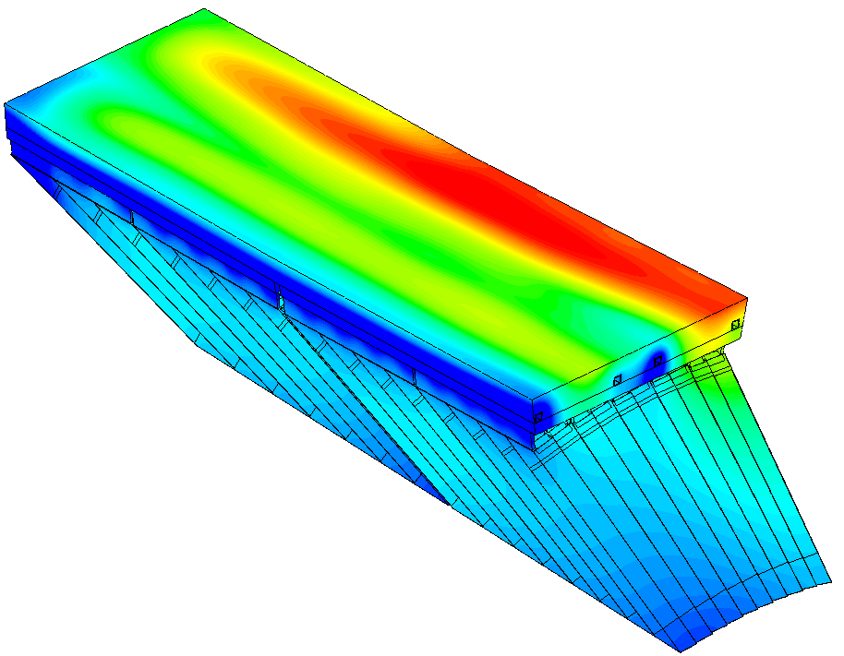
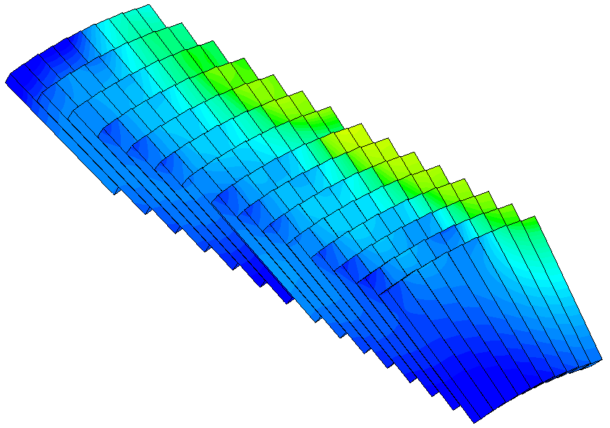
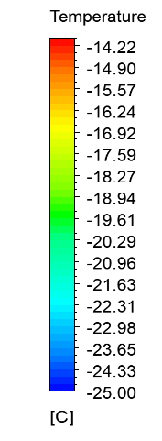
Preliminary results – cooling system failures
it is assumed that mass flow rate in the second circuits is only 5% of the mass flow rate in the first one
Temperature field – surface of the whole domain
Temperature field – surface of the crystals

Slide 11
Conclusion
Goal: cool down crystals to approx. - 25 °C
ensure stability of temperature & homogenous temperature field
Difficulties: complex geometry with lots of connections between components that are simulated as ideal ones
lack of free space for proper cooling system
1D simplification of supermodules
high accuracy of simulations
sensitivity to boundary conditions
difficulties with material properties at working temperature
Follow-up research: result comparison between various cooling system designs
propose cooling design modifications
simulate cooling system failures
VALIDATION OF PARTIAL RESULTS

Slide 12
Thank you
FACULTY OF MECHANICAL
ENGINEERING
UNIVERSITY
OF WEST BOHEMIA
Ing. Michal VOLF
+420 608 282 562
volfm@kke.zcu.cz

