Slide 1
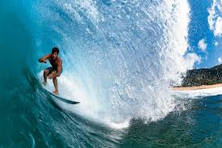
EMC Feature extraction for time-based simulation
Viktor Rodin
Myroslav Kavatsyuk, Peter Schakel

Slide 2
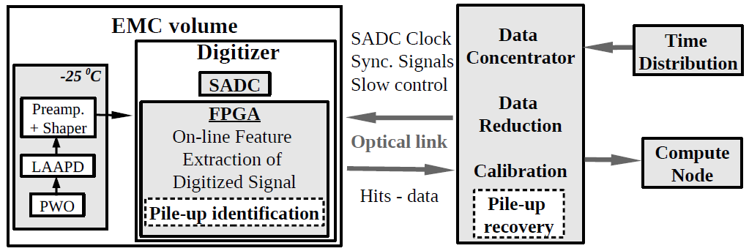
EMC readout
Hardware trigger
?????
????
Main features
Continuous data flow
No physical triggers
Intelligent FEE

Slide 3
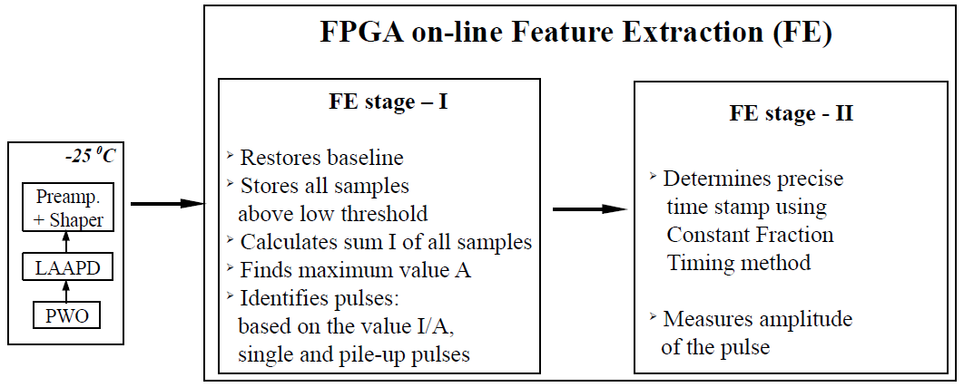
EMC readout
Feature extraction stages of digitized signals.

Slide 4
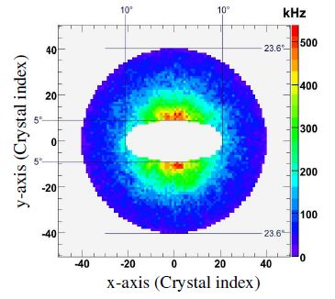
Pile-up happens…
Integrated single-crystal hit rate as a function of X and Y for the Forward Endcap EMC obtained from simulations with full interaction rate.
EMC TDR

Slide 5
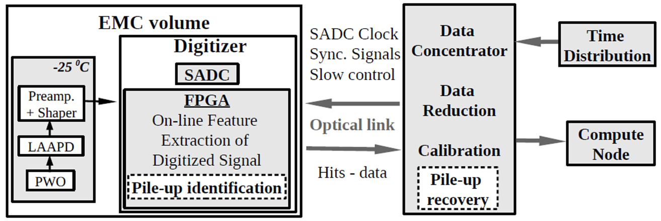
Pile-up recovery

Slide 6
MWD and MA
Moving Window Deconvolution
(differentiation with exponential tail recovery)
$${MWD}_{m}\left[n\right]=x\left[n\right]−x\left[n−m\right]+\frac{1}{τ}\sum_{i=n−m}^{i−1}{x\left(i\right)}$$
x(i) – value of sample,
m – length of window in samples,
$τ$ – inverted index of exponential tail of the pulse.
Moving Averaging
(integration, low pass efficient filter)
$$MA\left[n\right]=\frac{1}{L}\sum_{j=0}^{L−1}{A\left(n+j\right)}$$
L – number of samples for averaging.

Slide 7
Feature Extraction on FPGA
MWD I
FE
long
SADC
I/A
FE
Tr
MWD II
CFT
Time
short
Base-line
MA
E

Slide 8
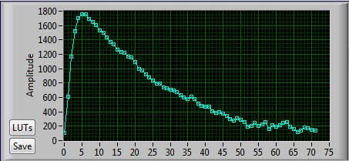
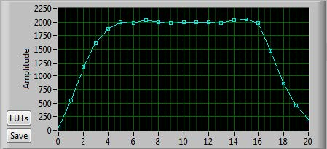
Waveform after filter
This waveform was measured with latest ADC version
(weaker shaping)
Raw waveform
MWD waveform
Samples

Slide 9
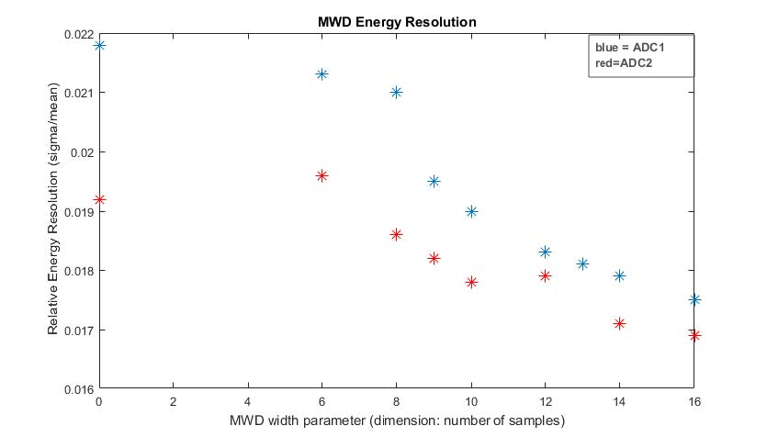
Energy resolution
C.Tsolanta (Bachelor thesis)
Energy = Pulse Integral over threshold
The longer filter length → better resolution

Slide 10
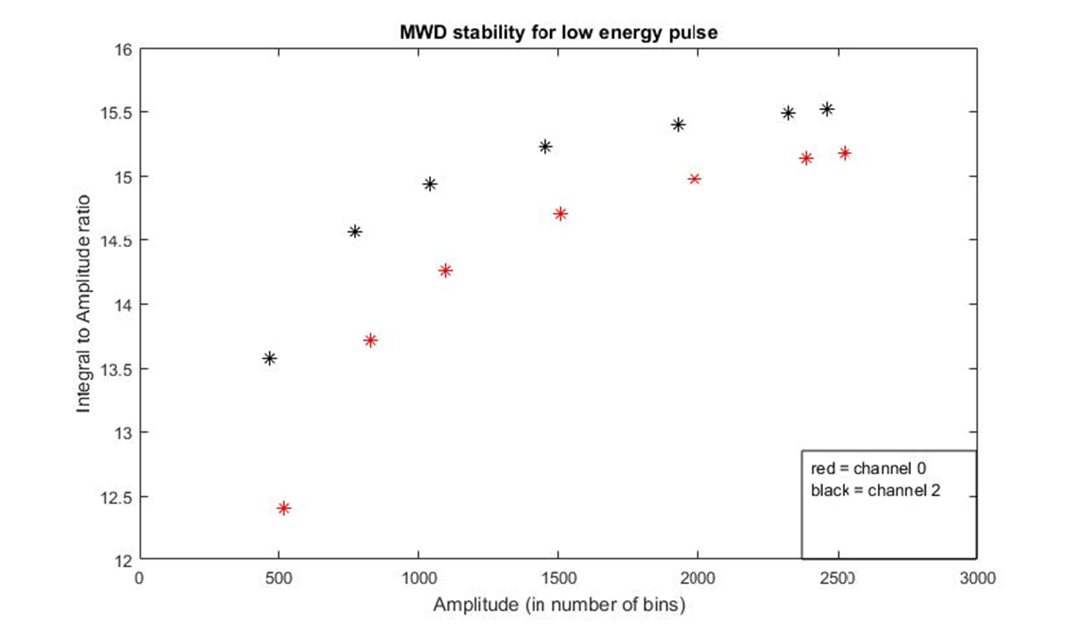
Disadvantages of dynamic integration
C.Tsolanta (Bachelor thesis)
Using of MWD filter improves but does not fix the non-linear dependency
of integral and amplitude(energy). Before it was working with old filter.

Slide 11
Possible solutions
Fixed window for the integration including
area below thresholds
( hard to implement)
Definition of energy with help of amplitude
( sensitive to noise effects )
Integrate the flat area after MWD filter
Using MA filter
(Energy is defined by amplitude
but noise effects are small)

Slide 12
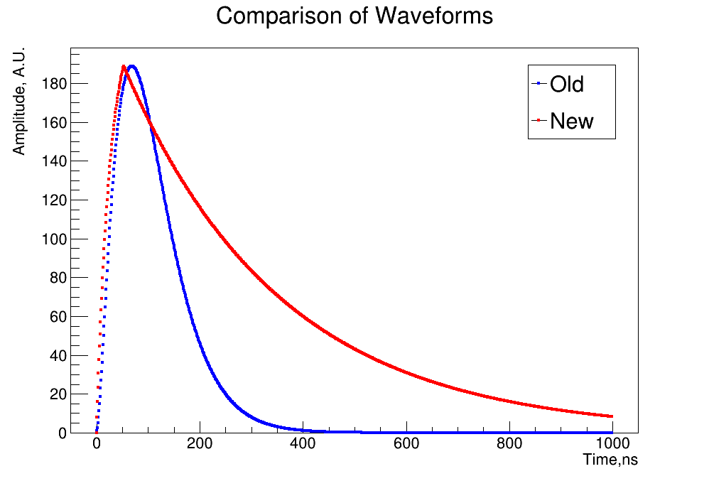
PandaRoot implementation
Old vs New pulse shape:
Old → shape of the pulse with ADC prototype
New → shape of the pulse produced by the final ADC version

Slide 13
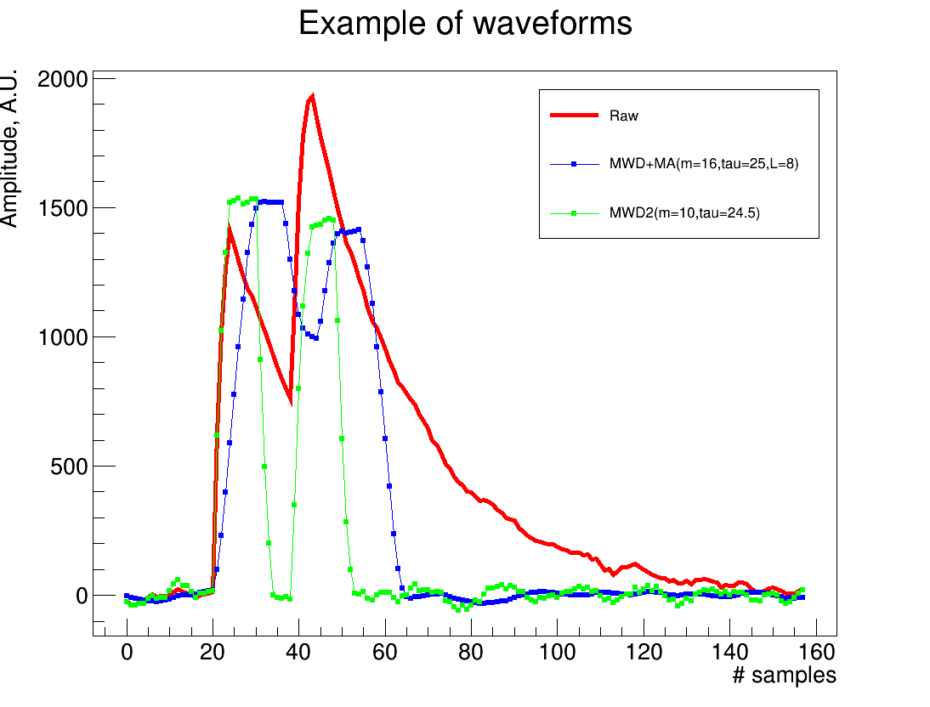
Implementation of pile-up identification&recovery
Aim of investigation
Pile-up treatment
Implementation of new waveform
(implemented but not optimized)

Slide 14
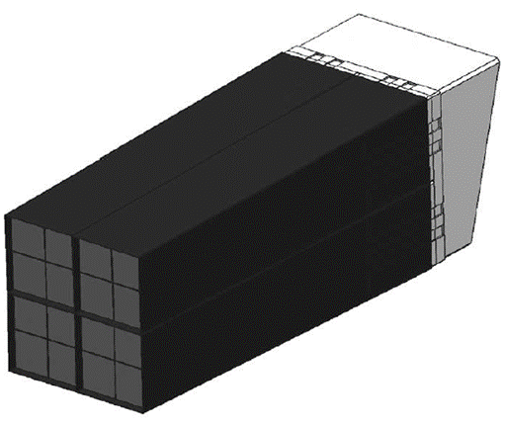
Timebased Simulation
$$γ$$
Input parameters
G4generator – Box Generator Particle – photon
Number – 10000 Energy – 0.5 GeV Hit rate – 100kHz
Shooting in one point
Clustering algorithm – online clustering

Slide 15
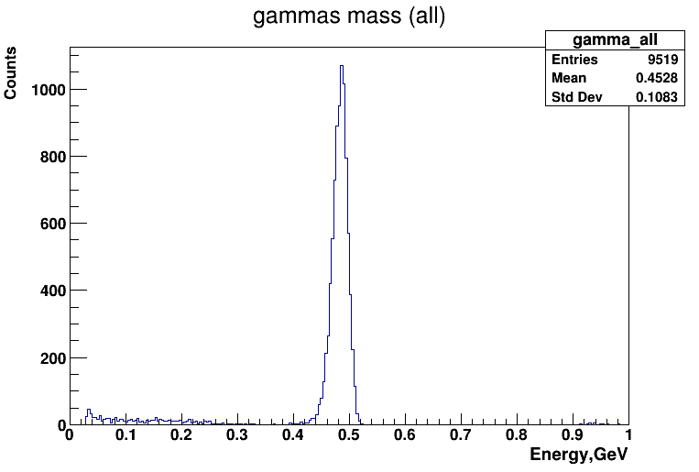
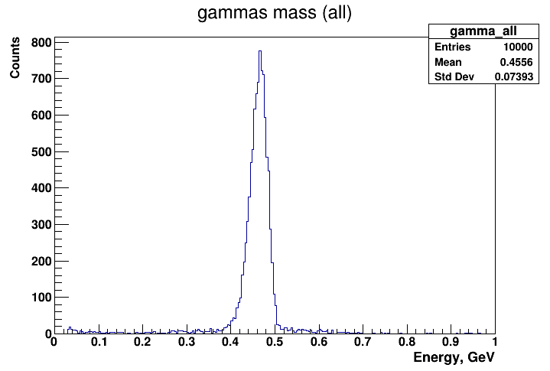
Simulation results
New waveform w/o pile-up
recovery
New waveform + pile-up
recovery
Photon energy
Raw wf
MWD+MA(16,25, 8) MWD II(10,24,5)

Slide 16
Summary
Pile-up identification and pile-up recovery algorithms have been added and tested in the Pandaroot timebased simulations
A new shape of pulse is implemented. It corresponds the real shape
The scrutiny of the pile-up issues is ongoing and possible adjustments in the cluster reconstruction and noise adding will be implemented

Slide 17
Thank you for attention!

Slide 18
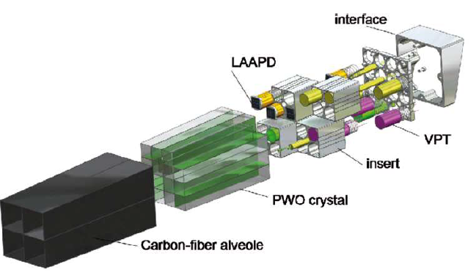
EM Calorimeter
Subunit of 16 crystals
Internal structure of subunit
Our prototype: 9 crystals + dummies
Each crystal has 2 LAAPDs

Slide 19
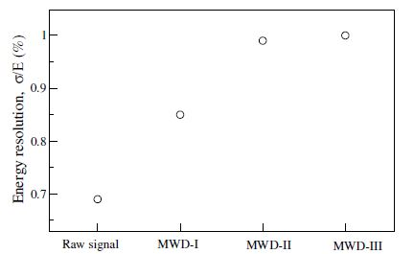
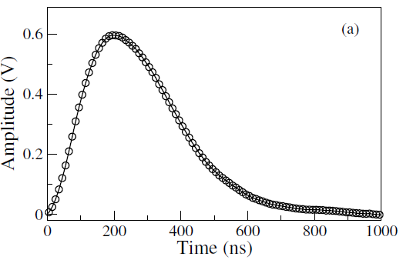
FE with old filter
G.Tambave(PhD thesis)

