Slide 1
WP 2.3: an in-kind model for SPIRAL2
Sonia Utermann
Felix Arndt
Haik Simon
…and the entire group at IKBest5 in Helsinki yesterday

Slide 2
An IKC is a non-cash contribution
IP, services, hardware, software, models, materials…
Why does GANIL need it?
Because it brings
Long-term scientific partnerships
State-aid-law compliance
State-of-the-art technologies
Bespoke solutions
For partners, it ensures
Access to SPIRAL2 governance
Support for national research strategies (e.g.India)
Geographical return
Access to state-of-the-art research
Reputation
Export control compliance

Slide 3
The SPIRAL2 in-kind “process”
White paper
Green papers
(Most) technical and scientific scope
Legal form
…black box…
Science!

Slide 4
We define the in-kind process
White paper
Green papers
(Most) technical and scientific scope
Legal form
Basic procurement strategy
Technical project planning
Piece list
Cost book
Detailed planning
Specification and design
Procurement … commissioning
Science!

Slide 5
In-kind cost book with a sliding scope
“Wedding list”
+
Creative consultation
=
Hybrid cost book

Slide 6
“Wedding list” cost book
A list of things we need
Their economic value in €
Their delivery deadline

Slide 7
“Wedding list” proposal
A list of things we need
Their economic value in €
Their delivery deadline
Value in €?
Price point?
Inflation?
Material cost changes?
Personnel costs?
Motivation?
Sexy factor?
Backdating?
A CBWG
Signing of MoU (2015)
Use real prices
Case-by-case
Yes, French per diem
observer rights
0.8 and 1.2
Use actual costs

Slide 8
Creative consultation
Invite suggestions
Remain flexible and fair
Explore and define scope
Use existing bodies (e.g. CODIR)

Slide 9
Peer review of the recommendations on 9th and 10th April 2019!

Slide 10
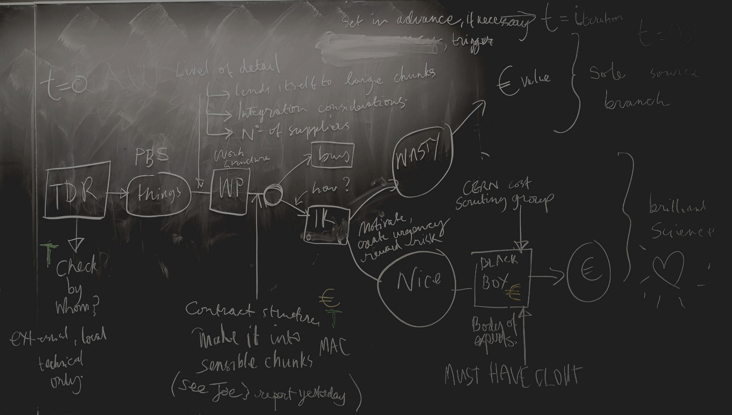
Crowd-sourced in-kind procedure for GANIL/SPIRAL2

Slide 11
Boundary conditions
We can consult the market only once per item.
Already built items have the real cost tag.
Some bits are under difficult conditions where there are few suppliers

Slide 12
Finishing line
 | material | R+D | risk | spares | “sexy” | integration | Σ
Item 1
Item 2
Item x
Where x is a finite, manageable number
+ certification by nuclear body

Slide 13
Crowd-sourced in-kind procedure for GANIL/SPIRAL2

Slide 14
Great comments from IKBest5
All local, old problems should be solved locally → any liability caused by an action in the past belongs to the host → Important because GANIL has the status of a nuclear reactor
Level of detail (fine/coarse graining) of wedding list is important → it is a game of poker
As host institute, it’s worth swallowing the frog if absorbing extra costs if you consider the costs over the lifetime of the facility
Labour done in France → taxes to France

Slide 15
Next steps
Cost book 1.0 (Q2 2019)
Consultation workshop at GANIL on 4th June
Review CB 1.0 (Q3 2019)
Draft of CODIR proposal (Q3 2019)
Nomination and launch of IKRB and CBWG (Q1 2020)
CBWG releases CB 1.1 (Q2 2020)
First cost book iteration CB 2.0 (Q4 2020)
→ IDEAAL extension!

Slide 16
Kiitos…
…et à bientôt au GANIL!
Put it in your calendar now:
Cost book consultation
GANIL guest house
4th June 2019

Slide 17
Task of a cost book
What it does | What it doesn’t do
Keeps a tally of each country’s contribution | Act as a part list
Communicates our needs to providers | Track total investment
Weights and groups items for attractiveness | Serve as an accountancy tool
Tracks FTEs | Monitor progress
Separates investment from running costs | Impose budget planning

