Slide 1
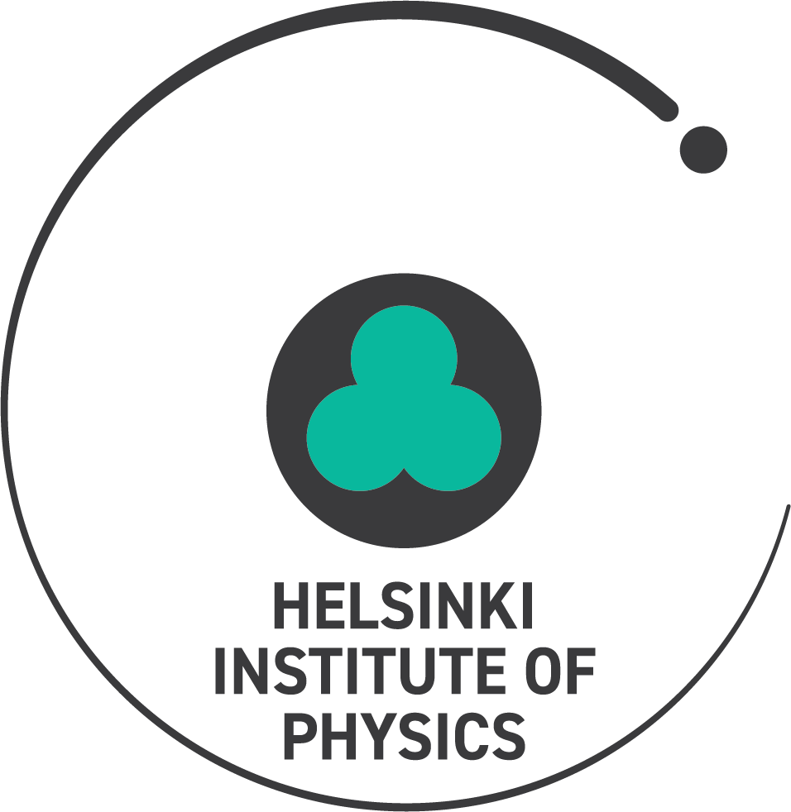
WELCOME to IKBest5

Slide 2
WELCOME to IKBest5
Helsinki Institute of Physics
Antti Väihkönen
Vice Director
9.4.2019

Slide 3
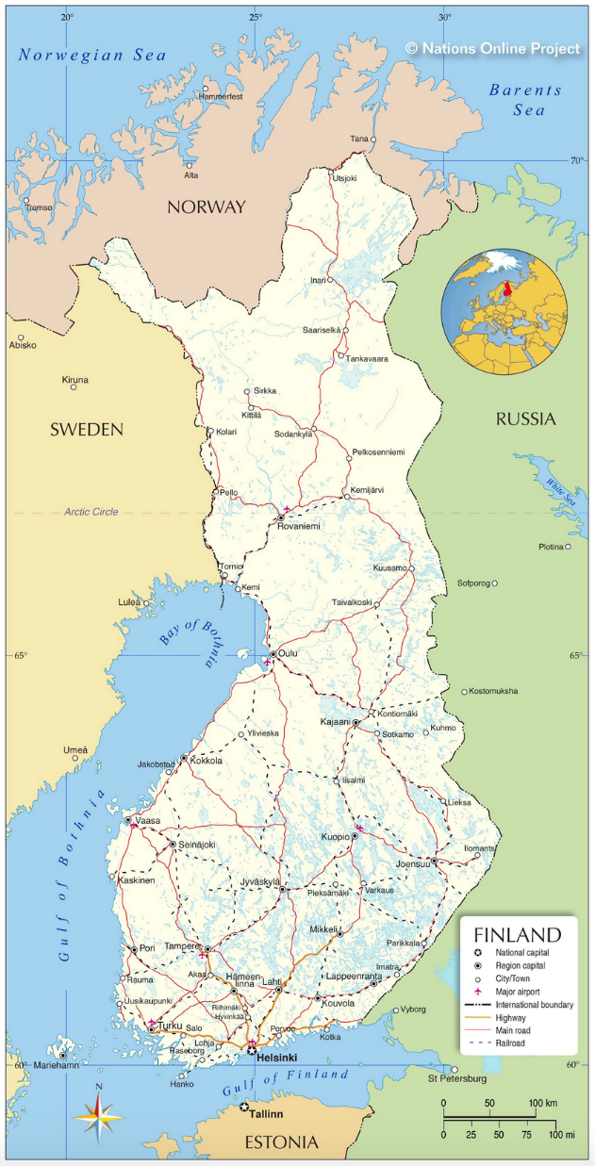
Helsinki Institute of Physics, HIP
Founded in 1996
University of Helsinki (UH) 1996-
Aalto University (AU) 1996-
University of Jyväskylä (UJ) 2002-
Lappeenranta-Lahti University of Technology (LUT) 2006-
Tampere University (TUNI) 2008-
Radiation and Nuclear Safety Authority (STUK)
Interim member 2018-2019
UJ
TUNI
LUT
UH,AU,STUK

Slide 4
Mission
Research in basic and applied physics as well as technology development at international accelerator laboratories
Finnish research collaboration with CERN, and coordination of the Finnish contribution to the FAIR laboratory
Researcher education
Societal impact

Slide 5
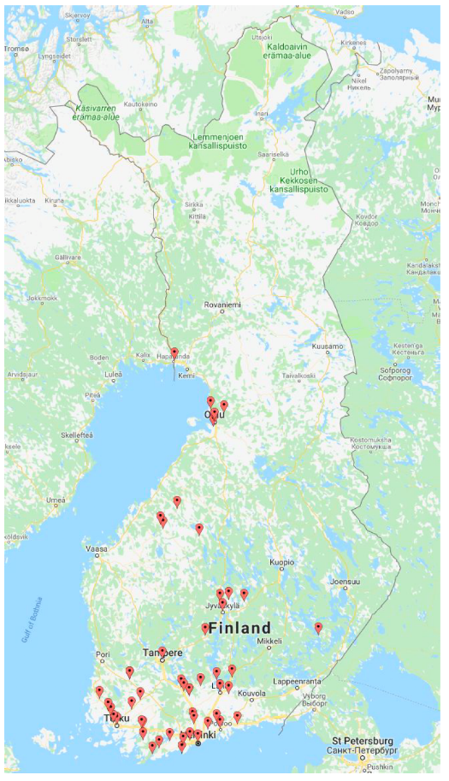
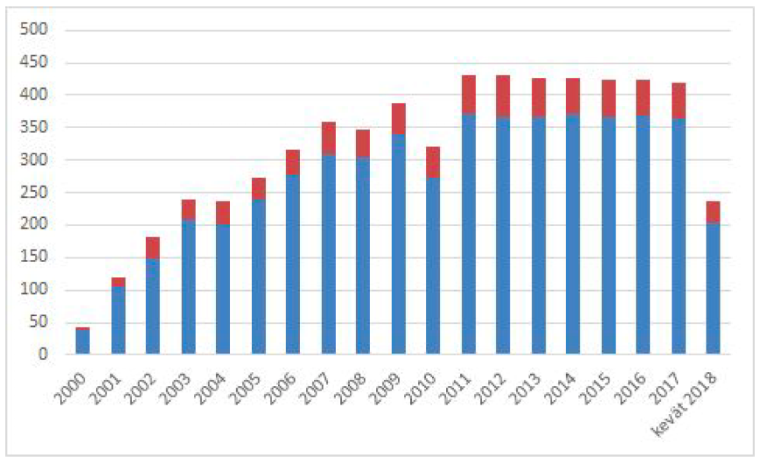
High school visits to CERN: 2000-June 2018: 5220 students from 365 schools; 1204 teachers from 239 schools
Budget ~ 6 M€
Staff ~ 80
~ 300 publications and
~ 10 doctoral degrees per year
Schools in 2017-2018:

Slide 6
Helsinki Institute of Physics
Scientific Advisory Board
Board
Steering Group
Director
Reseach Coordinator
Theory
QCD
High Energy Phenomenology
Cosmology
Nuclear Structure
Domain Wall Dynamics
CMS
CMS Experiment
CMS Upgrade
Tier-2 Operations
TOTEM
Nuclear Matter
ALICE
ISOLDE
FAIR
Technology
Accelerator Tech (MSM)
Accelerator Tech (MAT)
Radiation Safety
RadMet
BIC
GAMMA
BIGS
PLANCK­­-EUCLID
CLOUD Experiment
Education
and
Open Data
Detector Laboratory

Slide 7
HIP and In-Kind Contributions
Budget funding is used for general operation and maintenance
External funding for in-kind contributions
National FIRI research infrastructure funding
Mainly for CERN experiments and FAIR construction
CMS detector upgrades, ALICE
Computing and data cababilities for CMS, ALICE,…
Super-FRS beam tracking and diagnostics detectors and their mechanical solutions: MUSIC, GEM-TPC, SEM-Grid,…

