Slide 1
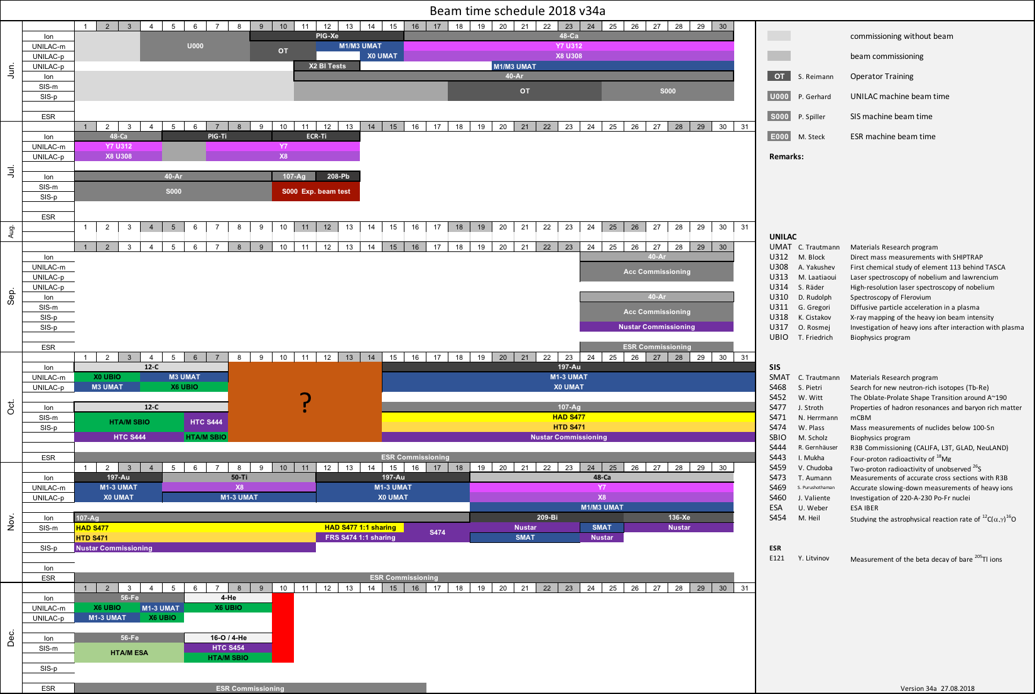
Draft

Slide 2
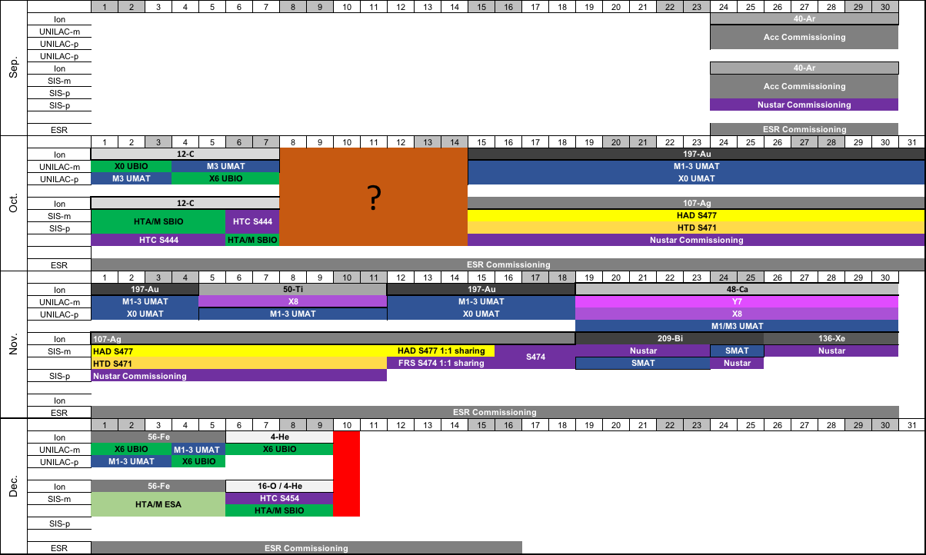
Draft

Slide 3
Draft
U000
U000

Slide 4
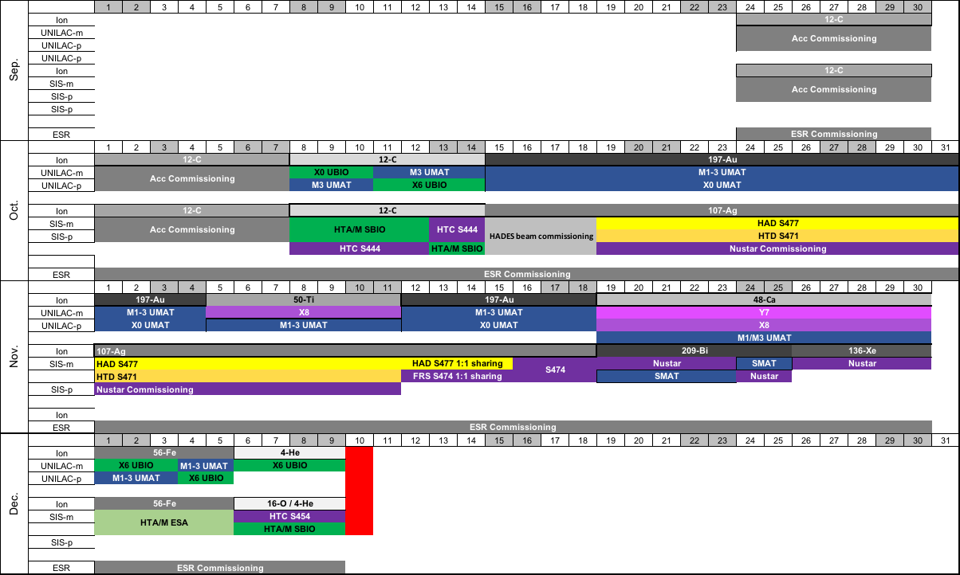
Draft

