Slide 1
HEST status
2018.08.28
m.sapinski

Slide 2
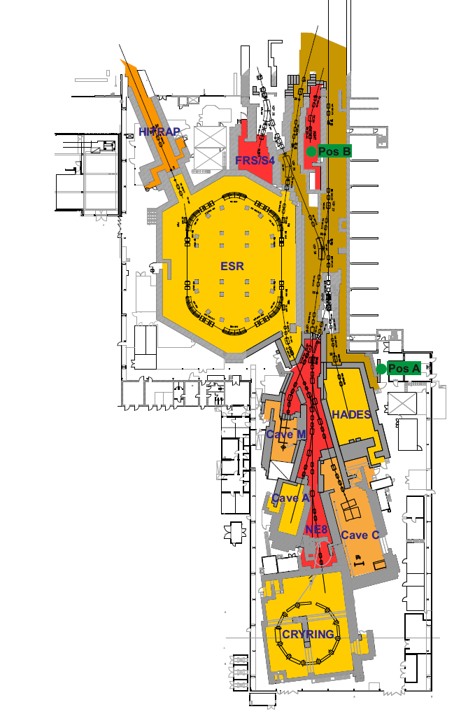
HEST news
positions of radmons which gave signal 5-10 above threshold (3 µSv/h, averaging time 5 s)
data from T. Radon
Last week: all equipment on HADES checked (again)
Water leak detected (tbc)
Investigation of BioRem alarms:
Pos A: losses behind the pion target, probably close to the bend GHADMU1
Pos A: BioRem close to wall opening for cable trays
Pos B: inside HHT cave, why neutrons there? Coming from GTH3MU1 (small vertical aperture, losses often observed in the past)? GHHTMU1 (see next slide)?

Slide 3
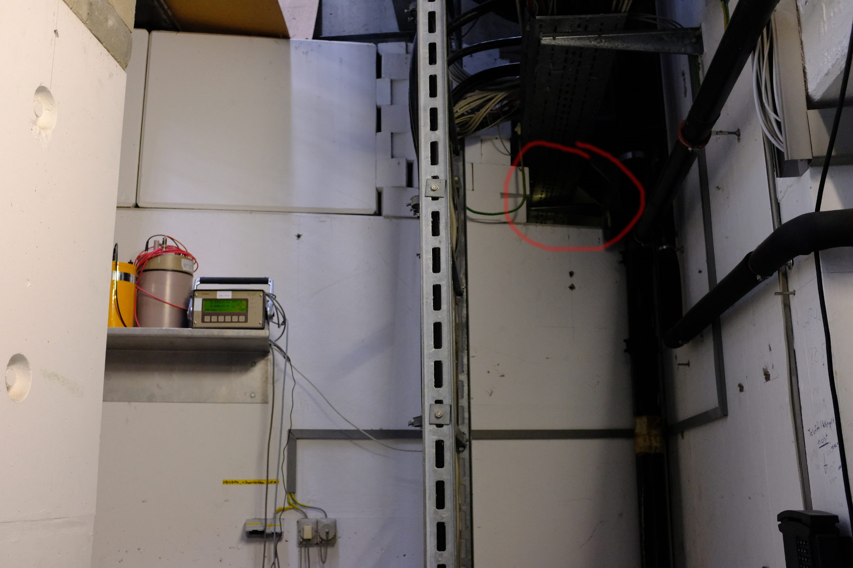
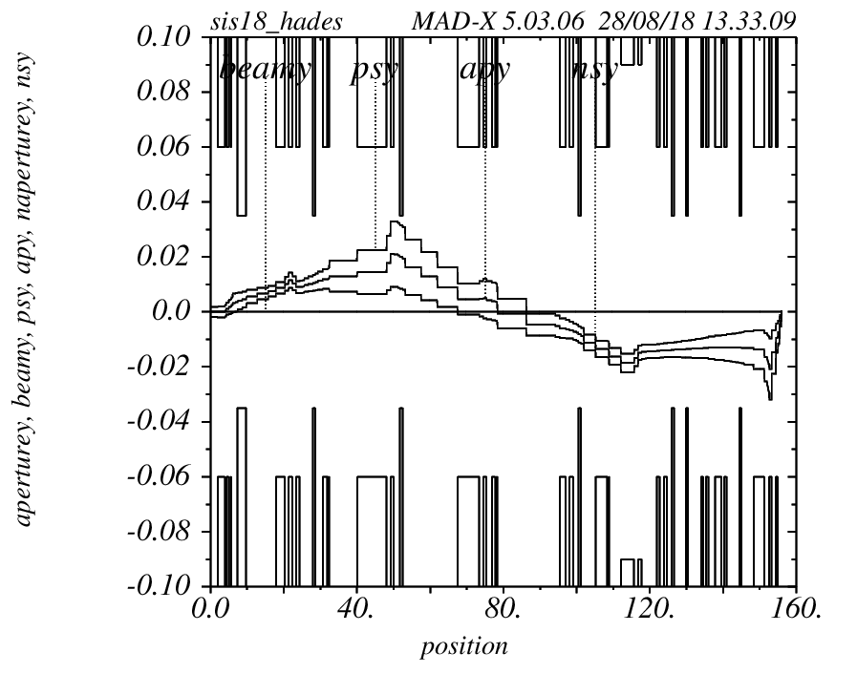
BioRem alarm mitigations
Pos A and B:
open vacuum chambers and check for obstacles (vacuum sectors TH2, HAD1, what about HAD2?) - week 37
optimize the optics (partly done)
increase BioRem averaging time?
Pos A:
close the opening for cables
Pos B:
put NE6 in Operation (=increase thresholds)
beam envelope exaggerated
GHHTMU1
vacuum opened during last shutdown

