Slide 1
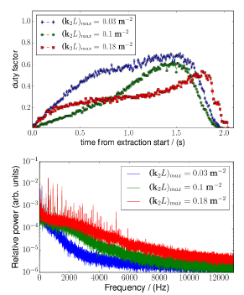
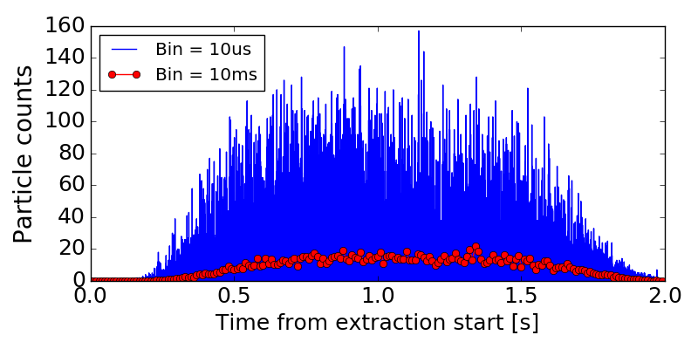
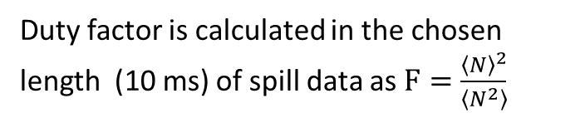
Slow extraction measurements July 2018
R. Singh, S. Sorge, P. Forck, H. Welker and A. Stafiniak
1) Verify/understand the effect of sextupole strengths and relevant tune settings on the fine spill structure
2) Look for options to damp the lines around 600 Hz in line with MIT/HIT air quadrupoles, first results
Duty factor is calculated in the chosen length (10 ms) of spill data as $F=\frac{{\left\langle N\right\rangle }^{2}}{\left\langle N^{2}\right\rangle }$

Slide 2
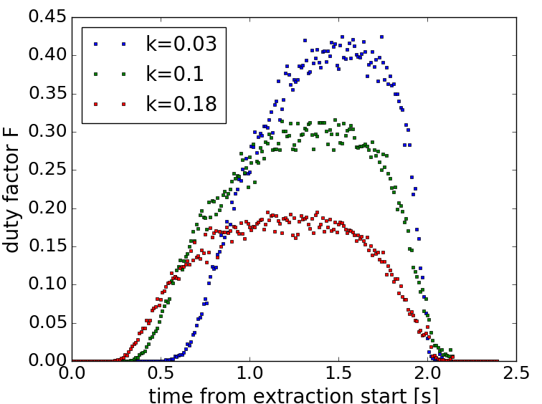
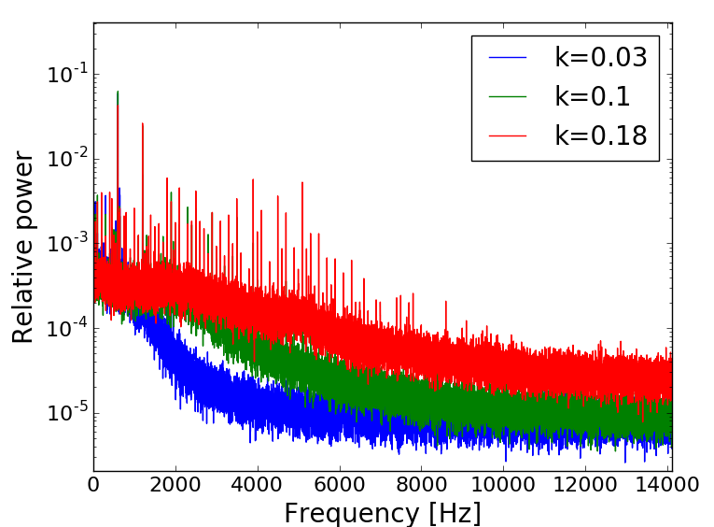
Sextupole strengths and external ripples
External 30 mA ripples from 250 Hz to 4 kHz were introduced into the quadrupole power supply
Three machines with sextupole strengths k₂⋅L = 0.02, 0.1,0.18 were set-up (Typical machine setting for sextupoles is 0.06 to 0.1)
Counters just after SIS extraction GTE1DF1SP (10 us readout and 10 ms bins used for duty factor calculation)

Slide 3
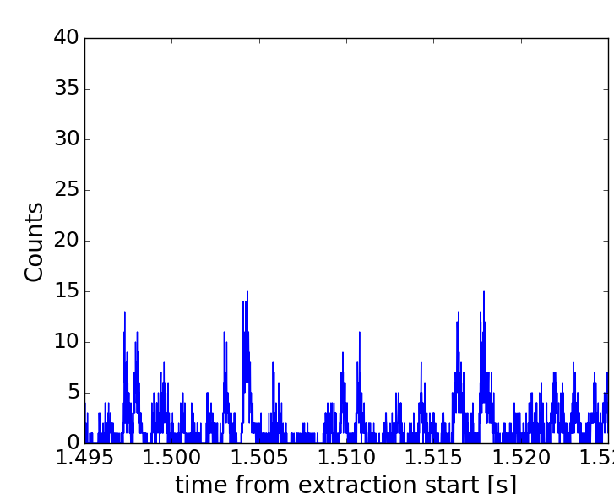
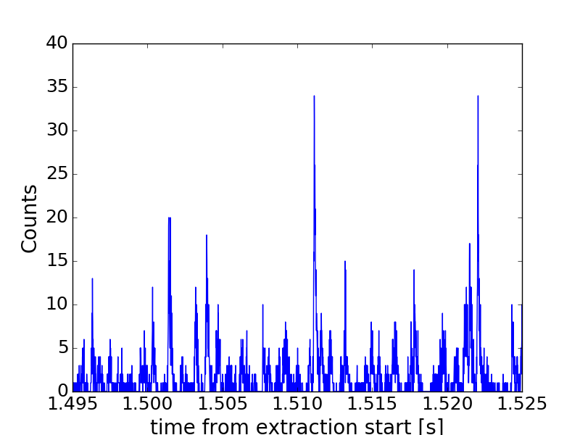
Sextupole strengths and external ripples
External 30 mA ripples from 250 Hz to 4 kHz were introduced into the quadrupole power supply
Three machines with sextupole strengths of k2L = 0.02, 0.1,0.18 were set-up (Typical machine setting for sextupoles is 0.06 to 0.1)
Counters just after SIS extraction GTE1DF1SP (10 us readout and 10 ms bins used for duty factor calculation)
Total extracted particles same within 10 %
k = 0.03
k = 0.1

Slide 4
Sextupole strengths and external ripples
External 30 mA ripples from 250 Hz to 4 kHz were introduced into the quadrupole power supply
Three machines with sextupole strengths of k2L = 0.02, 0.1,0.18 were set-up (Typical machine setting for sextupoles is 0.06 to 0.1)
DCCT
PS Control System
Power Supply
Magnet family
Current generator

Slide 5
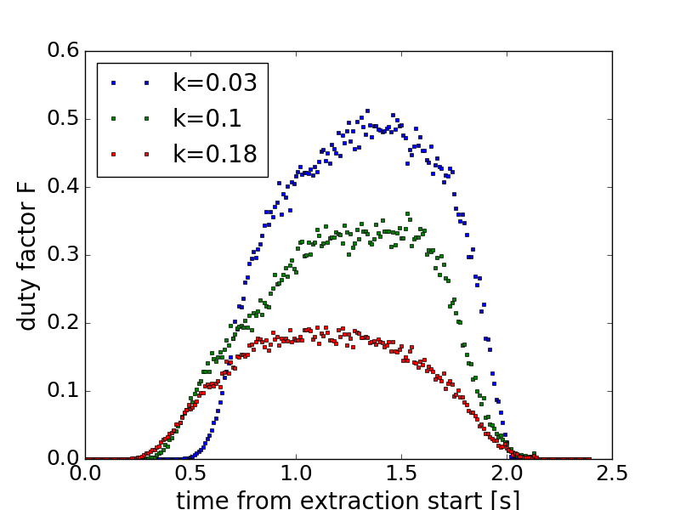
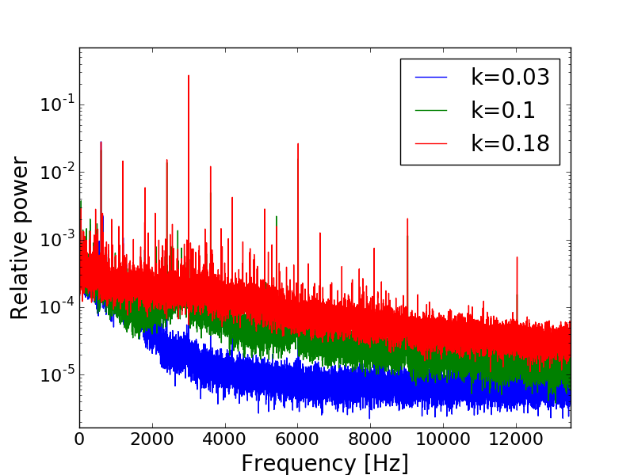
Sextupole strengths and external ripples
External 30 mA ripples from 250 Hz to 4 kHz were introduced into the quadrupole power supply
Three machines with sextupole strengths of k2L = 0.02, 0.1,0.18 were set-up (Typical machine setting for sextupoles is 0.06 to 0.1)
Counters just after SIS extraction GTE1DF1SP (10 us readout and 10 ms bins used for duty factor calculation)
3.01 kHz excitation
3.01 kHz excitation

Slide 6
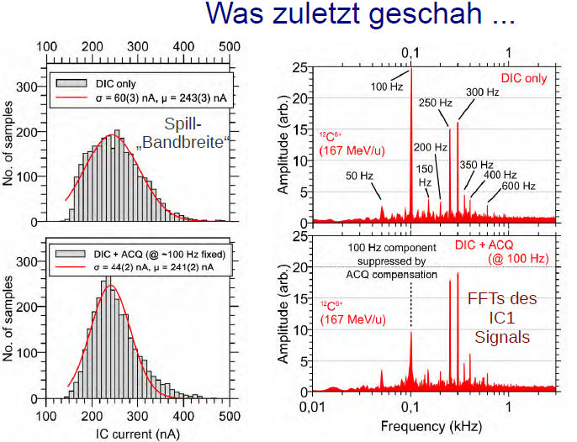
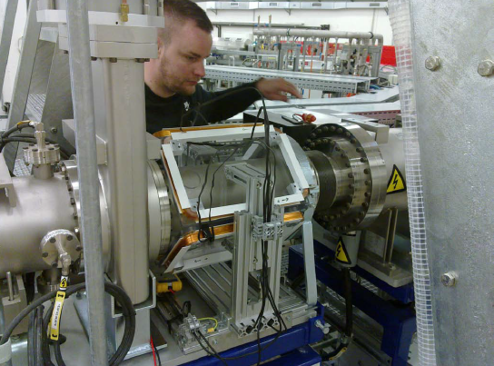
Slow extraction measurements July 2018
R. Singh, S. Sorge, P. Forck, H. Welker and A. Stafiniak
1) Verify/understand the effect of sextupole strengths and relevant tune settings on the fine spill structure
2) Look for options to damp the lines around 600 Hz in line with MIT/HIT air quadrupoles, first results
Courtesy : C. Krantz

Slide 7
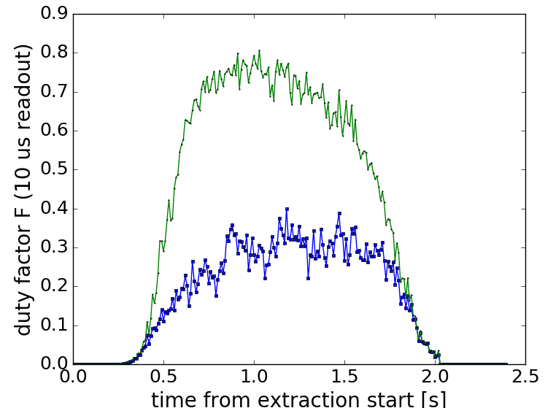
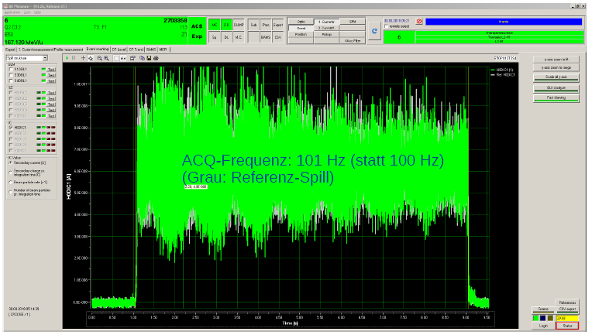
Spill beating
External ripples with 597 Hz with four amplitudes in range of 5 – 40 mA were coupled into quadrupoles - > Beating of duty factor with 3 Hz seen
Can be used to reduce the amplitudes of the inherent 600 Hz ripples -> Idea comes from HIT/MIT, where an air-quadrupole is fed with a grid-locked signal cancelling the tune ripples
Courtesy : C. Krantz, Marburg Ion therapy

Slide 8
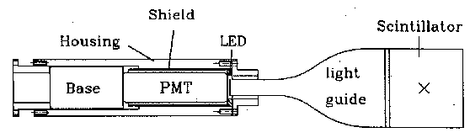
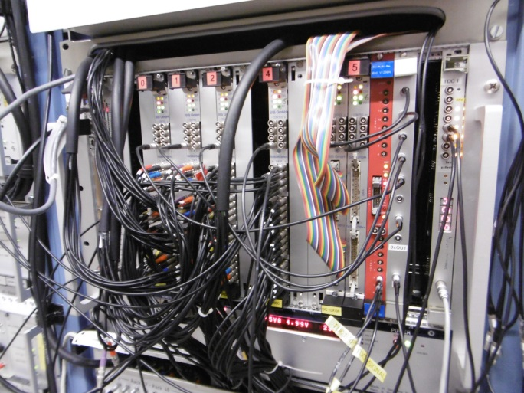
Standard Scintillator Electronic and Data Acquisition
Analog and digital chain:
Example: Analog pulses from a plastic scintillator
with 200 m cable for 300 MeV/u Kr beam
Parallel digitalization of:
Scintillators
Ionization Chambers
SEM-detectors
any detector from experiment
e.g. diamond from HADES
Entire cycle stored with
min. sample time t_{read} = 1 µs
Various online analysis tools
long cable ≈ 50...300 m
100 mV
20 ns
300 MHz discriminator
250 MHz scaler Struck 3820
sc
al
er
ti
ming
CPU
30 mV
⇔ 4 %
VME
128 channels
Advantage of particle counting:
single particle detection, well to be triggered
100 ps time resolution
no noise or background
⇒ could be directly compared to particle simulation
Notes:
8

Slide 9
Comments, Proposals and Conclusion
Spill quality significantly improved by lower sextupole strength
Study of losses at septa must be studied
Correlation with 50 Hz-related lines and ‘broad-band’ response
MIT: Better spill by compensation of 600 Hz line
Possibility at GSI by extra quad or feedback in power supplier dcct ?
Simulations ongoing, must be continued with high priority
Experimental verification required with high priority,
i.e. beam time and man-power
Possible physical quantity: transit time as the basis for the understanding
(i.e. time between crossing seperatrix and reaching septum)

Slide 10
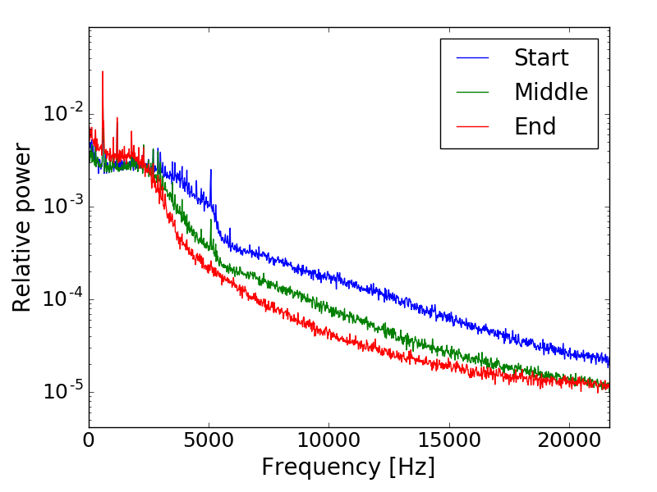
Spill spectra if the spill is divided into three consecutive parts
-> Spill spectrum changes as a function of distance from resonance

Slide 11
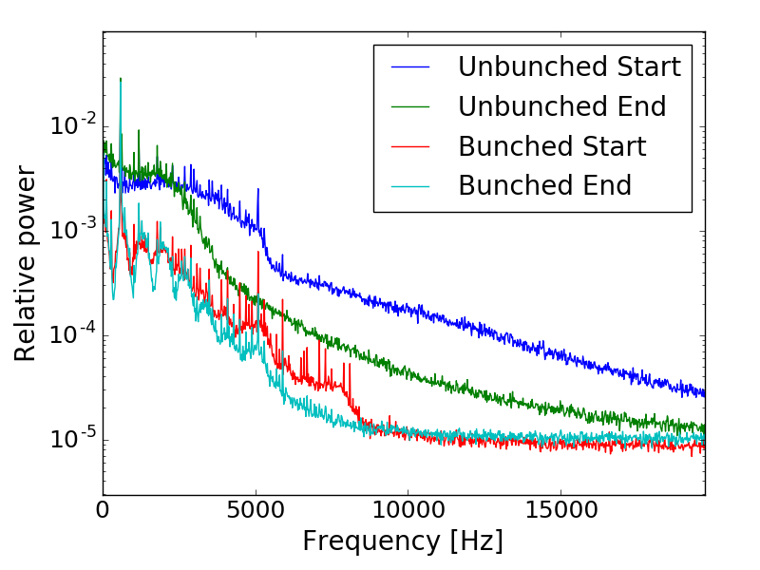
Bunched vs unbunched spill spectra if the spill is divided into two parts

