Slide 1
UNILAC Vacuum Control replacement
Project schedule

Slide 2
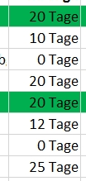
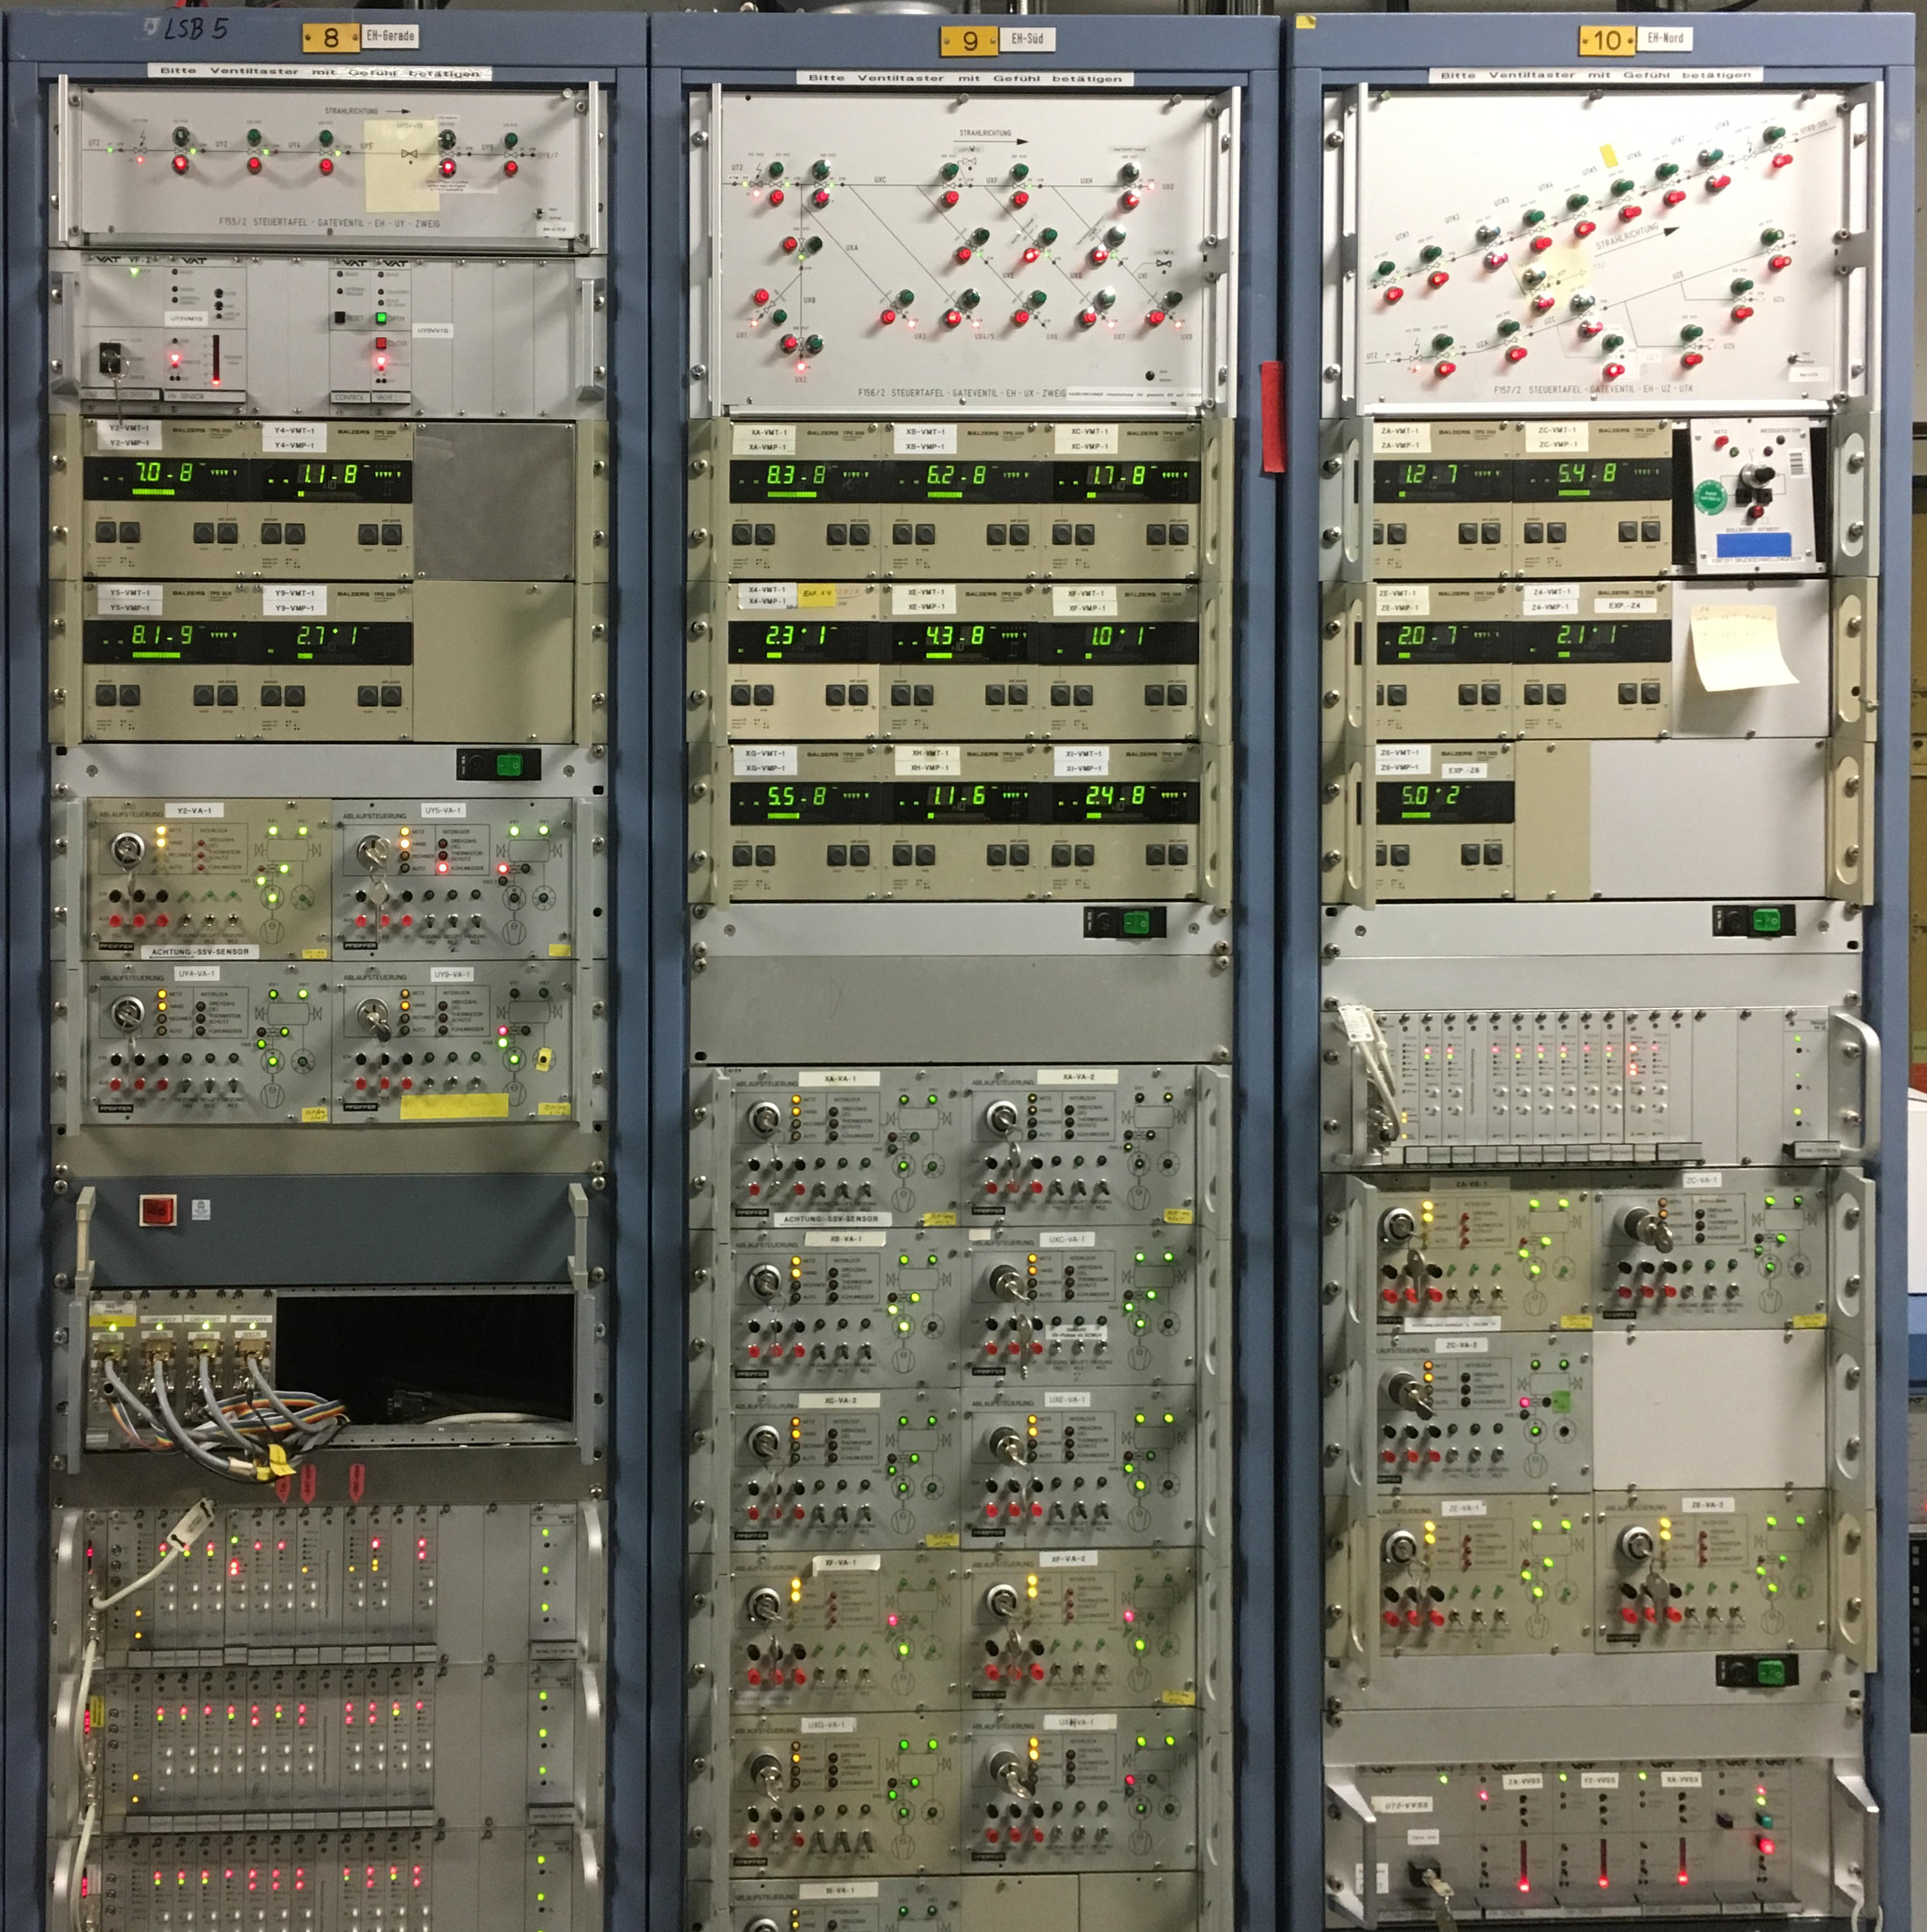
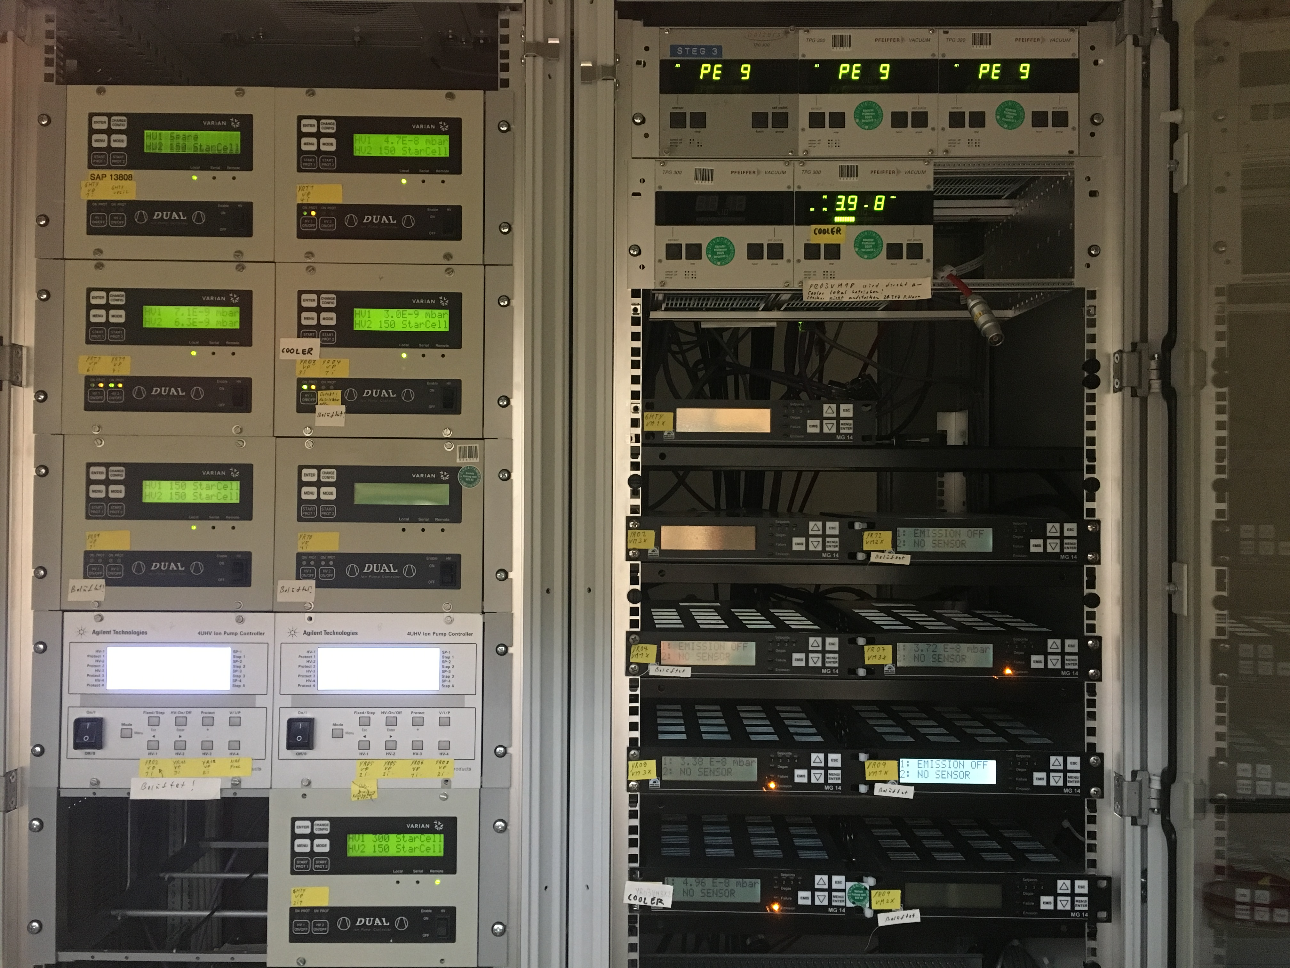
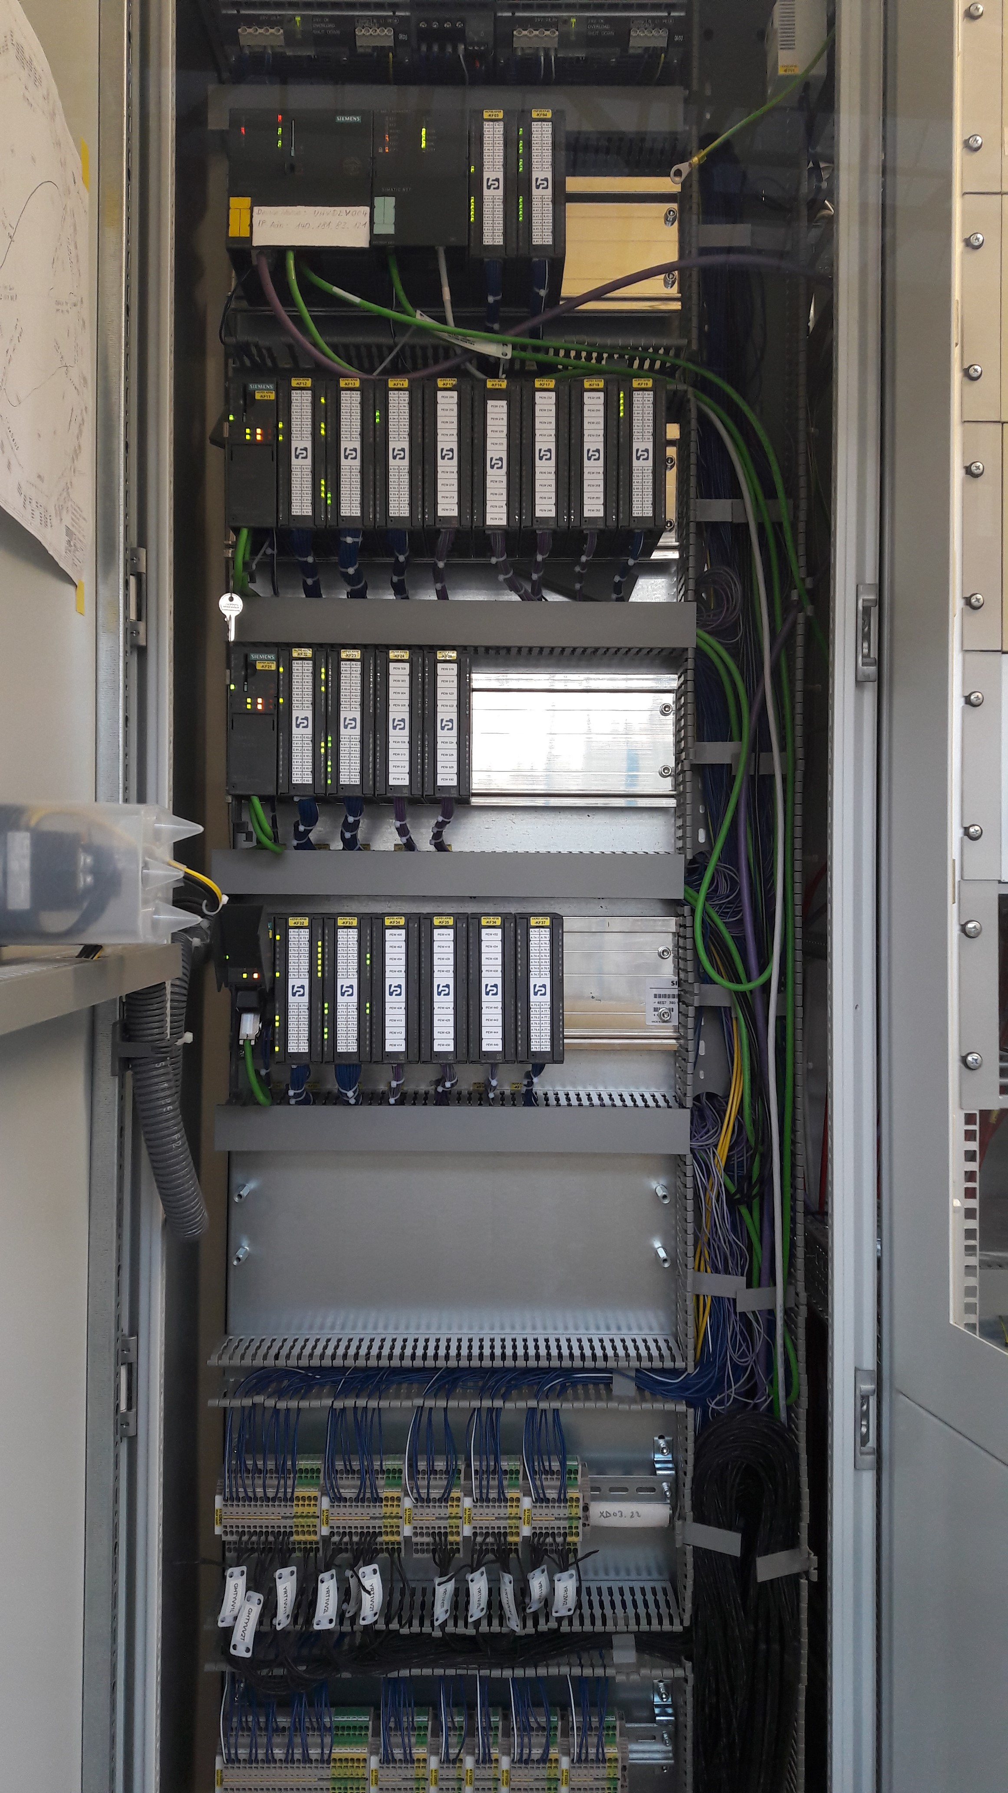
UNILAC vacuum controls: From Old to New

Slide 3
UNILAC vacuum vs. Cryring vacuum controls
Device / Sub-System | Cryring / qty. | UNILAC / qty.
PLC system / racks | 1 | 6
Gate valves | Yes / 12 | Yes / 53
IG pumps | Yes / 19 | Yes / 101
Pressure gauges | Yes / 29 | Yes / 143
Stationary pumping stations | No | Yes / 74
Turbo pumps (controller types) | No | Yes / 74 (3)
Non-standard TP controller interfaces | No | Yes / 21
Contactor controllers | No | Yes / 74
Centralized pre-vacuum systems | No | Yes / 3
Fast closing valves | No | Yes / 6
Interface to chopper control / interlock channels | No | Yes / ?
New cables / strands to be connected | ~100 / ~1500 | 963 / 14668*
*: 6050 in connectors, 8620 in terminal blocks

Slide 4
UNILAC vacuum vs. Cryring vacuum controls
Vacuum control system for UNILAC based on Cryring
Schedule based on Cryring experience
Commissioning of Cryring vacuum controls took 1 year
But:
Migration to new SPS Series S7-1500 necessary
Implys new UNICOS version, new programming tools, adaption of Cryring software
New UNICOS version still in development at CERN, release January 2019, high impact on UNILAC vacuum controls expected, i.e. additional effort for adaption of Cryring code

Slide 5
UNILAC vacuum vs. Cryring vacuum controls
Vacuum control system for UNILAC based on Cryring
schedule based on Cryring experience
UNILAC 6 times larger
based on size of PLC control system
based on number of vacuum sections
based on quantity of comparable devices like gate valves, pressure gauges, IG pumps
UNILAC features large number of new device types
new software modules etc. needed
have to be programmed, tested, commissioned
UNILAC much more complex than Cryring
larger facility, more sections, more complex structure

Slide 6
Assumptions made for time schedule
have to maintain basic vacuum at any time in all sections
on time delivery of hardware (contingency used up)
high quality of hardware (experience from cryring)
low number of cabling errors (experience from cryring)
high quality of software (internal & Cosylab, experience from cryring)
high quality of wiring during setup
boring & exhausting work, highly motivated staff necessary!
support by Jöhnke
overall allowance for 8 weeks of absence per year
no major unplanned absence of staff (long sick leave)
no interruption due to other tasks / requests / system changes
experience from cryring!
only very limited vacuum service available during setup for UNILAC, substitute by TRI possible
UNILAC rf operation will be supported only for dedicated cavity
HSI-RFQ interleaved
no other major activities, where vacuum is involved, should be planned

