Slide 1
Relevance of cluster formation in heavy ion collisions and the fragmentation code FRIGA
Cold nuclei and hot matter
CBM Symposium
3.10.2018
Y. Leifels, A. Le Fevre
GSI Helmholtzzentrum für
Schwerionenforschung, Darmstadt
J. Aichelin, C. Hartnack
SUBATECH, CNRS, University of Nantes

Slide 2
Outline
Heavy ion reactions between 0.1 - 10AGev
Introduction to transport models
Characteristic observables
Relevant quantities and comparison to experimental data
  Equation of state of nuclear matter
  Dependencies to other input parameters
  Importance of cluster formation
FRIGA
  Introduction
  Benchmarking BQMD + FRIGA
  Benchmarking IQMD + FRIGA
  Hyper nuclei
Summary and Outlook

Slide 3
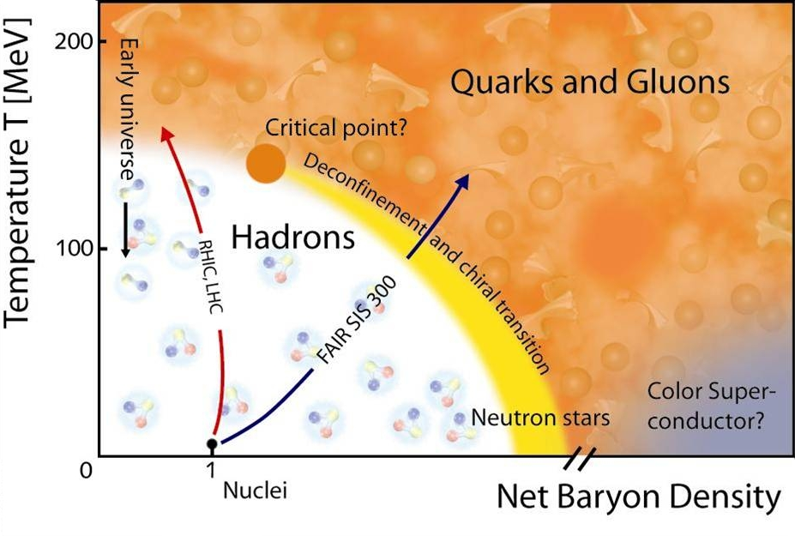
Phase diagram of QCD matter
How to explore nuclear matter under extreme conditions?
Liquid gas coexistence
SIS18
heavy ion collisions tool to explore characteristics of compressed nuclear matter in the laboratory
need microscopic transport models to interpret the data

Slide 4
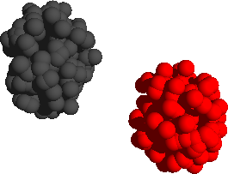
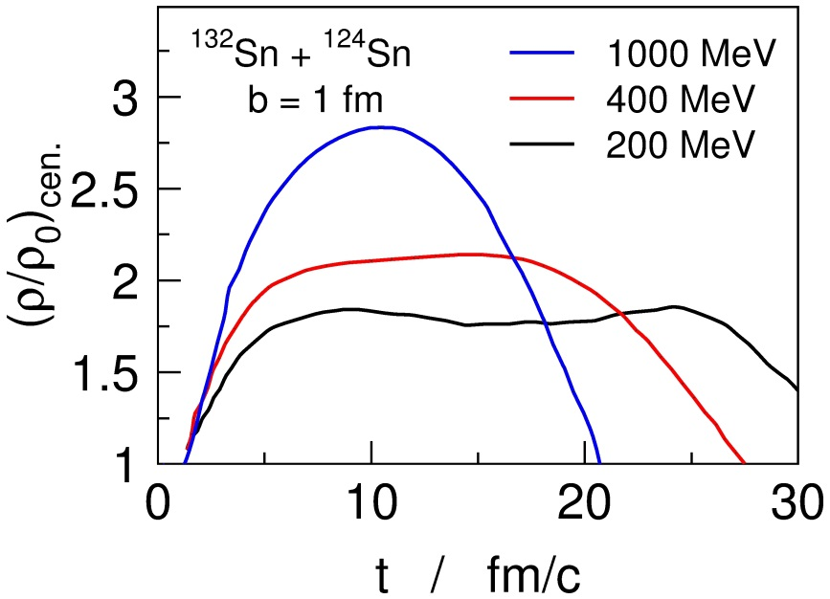
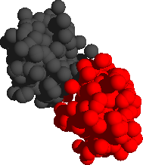
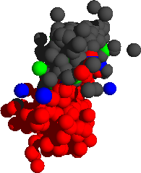
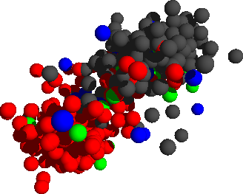
HICs: Characteristics at 0.1 – 10 GeV/u
Au+Au, 1 GeV/u
Au
Au
Bao-An Li, PRL 88,
192701 (2002)
p,n,d,t,α...
compression
particle creation
π,K
reaching high densities, several ρ₀
creating (thermal) pressure
controlling density and pressure by varying system size and/or energy
rapidly evolving transient state
equilibration – if at all – reached only locally
need microscopic transport models to interpret the data
fragments
hyperons...
expansion
freeze-out
resonance decays

Slide 5
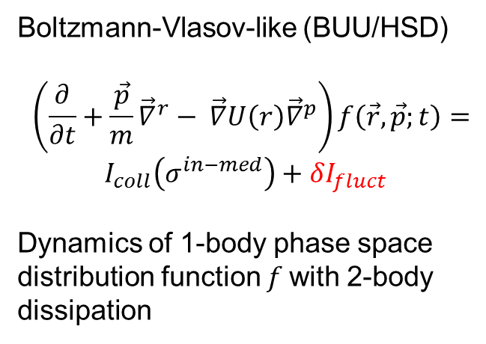
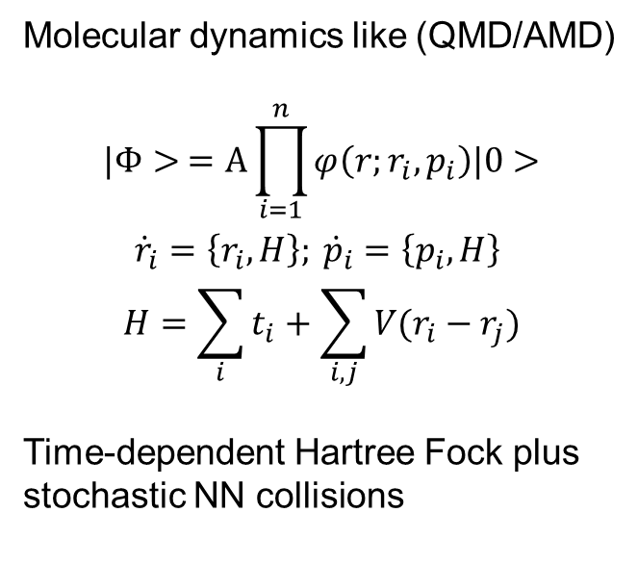
Microscopic models – two approaches
Boltzmann-Vlasov-like (BUU/HSD)
$$\left(\frac{∂}{∂t}+\frac{\vec{p}}{m}{\vec{∇}}^{r}− \vec{∇}U\left(r\right){\vec{∇}}^{p}\right)f\left(\vec{r}, \vec{p};t\right)=$$
$$I_{coll}\left(σ^{in−med}\right)+δI_{fluct}$$
Dynamics of 1-body phase space
distribution function $f$with 2-body
dissipation
Molecular dynamics like (QMD/AMD)
$$|Φ> =A\prod_{i=1}^{n}{φ\left(r;r_{i},p_{i}\right)|0>}$$
$$\begin{aligned} \\ \begin{aligned}{\dot{r}}_{i}=\left\{r_{i}, H\right\}; {\dot{p}}_{i}=\left\{p_{i}, H\right\} \\ H=\sum_{i}{t_{i}}+\sum_{i,j}{V(r_{i}−r_{j})}\end{aligned}\end{aligned}$$
Time-dependent Hartree Fock plus
stochastic NN collisions
physical input:
mean field (potential), σ_{inmed}, spectral functions
transport code
observables
“technical input”: discretization, averaging (coarse graining), Pauli blocking, etc.
Code comparison project: H. Wolter, M. Colonna, J. Xu et al.

Slide 6
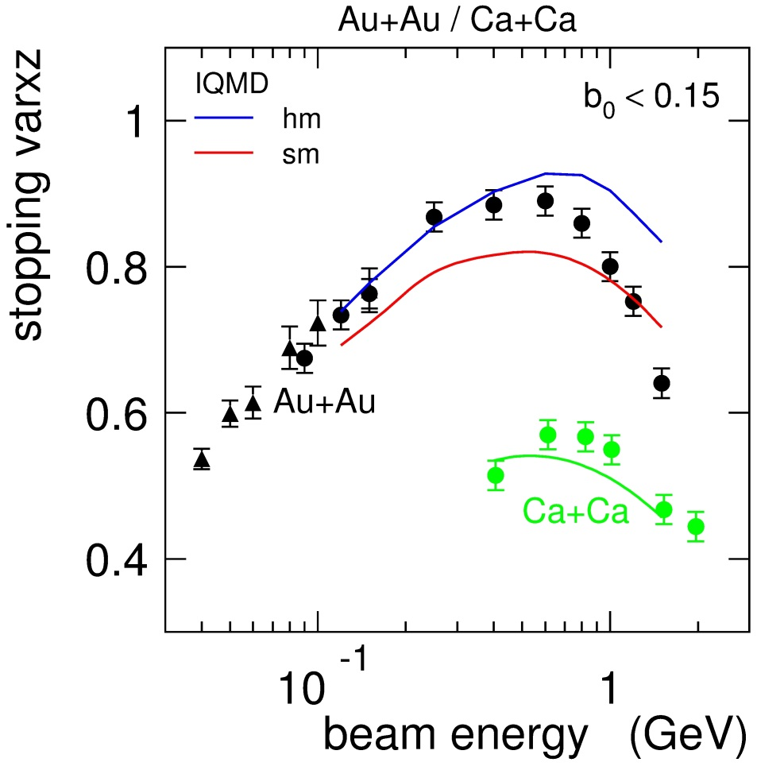
1. Stopping
  Stopping deduced from phase space distributions
  measured 0.12 – 1.5 (2.0) AGeV for Au+Au to Ca+Ca
  depending on energy (maximum at 0.5AGeV)
  sensitive to in-medium cross sections
FOPI
INDRA
Data: FOPI+Indra, A.Andronic et al.
Eur.Phys. J.30 (2006) 31-46
IQMD, C. Hartnack et al. EPJ A1 (1997) 151

Slide 7
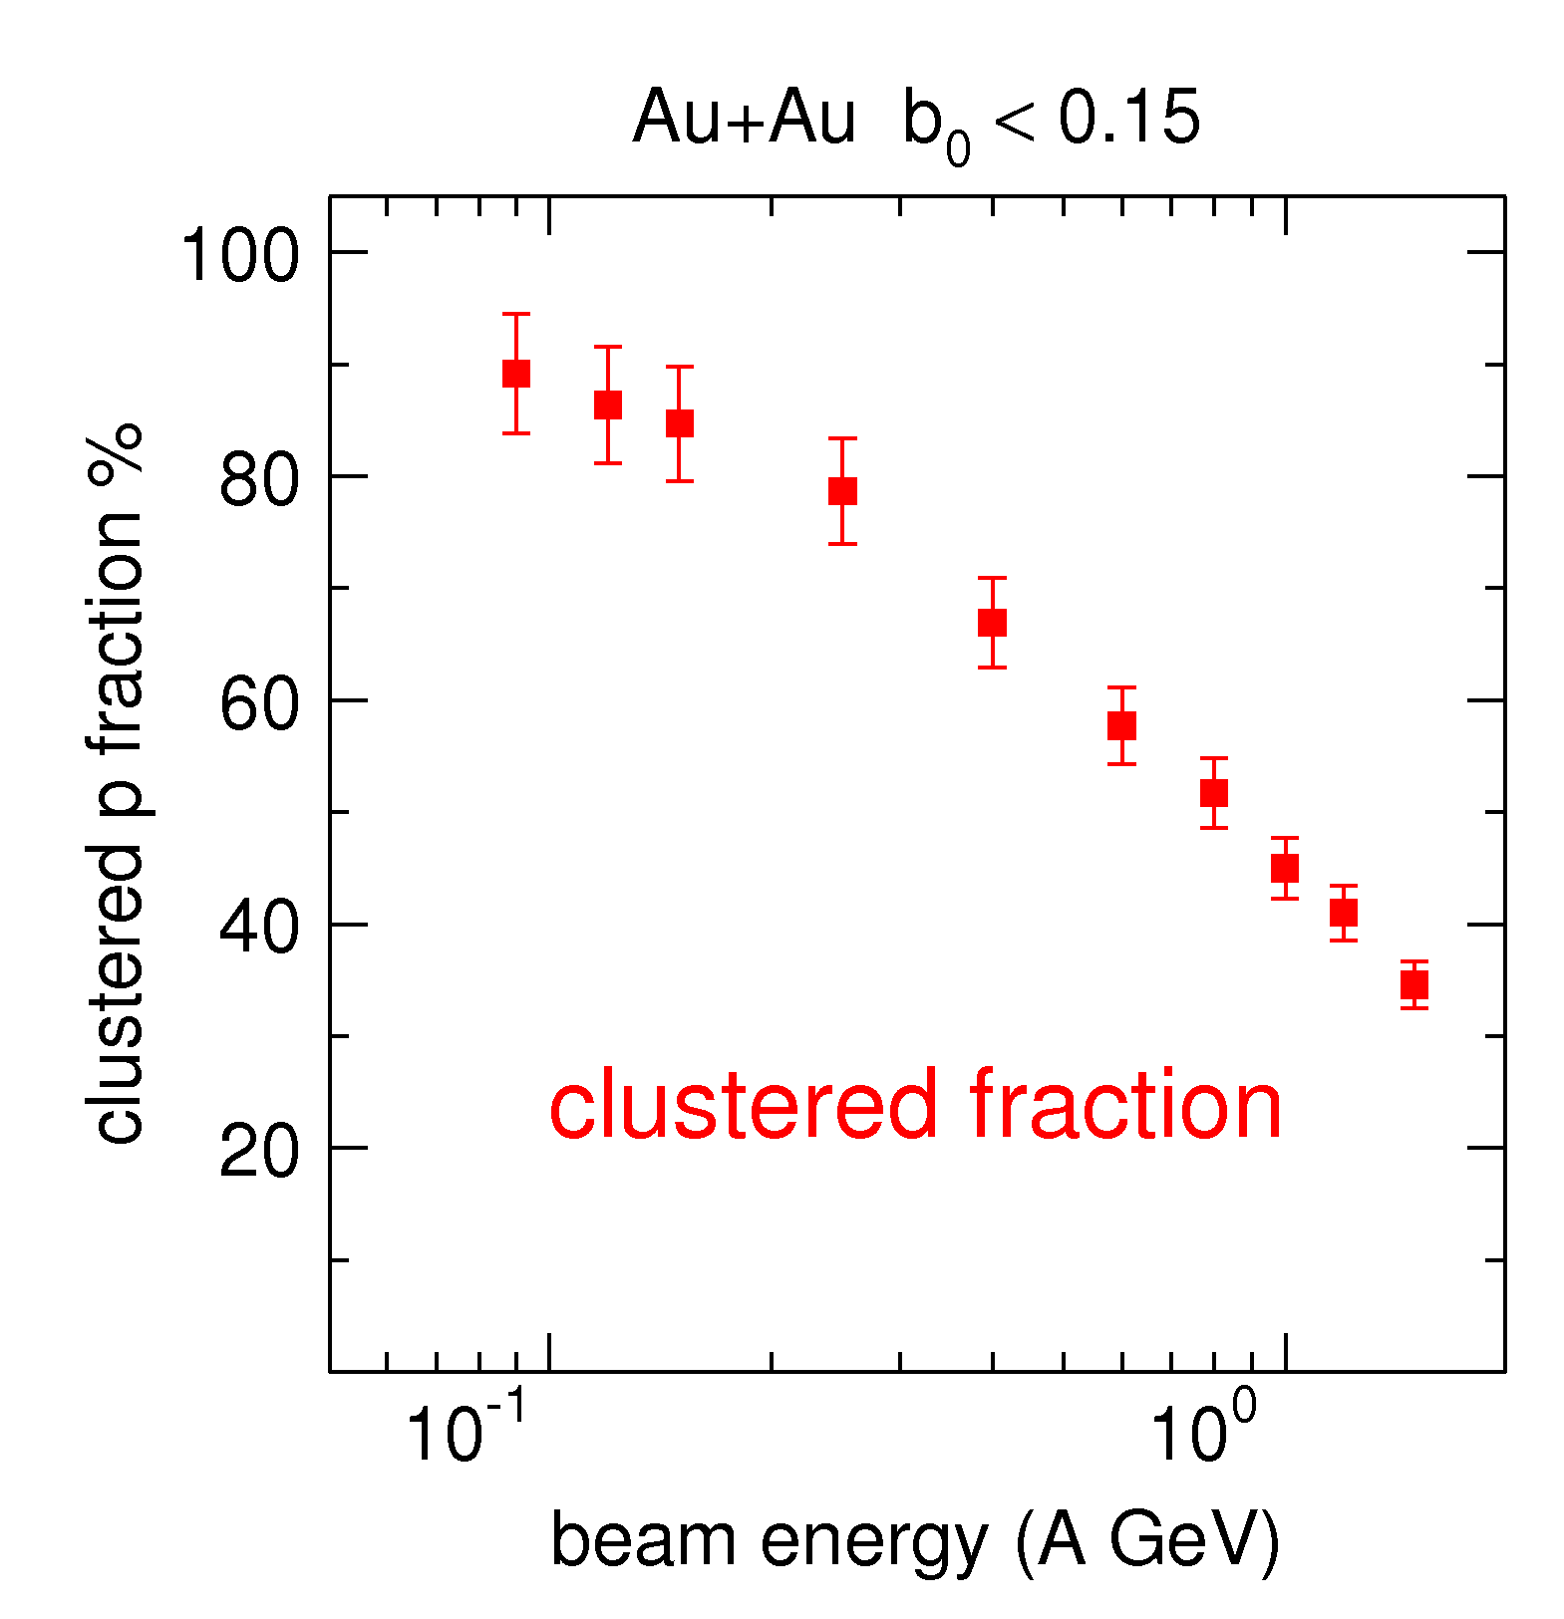
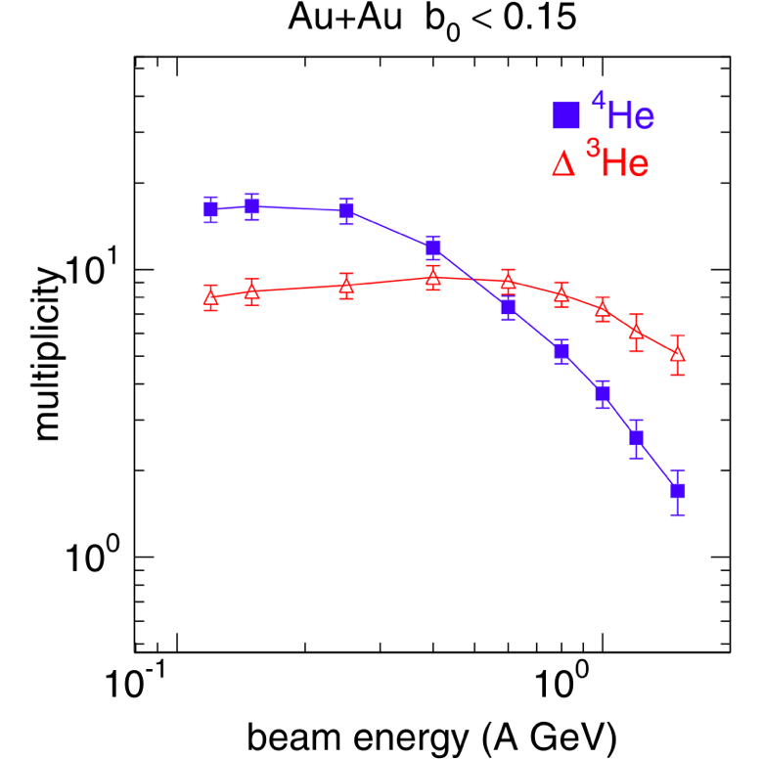
2. Formation of clusters
Au+Au b₀<0.15
high degree of cluster formation in most central collisions
yields cannot be described by coalescence
  neutron capture of ³He enhances α yield at low energies
cluster production influences phase space distribution of other particles

Slide 8
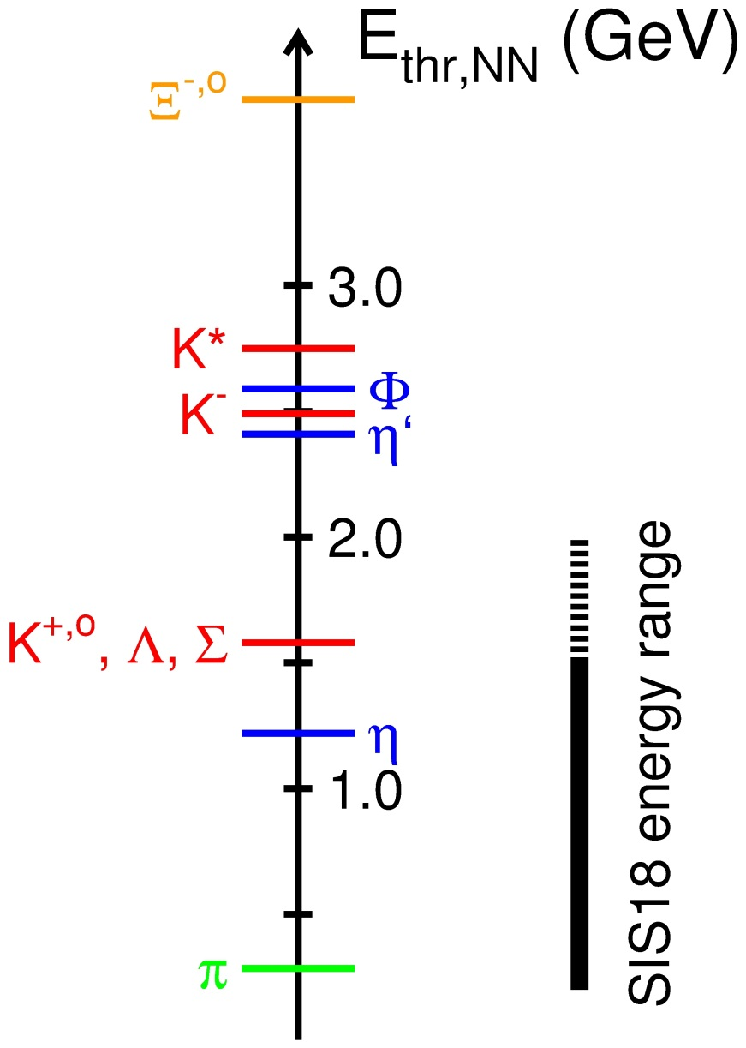
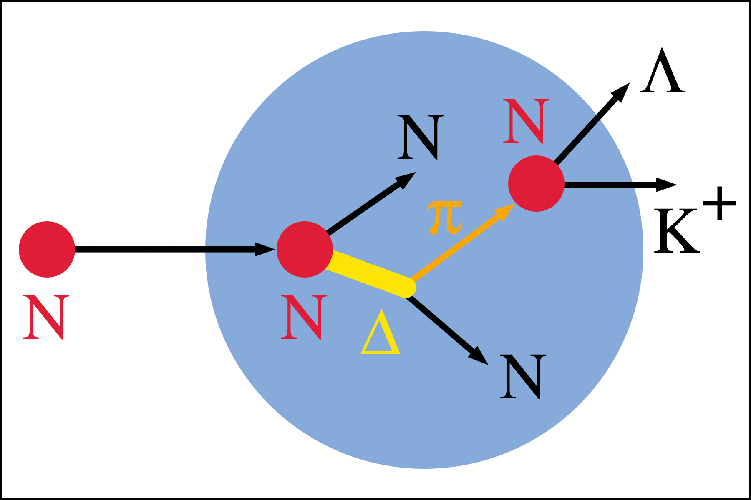
3. Particle production
Possible at energies below to the threshold in NN system
multi-step processes can cumulate the energy needed
intermediate resonances used as an energy reservoir
production at high densities due to short life time of resonances
probing density (number of binary collisisons)

Slide 9
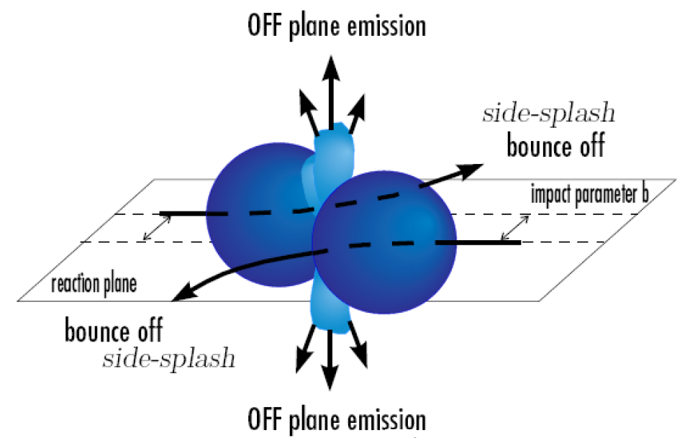
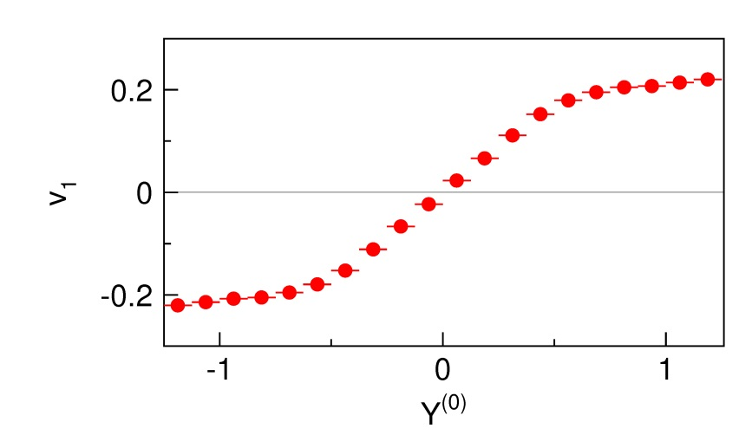
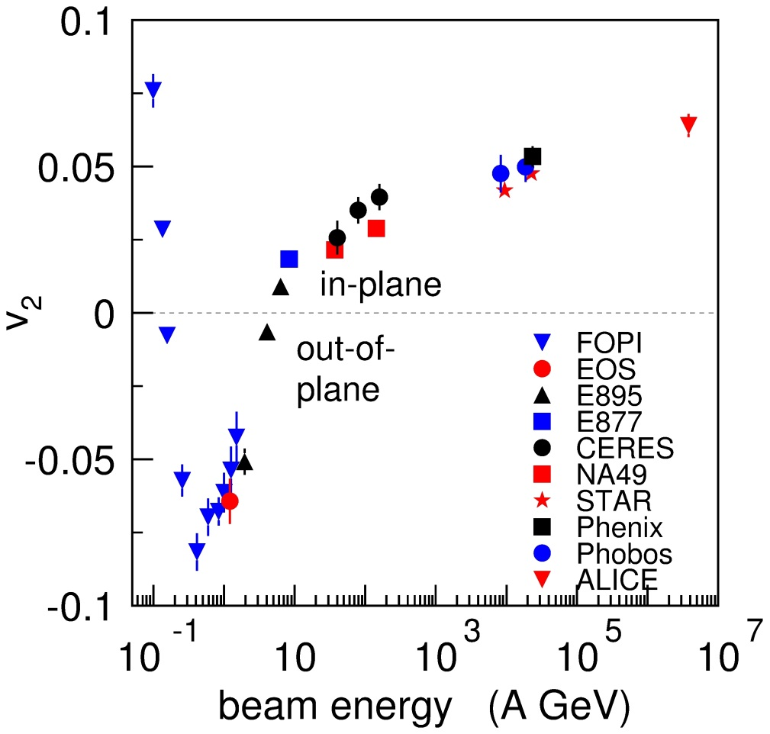
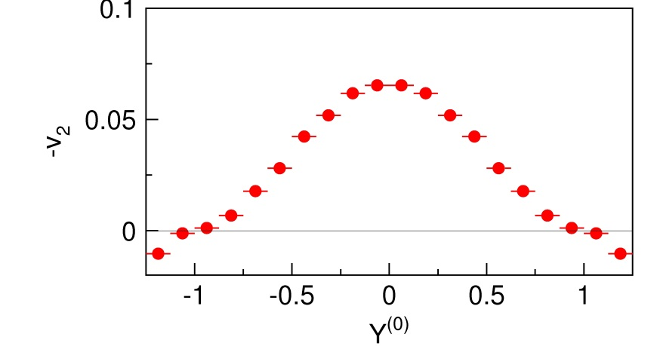
4. Flow
Elliptic flow v₂
Side flow v₁
side flow
elliptic flow
rapidity:
Predicted by Hydrodynamics
H. Stoecker et al., PRC 285(1982) 349
Discovery at Bevalac
H.A. Gustafsson, et al., Phys. Rev. Lett. 52 (1984) 1590.
R.E. Renfordt, et al., Phys. Rev. Lett. 53 (1984) 763.

Slide 10
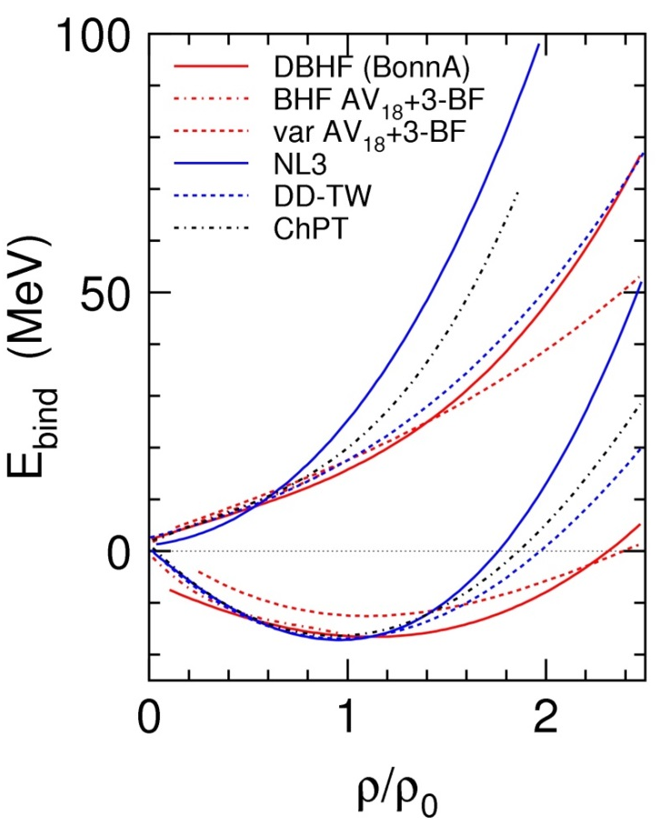
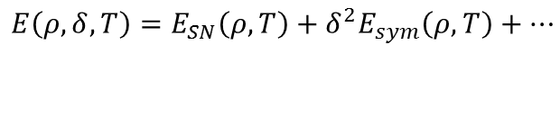
Comparing experimental results to model predictions…
Yield information on
  nuclear matter equation of state
      momentum dependence
      symmetry energy
  in-medium cross sections
      scattering and production
  in-medium characteristics of particles
      effective masses/potentials, spectral functions
      decay widths
Convincing conclusions on basic nuclear properties imply a successful simulation:
  of a full set of experimental observables
  with the same code
  using the same physical and technical parameters.
Fuchs and Wolter, EPJA 30 (2006)
$$E\left(ρ,δ,T\right)=E_{SN}\left(ρ,T\right)+δ^{2}E_{sym}\left(ρ,T\right)+…$$
Neutron matter
δ=1
Symmetric matter
δ=0
Symmetry energy
Notes:
zuviel ergebnis
momentum dependence
Nuclear Physics A
Volume 110, Issue 1, 15 March 1968, Pages 91-110

Slide 11
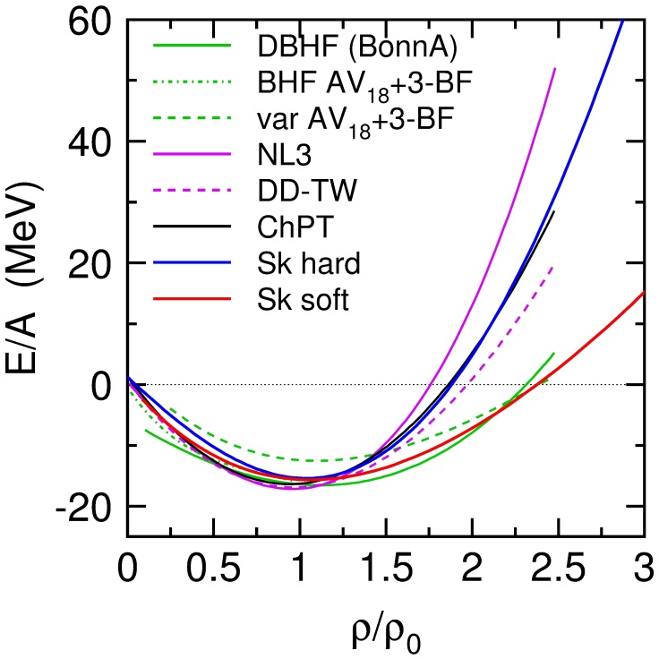
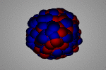
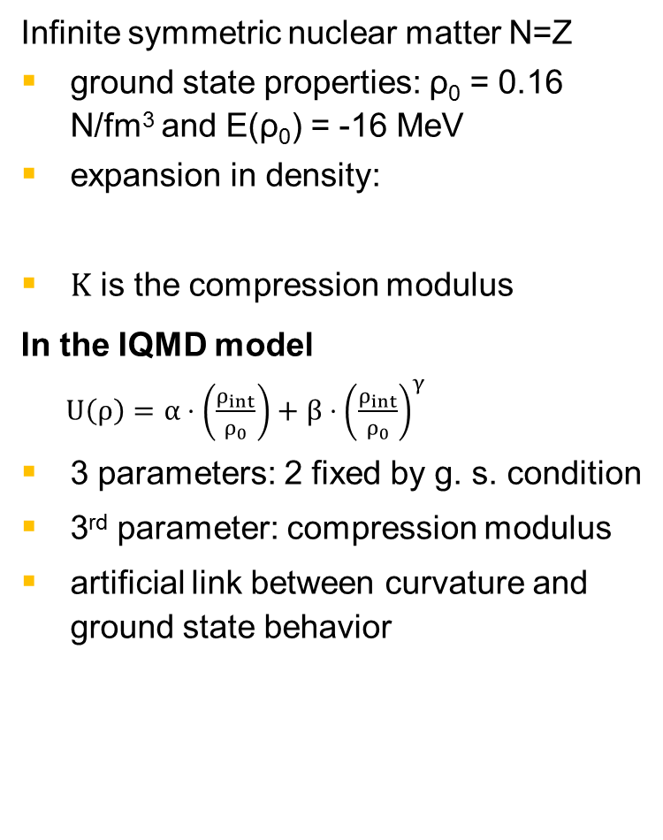
Equation of state for symmetric nuclear matter
Fuchs and Wolter, EPJA 30 (2006)
Infinite symmetric nuclear matter N=Z
ground state properties: ρ₀ = 0.16 N/fm³ and E(ρ₀) = -16 MeV
expansion in density:
$Κ$ is the compression modulus
In the IQMD model $U\left(ρ\right)=α⋅\left(\frac{ρ_{int}}{ρ_{0}}\right)+β{⋅\left(\frac{ρ_{int}}{ρ_{0}}\right)}^{γ}$
3 parameters: 2 fixed by g. s. condition
3rd parameter: compression modulus
artificial link between curvature and ground state behavior
380 MeV
200 MeV
J. Piekarewicz, PRC 69 (04) 041301,
RMF: K=248 MeV
G. Colò et al.,PRC 70 (04) 024307
Skyrme HF: K=230 MeV
S. Shlomo et al. Eur. Phys. J. A 30, 23 (06)
K=240±20 MeV
D.H. Youngblood et al., PRC 80, 064318 (09):
K=231±5 MeV

Slide 12
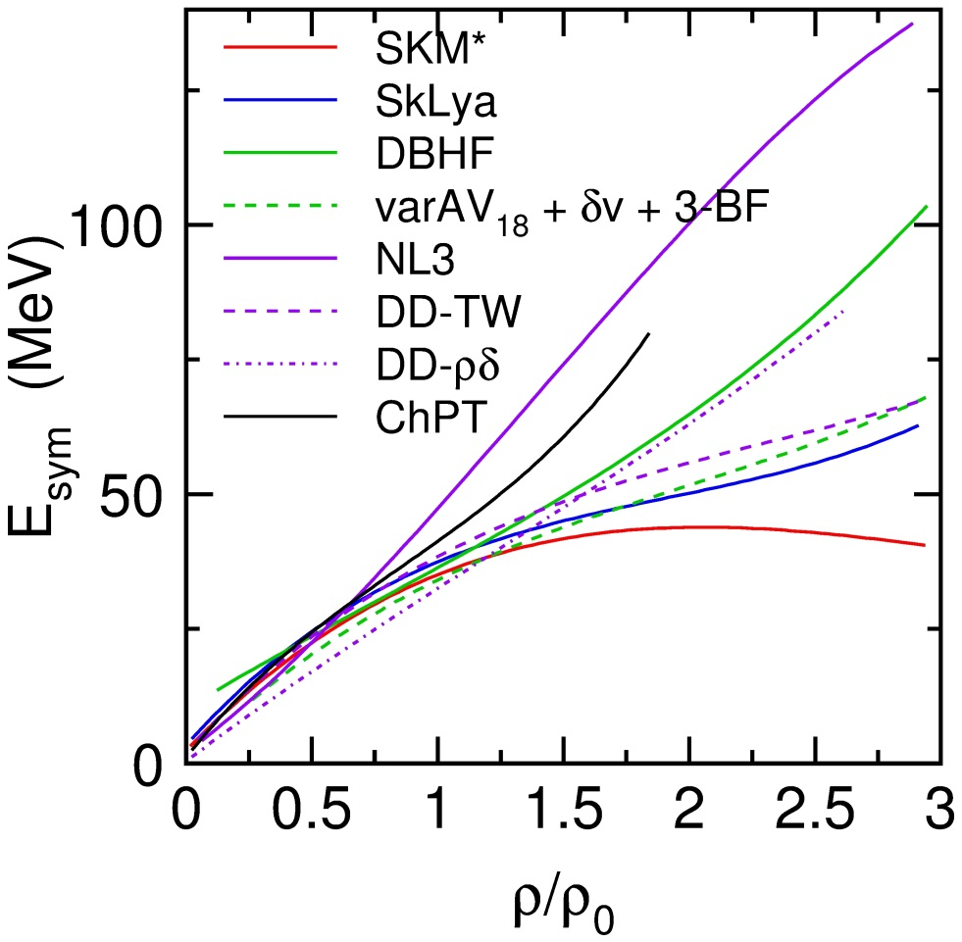
Symmetry energy
Fuchs and Wolter, EPJA 30 (2006)
hard
Largely unconstrained at high densities → related to uncertainty of three-body and tensor forces at high density
In IQMD
E_{sym}=S₀∙ (ρ/ρ₀)^{γ}
soft

Slide 13
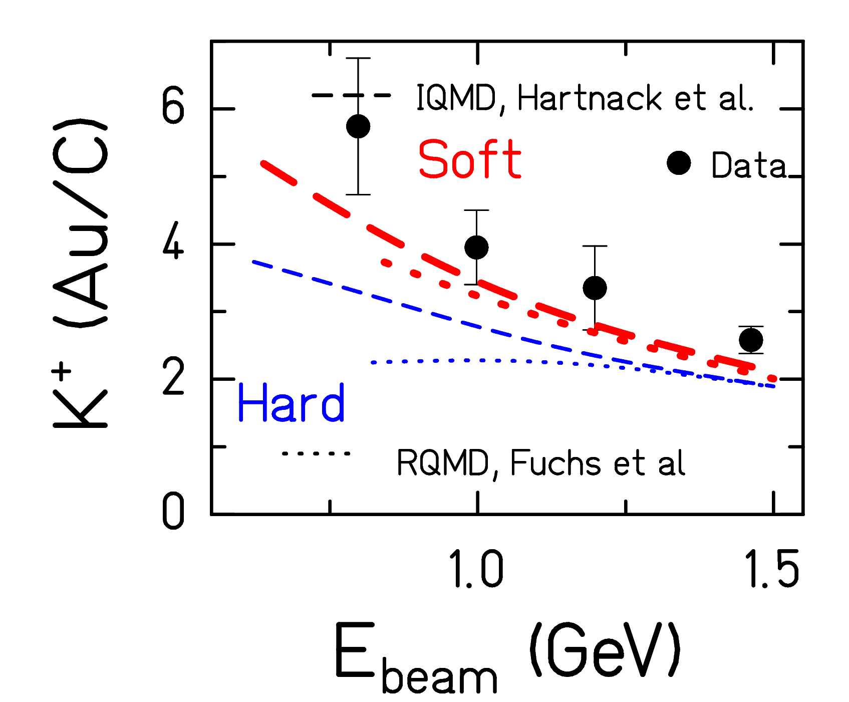
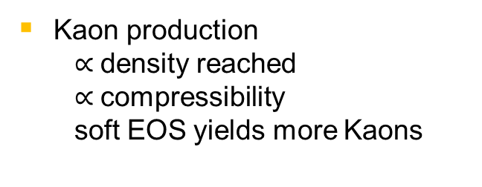
Compressibility of symmetric nuclear matter:
Kaon production
C. Sturm et al., PRL 86 (01) 39
Ch. Hartnack et al., PRL 96 (2006) 012302
results are independent on production cross sections and mechanisms and on the in-medium properties of kaons
sensitivity to compressibilty largest below threshold
relevant density ~2ρ₀
Kaon production
  $∝$density reached
  $∝$compressibility
  soft EOS yields more Kaons

Slide 14
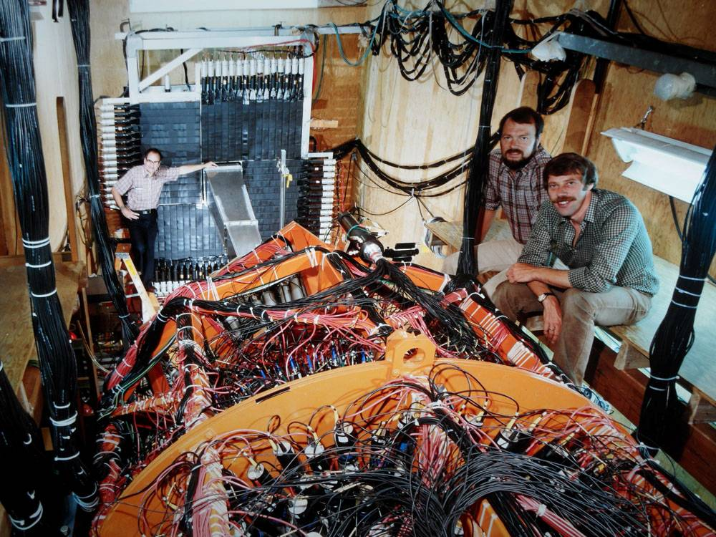
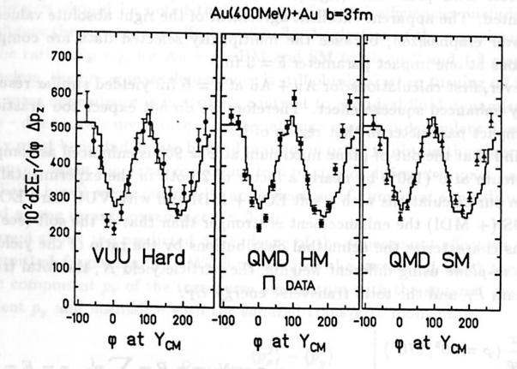
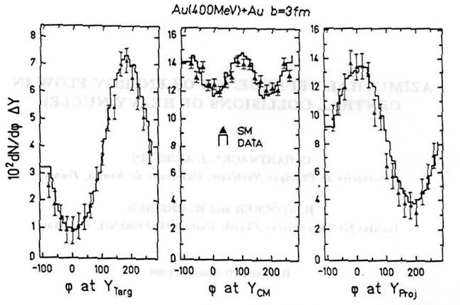
Compressibility of symmetric matter:
Directed flow at Plastic Ball
Plastic ball
Plastic ball
plastic ball
IQMD comparison to Plastic Ball data favors a soft EOS with mdi (C. Hartnack GSI-Report-93-05, Mod. Phys. Lett. A 09, 1994)
ambiguities between Skyrme part and mdi contribution
influence of cross sections

Slide 15
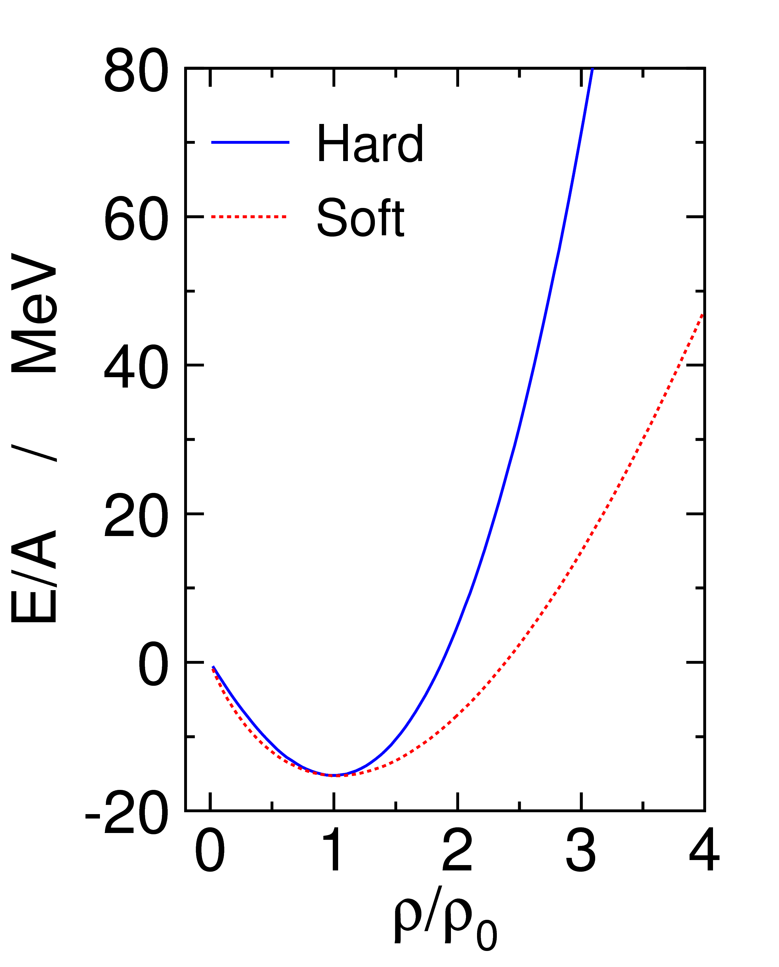
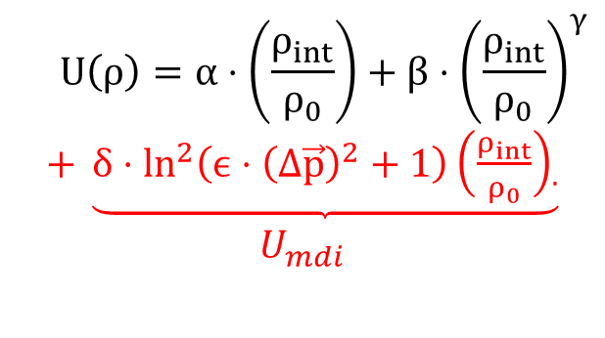
Momentum dependent interaction in IQMD
$$U\left(ρ\right)=α⋅\left(\frac{ρ_{int}}{ρ_{0}}\right)+β⋅{\left(\frac{ρ_{int}}{ρ_{0}}\right)}^{γ}$$
$+ \underbrace{δ⋅{\ln^{2}\left(ϵ⋅{\left(Δ\vec{p}\right)}^{2}+1\right)\left(\frac{ρ_{int}}{ρ_{0}}\right)}_{.}}$ $U_{mdi}$
H,HM
Κ=380 MeV
optical potential linear in density
parameters fitted to experimental pN data
a soft EOS with mdi (SM) shows the same density dependence as a soft EOS without mdi (S)
S,SM
Κ=200 MeV
IQMD, C. Hartnack et al.
EPJ A1 (1997) 151

Slide 16
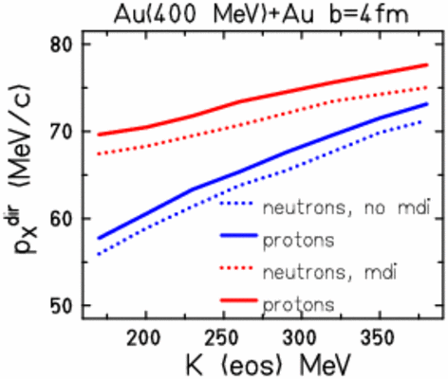
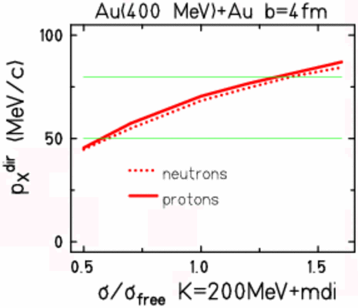
Directed flow depends on the EOS and…
IQMD C. Hartnack 1994
Effect of mdi similar to the influence of EOS … effects of other ingredients also strong

Slide 17
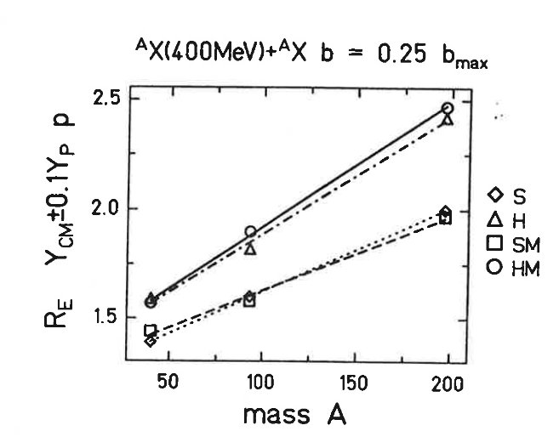
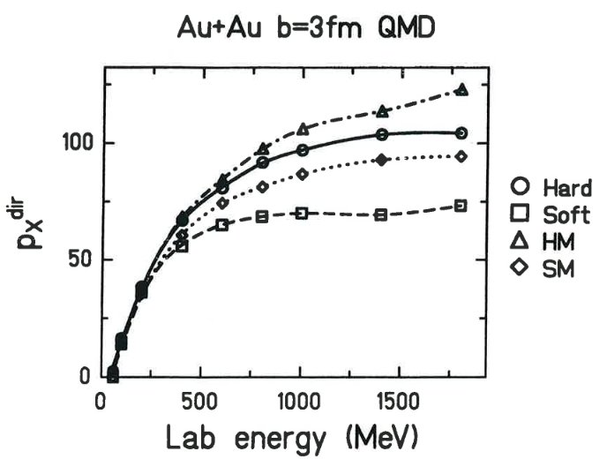
Luckily there is more than just one observable…
Elliptic flow ratio
at mid-rapidity
Directed flow
SM: same flow as H
difference between H/HM and S/SM
small
C. Hartnack GSI-Report 93-05

Slide 18
Directed flow data in comparison to IQMD
A. Andronic et al. PRC 67 (2003)034907
all charged particles weighted with Z
semi-central collisions
no conclusions can be drawn

Slide 19
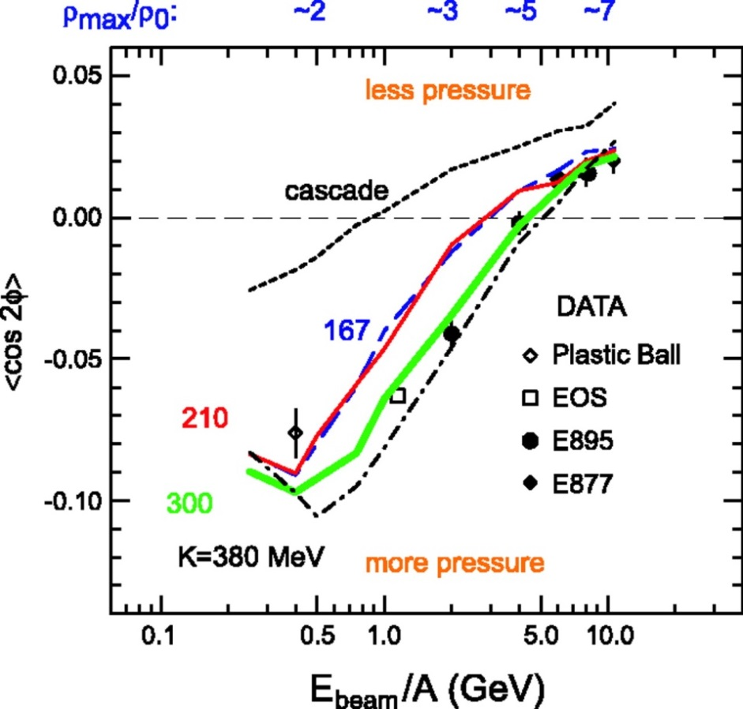
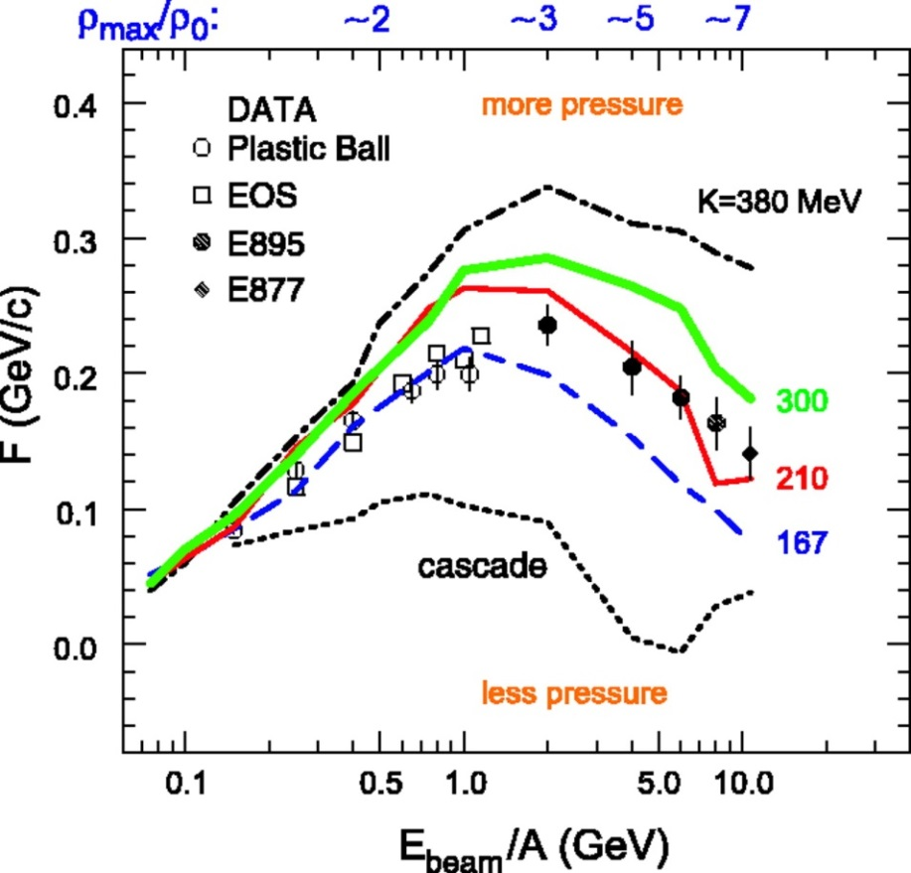
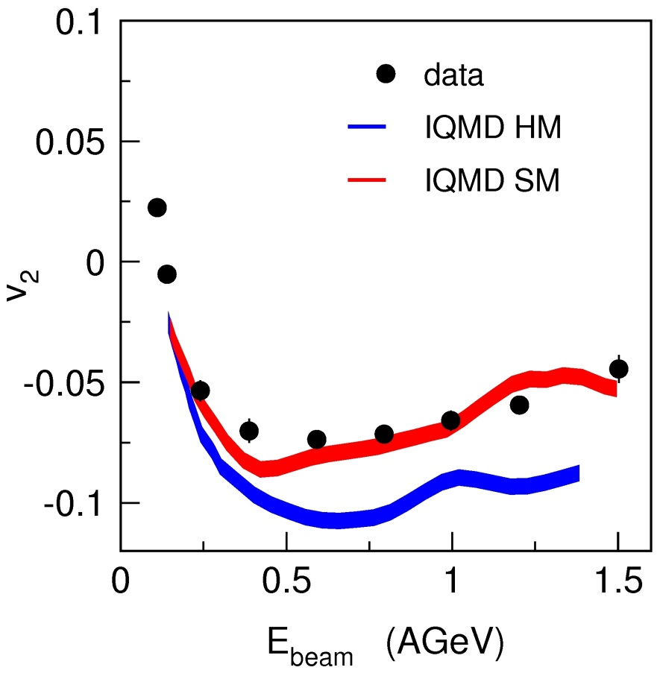
Compressibility of symmetric nuclear matter:
Directed flow of protons
Reisdorf et al,
NPA 876 (2012)
elliptic flow
P. Danielewicz et al.
Science 298, 1592 (2002)
side flow
quote of the authors: additional constraints needed on momentum dependence of NN potential and in-medium cross sections and symmetry potential
newer data on elliptic flow in agreement with a soft EOS (SM)
→ most available data and Kaon production is reasonably described by this model (input parameters constrained with experimental data)

Slide 20
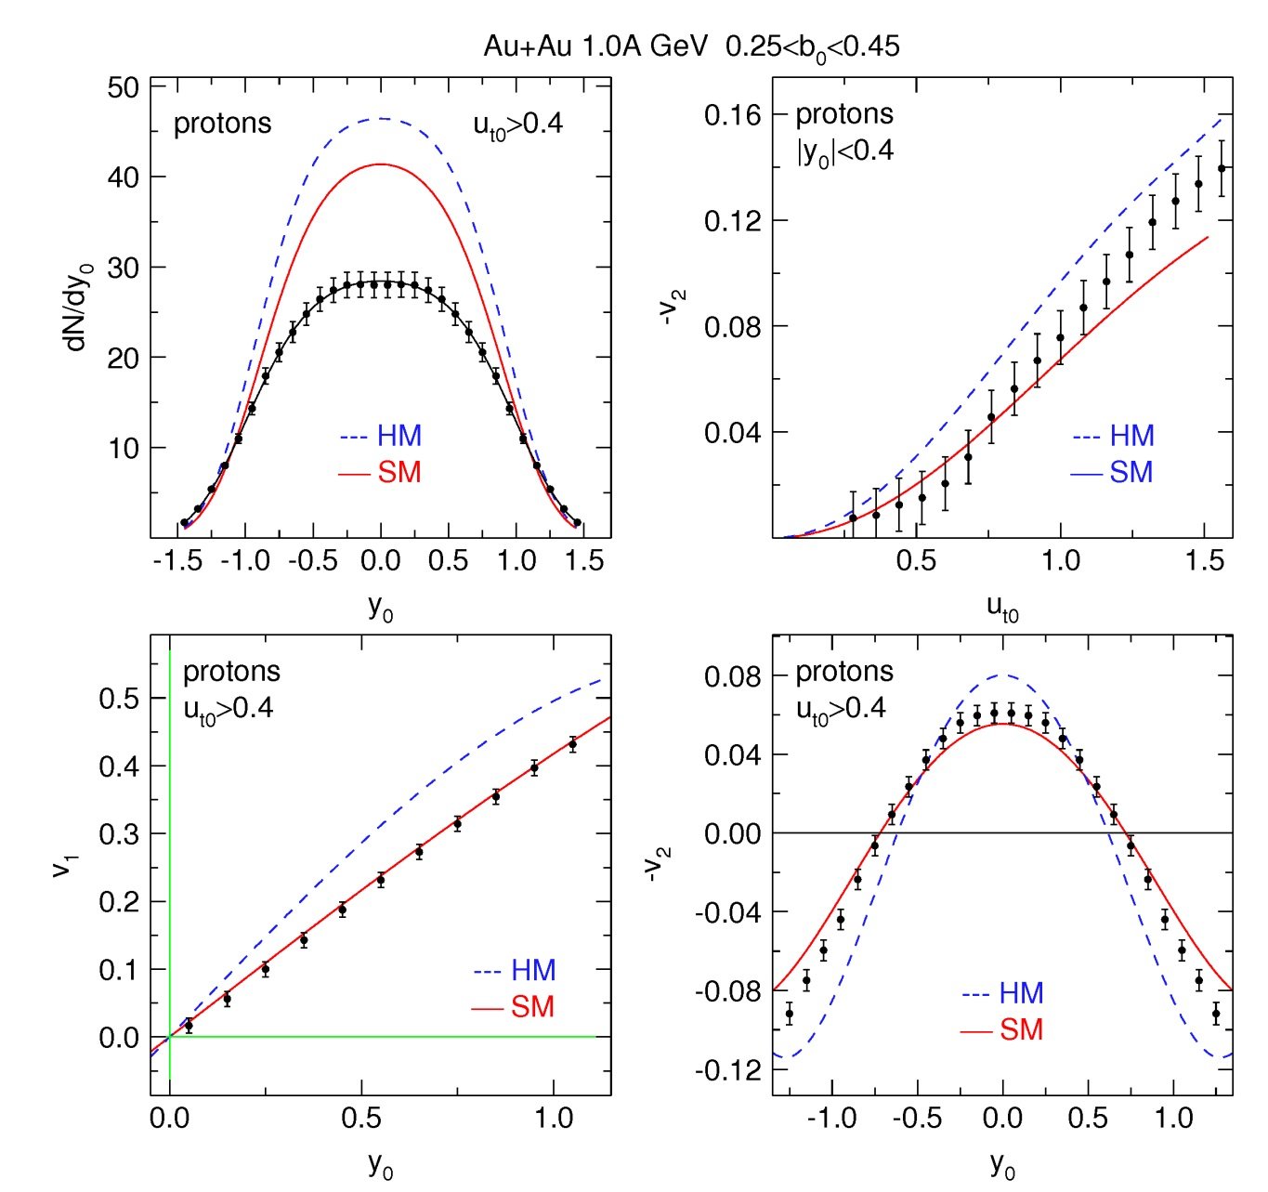
Collective flows in Au+Au at 1.0A GeV
All flow results
Au+Au 0.4 – 1.5AGeV Ru+Ru/Zr+Zr
directed flow
elliptic flow
protons
d, t, ³He, α
are reasonably well described by IQMD transport code employing a SM EOS for symmetric matter
W. Reisdorf et al, Nucl. Phys. A 876 (2012) 1
differential
elliptic flow
directed flow
elliptic flow
Notes:
In the magnet period FOPI had an extended phase space coverage but no access to neutron observables any more.
But to flow of identified charged particles shown here for protons at 1. AGeV Au+Au collisions...
All flow observables shown here are reasonably well described by a soft EOS with mom.

Slide 21
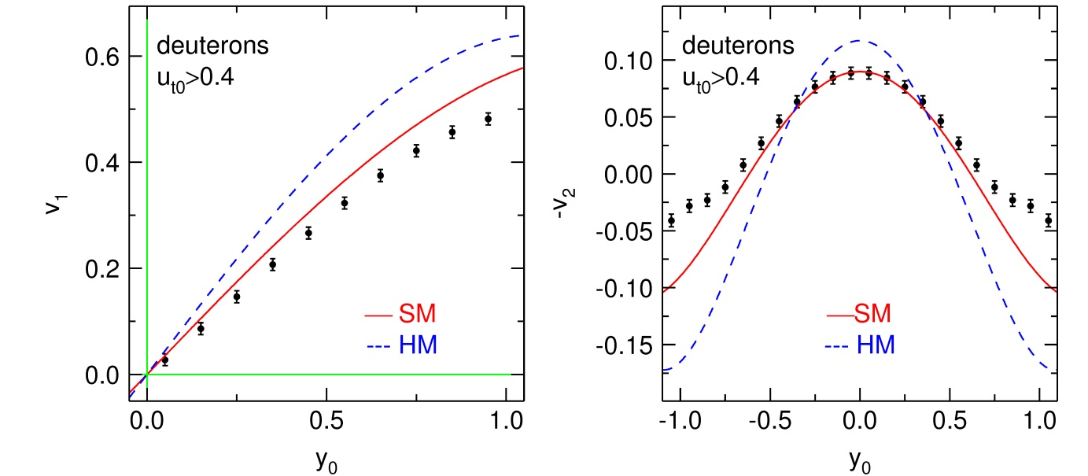
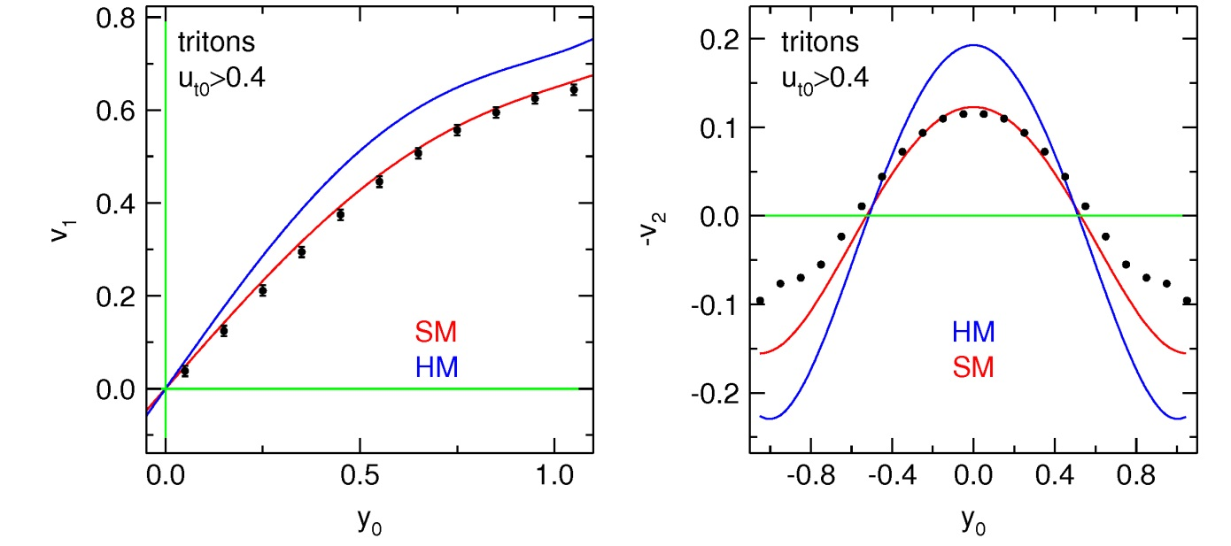
Collective flow of light charged particles
Au+Au 400A MeV 0.25<b0<0.45
composite particles are less influenced by thermal noise, larger flows
flow pattern of clusters described by IQMD SM despite mismatch in the overall yields
mismatch in the region of target/projectile rapidity point to insufficient description of clusterization

Slide 22
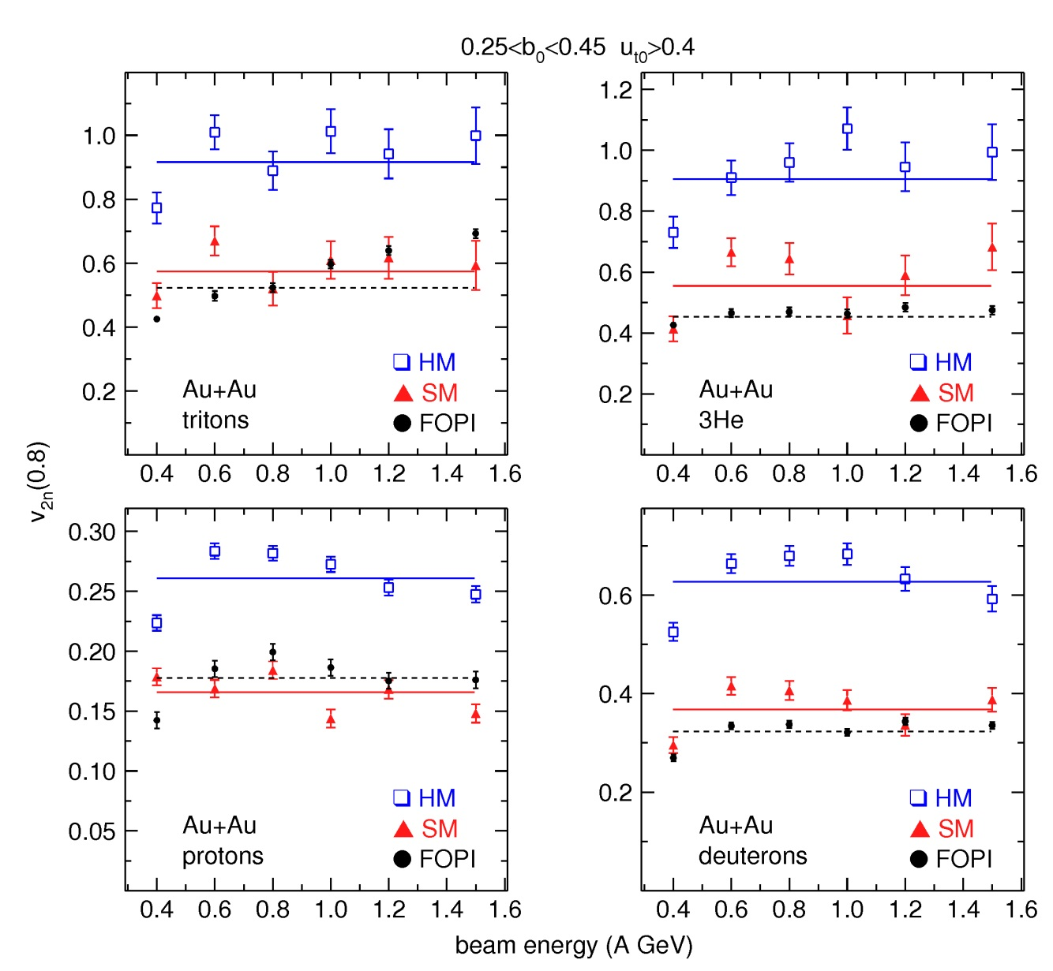
Elliptic flow of light charged clusters
influence of clusterisation is partially removed by using this observable
isotopically resolved elliptic flow is described by IQMD employing an SM EOS
huge difference for the two types of EOS (SM and HM)
much larger than the experimental error bars
promising observable to constrain the EOS for symmetric matter
A. LeFevre et al, Nucl. Phys. A 876 (2012) 1

Slide 23
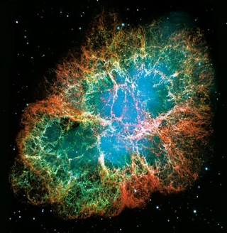
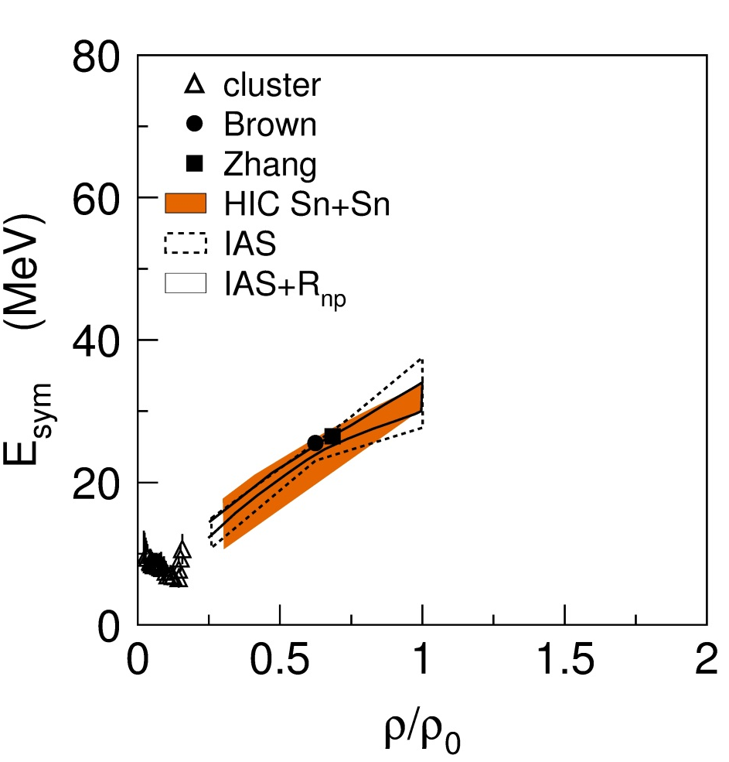
Constraining the symmetry energy
Sensitive observables that are or will be
more extensively explored :
neutron stars...
nuclear masses
neutron skins
cluster formation at low densities
fragmentation of nuclei
isospin diffusion und isospin drift between nuclei of different N/Z in peripheral HIC
neutron/proton, t/³He spectra and collective flows
π-/π+ multiplicities and spectra
?
?
cluster/HIC Sn+Sn/ IAS:
Horrowitz et al. JPhG 41 (2014)
Brown: arXiv:1308.3664

Slide 24
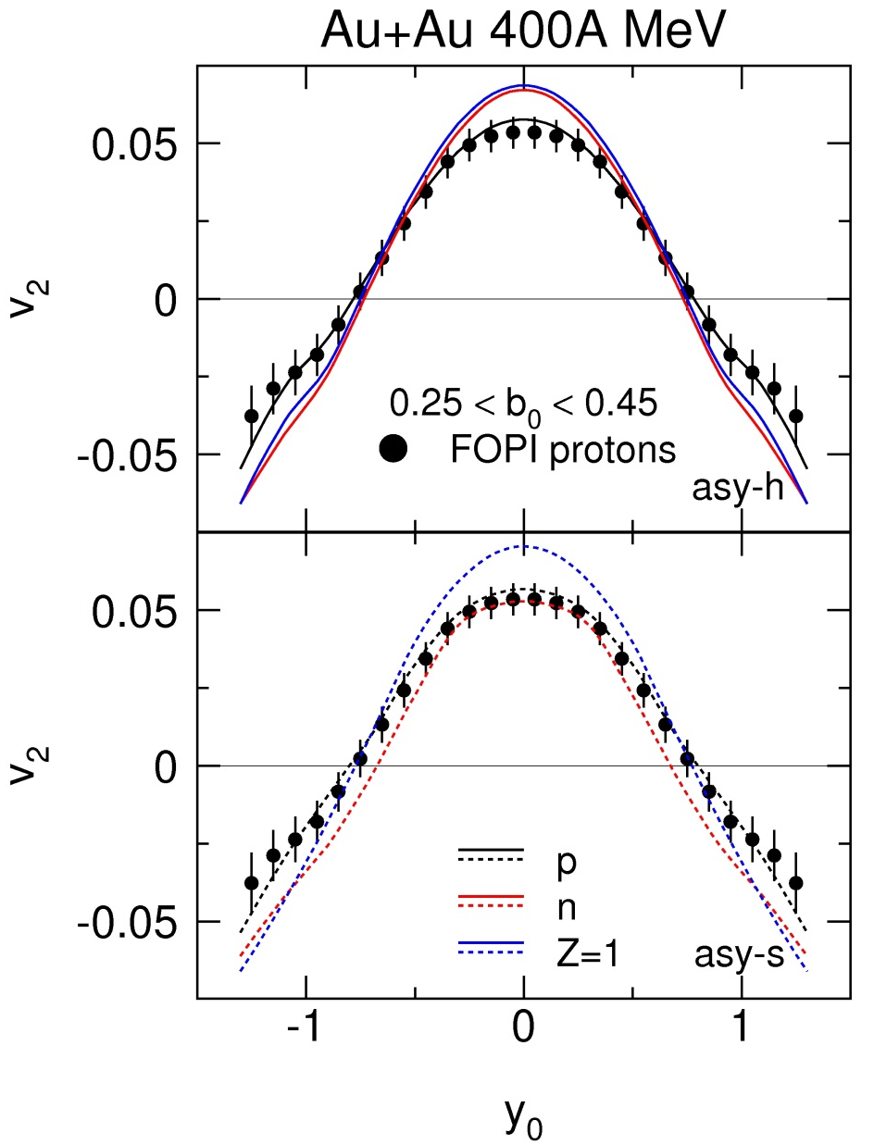
Symmetry energy at supra-normal densities
Differential elliptic flow v₂ of n/p
UrQMD* (Q. Li et al.) predicts
protons unchanged
neutron and proton flow inverted
Model independence investigated in
M.D. Cozma et al., arXiv:1305.5417
P. Russotto et al., PLB 267 (2010)
Y. Wang et al.,PRC 89, 044603 (2014)
“hard” E_{sym}
“soft” E_{sym}
UrQMD*: Qingfeng Li
Data. W. Reisdorf et al.

Slide 25
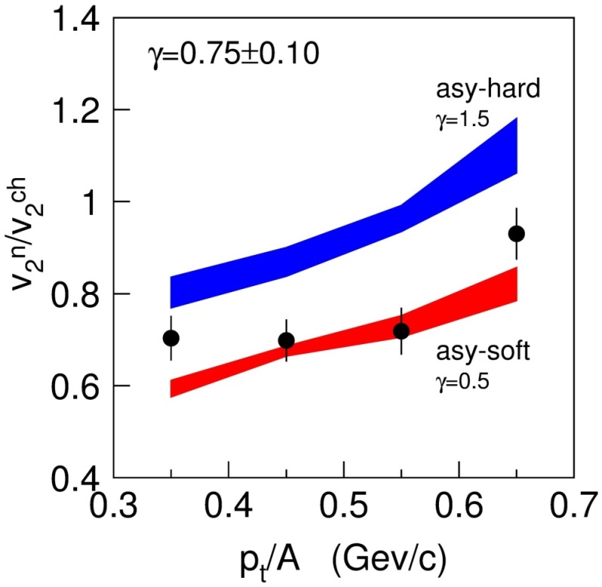
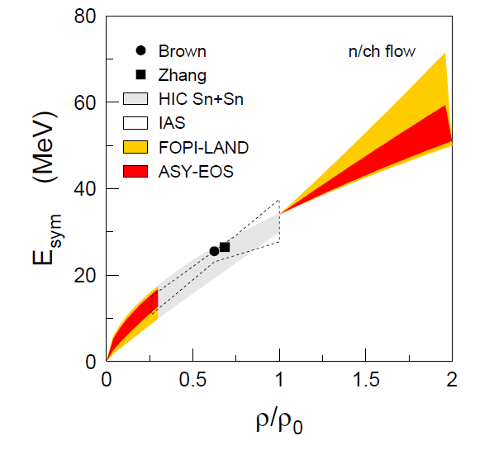
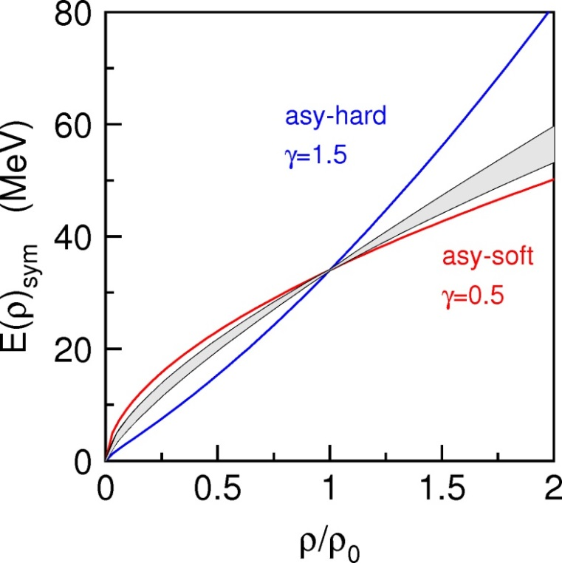
Elliptic flow ratio of neutrons and charged particles
P. Russotto et al., PRC 94, 034608 (2016)
37.7° ≤ θ_{lab} ≤ 56.5°
parametrization for SE used in UrQMD* model:
  E_{sym} = E_{sym}^{pot}+E_{sym}^{kin} = 22MeV·(ρ/ρ₀)^{γ}+12MeV·(ρ/ρ₀)^{2/3}
systematic errors corrected: γ = 0.72 ± 0.19
slope parameter: L = 72 ± 13 MeV, E_{sym}(ρ₀) = 34 MeV
slope parameter: L = 63 ± 11 MeV, E_{sym}(ρ₀) = 31 MeV
clusterization important

Slide 26
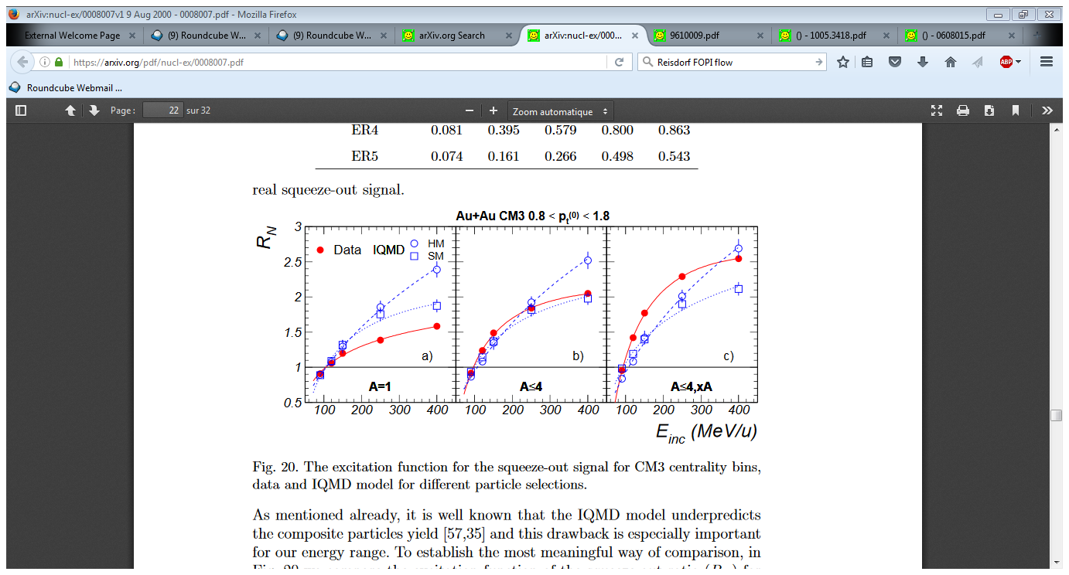
But… what about the clusters and fragments…?
ambiguities due to different fragment species
fragments much more sensitive to dynamical effect
clusters formation is omnipresent in HIC, important for analysis (observables depend on degree of cluster formation)
Elliptic flow
Ratio out-of plane to in-plane
FOPI: Stoicea et al. (1996)
cluster production
in HIC
statistical
(grand) canonical ensemble
dynamical
evolution of the reaction
often successful
few body correlations, treat clusters as explicit degrees of freedom (AMD, pBUU)
fluctuations and/or mean field + coalescence (BUU, ..MD)

Slide 27

FRIGA
Fragment Recognition In General Applications
Simulated Annealing Procedure: PLB301:328,1993; later called SACA (Simulated Annealing Clusterisation Algorithm)
So far applied with various transport models: BQMD, IQMD, pHSD.
Prediction of (light and heavy) (hyper)isotope yields and full phase space distribution.
A. LeFevre, J. Aichelin, E. Bratkovskaya, C. Hartnack, V. Kireyeu, Y. Leifels
Germanic mythological goddess Frigg/Friga, spinning the clouds

Slide 28
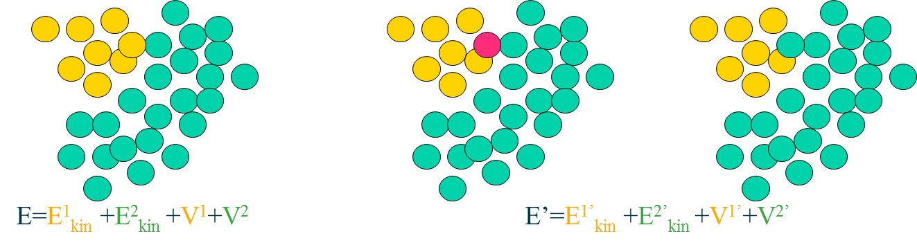
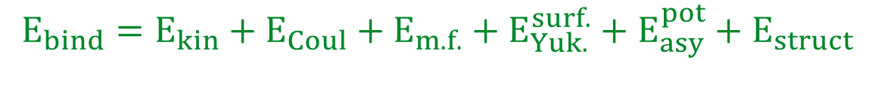
Model used
Transport : IQMD (C. Hartnack et al., Eur. Phys. J. A 1 (1998) 151)
+ Clustering algorithm: FRIGA (A. Le Fèvre et al, 2016 J. Phys.: Conf. Ser. 668 012021)
  simulated annealing with Minimum Spanning Tree coalescence as 1st step
  + overall cluster binding energy minimization
  veto of unstable isotopes
  ³He+n; secondary decay of excited primary clusters (GEMINI);
$$E_{bind}=E_{kin}+E_{Coul}+E_{m.f.}+E_{Yuk.}^{surf.}+E_{asy}^{pot}+E_{struct}$$
Preselect fragments with MST
Take randomly 1 nucleon out of 1 fragment
Place it randomly in another fragment
If E’ < E take the new configuration
If E’ > E take the old with a probability depending on E’-E
Repeat this procedure very many times... (Metropolis procedure)
It leads automatically to the most bound configuration.
Notes:
If we want to identify fragments early, one has to use momentum space info as well as coordinate space info.
Idea by Dorso et al. (Phys.Lett.B301:328,1993) :
a) Take the positions and momenta of all nucleons at time t.
b) Combine them in all possible ways into fragments or leave them as single nucleons.
c) Neglect the interaction among clusters.
d) Choose that configuration which has the highest binding energy.
Simulations show: Clusters chosen that way at early times are the pre-fragments of the final state clusters, because fragments are not a random collection of nucleons at the end but initial-final state correlations.

Slide 29

FRIGA vs Minimum spanning tree
BQMD*
Unlike FRIGA, MST is not able to describe the early formation of fragments.
MSTs applied at later times (typically 200-400 fm/c
Advantage of FRIGA
Fragment partitions reflect the early dynamical conditions (Coulomb, density, flow details, strangeness…), which is particularly important for hyper nucleus formation.
* P.B. Gossiaux, R. Puri, Ch. Hartnack, J. Aichelin,
Nuclear Physics A 619 (1997) 379-390

Slide 30

Clustering with FRIGA
MST at 200 fm/c
FRIGA at 2-3 t_{pass} (time of nuclei to pass each other completely without deceleration)
Less heavy fragments are produced with MST
MST shows broader distribution
Symmetry energy narrows distributions at around N=Z
Structure effects small and underestimate binding energies for small clusters
FRIGA

Slide 31

Benchmarking BQMD+FRIGA with
ALADIN data
ALADiN Magnet
TP-MUSIC IV
HodoCT
Target
TOF-Wall
LAND
ALADIN S254 measured by the ALADIN2000 collaboration
Projectile fragmentation of ¹⁹⁷Au+Au at 600 MeV/u
M_{imf} multiplicity of intermediate mass fragments (Z≥2) measured in forward direction
Z_{bound} sum of charges detected at small polar angles (measures impact parameter)

Slide 32
Clustering with IQMD+FRIGA
¹²⁹Xe+¹²⁴Sn @ 100 MeV/u b<2.8fm
MST at 200 fm/c
FRIGA at 2-3 t_{pass} (time of nuclei to pass each other completely without deceleration)
Less heavy fragments are produced with MST but more light fragments
Structure effects small and underestimate binding energies for small clusters
INDRA data, A. LeFevre et al., NUPA 735 (2005) 219

Slide 33
Clustering with FRIGA after secondary decays
¹²⁹Xe+¹²⁴Sn @ 100 MeV/u b<2.8fm
MST at 200 fm/c
FRIGA at 2-3 t_{pass} (time of nuclei to pass each other completely without deceleration)
after secondary decays
IQMD SM does not produce enough (heavy) clusters
INDRA data, A. LeFevre et al., NUPA 735 (2005) 219

Slide 34


Clustering with IQMD SM - revisited
¹⁹⁷Au+ ¹⁹⁷Au 600 MeV/u b=8 fm
R. OGUL et al. PHYSICAL REVIEW C 83, 024608 (2011)
Possible to describe fragment yields with IQMD SM

Slide 35


Benchmarking IQMD+FRIGA results
IQMD modifications
  smaller Gaussian package width: 4.33 fm²
  reduction of Fermi momentum during initialization
cluster multiplicity stable upto 200 fm/c
SM and H EOS yield similar results
Au+Au 600 MeV/u
ALADIN S254 measured by the ALADIN2000 collaboration

Slide 36





Reconstruction of hyper nuclei
Soft EOS
no m.d.i.
no Kaon pot.
Soft EOS
with m.d.i.
no Kaon pot.
Soft EOS
with m.d.i.
with Kaon pot.
Soft EOS
no m.d.i.
with Kaon pot.
FRIGA ingredients:
Volume component: mean field (Skyrme, dominant), for NN, NΛ (hypernuclei). We consider the strange quark as inert as a first approach ⇒ U(NΛ) = 2/3∙U(NN)
Surface effect correction: Yukawa term.
And optionally:
③ Symmetry energy E_{asy}
④ Extra « structure » energy (N,Z,ρ) = BMF(ρ).((Bexp-BBW)/(BBW-BCoul-Basy))(ρ0)
⑤ ³He+n recombination.
⑥ Secondary decay: GEMINI.
⑦ Rejection of « non-existing » isotopes and hyper-clusters.
IQMD+FRIGA 1.9GeV/u Ni+Ni
Λ⁶He
Λ⁶He
Λ⁶He
Λ⁶He
Λ⁵He
Λ⁵He
Λ⁵He
Λ⁵He
Λ⁴H
Λ⁴He
Λ⁴H
Λ⁴H
Λ⁴He
Λ⁴H
Λ⁴He
Λ⁴He
Λ³H
Λ³H
Λ³H
Λ³H
n-Λ
p-Λ
n-Λ
n-Λ
p-Λ
n-Λ
p-Λ
p-Λ

Slide 37


Influence of Lambda re-scattering
fitted to existing data
IQMD calculations C. Hartnack
rescattering changes rapidity distribution of hyperons
and consequently the overlapp region between hyperons and spectator nucleons
huge influence on yields on hyper nuclei

Slide 38

Clusterisation time influence on rapidity distributions
HSD+FRIGA Au+Au @ 11.45 GeV/u, b=6fm, passing time 7.5 fm/c
heavy (Z>2) hypernuclei
4 fm/c
8 fm/c
10 fm/c
15 fm/c
20 fm/c
30 fm/c
(y/yproj.)c.o.m.

Slide 39

HYPHI@GSI results in comparison to IQMD+FRIGA
IQMD*+FRIGA
⁶Li+¹²C @ 2A.GeV
(t = 2 tpass)
min. bias
nominal σ_{NΛ}
dMult/dy / 0.02
R=Y(Λ³H)/Y(Λ⁴H)
with Easy in FRIGA
HyPHI @ GSI
Ch. Rappold et al.,
PLB 747 (2015) 129–13:
R=1.4 ± 0.8
R=18 ± 3
R=3.1 ± 0.4

Slide 40

HYPHI@GSI results in comparison to IQMD+FRIGA
IQMD*+FRIGA
⁶Li+¹²C @ 2A.GeV
(t = 2 tpass)
min. bias
nominal σ_{NΛ}
dMult/dy / 0.02
R=Y(Λ³H)/Y(Λ⁴H)
no Easy in FRIGA
HyPHI @ GSI
Ch. Rappold et al.,
PLB 747 (2015) 129–13:
R=1.4 ± 0.8
R=10 ± 3
R=2.2 ± 0.4

Slide 41

HYPHI@GSI results in comparison to IQMD+FRIGA
IQMD*+FRIGA
⁶Li+¹²C @ 2A.GeV
(t = 2 tpass)
b>3 fm
nominal σ_{NΛ}
dMult/dy / 0.02
R=Y(Λ³H)/Y(Λ⁴H)
no Easy in FRIGA
HyPHI @ GSI
Ch. Rappold et al.,
PLB 747 (2015) 129–13:
R=1.4 ± 0.8
R=11 ± 3
R=1.3 ± 0.4

Slide 42


HYPHI@GSI results in comparison to IQMD+FRIGA
IQMD*+FRIGA
⁶Li+¹²C @ 2A.GeV
(t = 2 tpass)
b > 3 fm
y0 > 0.9
formation of heavy hyper- nuclei predominantly in the spectator region
crucially ingredient is the ΛN re-scattering cross section
cluster multiplicity in the mid-rapidity region depends on the clusterization time
in contrast to spectator region (relatively stable)
multiplicity of the HYPHI data overpredicted
different slopes of transverse momentum spectra of $._{Λ}^{3}H$ and $._{Λ}^{4}H$ reproduced
dMult/dp_{t} / 40. MeV/c
*: Ch.Hartnack et al., Eur. Phys. J. A 1(1998) 151.

Slide 43


Summary
Cluster formation is omnipresent in heavy ion collisions
  Cluster have a larger sensitivity to dynamics
  and influence all observables
Understanding of production needed for more stringent constraints on equation of state and symmetry energy, important for reaction dynamics and formation mechanisms
Dynamical creation of clusters during transport would be the most elegant approach
Advantage of FRIGA
  minimazation of cluster binding energies - relatively fast
  allows for clusterization at early times to preserve the dynamics at this stage
    the final state of FRIGA is a classical bound state (no Fermi motion)
Experimental data
  production of heavy clusters in the projectile/spectator region
  light clusters in particular in the mid-rapidity region
First results on cluster production with IQMD SM available, needs benchmarking
Hyper nuclei production might be a very important tool to study the mechanisms of fragmentation and production of clusters
more data (with larger phase space coverage) urgently needed

Slide 44


Outlook – Constraining the EOS with I/UrQMD
P. Russotto et al.,
PLB 267 (2010)
LeFevre et al.,
NPA (2016)
P. Russotto et al.,
PRC (2017)
Equation of state of symmetric nuclear matter from comparison of FOPI data with IQMD
the symmetry energy as extracted from ASY-EOS results with UrQMD*

Slide 45




Outlook
Pressure in a neutron star
L as from AsyEOS at 1-2ρ0
  L = 63 ± 11 MeV
  for Epot^{asy}(ρ0)=19 MeV)
  or L = 72 ± 13 MeV
  for E_{pot}^{asy}(ρ0)=22 MeV
  [Russotto et al. PRC94(2016)034608]
K0 as from FOPI flow data
[A. Le Fèvre et al., NPA945(2016)112-133]
[Y. Wang et al., PLB-778(2018)207-212]
GW170817 ArXiV 1805.11581 (2018)
$$(P_{NN}^{sym}(K_{0})+P_{asy}(L))δ$$
$$δ=0.9(5\%protons+degeneratee^{−})$$
AsyEOS+FOPI
$$IQMD−>K_{0}=190±30MeV$$
$$UrQMD−>K_{0}=220±40MeV$$

Slide 46

My thanks to the FOPI collaboration
A. Andronic, R. Averbeck, Z. Basrak, N. Bastid,
M.L. Benabderramahne, M. Berger, P. Bühler,
R. Caplar, M. Cargnelli, M. Ciobanu, P. Crochet, I. Deppner, P. Dupieux, M. Dzelalija, L. Fabbietti, J. Frühauf, F. Fu, P. Gasik, O. Hartmann,
N. Herrmann, K.D. Hildenbrand, B. Hong,
T.I. Kang, J. Keskemeti, Y.J. Kim, M. Kis,
M. Kirejczyk, R. Münzer, P. Koczon, M. Korolija, R. Kotte, A. Lebedev, K.S. Lee, Y. Leifels,
A. LeFevre, P. Loizeau, X. Lopez, M. Marquardt, J. Marton, M. Merschmeyer, M. Petrovici,
K. Piasecki, F. Rami, V. Ramillien, A. Reischl, W. Reisdorf, M.S. Ryu, A. Schüttauf, Z. Seres,
B. Sikora, K.S. Sim, V. Simion,
K. Siwek-Wilczynska, K. Suzuki, Z. Tyminski, J. Weinert, K. Wisniewski, Z. Xiao, H.S. Xu,
J.T. Yang, I. Yushmanov, V. Zimnyuk, A. Zhilin, Y. Zhang, J. Zmeskal
IPNE Bucharest, Romania, ITEP Moscow, Russia
CRIP/KFKI Budapest, Hungary, Kurchatov Institute Moscow, Russia, LPC Clermont-Ferrand, France, Korea University, Seoul, Korea, GSI Darmstadt, Germany, IReS Strasbourg, France, FZ Rossendorf, Germany, Univ. of Heidelberg, Germany , Univ. of Warsaw, Poland, RBI Zagreb, Croatia, IMP Lanzhou, China, SMI Vienna, Austria, TUM, Munich, Germany, T.Yamazaki(RIKEN)

Slide 47














and to the ASYEOS collaboration
^{Lis}
authors of proposal 2009
List from the Proposal

Slide 48

FAIR in 2025
THANK YOU FOR YOUR ATTENTION

Slide 49


Confining the input parameters of IQMD
Au+Au central b₀<0.15
u_{t0}>0.4
Choice in IQMD for
σ_{NN},
momentum dependence of optical potentials,
prescription of Pauli blocking and detailed balance etc.
describes most of the data

