Slide 1
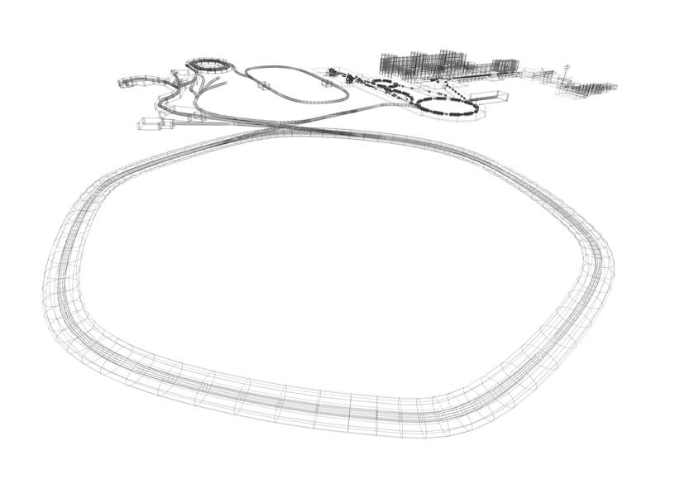
GSI-FAIR
The Universe in the Laboratory
CBM Collaboration Meeting, October 2018
Paolo Giubellino,
FAIR and GSI

Slide 2
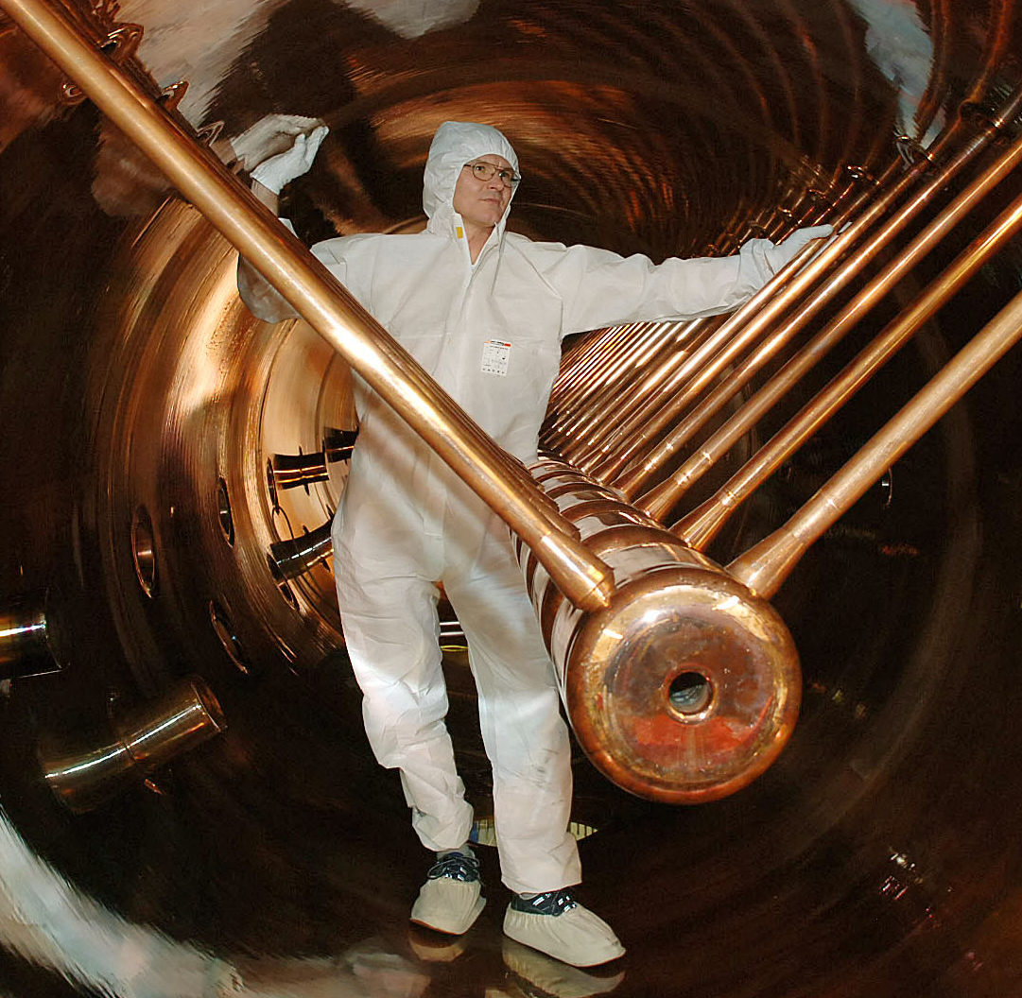
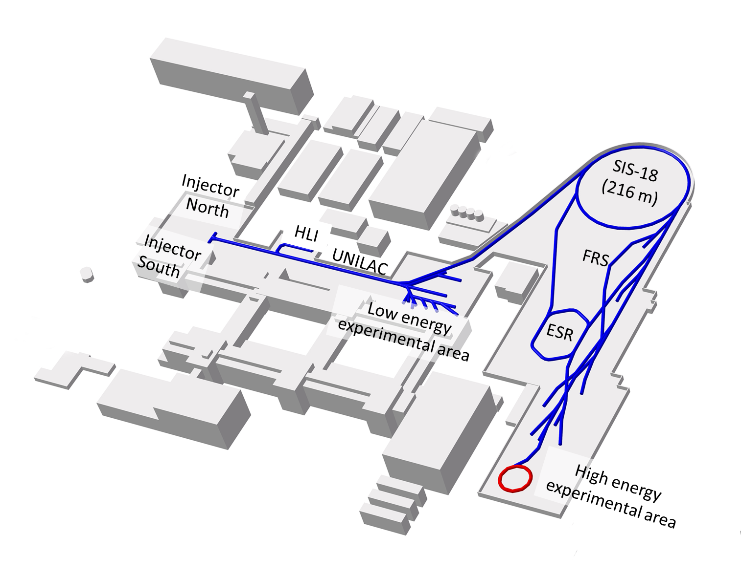
GSI – Almost 50 Years of Scientific and Technical Competence
Phelix
Laser
CRYRING
Existing accelerator facility has been upgraded to serve as injector for FAIR and – in the meantime – for FAIR phase 0
Notes:
Beschriftung/Beschneiden des Beschleunirgebildes

Slide 3
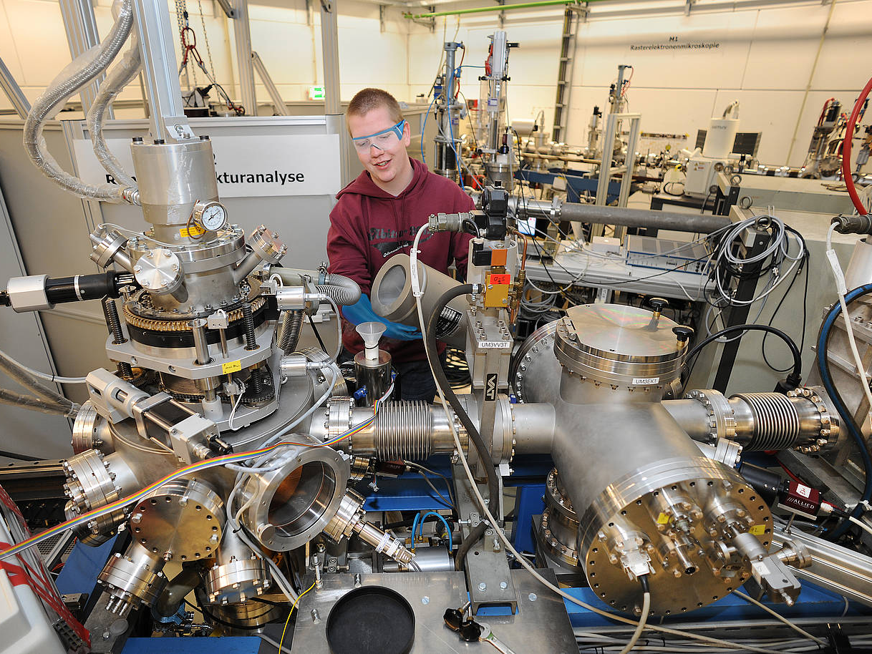
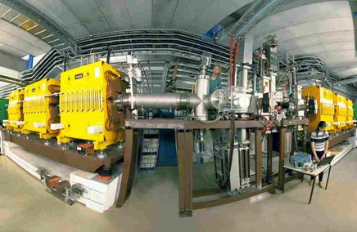
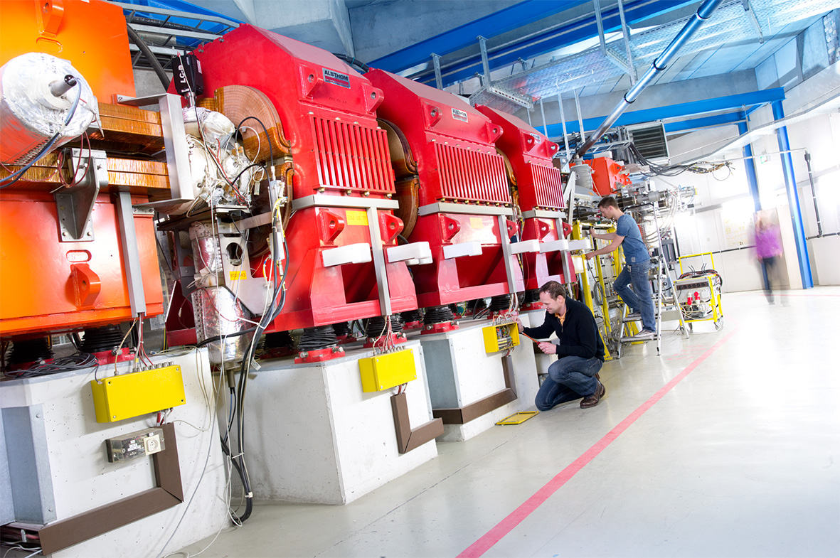
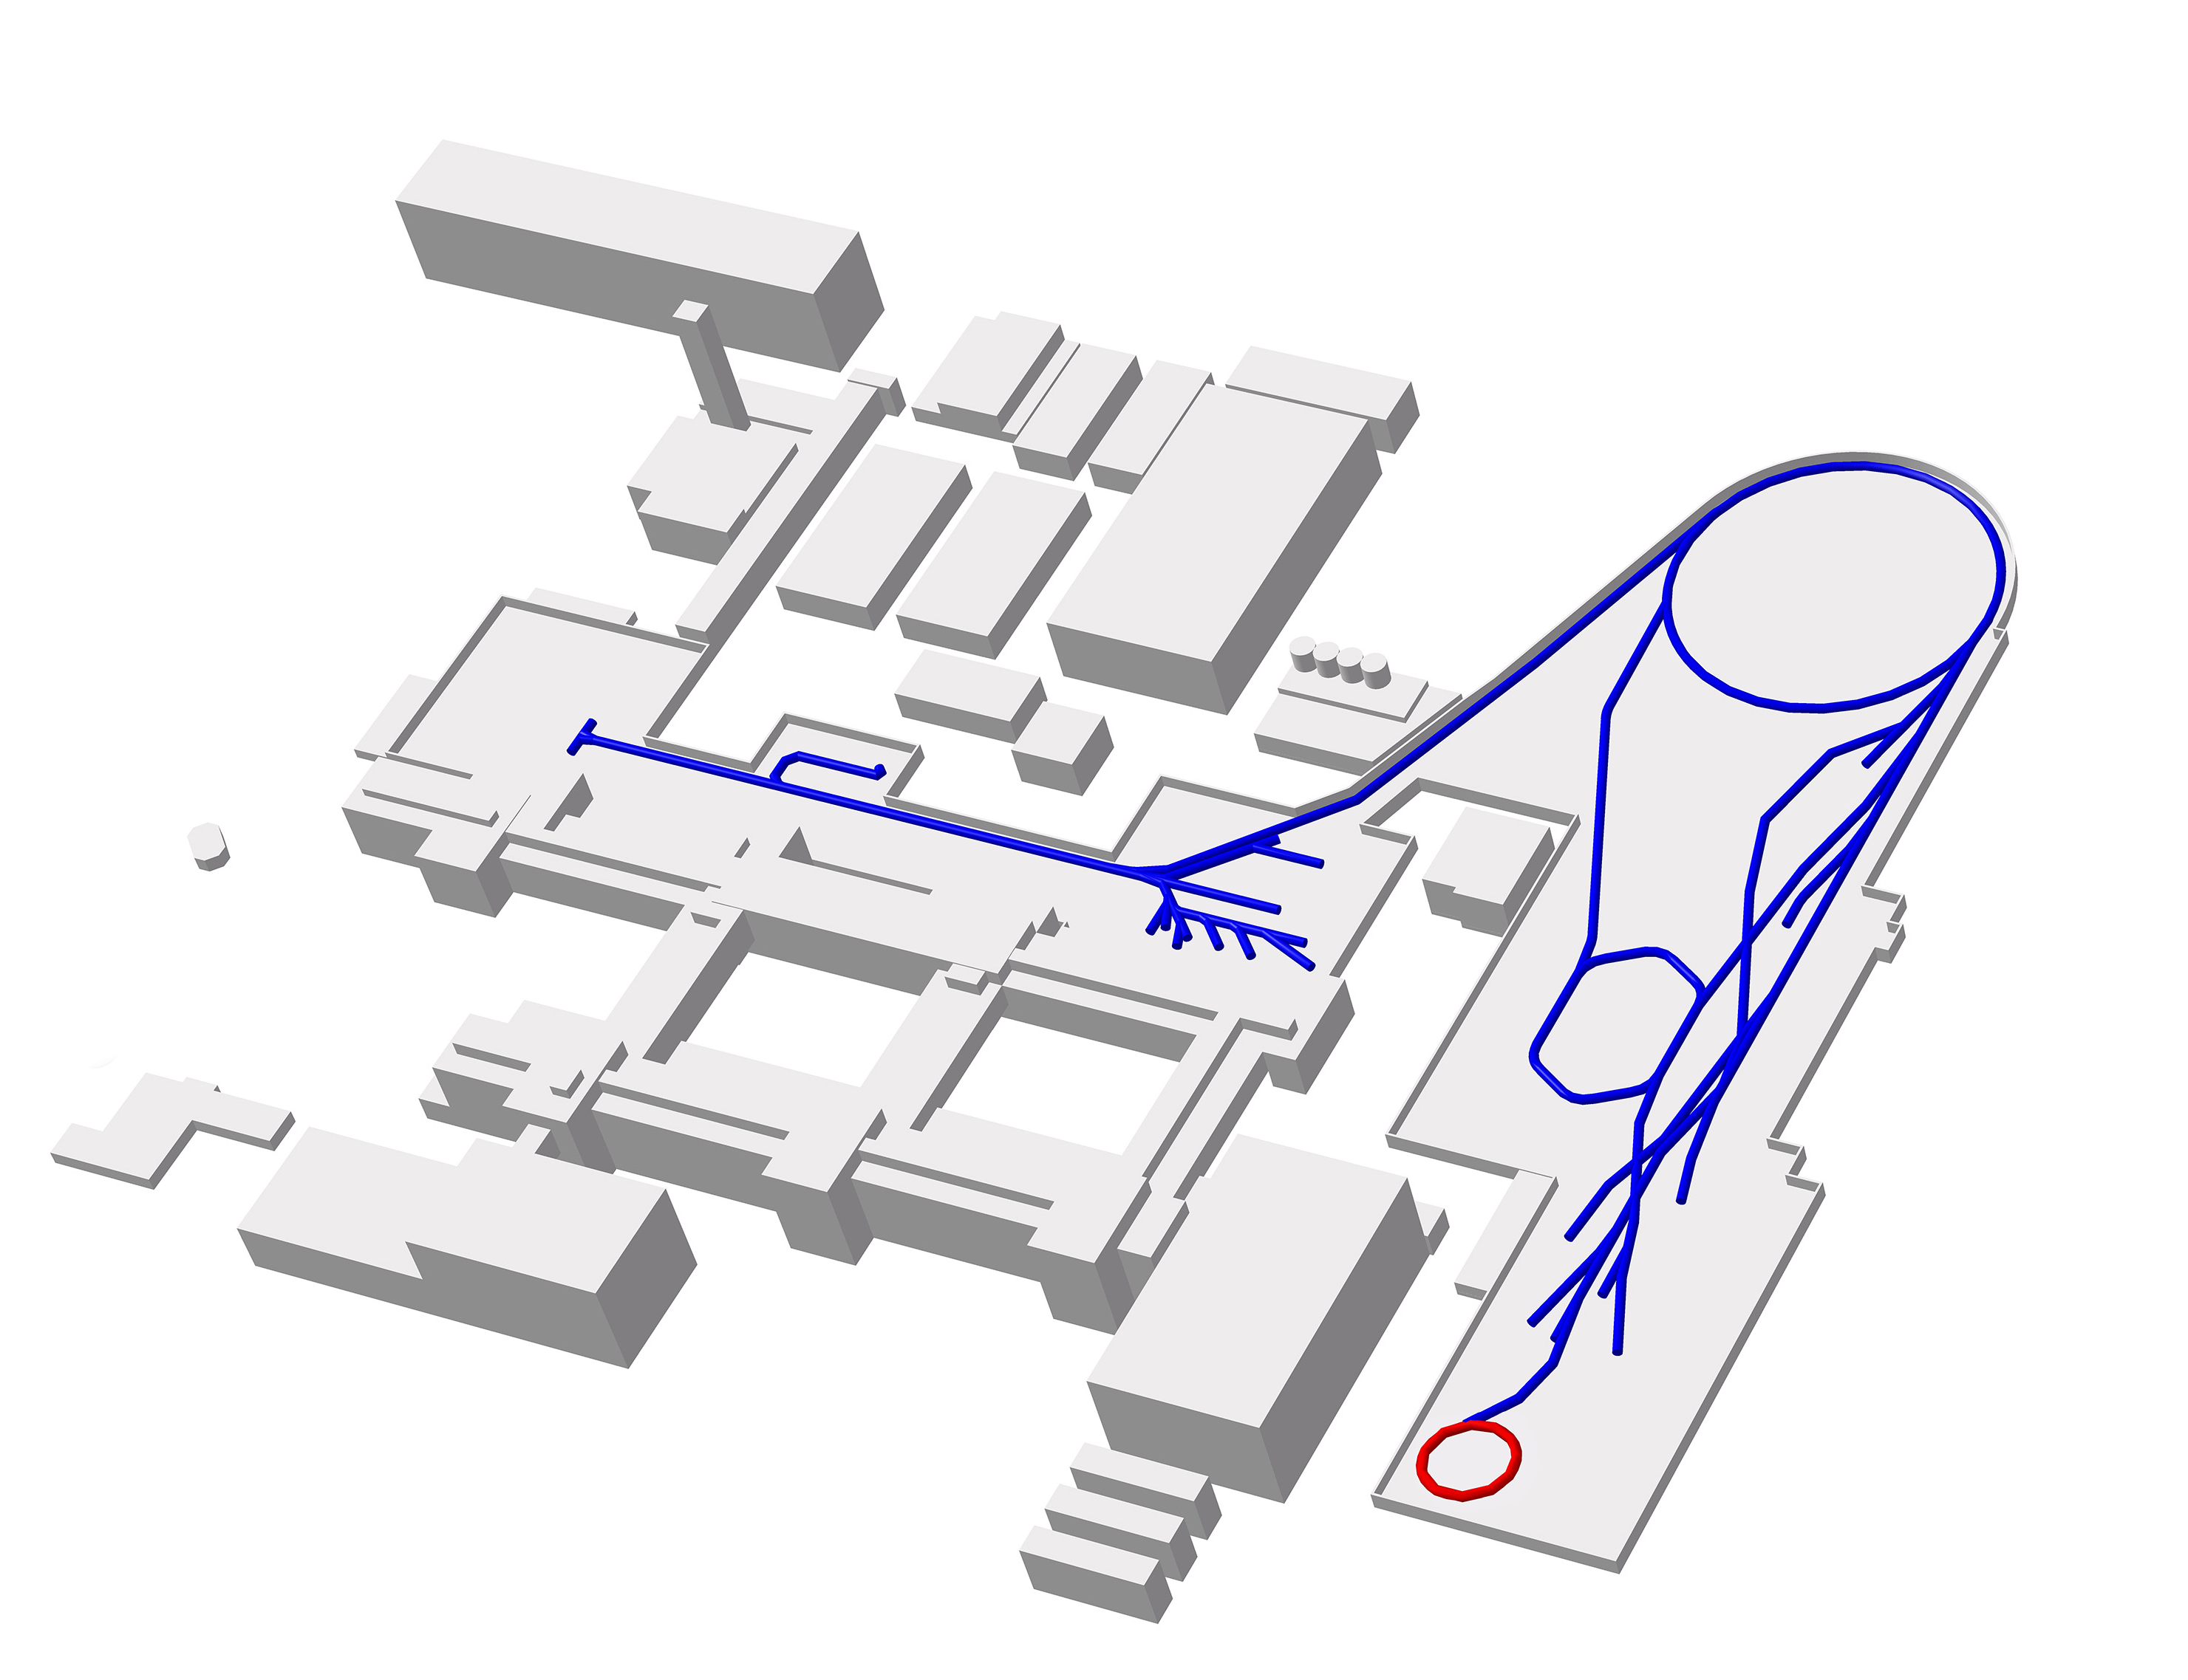
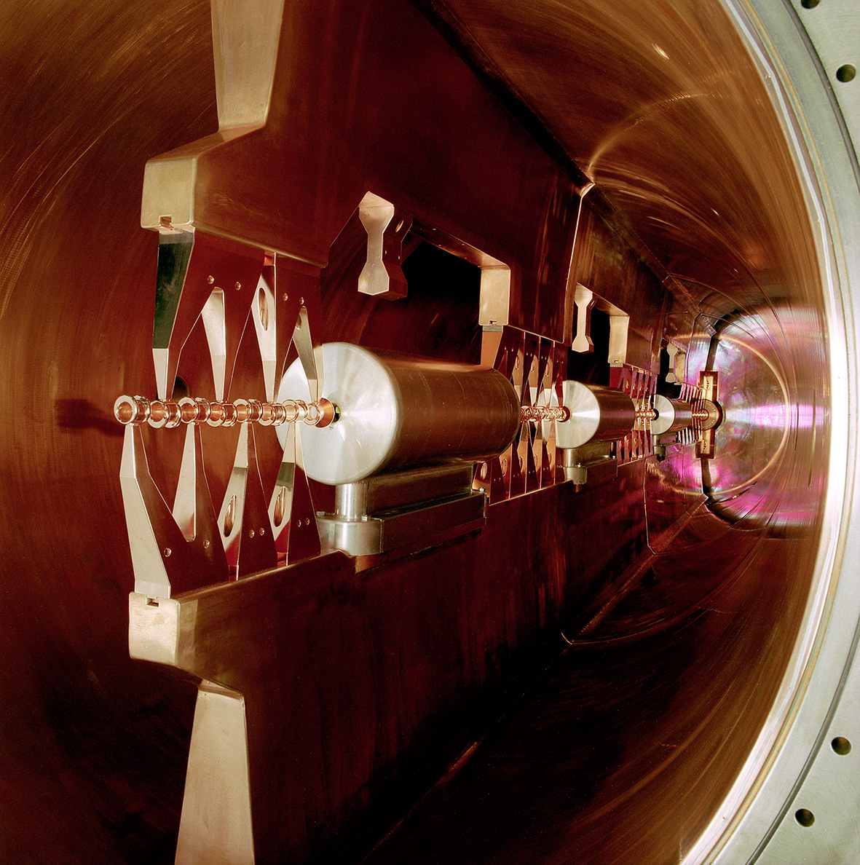
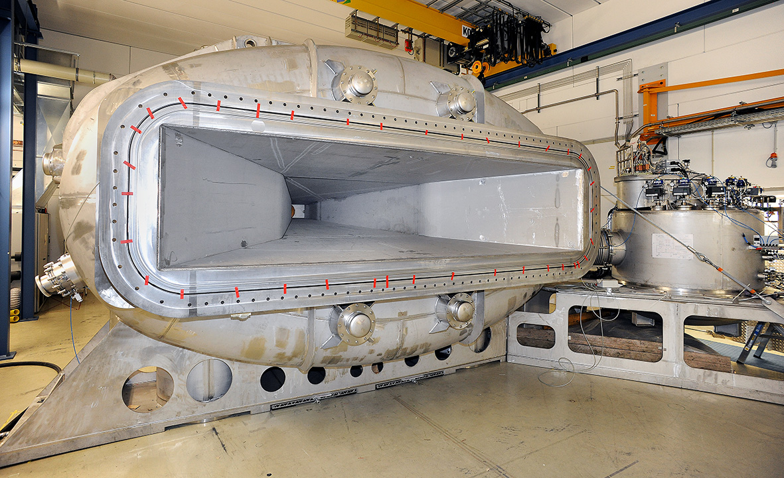
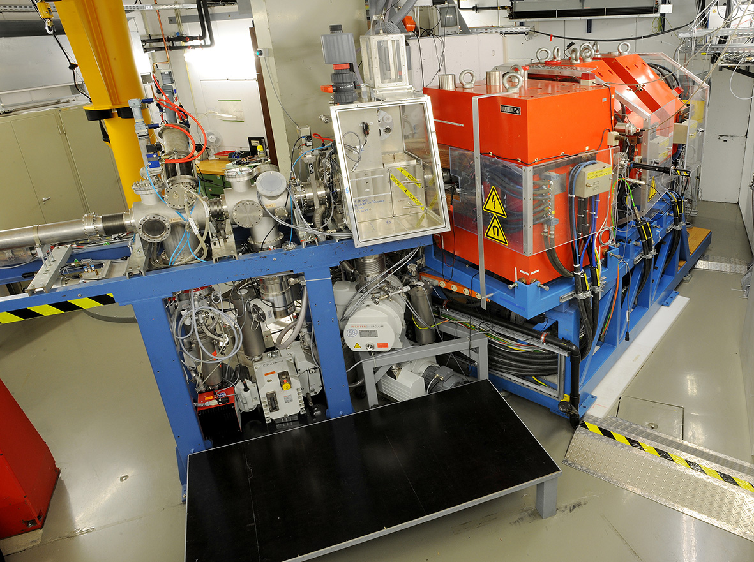
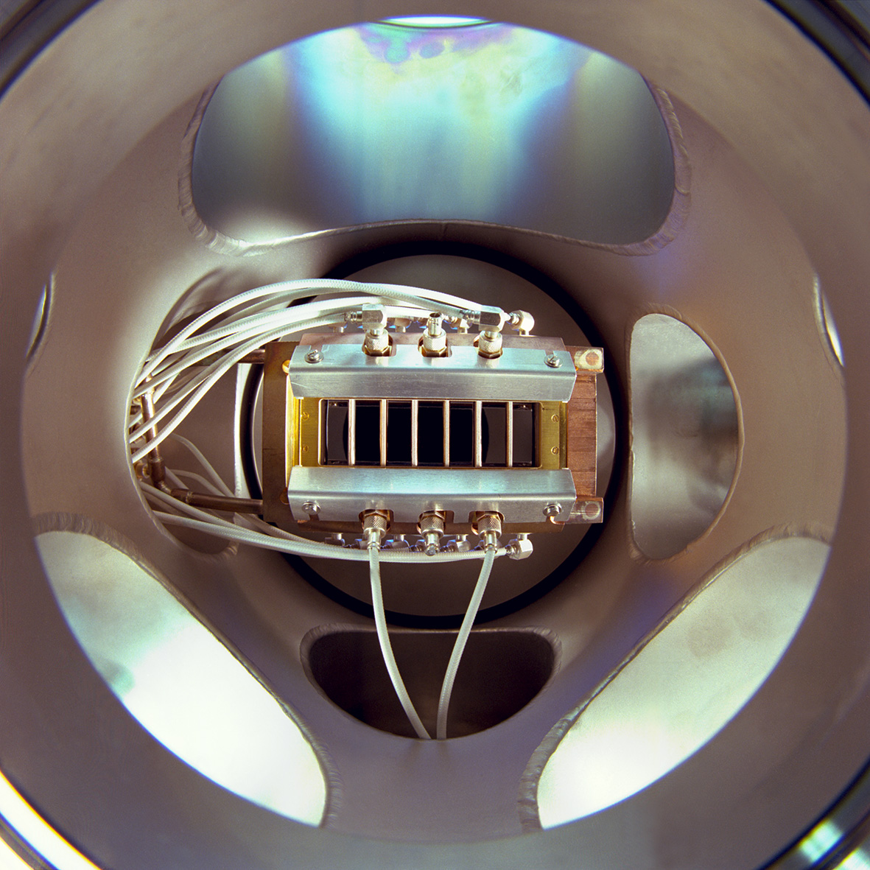
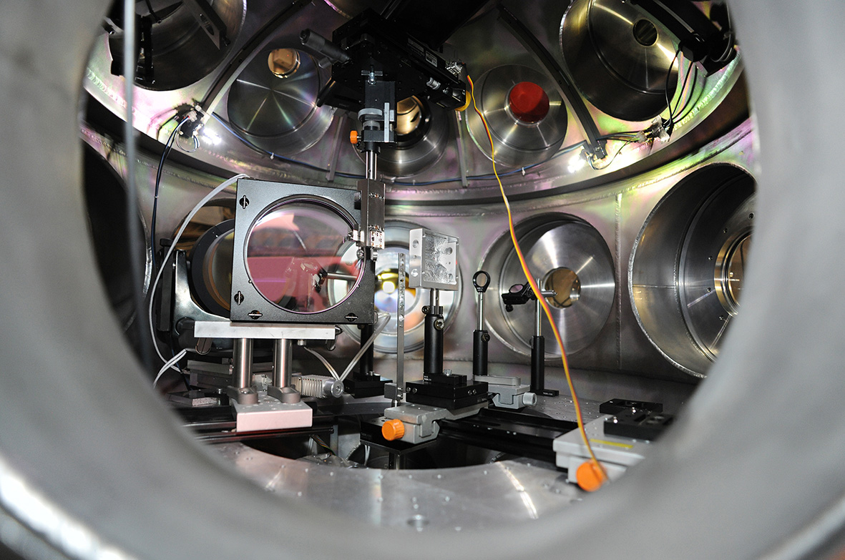
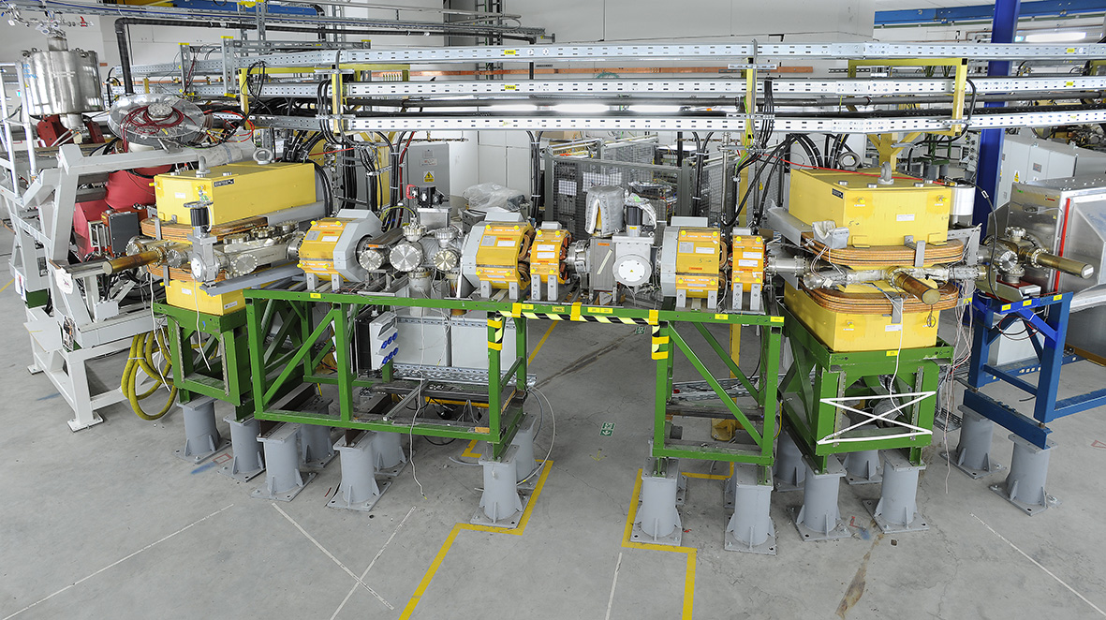
Research Infrastructures available at GSI
- open to external users, in particular from univ.
M-Branch
FRS
ESR
HADES
SIS18
UNILAC
ESR
UNILAC
R3B
CRYRING
TASCA
SHIP
PHELIX
Cryring

Slide 4
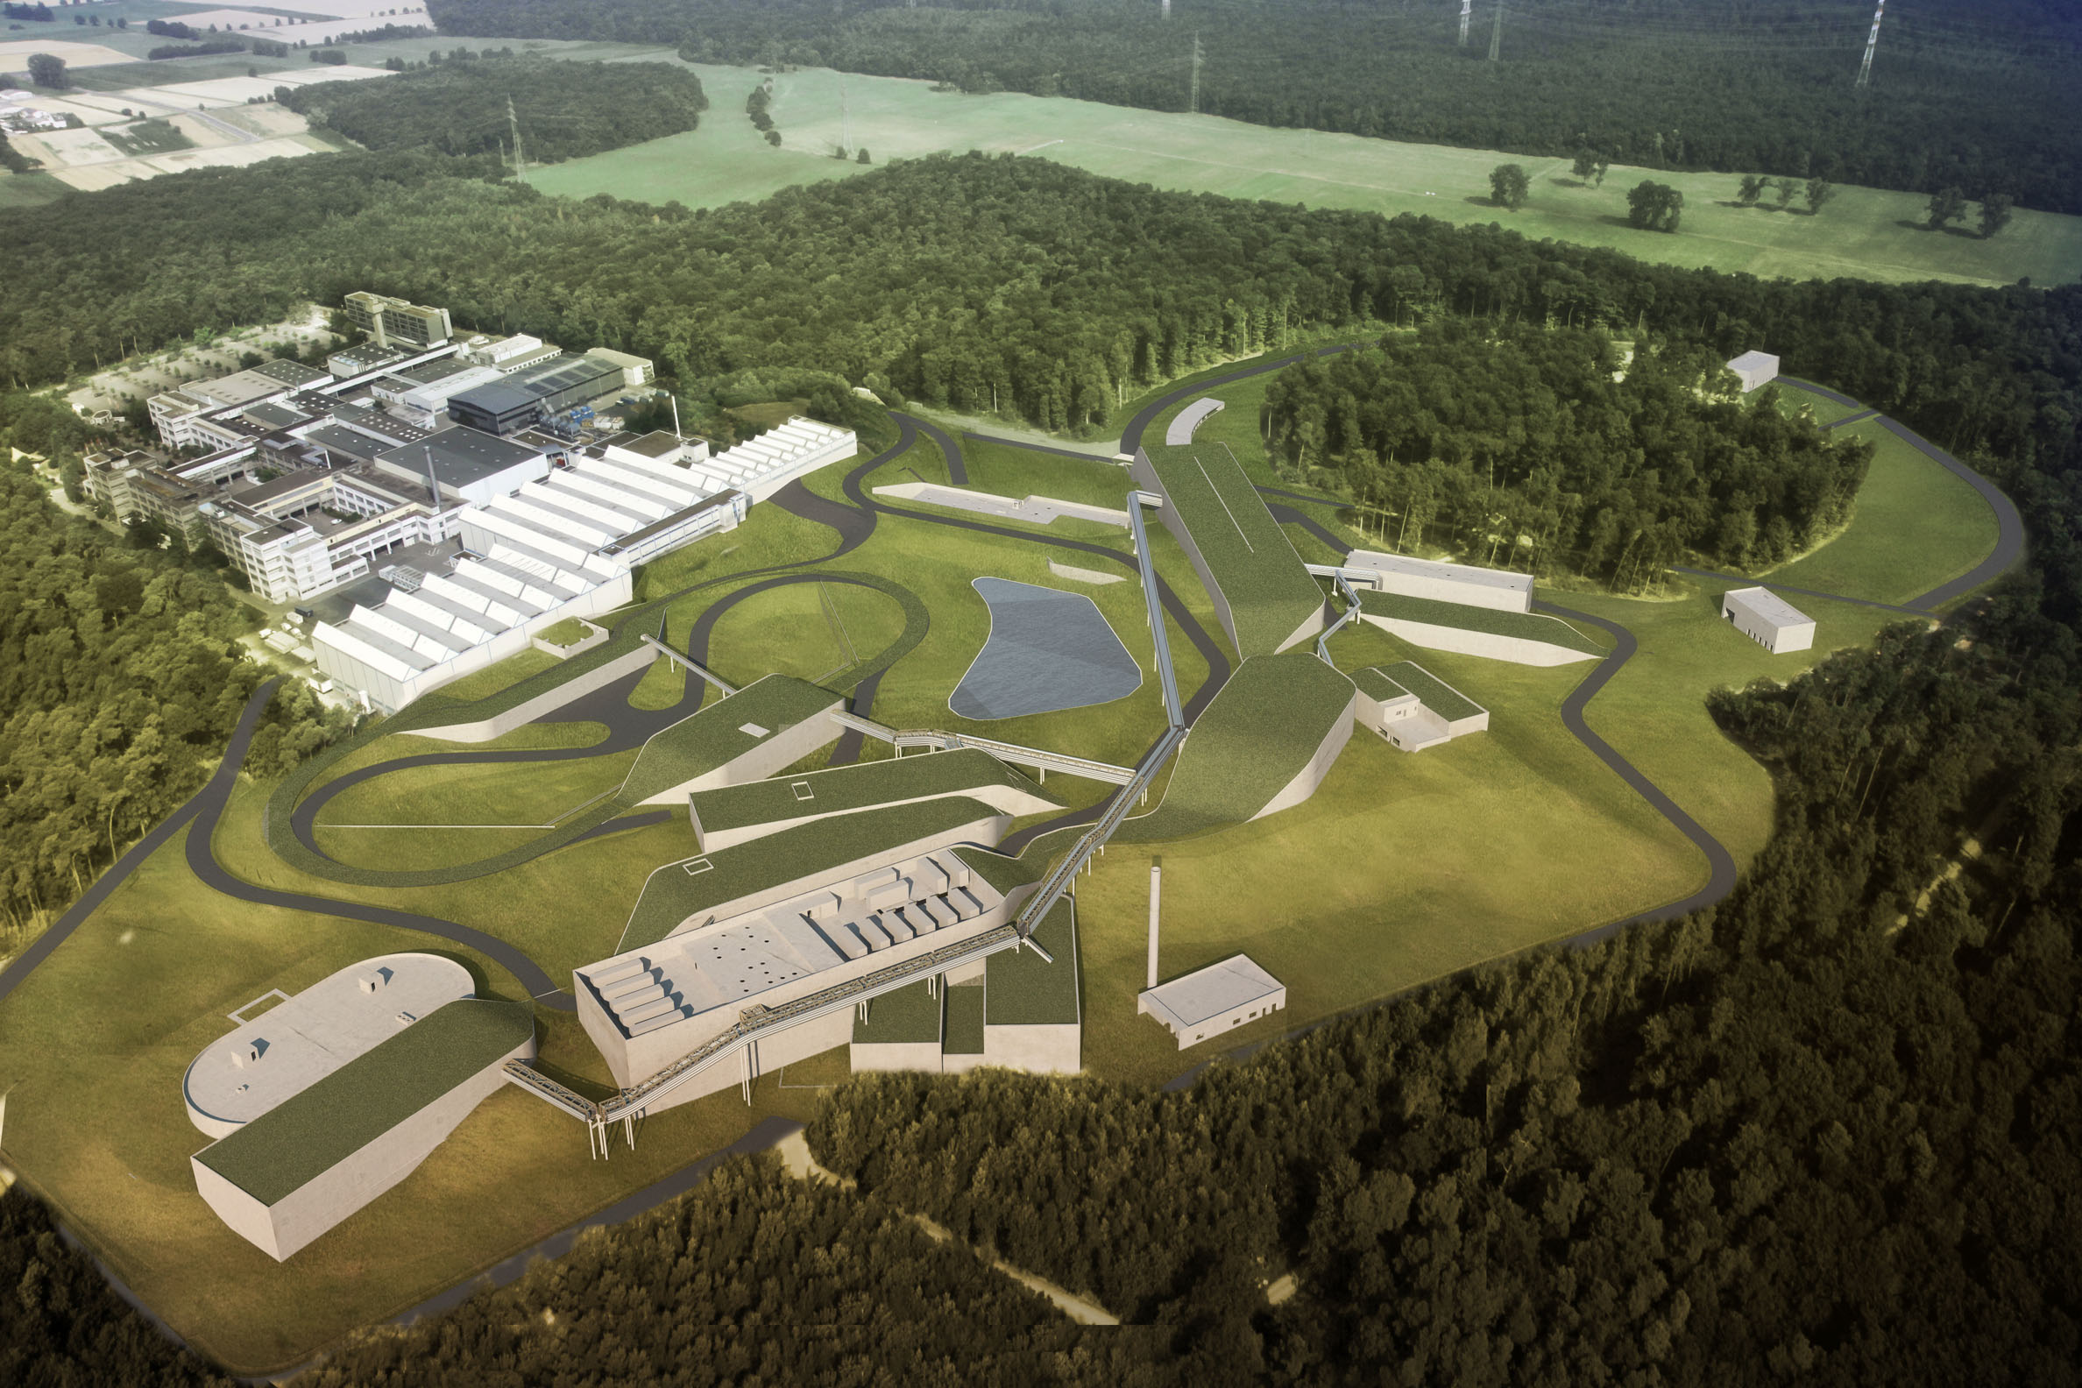









FAIR: Facility for Antiproton and Ion Research
– A World-Wide Unique Accelerator Facility
ESFRI Landmark
Top priority for European
Nuclear Physics Community
Driver for Innovation in Science and Technology
Finland
France
Germany
India
Poland
Romania
Russia
Slovenia
Sweden
UK
4

Slide 5
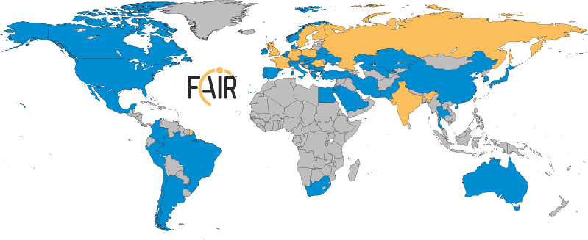
FAIR: International Cooperation
Realization and operation of FAIR in international cooperation
Nine international FAIR shareholders
Participation of 3.000 scientists from all continents

Slide 6
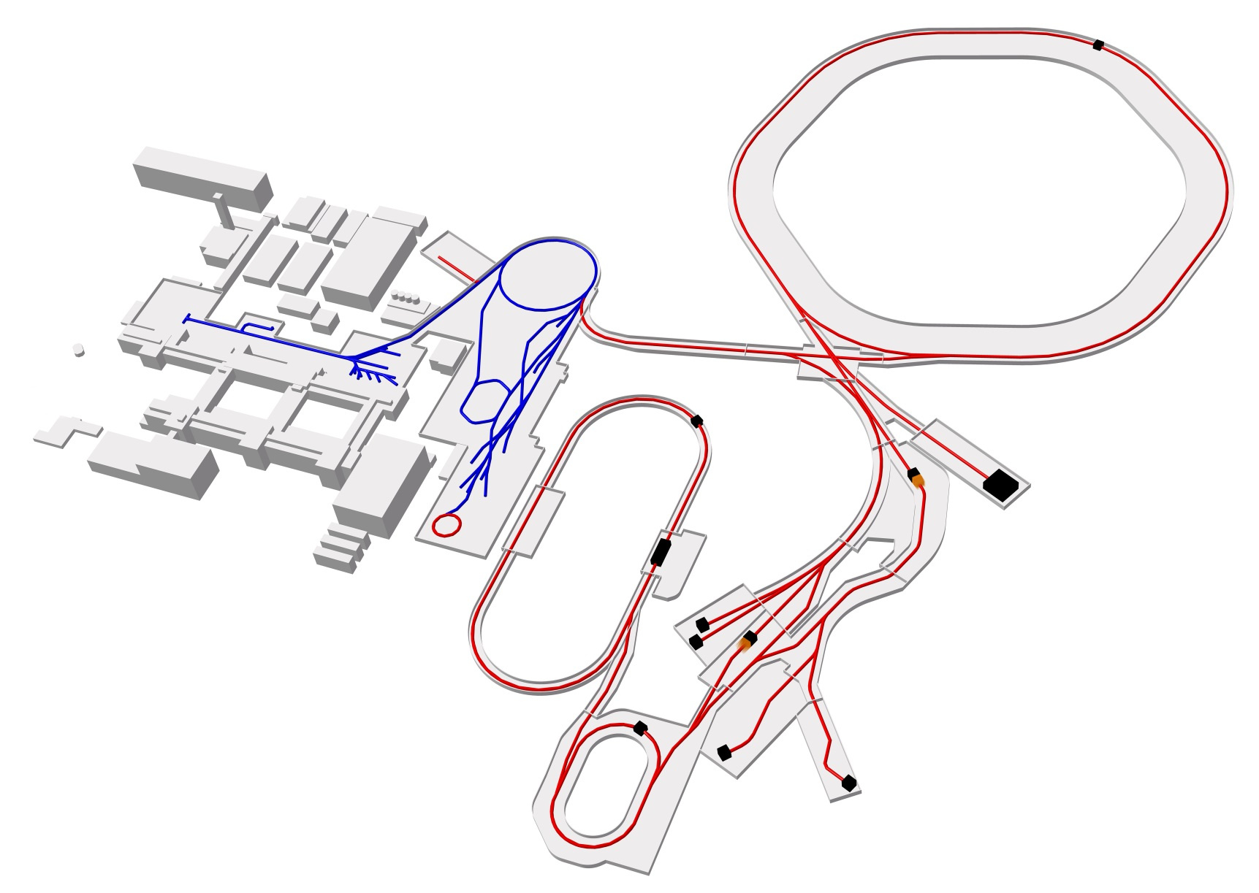
FAIR – The Facility
Ring accelerator
SIS18
Ring accelerator SIS100
Linear
accelerator
UNILAC
ESR
Production of new exotic nuclei
Antiproton
ring
HESR
Production of antiprotons
100 meters
CRYRING
“Gain factors” rel. to GSI
100 – 1000 x intensity
10 x energy
antiproton beams
system of storage cooler rings
Existing facility
Planned facility
Experiments
Collector
ring CR

Slide 7
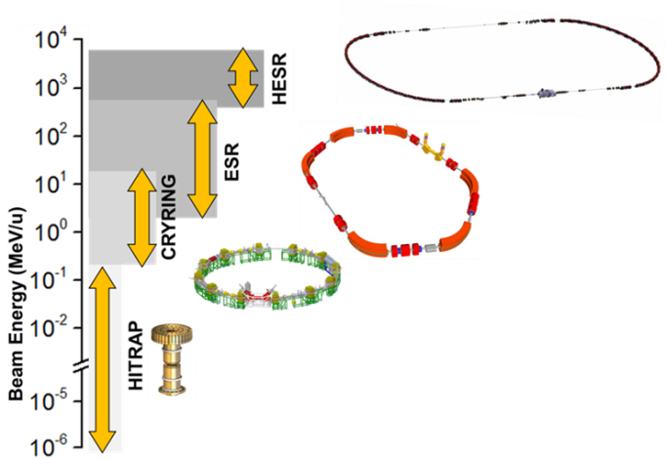
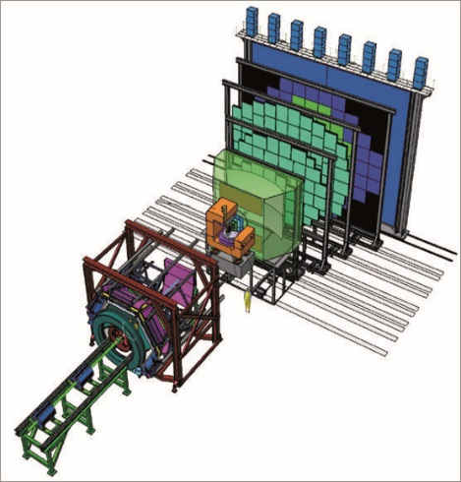
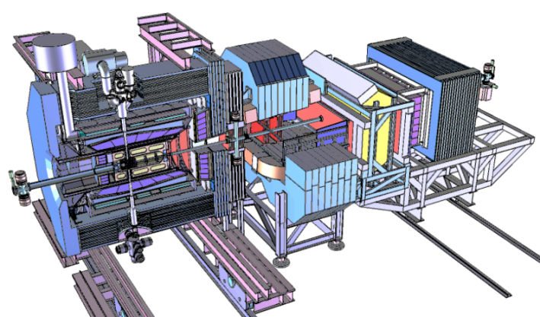
FAIR – four research pillars
SIS100
APPA
CBM
HESR
Production of antiprotons
NUSTAR
100 meters
Super-FRS
Existing facility
Planned facility
Experiments
PANDA

Slide 8
FAIR Research Pillars:
- a fore-front scientific program in many areas
Atomic Physics and Fundamental Symmetries,
Plasma Physics,
Materials Research,
Radiation Biology,
Cancer Therapy with Ion Beams / Space Research
Dense and Hot Nuclear Matter
Nuclear Structure and Reaction Studies
with nuclei far off stability,
Physics of Explosive Nucleosynthesis (r-process)
Hadron Structure & Dynamics
with cooled antiproton beams
APPA
CBM
NUSTAR
PANDA

Slide 9
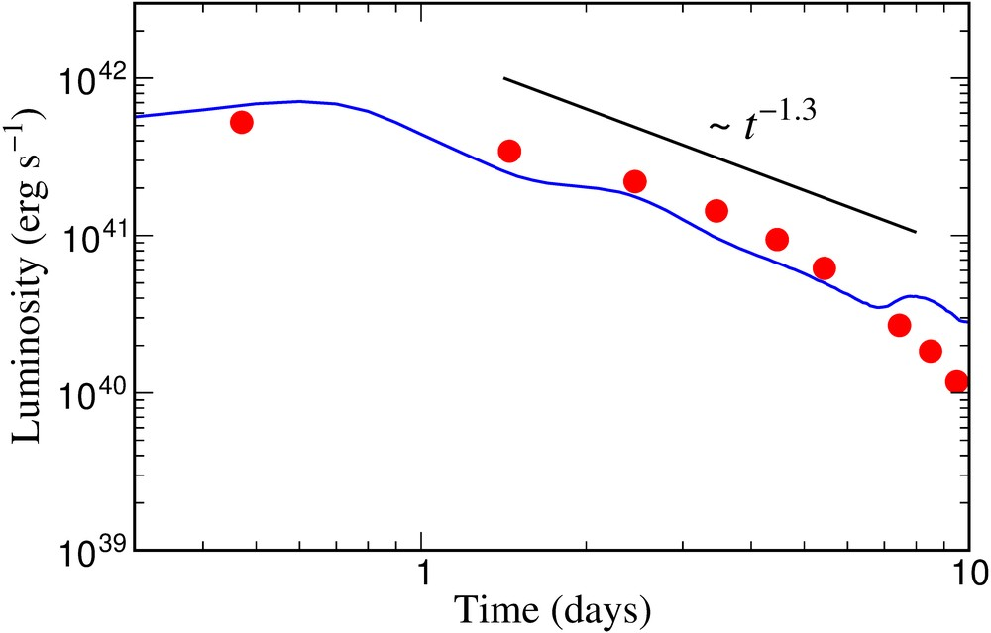
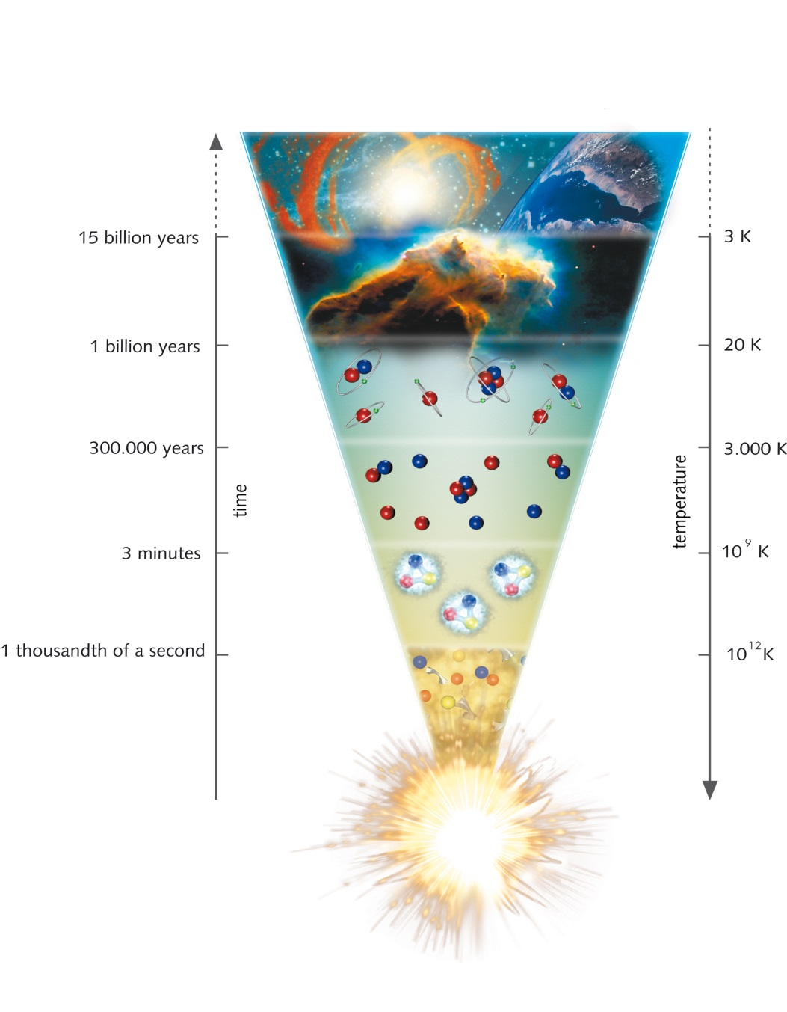
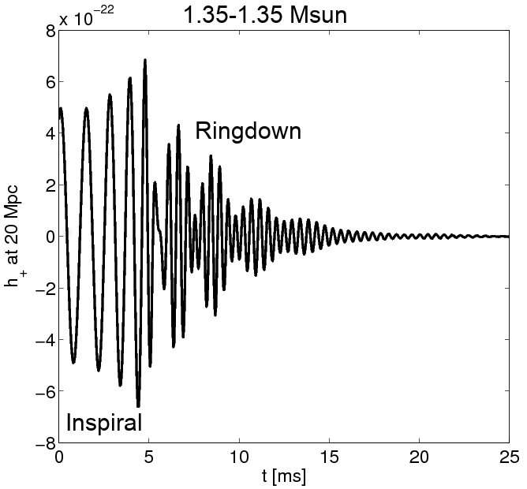
Further push of FAIR science motivation
… by multimessenger study of a neutron-star merger last summer combined with theory & simulations
Theoretical prediction by
GSI researchers (2010):
Neutron star mergers are the astrophysical site of the r-process producing the very heavy elements like Pt, Au and beyond,
thereby exhibiting a characteristic electromagnetic “Kilonova” signal.
Confirmation by Ligo, Virgo and other astronomer groups (2017)
via detection of both
gravitational and electromagnetic waves emerging from such an event.
FAIR was designed to study the properties of neutron star matter and to trace back the production paths of the heavy elements!
Metzger, Martinez-Pinedo, Arcones et al. (2010)
Cowperthwaite, et al. (2017)
Kilonova observations
Electromagnetic “Kilonova” Signal
Gravitational Wave Signal

Slide 10
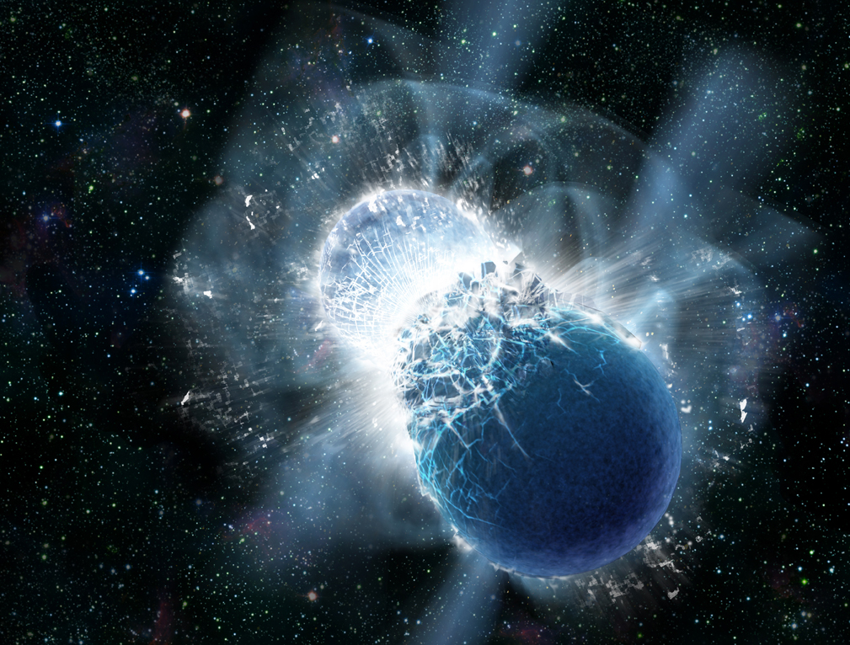
Neutron Star Mergers and FAIR research …
Neutron Star Mergers
FAIR Research Pillars
Copyright: Dana Berry, SkyWorks Digital, Inc
Equation of State (Hades, CBM)
Gravitational wave signal
Amount of ejecta
Baryon-Baryon interaction (PANDA)
Exotic neutron-rich nuclei (NUSTAR)
r-process nucleosynthesis and abundancies of the heaviest elements gold, platinum and beyond
Plasma and atomic opacities (APPA)
  Kilonova electromagnetic transient
The FAIR experiments offer unique opportunities for studying and solving these fundamental questions!
10

Slide 11
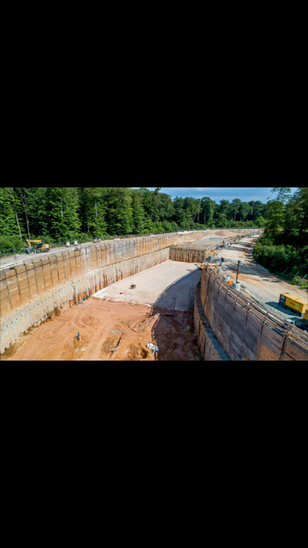
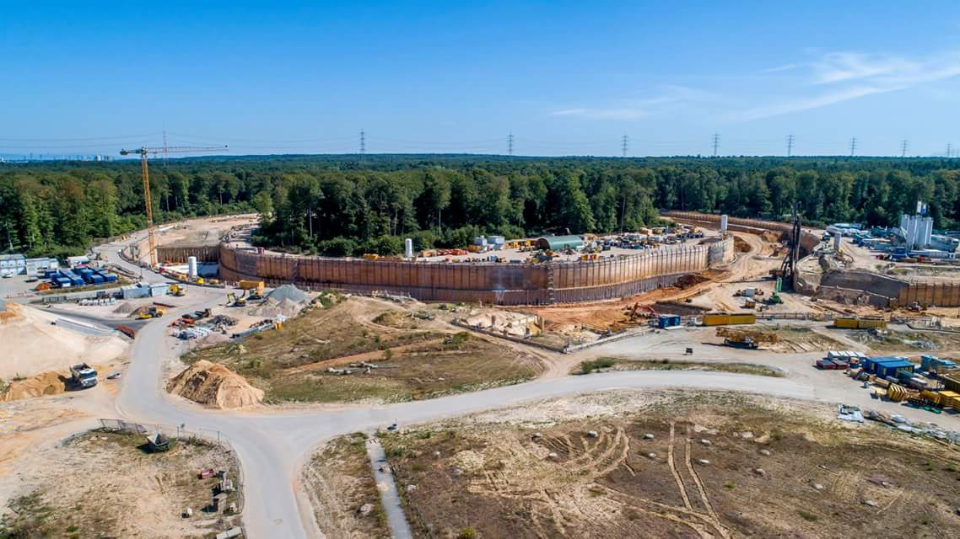
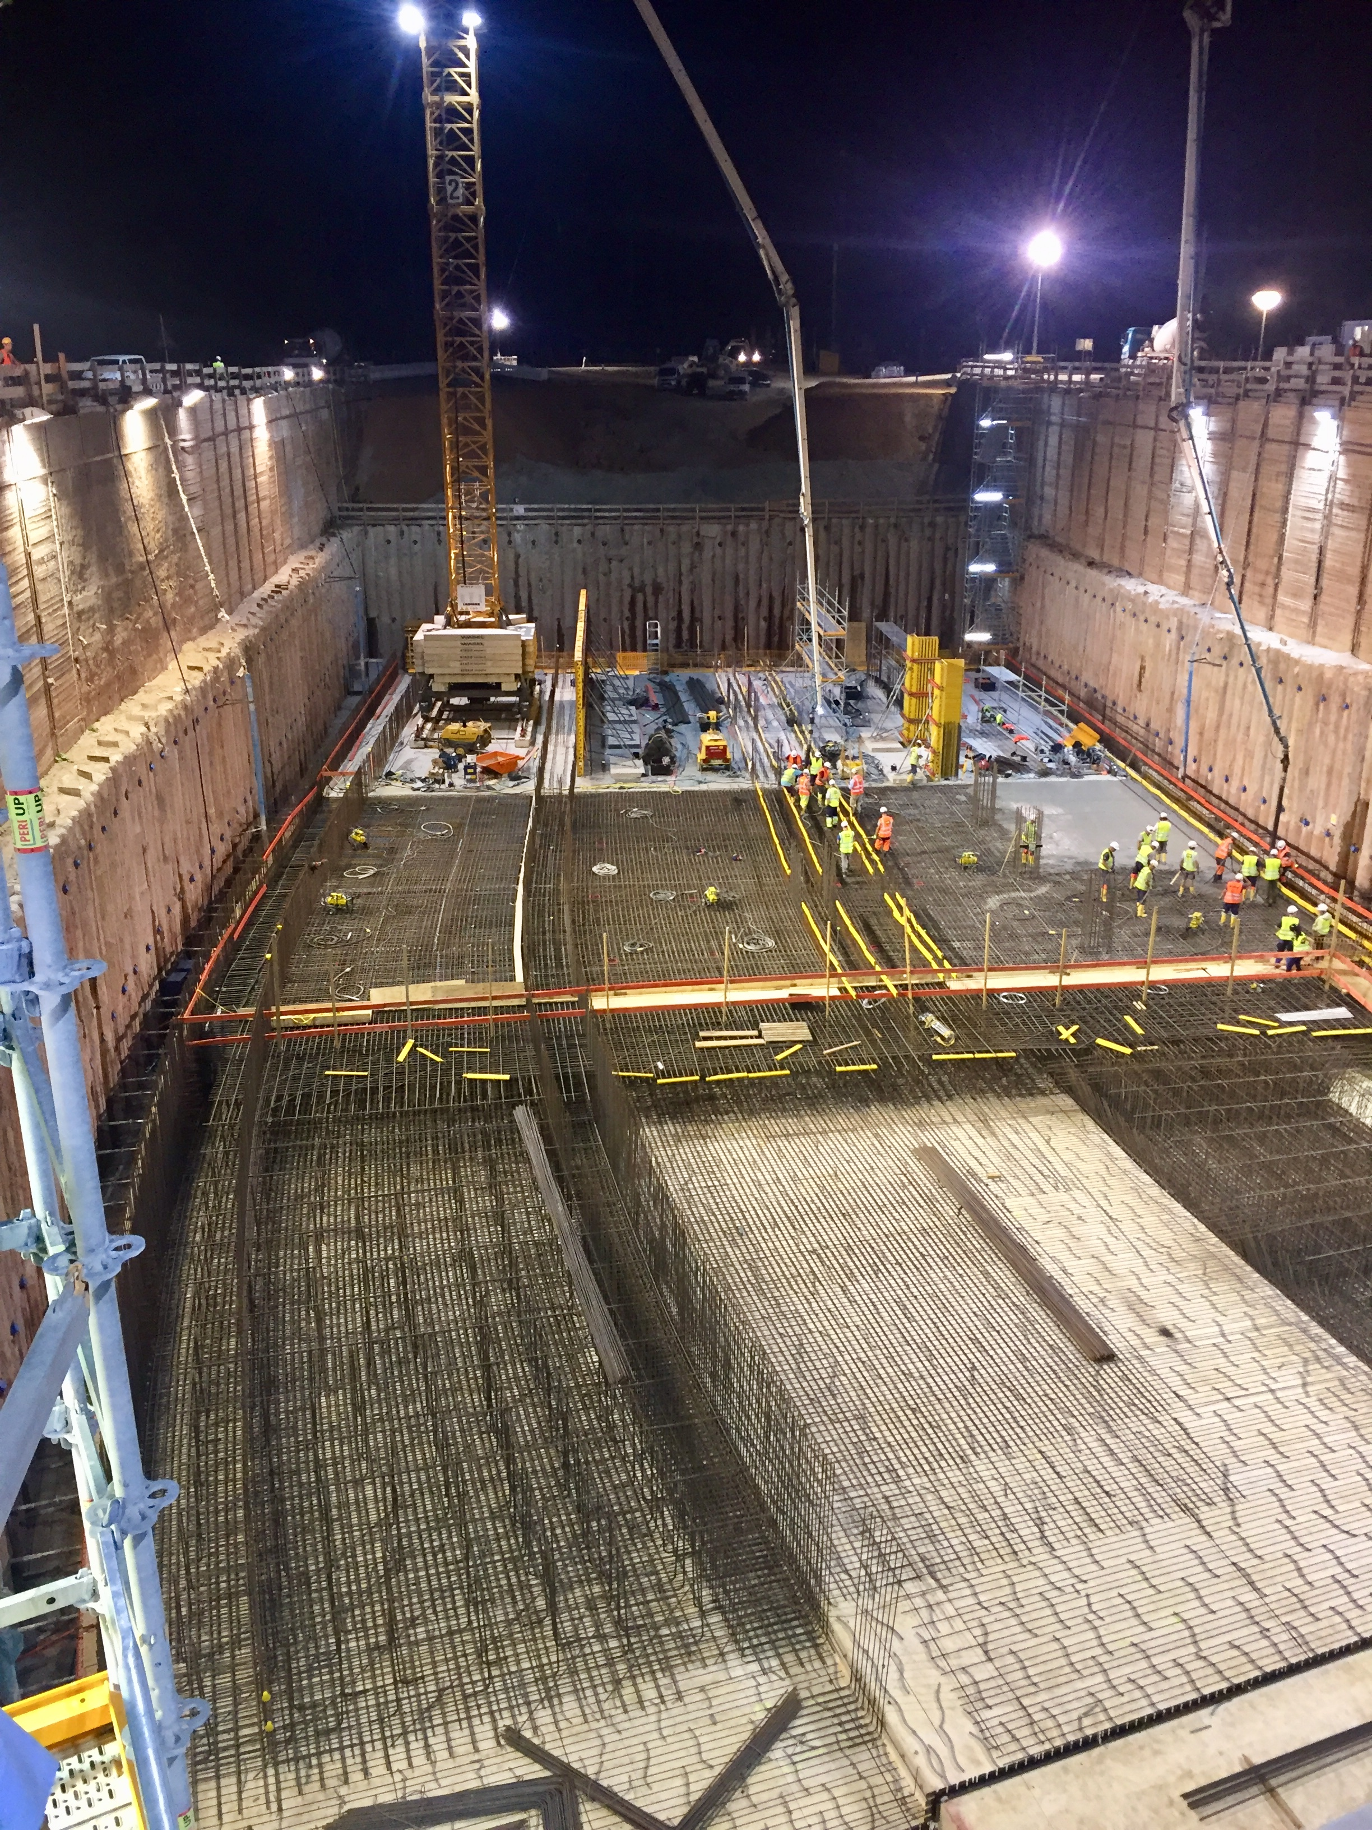
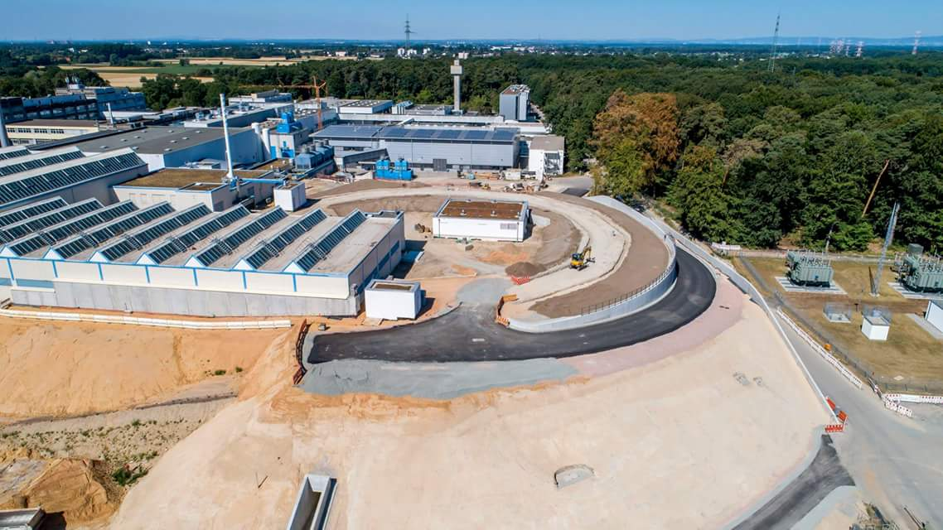
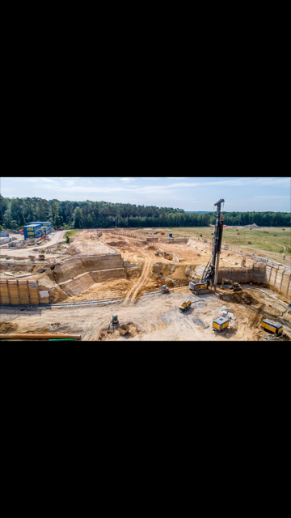
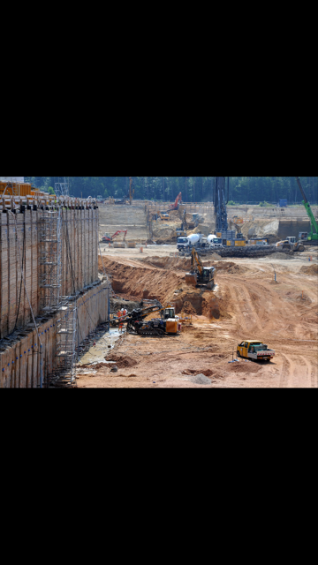
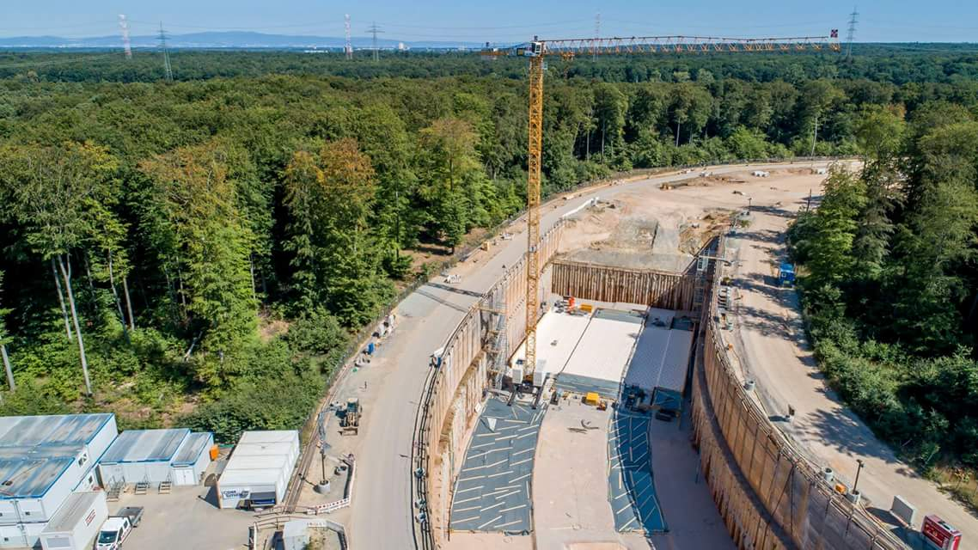
Status of FAIR: Civil Construction rapid progress since official start on 4th of July 2017
Excavation SIS100 tunnel
Upgraded SIS18 completed ready for FAIR and FAIR phase 0
Excavation transfer building & CBM cave
Start of concrete shell works for SIS100

Slide 12
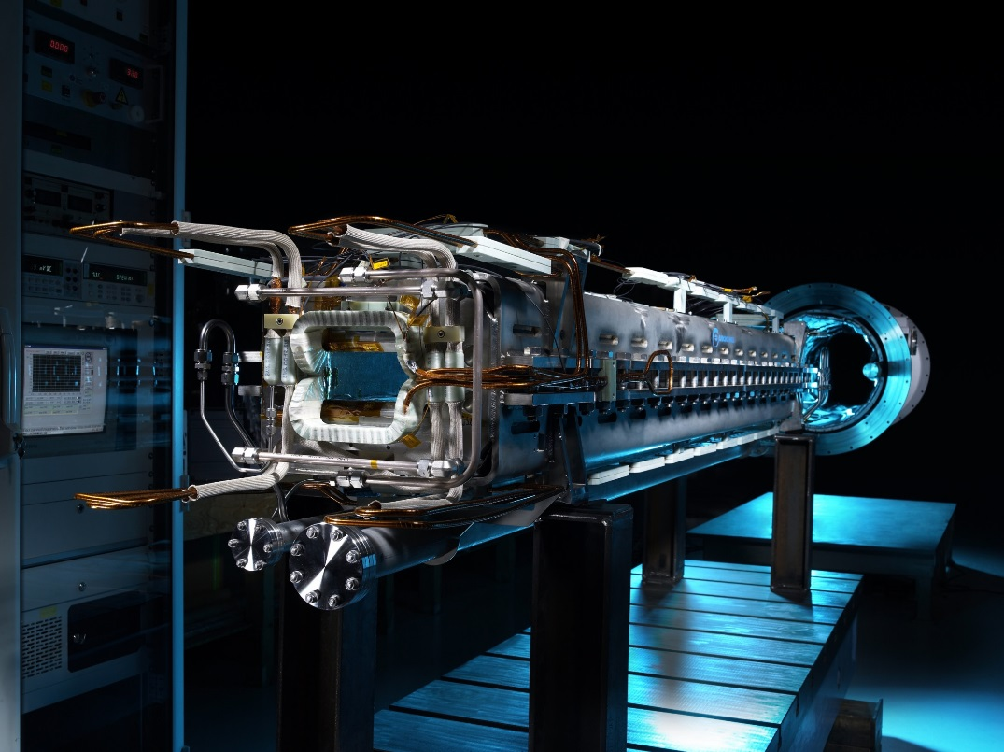
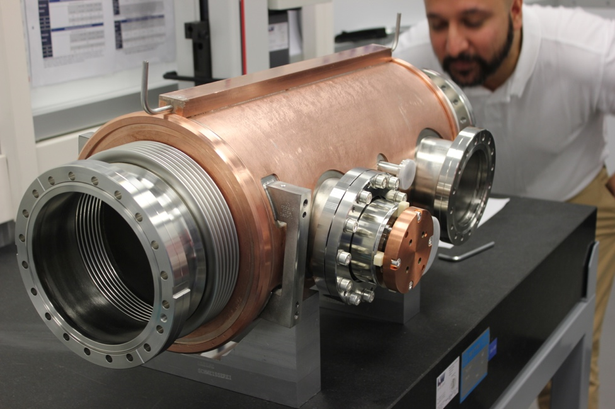
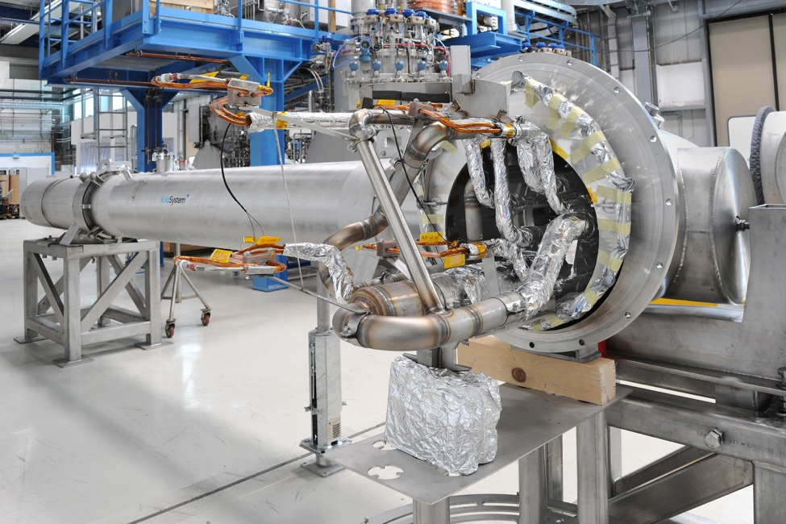
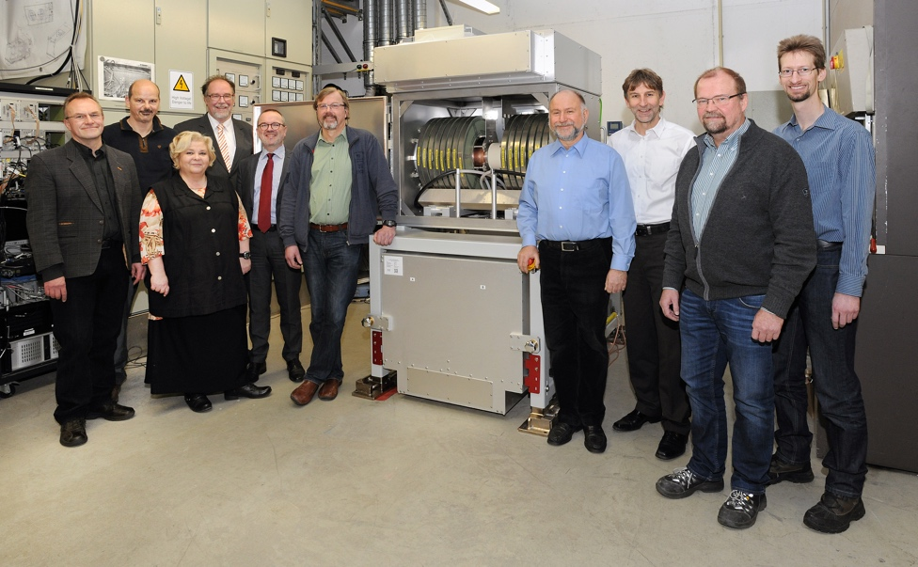
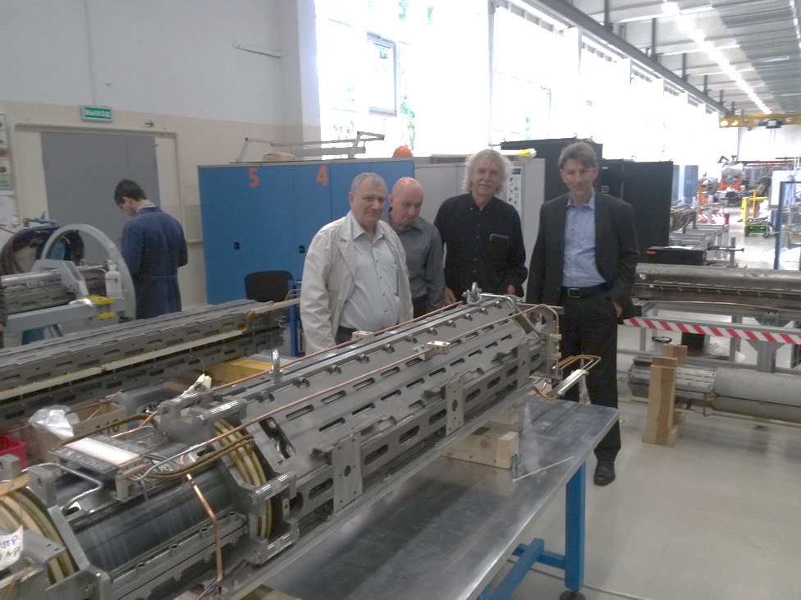
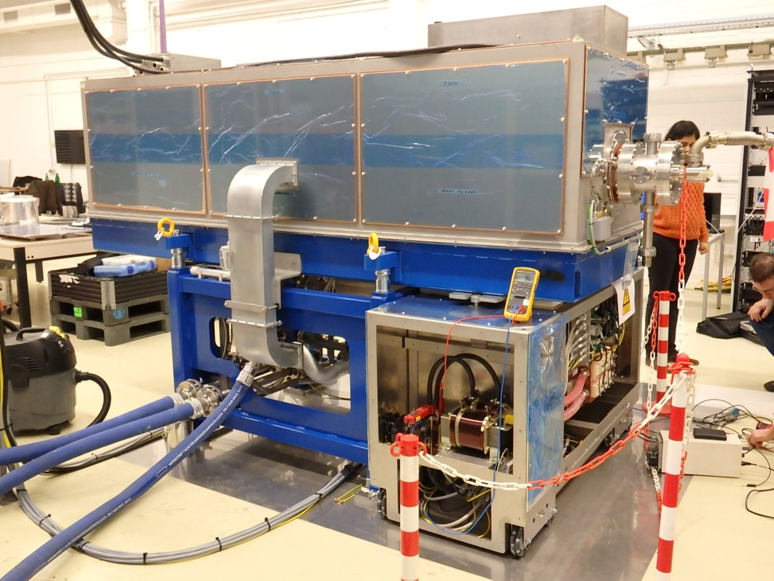
Status of FAIR: accelerators: construction / procurement progresses well
Serial production for major components for SIS 100 is progressing
with one quarter of the dipole magnets already manufactured.
SIS100 Dipole Magnets
Cryo Catcher
Cryo-Bypass Line
Bunch Compressor
Quadrupole Unit
RF Cavity System

Slide 13
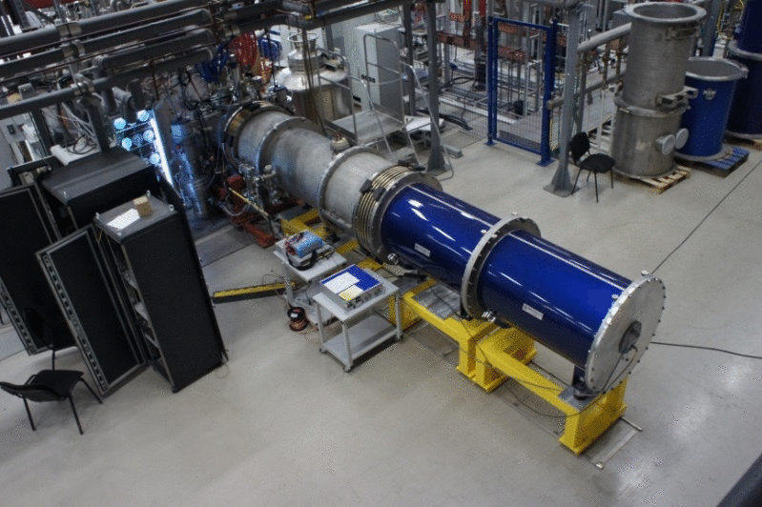
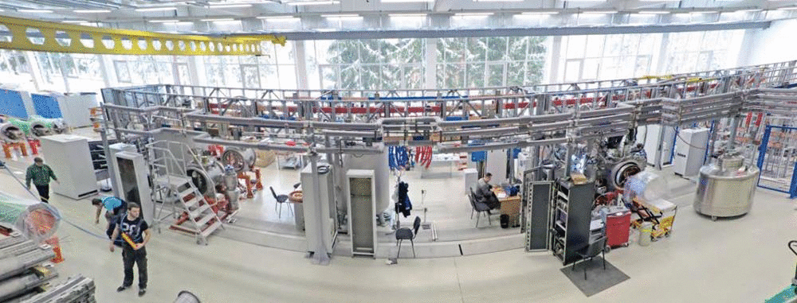
First of Series of SIS100 Quadrupole Magnets successfully cold-tested at JINR…
SIS100 quadrupole unit mounted in the test cryostat (blue) at JINR, Dubna
Cold-Test Facility at JINR, Dubna

Slide 14
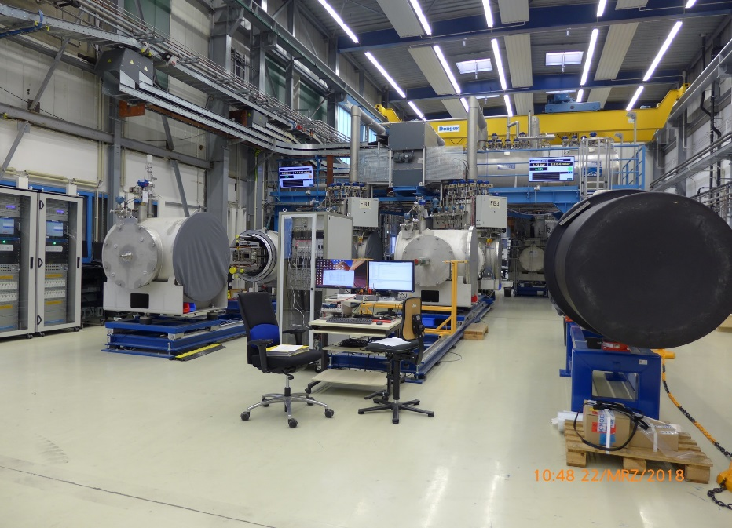
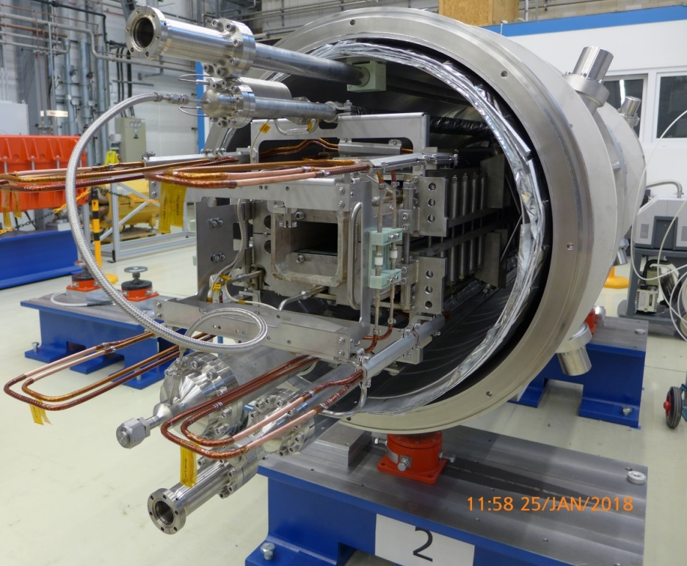
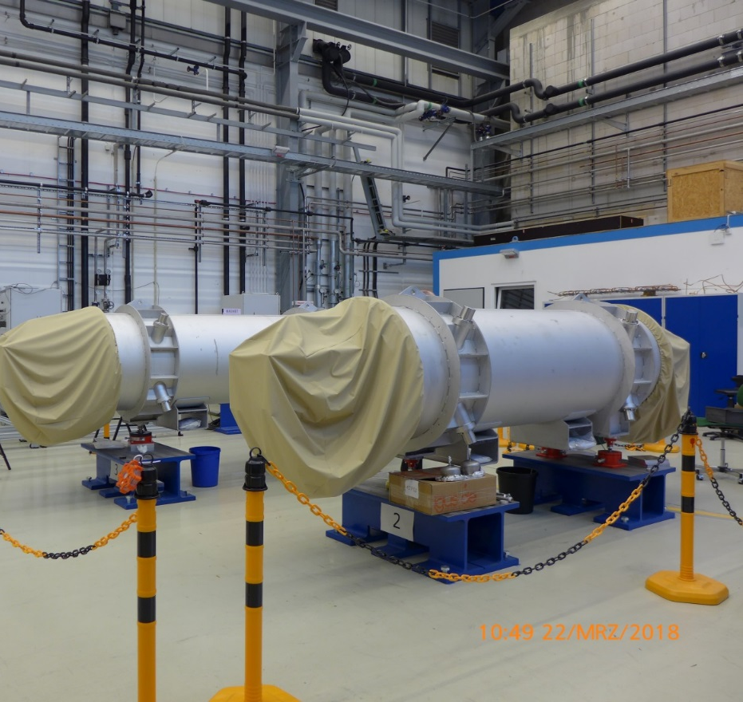
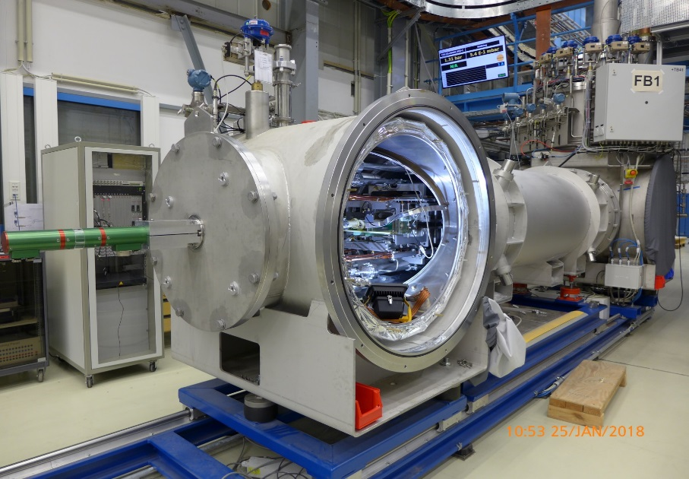
24 SIS100 (of 120) dipole magnets have been delivered and are being cold-tested …

Slide 15
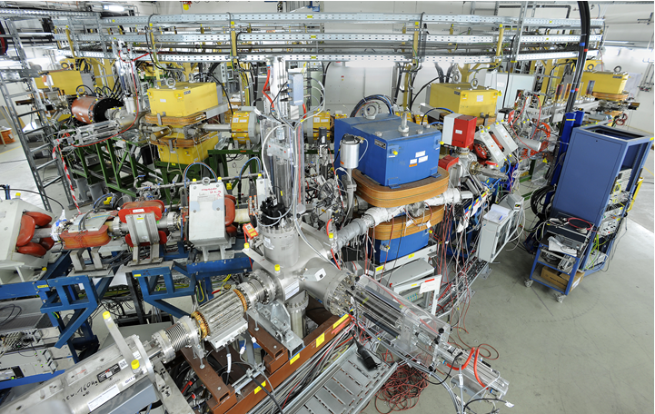
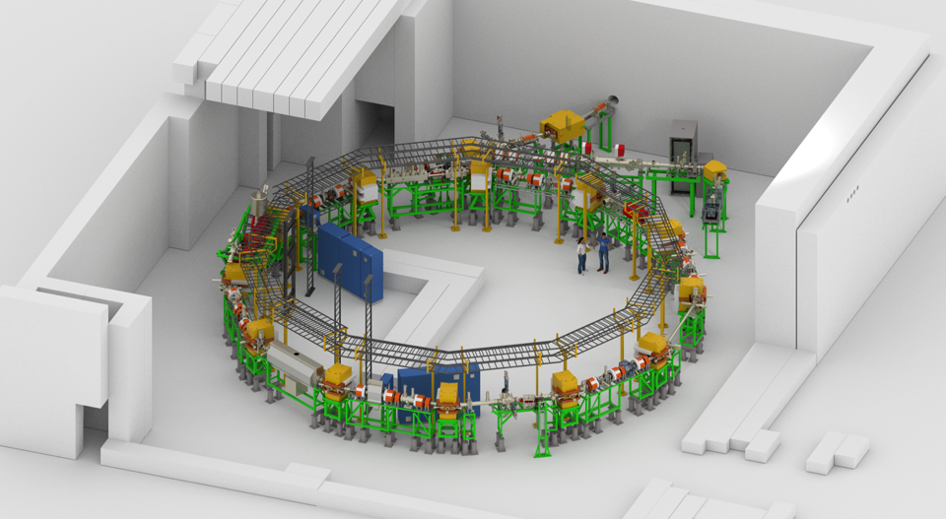
New CRYRING@GSI/FAIR
ready for experiments and tests
View from local injector to the ring

Slide 16
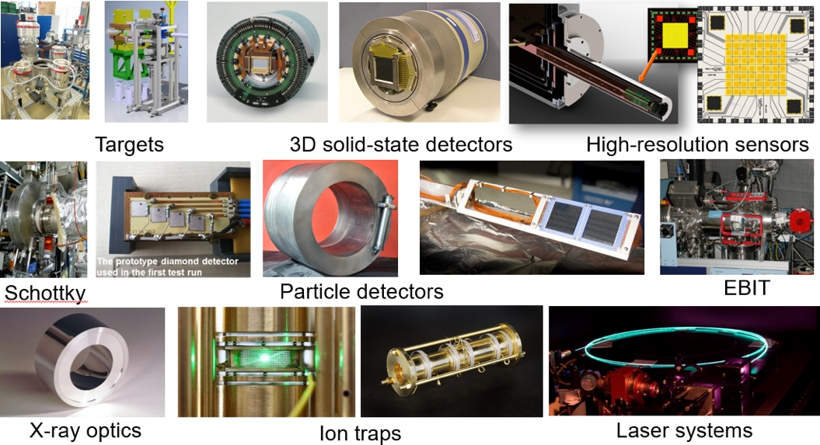
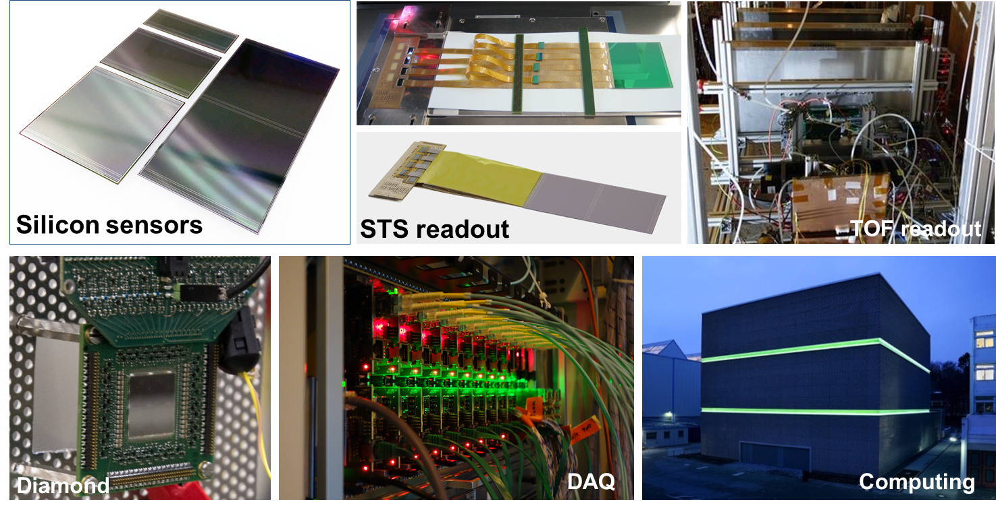
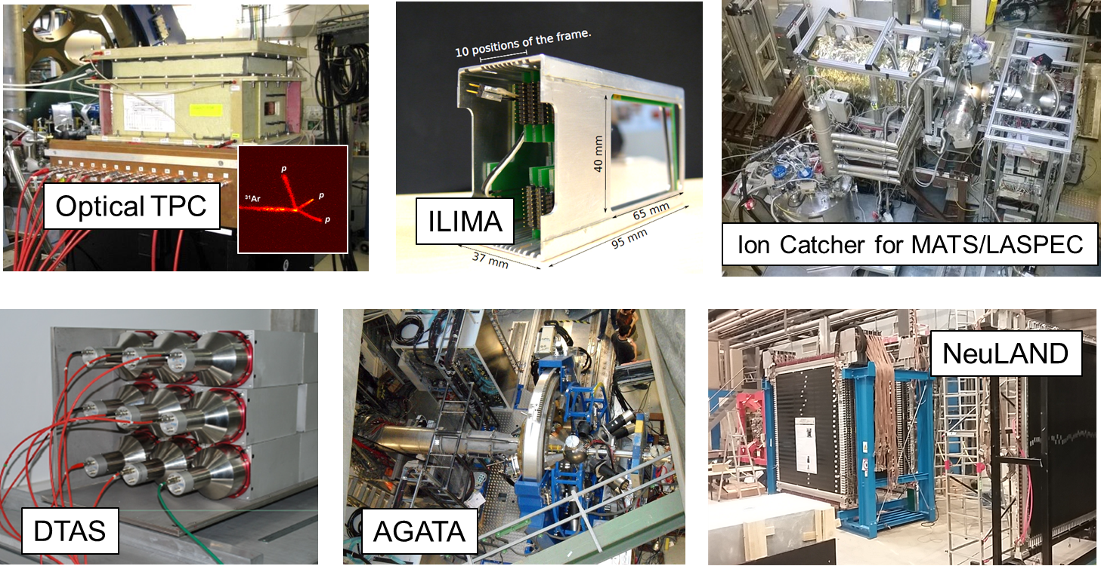
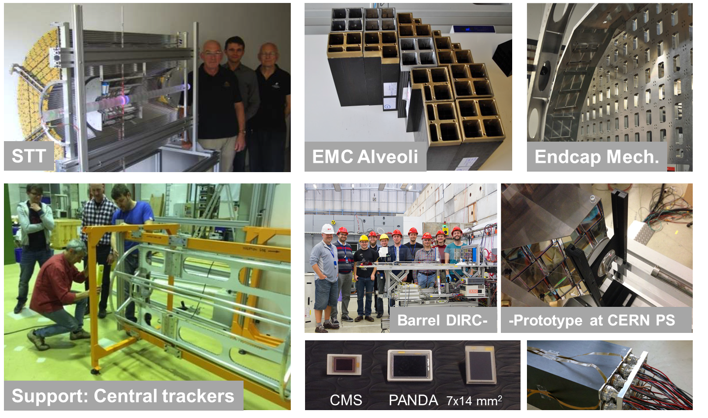
Status of FAIR: experiments detector R&D and construction well on track …
A
P
P
A
C
B
M
N
U
S
T
A
R
P
A
N
D
A
MUCH
TRD
16

Slide 17
Schedule for Realizing FAIR
Working towards the completion of FAIR by 2025
Major thrust is on construction of FAIR accelerators and experiments
But at the same time we pursue a staged approach to FAIR science and to the progressive commissioning of accelerators and detectors:
  FAIR phase 0 : start in 2018/2019
  FAIR day 1/ phase 1 with FAIR accelerators progressively approaching design parameters
  Full FAIR operation

Slide 18
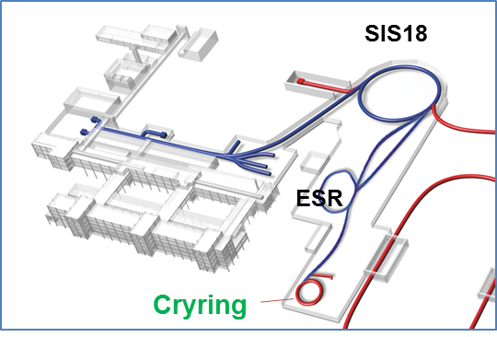
FAIR Phase-0 intermediate research program
Objectives:
  Commissioning of accelerators and detectors
  Forefront research by employing
  and testing new FAIR detectors
  Exploiting upgraded GSI
  accelerator facilities incl. the
  newly installed CRYRING
  Education of young scientists
  Maintain and extend skills and
  expertise
  Serve national and international
  user community
requires careful techn. preparation:
  full re-commissioning of the
  UNILAC/SIS18/ESR complex
  incl. new controls
  gradual implementation

Slide 19
Scientific Steps towards implementing FAIR Phase-0
  Scientific programme and beam parameters defined, taking into account scientific and technical priorities of the FAIR Collaborations
  110 days of beam time in 2018 planned,
  similar amount of beam time envisaged for 2019
  ‘Call for Proposals’ opened 2017
  Nearly 150 submitted experiment proposals by well over 1000 scientists “overbook” available beam time by a factor of 2-3
  High-profile international Program Advisory Committees, Overall PAC chaired by Prof. Sydney Galès evaluated proposals (G-PAC meeting held on 19.-21. Sept. 2017)

Slide 20
Evaluation of proposals for
first FAIR Phase-0 Campaign 2018/19
Results G-PAC (overall):
beamtime recommendations in 8 h-shifts
Total
requested
Total
recommended
Total
recomm. plus “flexible reserve”

Slide 22
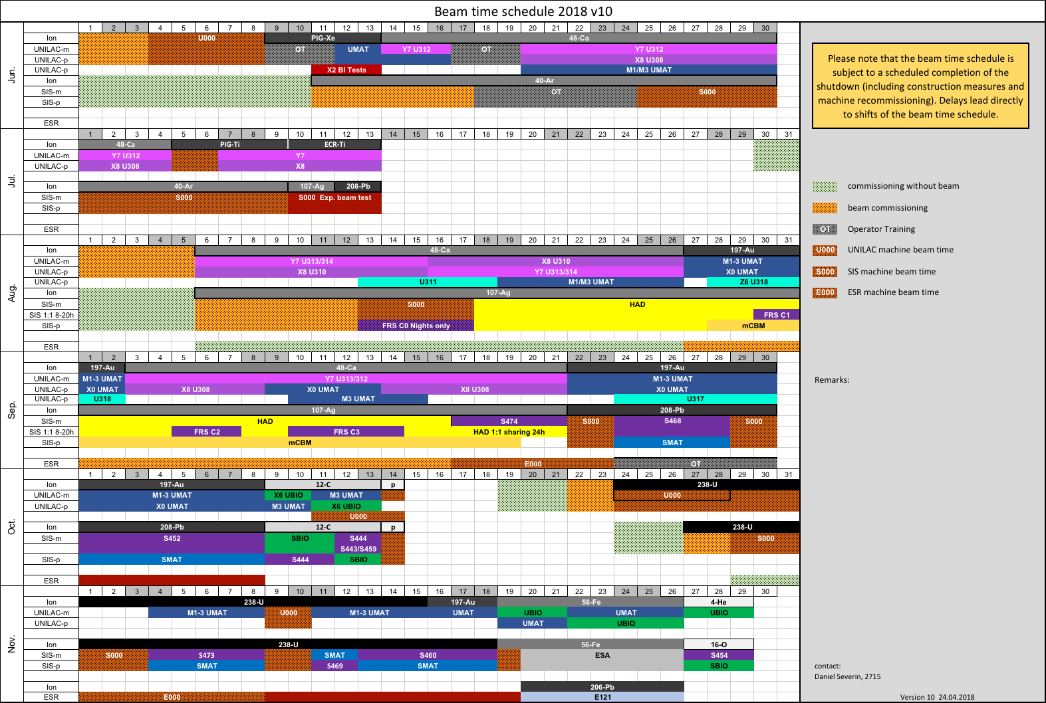
Beam time schedule foreseen for 2018

Slide 23


Accident: ER1 fire and RF ventilation contamination
Fire in the ER1 transformer
Power-off in the entire rf gallery
Separation of the ER1 system
  No single gap resonators
Cleaning of all amplifiers AND all transformers
  No rf operation until mid. Oct.
→ No more physics beam time 2018
images: B. Schlitt

Slide 24



Main other challenges of the machine
RFQ
Limited amplitude causes limitation of m/q
Very heavy ions: No high intensity yet
New control system
FAIR control system not completed
Complex operating
ESR not in operation
Still a lot commissioning needed
Limited parallel operation
images: P. Gerhard

Slide 25
New Plan
Following the interruption of the physics run due to the accident and the resulting extended downtime, new plans had to be developed. After a careful analysis of the damage and the situation, the machine operation strategy is to shift the two data taking periods foreseen for fall 2018 and fall 2019 by a few months. They now will be performed in early 2019 and early 2020 respectively, and commissioning time has been added for the accelerators in order to address some of the technical issues in an optimised way.

Slide 26
New Plan: Goals and boundary conditions
Engineering run: Nov. 2018 – Dec. 2018
  Goal: to establish basic operation conditions that are required for the Physics program in 2019
  boundary conditions:
    limited capabilities of new FAIR controls
      Not yet comprehensive tools including up to date lattice layouts for beamline tuning
      no storage mode capabilities available for comprehensive ESR commissioning
Physics run: March 2019 – April 2019
  Goal: to provide reliable operation for the scheduled Physics programs
  boundary conditions
    limited choice of heavy ions due to HSI RFQ technical limitation
    No single gap resonators at the end of post striper
    No parallel operation in planning to ensure reliability
Engineering run: Nov. 2019 – Dec. 2019
  Goal: 1) to establish ESR storage mode 2) to establish deceleration in ESR 3) to complete the comissioning of CRYRING with ESR beam
  newly introduced FAIR controls for ESR must allow storage mode
    Expect to be available for commissioning no earlier than Sept. 2019

Slide 27

Engineering run
Main focus of the engineering run
establilsh slow extraction beam to HADES
start ESR commission controls
FRS commissioning, mCBM detector setup

Slide 28

Engineering run
Planned shutdown major activities
UNILAC HSI RFQ new electrodes
  in progress. Expect installation ~mid 2019
UNILAC UHV upgrade: full scale: 8 month
TGA fire protection renovation

Slide 29

FAIR 2025
Thank You!

