Slide 1
High voltage fast semiconductor switch (HVFSS)
Main purpose of HVFSS
Purpose: To reduce beam impidance while cavity is not used. It is made by discharging cavity gap voltage.
Main task.
Provide higher durability
Provide better stability
Expected result:
Replace with HVFSS slow Si semiconductor switches
Contents:
Requirements for HVFSS
Basic schematic and working principals
Comparison of existing MOSFETs and a switch which are used right now
Three main challenges
Measurements for a WP0 and WP1
Working plan
Expected results for a WP0 and WP1

Slide 2
Requirements for the switch
Parameter | Value
Impulse current | 150 A_{peak}
Duration of one pulse | 30 ns
Duration between pulses | 30 ms
OFF-capacitance | ≤100 pF
ON-impedance | ≤5 Ohm
Radiation capability | +
EMV sustainability | +
Turn OFF and turn ON time | 10 us
Off state blocking voltage | ±25 kV; 50 kV p-p

Slide 3
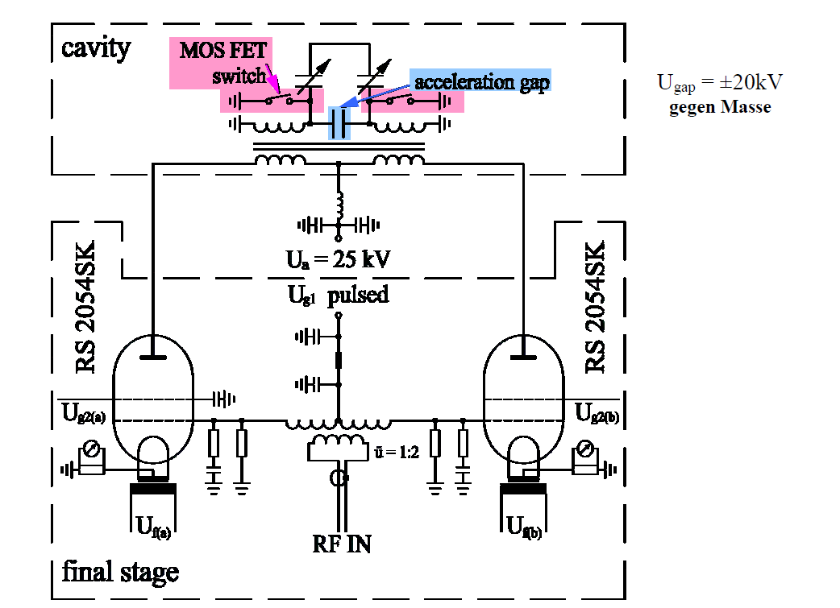
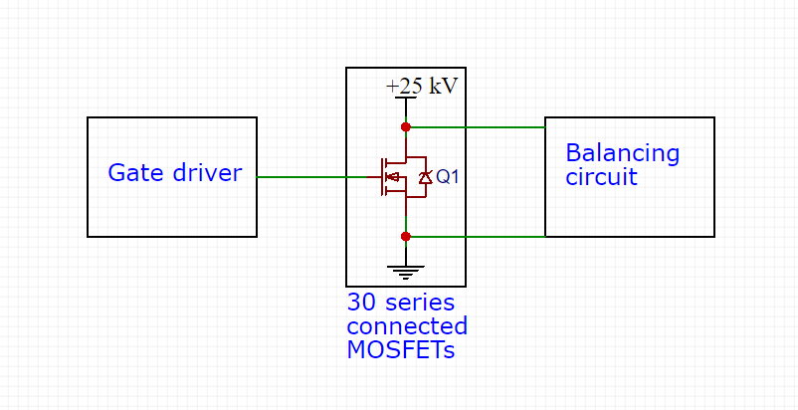
Schematic for the bunch compressor and cavity
Working principle of the switch

Slide 4
First comparison of existing WBG semiconductor devices
MOSFET/Parameter | SiC C2M0025120D Cree | SiC SCT50N120 ST | SiC SCT50N120 Rohm semiconductor | GaN Half Bridge 1200V VM40HB120D Visic Technologies | Behlke HTS 301 Semiconductor switch(for comparison)
Drain-Source voltage (V) | 1200 | 1200 | 1200 | 1200 | 30000
Drain current (const) (A) | 90(25°C), 60(100°C) | 65(25°C), 50(100°C) | 68(25°C), ?(100°C) | 80(25°C), 58(100°C) | 1.52
Drain current (pulse) (A) | 250 | 130 | 160 | 180 | 30
Gate Threshold Voltage (V) | 2.0 – 4.0 | 1.8 – 3.0 | 1.6 – 4.0 | 5 | 5
Drain-Source On-State Resistance (mΩ) | 25 – 34 (43 - 150°C) | 52 – 69 (59 - 150°C) | 45 – 56 (70 - 125°C) | 44 (88 - 150°C) | 185000
Output Capacitance (pF) | 220 | 170 | 137 | 140 | -
Turn-On Delay Time (ns) | 14 (800 V 50 A) | Ntc | 33 (400 V 18 A) | 7.5 (800 V 32 A) | 100
Rise Time (ns) | 32 (800 V 50 A) | Ntc | 42 (400 V 18 A) | 10 (800 V 32 A) | 20
Turn-Off Delay Time (ns) | 29 (800 V 50 A) | Ntc | 94 (400 V 18 A) | 36 (800 V 32 A) | 500
Fall Time (ns) | 28 (800 V 50 A) | Ntc | 28 (400 V 18 A) | 4 (800 V 32 A) | 10
Gate-source leakage current (nA) | 600 | 100 | 100 | 3-5 | -
Drain source leakage current (uA) | 2-100 | 1-100 | 1-10 | 300-700 | 5
Assuming parameters in datasheet are true, there are two devices suitable for this application.
First is SiC MOSFET produced by CREE and the second is GaN half bridge developed by Visic Technologies.

Slide 5
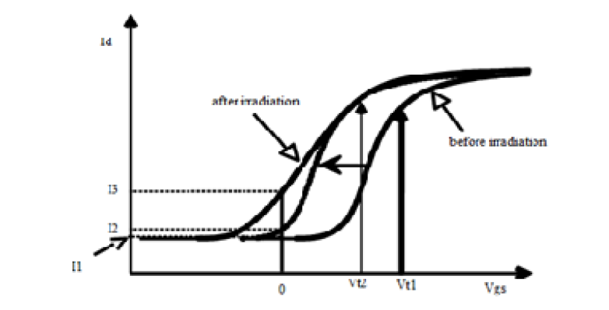
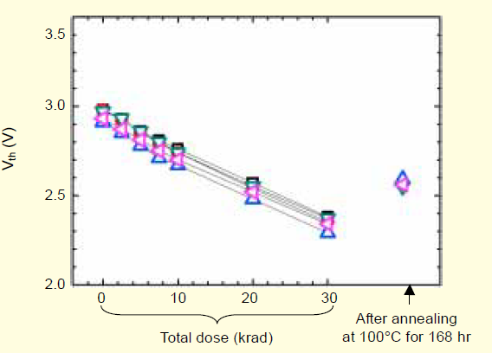
The first challenge: Radiation
Increase of the sub-threshold current in a
n-channel transistor given by a decrease in the
threshold voltage and in the sub -threshold slope[3]
Threshold voltage characteristics of a MOSFET (100 V)
under a dose rate of 4.97 rad/s.[4]

Slide 6
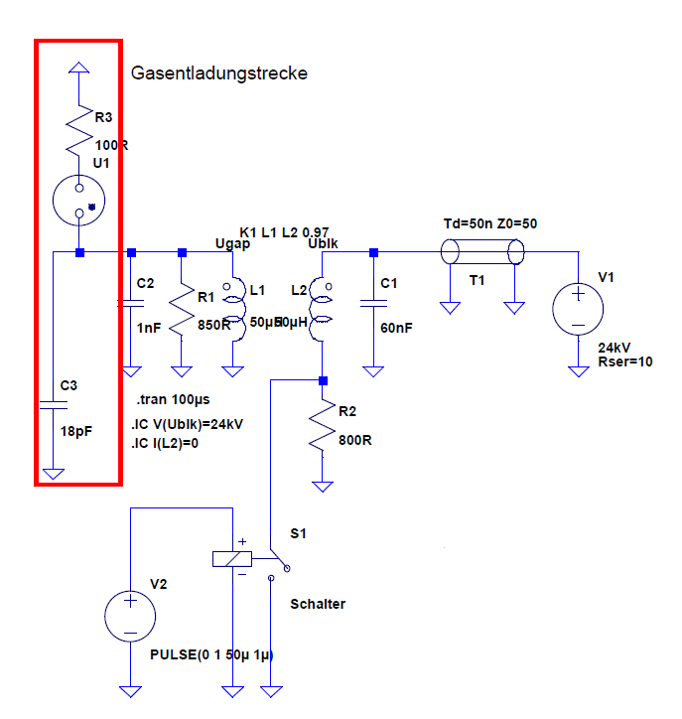
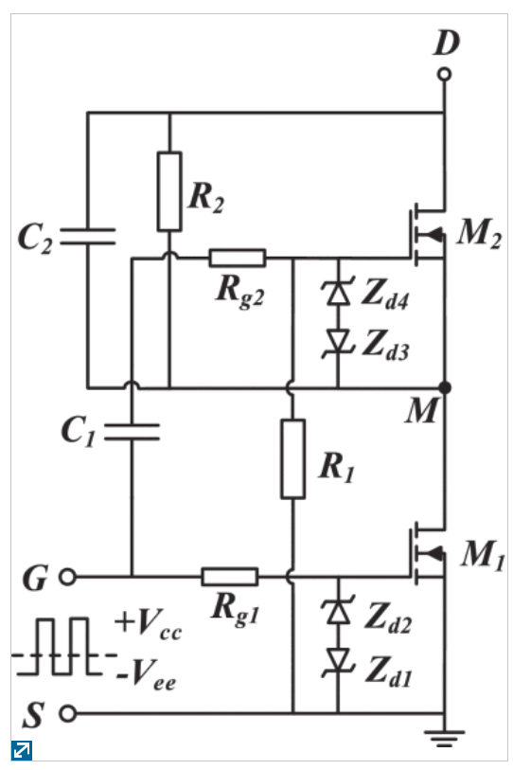
The second and third challenges: Impact of the LCR parameters of the circuit and drain-source voltage balancing.
Voltage balancing and impact of LCR parameters of the controlled circuit.
Proposed series-connected SiC MOSFET topology. [2]
This image is an example of voltage balancing in DC-chopper.
Lumped circuit analogy and SPICE model of resonant cavity

Slide 7
Measurements and needed data for development process
WP0 Data accumulation:
- LCR parameters of the circuit
- Voltage characteristics
- Operating frequency
- Resonant frequency
WP1 Endurance test
- Threshold voltage degradation over time
- Break down voltage decrease over time
- Leakage current
- Drain current
- Radiation

Slide 8
Working plan
WP0 – Yellow, WP1 – Green, WP2 – Red, WP3 - violet

Slide 9
Conclusion and expecting results for WP0 and WP1
WP0 results:
Math model for RF cavity
Assumption for a MOSFET parameters based on math model
Measured data
Choice of the existing MOSFET
WP1 results:
Schematic and PCB for a Endurance test stand
Stand must consist of Si MOSFET and SiC MOSFET, to compare their characteristics and breakdown voltages
Functional stand for endurance test
Test data from TU Darmstadt
Test data from GSI

Slide 10
Used sources
1) Unit 4 - Lecture 9 RF-accelerators: RF-cavities
William A. Barletta Director, United States Particle Accelerator School Dept. of Physics, MIT
2) IEEE Transactions on Industrial Electronics ( Volume: 64, Issue: 10, Oct. 2017 ), A Compact Gate Control and Voltage-Balancing Circuit for Series-Connected SiC MOSFETs and Its Application in a DC Breaker, Yu Ren; Xu Yang; Fan Zhang; Kangping Wang; Wenjie Chen; Laili Wang; Yunqing Pei.
3) International Journal of Advanced Research in Computer Science and Software Engineering, Radiation Effect on MOSFET at Deep Submicron Technology, Nisha, Rekha Yadav Department of Electronics and Communication Eng.
4) ETRI Journal, Volume 27, Number 4, August 2005, Radiation Effects on the Power MOSFET for space applications, Young Hwan Lho, Ki Yup Kim.

