Slide 1
“Wiederinbetriebnahme” RF Gallery w/o ER1 - Status -
August 14th, 2018
Bernhard Schlitt,
Gerald Schreiber,
Linac RF Department
GSI, Darmstadt, Germany

Slide 2
„Wiederinbetriebnahme“
Availability of air cooling system
Switch-on of all HV power supplies and RF amplifiers (damage-check)
Reconditioning/Retuning of RF systems
Reconditioning of UNILAC RF cavitities

Slide 3
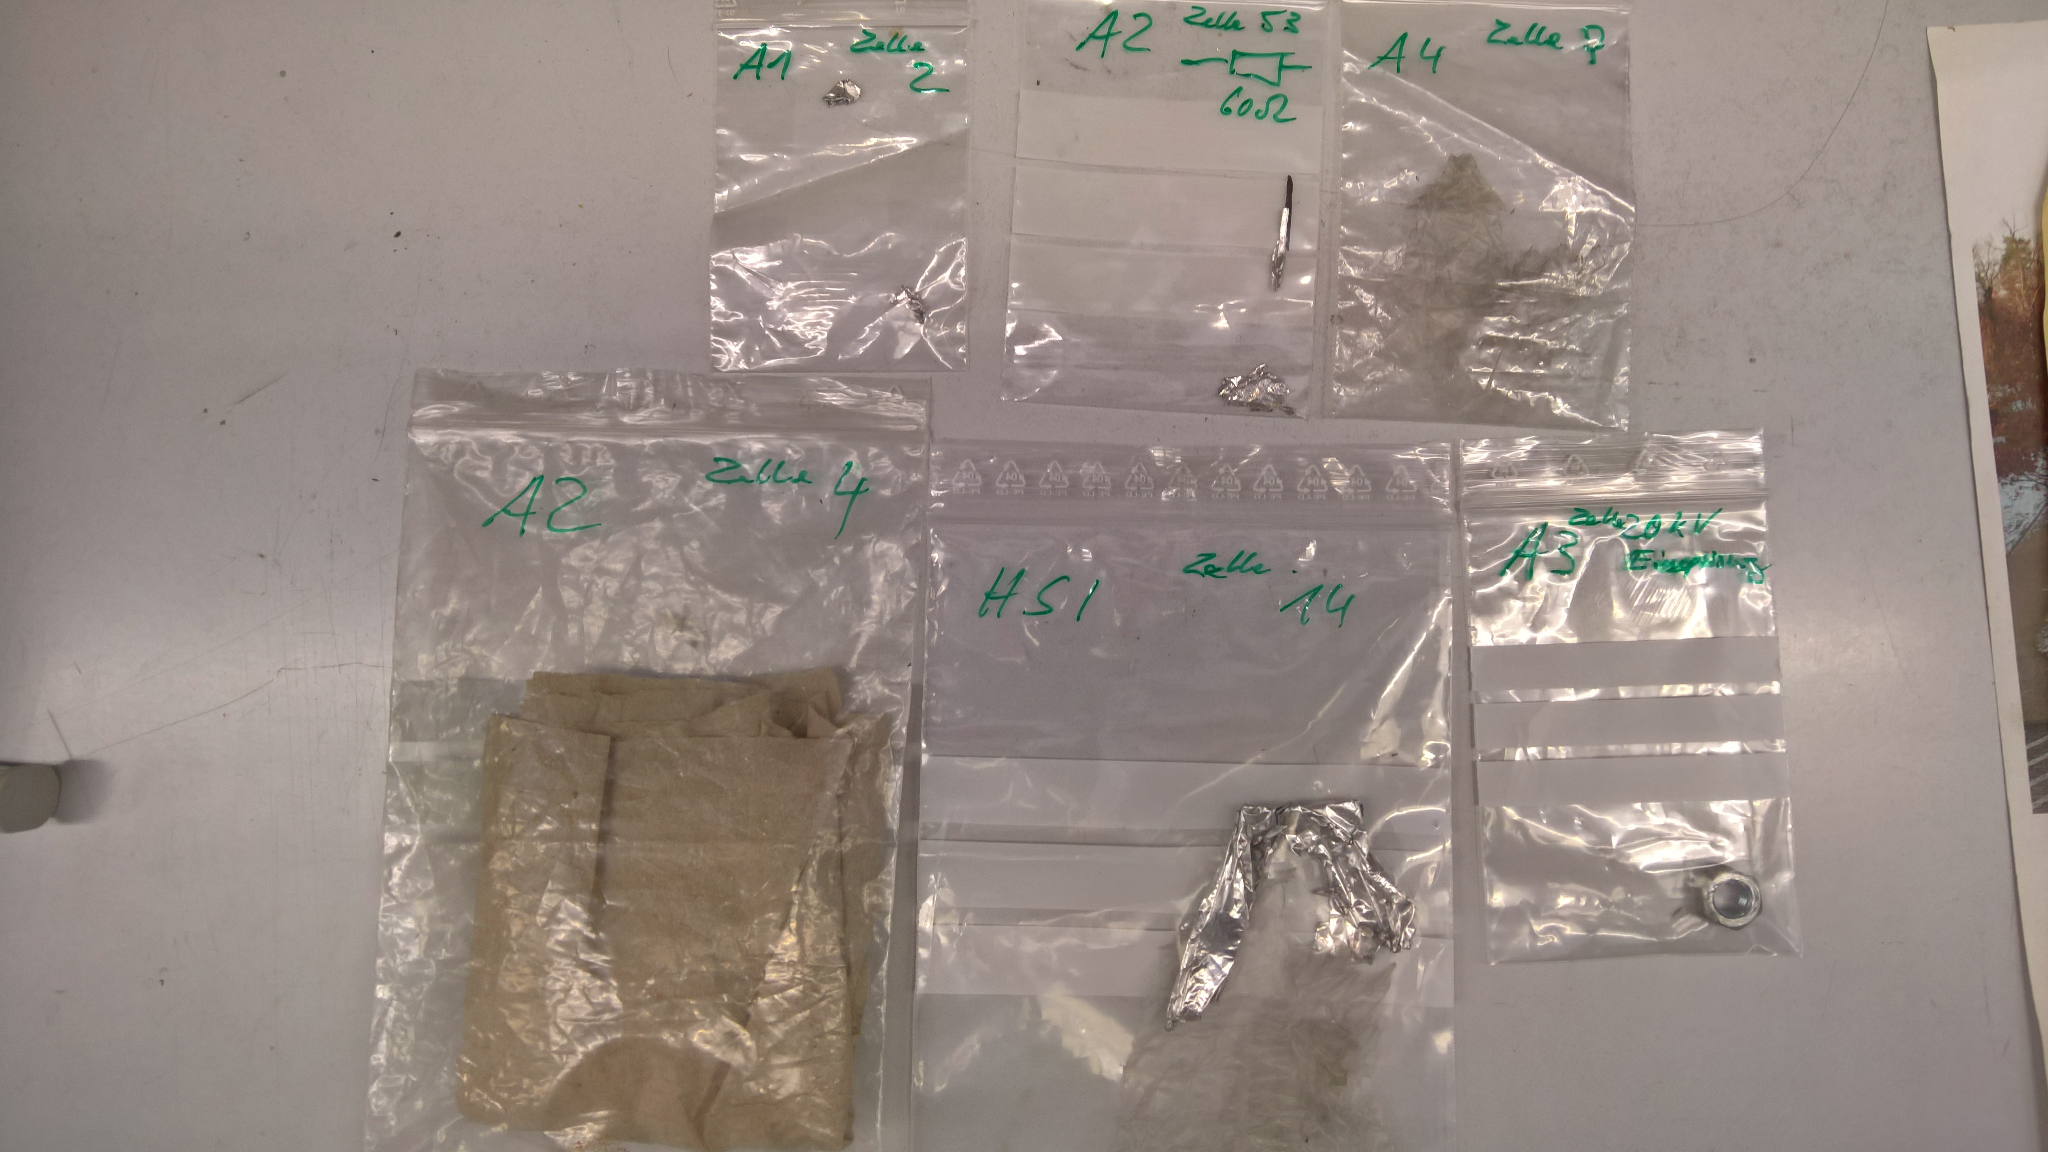
Air Cooling System (I)
Metal pieces found in RF high voltage power supplies and Alvarez amplifiers !

Slide 4
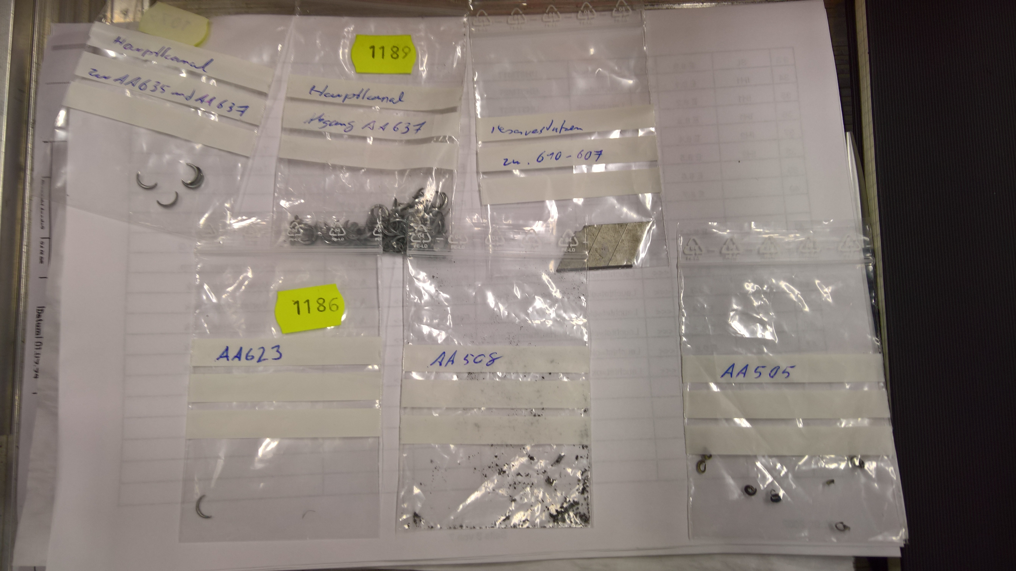
Air Cooling System (II)
Metal pieces found in air cooling system – above amplifiers and HV PS (incl. ER1!)

Slide 5
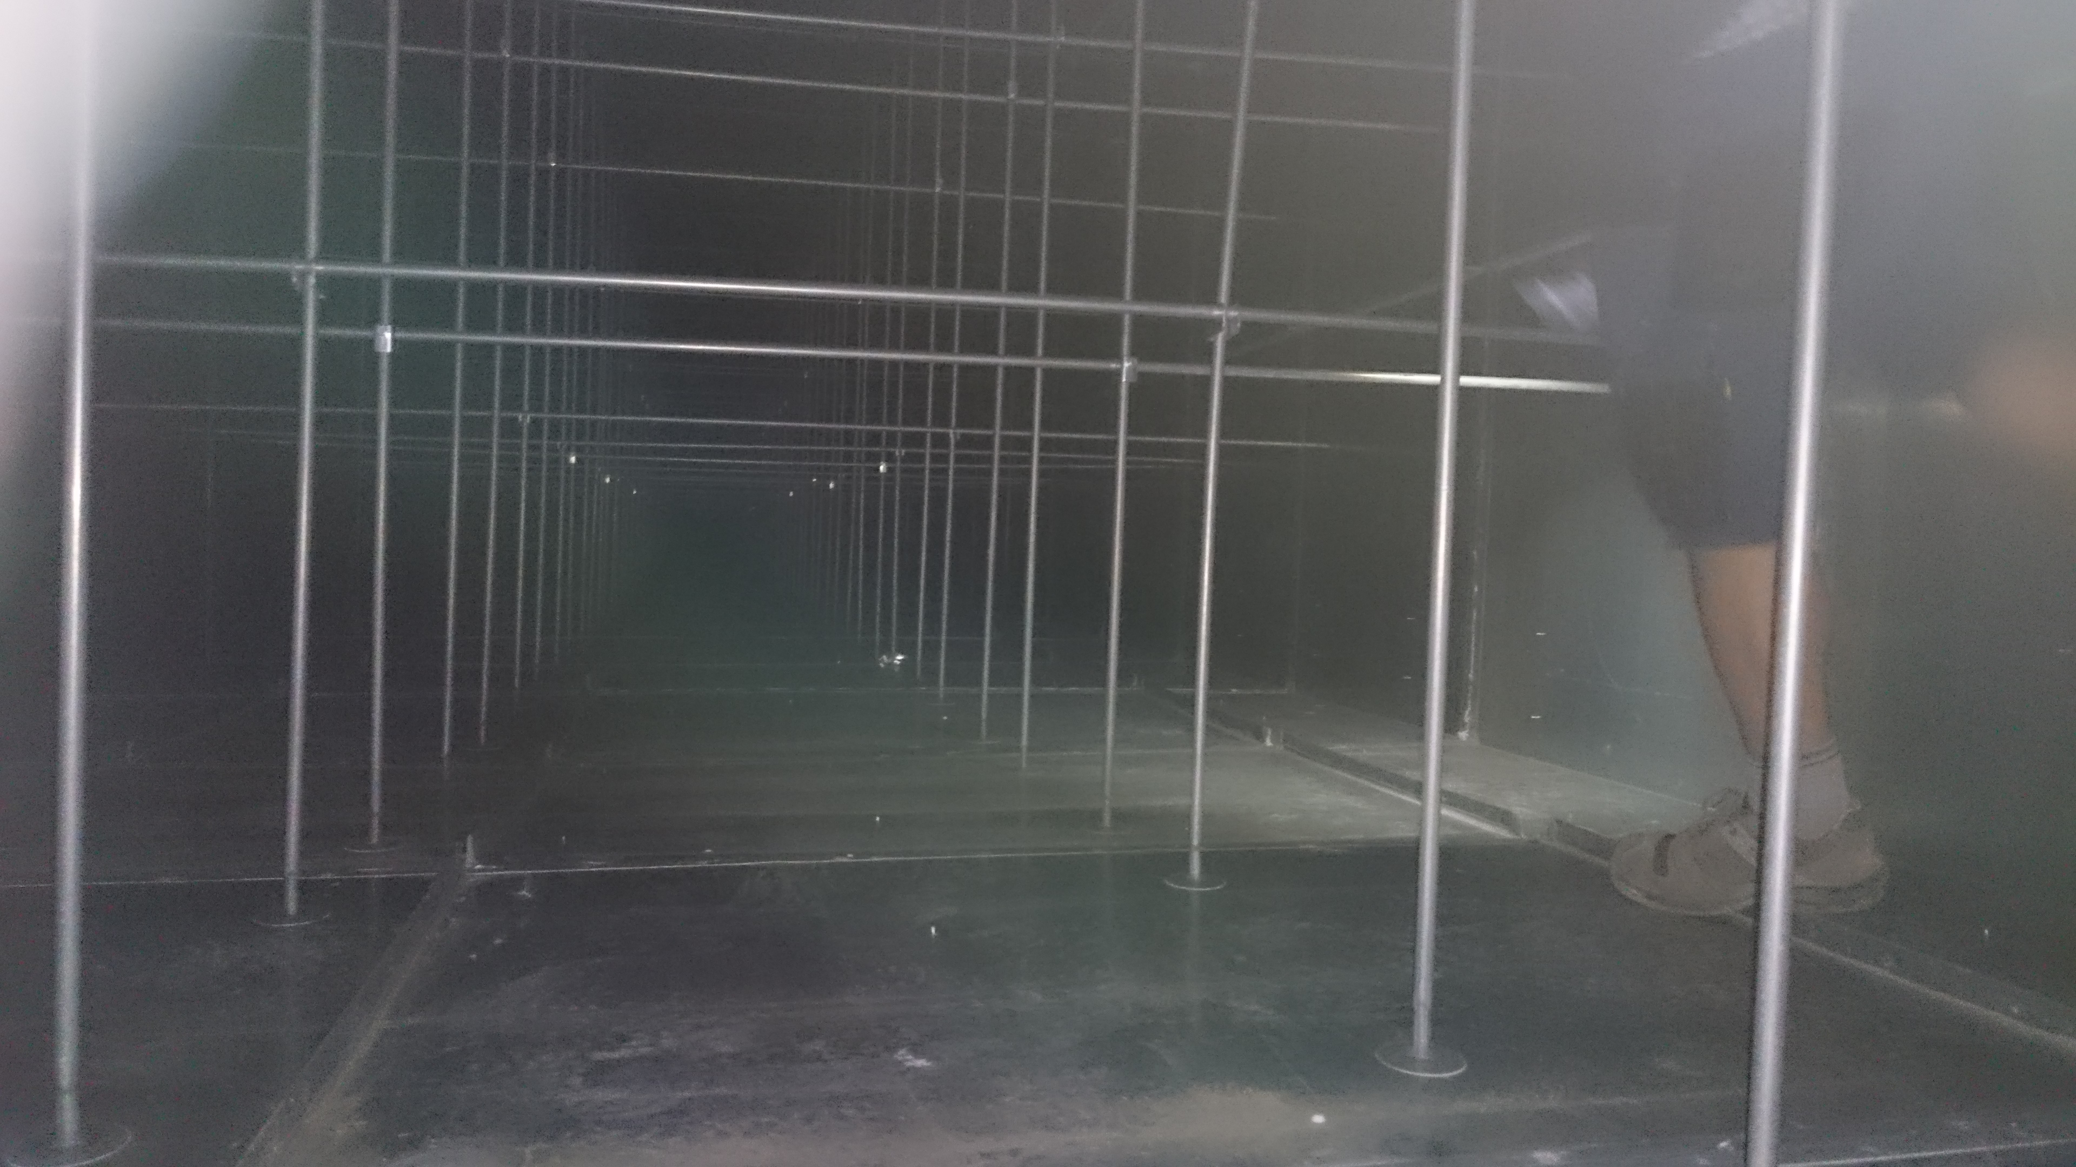
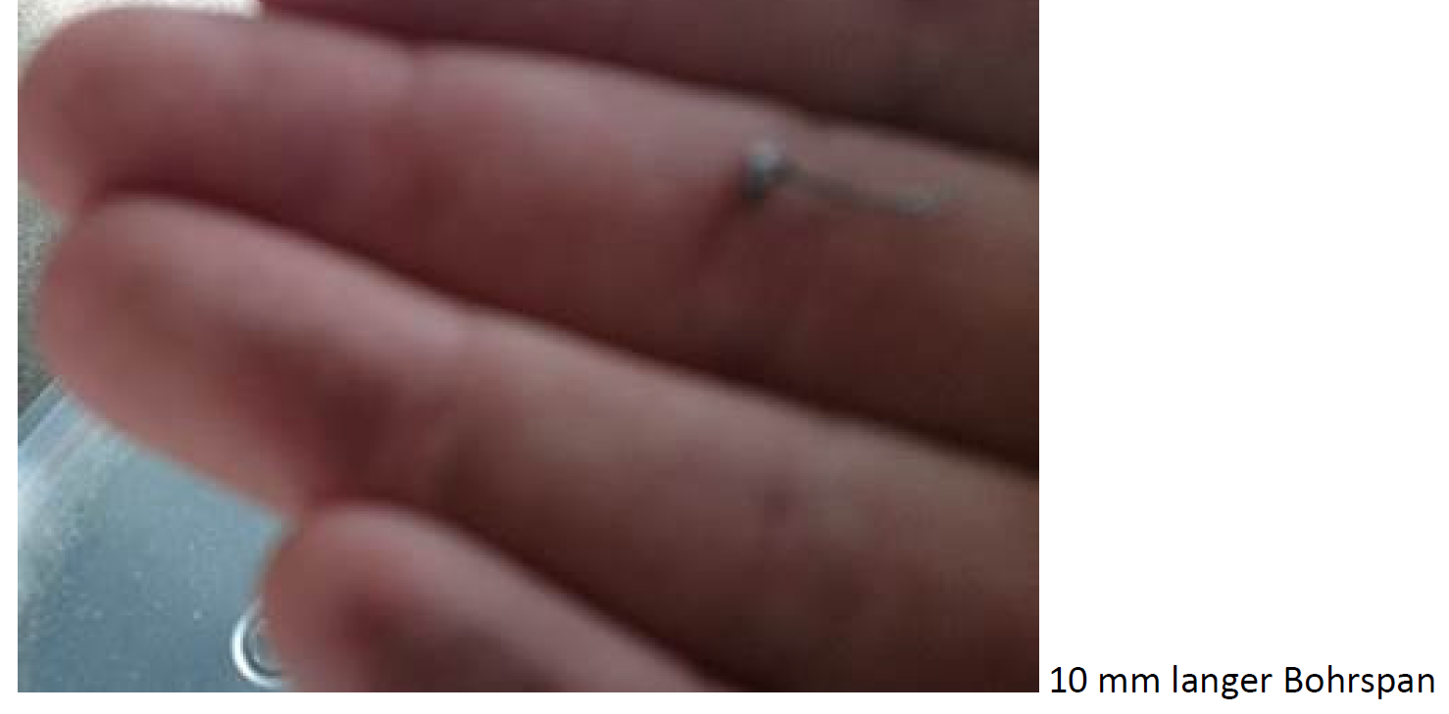
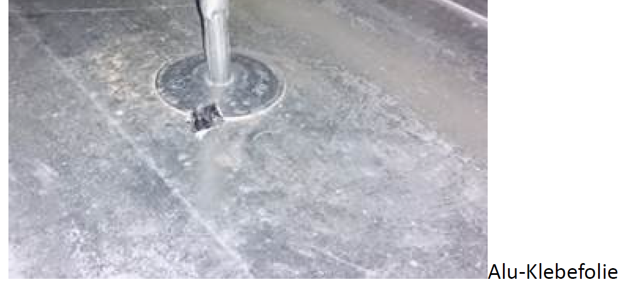
Air Cooling System (III)
Metal pieces found in air cooling system – „Technikzentrale“ (UNILAC roof)

Slide 6
Status
Pre-cleaning of surrounded area finished, Fr, 20th July
Disassembly of Air Cooling System (GA, J. Dreger), Mo/Thu, 23rd/24th July
First Swab/Smear tests (Wisch-/Abklatschtests by DACORD, Schnelltest), Wed, 25th July
Dry ice cleaning (CO2) ER1 power supply: 26th / 27th
Again more dirt in the area -> more cleaning required (complete RF gallery cleaned in week 32)
Further swab tests at RF gallery by SiSt, Wed, 1st August (final report not yet received)
Disconnection / separation of ER1 air cooling system
Air cooling ducts above ER1 cleaned (Ruß)

Slide 7
Status
Cleaning of complete air cooling ducts (metal pieces) at RF gallery by GA & external company
Air cooling: Replacement of flexible tube connections due to contamination with metal pieces
Inspection & cleaning of RF amplifiers (metal pieces)
Restart air cooling
Restart RF systems

Slide 8
Preleminary Schedule
?

Slide 9
Thank You!

Slide 10
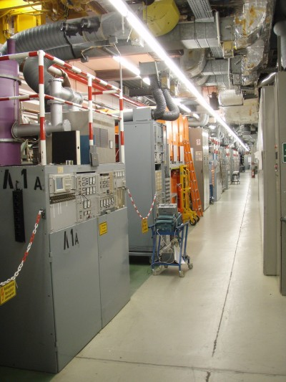
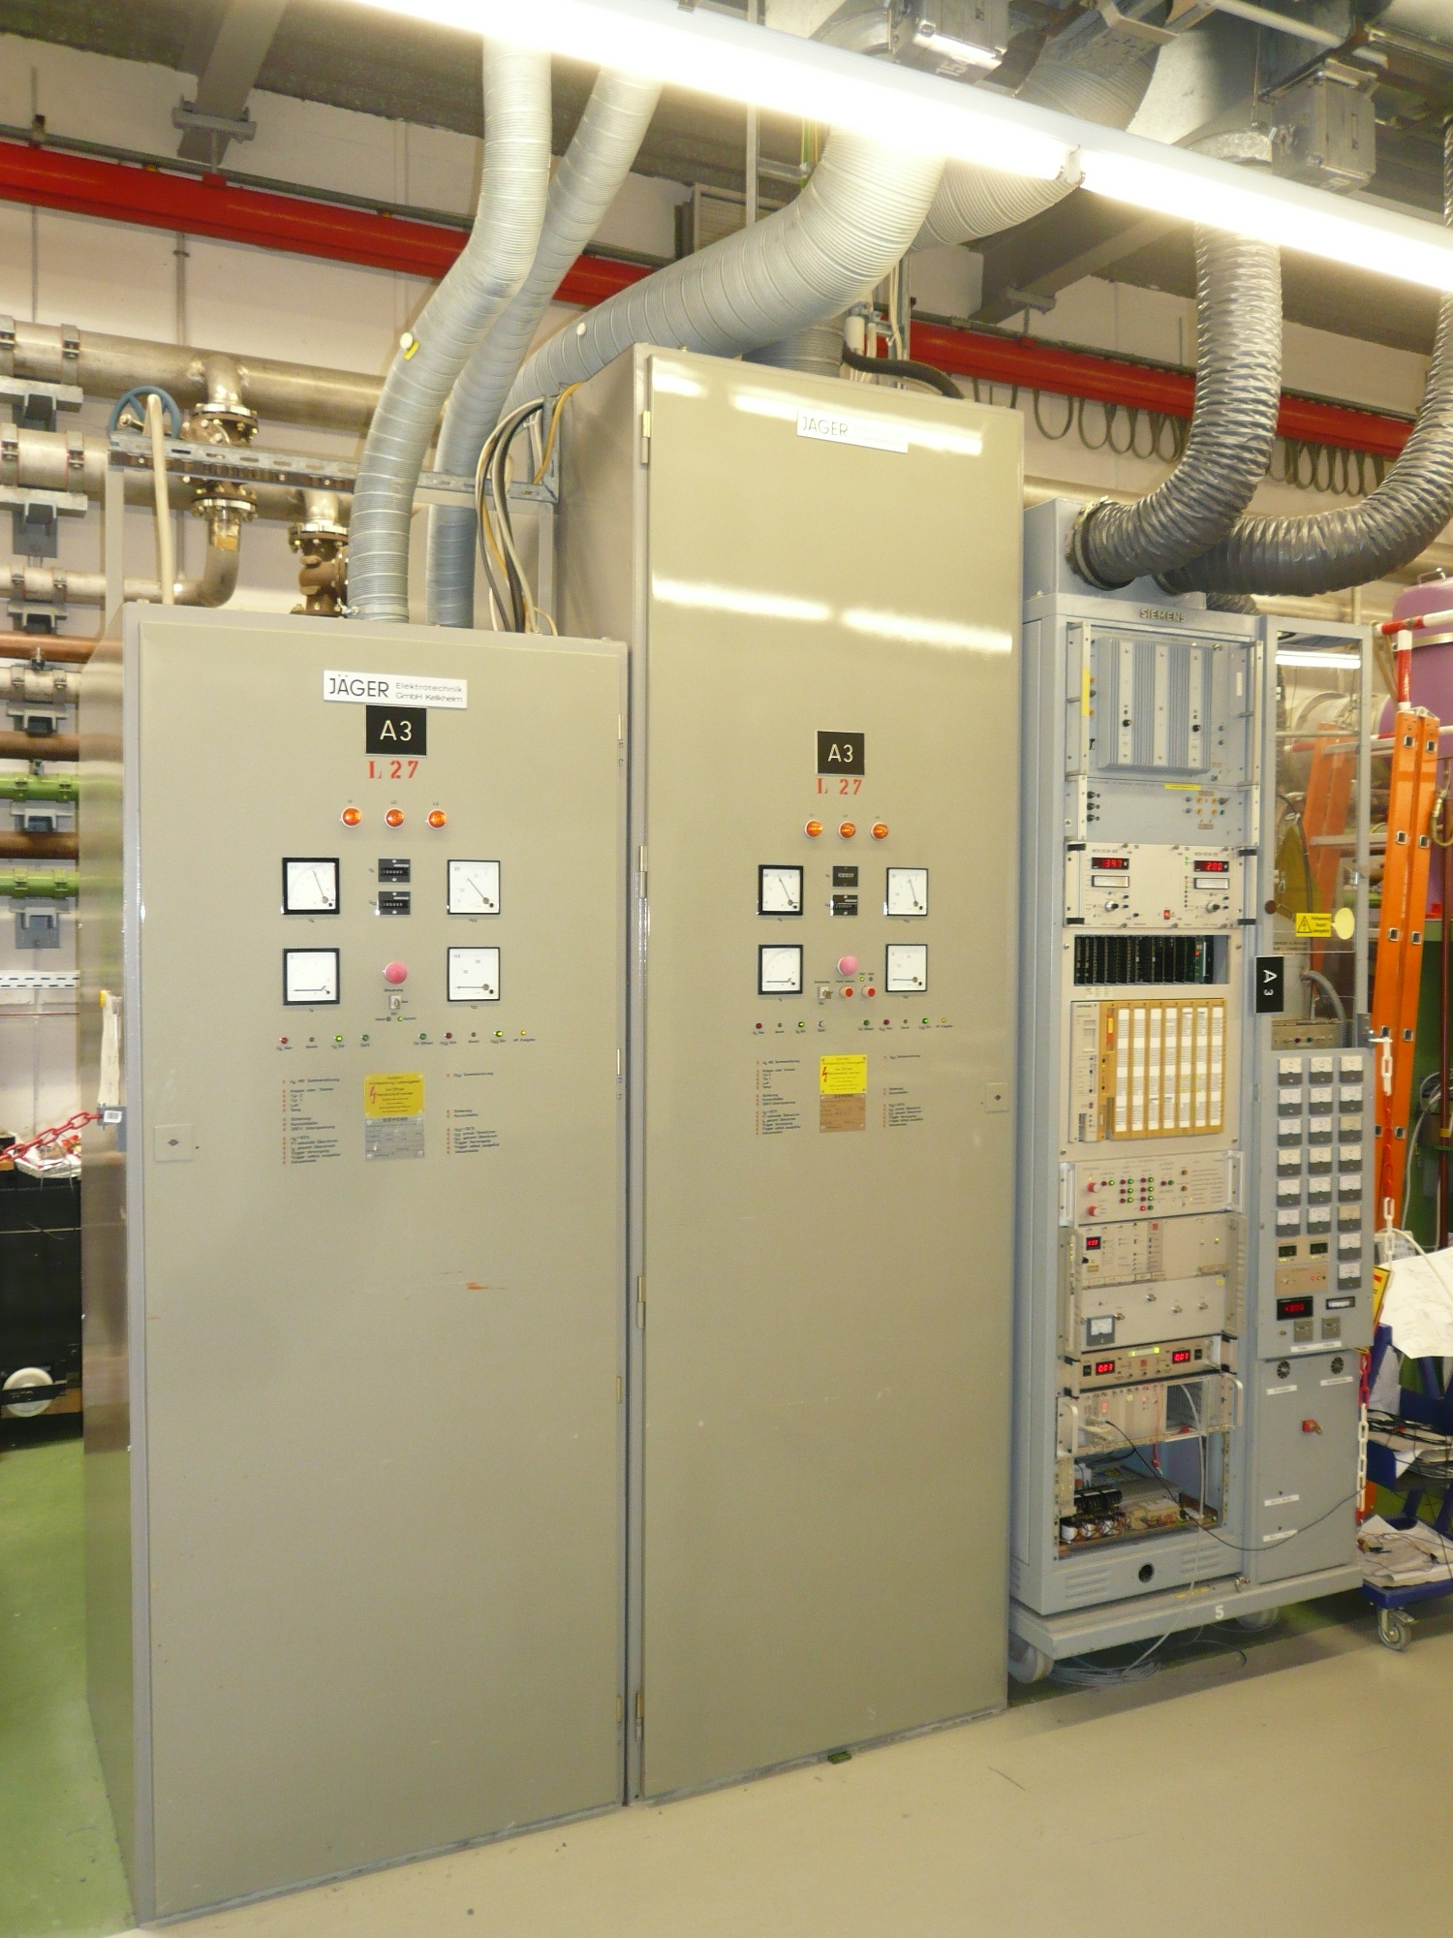
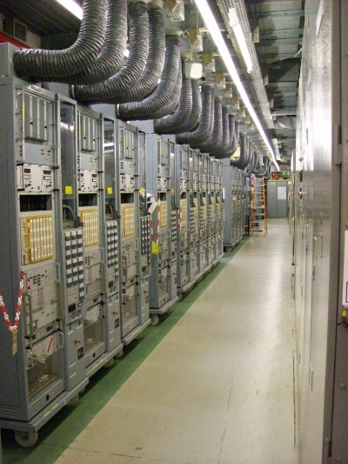
UNILAC RF Gallery
1.6 MW HPA (5 x)
@ Alvarez DTL
Single Gap Resonators (not needed for FAIR op.)
160 kW Driver

