Slide 1
Micro Vertex Detector
Tracking
15.2.2018 Tobias Stockmanns

Slide 2
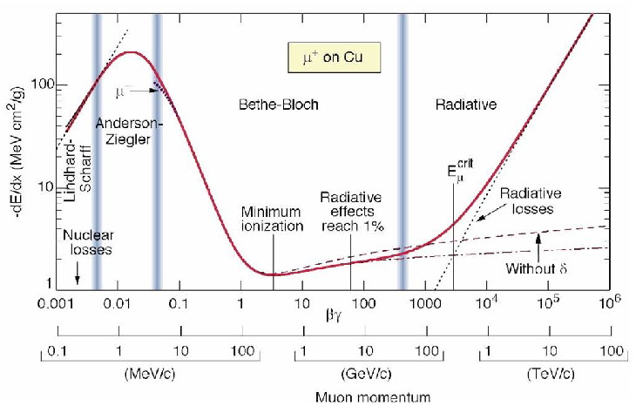
Mean dE/dx
Bethe-Bloch Formula
electronic stopping power ~ β
non-ionizing interactions
bremsstrahlung
~ 1/β²
(Fermi-)Plateau
Rise: T_{max} ~ β²γ²
const
~ ln βγ
Minimum at βγ ≈ 3.0 – 3.5
➔ minimum ionizing particle (MIP)

Slide 3
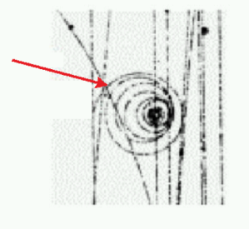
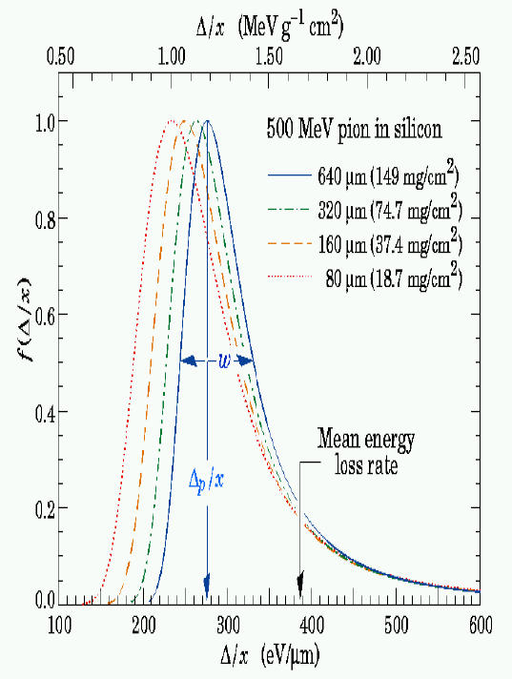
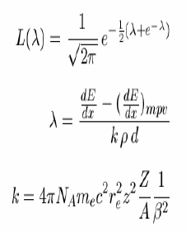
Energy loss distribution (straggling)
Energy loss is a statistical process
Distribution function is asymmetric for small absorbers
For thick absorbers the distribution becomes Gaussian
Collisions with small dE more probable
large dE rare → electrons with large energy (keV) are called δ-electrons (or –rays)
δ-electrons have enough energy for their own ionization trace
Parameterized via asymmetric Landau(-Vavilov) distribution

Slide 4
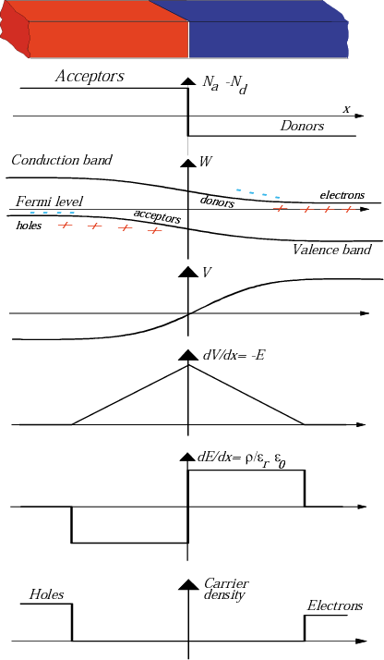
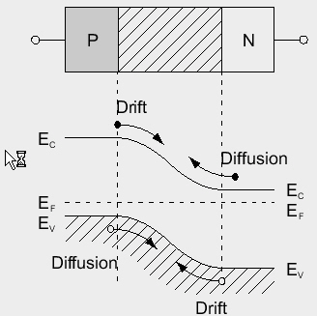
pn - junction
p
n

Slide 5
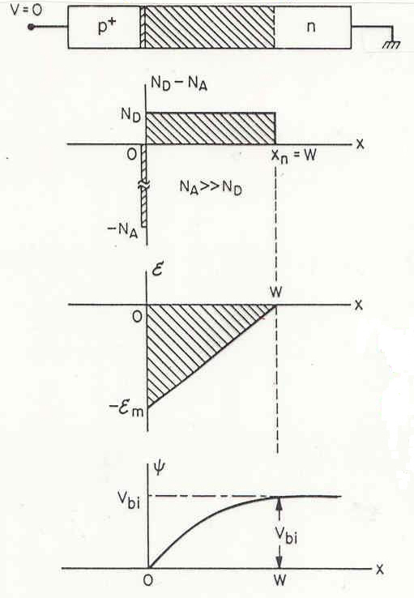
pn junction as particle detector
thin, highly doped p⁺ (~10¹⁹ cm⁻³) layer
on lightly doped n⁻ (~10¹² cm⁻³) substrate
p⁺
n⁻
Space charge
region
Electric field
Potential
neutrality cond.
Maxwell
!!

Slide 6
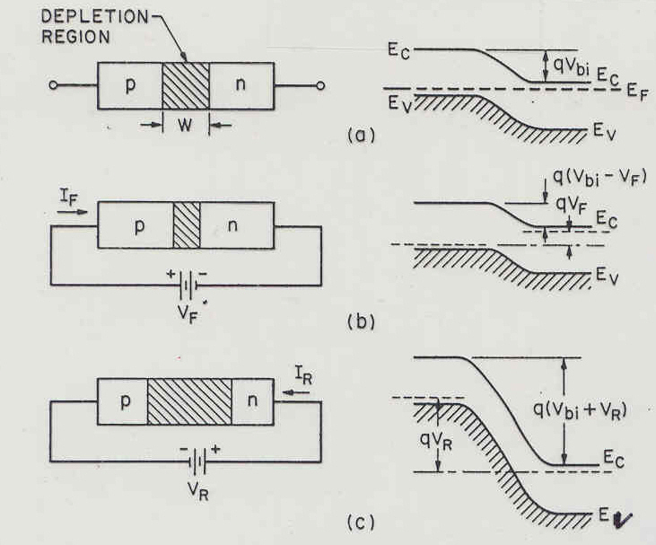
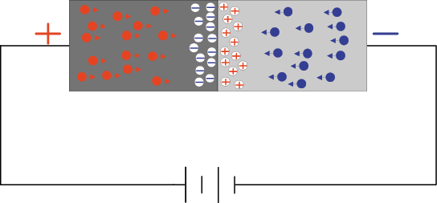
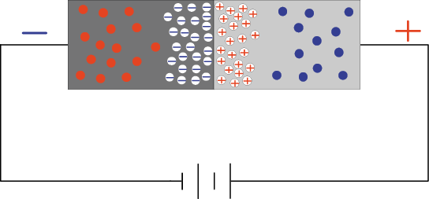
pn junction under reverse bias (V_{ext})
1. V_{bi} → V_{bi} + V_{ext} 2. no thermal equilibrium => E_{F}(n) ≠ E_{F}(p)
Hole Electron
current current
no bias
p n
Depl. ↓ I ↑
forward bias
Depletion
region
p n
reverse bias
Depl. ↑ I ↓

Slide 7
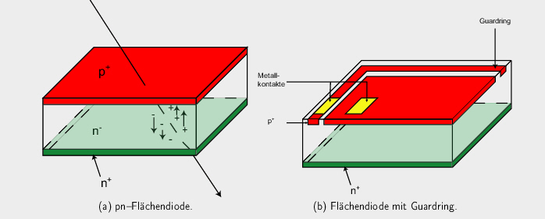
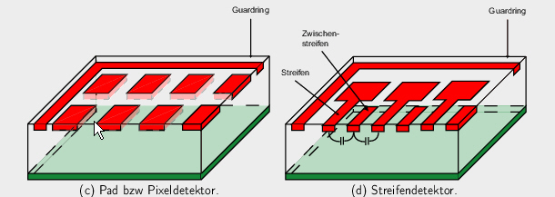
Single sided processing

Slide 8
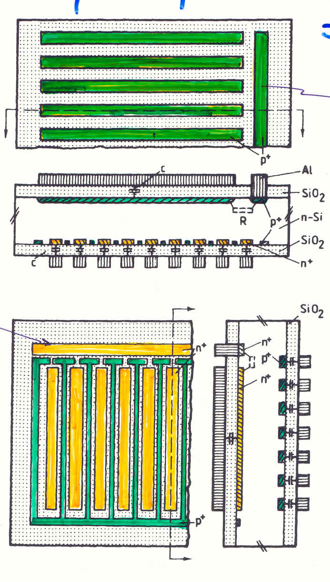
Double sided microstrip detector
top side
read-out strips
bias strips
bottom side
p-type insulation

Slide 9
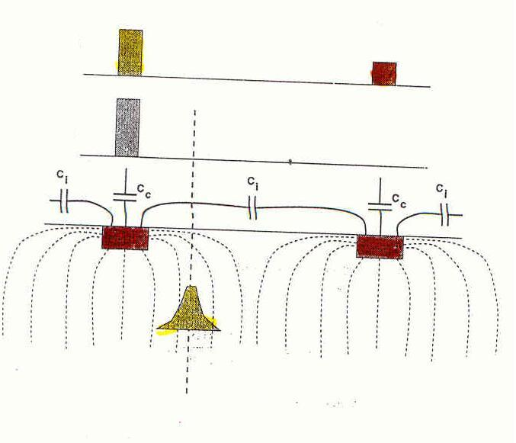
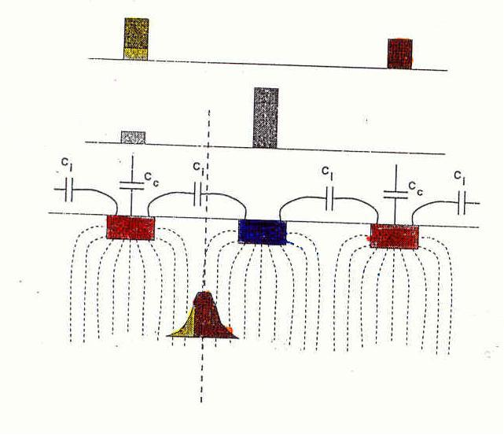
Capacitive charge division
read Q
collected Q
incoming particle
incoming particle
intermed. strip

Slide 10
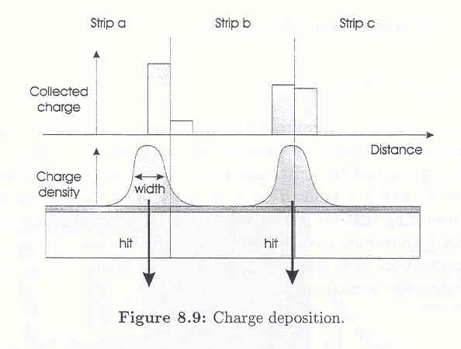
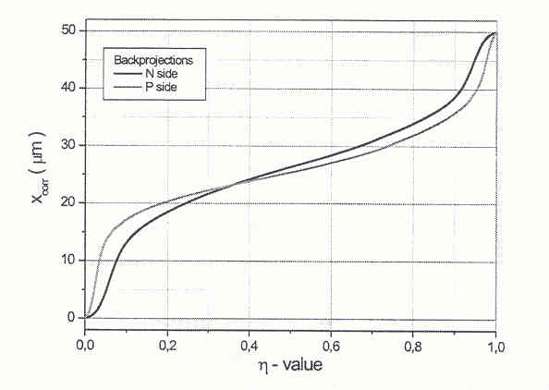
η - distribution for position-interpolation
simple expectation:
x = η*d
not quite correct, use more complex function:
η = Q_{L}/(Q_{R}+Q_{L})

Slide 11
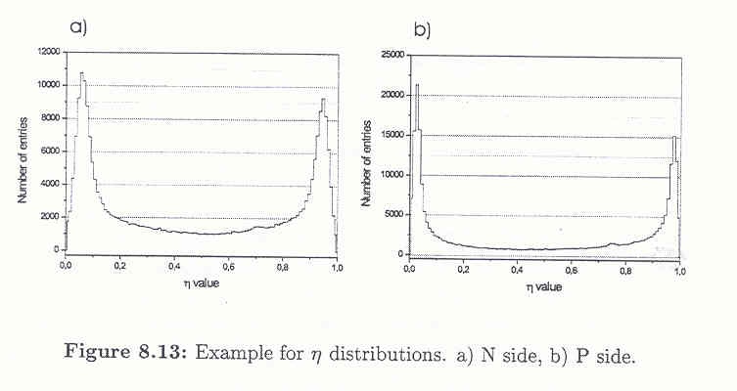
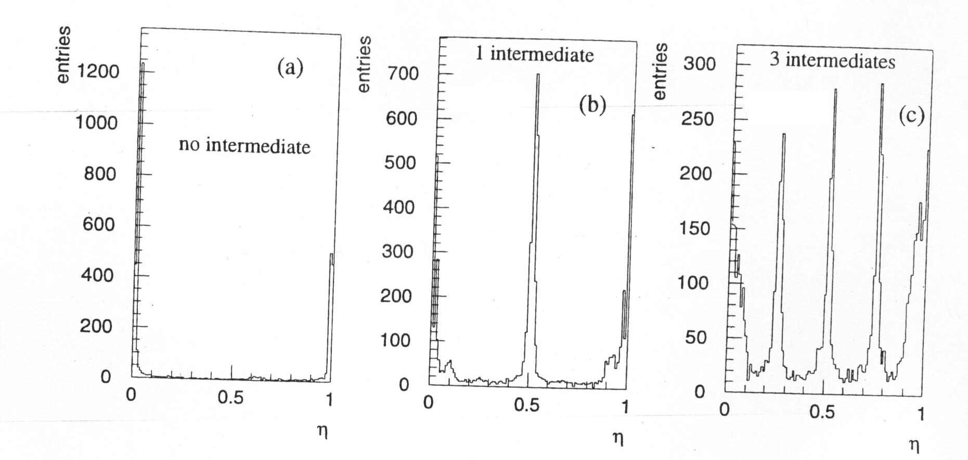
η - distribution for position-interpolation
ideally → symmetric but: parasitic capacitances and r/o specifics
intermediate strips → intermediate “structure” in η

Slide 12
MVD
Barrel:
  2 pixel layers
  2 strip layers
Forward:
  4 pixel layers
  2 mixed layers
Thickness:
  100 µm pixel
  280 µm strips

Slide 13
MVD Pixel Part

Slide 14
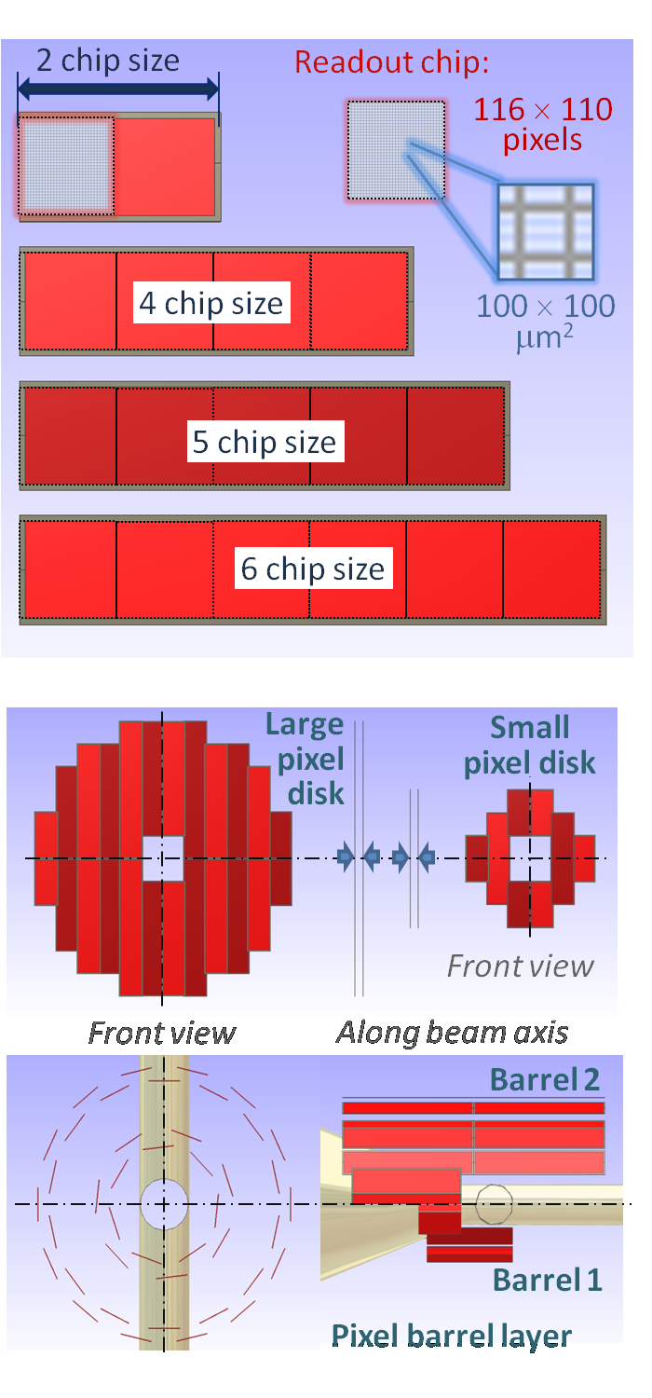
Pixel Modules
6.8 cm

Slide 15
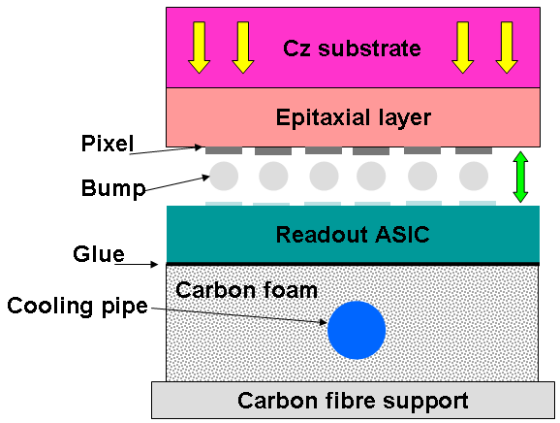
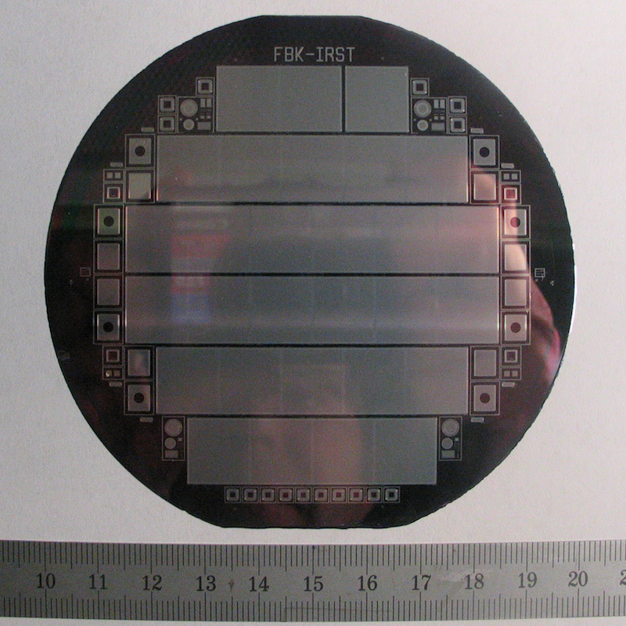
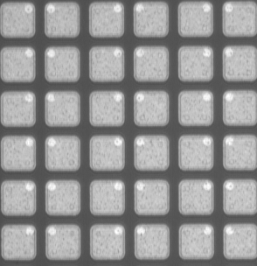
Pixel Sensors
Epitaxial Silicon Sensor
100 µm thickness
Pixel dimensions 100 µm x 100 µm

Slide 16
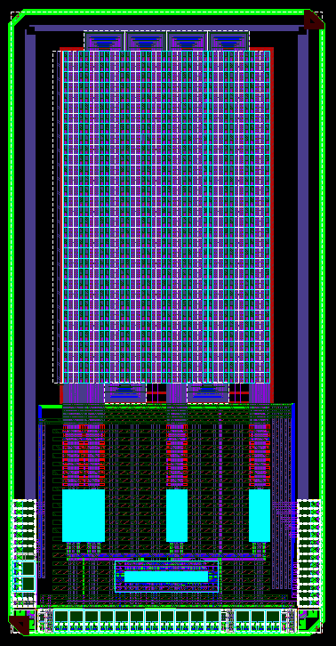
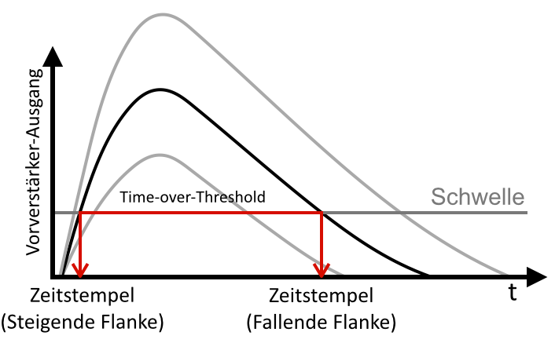
Pixel Front End Electronics – ToPix
ToPix – Torino Pixel ASIC
Charge measurement: time over threshold (ToT)
CMOS 130 nm technology
Recent prototype (reduced size): ToPix 4 (640 pixels)
preamplifier-output
threshold
ToT
leading edge
trailing edge
Input charge range | 50 fC
Input channels | 12,760 pixels
Max event rate | 6.1 x 10⁶ Hits/s/cm²
Power consumption | < 800 mW/cm²
Charge resolution | 12 bit
Radiation dose | < 100 kGy (goal)
Floorplan ToPix 4
Reduced Size Prototype

Slide 17
ToPix 4 Measurements: Lab
Power consumption
ToT-Linearity
S-Curve Sigma
Radiation Hardness

Slide 18
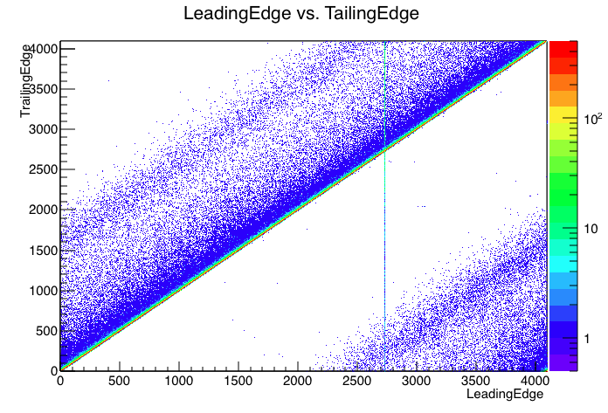
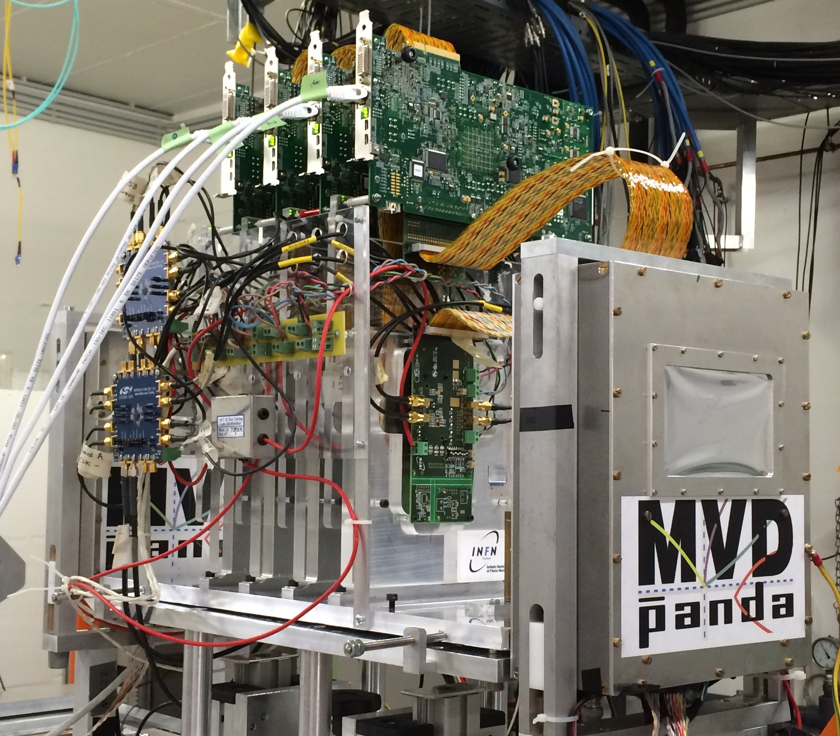
ToPix 4 Measurements: Testbeam
Test beam measurement with ToPix beam telescope with protons @ COSY
p_{beam =} 2.95 GeV/c
Successful measurements with ToPix 4 prototype
Leading vs. Trailing Edge
Hitmap
Hit distribution over time
Readout
Board
Beam
ToPix 4

Slide 19
MVD Strip Part

Slide 20
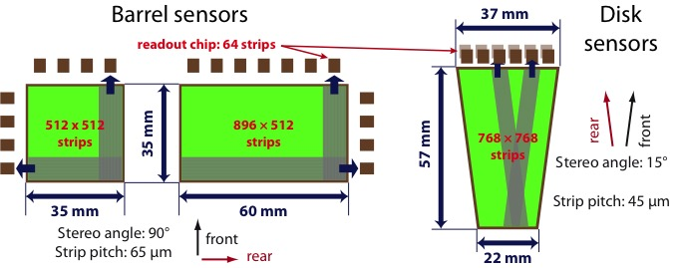
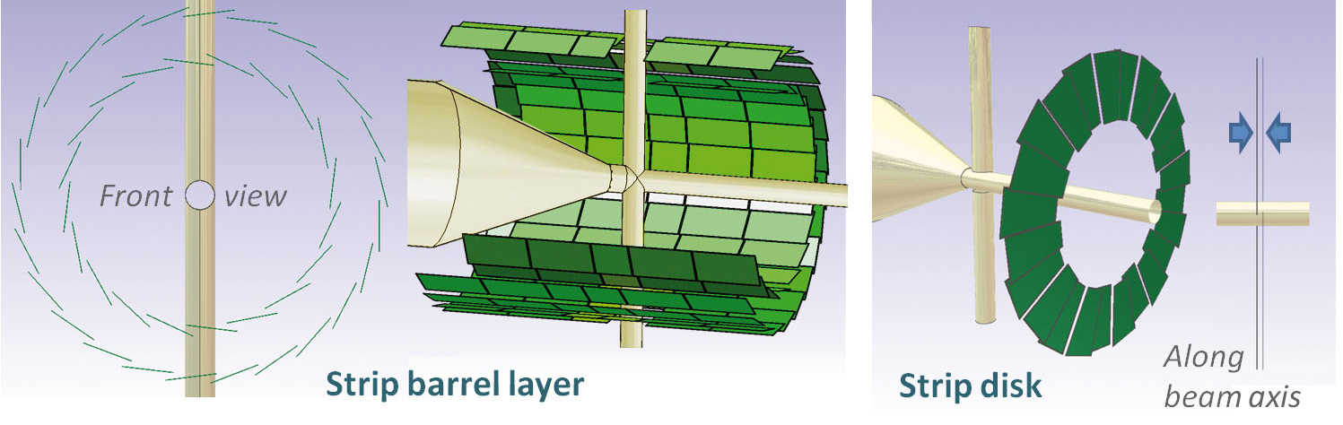
Strip Part – Design Concept

Slide 21
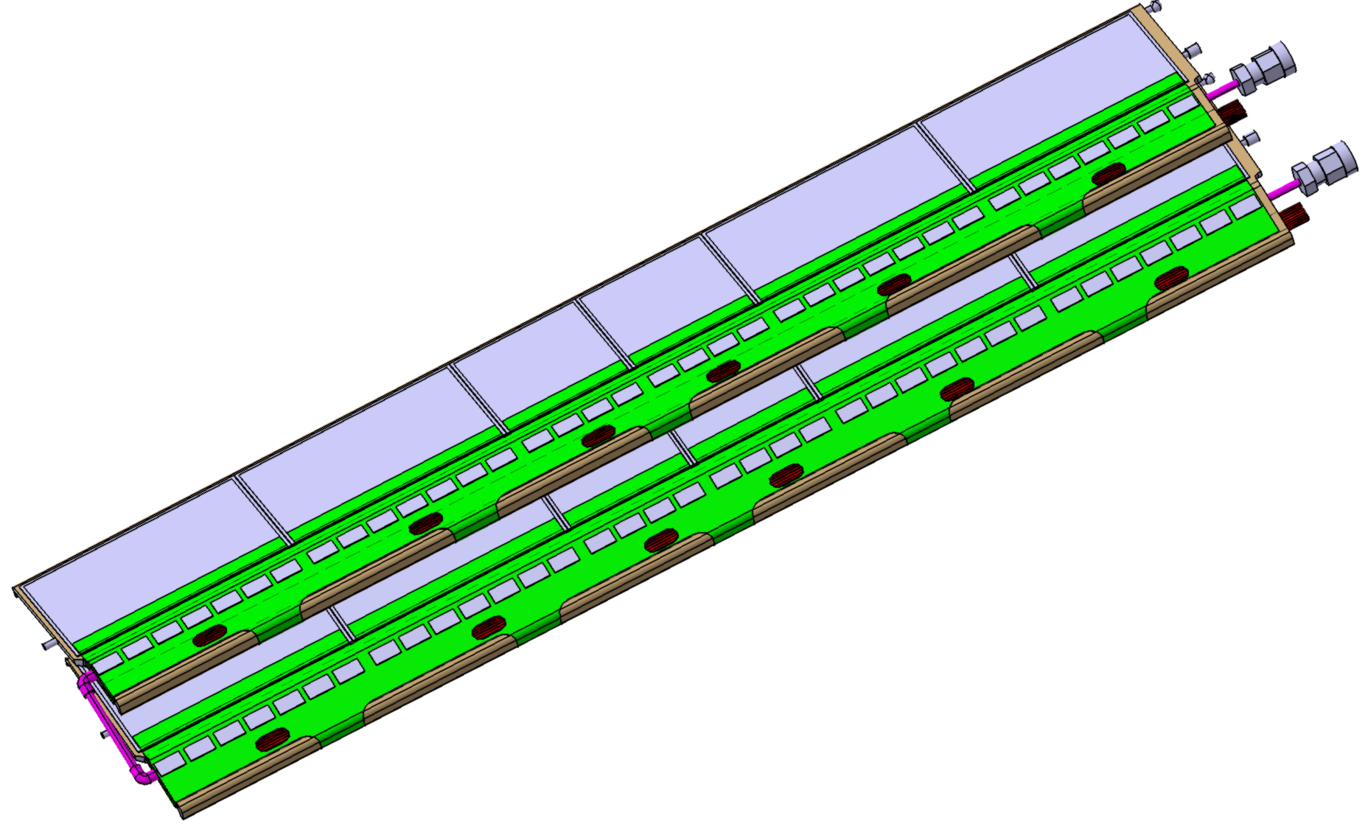
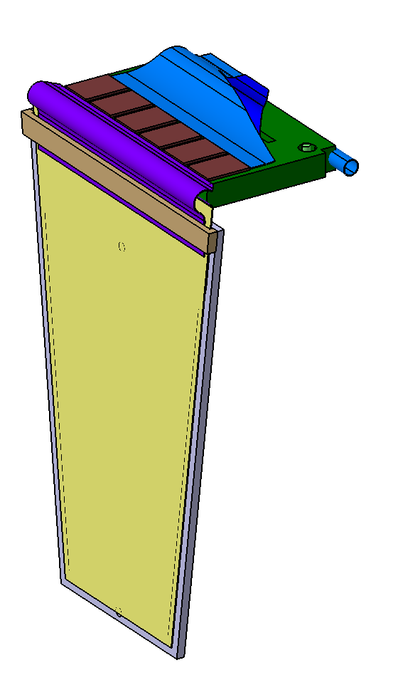
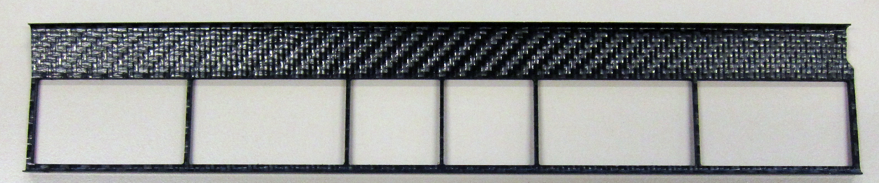
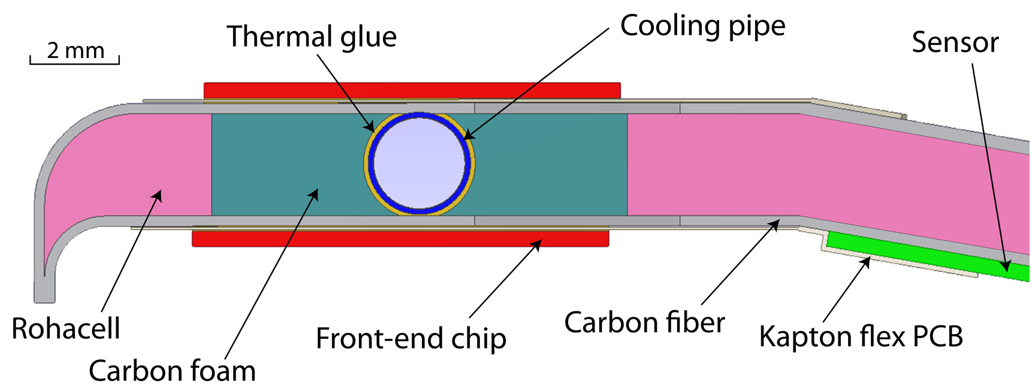
Strip Part – Module Design
Front-end chip
Cooling Pipe
Sensors
Cable channel
Hybrid flexible PCB
  Flex PCB
  Cooling pipe
31.3 cm
  Chip support: carbon foam
  Readout chips
Carbon foam: POCOFoam® or HTC
for thermal management
  Sensor
  Sensor Frame: CFRP
2mm

Slide 22
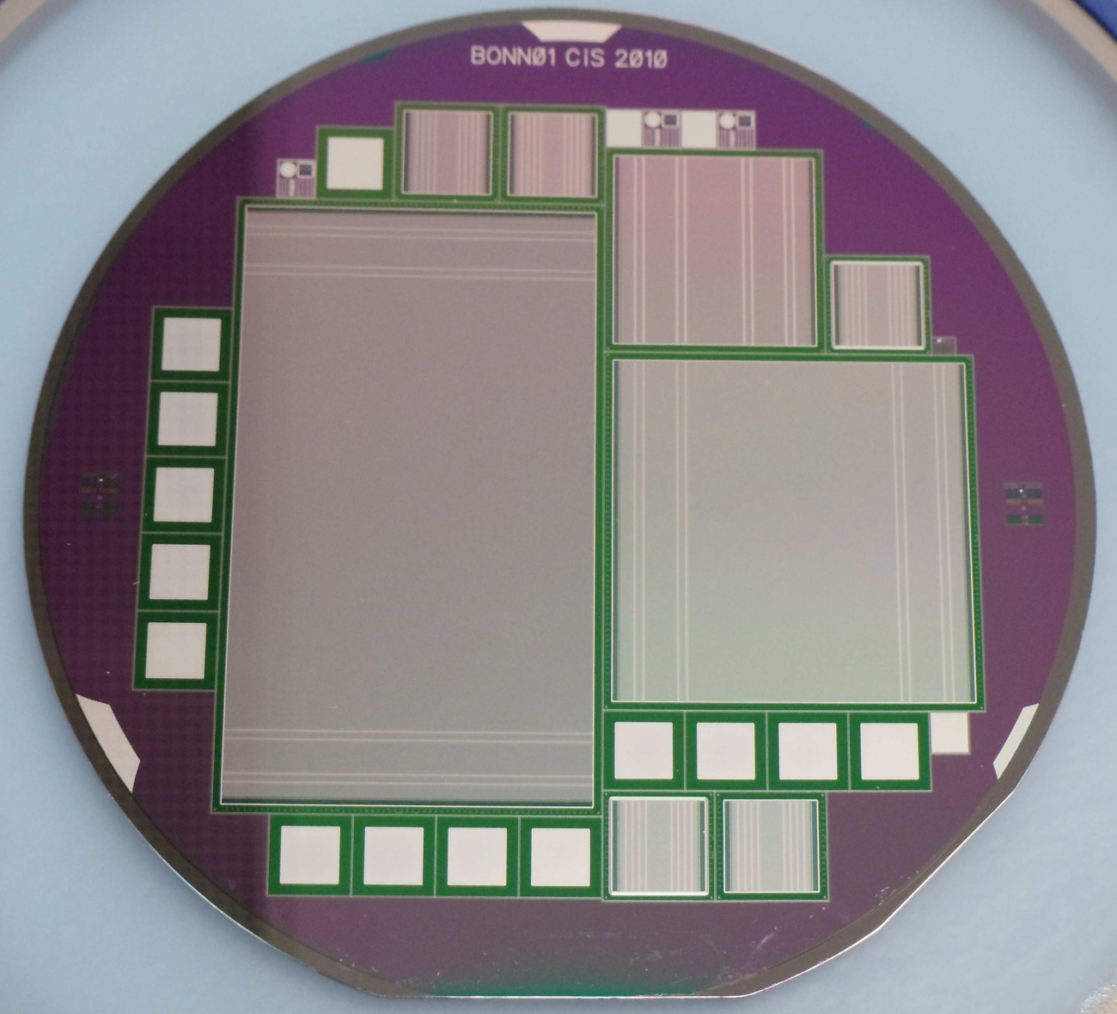
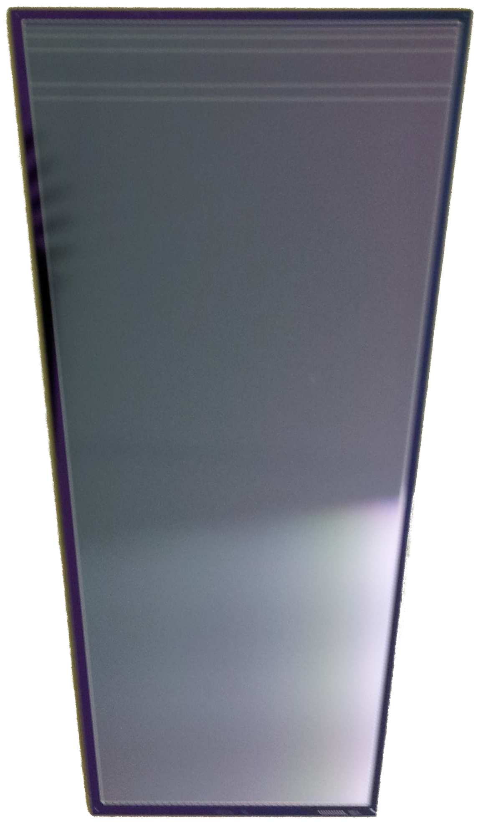
Strip Sensors
3.7 cm
5.7 cm
6 cm
3.5 cm
Barrel Sensor
Thickness 285 µm
896 x 512 strips
65 µm pitch
Readout every 2nd strip
90° stereo angle
Wedge Sensor
Thickness 285 µm
768 strips per side
45 µm pitch
Readout every 2nd strip
15° stereo angle
2.2 cm
Notes:
final wedge sensor pith 45 mu m jeder zweite wird gelesen
bei 67,5 wird jeder streifen gelesen
barrel sensor final 65 mu m aber jeder zweite wird gelesen

Slide 23
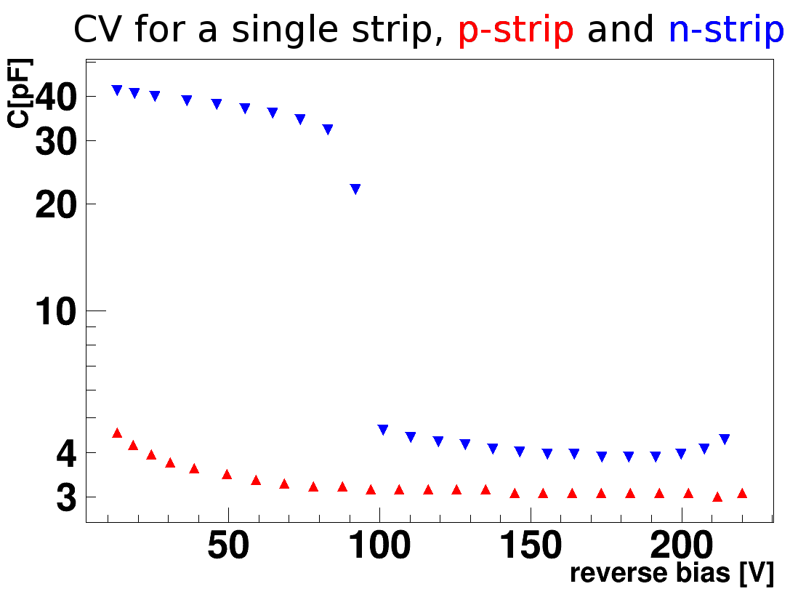
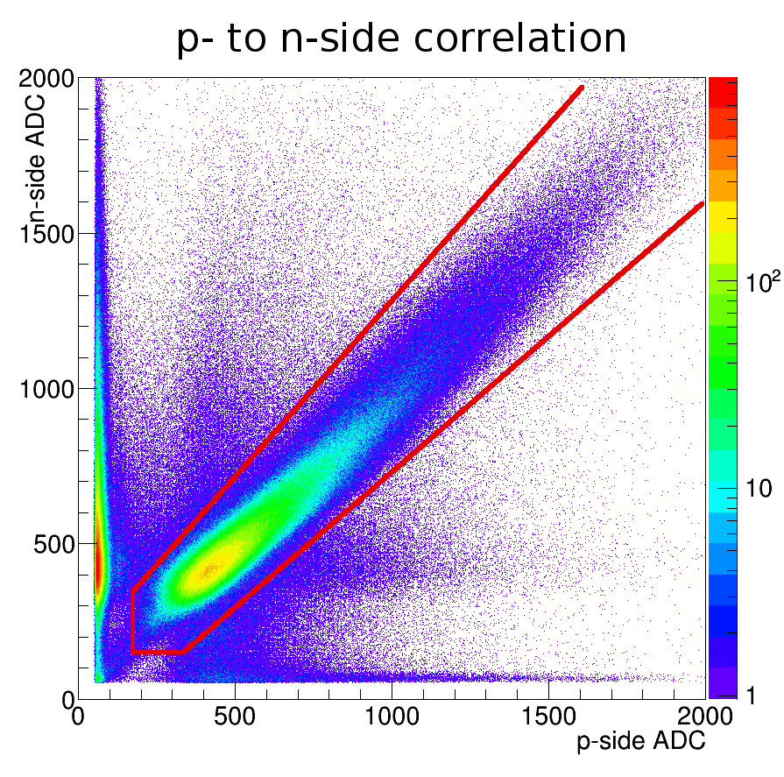
Measurements Disk Prototype
Lab measurements
APV25 Front End
Test beam, p_{beam} = 0.8 GeV/c Protons
Prototype successfully tested
Notes:
! APV 25 messungen!

Slide 24
Barrel Prototype
3.5 x 3.5 cm² PANDA fullsize sensor S2 (@130 µm r/o)
Hitmap
Flex-PA and squared sensor assembled on a test board and successfully tested at SPS, CERN
^{(September 2012)}

Slide 25
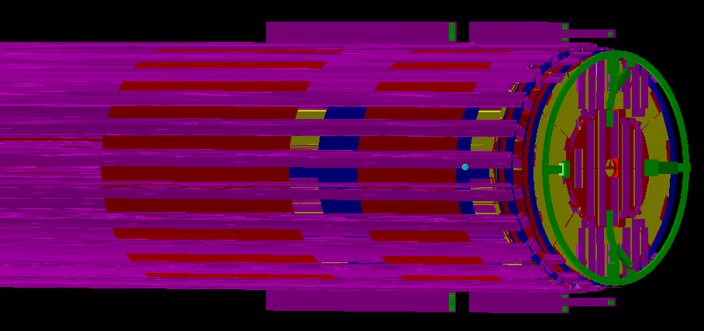
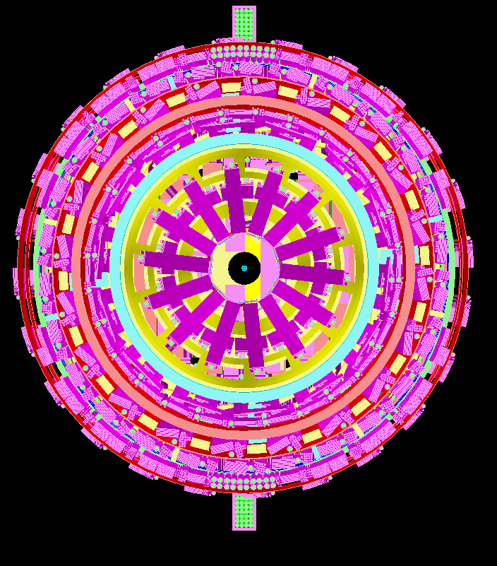
Geometry
Full geometry description of all components
Slightly outdated
Contains all materials in a (semi)realistic manner
CAD design of MVD not finished

Slide 26
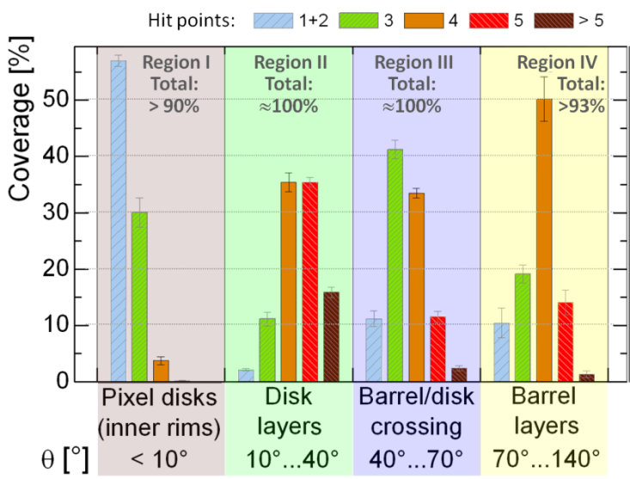
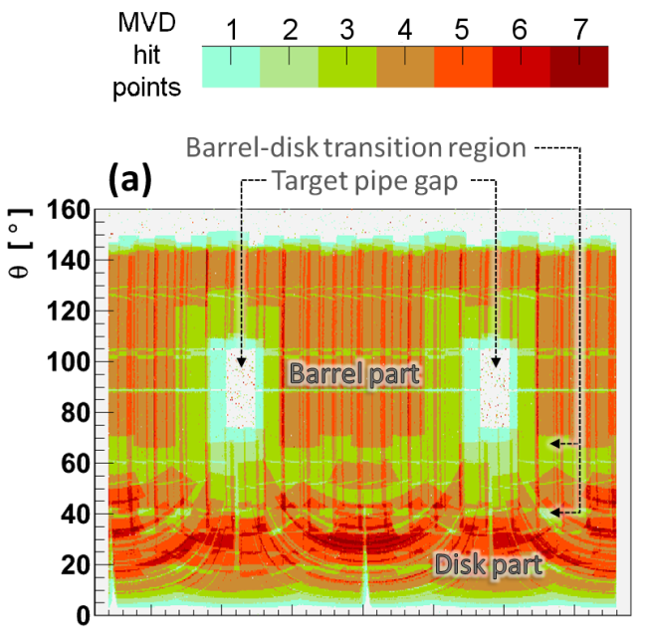
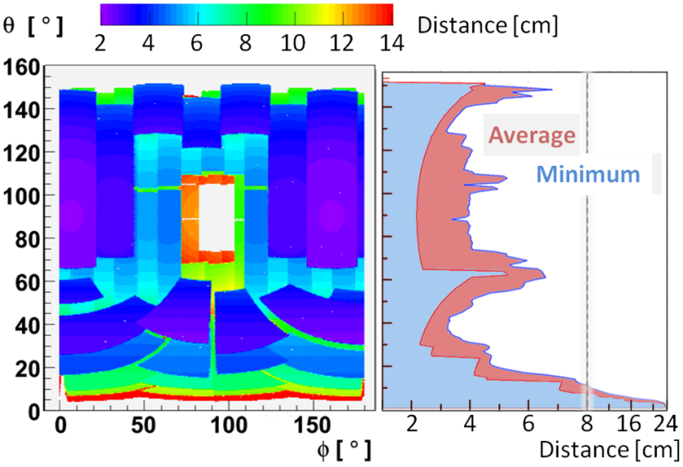
Angular Coverage
Notes:
A minimum amount of hits is required to obtain a good tracking of particles.
the detector geometry was optimizes to aim a minimum of 4 hits per track.
For this simulation particles with fixed momentum where isotropically emitted in the detector.
The goal of four hits per track is acheived in a large range of the solid angle.

Slide 27
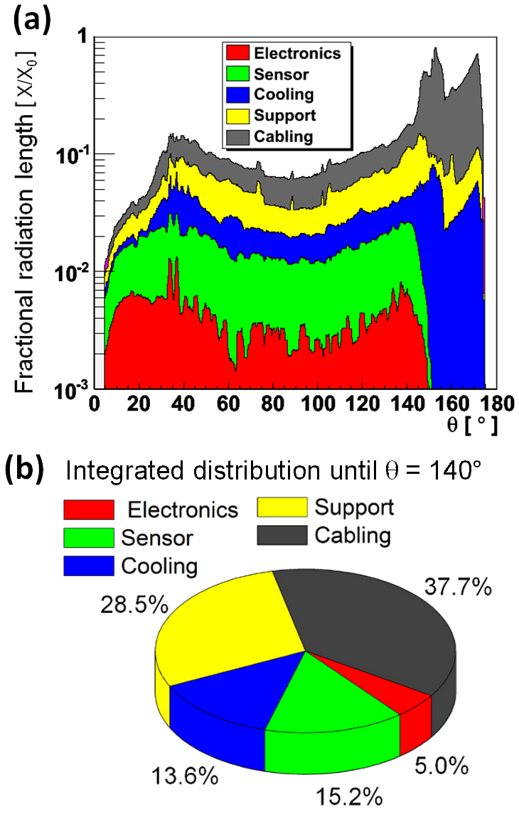
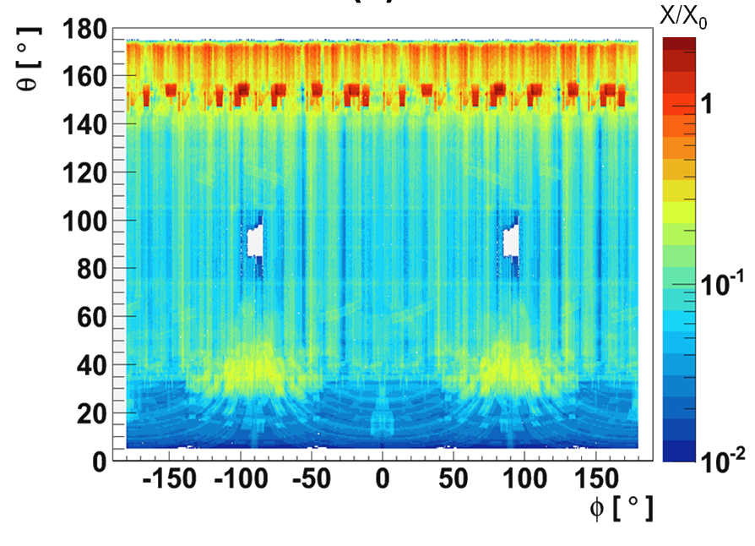
Radiation Length
< 10 % for most Θ angles
Main contributions from cables and support

Slide 28
Digitization
Parameterizes charge cloud effect
Splits charge to adjacent pixels / strips according to path of particle and diffusion
Data format matches with electronics
Pixel digitization matches with ASIC (ToPix)
Strip digitization works like pixel digitization. Adoption to strip ASIC (PASTA) still has to be done
  Strip ASIC has a much higher time resolution but not clear if it can be used in combination with silicon sensor
  Pile-up behavior different

Slide 29
Reconstruction
Pixel and Strip Clusterization: Search for nearest neighbors
Strip matching of top and bottom cluster taking charge information into account
Space point reconstruction based on different algorithms:
  Geometrical mean
  Eta distribution
Noise reduction by cutting on charge measurement
Comparison with test beam data done

Slide 30
Time-Based Simulation
MVD fully supports time based simulation
Pile-up is handled in a parametric way in the pixel part matching with the ToPix ASIC
  first hit is measured
  ToT is enlarged (wrong charge measurement)
  second hit is lost
TOAST features are not implemented (Strips behave as pixel)
Reconstruction steps
  Hit sorting by time stamps
  Time-gap event building
  Event based reconstruction steps

Slide 31
Test Beam Analysis
Different test beam analysis software exist
  Stand alone pixel and strip software
  PandaRoot based reconstruction for pixel and strip
  FairMQ based online reconstruction of pixel
Cross-check between simulation and measured data still missing

Slide 32
General points
Open issues in MVD:
  Update of geometry (medium)
  Implementation of TOAST features (high)
  Comparison of test beam data with simulated data in PandaRoot
  Refactoring and clean up of code
  Manpower needed: 2 FTE years (depending on skill)
  Manpower available: 0.2 FTE per year

