Slide 1
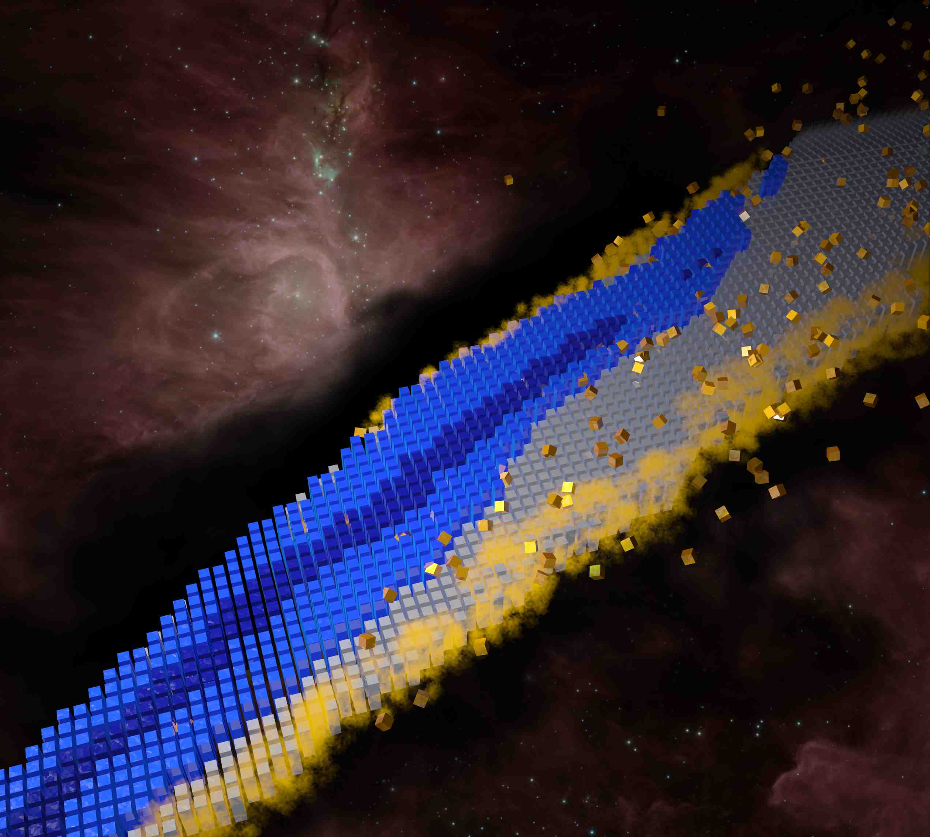
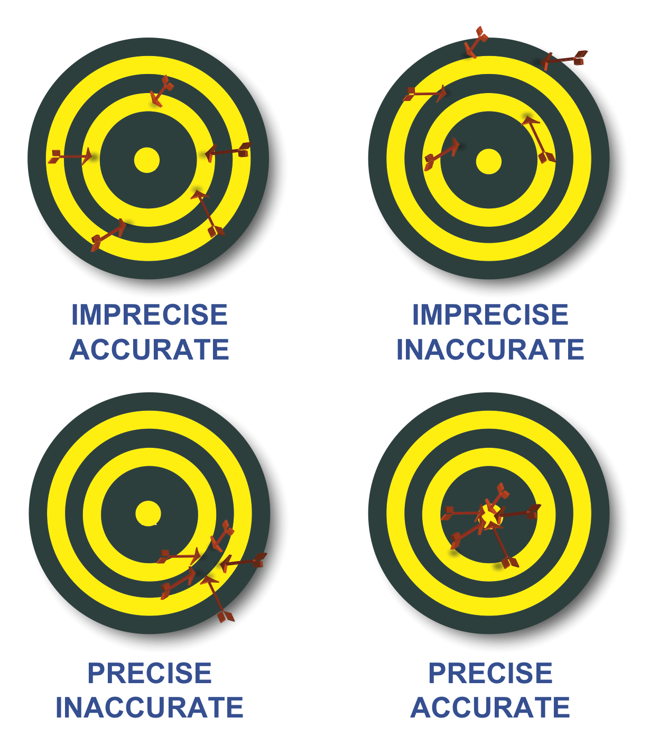
Extrapolations with Bayesian machine learning
Witold Nazarewicz (FRIB/MSU)
Uncertainty Quantification at the Extremes (ISNET-6)
Oct 8 - 12, 2018, TU Darmstadt
Bayesian extrapolations, examples
Bayesian Model Selection and Averaging
Perspective

Slide 2
Next : α-decay Q-values
(with E. Olsen)

Slide 3
Next : Quantified predictions for r-process network simulations
Mass table with covariances (to compute quantified mass differences; Q-values)
Beta-decay and neutron capture rates
Fission yields
Goal: several quantified input sets allowing Bayesian model mixing (first step: UNEDF0 and SV-min, Vojtech’s talk)
Léo’s talk: p_{ex} in the nuclear landscape

Slide 4
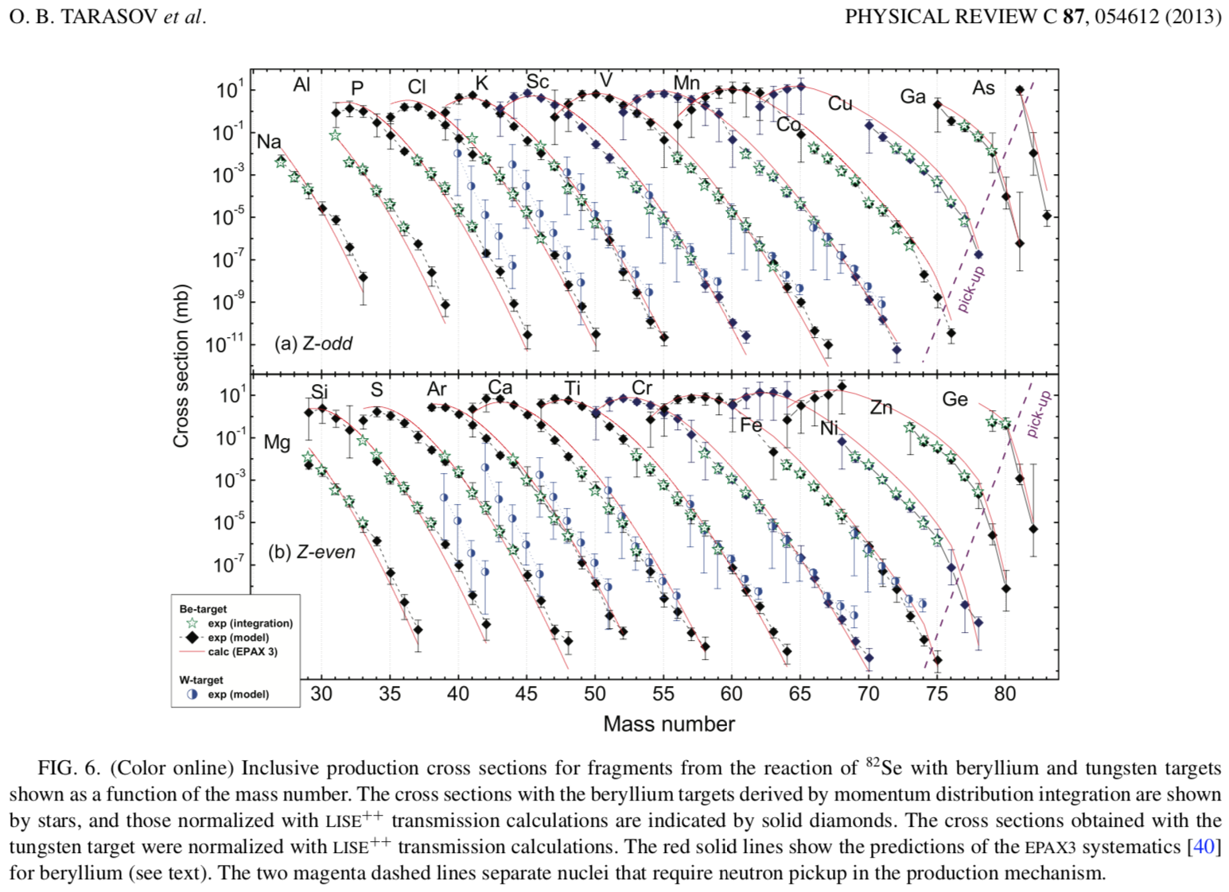
Next : production cross sections for FRIB
(with O. Tarasov)

Slide 5
Naïve nuclear theorist’s approach to a systematic (model) error estimate:
Take a set of reasonable global models M_{i}, hopefully based on different assumptions/formalism, that satisfy basic theoretical requirements (here comes the expert belief thing)
Make predictions: E(y;M_{i})=y_{i}
Compute average and variation within this set
Compute rms deviation from existing experimental data.
Can we do better? Yes!

Slide 6
What is required?
Common dataset Y (as large as possible) needs to be defined
Statistical analysis for individual models needs to be carried out (parameter posteriors determined)
Individual model predictions carried out, including statistical uncertainties
Decision should be made on the prior model probability p(M_{k})
M₁
M₁₂₇₁
M₂
Y
M₃
Y ⊂Y_{α} ⊂Y_{tot}
M_{α}
Y_{α}
set of observables Y_{tot}

Slide 7
Bayesian Model Averaging (BMA)
models considered
posterior distribution given data
Posterior distribution of y under each model
quantity of interest
observables
(data)
posterior probability of a model
The posterior probability for the model M_{k}
prior probability that the model M_{k} is true (!!!)
marginal density of the data; integrated likelihood of model M_{k}
likelihood
prior distribution of parameters

Slide 8
Model selection and Bayes Factor (BF)
BF an be used to decide which of two models is more likely given a result y.
The outcome
The posterior mean and variance of y are:

Slide 9
From Hoeting and Wasserman:
When faced with several candidate models, the analyst can either choose one model or average over the models. Bayesian methods provide a set of tools for these problems. Bayesian methods also give us a numerical measure of the relative evidence in favor of competing theories.
Model selection refers to the problem of using the data to select one model from the list of candidate models. Model averaging refers to the process of estimating some quantity under each model and then averaging the estimates according to how likely each model is.
Bayesian model selection and model averaging is a conceptually simple, unified approach. An intrinsic Bayes factor might also be a useful approach.
There is no need to choose one model. It is possible to average the predictions from several models.
Simulation methods make it feasible to compute posterior probabilities in many problems.
It should be emphasized that BMA should not be used as an excuse for poor science... BMA is useful after careful scientific analysis of the problem at hand. Indeed, BMA offers one more tool in the toolbox of applied statisticians for improved data analysis and interpretation.

