Slide 2
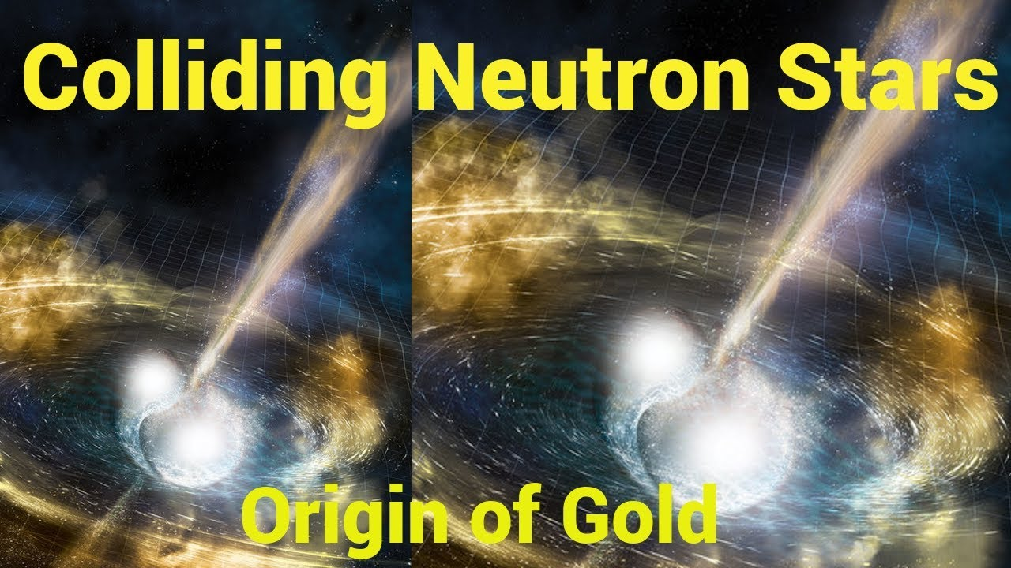
?
Aprahamian Extreme Matter Institute
Alikhanyan National Laboratory Nov. 20, 2018
University of Notre Dame
Notes:
Thank you for the invitation to EMMI Days!….it is a Pleasure to be here …
Our century is young…but the the observation of gravitational waves from a merger with the simultaneous measurement
Of the light…may turn out to be one of the greatest discoveries of the century….science media…public media…even the business media was interested!
Solar masses of Gold!

Slide 5
Observations revealed the event forged roughly 50 Earth masses' worth of silver, 100 Earth masses of gold, and 500 Earth masses of platinum.

Slide 6
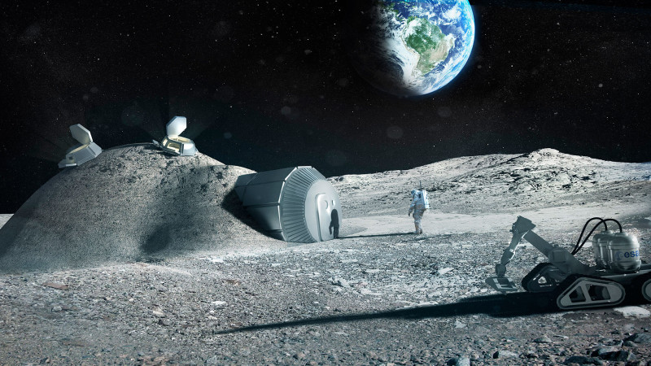
Financial Times
Special Report: Space mining?

Slide 7
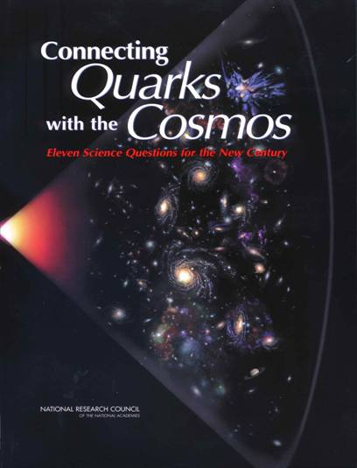
Eleven Most Challenging Open Questions…21st Century
What is dark matter?
What is dark energy?
How did the universe begin?
Was Einstein right about gravity?
How have ν shaped the universe?
What are nature’s most energetic particles?
Are protons stable?
Are there new states of matter at exceedingly high density/energy?
Are there additional dimensions?
How were elements Fe to U made?
Is a new theory needed at the highest energies and EM Fields?
Notes:
More important or relevant to us....is did it answer one of the

Slide 8
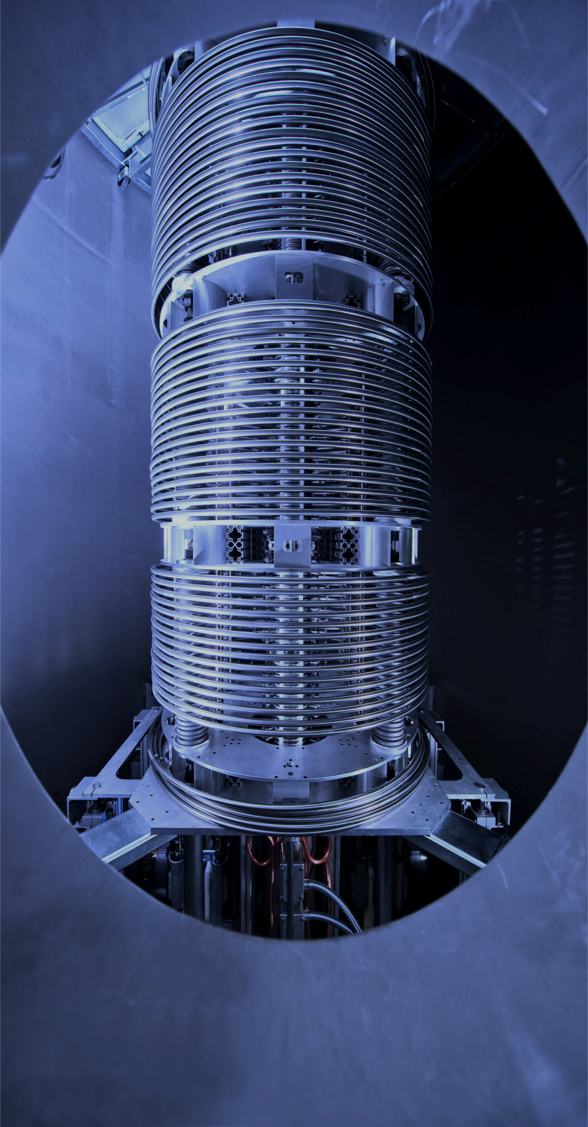
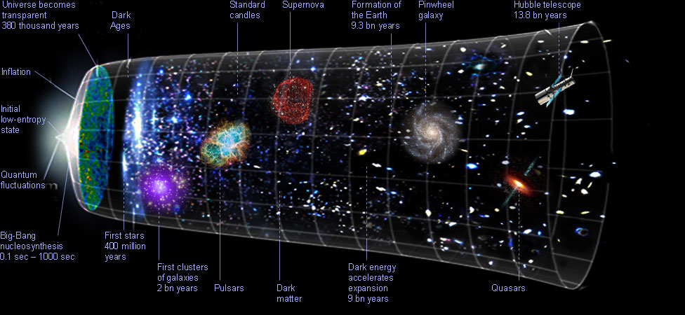

Origin of the heavy elements:
are gravitational waves from neutron star mergers the answer?
Notes:
.Title: Origin of the heavy elements…identified as one of 11 big unknowns in all of physics in the beginning of this century….
And then…last August….A lot of excitement about the observation of gravitational waves in August of 2017..GW170817…Rush to discovery and solution of one of one of the great challenges….
are gravitational waves from neutron star mergers the answer….Spoiiler Alert…..We don’t know yet…..I would like to take you on a trip today through the universe with a nuclear physics lens…..

Slide 9
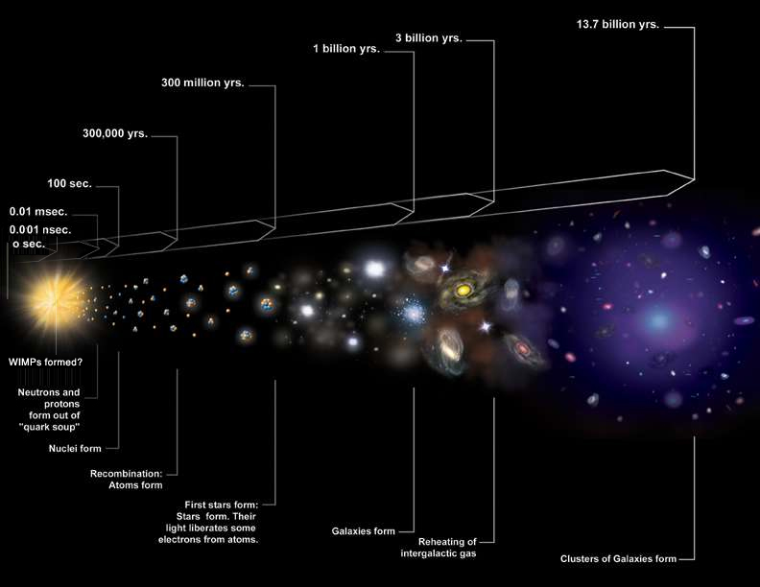
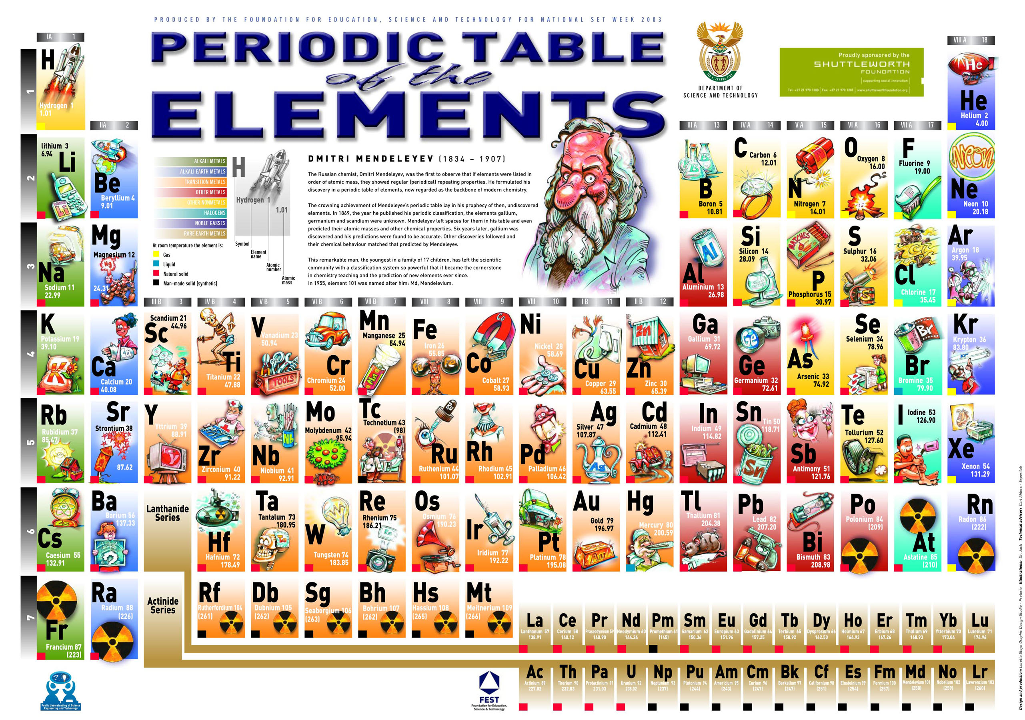
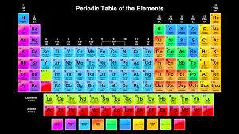
Notes:
THE TIME LINE OF THE UNIVERSE….SHORTLY AFTER THE BIG BANG…NeuTRONS AND PROTONS FORM…THE PRIMORDIAL ELEMENTS…STARS…
THE EVOLUTION OF STARS TO THE PRESENT DAY SYSNTHESIS OF THE ELEMENTS AS WE KNOW IT TODAY…
….over the history of the universe….nuclear physics has not changed….
The universe or the astrophysical conditions have changed ….nuclear physics does what it can in the ….and then the results….of nuclear physics acting on the astrophysical scenario produces what we see….in this case the abundances of the heavy elements….that is the lens we take towards solving one of the greatest open questions in all of physics today.

Slide 10
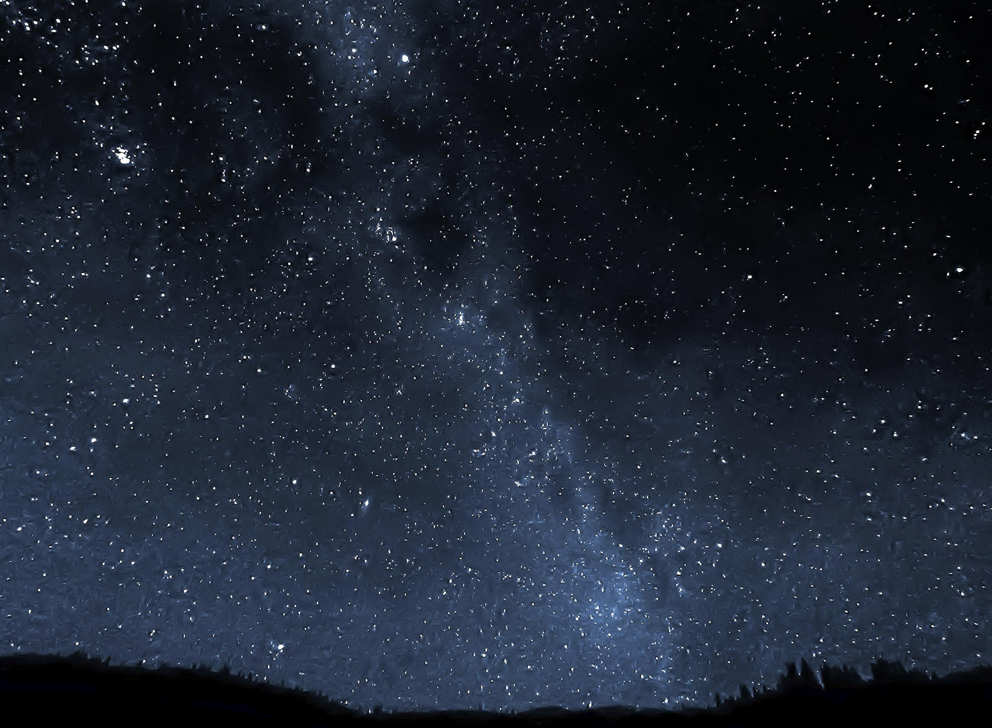
Notes:
Spectacular view of milky way in the night sky…preponderance of stars…varying luminocities, varying stages between life and death…….stellar evolution…that is how quickly a star burns up its fuel and what are the ashes of the burning up….because they determine the future.
Challenges: Unknown nuclear structure of these light nuclei that enhance or detract from the fusion..or burning processes…And the reaction rates at stellar temperatures or energies….

Slide 11
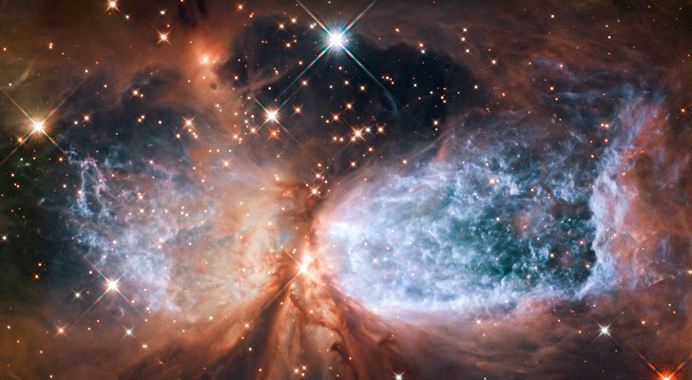
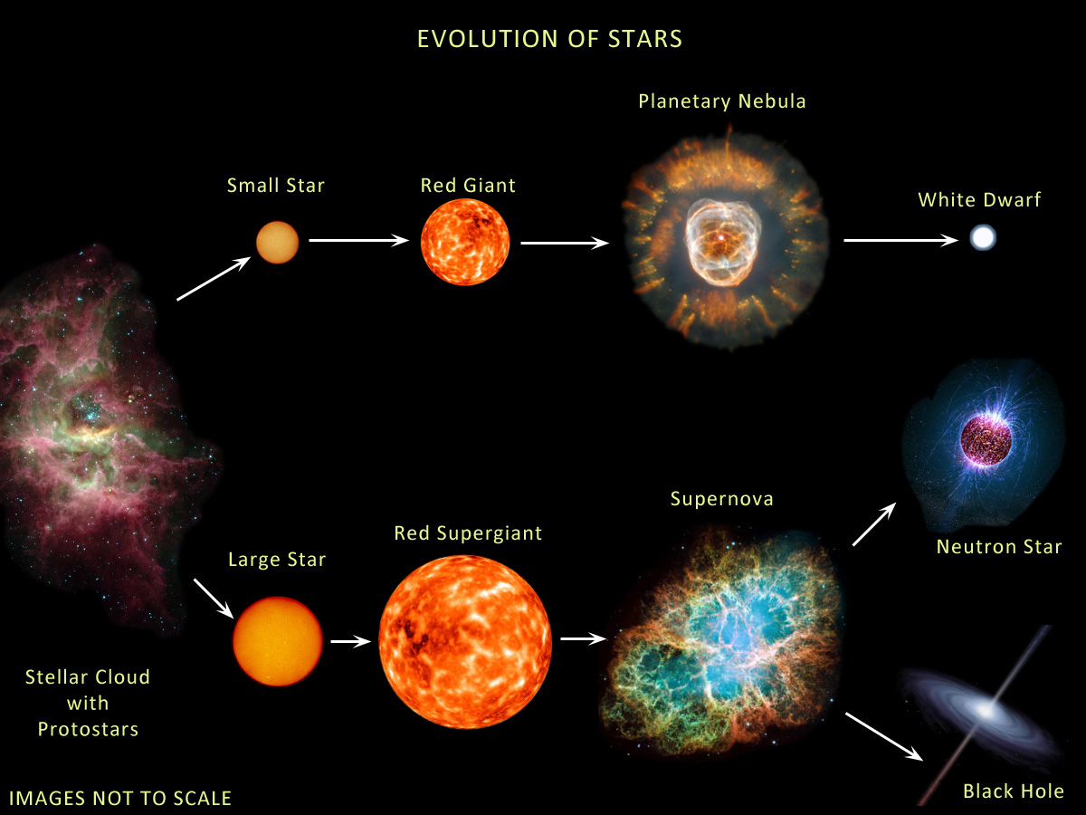
Notes:
STARS ARE BORN of the interstellar gas……they live AND DIE ALL THE TIME IN THE UNIVERSE….AND THEIR LIFECYCLE /ENERGY GENERATION IS DETERMINED WITH WHAT NUCLEAR REACTIONS ARE POSSIBLE…the structure of light nuclei can enhance or slow down the life of a star depending…..

Slide 12
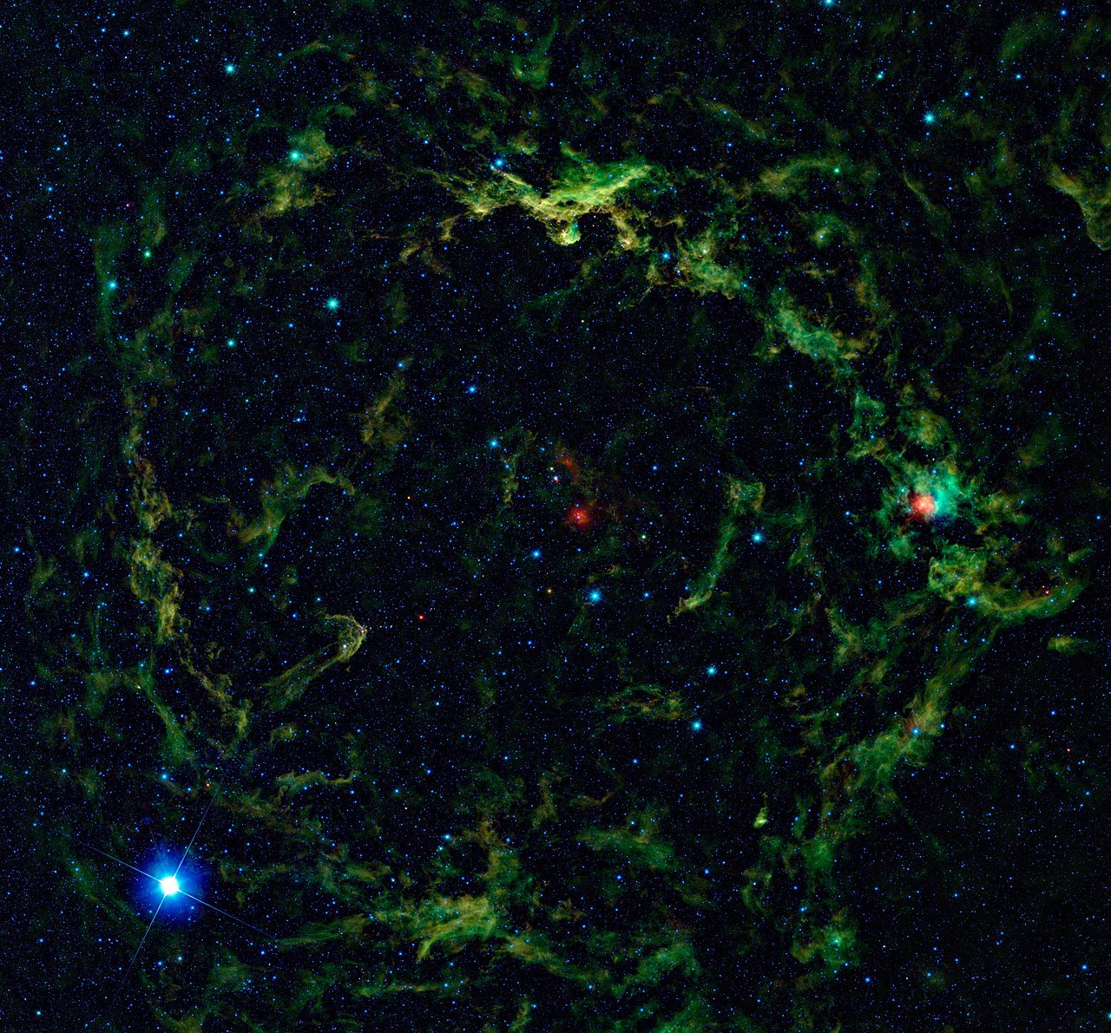
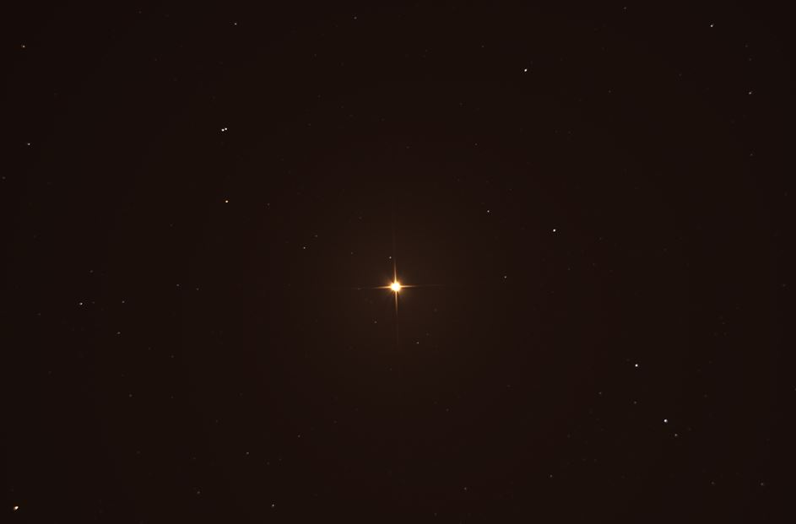
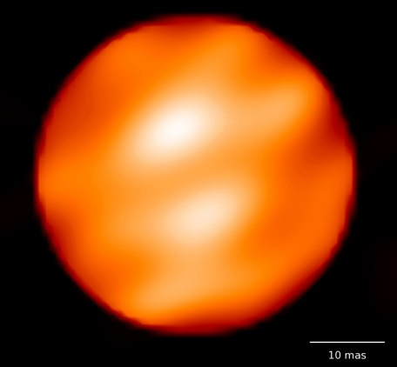
The engine of stars
Nuclear physics determines life and death of stars

Slide 13
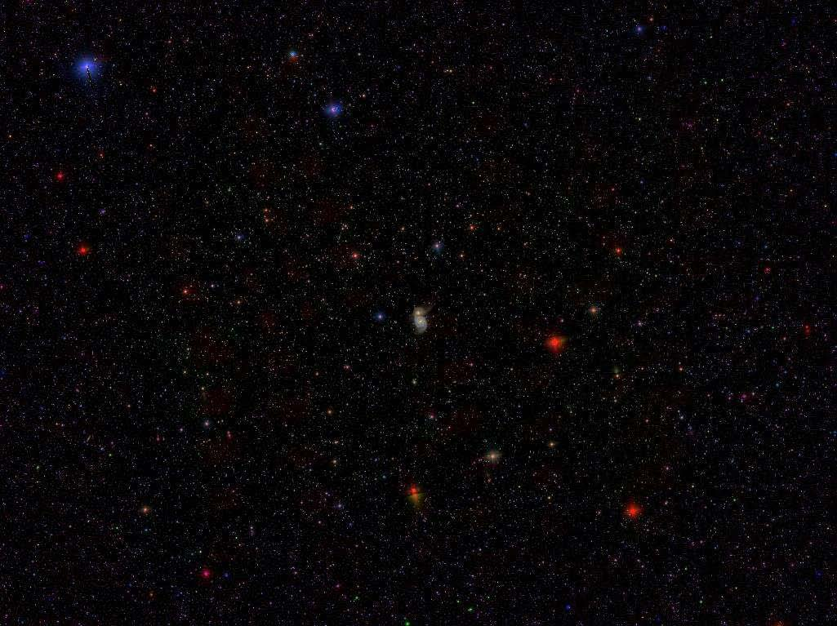
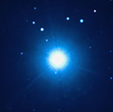
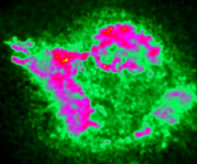
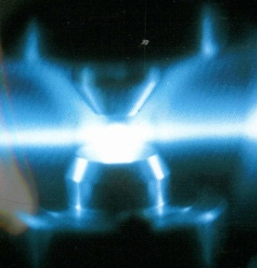
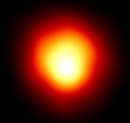
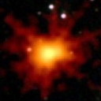
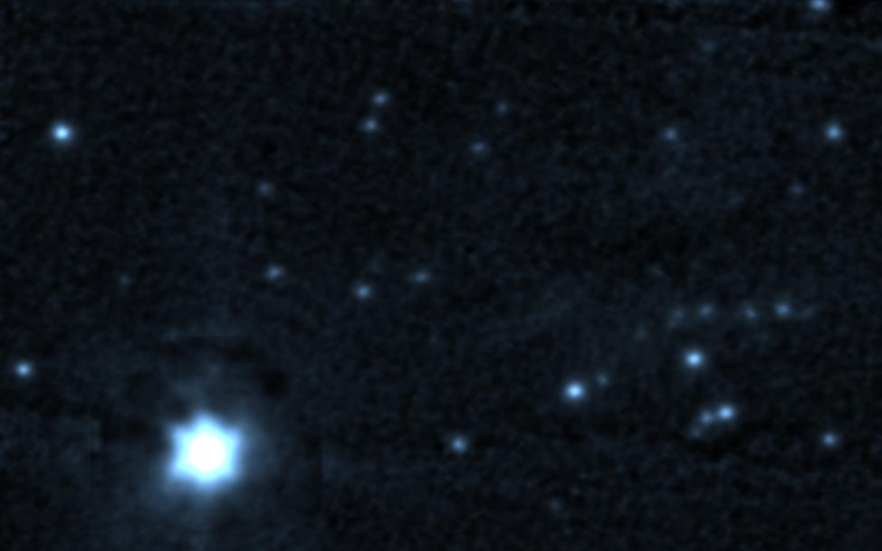
Stellar Evolution
Main sequence
10
Si-ignition
O-ignition
Ne-ignition
9
Solar neutrino production
Solar metallicity
The lifetime of stars
The nuclear fuel conditions
Stellar neutron sources
The ignition of type Ia supernovae
The seed for explosive processes
C-ignition
log (T_{c})
He-ignition
8
H-ignition
7
0
2
4
4
6
8
10
log (ρ_{c})
Notes:
Main sequence stars
TEMPERATURE AND DENSITY CONDITIONS THAT ALLOW A STAR TO REMAIN IN THE MAIN SEQUENCE OR TO FALL OUT OF IT…..has consequences to
NEUTRINO PRODUCTION
METALICITY ARE SIGNATURES
THEY PROVIDE THE SEEDS OF WHAT IS TO COME LATER….

Slide 14
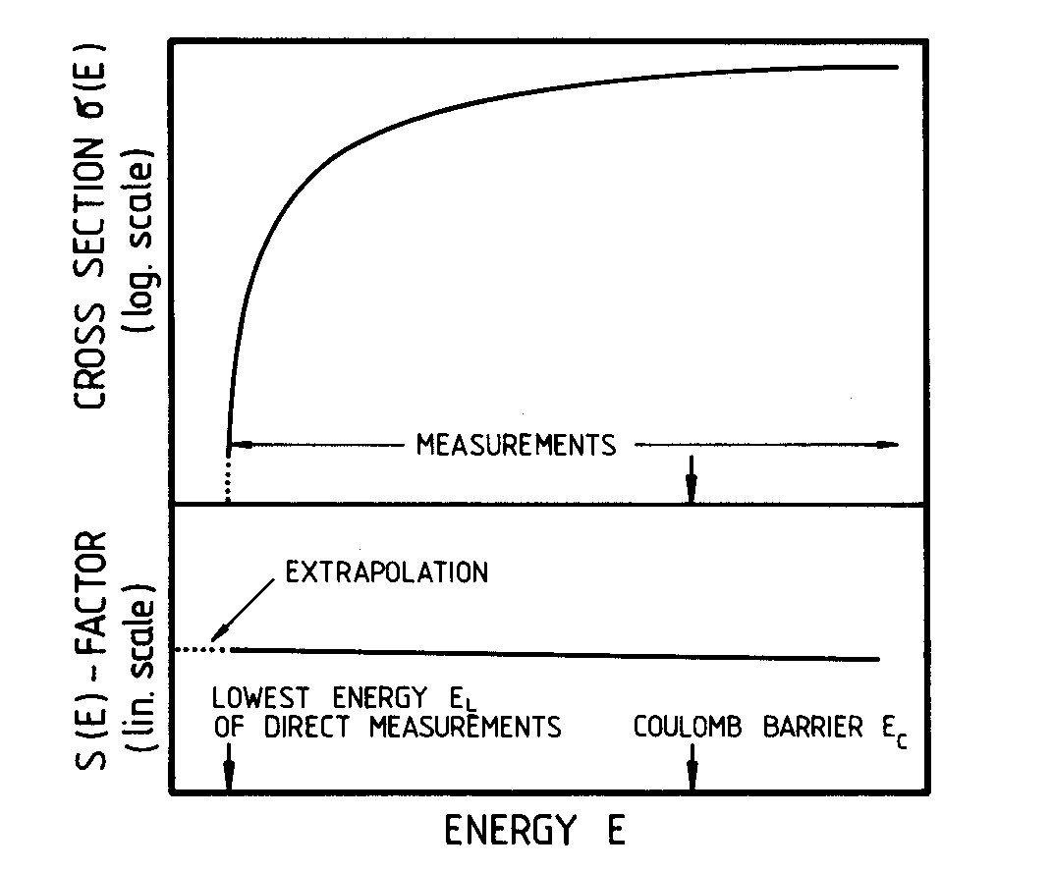

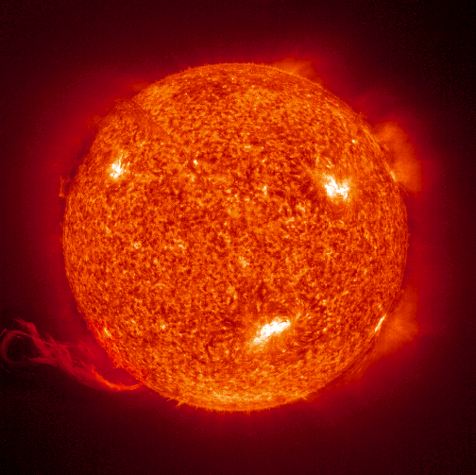
Stellar Reaction Rates
Characterize the engine of stars; determine the energy production, provide the fuel for next burning stage and generate the seed for explosive stages towards the end of stellar life. Also important for identifying observation signatures.
MB distribution
background

Slide 15
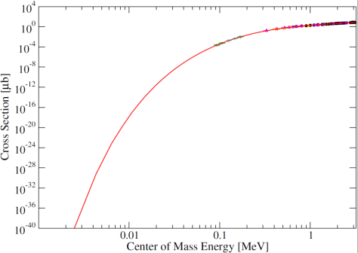
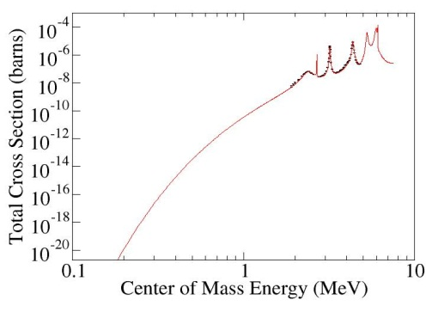
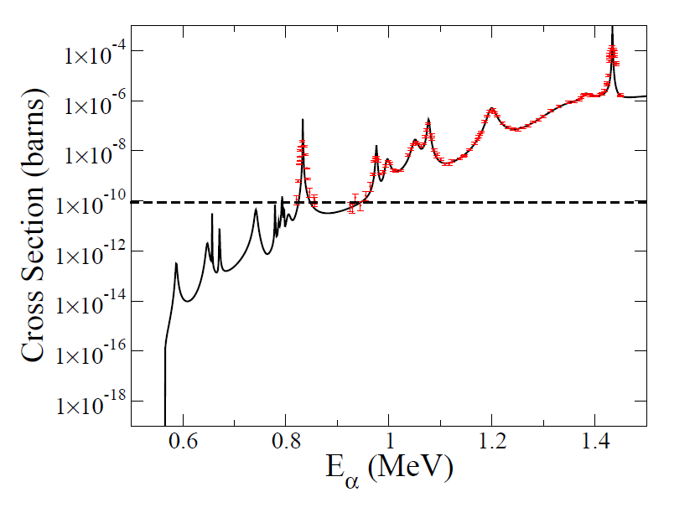
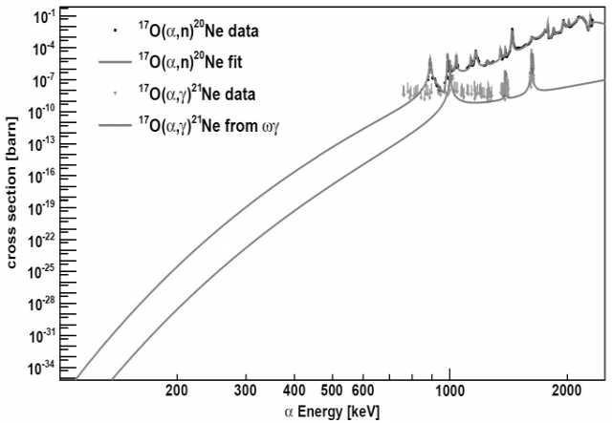
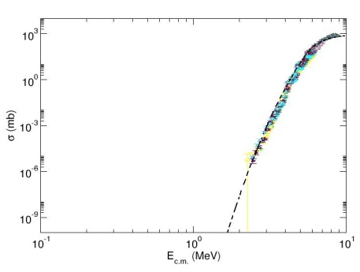
The experimental challenges
determine, energy production, isotopic abundance distribution, timescale of stellar events –The name of the game is to identify the critical ones!
¹⁴N(p,γ)¹⁵O
³He(α,γ)⁷Be
¹²C(α,γ)¹⁶O
¹²C+¹²C
²²Ne(α,n)²⁵Mg
¹⁷O(α,n)²⁰Ne
Challenge is to model the experimental cross sections towards a reliable form to translate into reaction rates: Direct reaction models, R-matrix, statistical HF model are all part of the game!
Notes:
LOW CROSS SECTIONS….

Slide 16
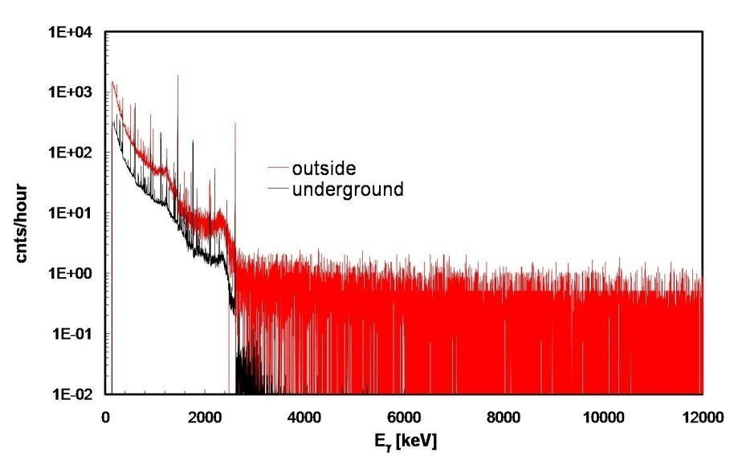
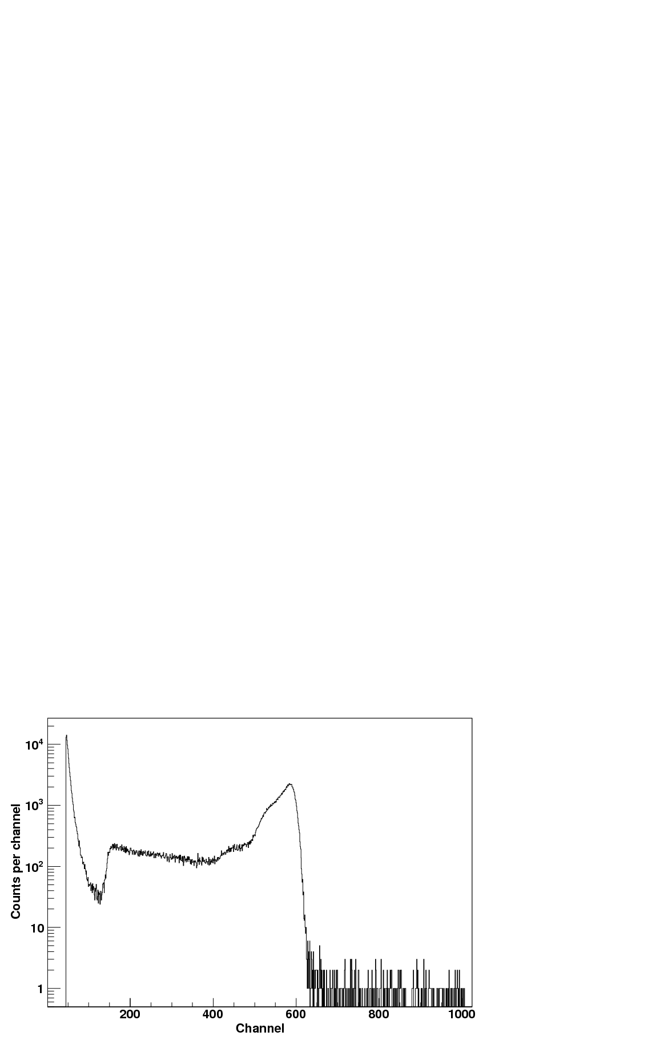

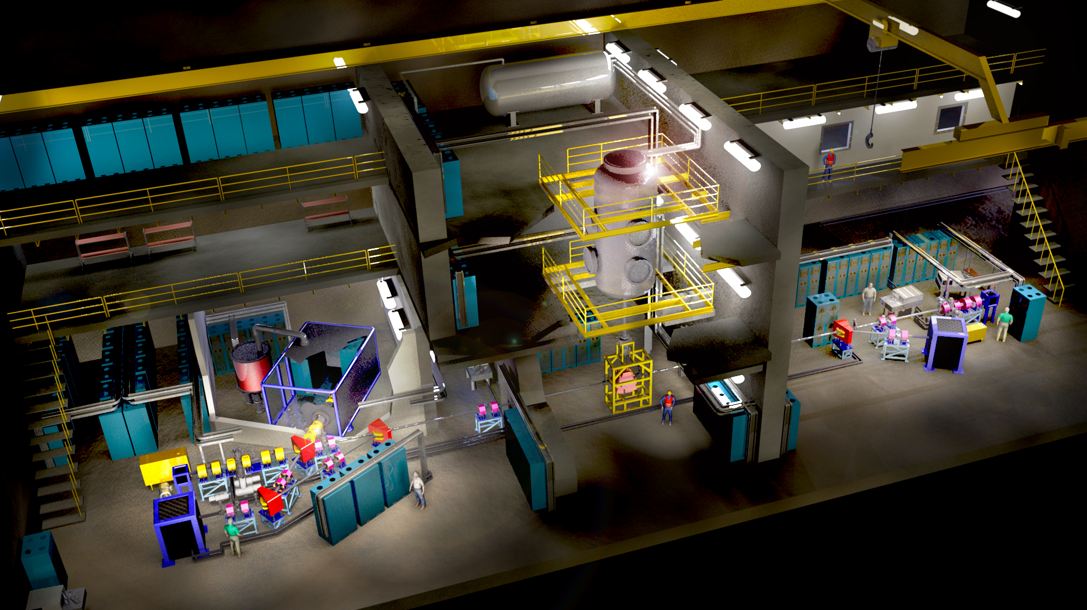
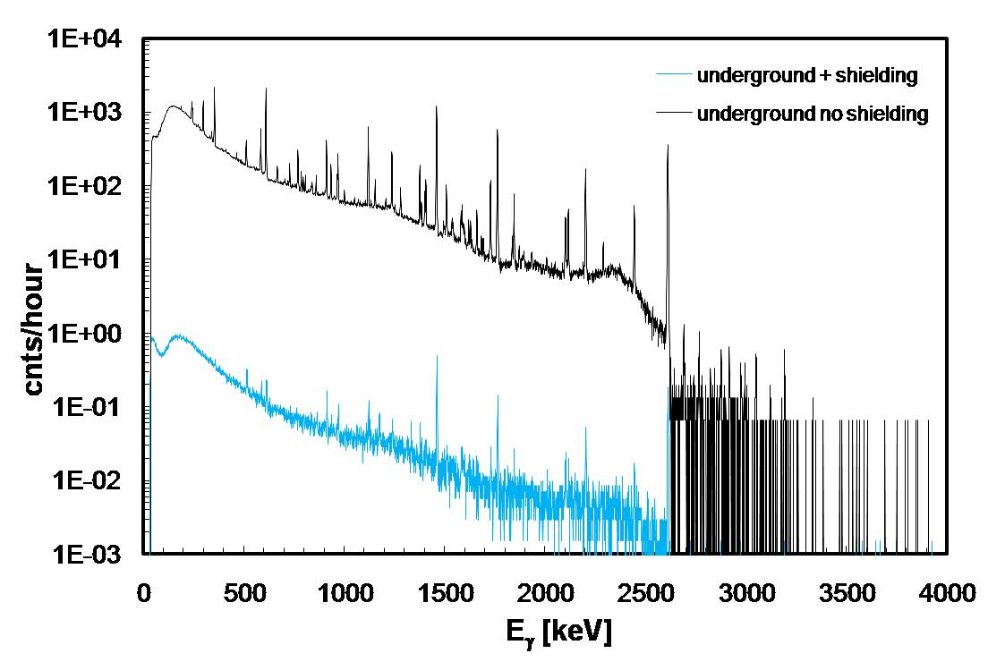
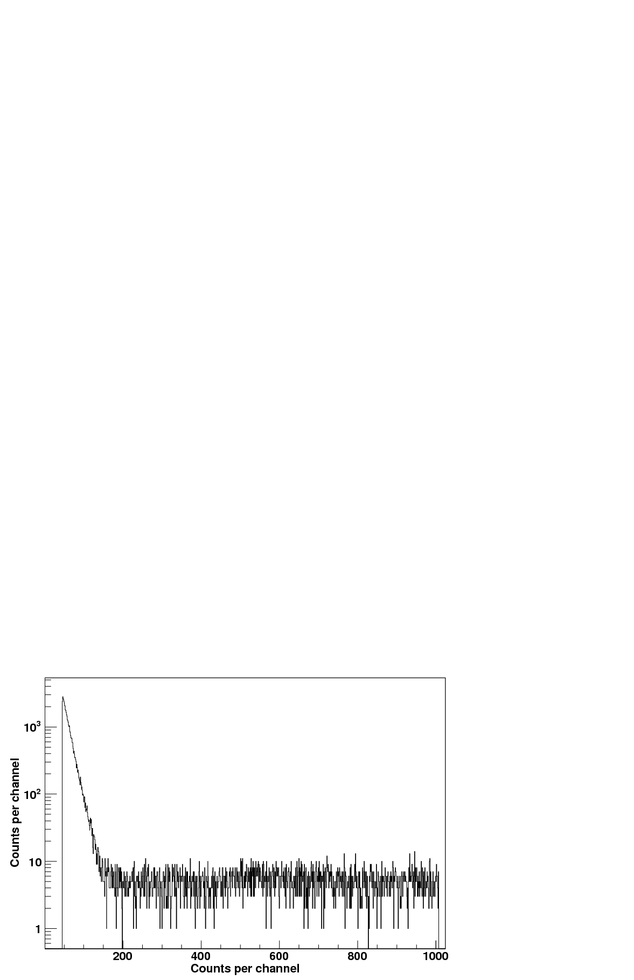
Underground accelerator project DIANA
Environmental Radioactivity
CR induced neutron spectrum
CR induced γ spectrum
underground gamma spectrum
(Gran Sasso)
underground neutron spectrum
(KURF, Soudan)
up to 5 orders of magnitude reduction
p, α, HI beams
100 x LUNA luminosity
High luminosity, low background experiments

Slide 17

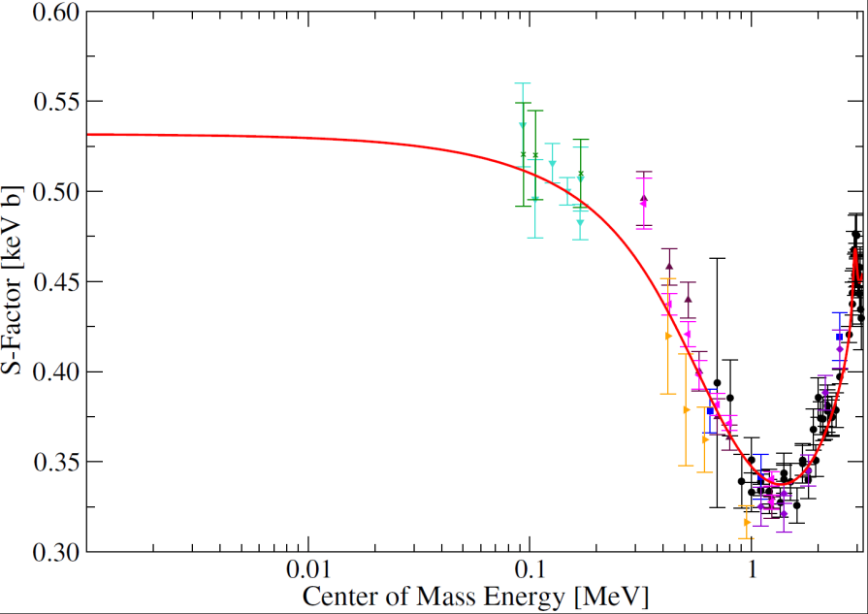
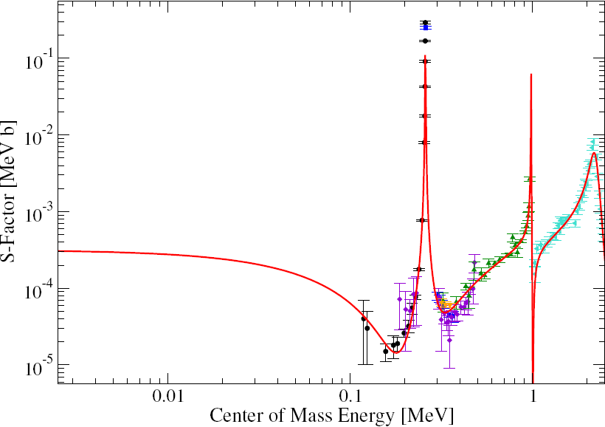
The two most critical rates
³He(α,γ)⁷Be
¹⁴N(p,γ)¹⁵O

Slide 18

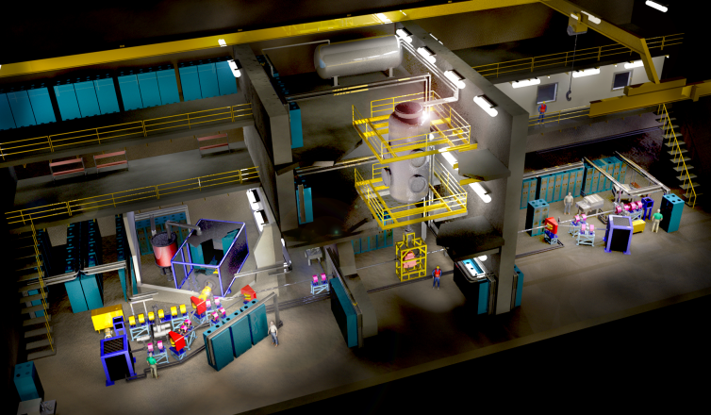
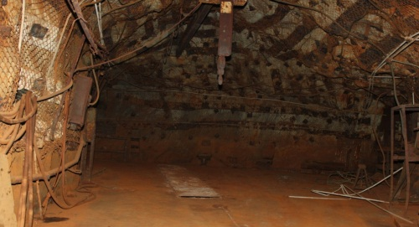
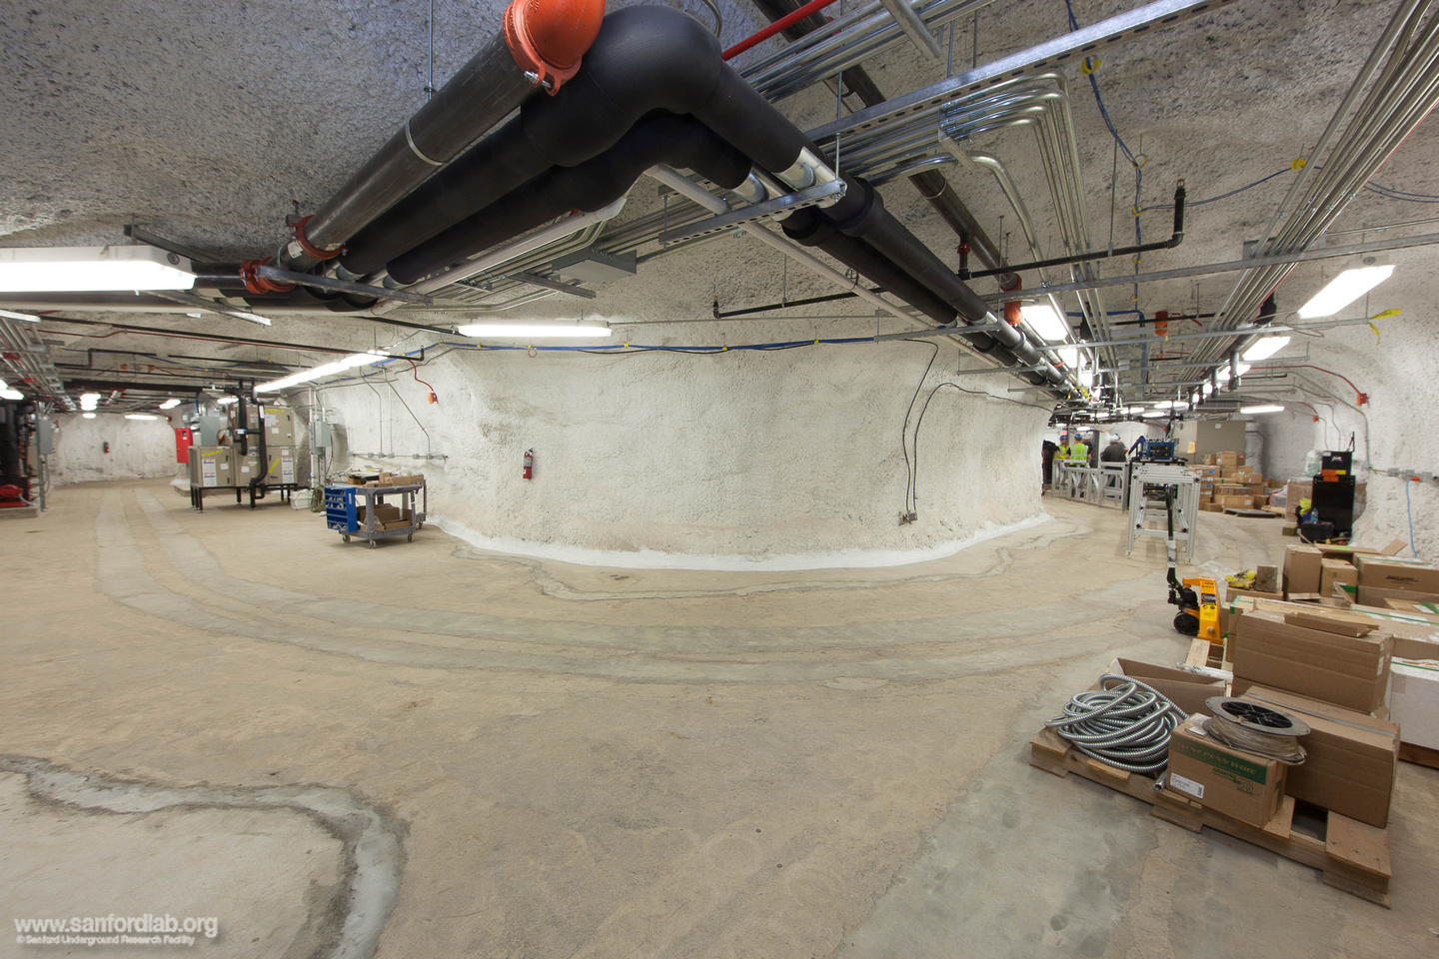
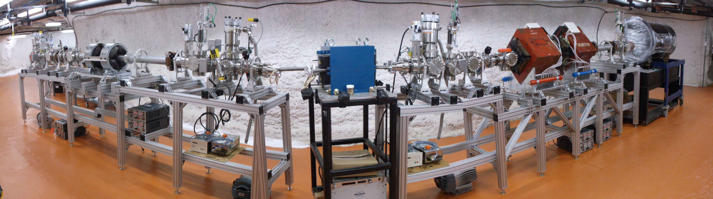
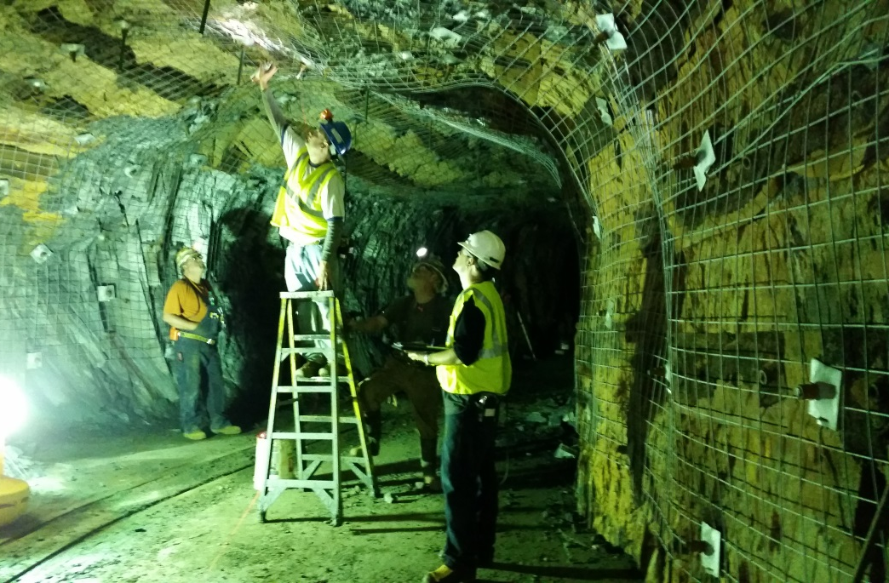
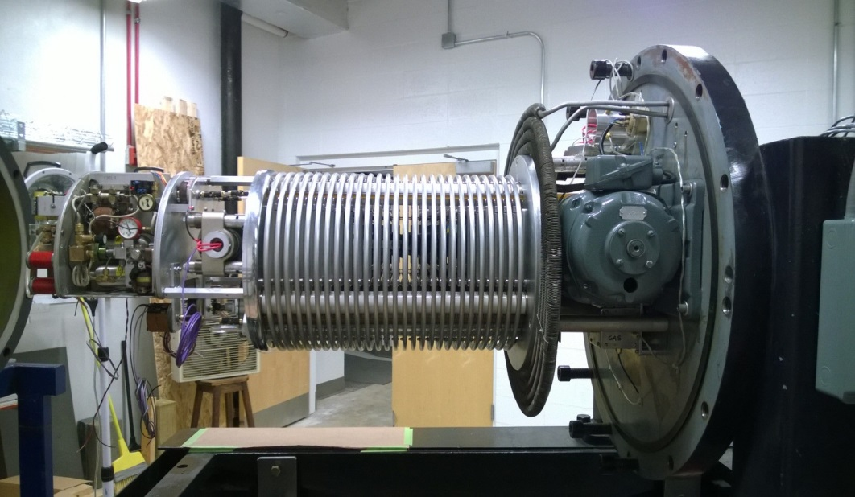
From DIANA to CASPAR
Move down instead of up!
DIANA, plans for the construction of a deep underground accelerator facility at SURF .
CASPAR as pilot project
Thanks to Sequestor, the DIANA Demonstrator
Vault completion in August 2015
Project will be run in close collaboration with the SDSM&T and LUNA, Italy

Slide 19
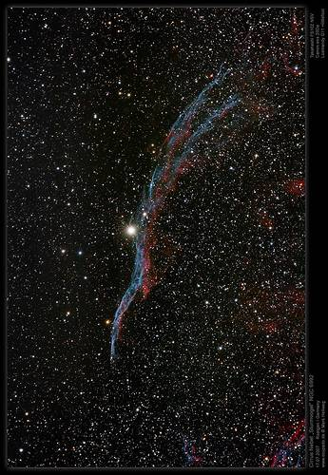
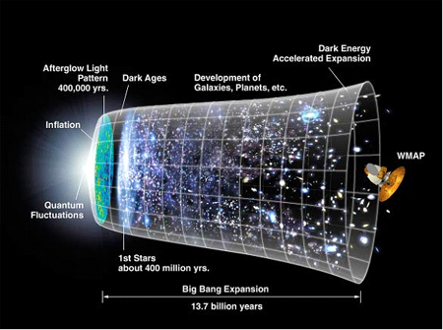
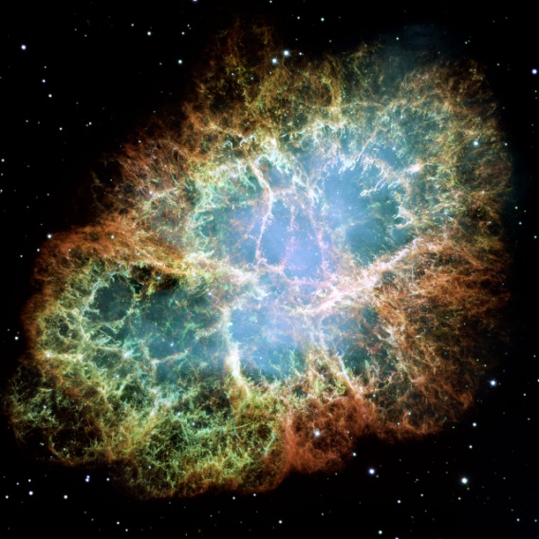
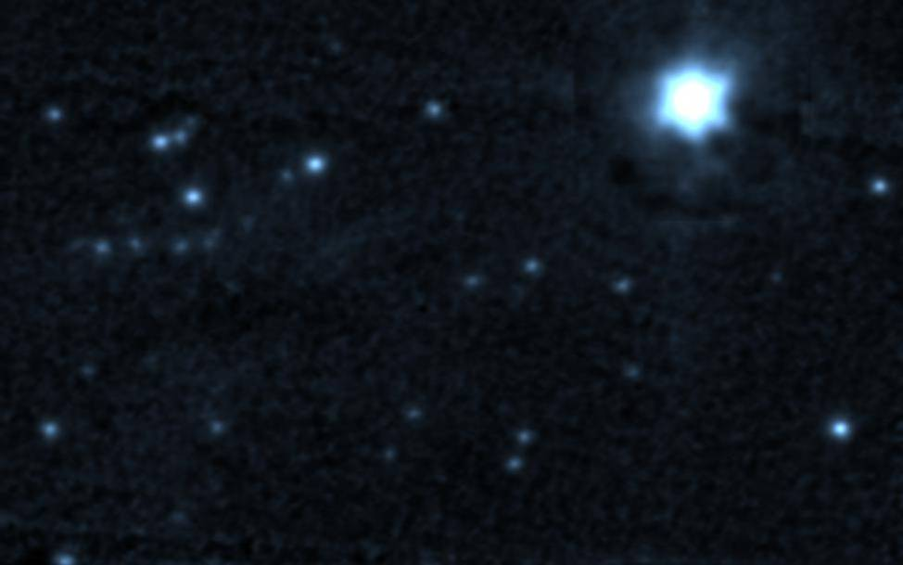
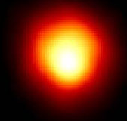
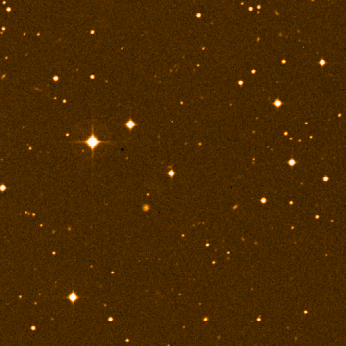
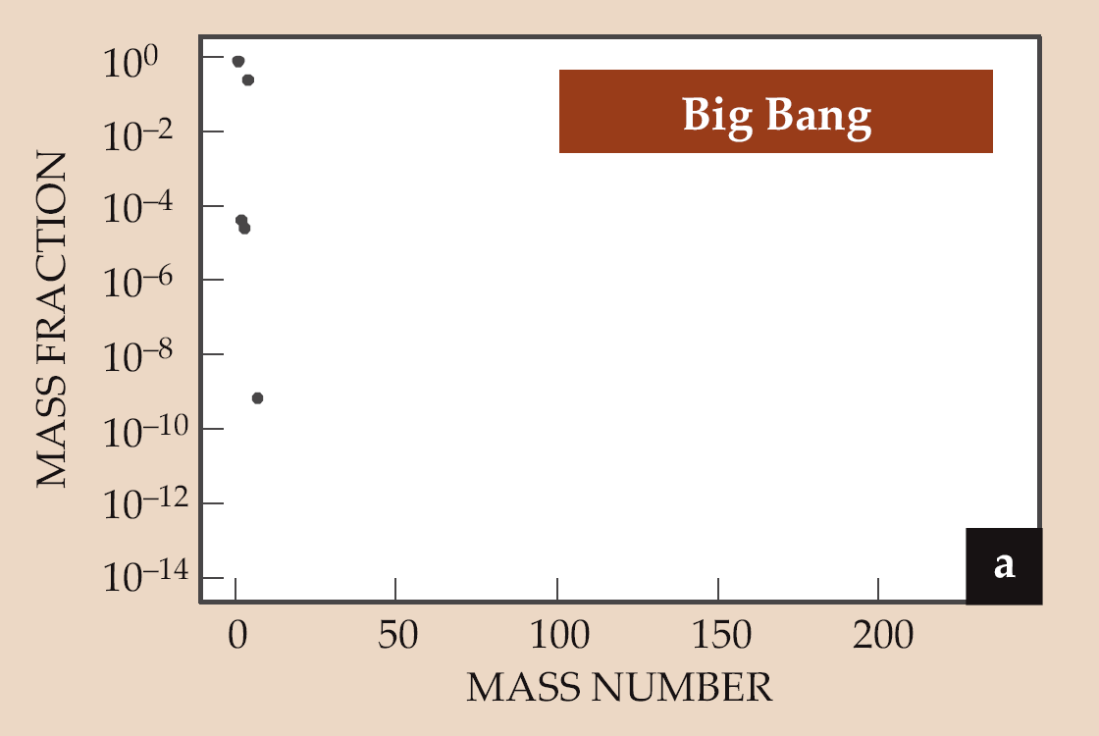
M. Wiescher
H. Schatz
Sr
Notes:
Nuclear Physics is imbedded in the observed abundances of the elements…..history of the universe….nuclear physics + astrophysics give us the observed abundances ….Binding Energy per nucleon …..stars…..neutron capture processes…. Slow and fast….

Slide 20
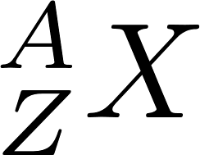

r process
β-decay
(γ, n)
(n,γ)
Proton Number, Z
General classifications:
Hot :
Cold: no equilibrium, competition between decay and neutron-capture
Neutron Number, N

Slide 21
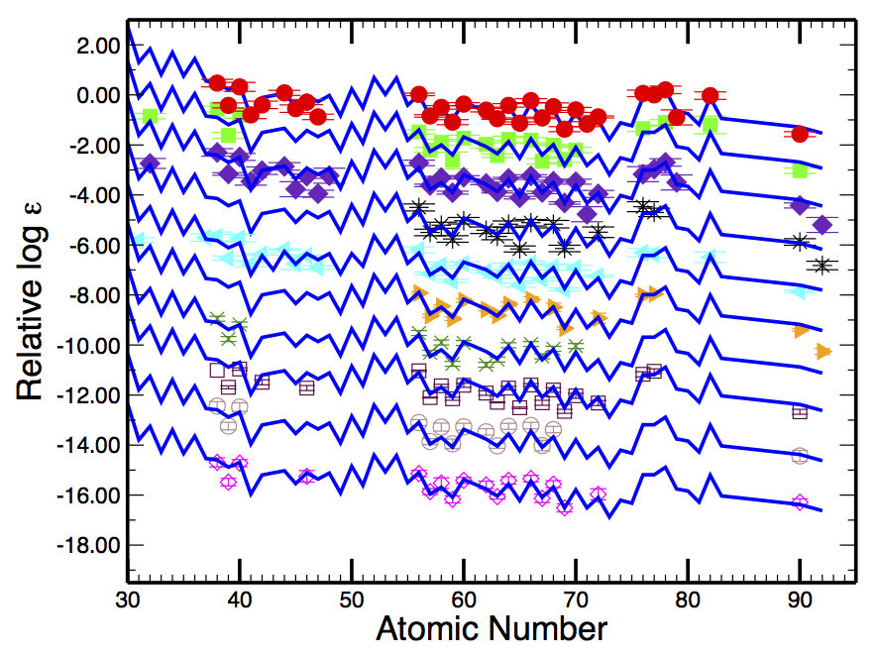


r-process
Explosive
Cowan et al. 2011
Origin of more than 50% of all the elements beyond iron
Site of r-process is still one of open challenges in all of physics today
Temperature, density as a function of time, initial compositions, neutrons
Notes:
We had two popular scenarios…the issues were we know what physics has to take place! Neutron capture processes….
Core collapse supernovae…did not get up to the actinides…ran out of neutrons
Mergers…expected to get all the way up to actinides…frequency of mergers was an issue…
The signatures are robust from observers…indicating a unique source…even in ancient dwarf galaxies
Compact object mergers…

Slide 22


Slide 23


Slide 24

What is the Role
of
Nuclear Physics
Experiments?
Notes:
Nuclear physics has not changed over the history of the universe….Basic Nuclear Physics tells us that the heavy elements had to be made in neutron processes
challenge is that we don’t know properties of nuclei with great certainty far from stability….at large densities
Origin of the heavy elements…
What is the role of nuclear physics experiments…after all…we have built RIKEN, FRIB, CERN, other facilities….
What is the site of the r-process….

Slide 25








Motivations
Origin of the heavy elements in the universe?
Can we measure nuclei along the r- process path?
Which ones are the most important?

Slide 26


Slide 27
How do you decide which nuclei to measure
What is the required precision?
Courtesy of N. Vassh

Slide 28

What are the Nuclear Physics Challenges? Nuclear Structure
Major Shells and evolution of shells…
R-process Sensitivity Studies
Mumpower, Surman, McLaughlin, Aprahamian, et al.
Nuclear masses
β-decay rates
n- capture
β-delayed n-emission
Onset of deformation

Slide 29

Legend
Solar Data
Baseline

Slide 30

Legend
Solar Data
Baseline
(n,g)-rates only

Slide 31

Legend
Solar Data
Baseline
(n,g)-rates only
Beta-decay rates only

Slide 32

Legend
Solar Data
Baseline
(n,g)-rates only
Beta-decay rates only
Sn only

Slide 33

Legend
Solar Data
(n,g)-rates only
Beta-decay rates only
Sn only
All together
Over an order of magnitude difference in the Y(A) for 0.5MeV addition in mass of 140-Sn!

Slide 34
CARIBU
FRIB
¹³⁸Sn
¹³⁶Sn
¹⁴⁰Sn
Notes:
What is the mechanism behind 25% change in separation energy?

Slide 35


Same astrophysical trajectory (hot r-process): 3 different mass models
FRDM
DZ
HFB-21
FRIB
EPJ Web of Conferences 66, 07024 (2014)
Notes:
Qian trajectory…H….T9 -1.5 density 3.4x10² g/cm^{3….}dynamical calculation with temperature and density to decline exponentially …(dynamical timescal of 0.86 s)
Neutron/seed ratio of 67 with a seed of 70Fe electron fraction Ye=0.190 (compared to n/seed ratio of 86 for a 90Se seed).
Gray…measured in AME2012

Slide 36


3 different astrophysical scenarios with the same mass model (FRDM)
s/k = 10
s/k = 100
s/k = 200
Notes:
Entropy per baryon
Astrophysical conditions determine the location of the r-process path…which is set by the temperature and neutron number density.
Trajectories are three adiabatic wind parameterization of Meyer as implemented by us…
T=10GK
Ye= 0.15…0.25…and o.30

Slide 37

Mumpower, Surman, McLaughlin, Aprahamian
Progress in Particle and Nuclear Physics 86, 2016
FRIB
Low entropy hot wind
FRIB
High entropy hot wind
Cold wind
FRIB
FRIB
Neutron Star Merger
F- values available and provide motivations to rib facilities worldwide

Slide 38


Each sensitivity study has prompted JINA-CEE collaborations
Ani Aprahamian - CPT
Fernando Montes - RIKEN
Iris Dillmann - BRIKEN
Nuclear masses
β-decay rates
n- capture
β-delayed n-emission

Slide 39
Mumpower, Surman, McLaughlin, Aprahamian
Progress in Particle and Nuclear Physics 86, 2016
RIKEN
CPT at CARIBU
ISAC at TRIUMF
★
Experimental reach for the present and future…

Slide 40


Improvements that can be realized
with new experiments …
Extrapolated AME2012 + FRDM2012
Surman, Mumpower, Aprahamian, Mazurian Lakes, 2015
FRDM2012
FRIB reach

Slide 41

What is the required precision?
ΔBE=+/- 0.5 MeV
Mumpower, Surman, McLaughlin, Aprahamian, Progress in Particle and Nuclear Physics 86, 2016
Notes:
How precisely ?

Slide 42


Slide 43

Hot r-process trajectory
rms error reduced to 100 keV
Mumpower, Surman, McLaughlin, Aprahamian
Progress in Particle and Nuclear Physics 86, 2016

Slide 44


CARIBU
The CAlifornium Rare Isotope Breeder Upgrade facility
proton Number
Neutron Number

Slide 45

Penning trap mass measurements

Slide 46



Penning Traps
Strong magnetic field provides radial confinement
Addition of hyperbolic electric potentials produce axial confinement
TOF-ICR Method was standard
Phase-imaging mass measurements
Use a position-sensitive MCP with delay-line anode to
measure the position of ions when they hit the MCP.
Notes:
Phase imaging ion-cyclotron resonance technique

Slide 47



CARIBU MR-TOF
MIRROR
300mm
LIFT
750mm
MIRROR
300mm
Sized-up replica of the ISOLTRAP MR-ToF
Fast, high-resolution isobar separator
Consists of two electrostatic mirrors separated by a central lift electrode. Each mirror has six independently controlled electrodes
Between each electrode is a shielding electrode held at intermediate voltage.
Ions cycle back and forth between mirrors and pick up a time separation according to t~$\sqrt{\frac{m}{q}}$

Slide 48
MR-TOF capture/eject

Slide 49



MR-TOF Performance A = 150

Slide 50


Known masses in the rare-earth region
PI-ICR
Fission from ²³⁵U --- Finland - TOF-ICR
TITAN – TRIUMF -

Slide 51

TOF-ICR: JyFLTRAP
Phys. Rev. Lett. 120, 262701, 2018
No N=100 subshell closure

Slide 52

Fission recycling
Without fission recycling
A
Notes:
Rare earth abundance peak…formed by the dynamical processes or fission recycling?

Slide 53

Mumpower, McLaughlin, Surman, and Steiner
J. Phys. G: Nucl. Part. Phys. 44, 034003 (2017)

Slide 54


The rare-earth peak
Two proposed ways to form the rare-earth peak
  Dynamical formation during freeze-out
  Fission cycling
Dynamical formalism needs some nuclear structure effect where material can “pile up” as they decay towards stability.
N=82-126
Courtesy of R. Orford
Notes:
Neutron star merger wind in the absence of significant neutrino flavor transformation….Conditions are not neutron rich enough for fission cycling….

Slide 55

Mumpower, McLaughlin, Surman, and Steiner, Astrophysical Journal, 833:282, 2016

Slide 56


Results
Duflo Zuker mass model prediction
Considered a hot r process environment that you may find in the accretion disk of neutron star merger scenario
Comparing predicted masses to measurements allows us to say something about the astrophysical environment.
Phys. Rev. Lett. 120, 262702 (2018)
Notes:
Same mass surface…orange and red….but slightly different disk wind parameters

Slide 57
Orford et al., Phys. Rev. Lett. 120, 262702 (2018)
Merger accretion disk wind scenario
Varying thermodynamics has little effect
Notes:
Varying thermodynamics has little impact….the masses make a huge difference….

Slide 58
Courtesy of N. Vassh

Slide 59

Results
N. Vasshe et al.

Slide 60


What is the Role of Nuclear Physics Experiments?
Conclusions:
Nuclear Physics is the engine of the cosmos
Comprehensive sensitivity studies of the r-process to individual nuclear
properties
Propagation of mass changes to all dependent properties
(self-consistence)
Identifying the site of the r-process path….
Disentangling Nuclear Physics uncertainties
from the Astrophysical uncertainties…Progress.
Details of neutron merger scenario….nuclear physics
Nuclear Physics provides insight into details of r-process
Role of Nuclear Physics
Experiment
Notes:
Precision of nuclear masses…..

Slide 61







