Slide 1
Designing for availability:
Modelling approaches based on industrial best-practices and experience from the operational facilities based on practical examples
APEC Workshop – Reliability and Availability of Particle Accelerator
10-12 December 2018, Fleming's Hotel, Frankfurt am Main
Jussi-Pekka Penttinen

Slide 2
Outline
Introduction
  Ramentor, ELMAS, RAMS, Risk assessment process
Practical examples of industrial use cases
  Availability and radiation safety of nuclear waste encapsulation plant
  Life Cycle Profit Management (LCPM) – Process critical molding cranes
  Analysis of alternative bypass lines of mineral processing line
  Infrastructure availability – Design-phase data center
  Nuclear Power Plant (NPP) – Safety, availability and performance

Slide 3
Ramentor Oy
Solutions for RAMS engineering and Risk management
Founded in 2006 and based in Tampere, Finland
  Personnel ~10 (Reliability/maintenance management, applied mathematics/software dev.)
  Privately owned and independent software and expertise company
Background: From research to practical applications
  Finnish Technology Agency (TEKES) supported research programs: 1996-2012
  Tampere University of Technology (TUT) research projects: 2001-2012
  Ramentor-TUT-CERN research project for FCC RAMS methods/tools 2014-2018
Please visit for more information: http://www.ramentor.com

Slide 4
Jussi-Pekka Penttinen
Tampere University of Technology (TUT)
  Researcher (2004 – 2008): Reliability analysis, applied mathematics
  Doctoral researcher (2016 – 2018): Thesis now in pre-examination
  Thesis title: An Object-Oriented Modelling Framework for Probabilistic Risk and Performance Assessment of Complex Systems
CERN FCC RAMS methods R&D project (2015 – 2018)
Ramentor Oy
  Chief architect (2006 – Present): ELMAS software

Slide 5
ELMAS – An Acronym
Event
Time to Failure: Distribution/MTTF
Logic
OR
AND
Modeling
Fault tree
Event tree
Analysis
Software
Simulation
Graphical user interface
K/N-Voting
Conditional probability
Cause-consequence-tree
Reliability block diagram
Process diagram
Risk Analysis
Importance measures
Conditional probabilities
FMEA, RCM
Hazards
Costs: Break, downtime, repair
Maintenance: Service actions
Failure modes, RCA
Usage/stress profile
XOR-Exclusive
Limits
Delays
HTML report
Excel export and import
ERP interface
Throughput,
fuzzy logic
Dynamic code/scripts
Reliability, Availability
Spare part consumption
Resources
Web start
Project versioning
Template library
Search
Table summary
External events
Wait/redundancy
Buffers
Time to Repair: Distribution/MTTR

Slide 6
ELMAS – Modelling Techniques
Several modelling techniques are included in ELMAS
Causes and consequences
Dynamic operation phases
Key performance indicator

Slide 7
ELMAS – Comprehensive System Model

Slide 8
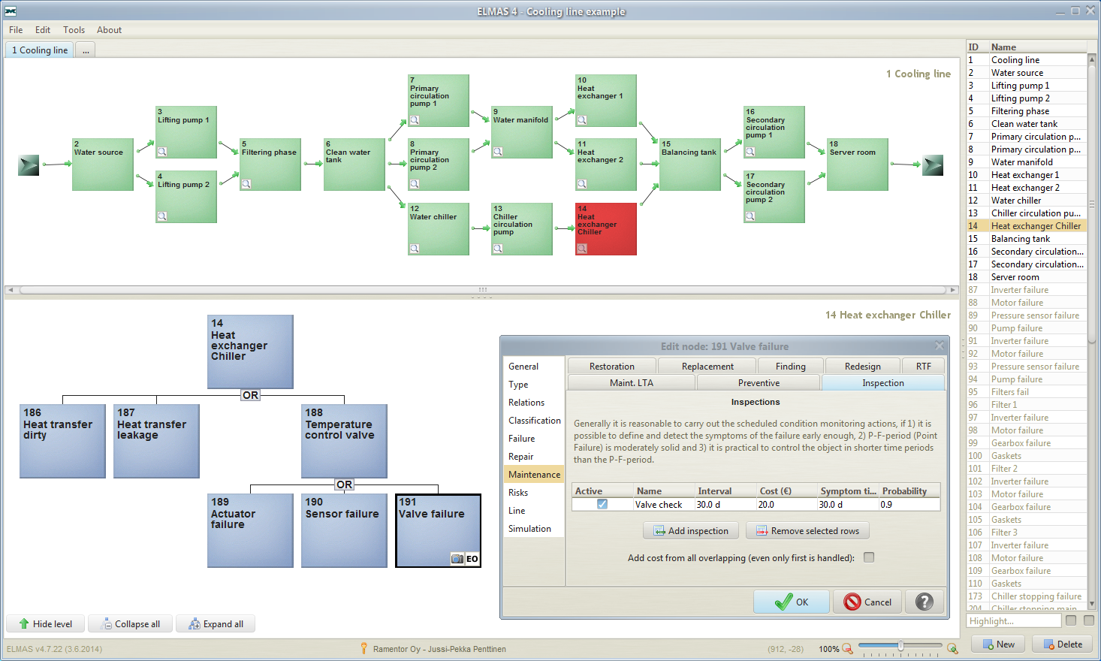
ELMAS 4.9
http://www.ramentor.com/elmas/
Primary cooling circulation - Water
Model process functions (RBD)
Secondary cooling circulation
Water filtration
Primary cooling circulation - Chiller
All items of the model listed
Model failures of the selected system (FTA)
Input data for the selected component

Slide 9
Design for RAMS (Greenfield)
At early design state: Find out any possible design flaws
Design for Reliability
  Needs for redundancy? Change or improve components?
Design for Availability
  Compare production scenarios, manage overall lifecycle
Design for Maintainability
  Optimize maintenance strategies, understand resource needs

Slide 10
Continuous RAMS development (Brownfield)
Identify improvement potential/targets
  Calculate the effect of improvement actions
Justification of investments based on cost calculations
  Compare alternative investments
Maintenance optimization
  Improve dependability or reduce maintenance costs
Use all available history data and improve its quality

Slide 11
ELMAS – Risk Assessment and RAMS
Risk Assessment
Likelihoods/Events
Repair durations
Preventive maintenance schedule & effects
Consequences/Costs
Break and downtime costs
External / conseq. events
Failures
Repair costs
Maintenance costs
Environ., human, etc. hazards
ELMAS
RAMS

Slide 12
ELMAS – RAMS and Risk

Slide 13
Risk Assessment Process (ISO GUIDE 73)
Risk identification (Find, recognize and describe risks)
Risk analysis (Comprehend the nature and determine the level of risk)
Risk evaluation (Compare analysis results with risk criteria to determine whether the risk and its magnitude is acceptable or tolerable)

Slide 14
Risk Assessment Process (ISO GUIDE 73)
– ELMAS: Modeling and Simulation of Explicit Results
Risk identification (Find, recognize and describe risks)
  ELMAS: Collect available information to comprehensive model
Risk analysis (Comprehend the nature and determine the level of risk)
  ELMAS: Stochastic discrete event simulation of the model
Risk evaluation (Compare analysis results with risk criteria to determine whether the risk and its magnitude is acceptable or tolerable)
  ELMAS: Report explicit results, compare scenarios, …

Slide 15
Risk Management Concept
Objectives + Requirements
C) Operation & Maintenance
Technical Management
A) System
Design
Actual Performance
B) System Realization

Slide 16
A) System Design Processes
Feasibility study (Stakeholders expectations/requirements)
  Desired performance (1) – Function specification
Conceptual design (System/structure requirements)
  Desired performance (2) – System/Structure specification
Detail design (Main component requirements)
  Desired performance (3) – Component specification

Slide 17
A) System Design Processes
– ELMAS: Creation of specification models
Feasibility study (Stakeholders expectations/requirements)
  Desired performance (1) – Function specification
  ELMAS: Risk event cause-consequence model
Conceptual design (System/structure requirements)
  Desired performance (2) – System/Structure specification
  ELMAS: Functions-Systems-Structures-Components model
Detail design (Main component requirements)
  Desired performance (3) – Main component specification
  ELMAS: Operation and Maintenance model

Slide 18
B) System Realization Processes
Planning Stage
  Work Packages (WP) + Suppliers
  Objectives + Requirements + Cost budget + Time schedule
Procurement Stage
  Bids specification and proposal comparison, Supplier selection and contracts
Supply Stage
  Management: Requirements + Data + Design change + …
  Fault tree analysis (FTA) + Failure Modes and Effects Analysis (FMEA)
Installation + Commissioning

Slide 19
B) System Realization Processes
– ELMAS: Design for RAM
Planning Stage
  Work Packages (WP) + Suppliers
  Objectives + Requirements + Cost budget + Time schedule
Procurement Stage
  Bids specification and proposal comparison, Supplier selection and contracts
Supply Stage
  Management: Requirements + Data + Design change + …
  Fault tree analysis (FTA) + Failure Modes and Effects Analysis (FMEA)
Installation + Commissioning
RAMS Engineering Application in Product and Service Business (Excel/Other + ELMAS)
ELMAS –
Design for RAM

Slide 20
C) Operation and Maintenance
Maintenance Optimization
Condition monitoring and predictive analytics
Field failure reporting and corrective actions

Slide 21
C) Operation and Maintenance
– ELMAS: Continuous RAMS assessment
Maintenance Optimization
  ELMAS: Component importance, Maintenance schedule planning
Condition monitoring and predictive analytics
  ELMAS: Predict effect of changes, Compare improvement scenarios
Field failure reporting and corrective actions
  ELMAS: RAMS model update based on collected history data
  Direct connection between RAMS model and operational database

Slide 22
Case examples

Slide 23
Case A) – Final Disposal Facility (FDF)
The purpose of the FDF is to take care of packing the spent nuclear fuel assemblies in canisters and to dispose them permanently into the bedrock
Aboveground encapsulation plant
  Spent nuclear fuel is received, dried and packed into disposal canisters
Repository (ONKALO)
  Tunnels are located deep inside the bedrock, where the encapsulated spent nuclear fuel is disposed of

Slide 24
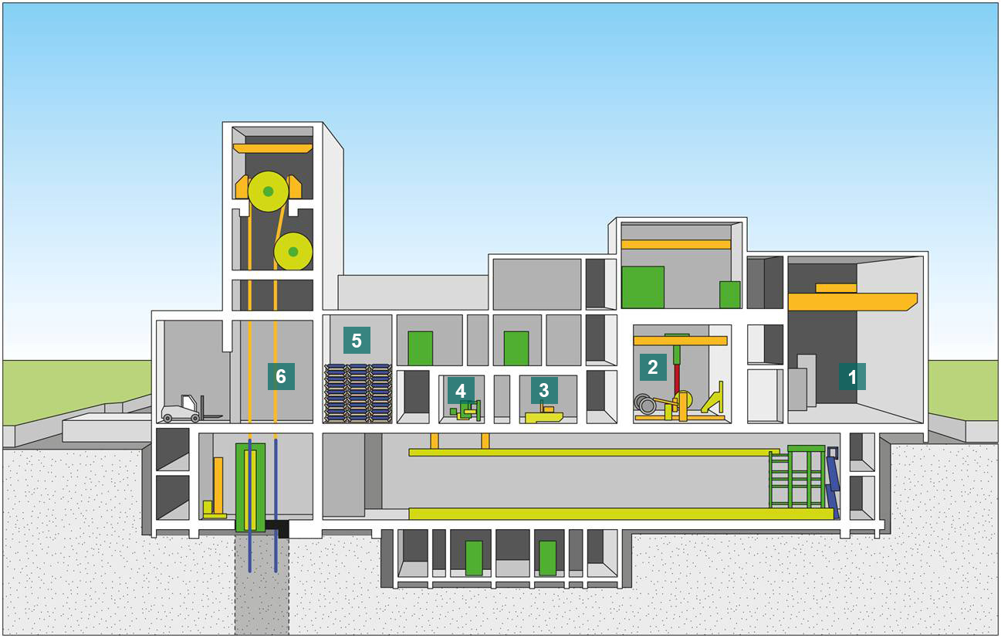
Case A) – Final Disposal Facility (FDF):
Aboveground Encapsulation Plant
1) Receiving and storage area for new canisters
2) Hot cell (Cask -> Fuel drying -> Disposal canister)
3) Copper lid welding chamber
4) Weld inspection
5) Canister surface cleaning area
6) Canister lift for transfer of canisters into repository

Slide 25
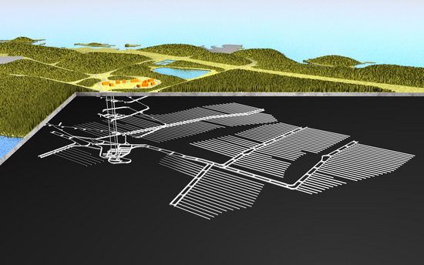
Case A) – Final Disposal Facility (FDF):
Repository (ONKALO)

Slide 26
Case A) – Final Disposal Facility (FDF):
Encapsulation Plant Case Description
ELMAS analyses were made by Pöyry for Posiva
  Availability and radiation safety of encapsulation plant
Transportation cask -> Fuel drying -> Disposal canister
  Availability models: Docking, Lifting, Moving (AGV), Welding, …
PSAM 12: Design review and change management
Safety models and reports
  Ventilation system: Cooling, heating, filtering, low pressure
  STUK (The Radiation and Nuclear Safety Authority in Finland)

Slide 27
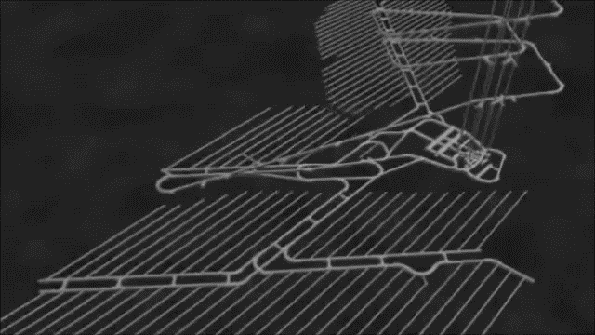
Case A) – Final Disposal Facility (FDF):
Fuel Handling Cell Equipment Example (1/5)
Full video: https://youtu.be/hZI3AYI85n8

Slide 28
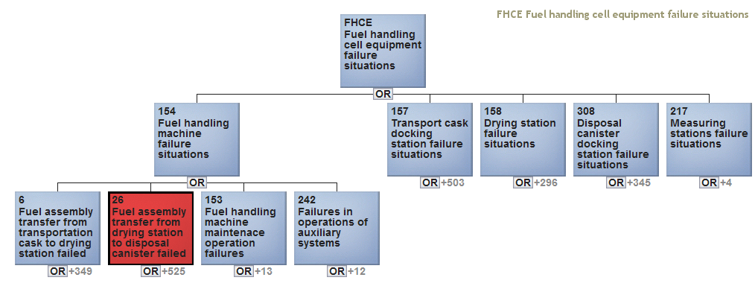
Case A) – Final Disposal Facility (FDF):
Fuel Handling Cell Equipment Example (2/5)
Similar availability models also for:
Receiving and storage are
Transportation cask transfer corridor
Disposal canister transfer corridor
Power supply grid
Ventilation system
Small part of the full FDF availability model
Subtrees of different failure situations are hidden

Slide 29
Case A) – Final Disposal Facility (FDF):
Fuel Handling Cell Equipment Example (3/5)
Remove failed, Move failed, Add failed, …
More detailed causes for availability risk
Fuel assembly
is curved, …

Slide 30
Case A) – Final Disposal Facility (FDF):
Fuel Handling Cell Equipment Example (4/5)
Radiation in fuel handing room
Remove failed, Move failed, Add failed, …
A cause can have other consequences
Not able to close disposal canister
Fuel assembly
is curved, …

Slide 31
Case A) – Final Disposal Facility (FDF):
Fuel Handling Cell Equipment Example (5/5)
Safety risk
Radiation in fuel handing room
Remove failed, Move failed, Add failed, …
Not able to close disposal canister
Fuel assembly
is curved, …

Slide 32
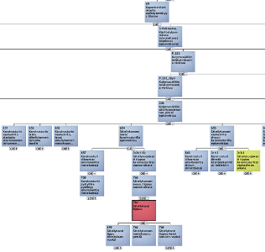
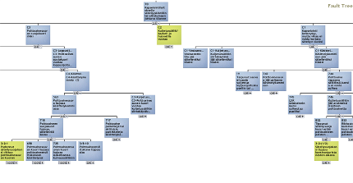
Case A) – Final Disposal Facility (FDF):
Combined Risk Model – Availability/Safety
  All items and their causalities related to availability and safety risks are collected to a comprehensive model:
  Availability and Radiation Safety of Encapsulation Plant
Availability risk
Safety risk
An item in availability model can be a cause also to safety risk

Slide 33
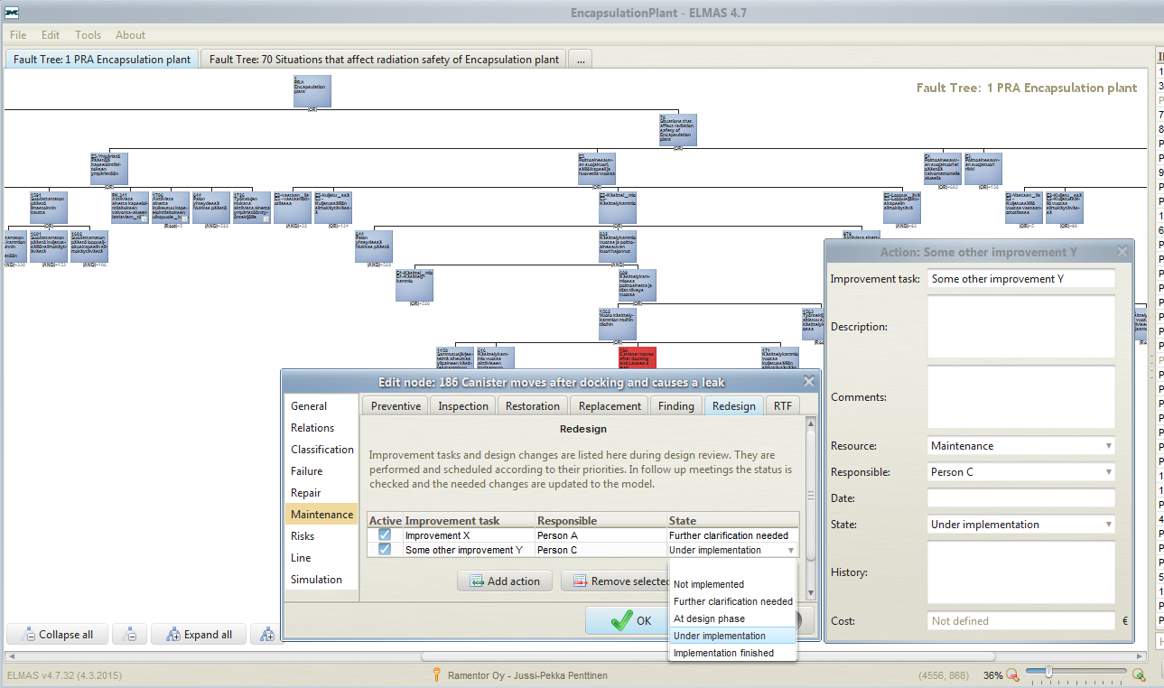
Case A) – Final Disposal Facility (FDF):
Design Review / Change Management
Design Review Process and Management of Design Changes:
List improvement tasks to
items in Design Review
Schedule and prioritize the task listings based on risk and feasibility
Update the status and model the impacts in follow-up meetings

Slide 34
Case A) – Final Disposal Facility (FDF):
Key Findings and Improvements
Comprehensive availability and safety model created
Several changes were made based on design reviews
  Improved identification of unexpected impacts of design changes
  Early stage identification of the problem areas became possible
STUK statement 12/02/2015 (construction license):
  Nuclear waste facility can be built to be safe
Failure tolerance analysis can utilize the created models
  STUK operating license (Common cause failures, Defense in depth levels, …)

Slide 35
Case B) – Life Cycle Profit Management (LCPM)
Aims to maximize the life cycle profit of an investment
Guides development work and investment decisions to focus on overall costs (not just investment costs)
  All relevant cost factors from specification to decommission
Emphasizes to take unavailability into consideration
  Production loss
  Break costs
  Overtime work costs

Slide 36
Case B) – Life Cycle Profit Management (LCPM):
Molding Crane

Slide 37
Case B) – Life Cycle Profit Management (LCPM):
Molding Cranes Case Description
Scenario analysis of two process critical molding cranes
  Work rhythm 3 shifts/day and 5 days/week
  One crane can handle 75% of the process flow
  Overtime works can be used at weekends if necessary
Comparison of 3 scenarios:
  Current situation
  Modernization of auxiliary hoisting & corrective action planning based on improvements potentials
  Modernization of auxiliary hoisting & renewal of older crane

Slide 38
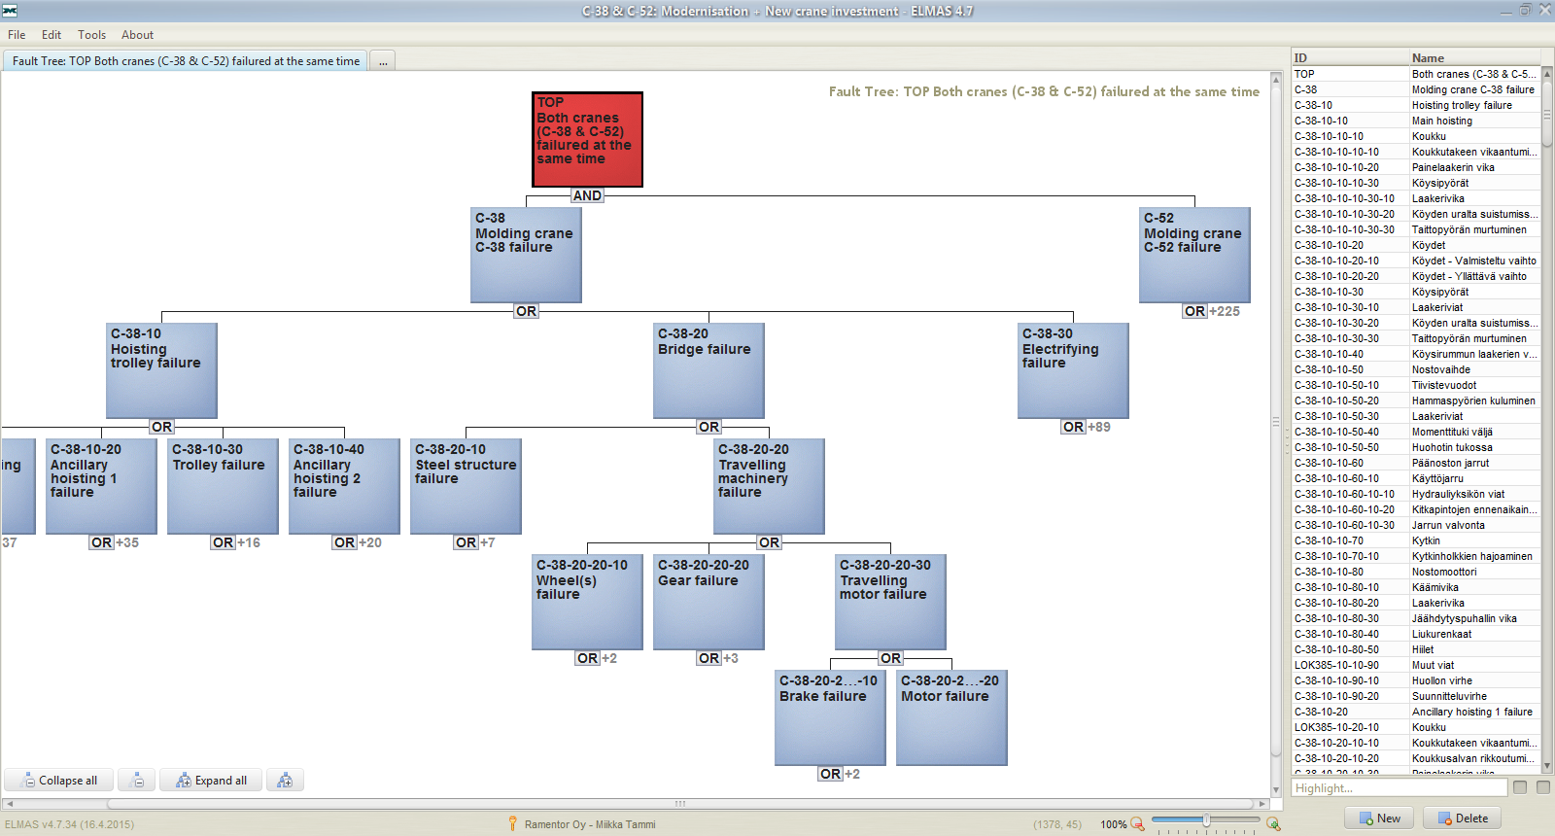
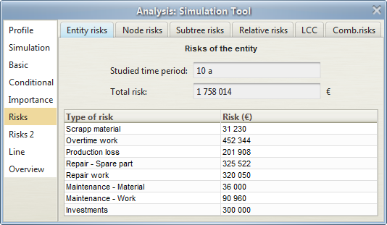
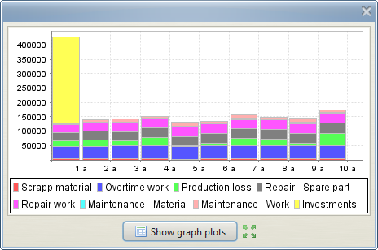
Case B) – Life Cycle Profit Management (LCPM):
Modeling, Simulation and Analysis
Figures are fictional
Modeling of:
Crane failure logic
Cause consequence logic between failure modes, functions, process effects and costs

Slide 39
Case B) – Life Cycle Profit Management (LCPM):
Comparison of Scenarios
Figures are fictional

Slide 40
Case B) – Life Cycle Profit Management (LCPM):
Comparison of Scenarios
Figures are fictional
Scenario 3 has the largest investment costs but the lowest overall costs due to residual unavailability

Slide 41
Case B) – Life Cycle Profit Management (LCPM):
Key Findings and Improvements
Figures are fictional
Based on LCPM analysis, the modernisation of auxiliary hoisting & renewal of older crane (Scenario 3), improves the life cycle profit:
  Production loss reduced ~43 %
  Overtime work costs reduced ~39 %
  Simultaneous failures reduced ~39 % and unavailability ~31 %
  Total cost risk (including investments) reduced by ~16 % and 280 000 € during the 10 years period
  Investment payback time ~5 years

Slide 42
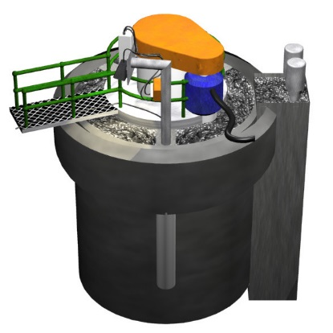
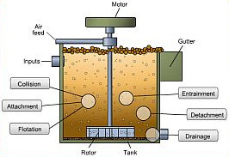
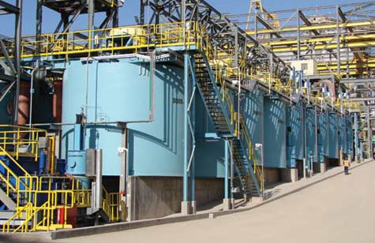
Case C) – Mineral Processing Line
Flotation process
  Six processing tanks
  Installed in series
  Forming three tank pair units
Goal of process
  Recover metal particles from the slurry flowing through the tanks
  with the help of rising air bubbles from the bottom of the processing tank

Slide 43
Case C) – Mineral Processing Line (MPL):
Case Description
The main goals of the project were:
  Determine the availability and OEE of the analyzed process line
  Locate critical failure modes for the line operation
  Create methods for increasing the OEE value of the process
Project team created a model (Experts from Ramentor and client)
  All mechanical and automation components of processing tanks and supporting systems, and process and user-related faults were included
Overall equipment effectiveness (OEE)
  In addition to availability also performance (and quality) included

Slide 44

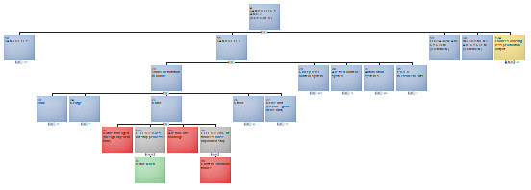
Case C) – Mineral Processing Line (MPL):
ELMAS Project Model
The flow characteristics model of the flotation process was combined with extensive
fault tree analytics
600 nodes
200 failure modes

Slide 45
Case C) – Mineral Processing Line (MPL):
Key Findings
The failure events slowing down the production had a major effect on the line OEE value (High availability, Low OEE)
  Failures stopping the production caused 30% of the total loss
  Failures slowing down the process 70% of the total loss
    Focus on the situations slowing down the process
About 10% of the failure modes caused over 83% of the total lost production
    Focus on the highest impact failure modes

Slide 46
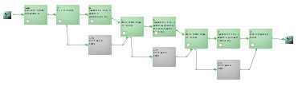
Case C) – Mineral Processing Line (MPL):
Improvement – Maintenance bypass lines
The effect of maintenance bypass lines installation
  Direct the process flow around when a tank pair on repair
  Only minor slowing down for the process during bypass
Tank pairs
Bypass lines
Manufacturer can justify the investment to customer
  Lost production decreases by millions of euros during 10 years
  The installation is quite inexpensive -> Very good investment!

Slide 47
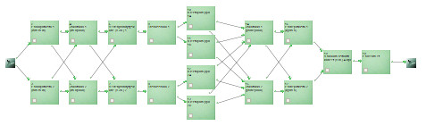
Case D) – Infrastructure Availability:
Design-Phase Data Center
Availability study of a Data Center infrastructure
  Including: Cooling system, Power input for the cooling, IT racks
Return
pipes
Water
coolers
Water tanks
and pumping
Cooling
pipes
Cold air
blowers
IT
racks
+ Power input system (National grid inputs, Internal grid, UPS) for equipment and IT racks

Slide 48
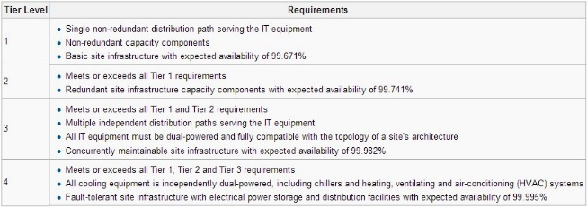
Case D) – Infrastructure Availability:
Case Description
The main goals of the project were:
  Calculate the infrastructure availability
  Modifying the design structure to meet the highest Tier level 4*
(standard TIA-942)
*) 99.995% availability
= Tier level 4

Slide 49
Case D) – Infrastructure Availability:
Key Findings
The availability of the original design was at Tier level 3
  The required highest Tier level 4 was not met
8 hand valves were the source of highest availability risk
  Minimum cooling power for operation is 75%, but repair of any of the 8 critical hand valves causes drop to 50% cooling power
The power input line was extremely reliable even without the backup generator
  Discussions started considering the need of a backup generator

Slide 50
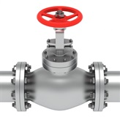
Case D) – Infrastructure Availability:
Improvement – Eight new hand valves
Effect of installing eight new hand valves shown
  Now also the original eight critical hand valves can be isolated
  Possible to repair/change any valve on the cooling line without lowering the cooling power below the required 75%
Tier level 4 was met

Slide 51
Case E) – Nuclear Power Plant (NPP):
Project Scope
RCM analysis of Main Cooling Water Pumping System
  Main function: Cooling of turbine condensers
  Secondary function: Cooling of auxiliary systems of secondary circuit
The Main Cooling Water Pumping System Includes:
  Sea water input, output and filtering system
  Main sea water system (pumps, motors, tubes, sea water ejectors, …)
  Initial lubrication water system
  Cleaning system of condenser tubes

Slide 52
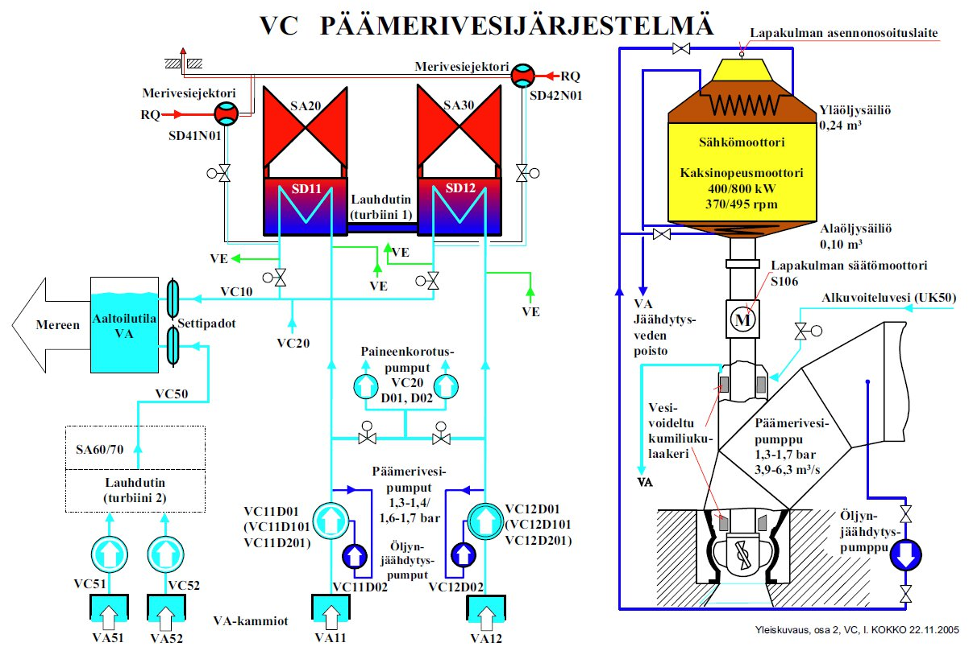
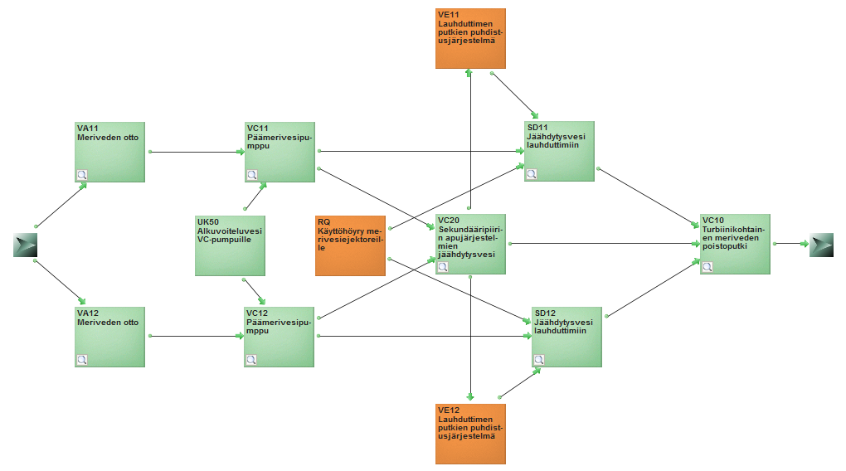
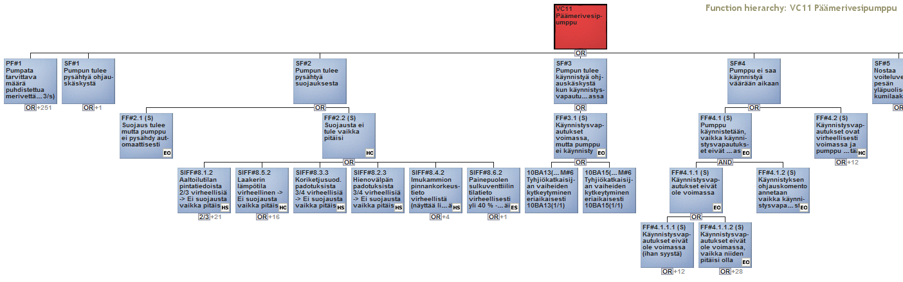
Case E) – Nuclear Power Plant (NPP):
ELMAS Project Model
System definition
Project scope and system relations
Functional failure logic of each system

Slide 53
Case E) – Nuclear Power Plant (NPP):
Customer Demands
RCM analysis must include
  All functions and functional failures
  Safety, reliability, availability and maintainability aspect
  All necessary cost types for comprehensive risk analysis
  Maintenance action planning and optimization for critical equipment
RCM/ELMAS methodology training during the project

Slide 54
Case E) – Nuclear Power Plant (NPP):
Key Findings & Value Added
Reduced preventive maintenance costs by ~20%
Reduced overall cost risks by ~10%
Advanced criticality classification for equipment
List of critical spare parts
  Recommendations for spare part policy
Motivation to improve the use of operative IT-systems
Scenarios for risks & equipment life cycle management

Slide 55
Summary – Applied ELMAS Features
Cause-consequence relations model applied in each case
  Fault tree applied in each case (Logic and stochastic relations)
  Block diagram applied in two cases (Production flow)
  Fuzzy relation in one case (75% operation with one crane)
  Dynamic relations applied in one case (Change logic of backup)
Stochastic discrete event simulation made in each case
  Failure/repair distributions -> Risk/availability analysis results/reports
Management of improvement tasks of items in one case
  List tasks -> Prioritize and schedule -> Update model

Slide 56
OpenMARS –
An Open Modelling approach for Availability and Reliability of Systems

Slide 57
OpenMARS publications
A new approach for complex systems' risk assessment
  Co-operation: CERN, Tampere University of Technology & Ramentor
OpenMARS journal article
  Reliability Engineering & System Safety: https://authors.elsevier.com/a/1YBC03OQ~fLaeo
OpenMARS specification
  CERN Document Server: https://cds.cern.ch/record/2302387

Slide 58
Database and Computing Environment

Slide 59
Remote use of the Computing Cluster

Slide 60
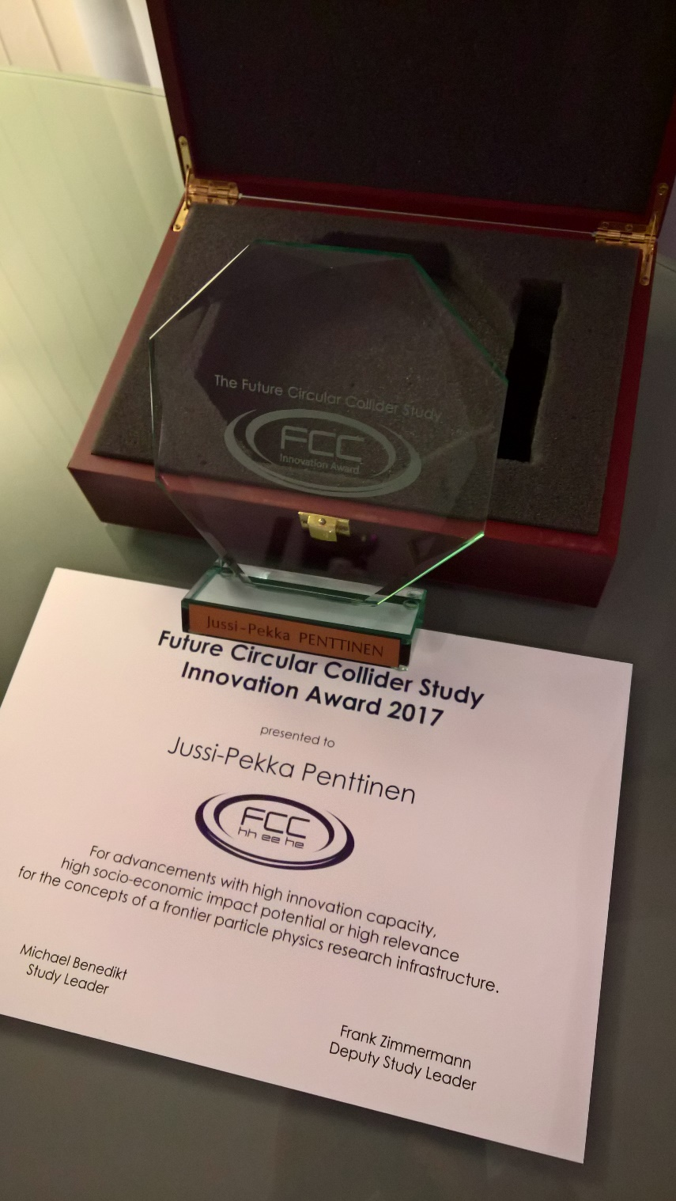
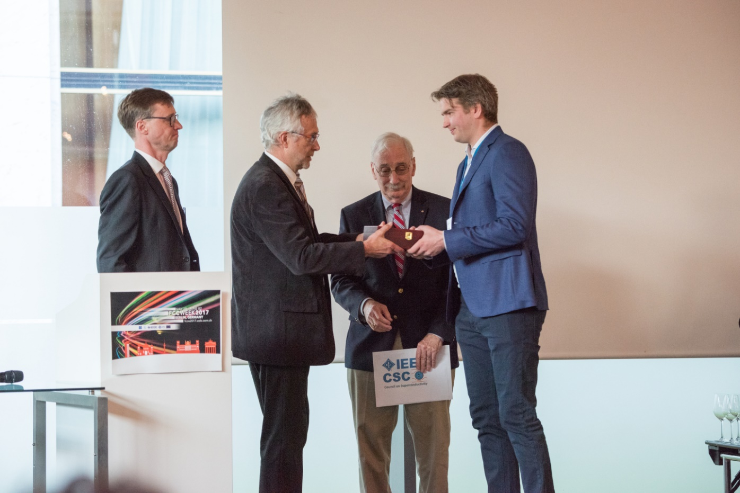
FCC Study Innovation Award
Read more: http://www.ramentor.com/fcc-innovation-award/

Slide 61
Ramentor Oy

Slide 62
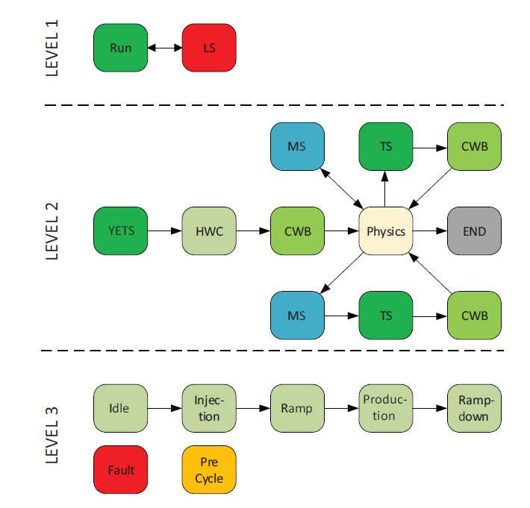
Example: CERN three level state model
Multi-year operation schedule:
Run, Long Shutdown (LS)
Yearly operation schedule:
Technical stops (TS, YETS),
Hardware commissioning (HWC),
Beam commissioning (CWB),
Machine studies (MS),
Physics production
Beam production mode cycle phases:
Injection, Ramp, Stable beams,
Ramp-down, Idle time between cycles

Slide 63
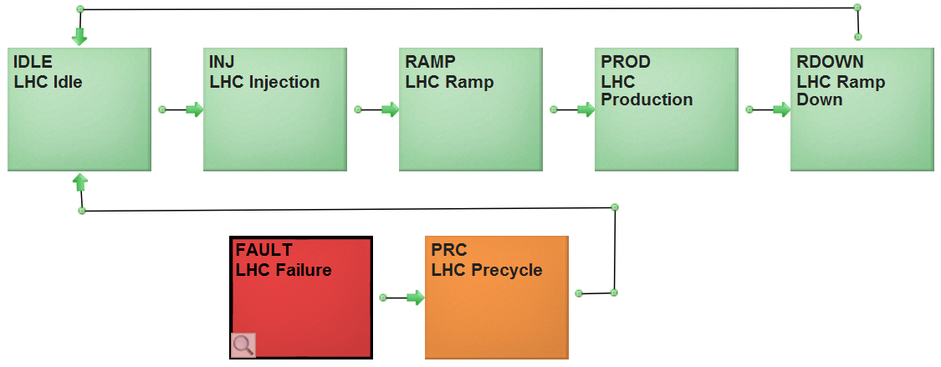
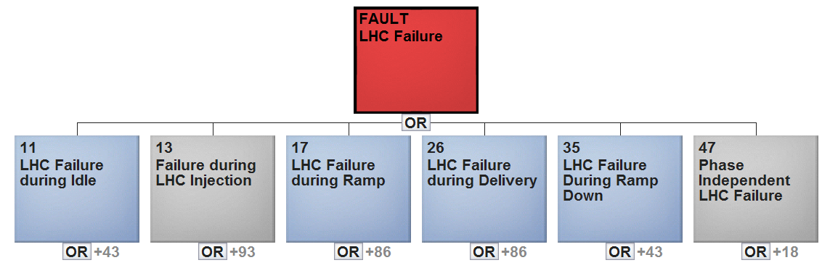
Example: CERN phase dependent failure
Probabilistic phase transitions (Monte Carlo approach)
Randomly generated failures
(based on probability distributions)
Phases are connected
to fault trees
All failures are not relevant in all phases

