Slide 1
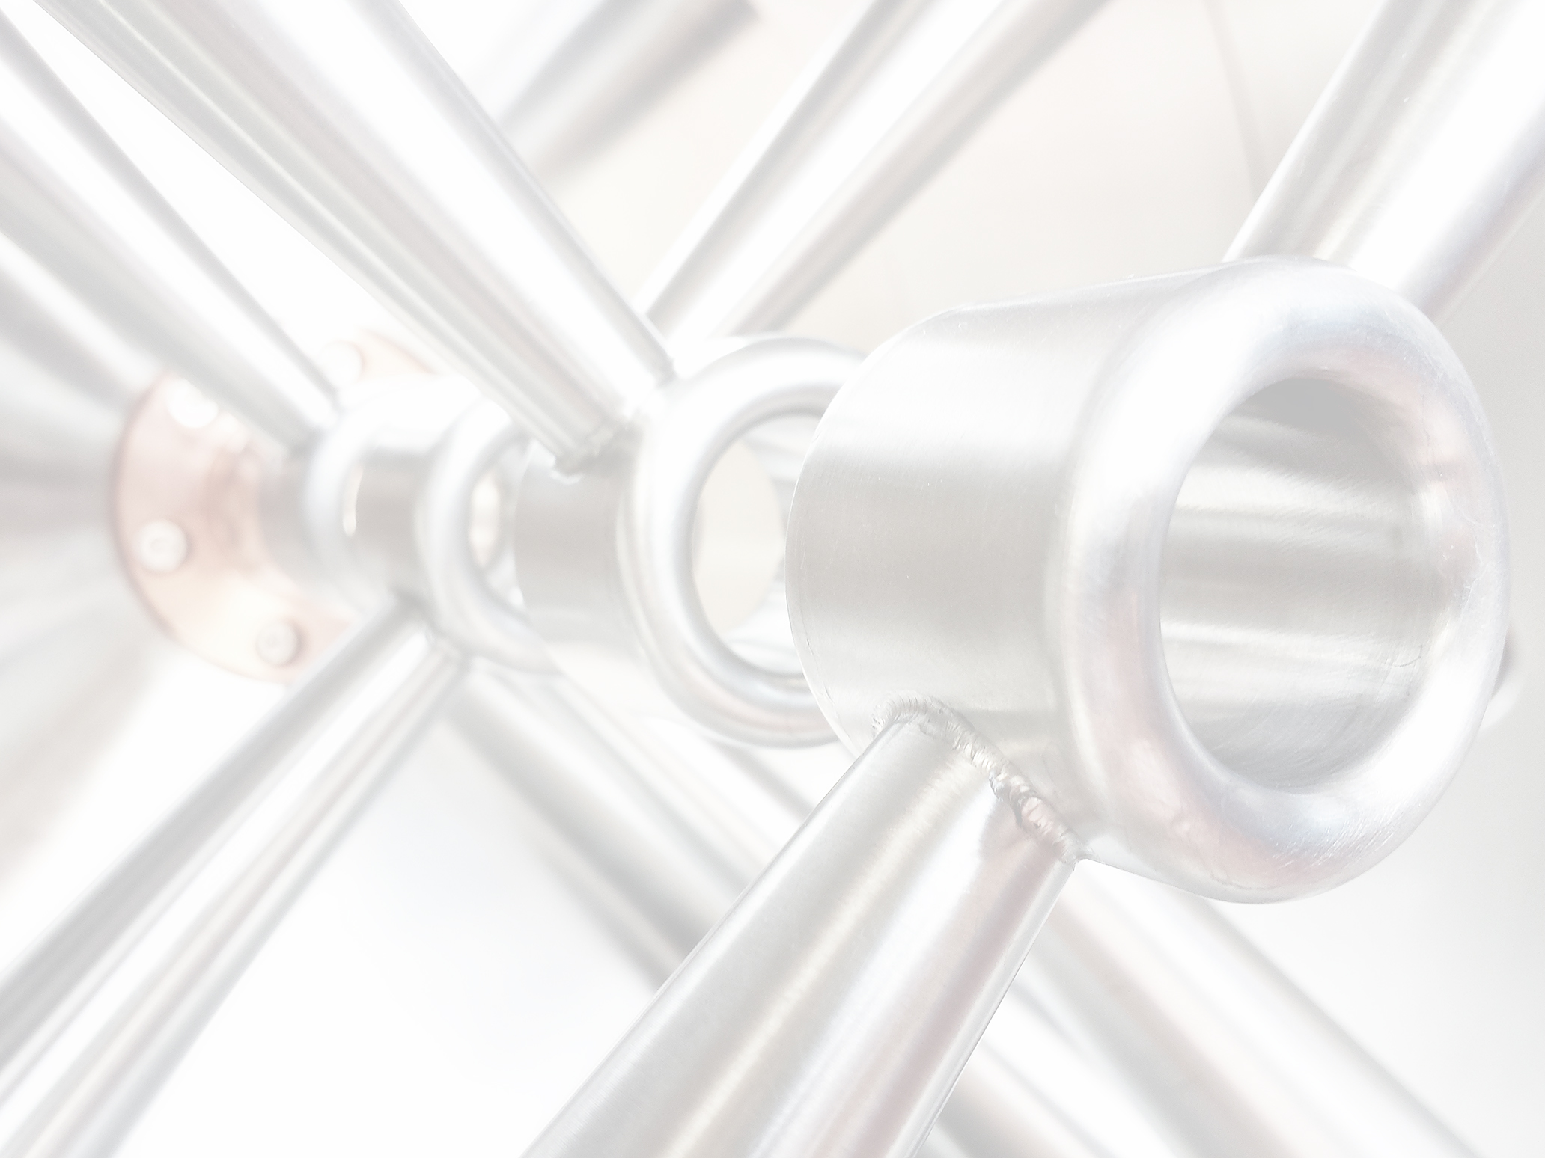
RFQ Reliability Optimization for MYRRHA
Accelerator Performance and Concept Workshop
Frankfurt
December 12th 2018
H. Podlech
Institut für Angewandte Physik
Goethe Universität Frankfurt

Slide 2
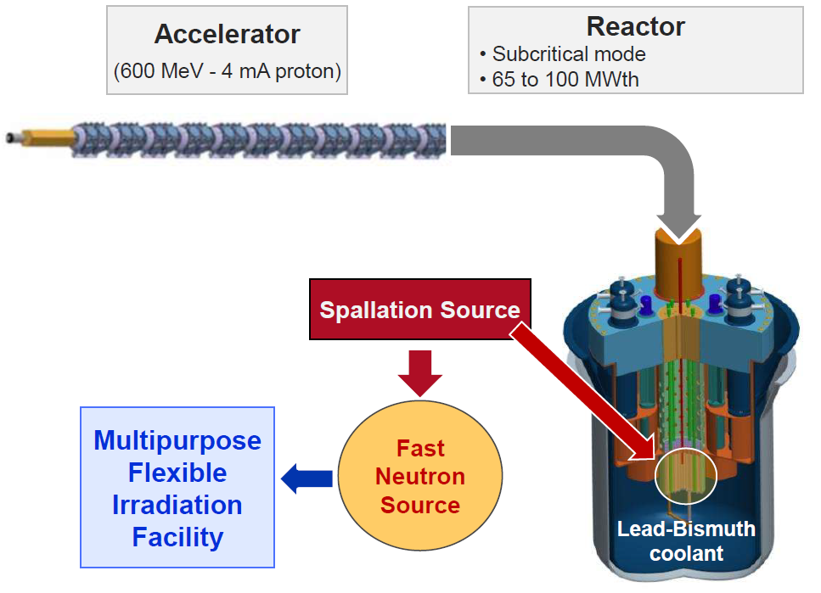
MYRRHA: Multi purpose hYbrid Research Reactor for High tech Applications
Proton accelerator (cw)
4=mA, E=600 MeV (P=2.4 MW)
Subcritical reactor
with spallation target
K_{eff} 0.95-0.98
Spallation neutrons create fissions
Additional neutron by fission
2-5% external neutrons required
Reactor power 20-50 times higher compared to beam power

Slide 3
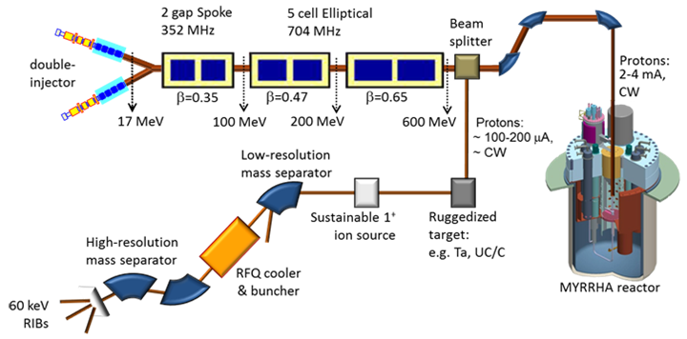
Schematic Layout of the MYRRHA Project
Parallel redundancy
Serial redundancy
3 gap ESS Spoke 352 MHz
5 cell elliptical 704 MHz
Construction has started

Slide 4
Lay-Out of the MYRRHA-Linac
Courtesy J.-L. Biarrotte

Slide 5
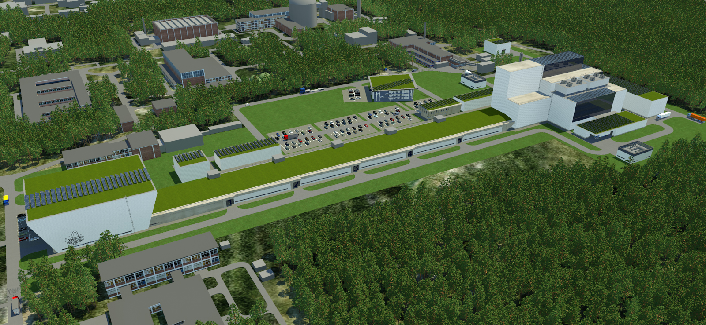
Courtesy SCK • CEN

Slide 6
17 MeV MYRRHA Injector
LEBT
MEBT-1
CH-cavities
MEBT-2
CH-cavities
ECR
RFQ
32 m
Design driven by emittance conservation (especially longitudinally)
Conservative beam dynamics design
Cw Solid state amplifiers as RF sources (up to 200 kW)

Slide 7
Parameter MYRRHA Linac
Proton energy | 600 MeV
Beam current | 0.1 to 4.0 mA
Beam power | 2.4 MW
Beam duty cycle | 100%
Beam power stability | < ± 2% on a time scale of 100ms
Beam footprint on reactor window | Circular ∅85mm
Beam footprint stability | < ± 10% on a time scale of 1s
# of allowed beam trips on reactor longer than 3 sec | 10 maximum per 3-month operation period
# of allowed beam trips on reactor longer than 0.1 sec | 100 maximum per day
# of allowed beam trips on reactor shorter than 0.1 sec | unlimited
Extreme reliability level
J-L. Biarrotte, MYRTE TEC meeting, Brussels, 29 October 2015.

Slide 8
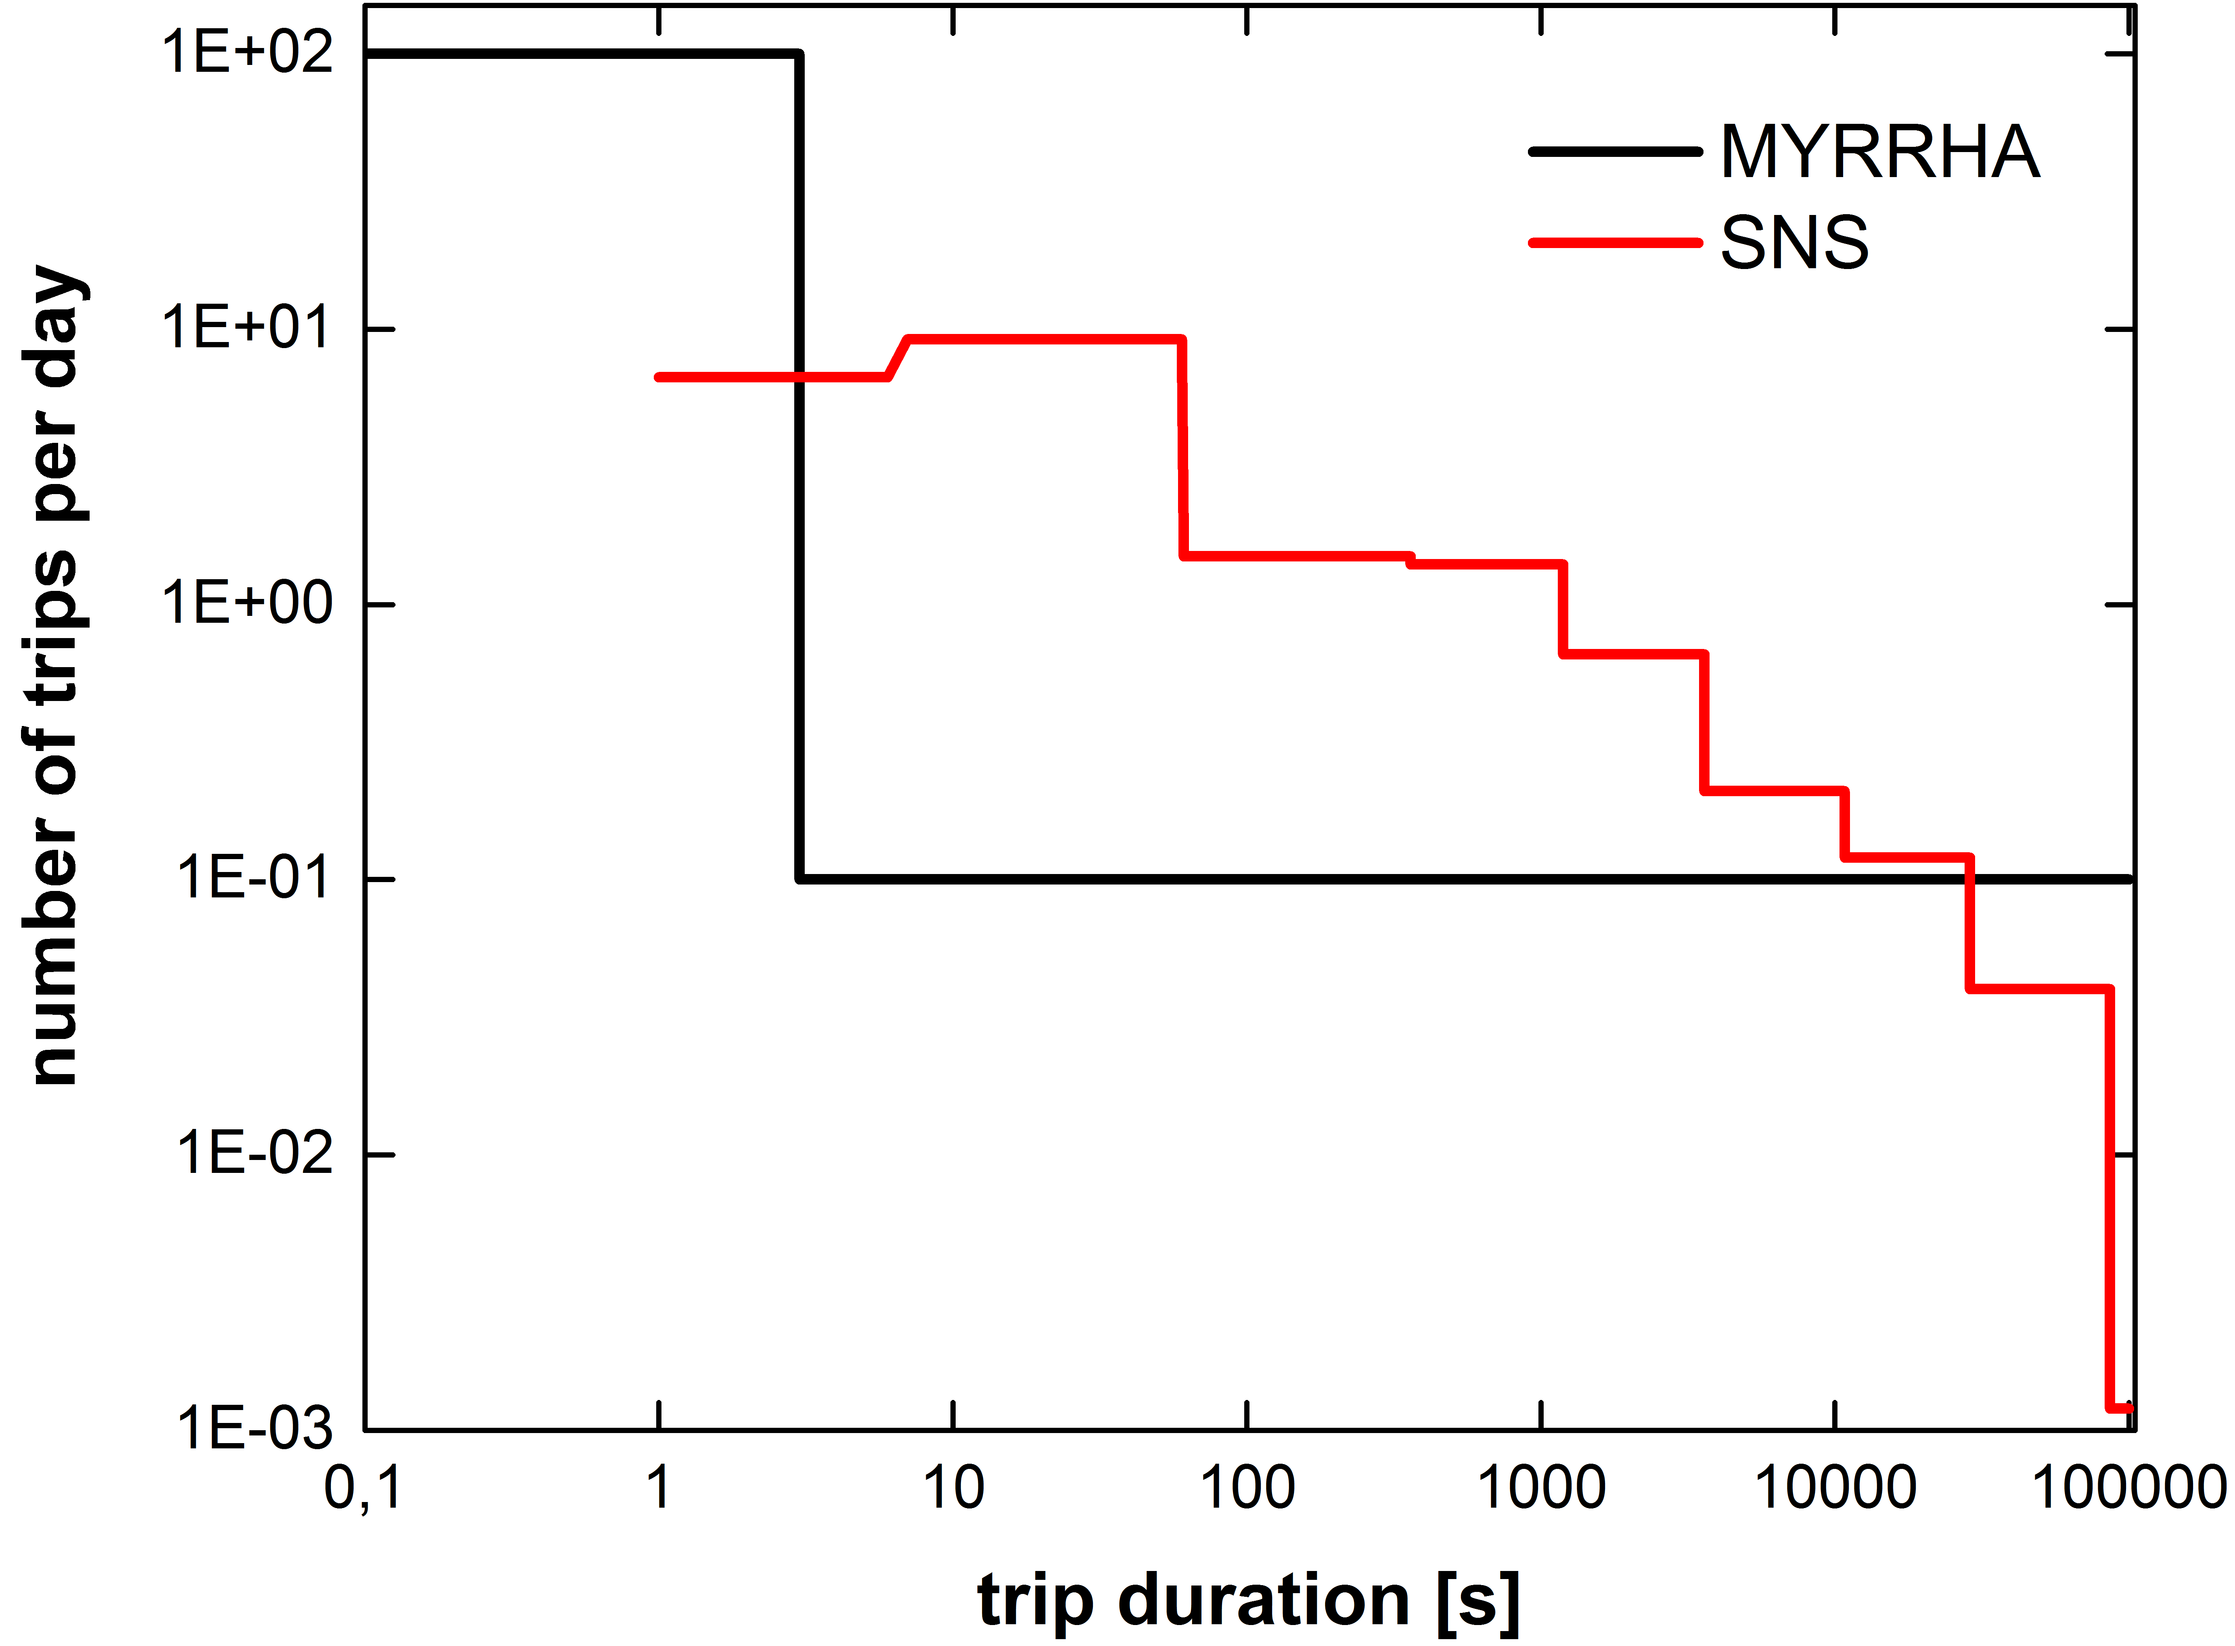
Reliability Issues
Beam trips longer than 3 sec must be very rare:
→ To minimize thermal stress & fatigue on the target window, reactor structures & fuel assemblies
→ To ensure an 80% availability – given the foreseen reactor start-up procedures
Conservative design & redundancy

Slide 9
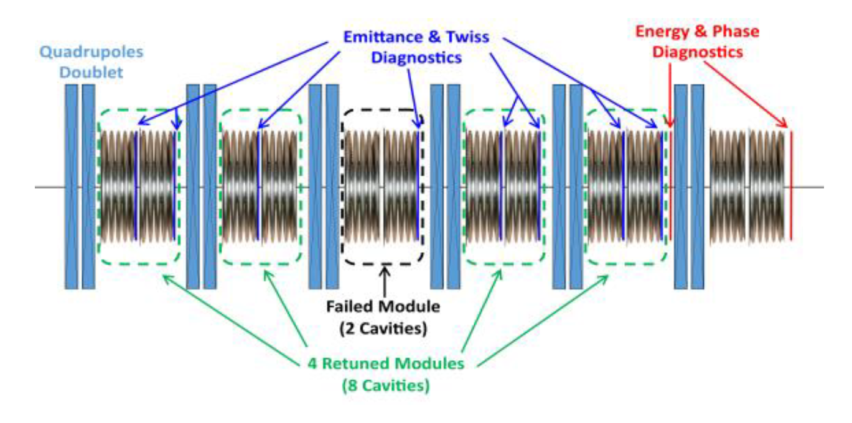
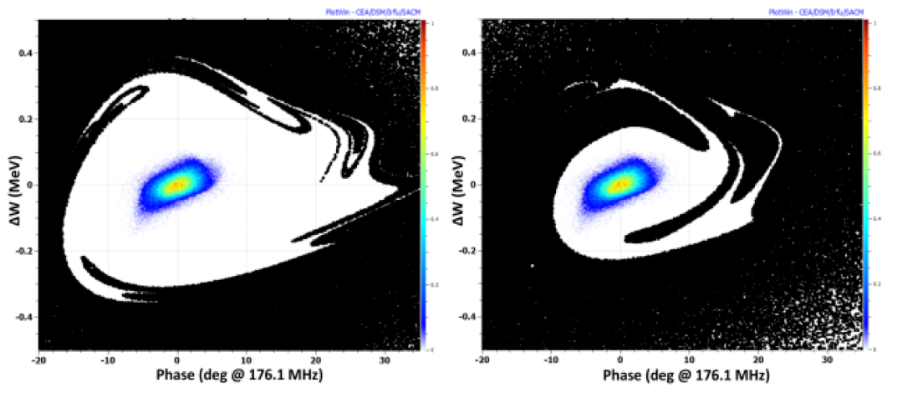
Reliability Issues
Conservative design: All components will be operated well below their design parameters
Low energy part: Parallel redundancy
Main Linac: Serial redundancy
Injector is most critical part, especially the RFQ

Slide 10
MYRRHA RFQ
Parameter | Value | Unit
RF Structure | 4.Rod | ---
Frequency | 176.1 | MHz
Beam current | 4 | mA
Duty factor | 100 | %
E_{out} | 1.5 | MeV
R_{p} | 73 | kΩm
RF Power | 107 | kW
Specific power | 26.5 | kW/m
Voltage | 44 | kV
Length | 4 | m

Slide 11
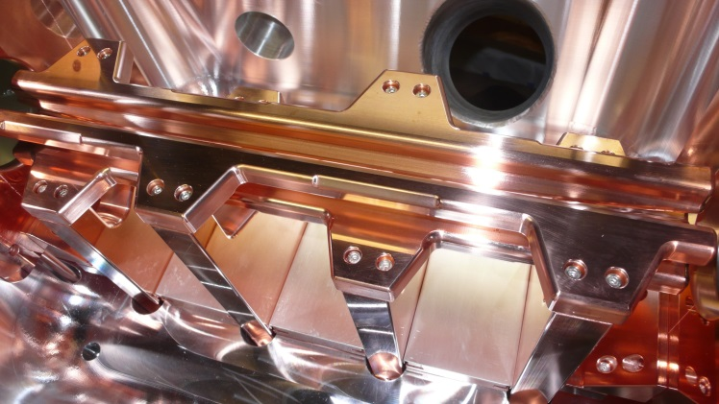
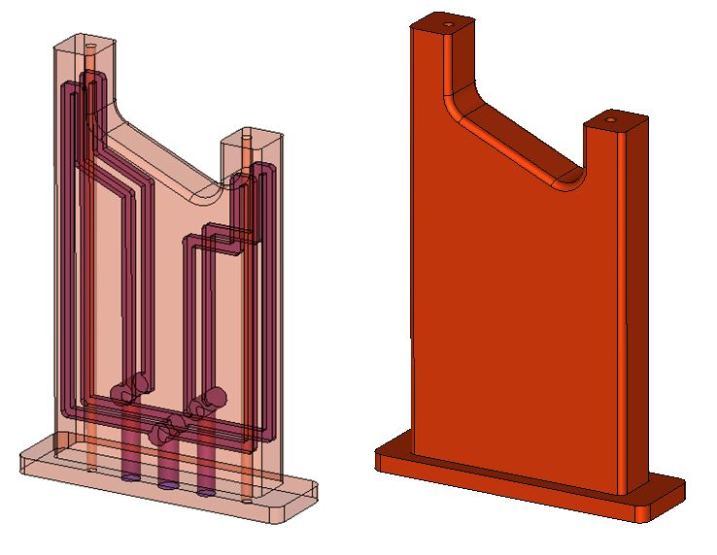
Cooling Issue of 4-Rod RFQs (MYRRHA, FRANZ, HLI, HBS)
Cw operation major concern
Conservative design
Research program to optimize cooling
P_{th}=130 kW/m
U=100 kV
E_{p}=33 MV/m
New fabrication technologies have been developed
Result prototype high power test

Slide 12
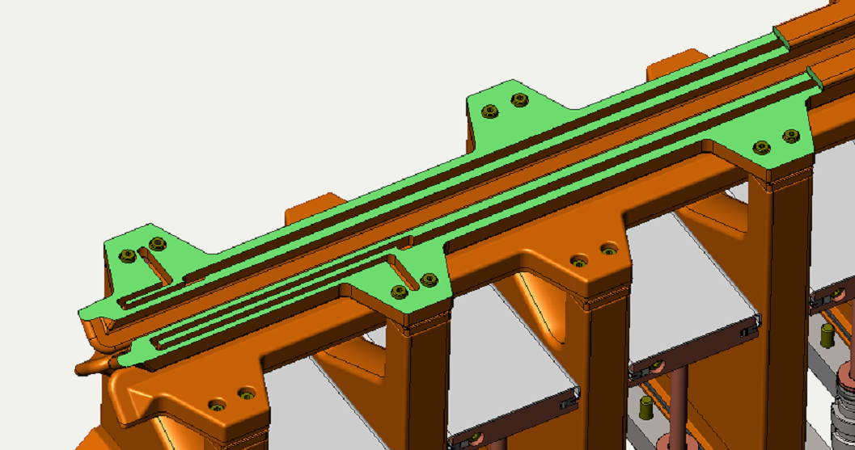
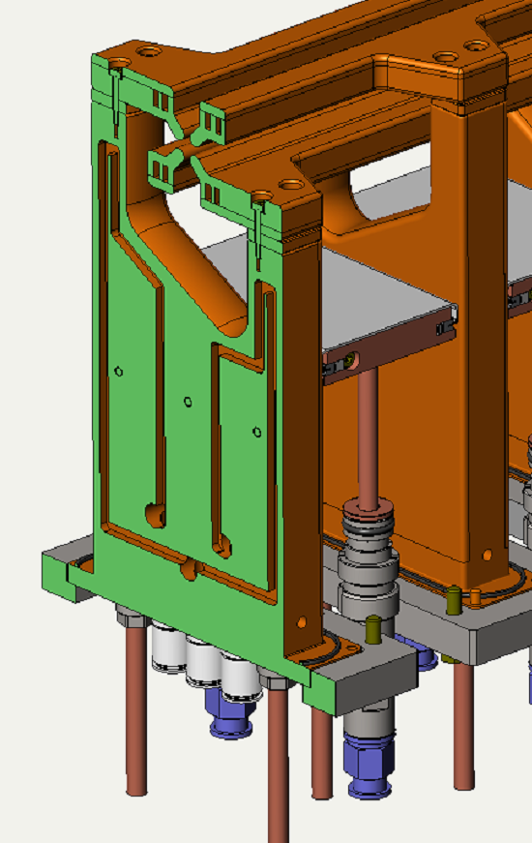
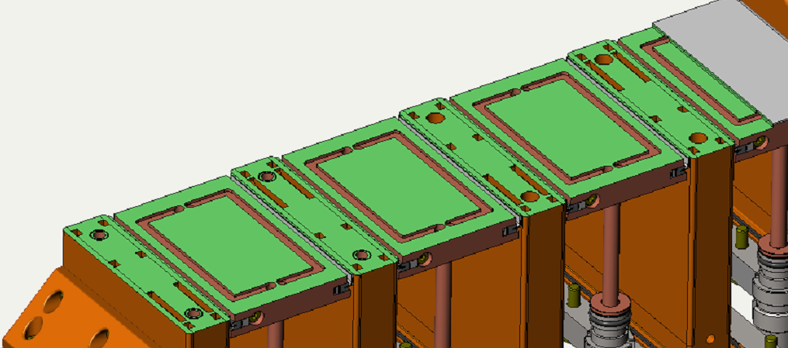
Cooling System on Main Parts of the RFQ
copper electro forming
Tuning plates

Slide 13
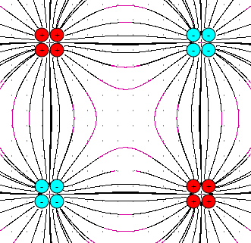
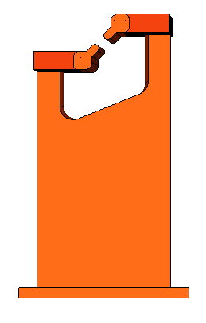
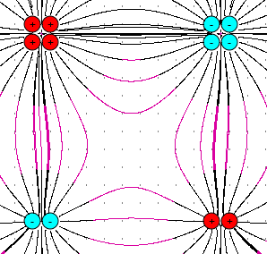
Dipole Compensation
A 4-Rod RFQ has an intrinsic dipole component
Upper electrode is on higher potential
Corresponds to a shift of beam axis
Can create non-linearities close to electrodes

Slide 14
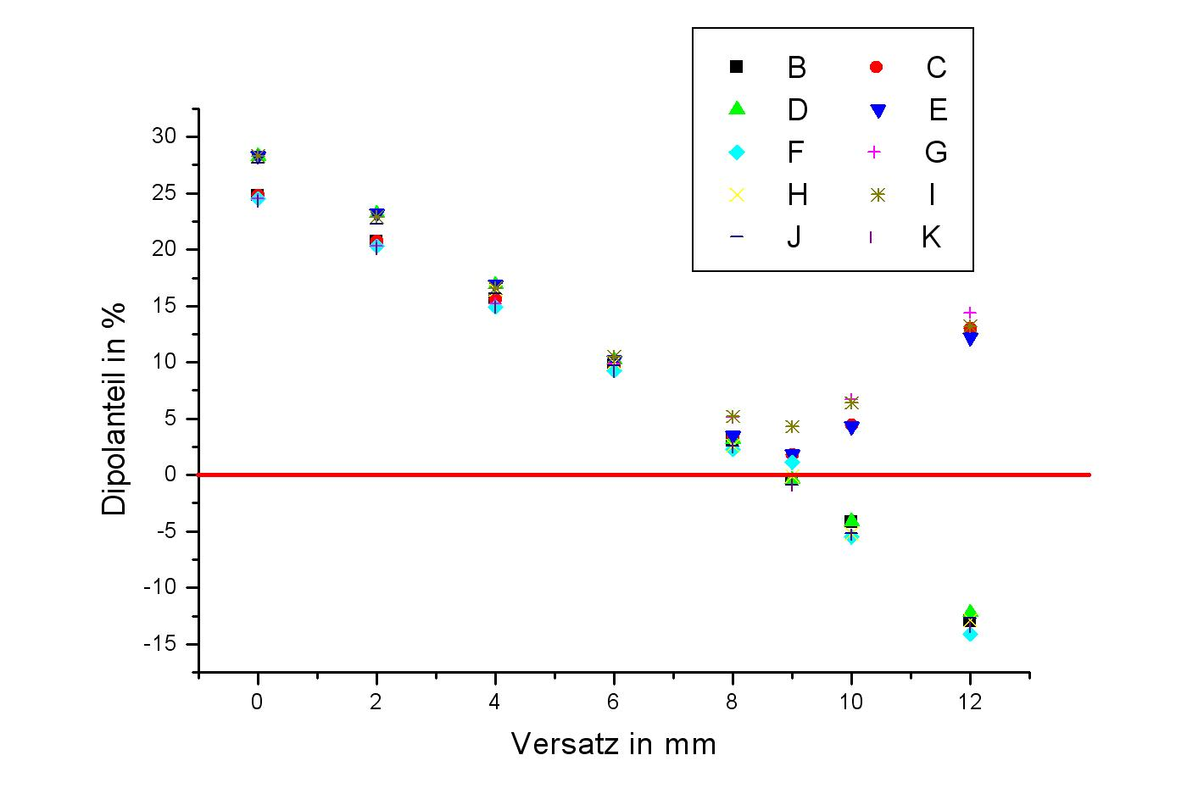
Dipole Compensation
Dipole compensation by shifting the stems

Slide 15
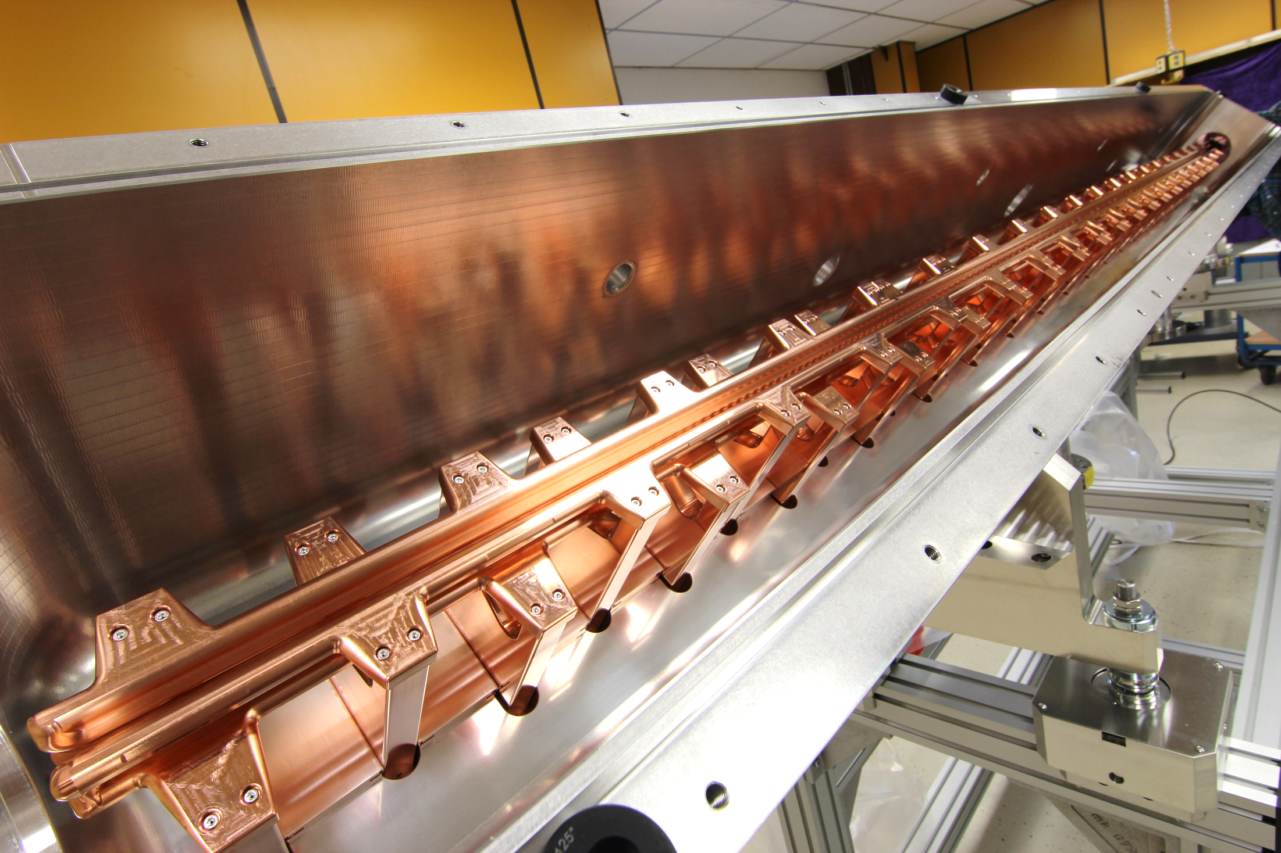
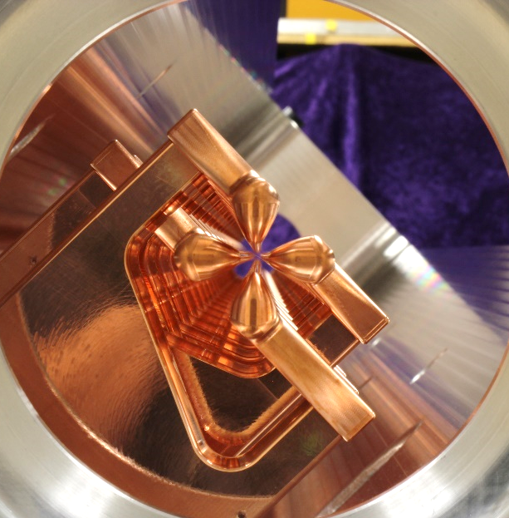
MYRRHA RFQ

Slide 16
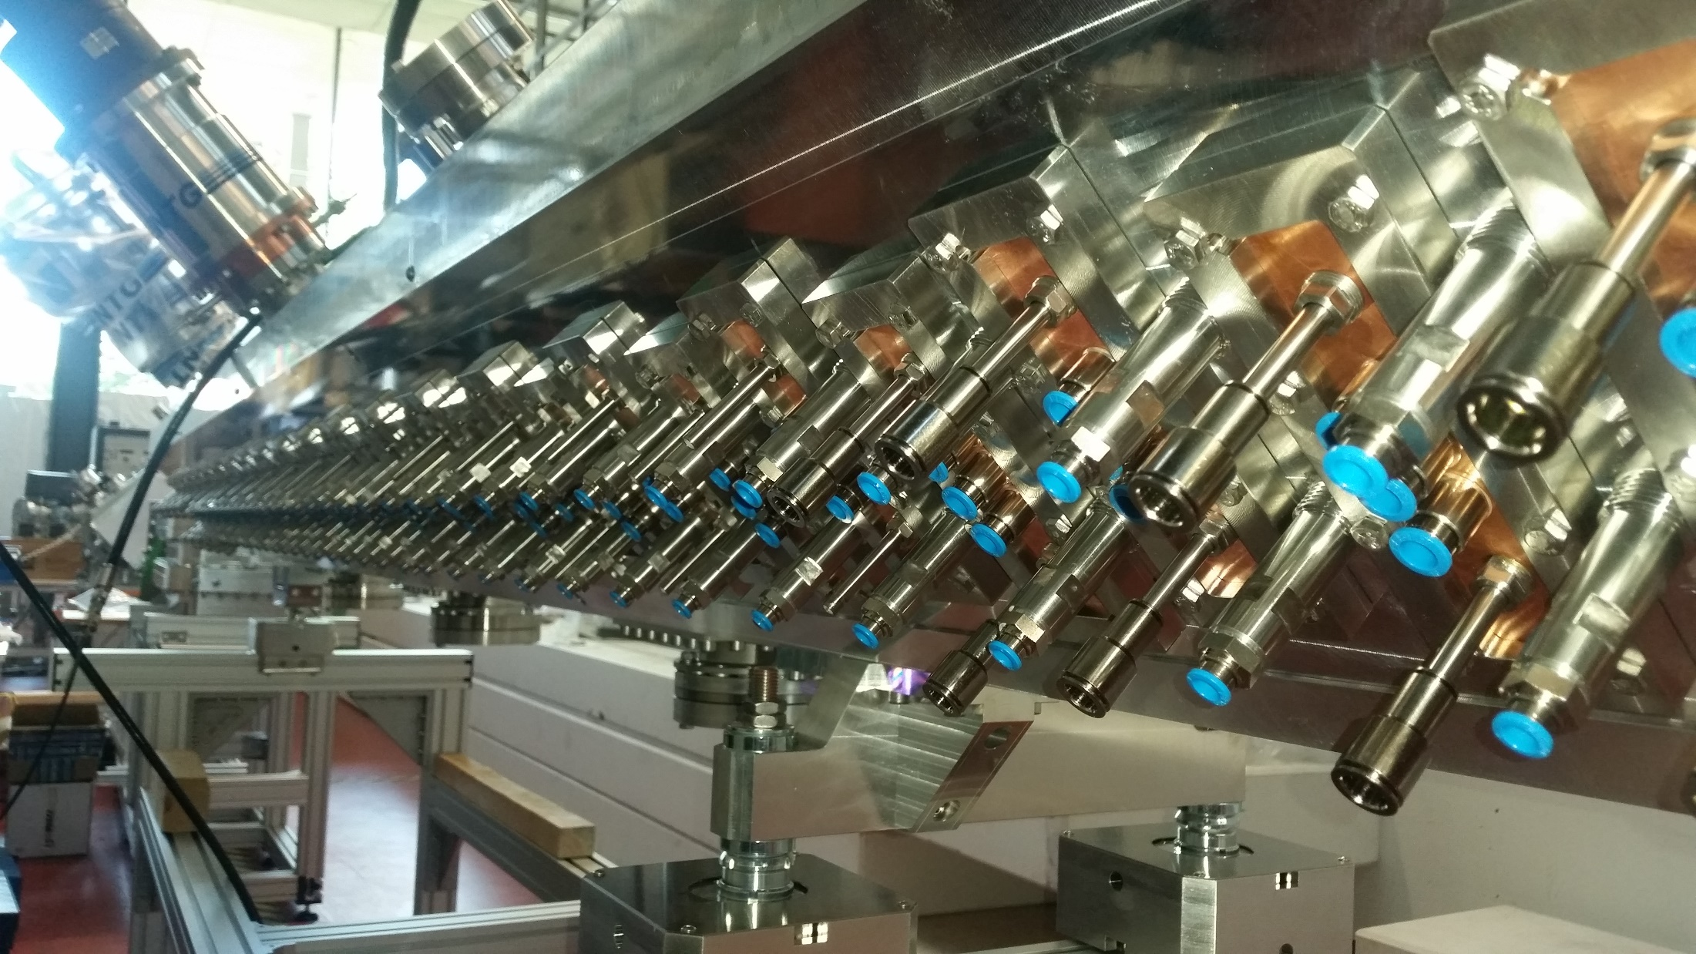
MYRRHA RFQ

Slide 17
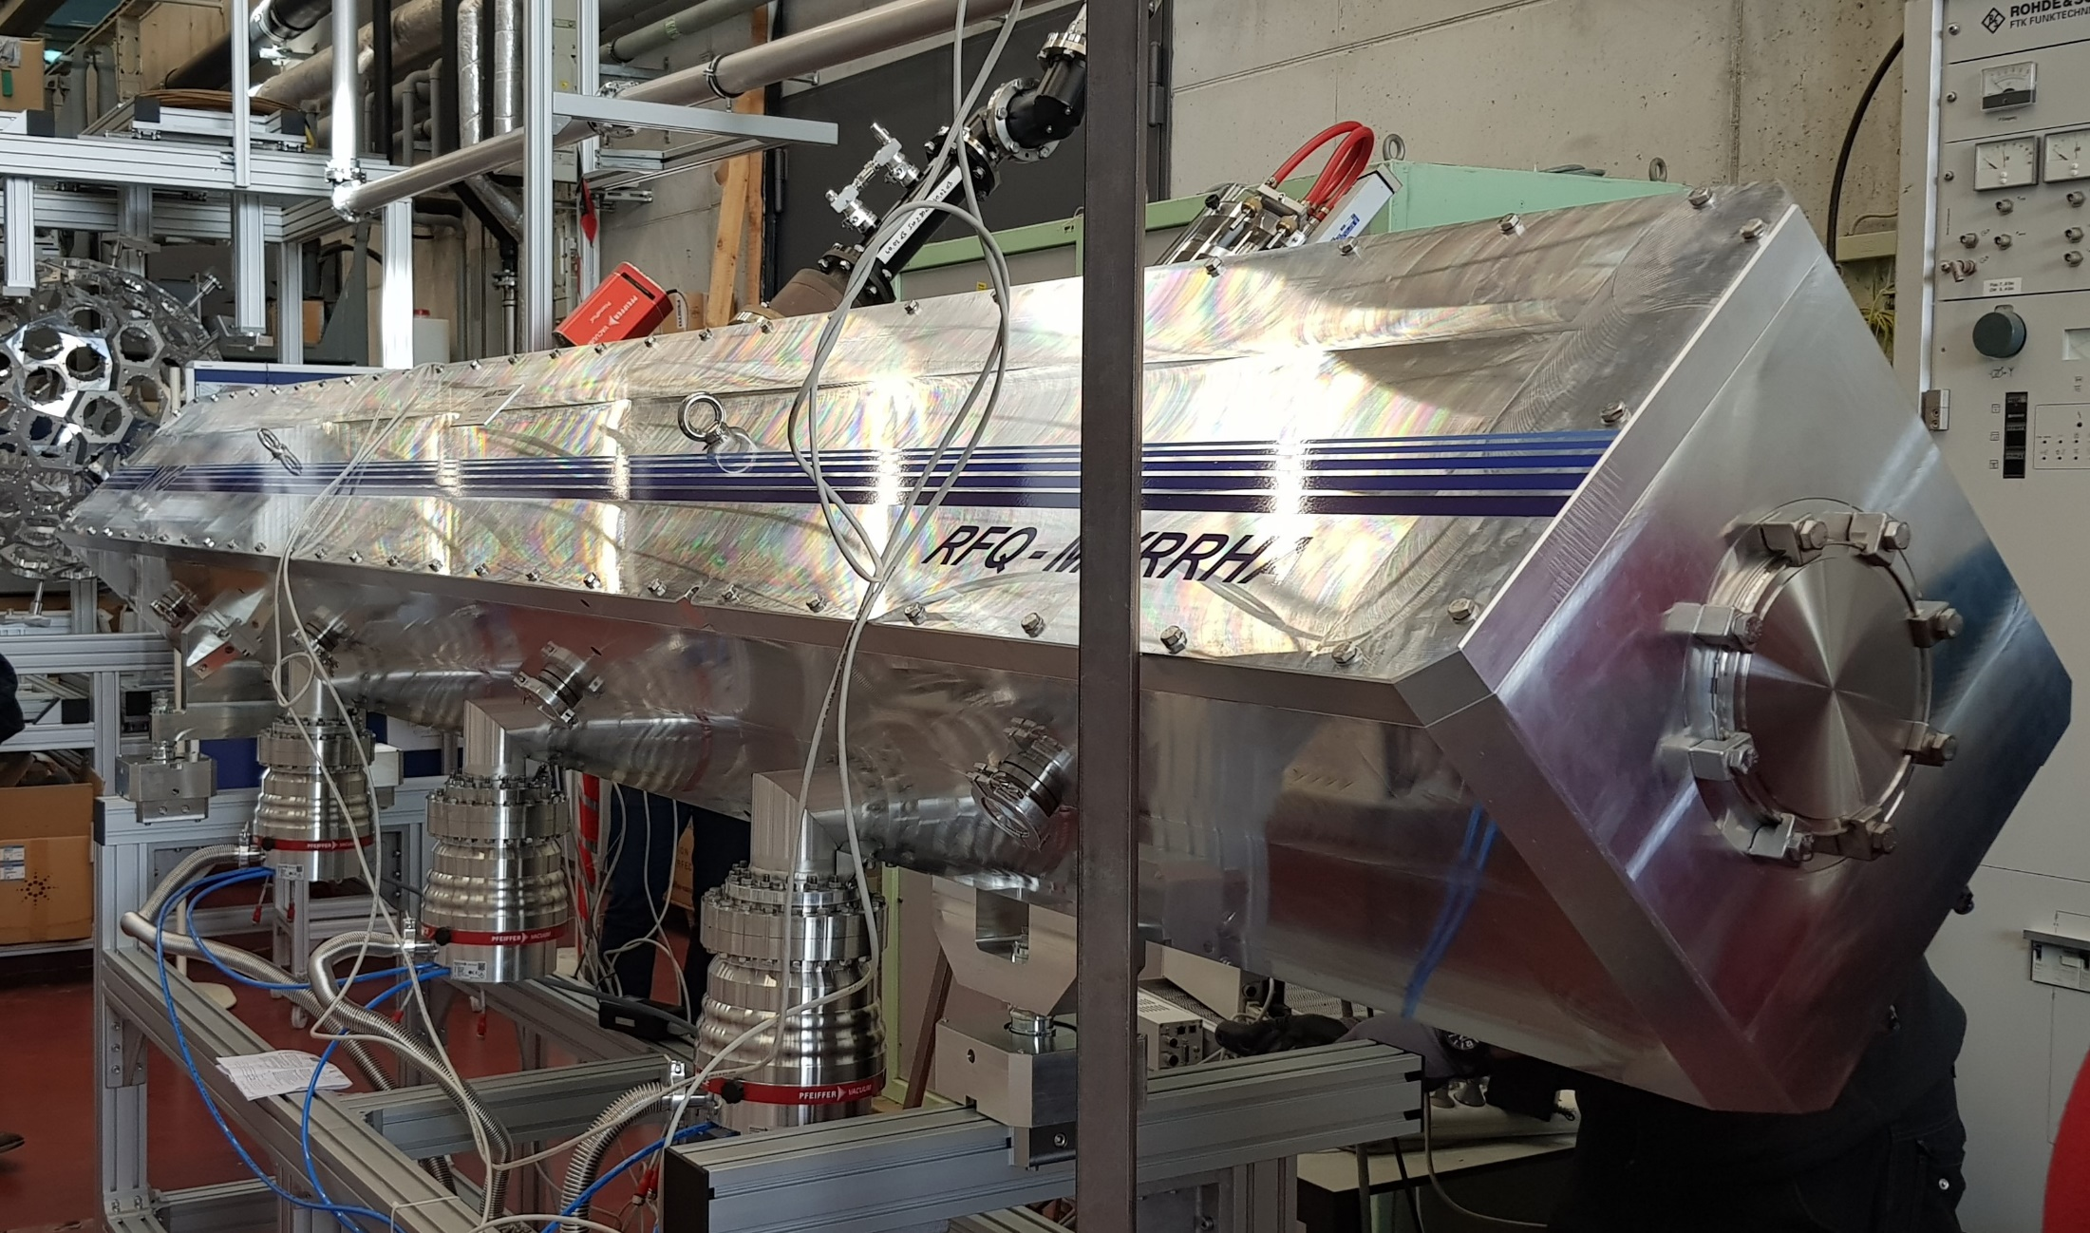
MYRRHA RFQ

Slide 18
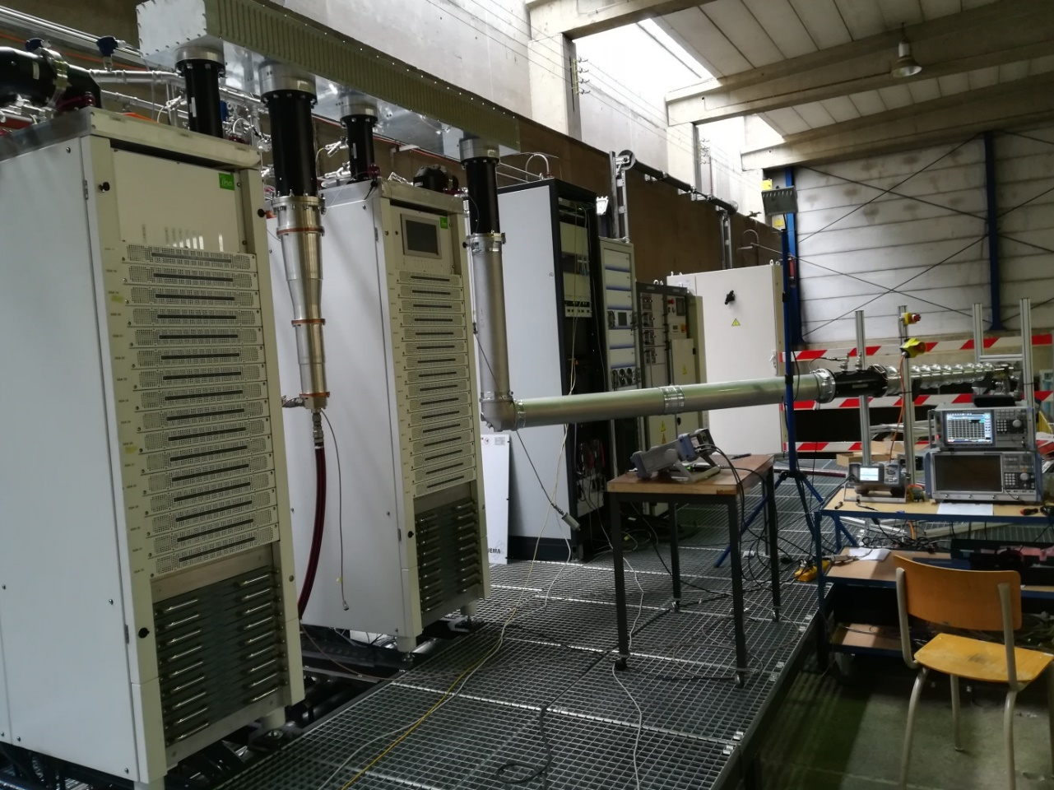
192 kW cw Solid State Amplifier
SSA for RFQ delivered on the 9th of May
September, 9th:
190 kW on dummy load!

Slide 19
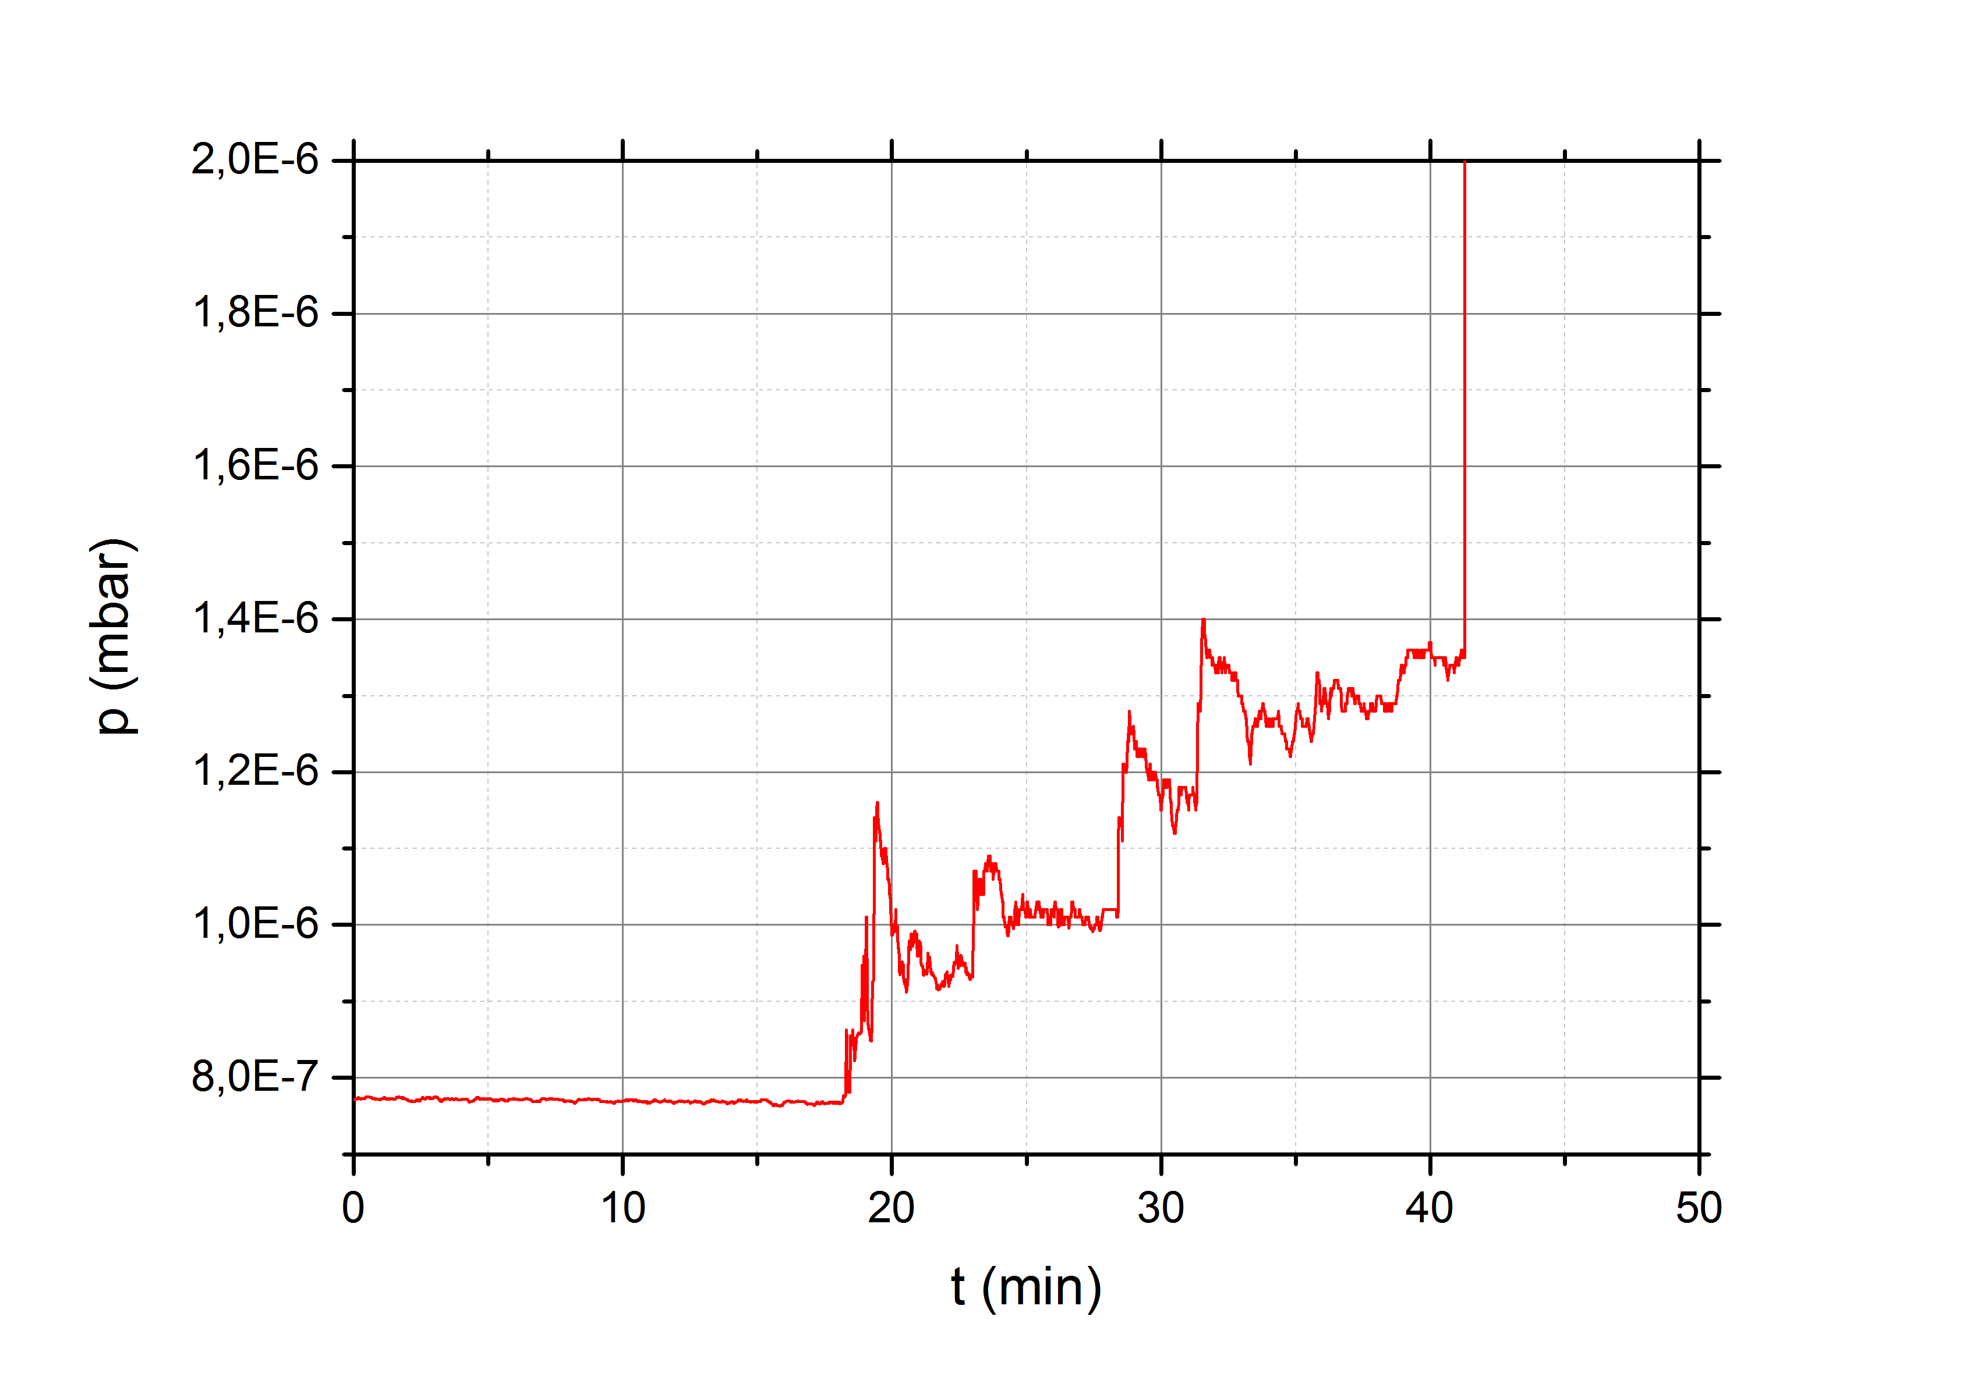
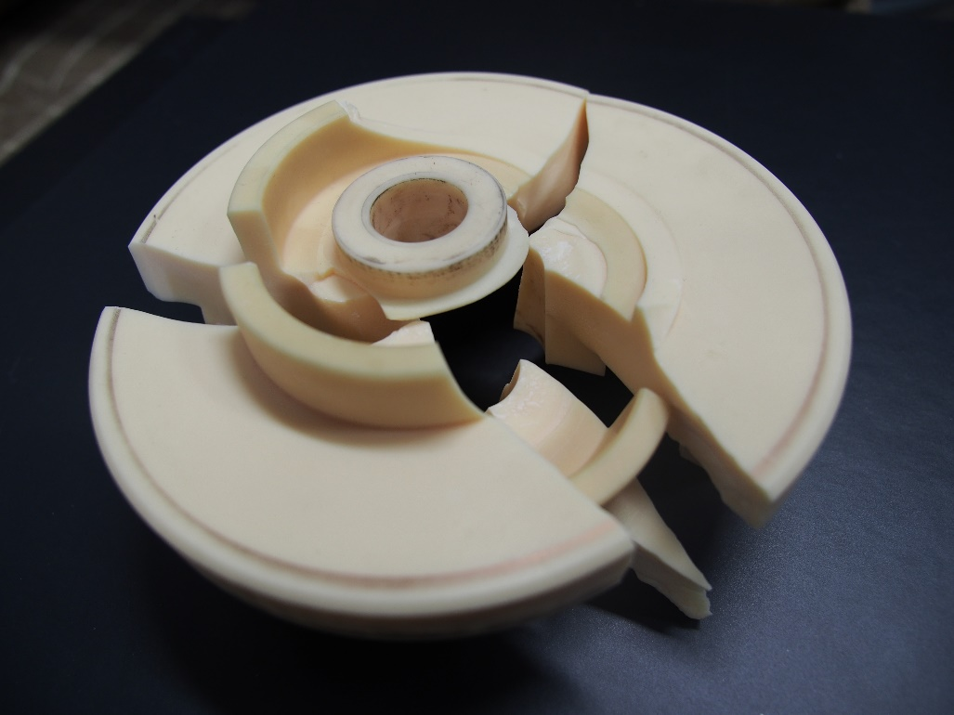
Event Prediction Systems
Implement diagnostics to predict failures in advance
Example: Signature of breaking power coupler

Slide 20
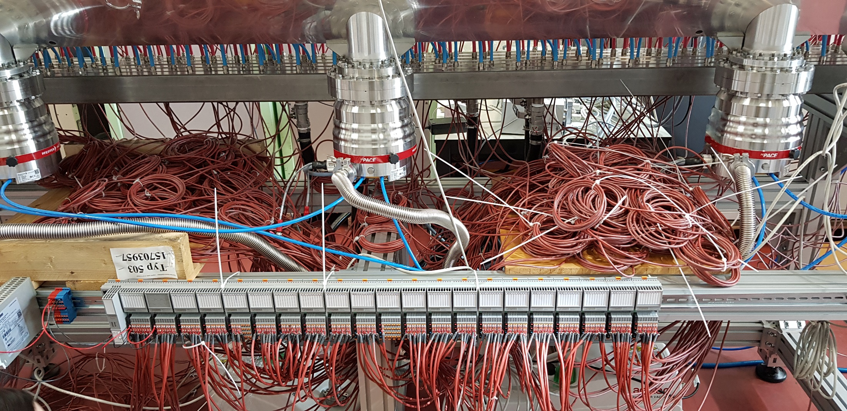
Temperature Acquisition System
Continous data logging of 180 water outlets
Connected with an interlock system

Slide 21
Summary
For MYRRHA a very reliable Linac is required
Injector: Parallel redundancy
Main-Linac: Serial redundancy
Every component designed very conservatively
Operated well below design parameters
RFQ reliability
Optimized cooling
Relative low rod voltage (44 kV) and power losses
Solid state amplifier
Diagnostic and event prediction systems to prevent severe damage
(T-Sensors, Vacuum measurement)

Slide 22
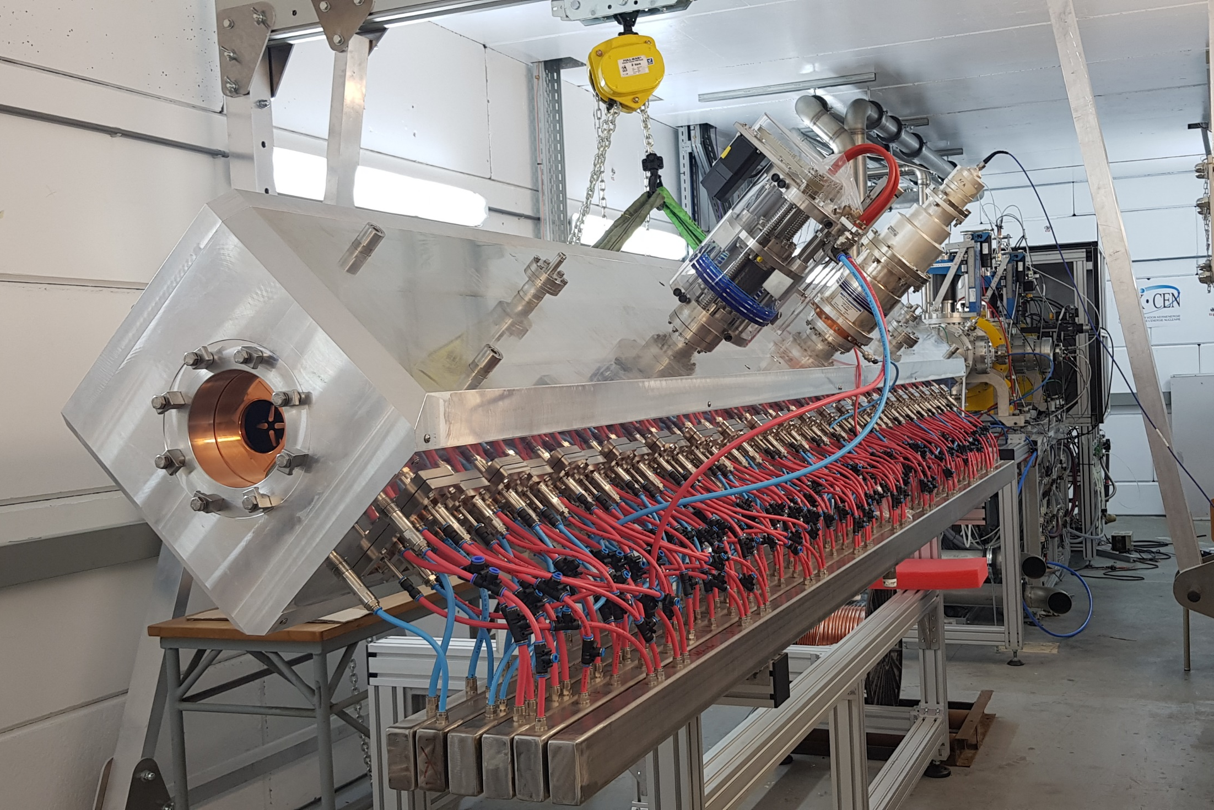
MYRRHA RFQ@LLN

Slide 23
Thank you

