Slide 1
Institute of Machine Components (IMA)
3 Years of Experience of Reliability Training in the Accelerator Community

Slide 2
Contents
Initial situation in 2015
Cooperation CERN – IMA
Training Reliability („Basic Level“)
Motivation
Review of the contents
Feedback from participants
RAMS challenges for future accelerators
UNI STUTTGART
APEC 2018

Slide 3
Contents
Initial situation in 2015
Cooperation CERN – IMA
Training Reliability („Basic Level“)
Motivation
Review of the contents
Feedback from participants
RAMS challenges for future accelerators
APEC 2018

Slide 4
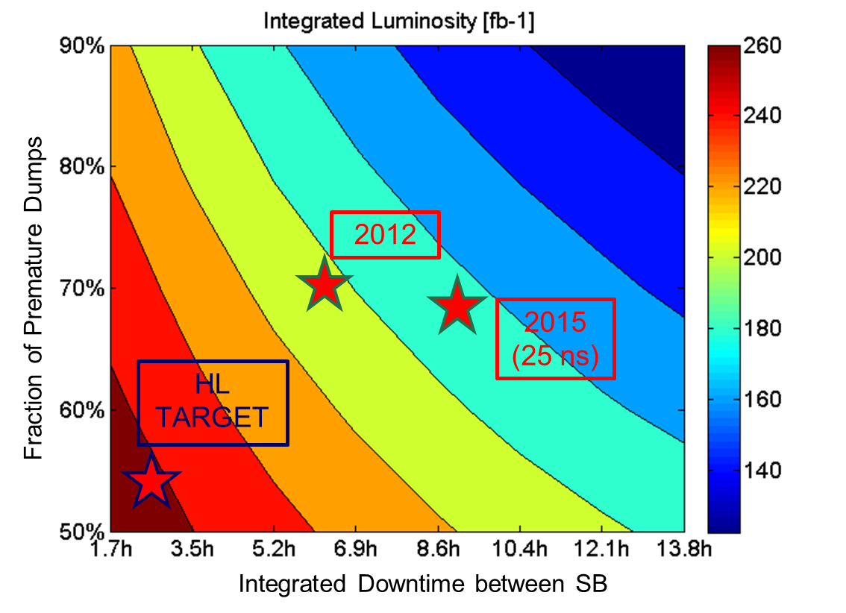
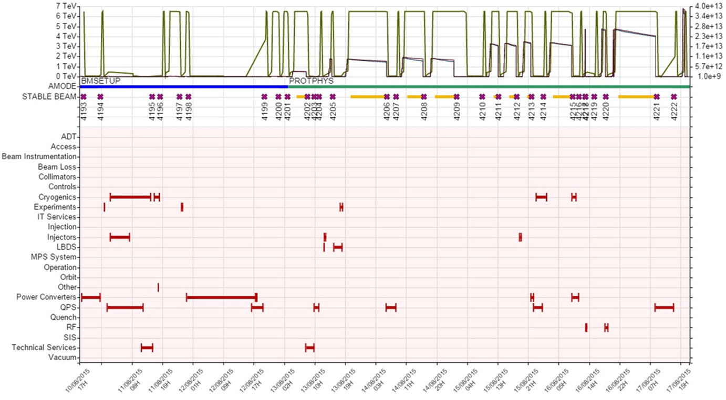
Initial Situation in 2015
Goal of reliability studies:
Increase of integrated luminosity without increasing performance
Decrease of downtime
Low reliability and availability of LHC
No common terminology
Overall availability of an accelerator
Accelerator / machine availability
Overall circuit availability
Availability of injectors
Hardware/network availability
Operational availability
Availability (long-term average)

Slide 5
Contents
Initial situation in 2015
Cooperation CERN – IMA
Training Reliability („Basic Level“)
Motivation
Review of the contents
Feedback from participants
RAMS challenges for future accelerators
APEC 2018

Slide 6
Cooperation CERN – IMA
12 Technical Students (mostly working in MPS @ LHC)
Workshop on availability modelling
Currently 2 PhD Students
Journal articles
Training Reliability („Basic Level“)
UNI STUTTGART
APEC 2018

Slide 7
Contents
Initial situation in 2015
Cooperation CERN – IMA
Training Reliability („Basic Level“)
Motivation
Review of the contents
Feedback from participants
RAMS challenges for future accelerators
APEC 2018

Slide 8
Training Reliability („Basic Level“)
Motivation - Why RAMS studies & training?
Establish a body of knowledge for RAMS tools and methods to improve the efficiency of particle accelerator operation
Establish a set of common standards, methods and practices to analyse, specify and assess RAMS characteristics of particle accelerator systems and components
Completed with practical tutorials, introducing standard tools, analysis and design techniques based on concrete, practical examples from the particle accelerator domain
Organization:
Twice a year until end of 2019 @CERN
15-20 participants per training (~ 100 in total) from CERN, DESY, … (PhD & Staff)
Next Training probably in May 2019
APEC 2018

Slide 9
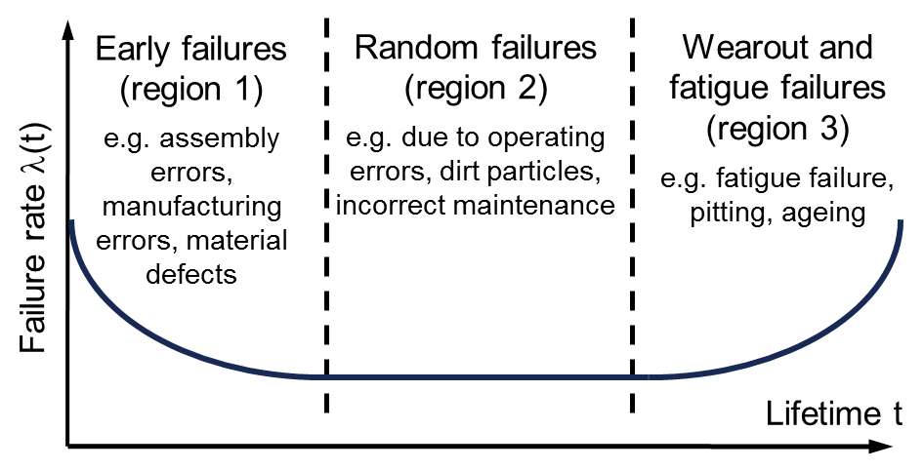
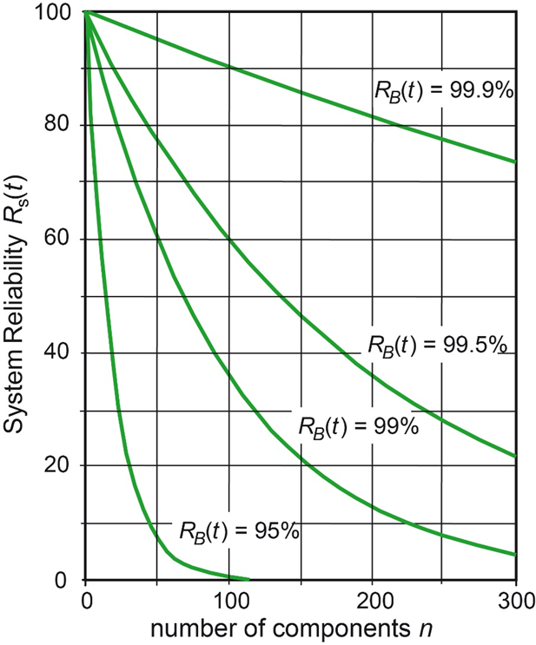
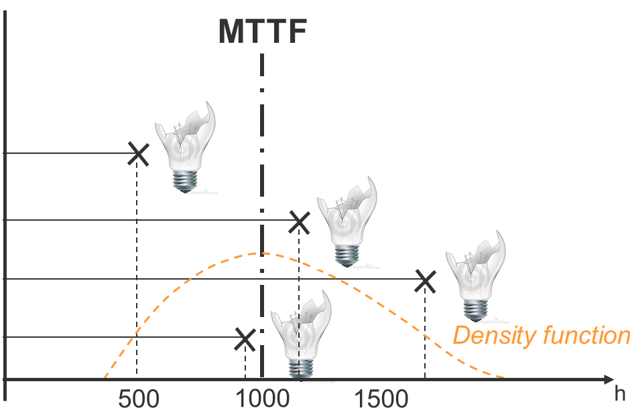
Training Reliability („Basic Level“)
Contents
Common basis of the use of Reliability terms
Mathematical Basics – Weibull Distribution
Necessity to include P_{A}
Disadvantages of MTTF / point estimates
System Reliability
Reliability of complex systems
APEC 2018

Slide 10
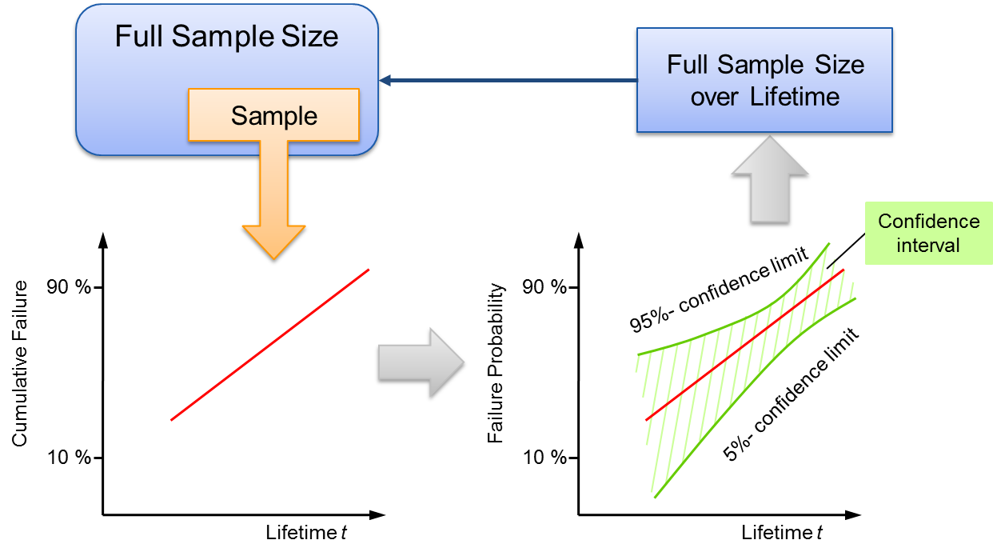
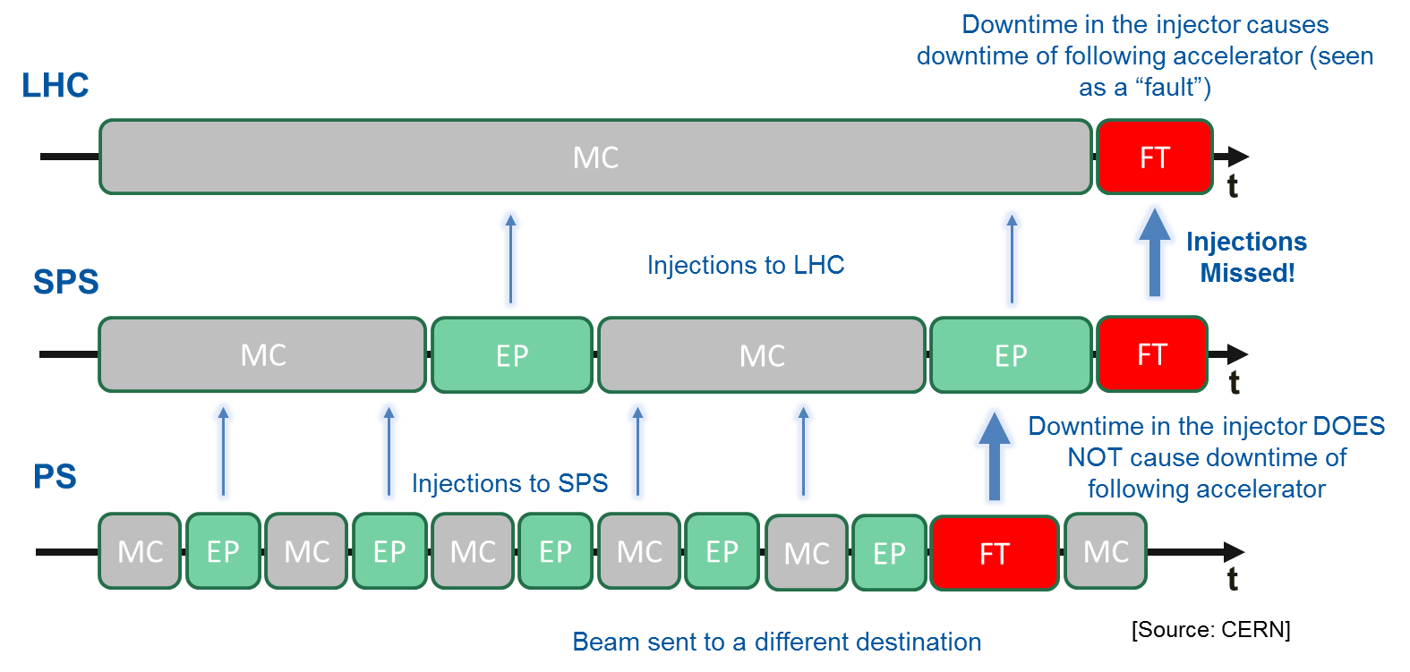
Training Reliability („Basic Level“)
Contents
FMEA
Approaches to find weak links in a system
Fault Tree Analysis (FTA)
Qualitative FTA
Quantitative FTA
Evaluation of Test Data
Weibull Analysis
Single failure modes
Availability Modeling
Availability for operation
Availability for physics

Slide 11
Feedback from Training Reliability
25 participants, 3 trainings
bad good
1 2 3 4
Overall impression of this course:
Relevant to current activity: ∅3.00
Met expectations: ∅3.16
Satisfaction with overall course level: ∅3.32
Rate the following aspects of the course:
Content: ∅3.32
Theoretical part: ∅3.24
Practical part: ∅3.16
Structure and organisation: ∅3.28
There should be an advanced level follow-up training: ∅3.20
APEC 2018

Slide 12
Feedback from Training Reliability
Not enough attention:
Reliability challenges for electronics and software
Design for reliability, robust design
Failure analysis and root cause analysis
Best practice examples from industry
Advanced qualitative methods
Operational maintenance
Reliability prediction
Aspects relevant to CERN
Ideas on how to break down complex systems into manageable parts
Cost/effort for maintenance
Reliability-centered maintenance
Modeling and simulation of availability
Complex real case examples
APEC 2018

Slide 13
Contents
Initial situation in 2015
Cooperation CERN – IMA
Training Reliability („Basic Level“)
Motivation
Review of the contents
Feedback from participants
RAMS challenges for future accelerators
APEC 2018

Slide 14
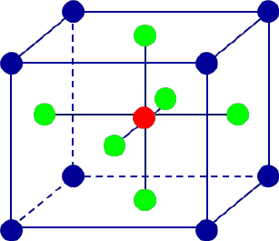
RAMS challenges for future accelerators
Topics for future trainings
Statistical planning of Tests:
New technology (new magnet technology, technology closer to physical limits)
New materials
Higher radiation levels (Transistors @FCC)
Methods to decrease testing effort:
Physics of Failure
DoE (Design of Experiments)
Reliability-DoE
Lifetime/Degradation/Ageing models
Müller, M., et al. "Understanding and reducing the variations in multicrystalline Si solar cell production." 28th EU PV Solar Energy Conference. 2013.
APEC 2018

Slide 15
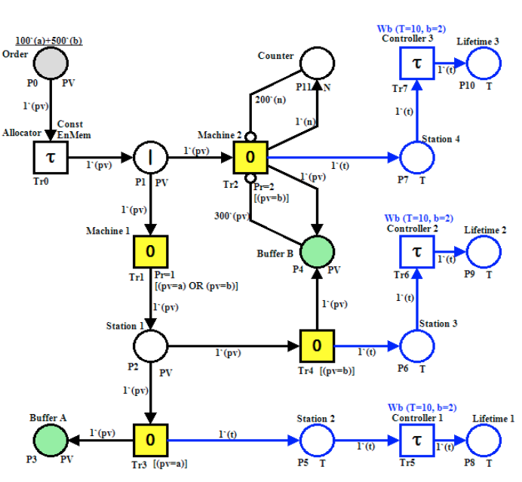
RAMS challenges for future accelerators
Topics for future trainings
Advanced Modelling Methods:
Increasing complexity
Increasing functionality
Modelling of operational phases
Functional dependencies
Methods:
Petri nets
Extended & adapted standard methods
Dynamic Fault Tree
Dynamic RBD
Long, F., P. Zeiler, and B. Bertsche. "Modelling the production systems in industry 4.0 and their availability with high-level Petri nets." IFAC-PapersOnLine 49.12 (2016): 145-150.
APEC 2018

Slide 16
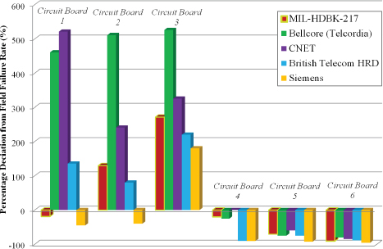
RAMS challenges for future accelerators
Topics for future trainings
Reliability of Electronics:
Load spectrums
Reliability modeling
Predictability
Failure analysis
Prediction accuracy MIL HDBK 217, FIDES & other alternatives
Radiation testing
DoE
Burn-In tests
National Research Council. Reliability growth: enhancing defense system reliability. National Academies Press, 2015.
APEC 2018

Slide 17
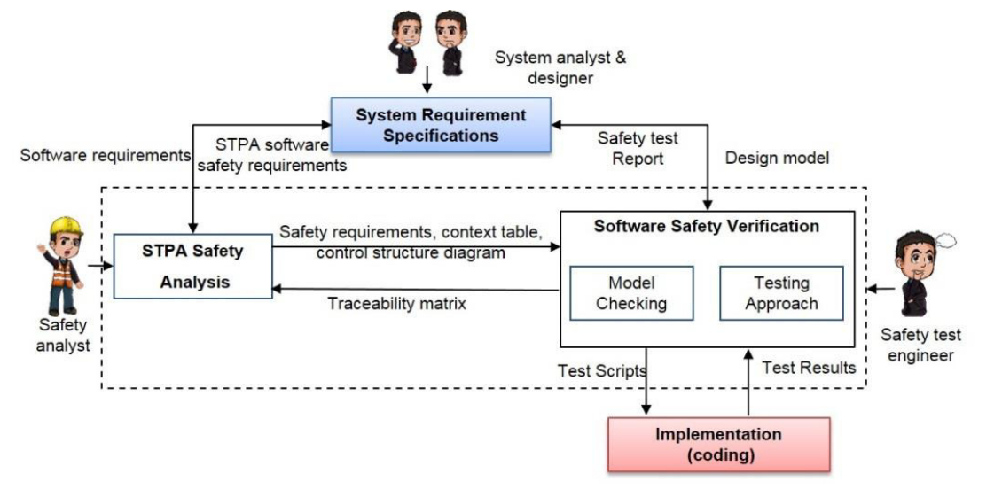
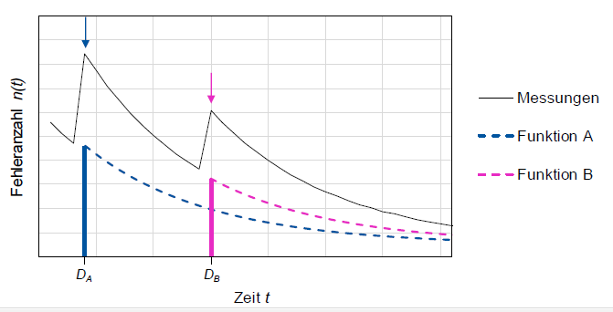
RAMS challenges for future accelerators
Topics for future trainings
Software/Firmware Reliability:
Software test planning
Software Reliability Growth
Update strategy
Methods:
STPA
STAMP
CAST
Abdulkhaleq, Asim, Stefan Wagner, and Nancy Leveson. "A comprehensive safety engineering approach for software-intensive systems based on STPA." Procedia Engineering 128 (2015): 2-11.
Measurements
Function A
Function B
# failures
[nach G. Kalverkamp, Software-Zuverlässigkeit in der Automobilindustrie, Reliability Days 2018]
Time t
APEC 2018

Slide 18
RAMS challenges for future accelerators
Topics for future trainings
Prognostics & Health Management (PHM):
Data acquisition
Data processing
Condition assessment of current state
Diagnostics
Online failure detection
Online failure analysis
Prognostics
Reliability prediction
Decision support
Maintenance
Methods:
Machine Learning
Neural Networks
Random Forest
■ Focus prognostics
■ Focus health management
Data
0 1 1 0 0 1 1 0 0 0 1 0 1 1 1
System
Diagnostics
Assess
Control
Optimization
Prognosstics
[Steinhilper, Rolf, and Frank Rieg, eds. Handbuch Konstruktion. Carl Hanser Verlag GmbH Co KG, 2012.]
APEC 2018

Slide 19
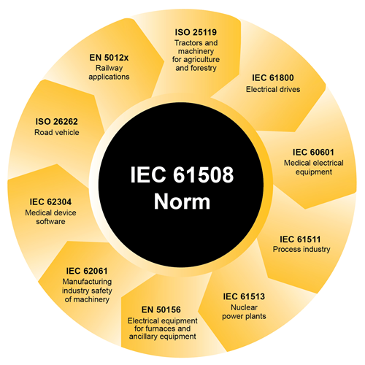
RAMS challenges for future accelerators
Topics for future trainings
Functional Safety:
Safe state in case of emergency
Risk Management (higher risk potential of FCC)
Growing number of Machine Protection Systems (QPS, …)
Problem of false positives (fail-operational, fail-safe, ghosting)
Evacuation from accelerator complex & tunnel
Tradeoff: Protection <=> Availability
SIL / ASIL - levels
Advanced qualitative methods:
Limitations of FMEA
STAMP/CAST/STPA (Model of incident 2008)
HAZOP
Markov, failure dependencies
[http://www.latticesemi.com/en/Blog/2018/02/02/00/07/ImportanceofFunctionalSafety]
APEC 2018

Slide 20
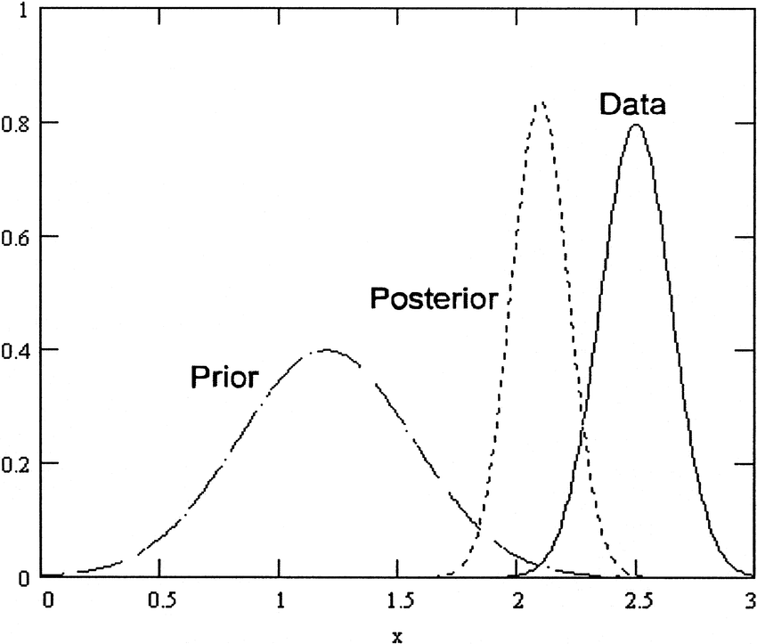
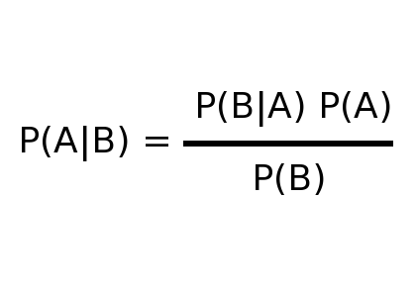
RAMS challenges for future accelerators
Topics for future trainings
Preknowledge:
from existing accelerators
Decrease of test sample size
Methods:
Bayes
Krolo, Kececioglu
[https://www.researchgate.net/figure/Relationship-between-Bayesian-prior-posterior-and-data-Prior-knowledge-and-insight-is_fig1_254087538]
APEC 2018

Slide 21
RAMS challenges for future accelerators
Topics for future trainings
Maintenance / Availability:
Maintenance strategy
Maintenance & availability budget for subsystems
Cost budget for Availability
Operation schedule
Autonomous systems
Recall strategy
[Niemi, Arto, Andrea Apollonio, and Katy Foraz. Considerations on operation schedule and maintenance aspects of FCC-hh. No. CERN-ACC-2018-0013. FCC-DRAFT-ENG-2018-007, 2018.]
APEC 2018

Slide 22
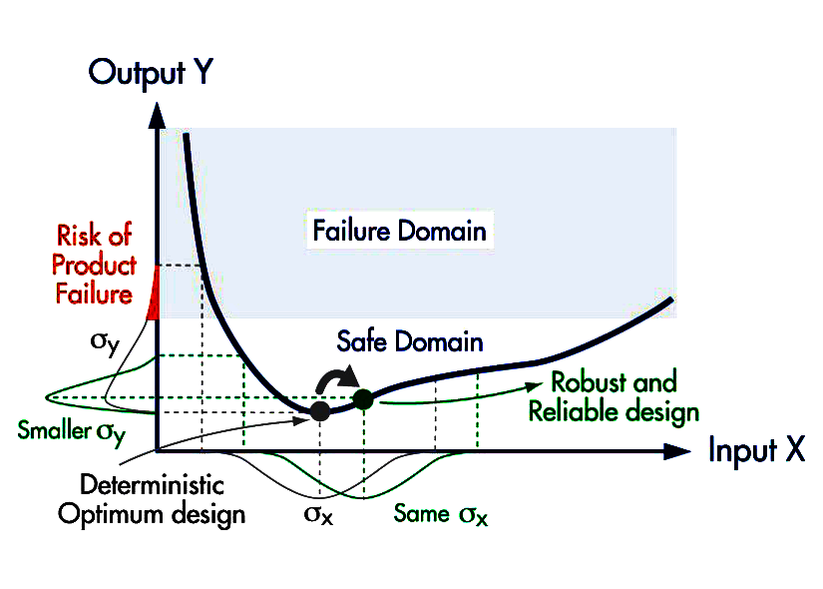
RAMS challenges for future accelerators
Topics for future trainings
Reliability Management:
Early development process
Reliability & cost for rel. budget for subsystems
Strategies for handling failures
Prognosis and planning of reliabiltiy, not just analysis
Power of Ten rule
Methods:
Reliability Growth Management
AMSAA Crow Planning Model
Robust Design
Design for Reliability + Availability
Functional Safety
[https://www.jmp.com/support/help/14/crow-amsaa.shtml]
[https://www.noesissolutions.com/our-products/optimus/robustness-reliability]
APEC 2018

Slide 23
Institute of Machine Components (IMA)
Thomas Herzig
Thomas.herzig@ima.uni-stuttgart.de
69962
Institute of Machine Components (IMA)
Pfaffenwaldring 9 D-70569 Stuttgart

